Slide 1
5.3.1 TOI
GUI Network Configuration UPDATES
Paal Olsen
5 April 2016

Slide 2
5.3.1 GUI APPLIANCE NETWORK CONFIGURATION UPDATES
Static Routes Management
  GUI feature added in 5.3.0
  Customer (Apple MVP) is unable to use the 5.3.0 GUI feature to fully configure the static routes as currently all routes are applied equally on both nodes. Lattus ingest was routed to the 1GB interface resulting in poor performance.
  Feature has been extended in 5.3.1 to allow for a Target Node selector so that routes can be configured separately on the two nodes for proper packet routing.
  Users can choose to apply the added route(s) to only ‘Primary’ or ‘Secondary’ nodes.
  Default selection for both host-routes or subnet-routes is ‘Both’.
  http://bo.quantum.com/bugzilla/show_bug.cgi?id=61826
  (Static Routing table configurations need stricter rules for complex networks)

Slide 3
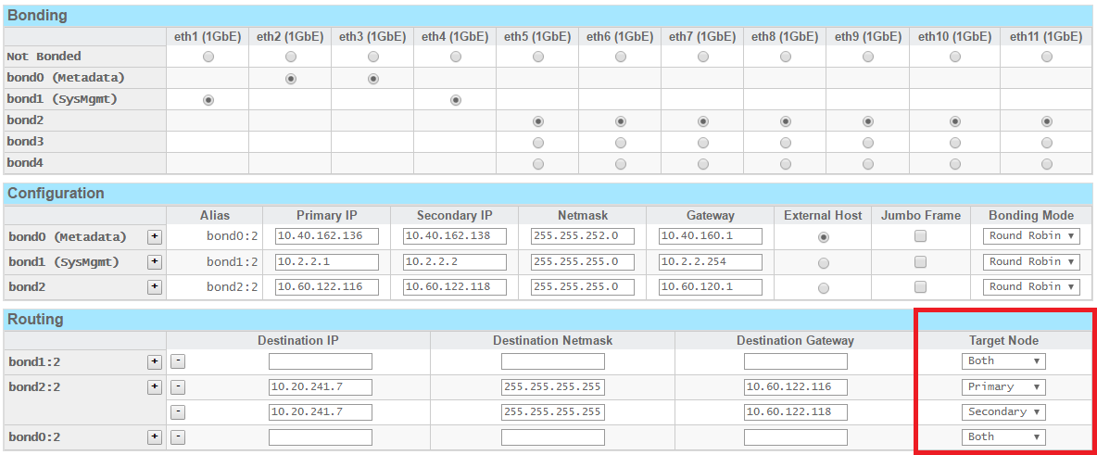
Appliance Network Config – Static Routes

Slide 4
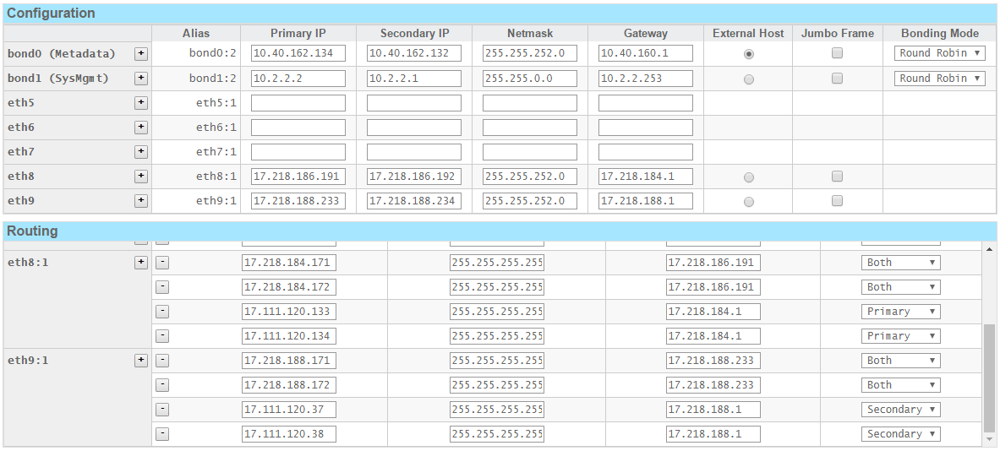
Appliance Network Config – Static Routes

