Slide 1
Stornext 5.3.1 overview
Bill Webster | Product Manager
5 April 2016

Slide 2
StorNext 5.3.1 Overview
Available now!
Goals for this release:
  Updated platform and client support
  License key enablement of Alternate Store Location Option
  Incorporate scripts created by Custom Engineering into a mainline release
  Deliver Lattus object store deletion enhancements
  Expanded device support for Grass Valley (OEM)

Slide 3
Updated platform and client support
StorNext 5.3.1 includes new support for:
  Red Hat 7.2
    SAN, DLC and FX clients
  Red Hat 6 update 7
    SAN, DLC, DDM and FX clients
    Metadata controller
  CentOS 7.2
    SAN, DLC and FX clients
  SUSE 11 SP4
    SAN, DLC DDM and FX clients
    Metadata controller
StorNext 5.3.1 is the final release for M330 appliances
Please review the new kernel specific footnotes in the compatibility guide

Slide 4
Storage Manager and Tape Peripherals
The following libraries have been qualified for use with 5.3.1:
  Quantum i500 with IBM LTO-7
  Quantum i40 and i80 with IBM LTO-7
  Quantum Scalar and AEL i6000 with IBM LTO-7
  IBM TS1150 ‘enterprise’ 3592 series tape drive
  IBM TS4500 library
  IBM TS3100 library with IBM LTO-7
Quattro library support deferred to mid-2016
IBM Advanced Path Failover is not supported
  Due to device reservation conflicts
  We’re assessing options for supporting APFO as quickly as possible

Slide 5
Alternate Store Location
Policy-driven data movement solutions for StorNext solutions from Quantum include:
  StorNext Replication
  StorNext Alternate Store Location
StorNext Replication
  Strengths: Deeply integrated with SNFS and SNSM, prevents file truncation until replication completes
  Weaknesses: Poor performance and limited scalability
StorNext Alternate Store Location
  Strength: Extensible, secure, remote copy generated in parallel with ‘local’ copy
  Weaknesses: Management scales in relation to number of sources and destinations
  Targeted use cases: File migration prior to StorNext upgrade or transition to an appliance, and DR

Slide 6
Alternate Store Location
Included with StorNext 5.3
Enabled per Storage Manager Class Policy per file system
Copies files to (local) tertiary media and remote StorNext site
Uses scp by default – can be configured to use NFS or ftp
Complementary to Alternate Retrieval Location feature
Remote files are “copy of last resort”
Source StorNext instance does not maintain status of remote copies
Local and remote sites must at same version of StorNext
  Each site can serve as main site, remote site or both at the same time
  Multiple main site instances can share a single remote site

Slide 7
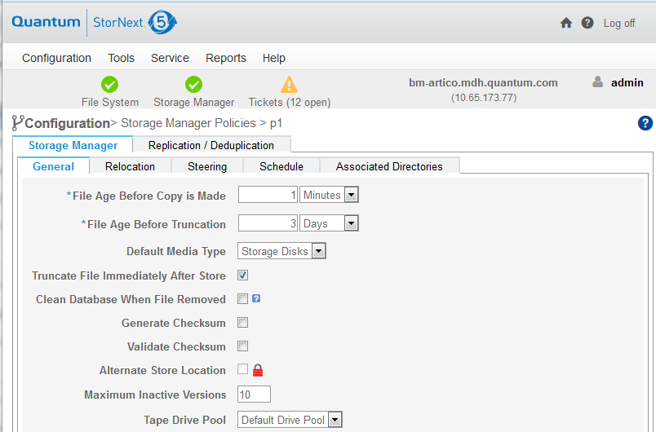
License key enabled @ 5.3.1
An ASL license is needed in order to configure Storage Manager policies

Slide 8
Requirements for an Alternate Store Location Solution
The following licenses are required for an ASL solution effective with StorNext 5.3.1
  Storage Manager [capacity] for the source and destination systems
  New Alternate Store Location license [for source (sending) system only]
  Quantum PS for design validation, implementation and validation
  Quantum services

Slide 9





Single and multi configurations
Single (sending) site
Storage Manager capacity – may be bundled with appliance
ASL license, PS and service required
Multiple (sending) sites
Storage Manager capacity – may be bundled with appliance
ASL license, PS and service required
Destination site
Storage Manager (capacity)
ASL license NOT required for a single destination system
Additional Storage Manager capacity may be necessary for tape, AEL or Vault use
Destination must be a managed file system
Destination sites
Storage Manager (capacity)
ASL license is required if this destination site will send files to another location
Additional Storage Manager capacity may be necessary for tape, AEL or Vault use
Destination must be a managed file system

Slide 10
ASL Part numbers: License, PS and service
Name | Part number
Alternate Store Location Option (license) | 600-00001-22
Alternate Store Location Option (PS), zone 1 | 7-00824-xx
Alternate Store Location Option (PS), zone 2 | 7-00824-xx
Alternate Store Location Option (PS), zone 3 | 7-00824-xx
Alternate Store Location Option, Silver Support [5x9TS, Annual] | 700-000009-01
Alternate Store Location Option, Gold Support [7x24TS, Annual] | 700-000009-02
QSP, Alternate Store Location Option, Software Phone Support [5x9TS, Annual, All zones] | 700-000009-03
QSP, Alternate Store Location Option, Software Phone Support [7x24TS, Annual, All zones] | 700-000009-04

Slide 11
Wait, there’s more!
Lattus capacity reporting script created for QVC
“Per share” data collection for chargeback script created for Yale
Support for new storage arrays attached to Windows MDC

Slide 12
Questions?

Slide 13
Good selling!

