Slide 1
StorNext 4.3 TOI
July 2012
StorNext 4.3: Product management perspective
Richard Reitmeyer
July 2012
Filename goes here (e.g., P12345A-v01)

Slide 3
StorNext 4.3: Short Sales Summary
~10 minute overview for sales

Slide 4
Introducing StorNext 4.3 File System & Archiving
Managing Volume, Velocity & Variety to Extract Value
Major database restructure (MySQL)
Scalability: 1 billion files per MDC
Total files in 1 to 8 file systems
Performance
Focus on tiering and archiving
Faster creation, trunction at scale
Faster archive of small files
Faster high-speed LAN access
Intelligence
Active Vault: a new tape tier
Project-based management, archiving
Notes:
Major Restructuring for Reliability, Scale, Performance: Replaced Linter database with mySQL
Scalability: Tested to 1 Billion files and petabytes of storage
Performance
Focus on Storage Manager (tiering and archiving)
Faster truncation : Up to 1.5 x faster @ 1 million w/ linear performance
Faster archiving of small files: Up to 40% faster writes for files < 1 MB
Faster file creation: Up to 20% faster @ 1 Million files
Improved high-speed file access via Ethernet
Intelligence
Active Vault: new tier of tape between library and box on shelf
Project archiving: managing groups of files intelligently

Slide 5
StorNext 4.3: Scalability
1 Billion Files
per MDC
Across 1 to 8 File Systems

Slide 6
StorNext 4.3: Scalability
1 Billion Files
per MDC
Across 1 to 8 File Systems
Save money and hassle:
Don’t have to break up file systems
or add MDCs!

Slide 7
StorNext 4.3: FASTER FILE SYSTEM
Customers already buy StorNext because it’s FAST
4.3 has even better PERFORMANCE
Creating files: 50% faster
Deleting files: 30% faster
Small writes on Windows
SAN clients: 200% faster (single stream);
70% faster (4 streams)
LAN clients: predicting 3.6x as fast on 10 GbE networks
I/O path latency in Windows code: 7x reduction
Notes:
All numbers on this page are measured numbers; treat them as “up to” comparisons against StorNext 4.2.
StorNext is used because it’s a very fast, shared, heterogeneous file system. People purchase it for its speed.
StorNext 4.3 lets customers take advantage of larger FSM caches to boost directory operations, like create and delete, the heart of what a file system does.
Performance has been measured as 50% faster for creates, and 30% faster for deletes. This means that customers can now do jobs in one file system where they might have wanted to split it into two before. And it means that long tasks, like importing a project with a lot of files, or deleting a huge project, now take significantly less time.
Windows is the most popular OS in the world. The StorNext field has noticed that windows is slower than other operating systems like Linux. StorNext 4.3 helps to address that by dedicated optimizations to boost windows performance: I/O latency in the code has been reduced by a factor of 7x. Small writes (64k) have were measured at 200% faster in single stream, and 70% faster with four streams. Customers (Ball Aerospace) have complained about DLC performance over 10 GbE networks, and we predict that will jump by 3.6 times! All this means that customers can get more out of their windows systems than ever before.

Slide 8
StorNext 4.3: FASTER FILE SYSTEM
Customers already buy StorNext because it’s FAST
4.3 has even better PERFORMANCE
Creating files: 50% faster
Deleting files: 30% faster
Do bigger tasks with StorNext!
Save time with StorNext!
Small writes on Windows
SAN clients: 200% faster (single stream);
70% faster (4 streams)
LAN clients: predicting 3.6x as fast on 10 GbE networks
I/O path latency in Windows code: 7x reduction
Windows Clients perform better with 4.3!
Notes:
All numbers on this page are measured numbers; treat them as “up to” comparisons against StorNext 4.2.
StorNext is used because it’s a very fast, shared, heterogeneous file system. People purchase it for its speed.
StorNext 4.3 lets customers take advantage of larger FSM caches to boost directory operations, like create and delete, the heart of what a file system does.
Performance has been measured as 50% faster for creates, and 30% faster for deletes. This means that customers can now do jobs in one file system where they might have wanted to split it into two before. And it means that long tasks, like importing a project with a lot of files, or deleting a huge project, now take significantly less time.
Windows is the most popular OS in the world. The StorNext field has noticed that windows is slower than other operating systems like Linux. StorNext 4.3 helps to address that by dedicated optimizations to boost windows performance: I/O latency in the code has been reduced by a factor of 7x. Small writes (64k) have were measured at 200% faster in single stream, and 70% faster with four streams. Customers (Ball Aerospace) have complained about DLC performance over 10 GbE networks, and we predict that will jump by 3.6 times! All this means that customers can get more out of their windows systems than ever before.

Slide 9
StorNext 4.3: FASTER STORAGE MANAGER
Customers already buy StorNext because it’s FAST
4.3 has even better PERFORMANCE
Truncation: 1000x faster in huge FS
1.5x faster @ 1M files
Writing to tape: 4x faster for small files
Creating files: 20% faster @ 1M files
larger gain as file count increases
Notes:
All numbers on this page are measured numbers; treat them as “up to”.
StorNext Storage Manager truncation performance is important to prevent a file system from filling up.
In prior releases, truncation slowed down as the file system size grew, which meant a customer adding files could “constipate” by adding files faster than they were moved to tape, and this was more likely to happen as the file system grew in size.
StorNext 4.3 ran truncation 7000x faster than the prior code in a huge file system. At a smaller size of 1 million files, it performed at least 1.5x faster. This means a customer can have, and add files into, a much, much larger file system and prevent it from filling disk by using Storage Manager’s ability to seemlessly write to tape.
StorNext was designed for writing large files. But customers with smaller files complained that earlier versions of StorNext could not handle small files as rapidly. In StorNext 4.3, performance of writing 1 MB files to tape has increased 4.x, meaning happier customers with smaller data files, like 12 MB DPX (2K) files or satellite images.
There’s been concern that adding StorNext Storage Manager to an environment can slow it down. StorNext 4.3 boosts file system’s ability to create files by 20% @ 1 million files --- and the performance gain increases as the file system size grows.

Slide 10
StorNext 4.3: FASTER STORAGE MANAGER
Customers already buy StorNext because it’s FAST
4.3 has even better PERFORMANCE
Truncation: 1000x faster in huge FS
1.5x faster @ 1M files
Handle bigger FS without filling up!
Writing to tape: 4x faster for small files
Save money on tape drives—or save time
Creating files: 20% faster @ 1M files
larger gain as file count increases
Don’t shy away from Storage Manager where
performance is important!
Notes:
All numbers on this page are measured numbers; treat them as “up to”.
StorNext Storage Manager truncation performance is important to prevent a file system from filling up.
In prior releases, truncation slowed down as the file system size grew, which meant a customer adding files could “constipate” by adding files faster than they were moved to tape, and this was more likely to happen as the file system grew in size.
StorNext 4.3 ran truncation 7000x faster than the prior code in a huge file system. At a smaller size of 1 million files, it performed at least 1.5x faster. This means a customer can have, and add files into, a much, much larger file system and prevent it from filling disk by using Storage Manager’s ability to seemlessly write to tape.
StorNext was designed for writing large files. But customers with smaller files complained that earlier versions of StorNext could not handle small files as rapidly. In StorNext 4.3, performance of writing 1 MB files to tape has increased 4.x, meaning happier customers with smaller data files, like 12 MB DPX (2K) files or satellite images.
There’s been concern that adding StorNext Storage Manager to an environment can slow it down. StorNext 4.3 boosts file system’s ability to create files by 20% @ 1 million files --- and the performance gain increases as the file system size grows.

Slide 11
StorNext 4.3: Intelligence w/ Active Vault
Active Vault is new tier of storage
Exclusive to Scalar i6000 and Stornext AEL6000 Archives
Tape in host-managed Slots:
Fully automated, fully protected, highest value
Positioning
Tape in ACTIVE VAULT:
Partly automated, fully protected, medium value
Tape vaulted outside the library on a shelf:
manual, unprotected, least expensive

Slide 12
StorNext 4.3: Intelligence w/ Active Vault
Active Vault is new tier of storage
Exclusive to Scalar i6000 and StorNext AEL6000 Archives
Policy-based selection of tapes to vault
Schedule-able kickoff of tape movement
StorNext 4.3 adds

Slide 13
StorNext 4.3: Intelligence w/ Active Vault
Active Vault is new tier of storage
Exclusive to Scalar i6000 and StorNext AEL6000 Archives
Policy-based selection of tapes to vault
Schedule-able kickoff of tape movement
StorNext 4.3 adds
Active Vault now EASIER TO USE
LOW COST OF ACTIVE VAULT TIER
NO HUMAN TOUCH OF TAPE
EDLM FOR AV PARTITON
SELL

Slide 14
StorNext 4.3: Intelligence w/ Directory Quotas
Customers want quotas on projects
Beyond existing user and group quotas
Oil & Gas (DASD), Bioinformatics (Baylor), …
StorNext 4.3 adds
Directory Quotas for TB and file count

Slide 15
StorNext 4.3: Intelligence w/ Directory Quotas
Customers want quotas on projects
Beyond existing user and group quotas
Oil & Gas (DASD), Bioinformatics (Baylor), …
StorNext 4.3 adds
Directory Quotas for TB and file count
Manage Space for Projects, not People
Prevent “pig” projects from hogging resources

Slide 16
StorNext 4.3: Intelligence w/ Directory Quotas
Speed of access across files becoming important
File-per-frame movies (DPX)
StorNext 4.2 added Allocation Session Reservation
Intelligent layout once turned on
Does not fix files written previously, or files retreived from SNSM
StorNext 4.3 adds
Tool to re-order file layout on disk

Slide 17
StorNext 4.3: Intelligence w/ Directory Quotas
Speed of access across files becoming important
File-per-frame movies (DPX)
StorNext 4.2 added Allocation Session Reservation
Intelligent layout once turned on
Does not fix files written previously, or files retreived from SNSM
StorNext 4.3 adds
Tool to re-order file layout on disk
Optimize file layout of old projects to
eliminate dropped frames!

Slide 18
But wait, there's more!
Material that does not fit in a short sales deck…

Slide 19
RAS Filtering

Slide 20
StorNext 4.3: Other features
Fixed > 630 bugs & enhancements
> 120 customer-reported issues (customer name is not NULL)
Improvements to StorNext-optimized copy, cvcp:
Now supports incremental copy (can run –u “updated only” and –z “preserve modification times” flags together)
Support for long path names with \\?\ prefix
Problems with very large windows directories have been addressed
Migration to different metadata disk geometry
Enhanced snmetadump lets users move to larger LUN sizes
Improved LDAP integration
Support for finding user & group info in secondary LDAP server
Control of GUI auto-logout
Can adjust now from 10 minutes to 12 hours
Requires “manage users” privilege

Slide 21
Neutral icons for missing licenses

Slide 22
StorNext 4.3: Other features
Improvements to cvfsck
Faster directory repair on large directories
More summary information on the file system after each run
Performance information on how long cvfsck took to run
Improved error reporting and progress messages in replication
Updates to 3rd party packages
Tomcat: 5.5.23 → 7.0.23
Java: 1.6.0.21 → 1.6.0.31
Man pages available as PDF
Don’t have to find a Linux prompt
Now easy to search body of the man pages

Slide 23
StorNext 4.3: Other features
Support for no-downtime upgrade (RPM only)
Customers who have HA and only use the RPM install can upgrade without downtime
Install on 2nd node, fail over, upgrade 1st node
Admins can prevent clients from halting a file system
Security fix: every client used to be able to halt the file system (DoS)
Now admin can control which clients; see Install Guide > SN Files > Cluster-Wide Central Control
Support for Named Streams in Mac-only FS
Named streams supported, in FS-only, Mac-only environments
Names Streams sliced off if Storage Manager, replication, Windows or Linux clients….
Added support for RHEL 5.8
Dropped support for RHEL 5.1-5.3, SuSE 10.1-10.2
Product Alert #20 releases

Slide 24
StorNext Appliances
Important source of revenue

Slide 25
StorNext Appliances building momentum
StorNext M660:
Already 36 opportunities in NA and EMEA
Sold 6 units in the last two weeks of FQ1!
StorNext M330: growth every quarter, over 50 units sold to date
StorNext G300: 50% growth vs. FQ4
Notes:
Notes for Richard:
For the M660
we’re already starting Q2 with some opportunities in July
Mostly M662 and only one expansion unit so far
Usually part of big deals that include Q-Series and AEL
M330: going strong and the most successful appliance in terms of sales vs. AOP, still has a big pipeline
G300: to be honest needs a little more time in the market to really grow – the deal cycles are long (6+ months); M660 benefits from some M330 “switches”

Slide 26
StorNext Q-Series is also doing well
Q-Series: 166% funnel growth in FQ1
18 units sold in FQ1
Pitch Q-Series in any new Big Data deal
Bring it to existing customers when they grow
Use your SA and Solutions Engineering to help with sizing
Don’t forget: Q-Series is ONLY for use with StorNext
Notes:
Notes for Richard:
You can say over $1m in Q-Series sales
We have a good growing pipeline in Q2 with some bigger possible repeat deals for resellers/integrators
QD6000 is the most popular model due to the cost-effectiveness
Tell these guys we are running the “Sales Play” to promote the sales

Slide 27
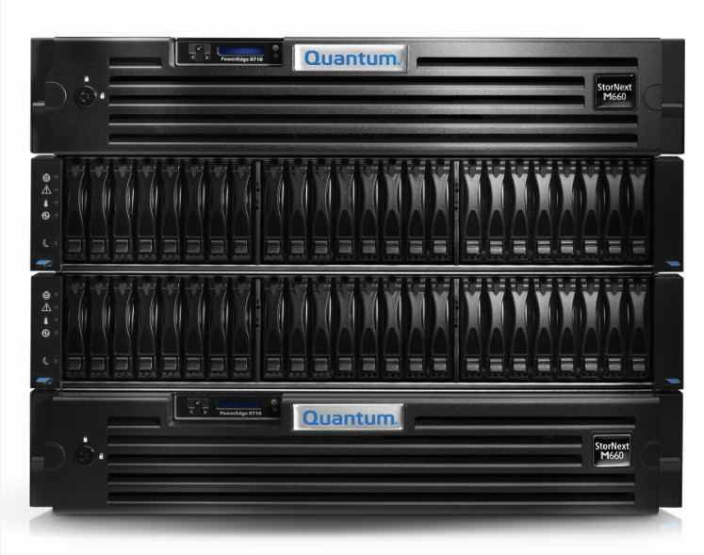
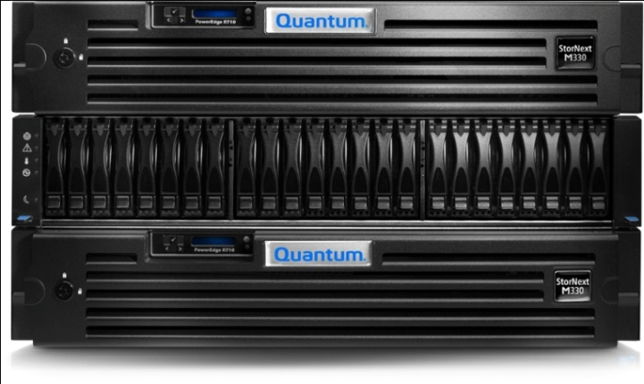
M330 vs M660: Where to Sell
Customers should buy StorNext M660 for:
Very high performance
Four to eight file systems
Up to 125M files per file system (with StorNext 4.3)
Fibre Channel redundancy for disk and tape
Integrated Gateway functionality
Integrated DDM functionality
Customers should buy StorNext M330 for:
Mid-range performance
Two to four file systems
Up to 60M files total
Customers should “roll their own” when:
Optimizations to tailor hardware to their specific workflow
Custom metadata array configuration

Slide 28
StorNext Appliances: REMEMBER !!!
M660: Base System & Expansion Unit Sold Separately!
M660: $20K off list through September
Q-Series and G300: Do you want fries with that?
M330: non-TPM configuration in PB64
AEL: don’t forget to add the MDC

