Slide 1
StorNext
G300 Gateway
Appliance
July 18th, 2012

Slide 2
StorNext G300 Gateway Appliance
NFS on steroids, fast Ethernet access, unlimited clients
For compute intensive applications that don’t require SAN performance
Gene sequencing, transcoding
StorNext G301 (1GbE)
750 MB/s max throughput
StorNext G302 (10GbE)
1.6 GB/s max throughput
Per-gateway licensing
Unlimited DLC clients
Load balancing & failover
G300 Gateway Appliance
Blazing fast shared file access over Ethernet

Slide 3
StorNext Appliances building momentum
StorNext M660:
Already 36 opportunities in NA and EMEA
Sold 6 units in the last two weeks of FQ1!
StorNext M330: growth every quarter, over 50 units sold to date
StorNext G300: 50% growth vs. FQ4

Slide 4
StorNext Appliances: REMEMBER !!!
M660: Base System & Expansion Unit Sold Separately!
M660: $20K off list through September
Q-Series and G300: Do you want fries with that?
M330: non-TPM configuration in PB64
AEL: don’t forget to add the MDC

Slide 5
StorNext G300 Gateway Appliances
5

Slide 6
StorNext G300 Gateway Appliance
Flexible and affordable access to big data
High speed networking technology that virtualizes Ethernet access to data stored in StorNext
Ensures rapid content delivery and on-demand access
StorNext G300 Gateway Appliance
StorNext G301 – 1GbE model – 800MB/s
StorNext G302 – 10GbE model –1.6GB/s
Notes:
Media & Entertainment example
Optimized Proxy Workflows - seamlessly access low resolution proxy copies of big, high resolution source files
Highly available broadcast news workflows - Editors working with news-oriented compressed images benefit with “always available” access to content in order to meet on-air deadlines.
On demand provisioning - Immediate and affordable access to many nodes for transcoding formats to mobile
G300 available in two models to support 1GbE and 10GbE infrastructure
- Conversion kit offers INVESTMENT PROTECTION
- Built-in Load-Balancing, Failover for resiliency and performance
- Monitoring and usability advantages
- Pick your performance with StorNext - by using gateways with LAN clients or SAN clients for even higher performance needs - no need to choose one or the other like with other vendors' solutions
- Economical sharing of SAN content
- Easy to buy; one purchase/price
- Cross-Platform capable (heterogeneous)
- Application-agnostic
- Provision new clients "on-demand"
- Ideal for customers who have farms of servers or workstations (rendering, seismic processing, desktop editors, etc.) all needing to access a shared set of files, but not at FC speeds
Use cases:
- For customers who want one-stop-shopping and one-stop-service from a single vendor
- For customers with higher LAN performance requirements than CIFS or NFS can provide.
- These include M&E proxy and SD production workflows, MAM browse clients, large numbers of transcode/render nodes
- These include pharma customers using DNA sequencers
- These include siesmic customers using

Slide 7
Business Benefits
Affordable Access to Big Data
High-Performance Workflows
Affordable concurrent access to content managed by StorNext
Collaborate with teams and speed through workflows faster with higher per-stream performance
Flexible On-Demand Provisioning
Virtual access to shared data for on-demand provisioning of clients
World-class Support
End –to-end single vendor experience and support from StorNext experts
Scalable Throughput & Speed
Scale throughput as needed by combining multiple gateways into a single cluster for faster speed and higher availability
Notes:
Affordable Access to Big Data
The StorNext G300 Gateway appliance offers affordable concurrent access to content managed by StorNext in big data environments.
Flexible On-Demand Provisioning –
The StorNext G300 Gateway appliance’s virtual access to a shared data pool enables on-demand provisioning of clients over the network.
Scalable Throughput & Speed
Quickly scale throughput as needed by combining multiple gateways into a single cluster for faster speed and higher availability.
High-Performance Workflows
Collaborate with teams and speed through workflows faster with higher per-stream performance compared to traditional networking technology like CIFS or NFS.
World-class support
Customers have a single vendor experience from point of purchase to service and support from StorNext experts at Quantum.

Slide 8
Key Features
Gateway Metrics Monitoring
Two Performance Levels
Integrated appliance software monitoring
Scalable throughput with two appliances; G301 (800MB/sec) and G302 (1.6GB/sec)
Automatic Load Balancing
Dynamically reallocates requests to balance traffic
New Licensing
Gateway-based LAN client licensing brings greater flexibility, making it easy to accommodate changes in workflows
Automatic Failover for HA
Built in failover with I/O request re-direction to active gateways
Notes:
New Gateway Metrics Monitoring module
Automated load balancing between Gateways
Automatic failover for High Availability
G301 features 1GbE client connectivity for a total bandwidth of 800MB/s
G302 features 10GbE client connectivity for a total bandwidth of 1.6GB/s
Gateway LAN Client License

Slide 9
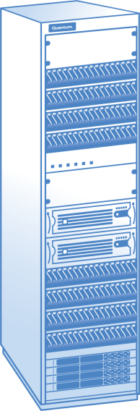
G300 Gateway Appliances
Provides uncompromising performance
using specialized communication protocol
(4x faster than CIFS, 3x faster than NFS)
Dynamic and transparent load balancing and path failover
Extends Collaboration Beyond the SAN
Allows fan-out to lower cost IP servers
and processing farms
Increases uptime and performance using G300 Gateway Applances
LAN
SAN
LAN Users
G300 Gateway
Appliance Cluster
SAN Clients

Slide 10
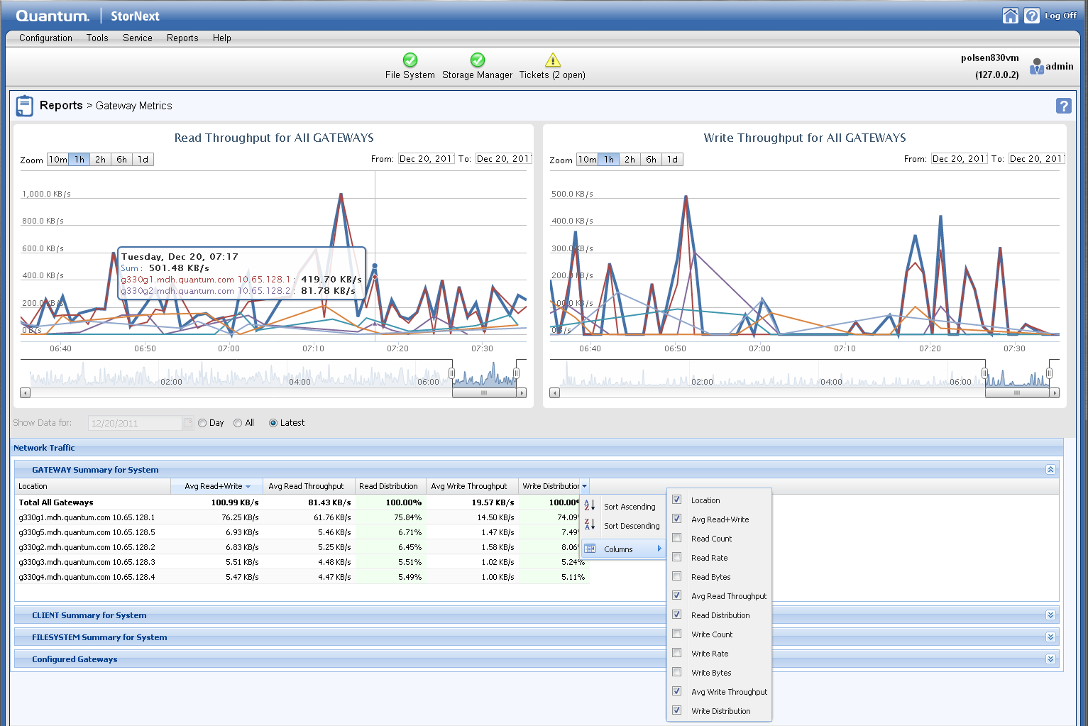
StorNext G300 Appliance INCLUDES
A single StorNext Per Gateway License
StorNext DLC LAN Client Connectivity Licenses are included in base price
Will work in existing traditional DLC environments
Highly recommend replacing these gateways in order to take full advantage of the new Gateway license model
Enhanced StorNext Gateway Metrics Monitoring
For improved usability and reduced cost of administration
Provides graphical and table views of performance metrics for all connected StorNext Gateways, Clients and File Systems
Comprehensive tool for identifying and resolving anomalies in the LAN environment

Slide 11
G300 Gateway Positioning
G300 Gateway Appliances should not be targeted at direct enterprise NAS applications
High IOPS are an issue
G300 Gateway Appliances should be positioned at the “Gray” area where NAS is performance challenged, but SAN is too expensive
Clustered NAS or accelerated NAS Products like Isilon, BlueArc, Polyserv attempt to hit this space
Target these guys!
Large files, Steaming high resolution data, Big I/O are optimal

Slide 12
StorNext Gateway G300 Use Cases
12

Slide 13
Animation: Creation of Games, Video, and Film Using G300 Gateways to speed animation project to be Created/Rendered
LAN
SAN
Render Farm Clients
G300 Gateway Cluster
Shared access at up to 4x NAS performance
Protocol adjustable payload 64K to 1MB
Provides highly available,
high performance access
for LAN users
StorNext AEL6000
G300 Gateway Cluster
DI Environment
DI SAN
LAN
SAN Clients
3D Animators
SAN Clients
Color Correction, NLE, Film Shooter or Scanner

Slide 14
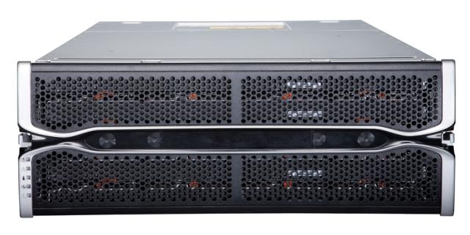
BIO-IT: Genomics Research Using StorNext G300 Gateways to move DNA sequences to archive
Genome SOLiD Sequencing machines
Gig-e links to GW DLC SNFS Linux server
StorNext Q-Series DS6000
180TB growing to 360TB
Genome Solexa Sequencing machines
Storage Area Network
Gig-e links to GW DLC SNFS Linux server
Titanium Sequencing machines
Gig-e links to GW NAS server
160TB AEL500
All data archived. Second copy vaulted offsite for critical data
Workflow:
Sequencing machine run analysis to create items like DNA information. It takes 24 hours to run one experiment. Each experiment/run creates 1TB of result files. Results are moved to the archive for long term retention.
StorNext M330 Metadata Appliance
G300
Gateway Clusters

Slide 15
Adding or Replacing G300 in a StorNext Environment with an Existing Traditional Gateway
15

Slide 16
Traditional RYO Gateway
Initial DLC Customer Configuration Example w/ 50 DLCs
50 DLC Licenses are Stored on MDCs
Metadata
Controller
HA MDC
PRIMARY TIER
FC/iSCSI
50 DLC Licenses
DISTRIBUTED LAN CLIENTS
GigE TCP/IP
Traditional RYO Gateway

Slide 17
Combining G300 and Traditional RYO Gateway
New DLC Customer Configuration Example with an Added Gateway
50 DLC Licenses are Stored on MDCs
Metadata
Controller
HA MDC
PRIMARY TIER
FC/iSCSI
50 DLC Licenses
DISTRIBUTED LAN CLIENTS
GigE TCP/IP
Traditional RYO Gateway
Added G30x Gateway
This is a valid configuration:
Still restricted to the 50 DLC licenses
Optimal for customers who want added performance and don’t want to grow clients

Slide 18
G300 Replacing a Traditional RYO Gateway
Initial DLC Customer Configuration Example w/ 50 DLCs
Need to wipe existing 50 DLC Licenses from MDCs
Metadata
Controller
HA MDC
PRIMARY TIER
Can now add or remove users on demand
FC/iSCSI
50 DLC Licenses
DISTRIBUTED LAN CLIENTS
GigE TCP/IP
Traditional RYO Gateway
Added G30x Gateway
Requirements:
Update to latest SN 4.2 code release
Need to remove DLC licenses from MDCs
1 Gateway License

Slide 19
Q&A

