Slide 1
StorNext 4.3 “Brubeck” TOI
What’s new in SNFS
Brent Petit
17JUL2012
Notes:
© 2008 Quantum Corporation. Company Confidential. Forward-looking information is based upon multiple assumptions and uncertainties, does not necessarily represent the company’s outlook and is for planning purposes only.
1

Slide 3
What will we cover?
This presentation will cover some of the many new and improved items in SNFS 4.3
In addition to the improvements noted here, there were over 150 bug fixes in the SNFS components alone.

Slide 4
What’s New in StorNext 4.3
Overview of 4.3 features
Allocation Sessions enhancements – The following tools can be used with the ASR feature
vidio – file sequence test tool
This tool measures create, write, read throughput and latency while simulating file sequence use cases
vidiomap - tool for analyzing file sequencing effectiveness
This tool has the ability to resequence files

Slide 5
Vidiomap (reporting sequencing)
[root@bpetit-brubeck-mdc1 test]# vidiomap -v .
. {
gap start end nblks MBytes
file0 +0 0xf000 0xf13f 320 5.00
file1 +0 0xf140 0xf27f 320 5.00
file2 +0 0xf280 0xf3bf 320 5.00
file3 +0 0xf3c0 0xf4ff 320 5.00
file4 +640 0xf780 0xf8bf 320 5.00
file5 +320 0xfa00 0xfb3f 320 5.00
file6 +0 0xfb40 0xfc7f 320 5.00
file7 +0 0xfc80 0xfdbf 320 5.00
file8 -1280 0xf8c0 0xf9ff 320 5.00
file9 -960 0xf640 0xf77f 320 5.00
File system block size 16384
Total files 10
Total MBytes 50
Total extents 10
Total gaps 4 -2 +2
Average gap in fsblocks 800 -1120 +480
Percent contiguous 60%

Slide 6
Vidiomap (resequencing)
[root@bpetit-brubeck-mdc1 test]# vidiomap -vr .
…
vidiomap: Info: Resequencing files in .
. {
gap start end nblks MBytes
file0 +0 0xfdc0 0xfeff 320 5.00
file1 +0 0xff00 0x1003f 320 5.00
file2 +0 0x10040 0x1017f 320 5.00
file3 +0 0x10180 0x102bf 320 5.00
file4 +0 0x102c0 0x103ff 320 5.00
file5 +0 0x10400 0x1053f 320 5.00
file6 +0 0x10540 0x1067f 320 5.00
file7 +0 0x10680 0x107bf 320 5.00
file8 +0 0x107c0 0x108ff 320 5.00
file9 +0 0x10900 0x10a3f 320 5.00
File system block size 16384
Total files 10
Total MBytes 50
Total extents 10
Total gaps 0 -0 +0
Average gap in fsblocks 0 -0 +0
Percent contiguous 100%

Slide 7
Resequencing files
Resequencing file utilizes interfaces similar to snfsdefrag
As a result, resequencing requires reading up the original files and writing data to new files
If ASR is configured correctly, there should be little need for resequencing files
However, under some circumstances other tools could ingest data out of order. In this case vidiomap will help
Vidio and vidiomap together are useful in setting up a file system with ASR. Tools will simulate DPX-type operations and measure the throughput and latency of file and I/O operations

Slide 8
What’s New in StorNext 4.3
SNFS CvApi files now available on non-Linux platforms
Previously, APIs were only available on Linux
CvApi documentation posted on Quantum.com website and included with product
FSM buffer cache maximum increased from 1GB to 8GB
Potential for improved performance when working with large directories and busy file systems
Slight modification to the client buffer cache read I/O path
Lowers buffered read latency
Helps to improve balance between buffered reads and writes
Not the complete solution yet, but a step towards the solution
There’s much more coming in Parker (based on CE work completed for Western Geco)

Slide 9
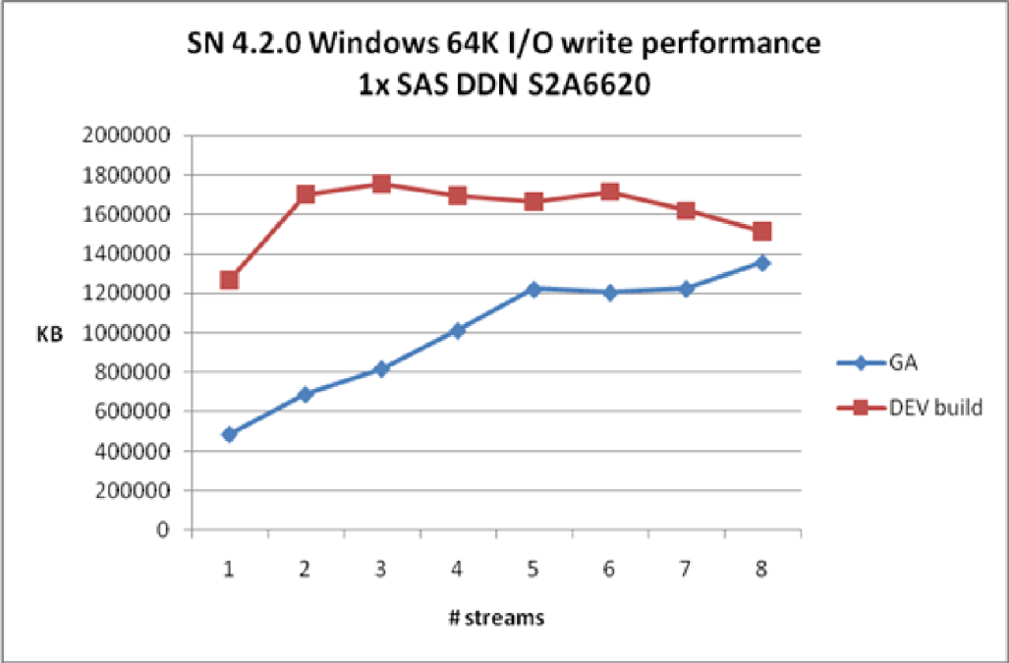
Performance improvements
Improved small I/O performance on Windows clients
Small buffered I/O overhead has been reduced, improving potential peak buffered throughput.
When testing 64K sequential I/O
Read performance was ~2GB/s in 4.3.0 compared with ~600MB/s in 4.2.1
Write performance was ~1.2GB/s in 4.3.0 when compared with ~300MB/s in 4.2.1
Keeper verified this change in DDN’s lab and saw reads run at 3GB/s and writes run at 2.5GB/s (with similar “before” numbers)

Slide 10
Performance Improvements
Improved Windows DLC performance
The change mentioned in the previous slide also showed improvement in Windows DLC throughput
Prior to this change DLC read and write throughput on Windows would peak out at ~250MB/s
After this change was made Windows DLC throughput was measured at 1.14GB/s for write and 879MB/s for read.
Measurement done through iozone
In addition to throughput improvements, CPU utilization is reduced notably when running these tests

Slide 11
Performance Improvements
Improved single stream write throughput with 10G networks and Linux DLC Gateways
Prior to this fix Novartis would see no-more-than 512MB/s on a single write stream through DLC
Single stream read performance through DLC was good at just over 1GB/s
After investigation it was determined that TCP wasn’t advertising optimal window sizes – effectively capping the maximum throughput of traffic from the DLC client to the DLC server
After applying this change, Novartis was able to generate to 975MB/s per write stream on a 4.2 based LCR
In our internal testing with 4.3 we have seen in-excess of 1.6GB/s read throughput when utilizing multiple 10G NICs

Slide 12
Performance Improvements
Improved metadata I/O path behavior
Improved parallelism in metadata read and lookup operations
Lowered contention between metadata lookup and metadata update operations
Internal testing showed
40% improvement in creates/second
30% improvement in deletes/second
This change reduces the time that an I/O can spend queued before submitting (PIO time and systime should be much closer now)
These changes allow more I/Os to be submitted in parallel, allowing the underlying storage to be more efficient

Slide 13
What’s New in StorNext 4.3
Stability improvements in the Windows Admin GUI
Underlying Windows API usage was brought up to date, allowing some of the less stable interface usage to be removed
Improvements to cvcp
Stability improvements on Windows with very large directories
Improved support for long path names using the long path prefix (\\?\)
cvcp now allows the use of –u and –z concurrently to improve support for incremental copy operations
Improvements to cvfsck
Performance improvements in directory repair
Tests repairing directories with hundreds of thousands of files shows significant improvement (minutes vs. hours in some tests)
Additional timers and metadata statistics displayed during checks and repairs
Stages in cvfsck include timers for each stage

Slide 14
Summary information in cvfsck

Slide 15
Cvfsck - timings

Slide 16
Questions?

