Slide 1
StorNext 4.3 “Brubeck” TOI
Directory Quotas
Ken Preslan
17 JUL 2012
Notes:
© 2008 Quantum Corporation. Company Confidential. Forward-looking information is based upon multiple assumptions and uncertainties, does not necessarily represent the company’s outlook and is for planning purposes only.
1

Slide 3
Directory Quotas (DQs)
Allows tracking and limiting of:
the amount of disk space in a directory tree
the number of files in a directory tree
Space tracking counts the space used by data blocks in regular files only
Holes and truncated space isn’t counted
File tracking counts regular files only
No tracking/limiting of metadata
Useful for limiting usage, but also for reporting of usage

Slide 4
Directory Quota Name Space (DQNS)
The file system only tracks/limits the usage of certain specific directories (not all)
Tracking for a directory is enable by creating a DQNS on it
Once the DQNS is created, limits may be placed on it
The admin can list all DQNSs, their current usage, and their limits
DQNS are referred to by the name of their root directory
Current code has been tested up to 4000 DQNSs in a single file system

Slide 5
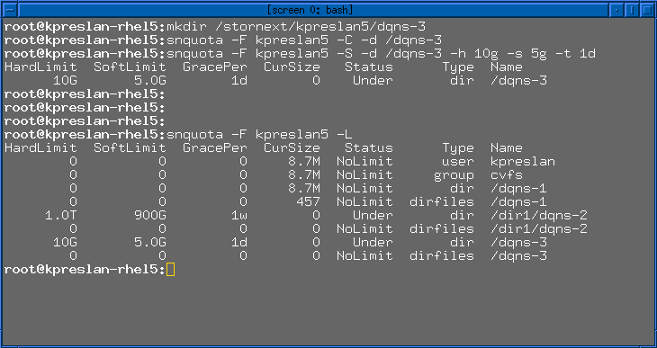
Example

Slide 6
Limits
DQs support Hard and Soft Limits
The user can never exceed a hard limit
Soft limits can be exceeded for a period of time (the grace period)
After the grace period expires, soft limits are treated as hard limits
Check the logs on the MDC for quota messages
On the UNIXs, soft limit overruns cause messages on the user’s TTY
Hitting a hard limit returns EDQUOT
Root may overrun any quota it wants
Due to the distributed nature of SNFS, small overruns are possible

Slide 7
DQs and User/Group Quotas
DQs are an extension to the current quota subsystem
Both run at the same time
Quota limits and values are stored in a pair of hidden b-trees in the file system
the IDDB tree and the Quota tree
Single on/off switch in the config file “<quotas>true</quotas>”
All limits are enforced – The first limit hit triggers the EDQUOT error
Implementation:
Tracking happens in the FSM
Enforcement happens in the clients

Slide 8
DQ Limitations/Caveats
Creating a new DQNS can take a while if it’s a big directory
No DQNS nesting (one DQNS can't be within another)
There are limits for hard links and renaming across DQNS boundaries
Linux/Cygwin "mv" command does the right thing
Disk space is removed from Dir Quota when the file is unlinked – different from User/Group Quotas
Implementation uses RPL to figure out which DQNS files belong to, so RPL must be enabled and working

Slide 9
Interactions with Storage Manager
Only counts blocks currently allocated in the file system
Space not present in the FS due to truncation doesn't count
Low quota doesn't start truncation
The root of a DQ namespace may not be a subdirectory of a replication target directory. (Replication Name space resolution uses hard links.)
Restoring a file from tape may put a user over quota

Slide 10
Older Clients / XSan
Older clients can mount a DQ-enabled file system
Tracking works since that's done in the FSM
Enforcement doesn't work since that's done in the client
The FSM logs when a non-DQ-enabled client mounts
XSan 3.0 client supports DQs

Slide 11
Reporting
"cvadmin -e repquota" works as usual
Drops files in /usr/cvfs/data/<fsname>/
quota_report.txt, quota_report.csv, quota_regen.in files
The MDC also will also keep nightly logs
In /usr/cvfs/data/<fsname>/quota_history/
Config file parameter: quotaHistoryDays
Same three files as repquota
Runs daily at 5am
Customers can use these logs instead of periodic “du” runs to charge projects for the disk space they use

Slide 12
Quotacheck
Can run quotacheck on a file system to rebuild the quotas (user/group and DQ)
The FSM should be running
Writes are blocked while quotacheck is running
Should probably run quotacheck after a cvfsck that makes changes
Can run quotacheck via “cvadmin –e quotacheck” or “snquota –R”
If quotas are reset, limits and DQNSs can be restored by passing quota_regen.in to cvadmin

Slide 13
DQ interfaces
Cvadmin – the old quota interface with new DQ extensions
Snquota – new CLI interface for all quotas
Web GUI – DQ manipulation and reporting
Windows GUI – newly reworked
LibSnadmin – C API

Slide 14
Snquota

Slide 15
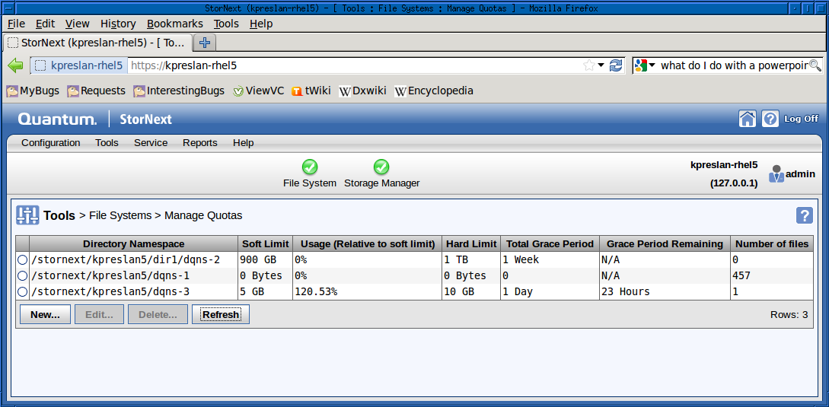
Web GUI – Current Values

Slide 16
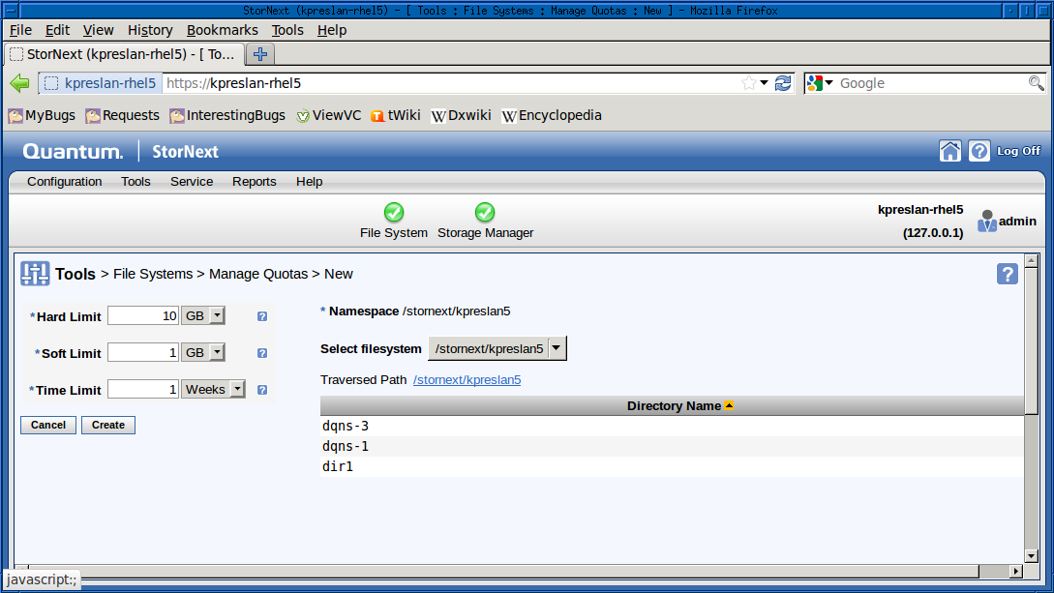
Web GUI – DQNS Creation

Slide 17
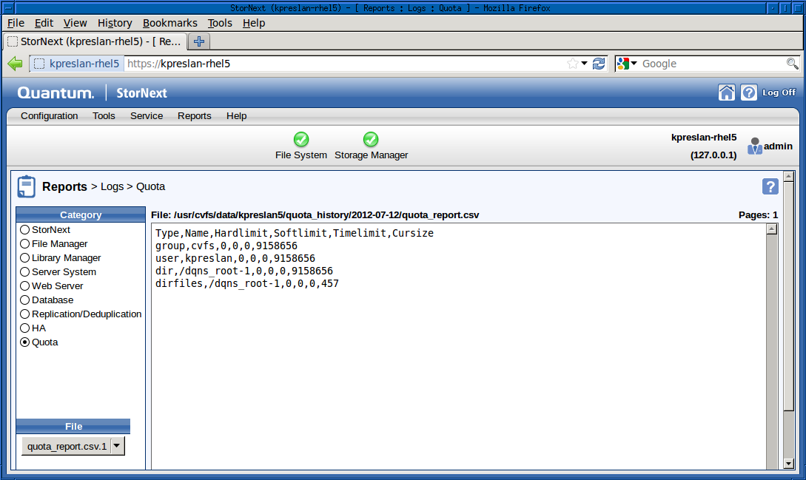
Web GUI – Reporting

Slide 18
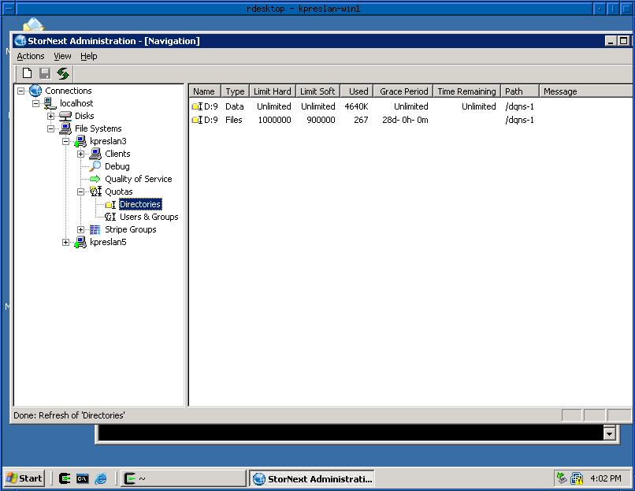
Windows GUI – Current Values

Slide 19
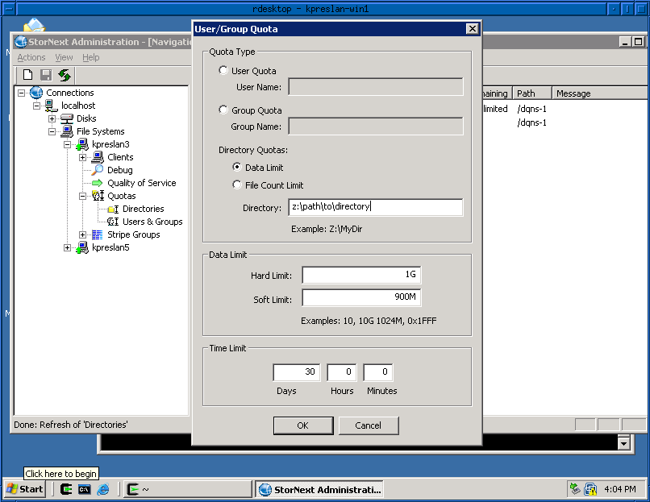
Windows GUI – DQNS Creation

Slide 20
The DQ we really wanted

