Slide 1
Dell DOSD
Quantum ASPS PROCEDURES FOR USING DOSD.
29Mar12
ASPSDOSD-v01.pptx

Slide 2
DOSD Overview
The Dell Online Self Dispatch (DOSD) web site is the single location on the internet for Quantum ASPS technicians to perform the following items .
  Train and Certify on Dell products that Quantum ASPS supports.
  Download documentation for the Dell products that Quantum ASPS supports.
  Order parts for equipment supported by Quantum ASPS.
To access the DOSD web site use the following address.
http://www.dosd.dell.com/

Slide 3
DOSD Sections of this document
DOSD Training and Certification
  Overview of Certification. (Pg 4)
  Logging into DOSD. (Pg 7)
  Learn Dell Web site. (Pg 12)
  Accessing the courses. (Pg 14)
  Certification. (Pg 19)
DOSD Parts ordering. (pg 25)
  Primary contact information (pg 32)
  Ship to address (pg 33)
  Part selection (pg 34)
  Order status (pg 39)
  DPS number (pg 41)
Oracle tasks (Pg 42)
Questions and contacts. (Pg 43)

Slide 4
DOSD First time access

Slide 5
First time How To: Process Flow and Steps
  Access the DOSD website with your temporary password sent in email.
  Reset password by clicking on “My Account.”
  Create a new password using the password requirements.
  Set security Question and Answer.
  Access Learn Dell via the “How To” tab.
  Disable pop-up blockers.
  View four courses needed by Quantum ASPS.
    Dell Online Self Dispatch Policies & Procedures.
    Dell Online Self Dispatch PowerEdge 9G and 11G.
    Dell Online Self Dispatch PowerVault.
  Access courses.
  Take Assessment Test.
  Pass Assessment Test.
  You can view and print the Certification from the DOSD tool.

Slide 6
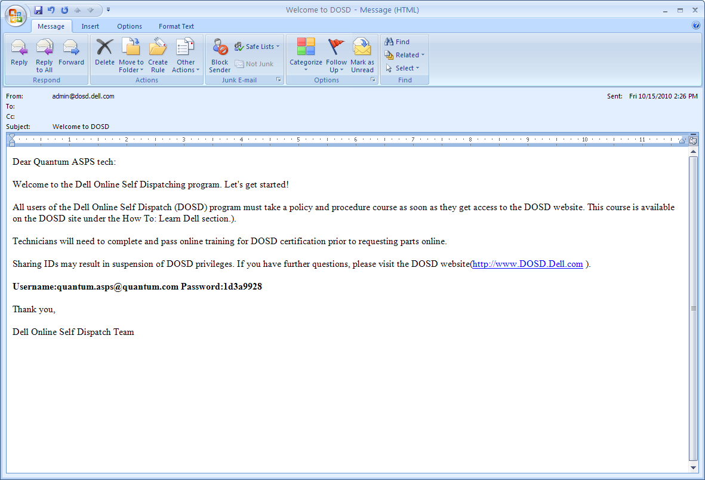
Technician E-mail notification to the DOSD tool
E-mail has Username which is your e-mail address.
E-mail has temporary Password to the DOSD web site.

Slide 7
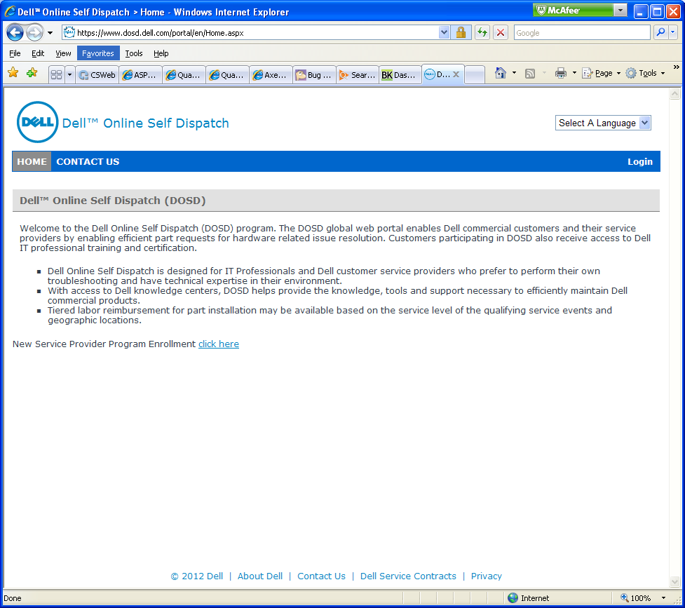
DOSD Home page
DOSD Home page.
Click on the Login link on the right side of the screen.
Please Note: Displayed screen shots in this How To guide may change and look different as enhancements are made to the DOSD tool but the process and steps for Certification and order parts should remain the same.

Slide 8
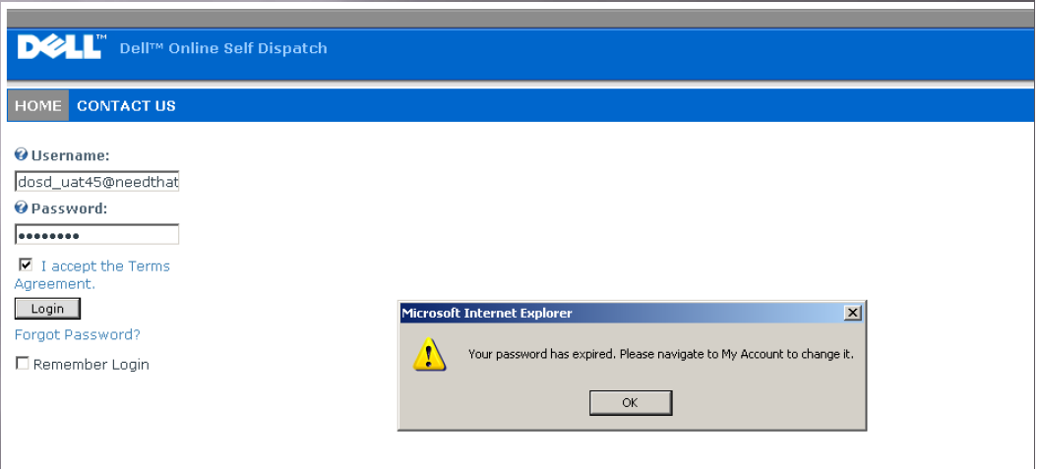
DOSD Login Screen
Enter your Username and Password and verify the “I accept the Terms Agreement” is checked.
Click on “OK”.
If you are a first time user you will need to change your password, because the issued one was a temporary.

Slide 9
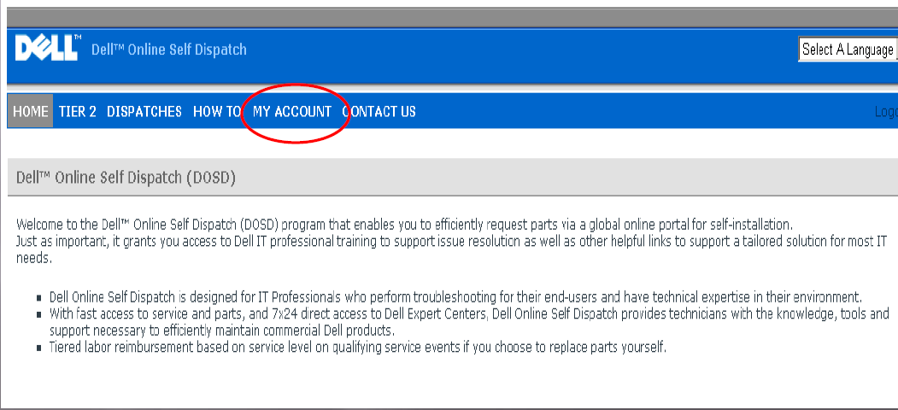
DOSD Reset your password
Click on “My Account” to access your account information and to change your password.

Slide 10
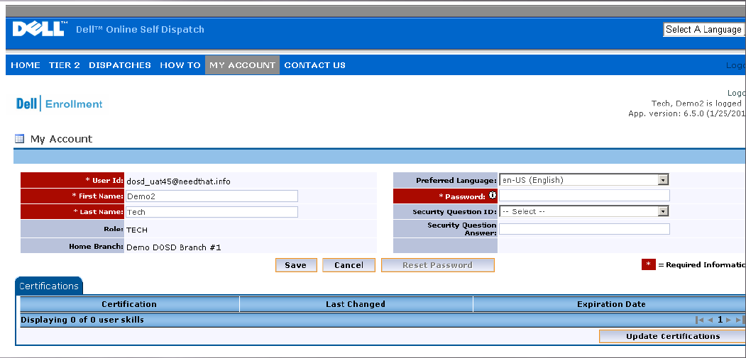
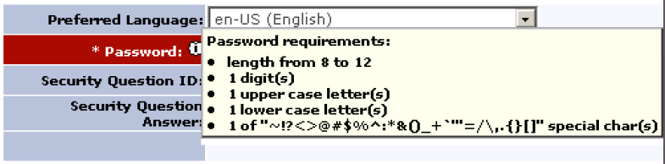
DOSD Updating your password
Click on the “Password” “i” for information to show password requirements.
Once the password is set you can setup the “Security Question Answer” in case of a forgotten password.
Click “Save” button once complete.

Slide 11
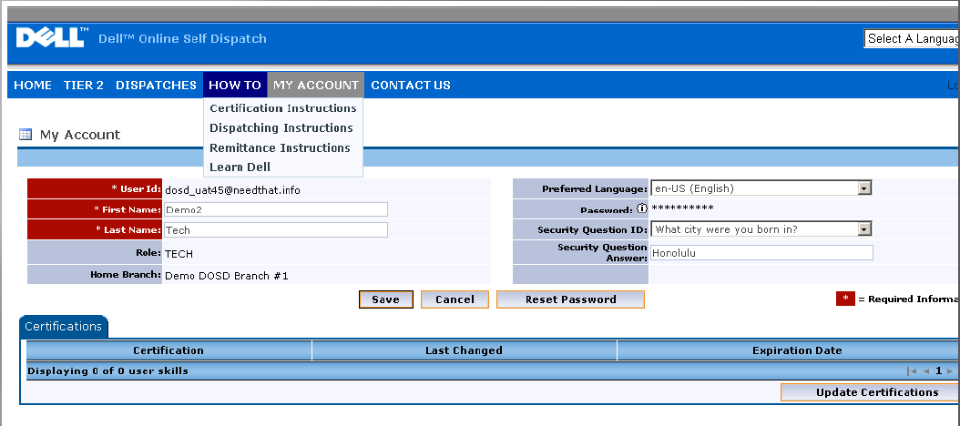
DOSD getting to Certification Tests
Select the “How To” tab at the top of the page.
In the Drop down select “Learn Dell”.

Slide 12
DOSD Learn Dell website

Slide 13
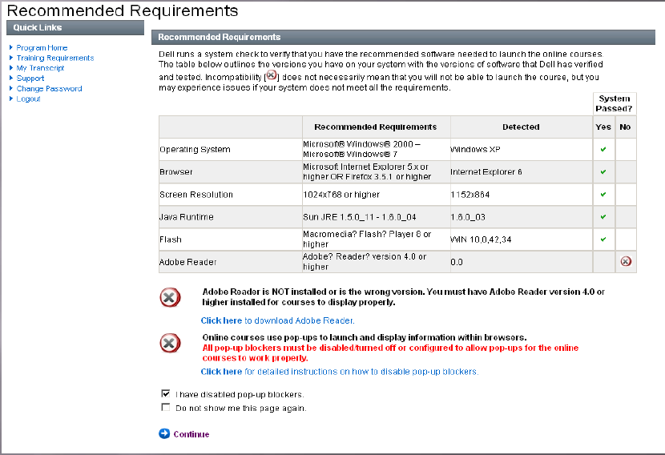
DOSD Learn Dell web site
This will open up the Learn Dell web site with a list of recommended requirements.
Make sure to disable your pop-up blockers and make sure the check boxes at the bottom of the page are properly checked.
Click on “Continue” to move onto the next page.

Slide 14
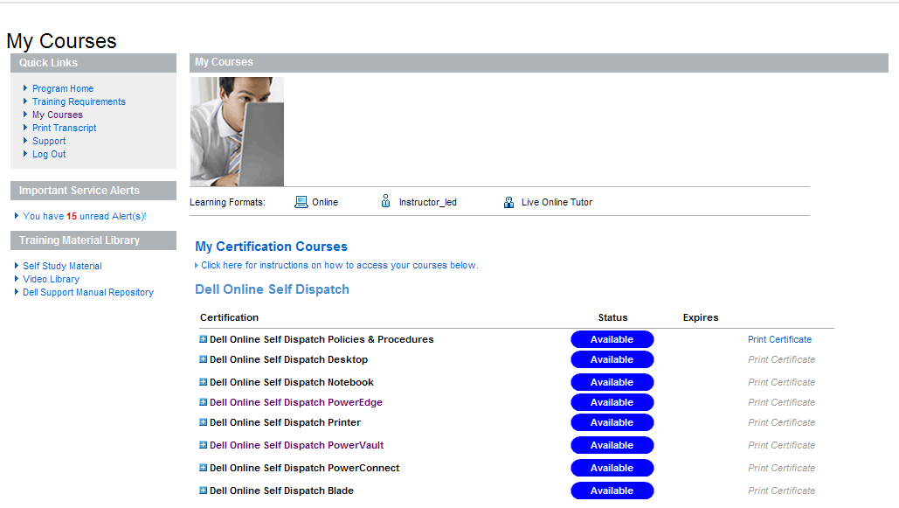
DOSD Certification listing page
Quantum ASPS needs to certify for the following:
  Dell Online Self Dispatch Policies & Procedures.
  Dell Online Self Dispatch PowerEdge 9G and 11G.
  Dell Online Self Dispatch PowerVault.

Slide 15
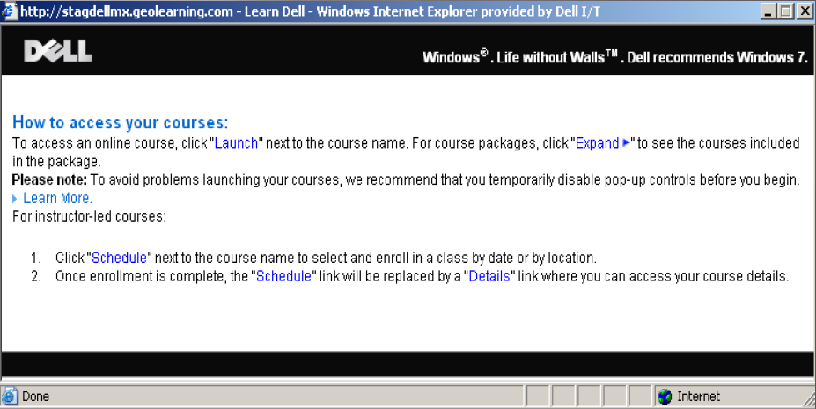
DOSD How to Access the course link
Instructions for usage can be found in the My Certification Courses section.
Click on the “Click here for instructions on how to access your courses below.” for the instructions on taking the courses.

Slide 16
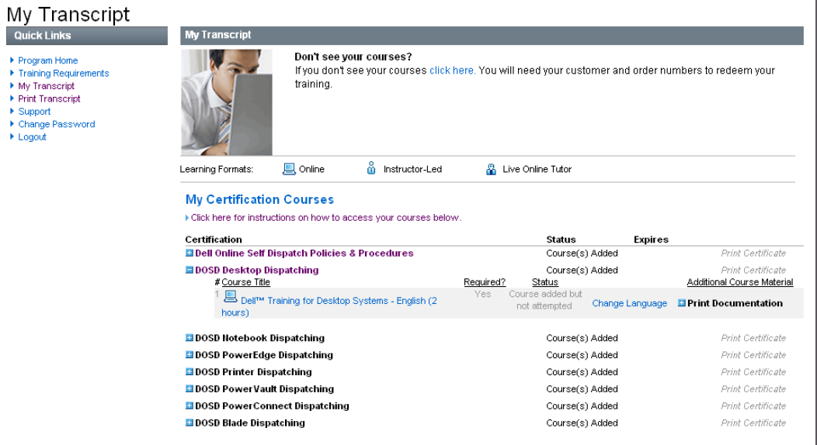
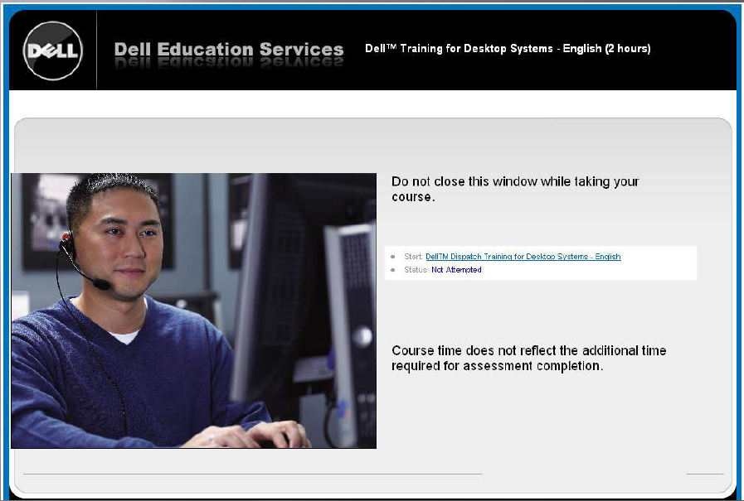
DOSD Select Course to start
Select Course you wish to Learn.
A pop-up will open.
Select the start link in the pop-up.

Slide 17
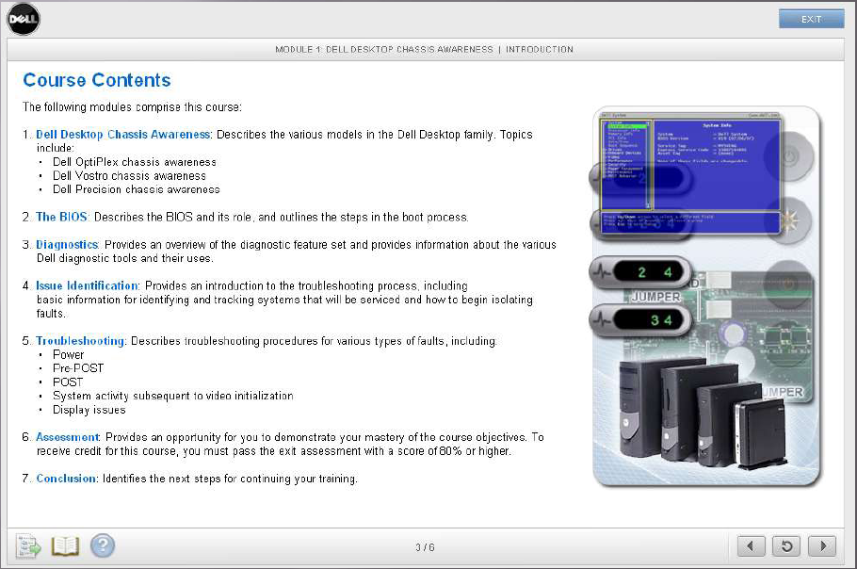
DOSD Courses
The course will start and you will be able to navigate with the buttons at the bottom of the screen or in the content.

Slide 18
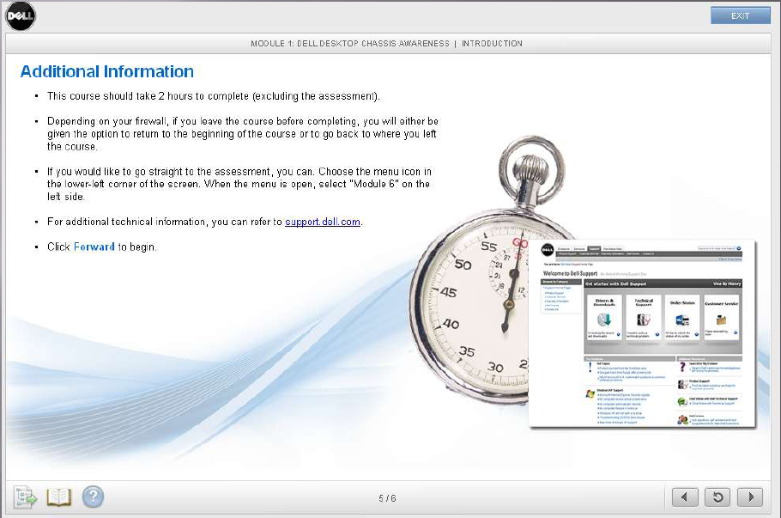
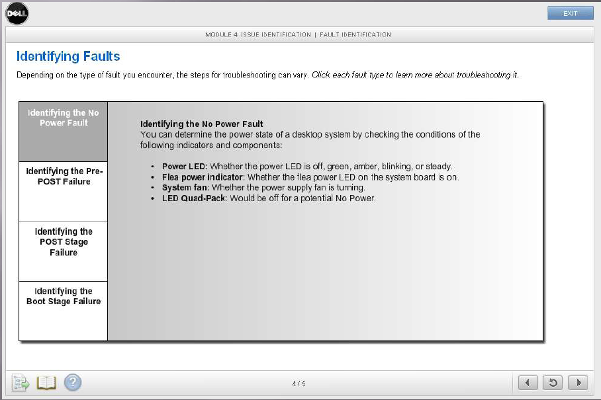
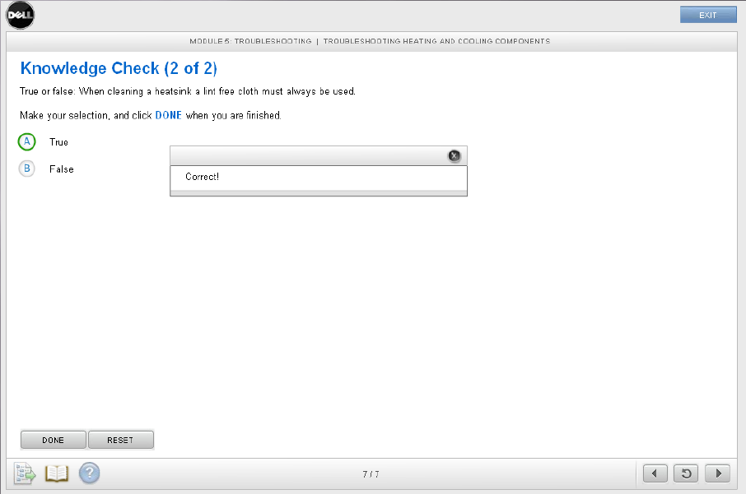
DOSD Courses
The course will
give a time
estimate and
will lead you through with test
questions along the way.

Slide 19
DOSD Certification

Slide 20
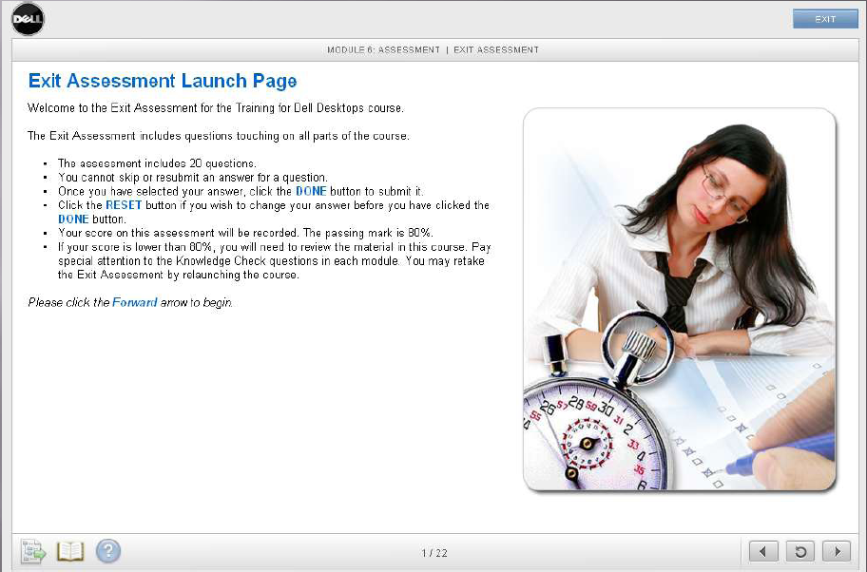
DOSD Assessment test to Certify
After completing the training you will then be taken to the Assessment test.
This page will tell you how many questions and the score you will need to certify.

Slide 21
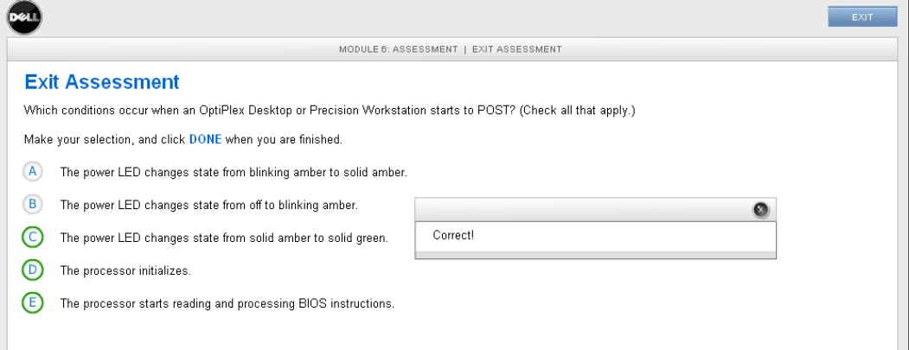
DOSD Assessment test to Certify
The testing will be multiple choice type questions. Some questions will want more than one answer.
If a question is answered correctly you will be able to see if it is answered correctly.

Slide 22
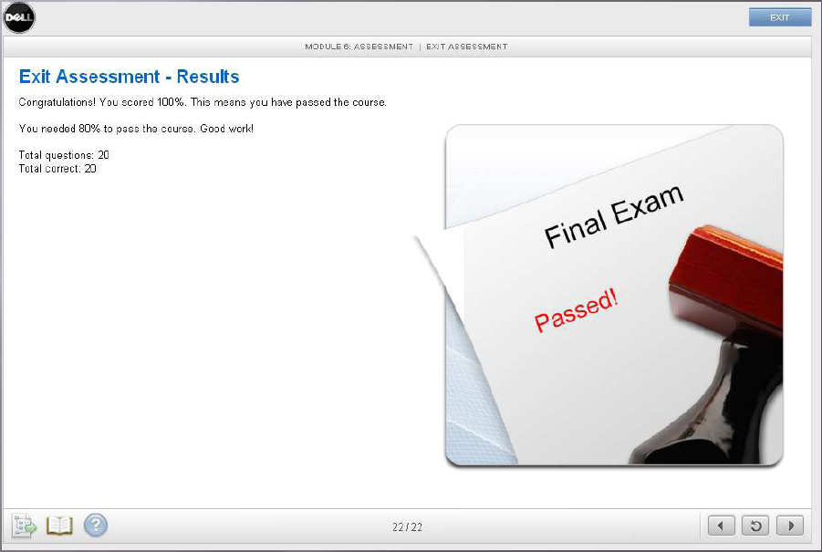
DOSD Assessment test results
This page show a passing grade on an Assessment test which is needed to Certify.

Slide 23
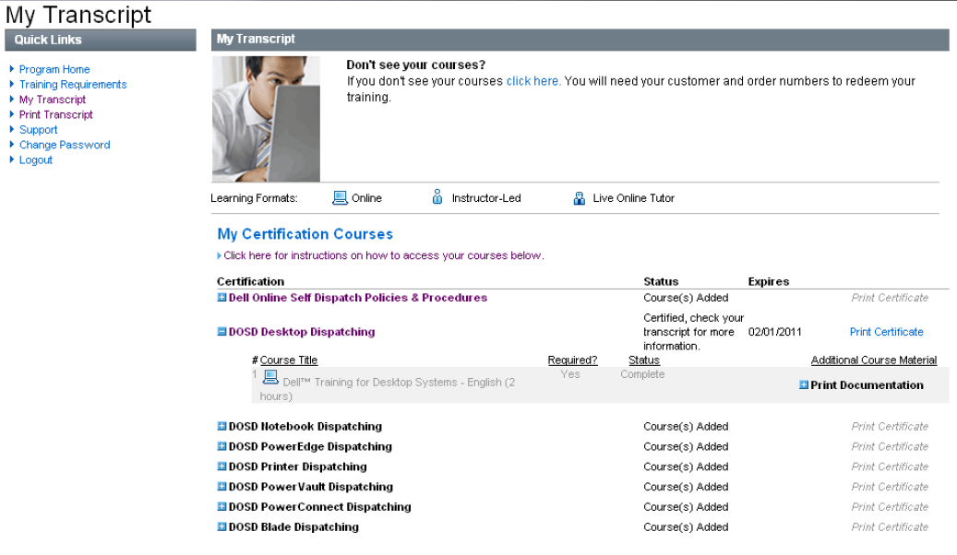
DOSD Certification status
Your “My certification Courses” page will now show your Certification and the expiration date.
You can continue to take the other courses for certification.

Slide 24
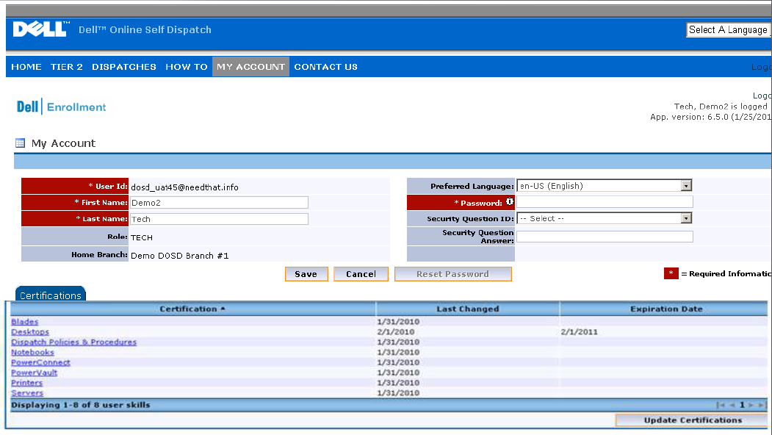
DOSD Certifications
You can also go to “My Account” page to see all of your Certifications and the expiration date.
Once you have 30 days left on your certification the course will be unlocked to re-certify.

Slide 25
DOSD Parts ordering process

Slide 26
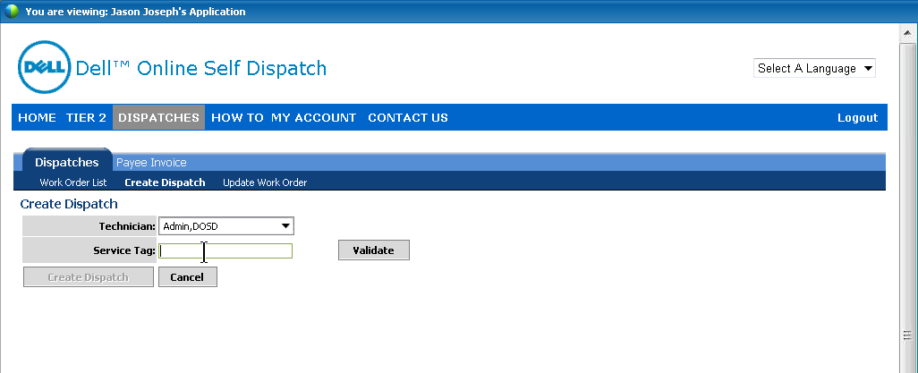
DOSD Parts ordering
To order parts select “Dispatches” to access the parts ordering menu.
There are three types of account types “Logistics” and “Technician” and “SPOC”.
A “Technician” login will not see a technician selection drop down. A “Logistics login will allow ordering for other technicians. “SPOC” is a system administrator.

Slide 27
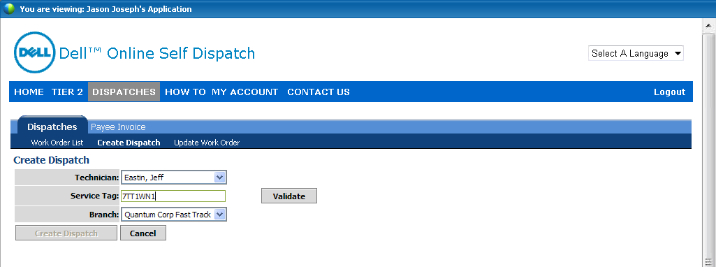
DOSD Parts ordering
If you have a logistics login, Select the technician and enter the Service Tag.
Select the correct branch – APAC, EMEA Quantum Corp Fast Track (US).
If the technician is not certified you will get the red error “Not Certified – Technician is not certified to dispatch for this line of business. Please verify service tag and selected.
If the Service tag is incorrect or is not in the Dell database you will need to correct it or Call Dell for support.
Click “Create Dispatch” to continue once the information is correct.

Slide 28
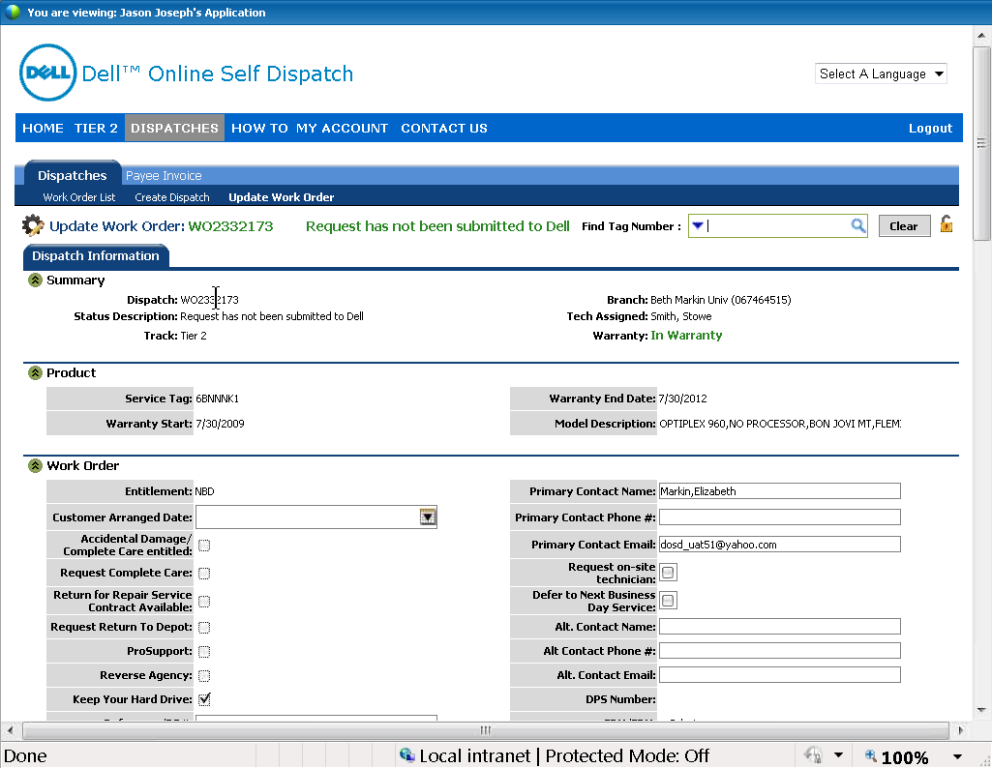
DOSD Parts ordering template
The parts ordering template will open up to start entering information.

Slide 29
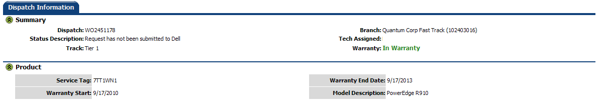
DOSD Parts ordering
Verify the system you have selected show the coverage of “In Warranty”.
Verify that the Model description is also correct. For the Example above the DXi 8500 node would show up as a PowerEdge R910.
The Status Description also shows you the status of your dispatch to Dell.

Slide 30
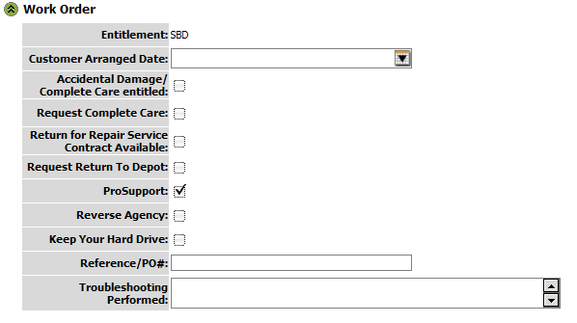
DOSD Parts ordering
Start filling out the template. In the example above the Entitlement is SBD or Same Business Day.
Verify that some one will be onsite to receive the parts at the ship to address. If not you can change the Customer Arranged Date or select the Defer to Next Business Day Service checkbox.
If the time at the ship to location is after 5:00 it would be best to call Dell as the DOSD system will not be monitored. Using DOSD could delay the part by another day.

Slide 31
DOSD Parts ordering template
The check boxes in this section should be left alone.
In the Reference/PO# section enter in the Quantum Service Request number.
In the Troubleshooting Performed section enter the troubleshooting performed and log excerpts as well as part specifics (i.e. in case the system has two different hard drives list the Size/type of drive to replace).

Slide 32
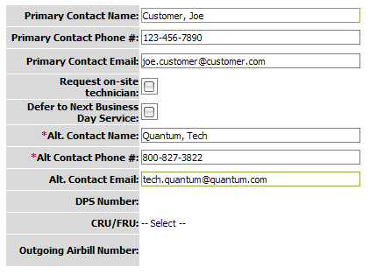
DOSD Parts Primary contact
Change the Primary contact information to the end user or technician that you are shipping the part. This is the name printed on the shipping label.
If you are requesting that Dell send a technician check the “Request on-site technician” box.
If you wish for Next Business Day service Select the “Defer to Next Business Day Service”. Note: If after 5:00 PM for the DXi location call Dell.
In the Alternate Contact information please input your information.
The DPS number fields will be populated by Dell once the order has been approved. If Airbill information is needed it will also be populated.

Slide 33
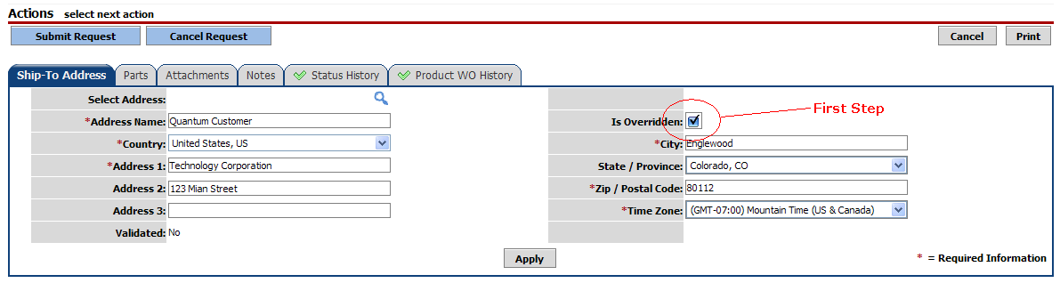
DOSD Parts ordering template ship-to address
Next click on the “Ship-To-Address” tab.
Start by checking the “Is Overridden” check box. If this is not overridden the part will be shipped to the default address that Dell has on file. This address is usually a Quantum facility.
Enter in the “Address Name” this is the address that is saved to your personal address book.
The ship to company name will be Quantum. Fill in the end users company name on the “Address 1” line.
Address 3 line will not be printed or seen by shipping company.

Slide 34
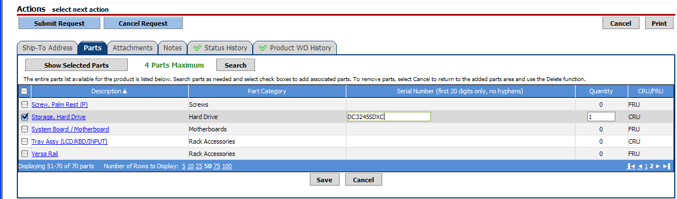
DOSD Parts selection
Next click on the “Parts” tab.
Find the part you need to order.
The list is a list of parts Dell has as the “Assembled and Shipped” configuration.
For example a hard drive would be listed as “Storage, Hard Drive”
Enter the Serial number of the part if available.
Select quantity needed.

Slide 35
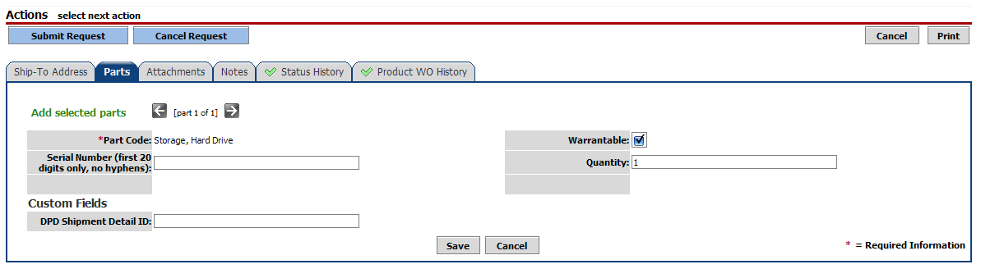
DOSD Parts selection
If on the previous parts screen you click on the part listed in the description field you will get this page.
Fill in the serial number if available.
Select quantity.
If you entered the information on the previous screen you don’t need to enter it on this screen.
Click the “Save” button after you are done with either screen.

Slide 36
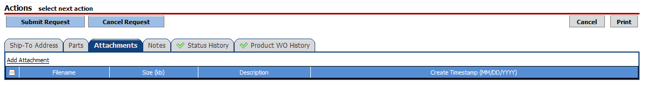
DOSD Parts attachments
Use the “Attachments” tab to attach pictures or other information that might be needed to get the correct part.
This tab is not needed every time and only to be used if there needs to be more clarification.

Slide 37
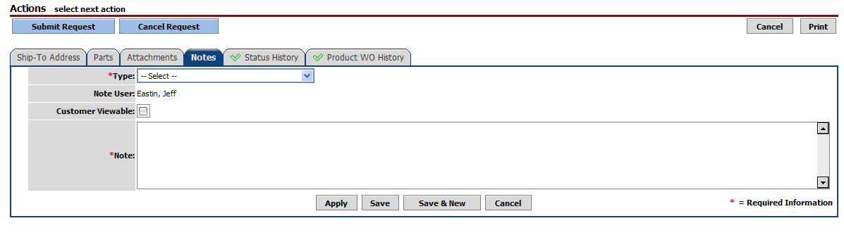
DOSD Parts notes
The “Notes” tab is for your use to attach case notes for your tracking.
This is not necessarily used for Dell to dispatch parts in DOSD, but they may look at this information.

Slide 38

DOSD Parts submit
Once all the previous fields have been completed click on the “Submit Request” button.
This will submit the request for Dell to review.
Once reviewed Dell will either accept or reject the order.
If rejected an email with the reason for rejection will be sent or you can view the status page.

Slide 39
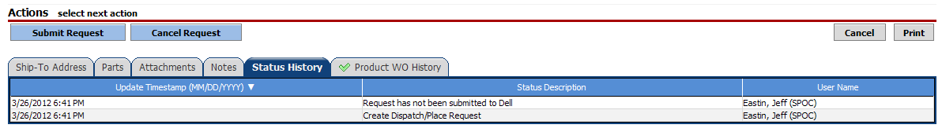
DOSD Parts Status
Once you have submitted the parts request you can follow the history in the “Status History” tab.
This will show all the history of this request.

Slide 40
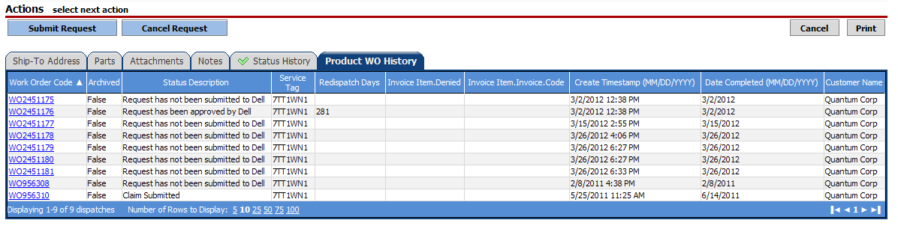
DOSD Parts Product WO history
The “Product WO History” tab will show you the entire history of DOSD requests for this Service Tag.

Slide 41
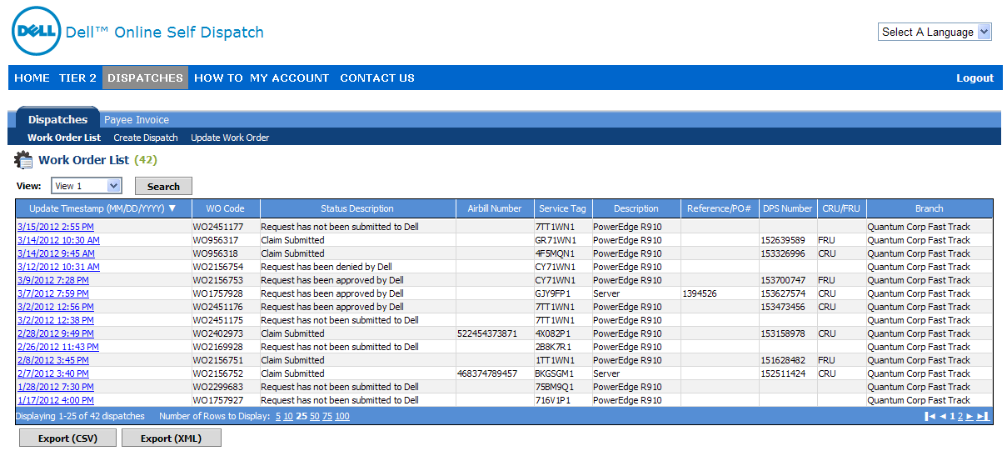
DOSD Work order list
An easy reference point to see if your dispatch request was accepted by Dell is the “Work Order List” in the “Dispatches” section. View it by the Service Tag number or the WO code from the work order form.
You can also get the DPS number once the part request has been approved from this screen.

Slide 42
DOSD Oracle tasks
Once the part has been approved you will need the DPS number from the previous slide or found in the email sent after the request is accepted to enter notes into the Quantum Oracle database.
ASPS to open ‘Dell Part Dispatch-CS’ task when dispatching QFE/TPM and a Dell part is required.
ASPS creates a ‘Dell Part Dispatch’ note type in the workbench tab recording:
  Dell Part number & description ordered
  DSP number – given by Dell to ASPS
ASPS assigns task to QFE to close (or GCH - if the unit is TPM supported)
If QFE supported and an additional part is needed the QFE will be responsible for ordering the part from Dell and:
  Creating a new ‘Dell Part Dispatch-CS’ task in the SR when dispatching Dell for the additional part
  Creating a ‘Dell Part Dispatch’ note type in the workbench tab recording:
    Dell Part number & description ordered
    DSP number – given by Dell to ASPS
QFE (or GCH when unit is supported by a TPM) will close the task once the parts have arrived and will create a ‘Dell Part Dispatch’ note type in the workbench tab recording non-expendable parts return information (this information will be available from the TPM in the call closure details sent to GCH):
  Date Part and description returned
  Dell Part number returned
  Waybill #
  DSP number
**Note: A separate ‘Dell Part Dispatch’ note type is required for each part being returned to Dell unless the used part is an expendable/non-returnable part.

Slide 43
DOSD Questions
For any Enrollment or Certification issues, send an e-mail to:
DOSD_ADMIN@Dell.com
For any Parts Dispatch issues, send an e-mail to:
DOSD_Support@Dell.com
For any other type of questions, refer to the “Contact Us” tab at the top of the main DOSD web site.

