Slide 1
QXS 3, 4, 6
TOI Refresh for Global Service
March 2016 – Initial Delivery
June 2016 - Refresh

Slide 2
Agenda
Product Overview – Matthew Apodaca
QXS and Dot Hill Populations – Lance Allred
QXS Licensing – Lance Allred
Virtual Volumes – John Badger
QXS Firmware Versions – Lance Allred
Training Update – Alex Duncan
Service Product Management – Richard Tyrell
Service Program Management– Jim Hibbard
Notes:
  Please ask questions as we go
  Please mute your phone line unless asking a question
  Recording will be posted on Qwikipedia

Slide 3
Product Overview
Matthew Apodaca – Product Management

Slide 4
Product Goals
QXS-3/4/6 rebranding goals:
  Consolidate sales, ordering and fulfillment of QX, QXS-12/24/56 and Dot Hill (DH) resale as a single set of part and model numbers
  Add Quantum branding to all products
  Adjust to market based pricing
  Add configuration flexibility for market conditions
  Fulfill orders from Avnet
  Have new systems ship with G222 firmware
The goal will require multiple steps to prevent customer and sales confusion and mitigate inventory constraints
  Step 1 – Transition
  Step 2 – Launch and Consolidation
  Step 3 – Discontinue old part and model number ordering

Slide 5
  Step 1 – Transition
QX
QX-1200
QX-2400
QXS - SN
QXS-1200
QXS-2400
QXS-5600
Dot Hill Resale
3xxx
4xxx
6xxx
QXS Hybrid Disk
QXS-3
QXS-4
QXS-6
Why a transition is needed
  The transition has been used to accommodate lead time concerns, broad price changes and firmware release delays
  To protect quarter end deals
Some Dot Hill resale orders will be fulfilled with Avnet inventory and others from Seagate
  EMEA orders continued to be fulfilled through Hammer
Some differences do exist such as part numbers and IB record data

Slide 6
Step 1 – Transition (cont.)
Simple way to look at this: Customer is ordering either QXS StorNext or Dot Hill resale product and we are fulfilling “behind the scenes” with Q brand QXS-3/4/6 components
PTO part numbers were created representing the QXS-12/24/5600 and high running Dot Hill resale systems
As inventory was depleted these new PTO part numbers were switched on in Oracle to equal the equivalent model number
  This allows for fulfillment of the order with the new QXS Hybrid Disk components
  Keeps the model number help keep the paperwork consistent from start to finish
Order Placement
  Continue to use the same model numbers as before but the underlying part numbers may have changed
    Do not use configurator
    Changes will be communicated as inventory is used up
Transition PTO part number BOMs
  StorNext QXS-12/24/56 – all configurations – Agile released ~3/4
    Effective in April, shifting as many of these orders as possible to Avnet for Qbrand QXS-3/4/6 components
  Xcellis implemented QXS-3xx/4xx/6xx; already released in Agile
Fulfillment of some orders will be placed using existing Dot Hill part numbers and be fulfilled through Seagate as Dot Hill branded product:
  EMEA orders still being fulfilled as Dot Hill resale brand product from Hammer Germany
  Legacy (Fed/EOL product/Titanium,Chromium) still being fulfilled as Dot Hill product from Foxconn
  Orders going through Seagate will have longer lead times
All systems leaving Avnet include a customer transition flyer highlighting changes

Slide 7
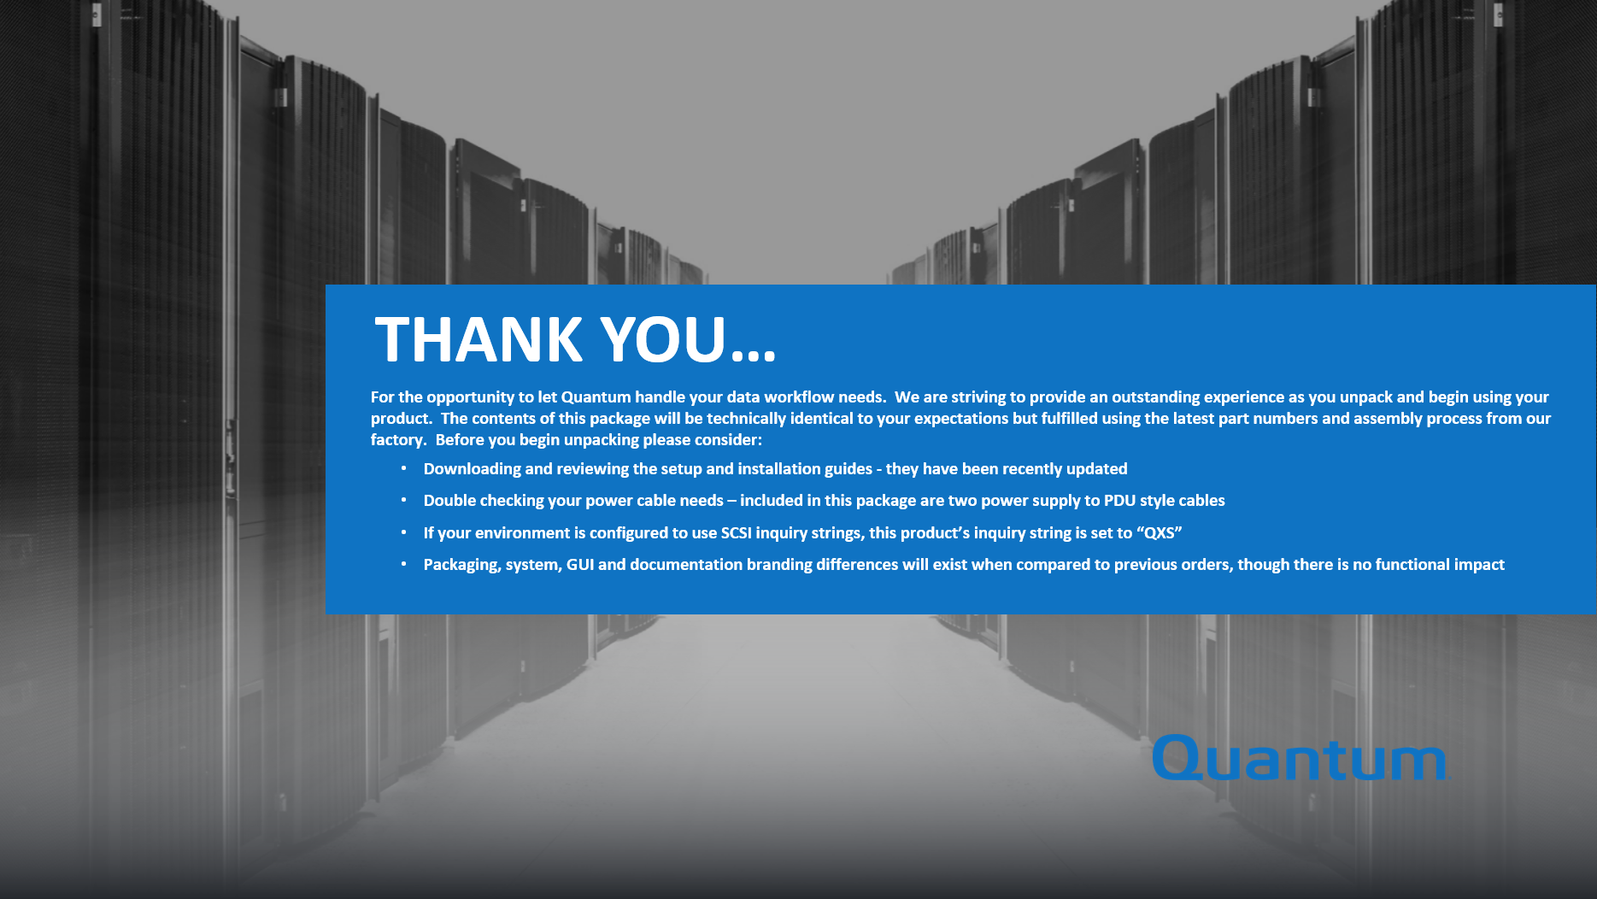
Step 1 – Transition - Flyer
Flyer inserted in all QXS systems leaving Avnet
Not included in Xcellis

Slide 8
Where to Next - Step 2 – Launch and Consolidation
QX
QX-1200
QX-2400
QXS - SN
QXS-1200
QXS-2400
QXS-5600
DotHill Resale
3xxx
4xxx
6xxx
QXS Hybrid Disk
QXS-3
QXS-4
QXS-6
The first half of FY’17 price book v84 and marketing collateral will publically release the QXS Hybrid Disk part number and pricing
QX, QXS-SN and Dot Hill part numbers will go EOL to push orders to the new part numbers
StorNext users would use the QXS Hybrid Disk section of the price book to buy user storage
All orders will completely fulfilled through Avnet and Hammer
All orders will ship with G222 firmware

Slide 9
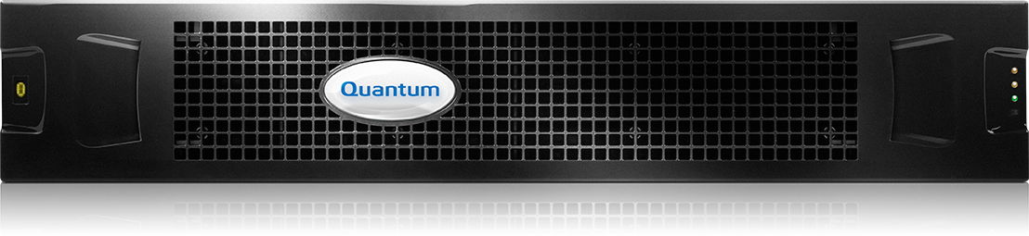

QXS Hybrid Disk Building Block Configuration
Select RAID Chassis
- Choose controller
- Choose density
- Empty RAID
Select Drives
- Pick size and quantity
- SSD and/or HDD
Select Connectivity
- Select SFP type for CNC chassis (1GbE iSCSI, 10GbE iSCSI, 8Gb FC and 16Gb FC)
- SAS Y-Cable
Optional Software
- Only applied to RAID chassis
Select Expansion
Service
- Tied to chassis
- Extended warranty options available
-Choose Density
- Choose Drives
Selling today
  QX and QXS-SN were priced and configured with a limited set of capacity combinations in complete bundles (drives, chassis and connectivity)
  Dot Hill resale offers a broader set of bundles (drives and chassis) but with the option to customize the number and type of drives
QXS Hybrid Disk will use building blocks to build complete systems

Slide 10
QXS Hybrid Disk Building Block Options
Additional options are available for order
  Spare chassis, controllers and AC/DC power supplies
  DC power supply as a field upgrade option – IB trackable
  Non-SED or SED drives
    Mixing will not permitted
    The default drive type non-SED
Latest firmware/software, G222, will GA in the coming weeks
  All systems must be upgraded to latest firmware at install

Slide 11
QXS Hybrid Disk Building Blocks
Chassis density options
  2u12
  2u24
  2u48
  4u56
Controller options
  QXS-3 or internally as 3004 or EX
    SAS or CNC (FC/iSCSI) SFP+ connectivity
    SAS expansion connectivity
  QXS-4 or internally as 4004 or LX
    SAS or CNC (FC/iSCSI) SFP+ connectivity
    SAS expansion connectivity
  QXS-6 or internally as 6004 or FX
    SAS or CNC (FC/iSCSI) SFP+ connectivity
    SAS expansion connectivity
Drives
  Important! There are different drive sleds with 2u24 and 2u48 versus 2u12 and 4u56
  HDD spinning disk – 7.2K RPM, 10K RPM and 15K RPM
  SSD – 10 Drive Writes Per Day (DWPD) and 3 DWPD endurance levels
    Can be expressed as read/write intensive and enterprise (10DWPD) or read intensive and consumer (3DWPD)

Slide 12
QXS Hybrid Disk Naming
More descriptive naming containing searchable terms when sold on DMR websites (CDW)
Price book descriptions updated to show inclusions, exclusions and service offerings
Quantum QXS-312RC Storage, RAID Chassis, FC/iSCSI, 12-slot, LFF
Controller type (3/4/6)
Drives Possible and drive dimension (LFF/SFF)
Drives Possible (12/24/48/56)
Connectivity Type (FC/iSCSI or SAS)
Type of chassis (R – RAID/E – EBOD)
Chassis Type (RAID or Expansion)
Connectivity Type (C – CNC (FC/iSCSI) or S – SAS)

Slide 13
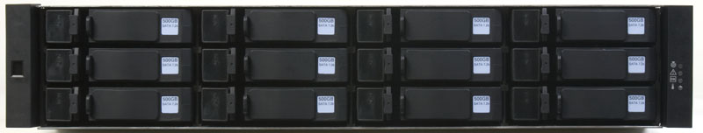
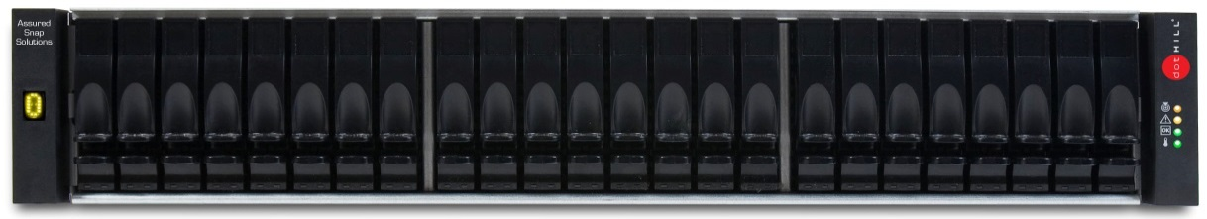
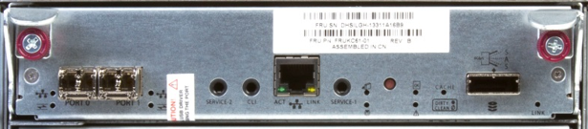
QXS-3xx
Basics
  40,000 IOPs, 3300 MBps Read, 2400 MBps Write
  12GB system cache (6GB per controller)
  Supported in low density (2U12, 2U24) chassis
  Max chassis 4x (3x expansions plus base) or 96 spindles
Host Connections
  2 ports per controller
  16Gb/8Gb Fibre Channel, 12Gb/6Gb SAS, and 10Gb/1Gb iSCSI host connectivity
Green Technology
  Patented battery-free cache backup eliminating battery replacement.
Rugged, Mobile Applications
  NEBS Level 3 and MIL STD 810G compliant to meet Telecommunications requirements and Military standards for shock and vibration
2u12
2u24

Slide 14
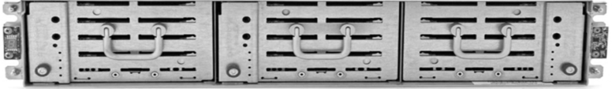
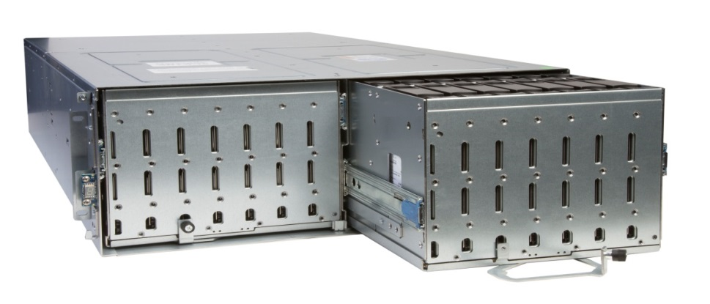
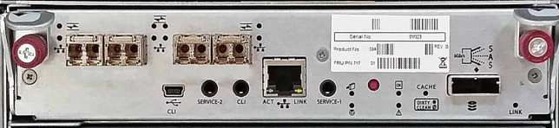
QXS-4xx
Basics
  120,000 IOPs, 6400 MBps Read, 5300 MBps Write
  12GB system cache (6GB per controller)
  Supported in low density (2U12, 2U24) and high density (2U48, 4U56) chassis
  Max chassis 8x (7x expansions plus base) or 248 spindles
Host Connections
  4 ports per controller
  16Gb, 8Gb Fibre Channel, 12Gb, 6Gb SAS, and 10Gb, 1Gb iSCSI host connectivity
Green Technology
  Patented battery-free cache backup eliminating battery replacement
Drive Support
  Support for encryption drives
  Support for mixed SAS and SSD drives for hybrid solutions
Rugged, Mobile Applications
  NEBS Level 3 and MIL STD 810G compliant to meet Telecommunications requirements and Military standards for shock and vibration
2u12
2u24
2u48
4u56

Slide 15
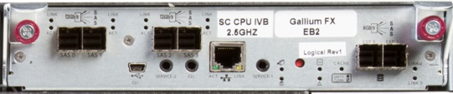
QXS-6xx
Basics
  200,000 IOPs, 12 GBps Read, 5700 MBps Write
  40GB system cache (20GB per controller)
  Supported in high density (2U48, 4U56) chassis
  Max chassis 8x (7x expansions plus base) or 248 spindles
Host Connections
  4 ports per controller
  16Gb, 8Gb Fibre Channel, 12Gb, 6Gb SAS, and 10Gb, 1Gb iSCSI host connectivity
Green Technology
  Patented battery-free cache backup eliminating battery replacement
Drive Support
  Support for encryption drives
  Support for mixed SAS and SSD drives for hybrid solutions
Rugged, Mobile Applications
  NEBS Level 3 and MIL STD 810G compliant to meet Telecommunications requirements and Military standards for shock and vibration
2u48
4u56

Slide 16
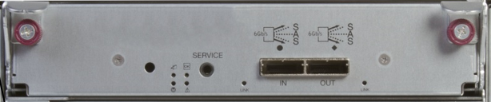
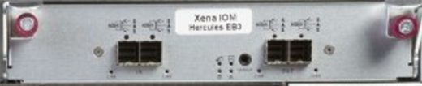
Expansion IOM
For 2u12, 2u24 and 2u48 expansion modules the IOM has one 6Gb input and output SAS connector or two per chassis
For 4u56 expansion modules the IOM has two 12Gb input and output SAS connectors or four per chassis

Slide 17
QXS and Dot Hill Populations
Lance Allred

Slide 18
Populations Overview
As time has gone on, multiple populations of QXS and Dot-Hill-branded have been created
Populations matter, they affect:
  What exactly a customer receives
  How the unit is branded
  How to obtain licenses
  How the unit or components appear in the IB
  Where the warranty or service contract resides
  What CRUs or replacement parts are used
  Who provides first call and ultimate service
To understand populations, we need to separate who sold it and how it was fulfilled

Slide 19
Populations – Ordering and Fulfillment Timeline
Many years ago, QX-1200/2400 were launched
  Initially drop shipped from Dot Hill and Dot Hill-branded a.k.a. “Denali”
  Later shipped by Quantum (through Avnet) and Quantum-branded
QXS-1200/2400 and later QXS-5600 were also launch 1+ years ago
Prior to Mar’15, orders and fulfillment could have come from:
  Quantum for QXS-1200/2400/5600 (Quantum for the most part fulfills through Avnet)
  Dot Hill for Dot Hill-branded equipment Quantum acquired the former Dot Hill channel in Mar’15

Slide 20
Populations – Ordering and Fulfillment Timeline (cont.)
From Mar’15 through late Jul’15, Quantum acquired the Dot Hill “channel”
  All former Dot Hill-branded sales now sold by Quantum, DH Sales team came to Quantum
  Quantum sold Dot Hill part numbers and dropped the order on Dot Hill to fulfill
    These units were on Seagate warranty and / or service contract
  Quantum continued to take orders and fulfill QXS-1200/2400/5600
Starting late Jul’15 through approximately Mar’16
  Quantum introduced QXS-3/4/6 and sold the Dot Hill-branded systems and components with QXS-3/4/6 moniker
    Underlying equipment continued to be Dot Hill fulfilled and branded
    Units are sold by and under Quantum warranty and / or service contract
    In some cases service contracts were sold for expansions where Quantum did not sell the base
  Quantum continued to take orders and fulfill QXS-1200/2400/5600
(Seagate acquired Dot Hill in late ‘15)

Slide 21
Populations – Ordering and Fulfillment Timeline (cont.)
Mar’16 through present
  Quantum-branded QXS-3/4/6 launch delayed to CQ3
  Quantum continued to take orders and fulfill QXS-1200/2400/5600
  Quantum continued to take orders and fulfill Dot Hill reseller channel
  Transitions
    Originally intended to handle small number of quotes already locked with old 1200/2400/5600 or DH Reseller models / parts
    To overcome launch delay and inventory positioning, transition plan was expanded
      Fulfill QXS-1200/2400/5600 with Quantum-branded QXS-3/4/6 components
        Use so-called 1200/2400/5600 transition BOMs
      Fulfill select DH Reseller systems with Quantum-branded QXS-3/4/6 components
        Initially by running a DH Reseller part number order through the Quantum-branded QXS-3/4/6 configurator, and fulfilled with Quantum-branded components out of Avnet
        Later by using DH Reseller transition BOMs, still fulfilled out of Avnet

Slide 22
Populations – Ordering and Fulfillment Timeline (cont.)
Xcellis history
  Nov’15 to Mar’16
    Xcellis launched
    Using yet-to-be-released Quantum-branded QXS-4xx components
    Existing QXS-1200/2400/5600 inventory was “reworked” to turn it into Quantum-branded QXS-412/424/456 for use in Xcellis
  Mar’16 through present
    Inventory of QXS-1200/2400/5600 to rework started running out
    Xcellis started using Quantum-brandedQXS-3/4/6 components
    Xcellis is, today, shipping with Quantum-branded QXS-3/4/6 components; no longer shipping with “reworked” 1200/2400/5600

Slide 23
Populations – Ordering and Fulfillment Timeline (cont.)
Future
  Quantum-branded QXS-3/4/6 launch delayed from Mar’16 to CQ3
    Exact new launch date has not been set yet
  Release to consolidate all offerings into single Quantum-branded QXS-3/4/6 population:
    QXS-1200/2400/5600 would be EOL’ed
    All transition methods EOL’ed
    Dot Hill-branded hardware no longer be sold
    Everything sold would be from the Quantum-branded QXS-3/4/6 price list
    Fulfillment would be from Quantum (using Avnet)
    Quantum branding
  Exception to consolidation
    Certain former Dot Hill government customers (GTS, AAI, AEGIS, etc.) take older generation hardware
      Difficult for these customers to take new hardware / firmware without expensive qualification cycles
    A separate program was spun off to deal with GTS special needs
      Program defines unique models / parts for GTS only
      GTS leverages off of QXS-3xx
    AAI in the very short term dealt with through Seagate drop shipping, but hardware is all EOL, new program needed
    AEGIS requirements are being gathered
    Others will be dealt with on a case-by-base basis, in general government customers will require special handling

Slide 24
QXS and Dot Hill Reseller Populations Details
Quantum-branded QXS-3/4/6
  Sold under Quantum model / part, Quantum warranty / contract
  Fourth generation Gallium x004 controllers (e.g. Seagate model 4834, 3523, etc.)
  Firmware (prefix GL, GF) obtained from quantum.com
  Start shipping in CQ3’16
  Built by Avnet with Seagate-provided QXS-3/4/6 components
  Drives installed in-the-field
  OUI: Quantum, Inquiry string: QXS, QTM branding
  Add-on licensing from Quantum
QX-1200/2400
  Sold under Quantum model / part, Quantum warranty / contract
  Chromium x003 controllers
  Firmware (prefix CF) obtained from quantum.com
  EOL, No longer shipping
  Built by Dot Hill as complete systems
  Drives installed by Dot Hill
  OUI: Quantum, Inquiry string: StorNext QXS, QTM branding
  Add-on licensing not supported
“Transition” QXS-1200/2400/5600
  Sold under Quantum model / part, Quantum warranty / contract
  Gallium x004 controllers
  Firmware (prefix GL) obtained from quantum.com
  Start shipping in March’15 until 3/4/6 launches
  Built by Avnet with Seagate-provided QXS-3/4/6 components, includes flyer
  Drives installed in-the-field
  OUI: Quantum, Inquiry string: QXS, QTM branding
  Add-on licensing require special approval, fulfill from Quantum
“Denali”
  Sold under Dot Hill part, Dot Hill warranty / contract
  Nitro x001 and Titanium x002 controllers
  Firmware (multiple prefixes) obtained from Dot Hill CRC
  EOL, no longer shipping
  Built and shipped by Dot Hill
  Drives installed by Dot Hill
  OUI: Dot Hill, Inquiry string: DH model, DH branding
  Add-on licensing from Dot Hill
“Classic” QXS-1200/2400/5600
  Sold under Quantum model / part, Quantum warranty / contract
  Gallium x004 controllers
  Firmware (prefix GL) obtained from quantum.com
  Only shipping remaining inventory, otherwise selling transition 1200/2400/5600
  Built by Seagate as complete systems
  Drives installed by Dot Hill / Seagate for 2U12 / 2U24
  OUI: Quantum, Inquiry string: StorNext QXS, QTM branding
  Add-on licensing require special approval, fulfill from Seagate
Other minor differences exists including power cables, SFPs, part numbers, documentation included, others

Slide 25
QXS and Dot Hill Reseller Populations Details (cont.)
Xcellis w/ reworked QXS-1200/2400/5600
  Sold under Quantum model / part, Quantum warranty / contract
  Gallium x004 controllers
  Firmware (prefix GL) obtained from quantum.com
  Started shipping in Nov’15
  Built by Avnet from reworked QXS-1200/2400/5600
  Drives installed by Avnet
  OUI: Quantum, Inquiry string: QXS, QTM branding
  Add-on licensing from Quantum
Xcellis w/ Quantum-branded QXS-3/4/6 components
  Sold under Quantum model / part, Quantum warranty / contract
  Gallium x004 controllers
  Firmware (prefix GL) obtained from quantum.com
  Started shipping in Mar’16
  Built by Avnet with Seagate-provided QXS-3/4/6 components
  Drives installed by Avnet
  OUI: Quantum, Inquiry string: QXS, QTM branding
  Add-on licensing from Quantum

Slide 26
QXS and Dot Hill Reseller Populations Details (cont.)
Dot Hill Reseller w/ Dot Hill parts, Dot Hill components
  Sold by Quantum under Dot Hill part, Dot Hill warranty / contract
  Gallium x004 and Titanium x002 controllers (Chromium not sold by Quantum)
  Firmware obtained from Seagate CRC
  Sold by Quantum Mar’15 to Jul’15
  Built and shipped by Seagate
  Drives installed in-the-field, note SFPs not included by default
  OUI: Dot Hill, Inquiry string: DH Model, DH branding
  Add-on licensing from Seagate
Dot Hill Reseller w/Quantum parts, Dot Hill components
  Sold by Quantum under Dot Hill model, Quantum warranty / contract (for Gallium only)
  Gallium x004 and Titanium x002 controllers (Chromium not sold by Quantum)
  Firmware obtained from Seagate CRC
  Sold by Quantum Jul’15 to present
  Built and shipped by Seagate
  Drives installed in-the-field, note SFPs not included by default
  OUI: Dot Hill, Inquiry string: DH Model, DH branding
  Add-on licensing from Seagate

Slide 27
QXS and Dot Hill Reseller Populations Details (cont.)
Transition Dot Hill Reseller w/ Quantum parts, Quantum-branded 3/4/6 components using 3/4/6 configurator
  Sold under Dot Hill model, Quantum warranty / contract (for Gallium only)
  Gallium x004 controllers only
  Use Quantum part numbers to sell, Quantum holds the service contract
  Firmware prefix GL obtained from quantum.com
  Sold by Quantum Mar’16 to present
  Built by Avnet with Seagate-provided QXS-3/4/6 components
  Drives installed in-the-field
  OUI: Quantum, Inquiry string: QXS, QTM branding
  Add-on licensing from Quantum
Transition Dot Hill Reseller w/Quantum parts, Quantum-branded 3/4/6 components using DH Reseller transition BOMs
  Sold under Dot Hill model number, Quantum part number
  Gallium x004 controllers only
  Use Quantum part numbers to sell, Quantum holds the service contract
  Firmware (prefix GL) obtained from quantum.com
  Sold by Quantum May’16 to present
  Built by Avnet with Seagate-provided QXS-3/4/6 components
  Drives installed in-the-field
  OUI: Quantum, Inquiry string: QXS, QTM branding
  Add-on licensing from Quantum

Slide 28
QXS and Dot Hill Reseller Populations Details (cont.)
But end results is what really matters from Service perspective:
  1) serial number
  2) branding
  3) who holds warranty and / or service contract
These elements determine how to handle a service request or service a unit

Slide 29
QXS Licensing
Lance Allred

Slide 30
QXS Licensing Synopsis
Quantum now supports most licenses offered by Seagate
Quantum’s license names differ from Seagate’s names
Quantum team should use the Quantum name for licenses
  But beware the license file and GUI show the Seagate names
One license is applied in Manufacturing
  A 2nd license is applied for Xcellis SSD systems
All other licenses are add-on licenses, purchases separately by the customer
Fulfillment of licenses is dependent on who fulfilled the base server (Quantum or Seagate)
  If base unit fulfilled by Quantum / Avnet, license comes from Quantum
  If base unit fulfilled by Seagate, license comes from Seagate
  Full ramp-up of QXS licensing does not start until Quantum-branded QXS-3/4/6 is launched
  Dot Hill-branded orders transitioned to Avnet, license fulfillment also transfer
Add-on licenses for QXS-1200/2400/5600 are supported, but require:
  Permissions from Matthew to sell into the deployment
  These licenses are fulfilled through Seagate, not Quantum

Slide 31
Licensable Features New to Quantum
Q-Tools
  Caching
  Tier data based on usage from HDD to HDD (e.g. 7K to 10K/15K)
  Frequently accessed, “hot” data can move to disks with higher performance, lower capacity, and higher costs.
  Infrequently accessed, “cool” data can move to disks with higher capacity, lower performance, and lower costs.
  Creation of virtual pools
  Quick rebuild
  Thin provisioning – allocate physical space just-in-time
Q-Tier
  Tier data based on usage from HDD to SSD
Q-Snap
  Allow up to 512 (QXS-3), 1024 (QXS -4) and 2048 (QXS-6) snapshots to be taken, at any time, with zero impact on storage performance.
  Using the Quantum users can set up and schedule snapshots for several volumes simultaneously.
Q-Replicate
  Schedule when replications will occur
  Uses snapshots
  Optimal for long distances
  Minimized time and bandwidth vs synchronous replication which occurs at simultaneously as the primary storage
Q-Copy
  Makes a copy of data to another set of disk within the array
  Controller based
  No host resources used

Slide 32
QXS License Details
Quantum Offering Name | Seagate or other Equivalent Names | Installed by Seagate Manufacturing for DH Reseller | Seagate Add-on Offering | Installed in Avnet Manufacturing for Quantum-branded QXS-3/4/6 | Quantum Add-on Offering | Installed in Avnet Manufacturing for Xcellis
Q-Tools | Virtualization RealStor | Yes (as of GL200) | Yes for transition to GL200 and later | Yes | For QXS-1200/2400/5600 only, not in Quantum-branded QXS-3/4/6 price book | Yes
Q-Tier | RealTier AssuredTier Performance tier SSD Tier | No | Yes | No | Yes | For SSD models only
Q-Replicate | RealRemote AssuredRemote Replication | No | Yes through DMS bundle | No | Yes | No
Q-Snap | RealSnap AssuredSnap Licensed snapshots | No | Yes through DMS bundle | No | Yes | No
Q-Copy | RealCopy AssuredCopy Volume Copy | No | Yes through DMS bundle | No | Yes | No
QL-Tools | Microsoft Volume Shadow Copy Service (VSS) | No | Yes | No | Not in QXS-3/4/6 price book at initial launch, available for DH Reseller | No
 | VMWare Site Recovery Adaptor (SRA) | No | Yes | No |  | No
 | Microsoft Virtual Disk Service (VDS) | No | Yes | No |  | No

Slide 33
Quantum-branded QXS-3/4/6 Licensing Process
Quantum-branded QXS-3/4/6 receive Q-Tools by default
  No certificate required, license is pre-installed
  End-User interface will show licenses pre-installed for a given serial number
End-users ordering add-on licenses receive a certificate with authorization code representing license ordered
End-user goes to web site listed on certificate to enter serial number and authorization code: www.quantum.com/licensekeys
End-users receive back license file; license file is applied through QXS GUI

Slide 34
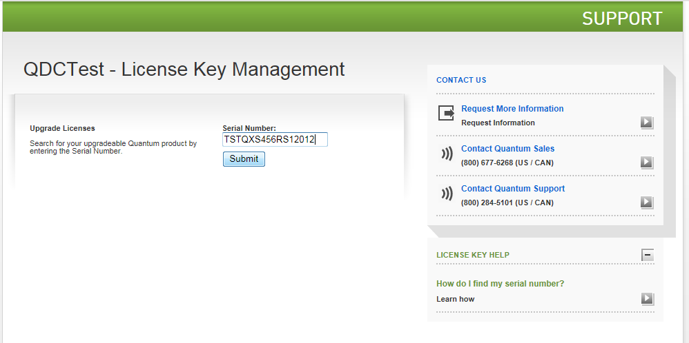
Quantum-branded QXS-3/4/6 Licensing Process (cont.)
End-users navigate to the multi-product license page supported by QuIL
Serial number of the unit is entered and submitted
Only valid serial numbers allow the end-user to progress to the next step

Slide 35
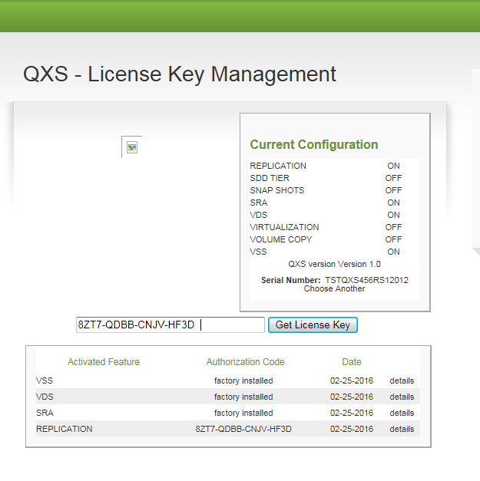
Quantum-branded QXS-3/4/6 Licensing Process (cont.)
Licensing applied to the serial number is shown
Any factory installed licensing is also shown
End-users may enter the one-time-use authorization code
NOTE: Names subject to change as shown on left, will align with official Q-xxx names

Slide 36
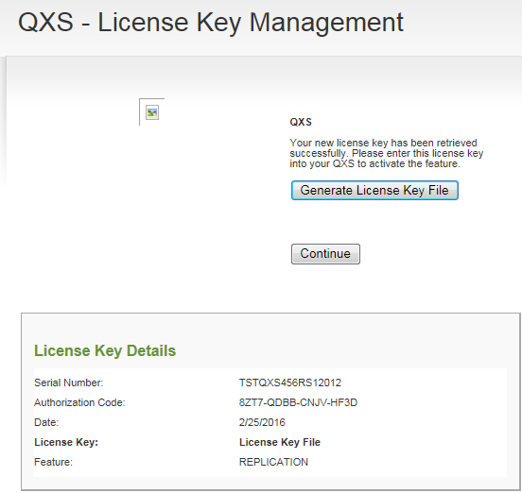
Quantum-branded QXS-3/4/6 Licensing Process (cont.)
Once an authorization code is entered, and if the authorization code is accepted, the next step is for the end-user to generate a license key file
The generated license file can be saved on the end-user’s computer (not shown)
The generated file contains only the single key associated with the authorization code
Keys are only useful for a single serial number

Slide 37
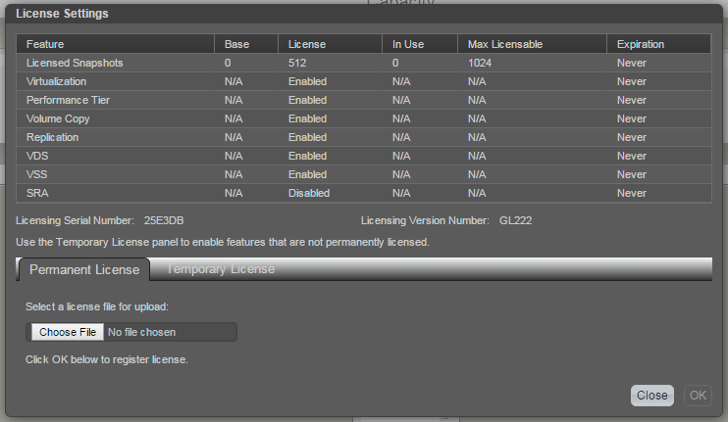
Quantum-branded QXS-3/4/6 Licensing Process (cont.)
Licenses are applied through the Quantum Disk Storage Management utility
The License Settings view shows licenses installed and provides a mechanism to specific a license file to apply a new license
NOTE: Snapshot license represented by a count
NOTE: license names on GUI remain Seagate-centric at G222

Slide 38
Seagate Licensing Process
Use this process where
  Base unit was fulfilled by Seagate (and therefore is Dot Hill-branded)
  Someone wants an add-on license for QXS-1200/2400/5600
    QXS-1200/2400/5600 typically will not need add-on licenses and they were not sold previously
Pre-requisite, need a sale
  Quantum sells the license against a Seagate base or QXS-1200/2400/5600
  NOTE: There is no licensing certification in this process; the SO is the only paperwork
Prior to Obtaining License
  Seagate must receive a PO from Quantum for the license ahead of the actual license request
  IMPORTANT: PO process can take a few days to make its way from Quantum to Seagate and get into the Seagate systems
Obtaining License Process
  Gather following information
    User name
    Company name
    Company address
    User phone number
    User email ID
    License type (License PN if available)
    Chassis serial number
  Call Seagate at 1-877-368-7924 to obtain the license file providing the information required by Seagate
  Apply the license file to the running system as previously shown in the Quantum-branded QXS-3/4/6 process

Slide 39
Licensing for Various Populations
Remember – license fulfillment process depends on who fulfilled the base server AND whether it is Quantum-branded QXS-3/4/6 or QXS-1200/2400/5600 or DH Reseller
  Only Quantum-branded QXS-3/4/6 and some Xcellis populations (using QXS-3/4/6) after 3/4/6 component cut-in work through QuIL
  QXS-1200/2400/5600 (and earlier QXS) do not work through QuIL
    License fulfillment is through Seagate
    Expected to be zero to very low volume
    QXS-1200/2400/5600 could be added if needed
  Any DH Reseller units sold by Quantum or Seagate do not use QuIL
    Fulfillment is through Seagate

Slide 40
Virtual Volumes
John Badger

Slide 41
Traditional Linear Volumes
Logical Block Addresses (LBAs) laid out sequentially on disk
One for one mapping of LBAs from host
Rigid partitions
A disk failure in a RAID group requires reconstruction of all blocks
A copy of a volume requires copying all blocks
Notes:
Very inflexible when it comes to configuration as it has rigid partitions and permanent size.

Slide 42
Virtual (Mapped) Volumes
LBAs from host are remapped by the array
  Mapping is done is 4 MByte pages
  Allocation is FIFO
LBAs are mapped and allocated when first written
Read of unmapped LBAs return zeros
Extremely flexible volume management
Fast reconstruct times
Fast volume copy times
Notes:
Virtual volumes are also known as mapped volumes and sometimes thin-provisioned volumes.
Flexibility in configuration is a big advantage for StorNext metadata appliances. The number and size of volumes – file systems – can be easily accommodated. Working on volume expansion for StorNext.
Things like reconstruction after a drive failure or volume copy can be faster as you only have to reconstruct/copy blocks that are allocated.

Slide 43
Virtual volumes - continued
Overprovisioning (thin-provisioning) supported
Need to tell array when files are deleted
  SCSI unmap (trim) command
  Working on unmap for StorNext
Performance can be inconsistent
  It depends on allocation
  Can suffer fragmentation as volume fills – just like a file system
May not be well-suited for real-time applications
Notes:
Like virtual memory, we can pretend to have more space than we physically have.
Can be useful as file systems grow at different rates.
Because space is allocated upon the first write, we need to let the array know when we free blocks – the file is deleted.
This is done through a SCSI unmap operation (a.k.a. trim).

Slide 44
Four volumes – linear vs. virtual
Notes:
A total of four volumes. Shows rigid partitioning of linear volumes on the left, and the FIFO allocation on write of the same four virtual volumes on the right

Slide 45
Virtual volumes – practical considerations
Disk Group creation, all blocks unmapped/unallocated
Pages are allocated when first written
Without trim - mapped blocks remain mapped –
  When files are deleted
  On cvmkfs
The QXS Array does the allocation
  StorNext allocator is effectively neutered
    ASR meaningless – just added complexity
Notes:
Like virtual memory, we can pretend to have more space than we physically have.
Can be useful as file systems grow at different rates.
Because space is allocated upon the first write, we need to let the array know when we free blocks – the file is deleted.
This is done through a SCSI unmap operation (a.k.a. trim).

Slide 46
Practical considerations - continued
sn_dmap utility
  Can be used to display map
  Can be used to manually clear maps on a volume at cvmkfs time
Disk groups need to be power of two data drives
  (4+2) or (8+2) for RAID-6
  Stripebreadth should be 4 MBytes.
Notes:
Like virtual memory, we can pretend to have more space than we physically have.
Can be useful as file systems grow at different rates.
Because space is allocated upon the first write, we need to let the array know when we free blocks – the file is deleted.
This is done through a SCSI unmap operation (a.k.a. trim).

Slide 47
Write Rates

Slide 48
QXS Firmware
Lance Allred

Slide 49
Firmware Versions and Bundles
Same firmware released by both Seagate and Quantum
  Underlying firmware build is the same if the firmware version matches
  For example, both will report GL222P007 as a firmware version
BUT, firmware bundles not the same from Seagate and Quantum
  GL210
    Quantum’s bundle includes a “CTK” that corrects Quantum V3 branding
      Needed since GL210 to fix a V3 GUI branding issue during firmware updates where Quantum branding not updated
    Seagate bundle does not include the CTK
  G222 (GF for 6xx FX controllers, GL for 3xx/4xx EX/LX controlers)
    Quantum’s bundle continues to include the “CTK” from GL210
    Quantum’s firmware files now “wrapped” to display message to be read prior to updates

Slide 50
Firmware Versions and Bundles
Where to get firmware
  Customers running Quantum-branded QXS acquire firmware from Quantum
    IMPORTANT: Customers who purchased systems from Seagate should not acquire firmware from Quantum
  Customers running Dot Hill-branded systems acquire firmware from Seagate CRC web site
    Even if Quantum sold the hardware!!
    Here branding is what is manifested on the GUI, not how the system was sold or fulfilled
    Important to only use firmware that has been approved by Quantum; Seagate has other firmware versions posted
    Quantum does not post the Seagate
What bundle to use
  Best practice: use the correct bundle, especially for any firmware updates from GL205 or before to G222
  But customers may not always engage in best practice
  Usage of the incorrect bundle for systems starting at GL205 or earlier could have unpredictable results
  For updates from GL210 or later to G222
    Quantum bundle can be used on Dot Hill-branded system
      Using this bundle will NOT change the branding or inquiry string from Dot Hill to Quantum
    Seagate bundle can be used on a Quantum system
      Using this bundle will NOT revert the branding back to Dot Hill

Slide 51
Firmware Versions and Bundles (cont.)
Same firmware operates differently depending on the underlying OUID in the chassis
Key differences between Dot Hill-branded and Quantum-branded:
  SCSI ID (‘StorNext QXS’ or ‘QXS’ versus Dot Hill model number DHxxxx)
    QXS-1200/2400/5600 could manifest either Quantum inquiry string depending on if fulfilled with transition or not
    QXS-3/4/6 only manifests the “QXS” inquiry string
    Inquiry string does not change with a firmware update and is not tied too the firmware itself
  GUI branding (Quantum-branded versus Dot Hill-branded)
  One-button-configuration functionality (present or not)
It is NOT a trivial process to change branding
  Requires that the OUID in the chassis be changed with a special tool
  The OUID change is the easy part
  Should never be done without engaging the QXS product manager and seeking approvals
  Can have implications on providing service to the unit, providing correct firmware, etc.
  A formal process to perform these conversions is under development

Slide 52
Firmware Versions and Bundles (cont.)
Seagate releases (channel releases only, not all releases shown)
  G200 – introduced virtualization, disk tiers, V3 SMC GUI
  (GL207, others here)
  G210 – additional vurtual functionality, other functionality
  G222 – virtual replication
    G222R003 – running on a small number of Dot Hill-branded 6xx controllers sold by Quantum and fulfilled by Seagate
    G222P007 – release imminent, note does NOT have the binary wrapper
Quantum releases (QXS only)
  GL105 – initial release of QXS with Gallium-based 4xx controllers, 2U12, 2U24 support, OBC
  GL205 – added support for 4U56 4xx controllers, additional OBC options
  GL210 (R003, P001) – additional OBC options
    NOTE: CTK for V3 branding was shipped separately for GL210 only
  G222 – support for non-StorNext verticals, alerts enhancements
    G222R003 (limited release) – released briefly in early March then pulled down due to issues reported by Seagate
    G222P007 (limited release) – launched Jun 22, for specific approved customers only
    G222P007G (general release) – imminent release date, same firmware build as G222P007 but contains a wrapper around binaries

Slide 53
G222 Firmware
Features
  Corrects the GL210 V3 GUI branding issue with a new 1-step update process
  One-button-configuration
    Ability to dynamically create new profile sets without firmware rebuild
      No new sets created yet, will be used to support new Quantum non-StorNext verticals
    Removes limitation that all OBC profiles write StorNext label
    Filters the OBC profile set by number of drives on base chassis (removes profiles that do not apply to chassis type)
  Replication functionality support extended to virtual volumes
  Quantum customization - linear storage mode is default
  NOTE: Quantum does not promote usage of Q-tools on QXS-1200/2400/5600
  Alerts enhancements
    Alerts now carry the system serial number (QTMCHOU…)
    Alerts are set up by default to go to techsupport@quantum.com
      Requires SMTP setup at time of install
    Sending Warning, Error and Critical alerts
    Service to apply back-office intelligence to proactively act on certain types of alerts (open SRs, etc.)
Models this firmware applies to:
  Quantum-branded QXS-1200/2400/5600/3xx/4xx/6xx
  “Transition” QXS-1200/2400/5600
  Xcellis QXS units
  Dot Hill-branded models (3xxx, 4xxx, 6xxx)
  Reminder: obtain and use correct firmware bundle

Slide 54
Training and Documentation
Joe LaRoue and Alex Duncan

Slide 55
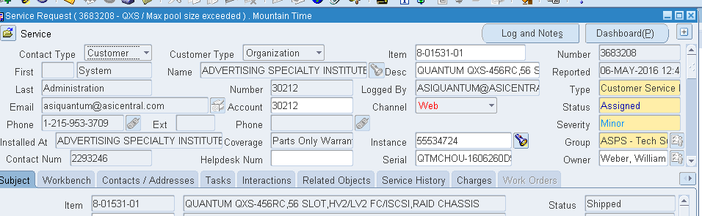
Oracle SR Form Decoder Tool
We’ve developed a decoder tool to help decode the cryptic product descriptions that populate the Desc/Item fields in the Oracle SR form.
The decoder tool will be available on CSWeb and will be a part of the QXS Service course.

Slide 56
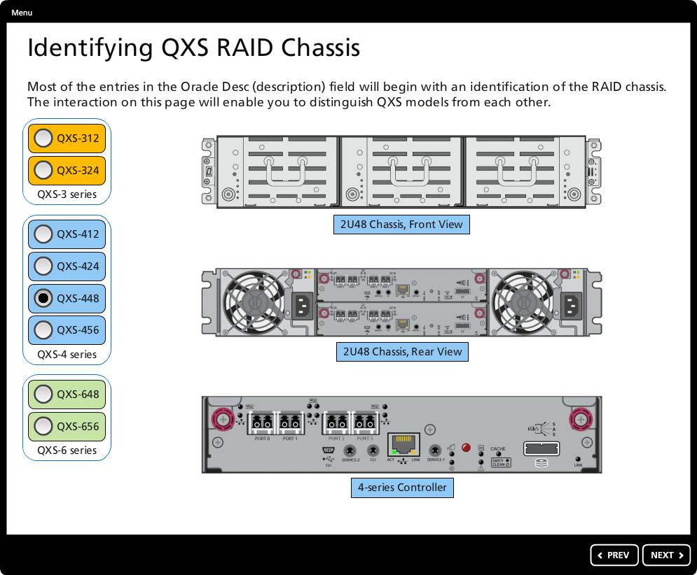
Decoder Tool – QXS Chassis
The decoder tool includes a slide reviewing the types of QXS chassis.
Radio buttons on the left enable the user to select different models.
For each QXS model, a front and rear view is provided, along with an expanded view of the RAID controller.

Slide 57
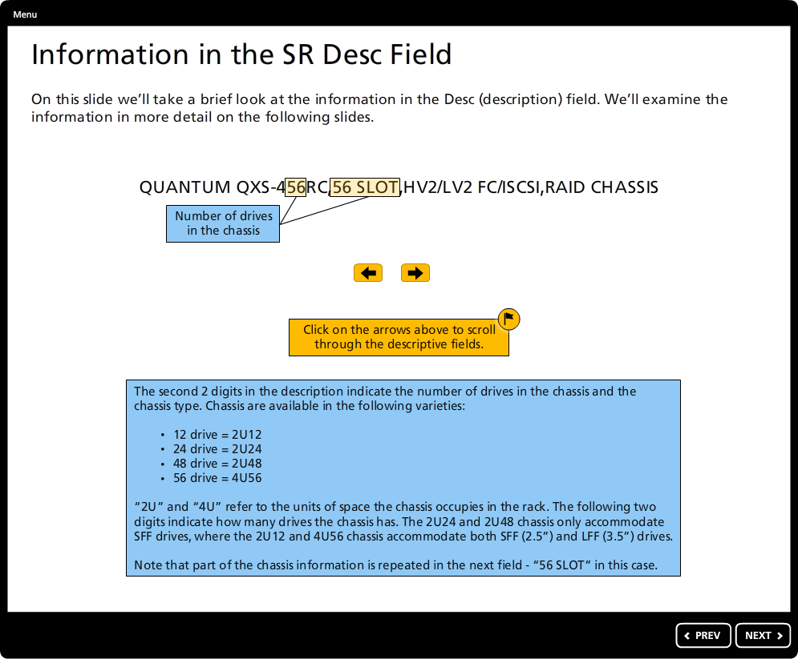
Decoder Tool – Information Page
This page provides information that helps service personnel decipher the SR Desc field.

Slide 58
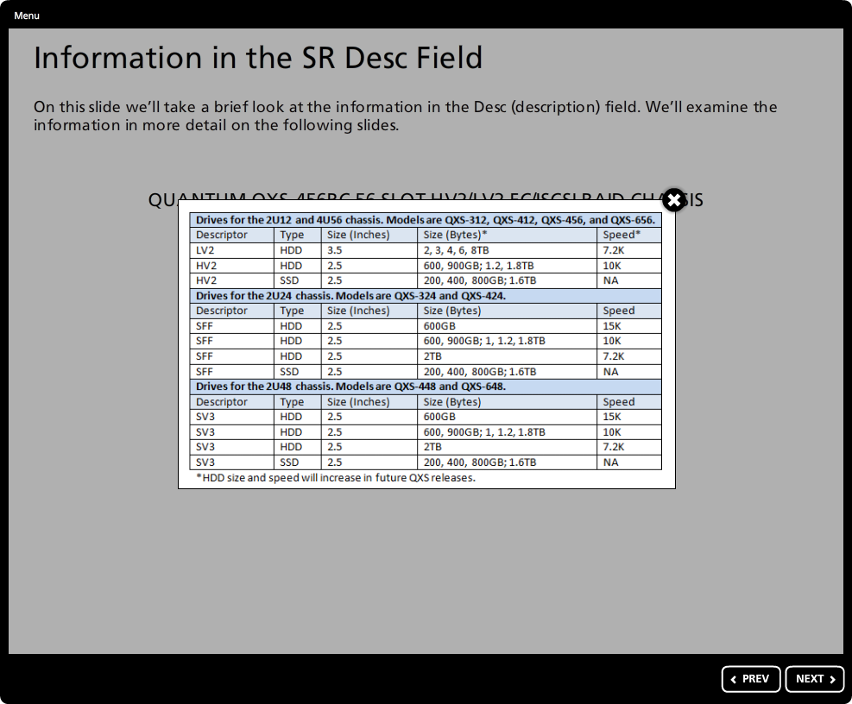
Decoder Tool – Specific Drive Sled Information
For drive sleds, there is a table offering additional information.

Slide 59
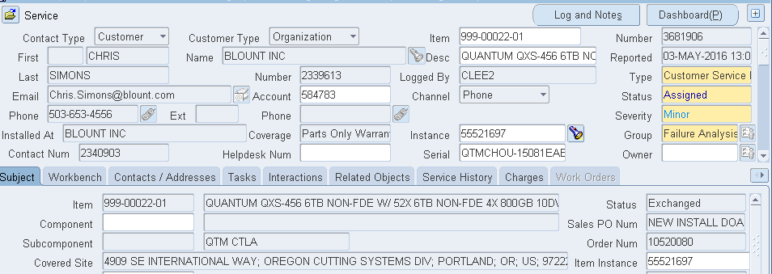
Decoder Tool – Additional Features
An alternative path provides instruction in decoding information found for the Dot Hill Reseller program.
An example demonstrates how to find part numbers for more complex information found in Express orders.

Slide 60
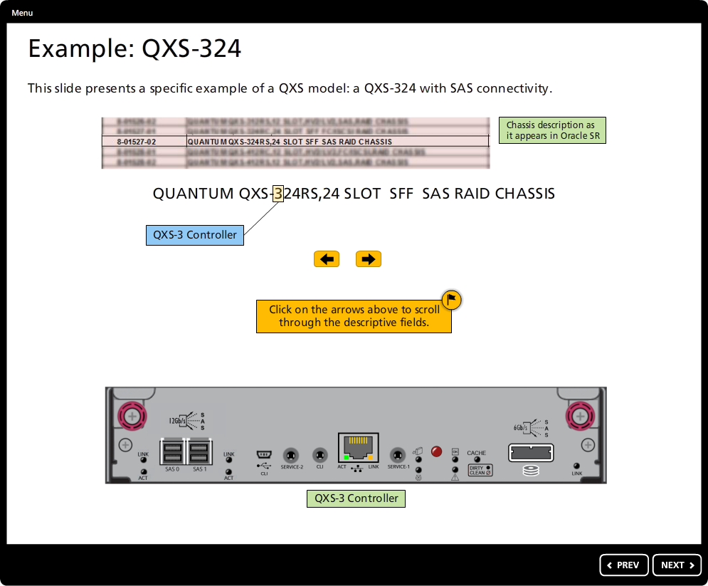
Example: QXS-324 (1)

Slide 61
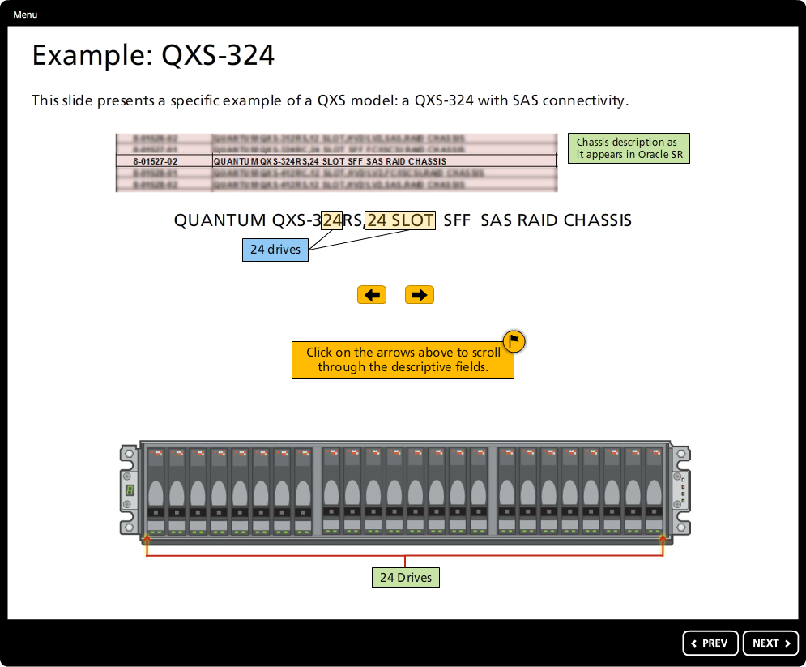
Example: QXS-324 (2)

Slide 62
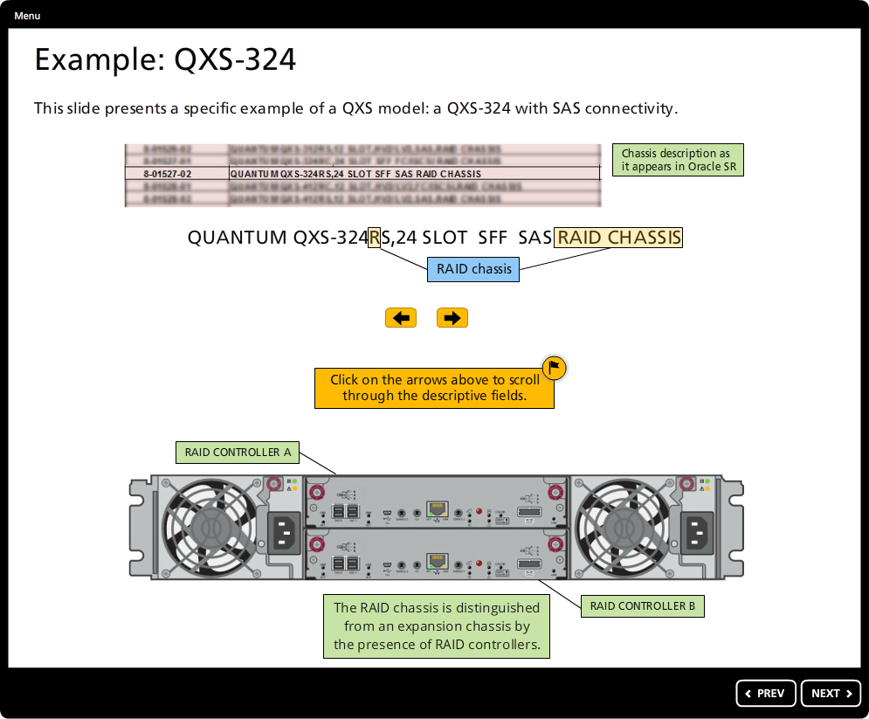
Example: QXS-324 (3)

Slide 63
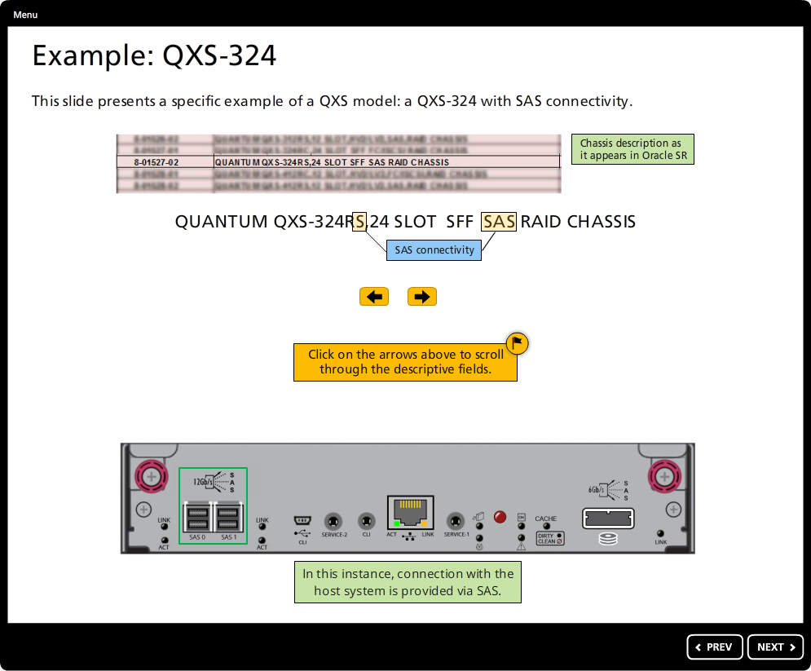
Example: QXS-324 (4)

Slide 64
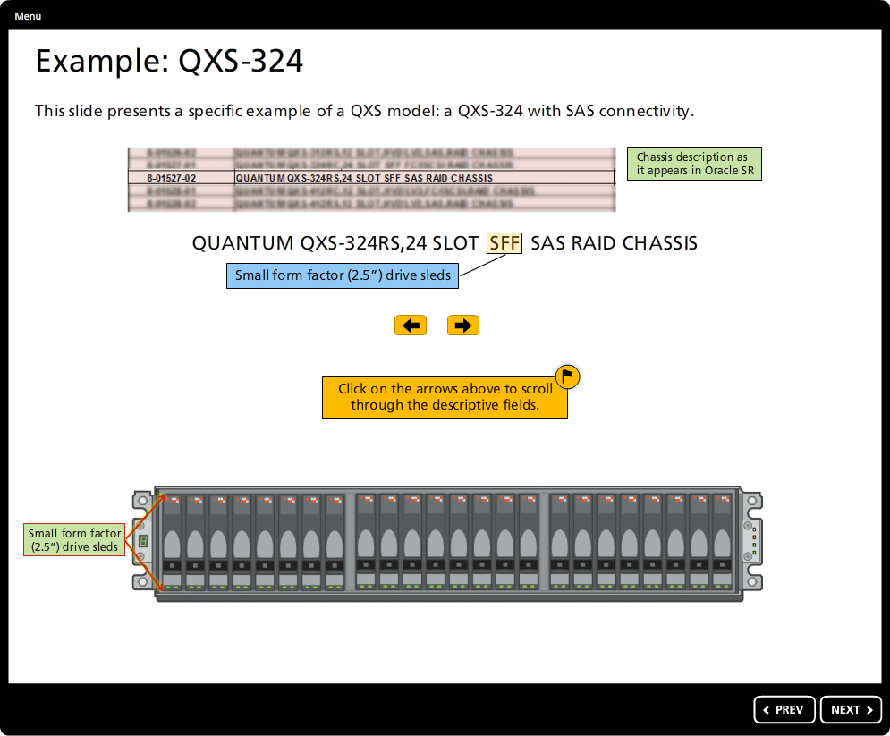
Example: QXS-324 (5)

Slide 65
Service Product Management
Richard Tyrrell

Slide 66
Customer Experience
We need to iron out the operational hiccups to improve the customer’s confidence
Sales wants customer on Quantum Support
  Because we have a global footprint
  Have robust processes and know how
  Are experts in supporting storage for over 40 years
Our Warranty is richer than Dot Hill’s
  They send a part 4-5 days using ground
  We send the part NBD provided cut-off is met
We win the long game by getting customers on Quantum support
  Delivering fantastic, consistent support

Slide 67
Challenges We Must Overcome with Dot Hill Reseller
Product may not have shipped with standard Quantum Warranty
  Means customers calling us have been directed to do so
IB records are different; more detail than we often expect
  Some carrying 3rd party Warranty; Some carrying Quantum warranty (see next slide)
Assets not always linked in IB
  Some Expansions are orphaned (missing RAID parent)
  May result in mixed warranty
Some partners have not provided full end user detail on initial booking
Part number descriptions have changed over the 15 months

Slide 68
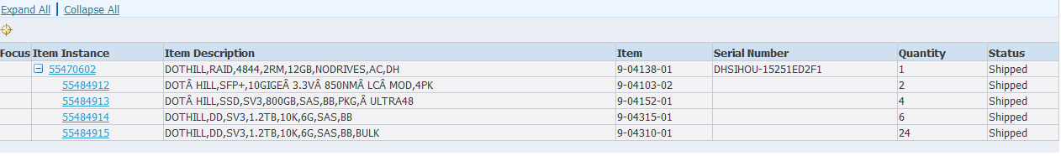
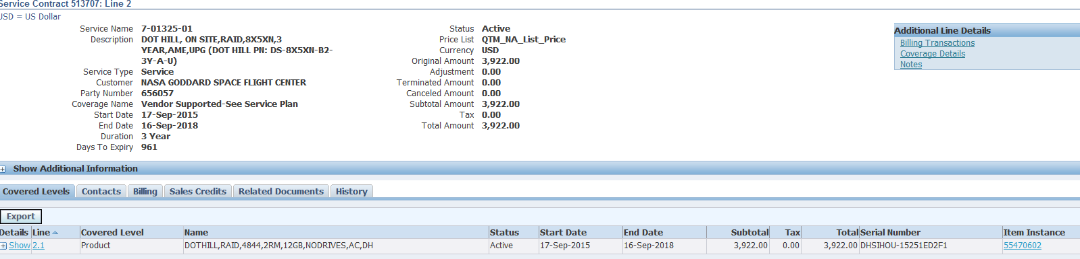
Existing Dot Hill Contracts in Oracle
Dot Hill Service Description
Service Coverage Template Indicates Dot Hill holds contract; triggers Service Delivery to redirect call to Dot Hill /Seagate

Slide 69
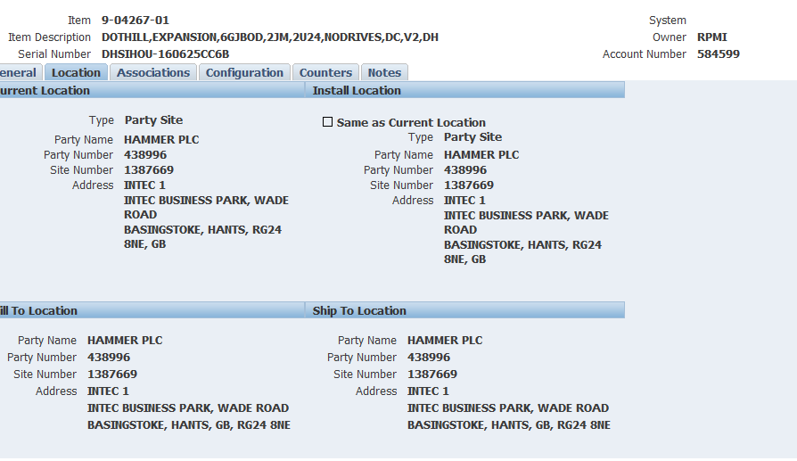
EMEA IB Example from Hammer
Hammer in EMEA has been manufacturing the product in Europe
Their orders are often lacking end user details
Only mention of end user is under system owner
Requires that we update when calls come in

Slide 70
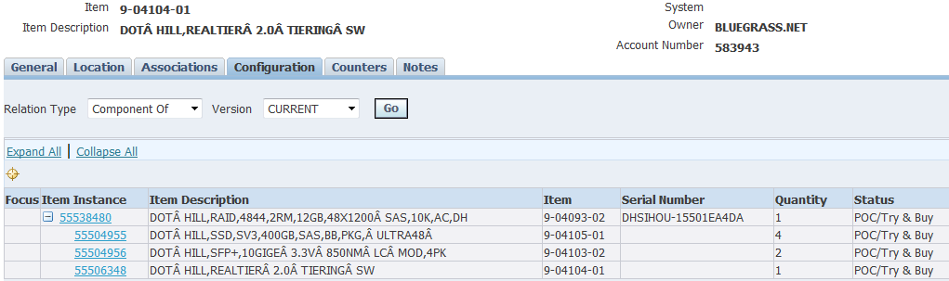
Software License Example-Q-Tier
Non-Chargeable Option
Non-Chargeable Option
Software
Software License underneath the RAID parent
Look For Real Tier or since March 2016 Q-Tier SW

Slide 71
Service Program Management
Jim Hibbard

Slide 72
Important Points for Service
Product Serial Number
  QTM… Prefix = Quantum Branded Disk
  DHSI… Prefix = Dot Hill Branded Disk
Product Description
  Quantum… Prefix = Quantum Branded
  Dot Hill… Prefix = Dot Hill Branded
Support Coverage
  Quantum traditional Gold/NBD Gold/Bronze
    Could be Quantum or Dot Hill Branded – Quantum owns
    Quantum owns tech support, FW upgrade distribution, CRU stocking and dispatch
  Vendor Supported
    Dot Hill Branded Disk with Dot Hill Support Contract Dot Hill owns
    Gracefully refer the customer to Dot Hill Support @ +1-877-368-7924
    Dot Hill owns tech support, FW upgrade distribution, CRU stocking and dispatch
Pay attention and react to what populates in the SR from for Serial Number/Product Description and Contract Coverage

Slide 73
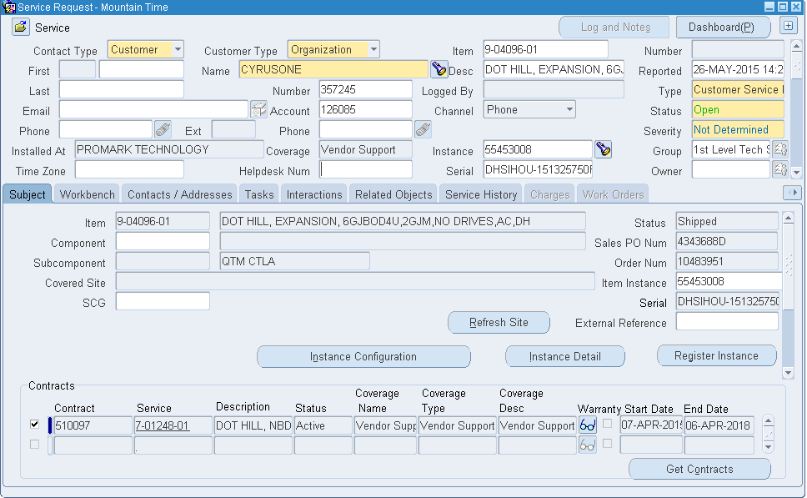
Service Request for Dot Hill Branded Disk w/Dot Hill Support

Slide 74
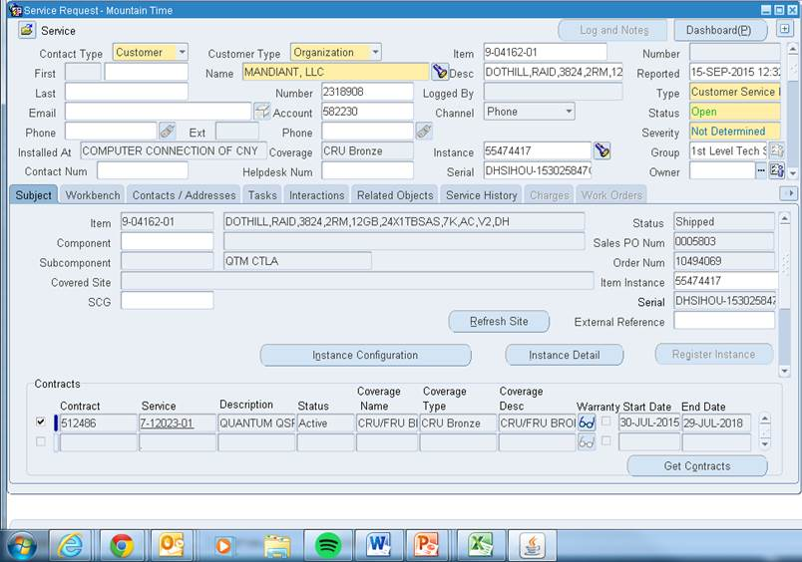
Service Request for Dot Hill Branded Disk w/Quantum Support

Slide 75
Service Request Routing (SPS/ASPS) Goal
SPS Supports StorNext use cases, else ASPS supports
If Product Line = “Dot Hill Disk” – Route to ASPS always, regardless of what it is associated with
If Product Line = “QX-Series” – Route to SPS always (by design, these are always in a Stornext environment).
If Product Line = “QXS Hybrid Storage” AND
  Top Parent Product Line = Xcellis OR
  Top Parent Product Line = Artico OR
  Top Parent Product Line LIKE StorNext Pro% OR
  Product Line of any relationship (parent or sibling) in the Config = SPSO AEL500 OR Stornext M440 OR Stornext M660
  THEN – Route to SPS, ELSE Route to ASPS

Slide 76
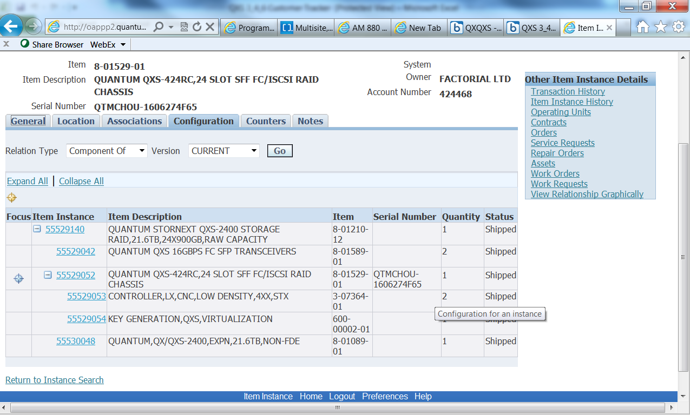
QXS-2400 Fulfilled with QXS-424 – IB Record

Slide 77
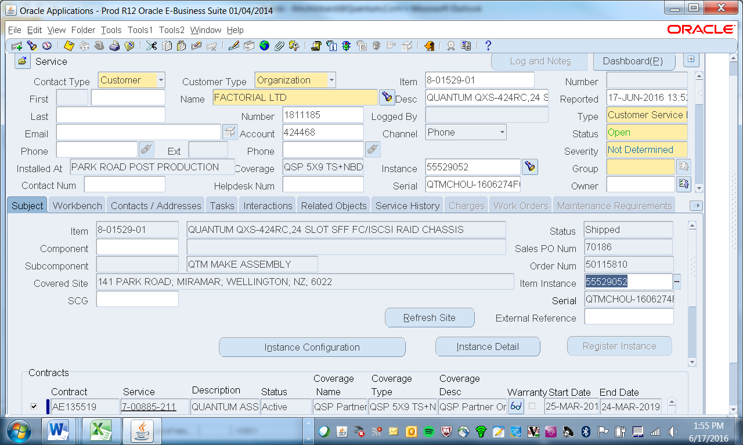
QXS-2400 Fulfilled with QXS-424 (cont.) – SR Form

Slide 78
FRU/CRU Strategy
All field replaceable components are defined as CRUs
Most CRUs shared between QXS 3/4/6, QXS 1200/2400/5600, DH Reseller, some critical components different
  Controllers and Chassis CRUs for QXS 3/4/6, QXS 12/24/56, and Dot Hill branded systems are not interchangeable
  Refer to individual product columns on new consolidated FRU/CRU list
Consolidated FRU/CRU list has been updated to show field replaceable components for:
  Legacy Quantum branded QXS 1200/2400/5600.
  Dot Hill branded disk as part of Dot Hill Reseller Part 1.5 (Dot Hill branded disk with Quantum support.)
  New Quantum branded QXS 3/4/6 models
  Xcellis Disk
  Part Number 6-67820-01, Rev S
  Demo if time available

Slide 79
CRU Components
RAID Chassis - There are four types of chassis. The description that populates in the SR will indicate 2U12 w/LFF, 2U24 w/SFF, 2U48, or 4U56. Service will match this to the corresponding CRU on the FRU/CRU list.
Controller – There are three types of controllers; EX, LX, and FX.
  QXS-3xx uses EX
  QXS-4xx uses LX
  QCS-6xx uses FX
  Note: all controllers are available in CNC (FC/iSCSI) or SAS
Drive – There are two sizes of drives; Large Form Factor (LFF) and Small Form Factor (SFF). The two sizes of drives will install on one of four types of drive sleds; LV2, HV2, SFF, and SV3.
  LV2 is standard LFF sled with an LFF style drive
  HV2 is a hybrid sled allowing an SFF drive to be placed into an LFF compatible chassis
  SFF is a standard SFF sled with a SFF style drive
  SV3 is a SFF sled that fits into a 2U48 chassis
  Note that all SSDs are SFF drives requiring one either, SFF, HV2, or SV3 sled

Slide 80
CRU Components (cont.)
Expansion Module Chassis – Expansion modules don’t have controllers, they have less capable I/O Modules (IOMs)
  Shares same chassis with RAID, just a difference in the controller à IOM
  Still have 2U12, 2U24, 2U48, and 4U56 options
  IOM choice is dictated by the choice of controller
    Choice #1 compatible with 3xx (EX) and 4xx (LX) low density (2U12 and 2U24) chassis / controller pairs
    Choice #2 compatible with 4xx (LX) high density (2U48 and 4U56) chassis / controller pairs
    Choice #3 compatible with 6xx (FX) chassis / controller pair
Power Supplies – There are six different Power Supplies for QXS-3,4,6
  2 different 595W power supplies for 2U12 and 2U24 chassis; Energy Star Certified and non-Energy Star Certified
  1000W power supply for 2U48 chassis
  3000W power supply for 4U56 chassis
  DC power supply option for 2U12 and 2U24 chassis
  DC power supply option for 4U56 chassis

Slide 81
How to determine Chassis CRU Example
Description that populates in SR shows QXS 312, 324, 412, 424, 448, 456, 648, 656
  QXS-312/412 use 2U12 chassis
  QXS-324/424 use 2U24 chassis
  QXS-448/648 use 2U48 chassis
  QXS-456/656 use 4U56 chassis
Example: QUANTUM QXS-448RC,48 SLOT SV3 FC/ISCSI RAID CHASSIS
  Uses 2U48 CRU chassis
  Select “CRU, CHASSIS, EMPTY, 2U48, 4XX/6XX, STX”, PN 9-05082-01 on FRU/CRU list
  Can use Show FRUs command
    Returns 1-, 3-, 9- PN that can be referenced on the FRU/CRU.

Slide 82
How to determine Controller CRU Example
Description that populates in SR shows Model and FC/iSCSI (CNC) or SAS
  QXS-3xx = “EX” Controller
  QXS-4xx = “LX” Controller
  QXS-6xx = “FX” Controller
  FC/iSCSI = “CNC” on FRU/CRU list
Example: QUANTUM QXS-448RC,48 SLOT SV3 FC/ISCSI RAID CHASSIS
  We know QXS-448 uses “LX” controller
  We know QXS-448 is a 2U48 high density chassis
  We know “FC/iSCSI” = “CNC”
  Select “CRU, CONTROLLER, LX, CNC,HIGH DENSITY,4XX,STX”, PN 9-03980-01 on FRU/CRU list

Slide 83
How to determine Drive CRU Example
Description that populates in SR shows the sled type
  LV2 = standard LFF sled with an LFF style drive
  HV2 = hybrid sled allowing an SFF drive to be placed into an LFF compatible chassis
  SFF = standard SFF sled with an SFF style drive
  SV3 = SFF sled that fits into a 2U48 chassis
Example: QUANTUM QXS-448RC,48 SLOT SV3 FC/ISCSI RAID CHASSIS
  Determine capacity of drive from Show Disks command or logs
  Determine SED/non-SED from Show Disks command or logs
  Determine speed of drive from Show Disks command or logs
  We know SV3 sled and thus SFF drive (2.5” HDD)
  Select SV3, capacity, SED/non-SED, and speed (or Reliability for SSDs) on FRU/CRU list

Slide 84
How to determine Power Supply CRU
Description that populates in SR shows the chassis type
  2 different 595W power supplies for 2U12 and 2U24 chassis; Energy Star Certified and non-Energy Star Certified
    Energy Star can be found in Show FRUs command and system Logs
  1000W power supply for 2U48 chassis
  3000W power supply for 4U56 chassis
  DC power supply for 2U12 and 2U24 chassis
  DC power supply for 4U56 chassis
Example: QUANTUM QXS-448RC,48 SLOT SV3 FC/ISCSI RAID CHASSIS
  QXS-448 uses 2U48 Chassis
  2U48 Chassis uses 1000W power supply
  Select “CRU, PSU,1000W,AC,2U,STX”, PN 9-05096-01 from FRU/CRU list

Slide 85
THANK YOU
For meeting with Quantum, the LARGEST Data Protection
and Big Data management specialist in the world.
© 2013 Quantum Corporation. Company Confidential. Forward-looking information is based upon multiple assumptions and uncertainties,
does not necessarily represent the company’s outlook and is for planning purposes only.

