Slide 1
QXS 3, 4, 6
TOI for Global Service
March 2016

Slide 2
Agenda
Product Overview – Matthew Apodaca
  Licensing Strategy – Lance Allred
Engineering Overview – Dan Byers/Lance Allred
Training and Documentation – Joe LaRoue/Alex Duncan
Service – Jim Hibbard
Notes:
  Please ask questions as we go
  Please mute your phone line unless asking a question
  Recording will be posted on Qwikipedia

Slide 3
Product Overview
Matthew Apodaca – Product Management

Slide 4
Level Set – Today
QX
QX-1200
QX-2400
QXS - SN
QXS-1200
QXS-2400
QXS-5600
DotHill Resale
3xxx
4xxx
6xxx
Individual product groups sold and fulfilled differently
  QX and QXS-SN were priced and configured for StorNext environments with a limited set of capacity combinations in complete bundles (drives, chassis and connectivity), using GL210 firmware
  DotHill resale is datacenter focused with a broader set of bundles (drives and chassis) but with the option to customize the number and type of drives and sold ad QXS-3/4/6
Technically the same hardware from Seagate/DH but software and configuration changes made them function different to the customer
  QX and QXS-SN have been fulfilled with StorNext orders with value added, such as software, Quantum branding, installed drives and one button configuration
  QXS-DH or QXS Dot-Hill resale highlighted building or optional RealStor software capabilities and orders were placed with Quantum but fulfilled though DH/Seagate Foxcon or Hammer (EMEA)
  All are shipping with the GL-210 firmware
All product had service contracts tried to the system with pricing based on the RAID chassis
Software licensing (Tiering, snapshots, replication etc..) managed by the Seagate/DH license generator
QXS-DH is competitively disadvantaged to market conditions

Slide 5
Product Goals
QXS-3/4/6 rebranding goals:
  Consolidate sales, ordering and fulfillment of QX, QXS-12/24/56 and DotHill (DH) resale as a single set of part and model numbers
  Add Quantum branding to all products
  Adjust to market based pricing
  Add configuration flexibility for market conditions
  Fulfill orders from Avnet
  Have new systems ship with G222 firmware
Do not impact FY’16 quarter end sales
Maintain supply continuity
The goal will require multiple steps to prevent customer and sales confusion and mitigate inventory constraints
  Step 1 – Transition
  Step 2 – Launch and Consolidation
  Step 3 – Discontinue old part and model number ordering

Slide 6
Step 1 – Transition
QX
QX-1200
QX-2400
QXS - SN
QXS-1200
QXS-2400
QXS-5600
DotHill Resale
3xxx
4xxx
6xxx
QXS Hybrid Disk
QXS-3
QXS-4
QXS-6
Why a transition is needed
  Originally a transition plan was in place as part of the consolidation to the QXS Hybrid Disk model because the public launch of the Hybrid Disk model was push out to Q2’16 we needed to bridge the ordering and fulfillment process for the remainder of Q1’16
  With inventory running low on QXS-12/24/5600, Quantum will utilize the new QXS Hybrid Disk components to fulfill QXS-12/24/5600 orders
    Fulfillment of product was originally out of Seagate but had been forecasted to be out of Avnet
  Required, given timing of events, forecast already in place to Avnet and Seagate to not disrupt revenue in the quarter
By March 2016 inventory of QX and QXS-12/24/56 will be depleted
  Inventory of the QXS Hybrid Disk components have started to be stocked at Avnet
QX and QXS-12/24/56 will begin to be fulfilled out of Avnet using the new QXS Hybrid Disk material/part numbers in mid-March
Some QXS-DH orders will be fulfilled with Avnet inventory and others from Seagate
  EMEA orders continued to be fulfilled through Hammer
Some differences do exist such as part numbers and IB record data

Slide 7
Step 1 – Transition (cont.)
PTO part numbers were created representing the QXS-12/24/5600 and high running QXS-DH resale systems
As inventory is depleted these new PTO part numbers will be switch on in Oracle to equal the equivalent model number
  This allows for fulfillment of the order with the new QXS Hybrid Disk components
  Keeps the model number help keep the paperwork consistent from start to finish
Order Placement
  Continue to use the same model numbers as before but the underlying part numbers may have changed
    Do not use configurator
    Changes will be communicated as inventory is used up
Transition PTO part number BOMs
  StorNext QXS-12/24/56 – all configurations – Agile release ~3/4
  QXS (Dot Hill Branded); fully populated high runners only – Agile release ~3/11
  Xcellis is implementing QXS-3xx/4xx/6xx; already released in Agile
Fulfillment of QXS low running and hybrid configuration orders will be placed using existing DotHill part numbers and be fulfilled through Seagate
  Orders going through Seagate will have longer lead times
All systems leaving Avnet will include a customer transition flyer highlighting changes

Slide 8

Step 1 – Transition - Flyer
Flyer inserted in all QXS systems leaving Avnet

Slide 9
Where to Next - Step 2 – Launch and Consolidation
QX
QX-1200
QX-2400
QXS - SN
QXS-1200
QXS-2400
QXS-5600
DotHill Resale
3xxx
4xxx
6xxx
QXS Hybrid Disk
QXS-3
QXS-4
QXS-6
The first half of FQ1’17 price book v.83 and marketing collateral will publically release the QXS Hybrid Disk part number and pricing
QX, QXS-SN and QXS-DH part numbers will go EOL to push orders to the new part numbers
StorNext users would use the QXS Hybrid Disk section of the price book to buy user storage
All orders will completely fulfilled through Avnet and Hammer
All orders will ship with G222 firmware

Slide 10
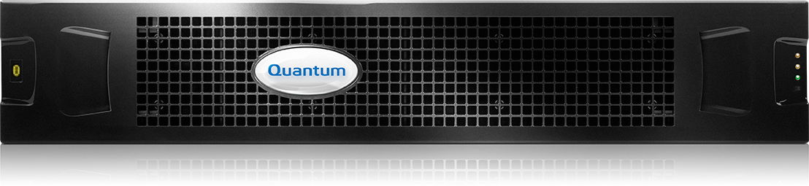

QXS Hybrid Disk Building Block Quoting
Selling today
  QX and QXS-SN were priced and configured with a limited set of capacity combinations in complete bundles (drives, chassis and connectivity)
  QXS-DH sells with a broader set of bundles (drives and chassis) but with the option to customize the number and type of drives
QXS Hybrid Disk will use building blocks to build complete systems
Select Chassis
- Choose controller
- Choose density
- Empty RAID
Select Drives
- Pick size and quantity
- SSD and/or HDD
Select Connectivity
- Select SFP type for CNC chassis (1GbE iSCSI, 10GbE iSCSI, 8Gb FC and 16Gb FC)
- SAS Y-Cable
Optional Software
- Only applied to RAID chassis
Select Expansion
Service
- Tied to chassis
- Extended warranty options available
-Choose Density
- Choose Drives

Slide 11
QXS Hybrid Disk Building Block Options
Additional options are available for order
  Spare chassis, controllers and AC/DC power supplies
  DC power supply as a field upgrade option – IB trackable
  Non-SED or SED drives
    Mixing will not permitted
    The default drive type non-SED
Latest firmware/software, G222, is available for download
  All systems must be upgraded to latest firmware at install

Slide 12
QXS Hybrid Disk Building Blocks
Chassis density options
  2u12
  2u24
  2u48
  4u56
Controller options
  QXS-3 or internally as 3004 or EX
    SAS or CNC (FC/iSCSI) SFP+ connectivity
    SAS expansion connectivity
  QXS-4 or internally as 4004 or LX
    SAS or CNC (FC/iSCSI) SFP+ connectivity
    SAS expansion connectivity
  QXS-6 or internally as 6004 or FX
    SAS or CNC (FC/iSCSI) SFP+ connectivity
    SAS expansion connectivity
Drives
  HDD spinning disk – 7.2K RPM, 10K RPM and 15K RPM
  SSD – 10 Drive Writes Per Day (DWPD) and 3 DWPD endurance levels
    Can be expressed as read/write intensive and enterprise (10DWPD) or read intensive and consumer (3DWPD)

Slide 13
QXS Hybrid Disk Naming
More descriptive naming containing searchable terms when sold on DMR websites (CDW)
Price book descriptions updated to show inclusions, exclusions and service offerings
Quantum QXS-312RC Storage, RAID Chassis, FC/iSCSI, 12-slot, LFF
Controller type (3/4/6)
Drives Possible and drive dimension (LFF/SFF)
Drives Possible (12/24/48/56)
Connectivity Type (FC/iSCSI or SAS)
Type of chassis (R – RAID/E – EBOD)
Chassis Type (RAID or Expansion)
Connectivity Type (C – CNC (FC/iSCSI) or S – SAS)

Slide 14
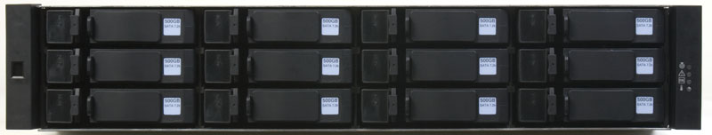
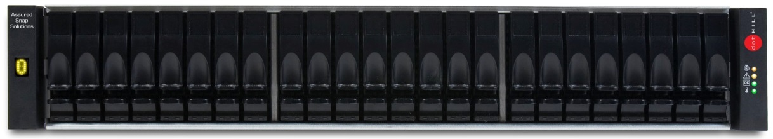
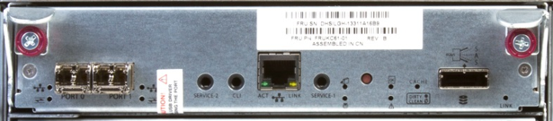
QXS-3xx
Basics
  40,000 IOPs, 3300 MBps Read, 2400 MBps Write
  12GB system cache (6GB per controller)
  Supported in low density (2U12, 2U24) chassis
  Max chassis 4x (3x expansions plus base) or 96 spindles
Host Connections
  2 ports per controller
  16Gb/8Gb Fibre Channel, 12Gb/6Gb SAS, and 10Gb/1Gb iSCSI host connectivity
Green Technology
  Patented battery-free cache backup eliminating battery replacement.
Rugged, Mobile Applications
  NEBS Level 3 and MIL STD 810G compliant to meet Telecommunications requirements and Military standards for shock and vibration
2u12
2u24

Slide 15
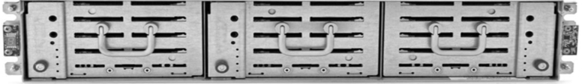
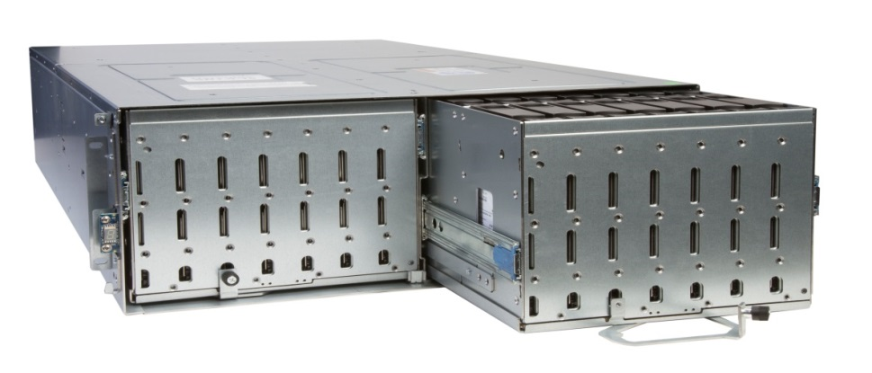
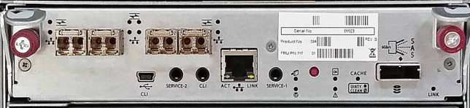
QXS-4xx
Basics
  120,000 IOPs, 6400 MBps Read, 5300 MBps Write
  12GB system cache (6GB per controller)
  Supported in low density (2U12, 2U24) and high density (2U48, 4U56) chassis
  Max chassis 8x (7x expansions plus base) or 248 spindles
Host Connections
  4 ports per controller
  16Gb, 8Gb Fibre Channel, 12Gb, 6Gb SAS, and 10Gb, 1Gb iSCSI host connectivity
Green Technology
  Patented battery-free cache backup eliminating battery replacement
Drive Support
  Support for encryption drives
  Support for mixed SAS and SSD drives for hybrid solutions
Rugged, Mobile Applications
  NEBS Level 3 and MIL STD 810G compliant to meet Telecommunications requirements and Military standards for shock and vibration
2u12
2u24
2u48
4u56

Slide 16
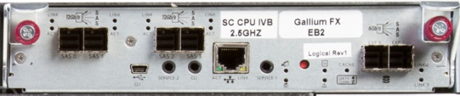
QXS-6xx
Basics
  200,000 IOPs, 12 GBps Read, 5700 MBps Write
  40GB system cache (20GB per controller)
  Supported in high density (2U48, 4U56) chassis
  Max chassis 8x (7x expansions plus base) or 248 spindles
Host Connections
  4 ports per controller
  16Gb, 8Gb Fibre Channel, 12Gb, 6Gb SAS, and 10Gb, 1Gb iSCSI host connectivity
Green Technology
  Patented battery-free cache backup eliminating battery replacement
Drive Support
  Support for encryption drives
  Support for mixed SAS and SSD drives for hybrid solutions
Rugged, Mobile Applications
  NEBS Level 3 and MIL STD 810G compliant to meet Telecommunications requirements and Military standards for shock and vibration
2u48
4u56

Slide 17
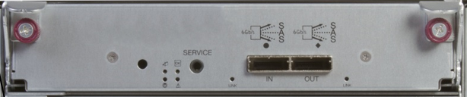
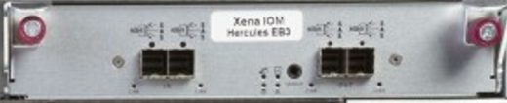
Expansion IOM
For 2u12, 2u24 and 2u48 expansion modules the IOM has one 6Gb input and output SAS connector or two per chassis
For 4u56 expansion modules the IOM has two 12Gb input and output SAS connectors or four per chassis

Slide 18
QXS Hybrid Disk Roadmap
1H16
2H16
1H17
2H17
Platform
Software
G-222
Asynch Replication
OpenStack Cinder
Profile labeling
Volume affinity
Faster RAID6
HeatMap Tool
AFA mode
G-250
Windows ODX driver
Phone home
Multi-core support
G-300
VMware vVols
Adapt RAID
T10PI
4K Native
RAID
Platform
Hardware
QXS-6 CNC
12Gb SAS Chassis
QXS-3 – 100K IOPS
QXS-4 – 250K IOPS
QXS-5 – 400K IOPS
2U12 & 2U24
Broadwell CPU
Break out of CNC
  10GBase-T iSCSI
  16GB FC
12Gb SAS to expansions
AFA
Hardware Capabilities
32GB Fiber
40GB iSCSI
New ASIC
NEBS
High density 3/4/5
End of Sale for QX, QXS-12/24/56, DH resale
QXS Full Launch
QXS-3, 4, 6
QTM System
Vertical bundles
Unified StorNext & DC
GL-222 based
Xcellis support
12Gb QXS-6
High density chassis
1M IOPS
2.5” SFF Disk
Technology
SED variants – all capacities
12Gb Drive support for 12Gb chassis
Full range of 12Gb drives for 6Gb chassis
15K
900GB, 600GB, 300GB – 512e
10K:
2.4TB, 1.8TB, 1.2TB, 900GB, 600GB – 512e
3.5” LFF Disk
Technology
7K
10TB
12Gb Drive support for 12Gb chassis
Full range of 12Gb drives for 6Gb chassis
SED variants – all capacities
SSD
Technology
3.2TB – 10 DWPD
400GB, 800GB, 1.6TB - 1 DWPD
400GB, 800GB, 1.6TB - 3 DWPD
SED variants for 10DWPD capacities
12Gb Drive support for 12Gb chassis
Full range of 12Gb drives for 6Gb chassis
Post-Phase 2
Pre-Phase 2
Pre-Phase 0

Slide 19
QXS Licensing
Lance Allred

Slide 20
QXS Licensing Improvements Synopsis
  With Quantum-branded QXS-3/4/6 launch, adding support for most Seagate licenses
    Some licenses have already been applied to Xcellis QXS-4xx since November
    Certain licenses not available on 3xx, 4xx, 6xx
  Quantum license parts adopting new parts naming and numbering structure
  Certain licenses now applied in Manufacturing to QXS systems
  All other licenses ordered separately as add-on software features for a base system
  End-users obtain add-on licenses through a web interface using an authorization code
  IMPORTANT: Seagate will continue to generate licenses for Dot Hill-branded populations
  NOTE: QXS-1200/2400/5600 do not have QXS licensing applied and do not support add-on licenses at this time

Slide 21
Licensable Features New to Quantum
Q-Tools
  Caching
  Tier data based on usage from HDD to HDD (e.g. 7K to 10K/15K)
    Frequently accessed, “hot” data can move to disks with higher performance, lower capacity, and higher costs.
    Infrequently accessed, “cool” data can move to disks with higher capacity, lower performance, and lower costs.
  Creation of virtual pools
  Quick rebuild
  Thin provisioning – allocate physical space just-in-time
Q-Tier
  Tier data based on usage from HDD to SSD
Q-Snap
  Allow up to 512 (QXS-3), 1024 (QXS -4) and 2048 (QXS-6) snapshots to be taken, at any time, with zero impact on storage performance.
  Using the Quantum users can set up and schedule snapshots for several volumes simultaneously.
Q-Replicate
  Schedule when replications will occur
  Uses snapshots
  Optimal for long distances
  Minimized time and bandwidth vs synchronous replication which occurs at simultaneously as the primary storage
Q-Copy
  Makes a copy of data to another set of disk within the array
  Controller based
  No host resources used

Slide 22
QXS License Details
Quantum Offering Name | Seagate or other Equivalent Names | Installed by Seagate Manufacturing for DH Reseller | Seagate Add-on Offering | Installed in Avnet Manufacturing for Quantum-branded QXS-3/4/6 | Installed in Avnet Manufacturing for Xcellis | Quantum Add-on Offering
Q-Tools | Virtualization RealStor | Yes (as of GL200) | Yes for transition to GL200 and later | Yes | Yes | For QXS-1200/2400/5600 only, not in Quantum-branded QXS-3/4/6 price book
Q-Tier | RealTier AssuredTier Performance tier SSD Tier | No | Yes | No | For SSD models only | Yes
Q-Replicate | RealRemote AssuredRemote Replication | No | Yes through DMS bundle | No | No | Yes
Q-Snap | RealSnap AssuredSnap Licensed snapshots | No | Yes through DMS bundle | No | No | Yes
Q-Copy | RealCopy AssuredCopy Volume Copy | No | Yes through DMS bundle | No | No | Yes
QL-Tools | Microsoft Volume Shadow Copy Service (VSS) | No | Yes | No | No | Not in QXS-3/4/6 price book at initial launch, available for DH Reseller
 | VMWare Site Recovery Adaptor (SRA) | No | Yes | No | No
 | Microsoft Virtual Disk Service (VDS) | No | Yes | No | No

Slide 23
QXS Licensing in IB
QXS adopts new license parts naming and numbering scheme under development in another program
Add-on “licenses are represented by BOMs, with a add-on “sellable” 9xx part and an underlying 600 counting” part representing the component the license generator actually generates
The relationship is not always 1-to-1 between sellable part and counting part
The IB captures the connection between what was sold and what it represents
SSA must move separately sold license IB records under serialized component where sale is separated by time
NOTE: Snap license is sold based on controller type (3xx, 4xx, 6xx)
Quantum Offering | Sold Part (S/C, IBT) | Counting Part (IBT)
Q-Tools | 901-00001-08 QUANTUM,QXS Q-TOOLS,LICENSABLE FEATURE | 600-00002-01 KEY GENERATION,QXS,VIRTUALIZATION
Q-Tier | 901-00001-01 QUANTUM QXS Q-TIER,LICENSABLE FEATURE | 600-00002-02 KEY GENERATION,QXS,SSD TIER
Q-Replicate | 901-00003-01 QUANTUM QXS Q-REPLICATE,LICENSABLE FEATURE | 600-00002-05 KEY GENERATION,QXS,REPLICATION
Q-Snap 3xx | 901-00004-01 QUANTUM QXS Q-SNAP FOR QXS-3XXR,LICENSABLE FEATURE | 600-00002-03 KEY GENERATION,QXS,SNAPSHOTS
Q-Snap 4xx | 901-00005-01 QUANTUM QXS Q-SNAP FOR QXS-4XXR,LICENSABLE FEATURE | 600-00002-03 KEY GENERATION,QXS,SNAPSHOTS
Q-Snap 6xx | 901-00006-01 QUANTUM QXS Q-SNAP FOR QXS-6XXR,LICENSABLE FEATURE | 600-00002-03 KEY GENERATION,QXS,SNAPSHOTS
Q-Copy | 901-00007-01 QUANTUM,QXS Q-COPY,LICENSABLE FEATURE | 600-00002-04 KEY GENERATION,QXS,VOLUME COPY
QL-Tools (not sold at launch) | 901-00002-01 QUANTUM QXS,QL-TOOLS,LICENSABLE FEATURE | 600-00002-06 KEY GENERATION,QXS,MICROSOFT VOLUME SHADOW COPY SERVICE (VSS) 600-00002-07 KEY GENERATION,QXS,MICROSOFT VIRTUAL DISK SERVICE (VDS) 600-00002-08 KEY GENERATION,QXS,VMWARE SITE RECOVERY ADAPTOR (SRA)

Slide 24
QXS Licensing Process
Customers ordering QXS-3/4/6 get Q-Tools by default
  No certificate required, license is pre-installed
  End-User interface will show licenses pre-installed for a given serial number
End-user ordering add-on licenses will receive a certificate with authorization code representing license ordered
End-user go to web site listed on certificate to enter serial number and authorization code www.quantum.com/licensekeys
End-users receive back license file; license file is applied through QXS GUI

Slide 25
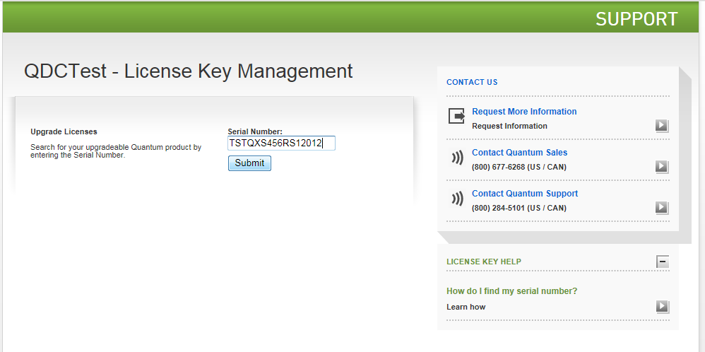
Obtaining QXS Add-on Licenses Through Licensing Website
End-users navigate to the multi-product license page supported by QuIL
Serial number of the unit is entered and submitted
Only valid serial numbers allow the end-user to progress to the next step

Slide 26
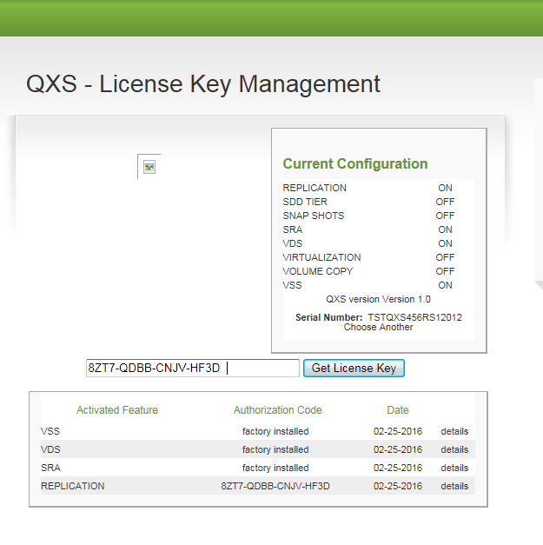
Obtaining QXS Licensing Through Licensing Website
Licensing applied to the serial number is shown
Any factory installed licensing is also shown
End-users may enter the one-time-use authorization code
NOTE: Names subject to change as shown on left, will align with official Q-xxx names

Slide 27
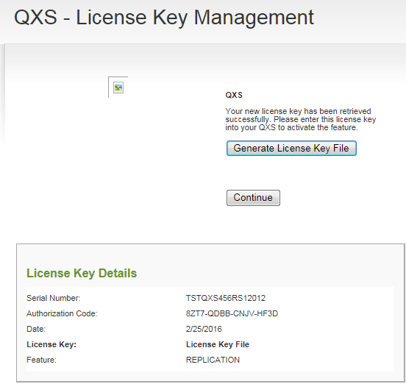
Obtaining QXS Licensing Through Licensing Website
Once an authorization code is entered, and if the authorization code is accepted, the next step is for the end-user to generate a license key file
The generated license file can be saved on the end-user’s computer (not shown)
The generated file contains only the single key associated with the authorization code
Keys are only useful for a single serial number

Slide 28
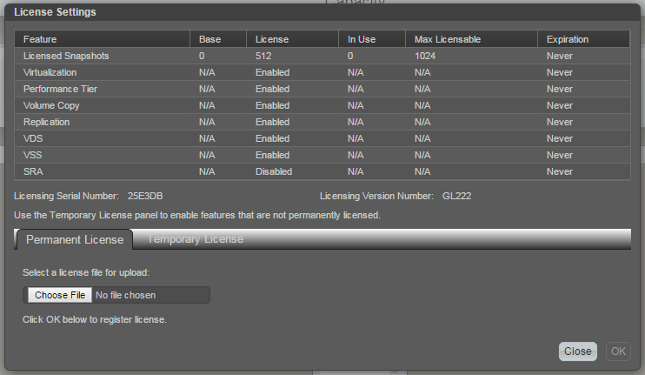
Applying QXS License through QXS GUI
Licenses are applied through the Quantum Disk Storage Management utility
The License Settings view shows licenses installed and provides a mechanism to specific a license file to apply a new license
NOTE: Snapshot license represented by a count
NOTE: license names on GUI remain Seagate-centric at G222

Slide 29
Licensing for Various Populations
Only Quantum-branded QXS-3/4/6 and some Xcellis populations after 3/4/6 component cut-in work through QuIL
QXS-1200/2400/5600 (and earlier QXS) do not work through QuIL
  Expected to be zero to very low volume
  QXS-1200/2400/5600 could be added if needed
Any DH Reseller units sold by Quantum or Seagate do not use QuIL
Licenses for any DH-branded unit has to come from Seagate using their license process

Slide 30
Engineering Overview
Dan Byers / Lance Allred

Slide 31
GL210 Firmware – Launched September 2015
Features
  Initial Quantum adoption of Seagate virtualization functionality
  Q-tools (a.k.a. RealStor) virtual storage features (virtual volumes), including:
    Provisioning of virtual pools
    Thin Provisioning
    SSD Read Cache
    Disk tiering (7K, 10K/15K, SSD) (requires Q-Tier if SSDs are present)
  NOTE: Quantum does not promote usage of Q-tools on QXS-1200/2400/5600
  Snapshot functionality support extended to virtual volumes
  Quantum customization - linear storage mode is default
  New V3 WBI version (SMC) with Quantum branding
    Requires a mandatory 2-step firmware installation process to Quantum-brand the V3 GUI
    Q-tools usage requires the V3 WBI
  Two new one-button-configuration profiles
  Added CLI method to write a StorNext volume label
  Q-Turbo concurrently writes to both the primary and partner controllers which provides up to a 50% ingestion improvement over traditional methods.
Models
  Quantum-branded QXS-1200/2400/5600/3xx/4xx (but not 6xx)
  “Transition” QXS-1200/2400/5600
  Xcellis QXS units
  Dot Hill-branded models (including DH Reseller 3xx/4xx, but not 6xx CNC models)
Distribution
  Quantum provides GL210 for Quantum-branded QXS models
  Seagate provides GL210 for Dot Hill-branded models through CRC website

Slide 32
Hybrid Storage Tiers
Each virtual disk group, depending on the type of disks it uses, is automatically assigned to one of the following tiers:
  Performance: The highest tier uses SAS SSDs, which provide the best performance but also the highest cost and lowest capacity.
  Standard: The middle tier uses enterprise-class SAS disks, which provide good performance with mid-level cost and capacity.
  Archive: The lowest tier uses midline SAS disks, which provide the lowest performance with the lowest cost and highest capacity.
As an example, a 2U12 chassis might use three SSDs as its performance tier, three 10k SFF HDDs as its standard tier, and six 7k LFF HDDs as its archive tier.

Slide 33
Hybrid Storage – Available Disk Types
 |  | Availability by Chassis Type (requires appropriate drive sled)
Disk Type | Size | 2U12 | 2U24 | 2U48 | 4U56
SFF SSD | 200 GB - 1.6 TB | • | • | • | •
SFF 7k HDD | 1 - 2 TB |  | • | •
SFF 10k HDD | 600 GB - 1.8 TB | • | • | • | •
SFF 15k HDD | 600 GB |  | • | •
LFF 7k HDD | 2 - 8 TB | • |  |  | •
Blanks required for sparsely populated 2U12, 2U24, 2U48 units

Slide 34
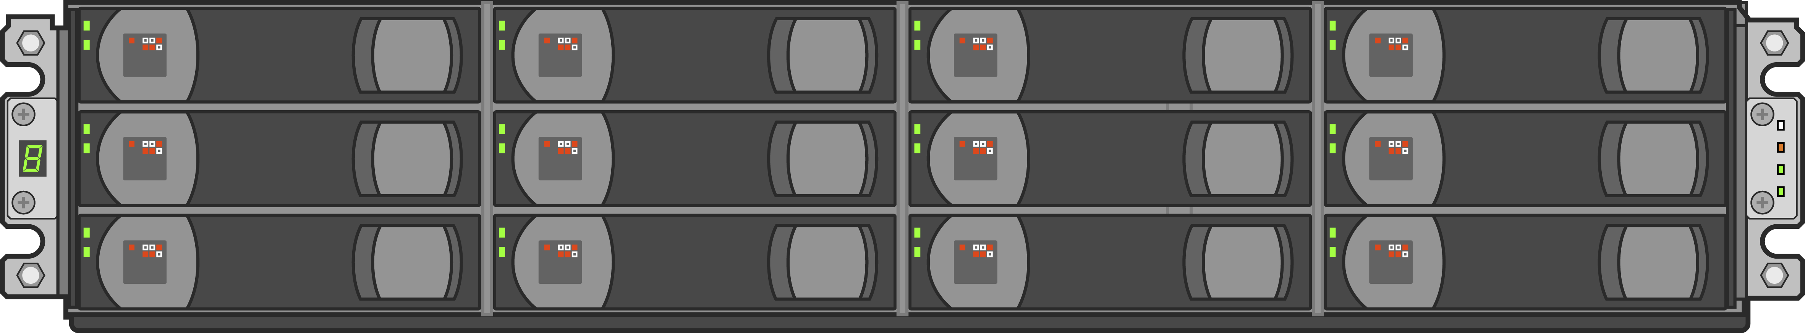
QXS-412 Hybrid Example
1 RAID Chassis (top unit/RBOD)
2 Expansion Chassis (bottom units/JBODs)
3 Hdds 10K SFF
3 SSDs
6 Hdds 7K LFF
6 Hdds 10K SFF
6 Hdds 7K LFF
6 Hdds 10K SFF
6 Hdds 7K LFF

Slide 35
G222 Firmware – Launched Mar 4, 2016
Features
  Corrects the GL210 V3 GUI branding issue with a new 1-step update process
  One-button-configuration
    Ability to dynamically create new profile sets without firmware rebuild
      No new sets created yet, will be used to support new Quantum non-StorNext verticals
    Removes limitation that all OBC profiles write StorNext label
    Filters the OBC profile set by number of drives on base chassis (removes profiles that do not apply to chassis type)
  Replication functionality support extended to virtual volumes
  Quantum customization - linear storage mode is default
  NOTE: Quantum does not promote usage of Q-tools on QXS-1200/2400/5600
  Alerts enhancements
    Alerts now carry the system serial number (QTMCHOU…)
    Alerts are set up by default to go to techsupport@quantum.com
      Requires SMTP setup at time of install
    Sending Warning, Error and Critical alerts
    Service to apply back-office intelligence to proactively act on certain types of alerts (open SRs, etc.)
Models
  Quantum-branded QXS-1200/2400/5600/3xx/4xx/6xx
  “Transition” QXS-1200/2400/5600
  Xcellis QXS units
  Dot Hill-branded models (including DH Reseller 3xx/4xx, but not 6xx CNC models)
Distribution
  Quantum provides GL222 (3xx/4xx) and GF222 (6xx) for Quantum-branded QXS models
  Seagate provides GF222 (3xx/4xx) and GF222 (6xx) for Dot Hill-branded models through CRC website

Slide 36
Same Firmware, Different Behavior
As mentioned in GL210 TOI, using the same firmware on a Dot Hill-branded versus Quantum-branded box will have different behavior
Key differences are:
  SCSI ID (StorNext QXS or QXS versus Dot Hill model number)
  GUI branding (Quantum-branded versus Dot Hill-branded)
Behavior queued off the OUID burned into the chassis
It is NOT a trivial process to change branding, requires Seagate intervention
Due to Quantum-specific G222 fix related to V3 GUI, important to use the correct firmware bundle depending on the branding of the unit!!

Slide 37
QXS and Dot Hill Reseller Populations
Quantum-branded QXS-3/4/6 (stand-alone)
  Gallium x004 controllers
  Firmware prefix GL, GF
  Start selling in April
  Built by Avnet with Seagate-built QXS-3/4/6 components
  Drives never installed in Manufacturing
  OUI: Quantum, Inquiry string: QXS, QTM branding
QX-1200/2400
  Chromium x003 controllers
  Selling today, EOL shortly
  Built by Seagate
  Drives installed by Seagate
  OUI: Quantum, Inquiry string: StorNext QXS, QTM branding
“Transition” 1200/2400/5600
  Gallium x004 controllers
  Firmware prefix GL
  Start shipping in March until 3/4/6 launches
  Built by Avnet with Seagate-built QXS-3/4/6 components
  Drives never installed in Manufacturing
  OUI: Quantum, Inquiry string: QXS, QTM branding
“Denali”
  Nitro x001 and Titanium x002 controllers
  EOL
  Built and shipped by Seagate
  Drives installed by Seagate
  OUI: Dot Hill, Inquiry string: DH model, DH branding
“Classic” 1200/2400/5600
  Gallium x004 controllers
  Firmware prefix GL
  Selling today
  Built by Seagate
  Drives installed by Seagate for 2U12 / 2U24
  OUI: Quantum, Inquiry string: StorNext QXS, QTM branding
Other minor differences exists including power cables, SFPs, part numbers, documentation included, others

Slide 38
QXS and Dot Hill Reseller Populations (cont.)
Xcellis w/ QXS-3/4/6 (initial)
  Gallium x004 controllers
  Firmware prefix GL
  Started selling in Nov’15
  Built by Avnet from reworked QXS-1200/2400/5600
  Drives installed in Manufacturing
  OUI: Quantum, Inquiry string: QXS, QTM branding
Xcellis w/ QXS-3/4/6 (component cut-in)
  Gallium x004 controllers
  Firmware prefix GL
  Start shipping in Mar’16
  Built by Avnet with Seagate-built QXS-3/4/6 components
  Drives never installed in Manufacturing
  OUI: Quantum, Inquiry string: QXS, QTM branding

Slide 39
QXS and Dot Hill Reseller Populations (cont.)
Dot Hill Reseller (sold as Dot Hill parts and models)
  Gallium x004 controllers, also Chromium x003 and Titanium x002
  Use DH part numbers to sell, DH holds the service contract
  Firmware prefix GL
  Sold Mar’15 to Jul’15
  Built and shipped by Seagate
  Drives not installed in Manufacturing
  OUI: Dot Hill, Inquiry string: DH Model, DH branding
Dot Hill Reseller (sold as QXS-3/4/6 models and parts)
  Gallium x004 controllers, also Chromium x003 and Titanium x002
  Use Quantum part numbers to sell, Quantum holds the service contract
  Firmware prefix GL
  Sold Jul’15 to present
  Built and shipped by Seagate
  Drives not installed in Manufacturing
  OUI: Dot Hill, Inquiry string: DH Model, DH branding

Slide 40
Training and Documentation
Joe LaRoue and Alex Duncan

Slide 41
DOCUMENTATION: G222 FW
Updates: new DOT HILL/Seagate information per G222 FW & SME inputs
Hybrid drives data provided in Training Section (mixing of drive types and speeds).
Updates include adding the following systems to the documents:
Model | Host Interface | Drives | Form Factor
QXS-312/QXS-412 | CNC* or SAS | 3.5” LFF | 2U12
QXS-324/QXS-424 | CNC* or SAS | 2.5” SFF | 2U24
QXS-448/QXS-648 | CNC* or SAS | 2.5” SFF | 2U48
QXS-456/QXS-656 | CNC* or SAS | 3.5” LFF | 4U56
*CNC (converged network controller) allows for FC, iSCSI (10GbE), iSCSI (1 Gb) host interface connections using SFPs.
Note 1: Air management solution (AMS) inserts must be installed within the QXS-448 & QXS-648 chassis in the unpopulated drive slots to ensure system cooling.
Note 2: When addressing drives within a system, the word drive(s) indicates HDDs or SSDs.

Slide 42
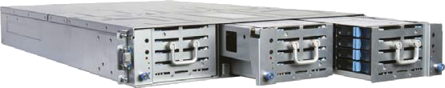
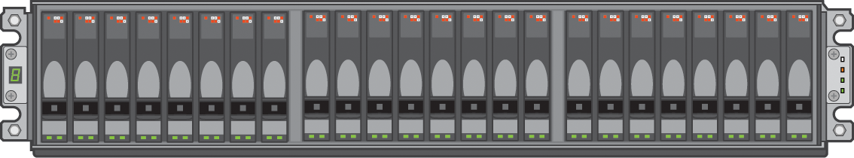
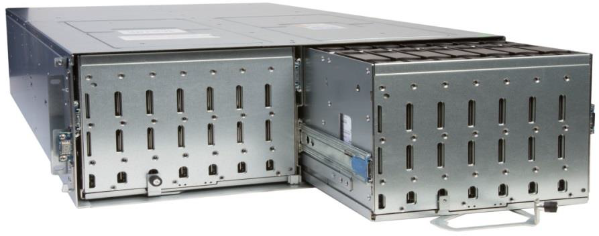
DOCUMENTATION: QXS-3/4/6 Series Chassis
2U12
2U48
2U24
4U56

Slide 43
DOCUMENTATION: OBC
Updated One Button Config (OBC): added 48-drive system
Default profile set: but it can be replaced with another profile set using Quantum Storage Profiles (QSP) process
Profile | Vdisk | Chunk Size | 12-Drive System | 24-Drive System | 48-Drive System | 56-Drive System
StorNext Metadata 1+1 | RAID 1 | N/A | Yes | Yes | Yes | Yes
StorNext Data 10+2 | RAID 6 | 256k | Yes | Yes | Yes | Yes
StorNext Data 12+2 | RAID 6 | 256k | No | No | No | Yes
StorNext Data 5+2 | RAID 6 | 256k | Yes | Yes | Yes | Yes
StorNext Data 8+2 | RAID 6 | 128k | Yes | Yes | Yes | Yes
StorNext MultiVolume 10+2 | RAID 6 | 256k | Yes | Yes | Yes | Yes
StorNext MultiVolume 12+2 | RAID 6 | 128k | No | No | No | Yes
StorNext Archive MultiVolume 10+2 | RAID 6 | 128k | Yes | Yes | Yes | Yes

Slide 44
DOCUMENTATION
Phase 1 released on 03/4/2016
Docs provide instructions for QX and QXS systems (where applicable).
Doc Title | Provides information on: | Customer | Service & Support
QXS Gx222R003 Release Notes | Enhancements, known issues, and late-breaking information not included in product documentation | http://www.quantum.com/ | https://qsweb.quantum.com/
QX and QXS Getting Started Guide | Product information and overview of setup tasks
QX and QXS Setup Guide | Product hardware setup and related troubleshooting
QX and QXS Bezel Installation Guide | Installing the front bezel on a QX and QXS system

Slide 45
DOCUMENTATION: PHASE 1 Docs CONTINUED
These docs also released on 03/4/2016
Docs provide instructions for QX and QXS systems (where applicable).
Doc Title | Provides information on: | Customer | Service & Support
QX and QXS 12- and 24-Drive Rackmount Install Guide | Using a 12- and 24-drive rackmount bracket kit to install an chassis into a rack | http://www.quantum.com/ | https://qsweb.quantum.com/
QXS 48-Drive Rackmount Install Guide | Using a 48-drive rackmount bracket kit to install an enclosure into a rack
QXS 56-Drive Rackmount Install Guide | Using a 56-drive rackmount bracket kit to install an enclosure into a rack
QXS Disk Management Utility User Guide V3 | Managing a QXS system by using its primary web interface (V3), the Disk Management Utility

Slide 46
DOCUMENTATION: PHASE 2 Docs
Phase 2 docs due NLT 03/31/2016
Docs provide instructions for QX and QXS systems (where applicable).
Doc Title | Provides information on: | Customer | Service & Support
QX and QXS CRU Installation And Replacement Guide | Identifying and installing or replacing CRUs | http://www.quantum.com/ | https://qsweb.quantum.com/
QX and QXS Disk Management Utility User Guide V2 | Managing a QX and QXS system by using its secondary web interface (V2), the Disk Management Utility
QX and QXS Event Descriptions Reference Guide | Events that the QX and QXS Series may report, and recommended actions to take in response to those events
QX and QXS CLI Reference Guide | Using the CLI to configure and manage the product

Slide 47
TRAINING
Training submitted to Agile on 03/9/2016
All deliverables identified as “course” have a customer-facing and a service version.
  Customer Facing: http://www.quantum.com/qseriesdocs
  Service: http://scl.quantum.com
QXS System Overview (course): An overview of QXS hardware, firmware, Disk Management Utility (v3), and a brief section on installation/configuration.
  1-4567: Customer-facing
  2-4567: Service-facing
QXS User Essentials (doc): PDF foldout with hardware overview, basic operations, and where to get help. For customers, available at http://www.quantum.com/qseriesdocs.
QXS At a Glance (doc): PDF foldout for GSC with very basic troubleshooting information. Available at https://qsweb.quantum.com/wiki/tiki-index.php?page=Homepage%20-%20GSC#resources.

Slide 48
TRAINING
Training delivered NLT: 03/31/2016
QXS System Installation and Configuration (course): A detailed install/config course to replace section in QXS Overview course. Topics will include hardware installation, cabling, host connection, and configuration.
  1-4468: Customer-facing
  2-4468: Service-facing
QXS G222 Service Update for Firmware G222 (course): Review of new features in G222 (2-4568d).
  2-4568d: Service-facing

Slide 49
Service
Jim Hibbard

Slide 50
Support Model Summary
Call Handling: Global Service Center (GSC)
Tech Support:
  Dot Hill Support for Dot Hill Reseller with Dot Hill Coverage
  ASPS for Dot Hill Reseller with Quantum Support
  SPS is Primary for QXS 3/4/6
    ASPS will provide support for QXS 3/4/6 that are stand alone arrays. We’re looking for ways to automate this.
Field Support: Break-fix
  Third Party Maintainer (TPM) led for Quantum Supported
Escalation Resources
  Service Engineering Specialists (SES), StorNext Sustaining (SUS), Quantum HW Engineering, Dot Hill Solutions
  TrackIT for Licenses

Slide 51
Service Offerings
Dot Hill Reseller w/Dot Hill Support – Coverage in IB and the SR indicates “Vendor Supported”
  Quantum does warm handoff to Dot Hill (Seagate) Support
Dot Hill Reseller w/Quantum Support – Coverage in IB and the SR indicates Quantum branded support (Gold/NBD Gold/Bronze)
  Quantum ASPS supports
Quantum QXS 3/4/6
  Warranty: 3 year Parts-only Warranty
  Support Contract Uplifts: Bronze, NBD Gold, and Gold Support Plan uplifts
  Annual extensions are available for Bronze, NBD Gold, and Gold contracts
  Annual renewals are available for Bronze, NBD Gold, and Gold
Although QXS disk is customer installable, optional Installation and Integrations Services are available
  Post sale capacity upgrade services are available

Slide 52
History – Dot Hill Reseller Program
Dot Hill Reseller Part 1
  Started in March ‘15
  Resell Dot Hill branded disk with Dot Hill Support
    Part number descriptions in IB all start with “Dot Hill…”
    Coverage in SR form will be either blank or “Vendor Supported…” Service action to do warm handoff (open case on behalf of customer) with Dot Hill Support. Blank Coverage IBs being updated to “Vendor Supported…”
  Service Plan released and posted on CSWeb (PN 0-15813-01)
Dot Hill Reseller Part 1.5
  Starts July 15, 2015
  Resell Dot Hill branded disk with Quantum Support
    Part number descriptions in IB all start with “Dot Hill…”
    Coverage in SR form will show a Quantum Warranty or Support contract.
  Service Plan released and posted on CSWeb (PN 0-15985-01)
QXS 3, 4, 6 Rebrand Program (Dot Hill Reseller Part 2)
  Resell Dot Hill disk with Quantum branding and Quantum Support
  New QXS 3, 4, 6 models
  Service Plan in progress (PN 0-16037-01)

Slide 53
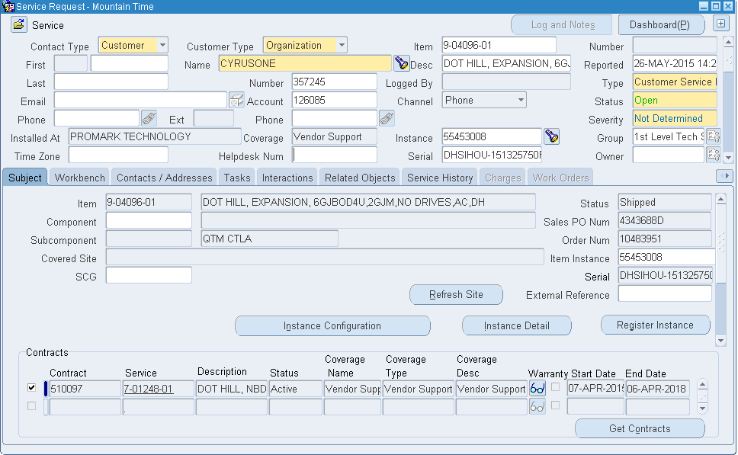
Service Request Screenshot – Dot Hill Reseller Part 1

Slide 54
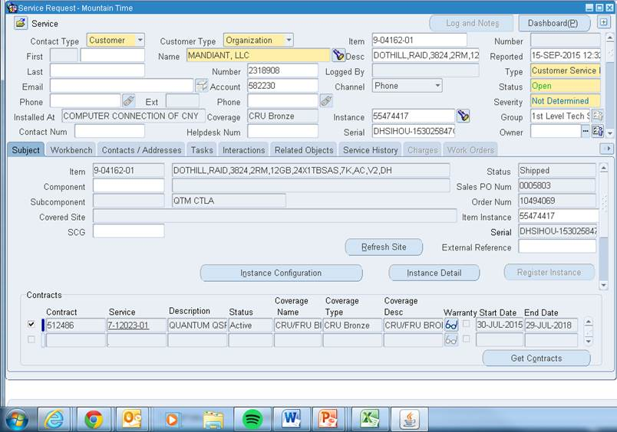
Service Request Screenshot – Dot Hill Reseller Part 1.5

Slide 55
FRU/CRU Strategy
All field replaceable components are defined as CRUs
Most CRUs shared between QXS 3/4/6, QXS 1200/2400/5600, DH Reseller, some critical components different
  Controllers and Chassis CRUs for QXS 3/4/6, QXS 12/24/56, and Dot Hill branded systems are not interchangeable
  Refer to individual product columns on FRU/CRU list
Consolidated FRU/CRU list has been updated to show field replaceable components for:
  Legacy Quantum branded QXS 1200/2400/5600.
  Dot Hill branded disk as part of Dot Hill Reseller Part 1.5 (Dot Hill branded disk with Quantum support.
  New Quantum branded QXS 3/4/6 models
  Xcellis
  Part Number 6-67820-01, Rev S

Slide 56
Show FRUs Command
FRU
Name: CHASSIS_MIDPLANE
Description: CHASSIS 6G 4U56 QTM
Part Number: 1-05312-01
Serial Number: QTMCHOU-152425E38E
Revision: C1
Dash Level:
FRU Shortname: Midplane/Chassis
Manufacturing Date: 2015-05-20 09:07:57
Manufacturing Location: Tianjin,TEDA,CN
Manufacturing Vendor ID: 0x017C
FRU Location: MID-PLANE SLOT
Configuration SN: QTMCHOU-152425E38E
FRU Status: OK
Enclosure ID: 0
FRU
Name: RAID_IOM
Description: CRU RAID CONTROLLER BASE QXS
Part Number: 9-03980-01
Serial Number: QTMCHOU-152425C7E2
Revision: B2
Dash Level:
FRU Shortname: RAID IOM
Manufacturing Date: 2015-03-19 22:23:05
Manufacturing Location: Tianjin,TEDA,CN
Manufacturing Vendor ID: 0x017C
FRU Location: RIGHT IOM SLOT
Configuration SN: QTMCHOU-152425E38E
FRU Status: OK
Enclosure ID: 0

Slide 57
Show Disks Command
Location Serial Number Vendor Rev Description Usage Jobs Speed (kr/min) Size Sec Fmt Disk Group Pool Tier Health
--------------------------------------------------------------------------------------------------------------------------------------------------------------
0.0 1EGD5U9C HGST A1E2 SAS MDL LINEAR POOL 7 6001.1GB 512n snfs_data_L2 snfs_data_L2 N/A OK
0.1 1EG8P8KB HGST A1E2 SAS MDL LINEAR POOL 7 6001.1GB 512n snfs_data_L2 snfs_data_L2 N/A OK
0.2 1EGDK6YB HGST A1E2 SAS MDL LINEAR POOL 7 6001.1GB 512n snfs_data_L2 snfs_data_L2 N/A OK
0.3 1EGDK7YB HGST A1E2 SAS MDL LINEAR POOL 7 6001.1GB 512n snfs_data_L2 snfs_data_L2 N/A OK
0.4 1EGBYB0C HGST A1E2 SAS MDL LINEAR POOL 7 6001.1GB 512n snfs_data_L2 snfs_data_L2 N/A OK
0.5 1EGD5UEC HGST A1E2 SAS MDL LINEAR POOL 7 6001.1GB 512n snfs_data_L2 snfs_data_L2 N/A OK
0.6 1EGD4VHC HGST A1E2 SAS MDL LINEAR POOL 7 6001.1GB 512n snfs_data_L2 snfs_data_L2 N/A OK
0.7 1EGBYAHC HGST A1E2 SAS MDL LINEAR POOL 7 6001.1GB 512n snfs_data_L2 snfs_data_L2 N/A OK
0.8 1EGDK74B HGST A1E2 SAS MDL LINEAR POOL 7 6001.1GB 512n snfs_data_L2 snfs_data_L2 N/A OK
0.9 1EGDLABC HGST A1E2 SAS MDL LINEAR POOL 7 6001.1GB 512n snfs_data_L2 snfs_data_L2 N/A OK
0.10 1EGBLT9B HGST A1E2 SAS MDL LINEAR POOL 7 6001.1GB 512n snfs_data_L2 snfs_data_L2 N/A OK
0.11 1EGDK7AB HGST A1E2 SAS MDL LINEAR POOL 7 6001.1GB 512n snfs_data_L2 snfs_data_L2 N/A OK
0.12 1EGDL9XC HGST A1E2 SAS MDL LINEAR POOL 7 6001.1GB 512n snfs_data_L2 snfs_data_L2 N/A OK

Slide 58
CRU Components
RAID Chassis - There are four types of chassis. The TLA that populates in the SR will indicate 2U12 w/LFF, 2U12 w/SFF, 2U48, or 2U56. Service will match this to the corresponding CRU on the FRU/CRU list.
Controller – There are three types of controllers; EX, LX, and FX.
  QXS-3xx uses EX
  QXS-4xx uses LX
  QCS-6xx uses FX
  Note: all controllers available in CNC (FC/iSCSI) or SAS
Drive – There are two sizes of drives; Large Form Factor (LFF) and Small Form Factor (SFF). The two sizes of drives will install on one of four types of drive sleds; LV2, HV2, SV2, and SV3.
  LV2 is standard LFF sled with an LFF style drive
  HV2 is a hybrid sled allowing an SFF drive to be placed into an LFF compatible chassis
  SV2 is a standard SFF sled with and SFF style drive
  SV3 is a SFF sled that fits into a 2U48 chassis
  Note that all SSDs are SFF drives requiring one either SV2, HV2, or SV3 sled

Slide 59
CRU Components (cont.)
Expansion Module Chassis – Expansion modules don’t have controllers, they have less capable I/O Modules (IOMs)
  Shares same chassis with RAID, just a difference in the controller à IOM
  Still have 2U12, 2U24, 2U48, and 4U56 options
  IOM choice is dictated by the choice of controller
    Choice #1 compatible with 3xx (EX) and 4xx (LX) low density (2U12 and 2U24) chassis / controller pairs
    Choice #2 compatible with 4xx (LX) high density (2U48 and 4U56) chassis / controller pairs
    Choice #3 compatible with 6xx (FX) chassis / controller pair
Power Supplies – There are six different Power Supplies for QXS-3,4,6
  2 different 595W power supplies for 2U12 and 2U24 chassis; Energy Star Certified and non-Energy Star Certified
  1000W power supply for 2U48 chassis
  3000W power supply for 4U56 chassis
  DC power supply for 2U12 and 2U24 chassis
  DC power supply for 4U56 chassis

Slide 60
How to determine Chassis CRU Example
Description that populates in SR shows QXS 312, 324, 412, 424, 448, 456, 648, 656
  QXS-312/412 use 2U12 chassis
  QXS-324/424 use 2U24 chassis
  QXS-448/648 use 2U48 chassis
  QXS-456/656 use 4U56 chassis
Example: QUANTUM QXS-448RC,48 SLOT SV3 FC/ISCSI RAID CHASSIS
  Uses 2U48 CRU chassis
  Select “CRU, CHASSIS, EMPTY, 2U48, 4XX/6XX, STX”, PN 9-05082-01 on FRU/CRU list
  Can use Show FRUs command
    Returns 1-, 3-, 9- PN that can be referenced on the FRU/CRU.

Slide 61
How to determine Controller CRU Example
Description that populates in SR shows Model and FC/iSCSI (CNC) or SAS
  QXS-3xx = “EX” Controller
  QXS-4xx = “LX” Controller
  QXS-6xx = “FX” Controller
  FC/iSCSI = “CNC” on FRU/CRU list
Example: QUANTUM QXS-448RC,48 SLOT SV3 FC/ISCSI RAID CHASSIS
  We know QXS-448 uses “LX” controller
  We know QXS-448 is a 2U48 high density chassis
  We know “FC/iSCSI” = “CNC”
  Select “CRU, CONTROLLER, LX, CNC,HIGH DENSITY,4XX,STX”, PN 9-03980-01 on FRU/CRU list

Slide 62
How to determine Drive CRU Example
Description that populates in SR shows the sled type
  LV2 = standard LFF sled with an LFF style drive
  HV2 = hybrid sled allowing an SFF drive to be placed into an LFF compatible chassis
  SV2 = standard SFF sled with an SFF style drive
  SV3 = SFF sled that fits into a 2U48 chassis
Example: QUANTUM QXS-448RC,48 SLOT SV3 FC/ISCSI RAID CHASSIS
  Determine capacity of drive from Show Disks command or logs
  Determine SED/non-SED from Show Disks command or logs
  Determine speed of drive from Show Disks command or logs
  We know SV3 sled and thus SFF drive (2.5” HDD)
  Select SV3, capacity, SED/non-SED, and speed (or Reliability for SSDs) on FRU/CRU list

Slide 63
FRU/CRU Strategy – How to determine Power Supply CRU
Description that populates in SR shows the chassis type
  2 different 595W power supplies for 2U12 and 2U24 chassis; Energy Star Certified and non-Energy Star Certified
    Energy Star can be found in Show FRUs command and system Logs
  1000W power supply for 2U48 chassis
  3000W power supply for 4U56 chassis
  DC power supply for 2U12 and 2U24 chassis
  DC power supply for 4U56 chassis
Example: QUANTUM QXS-448RC,48 SLOT SV3 FC/ISCSI RAID CHASSIS
  QXS-448 uses 2U48 Chassis
  2U48 Chassis uses 1000W power supply
  Select “CRU, PSU,1000W,AC,2U,STX”, PN 9-05096-01 from FRU/CRU list

Slide 64
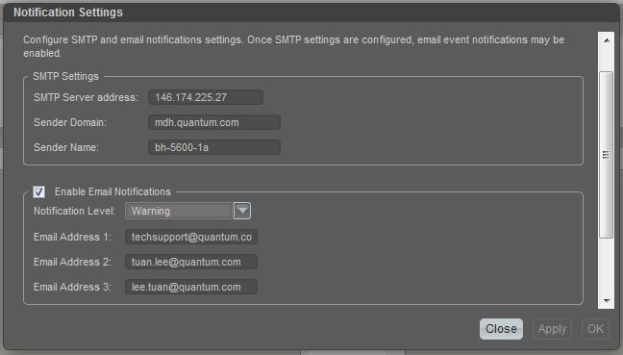
Alerting Functionality
Alert Setup in Firmware Version GL210
  Alert Level is global to all recipients.
  Manual entry of techsupport@quantum.com is required

Slide 65
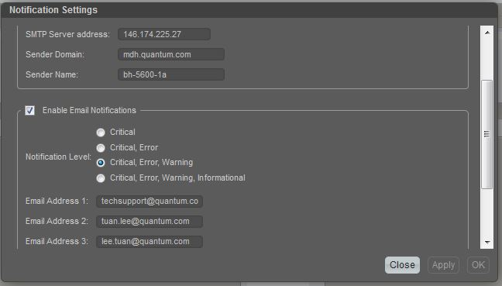
Alerting Functionality (cont.)
Alert Setup in Firmware Version G222
  Alert Level is global to all recipients.
  Default Alert Level is Critical, Error, Warning. Warnings filtered out of inbox for SR opening.
  techsupport@quantum.com is default

Slide 66
Transition Fulfillment Plan
QXS-3/4/6 models to GA in April. We will continue to sell QXS 1200/2400/5600 but fulfill with QXS 3/4/6 components.
Base Systems
  Customers order “classical” QXS-1200/2400/5600 Base unit and receive QXS-4xx components.
  Base Systems are IB Track-able and Serial Control

Slide 67
Transition Fulfillment Plan (cont.)
Expansions
  Customers order “classical” QXS-1200/2400/5600 Expansions and receive QXS-4xx Expansion components.
  Install Base Records show both Book and IB Product Descriptions.
  Expansions are IB Track-able but NOT Serial Control

Slide 68
THANK YOU
For meeting with Quantum, the LARGEST Data Protection
and Big Data management specialist in the world.
© 2013 Quantum Corporation. Company Confidential. Forward-looking information is based upon multiple assumptions and uncertainties,
does not necessarily represent the company’s outlook and is for planning purposes only.

