Slide 1
QXS-1200/2400
Q-Series Disk
(Everglades, Program)
TOI for Global Service
March 18, 2014
Quantum Confidential / Internal Use Only

Slide 3
Agenda
Product Overview
HW/SW Engineering
Documentation and Training
Service Strategy
Note: Ask questions as we go. Q&A also at the end.

Slide 4
Product Overview
Presented By: Nick Elvester

Slide 5
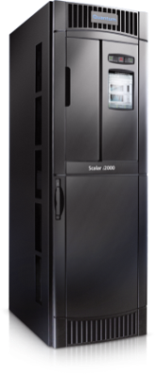
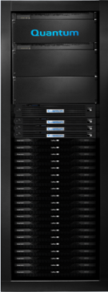
StorNext QXS Storage: Scale out Storage Solution
Good for Customers
Completes the solution from a single vendor
Predictable performance and behavior
Assurance of solution compatibility
Good for Quantum
Easier to support: we’ve tested the entire solution
We gain ownership for a bigger part of the solution
Increases visibility as Big Data experts
Remember
Always sold with StorNext (or Xsan)
Usually sold with an Metadata Appliance and/or tape
Not sold for use cases outside of StorNext (VMware, etc.)
CIFS & NFS
StorNext SAN Clients
GbE
StorNext DLC
LAN
SAN
(FC or iSCSI)
DLC
Gateway
GbE
Group Logic LAN Client for Mac
StorNext
Metadata
Controller

Slide 6
StorNext QXS Storage
New, upgraded controllers to replace the QX
Very similar to QX with a performance boost
Uses the same expansion units as the QX
Easy, Flexible, Reliable
Great fit for Xsan customers
High Performance
Up to 5.1GB/s sequential read
Up to 3.6 GB/s sequential write
Affordable price/performance ratio

Slide 7
StorNext QXS: What’s New vs. QX
All new ASIC-based high-performance RAID controller
16Gb FC connection for hosts
Increase in “up-to” performance and bandwidth
~6% on reads; now up-to 5.1GB/s
~40% on writes; now up-to 3.6GB/s
INTERNAL ONLY: New features we DO NOT use
Array based snapshots, copies, and replications
FDE disk (ALL QX and QXS disk are non-FDE)

Slide 8
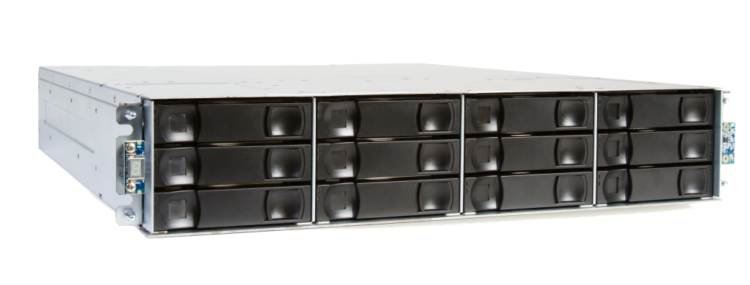
Product Models
StorNext QXS-1200
12 drive 2U chassis
Base system and expansion unit
24TB, 36TB, and 48TB
2TB, 3TB, and 4TB drives
12x 7.2K RPM 3.5” NL-SAS drives
StorNext QXS-2400
24 drive 2U chassis
Base system and expansion unit
14.4TB, 21.6 TB and 28.8TB
600GB, 900GB, 1200GB drives
24x 10K RPM 2.5” SAS drives
QXS Base, expansion, capacity, and models can be mixed in a single configuration
QX and QXS use the same expansion units

Slide 9
QXS Availability and Transition
A handful have been quoted for FQ4’14
Official launch is in conjunction with NAB in ~3 weeks
QXS will completely replace QX
If we run out of QX this quarter, we will replace orders with QXS
QX
QXS

Slide 10
HW/SW Engineering

Slide 11
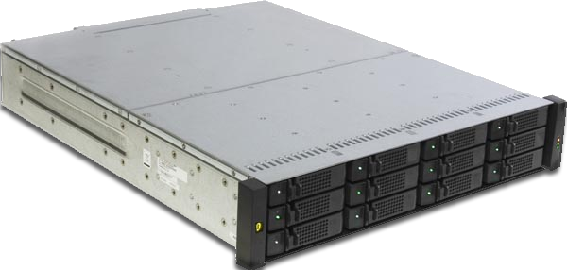
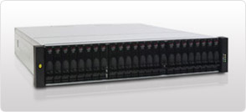
Array Overview
Dual controller hardware configurations
2U, 12/24 drive efficient packaging
Fully redundant
Hot-swap components
DAS and SAN connectivity
Windows, Linux and VMware support
8 host interface ports, 4 per controller
FC – 16 Gbit/s Fabric protocol support (PTP)
Support from 2 to 192 disks, current industry offerings
Support for up to 192 SAS or Nearline SAS Drives
Freely mix drives in any quantities, any locations
RAID 1, 5, 6, 10, 50 data protection
Local and Global hot spare support
Embedded Management software is OS platform independent
3.5” Nearline SAS 7.2K RPM - 2, 3, 4 TB – max 96 drives
2.5” SAS 10K RPM - 600, 900GB, 1.2TB – max 192 drives
Battery-free Cache backup
2U12 Chassis
2U24 Chassis

Slide 12
Product Comparison
QX aka Chromium or 4000
QXS aka Gallium LX or 4004
ASIC RAID processor
More capable processor
Faster memory
Faster front-end FC
Quantum Branded SFPs

Slide 13
Controller Module
16 Gb FC
6 Gb SAS OUT
3.5mm CLI port
Ethernet Port

Slide 14
Management Login
User name: manage
Password: !manage
In a web browser, type a controller module IP address in the address or location field and press Enter
Type the User name (Default = manage)
Type the Password (Default = !manage)
Select Sign In

Slide 15
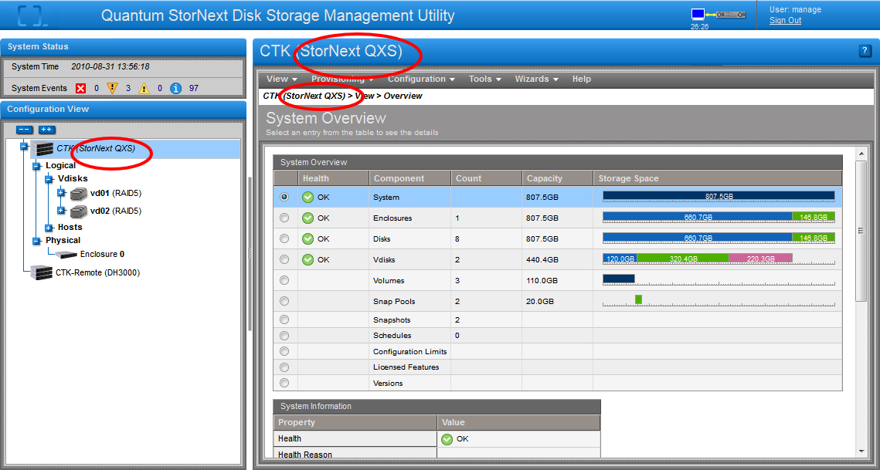
Storage Management Introduction
Overall system events
Enclosures
Navigation and configuration options
RAID sets
Volumes within each vdisk
Physical hosts seen by the host ports
Physical enclosures attached

Slide 16
Documentation and Training
Presented By: Charlotte Taylor

Slide 17
Documentation
Posted on CSWeb and Quantum.com
StorNext QXS Storage: Getting Started Guide
StorNext QXS Storage: Setup Guide
StorNext QX and QXS Storage: Rackmount Bracket Kit Installation Guide
StorNext QX and QXS Storage: QX and QXS-1200 Bezel Installation Guide
StorNext QXS Storage CRU Guide
StorNext QXS Storage: Disk Management Utility Users Guide
StorNext QX and QXS Storage: CLI Reference Guide
StorNext QX and QXS Storage: Event Descriptions Reference Guide
Quantum QX and QXS Series: Product Regulatory Compliance and Safety Guide
StorNext QXS Storage Release Notes

Slide 18
Training
Post this recorded TOI session on CSWeb.
The TOI will also serve as a Service Update online course for QXS1200/2400.

Slide 19
Service Strategy
Presented By: Jim Hibbard

Slide 20
QXS-1200/2400 Service Model Summary
Identical Service Model to existing QX1200/2400 products.
For QX/QXS Series we will not sell support contracts that co-terminate with the main StorNext MDC Service Contract. QX/QXS Series will have stand alone support contracts. Each QX/QXS-1200/2400 system will be related (not linked) to a StorNext product (SW or M330/M440/M660) in Oracle IB, The StorNext MDC serial number MUST be collected and documented by Sales when the QX/QXS-1200/2400 is sold.
Product Category: Software Products (StorNext disk)
Case Management: Global Call Handling (GCH), CDS, Kuala Lumpur
Technical Support: Software Product Support (SPS)
Field Support: TPM led Field Support
All field replaceable components are CRUs.
Entitle with TPMs if end user customer purchases uplifted contract that requires onsite CRU replacement.
Escalation Support: Dot Hill Solutions, StorNext Sustaining (SUS), and Quantum HW Engineering
Replacement Part Fulfillment: Customer Replaceable Units (CRUs, no FRUs)
CRUs are ordered from Quantum stocking locations (Choice Logistics)
CRU list update includes new 4004 series controller and 1.2TB HDDs

Slide 21
QXS-1200/2400 Service Model Summary (cont.)
Installation Strategy
StorNext QX/QXS-1200/2400 Storage Systems are not customer installable and therefore requires the end user to purchase installation services. Installation and Integration of the StorNext QX/QXS-1200/2400 Storage Systems will be performed jointly by Quantum Field Engineers and Professional Services (or by Quantum Authorized Partners).
Service Offerings
Standard Warranty
WARRANTY - Three-year next business day parts replacement. Replacement item shipment targeted for next business day. Customer will perform the replacement and return of the failed item. Parts replacement service available 5x9 via telephone or email. Includes 30 days of 5x9 telephone and email software support.
Warranty uplifts, extensions, and renewals – (These are all the new CRU based contracts.)
BRONZE SUPPORT PLAN
NEXT BUSINESS DAY GOLD
GOLD SUPPORT PLAN
Supplemental Uplift: Bronze and NBD Gold Support Contract uplift for customers that require Quantum resources to replace all field replaceable components independent of CRU vs. FRU.
Annual renewals and extensions are available (Bronze, NBD Gold, and Gold).

Slide 22
Dot Hill Solutions Introduction (DHS)
DHS is based in Longmont, CO
Support contract with DHS – 7x24x365
Dot Hill Technical Support Locations:
Frontline Support (Level 1) – Chennai, India
Engineering Support – Hyderabad, India
Systems Engineering Support – US, EMEA, AP, Japan
L3 Technical Support – Longmont, CO
Dot Hill Solutions Technical Support may be leveraged for technical assistance
DHS prefers that cases are opened online, but will also accept phone calls.
SANsolve is Dot Hill’s online case management and knowledge base system.
Registration and access details are located in QX/QXS Series Service Plan
Dot Hill Solutions Level 1 support can be contacted directly via the phone
Contact details are located in the QX/QXS Series Service Plan
Dot Hill Solutions Escalations
DHS Level 3 Technical Support is responsible for escalations. If you feel your needs are not being addressed by the L1 team, you can ask the case be escalated to L3, or contact escalation management directly.
Escalation manager contact details are located in the QX/QXS Series Plan

Slide 23
FRU/CRU Model
All Field Replaceable Components are CRUs
CRU,RACK MOUNT KIT,SHELF,QX/QXS | 9-03008-01 | 1-04898-01
CRU,POWER SUPPLY,595W,AC,2U,QX/QXS | 9-03009-01 | 1-04899-01
CRU,POWER SUPPLY,DC,QX/QXS | 9-03045-01 | 1-04932-01
CRU,I/O Module,EXPN,QX/QXS | 9-03036-01 | 1-04920-01
CRU,RAID CONTROLLER,BASE,QX | 9-03037-01 | 1-04921-01
CRU, RAID CONTROLLER, BASE, QXS | 9-03552-01 | 1-05134-01
CRU,HDD,2TB,FDE,QX-1200 | 9-03012-01 | 1-04902-01
CRU,HDD,3TB,FDE,QX/QXS-1200 | 9-03046-01 | 1-04904-01
CRU,HDD,4TB,FDE,QX/QXS-1200 | 9-03053-01 | 1-04933-01
CRU,HDD,2TB,NONFDE,QX-1200 | 9-03012-02 | 1-04902-02
CRU,HDD,3TB,NONFDE,QX/QXS-1200 | 9-03046-02 | 1-04904-02
CRU,HDD,4TB,NONFDE,QX/QXS-1200 | 9-03053-02 | 1-04933-02
CRU, CHASSIS,12X3.5,NO DRIVES,QX/QXS-1200 | 9-03048-01 | 3-06632-01
CRU, CHASSIS,24X2.5,NO DRIVES,QX/QXS-2400 | 9-03047-01 | 3-06633-01
CRU,HDD,600GB,FDE,QX/QXS-2400 | 9-03049-01 | 1-04934-01
CRU,HDD,900GB,FDE,QX/QXS-2400 | 9-03050-01 | 1-04935-01
CRU,HDD,600GB,NONFDE,QX/QXS-2400 | 9-03049-02 | 1-04934-02
CRU,HDD,900GB,NONFDE,QX/QXS-2400 | 9-03050-02 | 1-04935-02
CRU,HDD,1200GB,FDE,QXS-2400 | 9-03553-01 | 1-05135-01
CRU,HDD,1200GB,NONFDE,QXS-2400 | 9-03553-02 | 1-05135-02
CRU,BEZEL W/BADGE,QX/QXS-1200 | 9-03051-01 | 1-04936-01
CRU,BEZEL W/BADGE,QX/QXS-2400 | 9-03052-01 | 1-04937-01
QX only =
QXS only =
QX&QXS =

Slide 24
Q&A

