Slide 1
Firmware Version GL210
For QXS 1200/2400/5600
TOI for Global Service
September 23 , 2015

Slide 2

Please Mute Your Line
Reminder: we are now using WebEx Audio for con calls.
Here are some things you need to know about WebEx Audio:
  Using “*6” does not work on WebEx Audio to mute/un-mute your line.
  You can mute your phone in two ways when using WebEx Audio:
    You can mute your phone from your end (using the mute feature on your phone)
    Within the WebEx, in the participants list, use the button next to your name showing a microphone. Press once to mute. Press again to un-mute.
      Note: this works best if you use the “call me back” function of WebEx
    If we need to mute all lines, use the “Raise Hand” feature to let us know you need to speak and we will un-mute your line.
    I will mute all the lines when we get started. You will have to unmute yourself in the webex list of attendees to ask questions. Please mute yourself again when finished with your question.

Slide 3
Agenda
Product Management
Engineering
Training and Documentation
Service
Please ask questions as we go.

Slide 4
Product Management
Mark Thacker

Slide 5
Quantum GL210 Overview
First firmware release that will be common between Dot Hill and Quantum
  Supports StorNext QXS
Provides the foundation for Quantum’s unified disk offering
New V3 GUI
  Enhanced look and feel ; support for page mode disks
Enhanced One Button Configuration
  Can add more profiles from the load of a simple .bin file in the field or at factory
Provides support for paged-mode (“virtual pool”) disk support
  Volumes carved from pool of disks rather than dedicated disks. Provides tiering to SSD from HDD.
  NOTE : StorNext will continue to use Linear / traditional volumes for some time
The default storage mode is linear. (Linear is what OEM is using today)
CLI method to write a Stornext Volume label
Notes:
4700 to 4701…
Org and flow…

Slide 6
Quantum GL210 Release
Released for field updates and factory week of 14Sep2015
Finished goods will continue to have previous release (GL205) until inventory exhausted
  No rework in factory
  If, and when, Quantum orders QXS-1200, 2400, 5600 from factory, it WILL arrive with GL210
  Very likely that customers will start to transition over to QXS-4 series
GL210 will start from factory with QXS-3, 4, 6
  Some existing finished good products will be re-worked as needed to QXS-4 series
  Rework will involve installing GL210 plus Quantum branding file
Notes:
4700 to 4701…
Org and flow…

Slide 7
GL210 Licenses
(Not applicable to QXS 1200, 2400, 5600)
As a general rule : These licenses are NOT applicable for StorNext QXS use
RealStor – RealStor, Virtual Volume, and Q-Tools are analogous and all mean the same which is the support for Virtual Volumes. Disks can be grouped into pools and virtual volumes created from the pool.
  Virtual volumes are not associated with any one specific disk and support thin provisioning, rapid rebuilding of replaced disks, SSD caching, and autonomic movement of data between performance and archive HDD tiers.
  Note: Virtual Volumes are not generally applicable for StorNext use at this time.
SSD Tiering – SSD Tiering and Q-Tier are the same. SSDs can be used by the Virtual Volume function as a high performance tier, with data being evaluated and moved every 5 minutes based on usage.
  This data movement is transparent to the application.
  Note: SSD Tiering with Virtual Volumes is not generally applicable for StorNext use at this time.
DMS Bundle
  Snapshots – Files and directories kept in storage as they were some time in the past.
  Volume Copy – Deep copy of volumes.
  Replication – Replication of volumes from one array to another. (iSCSI, FC only)
VSS – Windows Shadow Copy Services
SRA – VMWare Site Recovery Adapter

Slide 8
Obtaining QXS Licenses
License requests to Service need to be approved by Express Team
  Send email to DL-Express@Quantum.com
  In the email to the Express Team make sure to include the following:
    Subject Line: QXS 12/24/56 GL210 License Request
    Email body: Serial number, customer name, and contact detail and brief description of what licenses are being requested
License requests for OEM are expected to be very rare since StorNext can’t really use them.
  No mention of these licenses in OEM Release Notes
License requests for Dot Hill Branded QXS may be more frequent
  Licenses are on our Price List and may get fulfilled that way

Slide 9
Offerings to the Field
Today
  Dot Hill branded – GL210 doesn’t change any branding
  Dot Hill branded with Quantum QXS branding in price book – same as above
    See next slide
  StorNext QXS-1200, 2400, 5600 – branding remains StorNext QXS and same SCSI inquiry string
Future
  QXS-3, 4, 6 – branding is without StorNext, uses GL210 and differing SCSI inquiry string

Slide 10
Dot Hill to Quantum QXS Transition
Goal : Unify on QXS Hybrid Disk across all of Quantum
April through Oct/Nov 2015
  Systems, GUI and boxes branded Dot Hill
  Quantum QXS names in price book
  Dot Hill part numbers – can still honor existing quotes
  Quantum service parts sold
  Quantum warranty : 36 months, NBD parts replacement
Nov 2015 : True QXS product
  New Quantum part numbers
  New price book to reflect these numbers and bundling changes
  Systems, GUI and boxes will all be Quantum QXS branded
  Timed to be near same time as StorNext “Beachhead” appliance launch
Q1CY2016 : Transition out Dot Hill and StorNext QXS parts

Slide 11
Future Examples of QXS Configurations
Quantum
QXS Hybrid Disk Systems
QXS-3
QXS-4
QXS-6
Q-Tools + 1 Button Personality
Q-Tools + 1 Button Personality
1 Button Personality
QXS-312
QXS-324
QXS-412
QXS-424
QXS-448
QXS-456
QXS-648
QXS-656
StorNext Data Mgmt
Q-Tier
Flash
Mgmt
Media & Entertainment
Video Surveillance
Virtual Computing
Disk Backup
HPC
Database & Other IT
1-Button
Use Case Personalities

Slide 12
Engineering
Dan Byers/Lance Allred

Slide 13
General GL210 Notes
GL210 firmware can be used on QXS1200, QXS2400 and QXS5600 as well as the upcoming Quantum-branded QXS-3/4/6 models
  QXS-1200/2400/5600 have special update process that must be followed, see later slides
  Most “new” functionality to Quantum-branded QXS not new to Dot Hill reseller
    Previously released by Dot Hill, not made available or supported by Quantum until GL210
    Includes
      Virtualization functionality released by Dot Hill in GL200 firmware version, early 2015
      V3 GUI
Dot Hill released GL210 for Dot Hill-branded hardware simultaneous with Quantum’s release
  Obtain firmware and release notes from the proper distribution channel, there are important differences

Slide 14
Features New to Quantum QXS in GL210
Virtualization (branded Q-Tools by Quantum)
New V3 GUI
Additional one-button-configuration profiles
Ability to write StorNext label through the CLI

Slide 15
Features New to Quantum in GL210 – Virtualization
Virtualization (branded Q-Tools by Quantum, RealStor by Dot Hill)
  Requires additional licensing
  Q-Tool License includes:
    Virtual volumes
    Thin provisioning
    HDD tiering
    SSD Caching
    Rapid Rebuild
  Q-Tier license allows:
    Allows SSDs to be configured into a virtual pool such that:
      SSDs can be thin provisioned
      SSDs can be used as a tier
  Q-Tools configuration requires the V3 WBI

Slide 16
Features New to Quantum in GL210 – V3 GUI
V2 GUI was RAIDr; V3 GUI is Storage Management Console (SMC)
  Quantum rebrands both V2 and V3 interfaces
  V2 and V3 GUIs are both present in GL210
Factory machines will default to new V3 version
Default on field updates to GL210 is to continue to use V2 WBI (current version)
  Field upgrades require an additional file (branding) to be loaded during the GL210 FW update in the field.
    It does not matter if the V2 or V3 WBI will be used, this branding file must be installed on upgrades
    Quantum branding will not show up for V3 if this file is not loaded
WBI version can be selected by adding V2 or V3 to the URL or from CLI
  Example: http://10.40.165.24/v2 selects the version 2 gui
  Example: http://10.40.165.24/v3 selects the version 3 gui
  From cli: “set protocols management-mode v2” or v3

Slide 17
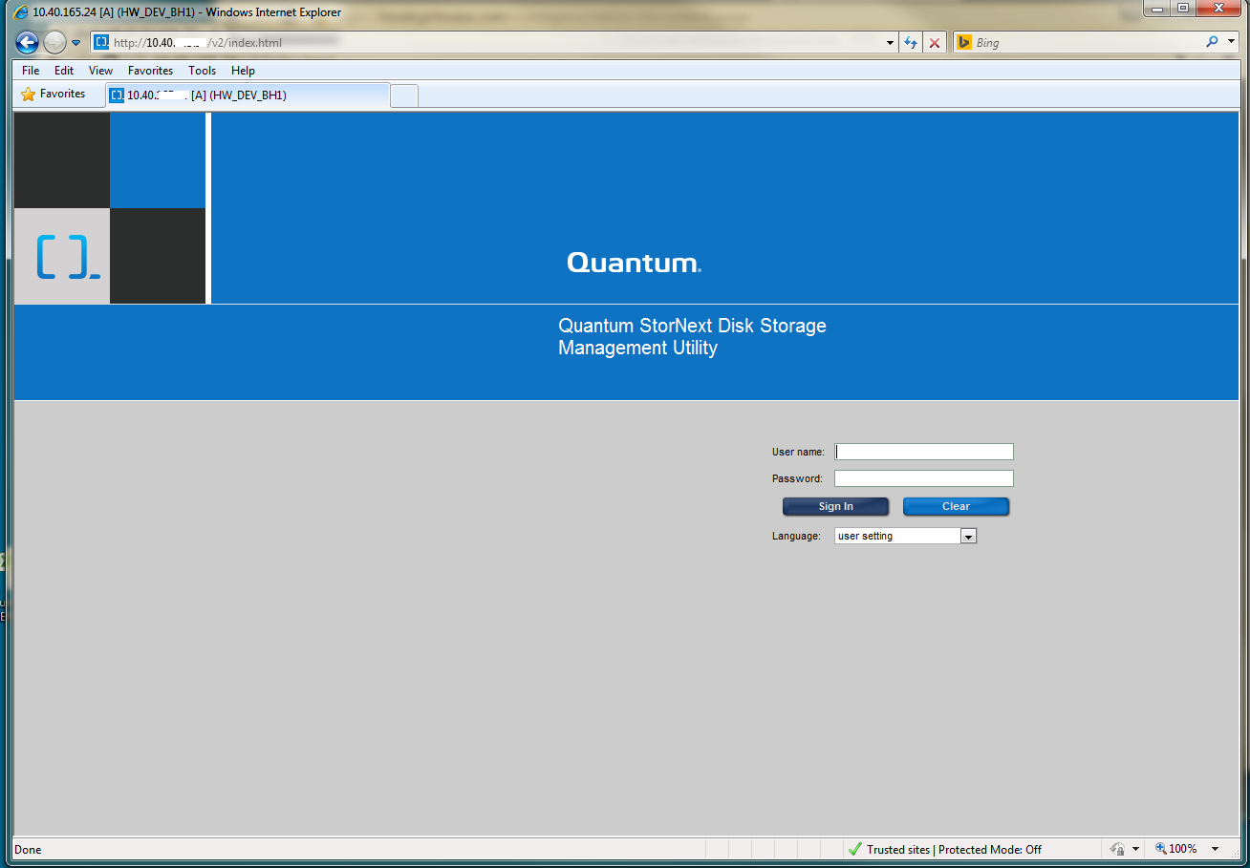
V2 WBI Login Screen

Slide 18
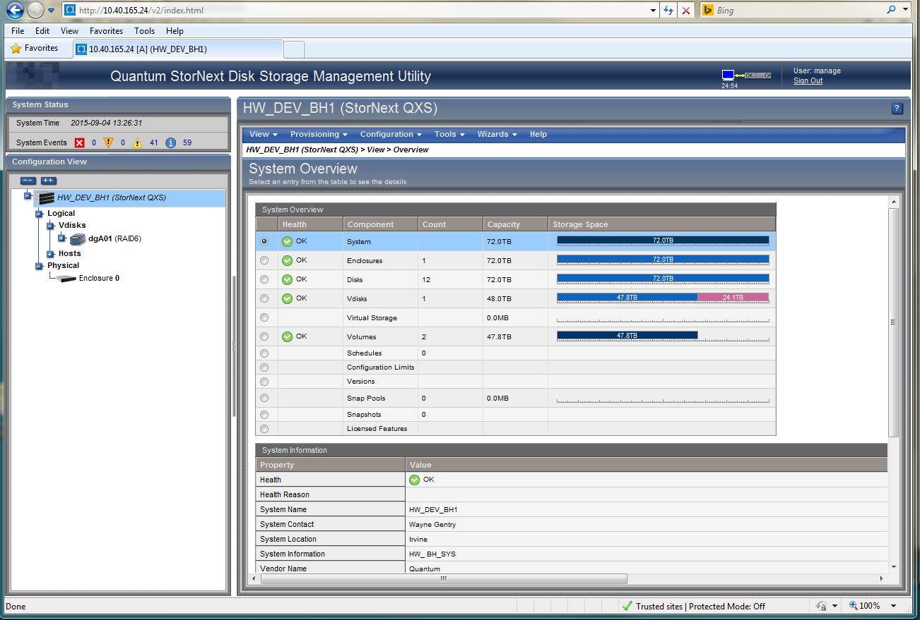
V2 WBI Look-and-feel

Slide 19
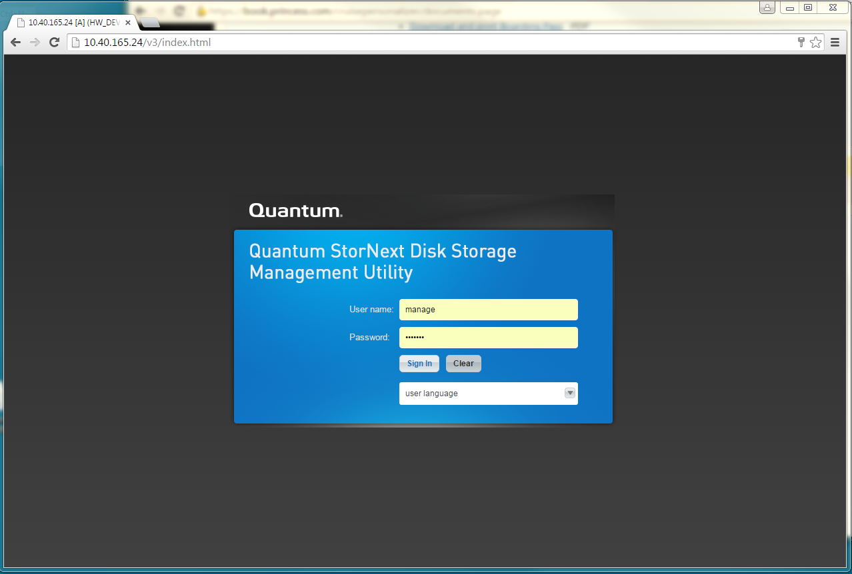
V3 WBI Login Screen

Slide 20
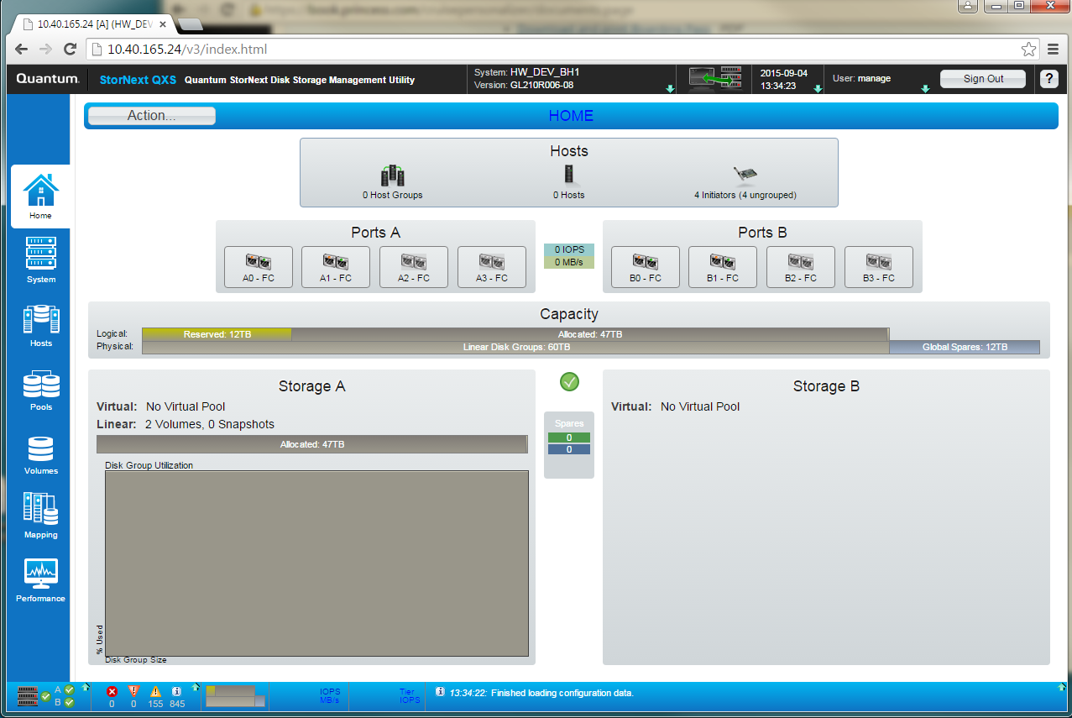
V3 WBI Look-and-feel

Slide 21

Features New to Quantum in GL210 – OBC Profiles
2 new profiles added to one-button-configuration
Now total of 8 profiles
Profiles added for Beachhead use

Slide 22
GL210 Firmware Update Process on QXS-1200/2400/5600
Specific to QXS-1200/2400/5600 firmware upgrades a two step process:
  Apply the Branding file
  Apply the Firmware file
  Both update steps use same WBI interface update raid controller
  Both are considered “Controller Module Firmware Files”
Note Branding file only needs to be installed one time
  Must be done at GL210 update time
  On the update from GL205 (or previous firmware version) to GL210
  Future firmware updates after GL210 would not require branding file update
    UNLESS GL210 was not applied

Slide 23
GL210 Firmware Update Process on QXS-1200/2400/5600
Select device in left hand Configuration View window of WBI
Select Tools -> Update firmware
The Update Firmware screen is now shown
Select Choose File and navigate to the Branding File
Select the branding file
Select Install Controller-Module Firmware
The branding file will upload and the Management Controller will be restarted.
When the MC restarts you will need to log in again.
Use the same method to install GL210 firmware. This time select to the firmware bundle file called GL210R006-06.bin

Slide 24
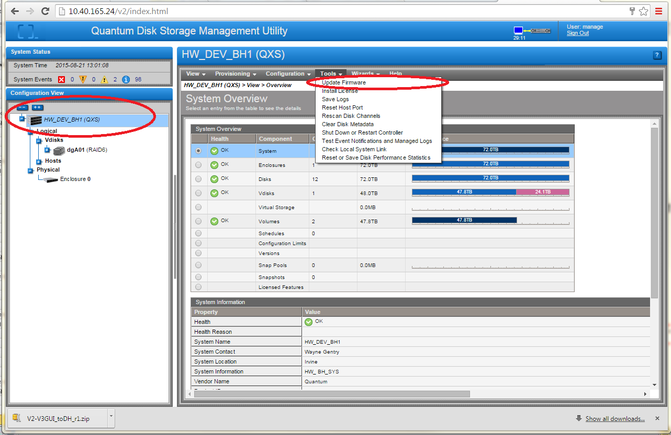
Firmware Update Steps WBI Walk-through
Select the device in the left hand Configuration View window of the WBI
Select Tools -> Update firmware

Slide 25
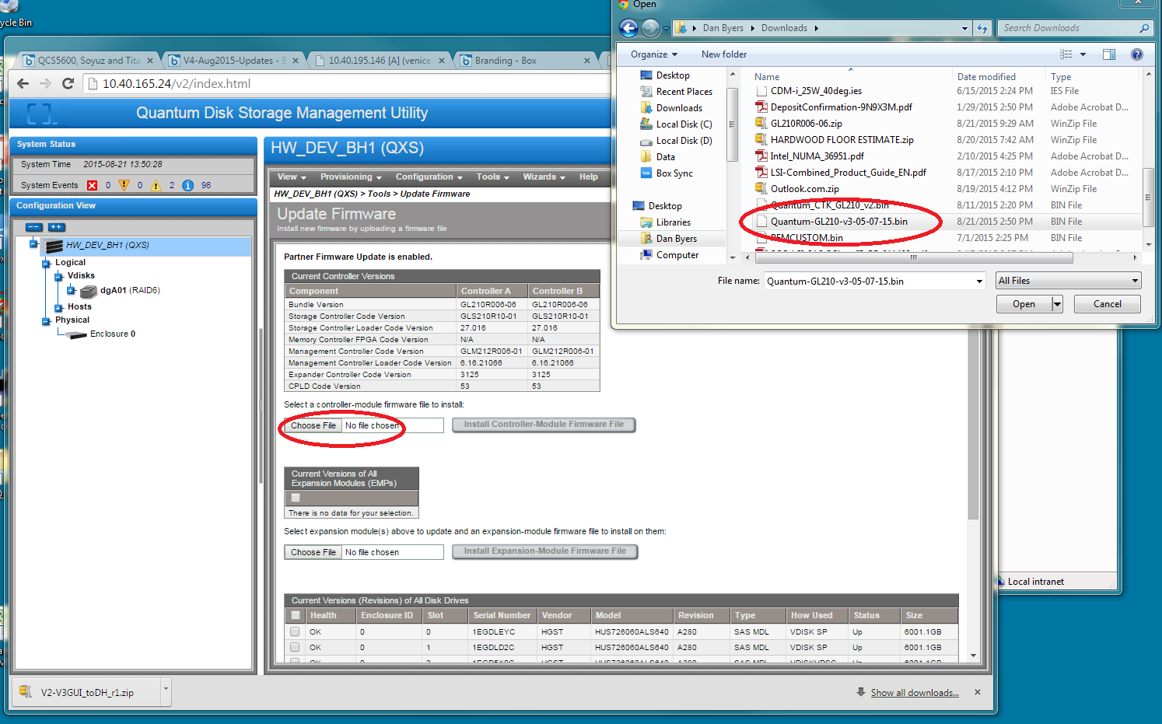
Firmware Update Steps Walk-through
The Update Firmware screen is now shown.
Select Choose File and navigate to the Branding File
Select the branding file

Slide 26
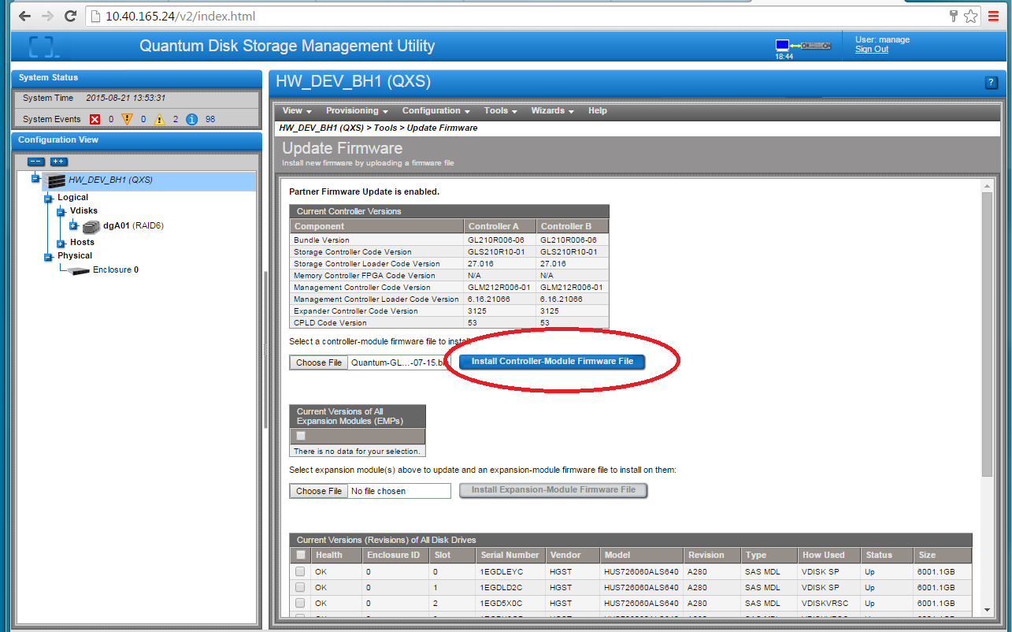
Firmware Update Steps Walk-through
Select Install Controller-Module Firmware File

Slide 27
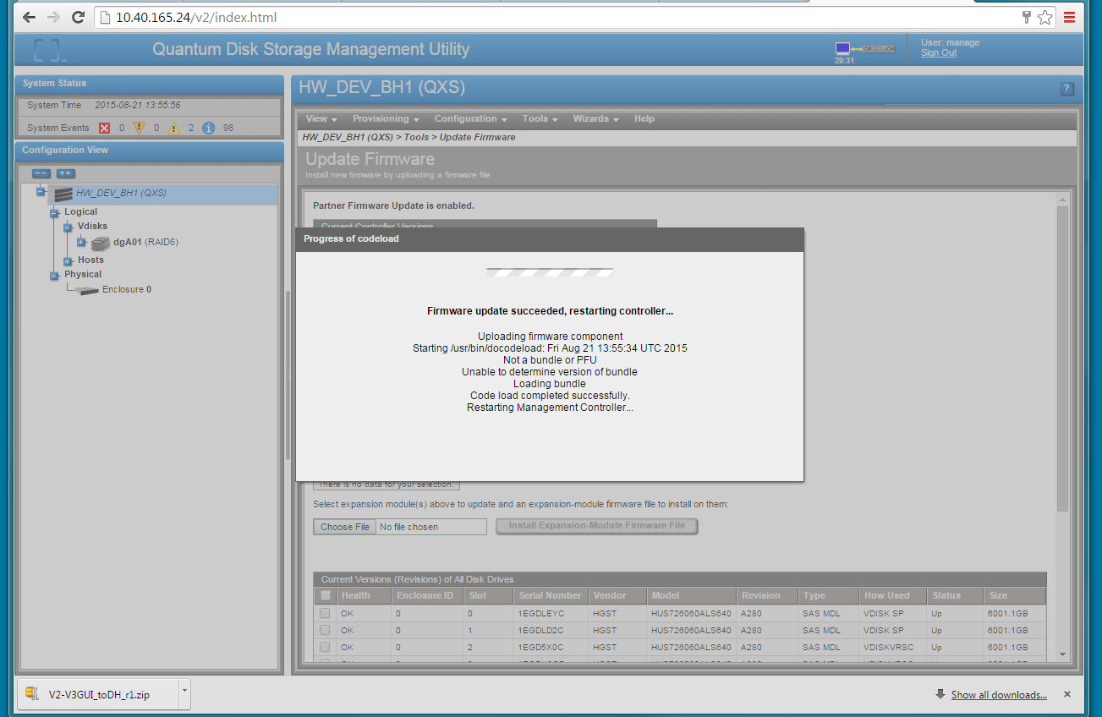
Firmware Update Steps Walk-through
Branding file will upload and Management Controller will be restarted
When the MC restarts you will need to log in again
Repeat for firmware load

Slide 28
GL210 Key Differences: Quantum OEM vs. Dot Hill Branded
Populations
  QXS-1200/2400/5600
  Quantum-branded QXS-3/4/6
  Dot Hill-branded QXS-3/4/6
  Dot Hill-branded non-QXS
Same FW image
  Starting at GL210, same firmware image used across all populations
  BUT as already mentioned, update process is different, obtain firmware from correct source and follow release notes!!!!
    Quantum OEM code posted on CSWeb and Quantum.com
    Dot Hill Branded code posted on Dot Hill’s customer portal https://crc.dothill.com/portal
Quantum-branded unique functionality:
  Quantum OUID, inquiry string, and branding only on Quantum-branded models
  One Button Configuration profiles only manifest in Quantum-branded models
  V3 GUI link
  Hot Spare Configuration
  Specific feature differences

Slide 29
Quantum-Branded Functionality: OUIDs and Inquiry Strings
Quantum-branded versus Dot Hill-branded chassis, OUID is different
  Chassis CRUs are not interchangeable, use proper chassis CRU for OUID
Branding file in controller uses OUID to determine what inquiry string to present
  Controllers CRU are not interchangeable, use correct controller CRU for OUID
Inquiry string differences
  QXS-1200/2400/5600 StorNext QXS
  Quantum-branded QXS-3/4/6 QXS
  Dot Hill-branded QXS-3/4/6 DHxxxx (where xxxx is the Dot Hill model number
  Dot Hill-branded non-QXS Same as Dot Hill-branded QXS-3/4/6

Slide 30
Quantum-Branded Functionality: Other Key Differences
One-button configuration only manifests in Quantum-branded models
Link to V3 GUI is hidden on the V2 GUI for an update customer in Quantum-branded models
No Global Hot Spare configured in Quantum-branded models
  There are typically no spare drives in current QXS deployments for StorNext to designate

Slide 31
Quantum-Branded Functionality: Other Key Differences
Key firmware behavioral differences in Quantum-branded versus Dot Hill-branded chassis, triggered by OUID
Item | UI Settable | Dot Hill-Branded | Quantum-branded
Slot Affinity | Yes | Enabled | Disabled
Burn-to-active | No | Enables | Enabled
Atomic Writes | Yes | Disabled | Disabled
Background vDisk scrub | Yes | Disabled | Enabled
Parity Auto-fix on Scrub | Yes | Enabled | Enabled
DHCP | Yes | Default off | Default off
Heroic Recovery | No | Enabled | Enabled
Recovery Time Limit | No | Enabled | Enabled
In-band CAPI | Yes | Enabled | Enabled
In-band SES | Yes | Enabled | Enabled
Auto Write-through on surviving controller | Yes | Disabled | Disabled
Write Drive Historical Performance | No | Enabled | Disabled
Slot Affinity | Yes | Enabled | Disabled

Slide 32
Known field issues addressed in GL210
Disabled SSL 3.0 to mitigate vulnerability CVE-2014-3566.
Increased the size of maximum supported paged storage pools to 300TiB per pool and 600TiB per system. Once storage pools are resized to be larger than the previous limits, downgrading to a previous release requires direct guidance by customer support personnel.
  This applies to Virtual Storage Pools that comes later in QXS 3/4/6
Review Release Notes because there are a lot more bug fixes

Slide 33
Training and Documentation
Joe LaRoue and Alex Duncan

Slide 34
DOCUMENTATION
Updates: new DOT HILL information per GL210 FW & SME inputs
Updated One Button Config (OBC): applicable docs (2 new profiles)
Profile | Vdisk | Chunk Size | Available For QXS-5600 | Available For QXS-1200 | Available For QXS-2400
StorNext Metadata 1+1 | RAID 1 | N/A | Yes | Yes | Yes
StorNext Data 10+2 | RAID 6 | 256k | Yes | Yes | Yes
StorNext Data 12+2 | RAID 6 | 256k | Yes | No | Yes
StorNext Data 5+2 | RAID 6 | 256k | Yes | Yes | Yes
StorNext Data 8+2 | RAID 6 | 128k | Yes | Yes | Yes
StorNext MultiVolume 10+2 | RAID 6 | 256k | Yes | Yes | Yes
StorNext MultiVolume 12+2 | RAID 6 | 128k | Yes | No | Yes
StorNext Archive MultiVolume 10+2 | RAID 6 | 128k | Yes | Yes | Yes

Slide 35
DOCUMENTATION
Docs updated in GL210 included:
Additional docs had slight tweaks to title and doc numbers
(per core team input)
Doc Set 1 | Doc Set 2
QXS GL210R006 Release Notes | QXS Disk Management Utility User Guide V3
QX and QXS Getting Started Guide | QX and QXS CRU Installation and Replacement Guide
QX and QXS Setup Guide | QX and QXS Event Description Reference Guide
QX and QXS Disk Management Utility User Guide V2 | QX and QXS CLI Reference Guide

Slide 36
TRAINING
QXS GL210 Service Update (2-4568c Online Self-Paced)
Covers the following documents:
  QXS Disk Management Utility User Guide V3
  QXS GL210R006 Release Notes
The course will:
  Highlight the new features in GL210, including:
    V3 Web-Based Interface (WBI)
    Virtual storage
    Automated tiered storage
    Thin provisioning
  Provide a visual guide to the WBI.

Slide 37
Beachhead & G220 Updates
Docs and training will be updated as required.
GL210 docs are currently being converted to Flare (new documentation authoring tool).
  Will use new QXS-3/4/6 branding
  Prioritizing content for Beachhead
  Content will be reused as needed
  Update once for all uses in all docs
Converted documentation will be updated for G220 as needed.
Schedule for rebranding and G220 updates TBD.

Slide 38
Service
Jim Hibbard

Slide 39
QXS (OEM) vs. Dot Hill Branded Service Model
We are selling Quantum Service with Dot Hill Branded disk as of July 15, 2015
  Pay close attention to the “Coverage Field” of the SR to determine who Supports the disk
Quantum supports all QXS models
  Product descriptions in SR starts with “QXS…”
Support for Dot Hill Branded Disk is a mixed bag
  Product description in SR starts with “Dot Hill…”
  If serial number is supported by Dot Hill then Coverage Field in SR = “Vendor Supported”
    Refer to details in Service Plan
    Warm hand-off to Dot Hill Support
  If serial number is supported by Quantum then Coverage Field in SR = Quantum standard Service offerings
QXS1200/2400/5600 (OEM) Service Offerings
  Standard 3-year NBD Warranty
  Bronze uplift and renewal (5x9xNBD)
  Next Business Day Gold uplift and renewal (7x24 xNBD)
  Gold uplift and renewal (7x24x4hrs.)
Dot Hill Branded Service Offerings
  Dot Hill Supported: “Vendor Supported” coverage field in SR
  Dot Hill Warranty: Blank coverage field
  Quantum Warranty = 3-year Bronze
  Quantum Support: Gold/NBD Gold/Bronze
Three Service Plans released
  Quantum QXS 1200/2400/5600 (PN 0-15019-01)
  Dot Hill Reseller with Quantum Support (PN 0-15985-01)
  Dot Hill Reseller with Dot Hill Support (PN 0-15813-01)

Slide 40
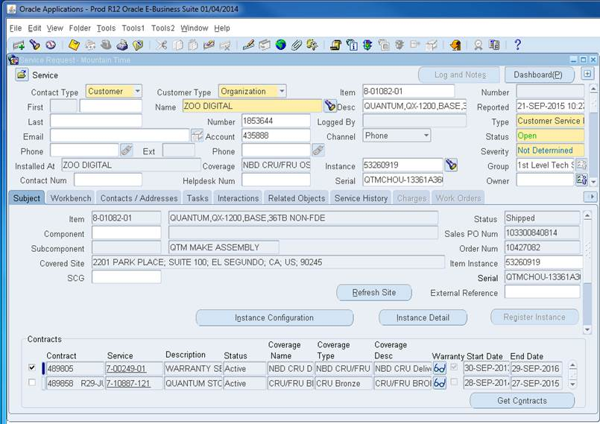
SR Example: Quantum OEM w/Quantum Support

Slide 41
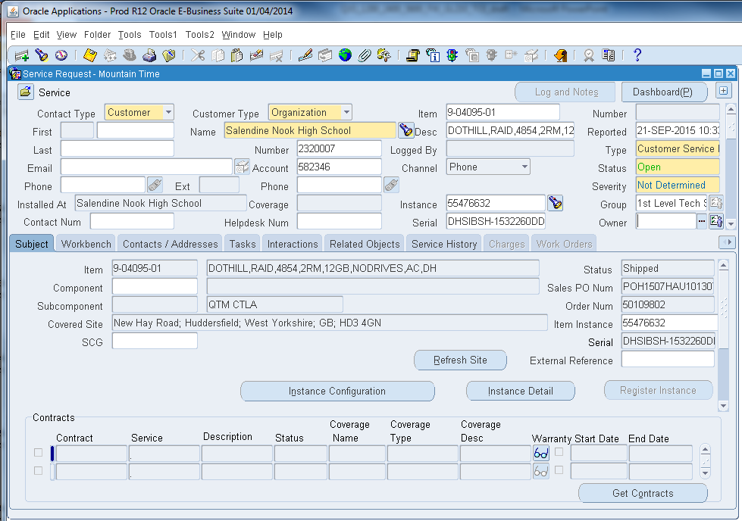
SR Example: Dot Hill Branded w/Dot Hill Warranty

Slide 42
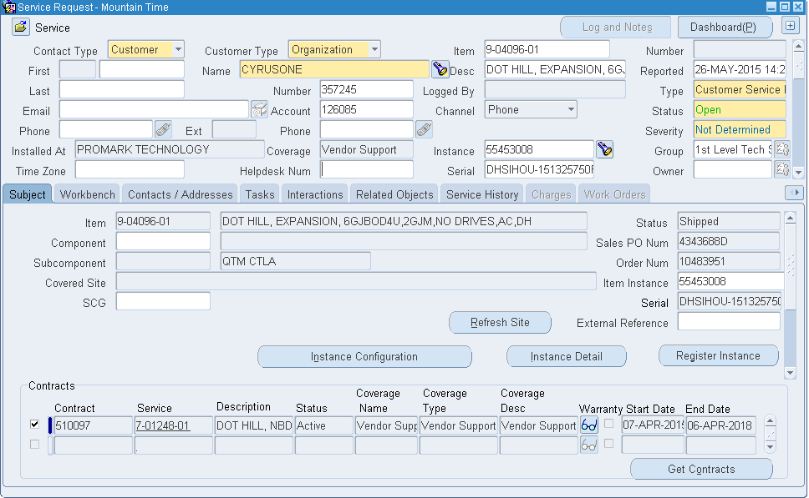
SR Example: Dot Hill Branded w/Dot Hill Support

Slide 43
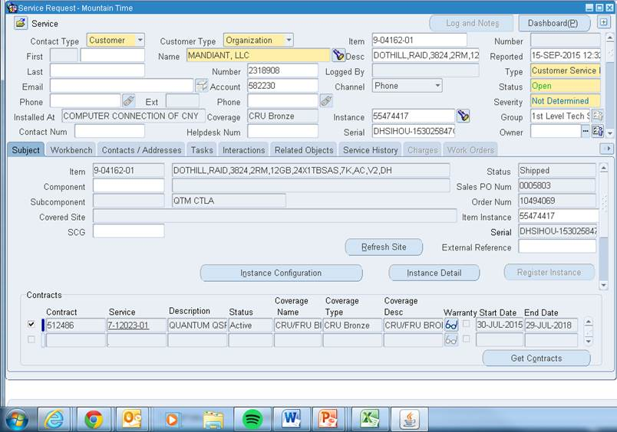
SR Example: Dot Hill Branded w/Quantum Warranty

Slide 44
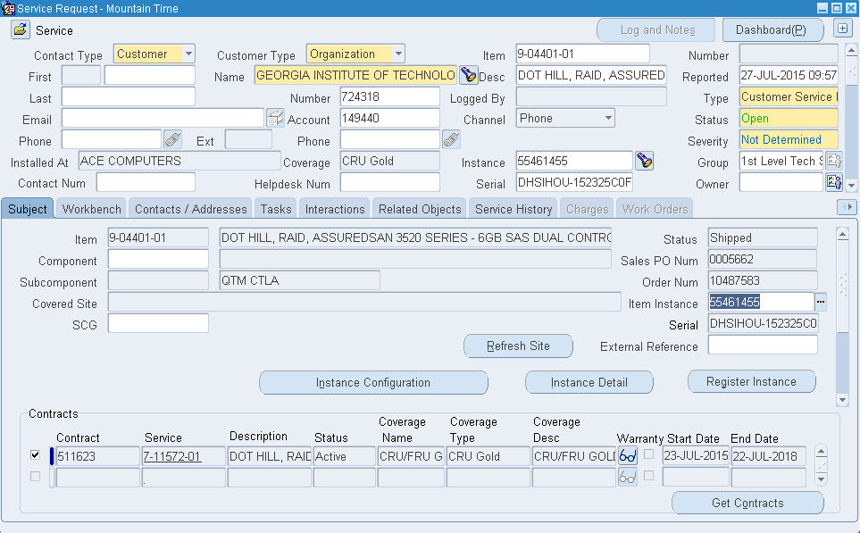
SR Example: Dot Hill Branded w/Quantum Gold Support

Slide 45
FRU/CRU Lists
All field replaceable components for Quantum QXS (OEM) and Dot Hill Branded disk are CRUs.
Quantum (QXS) uses traditional FRU/CRU list that is released and posted on CSWeb (PN 6-67820-01)
For Dot Hill Branded product a new FRU/CRU list is being released.
  CRU components are listed by Top Level Assembly (TLA)
  This same TLA populates in SR from serial number
  Should get released and posted to CSWeb this week
  See example screenshots on following slides

Slide 46
Dot Hill Branded SR w/Quantum Service

Slide 47
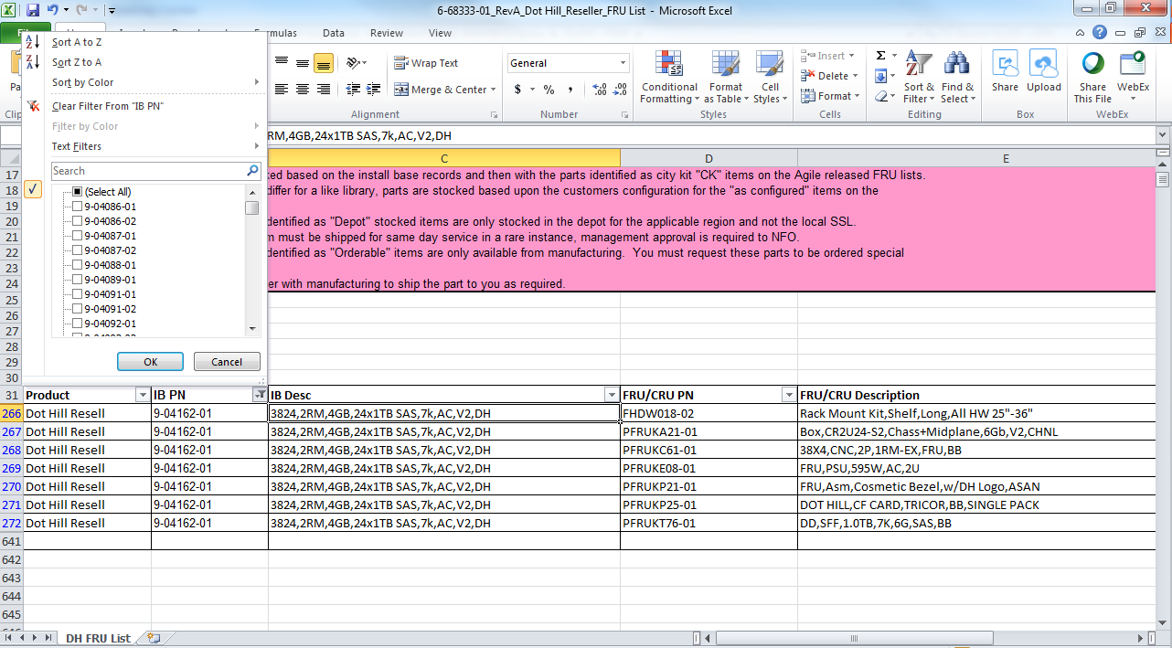
Dot Hill Branded FRU/CRU List

Slide 48
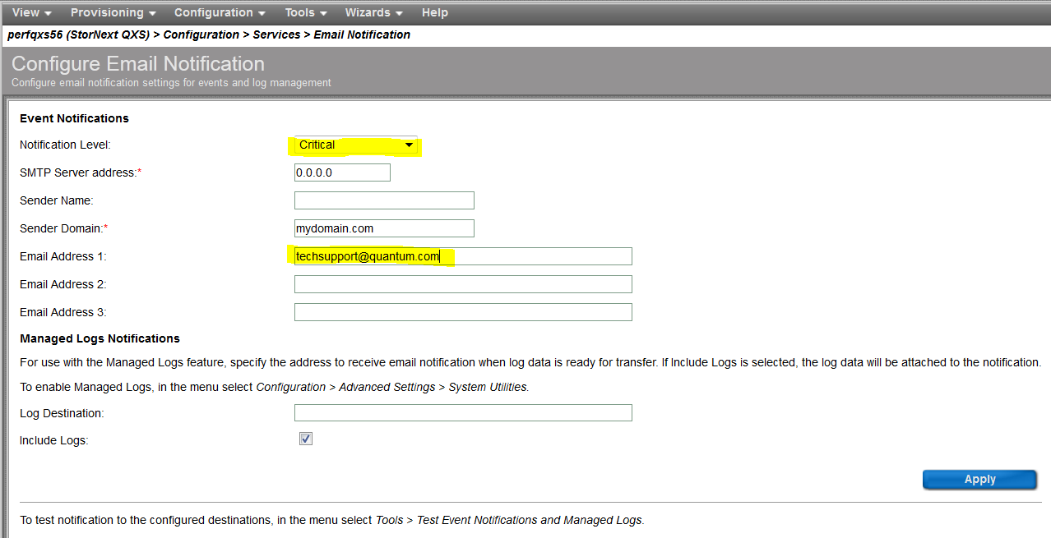
Email Alerts
Recommendations for manual setup
  Notification Level will be set to Critical
  Email Address 1 will be set to techsupport@quantum.com
  Plan for automatic setup in G220
Actual Alert notification has no SN listed – Plan to fix in G220
Refer to V2/V3 Disk Management Utility User Guide for setup details

Slide 49
THANK YOU
For meeting with Quantum, the LARGEST Data Protection
and Big Data management specialist in the world.
© 2013 Quantum Corporation. Company Confidential. Forward-looking information is based upon multiple assumptions and uncertainties,
does not necessarily represent the company’s outlook and is for planning purposes only.

