Slide 1
QX-1200/2400
(Denali, Q-Series Disk)
TOI for Global Service
April 30, 2013
Quantum Confidential / Internal Use Only

Slide 2


Slide 3
Agenda
Marketing Overview – Nick Elvester
Engineering – Charlie Kunkel (Dot Hill), Jeff Cheeney (Quantum)
Known Issues – Charlie Kunkel (Dot Hill), Jeff Cheeney (Quantum)
Documentation and Training– Dave Chapman
Service Strategy – Jim Hibbard
Note: Ask questions as we go. Q&A also at the end.

Slide 4
Marketing Overview
Presented By: Nick Elvester

Slide 5
















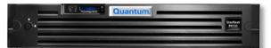

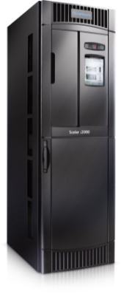
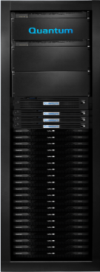





StorNext QX Storage: Part of the Big Data Solution
Good for Customers
Completes the solution from a single vendor
Predictable performance and behavior
Assurance of solution compatibility
Good for Quantum
Easier to support: we’ve tested the entire solution
We gain ownership for a bigger part of the solution
Increases visibility as Big Data experts
Remember
Always sold with StorNext (or Xsan)
Usually sold with an Metadata Appliance and/or tape
Not sold for use cases outside of StorNext (VMware, etc.)
CIFS & NFS
StorNext SAN Clients
GbE
StorNext DLC
LAN
SAN
(FC or iSCSI)
DLC
Gateway
GbE
Group Logic LAN Client for Mac
StorNext
Metadata
Controller

Slide 6
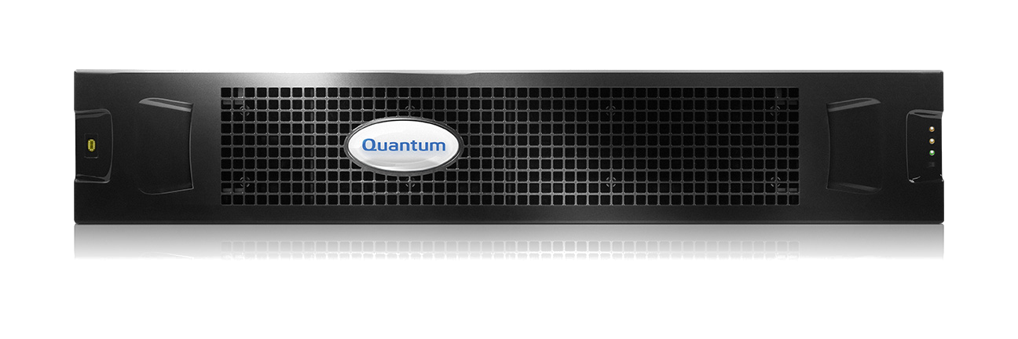
StorNext QX Storage
Originally sold as Denali and New Denali FQ3 – FQ4
Easy, Flexible, Reliable
Great fit for Xsan customers
High Performance
  Up to 4.5GB/s sequential read
  Up to 2.5GB/s sequential write
Affordable price/performance ratio

Slide 7
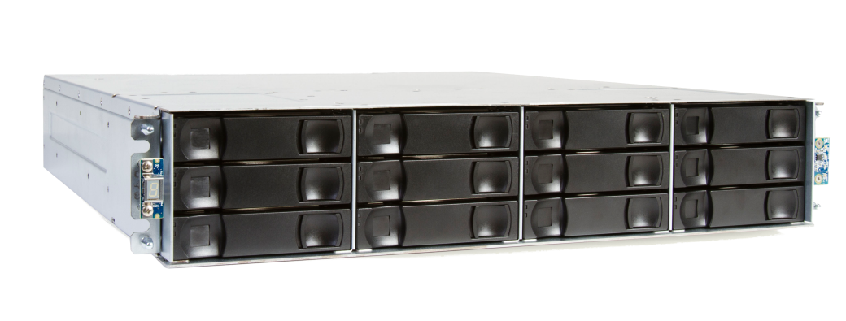
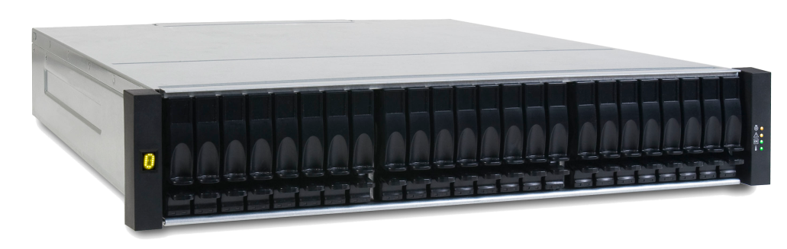
Product Models
StorNext QX-1200
12 drive 2U chassis
Base system and expansion unit
24TB, 36TB, and 48TB capacity
2TB, 3TB, and 4TB drives
12x 7.2K RPM 3.5” NL-SAS drives
StorNext QX-2400
24 drive 2U chassis
Base system and expansion unit
14.4TB and 21.6TB capacity
600GB and 900GB drives
24x 10K RPM 2.5” SAS drives
QX Base, expansion, capacity, and models can be mixed in a single configuration

Slide 8
HW/SW Engineering
Presented By: Charlie Kunkel (Dot Hill) & Jeff Cheeney (Quantum)

Slide 9
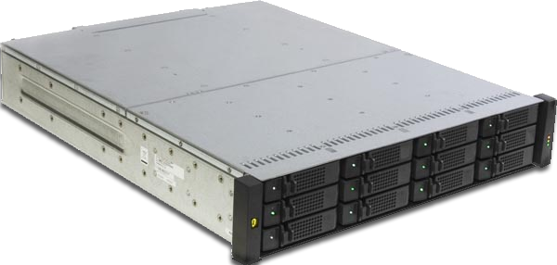
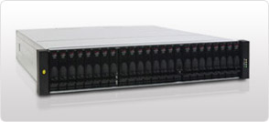
Array Overview
Single and Dual controller hardware configurations
2U, 12/24 drive efficient packaging
Fully redundant
Hot-swap components
DAS and SAN connectivity
Windows, Linux and VMware support
8 host interface ports, 4 per controller
FC – 8 Gbit/s Fabric protocol support (PTP)
Support from 2 to 144 disks, current industry offerings
Support for upto 192 SAS or Nearline SAS Drives
Freely mix drives in any quantities, any locations
RAID 0, 1, 3, 5, 6,10, 50 data protection
Local and Global hot spare support
Embedded Management software is OS platform independent
3.5” Nearline SAS 7.2K RPM - 2, 3, 4 TB
2.5” SAS 10K and 15K RPM - 600, 900GB
Battery-free Cache backup
2U12 Chassis
2U24 Chassis
9

Slide 10
Dot Hill Platform Architecture
Cache Memory
DDR
Management
Controller
Super Caps
And
NV Memory
DDR
RAID
Companion Processor
CPU Complex
PCIe
PCIe to other controller
PCI
PCI
Front-end I/O
FC, iSCSI, SAS, etc.
Back-end I/O
SAS, FC
PCI
PCI

Slide 11
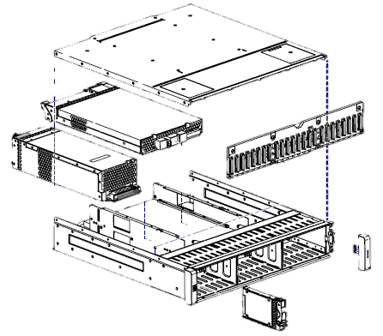


Mechanical Layout – 2U24
RIOM or JIOM
Midplane
Power Supply
Ear
Enclosure
2.5” Drive
11

Slide 12


Chassis Tour
12

Slide 13
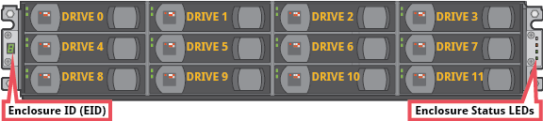
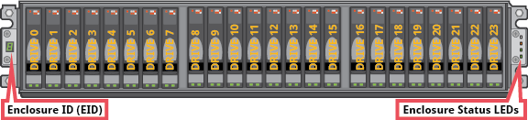
Chassis Tour - Disks
Disk Slot Order
13

Slide 14
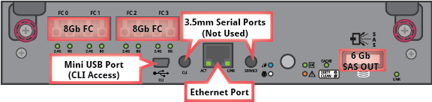
Controller Module
14

Slide 15
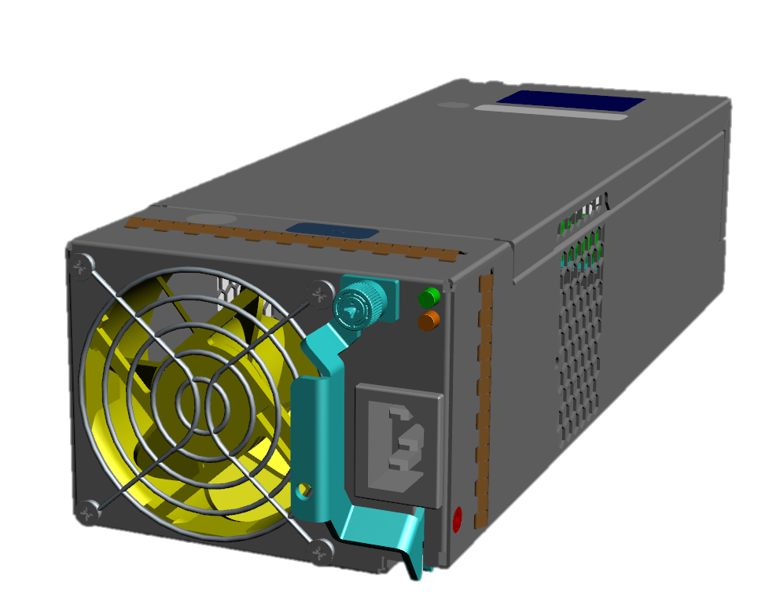
Power Supply Module or Unit (PSU)
SN & PN
ESD Shield
LED - OK
Fan Guard
Thumb Screw
?
LED – Fault/Warning
Fan
Power Cable Connector
Latch
15

Slide 16
SimulCache Data Write Sequence
Controller A
Front-end I/O
FC, iSCSI, SAS
RAID Companion Processor
Memory
DDR
Cache & Control
Ack
Write
Ack
Ack
Write
PCIe
Write
DDR
SimulCache
sends data to both controllers in a parallel
transaction
PCIe link to other controller
Host initiates write command
Controller acknowledges successful write
Front-end I/O
FC, iSCSI, SAS
RAID Companion Processor
Memory
DDR
Cache & Control
PCIe
DDR
Controller B
16

Slide 17
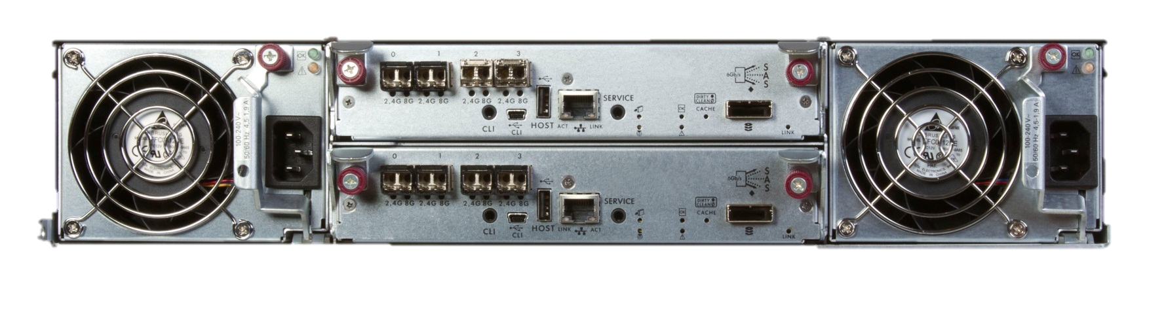

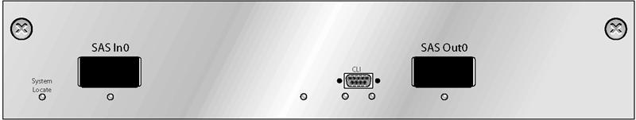
Cabling Expansion Trays
Controller A
SAS port “Out”
Egress
Expansion A
SAS port ‘Out’
Ingress
Controller B
SAS port “Out”
Egress
Expansion B
SAS port “Out”
Egress
17

Slide 18
Redundant Enclosure Cabling
Improved system redundancy, Improved data availability
Reverse Cabling
Down “A” side
Up “B” side
If middle JBOD fails, all data on non-failing JBODs can still be accessed
18

Slide 19
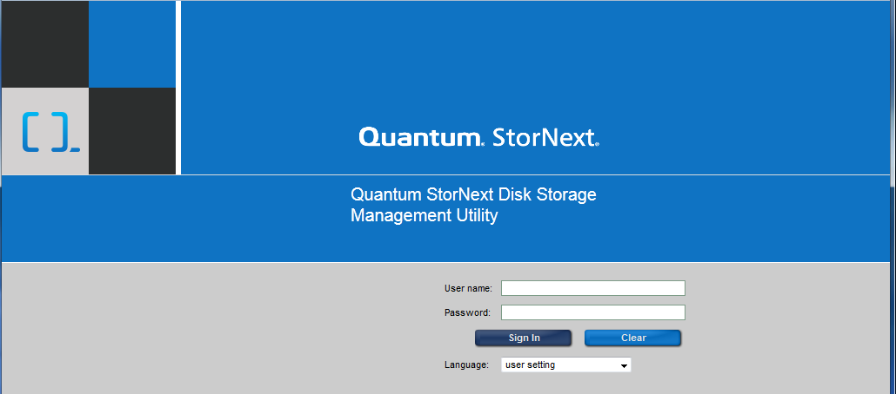
Management Login
User name: manage
Password: !manage
In a web browser, type a controller module IP address in the address or location field and press Enter
Type the User name (Default = manage)
Type the Password (Default = !manage)
Select Sign In
19

Slide 20
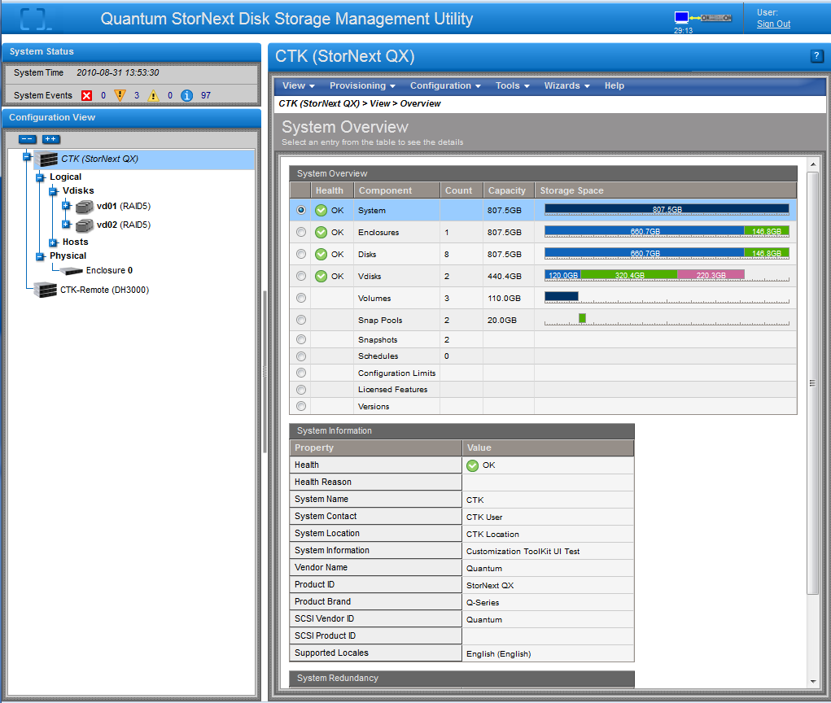
Storage Management Introduction
Overall system events
Enclosures
Navigation and configuration options
RAID sets
Volumes within each vdisk
Physical hosts seen by the host ports
Physical enclosures attached
20

Slide 21
Bug Fixes/Known Issues
Presented By: Charlie Kunkel (Dot Hill) & Jeff Cheeney (Quantum)

Slide 22
Known Issues
Maximum number of FibreChannel initiators – 64 per port
  8 port x 64 initators = 512 initiators per system
Outstanding requests
  SMTP credentials for

Slide 23
Documentation and Training
Presented By: Dave Chapman

Slide 24
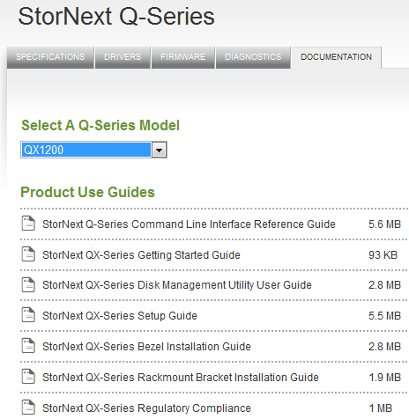
Documentation
CSWeb and Quantum.com
  StorNext QX-Series Getting Started Guide
  StorNext QX-Series Setup Guide
  StorNext QX-Series Rackmount Bracket Installation Guide
  StorNext QX-Series Bezel Installation Guide
  StorNext QX-Series Service Guide
  StorNext QX-Series Disk Management Utility User Guide
  StorNext Q-Series Command Line Interface Reference Guide

Slide 25
Training
Dot Hill led Training recordings are posted on StorageCare Learning (with assessment and participation tracking) and CSWeb (NO assessment/tracking).
  StorNext QX Storage: Product Intro
  StorNext QX Storage: Architecture
  StorNext QX Storage: Installation
  StorNext QX Storage: Intro to CLI
  StorNext QX Storage: CLI Demo
  StorNext QX Storage: Firmware Updates
  StorNext QX Storage: Configuring the System with the SMU
  StorNext QX Storage: More About Spares
  StorNext QX Storage: Disk Failures During VDisk Initialization
  StorNext QX Storage: Working with Logs
  Storage QX Storage: Identifying Issues in the SMU
Quantum branded training to come at a later date

Slide 26
Service Strategy
Presented By: Jim Hibbard

Slide 27
QX-1200/2400 Service Model Summary
Identical Service model to NetApp based Q-Series (intentional)
Case Management: Global Call Handling (GCH), CDS
Technical Support: Software Product Support (SPS)
Field Support: Quantum Field Engineers (QFE) as Primary with ASSPs/TPMs as Secondary
Escalation Support: Dot Hill Solutions, StorNext Sustaining (SUS), and Quantum HW Engineering
Replacement Part Fulfillment: FRU/CRUs stocked in Quantum Field Inventory.
Service Offerings
  Standard Warranty: Three-year next business day parts replacement. Replacement item shipment targeted for next business day. Customer will perform the replacement and return of the failed item. Parts replacement service available 5x9 via telephone or email. Includes 30 days of 5x9 telephone and email software support. (This warranty is designed to match competition with a longer warranty term and to take advantage of the trend toward Customer Replaceable Units (CRU))
  Uplifts and Extensions: Gold, NBD Gold, Bronze, Renewals and Extensions
  Installation and Integrations Services: Required
Service Plan: 0-15019-01

Slide 28
QX-1200/2400 Service Model Summary (cont.)
Oracle IB Records - In the Oracle Install base (IB), each StorNext QX-1200/2400 Storage Systems will be linked as a child to a specific StorNext product (SW or M330/M440/M660)
Opening an SR - SRs will be logged under that main StorNext (SW or M330/M440/M660) serial number.
  We need to look for a better process because this is causing confusion
  Logistics has difficulty with Service ordering parts against t a SW SR

Slide 29
Dot Hill Solutions Introduction (DHS)
DHS is based in Longmont, CO
Support contract with DHS – 7x24x365
Dot Hill Technical Support Locations:
  Frontline Support (Level 1) – Chennai, India
  Engineering Support – Hyderabad, India
  Systems Engineering Support – US, EMEA, AP, Japan
  L3 Technical Support – Longmont, CO
Dot Hill Solutions Technical Support may be leveraged for technical assistance
  DHS prefers that cases are opened online, but will also accept phone calls.
  SANsolve is Dot Hill’s online case management and knowledge base system.
    Registration and access details are located in QX Series Service Plan
  Dot Hill Solutions Level 1 support can be contacted directly via the phone
    Contact details are located in the QX Series Service Plan
    Dot Hill Solutions Escalations
  DHS Level 3 Technical Support is responsible for escalations. If you feel your needs are not being addressed by the L1 team, you can ask the case be escalated to L3, or contact escalation management directly.
    Escalation manager contact details are located in the QX Series Plan

Slide 30
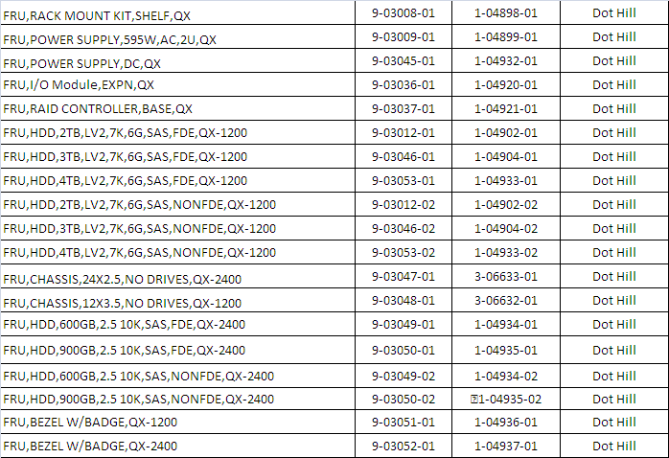
FRU/CRU Model
All Field Replaceable Components are CRUs

Slide 31
Q&A

