Slide 1
Q-Cloud Protect for AWS
TOI for Global Service
January 2016

Slide 2

Agenda
Prerequisite
Attendees are expected to review the Q-Cloud Protect Launch and Recovery Guide in advance of this live presentation. Link
Product Overview
  Market and sales strategy
  Customer use cases
Support Strategy and Resources
  Amazon vs. Quantum responsibility
  Documentation and Training resources
Core Concepts
  Launch and Deploy Demonstration
Support Scenarios
Service Model
Links are only active in
Slide Show

Slide 3
Product Overview
Pat Dolan

Slide 4


Introducing Q-Cloud Protect for Amazon Web Services
Q-Cloud Protect for AWS is a virtual deduplication appliance,
Available in the Amazon Marketplace,
That runs on Amazon EC2, and uses Amazon S3 storage.
Put simply:
Scales from 1 to 90 TB (useable)
DXi software refactored for AWS:
Branded “Q-Cloud Protect”
Amazon Machine Image
Security
Blockpool S3 Object Storage

Slide 5

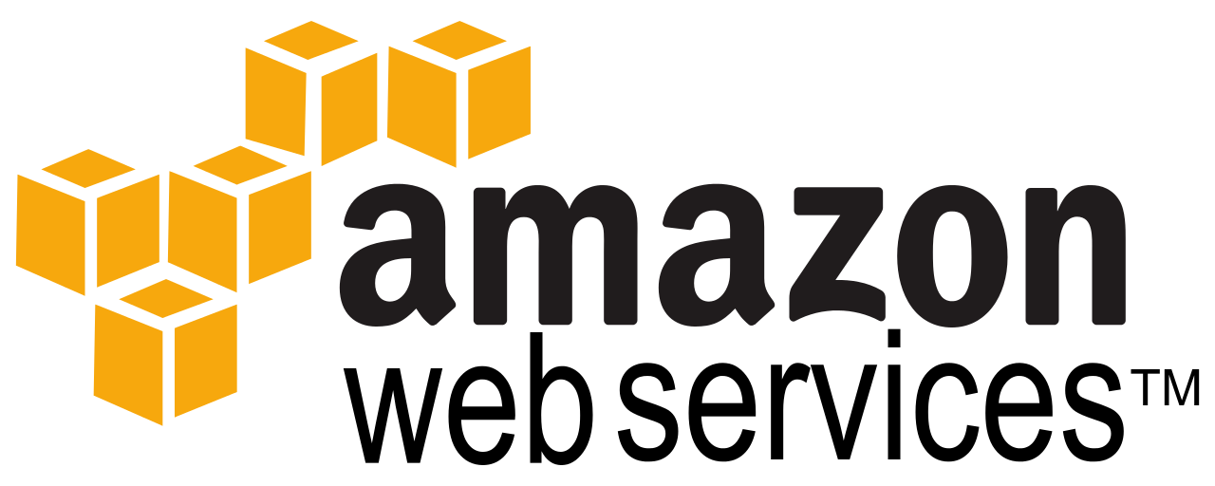

Benefits of Q-Cloud Protect for AWS
For companies using tape for offsite storage
  Eliminate tape
  Eliminate Iron Mountain costs
  Eliminate capex associated with DR
  Improve restore times
  Answer the “cloud mandate” – offsite DR is a great place to start
For companies considering two deduplication appliances
  Cut initial capex purchase by 50%, turn to opex
  Eliminate co-lo / DR site power, cooling, mgmt costs
  Answer the “cloud mandate” – start with DR
Q-Cloud Protect for Amazon

Slide 6

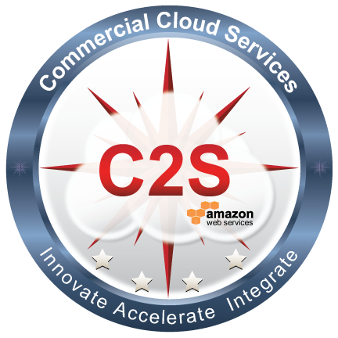

About Amazon Web Services (AWS)
Q-Cloud Protect is planned for three AWS Cloud Markets:
  AWS Marketplace (Public)
  AWS GovCloud Region
  Federal C2S Cloud (Private)

Slide 7
About Amazon Web Services (AWS)
Q-Cloud Protect is planned for three AWS Cloud Markets:
  AWS Marketplace (Public)
    Metered - no Quantum license - Amazon collects hourly* software fees
  AWS GovCloud Region
  Federal C2S Cloud (Private)
*Customer has an option to pre-pay annually to receive a discount

Slide 8
About Amazon Web Services (AWS)
Q-Cloud Protect is planned for three AWS Cloud Markets:
  AWS Marketplace (Public)
    Metered - no Quantum license - Amazon collects hourly* software fees
  AWS GovCloud Region
    BYOL – Quantum licensed via Mosaic server - V-Series Model
  Federal C2S Cloud (Private)
    BYOL – Quantum licensed via Mosaic server - V-Series Model (Dark Site)
*Customer has an option to pre-pay annually to receive a discount

Slide 9

Q-Cloud Protect Product Offerings
Offerings
  AWS Marketplace (Public)
    Small: Supports 1-20TB ($0.50/hour)
    Large: Support 1-90TB ($1.00/hour)
    Support: Included
  AWS GovCloud Region
    One product: 1-90TB ($1,000/TB)
    Support: Silver $150/TB, Gold $200/TB
  Federal C2S Cloud (Private)
    One product: 1-90TB ($1,000/TB)
    Support: Silver $150/TB, Gold $200/TB
Support Details
  QCP launched through AWS Marketplace includes service.
  GovCloud and C2S we’ll offer Silver & Gold uplifts
Consulting Services
  We are offering AWS implementation assistance, targeting customers without AWS experience
  Specifically: Q-Cloud Protect for AWS, Implementation

Slide 10
Customer Use Cases
Three basic customer use cases
  On-premise DXI Replication to Q-Cloud Protect for AWS
  On-premise DXI OST Opdup to Q-Cloud Protect for AWS
  Enabling OST with accent direct to AWS

Slide 11
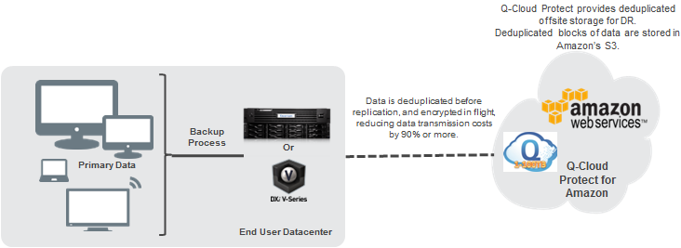
Primary Use Case
1. On-premise DXI Replication to Q-Cloud Protect for AWS

Slide 12
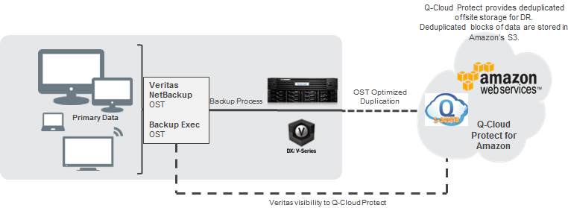
Secondary Use Case
2. On-premise DXI OST Opdup to Q-Cloud Protect for AWS

Slide 13
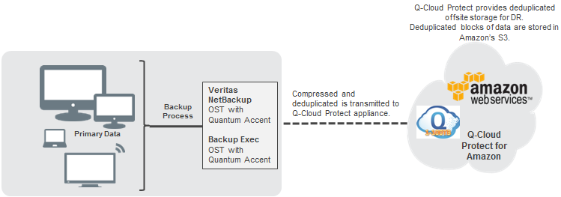
Tertiary Use Case
3. Enabling OST with accent direct to AWS
OpDup data is moved dedupped/compressed/encrypted

Slide 14
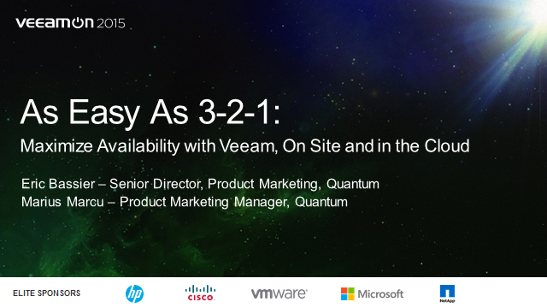
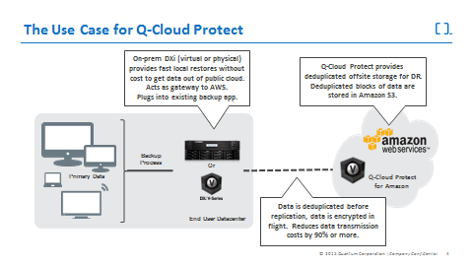
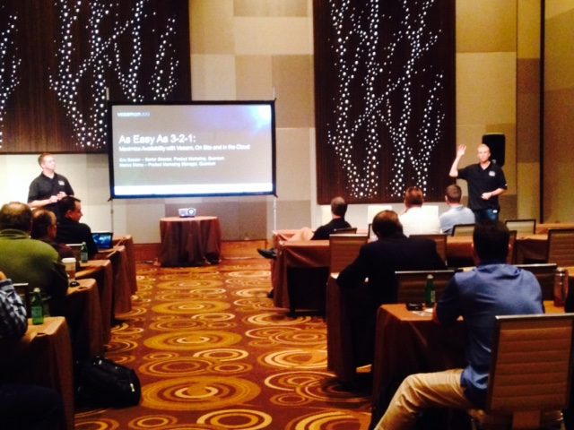
Launch Milestones and Timeline
December Sales trainings and internal announcements
December 23, 2015 initial release
January 11th press release
GovCloud region release: CQ1’16
C2S cloud release: CQ1’16
Each release will be offered as an upgrade with code continuing to mature

Slide 15
Support Strategy & Resources
Bill Weakley & Tabar Smith

Slide 16
Quantum vs. Amazon Responsibility
Quantum is responsible for supporting the Q-Cloud Protect (QCP) software running in AWS
Amazon is responsible for supporting all Amazon Infrastructure
Message to Customers (On the Q-Cloud Protect AWS Marketplace webpage):
  Support is included with Q-Cloud Protect purchased through the Amazon Marketplace. Please register your product at http://www.quantum.com/startup.
  Product serial number registration is required to activate support from Quantum. Your serial number is established during installation. Please register your product at www.quantum.com/startup.
  Telephone support will be provided 5x9 local business hours. We’ll also match the contract with the on-premise DXi.
  Link to Q-Cloud Protect AWS Marketplace Webpage
AWS Support
  AWS Support is a one-on-one, fast-response support channel that is staffed 24x7x365 with experienced and technical support engineers. The service helps customers of all sizes and technical abilities to successfully utilize the products and features provided by Amazon Web Services.
  All AWS Support tiers offer an unlimited number of support cases with pay-by-the-month pricing and no long-term contracts. The four tiers provide developers and businesses the flexibility to choose the support tiers that meet their specific needs.
  Link to AWS Support Webpage

Slide 17
Quantum vs. Amazon Responsibility
Quantum Support Responsibility
  Be familiar with the Amazon Infrastructure topics and terminology
  Know where to “draw the line” for what we support vs. what Amazon supports
  Know when to recommend Consulting Services Offering
  Quantum should not contact Amazon support on behalf of the customer
Topic | QTM Service Responsibility | Handling | QCP Launch & Recovery Guide
Customer prerequisites and Amazon Infrastructure | Familiarity | Hand-off to Amazon or Consulting Services | QCP Launch and Recovery Guide AWS Terms and Concepts
Networking: Data Center to AWS | Familiarity | Hand-off to Amazon or Consulting Services | VPC-Private Network Connections
Launching QCP Software | Familiarity & Ability to support | Hand-off to Amazon or Professional Services or Direct Support | Launch
Deploying QCP Software | Ability to support | Direct Support | Deploy
Connecting via SecureShell | Ability to support | Direct Support | SSH Connection
Storage: S3, EBS Expanding & Snapshots | Ability to support | Direct Support | S3, EBS Volumes, and Snapshots

Slide 18
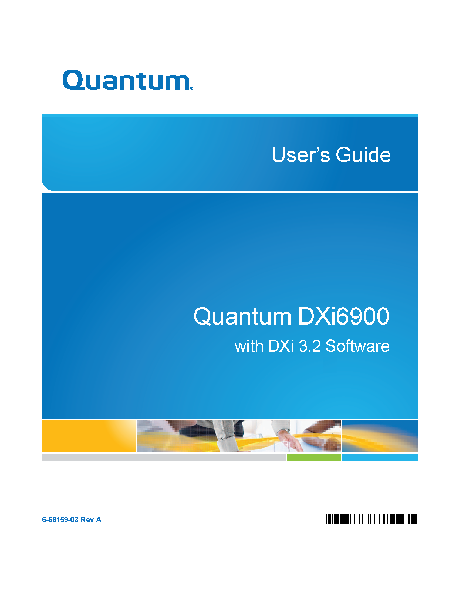
Available Documentation
Technical Publications
  Q-Cloud Protect Launch and Recovery Guide for AWS (6-68366-01)
  Q-Cloud Protect for AWS User’s Guide (6-68365-01)
  Q-Cloud Protect for AWS Release Notes (6-68367-01)
  Advanced Reporting for Q-Cloud Protect User’s Guide (6-68368-01)
  Advanced Reporting for Q-Cloud Protect Service Manual (6-68369-01)
  DXi-Series CLI Guide (6-67081-13)
  Link to Quantum.com Documentation
Sales Engineering materials (located on IQ)
  Quantum.com product webpage
  QCP Datasheet
  QCP Solution Brief
  QCP Marketing Announcement

Slide 19





Available Training
Transfer of Information
  Qwikipedia
Training
  Q-Cloud Protect for AWS At a Glance
  Q-Cloud Protect Service Overview
Consulting Services
  Consulting Services Team provides customer assistance for setup and negotiation of AWS terminology and processes
  Provides phone counseling on Amazon processes and setup along with guidance on becoming proficient in its use for backup
  Price to be included in price book under Consulting Services

Slide 20
Other Resources
General DXI…
  DXi-Series Core Concepts for Service (2-0443 Online Self-paced)
  DXi-Series Linux CLI Basics (2-4453 Online Self-paced)
  DXi Advanced Reporting Service Training (2-2414 Online Self-paced)
Knowledge Base
  Includes support scenarios (details to follow in TOI)
Service Plan (0-16065-01)

Slide 21
Core Concepts
Jim Peters & Aaron Laffin

Slide 22
Q-Cloud Protect Architecture
DXi, for the cloud.
  Embrace AWS resources and APIs.
  Targeted for Replication.
  Ingest with OST Accent (deduplication at the client).
AWS Resources
  EC2 "M" instances, xlarge and 2xlarge.
  S3 objects store Blockpool cluster bodies.
  EBS - Block storage, for root and metadata volumes.
AWS Adaptations
  S3 - Less expensive and more reliable than EBS.
  EBS snapshots - Improve recoverability.
  EBS expansion - Grow over time.

Slide 23
Q-Cloud Protect: EC2
Instance types
  M3 (future: M4)
  xlarge: ~15 GiB RAM and 4 CPU threads
    Up to 90 TB capacity
  2xlarge: ~30 GiB RAM and 8 CPU threads
    Up to 20 TB capacity
Metered cost is tied to instance type
  No easy method to grow from 20 TB to 90 TB.
Licensed system can grow into a larger instances.
  Shutdown instance, change type, start again.
  Cannot shrink.
API credentials: Instance attached IAM Role

Slide 24
Q-Cloud Protect: EC2
EBS
  Reliability similar to a physical drive (less than RAID)
    Adaptation: snapshots
  Root: 320GiB magnetic, fixed size, no encryption
  Metadata: 1 TiB SSD, encryption optional
    StorNext filesystem: contains BPW, Blockpool, and other metadata
    Can be grown through expansion feature.
      Default size will be reduced from 1 TiB to 256 GiB in next release.
EBS Snapshots
  EBS and EBS snapshots are part of EC2.
    Cost is charged as an EC2 line item.
  AWS states that EBS snapshots are stored in S3.
    Snapshot artifacts are not visible in S3.
    Gives snapshots the reliability of S3.

Slide 25
Q-Cloud Protect: S3
Cluster bodies are stored in S3
  Motivated by reliability and cost.
License capacity defined by S3 utilization:
  Size after reduction plus reclaimable space.
  Separate UI presentation of licensed capacity vs metadata
  Metadata to data ratio is not predictable.
    Start small and grow as needed with EBS Expansion feature.
    System can run out of metadata space independently of licensed space.
Snapshots: more than just EBS snapshots
  Blockpool feature to properly maintain S3 objects, index and metadata.
  Ensure proper and timely recovery.

Slide 26
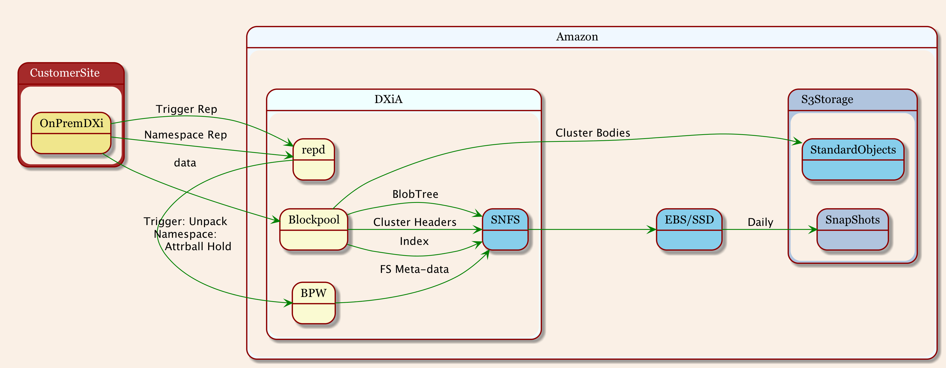
Architecture Diagram

Slide 27
Q-Cloud Protect: Odds 'N Ends
Recommendation: Always stop or reboot QCP instance using QCP UI
  EC2 Dashboard can be used, but does not allow sufficient time to shutdown cleanly.
Passwords
  Initial GUI password is the instance Id.
  All GUI passwords must then be set by GUI Administrator.
  No passwords allowed for shell access.
    AWS Requirement: SSH keys Only
  ServiceLogin account has AWS provided key installed.
    New GUI facility for installing customer provided SSH keys.
GUI has TLS/SSL enabled by default.
No support for non-deduplicated data.

Slide 28
AWS Terms and Concepts
Learn More: AWS Terms and Concepts
Term | Concept
EC2 – Elastic Compute Cloud | Virtual Servers in the Amazon Cloud. An area within AWS from which you can launch and manage Q-Cloud Protect instances.
AMI – Amazon Machine Image | This is the Software that runs in the Amazon cloud. It is a snapshot of a system that users can deploy as a new EC2 instance.
Instance | A unique virtual machine image of an AMI that operates in EC2. The virtual machine image of the Q-Cloud Protect AMI. Q-Cloud Protect runs as an EC2 instance after being launched.
Cloud Appliance | Q-Cloud Protect provides a powerful Web-based user interface that allows you to configure and manage the appliance. This virtual console must be accessed from a workstation that exists within the VPC-network configured for your Q-Cloud Protect appliance.
Regions | Geographic independent areas around the world in which EC2 data centers are located. A region is selected when launching a Q-Cloud Protect instance. We recommend selecting a region that is geographically close in proximity to your source DXi or OST server to reduce network latency.
AWS Marketplace offers two sizes:
  1 to 20TB AMI
  1 to 90TB AMI
GovCloud Region and C2S (Future):
  1 to 90 TB AMI

Slide 29
AWS Terms and Concepts
Learn More: AWS Terms and Concepts
Term | Concept
EBS Volumes | Persistent block-level storage attached to instances. These volumes remain without an instance so that stored data is not lost. The Q-Cloud Protect instance uses two main types of EBS volumes: 1) Root volumes store OS and initial configuration data. 2) Data volumes store metadata. | By using both types of EBS volumes along with S3, all data associated with the Q-Cloud Protect instance and appliance is being protected. To further protect data stored in these volumes, Q-Cloud Protect takes snapshots of each volume, which are also stored in S3.
S3 | Simple Storage Service (S3) is Amazon's cloud storage service. Q-Cloud Protect uses S3 to directly store the user data. It places this data into S3 buckets, which are identified by the serial number assigned to your Q-Cloud Protect appliance.
EBS Snapshots | Images of the volumes attached to EC2 instances. Snapshots are implemented with the reliability of S3, increasing the durability of stored data. Q-Cloud Protect takes advantage of this durability by capturing routine EBS snapshots of your instance's volumes. If you need to restore data on an EBS volume or entire instance — in cases where the data on the volume is corrupted or fails — you can use the volume's snapshots along with the data stored in S3.

Slide 30
AWS Terms and Concepts
Learn More: AWS Terms and Concepts
Term | Concept
VPC – Virtual Private Cloud | An isolated section within the AWS cloud where Q-Cloud Protect instances reside. You can configure your own VPC and its virtual network, including the configuration of the network connection between your Q-Cloud Protect instances and your on-site DXi appliances.
Security Groups | Virtual firewalls that you can create to control traffic to and from your instances.
IAM Roles – Identity and Access Management | They grant permissions to different users or applications within AWS. Use IAM roles with Q-Cloud Protect to grant instances permissions to manage S3 objects and EBS snapshots.
VPC Endpoints | A VPC S3 endpoint enables instances within your VPC to communicate with their S3 buckets over a private connection that does not require an Internet gateway or a VPN connection. All data transferred between your instances and their S3 buckets stays securely within the Amazon network.

Slide 31
Q-Cloud Protect
Demonstration
awsmarketplace
Launch & Deploy
Demo Overview
AWS Web Service Console overview
  Region, EC2, S3, IAM and VPC dashboards
Launch Q-Cloud Protect from AWS Marketplace
  Manual EC2 7-Step Launch Wizard
Q-Cloud Protect Initial Login and Setup
Q-Cloud Protect Home page differences
  Branding, License Capacity, Disk Usage
AWS Infrastructure used by Q-Cloud Protect
  EC2 EBS Volumes and Snapshots
  IAM Role
  S3 Bucket
  VCP (VPN, Route Table, Internet Gateway, DHCP Options Set, EndPoint, Security Group)
ssh login
Jim Peters

Slide 32
Pre-Launch Checklist
Create a AWS Account
  https://aws.amazon.com/getting-started/?nc2=h_l2_cc
Configure a VPC-Private Connection
  Per Q-Cloud Protect Launch and Recovery Guide for AWS section ‘VPC-Private Network Connections’
  Only VPC with VPN is support. Other AWS Network model VPC with EIP is not supported
Create IAM Role
  Per Q-Cloud Protect Launch and Recovery Guide for AWS section ‘Creating IAM Roles’
Determine Storage Needs
  Per Q-Cloud Protect Launch and Recovery Guide for AWS section ‘Calculating Storage Needs’

Slide 33
Pre-Launch Checklist – VPC-VPN
Create a VPC
Configure a Subnet for the VPC
Configure a Routing Table for VPC Subnet
Create VPN S3 EndPoint (recommended)
Create an Internet Gateway
Create a VPN Tunnel
  Uses existing customer gateway device or application to connect to the VPN
Configure Security Group
Configure DHCP Options Set
  Domain Name and DNS Servers IPs

Slide 34
Managing Metadata EBS
Low Space Notification from System
  Low Space indicator Yellow when within 15% of volume size
    RAS ticket every 24-hours
  Low Space indicatory Red when within 5% of volume size
    Ingest and replication stopped
    Expansion required
Expanding EBS Volume
  Procedure in Q-Cloud Protect Launch and Recovery Guide for AWS (6-68366-01)
Recovering from EBS failure (using a Snapshot)
  Procedure in Q-Cloud Protect Launch and Recovery Guide for AWS (6-68366-01)

Slide 35
Other Notable Changes – Home UI
Home page changes
  Hostname
    Default Instance ID
  Serial Number
    Metered - Auto Generated
    Licensed - Product Key
  Licenses Usage
    S3 Storage
  Metadata Disk
    EBS Storage
UI Rebranding

Slide 36
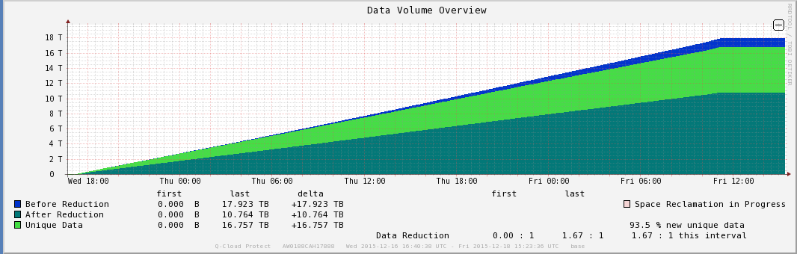
Other Notable Changes – Advanced Reporting
Advance Reporting changes
  VTL / Fibre Channel removed
  Data Volume removed
    Used Disk
    Allocated Disk
  Disk Usage removed
    Data not intended for deduplication
    Non dedup Throughput per week
    Non dedup Throughput per day
    Non dedup Throughput
    Non deup Data

Slide 37
Other Notable Items - Supported Configurations
AWS Regions Supported
  All Regions except new Seoul Region
Replication FanIn/FanOut Support
  1to1 FanIn & 1to1 FanOut
Vision partially supported
  Vision can discover and report on QCP Instances. It is unable to collect some data such as replication data. Vision uses ssh with password which is not support in AWS environment
  Vision requires change to support ssh key-pair
Guardian is not supported
  Guardian would require changes to support ssh key-pair

Slide 38
Other Notable Items – QCP UI
UI NAS Configuration for Replication support only
  CIFS / NFS Direct IO is NOT supported
  Non-Dedup Share is NOT supported (will write to EBS)
  NAS Replication Recovery is NOT supported
UI VTL Configuration for Replication support only
  Some un-needed VTL Pages remain in initial release
    Remote Host Mapping, Remote Host, Targets, & Target Usage
    Summary page highlight Host Mapping Needed
  VTL Direct IO is NOT supported – no FC
  VTL Replication Recovery is NOT supported
OST Accent configuration default is ‘disabled’
  Customer needs to enable Accent when using OST Direct
UI Security
  CLI Administrator ssh prepopulated with key-pair. Not shown in UI
UI Network NAT Configuration is not needed with VPC-VPN
  Similar to V-Series DHCP only

Slide 39
Support Scenarios
Jim Peters & Aaron Laffin

Slide 40
Potential Launch Issues - Configuration
Potential Customer Q-Cloud (QCP) Launch issues
  Launch QCP instance with no IAM Role attached (needed for Snapshots and S3 access)
    Alert posted
  Launch QCP instance with no internet access (needed for EBS Snapshots)
    Alert posted
  Launch QCP instance from AWS Marketplace using invalid Instance Type
    AWS fails launch
  Launch QCP instance from ‘Shared AMI’ using invalid Instance Type (not for AWS Commercial)
    Alert posted
  Launch QCP instance with no access to S3 – needed for blockpool storage
Symptoms and Troubleshooting steps
  Q-Cloud Protect Launch and Recovery Guide for AWS section ‘Troubleshooting Tips and FAQs’
  Knowledge Base and/or Q-Cloud Protect Launch and Recovery Guide for AWS section ‘VPC-Private Network Connections

Slide 41
Potential Launch Issues - Network
Potential Customer Q-Cloud (QCP) Launch issues
  Launches QCP instance in VPC that is not part of a VPN
  Launches QCP instance in VPC-VPN that is not setup with proper network connectivity to on-site DXi or ISV server
Symptoms and Troubleshooting steps
  The customer has an AWS Support contract they should leverage
  We have Q-Cloud Protect Launch and Recovery Guide which is intended to narrow the focus to the appropriate AWS Documentation available to the customer
  Consulting Service assistance
  What QTM Service might need to address:
    Similar to troubleshooting existing DXi to DXi Replication network issues
    Other services are working and connected to my AWS account but I can’t connect my DXi on-site to the DXiA…Ports, credential issue, etc.
    Check network set-ups. We only support VPC-VPN network model. No VPC-EIP
    Check network ports connectivity

Slide 42
Known Issues - QCP Software
JIRA and Bugzilla Used during product Development & Test
  Search existing JIRA and/or BUG under DXi-A project
Issues of interest
  Significant number of Blockpool messages logged to QCP /var/log/message
  OST Backup timeout – similar to current DXi
  GC Fails to restart if Blockpool is restarted – similar to current DXi
  Provide method to auto generate CA key/certificate – similar to current DXi
  Email SMTP does not support SMTP that require credentials – similar to current DXi
  Disallow non-DHCP Ethernet configuration - similar to current V-Series
  Q-Cloud Protect Welcome Wizard VTL indicates that Q-Cloud Protect can be used as VTL target - future
  Provide UI Utility to initiate EBS Volume Expansion – future
  Provide method to migrate to larger EC2 instance – future

Slide 43
Service Model
Jim Hibbard

Slide 44
Support Model Summary
Case Management
  Global Service Center (GSC), CDS, Kuala Lumpur
Technical Support
  Advanced Solutions Product Support (ASPS)
Field Support
  No Field Support is offered for Q-Cloud Protect
Escalation Support
  Service Engineering Specialists (SES), DXi Sustaining Engineering (SUS)
Replacement Part Fulfillment
  No field replacement components available (Amazon hardware)
Q-Cloud Protect Service Plan includes support details
  PN 0-16065-01

Slide 45
Service Offerings
Included Support with AMI purchase
  5x9 Phone Support as a warranty for both AWS Marketplace and GovCloud
  Or, will match support contract with on-premise DXi. If no valid warranty/contract for the on-premise DXi, support reverts to the included warranty.
Support Uplifts, Extensions, and Renewals
  No uplifts are available for the AWS Marketplace product other than match the support level with the on-premise DXi.
  Silver and Gold Software Support will be offered for the AWS GovCloud.
Consulting Services
  Available and highly recommended for customers that are unfamiliar with Amazon Web Services.
  Customers need to engage their account team who can quote Consulting Services.

Slide 46
IB Records
IB Records in Oracle Install Base under Quantum unique 14 character serial number
  2 character site code: AW Metered, CX BYOL
  4 numbers: random and unique
  3 character product code: CAH Metered and BYOL
  5 numbers: random and unique
Product registration is required to generate IB record
  Manual process initially where Service Sales receives Product Registration requests to setup IB records.
  Eventual automated process that IT is reviewing

Slide 47
Initial Engagement with the Customer
The Call Queue will manage response time
Support warranty/contract will be included in the IB
  Base TLA will include a warranty that populates in Coverage Field of SR
  We’ll match contract levels with the on-premise DXi (if valid contract exists)
Q-Cloud Protect Serial Number is required for SR
Customer doesn’t have a Serial Number
  The product will generate a unique 14 Character Quantum Serial Number when AMI is launched (refer to Q-Cloud Protect Launch and Recovery Guide).
    Determine which side of support line:
      Either punt to Amazon or Quantum Consulting Service Assistance
      Help them by using Generic Q-Cloud Protect Serial Number in IB (see service plan)
    Then they complete their AMI launch and register.

Slide 48
Billing Questions
For product sold in the AWS Marketplace, Amazon handles all billing
  Our AWS Marketplace Product page has clear information regarding the cost of running the product.
  The customer AWS Account pages have several tools and reports related to billing: “Billing and Cost Management’
For GovCloud and C2S BYOL
  We will bill for the capacity license and Silver or Gold service contracts.
  Amazon will bill for everything else.

Slide 49
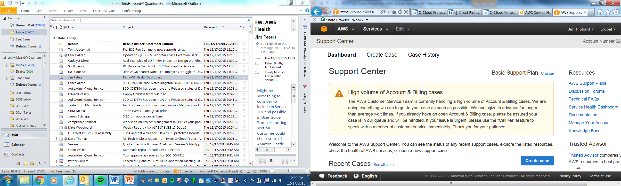
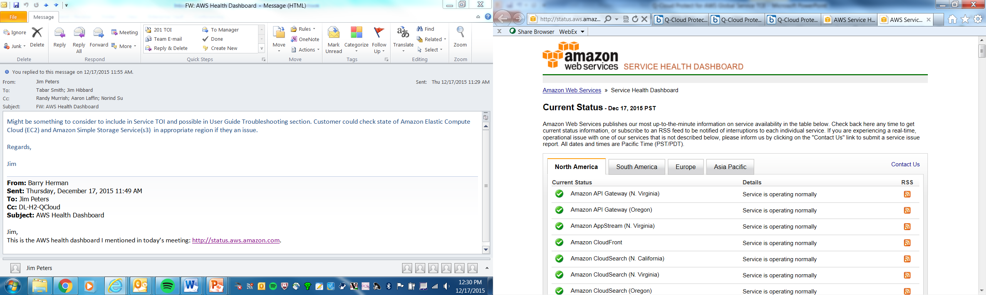
Amazon Support Details
Customers have support contract with Amazon; not Quantum.
Quantum has an Amazon Account Manager assigned to Quantum that can be contacted through Quantum Product Management (Pat Dolan).
If Quantum Service thinks they need to contact Amazon Support, Service should route the request through DXi Sustaining Engineering.
Amazon has a Health dashboard if you suspect an outage: http://status.aws.amazon.com

Slide 50
Appendix A
AWS Launch Steps

Slide 51
Amazon Marketplace – Product Page
Product Descriptions
Links to Resources
Pricing Details

Slide 52
Amazon Marketplace - Launch
Select Region in which to Launch Instance

Slide 53
Amazon Launch Wizard - Choose Instance Type

Slide 54
Amazon Launch Wizard - Configure Instance

Slide 55
Amazon Launch Wizard - Add Storage

Slide 56
Amazon Launch Wizard - Tag Instance

Slide 57
Amazon Launch Wizard - Configure Security Group

Slide 58
Amazon Launch Wizard - Review

Slide 59
Amazon Launch Wizard - Select ssh key pair

Slide 60
Amazon – EC2 Dashboard

Slide 61
Q-Cloud Protect – Initial Login
Initial Login use Instance Id for Password

Slide 62
Q-Cloud Protect – Getting Started Wizard

Slide 63
Q-Cloud Protect – EULA

Slide 64
Q-Cloud Protect – Access Control

Slide 65
Q-Cloud Protect – Confirm

Slide 66
Q-Cloud Protect – Configuration Wizard
Standard DXi
Config Wizard

Slide 67
Q-Cloud Protect – Home UI

