Slide 1

DXi 2.1.x FTS Custom Training
March 22, 2012
Notes:
© 2010 Quantum Corporation. Company Confidential. Forward-looking information is based upon multiple assumptions and uncertainties, does not necessarily represent the company’s outlook and is for planning purposes only.
1

Slide 2
What We’re Going to Cover
Optimized Synthetic Full Backups
New Replication Features in 2.1.x
Full System Data Shred
2
© 2011 Quantum Corporation. Company Confidential. Forward-looking information is based upon multiple assumptions and uncertainties, does not necessarily represent the company’s outlook and is for planning purposes only.
Notes:
© 2008 Quantum Corporation. Company Confidential. Forward-looking information is based upon multiple assumptions and uncertainties, does not necessarily represent the company’s outlook and is for planning purposes only.
2

Slide 3
Optimized Synthetic Full Backups
3

Slide 4

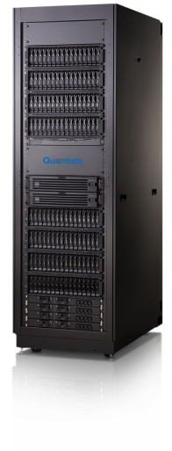
Optimized Synthetic Full Backups
Client
Optimized Synthetic
Full
Backup
Incremental
Backup
Incremental
Backup
Incremental backups
Lightening fast backups!
Load Balanced Media Servers
Today’s traditional synthetic full is created by pulling data through the media server then writing the new full image back to the device.
Zero data movement synthetic backups
Optimized Synthetic
Optimized synthetics are created by the storage server. NetBackup instructs which parts of previous backups to use. Storage server creates a pointer map.
4
© 2011 Quantum Corporation. Company Confidential. Forward-looking information is based upon multiple assumptions and uncertainties, does not necessarily represent the company’s outlook and is for planning purposes only.

Slide 5
Overview
Optimized synthetic backups
  Very fast full backups with no data movement
  Requires at least one prior full and an incremental backup
  Full backup is current up to the last incremental
  Does not depend on the existing backups after creation
  Has its own independent life cycle
Nature of change
  Changes involve the OST plug-in, Ostd, BPW and BFST
  Most of this is new code

Slide 6
Requirements (1 of 4)
The feature is tied to OST v10 and higher.
NetBackup
  6.5 or higher
  6.5 is at (v10)
  7.0 is at V10
  7.1 is at V11
OST Plug-in release 2.5.0 or higher
Galaxy release 2.1
Full and incremental and the target synthetic backup must be from the same diskpool volume

Slide 7
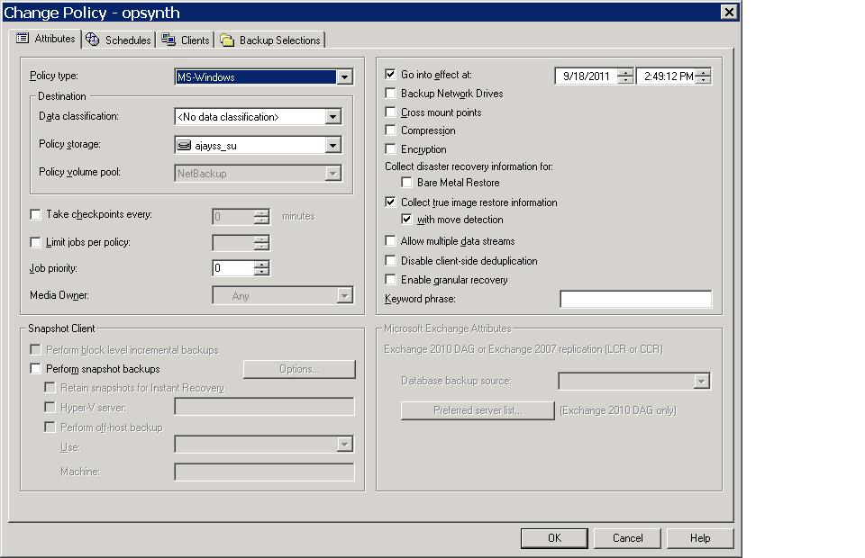
Requirements (2 of 4)

Slide 8
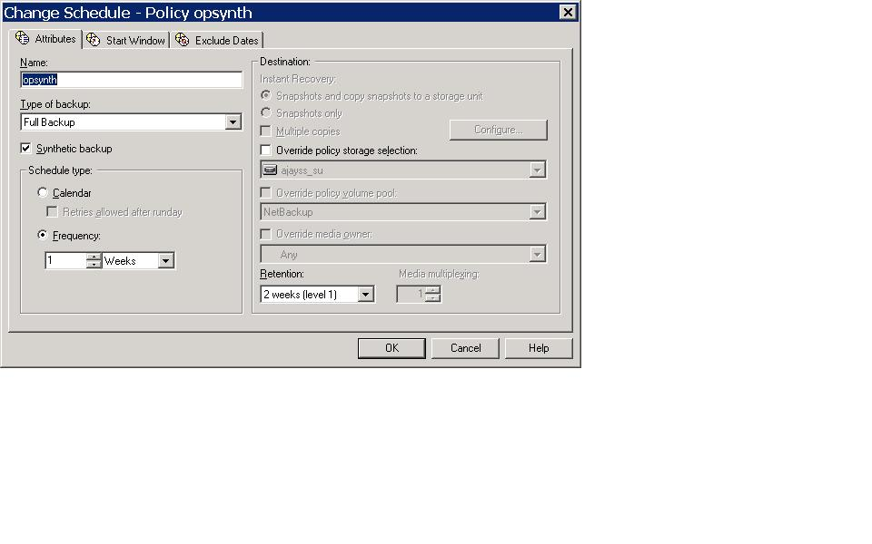
Requirements (3 of 4)

Slide 9
Requirements (4 of 4)
(Optional) If upgrading from a previous version you will need to add the OptimizedImage flag to the existing Storage Servers and Disk Pools using the following commands:
  nbdevconfig -changests -stype Quantum -storage_server ss_name -setattribute OptimizedImage
  nbdevconfig -changedp -stype Quantum -dp dp_name -setattribute OptimizedImage
You can confirm that the OptimizedImage flag is set by running the following commands:
  nbdevquery -liststs -U
  nbdevquery -listdp -U

Slide 10
2.1.x Replication Features
10

Slide 11
Trigger Replication Deletes
This Feature allows data deleted on the Source Share or Partition to be automatically deleted on the Target in a Trigger Replication configuration.
By default Trigger Deletes feature is enabled
Controlled by Seer variable <TriggerDeletesEnabled>true</TriggerDeletesEnabled>
Config file is (reboot needed) /data/hurricane/conf/Common.conf

Slide 12
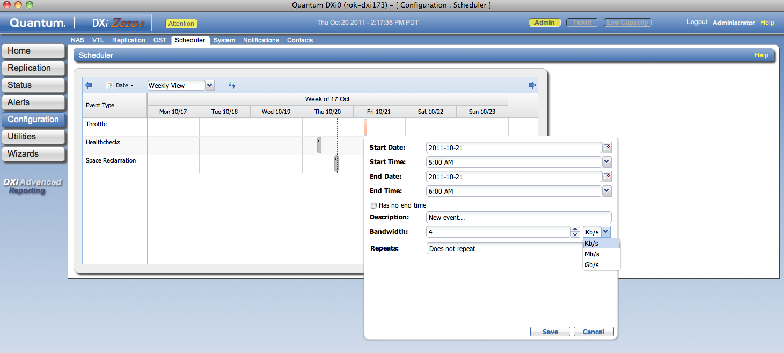
Replication Scheduling and Throttling
Default is no throttle; used when no event scheduled
12
© 2011 Quantum Corporation. Company Confidential. Forward-looking information is based upon multiple assumptions and uncertainties, does not necessarily represent the company’s outlook and is for planning purposes only.

Slide 13
Full System Data Shred
13

Slide 14
System Compatibility
DXi4510, DXi4520, DXi4601
DXi6510, DXi6520, DXi6530, DXi6540, DXi6550
DXi6700, DXi6701, DXi6702

Slide 15
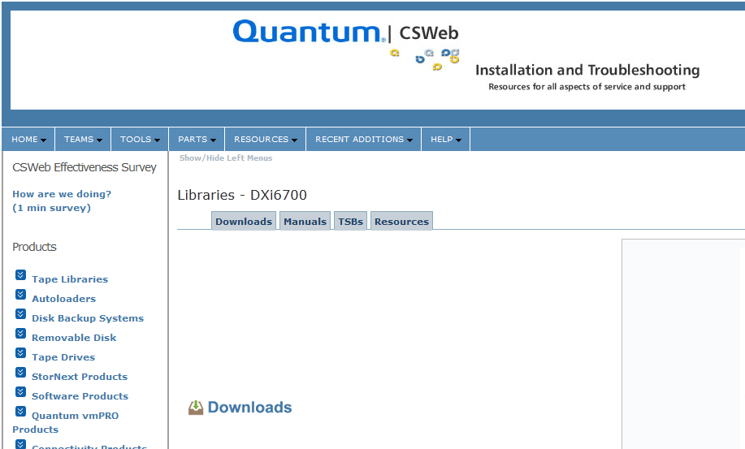
Download ISO and Instructions from CSWeb

Slide 16
Make Sure to Back Up Important Data
Running the System Data Shred utility will destroy all data stored on the DXi. Before you proceed, make sure any data you want to retain has been copied to a safe location off of the DXi. Any data not copied off the DXi is permanently lost after running System Data Shred

Slide 17

Questions???
What if...
How does…
Can I…
When will…

