Slide 1
Updated Service Contracts and Expectations
TOI for Global Service
October 10, 2013

Slide 3
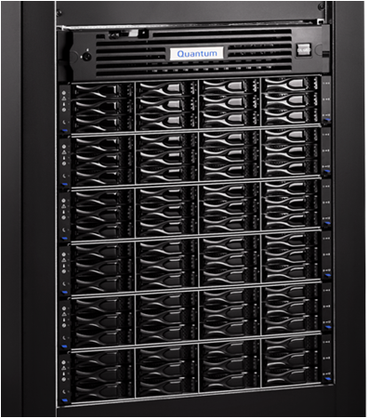
Agenda
Overview
New Warranty and Support Contracts
Positioning CRUs with our Customers
Customer Visibility
Contract Level Visibility for Service Team
CRU Visibility for Service Team
Boundary Conditions
Q & A
Note: Ask questions as we go. Q&A also at the end.

Slide 4
Overview
Presented By: Trudi Eisenhour

Slide 5
Overview
What?
Parts replacement for ‘Warranty, Bronze, & NBD gold’ contracts changed
No change to Gold contract parts replacement (unless preferred by the customer)
Going forward, customers will be able to replace Customer Replaceable Units (“CRUs”), i.e. disk drives, tape drives, etc.
If they can’t or don’t want to replace CRUs, they can buy Gold or an uplift to Bronze/NBD Gold
Added bonus: Clarify SLAs and service collateral to improve customer experience
Publish Internal boundaries document to help with the grey areas
When?
Effective Oct 1st for new sales and renewal sales
Active contracts continue as-is; however it never hurts to ask
Most customers will appreciate the opportunity to replace simple components. We need to be letting all customers on existing contracts know that they can replace the component themselves if they prefer
Why?
Customers have been asking for it
Faster time-to-resolution
Cost savings for Quantum
Everyone else is doing it ☺

Slide 6
Quantum Support Contracts vs Warranty
Items in red changed
Core Response Services | Notes | Warranty | Bronze | NBD Gold | Gold
Telephone Support (Product/functional Support) |  | N/A | 9x5 | 24x7 | 24x7
Telephone Support for warranty problem determination | 1 or 3 YR Warranty | 9x5 | Included with Warranty | Included with Warranty | Included with Warranty
Web Portal/Online Ticket Creation |  | 24x7 | 24x7 | 24x7 | 24x7
Proactive Remote Monitoring | RAS Response | N/A | N/A | Included | Included
Rights to New Releases of SW |  | N/A | Included | Included | Included
Call Back Response Time Target | May not publish externally | 4 Business hrs | 2 Business hrs | 60 min | 60 min (30 min for Critical)
Parts Replacement | CRU/FRU – Customer may uplift Bronze, NBD Gold contracts to CRU replacement by Quantum | Customer Replaces Required CRUs Quantum Replaces FRU | Customer Replaces Required CRUs Quantum Replaces FRU | Customer Replaces Required CRUs Quantum Replaces FRU | Quantum or Authorized Partner Replaces CRUs and FRUs
Parts Delivery Target | After problem diagnosis | NBD | NBD | NBD | Critical: 4 hrs Major: 8 hrs Minor/Minimal: 12 hrs
Onsite Support Target |  | T&M required if other than FRU replacement 9x5 NBD (excluding wknds, evenings and holidays) | 9x5 NBD (excluding wknds, evenings and holidays) | 9x5 NBD (excluding wknds, evenings and holidays) | 24x7 (including wknds, evenings and holidays) Critical: 4 hrs Major: 8 hrs Minor/Minimal: 12 hrs
Provision for Loaner | Type of loaner unit will be determined by Quantum and situation | N/A | N/A | Available | Available

Slide 7
SR Severity Definitions
Severity Value | Severity Definition | Examples
Not Determined | Default value used to quickly identify SR administrative problem | None
Critical | Production use of the covered Quantum product is stopped or so severely impacted that critical business functions cannot be performed. | Quantum product is 100% down Quantum product problem is preventing the customer from accessing the system or their data (e.g., DXi Blockpool Verify operation, one or more StorNext filesystems not accessible, etc.) Any data loss and/or data corruption
Downgraded from Critical | Work-around has been applied to a Critical SR such that the system and/or data is now available to the customer | Re-booting a non-responsive product Provided a temporary work-around that allows the customer to resume operations, even in a somewhat limited mode
Major | Quantum product is able to perform standard functions, but the product performance or functionality is severely degraded or limited. | Quantum product GUI is not accurately reflecting status on key values that the customer uses to effectively manage their operations A component failure that could result in a DUDL event if the redundant component fails (e.g., disk drive failure, redundant controller failure, redundant robot failure, etc.)
Minor | Quantum product is experiencing a minor loss of service, anomaly, or cosmetic defect that inflicts little or no business impact. Resolution may require a workaround or hardware/software upgrade to mitigate the problem. | Non-critical component failure (e.g., single tape drive in a multi-drive library product) Component expiration alert (e.g., battery) Non-critical GUI value is inaccurate
Minimal | Quantum product is operating normally and there is no impact to production systems. Includes customer requests for information, an enhancement, or documentation clarification regarding the use and maintenance of Quantum Product. | General customer question Product documentation is inaccurate Enhancement request

Slide 8
Positioning CRU with our Customers
Presented By: Trudi Eisenhour

Slide 9
Customer Positioning/Talking Points
When a CRU component is needed:
Explain to the customer (regardless of contract), that the component that needs to be replaced has been identified as customer replaceable
Ask if they would like the component simply shipped to them
Explain that the component is easily replaced and that many have been able to get their system back to full operation much faster
Let them know that the installation instructions are located on www.quantum.com/cssp (send an email with the info)
Let them know that if they encounter any problems, they can call Tech Support for additional assistance
Follow up with customer to confirm fix and close the SR
Use these customer advantages:
Be able to quickly replace failed components on a system in production as soon as the component arrives
Greater control of the repair process by not having to schedule maintenance windows around a service technician
Overall time to repair is reduced
The ability to implement similar policies and procedures across all vendors

Slide 10
Customer Visibility
Presented By: Trudi Eisenhour

Slide 11
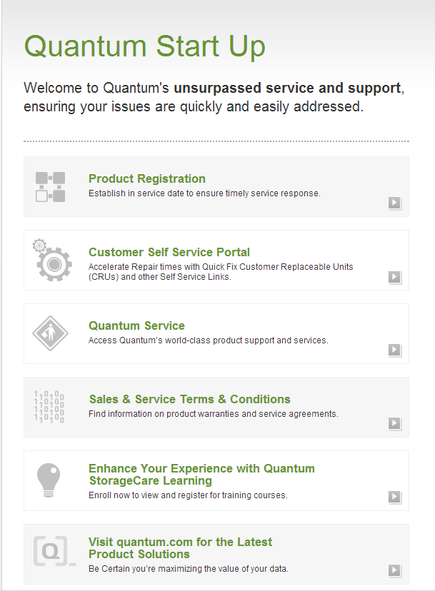
Startup Page for New Customers: www.quantum.com/startup
Modifications:
Phase I
10/1 - Add a link to CSSP
Phase II:
Q3 – Amp up this page to match Q.com branding

Slide 12
CRU Card – Inside shipped replacement components
Note:
The distribution of this card will take time.
At the time of SR, an email should be sent to the customer pointing them to the CSSP site.

Slide 13
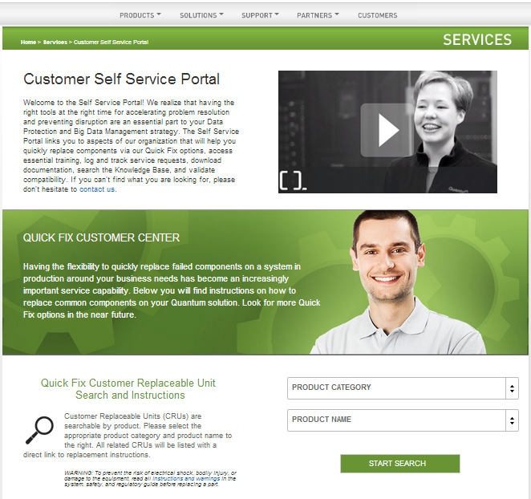
Customer Self Service Portal: www.quantum.com/cssp
Customer Value
Why CRU
Search

Slide 14
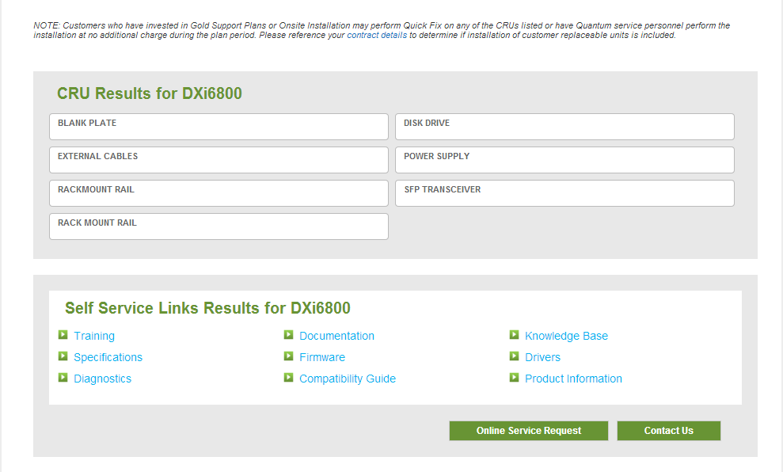
Customer Self Service Portal : www.quantum.com/cssp Search Results
Link directly to CRU instructions
Links based on Product Selection
If all else fails

Slide 15
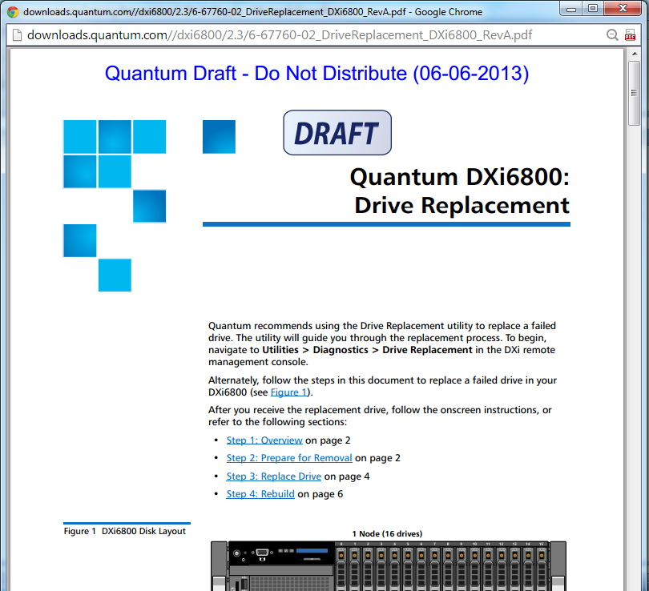
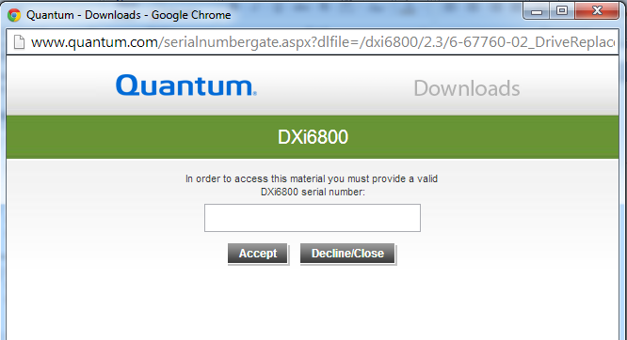
Customer Self Service Portal : www.quantum.com/cssp Serial Number Gate and Document Example
Not all Documents have the SN Gate. Dependent on sensitivity of document and existing gates.

Slide 16
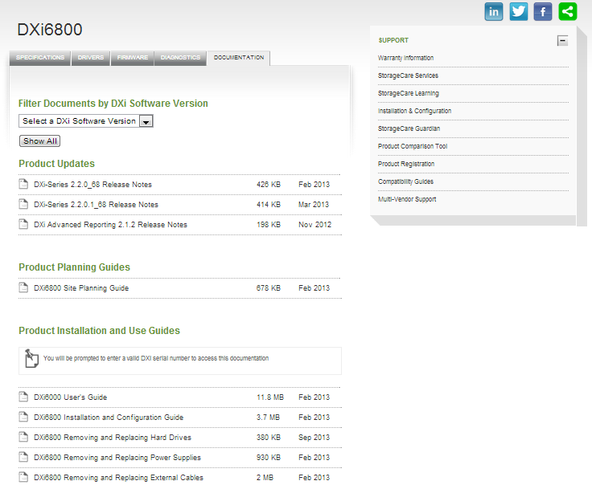
CRU Documentation also accessible here:

Slide 17
Contract Level Visibility for Service Team
Presented By: Jim Hibbard

Slide 18
Service Contract “Coverage” Names
Old contract names that show up in “Coverage” field of SR
5x9 ND (Bronze)
4HR TS–NBD OS (NBD Gold)
7x24 4HR (Gold)
Variations of the above for AFCP, ASSP, and ASP
New contract names that show up in “Coverage” field of SR
CRU Rapid Exchange
CRU Warranty
CRU Bronze
CRU NBD Gold
CRU Gold
CRU ASSP Bronze (FCP)
CRU ASSP NBD Gold (FCP)
CRU ASSP Gold (FCP)
New Supplemental Uplifts to new CRU contracts
Requires QFE/TPM resources to replace CRUs and FRUs.
“Coverage” field in SR for Supplemental Uplift will change in the near future
CRU Bronze → BRONZE Supplement
CRU NBD Gold → NBD GOLD Supplement
CRU Gold → GOLD Supplement
CRU ASSP Bronze (FCP) → ASSP BRONZE Supplement (FCP)
CRU ASSP NBD Gold (FCP) → ASSP NBD GOLD Supplement (FCP)
CRU ASSP Gold (FCP) → ASSP GOLD Supplement (FCP)
“Coverage” field in SR. Note that these coverage names are the old coverage names.
CRU Bronze → 5x9 ND
CRU NBD Gold → 4HR TS–NBD OS
CRU Gold → 7x24 4HR

Slide 19
Service Contract Response Targets
Call Back Response Time Targets
Managed dynamically in the Call Back Tool
Call Back Tool prioritizes call back targets for new and old Service contracts per pre-defined call back time targets
Onsite Parts and Engineer Targets
Old Contracts
5x9 ND – NBD
4HR TS–NBD OS – NBD
7x24 4HR – 4HR
New Contracts
CRU Rapid Exchange – within 2 business days
CRU Warranty – NBD
CRU Bronze – NBD
CRU NBD Gold – NBD
CRU Gold – Dependent on SR Severity Level
CRU ASSP Bronze (FCP) – NBD
CRU ASSP NBD Gold (FCP) – NBD
CRU ASSP Gold (FCP) – Dependent on SR Severity Level
New Contracts with Supplemental Uplift
Identical response times (callback, parts, and onsite) as CRU based contracts but includes QFE/TPM replacement of CRUs
Refer to Support vs. Warranty Slide for new response targets

Slide 20
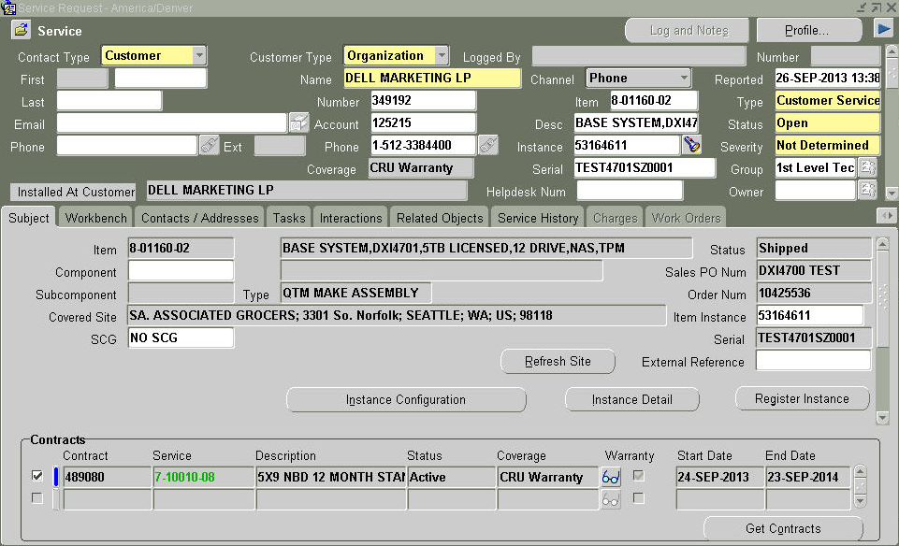
Oracle SR Visibility – CRU Warranty
GCH selects coverage type when opening SR
Contract Coverage Field in SR
5x9 Phone Support for defective part determination (4hr Call Back)
CRU parts dispatched to customer for NBD (advise customer of CSSP location and CRU card)
FRU parts and QFE/TPM dispatched to customer for NBD.

Slide 21
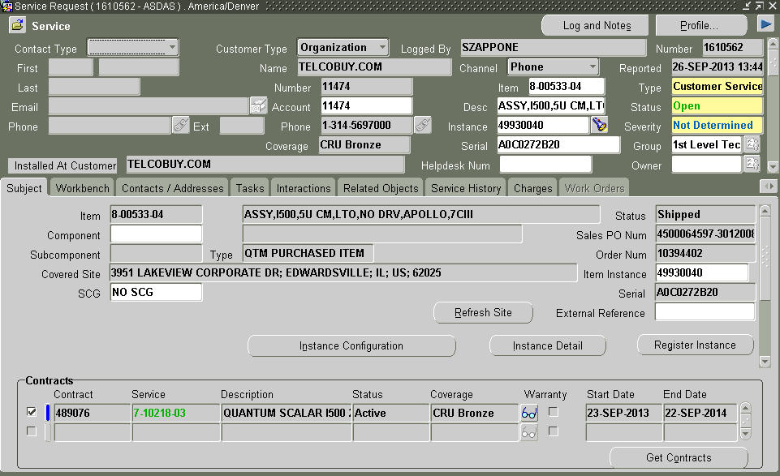
Oracle SR Visibility – CRU Bronze
GCH selects highest level of coverage when opening SR
Contract Coverage Field in SR
5x9 Phone Support (2hr Call Back)
CRU parts dispatched to customer for NBD (advise customer of CSSP location and CRU card)
FRU parts and QFE/TPM dispatched to customer for NBD

Slide 22
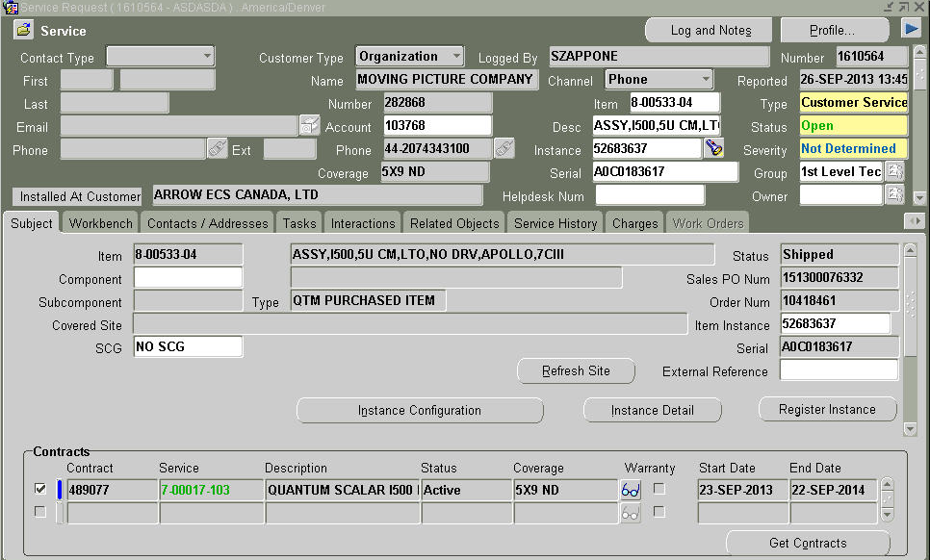
Oracle SR Visibility – CRU Bronze w/Supplement
GCH selects highest level of coverage when opening SR
Note: This coverage name will be “BRONZE Supplemental” on contracts created in the near future
Contract Coverage Field in SR
5x9 Phone Support (2hr Call Back)
FRU and CRU parts and QFE/TPM dispatched to customer for NBD

Slide 23
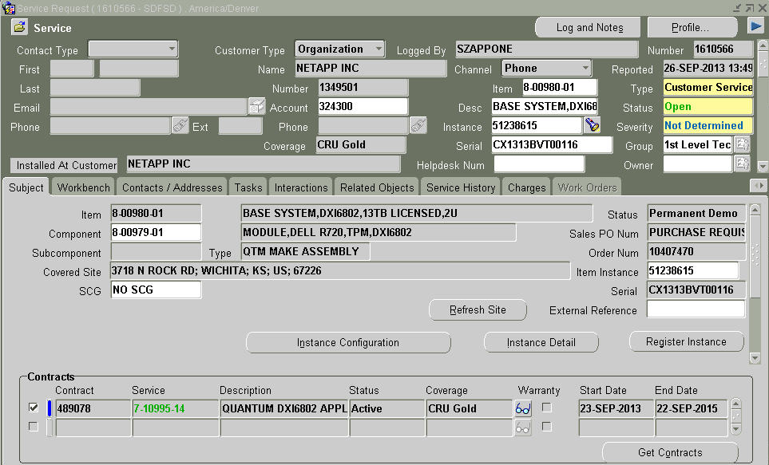
Oracle SR Visibility – CRU Gold
GCH selects highest level of coverage when opening SR
Customer agrees to replace CRUs
Contract Coverage Field in SR
7x24 Phone Support (60 min Call Back, 30 min Critical)
7x24 Onsite FRU and CRU parts and QFE/TPM (SR Severity Level dependencies)

Slide 24
Oracle SR Visibility – Gold Supplement
GCH selects highest level of coverage when opening SR
Note: An additional line for “GOLD Supplement” will show that GCH will select
Contract Coverage Field in SR (“GOLD Supplement”)
7x24 Phone Support (60 min Call Back, 30 min Critical)
7x24 Onsite FRU and CRU parts and QFE/TPM (SR Severity Level dependencies)

Slide 25
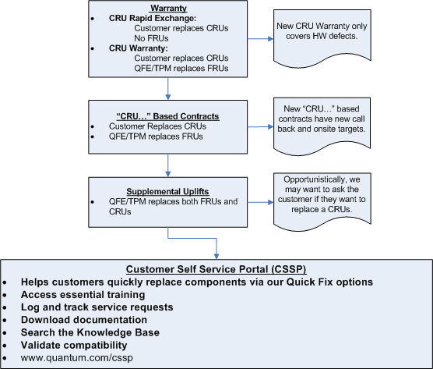
New Contract/CRU Strategy Summary

Slide 26
CRU Visibility for Service Team
Presented By: Bob O’Brien

Slide 27
Logistics Parts Catalog
The primary indicator of CRU status for the Service team will be the “DESCRIPTION” column of the Logistics Parts Catalog - CRUs will begin with the text “CRU, xxxxxx”
Note: External cables and power cords are always CRUs
Notes:
Is there any upgrade path from DXi6701/02 to DXi6802?
No, these are two distinctly different products with no storage or controller commonality.
Per DXi deduplication appliances, replication compatibility exists with existing DXi deduplication products.

Slide 28
FRU List
The primary indicator re: CRU status on the FRU list is that the Description for CRUs begins with the text “CRU, xxxxx” as shown below:
Notes:
Is there any upgrade path from DXi6701/02 to DXi6802?
No, these are two distinctly different products with no storage or controller commonality.
Per DXi deduplication appliances, replication compatibility exists with existing DXi deduplication products.

Slide 29
FRU List (cont.)
In addition to the PN description, some FRU lists have a column on the right showing whether the part is a CRU:
Notes:
Is there any upgrade path from DXi6701/02 to DXi6802?
No, these are two distinctly different products with no storage or controller commonality.
Per DXi deduplication appliances, replication compatibility exists with existing DXi deduplication products.

Slide 30
FRU List (cont.)
If a part can be both a CRU and FRU depending on the product, the PN description will begin with the text “FRU/CRU, xxxxx” and a column will show if this is a CRU or FRU on this product:
Notes:
Is there any upgrade path from DXi6701/02 to DXi6802?
No, these are two distinctly different products with no storage or controller commonality.
Per DXi deduplication appliances, replication compatibility exists with existing DXi deduplication products.

Slide 31
Service Visibility to CRUs - Summary
The primary mechanism for Service CRU visibility will be the Logistics Parts Catalog and embedded reference FRU lists
PN descriptions for CRUs will begin with “CRU, xxxx”
PN descriptions for parts that can be a CRU on one product and a FRU on another product will begin with “FRU/CRU, xxxx”
A column will be added to show the CRU/FRU status for the part on the current product
The secondary mechanism for Service CRU visibility is the CRU listing on the customer-facing Customer Self-Service Portal (CSSP) page
www.quantum.com/cssp

Slide 32
CRU Documentation Strategy
To reduce workload for the IS team and eliminate duplication of documentation that can lead to conflicts, CRU replacement instructions will be maintained in only one location
All CRU documentation will be posted to the product Service & Support page on Quantum.com, as well as on CSweb (alongside the other documentation)
When talking to customer we should always remind them of CSSP
Once a CRU removal and replacement procedure document has been created, this information will be removed from both the User Guide and Maintenance Guide (over time)
This will require Service personnel and partners to check the CRU procedure documents first – if a discrete CRU document does not exist, the information will be in the Maintenance Guide

Slide 33
Boundary Conditions
Presented By: Jim Hibbard/Bob O’Brien

Slide 34
Boundary Document (0-15150-01)
Objective
The primary Boundary Document is the official Product Support Terms and Conditions. This Supplemental Boundary Document is intended to help guide our Teams with the gray areas that we have historically encountered.
Summary
One of the difficult tasks that a Technical Support organization faces each day is determining how far to take aspects of their work or a customer issue.
It is important to set boundary expectations consistently for all customers across all teams. Inconsistencies between teams and technicians may lead to unbalanced expectation setting with the customer base.
The purpose of this document is to address the most frequent support boundary situations and provide guidelines on the action to be taken. Please remember to consult with a manager if any questions or a critical issue occurs.
It is very important that the Quantum Support organizations fully understand Quantum’s support model, support contract levels, and our terms and conditions. Please take time to reference Quantum’s Support page site on Quantum.com to become familiar with the Service and Support by accessing http://www.quantum.com/ServiceandSupport/Index.aspx.
In addition, CS Web contains a lot of valuable and required information to support our products.
Guidelines and Critical Documentation/Links
Provide links to docs and descriptions
Service Contracts and Support
Please reference the Quantum Support website for a description of the different contract levels.
Process Exceptions
Support Scenarios and Suggested Actions
Exceptions
Please escalate to your functional manager if an instance arises where the information in this document cannot be applied.
Updates to this Boundary Document are Forthcoming!

Slide 35
Boundary Examples
Customer has replaced the CRU, but the CRU is not working
Ship a replacement CRU to the customer, or
Dispatch field engineer to site
Customer has replaced the CRU, but now the product is no longer working
Dispatch field engineer to site
Customer is complaining that the level of their service has been reduced
Try to sell the value on CRU and reduced time to resolution
Take care of customer (dispatch as asked) and escalate to Service Sales in parallel
Escalate to your functional manager if further advice is needed
Customer has a dark site and cannot go there to replace CRUs
Contract inappropriate to customer environment – upgrade to Gold or purchase onsite parts replacement uplift
Customer has concerns that they can perform the CRU replacement
Notify customer that we have developed customer-focused replacement instructions that will assist them with the CRU replacement
Notes:
Is there any upgrade path from DXi6701/02 to DXi6802?
No, these are two distinctly different products with no storage or controller commonality.
Per DXi deduplication appliances, replication compatibility exists with existing DXi deduplication products.

Slide 36
Boundary Examples (cont.)
Customer is concerned that they are now responsible for part return (i.e. risk/financial exposure if part gets lost)
Upgrade to Gold or purchase onsite parts replacement uplift

Slide 37
Q&A

Slide 39
Appendix
Presented By: Matthew Apodaca

