Slide 1
NAS 1.4.0 TOI
April 5th, 2017

Slide 2
Agenda
What’s new in NAS 1.4.0
Key bug fixes
Upgrading NAS environment(s)
Named streams
ACL Support in OpenLDAP Environments
Doc Center

Slide 3
New in NAS 1.4.0
Support for multiple domains within an Active Directory forest
Automatic NAS Cluster Upgrades
You can now issue a single command to upgrade an entire NAS cluster from StorNext NAS 1.3.0
SNMP Support
You can now configure the Simple Network Management Protocol (SNMP) on appliances
Supports Net-SNMP for default Management Information Base (MIB)
Named Streams Option
Set named streams option on SMB to optimize macOS performance
ACL Support for LDAP
Access Control Lists (ACLs) when NAS is bound to an OpenLDAP or Apple Open Directory

Slide 4
Named Streams for macOS
Finder metadata traffic “swamps” data movement traffic
Result: Slow copies!
Named Streams reduces Finder metadata traffic across the network
94% reduction in metadata network traffic
NAS 1.4.0 adds Named Streams support
On/off CLI command
Caveat: cannot mix Xsan and SMB Named Streams clients

Slide 5
Key Bug Fixes
Auth Config ADS Fixes
64955* HYDRA-724: failed auth config ads provides unusable error for end user
65110* HYDRA-785: Large AD forest can crash winbindd
65111* HYDRA-786: Need ability to modify krb5.conf with custom KDC
65281* HYDRA-852: When Joining AD with a NAS cluster customer gets net rpc getsid failed Connection failed: NT_STATUS_NOT_SUPPORTED error
65456* HYDRA-918: Complex AD environments would cause NAS to timeout during reboots
65708 HYDRA-1024: Need to allow setting kerberos option dns_lookup_kdc=true
65956* HYDRA-1057: Winbind need to be allow to ignore domain.
65957* HYDRA-1056: Winbind check in nas_cluster_plugin.py should try more then once
66218 HYDRA-1088: Auth config ads should only bind to the master node.
*Customer reported

Slide 6
Key Bug Fixes – cont’d
Share Add/Create/Change
66615 HYDRA-1139: SMB option 'write ok' is rejected on share create
ACL Support
61593* HYDRA-951: Unable to access file if contain ACL from Apple Open Directory (AOD)
65565* HYDRA-948: Finder does not allow rename of folder if it contain in-use file
65616* HYRDA-1001: Allowed to move file to directory where ACL should prevent it.
66889 HYDRA-1228: Domain sid must be added to the StorNext's NAS appliance for sid mapping
67140 HYDRA-1244: Implement SID/GID mapping for ACL support
NFS
65045* HYDRA-749: allow easier conversion from NFS-HA to non-NFS-HA
65777* HYDRA-1048: nfs services won't get restarted in some failovers when HA is enabled
*Customer reported

Slide 7
Key Bug Fixes – cont’d
NAS Clustering
62062* HYDRA-793: Routing polices need to be updated for nascluster vip
64854* HYDRA-702: A nascluster show gets an exception when another node is not responding.
64997 HYDRA-732: NAS cluster join fails when VIP not in DNS
65380 HYDRA-879: shares not exported when new node joins NAS cluster
Misc
63682* HYDRA-460: Add support to detect StorNext case insensitive mount option on SMB shares
64123 HYDRA-467: cli 'system upgrade' does not require input on prompt to upgrade with defaults to 'Yes'
65389 HYDRA-900: Supportbundle should show the output of rpm --verify
65575* HYDRA-958: SMB incorrectly returns non-zero block count for truncated StorNext files
65799* HYDRA-1049: SN-NAS: "system shutdown" shuts down hardware without warning
65912* HYDRA-1055: snnas_controller systemd TimeoutSec needs to be increased.
*Customer reported

Slide 8
Upgrading NAS

Slide 9
Upgrading NAS
Upgrade Pre-requisites
Installed NAS release must be at 1.3.0
If at < 1.3.0, refer to ‘Upgrade to NAS 1.3.0’ link in the StorNext NAS Documentation Center
Upgrade Scenarios
Remote
Single System Not In NAS Cluster
NAS Cluster
NOTE: To check if updates are available – from the panshell:
system show software updates
Local
Single System Not In NAS Cluster
NAS Cluster

Slide 10
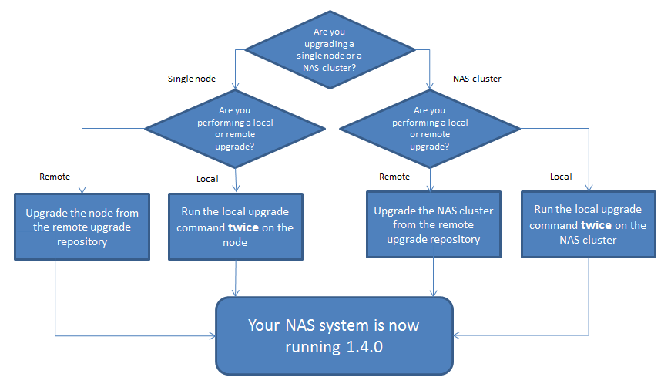
Upgrading NAS Flow Chart

Slide 11
Remote Upgrade of a Single System Not in a NAS Cluster
No change from previous release
From panshell:
system upgrade
Uses latest release available on the Quantum yum repo
If already at latest release, no change is made

Slide 12
Remote Upgrade of All Nodes In a NAS Cluster
New command available this release
From panshell:
nascluster upgrade
Upgrades every node in the NAS cluster to the latest available release
Command can only be issued from the NAS cluster master
If run from a non-master node, an error will be printed that includes:
Request allowed only from NAS cluster master
Uses latest release available on the Quantum yum repo
If NAS cluster master already at latest release, no change is made
In this case, individually upgrade any node not already upgraded using ‘system upgrade’ on the node
Minimizes time that a share is not available

Slide 13
Local Upgrade of a Single System Not in a NAS Cluster
Use browser to download the firmware:
Quantum Web Site Support page for StorNext Scale-Out Storage/Stornext NAS)
Firmware tab – select appliance (Artico or Xcellis)
You will be prompted for appliance serial number
Copy downloaded file to the /tmp directory on the appliance
Extract the files to the /var/upgrade directory
log in as root to the appliance
cd /var/upgrade
tar zxvf <full path to downloaded file>
rm <full path to downloaded file>
From panshell, run the following command TWO times:
system upgrade local
NOTE: The ‘system upgrade local’ command must be run twice to complete the upgrade process

Slide 14
Local Upgrade of All Nodes In a NAS Cluster
Use browser to download the firmware:
Quantum Web Site Support page for StorNext Scale-Out Storage/Stornext NAS)
Firmware tab – select appliance (Artico or Xcellis)
You will be prompted for appliance serial number
Copy downloaded file to the /tmp directory on the appliance that is the NAS Cluster master
Extract the files to the /var/upgrade directory
log in as root to the appliance that is the NAS Cluster master
cd /var/upgrade
tar zxvf <full path to downloaded file>
rm <full path to downloaded file>
From panshell, run the following command TWO times:
nascluster upgrade local
NOTE: The ‘nascluster upgrade local’ command must be run twice to complete the upgrade process

Slide 15
Named Streams
Case Sensitivity
ACLs with OpenLDAP

Slide 16
SMB Named Streams
Problem: Mac Finder is slow
Most notable: opening or copying directories with many files
Key finding:
Accessing and maintaining AppleDouble files is the most significant cause.
Solution:
Use SMB protocol features to avoid MacOS directly managing metadata stored in AppleDouble

Slide 17
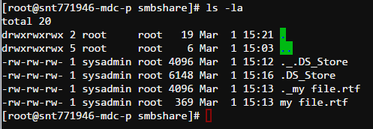
SMB Named Streams (continued)
What is AppleDouble?
A second file that is used to store metadata
File name prefixed with “._”
Example: “my file.rtf”
“._my file.rtf”
If file system does not directly support storage of metadata, AppleDouble is used
Examples:
VFAT on USB keys, SD cards
Samba (by default)
Xsan without Named Streams

Slide 18
SMB Named Streams
What metadata?
Small units of data tied to a file
But separate from the primary file content
Accessed differently from the primary file content
Extended attributes (xattrs)
Streams
Key property:
When the file is renamed or removed, metadata follows and is renamed or removed.
File also defines permissions and ACL to access the file and its metadata.
MacOS implements AppleDouble as an xattr database.

Slide 19
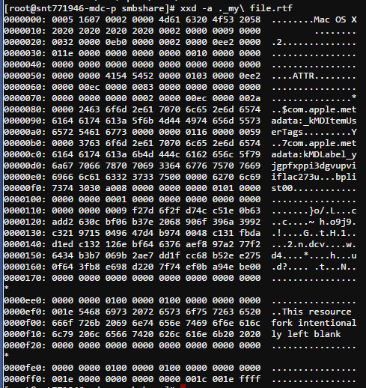
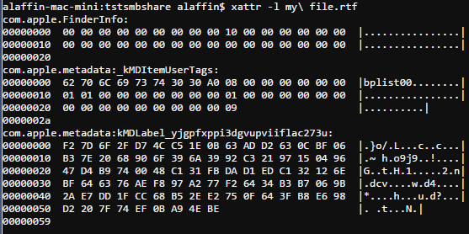
SMB Named Streams (continued)
A look inside AppleDouble

Slide 20
SMB Named Streams (continued)
How to avoid AppleDouble?
Use SMB protocol feature: Alternate Data Streams (ADS)
Windows NTFS feature
Samba VFS module: streams_xattr
Streams_xattr
Enables SMB Alternate Data Streams with Samba
Stores stream into an xattr
Xattr Problems
Small limits:
1 KiB in Stornext 5.3.1
4 KiB in Stornext 5.4
Larger examples won’t fit: Resource Fork is a primary example
Not protected by Storage Manager
Limits imposed by API differences (get/set vs read/write).

Slide 21
SMB Named Streams (continued)
Solution: Store metadata in files
Files are protected by storage manager
MacOS was already doing this with AppleDouble
New VFS module: snnas_radf
Intercepts xattrs from streams_xattr
Stores the data independently
Better: be compatible with AppleDouble
Stores intercepted xattrs to AppleDouble
Filename, attribute name, and data compatible.

Slide 22
SMB Named Streams (continued)
Details: Fruit
Samba VFS module for Mac compatibility.
Streams_xattr is almost functional with the Mac. Fruit solves Mac specific problems.
AAPL extension
Mac specific SMB extension that speeds directory enumeration
Measurable improvement to Finder directory open
Other “bug compatibility”
qfruit
Temporary home for bug fixes and improvements
Samba configuration options
fruit:veto_appledouble = true – hides AppleDouble files from clients
VFS modules added to stack:
qfruit streams_xattr snnas_radf

Slide 23
SMB Named Streams (continued)
Details: snnas_radf
“RADF” – Relocated Apple Double Files
Relocate the AppleDouble file to a subdirectory
Directory enumeration optimization
Disabled by default
No dynamic relocation
Location: ./.__radf/._file
Relocation is disabled by default
Mac client compatible location
Samba configuration options
snnas_radf:store_subdir = false – whether to store into relocated file location
snnas_radf:store_xattr = false – whether to store attribute to an xattr in addition to AppleDouble

Slide 24
SMB Named Streams (continued)
NAS configuration options
Global: share change smb global named streams = true
Default: false
This is the preferred method to enable SMB Named Streams
Per share: share change smb <share> named streams = true/false
Overrides global value for a specific share
Caveat: if the first share accessed by a Mac client is not Named Streams, the AAPL extension is not enabled.
Reduces performance
Disables posix directory rename behavior

Slide 25
Case Sensitivity
Goals:
Detect Stornext configuration to set optimal Samba configuration relating to case sensitivity.
Optimization to avoid extra work by Samba to handle mapping case insensitive clients to a case sensitive file system.
Default configuration should just work
Stornext case insensitive
File system caseInsensitive configuration – whether the file system is case insensitive.
Linux client mount option – whether to present a file system as case insensitive.
Push the effort of being case insensitive into Stornext.

Slide 26
Case Sensitivity
Samba
Presumes underlying file system is case sensitive.
“case sensitive” configuration option
whether the client should be treated as case sensitive
A case sensitive client requires no mapping to a case sensitive file system.
NAS Configuration
Until 1.4.0, share “case sensitive” setting is directly written to Samba configuration.
In 1.4.0+, if share “case sensitive” setting is “auto” (the default) and Stornext is case insensitive:
Override “auto” to set “case sensitive = yes” in Samba configuraiton.
Improved evaluation of share and registry settings. Evaluation order:
Default – registry cifs.case_sensitive
share global setting – share change smb global case sensitive = <value>
share specific value

Slide 27
ACLs with OpenLDAP
Auth map sid enable <domain-sid> - Enables sid mapping support for ACLs with Open Ldap server (relies on Samba to enforce ACLs with respect to Open Ldap)
Auth map sid disable – Disable sid mapping support (disable acls support for Open Ldap)
Obtain domain sid from the Open Ldap server:
dscl /LDAPv3/<server_FQDN>/ -read Config/CIFSServer

Slide 28
ACLs with OpenLDAP – cont’d
Setting ACLs using Xsan client (Reference online doc center under Configure NAS > NAS User Authentication > Apply Apple OD Authentication to NAS)
Checking users on the gateway pdbedit –L will list all users have been authenticated with the OpenLDAP Server)
Verify Samba ACL with smbcacls command
For example, smbcacls -k //snt771960-vip1.mdh.quantum.com/gwsmbshare2 acl/
Deleting ACLs Note: smbcacls has a known limitation when attempting to delete ACLs. Recommended to use snacls when deleting ACLs

Slide 29
SNMP
The Controller is expanding to configure and manage more than just NAS.
Future releases will expand to provide additional management for Quantum appliances.
When enabled, SNMP is granted read-only access on standard UDP Port 161
Ref online doc center under Configure NAS > System Management > SNMP Monitoring for details on how to enable and configure SNMP

Slide 30
SNMP CLI Commands
snmp service (enable | disable)
snmp sysinfo (sysContact=<contact>, sysDescr=<description>,
sysLocation=<location>, sysName=<name>)
snmp show [service, agent, sysinfo, community, view, ...]
snmp community add ro <community-name> [default | <host-id> |
<subnet/(mask | bits)> [<oid> | view=<view-name>]]
snmp community remove ro <community-name>
snmp view add <name> (included | excluded) <oid> [<mask>]
[comment=<description>]
snmp view remove <name> <oid>
snmp notification add (trapsink | trap2sink | informsink) <host-id>
[<trapcommunity-name>] [port=<port-number>]
snmp notification remove <host-id> [<port-number>]
snmp trapcommunity <community-name>
snmp authtrapenable (enable | disable)

Slide 31
Troubleshooting
Logs are located in /var/log
Key logs
/var/log/snnas_controller
/var/log/messages
/var/log/samba/samba.log.<username>
Logs can be directly viewed from CLI/shell
log list
log search <phrase>
log view <log-file>
log watch <log-file>
Example: log view snnas_controller

Slide 32
Troubleshooting (cont)
Get a Support Bundle
supportbundle create
The support bundle contains logs and a picture of the system
Config files from /etc
Summary reports of RPMs installed, Controller Registry settings, and SAR data from the past few days.
Check out the Troubleshooting Tips and FAQs

Slide 33
Questions?

Slide 34
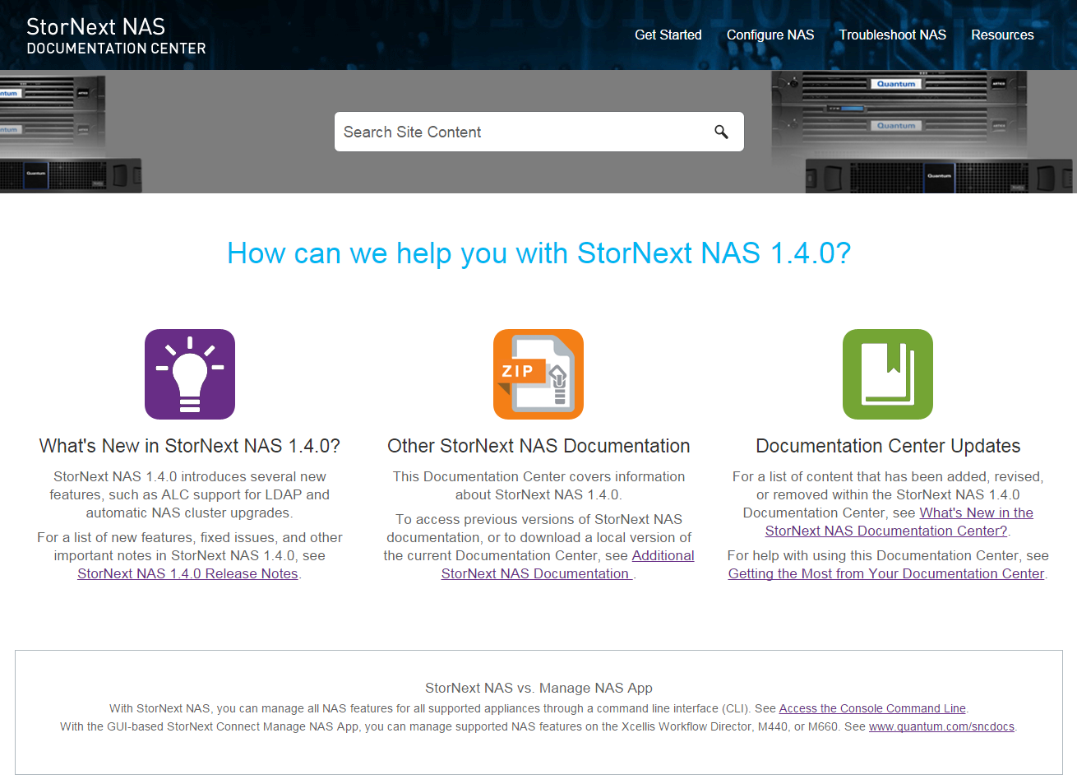
StorNext NAS 1.4.0 Documentation Center
New content covers the following StorNext NAS 1.4.0 features:
Available at www.quantum.com/snnasdocs or from the Documentation Portal (www.quantum.com/documentation)
Content | Menu Path
NAS cluster and local upgrades | Get Started > NAS Upgrades
Ability to define multiple Microsoft AD DC servers | Configure NAS > NAS User Authentication > Apply AD Authentication to NAS
SID mapping for full ACL support when the NAS server is bound to an OpenLDAP server | Configure NAS > NAS User Authentication > Apply OpenLDAP Authentication to NAS
Case Sensitive option | Configure NAS > Share Management > SMB Share Options
Named Streams option for environments in which macOS clients access file systems implemented with Samba | Configure NAS > Share Management > SMB Share Options
New feature supporting SNMP | Configure NAS > System Management > SNMP Monitoring
Updated Troubleshooting section | Troubleshoot NAS

Slide 35
Questions?

