Slide 1
NAS 1.3.0 TOI
Nick Elvester, Michael Sevy, and Tabar Smith
7 September 2016

Slide 2
Agenda
What’s new in NAS 1.3.0
Key bug fixes
Configuring NFS HA
Upgrading NAS environment(s)
Autosupport
Troubleshooting
Doc Center

Slide 3
New in NAS 1.3.0
NAS attach rate: better than 50% on Xcellis
Adding NFS v4 for Xcellis
Enables HA with proper locking on NFS
With 5.4, enables ACLs on NFS
Improved code upgrade process
Over the air
Through Connect (1.3.0 and beyond)
Upgrade an entire cluster gracefully and automatically
Autosupport Early Availability
First customer is Apple
Other targeted accounts can be selected for early availability
eXpress approval no longer needed for M-Series
Many, many bug fixes and improvements (100’s)

Slide 4
More on NFS v4
There are many benefits in NFS v4
We implemented it to enable robust HA on NFS
File locking is a core part of the protocol
Keeps state and allows state to failover to another node
NFS v3 has an add-on for locking but it is not built-in
Adds ACL support to NFS
When available in StorNext 5.4, ACLs will work across NFS, SMB, and SAN
Provides a unified security model in cross platform environments
Supports Linux, macOS, Windows

Slide 5
Connect NAS App v4
Available over the air around the same time as NAS 1.3.0 (late September)
NAS App v4 will support new NAS 1.3.0 features
Adds support for G300 in NAS clusters
Adds software update feature in NAS to grab new releases from YUM
Requires NAS 1.3.0 or later, which means it will be effective when something after NAS 1.3.0 is released
Allows the enabling of NFS clusters and NFS v4
Allows entering ‘nfshosts’ into the share options for NFS
Chooses the right network for the VIP during cluster creation based on the VIP entered
Allows changing of the VIP
Works with NAS 1.2.x
Automatically hides features if they are not supported for the older versions of NAS

Slide 6
Questions?

Slide 7
Key Bug Fixes
NAS 1.2.3
62249* Fix to support unbonded 10Gb interface on Xcellis
62253* Fixed issue where nascluster join was not correctly displaying progress from proxy'd requests
62316* Domain Admin membership is not required to join MSAD
62445 Supports upgrades from external YUM repository
62447* Enhanced debugging of user Samba sessions
61939* winbind failing when 200 client connections
*Customer reported

Slide 8
Key Bug Fixes
Authentication Fixes
61889* auth config timeout; cannot reset
62615 auth show config should give accurate status
63394* Cannot bind to AD with localize 'Domain Admins' group
64217* auth config ads fails with 'E-1059, "Strong(er) authentication required“
Configuration Improvements
60353* Request hide files SMB.Conf global option
63291* cifs.bind_interface default values change after upgrade
62100* share change smb global socket options silently ignores some options
63093 share delete should ask for confirmation
59102 share export | import config does not support NFS shares
60620 share import config should support 'creating' directories if they don't exist
63286 Need nascluster command to support cluster-wide upgrades
60282 NAS share add and share change commands allow for the same option to be specified
*Customer reported

Slide 9
Key Bug Fixes (cont.)
Cluster/HA Fixes
62648* can't change nascluster VIP after the nodes have joined
63240* Centos 7 Xcellis keepalived leave nas VIP on both MDC.
63105* haproxy drop idle connection after 1 minute because of timeout.
63225 haproxy needs to proxy port 139 for SMB to support NetBIOS over TCP
62195* Disable SMB from running on MASTER (in load-balancing configurations)
62703 config info not synced after system restore
Status Reporting
59052 "system status all" should include NFS status
60087 Adding support for nfs status
61816* ‘system show version’ list 5.2.1 while G300 reports running 5.3.0
63360 Allow mixed NFSv3 and NFSv4 for non-HA NFS configurations.
63613 Allow NAS controller to recognize the new bridge network interfaces.
*Customer reported

Slide 10
Key Bug Fixes (cont.)
Misc. Fixes
63492 Need to ad log rotation for log.ctdb
62730* Need to add delay between net ads join and winbind restart
63445* winbind gets turn off upon system reboot
63148* Need to prevent NAS services from running when not needed
63165* unable to unmount stornext FS when NAS is running
62679* support upgrade to Samba 4.2 (for Badlock fix)
*Customer reported

Slide 11
New nascluster commands
*nascluster release master
nascluster set master offload (yes | no)
nascluster set nfs-ha (yes | no) [force]
nascluster upgrade [local <reinstall>] [rejoin]
*NAS 1.2.3

Slide 12
New system commands
system enable smb
system disable smb
system enable nfs
system disable nfs
system set nfsv4 (yes | no)
system show version
Not new, but NAS 1.3.0 fixes a bug with reporting StorNext version information
system show nfs
system show software updates

Slide 13
NFS/HA Overview
Supported on Xcellis Workflow Director only
HA only; no load-balancing for NFS
Enabling NFS/HA also enables NFSv4
Required to support lock recovery
NFS clients connecting to the cluster must be NFSv4.1
NFSv3 clients will receive “protocol not supported”
Once configured for HA, NFS server only runs on the active node
If you attempt access the ‘non-master’ node via a static IP address, the mount will fail

Slide 14
Configuring NFS HA
Ensure all clients are unmounted
Issue the new nascluster set nfs-ha yes command
Stops NFS services on non-master node
Starts NFS v4 (only NFSv4 clients)
NFS clients must connect using the VIP
Important:
NAS should be configured on the 10 Gb network port.
The IP addresses reserved for both nodes of the NAS cluster and the NAS VIP must be configured on the 10 Gb network port (typically the LAN client network).
Using another network port will cause the NAS cluster to fail to configuring correctly.

Slide 15
Autosupport Overview
Requested by Apple
Offered as a limited feature in 1.3.0
Collects stats at 10 minute intervals, by default
Uploads to the Quantum site at 4 hour intervals, by default
The site analyzes uploaded stats
Processes uploaded data
Associates stats with appropriate customer and configuration
Provides an internal dashboard for all customer stats
Provides a customer dashboard

Slide 16
Autosupport Workflow
SN-NAS
1
Controller
2
Enables Feature
(autosupport enable)
Collects Stats (10 min interval)
Customer
Uploads to Site (4 hour interval)
3
Autosupport Site
Analyzes uploads
4

Slide 17
Autosupport Site Details
Support and customer views
Dashboard, Customer, Appliance, and Report pages
Admin creates a customer record & associates a report with this record
Health Score for cluster based on StorNext file system in use
F: >= 95% D: >= 90% C: >= 85% B: >= 80%
Health Score for appliance based on node's memory & CPU use
(memory in use) F: >= 97% D: >= 90%
(CPU idle) F: <= 3% D: <= 10% C: <=20% B: <= 40%

Slide 18
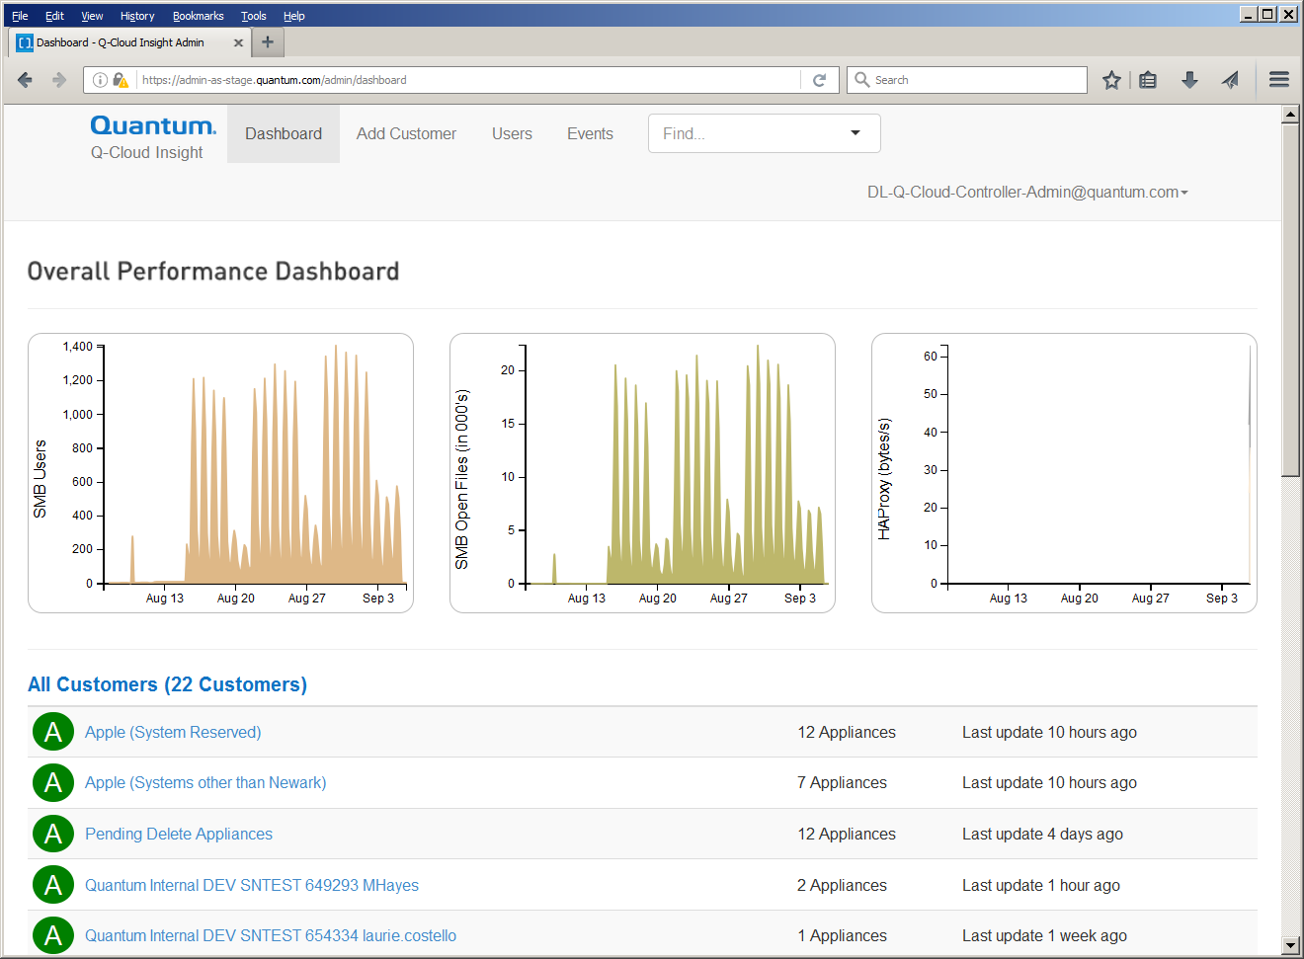
Autosupport Site – Dashboard Page

Slide 19
Upgrading NAS
Beginning with NAS 1.3.0, NAS clusters can be upgraded using the new “nascluster upgrade” command, from the Master node.
NOTE: This is a NAS 1.3.0 feature, and cannot be used until all nodes in the cluster are at 1.3.0
Upgrading to NAS 1.3.0
ALL nodes must be running NAS 1.2.5
Upgrades to NAS 1.2.5 follow “standard” procedure (either from local or external YUM repository)
NOTE: New with NAS 1.2.5, software for local install is a ‘tar-bundle’ un-tar this first, then run system upgrade local
Upgrade the Master node to 1.3.0, following standard procedure
Each non-master 1.2.5 node will automatically leave the cluster
Upgrade each non-Master node to 1.3.0
Each non-master node will automatically re-join the cluster once it’s at NAS 1.3.0

Slide 20
Upgrading NAS (cont.)
StorNext 5.4 will include NAS 1.3.0
Upgrade to NAS 1.3.0 is [mostly] automatic
NAS Installed or Configured?
NAS 1.3.0 seamlessly installed along with SN 5.4
NAS Installed, but not in Cluster?
NAS 1.3.0 is seamlessly installed along with SN 5.4
NAS Installed, but in a Cluster?
NAS is upgraded to 1.2.5
NAS 1.3.0, and dependent RPMs, are copied to /var/upgrade
Customer will need to run system upgrade local after all nodes have been upgraded to SN 5.4

Slide 21
Upgrading NAS (cont)
Example output, system upgrade
x86_64:snt660031-client1> system upgrade
Packages available for upgrade:
--------------------------------------------------------------------------------
quantum-snfs-nas.x86_64 1.3.0-5658.el6 snfs-nas
sernet-samba.x86_64 99:4.2.12-20.el6 snfs-nas
sernet-samba-client.x86_64 99:4.2.12-20.el6 snfs-nas
sernet-samba-common.x86_64 99:4.2.12-20.el6 snfs-nas
sernet-samba-libs.x86_64 99:4.2.12-20.el6 snfs-nas
sernet-samba-libsmbclient0.x86_64 99:4.2.12-20.el6 snfs-nas
sernet-samba-winbind.x86_64 99:4.2.12-20.el6 snfs-nas
sernet-samba-ctdb.x86_64 99:4.2.12-20.el6 snfs-nas
--------------------------------------------------------------------------------
*** During system upgrade, filesystem access will be interrupted. Continue (Yes/no)? Yes
Working... this may take some time...

Slide 22
Upgrading NAS (cont)
Example of new tar-bundle (for dark-sites and local installs)
[msevy@k2 ~]$ tar -tvf 1.2.5_customer_latest_OS6.tar.gz
-rw-r--r-- root/root 466556 2016-08-17 11:35 quantum-snfs-nas-1.2.5-5580.el6.x86_64.rpm
[msevy@k2 ~]$ tar -tvf 1.3.0_customer_latest_OS6.tar.gz
-rw-r--r-- root/root 128512 2016-08-03 13:54 libarchive-2.8.3-4.el6_2.x86_64.rpm
-rw-r--r-- root/root 597576 2016-09-03 03:53 quantum-snfs-nas-1.3.0-5658.el6.x86_64.rpm
-rw-r--r-- root/root 1620896 2016-08-03 13:54 sernet-samba-4.2.12-20.el6.x86_64.rpm
-rw-r--r-- root/root 465296 2016-08-03 13:54 sernet-samba-client-4.2.12-20.el6.x86_64.rpm
-rw-r--r-- root/root 248640 2016-08-03 13:54 sernet-samba-common-4.2.12-20.el6.x86_64.rpm
-rw-r--r-- root/root 349572 2016-08-03 13:54 sernet-samba-ctdb-4.2.12-20.el6.x86_64.rpm
-rw-r--r-- root/root 4842936 2016-08-03 13:54 sernet-samba-libs-4.2.12-20.el6.x86_64.rpm
-rw-r--r-- root/root 50652 2016-08-03 13:54 sernet-samba-libsmbclient0-4.2.12-20.el6.x86_64.rpm
-rw-r--r-- root/root 390116 2016-08-03 13:54 sernet-samba-winbind-4.2.12-20.el6.x86_64.rpm

Slide 23
Troubleshooting
Logs are located in /var/log
Key logs
/var/log/snnas_controller
/var/log/messages
/var/log/samba/samba.log.<username>
Logs can be directly viewed from NAS CLI/shell
log list
log search <phrase>
log view <log-file>
log watch <log-file>
Example: log view snnas_controller

Slide 24
Troubleshooting (cont)
Get a Support Bundle
supportbundle create
The support bundle contains logs and a picture of the system
Config files from /etc
Summary reports of RPMs installed, Controller Registry settings, and SAR data from the past few days.
Check out the Troubleshooting Tips and FAQs

Slide 25
Questions?

Slide 26
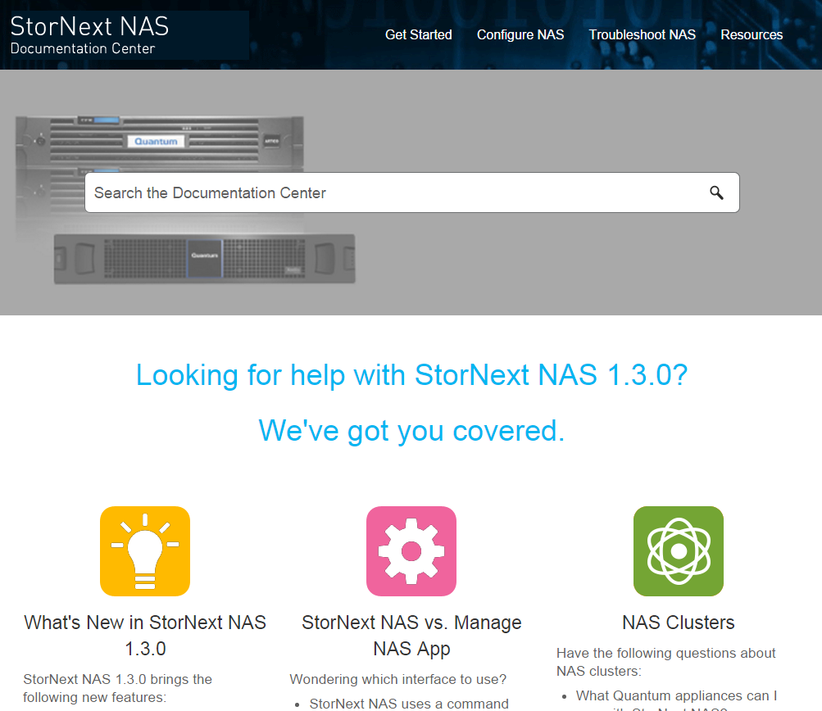
StorNext NAS 1.3.0 Documentation Center
All documentation is now consolidated into one searchable micro-site (Upgrade Flows, CLI Guide, Release Notes, and Troubleshooting Topics.)
Includes HTML pages and PDFs
Provides tasks specific to StorNext NAS 1.3.0
Links to the StorNext Connect Documentation Center, Appliance documentation, and StorNext documentation.
Available at www.quantum.com/snnasdocs
Can also be accessed from NAS Service and Support product pages on QDC and CSWeb.

Slide 27
Questions?

