Slide 1
Stornext M660 Service toi
Ping Hu
June 13th, 2012

Slide 3
Agenda
Product Management (5 minutes): Nick Elvester
Product Overview, Differences between M330/M660
Licensing, interactions between old/new
Service (2 minutes): Ping Hu
High Level Service Strategy and FRU list overview
Educational Services and Tech Pubs (2 minutes): Charlotte Taylor
Available documentation and training
Hardware (10 minutes): Dan Byers
System block diagram/Configuration
Platform Software (20 minutes): Brian Raccuglia
Differences in Service menu/Networking/Expansion
Root password, Upgrade expectations
StorNext Software (20 minutes): Brent Pettit/Paal Olsen
GUI changes, Software differences, File System Configuration
Gateway functionality/Setup, Gateway Metrics, Licenses

Slide 4
StorNext M660 Introduction
Nick Elvester
Product Manager
June 2012

Slide 5
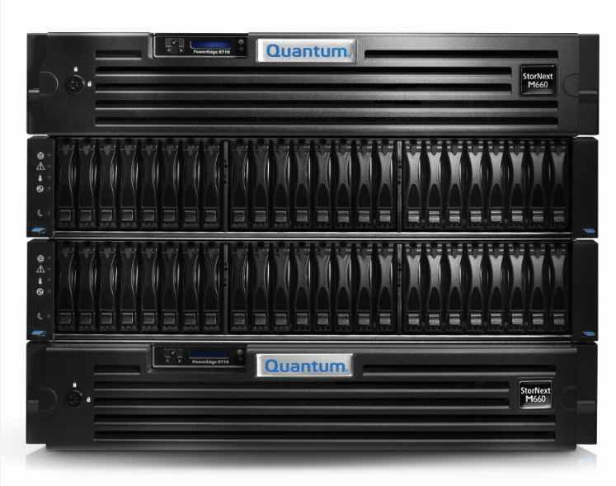
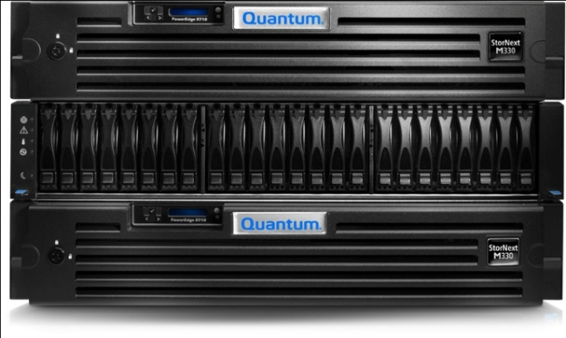
Introducing StorNext M660 Metadata Appliance
The brains behind the #1 file system & archive
Big brother to StorNext M330
Up to 800 million files in up to 8 file systems
What’s included:
Dual nodes for HA
Dedicated metadata array
10 SAN clients
Dual gateways for LAN access
DDM on standby node
M660 Metadata Appliance
Notes:
50 million files per file system in 4.2
100 million file per file system in 4.3
M660: 4 → 8 file systems = 400 → 800 files

Slide 6
M330 vs M660: Key Differences Chart
 | M330 | M661 | M662
Scalability | Up to 60 million files 2 or 4 file systems | Up to 800 million files 4 file systems base 8 file systems with optional expansion
Software Included in Base Price | 10 File System SAN Clients High-Availability | 10 File System SAN Clients High Availability Dual StorNext Gateway with unlimited DLC clients DDM license for secondary node
Base System Metadata Storage | Dedicated metadata array 6 drives plus 1 hot spare 2 or 4 file systems | Dedicated metadata array 22 drives plus 2 hot spares 4 file systems
Optional Metadata Expansion Unit | N/A | 22 drives plus 2 hot spares 4 additional file systems
High-Availability Features | Dual MDC with automatic failover RAID 1 Redundant power supplies Redundant cooling fans 4GB mirrored RAID battery backed cache | Dual MDC with automatic failover RAID 1 Redundant power supplies Redundant cooling fans 4GB mirrored RAID battery backed cache Redundant FC
Form Factor | 6U total height Rack-mountable | 6U base system Rack-mountable 8U with optional expansion unit
Connectivity (ports per node) | Two 8Gb FC Three copper 1GbE | Four 8Gb FC Eleven 1GbE | Four 8Gb FC Seven 1GbE Two 10GbE (optical or copper Twinax)
Client OS Support | Linux, Windows, AIX, HP-UX, Solaris, Mac OS

Slide 7
Qualifying Metrics for Reference Architectures
Qualifying Metrics | Entry Level | Mid-Range | High Perf. High Cap.
Raw Capacity | 36TB | 108TB | 2160TB
Usable Capacity | 24TB | 81TB | 1728TB
Aggregate Throughput | 3.6GB/s | 3.6GB/s | 7.2GB/s
Single Stream Throughput | 800MB/s with 8Gbps FC
Simultaneous Streams | 60 | 120 | 720
Max Latency (ms) | 40
Number of Files | 60 million |  | 100 million per file system
Number of File Systems | 1 - 4 |  | 1 - 8
Number of File Creates Per Second | 3500 | 3500 | 6000
Number of Clients | 1500
Number of disk drives is the limiting factor. Consider adding more EBOD chassis.
Number of Q-Series base systems is the limiting factor. Consider adding more base systems to add throughput and capacity.
8Gbps FC is the limiting factor. Consider adding more HBA ports to the client for additional throughput.
M330 is the limiting factor. Consider an M660.
StorNext Limit

Slide 8
StorNext M660 Service Overview
Ping Hu
June 2012

Slide 9
M660 Service Strategy
Service Strategy same as M330
GCH/CDS: 1st Call
SPS: Tech Support
HW Eng: HW escalations (only if escalation to Dell/NetApp unsuccessful)
StorNext SUS: StorNext SW and other escalations
QFE: Field Service
PS (Professional Services): Installation & Field HW upgrade/conversions
No CRUs
DELL field inventory for DELL FRUs
Quantum Choice Logistics for all other FRUs (including NetApp)

Slide 10
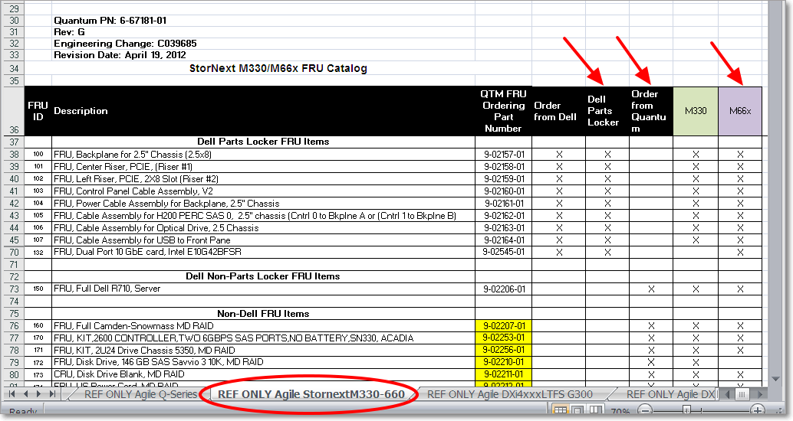
M660 FRU List

Slide 11
StorNext M660 Documentation & training
Charlotte Taylor
June 2012

Slide 12
Documentation and Training
Documentation
StorNext User’s Guide M660 Site Planning Guide M660 Hardware Guide M600 User Essentials document | Customer-facing
M660 Installation and Configuration Guide M660 Field Service Manual StorNext and StorNext Appliances: Troubleshooting Tools job aid | Professional Services (PS), ASSPs, Tech Support
M660 At a Glance document | Global Call Handling
Training
M660 Installation online course M660 Hardware and Cabling aid | PS, ASSPs, Tech Support, QFEs

Slide 13
StorNext M660 Hardware review
Dan Byers & Kempton Redhead
Hardware Engineering
June 2012

Slide 14
Hardware Overview
System Overview
Hardware Components
System Interconnect
Bios and Firmware

Slide 15
1. System Overview

Slide 16
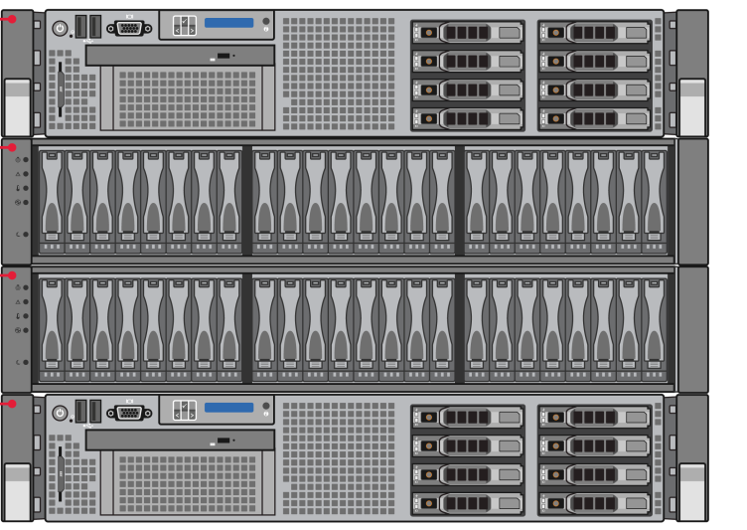
System Overview
M660 with bezels removed
M661 and M662 Metadata Nodes
M661 -Two Dell R710s.
4x 8G FC Ports
11x 1G Ethernet customer ports
1x 1G Ethernet service port
M662 – Two Dell R710s.
4x 8G FC Ports
2x 10G Ethernet customer ports
7x 1G Ethernet customer ports
1x 1G Ethernet service port
M661 and M662 Metadata Array
Uses NetApp 2600
Redundant Controllers
2x 900G 10K RPM drives as Hot Spares for 900G & 300G drive failures
6x 900G 10K RPM drives HA File System
16x 300G 15K RPM drives for meta data
Base System 6U
Base + Expansion 8U
Not shipped in a System Rack
Supports Quantum provided rack.
© 2009 Quantum Corporation. Company Confidential. Forward-looking information is based upon multiple assumptions and uncertainties, does not necessarily represent the company’s outlook and is for planning purposes only.
Notes:
© 2008 Quantum Corporation. Company Confidential. Forward-looking information is based upon multiple assumptions and uncertainties, does not necessarily represent the company’s outlook and is for planning purposes only.
16

Slide 17
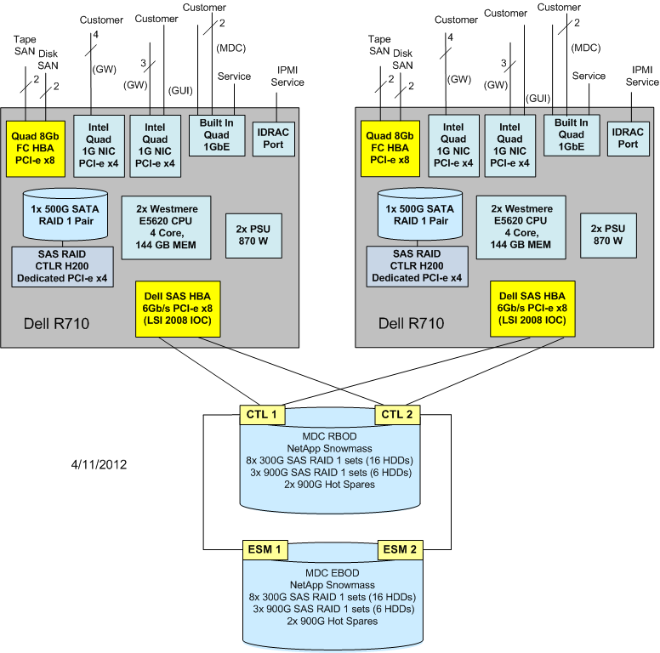
System Overview – M661 Architecture
Configuration Notes:
1. 7x User Configurable 1 GbE ports.
2. 2x 1GbE ports MDC connection.
3. 2x 1GbE ports for GUI/Management
4. 1x 1GbE port for service.
5. 4x 8G FC ports Disk and Tape SAN connection.
6. Allocated PCI-e slots:
Total PCI-e slots = 4 + 1.
x8 – 2 available
One used by quad port 8G FC HBA.
One used by dual port 6G SAS HBA
x4 - 2 available.
Quad port 1G NIC installed in both
x4 - Internal Raid H200.
© 2009 Quantum Corporation. Company Confidential. Forward-looking information is based upon multiple assumptions and uncertainties, does not necessarily represent the company’s outlook and is for planning purposes only.
Notes:
© 2008 Quantum Corporation. Company Confidential. Forward-looking information is based upon multiple assumptions and uncertainties, does not necessarily represent the company’s outlook and is for planning purposes only.
17

Slide 18
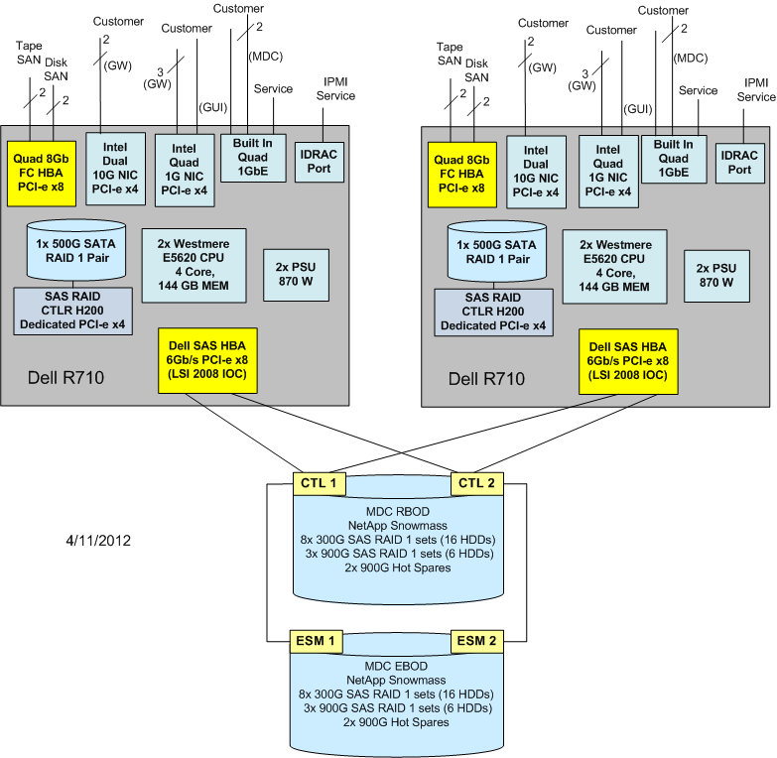
System Overview – M662 Architecture
Configuration Notes:
1. 2x Customer Configurable 10 GbE ports
2. 3x customer Configurable 1GbE ports
3. 2x 1GbE ports MDC connection
3. 2x 1GbE ports for GUI/Management
4. 1x 1GbE port for service.
5. 4x 8G FC ports Disk and Tape SAN connection.
6. Allocated PCI-e slots:
Total PCI-e slots = 4 + 1.
x8 – 2 available
One used by quad port 8G FC HBA.
One used by dual port 6G SAS HBA
x4 - 2 available.
One used for Dual port 10G NIC.
One used for quad port 1G NIC.
x4 - Internal Raid H200.
© 2009 Quantum Corporation. Company Confidential. Forward-looking information is based upon multiple assumptions and uncertainties, does not necessarily represent the company’s outlook and is for planning purposes only.
Notes:
© 2008 Quantum Corporation. Company Confidential. Forward-looking information is based upon multiple assumptions and uncertainties, does not necessarily represent the company’s outlook and is for planning purposes only.
18

Slide 19
2. Hardware Components

Slide 20
M66x Metadata Node
Summary of features
Dell R710
Dual Intel Westmere E5620 CPU’s (4 core/12MB cache).
Intel Tylersburg-EP chipset.
144GB DDR3 RDIMM (1066MHz).
72G per processor.
Uses 9 each of 4G RDIMMs per processor (3 per memory bank).
2x 500G SATA HDD’s installed as RAID 1 (6 blanks in slots 3-8).
No RAID battery backup unit used on Metadata node.
Dual, redundant hot swappable power supplies (870W).
© 2009 Quantum Corporation. Company Confidential. Forward-looking information is based upon multiple assumptions and uncertainties, does not necessarily represent the company’s outlook and is for planning purposes only.
Notes:
© 2008 Quantum Corporation. Company Confidential. Forward-looking information is based upon multiple assumptions and uncertainties, does not necessarily represent the company’s outlook and is for planning purposes only.
20

Slide 21
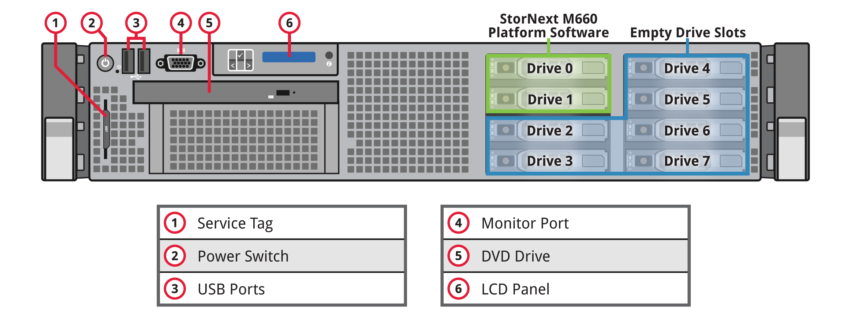
M66x Metadata Node (Same as M330) – Front View
© 2009 Quantum Corporation. Company Confidential. Forward-looking information is based upon multiple assumptions and uncertainties, does not necessarily represent the company’s outlook and is for planning purposes only.
Notes:
© 2008 Quantum Corporation. Company Confidential. Forward-looking information is based upon multiple assumptions and uncertainties, does not necessarily represent the company’s outlook and is for planning purposes only.
21

Slide 22
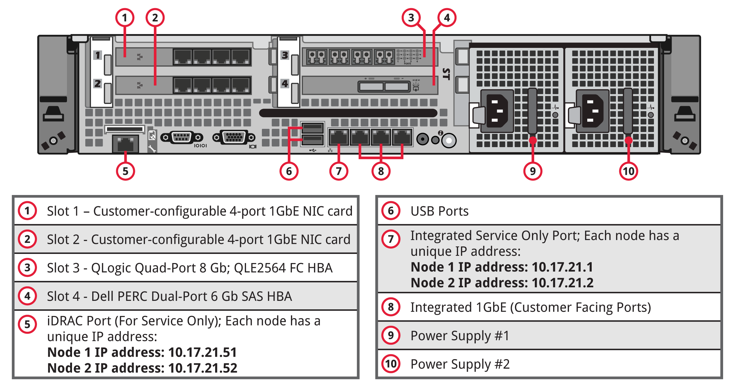
M661 Metadata Node –Rear View
© 2009 Quantum Corporation. Company Confidential. Forward-looking information is based upon multiple assumptions and uncertainties, does not necessarily represent the company’s outlook and is for planning purposes only.
Notes:
© 2008 Quantum Corporation. Company Confidential. Forward-looking information is based upon multiple assumptions and uncertainties, does not necessarily represent the company’s outlook and is for planning purposes only.
22

Slide 23
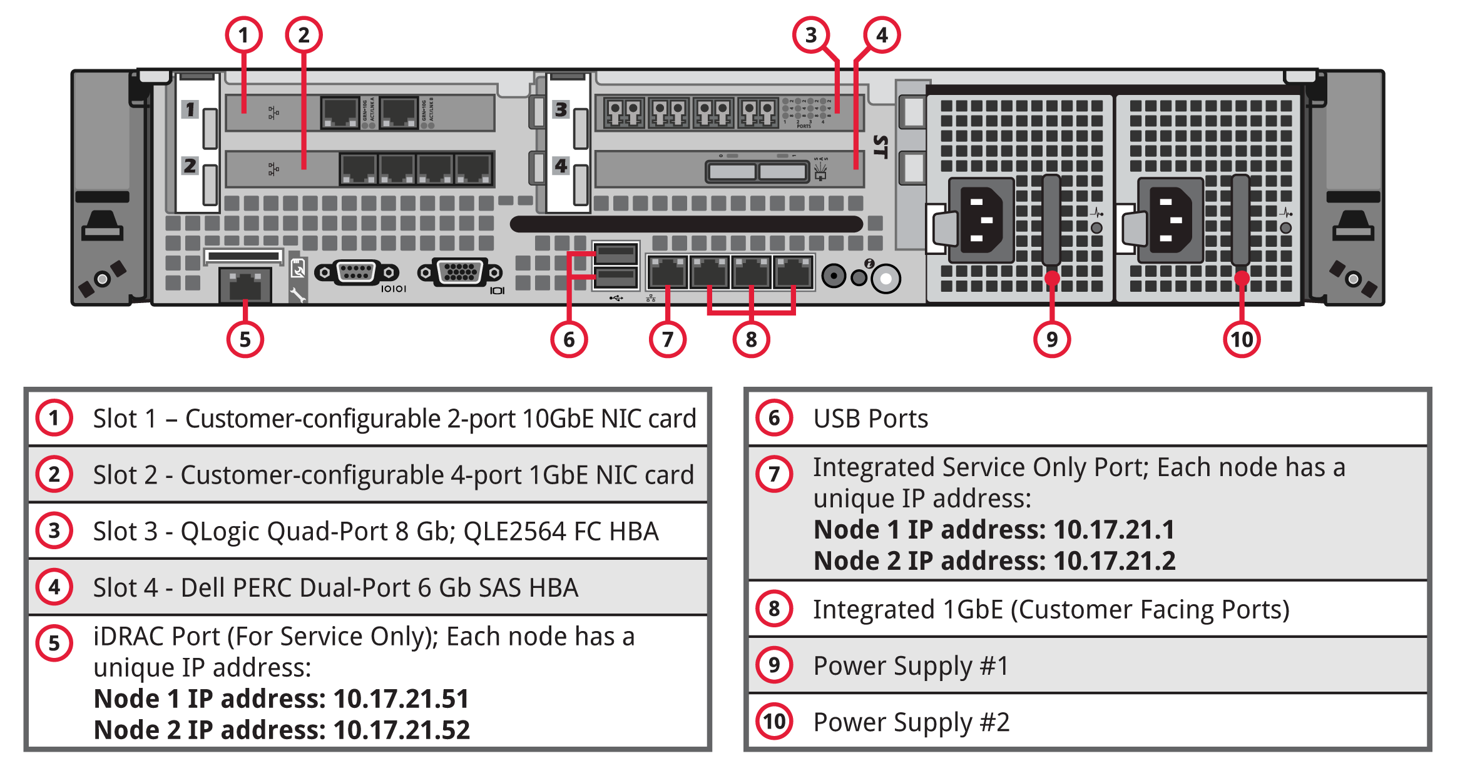
M662 Metadata Node –Rear View
© 2009 Quantum Corporation. Company Confidential. Forward-looking information is based upon multiple assumptions and uncertainties, does not necessarily represent the company’s outlook and is for planning purposes only.
Notes:
© 2008 Quantum Corporation. Company Confidential. Forward-looking information is based upon multiple assumptions and uncertainties, does not necessarily represent the company’s outlook and is for planning purposes only.
23

Slide 24
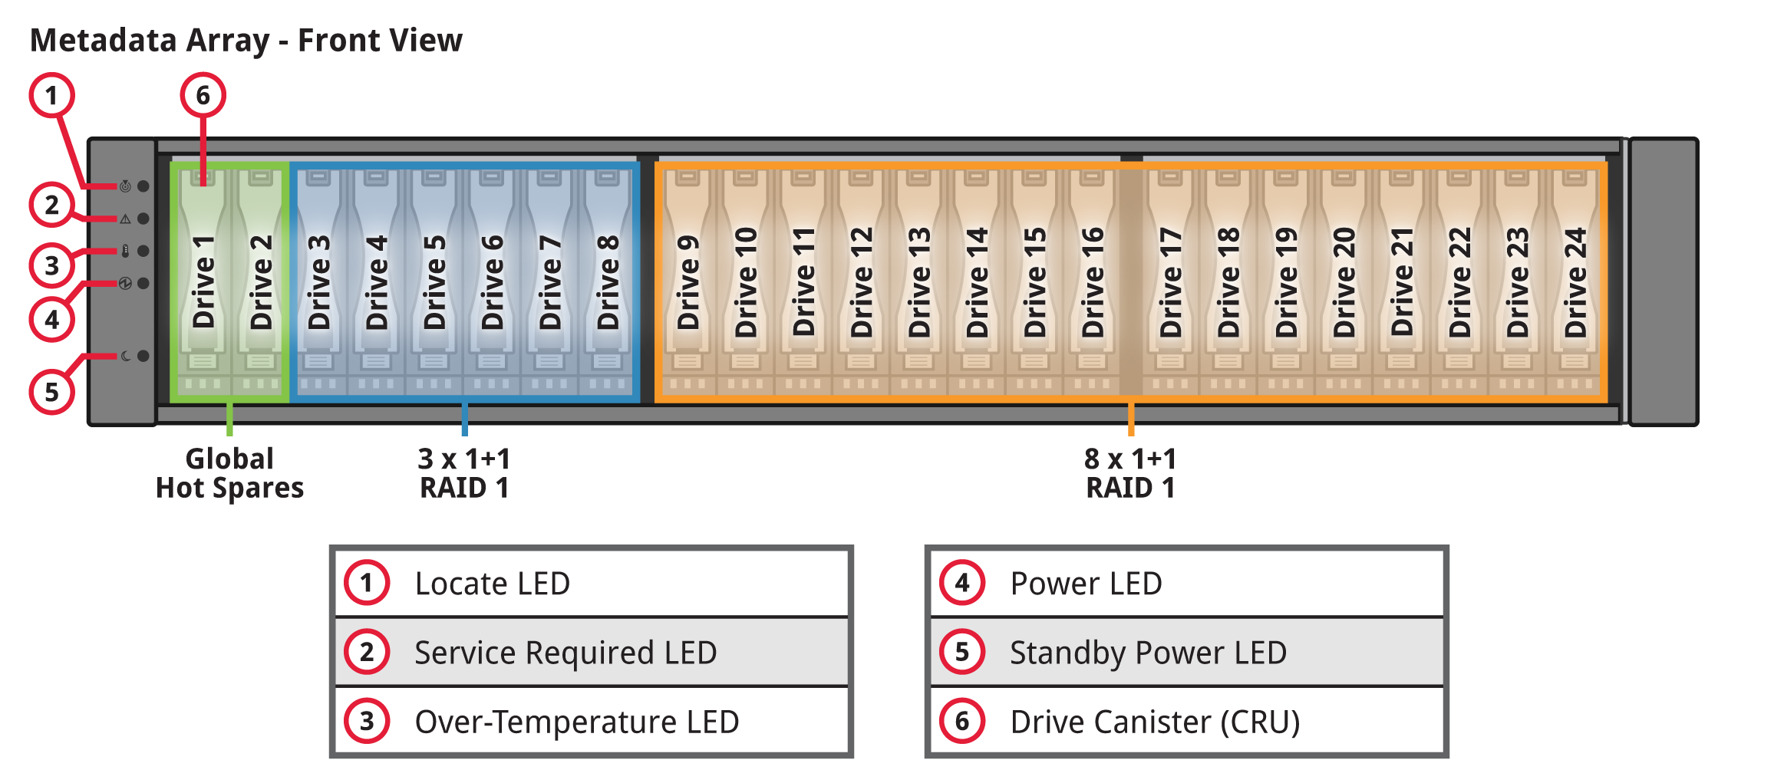
Metadata and Expansion Array Front View
24 Hdds installed
Drive Slots 1 and 2 are 900G Global Hot spares(used for both 900G and 300G HDD failures).
Drives in slots 3 though 8 are 900G 10K RPM
3 RAID 1 pairs
Shared HA file system and management
Drives in slots 8 though 24 are 300G 15K RPM
8 RAID 1 pairs
File system metadata.
The Expansion Array chassis is populated in the same fashion

Slide 25
Metadata and Expansion Array Rear View

Slide 26
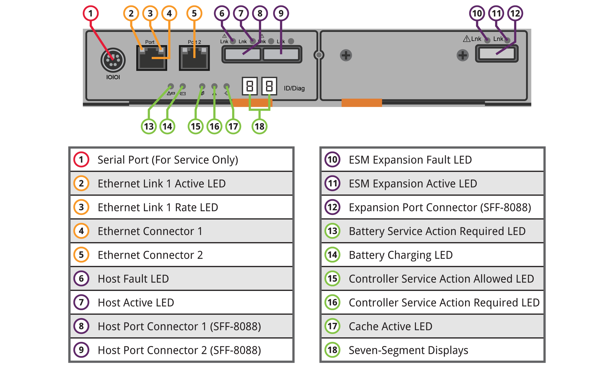
Metadata Array Controller

Slide 27
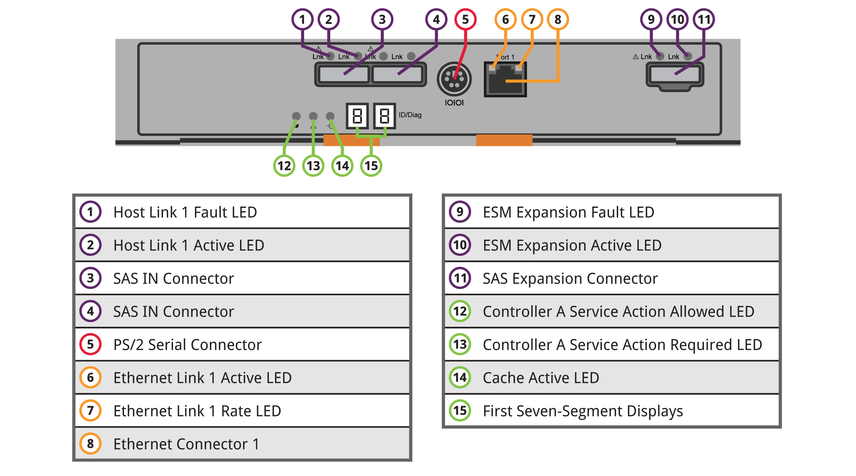
Metadata Expansion Array ESM

Slide 28
3. System Interconnect

Slide 29
SAS Cable Connections

Slide 30
Redundant Power Connection

Slide 31
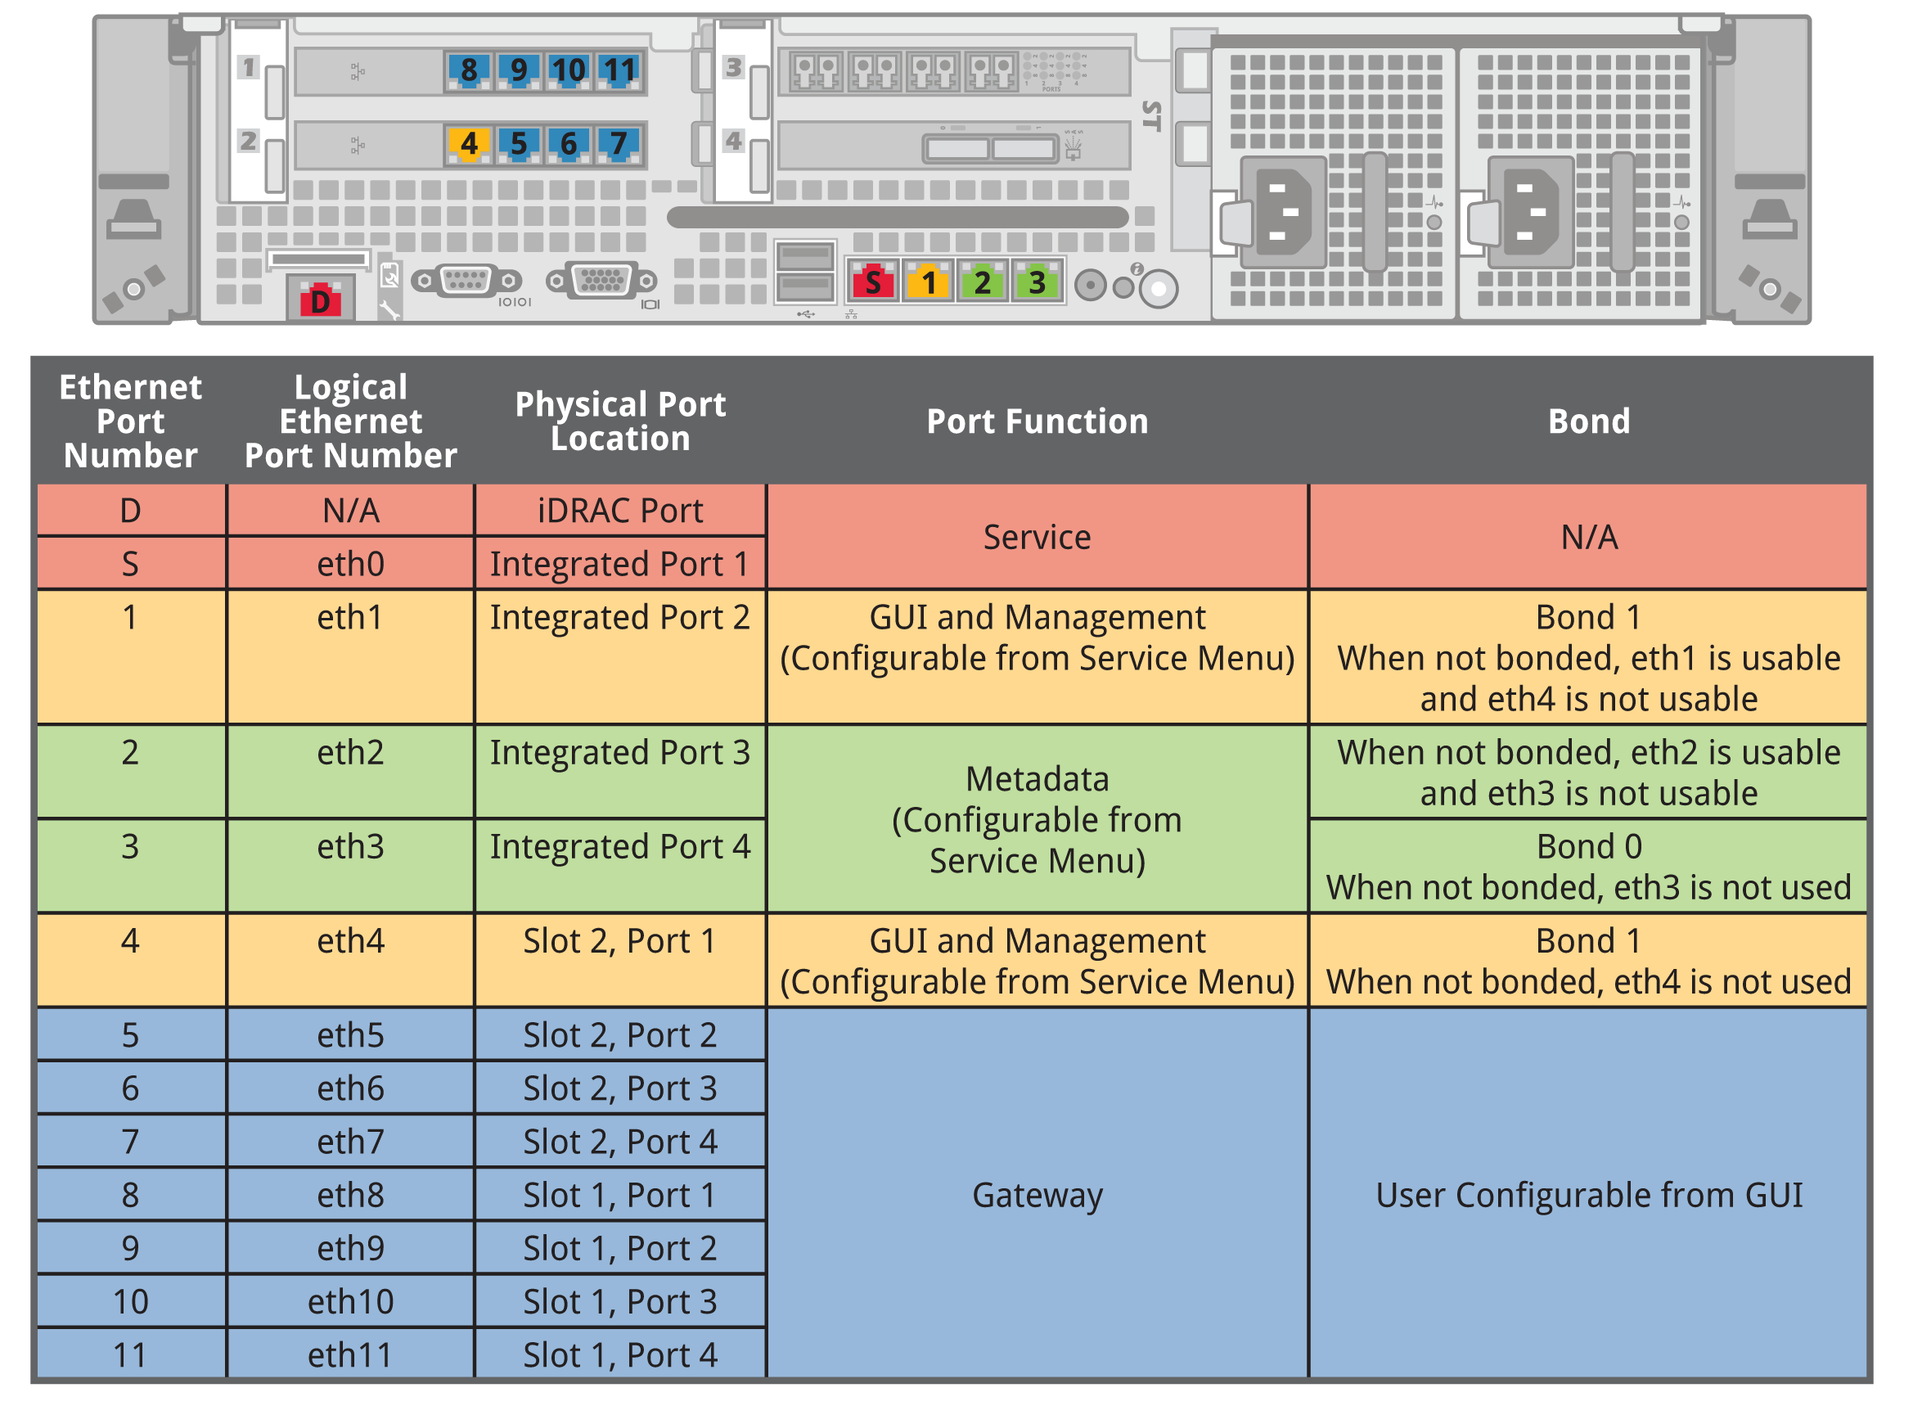
M661 Ethernet Port Usage
Notes:
31

Slide 32
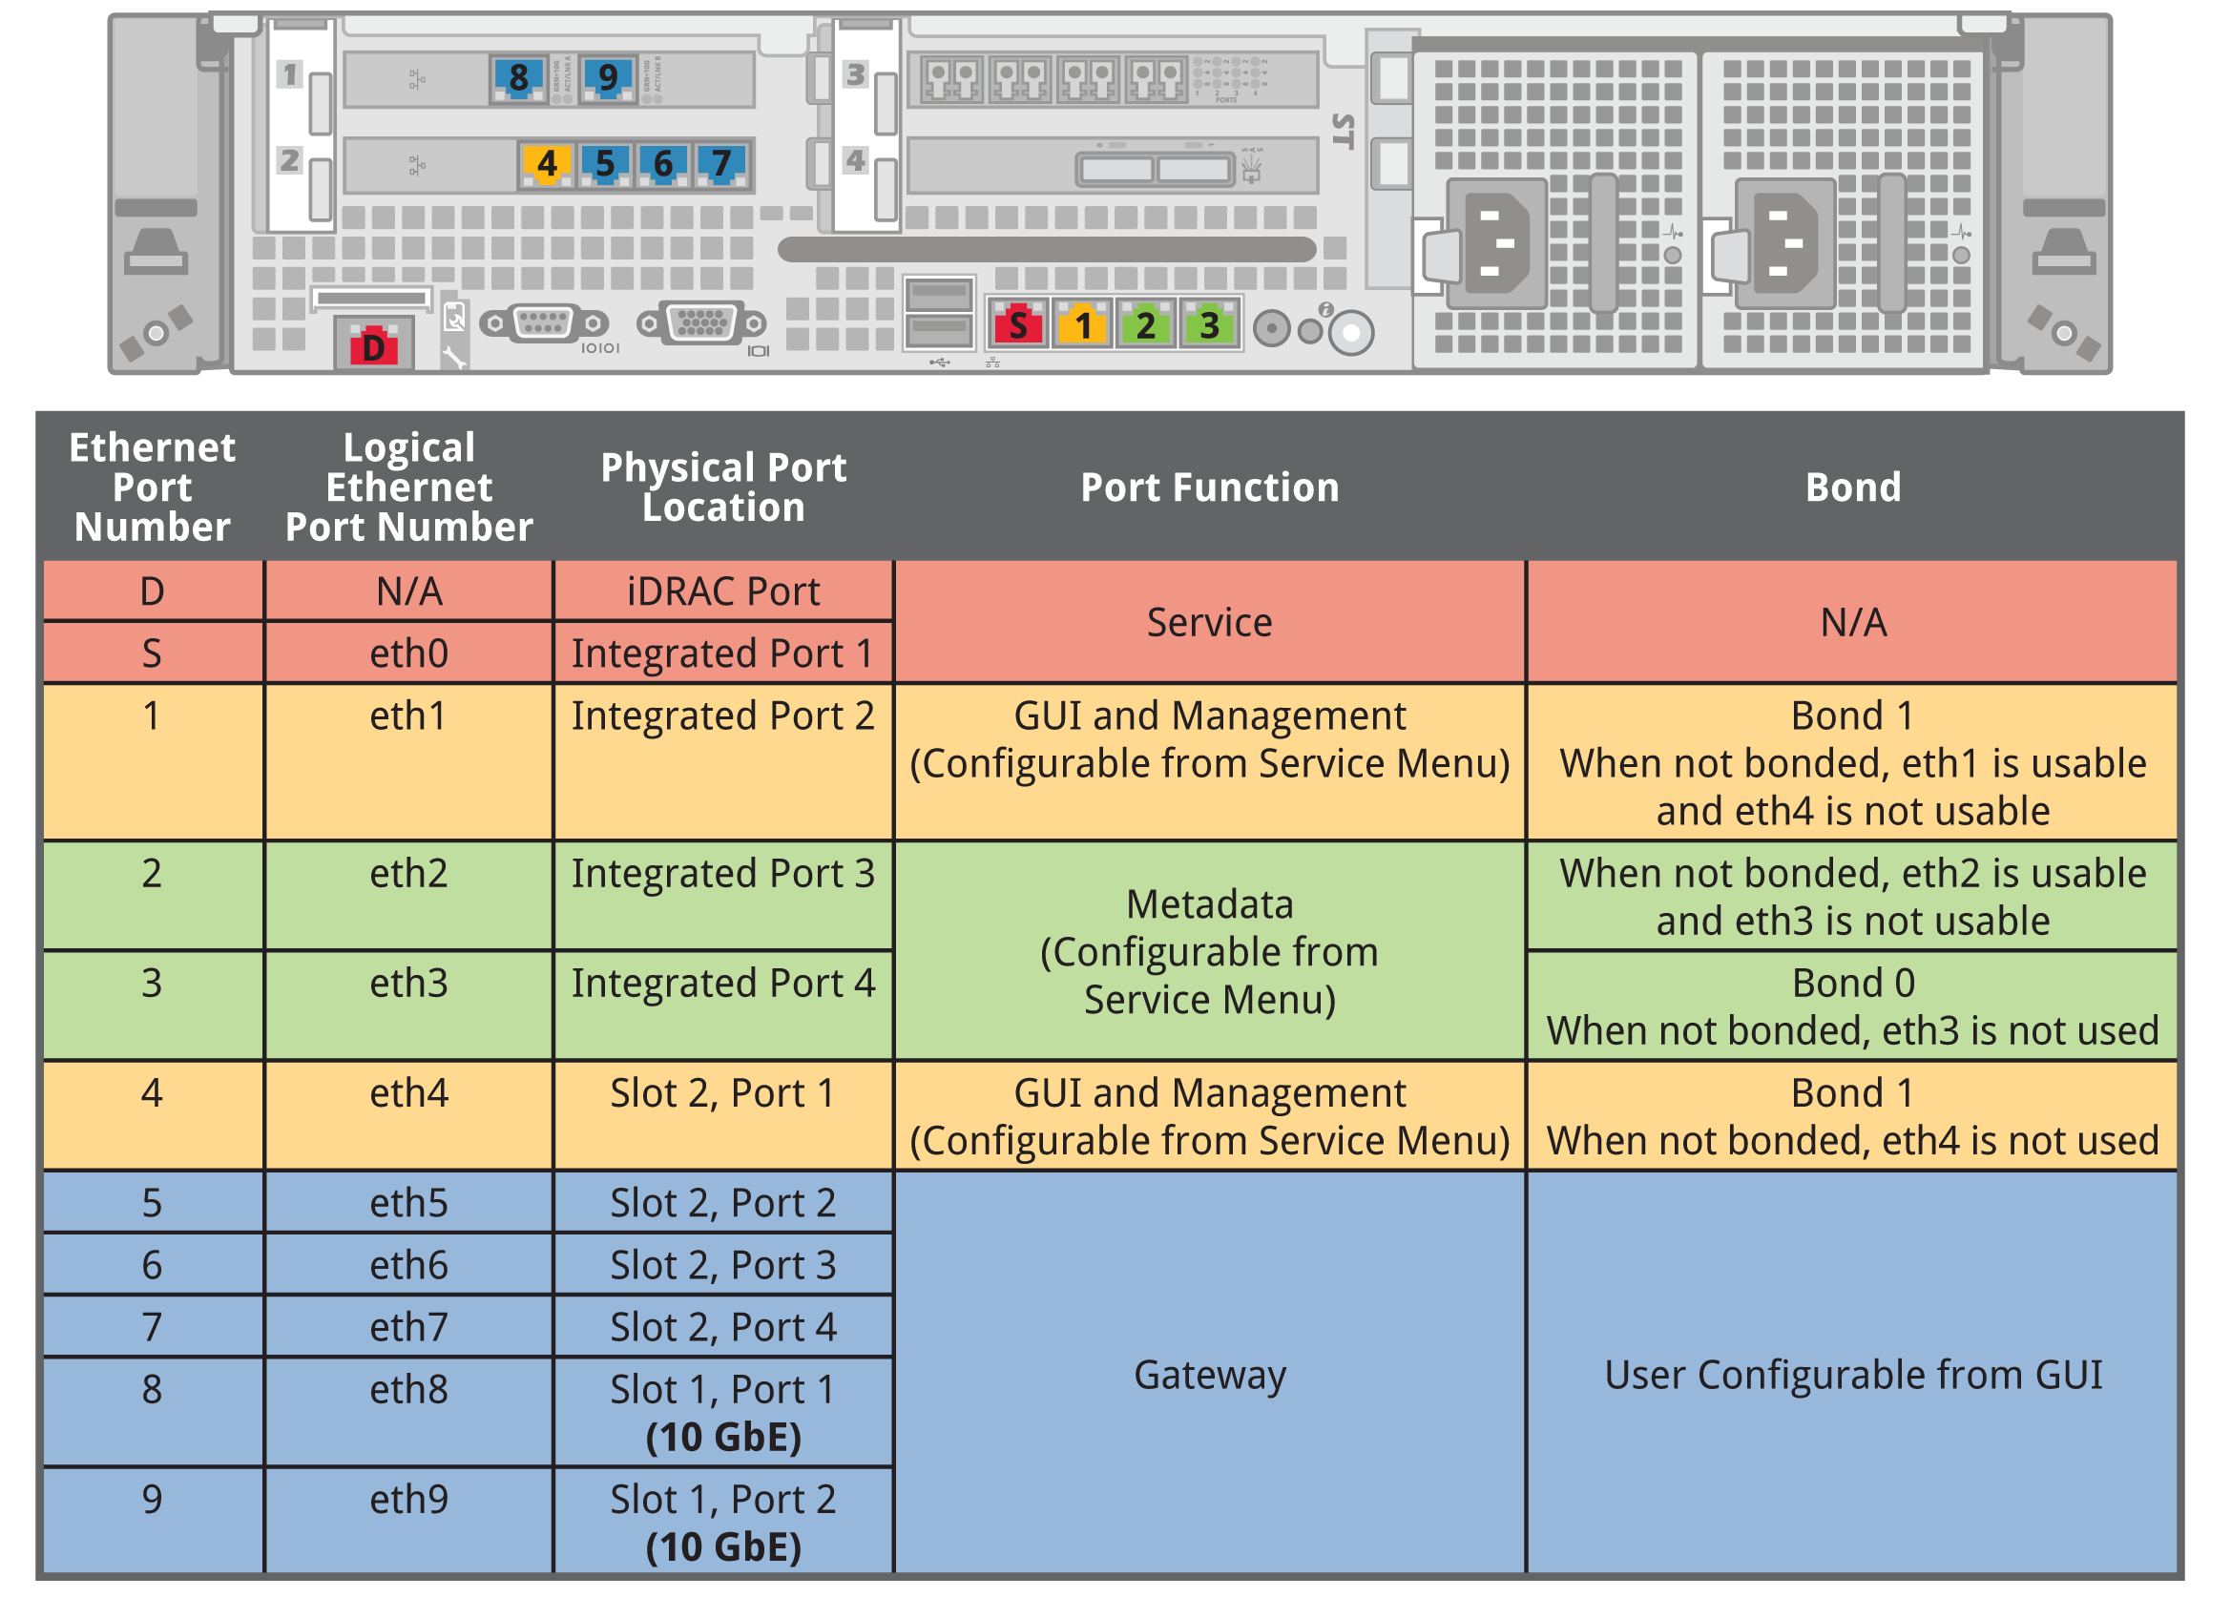
M662 Ethernet Port Usage
Notes:
32

Slide 33
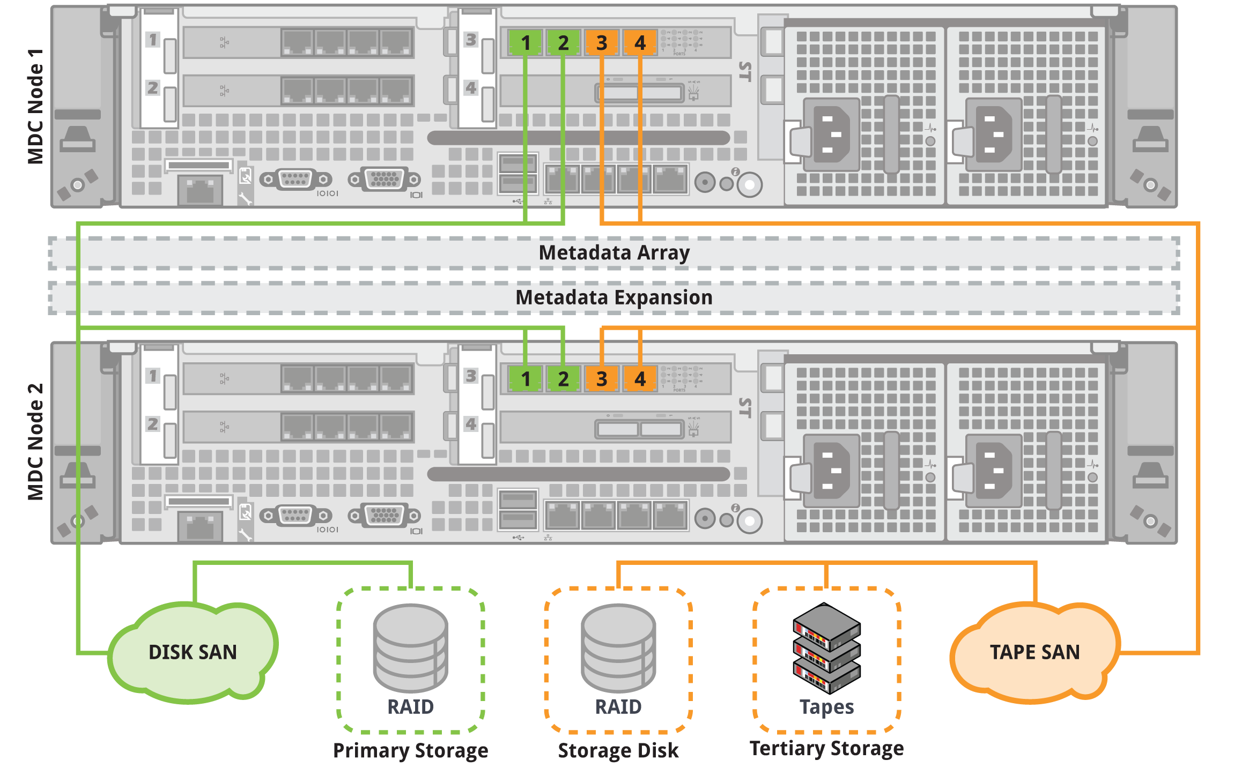
M66x FC Port Usage

Slide 34
4. Firmware and BIOS Settings

Slide 35
BIOS And Firmware
Bios and firmware versions are specified and qualified (as matched sets) by engineering. This includes:
M66x Server Bios.
M66x Server firmware.
Metadata Array firmware.
Product Bios and firmware versions do not change until qualified and released by engineering.
Unqualified versions should not be shipped or installed in the field.
Most M66x firmware is auto-leveled (up or down) by the software.
The BIOS is auto-upgraded only by the M660x software. Downgrade is manual.
© 2009 Quantum Corporation. Company Confidential. Forward-looking information is based upon multiple assumptions and uncertainties, does not necessarily represent the company’s outlook and is for planning purposes only.
Notes:
© 2008 Quantum Corporation. Company Confidential. Forward-looking information is based upon multiple assumptions and uncertainties, does not necessarily represent the company’s outlook and is for planning purposes only.
35

Slide 36
FW Version and Leveling
© 2009 Quantum Corporation. Company Confidential. Forward-looking information is based upon multiple assumptions and uncertainties, does not necessarily represent the company’s outlook and is for planning purposes only.
Notes:
© 2008 Quantum Corporation. Company Confidential. Forward-looking information is based upon multiple assumptions and uncertainties, does not necessarily represent the company’s outlook and is for planning purposes only.
36

Slide 37
BIOS Settings
OEM Ready XL BIOS(not custom for Quantum).
5 of the customized BIOS Settings are not configurable by M66x software. These settings need to be manually set in manufacturing and in the field during a FRU motherboard or CMOS battery replacement:
System Memory Testing – Default is enabled → Quantum sets to disabled.
Embedded NIC 1 and 2 – Default is enabled with PXE → Quantum sets to enabled.
Remote Terminal Type – Default is VT100 → Quantum sets to ANSI.
Report Keyboard Errors – Default is report → Quantum sets to Do Not Report
F1/F2 Prompt on Error – Default is enabled → Quantum sets to Disabled.
9 other BIOS settings are not checked by M66x software but use Dell defaults.
The rest of the Bios settings are checked and set by M66x software.
© 2009 Quantum Corporation. Company Confidential. Forward-looking information is based upon multiple assumptions and uncertainties, does not necessarily represent the company’s outlook and is for planning purposes only.
Notes:
© 2008 Quantum Corporation. Company Confidential. Forward-looking information is based upon multiple assumptions and uncertainties, does not necessarily represent the company’s outlook and is for planning purposes only.
37

Slide 38
StorNext M660 Platform Software
Brian Raccuglia
June 2012

Slide 39
Platform Software
Service Menu changes vs. M330
M660 does not have the options to reconfigure the MD LUNs to allow for more filesystem support. There is now a physical expansion option for the M660 to expand the number of supported filesystems
M661 has a “conversion” option to convert an M661 to and M662
*** Service Engineering Tools Menu ***
0) Base OS Network Setup - Setup networking for Base OS.
1) Hardware Status >>> - Display hardware component status and information.
2) Conversions Menu >>> - Convert node or network setup.
3) Create Shared Filesystem - MFG USE ONLY: Create the shared SNFS filesystem for HA use.
4) Convert to M662 model - Hardware conversion from M661 to M662 model.
This conversion option will ask for confirmation and then power down the node so the 4-port 1Gbe card can be replaced with the 2-port 10Gbe card.
Note: This should be done on both nodes at the same time.
The existing network configuration on the old 4-port card will be deleted and the network for the 10Gbe ports will need to be done by the customer in the GUI.
39

Slide 40
Platform Software
EBOD expansion option
New option under the Hardware Configuration -> Setup external Array menu
*** Service Setup Array Menu ***
0) Save Array configurations - Save all Array configs before modifications.
1) Rescan for Arrays - Rescan the system for the connected NetApp array.
2) Upgrade Array Firmware >>> - Download new Array Controller Firmware or NVSRAM.
3) Display Array BBU status - Display the status and age of the array BBU.
4) Reset Array BBU date - Reset the day counter for a replaced array BBU.
5) Replace Array controller - Replace an array controller.
6) Add an EBOD to an Array - Add an EBOD to an existing Array.
7) Manufacturing >>> - Tools for Manufacturing.
This option will walk you through connecting and powering on the new EBOD and importing the preinitialized LUNs. The shared filesystem will automatically be expanded during this process.

Slide 41
Platform Software
Manufacturing option
Option added to remove an EBOD from the system. This is for MFG use only since this will be used by MFG after initializing the tray in MFG to prepare the tray to be used as an expansion upgrade in the field. Do not use this in the field.
*** Service Setup Manufacturing Array Menu ***
0) Remove an EBOD - Remove an EBOD.
1) Initialize Array - Reinitialize the NetApp Array.
Your Choice ('q' to Exit this Menu):

Slide 42
Platform Software
Network configuration
These service menu items have changed the most for both the M330 and M660 systems
*** Network Menu ***
0) Display external ports - Display all external ethernet ports.
1) Configure host settings - Configure hostname, DNS and default gateway.
2) Configure Metadata Network - Configure metadata network ports.
3) Configure Management Network - Configure management network ports.
4) Activate Network Changes - Apply changes and restart the network.
Your Choice ('q' to Exit this Menu):
Many of these changes are modeled after the G300 service menu
Service menu can only be used to configure the Metadata and Management network ports. Remaining ports for gateway access etc. are only configurable through the GUI.
Metadata and Management networks can either use bonding (2 ports allocated for each network) or non-bonding (1 port can be used and remaining port is unused)

Slide 43
Platform Software
Root Password
Root access is unchanged from previous M330 release.
Stornext user account (stornext) should be used first for shell login and then sudo to root access using “sudo rootsh”
Customer still owns the stornext user account password.
Make sure the customer changes the password at the end of the installation using the “passwd stornext” command on both nodes.
Upgrades for M330 and G300
The M330 upgrade will include an OS upgrade from CentOS 5.4 to CentOS 5.7
The G300 upgrade will include an OS upgrade from CentOS 6.0 to CentOS 6.2 to match the M660
The upgrades also include several FW updates to hardware components in the nodes. This will cause the upgrade to run for approximately 1 hour and 40 minutes from start to finish on the M330.
Status during the upgrade process is limited. If you have an iDRAC console open, you can see the FW auto-leveling process during the boot up. The FW auto-leveling will also cause a few reboots of the nodes in order to reset and apply the FW on the various HW components.
The OS upgrades consists of 400+ RPM package updates
The message here is to please “be patient”

Slide 44
StorNext 4.2.2.0.1 For The M660/M330
Brent Petit
June 2012

Slide 45
StorNext on the M660
Key enhancements
The M660 is licensed and provisioned to serve as a DLC Gateway
Gateway Reporting is included
DDM license is included for the MDCs
Up to 8 User File Systems
Base unit supports 4 user file systems
Expansion option provides support for 8
Expansion provides more metadata disks and additional HA-Shared file system capacity
Updated StorNext Software
Initial release to include StorNext 4.2.2.0.1
StorNext 4.3.0 coming soon

Slide 46
M660 Disk Expansion
Base Array
Metadata for four file systems
800GB of metadata each
2.7TB of HA/SM Disk
Expansion Array
Metadata for four Additional file systems
800GB of metadata each
Additional 2.7TB of HA/SM Disk
When Expansion Array is added HA/SM File System is expanded
2.7TB Base + 2.7TB Expansion = 5.4TB total HA/SM
Expansion Array provides enough metadata and HA/SM space to support 100M files per file system
4.2.2.0.1 supports 30M files/FS, 4.3.0 will support 100M files/FS

Slide 47
Gateway on the M660
The M660 MDCs can be configured to serve as DLC Gateways
Both nodes will run active/active Gateway if configured
M660 includes new Gateway License
Configuration is accomplished via the CLI
Gateways on the M660 will show up in the Gateway reporting GUI

Slide 48
What's New in 4.2.2.0.1
M660 StorNext release based on the Software seen on the M330, with some modifications.
Updated Network Config GUI
Provides more flexibility in network configurations
Allows for configuring Jumbo Frames
M330 will also get an updates
Metadata I/O Path Updates
Improvements to eliminate the need for extraneous LUN carving
RAS Email Updates
M660/M330 Serial Number included in RAS emails

Slide 49
Updates to the GUI
Network Configuration Enhancements
Based on feedback from M330 deployments
Provides more flexibility in network configurations
Allows for configuring Jumbo Frames
M330 will also get an updated network configuration window

Slide 50
M660 Network Config Window

Slide 51
Metadata I/O Path Updates
The M330 included additional metadata LUN configurations to accommodate a field practice of providing multiple metadata LUNs to a file system
Options would carve a single disk into multiple LUNs
This LUN carving was to work around an a SN architectural limitation which would serialize I/Os
The down-side is that the LUN carving could introduce unnecessary seek latency due to the disk configurations
The metadata I/O path updates eliminate the need for carving disks into multiple LUNs
The recommendation moving forward is to not carve metadata disks into multiple LUNs
Whole single metadata disks will perform better than the same disk carved into multiple metadata LUNs.

Slide 52
Notes on 4.3.0
4.3.0 will release not long after the M660 is released
4.3.0 will be available on the M-series at 4.3.0 GA
This upgrade will include a conversion from the Linter DB to the MySQL DB
The supported number of files per file system on the M660 increases from 30M to 100M with the 4.3.0 upgrade

Slide 53
Q/A
Questions?

