Slide 1
LATTUS INSTALLATION
Sunil Joshi
August 2015

Slide 2
Lattus Installation Overview
Lattus Pre-Installation
Lattus Installation
Lattus Configuration / Post Installation
Lattus Tuning
Burn-in Test
Lattus Usage
StorNext GUI Configuration
Lattus Upgrades

Slide 3
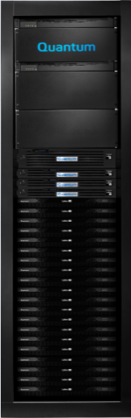
Lattus Pre-Installation
Lattus Single Site (Single Rack)
Lattus Single Site Lattus S10/S20/S30 Storage Node
  Extensible storage for the object data
Lattus C10/C5 Controller Node
  The brains of the Lattus wide area storage
Lattus S60/S55 Rack Switch
  Provides interconnectivity between controllers and storage nodes.
Lattus-M (M662)
  StorNext Storage Manager accessing Lattus via REST/S3 Interface

Slide 4
Lattus Pre-Installation
Analyze the Sizing Tool output to determine the customer’s need.
Verify the customer supplied host connection and IP address.
Complete the Installation Planning Worksheet with the customer. The worksheet contains:
  Customer’s IP address ranges, subnet ,etc.
  Node/port connections to racks/ports.
  Total network created on Controller

Slide 5
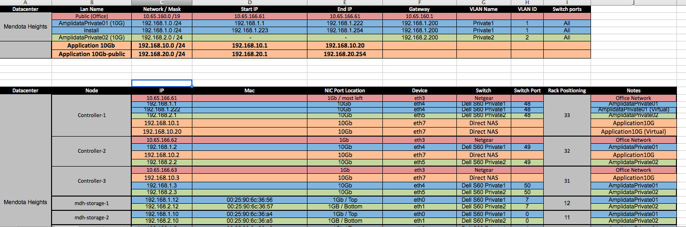
Lattus Pre-Installation
  Example of Single Site Installation Planning Worksheet

Slide 6
Lattus Pre-Installation
Installation Environment Considerations.
  Allow sufficient time for all components to properly acclimate to the environment; particularly during times of severe external temperatures (hot or cold).
  Never take a Lattus component directly from the dock to the Installation location and begin installing component and powering them on.
Firewall Settings
  Make sure to configure Firewall properly to ensure services required by Amplidata/HGST (more info in the Lattus Installation Guide).
    REST port on Client Daemons.
    Monitoring services : Open all ports for postgresql, ejabberd, workflowengine, and application server.
    Remote login services : Port 22 for secure shell access.
    CMC : Port 80 towards virtual IP address on management controller.

Slide 7
Lattus Pre-Installation
Perform an inventory to ensure that you have all the equipment's necessary to complete the installation.
Ensure you’ve received a hardcopy listing of MAC address and Serial Number for each storage nodes.
Decide on either USB or iDRAC port for OS Installation using virtual media mapping.
  If USB, it should be at least 16Gb. Also software needed to create ISO is ‘unetbootin’.
Cable Management Practices:
  Ensure you have sufficient tie/wraps.
  Ensure you have a labeler to identify key components (Ethernet, Power, FC cables, etc).
  Using different colors for each LAN is recommended.

Slide 8
Lattus Pre-Installation
Configure the Switches
  Rack Switch should come pre-configured (for single rack) with the latest supported firmware levels.
    If not, follow the instruction in the Lattus Service Reference Guide.
      Commands to list what is current firmware version.
      Steps to upgrade to new firmware version.
    Pre-loaded configuration are available at CSWeb for both S60 and S55 rack switches.
    Switch configuration for single rack is different from multi-rack.
    Switch configuration for Multi-geo is different from single site switch configuration
  System switches are used to connect 4 or more racks in single site.
  Interconnect Switch can be customer supplied or Quantum branded.

Slide 9
Lattus Pre-Installation
Network Requirements
  Single Site :
    Rack switch configuration
    System switch configuration (only in multi-rack configuration)
  Multi-GEO:
    Network latency between sites
    Rack switch configuration
    Ability of VLAN to communicate with remote sites
    DHCP helper

Slide 10
Lattus Pre-Installation
Installation Considerations:
  Make sure the Network Layout has been determined and all IP addresses have been defined.
  Controller nodes should come pre-configured with the latest supported BIOS settings and firmware levels, if not follow the Lattus Service Reference Guide for configurations.
  Make a firm decision on single site vs Multi-geo. Once system is configured for single site, it can’t be re-purpose for multi-GEO.
  Verify the iDRAC settings are correct or if you want to change default settings.
  Once installed, It’s very difficult to undo changes
    Metastore created can’t be deleted via CMC and need qshell expertise.
    Cache cluster created can’t be deleted via CMC and need qshell expertise.
    Most of the post-installation changes need qshell expertise or Amplidata support to changes.

Slide 11
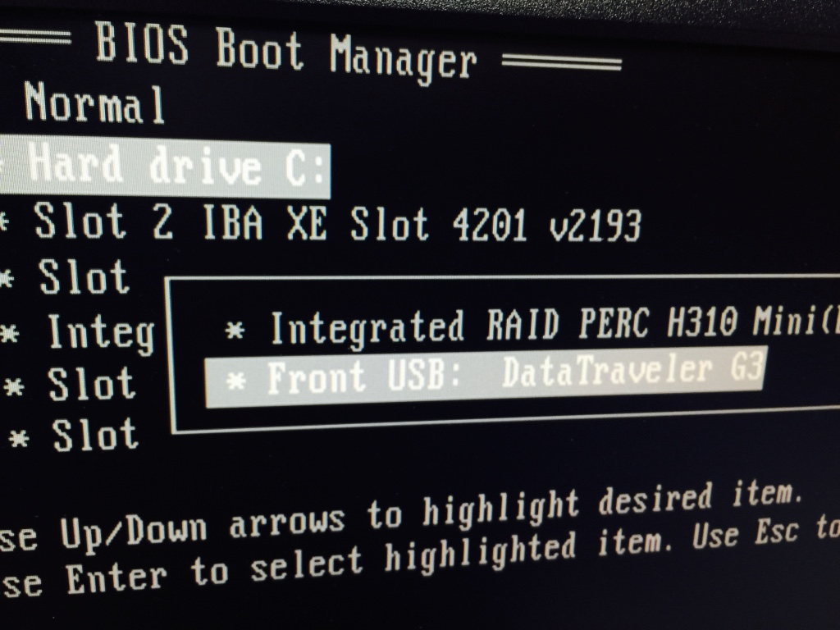
Lattus Installation
Controller Installation
  Boot the Controller with USB and press F11 to access the BIOS boot menu
  Select the Hard drive -> USB disk from the menu

Slide 12
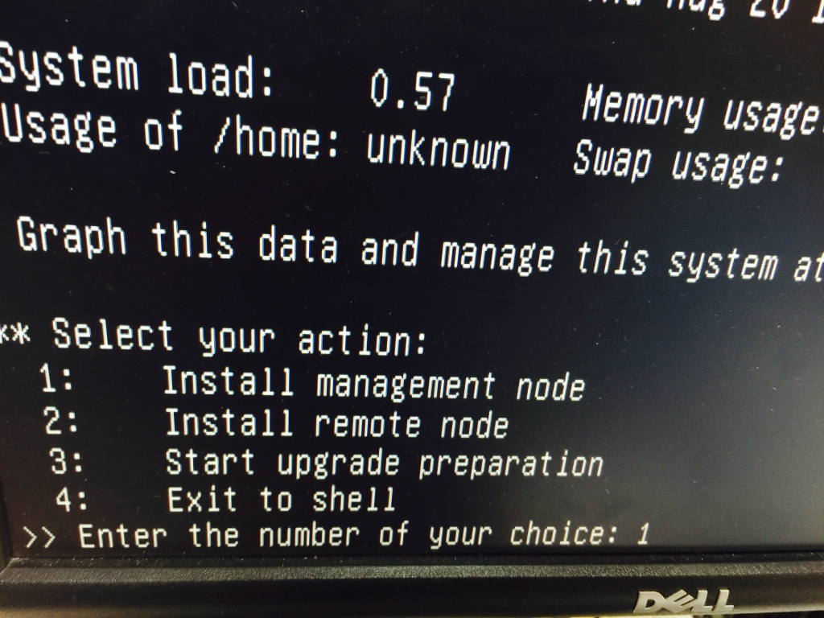
Lattus Installation
Controller Installation
  While installation, select option #1 (Install management node)

Slide 13
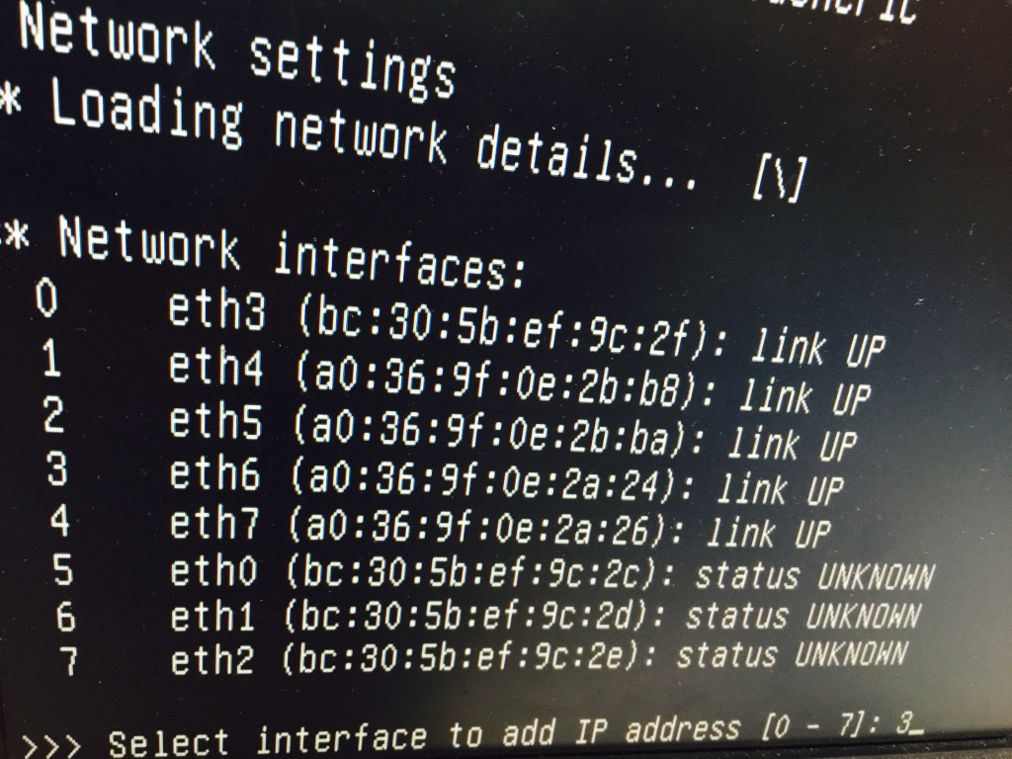
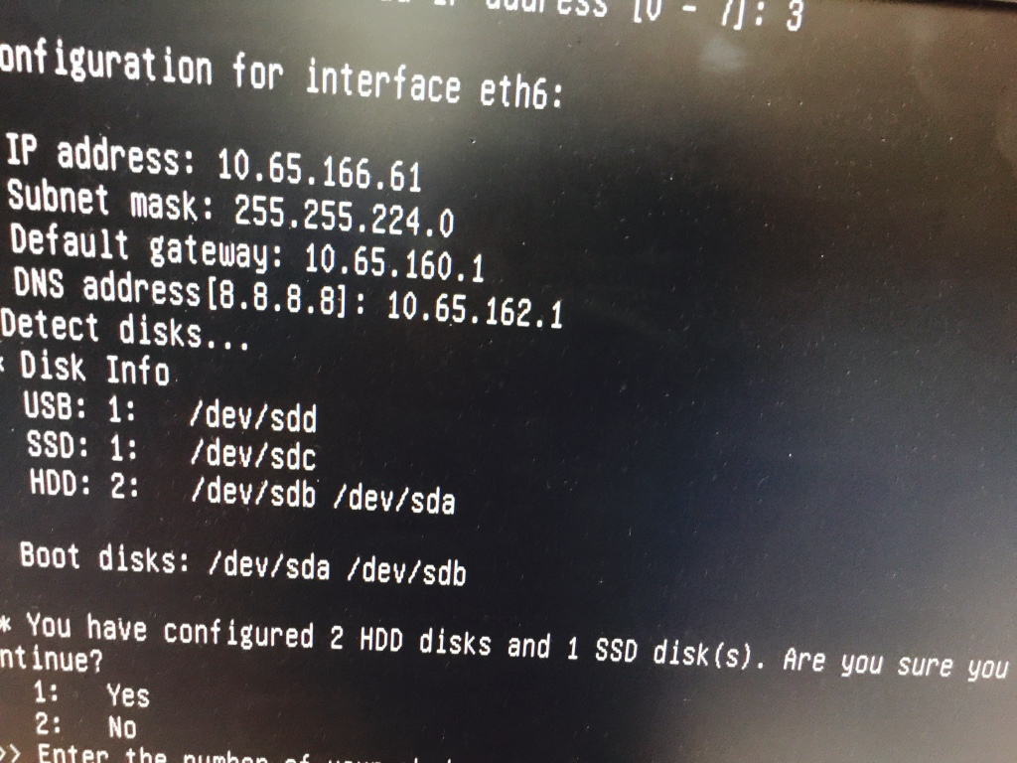
Lattus Installation
Controller Installation
  After selecting option #1 , select the network interface to configure and assign static IP (IP which is accessible via Laptop or via LAN)

Slide 14
Lattus Installation
Controller Installation
  Once Installation is complete (and controller reboots), access the CMC (Cloud Management Center) via the IP assigned
    If IP is private, connect your Laptop directly to CMC
      You need to configure your laptop in same network.
    If IP is part of LAN and accessible via network, no need to connect directly
    Default user/password to access CMC = admin/admin

Slide 15
Lattus Installation
Controller Installation
  Add the networks LAN (depending on Excel sheet) but usually following are required
    Private-1 (Storage Network) : Via rack switch-1 to storage node NIC-1
    DHCP_lan-private-1 (Automatically gets created if private-1 is selected as Managed Network)
    Private-2 (Storage Network) :Via rack switch-2 to storage node NIC-2
    Public Network-1 : Customer facing network
    Public Network-2 : Customer facing network
    1G Public : 1G public network , mainly for accessing CMC

Slide 16
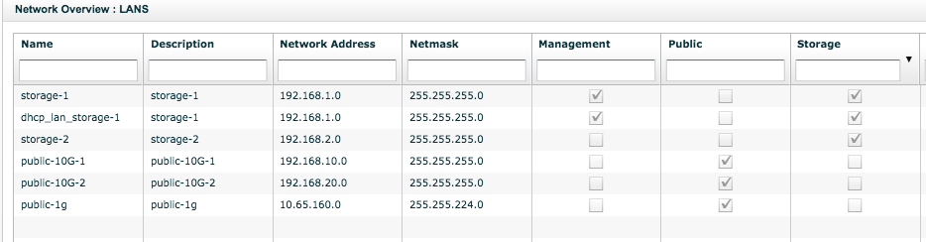
Lattus Installation
Controller Installation
  Network LAN should look similar to following (except Name, Network addresses and Netmask)

Slide 17
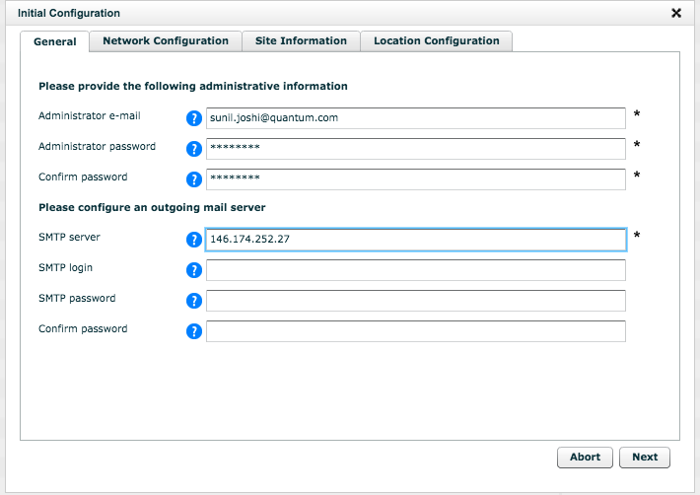
Lattus Installation
Finalizing the Cloud Service Setup
  From CMC > Dashboard > Administration > Lattus Management > Installation
    Read and accept the License and click on “Initial configuration”
    General Tab
      Fill the Admin Email, password and SMTP server.

Slide 18
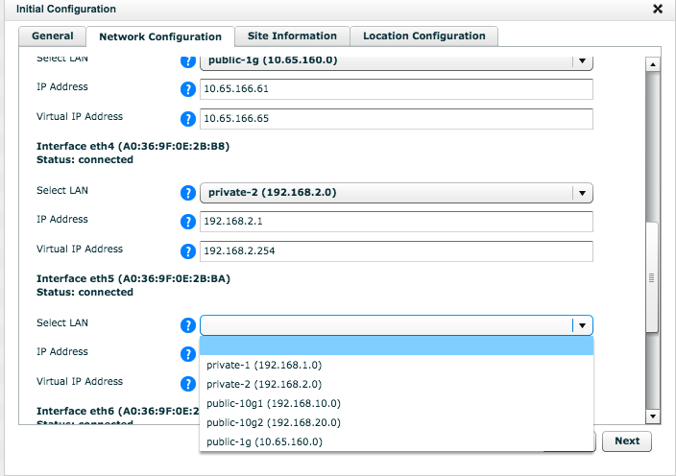
Lattus Installation
Finalizing the Cloud Service Setup (cont.)
    Network Tab : Assign the LANs to port designated (Excel sheet)

Slide 19
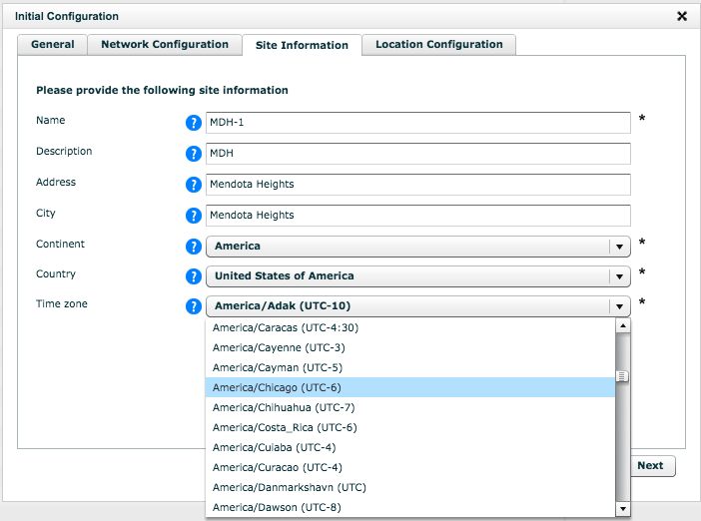
Lattus Installation
Finalizing the Cloud Service Setup (cont.)
    Site Information : Enter the name of the site (Customer supplied)
      Select the Continent, Country and Correct time zone

Slide 20
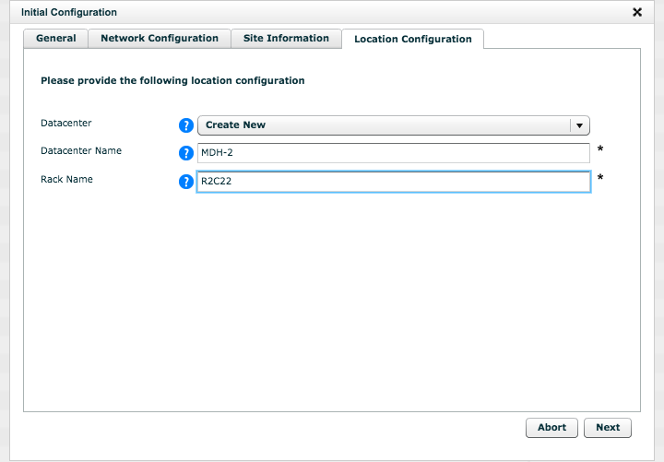
Lattus Installation
Finalizing the Cloud Service Setup (cont.)
    Location Tab : Enter Quantum Lattus System Serial number
      Click Next to continue the Initialization process.

Slide 21
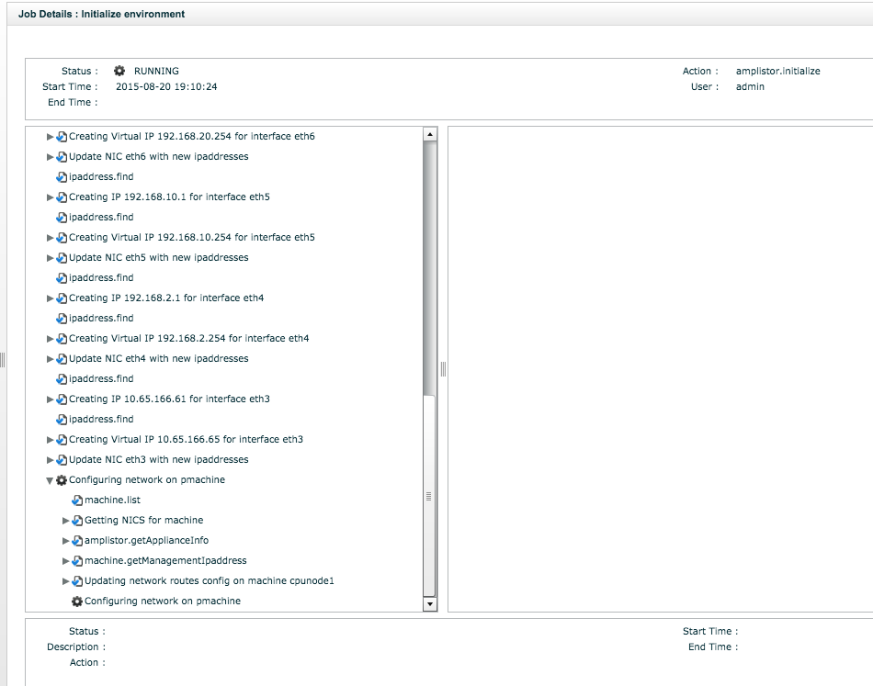
Lattus Installation
Finalizing the Cloud Service Setup (cont.)
    Click apply to commit the changes (may take around 20 minutes)

Slide 22
Lattus Installation
Post Installation of the Management Controller
  During Installation, the CMC is assigned CPUNODE1 name. If desired you can change it (select the controller node, edit and change the name).
  Adding racks and Data Centers
    If Lattus network spans multiple data centers or multiple racks, you will need to specify in the CMC which nodes are located to which racks and data centers.
    This is important as the way Lattus writes and retrieves data.
    Guarantee disk safety (will cover later).
    Prevent WAN overloading.
  Checking the Time or setting NTP server
    Dashboard > Administration > Lattus Management > Installation > Configure NTP.
    Add the NTP server (accessible via IP or DNS)

Slide 23
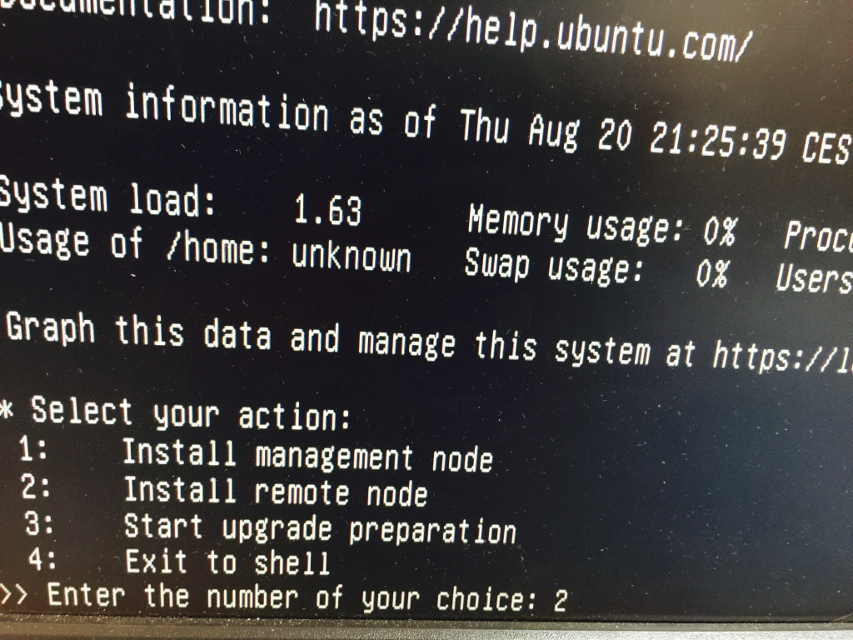
Lattus Installation
Configuring Additional Controller Nodes
  Power up the controller node
    OS can be installed via USB
    Steps is similar to CMC installation, except selecting “Install remote node” from the Amplidata/HGST OS boot menu

Slide 24
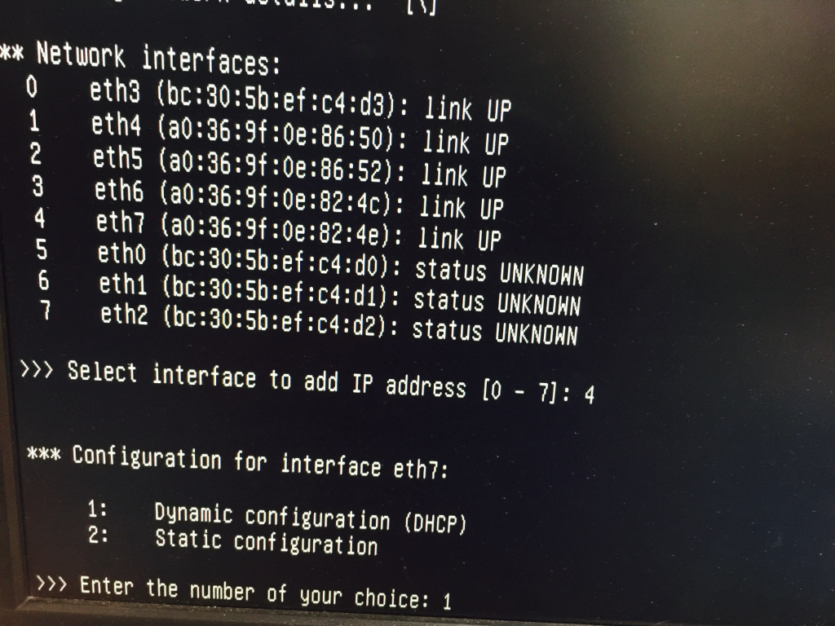
Lattus Installation
Configuring Additional Controller Nodes
    Select the network interface connected to the Rack switch of the management LAN
      Select DHCP address and confirm and verify that DHCP address is within range of DHCP addresses (In CMC)
      Accept the default settings
      Once installation complete, remove the USB and reboot the node
      Login to the installed node, verify DHCP address is visible.
  Repeat for any additional controller node.

Slide 25
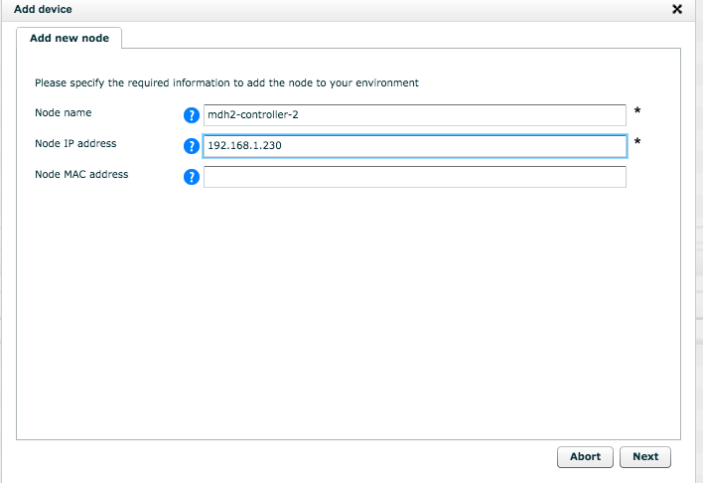
Lattus Installation
Adding Controller Node Device
  After the controller node has been rebooted, from CMC add the device from
    Dashboard > Administration > Hardware > Servers > Unmanaged Devices > Uninitialized
    Give the Node name
    Node IP Address (The DHCP address in previous screen)
    Node MAC address (Only needed for Multi-geo)
  Click Next and wait for job to finish and repeat the step for any additional controller nodes.
  After successfully adding, these nodes will appear as ACTIVE

Slide 26
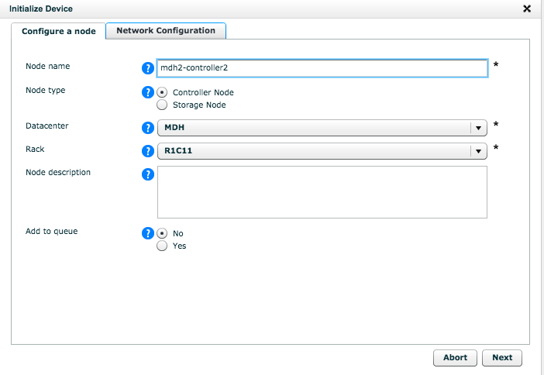
Lattus Installation
Initializing a Controller Node
  Dashboard > Administration > Hardware > Servers > Unmanaged Devices > Uninitialized
    Click on the Active controller node and select Initialize device in right panel.
      Assign the name
      Select the node type (Controller Node)
      Datacenter : Select the datacenter in which node is installed.
      Rack: select the rack in which node is installed.

Slide 27
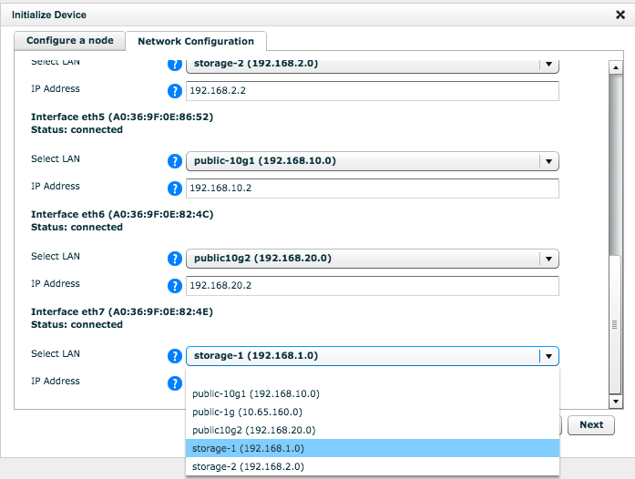
Lattus Installation
Initializing a Controller Node
  Network Configuration : Assign the proper LANs to the different Network Interface (as per Worksheet)
      Confirm and re-verify the setting and click Next to initiate Initialization.
  After successfully initialization, node will appear under CMC > Controller Nodes
  Repeat the step for any additional controller nodes to be initialized.

Slide 28
Lattus Installation
A Metastore is a system of processes to store metadata of objects, superblocks, spreads, policies and namespaces.
    Metastore sizing should be done before any attempt to create the metastore (refer to Admin Guide or Sizing tool).
    Metastore resides on the SSD on each controller node.
    Any changes in the sizing or deletion can cause some disruption and is not advisable.
    Small files should be taken into consideration while calculating the sizing of the metastore.
    A Metastore can’t grow beyond its limit.
    Metastore consists of exactly 3 SSDs.

Slide 29
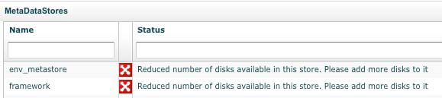
Lattus Installation
Metastore
  Internal defined metastore (default created by system)
    env_metastore = 20GiB
      This is used to keep all the metadata of the storage system (information on policies, namespaces..)
    Framework metasotre = 20GiB
      The framework contains all information on monitoring , events & GUI

Slide 30
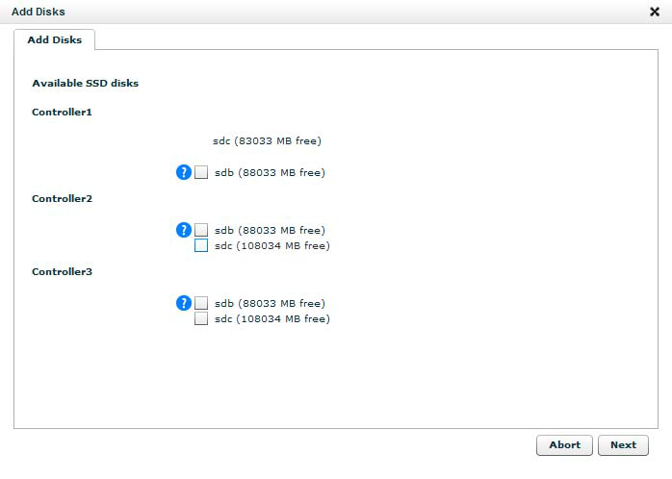
Lattus Installation
Metastore
    Expanding the default metastore.
    In the metastore Windows, click on the desired metastore
    Click on Add Disks in the right pane.
    Select the SSD on
    controller2 and controller3
    Don’t expand more
    than one metastore
    at the same time.

Slide 31
Lattus Installation
Creating a Data Metastore
  You can create any number of metastore, but each metastore can only have 3 SSD disks.
  Create new metastore via CMC > Dashboard > Administration > Storage Management > MetaStores
  Add Metastore, new Window will appear
    Name : The name of the new Metastore
    Size (MB): The desired size of the new Metastore
    Allocation Type : Set to either Auto or Manual
      Auto : All namespaces configured with automatic for metastore will use a metastore with Auto
      Manual : All namespaces configured to use a specific metastore will use the selected metastore.
    Disk Allocation : Specify the three SSD for metastore (These 3 SSD must be on 3 different controllers).

Slide 32
Lattus Installation
Adding Storage Nodes
  3 step process
    Boot the storage node (Appear as INSTOCK in CMC)
    Install the Operating system on the storage node (Appear as ACTIVE)
    Initialize the device by assigning the purpose of the node (storage node)
  Before you begin
    Ensure all the storage nodes are cabled to the private storage LANs
    Starting from the bottom of the RACK, reboot each storage node one at a time with 15-second interval (to prevent power spikes)

Slide 33
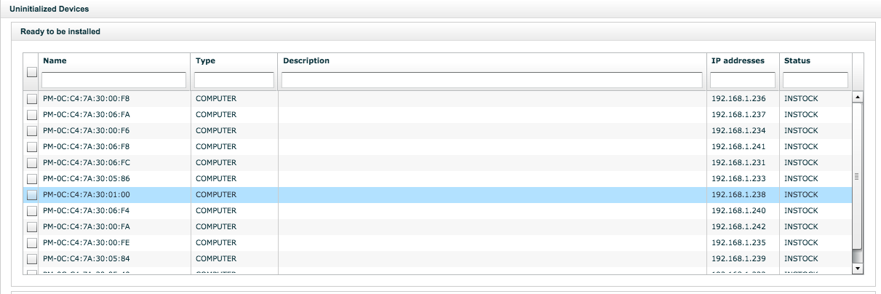
Lattus Installation
Install OS on the storage node
  Select Dashboard > Administration > Hardware > Servers > Unmanaged Devices > Uninitialized
    The uninitialized device will have the status “INSTOCK”

Slide 34
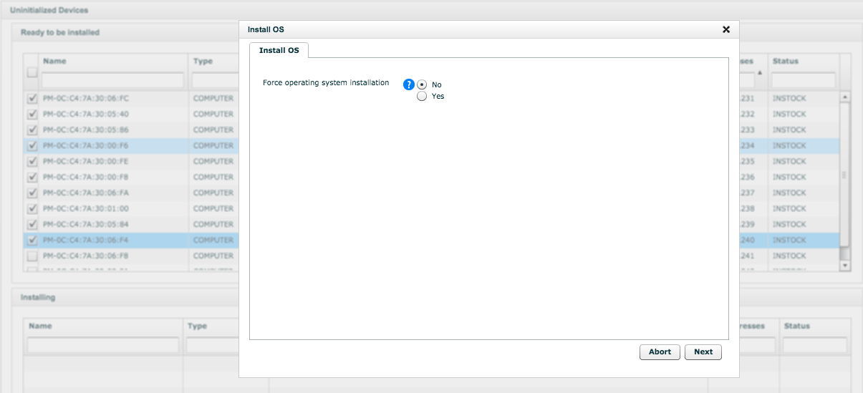
Lattus Installation
Install OS on the storage node (cont.)
  Check if the each powered storage nodes are in the list. If not, check what went wrong or which node is missing.
  Select group of Storage nodes (max 10) and Install OS
    Usually select force OS install if the nodes are being re-used.

Slide 35
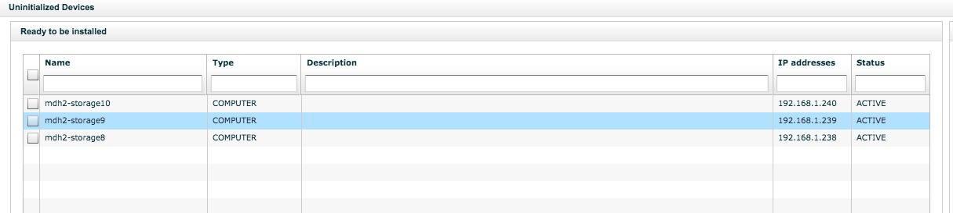
Lattus Installation
Install OS on the storage node (cont.)
  A Job will appear for the storage node OS Installation, after finishing the job, the storage node will be visible as ACTIVE
  Repeat until all the storage node has status ACTIVE

Slide 36
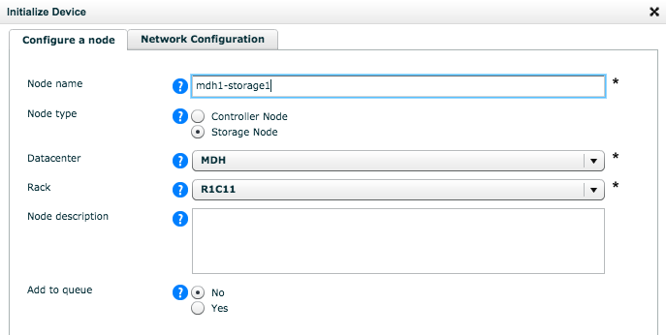
Lattus Installation
Initialization of the Storage Node (one node at a time)
  Select Dashboard > Administration > Hardware > Servers > Unmanaged Devices > Uninitialized
  Select the Active Storage node (select the appropriate node with MAC and Node number)
  In the command pane, initialize the node
    Node Name : Enter a name
    Node Type : Select the storage Node
    Data Center : Select from the dropdown list the data center in which the node is installed
    Rack : Select from the dropdown list the rack in which the node is installed.

Slide 37
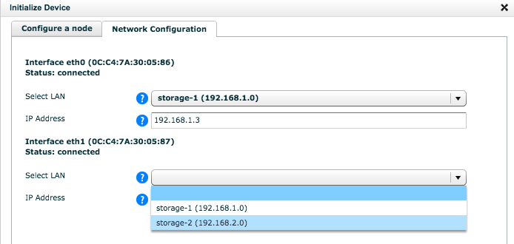
Lattus Installation
Initialization of the Storage Node (one node at a time)
  Node Description : Optional
  Add to Queue : Select No to initialize the storage node immediately.
  Network Configuration
    Assign the proper LAN to the different network interfaces.
    The DHCP IP will change once selecting the LAN for that interface.
  Once job is finished, the node will appear under Storage Node
  Repeat the procedure for all the Storage Nodes in Active status.

Slide 38
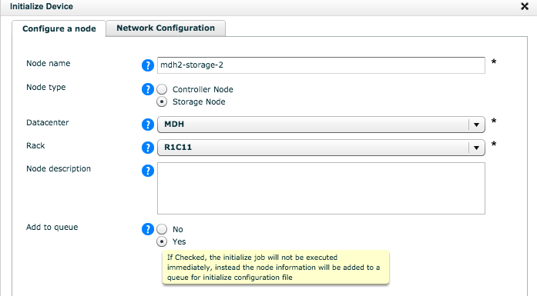
Lattus Installation
Initialization of the Storage Node (Add to queue)
  Storage node can be added into an initialization queue.
  Once nodes are added in queue, a batch initialization can be executed from CMC.

Slide 39
Lattus Installation
Initialization of the Storage Nodes (CSV file)
  Adding a group of storage nodes to the initialize queue via CSV
    Each .csv file allow up to 44 entries.
  Format of a .csv file
  Modify this file to add storage nodes which are in Active state and upload the file via CMC
    Dashboard → Administration → Hardware -> Servers→ Unmanaged Devices. Click on Select file
    Navigate the .csv file from your computer which you have created or modified.
    Click Upload and validate
    The content of the .csv file will be parsed, checked for errors and added to the initialization queue if there is no error.
  The location of initialize_queue.csv file is under /opt/qbase3/cfg in CMC controller node.

Slide 40
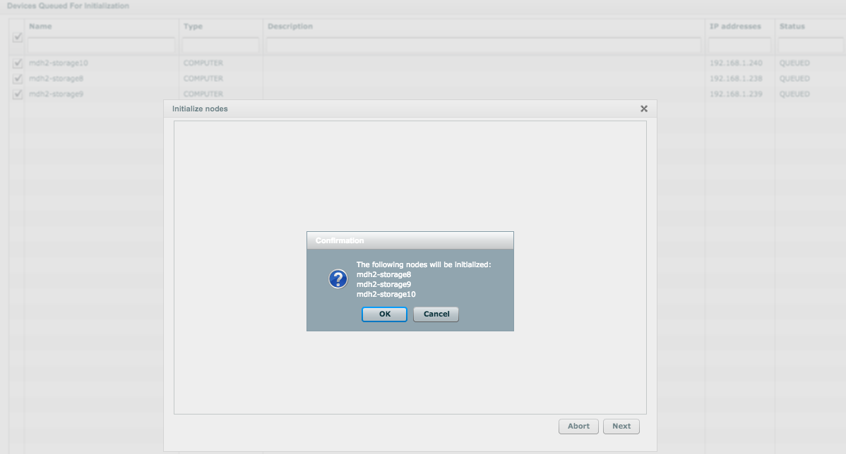
Lattus Installation
Initialization of the Storage Node in Queue
  Once nodes are added in queue, a batch initialization can be executed from CMC.

Slide 41
Lattus Installation
Out Of Band Management : IPMI
  You can add a separate LAN for IPMI purposes. This LAN needs to be a distinct LAN from any other LAN in your setup.
Creating an IPMI LAN
  In the CMC, go to Dashboard →Administration→ Lattus Management→ Network.
  In the Commands pane, click Add LAN.
  The Add LAN dialog appears.
  On the General tab, enter a Name and choose IPMI as the role of the LAN.

Slide 42
Lattus Installation
Creating an IPMI LAN (cont…)
  On the Details tab, specify the Network, Netmask, Start IP address and End IP address.
  Define the number of IPs to reserve.
    Note: The number of IPs to reserve has to be the same as the number of reserved IPs in the management LAN.
  Click Next.
  A job detail dialog appears and shows whether or not the action has been successful

Slide 43
Lattus Installation
Allocating IPMI on the Management LAN
  Access the IPMI by connecting a cable to the switch that also hosts the management LAN. You will need to reserve an IP address on the IPMI LAN for access to the IPMI (in order to avoid using an IP-address that is already used). Proceed as follows:
    1. In the Network window, click on the management LAN.
    2. In the Commands pane, click Reserve IP.
    3. Fill in the desired IP address to reserve for access to the IPMI LAN. After clicking Next, the IP address will be in the IP address list, without a designated machine. This IP can be used by the technician to connect to the IPMI LAN by connecting a cable to the switch hosting the Management LAN.

Slide 44
Lattus Installation
Known Issues with Storage Nodes.
  If there is a bad disk drive, the storage node initialization may fail. If so, clean the storage node before next installation.
  Attaching a monitor with S30 storage node during OS reboot can cause problem.
  In some cases the Initialization never fails and never times out. If this happens, restart the workflow engine and cleanup the particular storage node.
    q.manage.workflowengine.restart()
    Restart the process of Storage Node Installation and initialization.
  Not providing the correct SMTP server during cloud initialization will cause the initial configuration to fail.

Slide 45
Lattus Installation
What if you encounter a failure?
  If for any reason adding a controller or storage device fails, you have to clean it up from the system
    A node cannot be reused unless its cleaned after a failed initialization.
  Nodes with failed initializations can be found by the following:
    Administration→Hardware→Servers→Unmanaged → Devices→ Failed
  After selecting the node, it can be cleaned.
    Or from qshell : q.amplistor.cleanupMachine('<MAC>')
  Cleanup takes necessary actions to remove all data from the database.
    If a failed storage node has partially configured (having blockstore, maintenance agent or storage daemon configured), it has to be manually cleaned using qshell (KB Article BDY016)

Slide 46
Lattus Configuration/ Post-Installation

Slide 47
Lattus Configuration / Post-Installation
Completing the configuration
  Configuring the Durability Policy
    Define spread width and disk safety.
  Configure Namespace
    Create Namespace or S3 bucket
  Configure Interface
    Configuring Storage Daemon for AXR or S3 which listen on particular port.

Slide 48
Lattus Configuration / Post-Installation
Configuring the Durability Policy
  Spread width
    Number of disks over which data will be spread
  Storage safety
    Disks per object that can safely lost before data lost
  Safety Strategy
    How policy behave if full set of disks are not available
  Superblock size
    The size in Megabytes that large objects are broken down
  Data balance
    How data should be spread at the data center, rack
  AXR and S3 defaults
    AXR (default) : The durability policy will be primarily selected when creating a new namespace
    S3 (Default) : New S3 bucket will use the durability policy unless specified otherwise on per user basis.

Slide 49
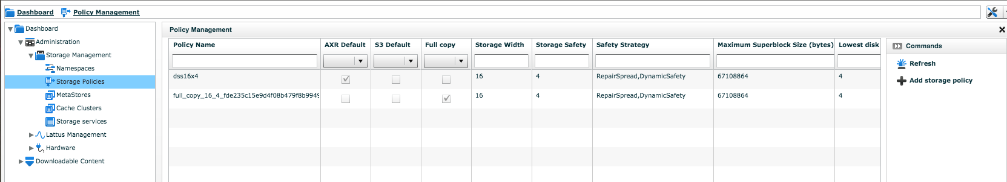
Lattus Configuration / Post-Installation
In the CMC, navigate to Dashboard > Administration > Storage Management > Storage Policy

Slide 50
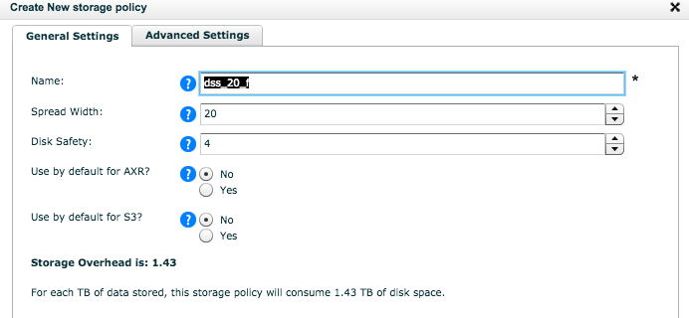
Lattus Configuration / Post-Installation
Click “Add Storage Policy” on the right side of the screen
  Provide a Name for DSS policy
  Select the Spread width and Disk Safety. You will notice a change in Storage Overhead at the bottom of the screen when you make change in any of the two parameter
  Use it for S3 or AXR default.

Slide 51
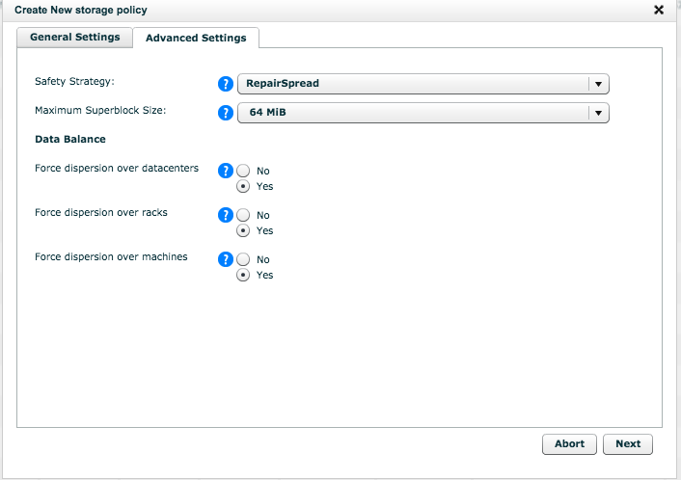
Lattus Configuration / Post-Installation
Click on the Advance Settings and make change if required

Slide 52
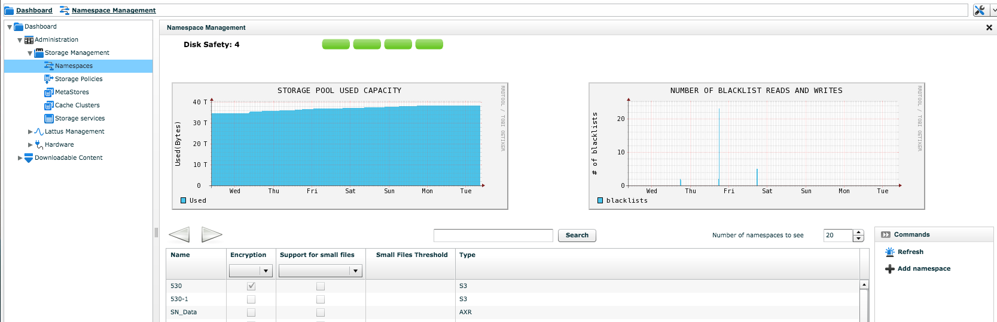
Lattus Configuration / Post-Installation
Configuring Namespaces
  Namespaces are the logical destination to which data is stored.
  A namespace must be associated with one metastore and one durability policy.
  Create Namespace via CMC, select Dashboard > Administration > Storage Management > Namespaces.

Slide 53
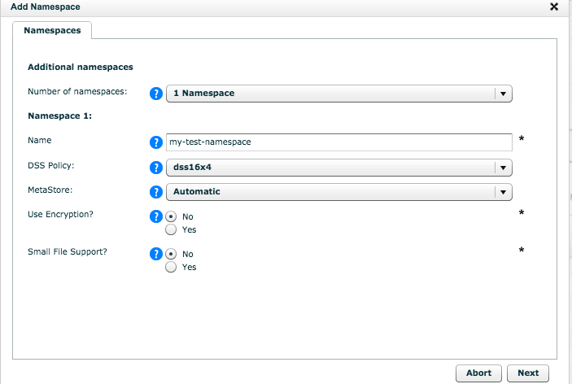
Lattus Configuration / Post-Installation
Configuring Namespaces

Slide 54
Lattus Configuration / Post-Installation
Configuring Namespaces
  Specify the Name for the namespace
  Select the desired Storage Policy
  Select the desired Metastore (automatic or static)
  Choose whether you want to have data encrypted
    When the 1st namespace is encrypted, the user will be asked to enter password.
  Select whether or not you want to use the namespace for small file support
    If you choose the small file support, provide the file size threshold (512KiB default)

Slide 55
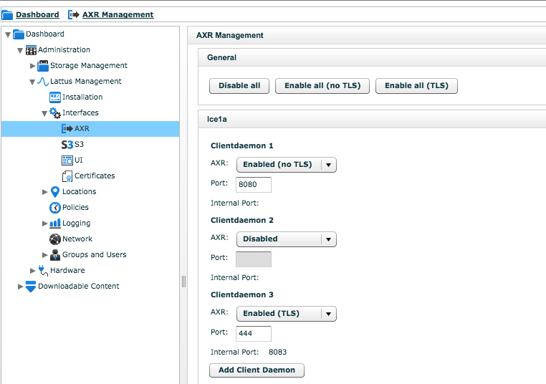
Lattus Configuration / Post-Installation
Configuring AXR
  AXR is the Lattus REST interface. By default AXR is enabled on all controller node (without TLS ) listening on port 8080
  To edit or add new client daemon, go to to Dashboard > Administration > Lattus Management > Interfaces > AXR.

Slide 56
Lattus Configuration / Post-Installation
Configuring AXR
  In the controller node section, Click Add Client Daemon
    Quantum recommends installing no more than four client daemons per controller node in production environments.
  Configure the client daemon
    AXR : Specify the AXR availability
      Enabled (No TLS)
      Enabled (TLS). TLS is equivalent of HTTPS
      Disable
      Port : Select the port with which to communicate
    Save the setting. Internal port is automatically created when enabling the client daemon.

Slide 57
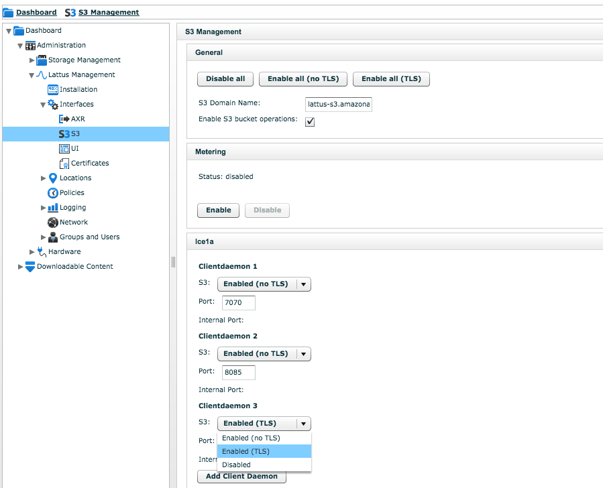
Lattus Configuration / Post-Installation
Enabling S3
S3 is disabled by default. To enable the S3 interface, go to Dashboard > Administration > Lattus Management > Interfaces > S3.

Slide 58
Lattus Configuration / Post-Installation
Enabling S3
  Fill out the desired S3 domain name. This step is mandatory and skipping this step will make S3 authorization fail.
  Select the option “Enable S3 bucket operations”. This option is disabled by Default
  In controller Node section, click Add Client Daemon
    Quantum recommends installation no more than 4 client daemons per controller
  Configure the client daemon
    S3 : Specify the S3 availability
      Enabled (No TLS)
      Enabled (TLS)
      Disable
    Port : Select port with which to communicate
  Save the settings. Internal port will be automatically created if daemon is enabled with TLS

Slide 59
Lattus Tuning

Slide 60
Lattus Tuning
Optimizing the environment
  Lattus can be tuned for two situations
    Slow upload/download but with maximum number of concurrent users.
    Fast upload/download with maximum performance.
  Tuning parameter depends on
    Number of racks
    Single Site vs Multi-geo
  Any installation after Lattus 3.2.1 are configured for maximum throughput .
  Repair settings are optimized for large objects.

Slide 61
Lattus Tuning
Optimal Connection Management
    By default, client daemon accept any incoming TCP connection.
    No performance gain in exceeding more than 100 concurrent connections per client daemon.
  Tuning “http_max_conn” (controller only)
    Open configuration file of your client daemon
      /opt/qbase3/cfg/dss/clientdaemons/<guid>.cfg
      Add or Edit the parameter “http_max_conn” under [config] section
      Set the value to 100.
      Restart the client daemon using qshell
      q.dss.clientdaemons.restartOne(<daemonguid>)

Slide 62

Lattus Tuning
Optimizing the environment (Maximum Throughput)
  It is recommended to have following settings Client daemon configuration file (controller nodes)
    /opt/qbase3/cfg/dss/clientdaemons/<guid>.cfg.
    Add the following parameter if they are not yet present under [config] section.
    After making any changes restart the client daemon using qshell
      q.dss.clientdaemons.restartOne(<daemonguid>)

Slide 63

Lattus Tuning
Optimizing the environment (Maximum Throughput)
  Storage Daemon configuration file (on all storage nodes)
    /opt/qbase3/cfg/dss/storagedaemons/<guid>.cfg
  Update the following section under [config] else add them
    After making any changes, restart the storage daemon on all the storage nodes in order to become effective.

Slide 64

Lattus Tuning
Optimizing the environment (Maximum Throughput)
  Maintenance agent configuration file:
    /opt/qbase3/cfg/dss/maintenanceagents/<guid>.cfg.
  Update the following section under [config] else add them
    After making any changes, restart the maintenance agent in order to become effective.

Slide 65
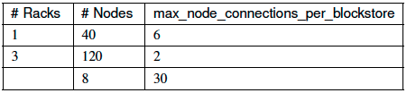
Lattus Tuning
Optimizing the environment
  Tuning for less than 6 racks
    Default, the settings for the client and the storage daemons and the maintenance agent are configured for 6-rack environment
    When running with a smaller environment, recommend to change “max_node_connections_per_blockstore” parameter in client daemon configuration file
    Formula used
      max_node_connections / (nr of blockstores x nr of connections to each blockstore)
2

Slide 66
Lattus Tuning
Optimal Repair Performance
  Default repair settings are optimized for large objects.
  In case there are namespaces that have many small files, we recommend changing “repair_queue_max_size“ parameter on storage daemons that are master for these namespaces:
    To identify the master storage daemon
      OSMI > Policies and Namespaces > List Namespace
        Check for Master storage daemon and corresponding IP
    Default value is 1000, recommend to change to 4000 and see the effect.

Slide 67
Lattus Tuning
Optimizing the environment for Optimal Repair Performance
    In Lattus, there is one Maintenance Agent (MA) per Storage Daemon and every MA can handle 4 repair tasks in parallel (default value).
    This significantly improves the repair performance but may have side effect that the load on the server also increase resulting in lower performance (depending on type of storage node, RAM and superblock size.
    Calculating maximum number of parallel task
      (#RAM - 1 GB) / (#MA * superblock size * 6)
Node | RAM | #MA | 16 | 32 | 64 | 128 | 256
AS36 Aaeon | 8 | 2 | 36 | 18 | 9 | 4 | 2
NSS1121 | 8 | 2 | 36 | 18 | 9 | 4 | 2

Slide 68
Lattus Tuning
Optimizing the environment for Optimal Repair Performance
  Lowering the number of Parallel Tasks
  If the performance become slow, you can lower the number of threads of the maintenance agent
    Login to affected storage node
    Open /opt/qbase3/cfg/dss/maintenanceagents/<guid>.cfg
    Lower the number of parallel_tasks (default =4 )
    Save the file
    Update the value for other Maintenance agent on this node.
    Log onto Controller and start OSMI
    OSMI > Machine ands Services > Maintenance agent > Stop Maintenance agent
      Select the proper agent to stop
      Repeat the step for all maintenance agent on the node
    Start the Maintenance agent again via OSMI > Machines and Services > Maintenance Agent > Start maintenance agent.

Slide 69

Lattus Tuning
Load Events
  Under certain circumstances, the load on the server passes the load threshold and the events are raised as a result. You should evaluate if the raised load influences the performance of the node significantly.
    If the performance remains acceptable with the higher load, you can opt to increase the load threshold.
    To increase the load threshold on a server
      Log onto the affected node
      Open the file /opt/qbase3/apps/monitoring_agent/monitoring.xml and change value
      Save the file and restart monitoring agent via qshell
        q.manage.monitoringagent.restart()

Slide 70
Lattus Tuning
Tuning for maximum number of concurrent users
  Update the client daemon configuration file (/opt/qbase3/cfg/dss/clientdaemons/<guid>.cfg) with the following parameters in the config section.
    superblock_mem_limit = 22548578304,3221225472
    nr_put_threads = 1
    nr_get_threads = 1
    rest_put_mode = nonblocking
    rest_get_mode = nonblocking
    Restart the updated client daemon in the Q-Shell (/opt/qbase3/qshell): q.dss.clientdaemons.restartOne(<daemonguid>)

Slide 71
Lattus Tuning
Maximum performance
  Update the client daemon configuration file (/opt/qbase3/cfg/dss/clientdaemons/<guid>.cfg) with the following parameters in the config section.
    superblock_mem_limit = 12884901888,12884901888
    nr_put_threads = 8
    nr_get_threads = 8
    rest_put_mode = blocking
    rest_get_mode = blocking
    Restart the updated client daemon in the Q-Shell (/opt/qbase3/qshell): q.dss.clientdaemons.restartOne(<daemonguid>)

Slide 72
Burn-In Test
Burn-in test (GET/PUT script)
  This is performance test provided by Amplidata/HGST which should be run before the system is deployed in production.
  This script can be run from the Controller or from StorNext MDC (having 10G Public network connection).
  This script can be tuned to run with 1 or multiple client daemon.
  This script can be run with AXR or S3 Interface.
  To run the script, create a temporary namespace and allow to run for at least 24 hours.

Slide 73
Burn-In Test
Burn-in test (Script output)
Getting policy-id of namespace putget for file size
Small-Files-Threshold: bytes
SAFETY_STRATEGIES=[ "RepairSpread", "DynamicSafety" ]
NAMESPACE_NAME=putget
POLICY_ID=4e8a530649274cd4abb7bfc9bd85a6c6
PUT RUN ID 7435
PUT START 1406057085: Tue Jul 22 14:24:45 CDT 2014
PUT 16 parallel series of 1 files of 1048576 KiB
PUT RATE LIMIT 0 KiB/s
PUT END 1406057125: Tue Jul 22 14:25:25 CDT 2014
PUT POLICY 16/4, FULL_COPY:false
PUT ENCODED DATA HEADER OVERHEAD 430320 bytes
PUT ENCODE FACTOR
PUT RATE LIMIT 0 KiB/s

Slide 74
Burn-In Test
Burn-in test (GET/PUT script output)
PUT DURATION 40.14 sec
PUT 16 files, 0.3986 files/sec
PUT UNENCODED 16777216 KiB, 417967.5137 KiB/sec, 408.1714 MiB/sec
PUT ENCODED 27541897.7856 KiB, 686145.9339 KiB/sec, 670.0644 MiB/sec
GET ENCODE FACTOR 1.2312
GET RATE LIMIT 0 KiB/s
GET DURATION 24.45 sec
GET 16 files, 0.6544 file reads/sec
GET UNENCODED READ SIZE PER FILE 1048576 KiB, RANDOM_READ_OFFSET_MIN 0 bytes, RANDOM_READ_OFFSET_MAX 0 bytes
GET UNENCODED 16777216 KiB, 686184.7035 KiB/sec, 670.1022 MiB/sec
GET ENCODED 20656423.3392 KiB, 844843.4904 KiB/sec, 825.0425 MiB/sec
GET ONELINE 7435 1406057125 16/4 false 322736 1.2312 16 1 1048576 1048576 0 0 24.45 16777216 686184.7035 20656423.3392 844843.4904 0

Slide 75
Burn-In Test
What to expect after Burn-in Test
  Burnin should be run for 24hrs to 48 hrs.
  After burn-in test, it provides the throughput summary
  Verify that the performance reported via Burn-in is expected
    If not, what needs to be looked
      Network issue
      Policy configuration
  Check the Event log and Dashboard for I/O errors
    For the Event list, navigate to Dashboard→ Administration→Lattus Management→ Logging→ Events.

Slide 76
Burn-In Test
What to expect after Burn-in Test
  Reviewing the Events
    If events about high load on your storage nodes are spotted, consult the Tuning section under Admin Guide
    If errors on the high number of processes are spotted, consult the Tuning section under Admin Guide
    If I/O errors are spotted
      Check the number of generated read/write blacklists for each Storage Daemon
      Check the generated response time graphs of the Storage Daemons
      Check the monitoring graphs of the controller nodes
      Check the number of degraded disks and diagnose them

Slide 77
Burn-In Test
What to expect after Burn-in Test
  Reviewing the Monitoring Graphs
    Dashboard →Administration →Hardware→ Servers→Controller nodes
    Select the desired controller nodes
    In the controller node dialog, click on the Monitoring graphs tab.
    Analyze the generated graphs. Compare the graphs to the generated load and spot unusual peaks or drops.

Slide 78
Burn-In Test
What to expect after Burn-in Test
  Handling Degraded Disks
    If disk is auto-decommissioned, replace the disk
    If disk is degraded but not auto-decommissioned, consult the Admin Guide – How to handle a degrade disk.
      With Lattus 3.4.3, we have auto-decommissioning feature.
      Disks part of RAID are not auto-decommissioned.

Slide 79
Burn-In Test
What to expect after Burn-in Test
  After the test
    When the test is finished and all results are positive or all degraded disks have been reset or removed, remove the temporary namespace and all data put on it via OSMI.
      In OSMI, navigate to: Policies and namespaces→ Delete namespace
      When prompted to choose a namespace, choose the temporary namespace
    It may take several hours until the namespace and all data on it are completely removed.

Slide 80
Lattus Usage: Serviceability

Slide 81
Lattus Usage: Serviceability
Serviceability Features
  Early detection of a problem can decrease or avoid the system downtime.
    What kind of issue we normally see
    Hardware Failure
      Hard drive failure is very common
      Memory fault
      CPU or Motherboard
      PSU failure
      Bad controller or bad chassis on storage nodes
  Phone Home
  RAS event alerts

Slide 82
Lattus Usage: Serviceability
Log collections
  Most logs use log rotate rules
    Log rotations happen daily or weekly
    Log rotation rules are located in /etc/logrotate.d
  Analyzing logs can be achieve with most OS related utilities used for viewing logs
Log type | Path to log | Lattus Component
Application server | /opt/qbase3/var/log | Controller and Storage
Monitoring Agent | /opt/qbase3/var/log/monitoring | Controller and Storage
Arakoon | /opt/qbase3/var/log/arakoon | Controller Nodes
DSS client Daemon | opt/qbase3/var/log/dss/clientdaemons | Controller Nodes

Slide 83
Lattus Usage: Policies
Durability Polices
  What Policy to use
  Capacity Planning
Namespace / Buckets :
  What is the difference between buckets and namespaces
  How does this relates to the MetaStores
  Username/Password

Slide 84
Lattus Usage: Policies
Durability Polices (Storage Policy)
  User data files stored in HGST/Amplidata namespace/bucket according to a durability policy are referred to as objects.
  Two parameter determine the data protection level.
    1st parameter determines the spread width : The number of disk drives that will be used to store the encoded data objects.
    2nd parameter is drive safety, which is number of drives in a spread width that can be simultaneously unavailable without impacting the Bit Spread's ability to reconstruct the original data.

Slide 85
Lattus Usage: Policies
Completing the configuration
  Configuring the Durability Policy
    Spread Width : Number of disks over which blocks of equations are spread
    Storage Safety : This value defiles the number of disks per object that can be safely lost before data becomes unrecoverable.
    Safety Strategy : This value defiles how the policy behave when a full set of disks are not available
      Dynamic Safety
        Single try and if enough blockstores have succeeded, the PUT will succeed and repair will run in background.

Slide 86
Lattus Usage: Policies
Completing the configuration
  Configuring the Durability Policy (cont.…)
      Repair Spread
        The upload will only succeed if it meets maximum safety. The upload will retry if it doesn’t fit with maximum safety.
      RepairSpread and Dynamic Safety (Quantum recommended)
        Upload will retry and succeed even if it meets lower safety.
      Fail on Stop
        As soon as a single blockstore behaves unexpected, a PUT operation will fail. Mainly used in Performance and not recommend in Production.
    Superblock Size : The number defines the size in megabytes that large object are broken down into before encoding.

Slide 87
Lattus Usage: Policies
Completing the configuration
  Configuring the Durability Policy (cont.…)
      Data Balance : This value defines how data should be spread at the data center, rack and system levels.
    AXR and S3 Defaults
      If AXR (Lattus REST) is selected, the durability policy will be selected when creating a new namespaces.
      If S3 is selected, the new S3 bucket will use the durability policy unless specified otherwise on a per user basis.
    Create Durability policy in CMC > Dashboard > Administration > Storage Management > Storage Policies

Slide 88
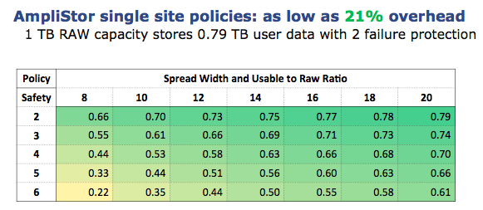
Lattus Usage: Policies
Durability Polices Storage Overhead

Slide 89
Lattus Usage: Policies
Durability Polices
  What Policy to use ?
    In single rack or single site environment, Quantum recommends 20/4. For smaller configuration (storage node < 20) Quantum recommends 16/4.
      Or depending how much data protection customer needs with penalty of raw data overhead.
    Multi-Geo environment
      3 Site with storage nodes at 2 site : Its usually ( spread width / 2 ) + 2
        For example : 20/12
      3 Site : Its usually (spread width /3) + 1
        For example : 18/7
        So even one site is lost, the data can be reconstructed from other site
      Data is spread across the number of data centers evenly and will satisfy the read request from the lowest latency location

Slide 90
Lattus Usage: AXR Namespace vs. S3 Bucket
Namespace | Bucket
Namespaces uses AXR REST Interface | Bucket uses S3 protocol
Path Style : <URL>/namespace/<NameSpaceName>/<ObjectID> | Path Style: <URL>/<BucketName><ObjectID>
No multi-part upload support | Supports multi-part upload
Namespace may be password protected | Bucket always have username/password
You can create Namespaces via CMC | You can’t create S3 bucket via CMC
AXR namespace can be converted into S3 bucket | S3 bucket can’t be converted into AXR
Metastore can be assigned when creating namespace | Metastore can’t be assigned.

Slide 91
Lattus Usage: Username/Password
Namespace / Buckets : Username/Password
  S3 buckets always have username/password but AXR namespace may or may not.
  Username/password with AXR namespace
    Create a user with password on Lattus using “qshell”.
    root@mdh1-controller1:~# /opt/qbase3/bin/dss --user-add sjoshi --secret sjoshi123
    { 'version':0, 'id':2, 'name':'sjoshi', 'secret':'(not_shown)', 'status':'ACTIVE', 'seq':0, 'default_policy_id':None, 'num_s3_namespaces':0, 'default_small_files_policy_and_threshold':None, 'custom':{ } }
    Turn off the inheritance
    root@mdh1-controller1:~# /opt/qbase3/bin/dss --permission-flags-set /namespace/UserPassword-1 --permission-flags “ “

Slide 92
Lattus Usage: Username/Password
Namespace : Username/Password (cont.…)
  Set the permissions for specific user
    root@mdh1-controller1:~# /opt/qbase3/bin/dss --permissions-set /namespace/UserPassword-1 --user-name sjoshi --permissions "UPDATE,LIST,DELETE,CREATE,READ"
      ["UPDATE","LIST","DELETE","CREATE","READ”]
  Verify the permission.
    root@mdh1-controller1:~# /opt/qbase3/bin/dss --permission-settings-get /namespace/UserPassword-1
    "Flags":[],
    "User-Permissions”:
    {
    "sjoshi":["UPDATE","LIST","DELETE","CREATE","READ”]
    }
    }

Slide 93
Lattus Usage: Policies
S3 Buckets : Username/Password
  Add a S3 user using “qshell”, for example : username = ‘s3user’ and password = ‘s3password’
  q.dss.manage.addUser('s3user', 's3password')
  Out[2]:
{'bucket_list': [],
'custom': {},
'default_policy_id': None,
'default_small_files_policy_and_threshold': None,
'id': 2,
'name': 's3user',
'secret': '(not_shown)',
'seq': 0,
'status': 'ACTIVE',
'version': 0}
  List the policy and note policy ID (CMC or qshell). Qshell command to list the policy
      q.dss.manage.listPolicies()
  Add the storage policy to the default setting of the S3 user created (using qshell).
      q.dss.manage.changeUser(userName='s3user’,defaultSettings={'policyID':'bc78f35950e5492c9bf7b5f690c461ec'})
  Now with StorNext GUI or ‘s3cmd’ you can create S3 bucket and use them (Covered later in StorNext GUI Configuration)

Slide 94
Lattus Usage: Policies
S3 Multipart Configurations
When S3 is configured following default settings are used in Lattus
Lattus support up to a maximum of 10,000 parts per object
These parameter can be defined or over-written in following DSS configuration file
  opt/qbase3/cfg/dss/clientdaemons/<guid>.cfg)
What | Parameter | Unit | Default Value
maximum object size | multipart_object_max_size | Bytes | 5,497,558,138,880 (5 TiB)
minimum object size | multipart_object_min_size | Bytes | 0
minimum part size | multipart_part_min_siz | Bytes | 5,242,880 (5 MiB)
maximum number of parts | multipart_max_partnr |  | 10,000 (*)

Slide 95
StorNext GUI Configuration

Slide 96
StorNext GUI Configuration
StorNext GUI configuration
  StorNext GUI users can configure the Object Appliance, protocol, controllers , I/O path ,namespaces/bucket and Storage policies
    Require “Manage Object Storage Settings” user admin access
Amplidata/HGST integration
  Users can’t create AXR namespaces from the SN GUI
  Users can create S3 bucket from the SN GUI
Lattus-M and RYO MDC
  Storage Manager solution
  Require object_storage license key
  SN GUI wraps /usr/adic/TSM/exec/fsobjcfg CLI command

Slide 97
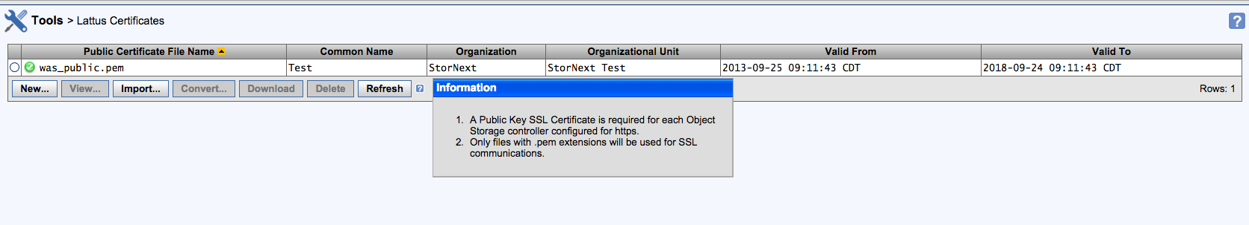
StorNext GUI Configuration
  Tools > Lattus Certificate.
    Self signed Certificate : SN GUI allows you to create or import self sign certificate
    With StorNext 5.2 and Q-cloud, StorNext support both system installed Certificate and Self sign Certificate
    Default , StorNext try to use the system installed certificate unless sysparam overrides the certificate.
    If you are working with Lattus self sign certificate and Q-cloud (highly unlikely), you should move self sign certificate to the system default location.

Slide 98
StorNext GUI Configuration
HTTPS Default CA ROOT Certificate File or Path
  Beginning in StorNext 5.2, /usr/cvfs/config/ssl is no longer the default repository that is referenced by Storage Manager for SSL certificates when using HTTPS.
  The default Certificate file or repository will depend on the OS vendor
    • Debian Systems: /etc/ssl/certs/ca-certificates.crt
    • Red Hat: /etc/pki/tls/certs/ca-bundle.crt or /usr/share/ssl/certs/ca-bundle.crt
    • SUSE: /etc/ssl/certs/
  If you are using /usr/cvfs/config/ssl you will have to set
    FS_OBJSTORAGE_CAPATH=/usr/cvfs/config/ssl in the /usr/adic/TSM/config/fs_sysparm_override file

Slide 99
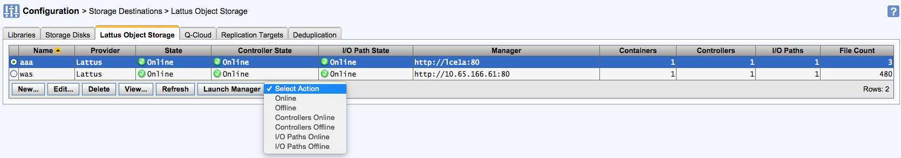
StorNext GUI Configuration
  Configuration > Storage Destination > Lattus Object Storage Tab
    OBJ component states are read from the SM database
    Launch Manager opens a new browser Windows and open Amplidata CMC
    Set OBJ component offline/online

Slide 100
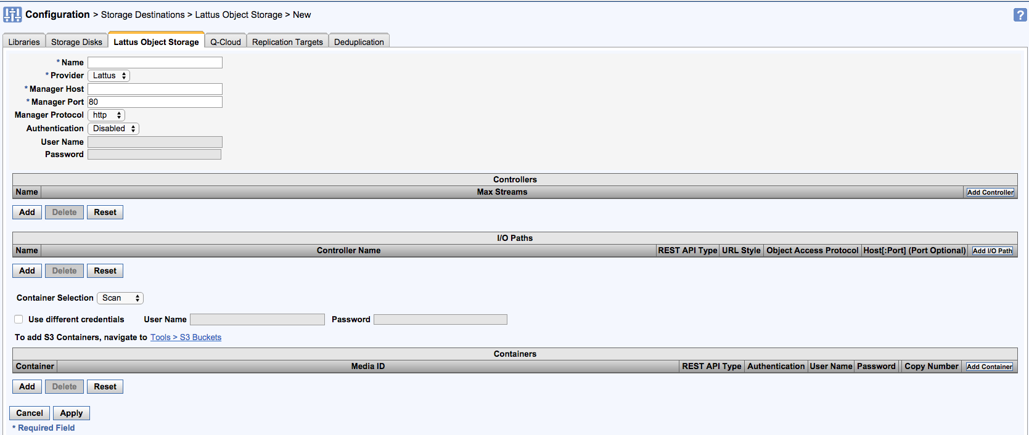
StorNext GUI Configuration
StorNext GUI configuration Walk-thru
  Lattus-M Object Storage Destination > New

Slide 101
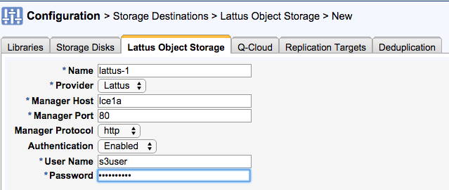
StorNext GUI Configuration
Appliance Configuration
  Manager Host can be IP or DNS
  Select HTTP or HTTPS for Manager Traffic (CMC GUI access)
  Enable / Disable Authentication
  Global Username/Password for all namespace

Slide 102
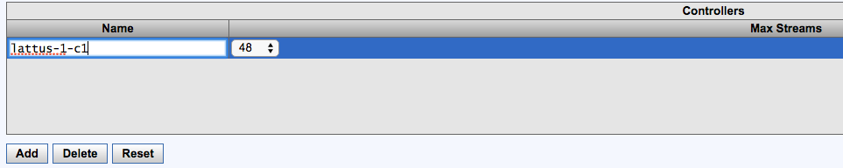
StorNext GUI Configuration
Adding a new controller
  Click ‘Add’ to insert new controller row, give it a name.
  Change max stream if needed.
  Default number of stream is 48 which can be adjusted from 1 to 200.

Slide 103
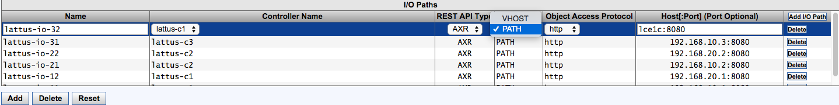
StorNext GUI Configuration
Adding “Endpoint Connections” or I/O path
  REST API can be either AXR or S3
  URL style can be PATH or VHOST
  Protocol can be selected for object access , i.e. HTTP or HTTPS
  Endpoint can be IP or hostname along with port number.

Slide 104
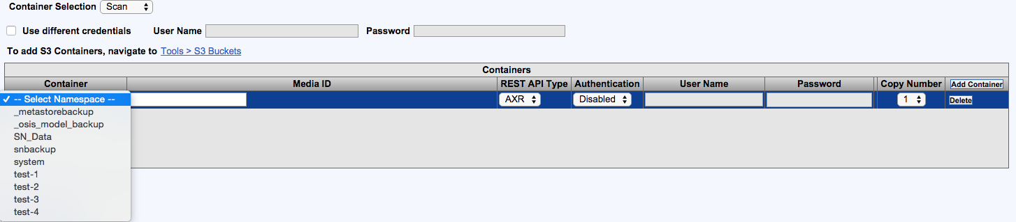
StorNext GUI Configuration
Adding a Namespace (NS Created on CMC)
  Select Container selection
    Scan : GUI will query the controllers and create drop down list
    Manual : Users manually type in NS name
  Enter SN media ID (user input)
  Authentication : If NS is owned by particular user, enter the details.

Slide 105
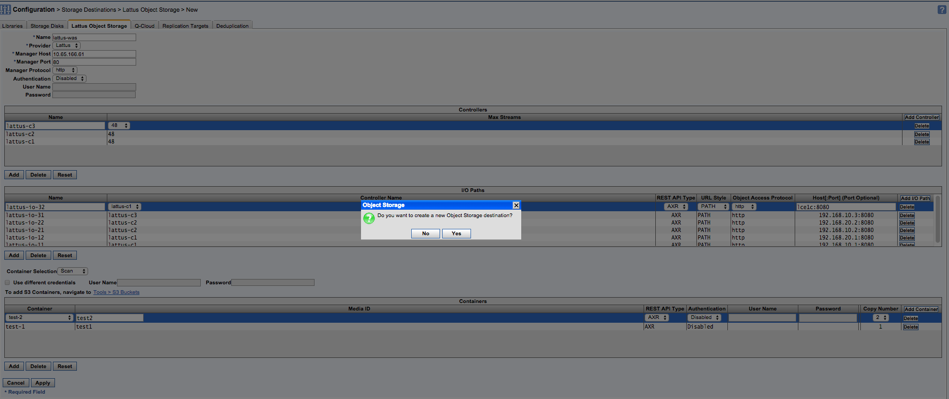
StorNext GUI Configuration
Click Apply to create or Edit Object Destination

Slide 106
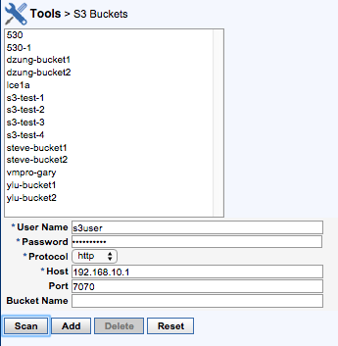
StorNext GUI Configuration
Creating S3 bucket
  SN GUI allows creation of S3 bucket
Assuming Lattus is already configured for S3
Current protocol supported is HTTP
Allows you to scan to list the existing bucket

Slide 107
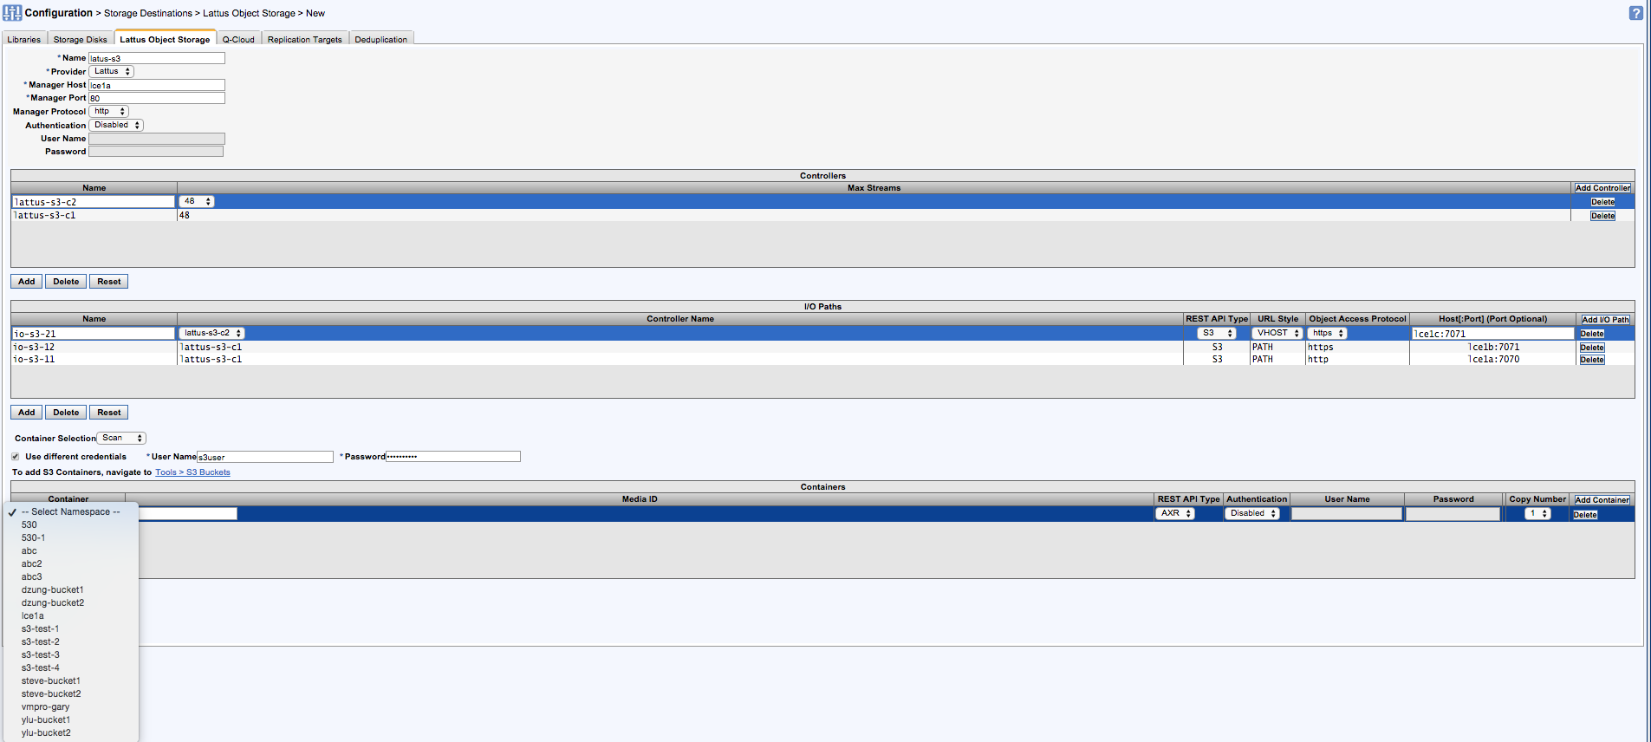
StorNext GUI Configuration
Creating Object Storage with S3

Slide 108
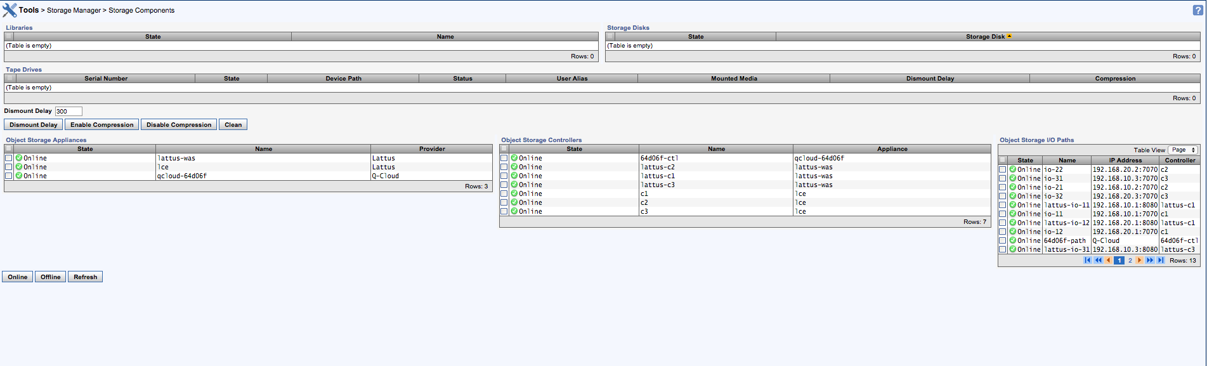
StorNext GUI Configuration
Set Object Storage Component Offline/Online

Slide 109
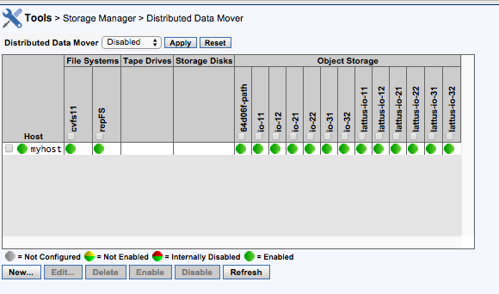
StorNext GUI Configuration
DDM with Object Storage

Slide 110
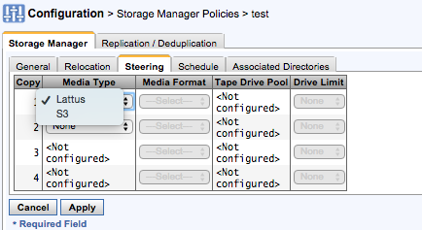
StorNext GUI Configuration
Storage Manager Policies and Object Storage Media
  There are two object storage media type
    Lattus for AXR Namespace
    S3 for S3 buckets
    Available in Steering tab while creating Storage Manager policy.

Slide 111
StorNext GUI Configuration
Set Object Storage Component Offline/Online

Slide 112
Lattus Upgrade

Slide 113
Lattus Upgrade
Check before upgrading
  Determine all existing or potential issues prior to upgrade.
  Determine the timing for the upgrade.
Upgrade Failure
  Known issues
  Steps for resolution

Slide 114
Lattus Upgrade
Upgrade Steps and expected duration
  Upgrade of the management node.
  Upgrade of all storage nodes and controller nodes.
    This takes 2-3 minutes per storage node and is done sequentially.
    After each storage node upgrade, it is automatically restarted.
  Upgrade of the CMC. This typically takes about 5 minutes.
  Restart of the storage daemons. This takes 5-6 minutes per storage node.
  Restart of the client daemons. This takes a couple of seconds per client daemon.
  Manually restart of all controller nodes. This takes 2-5 minutes per controller node.

Slide 115
Lattus Upgrade
Before you start the upgrade
  Run a health check on your environment and resolve all issues that are identified.
  If there are events indicating that a MetaStore is lagging behind, refrain from upgrading and make sure that none of your MetaStores are lagging behind.
  Replace the disks that are part of boot disks and has been degraded/decommissioned.
    Look for md0/md1 in the disk under storage nodes section.
  If there are any bad or degraded disks, decommission them before you start the upgrade.
  Ensure that all the MetaStores are up and none of them are degraded.

Slide 116
Lattus Upgrade
Before you start the upgrade
  In the list of Unmanaged Devices, look for the nodes which have status ACTIVE. Then either initialize the ACTIVE node or clean it.
    Cleanup using qshell “q.amplistor.cleanupMachine(‘MAC’)
  When upgrading from Lattus 3.4.x, disable the auto-decommission disks policy.
    There is a issue and may mark few disk as degraded when upgrading to 3.6.0
  Dashboard > Administration > Lattus Management > Policy and disable “Auto decommission disks”

Slide 117
Lattus Upgrade
Check before upgrade
  Upgrading to 3.6.0 is supported via the following upgrade paths:
Initial Lattus Version | Upgrade Path
3.4.3 and 3.5.1 | 3.6.0
3.4.0 – 3.4.2 | 3.4.4 -> 3.6.0
3.3.1 – 3.3.x | 3.4.4 -> 3.6.0
3.3.0 | 3.3.1-> 3.4.4 -> 3.6.0
3.2.0 | 3.2.1 -> 3.3.1 -> 3.4.4 -> 3.6.0
3.1.x | 3.2.1->3.3.1->3.4.4->3.6.0
3.0.x | 3.1.0-.3.2.1->3.3.1->3.4.4->3.6.0

Slide 118
Lattus Upgrade
Run the upgrade.
    Download the latest patch and check the md5-hash.
    Put the downloaded .tgz file on the Lattus management node in your root home directory.
    Extract the package:
      tar xzf Lattus_3.6.0.tgz -C /opt/qbase3/
    Open a screen session on the management node and script to capture terminal output.
      screen -S 3.6.0.upgrade ; script –f /var/tmp/upgrade-3.6.0
    Execute the upgrade tool:
      cd /opt/qbase3/utils/ ; ./apply_package.py -d –p Lattus_3.6.0
    At the end of running this command, you are asked to restart the controllers of your environment:
      Please reboot following controller nodes if they were not rebooted yet [<list of controllers>]

Slide 119
Lattus Upgrade
Run the upgrade (cont....)
  When your management node is restarted, restart the other controllers via the CMC.
    One controller node at a time, and wait until controller is fully functional.
  When all the controller nodes are restarted, login to management node
    Run the script with –r (restart your client daemons)
      cd /opt/qbase3/utils/ ; ./apply_package.py -r –p Lattus_3.6.0
  Complete the upgrade with following command
      cd /opt/qbase3/utils/ ; ./apply_package.py -c –p Lattus_3.6.0

Slide 120
Lattus Upgrade
Upgrade Failure – failing node upgrades will cause the apply_package script to stop.
Known upgrade failures:
  AU-821 - Old kernel images are not removed after upgrade (QTM-962)
  AMIF-4992 - Degraded disks after upgrade from 3.4.x (QTM-913)
  AU-661 - Installation of patch version v may fail because the monitoring agent cannot be stopped (QTM-635)
  Note that restarting the upgrade client daemon will cancel ongoing read/write requests. Also note that Lattus doesn’t support Rolling Upgrades.

Slide 121
Lattus Upgrade
In case upgrade fails:
  Check the logs and confirm which nodes have been upgraded and which have not.
  Spot the node where the failure happened and ensure the problem is resolved.
  Execute the upgrade tool again on the management node:

Slide 122
Lattus Upgrade
Mandatory steps after Upgrade
  If you have disabled Auto decommissioning policy before upgrade, enable it.
  Verify the Tuning parameter and make changes if necessary.
  If any of the disks appears degraded during upgrade, reset the disk using CMC.
  Make sure HTTPS certificate are available and secure connection can be established from the client.
  Any pound configuration changes apart from default will be over written by default value, you may need to re-apply pound settings.

Slide 123
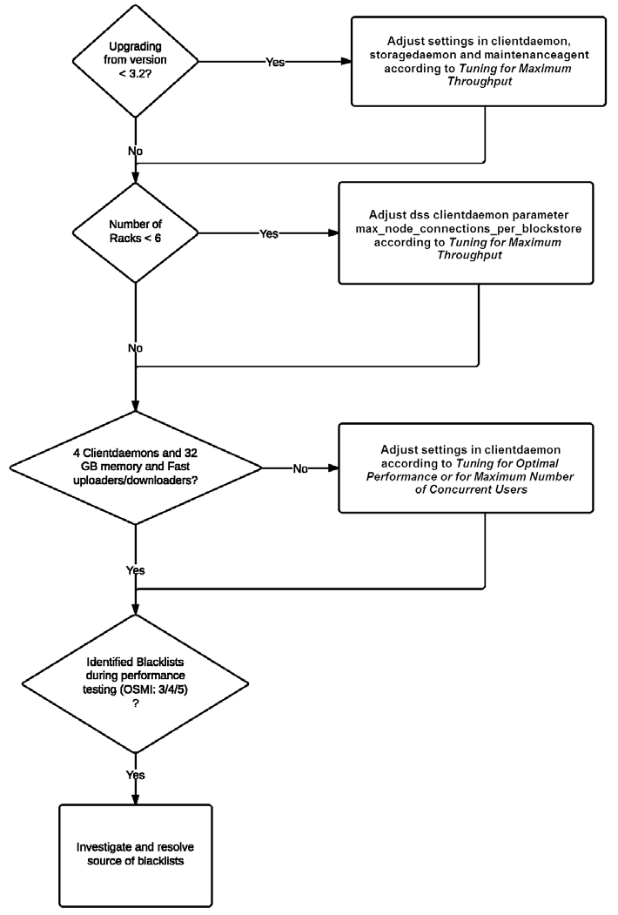
Lattus Upgrade

Slide 124
Contact Information
Email: Sunil.Joshi@Quantum.com
Phone 651-343-3766

Slide 125
THANK YOU
© 2013 Quantum Corporation. Company Confidential. Forward-looking information is based upon multiple assumptions and uncertainties,
does not necessarily represent the company’s outlook and is for planning purposes only.

