Slide 1
Quantum Lattus
Lattus Daily Phone-Home-Email Handling

Slide 2
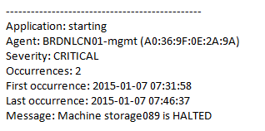
The Basics – Lattus Daily Phone-Home-Email SRs
Current (thru 3.5.x) Lattus Software Events include –
Application
Agent – Reporting node (MAC address)
Severity
Occurrences – How many occurrences within the reporting time period
First occurrence
Last occurrence
Message – Details of the issue
Ex.

Slide 3
The Basics – Lattus Daily Phone-Home-Email SRs
Lattus 3.6 will also include –
Software Version
Overall System Health
Controller/Storage Nodes
Offline, Decommissioned, Total Count
Disks
Degraded, Decommissioning, Decommissioned, Total Count
Metastores
Allocation Type, Degraded, Overall Status
Storage Pool
Worst Case Overall Disk Safety Level, Used Capacity, Total Capacity

Slide 4
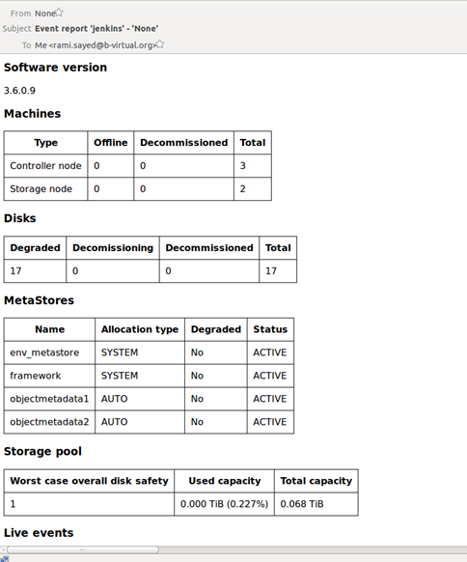
The Basics – Lattus Daily Phone-Home-Email SRs
Ex.

Slide 5
The Basics – The Process
Found on Munich > Product Information > Lattus

Slide 6
The Basics – The Process
Daily phone-home-email arrives in Techsup inbox
GSC/CDS creates SR and assigns to SW Tech Support queue
No contact with customer to see if immediate support is needed or to request logs
Next available SPS Eng takes SR
once it moves to the top of the queue
SPS Eng reviews the phone-home-email
This is where the fun begins…

Slide 7
The Basics – The Process (cont)
“Does the e-mail contain any event(s) that need further activity?”
Determine using your own parsing method, but the following must be done:
Weed out repeating events
Combine the number of occurrences of each event to determine the level of repetition
Look through the SR history for that serial number (via the Service History tab in Oracle) to see if there are any open SRs for the events
Look through the SR history for any close SRs for those events to see if:
the customer is aware of the issue
the issue has already been addressed
Note any “new” issues

Slide 8
The Basics – The Process (cont)
IF –
No further activity from Quantum needed that day
In Phone-Home SR, SPS Eng fills out the Actual Effort field on the SW Tech Support task
SPS Eng closes phone-home-email SR with ProbCode “EVENT EMAIL”, RootCauseCat “Event Email Generated”
Expectation – daily handling of phone-home-email SR - ~15 min
New issue found
SPS Eng has GSC/CDS create new SR for EACH issue
SR is to be assigned to the requesting SPS Eng
Since the new issue(s) is/are already being worked, the SLA clock start/stop is not necessary; thus, the CallCust task should be cancelled per direct assignment to the requesting SPS Eng.
If additional SRs were created and/or recurrences of open SR issues are encountered, the SPS Eng enters a list with SR #’s and Problem Summaries into the phone-home-email SR.
In Phone-Home SR, SPS Eng fills out the Actual Effort field on the SW Tech Support task
SPS Eng closes phone-home-email SR with ProbCode “EVENT EMAIL”, RootCauseCat “Event Email Generated”
Expectation – daily handling of phone-home-email SR - ~15 min

Slide 9
Demo

Slide 10
THANK YOU
© 2013 Quantum Corporation. Forward-looking information is based upon multiple assumptions and uncertainties, does not necessarily represent the company’s outlook and is for planning purposes only.

