Slide 1
Infinidat OEM TOI for Global Service, DXi SW ver 3.4.1
September 28th, 2017

Slide 2
Agenda
Product Overview
DXi SW Version 3.4.1
Training and Documentation Strategies
Service Model
Notes:
Please ask questions as we go. Your lines are muted on entry so *6 to unmute
Recording will be posted on Qwikipedia
Follow up Infinidat-led TOI scheduled for October 10, 2017

Slide 3
Product Overview
Mike Simone – Product Management

Slide 4
Infinidat OEM Business Overview
Infinidat sells high performance storage
Offering is object-based, but enhanced beyond traditional object storage
Triple active servers provide path to storage so that performance and availability is enhanced
One of their biggest source of leads is replacing very large EMC primary storage with the Infinibox (aka IBOX) product line
The Infinibox primary storage offering scales from 115TB to 2.8PB in a single 42 U rack
Performance is 12GB/sec with 130/180 µs latency
The OEM product is called the Infinidat Backup Appliance/IBA (internally, not final branding)
The goal of providing deduplicating backup is to displace large Data Domain appliances that are often in the same accounts where they are replacing EMC primary storage
It will run on the same IBOX architecture are the primary storage, but use a DXi software enabled server to act as the deduplication gateway
The IBA will deploy up to two active backup servers with a hot standby for availability

Slide 5
INFINIDAT backup appliance
High Performance
40TB/H target dedupe
70TB/H source dedupe
High Capacity
1PB physical capacity
20PB logical capacity
Availability and reliability
Highly available and Patented Error Recovery Technologies
Eco system Integration
Deep integration with leading backup software

Slide 6
NEW - INFINIDAT Dedupe Engine (DDE)
Backup optimized Dedupe engine
Variable block size
Inline process
Global per entire DDE pool
High Capacity - 540TB net capacity per DDE pool
High Performance – 20-35 TB/Hour digest rate

Slide 7
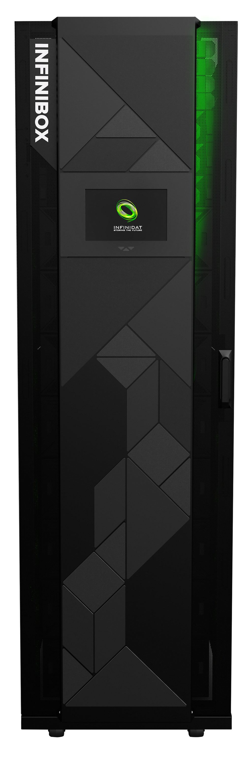
INFINIDAT Backup Appliance - IBA4260
3 DDEs per IBA
2 Active DDEs, one Passive for fast recovery
Semi-automatic recovery
1 PB net capacity
Up to 40TB/H digest rate
70TB/H with Client side dedupe
Underplaying IBOX is optimized for the DDEs workloads
Notes:
1GB/s backend TP at peak time

Slide 8
DXi SW Version 3.4.1
Jurgen van der Linden/Byron Hack – DXi Engineering

Slide 9
Infinidat Backup Appliance (IBA)
DXi node is called “DDE” by Infinidat (Deduplication Engine), actually DDE1, DDE2, DDE3, depending on the node (2 active nodes and 1 standby node)
DDE is based of the DXi6900-S family of code, version 3.4.1, based on the 3.4.0.1 Etna release identical feature set, just some functions disabled
Internally represented as Model DXi6800, ConfigurationID IBA1
SAS HBAs replaced by dual port 16G FC HBAs.
Removed backend storage monitoring
Instead DDE uses cable pull monitor to reboot system if connection to storage is lost.
Could be all paths to storage is lost, or could be iBOX is dead
DDE executes for 99.8% the same code as a regular 6900-S. It gathers the same collect logs, has more or less the same service menu, etc. Many GUI pages are hidden for non-Service users.

Slide 10
IBA DXi SW version 3.4.1
Quantum engineering provided binaries but Infinidat engineering modified configuration:
boot from the iBOS LUNs, no HDD in the node
Infinidat runs some post-install scripts to further integrate the DDE into the IBOX. (That is outside of Quantum’s visibility, Infinidat owns that part.)
*FW (and yum) are technically possible, but are handled by Infinidat technicians instead of the end-user. YUM upgrades (polling) disabled in DXi SW. Utilities > Firmware upgrade available via GUI for Service users.
What happens if a second DDE tries to access a LUN which is used by another DDE?
Prevented by the proper LunTable and Lables, e.g. Infinidat technicians configure it for the user, and use
Names like DDE1_BPMD_1, DDE2_BPMD_1 etc.
Also on the iBOX one has to map LUNs to specific FC ports, and they use a FC switch, which might have zoning as well.
This is all done by Infinidat service people, not end-users.
Bugzilla Support (for 3.4.1)
Flags: IBA_Approval +; IBA_Verification + (or ?)

Slide 11
IBA StorNext Configuration
Stornext configuration on boot (after install) relies on iBOX LUN names to figure out which LUN can be used for what purpose. The following was arranged by Infinidat:
iBOX can support 1, 2 or even 3 DXi node, and iBOX can have many, many LUNs.
iBOX setup, LUN creation is handled by Infinidat.
On DXi side /opt/DXi/RAID/LunTable.sh creates a LunTable file, with all LUNs found, serial number, and iBOX names. The LunTable can be changed to limit which LUNs to use.
This table is used by all DXi configuration tools to create Stornext configuration files.

Slide 12
StorNext Configuration
Naming conventions for this LUN’s for data metadata, boot etc. For Stornext labels, similar as for 6900-S:
There should be 1 or more bulk-data LUNs, use any name, each .
LUN must be larger than 1 TiB.
We have been testing mostly with 6 or 12 such bulk-data LUNs.
The metadata LUN must have names that contain the above Name strings, so that the DXi software can recognize the LUN, and use it for the right purpose.
(if multiple dedup nodes are on the same iBOX, one could use names like "DN-1-BDSS_JRN".)
What we can see if the Luntable file is corrupt (RAS ticket)? LunTable is only used during initial Stornext filesystem creation. Normal file like all other files on boot drives.

Slide 13
IBA Passwords
Infinidat chose to use the same password for everything
Root login is disabled
ServiceLogin is enabled, but Qtm Service needs to work with Infinidat Support to access the DDE
BIOS, iDRAC
GUI Service User, Etc
$NF#N#D^T23
Passwords should NOT be changed by Qtm Service without approval from Infinidat Support.
Passwords are used by proxy code on the Infinibox to log into the DDE GUI via Rest WS. Changing GUI passwords will break the connectivity unless the proxy is updated as well.

Slide 14
Hardware Monitoring
What do we monitor?
Only hardware in the DDE node is monitored. The usual hwmond is running.
Nothing external, storage, switches etc.
There are no physical disks in the node, but still has a PERC controller.
No SAS cards, FC HBAs instead, these are “system” ports, monitored for a link.
We do monitor multipath through (ironically) RAID_monitorExternal.pl
Will reboot if all paths to a LUN are lost.
Normal RAS tickets rules apply, but are sent to an Infinidat owned server.

Slide 15
DXi GUI Changes for IBA
DXi GUI is embedded in Infinibox GUI.
Select DDE from Infinibox navigation menu
Tabs for DDE1, DDE2 correspond to each DXi node
Login occurs under the covers via Rest WS; login page is not displayed
GUI features not displayed for non-service users:
Top banner (overall status, alerts, tickets indicator, logout button, user role, etc)
Configuration > Date & Time, Local Access, SSL/TLS, LDAP, Email, SNMP, Inactivity Timeout, Security Notice, Client PlugIns, Redirect Logging, Contacts
Alerts > Service Tickets
Status > Hardware Details, Logs (Admin Activity Log)
Utilities
Configuration Wizards
Map

Slide 16
DXi GUI Changes for IBA
Other GUI items not displayed for non-service users
Scheduler > Email Reports, HealthChecks, and Space Reclamation
Home page > IP Address, Version, Serial Number, Software Upgrade link, Current Activity > FC Out, & links to HealthChecks, Space Reclamation, and Network pages
Login pop-up notifications (Failed login attempts, service tickets present)
Configuration Network (non-service users)
General section not displayed
IP Address Table
External Host IP column not displayed
ETH1 not displayed
Traffic Type – Mgmt column not displayed
GUI Inactivity Timeout set to 600 minutes

Slide 17
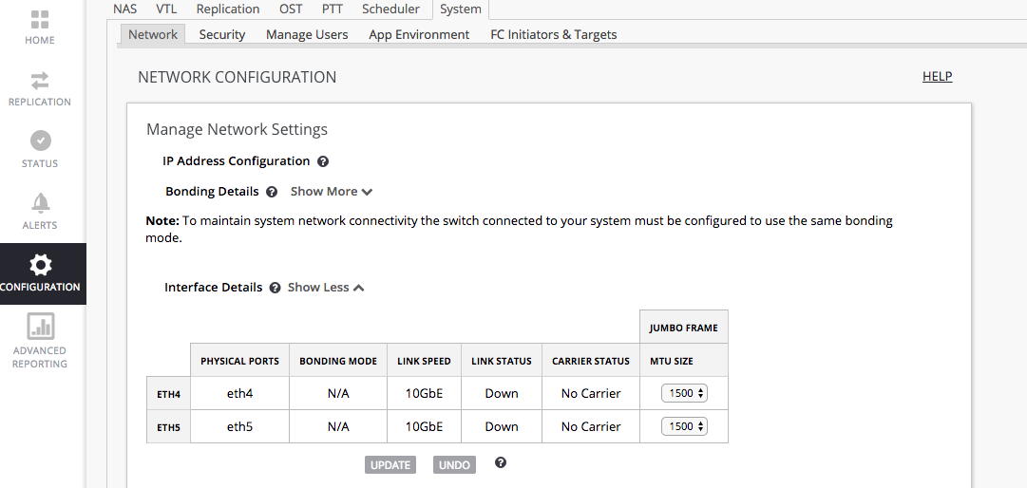
GUI Branding/Styling Changes for IBA
Colors, fonts, etc

Slide 18
Other UI Changes for IBA
Under Seer control (Infinidat may turn off at a later date)
Configuration > PTT, Configuration > FC Targets & Initiators
Advanced Reporting
Advanced Reporting (DAR) uses “Classic DAR”, menu selections and menu banner are slightly different than DAR on DXi.
Does not include DB Export button – see syscli command added in 3.4.0
Service Users for GUI and SysCLI (ServiceLogin) are enabled by default
SysCLI admin and viewer are disabled on the Local Access page (page hidden for non-service user)

Slide 19
SysCli Command for DAR DB Export
syscli --gen dbexport [--upload] [--sure] [--quiet]
This CLI allows the admin user to generate an Advanced Reporting DB export file on the system. It provides an option to upload resulting tar.gz file to the DART repository. Without upload option, the tar.gz file is generated and remains on system in /snfs/DART. Running this command may take several minutes and removes previous versions of DB export files in /snfs/DART.
Option description:
--gen: Generates Advanced Reporting (DAR) DB export file.
--upload: Export and upload (ftp) file to repository.
--sure: If specified, the command will execute immediately without asking for confirmation.
--quiet: Do not display status while generating DB export file, output redirected to /snfs/tmp/DART/DbExport.log. Use with --sure and --outfile to suppress all output to the console.

Slide 20
Accessing the DDE System as ssh ServiceLogin
Quantum Service needs to work with Infinidat support.
Infinidat support can login directly to nodes with ssh through SA (support appliance).
SA is a small server connected to the 3 DDEs via a 1 gb/s port and via the IDRAC port. It is also connected to the 3 ibox nodes.
Be sure to attend the upcoming TOI from Infinidat to learn more about working with Infinidat Support to access the DDE nodes.

Slide 21
Training and Documentation
Jim Bell/Neal Menke – Training and Documentation

Slide 22
Documentation Strategy
Documentation
Provide DXi documentation via FTP that Infinidat uses to create their own manuals.
Provide updated documentation with highlighted changes during program updates.
Provide final documentation with source files at program GA.
Online Help
Infinidat Online Help is specific to the Admin User. Service topics are hidden.
Service topics can be viewed by using the online help search field.
Infindat Online help can be found here: http://qsupport.quantum.com/kb/flare/Content/Sandbox/Infinidat/onlinehelpIBA/default.htm

Slide 23
Training Strategy
Suggested Infinidat DXi Learning Resources
Customer-Facing Training (available from Quantum.com)
DXi Core Concepts Explained: Available on the DXi6900 Support page
DXi Configuration Videos: Available on the DXi6900 Support page
Videos are also available in the QuantumKnowHow channel on YouTube.
DXi Advanced Reporting: Available on the DXi6900 Support page
Service-Facing Training: Available from StorageCare Learning
DXi-Series Core Concepts for Service (2-0443) Link
DXi-Series 2.x Configuration (2-2482) Link
DXi Advanced Reporting Service Training (2-2412) Link

Slide 24
Service Model
Jim Hibbard – Service NPI

Slide 25
Service Model
Service model is similar to the FTS service model
Quantum support responsibilities are for the DXi SW only and no HW support
Quantum Service provides support to Infinidat, not to Infinidat end users.
Calls from Infinidat end users should be referred to Infinidat Support. See Service Plan for contact details.
Infinidat sales will not reside in our IB records. “Infinidat” dummy serial number used to facilitate opening support Cases.
Infinidat support Cases should be opened against serial number “infinidat”. Infinidat should reference “infinidat” serial number when requesting support over the phone and online.
Support Contract: QUANTUM DXI OEM SOFTWARE, 7X24HR SOFTWARE PHONE SUPPORT, ANNUAL, ALL ZONES
Infinidat support Cases route to ASPS team.
Escalation resources: Service Engineering Specialists (SES) and DXi Sustaining Engineering (DXI SUS)
Service Plan (PN 0-16174-01) contains more details
Released and posted on CSWeb under Disk Backup Systems > Infinidat

Slide 26
Infinidat-led TOI
Joe Roa - INFINIDAT Senior Solution Architect will preform a live demo of the INFINIDAT BackUp Appliance aka IBA. We will also have INFINIDAT Support and Development leaders attending so feel free to raise questions in those areas.
Scheduled for 10/10/17
Infinidat’s meeting will be forwarded to Global Service Team
Meeting will require the use of “GoTo Meeting”. Please setup in advance of the meeting start.
We will record the session and post on Qwikipedia
Infinidat’s slide deck, IBA Support Training, is posted on CSWeb under Disk Backup Systems > Infinidat OEM > Manuals
Please try to review ahead of live TOI

