Slide 1
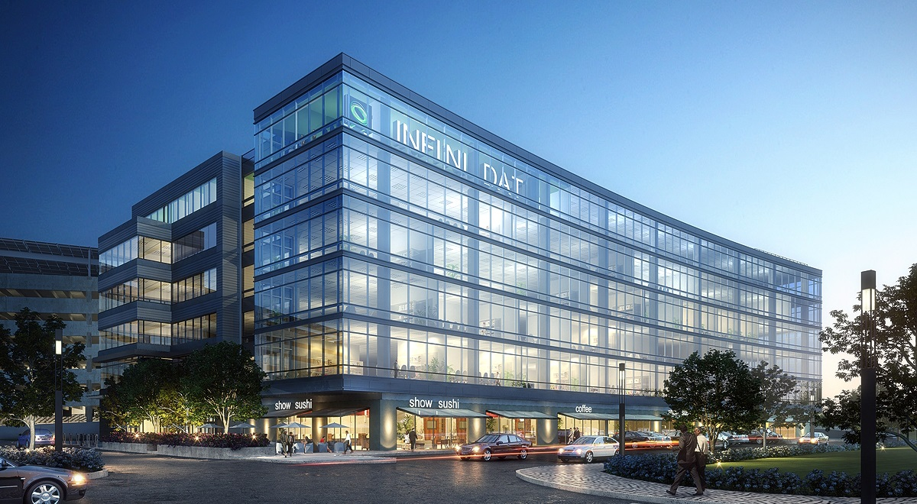
INFINIDAT Backup Appliance Deep Dive - 9/17
Confidential - Do not distribute 1

Slide 2
Agenda
B4260 Architecture Intro
INFINIDAT Backup Appliance (IBA) Specs
IBA Storage Architecture
Demo
Q&A

Slide 3
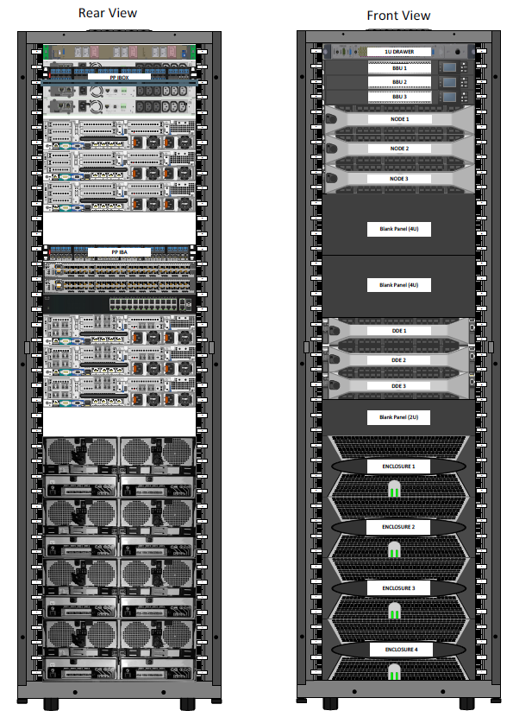
What is it?
It is an INFINIDAT Model B4260
A Flash Optimized Purpose Built Backup Appliance
2 Active Deduplication Engines for 1PB – Physical Useable Capacity
Racked and Ready Engine HA (Built-in)
Internal racked FC & Ethernet Switch between iBox & DDE’s
Use Market Proven, Licensed, Effective Variable Block Deduplication
Fully Racked & Wired with a simple custom Patch-Panel
Fully INFINIDAT Assembled, Installed, Configured & Supported
The INFINIDAT Backup Appliance (“The IBA”)

Slide 4
IBA Naming Conventions
IBA model number B4260
The B refers to an IBA solution (B for Backup)
Added components - 3 x DDEs, FC-SW’s , ETH-SW
The 4 refers to an F4000 or 4 enclosures
The 2 means 2nd generation node (R730xd)
The 6 refers to using 6TB HDD disks

Slide 5
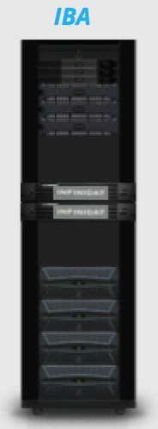
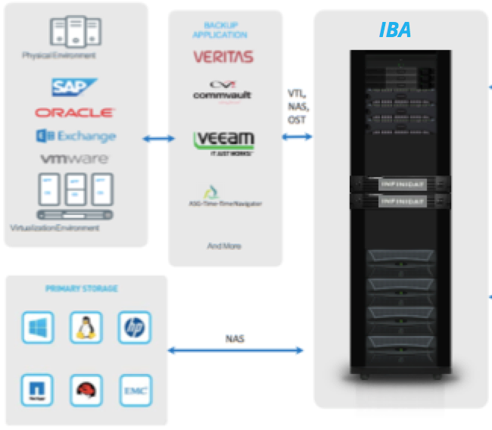
IBA Data Protection Portfolio
Limitations Up-to:
Upto ~76TB/Hr
128 VTL Partitions
1024 Virtual Tape Drives
18,000 Tape Media
256 NAS & Application Shares (NFSv3, SMB3, Application)
Upto ~ 200 Media Servers
Replication – 1-0, 1-1, 1-2, N-1
Pipes:
6 x 16GbE FC Ports (VTL)
- 4 Active
+ 12 x 10GbE Ports
- 8 Active
Or
18 x 10GbE Ports (no VTL)
- 12 Active
1-0, 1-1 or 1-2 & N-1
Site Replication

Slide 6
Goals
Turnkey Solution to Enter Enterprise Backup Market
Backup software independent – “Plugin and Play” for NBU, TSM, CV, Oracle, Veeam etc
Integrating the best and proven technologies for the backup market
Lowest Cost without compromise of Performance, Capacity or Quality
Simplified, integration and enhanced solution under single vendor support
Support Enterprise Data Protection Ecosystems
Go beyond the simple B2D use cases, software driven architecture or simple customers
Enterprise scale in capacity and performance
GA Date
Targeting September 29, 2017 (*=Post GA state of direction)
Notes:
1GB/s backend TP at peak time

Slide 7
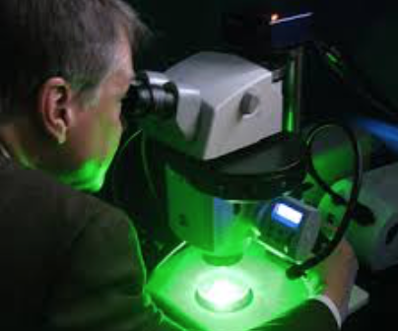
Deep Dive on the Architecture

Slide 8
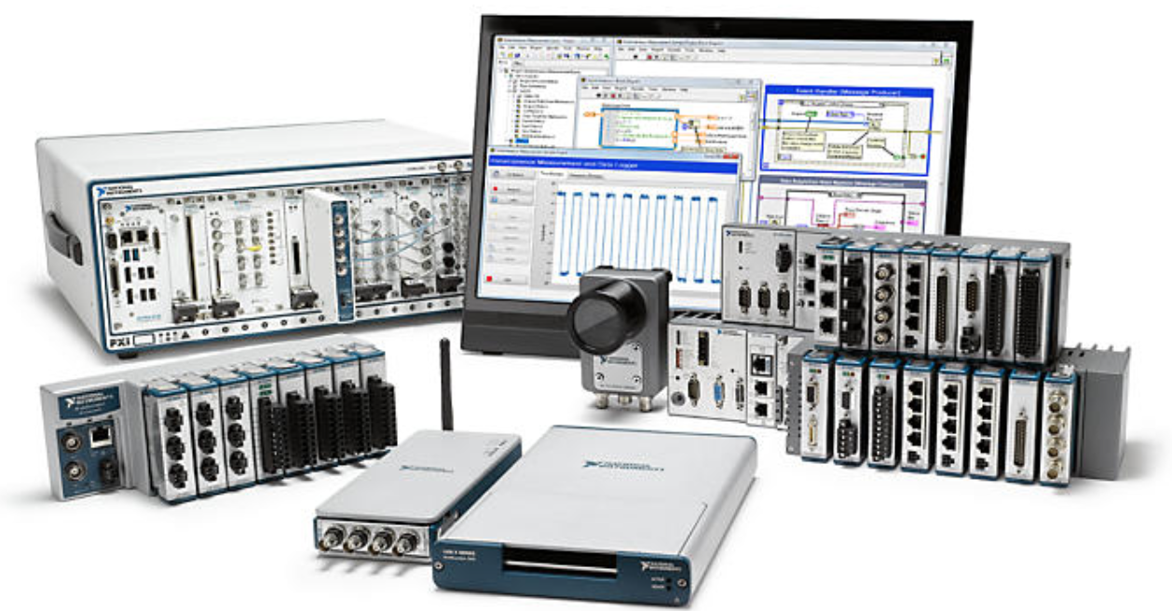
A look at the Hardware
Off the Shelf Hardware
Carefully selected based on performance, reliability, availability and cost
Assembled for highest performance & reliability
For optimized integration of exceptional Software based storage solutions by INFINIDAT

Slide 9
Hardware Layout |DDE Node PCI cards
Common Dell Servers Improves Inventory, Stock, Support Simplicity
Slots 2 & 3 Qlogic 2662 16Gb FC internal connections to IBox
Slots 4, 5, 7 Used for customer connections
Options of the following
Intel X520 Dual Port 10Gb (NAS, OST, Replication)
Qlogic 2662 16Gb FC (VTL) – Soft Zoning is preferred for FC – for proper Node Failover
ZONE All Media Server Switch Ports to All DDE FC Switch Ports
Typically Requested - 4 x 10GbE plus 2 x 16Gb/8Gb FC (for VTL integration)
Optionally – 6 x 10GbE (when no VTL is required)

Slide 10
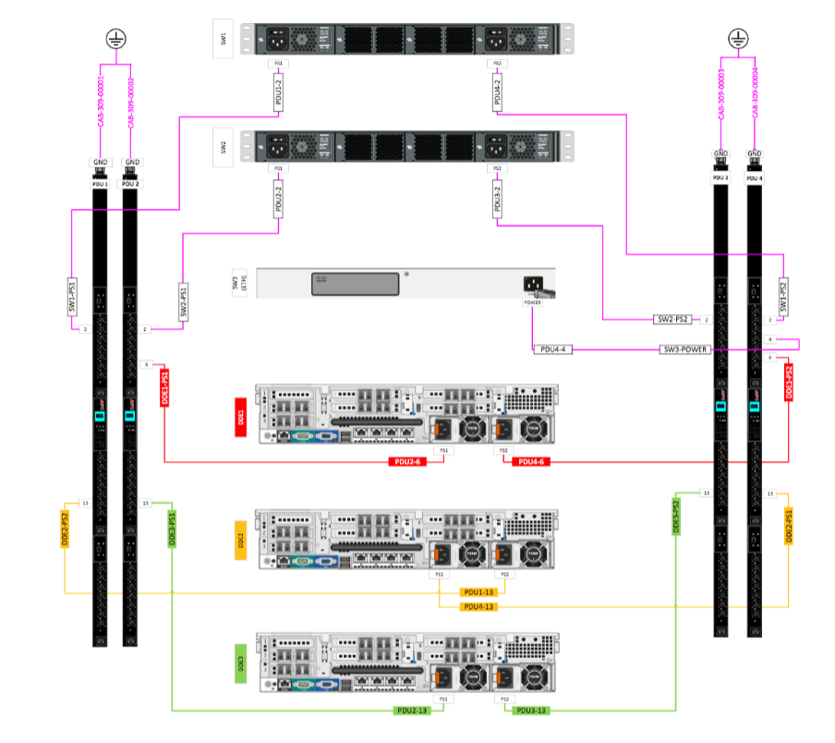
Power Distribution
Each IBA Component has two PSUs
(except internal 1Gb Switch)
Support for both single & three phase power
single phase - 2 PDU per side
three phase - 1 PDU per side
* Customer Choice
If 1GbE Switch is down, only access to management is lost. All configured functionality continues to be served until Support can restore the switch.

Slide 11
Internal Network Connectivity - Cabling
iBox Patch Panel – Shelf Top = 4 x 1GbE
Customer Run Cables – UI & Support
Optimized Switch Wiring
Patch Panel shows mgmt cable ports on IBA-Patch Panel but these are NOT for customer use
DDEs are managed through the IBA GUI
Support is managed thru iBox SA
2 IBA Patch Panels for External Cabling
FC or 10GbE
FC or 10GbE
FC or 10GbE
4 x 10GbE
4 x 10GbE
4 x 10GbE
Minimal Customer Wiring
4 x 1GbE
12 x 10GbE
6 x 8/16Gb FC (VTL Only)
IBA Patch Panel – Shelf Center
Top Row = 6 x 8/16Gb FC or 6 x 10GbE – Customer Choice
Bottom Row = 12 x 10GbE
Customer Run Cables – UI & Support

Slide 12
Optional Networking Schemes
VTL Rich Environment
10GbE is used for Replication
Each DDE FC Target Port is Zoned
To each Media Server Initiator Port
- 4 x FC Ports / DDE
2 x 10GbE Ports / DDE (Copper/Optical)
64Gb FC / DDE = ~ (6.4GB/Sec)
20Gb Ethernet / DDE = ~ 2.4GB/Sec
Total Pipe BW / DDE = ~ 8.6GB/Sec
NOTE:
1GB/Sec = 3.6TB/Hr
Backup Media Server Initiator Ports
FC Switch 1
FC Switch 2
30.9TB / Hr / DDE
10GbE Network WAN
To Backup Media Servers & IBA Targets
1
2
3
4
1
2
1
2
3
4
1
2
1
2
3
4
1
2
DDE1
DDE2
DDE3
16Gb FC ports
10GbE ports
16Gb FC ports
10GbE ports
16Gb FC ports
10GbE ports
1
1GbE Mgnt port
Internal
1
1
1GbE Mgnt port
Internal
1
1
1GbE Mgnt port
Internal
1
Internal iDRAC
Internal iDRAC
Internal iDRAC

Slide 13
Optional Networking Schemes
Ethernet Rich Environment- No VTL
(OST/NFS/CIFS & Replication)
10GbE is used for Data & Replication
6 x 10GbE Ports / DDE (Copper/Optical)
60Gb Ethernet / DDE = ~ 7.2GB/Sec
Total Pipe BW / DDE = ~ 7.2GB/Sec
NOTE:
1GB/Sec = 3.6TB/Hr
25.9TB / Hr / DDE
10GbE Network WAN
To Backup Media Servers & IBA Targets
1
2
3
4
5
6
1
2
3
4
5
6
1
2
3
4
5
6
DDE1
DDE2
DDE3
10GbE ports
10GbE ports
10GbE ports
1
1GbE Mgnt port
Internal
1
1
1GbE Mgnt port
Internal
1
1
1GbE Mgnt port
Internal
1
Internal iDRAC
Internal iDRAC
Internal iDRAC

Slide 14
Optional Networking Schemes
Balanced Mix
Ethernet & VTL Rich Environment
10GbE is used for Data & Replication
VTL Used for Data Only
Each DDE FC Target Port is Zoned
To each Media Server Initiator Port
- 2 x FC Ports / DDE
2 x 10GbE Ports / DDE (Copper/Optical)
32Gb FC / DDE = ~ (3.2GB/Sec)
40Gb Ethernet / DDE = ~ 4.8GB/Sec
Total Pipe BW / DDE = ~ 8GB/Sec
NOTE:
1GB/Sec = 3.6TB/Hr
Backup Media Server Initiator Ports
FC Switch 1
FC Switch 2
28.8TB / Hr / DDE
10GbE Network WAN
To Backup Media Servers & IBA Targets
1
2
1
2
3
4
1
2
1
2
3
4
1
2
1
2
3
4
DDE1
DDE2
DDE3
16Gb FC ports
10GbE ports
16Gb FC ports
10GbE ports
16Gb FC ports
10GbE ports
1
1GbE Mgnt port
Internal
1
1
1GbE Mgnt port
Internal
1
1
1GbE Mgnt port
Internal
1
Internal iDRAC
Internal iDRAC
Internal iDRAC

Slide 15
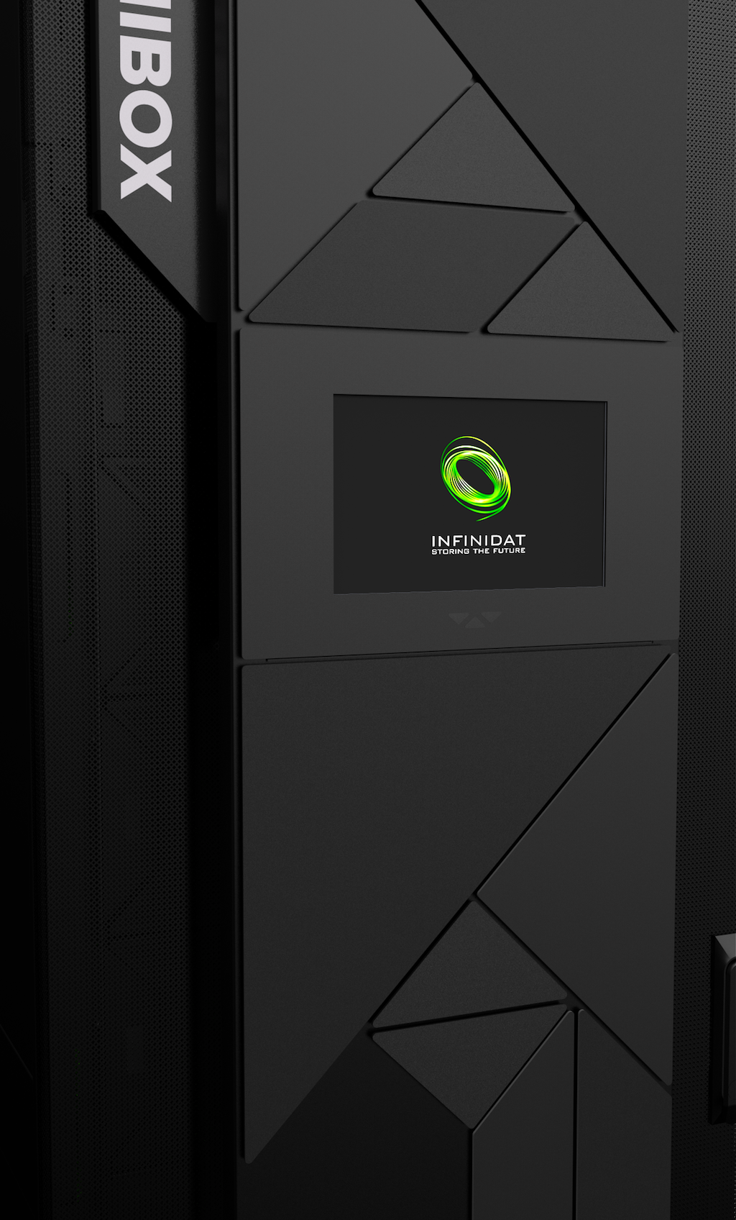
Ideally Workloads are balanced between DDE’s
Backup Server
Backup Server
Backup Server
Backup Server
Backup Server
Backup Server
Oracle Server
Oracle Server
VM Workloads
Windows Workloads
UNIX Workloads
Oracle Workloads
INFINIDAT
B4260
DDE1
DDE2
For Best Results
Balance work across both DDE’s
Keep Similar Workloads Together for Higher Efficacy
Balance us of IP’s and FC Ports on Each DDE
Balance use of VTL, NFS, CIFS
Use OST plugin wherever Possible (NetBoost/ACCENT)
Global Dedupe
is
DDE Centric
@ 506TB/DDE
The DDE’s are simply Disk Targets for Strategic Backup Data & Network Reduction

Slide 16
Oracle Workloads are balanced between DDE’s
Oracle Server
Oracle
Server
Oracle
Server
Oracle
Server
Oracle Server
Oracle Server
Oracle Server
Oracle Server
UNIX Workloads
Oracle Workloads
Special Oracle Application Shares
For Disk & Network reduction in Backup
Up-to 76TB/Hr
Backup & Restore
UNIX Workloads
Oracle Workloads
Oracle
Replication
Scenario 1
RMAN Scripts point backups to IBA SBT_Tape Devices then the IBA replicates the data.
INFINIDAT
B4260
Extreme Performance & Reliability at the Lowest Possible Transferable
$ Cost/TB in its Scale.
DDE1
DDE2
For Best Results
Oracle
Replication
Scenario 2
Balance work across both DDE’s
Keep Similar DB Workloads Together for Highest Efficacy
Balance us of IP’s and FC Ports on Each DDE
Balance use of “Application Shares” or NFSv3 targets
Use Oracle plugin wherever Possible (NetBoost/ACCENT)
RMAN Scripts point backups to IBA “SBT_Tape” Devices on both IBA’s (DUPLEX) allowing immediate access to restore from either target.
The DDE’s support simple Disk Based Targets for Strategic Backup Data & Network Reduction

Slide 17
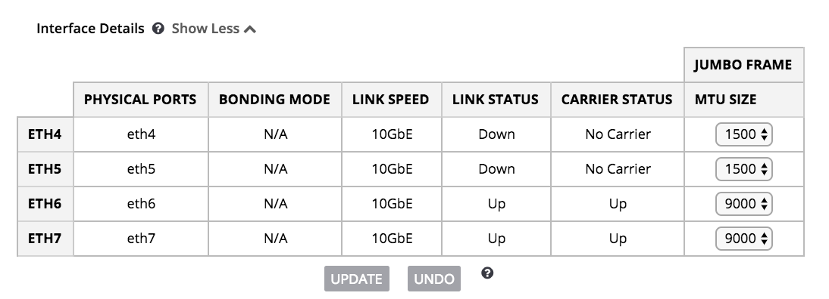
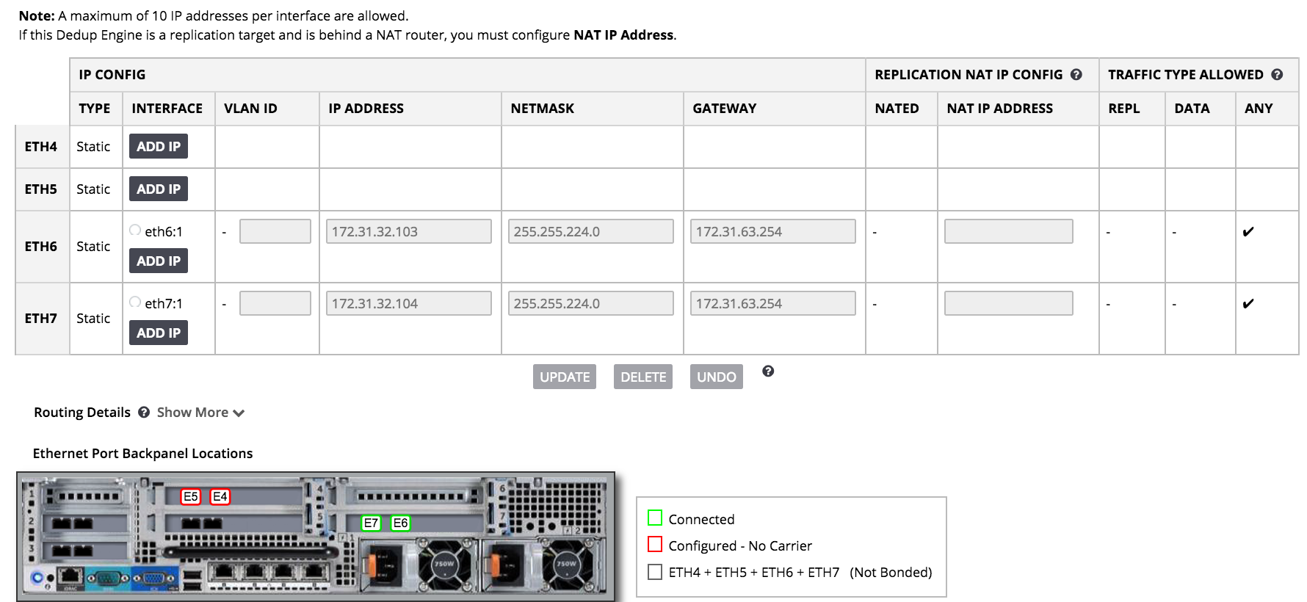
Networking the DDE’s
NIC Bonding with LACP provide the highest Network Reliability & BW to IP targets – Mode 0 (Active/Active)
Using all 10GbE NICs is recommended
Allowing Data & Replication from the IPs can also make best use of all networks
When all clients can use Jumbo Frames set MTU to 9000
4 active 10GbE ports on each DDE provide 40Gb performance for physical data transfer or ~ 4GB/Sec/DDE to IP targets
2x16Gb FC ports (for VTL) will provide approximately 3.2GB/Sec to DDE VTL targets.
IP addresses are used for OST integration, RMAN backups, NAS and Application Shares, and Veeam container Integrations. Bigger pipes = bigger yields

Slide 18
IBA Installation
IBA installation will need the standard IBOX requirements (plus) (Drives installed and FW update on Delivery – System installed in ~ 4hrs)
4 x 1Gb ethernet connections (mgmt per node + SA)
5 IP addresses (1 per node + 1 float + SA)
IBA DDE’s Require FC & 10GbE connections
12 x 10GbE (LACP or Independent IPs for Data & Replication)
6 x 8/16GbE FC (VTL only)
The install process will be to install the InfiniBox per normal procedure and then the IBA pieces after
Notes:
This is all the connectivity that we (Infinidat) need for the install - the customer will still need 10Gb copper/fiber or FC connectivity for data/replication traffic

Slide 19
Internal FC Connectivity & Cabling
ALL INFINIDAT MANAGED
DDEs have 2 connections per internal FC switch
Each IBox node has 2 connections per internal FC switch
Total of 12 FC ports used per internal FC switch
FC switches are internal ALL INFINIDAT MANAGED!
FC internal Switches are used for iBox to DDE volumes!
* This is Not used for VTL services on the DDE.
All Pools & Volumes are Pre-configured, Zoned, & Mapped

Slide 20
All Storage is Pre-Configured DDE’s use a Boot from SAN model for Highest Performance & Reliability All Storage to Each Deduplication Engine is managed in Separate Protected Pools All Volumes are pre-configured and Mapped to Each DDE Customers are not responsible for Storage Management of the IBA HW or SW Customers are not responsible for HW component Replacement (internals) Single-Sign On UI (Very INFINIDAT friendly) Integration with InfiniMetrics
Notes On Storage Integrations
DDE Volume Configuration
Block size - 4K page size
Thick Provisioned
Compression - IBox compression Off - Compression done in DDE software for dedupe LUNs
Pool Buffer is set to Unlimited
Alerts Warn - 80% Critical - 90% ( Warnings may warrant Old Backup Expiration )

Slide 21
Shutdown process
Customers will need to contact support for graceful shutdown of the IBA system at GA
To shutdown the system support will need to 1st shutdown each DDE and then the InfiniBox
DDE reboots and Hot Spare Node Replacements
– Take approximately 15 minutes on GA

Slide 22
IBA - 12 month roadmap
Full HA for DDEs
Mix-Mode & Gateway-mode
use the underplaying IBOX for replication, emergency restore and secondary storage
Add DDEs to existing customer’s IBOX
IBA based on F2280
IBA B4K using 10TB Drives
1PB DDE capacity
50%+ DDE performance increase
Infinimetrics to monitor DDEs performance
IBA replication to Leitrem cloud
Accent (source dedupe) to support more platform

Slide 23
Questions?

