Slide 1
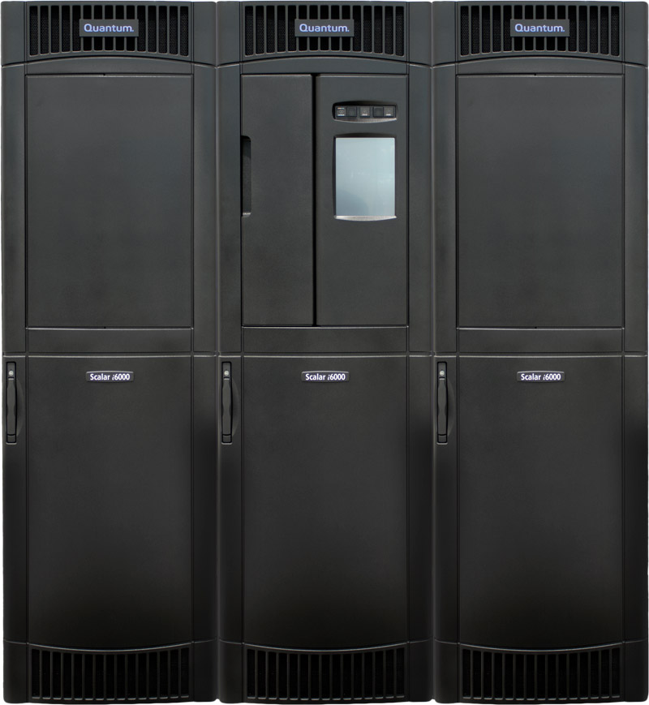


Scalar i6000
i10 Dual Robot
Release
Transfer of Information (TOI) for Service
6 January 2012
Filename goes here (e.g., P12345A-v01)

Slide 2

2
© 2011 Quantum Corporation. Company Confidential. Forward-looking information is based upon multiple assumptions and uncertainties, does not necessarily represent the company’s outlook and is for planning purposes only.

Slide 3

Asking Questions
This is an interactive session
Please ask questions
3
© 2011 Quantum Corporation. Company Confidential. Forward-looking information is based upon multiple assumptions and uncertainties, does not necessarily represent the company’s outlook and is for planning purposes only.

Slide 4
Agenda
Sales and Marketing Overview
  Ryan Duffy, Product Marketing
Gen 2 Dual Robot Hardware Overview
  Rob Yang, Engineering
Gen 2 Dual Robot Diagnostics
  Carsten Prigge, Engineering
New Software Features in i10
  Carsten and Rick Murray, Engineering
Documentation and Training
  Tom Sajbel, Educational Services
© 2011 Quantum Corporation. Company Confidential. Forward-looking information is based upon multiple assumptions and uncertainties, does not necessarily represent the company’s outlook and is for planning purposes only.
4
© 2011 Quantum Corporation. Company Confidential. Forward-looking information is based upon multiple assumptions and uncertainties, does not necessarily represent the company’s outlook and is for planning purposes only.
4

Slide 5
Sales and Marketing Overview
Presented by Ryan Duffy

Slide 6
New Scalar i6000 Features in the i10 Release
New Dual Robot feature
  Dual Robots provides high availability by allowing libraries to continue to operate in the event of a robot failure.
New Active Vault feature
  For companies keeping tapes on-site (nearline) for long periods of time, Active Vault offers a more efficient, safe, and secure alternative to vaulting tape cartridges outside the library.
Partitioning Enhancement Allows Automated Media Pool
  Automated Media Pooling saves customers time by making it easier to share spare media between multiple partitions.
Other Enhancements
  Adding a new SKU for an “Unlicensed” EM for use w/ Active Vault, EDLM.
  EDLM partitions no longer require licensed COD slots.
  EDLM no longer includes partitioning, but comes with necessary functionality.
  Partition Utilization Report – very limited use, no need to position with cusotmers
© 2010 Quantum Corporation. Company Confidential. Forward-looking information is based upon multiple assumptions and uncertainties, does not necessarily represent the company’s outlook and is for planning purposes only.

Slide 7
Sales Results
© 2010 Quantum Corporation. Company Confidential. Forward-looking information is based upon multiple assumptions and uncertainties, does not necessarily represent the company’s outlook and is for planning purposes only.
Dual Robot
  10 dual robot sales (9 customer orders)
    5 upgrade system and 5 new systems
      2 of the upgrade systems were new systems from a sales perspective
    1 in NA
    4 in EMEA
    2 in APAC (1 customer)
    3 in LA
  Expected 2 robots for spares (Unitech) and one system for Teradata
  $2.25M in DR revenue (includes all associated library revenue)
Active Vault
  Two deals, both media companies in NA
EDLM
  49 licensed sales
    26 in NA
    19 in EMEA
    4 in APAC

Slide 8
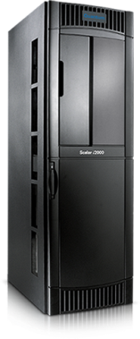
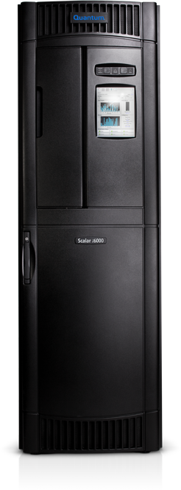
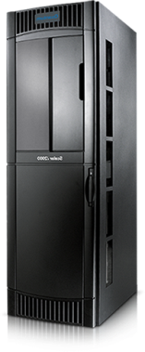
Scalar i6000 Dual Robot Overview
Product basics
  Active / Passive* operation for HA
  Does not reduce library capacities
  I2k/i6k field upgradable
Value proposition
  High availability, complements other HA features (nSNW with path failover)
Competitive positioning
  Smallest footprint for dual robots
  Swap a parked robot in seconds
  Swapping a parked robot is non-disruptive to application
  Wireless communications improves reliability and enables future scalability increase
Sales motion
  Use Dual Robot to address HA needs
  Move discussion back to management, iLayer, and EDLM
ADD
Left Parking
Module
RECONFIGURE
Right-most EM to be right
Parking Module
Control and Expansion Modules in the middle
Secondary
Robot
Parking
Area
Primary
Robot
Parking
Area
Only footprint added =
One 19” rack!
*Active / active coming 2012
Notes:
© 2010 Quantum Corporation. Forward-looking information is based upon multiple assumptions and uncertainties, does not necessarily represent the company’s outlook and is for planning purposes only.
8

Slide 9

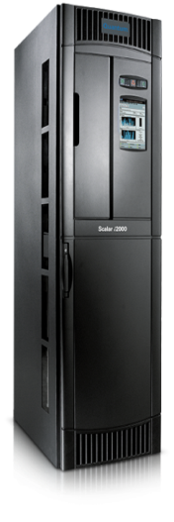
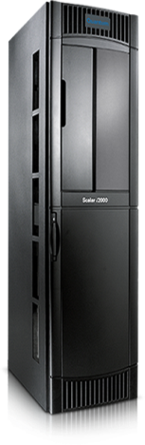

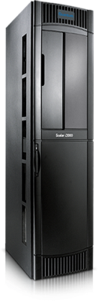
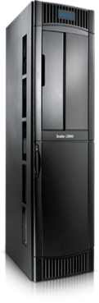
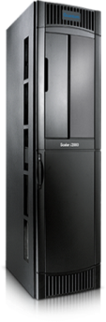








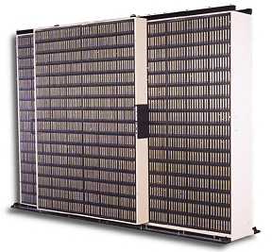
Problems with Vaulting Tapes
When all tapes are under app control…
High software and hardware costs for “inactive” data, so many tapes are removed to local vault.
Vaulting tapes takes time, is inefficient and puts data at risk, and tapes are not monitored for integrity.
Vault tapes
outside the library
Local vault
Notes:
© 2010 Quantum Corporation. Company Confidential. Forward-looking information is based upon multiple assumptions and uncertainties, does not necessarily represent the company’s outlook and is for planning purposes only.
9

Slide 10

Active Vault: First Automated, In-Library Vault
Lowers cost, improves data protection, saves time
Industry-First Benefits
Active Vault is an
in-library vault…
Capacity outside direct app control—reduces cost of storage and application license fees
Media does not leave the library—eliminates all manual media handling
Active Vault tapes are proactively scanned by EDLM—reports alerts, maintains media integrity over time
Host
Managed Partitions
Active Vault
partitions in unlicensed slots
Automated exports
…applications can export media to it directly
Notes:
© 2010 Quantum Corporation. Company Confidential. Forward-looking information is based upon multiple assumptions and uncertainties, does not necessarily represent the company’s outlook and is for planning purposes only.
10

Slide 11
Automated Media Pool
Solves problem of growth in partitioned environments with dynamic growth
  Supports growth in complex environments, including cloud
  Minimizes admin overhead
  Increases resource utilization
Creates pool of unassigned media available to any partition as needed
  Non-disruptive growth for any host managed partition
  Eliminates wasted capacity from over- provisioning
  Transparent to applications
Included as part of the Partition license
AUTOMATED MEDIA POOL
PARTITION
HOST MANAGED PARTITIONS
Non-disruptive assignment of slots and media to host managed partitions
Notes:
© 2010 Quantum Corporation. Forward-looking information is based upon multiple assumptions and uncertainties, does not necessarily represent the company’s outlook and is for planning purposes only.
11

Slide 12
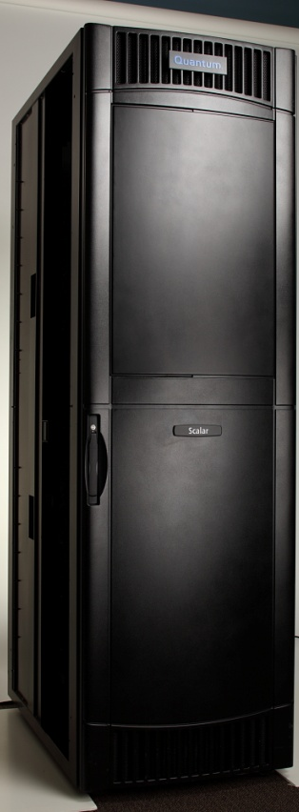
Unlicensed Expansion Module
Customer Use Cases
  #1: help customers manage growth
    For customers who expect high growth
    For customers who have difficult processes for adding HW
    For customers who want non-disruptive growth
  #2: archive customers who vault tapes
    Use Active Vault feature
    Use EDLM with Active Vault or just the LMP
  #3: customers who retain DR tapes for years
    Use with EDLM
Value proposition
  Cost reduction/containment
  Supports messaging around managing growth,
  archive, and data protection
Notes:
© 2010 Quantum Corporation. Forward-looking information is based upon multiple assumptions and uncertainties, does not necessarily represent the company’s outlook and is for planning purposes only.
12

Slide 13
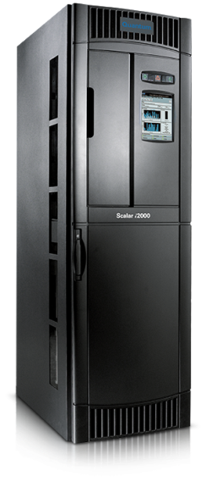
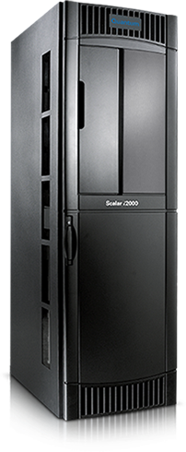

Two Ways to Scale
Initial Install
Year 2
Year 3
Example:
Initial Configuration
500 slots
8 LTO-5 drives
50% annual growth
Standard Capacity on Demand Model
Year 2
Year 3
Benefits:
Grow via SW keys
Non-disruptive growth
Avoid administrative processes
Install Extra Unlicensed Expansion Modules
Notes:
This slide illustrates the two different ways to scale the cartridge slots in a Scalar i6000.
The first example shows the standard
© 2010 Quantum Corporation. Forward-looking information is based upon multiple assumptions and uncertainties, does not necessarily represent the company’s outlook and is for planning purposes only.
13

Slide 14
Gen 2 Dual Robot Hardware Overview
Presented by Rob Yang

Slide 15
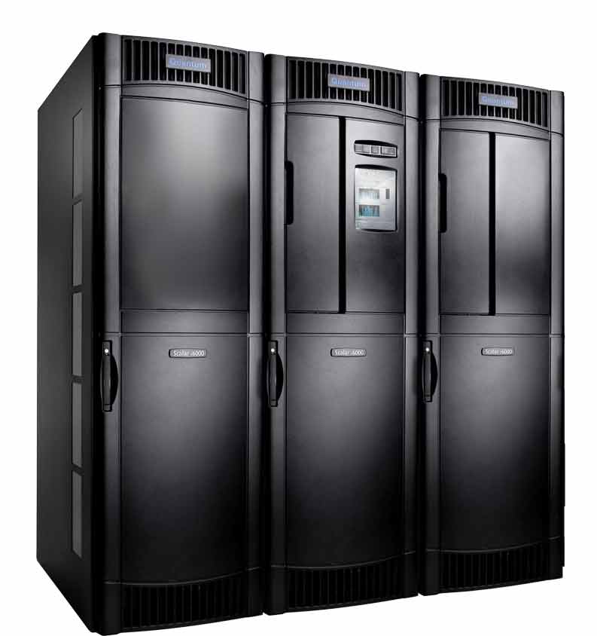
Gen 2 Dual-Robot Libraries
Available December 19, 2011
New Installations
Upgrades from Gen 1 single robot libraries
Notes:
Example shown of minimum Gen 2 dual robot system

Slide 16
Gen 2 Single-Robot Libraries
Gen 2 single-robot libraries NOT available until April 2012
From Dec 2011 to April 2012, Quantum selling both:
  Gen 2 dual robot libraries
  Gen 1 single robot libraries
Notes:
QFEs will perform new installations of both Gen 1 and Gen 2 libraries during the Dec 2011 to April 2012 time.

Slide 17
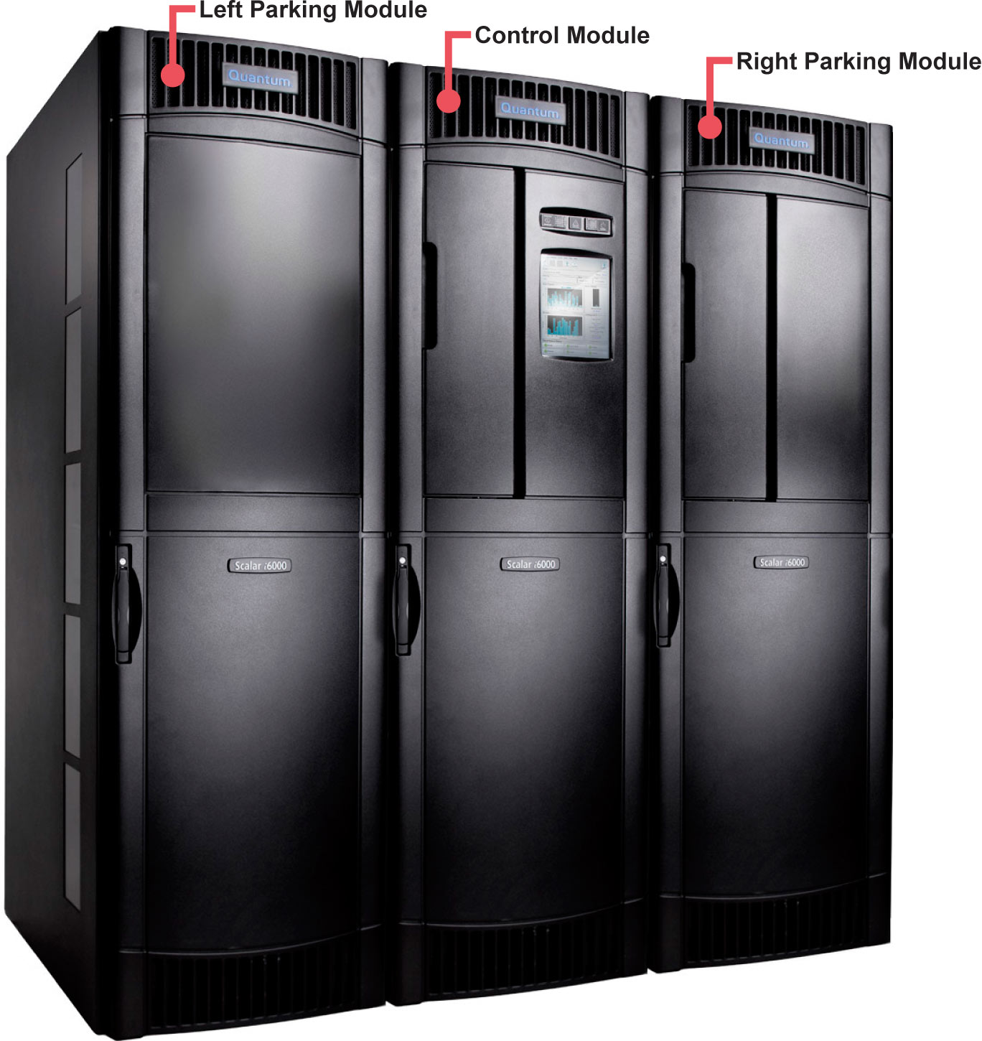
Parking Modules
New for Gen 2 dual robotics
Provide “parking areas” for robots

Slide 18
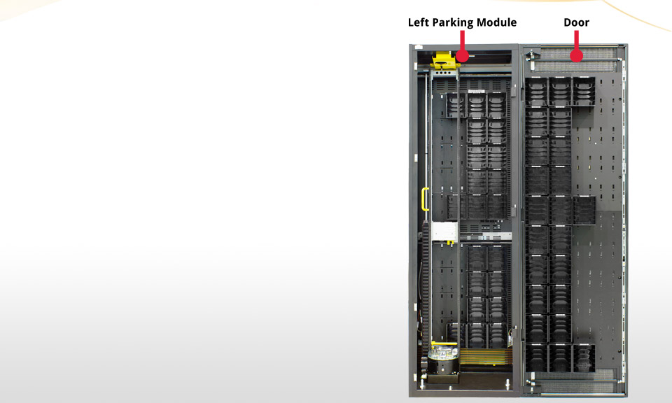
Left Parking Module
Same footprint as expansion
module
Module position 0 (zero)
Yes: storage slots
No: drives
No: I/E stations
No: power supplies
No: LBX/IEX cards
Notes:
Left parking module shown with access door open 180 degrees.
Left robot is in parking area.
The left parking module is always located to the left of the control module in module position 0 (zero); the control module is always identified as module 1. An example cell location coordinate for a tape cartridge located in the left parking module is 1, 0, 1, 1, 3, 1.

Slide 19
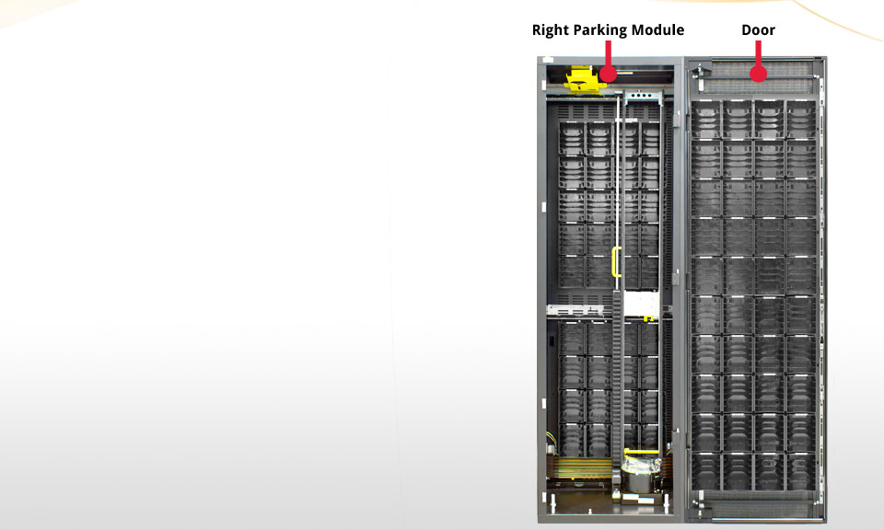
Right Parking Module
Right-most module
Parking area for robot
Yes: storage slots
Yes: drives
Yes: single 24 slot I/E station
No: 72 slot I/E stations
Notes:
Right parking module shown with access door open 180 degrees.
Right robot is in parking area in example photo.
Right parking module is always the right-most module.

Slide 20
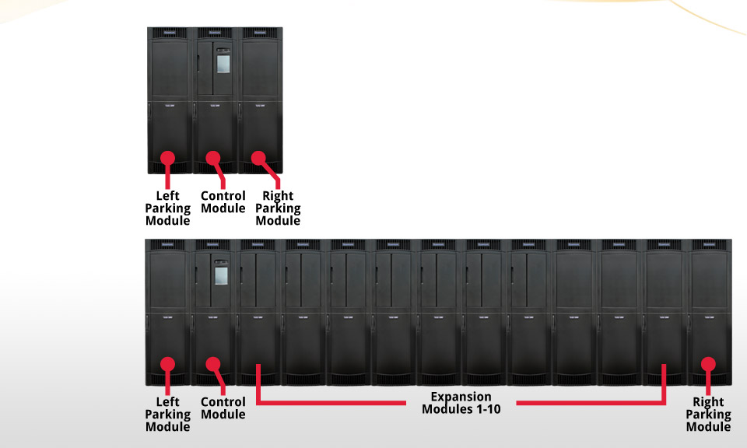
Dual Robot Min/Max Module Configurations
Minimum
Maximum

Slide 21
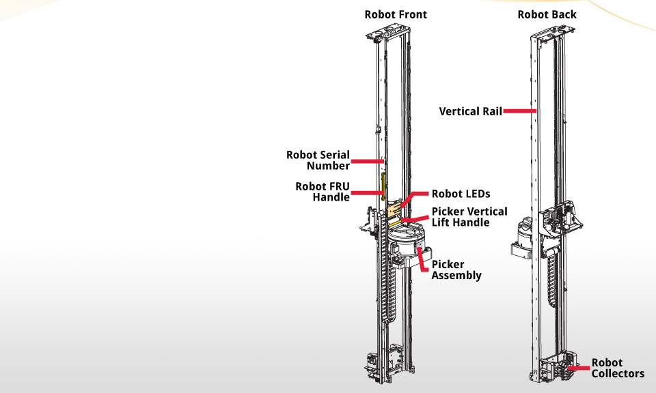
Gen 2 Robot
One (expensive) FRU
Entire robot must be replaced if there is a problem with any part (picker assembly, collectors, etc.)

Slide 22
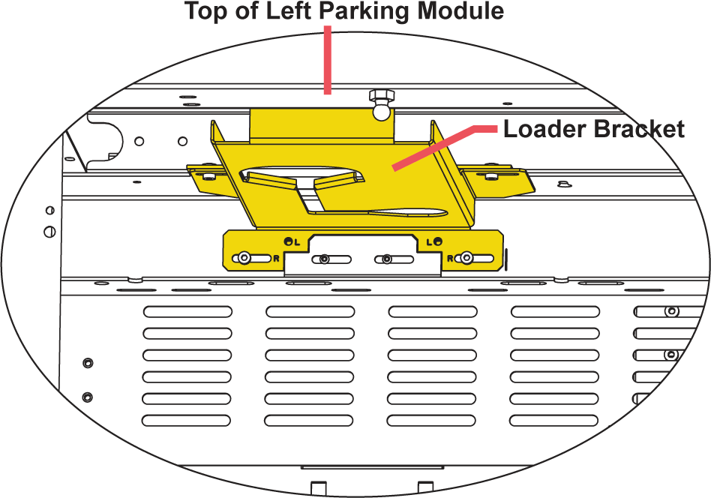
Loader Bracket
Installed in left and right parking modules
Used to install robot
Notes:
Required in both left parking module and right parking module.
For dual robot upgrades, it comes pre-installed left parking module, but you need to install it in the right parking module

Slide 23
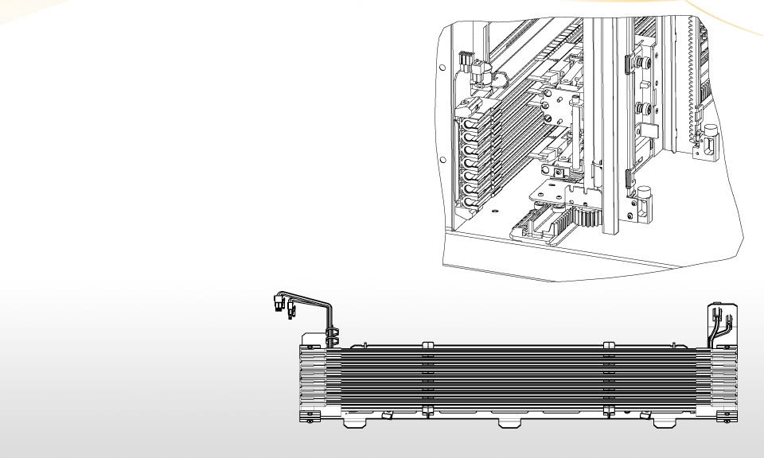
Power Rails
At the bottom of each module
Provides power and communication to robots
Notes:
The robot collectors engage with the power rails to receive power and communication.

Slide 24
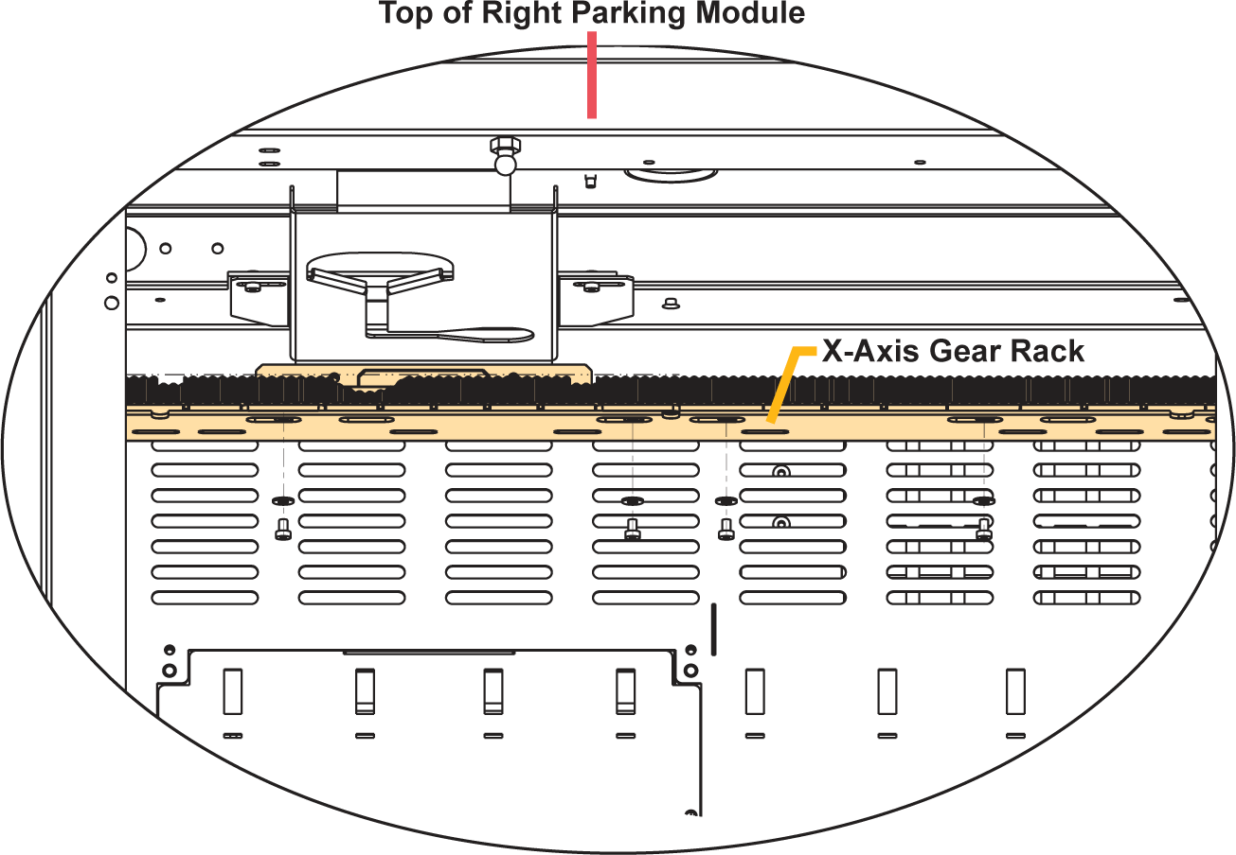
X-Axis Gear Racks
Robots move back and forth along black x-axis gear racks
Installed on bottom, middle, and top of each module
X-axis gear racks span frames and help with robot alignment
Notes:
Several types of x-axis gear racks:
Half Rack, Left Load Position — First position on the left. Contains cutouts for the left robot’s wheels to fit through during robot installation. These racks are pre-installed in the left parking module.
Full Rack, Standard — Covers all the space not taken by the other racks. Has no cutouts.
Full Rack, Right Load Position — Second position from right. Installed just to the left of the Half Rack, End Position. Contains cutouts for the right-side robot’s wheels to fit through during robot installation.
Half Rack, End Position — Last position on the right. Has no cutouts.

Slide 25
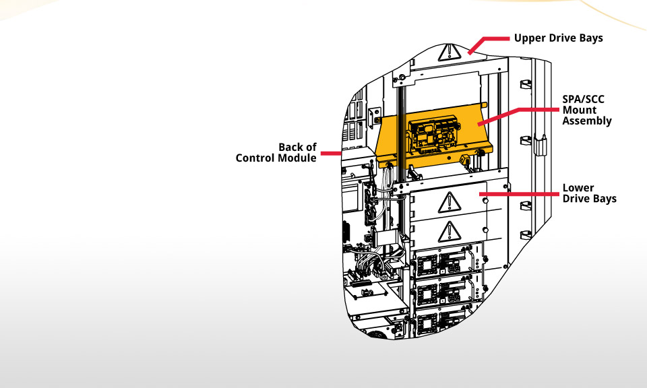
SPA/SCC Mount Assembly
Contains the new SPA1 and SCC2 boards
Provides connectors for the power cable and the aisle cable assembly connector

Slide 26
SPA/SCC Mount Assembly (cont)
SPA1 Board
  Used to switch on and off robot control power
  Attached to a sheet metal mounting bracket
  NOT hot-swappable
SCC2 Board
  Sits in front of the SPA1 board
  Provides communication from the RCU to the power rails and robots
  Hot-swappable
Notes:
The SCC2 card also has Ethernet switch functionality and provides a few more Ethernet ports to accommodate future requirements. The extra Ethernet ports are not currently used. Make sure that you do not plug the customer network into the Ethernet ports on this card.

Slide 27
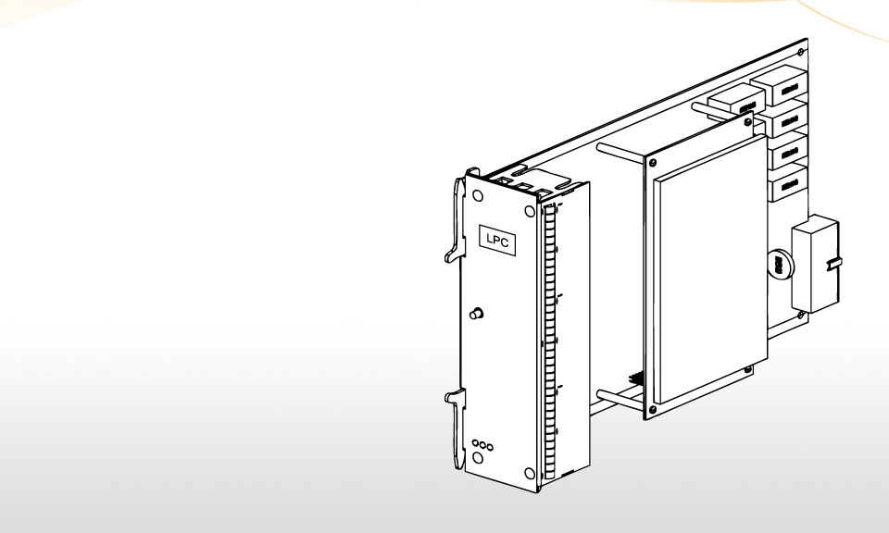
LPC1 Blade
Replaces the Gen 1 library motor drive (LMD) in the library management module (LMM)
Looks almost identical to the LMD
Distributes power to the robot through the power rails and operator panel
Notes:
The LPC1 blade contains an “LPC1” label on its spine.

Slide 28
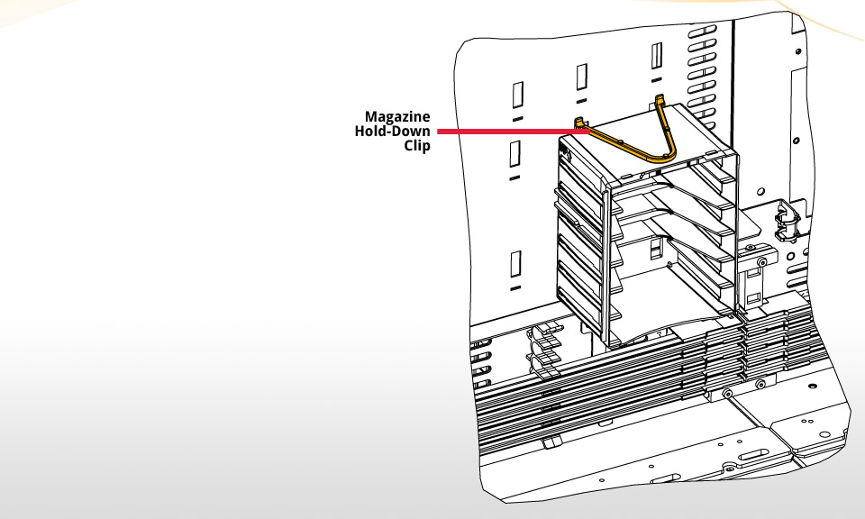
Magazine Hold-Down Clip
Installed on top of all magazines in sections 5 and 10 on rack 1 (firewall).
Keep the magazines from being dislodged when working in the aisle
Notes:
Magazine restraints are colored yellow
Example: Keeps the magazines from being accidentally dislodged when a Gen 2 robot assembly is installed during a Gen 1 robot to Gen 2 dual robot upgrade, or when replacing a Gen 2 robot FRU.

Slide 29
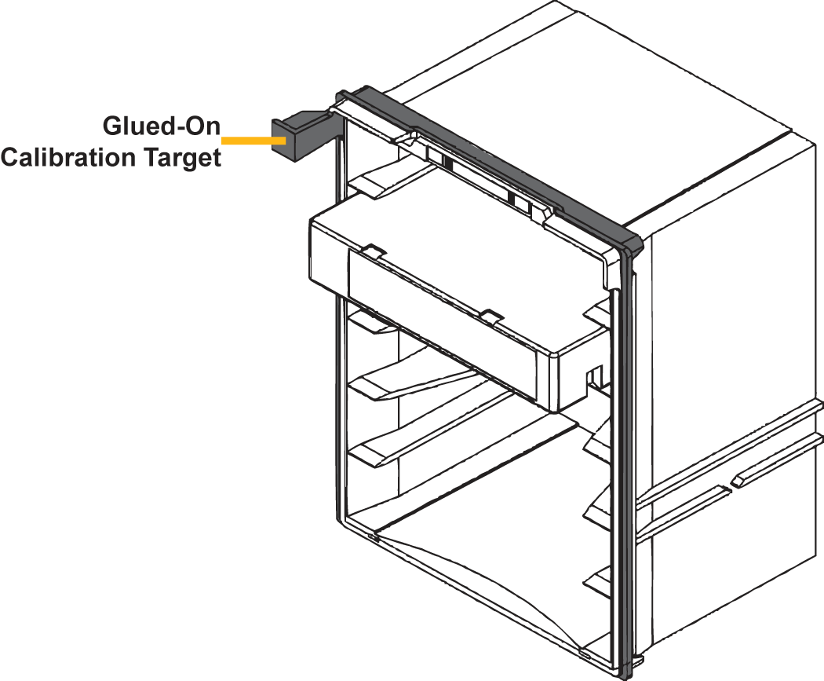
Magazines with Glued-On Calibration Targets
Required for all magazines with calibration targets in sections 5 and 10 on rack 1 (firewall)
Prevents calibration targets from being knocked off

Slide 30
Hardware TOI
30
© 2011 Quantum Corporation. Company Confidential. Forward-looking information is based upon multiple assumptions and uncertainties, does not necessarily represent the company’s outlook and is for planning purposes only.
Hardware Transfer of Information Subjects
    Collector brush droop
    Robot alignment marks
    X rack installation
    Bar code scanning of system labels
    Magazine Restraint Fit

Slide 31
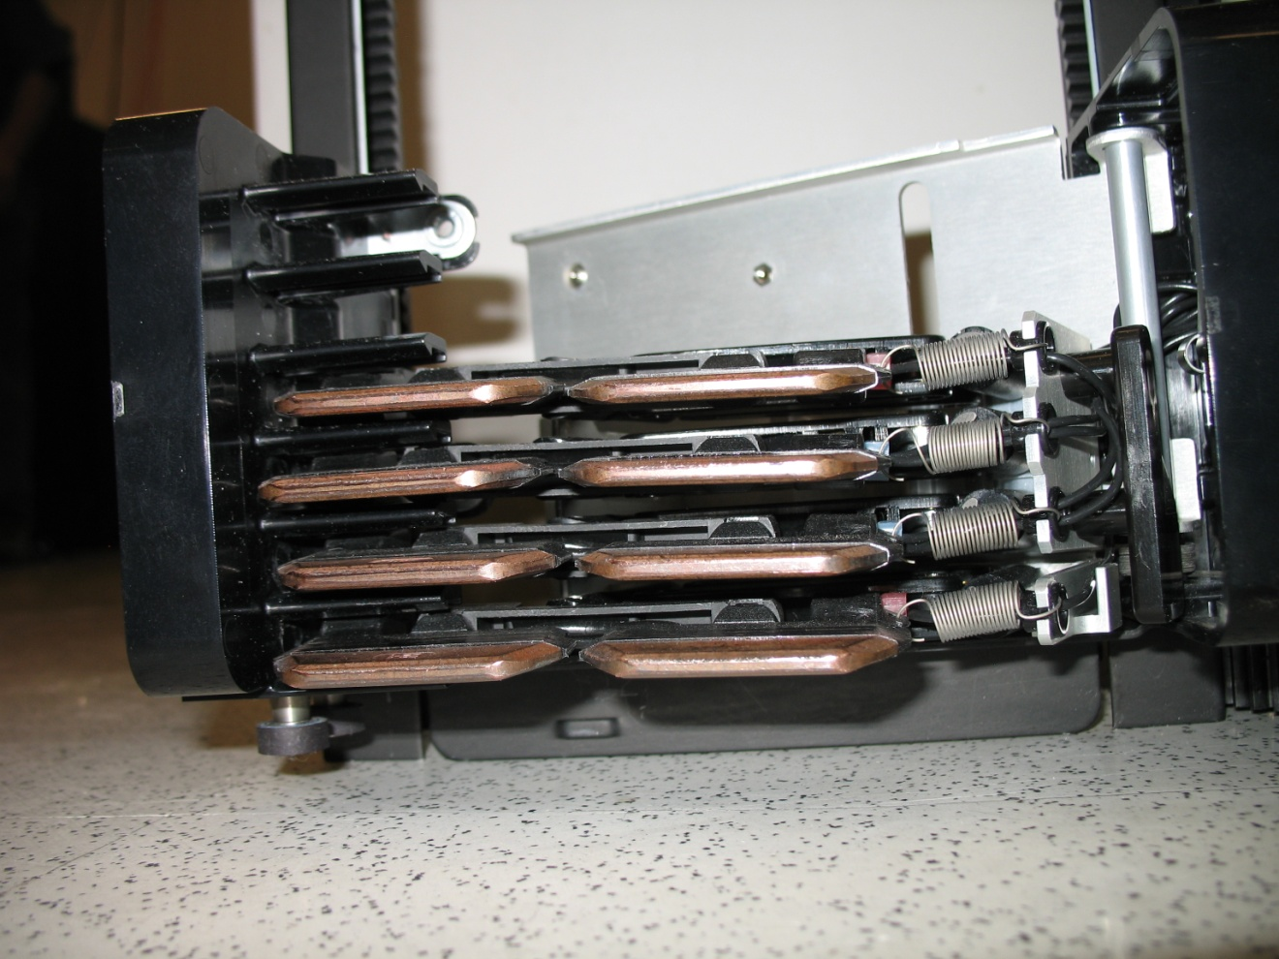
Hardware TOI – collector brush droop
31
© 2011 Quantum Corporation. Company Confidential. Forward-looking information is based upon multiple assumptions and uncertainties, does not necessarily represent the company’s outlook and is for planning purposes only.
  Left robot position has good collector alignment

Slide 32
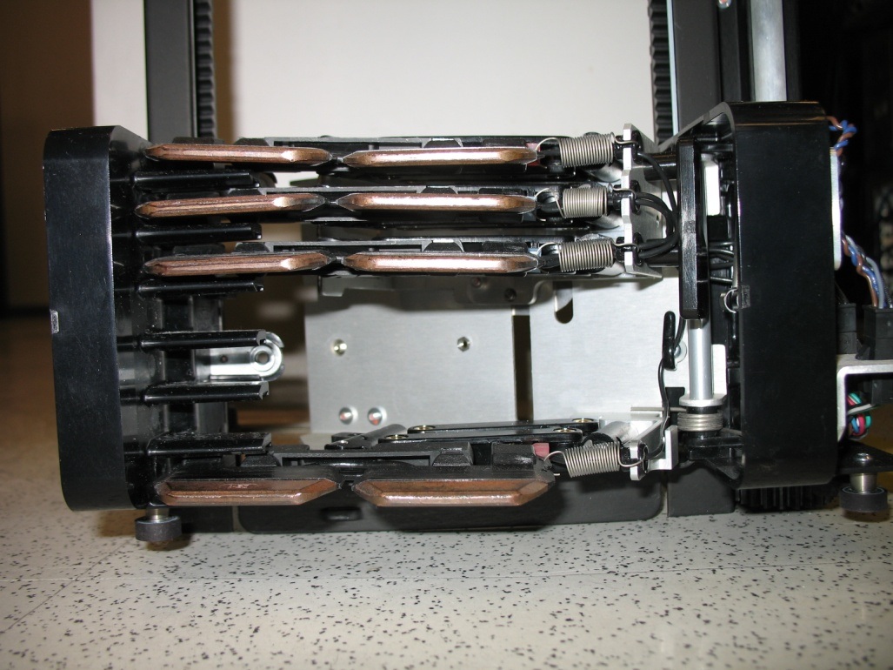
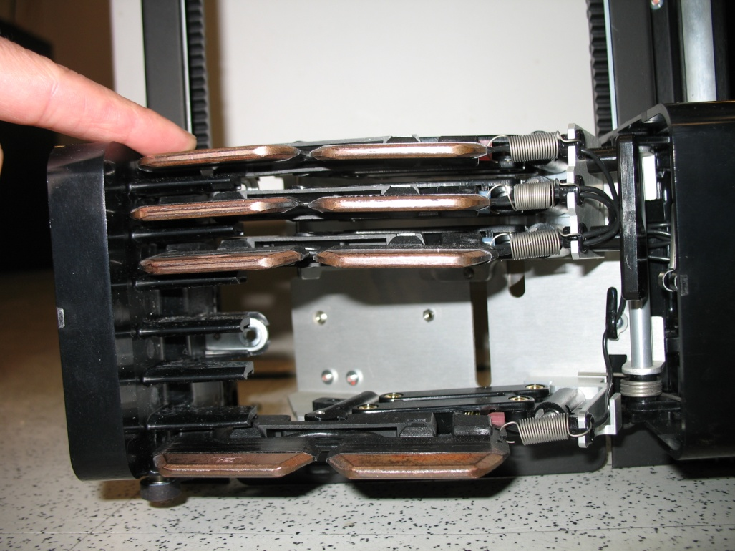
Hardware TOI – collector brush droop
32
© 2011 Quantum Corporation. Company Confidential. Forward-looking information is based upon multiple assumptions and uncertainties, does not necessarily represent the company’s outlook and is for planning purposes only.
  Collector brush alignment for right robot position is not as good. Top brush droops .
  Biasing door up or applying finger can help
  Closely the door quickly (not slowly) seems like a better technique
  Make sure brushes are set well in the “comb” before starting process
  Design improvement is being pursued

Slide 33
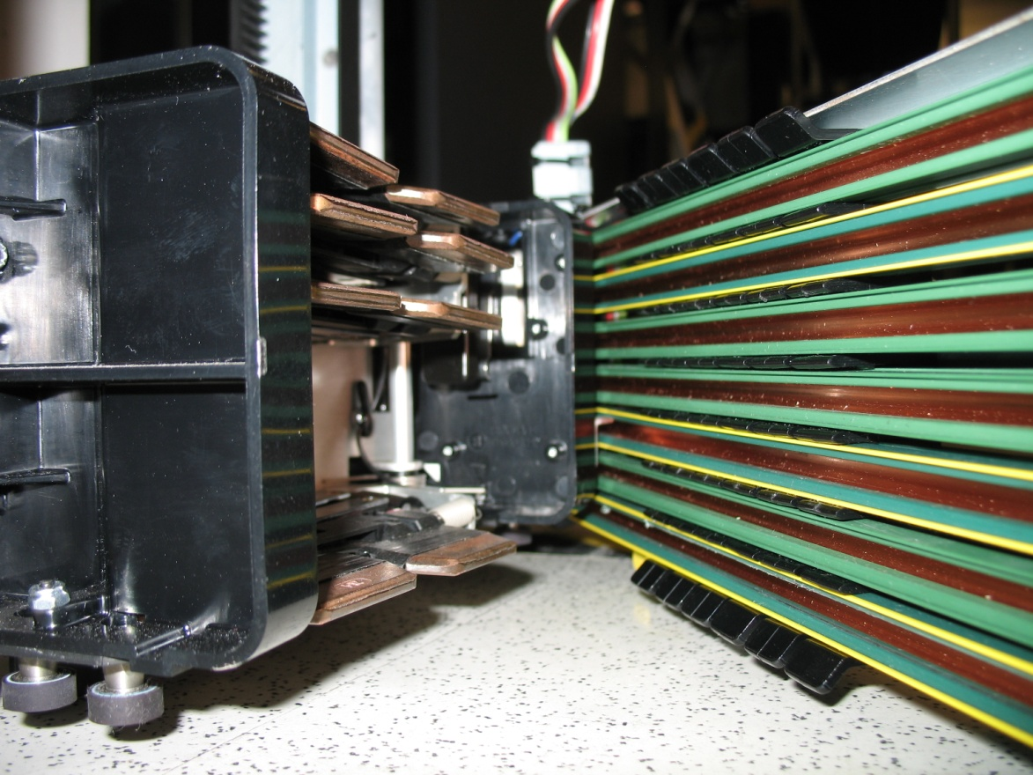
Hardware TOI – collector brush droop
33
© 2011 Quantum Corporation. Company Confidential. Forward-looking information is based upon multiple assumptions and uncertainties, does not necessarily represent the company’s outlook and is for planning purposes only.
  When you close the collector brush door, watch for the upper brush not falling into position. This can be obscured by magazines.

Slide 34
Hardware TOI – robot alignment
34
© 2011 Quantum Corporation. Company Confidential. Forward-looking information is based upon multiple assumptions and uncertainties, does not necessarily represent the company’s outlook and is for planning purposes only.
  Goal of robot alignment marks is the provide Field Engineer with a method to check alignment before IVT or RST.
  Experience will help you judge the alignment marks
    Hard for Field Engineers to know what a “bad alignment” looks like. Nothing to compare against.
    Large assembly + tolerance stack up + human visual alignment = some judgment is required.
  Use care when looking at alignment marks
    Flashlight
    Align your eye with the rail of the robot
    May not be perfect but we are looking for a whole gear tooth difference
  Remember – the number of teeth in the rack pieces does not change, the upper, lower and middle racks must have the same number of teeth.

Slide 35
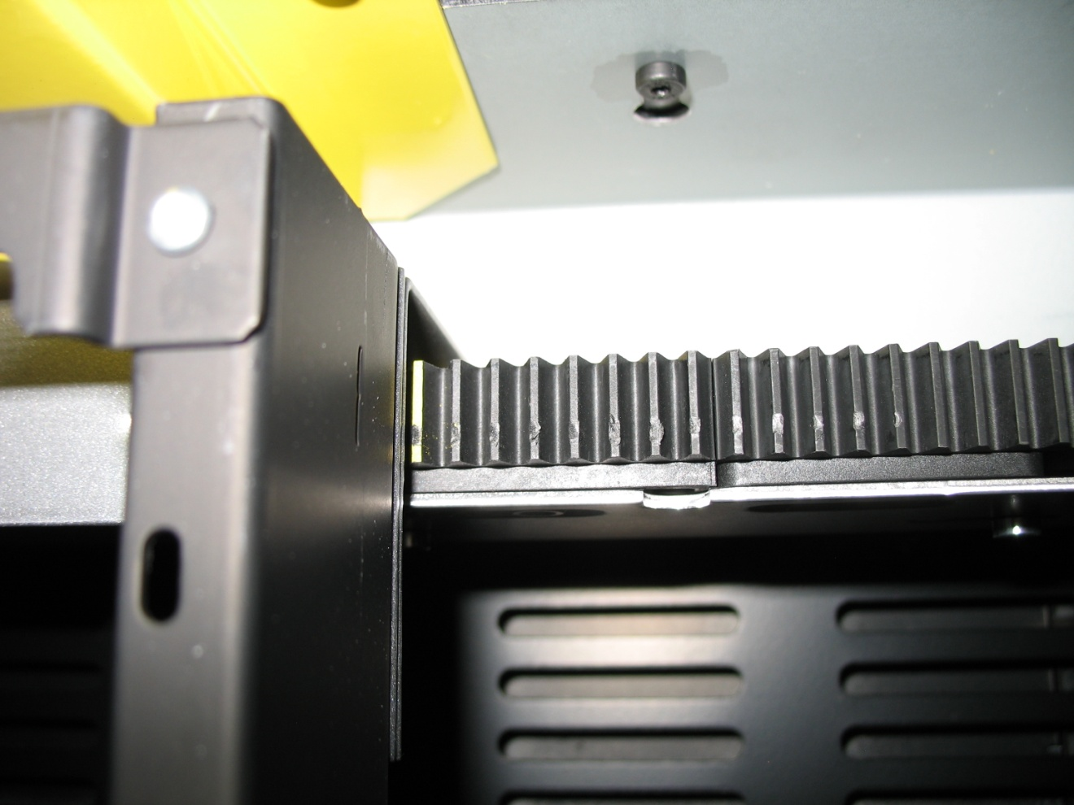
Hardware TOI – robot alignment
35
© 2011 Quantum Corporation. Company Confidential. Forward-looking information is based upon multiple assumptions and uncertainties, does not necessarily represent the company’s outlook and is for planning purposes only.
  Top alignment mark

Slide 36
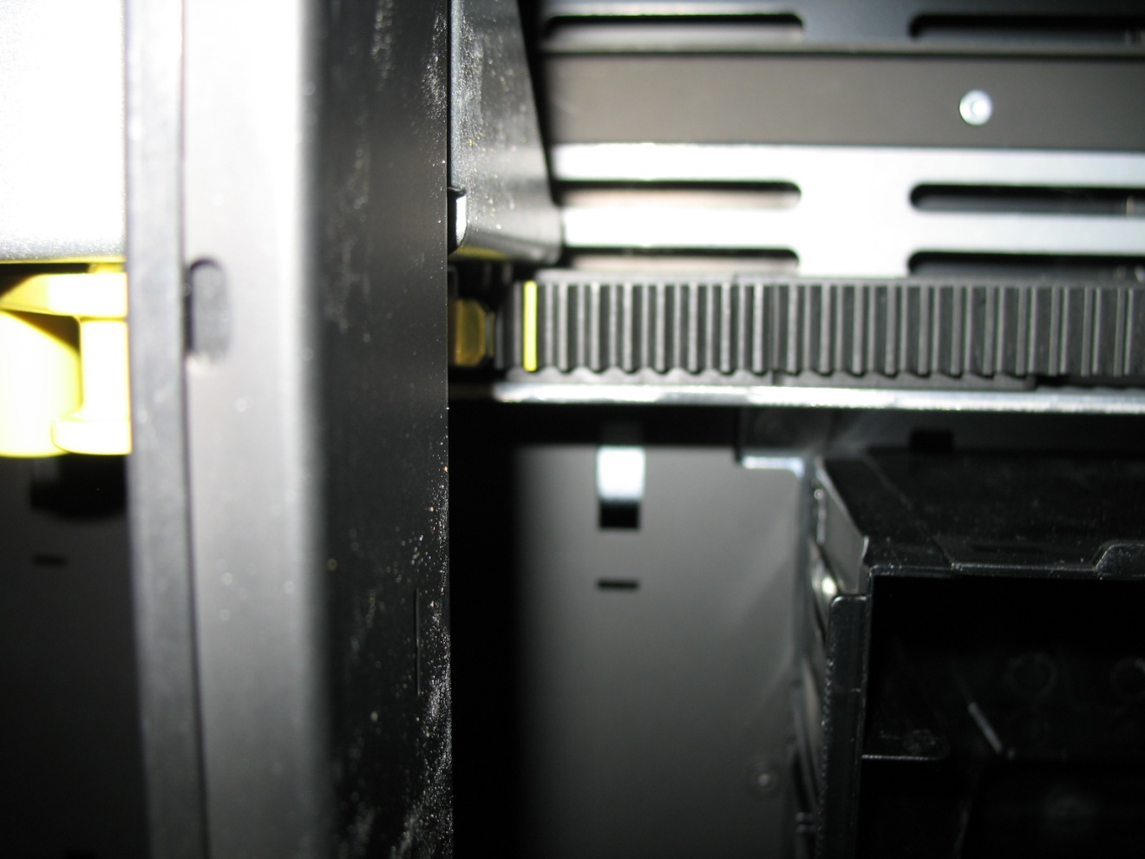
Hardware TOI – robot alignment
36
© 2011 Quantum Corporation. Company Confidential. Forward-looking information is based upon multiple assumptions and uncertainties, does not necessarily represent the company’s outlook and is for planning purposes only.
  Middle alignment mark

Slide 37
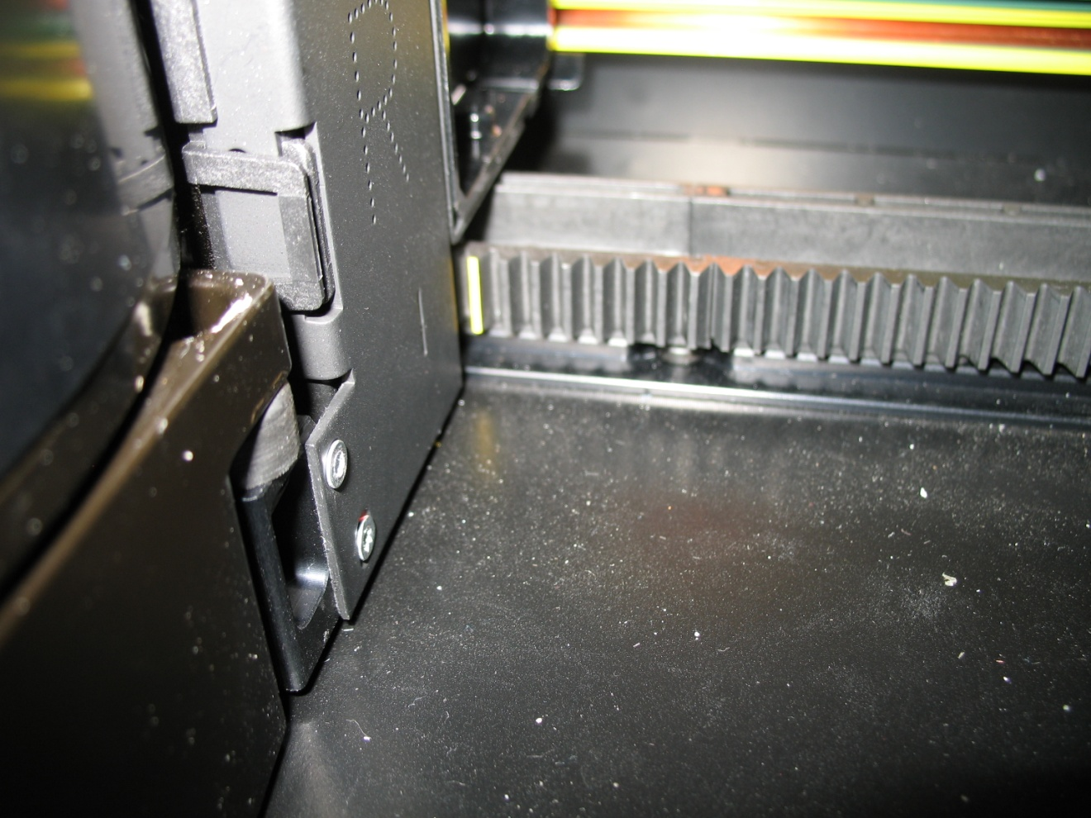
Hardware TOI – robot alignment
37
© 2011 Quantum Corporation. Company Confidential. Forward-looking information is based upon multiple assumptions and uncertainties, does not necessarily represent the company’s outlook and is for planning purposes only.
  Bottom alignment mark

Slide 38
Hardware TOI – X rack installation
38
© 2011 Quantum Corporation. Company Confidential. Forward-looking information is based upon multiple assumptions and uncertainties, does not necessarily represent the company’s outlook and is for planning purposes only.
  Things to watch for
    Racks mate easier when left piece is placed on top of right piece
      Molded parts have drafted walls and certain radius corners from the mold.
      Long molded parts have some warp
    Make sure the positioning pins properly mate with the metal parts they mount to
      The positioning pins on the bottom of the racks are a tight fit to the slots and holes in the sheet metal mating parts
      Minimal radius and lead in on all parts
      Dark library aisle and position above your eyes or at ankle level make visual inspection harder.

Slide 39
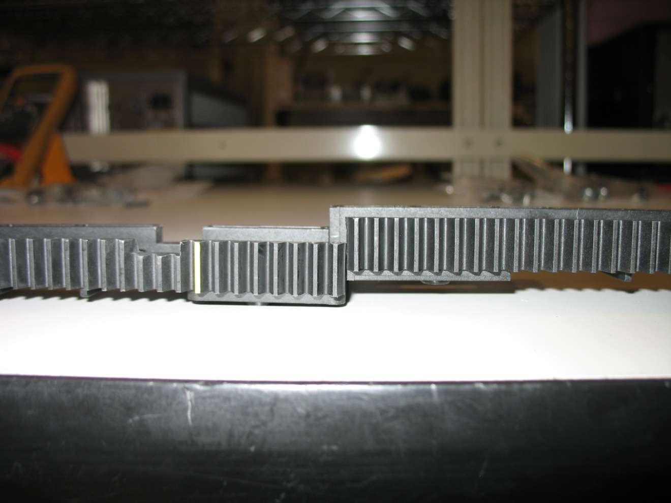
Hardware TOI – X rack installation
39
© 2011 Quantum Corporation. Company Confidential. Forward-looking information is based upon multiple assumptions and uncertainties, does not necessarily represent the company’s outlook and is for planning purposes only.
  Right on top of left = more resistance and more difficult and must be more careful to align well

Slide 40
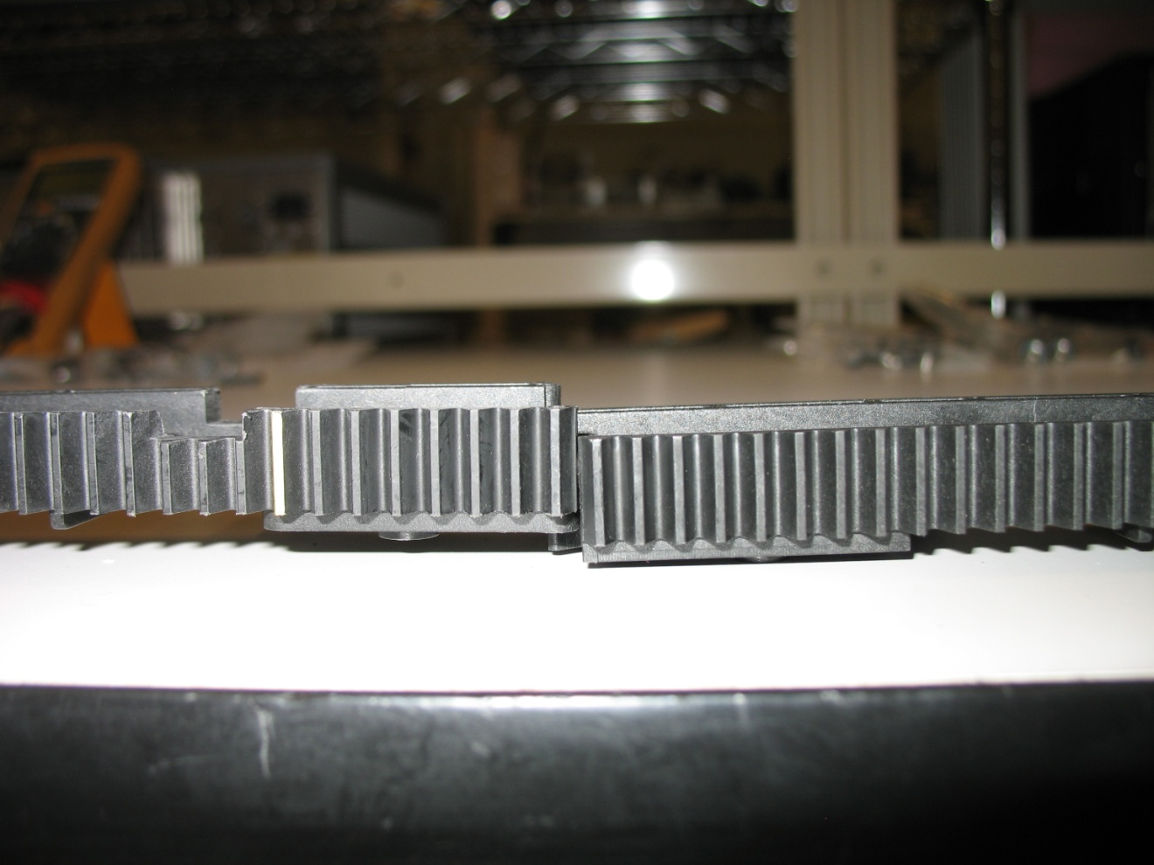
Hardware TOI – X rack installation
40
© 2011 Quantum Corporation. Company Confidential. Forward-looking information is based upon multiple assumptions and uncertainties, does not necessarily represent the company’s outlook and is for planning purposes only.
  Left on top of right = slips together easier

Slide 41
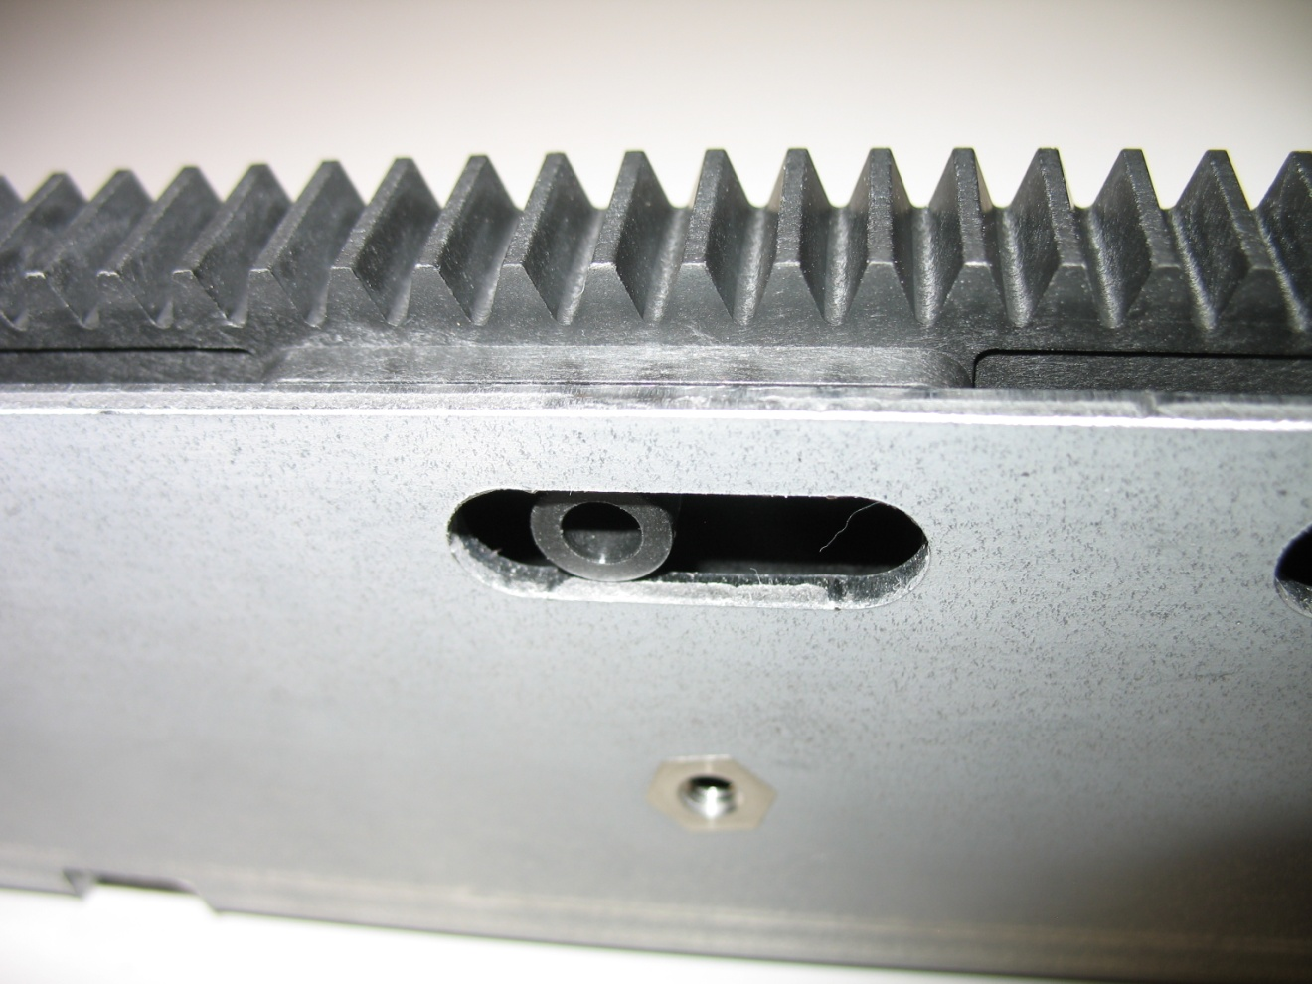
Hardware TOI – X rack installation
41
© 2011 Quantum Corporation. Company Confidential. Forward-looking information is based upon multiple assumptions and uncertainties, does not necessarily represent the company’s outlook and is for planning purposes only.
  Watch for rack positioning pins to nest completely in the slots and holes

Slide 42
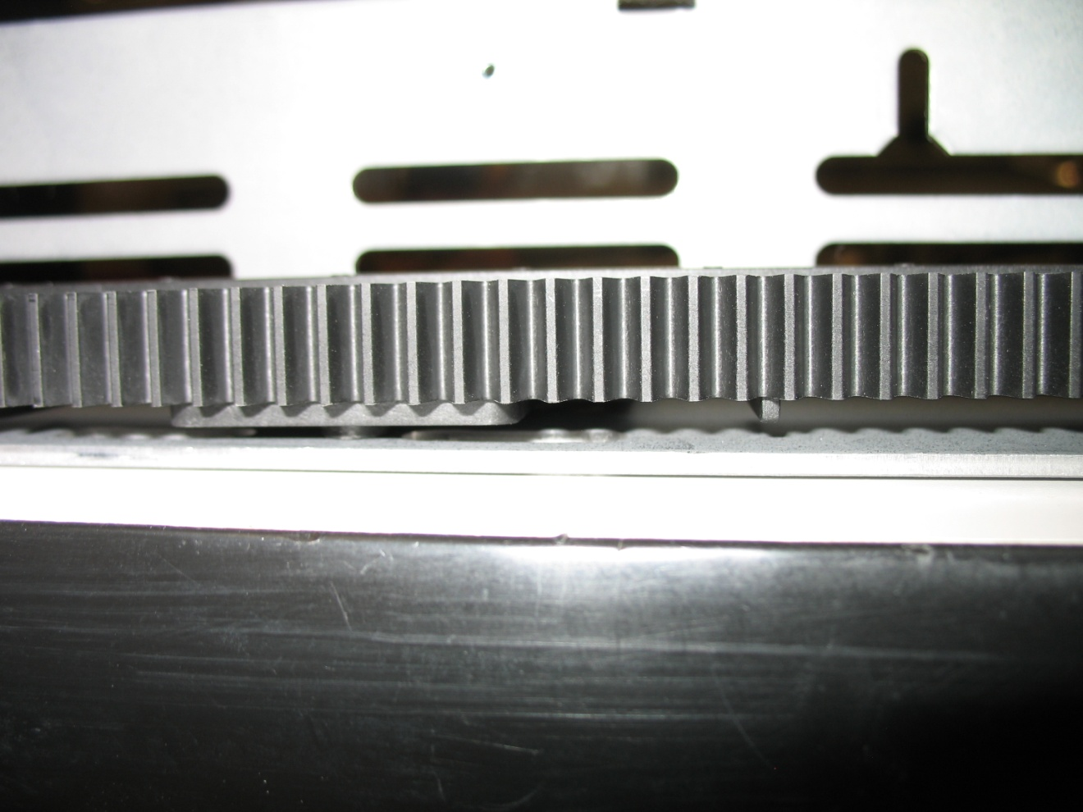
Hardware TOI – X rack installation
42
© 2011 Quantum Corporation. Company Confidential. Forward-looking information is based upon multiple assumptions and uncertainties, does not necessarily represent the company’s outlook and is for planning purposes only.
  Example of a positioning pin NOT in the slot

Slide 43
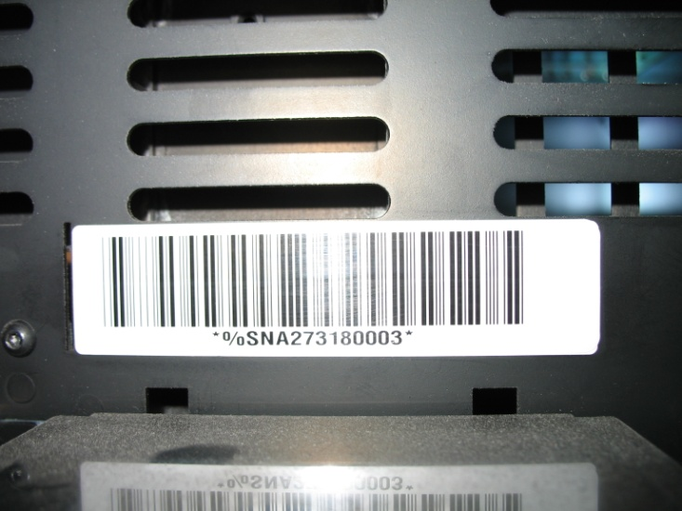
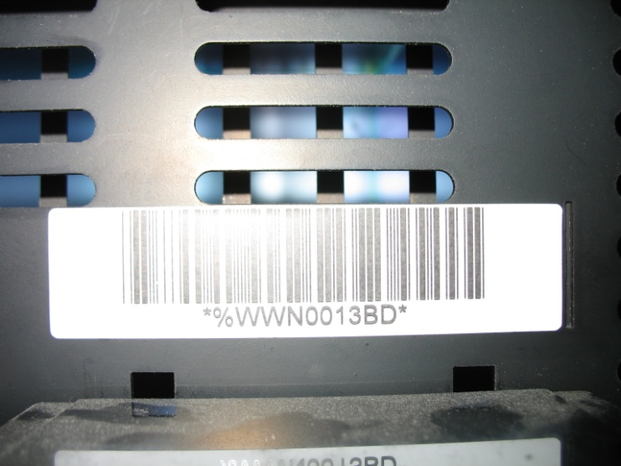
Hardware TOI – frame barcodes
Glossy
Matte
43
© 2011 Quantum Corporation. Company Confidential. Forward-looking information is based upon multiple assumptions and uncertainties, does not necessarily represent the company’s outlook and is for planning purposes only.
  Gen 2 robot uses i500 bar code scanner (different than Gen 1 robot)
  I500 bar code scanner has long, successful history of reading tape labels
  i6K (i2K) shipments began in 2003. All frame labels ever printed up to this date were not read with an i500 scanner.
  There is the chance that a Gen 2 robot with i500 scanner will encounter an i6K frame label that it cannot read in a Dual Robot upgrade scenario
  The plan right now is to provide new labels with upgrade kits

Slide 44
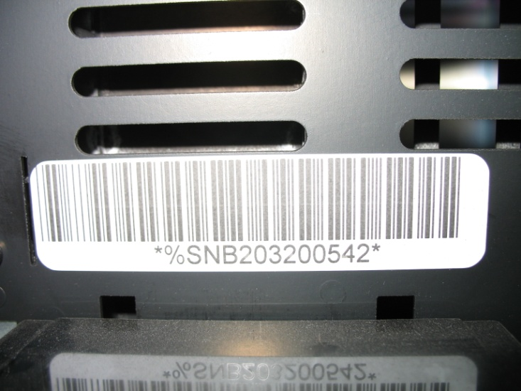
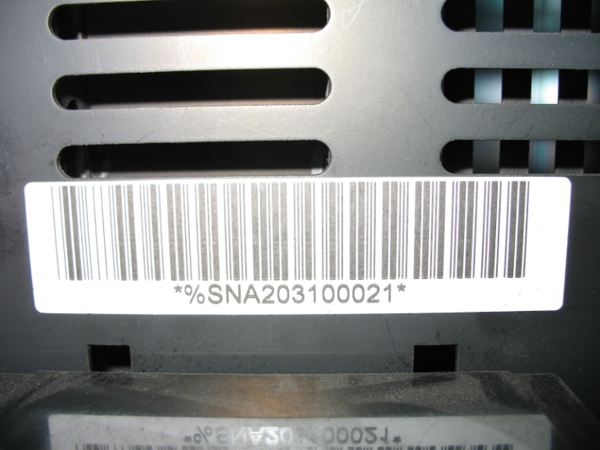
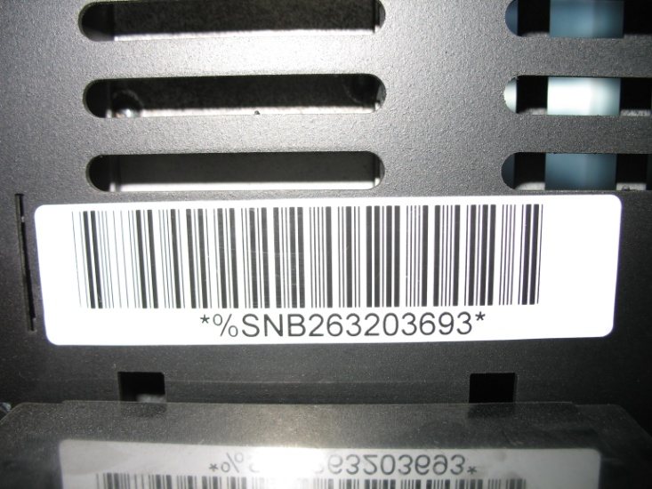
Hardware TOI – frame barcodes
No White Space
Matte
Glossy
44
© 2011 Quantum Corporation. Company Confidential. Forward-looking information is based upon multiple assumptions and uncertainties, does not necessarily represent the company’s outlook and is for planning purposes only.

Slide 45
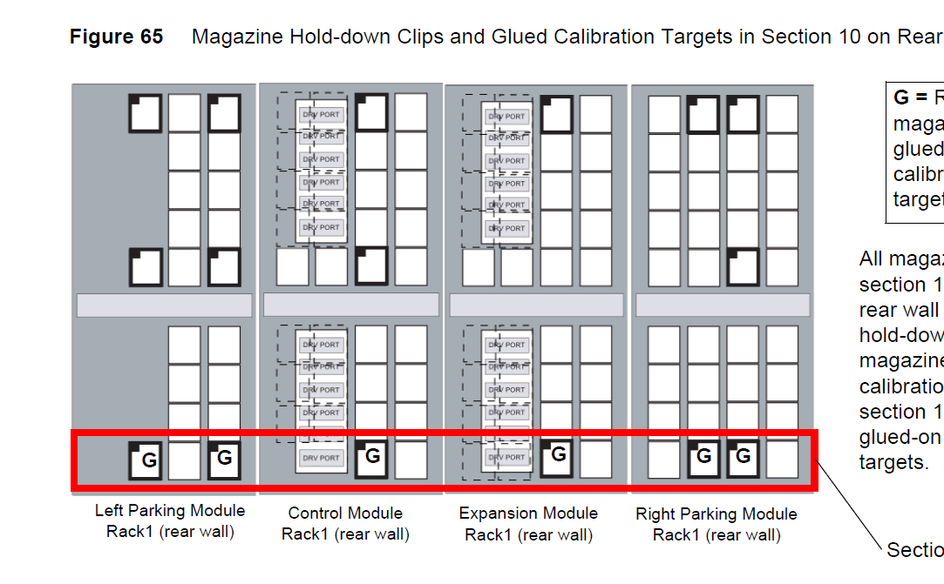
Hardware TOI - Magazine Restraint
Typical Installation Guide Figure – Where to put restraint clips

Slide 46
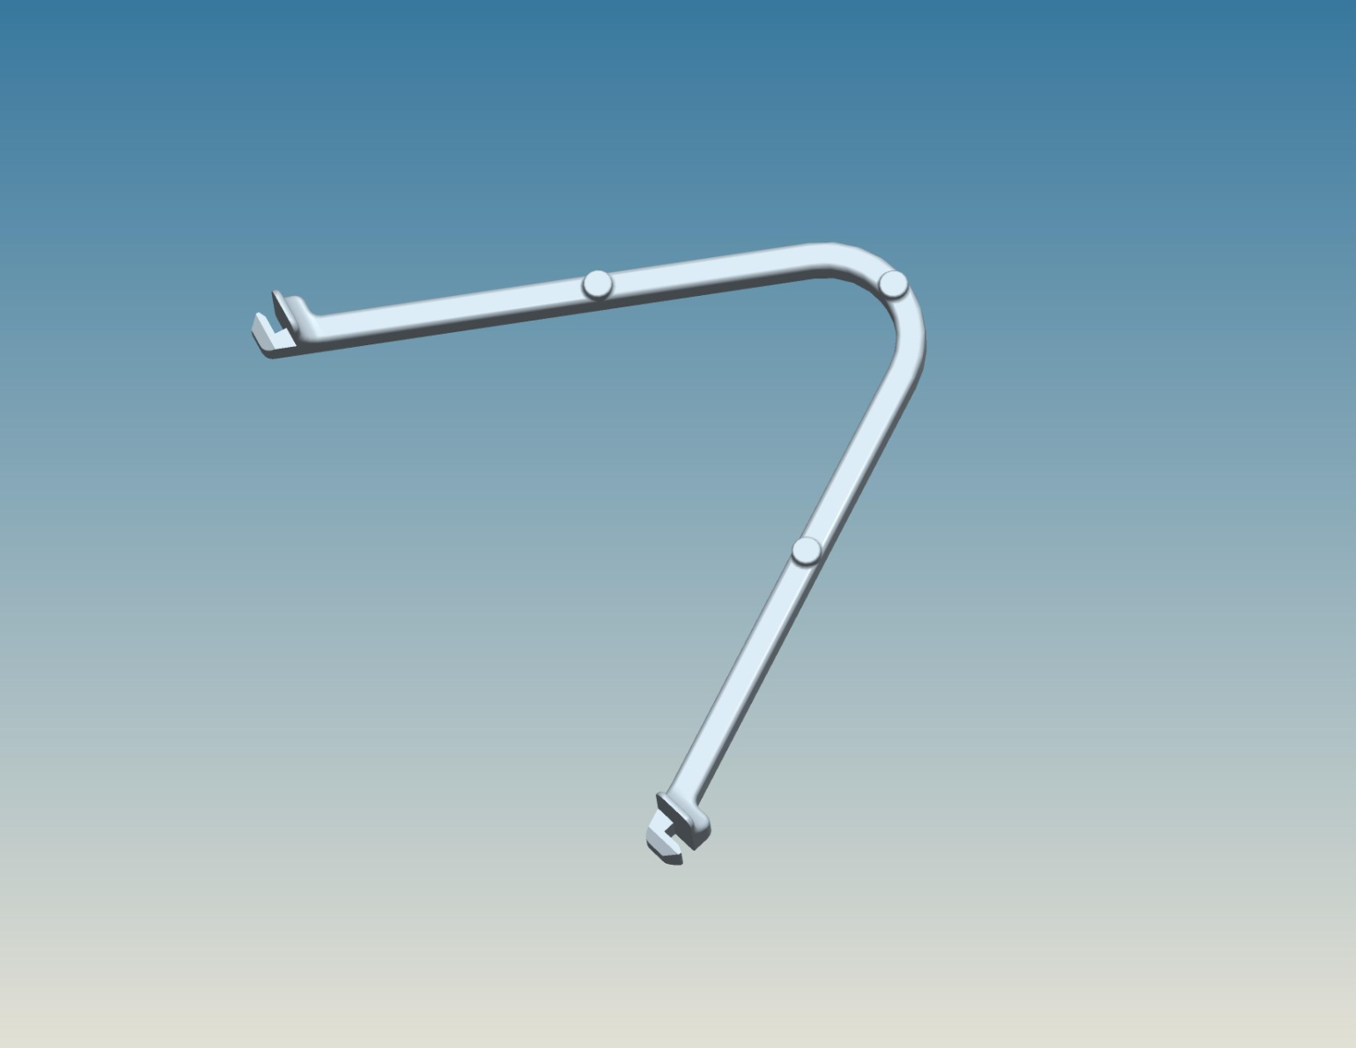
Hardware TOI - Magazine Restraint
Initial Design 3-06083-01
Single Notch

Slide 47
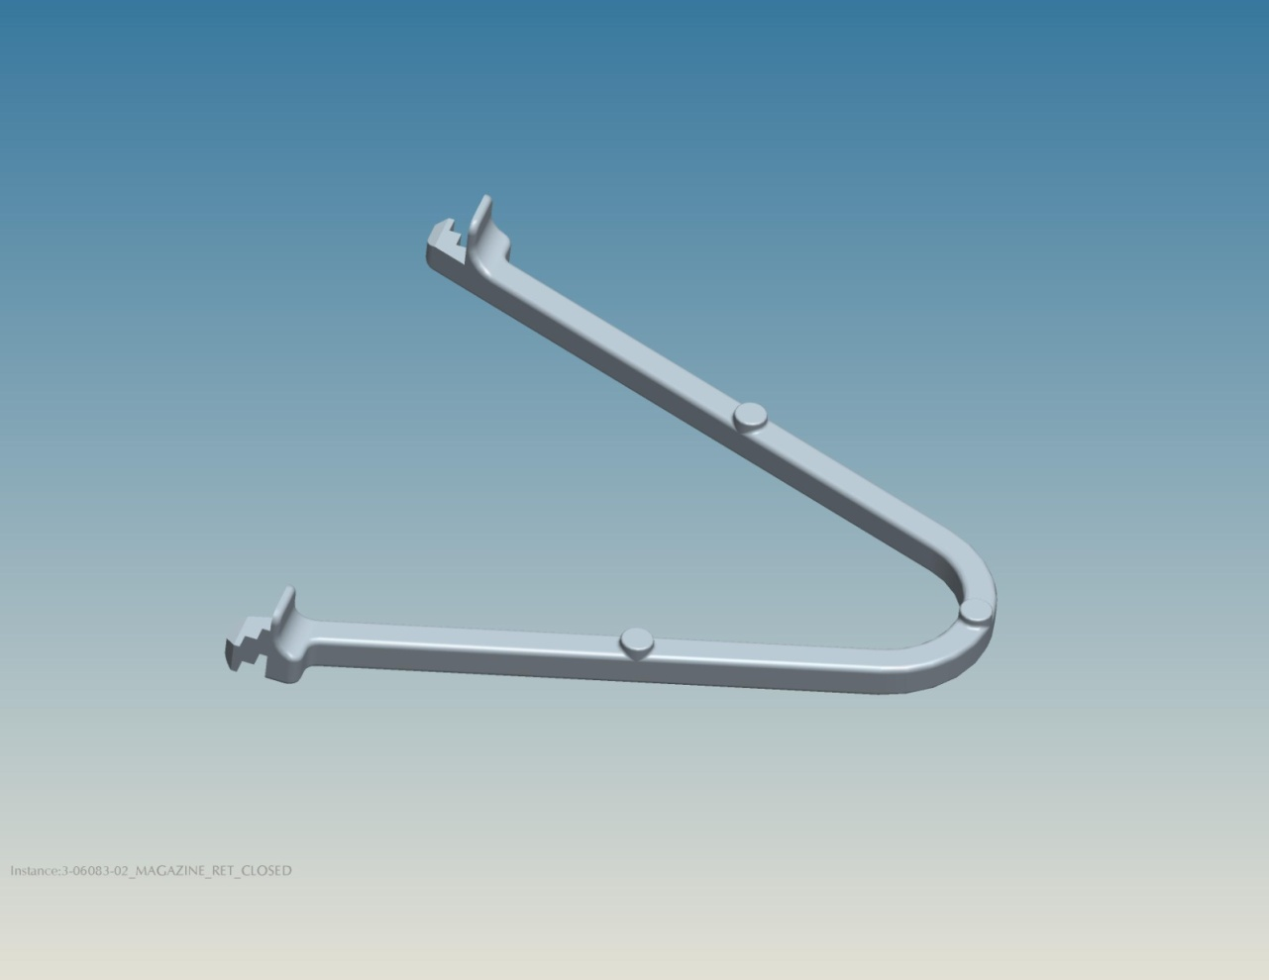
Hardware TOI - Magazine Restraint
Updated Design 3-06083-02
Found a few interference points in library that required double notch
Double notch

Slide 48
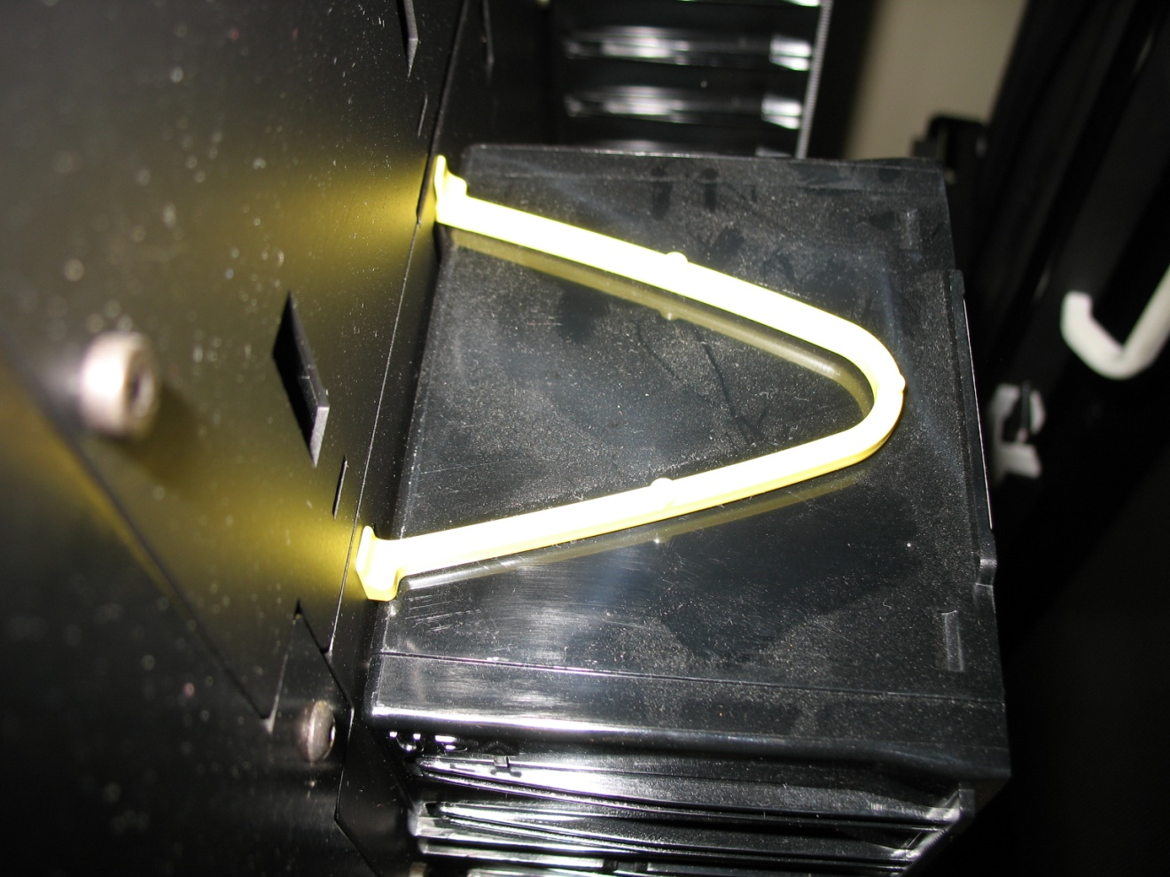
Hardware TOI - Magazine Restraint
Example of good fit

Slide 49
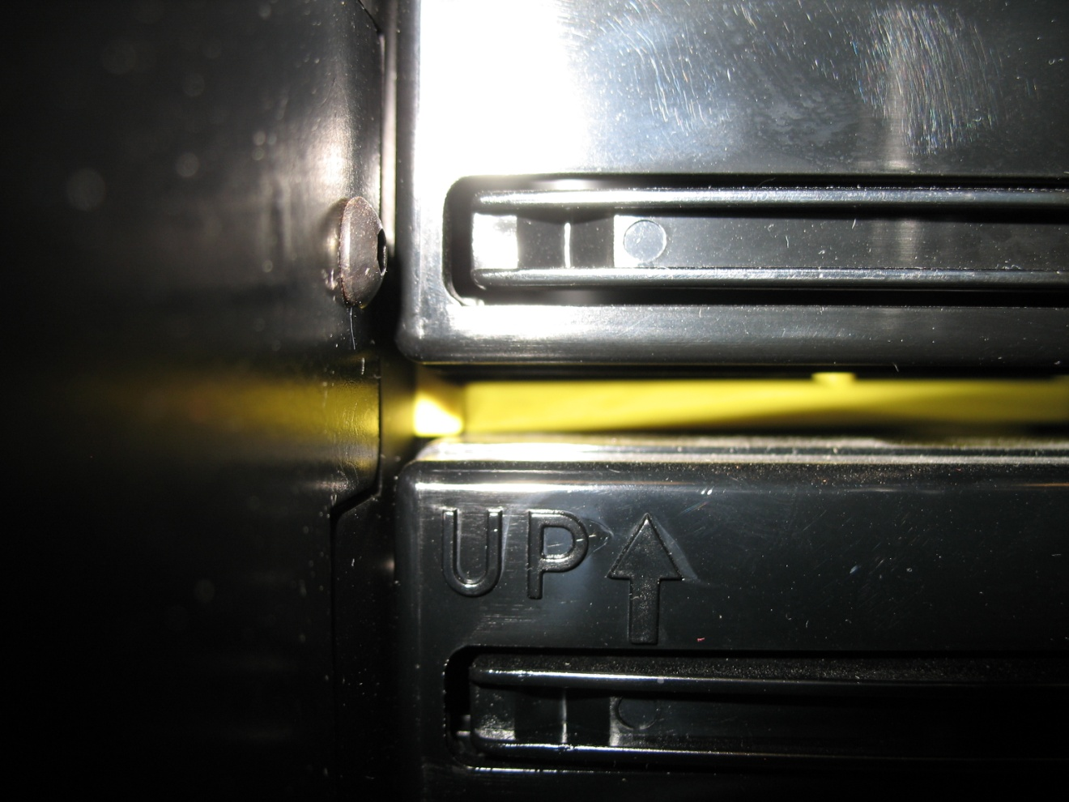
Hardware TOI - Magazine Restraint
Example of good fit with magazine on top

Slide 50
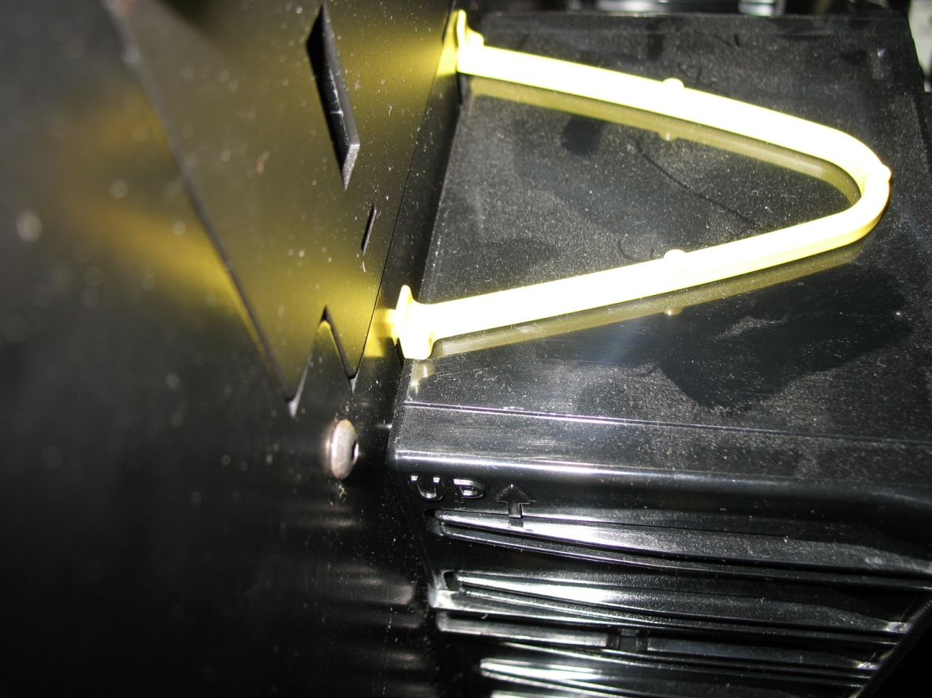
Hardware TOI - Magazine Restraint
Example of location where even double notch does not provide 100% intended fit due to frame side interferences
Restraint clip is slightly less secure
This fit is considered acceptable

Slide 51
Gen 2 Dual Robot Diagnostics
Presented by Carsten Prigge

Slide 52
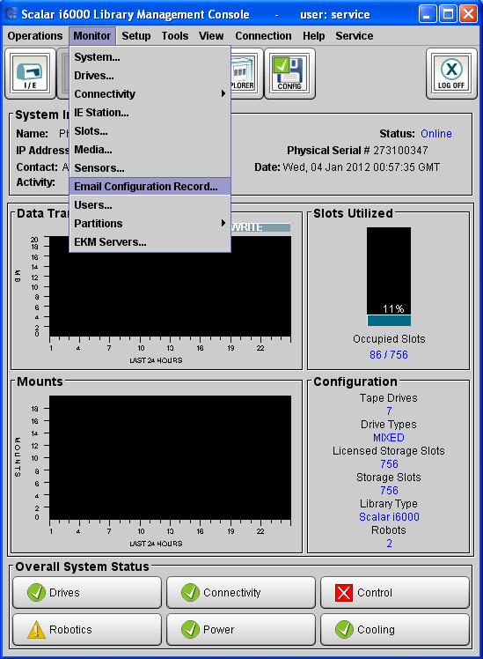
Gen 2 Dual Robot Diagnostics
How to find what robot hardware is installed…
  Via main screen …
52
© 2011 Quantum Corporation. Company Confidential. Forward-looking information is based upon multiple assumptions and uncertainties, does not necessarily represent the company’s outlook and is for planning purposes only.

Slide 53
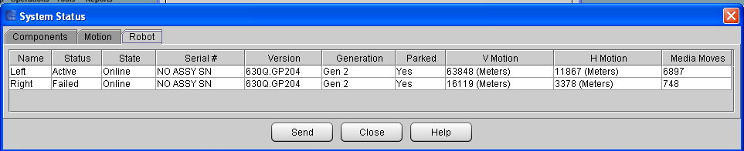
Gen 2 Dual Robot Diagnostics
How to find what robot hardware is installed…
  Via main Screen Monitor->System menu selection
    Select Robot tab from System Status Dialog window to view robot generation and robot status and state
      Dialog screen exists for Gen 1 and Gen 2 robot
53
© 2011 Quantum Corporation. Company Confidential. Forward-looking information is based upon multiple assumptions and uncertainties, does not necessarily represent the company’s outlook and is for planning purposes only.

Slide 54
Gen 2 Dual Robot Diagnostics
Robot Diagnostics
  No new diagnostics; - same diagnostic menu selections for Gen 1 and Gen 2 robots
    Robot specific tests performed via Tools->Verification Tests… by selecting tests and subtests such as the Accessor Assembly test
  Single Robot Assembly for Gen 2 robot
    Be certain that replacement will solve problem
    Determine best resolution based on ticket information and ticket resolution
    Make sure respective robot is active to perform test
      View robot status via Monitor->System to determine robot status
      Use Tools->Library->Robot Failover menu selection to activate respective robot if needed
        Can only fail over if robot is operational…
        Each robot always initializes after power up and door open/close procedure
    Use Robot Access and Aisle Access menu selections for online service
      Accessible from local UI only via Tools->Library->Access
        Robot Access guides through a robot replacement procedure while hosts are being informed of a Not Ready, Becoming Ready condition (SCSI sense 2/0401) for up to 10 minutes
        Aisle Access allows for door opening to investigate issue; Hosts also informed of a Not Ready, Becoming Ready condition for up to 10 minutes. Door closure will initiate robots
54
© 2011 Quantum Corporation. Company Confidential. Forward-looking information is based upon multiple assumptions and uncertainties, does not necessarily represent the company’s outlook and is for planning purposes only.

Slide 55
Gen 2 Dual Robot Diagnostics
Robot Diagnostics
  User needs to apply ticket resolution to failed robot
    Note that a failover operation activates the redundant robot and any diagnostic selection would apply to the active robot, not the failed robot
    Determine first which robot is currently active
    Note that the active robot may have failed too
    Limited way to perform actual diagnostics on failed robot
      Follow ticket resolution instructions to resolve issue
      May require a failover operation to select the required robot
      Failover operation not possible if robot is failed!??!!!
        Open/Close door process initiates Robot Self Test (RST)
        Preferably, use Aisle Access to initiate RST
        If failed robot becomes operational, tests can be invoked
        If failed robot does not become operational, investigate conditions that led up to the failure
55
© 2011 Quantum Corporation. Company Confidential. Forward-looking information is based upon multiple assumptions and uncertainties, does not necessarily represent the company’s outlook and is for planning purposes only.

Slide 56

Gen 2 Dual Robot Diagnostics
RAS Changes
  None, really…, kept existing methodology
  New tickets and resolutions defined for gen 2 robot hardware
    3 tickets defined to indicate that failover occurred or failed:
      Tickets accompany the ticket that details actual robot failure
      Tickets indicate successful, incomplete, or impossible failover condition
56
© 2011 Quantum Corporation. Company Confidential. Forward-looking information is based upon multiple assumptions and uncertainties, does not necessarily represent the company’s outlook and is for planning purposes only.

Slide 57
Gen 2 Dual Robot Diagnostics
57
© 2011 Quantum Corporation. Company Confidential. Forward-looking information is based upon multiple assumptions and uncertainties, does not necessarily represent the company’s outlook and is for planning purposes only.
Snapshot/Log Changes
  Snapshot includes the same log files regardless of whether for Gen 1 or Gen 2 hardware is installed
  Log information slightly different tracking robot generation and left or right robot information as needed
  Email-able and save-able configuration report provides robot hardware configuration information
  IVT logs stored and included in snapshot as implemented for Gen 1 systems
    IVT logs not stored per robot, but per last test execution
    Snapshot includes last 3 verification tests
    VT reports viewable from Tools->Verification Tests… selection for Gen 1 and gen 2 hardware:
      Last report selected for viewing by default
      Report selection available if multiple reports exist
      Reports show which tests were performed when and by which robot

Slide 58


Gen 2 Dual Robot Diagnostics
Verification Test Selection and Viewing
58
© 2011 Quantum Corporation. Company Confidential. Forward-looking information is based upon multiple assumptions and uncertainties, does not necessarily represent the company’s outlook and is for planning purposes only.

Slide 59
New Software Features
Presented by Carsten Prigge and Rick Murray

Slide 60
New Software Features
60
© 2011 Quantum Corporation. Company Confidential. Forward-looking information is based upon multiple assumptions and uncertainties, does not necessarily represent the company’s outlook and is for planning purposes only.
EDLM
  Extended Data Lifecycle Management (EDLM) implements the Media Data Integrity Analysis (MeDIA) concept and extends it to support scanning policies for library managed as well as host managed partitions
  MeDIA terminology retired
  EDLM support already released with the i8.3 release
    Policies allow scan candidate, scan type and scan result action configuration
  EDLM partition can use unlicensed storage slots
  EDLM is licensed via an EDLM license (formerly MeDIA license)
EDLM SNAPI Plug-In for StorNext
  SNAPI plug-in released for I8.3 firmware but updated version developed to support EDLM as well as Active Vault (AV) functionality
  Make sure customer uses the latest SNAPI plug-in if Active Vault will be configured for StorNext management too
    SNAPI plug-in 100i.GE001 for EDLM support only
    SNAPI plug-in 110i.GE001 or higher for EDLM as well as AV support
  UI references “external application” for generic EDLM application connectivity, but such reference will be changed post I10 to reference StorNext specifically, instead of using the generic term referencing an “external application”

Slide 61
















New Software Features
6. StorNext receives CopyMedia call and moves data to new tape
S
A
N
4. Once scan completes, tape cartridges are moved back to home slot in Archive Partition
SNAPI Client
“Archive” Partition
Managed by host application
EDLM partition
3. Drives scan tapes per current MeDIA functionality
Drives in MeDIA partition reserved for EDLM Scanning
5. Based on scan results, initiate policy defined actions (i.e. invoke SNAPI CopyMedia)
2. Based on partition polices, candidate tape cartridges are mounted into reserved MeDIA drives
1. Admin enables EDLM on a host partition and sets up policies (Ex: “Perform Normal scan, all tapes once every 6 months, initiate external application copy on fail”)
61
© 2011 Quantum Corporation. Company Confidential. Forward-looking information is based upon multiple assumptions and uncertainties, does not necessarily represent the company’s outlook and is for planning purposes only.
EDLM and StorNext

Slide 62
New Software Features
62
© 2011 Quantum Corporation. Company Confidential. Forward-looking information is based upon multiple assumptions and uncertainties, does not necessarily represent the company’s outlook and is for planning purposes only.
Automated Media Pool (AMP, aka LAMP)
  A library managed partition with storage and optional IE slots
    No drives
    No host access; - not visible via SCSI interfaces
  An AMP can be considered a scratch tape pool, a tape cartridge holding place to allow import operations to one or more partitions as needed.
  An AMP allows for on-the-fly-scratch-tape import operations without requiring operator to provide a scratch tape via the IE to the requiring partition.
  AMP allows for media movement to and from partitions
  AMP allows for magazine assignment to and from host partitions
    Allows for resource re-allocation without the need for ISV application reconfiguration
    Partition element status reported as accessible or not based on actual logical library slot access to its storage elements
  AMPs support limited EDLM policies
  AMP licensed via Partition license
  AMP requires licensed storage slots

Slide 63
New Software Features
Library Partitioning Setup
What the Backup App Sees
Customer 1
Customer 2
Customer 3
Customer 1
Customer 2
Customer 3
100 slots x3
Partition 1
w/
Allocated
Slots
Partition
2
w/
Allocated
Slots
Partition 3
w/
Allocated
Slots
Partition 1
100 slots
“accessible”
Partition 2
100 slots
“accessible”
Partition 3
100 slots
“accessible”
130 slots x3
30 tapes
Partition 4, Scratch Media Pool
30 slots “inaccessible”
30 slots “inaccessible”
30 slots “inaccessible”
  ‘Partition 4’ contains media that can be shared among the ‘customer’ partitions
  Library manages the tapes in Partition 4
  When tapes are allocated to one of the ‘customer’ partitions, library reserves those tapes, prevents other ‘customer’ partitions from accessing
  Adjustments to the number of available tapes in Partition 4 are not visible to backup apps, since Partition 4 is entirely managed by the library
  Each app sees a partition with 130 slots
  30 of the slots show up as “inaccessible”
  If additional media is needed for Partition 1:
  Admin selects the qty of tapes to assign to Partition 1
  Library logically changes slots within Partition 4 to make the tapes in those slots accessible to the application controlling Partition 1
  Application inventories newly “accessible” tapes
  Can then use the additional media
63
© 2011 Quantum Corporation. Company Confidential. Forward-looking information is based upon multiple assumptions and uncertainties, does not necessarily represent the company’s outlook and is for planning purposes only.
Example AMP Configuration

Slide 64
New Software Features
64
© 2011 Quantum Corporation. Company Confidential. Forward-looking information is based upon multiple assumptions and uncertainties, does not necessarily represent the company’s outlook and is for planning purposes only.
Active Vault (AV)
  A library managed partition with storage and optional IE slots
    No drives
    No host access; - not visible via SCSI interfaces
  An AV is intended for long-term storage of tape cartridges
  An AV allows for host partition configuration options to intercept export requests (move command to an I/E element) and re-direct the command to a configured AV partition.
    Redirect command is transparent to ISV application and I/E will be locked and unlocked despite the move being redirected to a storage element in the AV.
    ISV app is being tricked with UA 6/2801 after the move request to indicate that the IE element that “received” the tape cartridge has been emptied already.
    Host partition configuration options exist to either always “export” to an AV or to query the external application (StorNext) to determine if the export request is intended for an AV that has the same name as an AV configured on the library
  AVs support EDLM policies
  AV is licensed via an Active Vault license
  AV partitions can use unlicensed storage slots

Slide 65
New Software Features
FIPS 140-2, level 1 (Federal Information Processing Standard)
  Provides support for secure encryption key request communication with HP LTO 5 FC drives:
    Publication 140-2, FIPS PUB 140-2, is a U.S. government computer security standard used to accredit cryptographic modules.
    FIPS 140-2 defines four levels of security of which the HP LTO 5 drive supports level 1 for secure encryption key exchanges via the drive’s Ethernet connection:
      Security Level 1 provides the lowest level of security.
      Basic security requirements are specified for a cryptographic module (e.g., at least one Approved algorithm or Approved security function shall be used).
  Already implemented for the i8.3 release
  Requires an EKM as well as an SNW license
  How is FIPS mode enabled for secure encryption key communication to HP LTO 5 FC drives?
    EKM license must be installed
    SNW license must be installed
    FIPS mode can be specified during the LME mode selection for a partition
      Caution: If the required Ethernet Expansion blade or Ethernet connectivity fails and the attached tape drives have FIPS mode enabled, all encryption key requests on the attached tape drives will fail. These operations will NOT automatically continue over internal serial communication.
65
© 2011 Quantum Corporation. Company Confidential. Forward-looking information is based upon multiple assumptions and uncertainties, does not necessarily represent the company’s outlook and is for planning purposes only.

Slide 66
New Software Features
66
© 2011 Quantum Corporation. Company Confidential. Forward-looking information is based upon multiple assumptions and uncertainties, does not necessarily represent the company’s outlook and is for planning purposes only.
KMIP
  Key Management Interoperability Protocol support for KMIP compliant Key managers
  Already released support with the i8.3 release
  Library provides key management server type selection via the EKM configuration selection:
    Q-EKM
    SKM
    RKM
    KMIP Key Manager
  Requires an EKM license
  Requires at least two KMIP compliant key servers
  Supports a cluster of up to 10 KMIP key servers
    Connectivity warning ticket generated if automatic key Path Diagnostic Tests find less than two communicating key servers.
  Current testing performed so far with SafeNet Key Management servers only

Slide 67
New Software Features
67
© 2011 Quantum Corporation. Company Confidential. Forward-looking information is based upon multiple assumptions and uncertainties, does not necessarily represent the company’s outlook and is for planning purposes only.
Partition Utilization
  The Partition Utilization feature is a statistical tracking feature that collects logical library partition resource use information to determine overall library slot and tape drive use.
  Already released support with the I8.3 release
  Partition specific resource use information provides the user with information to optimize resource assignments among host applications and partitions and allows for billing according to library resource use.
    Sends reports with usage information on a monthly basis to configured e-mail address
  Collects high water mark usage information for each partition for
    Storage slot use,
    Drive use, and
    Media use.
  Licensed with the Partition Utilization license
  Installs maximum COD license and Partition license

Slide 68
SNW Wizard (i10)
68
© 2011 Quantum Corporation. Company Confidential. Forward-looking information is based upon multiple assumptions and uncertainties, does not necessarily represent the company’s outlook and is for planning purposes only.
General Information:
  Storage Networking (SNW) is a licensable feature that allows you to take advantage of the control path failover, data path failover, and host access configuration features of 8 Gbps HP LTO-5 tape drives, without those drives being connected to a 4 Gbps Fibre Channel I/O blade.
  Purpose of the wizard is to gather together in an organized method the
    SNW licensing of drives
    Configuration of CP/CPF
    Configuration of DPF
    Host Access (where it all comes together)
  CP, CPF, DPF feature applies only to EEB attached HP LTO5 drives.
  All FC IOB LUN mapping configuration methods remain as historically done.
  All CPF and DPF drives must have SNW licenses to allow configuration. CP does not require an SNW license.
  Setup of all SNW Wizard features requires that one logs in as Administrator.

Slide 69

SNW Wizard (i10)
69
© 2011 Quantum Corporation. Company Confidential. Forward-looking information is based upon multiple assumptions and uncertainties, does not necessarily represent the company’s outlook and is for planning purposes only.
General Information:
  Chapter 10 of the Scalar i6000 User’s Guide, 6-66879-02 Rev A, covers the SNW Wizard steps in detail.
  Accessed via the RUI or LUI by Setup > Drives > Access > SNW Wizard

Slide 70

SNW Wizard (i10)
70
© 2011 Quantum Corporation. Company Confidential. Forward-looking information is based upon multiple assumptions and uncertainties, does not necessarily represent the company’s outlook and is for planning purposes only.
Storage Network Drive Licenses
  Before using a drive for any storage networking feature (SNW), you must assign it to the SNW license.
  The SNW license covers a specific number of drives.
  Any drive you use for an SNW feature consumes one license count. A drive consumes only one license count even if you use it for multiple SNW features.
  Selection of Storage Networking Drive Licenses allows adding (by checking) or removing (by unchecking) drives from the SNW license.
  Once a license is applied to a drive, the access is restricted, i.e. the host will no longer be able to ‘see’ the drive.

Slide 71
SNW Wizard (i10)
71
© 2011 Quantum Corporation. Company Confidential. Forward-looking information is based upon multiple assumptions and uncertainties, does not necessarily represent the company’s outlook and is for planning purposes only.
NPIV Capable Switches Important
  For CP, CPF, DPF, NPIV switches are needed.
  N_Port ID Virtualization or NPIV is a Fibre Channel facility allowing multiple N_Port IDs to share a single physical N_Port. This allows multiple Fibre Channel initiators to occupy a single physical port, easing hardware requirements in Storage Area Network design, especially where virtual SANs are called for. NPIV is defined by the Technical Committee T11 in the Fibre Channel - Link Services (FC-LS) specification.

Slide 72
SNW Wizard (i10)
72
© 2011 Quantum Corporation. Company Confidential. Forward-looking information is based upon multiple assumptions and uncertainties, does not necessarily represent the company’s outlook and is for planning purposes only.
Control Path
  Support for configuring HP LTO-5 SNW licensed drives for control path failover. When control path failover is used, one drive is assigned as the primary control path and another drive as the control path failover (secondary) drive. The control path failover drive is used whenever the primary control path drive fails, becomes inoperable, or loses connectivity.
  Functionality exists to manually “failover” and “failback” among the configured control path drives to allow control path and drive diagnostics.
  The control path drive and control path failover settings are configured on the same screen. You do not need an SNW license to configure a drive as a control path but you do need an SNW license to configure CPF.
  In addition to previously stated requirements, the following are also needed:
    The tape drives must be connected to an Ethernet Expansion blade.
    The tape drives must be connected to the same NPIV switch.
    The tape drives must NOT be connected to an FC I/O blade.
    The tape drive topology must be sent to Point to Point (see Configuring Fibre Channel Drive Speed, Topology, and Loop ID on page 195 of Users Guide).

Slide 73

SNW Wizard (i10)
73
© 2011 Quantum Corporation. Company Confidential. Forward-looking information is based upon multiple assumptions and uncertainties, does not necessarily represent the company’s outlook and is for planning purposes only.
Control Path
  Select Control Path option of the SNW Wizard.
  The Storage Networking Partitions dialog box appears, displaying all partitions that contain drives eligible to be a control path (HP LTO-5 FC drives connected to an Ethernet Expansion blade).

Slide 74

SNW Wizard (i10)
74
© 2011 Quantum Corporation. Company Confidential. Forward-looking information is based upon multiple assumptions and uncertainties, does not necessarily represent the company’s outlook and is for planning purposes only.
Control Path
  Select a partition and the Control Path dialog will appear.
  If there is need(test that failover is setup correctly) to do a manual failover(failback) then this can be selected by the button at the bottom of the screen.

Slide 75
SNW Wizard (i10)
75
© 2011 Quantum Corporation. Company Confidential. Forward-looking information is based upon multiple assumptions and uncertainties, does not necessarily represent the company’s outlook and is for planning purposes only.
Data Path Failover (DPF)
  DPF allows redundancy on the data path to a drive via the two physical ports of the drive.
  The HP LTO-5 Fibre Channel tape drives have two Fibre Channel ports. If you enable Data Path Failover on the tape drive, one port is used as the “active port” for data transmission, and the other port stands by for use if the active port fails.
  A tape drive can be configured for both data path failover and control path failover. If both are configured, the control path will not fail over to another tape drive unless both ports on the control path tape drive fail.

Slide 76
SNW Wizard (i10)
76
© 2011 Quantum Corporation. Company Confidential. Forward-looking information is based upon multiple assumptions and uncertainties, does not necessarily represent the company’s outlook and is for planning purposes only.
Data Path Failover (DPF)
  To configure a tape drive for data path failover, you need the following:
    The library must have a Storage Networking license installed.
    The tape drive to be configured for data path failover must be licensed for storage networking (previous discussion, User’s Guide Chap 10)
    The tape drive must be an HP LTO-5 Fibre Channel tape drive(has 2 physical ports).
    The tape drive must be connected to an Ethernet Expansion Blade (EEB) via an Ethernet cable.
    Both FC ports on the tape drive must be connected to an NPIV-supported switch. Neither tape drive port may be connected to a host or Fibre Channel I/O blade.
    The tape drive topology settings must be set to Point to Point (see Configuring Fibre Channel Drive Speed, Topology, and Loop ID on page 195).
    HP LTO-5 FC tape drive firmware must be at the version qualified with the Scalar i6000 library (see the Scalar i6000 Release Notes for qualified firmware levels).

Slide 77

SNW Wizard (i10)
77
© 2011 Quantum Corporation. Company Confidential. Forward-looking information is based upon multiple assumptions and uncertainties, does not necessarily represent the company’s outlook and is for planning purposes only.
Data Path Failover (DPF)
  Select Data Path Failover option of the SNW Wizard.
  The Data Path Failover dialog box will appear. Drives with DPF configured have check marks in their select boxes.
  Select OK button and done.

Slide 78
SNW Wizard (i10)
78
© 2011 Quantum Corporation. Company Confidential. Forward-looking information is based upon multiple assumptions and uncertainties, does not necessarily represent the company’s outlook and is for planning purposes only.
Host Access
  For a complete understanding of the Host Access feature:
    Refer to the “Storage Networking” section in the User’s Guide
    Take the Scalar i6000 i10 Dual Robot Release Service Update (2-2314b) course
  The SNW Host Access feature provides a way to limit host access to specific SNW tape drives and partitions via the library interface.
  Without host access restrictions, all hosts can view all drives connected to the SAN and all partitions to which there is a library control path. Host access gives you the ability to deny/restrict access to specific hosts.
  Details about host access include:
    If a control path drive has an SNW license applied to it, it will not be seen by external applications until you create an access group and add the host and partition to the access group.
    Access is granted using “access groups.” An access group is made up of partitions, drives, and hosts. Drives and partitions can be in multiple access groups, but each host can only be in one access group.

Slide 79
SNW Wizard (i10)
79
© 2011 Quantum Corporation. Company Confidential. Forward-looking information is based upon multiple assumptions and uncertainties, does not necessarily represent the company’s outlook and is for planning purposes only.
Host Access
    A partition can be assigned to a host access group if its control path is through an SNW-licensed tape drive.
    Drives must be licensed for SNW before they can be added to access groups. Once a drive has been licensed for SNW, it is inaccessible to hosts until they are granted access via the host access feature. See Licensing Drives for Storage Networking on page 343.
    Tape drives that are licensed for SNW can only be accessed by hosts that are in the same host access group as the drives.
    Tape drives that are not licensed for SNW can be accessed by all hosts.
    If the control path and any control path failover tape drives for a partition are licensed for SNW, then only the hosts in the same access group as that partition will be able to send medium changer commands to that partition. Hosts not in the same access group as a partition will not be able to send medium changer commands to that partition. However, hosts that are not in the same access group as a partition do still have access and can send commands to any non-SNW-enabled tape drives in that partition.
    Host access to a partition means the host can issue media changer commands to the partition.
    Host access to a drive means the host can issue SCSI commands to the drive.

Slide 80

SNW Wizard (i10)
80
© 2011 Quantum Corporation. Company Confidential. Forward-looking information is based upon multiple assumptions and uncertainties, does not necessarily represent the company’s outlook and is for planning purposes only.
Host Access - Create, Modify, or Delete Hosts
  All hosts that are connected to your SAN are available(have a WWPN and a state and will show up as unknown if not named) to be assigned to host access groups.
  One can create hosts for future addition, delete hosts that are no longer connected to the SAN, or modify data for existing hosts.
  The most common usage is to modify the name to be more human readable.
  Select Host Access option and then the Host Configuration option of the SNW Wizard.
  Select Create, Modify, or Delete as desired.
  To Delete a host it must be offline(it must no longer be accessible on the SAN).

Slide 81

SNW Wizard (i10)
81
© 2011 Quantum Corporation. Company Confidential. Forward-looking information is based upon multiple assumptions and uncertainties, does not necessarily represent the company’s outlook and is for planning purposes only.
Host Access - Create, Change name,….host Access Groups
  A useful host access group is composed of at least one host, one drive, and one partition. Each host in the access group can send read/write commands to the drives in the group, and can send medium changer commands to the partitions in the group. A host can only be in one access group. Drives and partitions can be in multiple access groups.
  Select Host Access option and then the Access Group Configuration option of the SNW Wizard.
  Select Create, Change name, Delete, Add host, or Remove host as desired.

Slide 82

SNW Wizard (i10)
82
© 2011 Quantum Corporation. Company Confidential. Forward-looking information is based upon multiple assumptions and uncertainties, does not necessarily represent the company’s outlook and is for planning purposes only.
Host Access - Create, Change name,….host Access Groups
  As an example if one wants to Change name of an Access Groups then select Change Access Group name and check Expand tree to see the following dialog.
  Select the box corresponding to the desired Access Group and then change the name in the dialog as desired.
  The dialogs for the other options may differ given the actions required.

Slide 83
SNW Wizard (i10)
83
© 2011 Quantum Corporation. Company Confidential. Forward-looking information is based upon multiple assumptions and uncertainties, does not necessarily represent the company’s outlook and is for planning purposes only.
Host Access - Create, Change name,….host Access Groups
  Cautions
    Deleting a host from an access group will remove all host mappings configured for the host.
    When you delete a host access group, all host mappings for this group are deleted.
    If control path failover is configured for a partition you are planning to add to a host access group, make sure you assign both the control path drive and the control path failover drive to this host access group. If you do not, then during a control path failover, you will lose host access to the partition.

Slide 84

SNW Wizard (i10)
84
© 2011 Quantum Corporation. Company Confidential. Forward-looking information is based upon multiple assumptions and uncertainties, does not necessarily represent the company’s outlook and is for planning purposes only.
Host Access - Host Access Configuration
  Allows adding/removing drives and partitions to/from host access groups.
  Allows viewing the access groups.
  Select Host Access option and then the Host Access Configuration option of the SNW Wizard.
  The Select the Group to modify dialog will show and one can expand the tree to select the group to modify.

Slide 85


SNW Wizard (i10)
85
© 2011 Quantum Corporation. Company Confidential. Forward-looking information is based upon multiple assumptions and uncertainties, does not necessarily represent the company’s outlook and is for planning purposes only.
Host Access - Host Access Configuration
  The Select the drives for host access dialog will show and one can select or unselect drives.
  For each drive selected, make sure to select either Port 1 or Port 2 for processing drive commands (the default is Port 1).
  Selecting Next> will bring up the Select the partitions for host access dialog. For each partition selected, make sure to select either Port 1 or Port 2 for processing host medium changer commands (the default is Port 1).
  The port selected must be physically connected to the SAN.

Slide 86
SNW Wizard (i10)
86
© 2011 Quantum Corporation. Company Confidential. Forward-looking information is based upon multiple assumptions and uncertainties, does not necessarily represent the company’s outlook and is for planning purposes only.
Host Access - Host Access Configuration
  For viewing the access groups configured select Host Access option and then the Host Access Configuration option of the SNW Wizard.
  Select Next> to display the Select the Group to configure dialog
  Expand this to view the access groups.
  After viewing, Cancel to exit.

Slide 87
Updated Documentation and Training
Presented by Tom Sajbel

Slide 88
Documentation for the i10 Release
Scalar i6000 Installation Guide
  Includes installation and upgrade information on both Gen 1 and Gen 2 HW
  Available on the CSWeb only. It’s no longer shipped hardcopy.
Scalar i6000 Planning Guide
Scalar i6000 User’s Guide
Scalar i6000 i10 Release Notes
Scalar i6000 Online Help
Scalar i2000/i6000 Maintenance Guide
  Available on the CSWeb by January 6, 2012
Scalar i6000 Robot Handling Instructions
Scalar i6000 Pallet Unpacking Instructions
Scalar Intelligent Libraries SCSI Reference Guide

Slide 89
Training for the i10 Release
NEW Scalar i6000 i10 Dual Robot Release Service Update (2-2314b Online Self-paced)
  Available in StorageCare Learning
NEW Scalar i6000 Gen 2 Hardware Installation and Upgrade (2-3326 Classroom)
  Available in StorageCare Learning
NEW Scalar i6000 User Essentials document
  Replaces the Onsite Knowledge Transfer Checklist
  Available on CSWeb and ships hardcopy with the product
NEW Scalar i6000 At a Glance document
  Available on CSWeb
UPDATED Scalar i6000 Service Training Part 1 (2-0374 Online Self-paced)
  Available in StorageCare Learning
UPDATED Scalar i6000 Essential Training (1-0371 Online Self-paced)
  For customers only
  Available on Quantum.com and StorageCare Learning

Slide 90

TOI Recording
Will be available on Qwikipedia for Service team members who could not attend live and for future reference

Slide 91
Final Questions?

