Slide 1
LATTUS TOI INTRODUCTION
Version 4
John Hilgers
Director, StorNext & Lattus QA Engineering
August 24-27, 2015

Slide 2
Welcome to the Lattus Engineering TOI
Thank you for committing your time.
TOI Session Logistics - David Mason
TOI Session Tidbits
  Formal presentations by 4 presenters
  Interactive session by all (customers & escalation)
  All presentations will be available on the Lattus wiki (next week)
  Interactive nature – questions welcomed
  All is on Webex and recorded
  Courtesy Note: Cell phones on vibrate. No side-bar discussions.
  Lunches brought in Tue & Wed

Slide 3
Introductions
Software Engineering
John Hilgers
Larry Kriewald
Bill Schoofs
Sunil Joshi
Enrique Lopez-Pineda (Webex)
Bill Middlecamp (Webex)
Sustaining
Steve Cole
John Gould
Alain Renaud
Hardware Engineering
Wayne Gentry (Webex)
John Kastner (Webex)
Service
John Corkett
Dwayne Dorval
Jeff Trongaard
Jerry Ellinger
Steve Dockter
Jeff Parker
Jim Grunwald
Glen Horbach (Webex)
Nate Huff (Webex)
Christian Gerbrandt
John McIntosh (Webex)
Spencer Jno-Lewis (Webex)
SPS/SES
Ron Hausman
Ken Hall
Will Caetta
Phil Rill
Robby Robertson
Kevin Poole
Professional Services
Dale Britton
Mark Cookson
Marcus Dressler
Gary Phipps
Quality
Robert Polk
Larry Driver
Dean Glover (Webex)
Training & Docs
David Mason
Tom Sajbel
Bryce Bergeson
Steve Ino
Program & Project Management
Jeff Cheeney
Sam McCandless

Slide 4
Agenda (1 of 3)
Day 1 – Monday, 24th August, 2015
01:00 – 01:30 Introductions
01:30 – 03:00 Lattus Configuration & User Interfaces (Schoofs)
03:00 – 03:15 Break
03:15 – 05:00 Lattus System Overview, Features, Lineup (Schoofs)
05:00 - 05:15 Q&A / Daily Wrap-up
* Note all times are Mountain Time

Slide 5
Agenda (2 of 3)
Day 2 – Tuesday, 25th August, 2015
09:00 – 10:30 Lattus Pre-Installation, Install, Config (Joshi)
10:30 – 10:45 Break
10:45 – 12:00 Lattus Post-Installation, Tuning, Lattus Usage
12:00 – 01:00 Lunch
01:00 – 01:30 StorNext GUI Config, Lattus Upgrades (Joshi)
01:30 – 03:00 Lattus Monitoring & Events (Kriewald)
03:00 – 03:15 Break
03:15 – 05:00 Disk Auto-Decommissioning (Kriewald)
05:00 – 05:15 Q&A / Daily Wrap-up
* Note all times are Mountain Time

Slide 6
Agenda (3 of 3)
Day 3 – Wednesday, 26th August, 2015
09:00 – 10:30 Lattus Repair Management (Kriewald)
10:30 – 10:45 Break
10:45 – 12:00 Lattus Performance (Lopez-Pineda)
12:00 – 01:00 Lunch
01:00 – 03:00 Lattus Customer Escalations (All)
03:00 – 03:15 Break
03:15 – 05:00 Customer Support Discussion
05:00 – 05:15 Q&A / Daily Wrap-up
* Note all times are Mountain Time

Slide 7
Why the need for this TOI?
Provide a better customer experience
Share Lattus knowledge and triage expertise
Establish normal customer support
  Improved customer escalation procedures
  Engage Sustaining (Sue Bechly’s group)
  Reduction in engineering engagement
Address Challenges
  Upgrading existing Lattus customers to more current software
  Improving Lattus customer support issues
  Reducing unsupported Lattus configurations

Slide 8
Lattus Customers
Current Install Base
Escalation Summary/Trends
What do each of you need to do?

Slide 9
Lattus TOI Presenters
Lattus QA Engineering Group
Larry Kriewald – Test Architect
Bill Schoofs – Senior Test Engineer
Sunil Joshi – Senior Test Engineer
Enrique Lopez-Pineda – Senior Performance Engineer

Slide 10
Lattus Product – Bugs & Enhancements
Lattus Bugs
  Bugzilla ---> Product=Lattus
  File bugs for all things Lattus (software, hardware, packaging, support)
  Please file bugs as you encounter issues
Product Improvements
  File RFEs via bugzilla. Bugzilla Importance Field - Enhancement
  Many ideas collected at this TOI
Lattus Bug Scrub

Slide 11
HGST Tickets – Jira Ticketing System
All have access?
Ensure it's an Amplidata problem before filing a ticket
Do the homework (log collection, log analysis, etc)
File a bug in bugzilla – reference the HGST ticket
Amplidata wants a ticket filed for each customer occurrence of the same problem
A lot of tickets are getting filed with Amplidata that are already addressed in documentation. In particular the Lattus Service Guide contains many answers.

Slide 12
Lattus Installations
Pre-Installation, Installation, Post-Installation steps very important
  Hopefully the TOI should provide more info
  Gathering all inputs prior to starting actual installation
  Ensure tuning is applied
  Ensure burn-in script is run
  Ensure all post-install steps are done
Allow appropriate time for planning before hands hit the keyboard
  Planning meeting with Engineering before installation
  Post-mortem meeting with Engineering after installation

Slide 13
Lattus Maintenance
Are customers expected to do their own maintenance?
  Event driven. Phone home setup depends on severity level.
  Service Contract - onsite spares?
Many escalations tied to catch-up mode regarding regular maintenance
Degraded disks
  Need to correct
  Need track
Lattus upgrades
Backed up files, policies, configurations, encryption keys database, etc
Startup/shutdown procedures unique to each site. How does this happen?

Slide 14
Lattus Communication Vehicles
KB Articles
Quantum Bulletins
Quantum Alerts
Lattus Email Distribution List (Jeff Cheeney)
Other?

Slide 15
Lattus Escalation Paths
ISSUE: Lattus customer problems are Quantum's problems and should not be relayed as Amplidata problems.
When and how does sustaining get involved?
When and how does engineering get involved?

Slide 16
Future Lattus TOIs
Remote TOI to be planned for future Lattus releases
HGST TOI/Training (Tom S)

Slide 17
Lattus SR and escalations
August, 2015

Slide 18
Lattus Escalations
On average, about 40% of Quality SRs have an associated Amplidata Ticket.
20% have an Escalate to Amplidata task

Slide 19
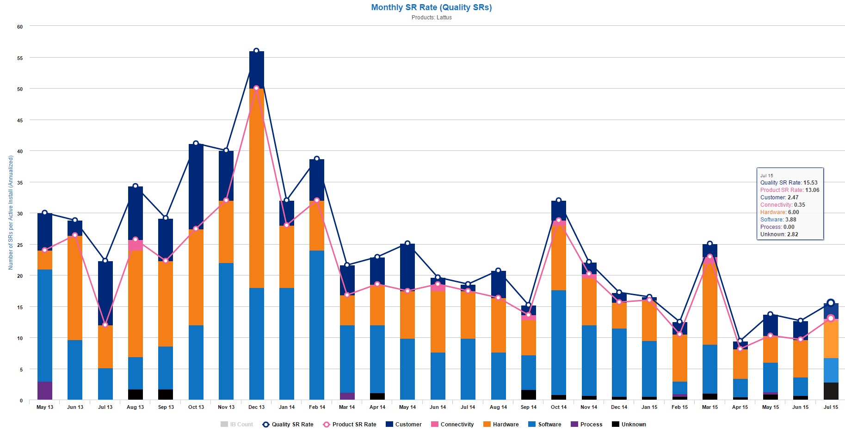
Lattus SR Trend
Overall SR Rate has been decreasing, and is below Quantum internal goal of 15 SR/System/Year
Customer | 16%
Hardware | 39%
Software | 40%

Slide 20
Top Customers, Quality SRs April – July 2015
Customer | Count of sr_number
QVC INC | 22
ZUFFA, LLC dba ULTIMATE FIGHTING CHAMPIONSHIP (UFC) | 13
The Ark | 13
APPLE MVP | 10
GOPRO | 10
DR/DANISH BROADCASTING CORPORATION | 9
KEEPER TECHNOLOGY | 9
APPLE MARCOM | 7
UNIVERSITY OF SURREY | 7
VUBIQUITY | 7
UMASS MEDICAL SCHOOL | 6
HIPSKIND | 5
QUANTUM (Switch SuperNAP) | 4
CROWN MEDIA INC | 3
DISNEY WORLDWIDE SHARED SERVICES | 1
SPACE SYSTEMS LORAL | 1
MTI FILM | 1
Grand Total | 128

Slide 21
Recent Lattus Escalations
Purpose
Apple MVP
  IPMI causing environment to be unusable
  Re-install of Lattus 3.6.0
  Fsclean issues
  Disk Issues
    Auto-decommissioning not working
    Cleanup of failed nodes
  Bugs - Tlog collapsing, S20 interfaces renamed, application server failure, healthcheck error, S20 power-off, delete performance)
  Tiger team in place to address all support issues (Will)

Slide 22
Recent Lattus Escalations
QVC
  Halting Storage Nodes
    RCA still under investigation.
    Memory contention.
  Halting Controllers
    New network drivers fixed issue
  Big Swap of Storage Nodes (S10s ---> S30s)
    Product never architected to do this
    Memory management problem on repairs (3.6.1. Patch).
      Still need tuning recommendations on # of maintenance agents

Slide 23
Recent Lattus Escalations
GoPro
  Adding a new Lattus environment --> multiple copies to multiple Lattus configs
  Customer requested training on managing events
UFC
  Upgrade Issue: Powered off Storage Nodes (3.6.0 problem)
    Blacklisting MEI driver (Mark)
  Tuning issues corrected (resolved by Mark --- doc mishap)
SuperNap
  Quantum does not support S3 Standard (just a subset)
  Multi-part upload gateway timeout

Slide 24
Thank You
Quantum, the LARGEST Data Protection and
Big Data management specialist in the world.
© 2013 Quantum Corporation. Company Confidential. Forward-looking information is based upon multiple assumptions and uncertainties,
does not necessarily represent the company’s outlook and is for planning purposes only.

