Slide 1
Installation Guidelines & Tips
July 7th, 2015

Slide 2
Agenda
Product Overview
Physical Install
  Installation considerations
  Racking procedures
  Components & Cabling
  Safety Considerations
Q/A

Slide 3
Product Overview

Slide 4
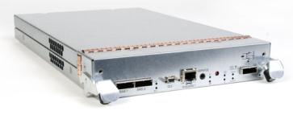

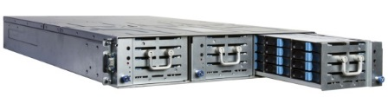
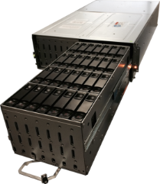
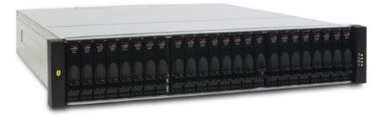
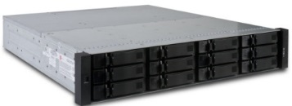
Product Overview
Controller
3 Types
3004
4004
6004
3 Interface Options
iSCSI, FC, SAS
Software
Tiering
Thin Provisioning
Rapid Rebuilds
Snapshots
SSD Read Cache
Chassis Options
2u48
4u56
2u24
2u12

Slide 5
Controller Architecture
Cache Memory
DDR
Embedded
Management
Super Caps
And
NV Memory
DDR
CPU Complex
Including dedicated CPU Control-store Memory
RAID Companion Processor
PCIe
PCIe to other controller
PCIe
PCIe
Front-end I/O
FC, iSCSI, SAS, etc.
Back-end I/O
SAS
PCIe
PCIe

Slide 6
SimulCache
Cache Memory
DDR
Embedded
Management
Super Caps
And
NV Memory
DDR
CPU Complex
Including dedicated CPU Control-store Memory
RAID Companion Processor
PCIe
PCIe to other controller
PCIe
PCIe
Front-end I/O
FC, iSCSI, SAS, etc.
Back-end I/O
SAS
PCIe
PCIe

Slide 7
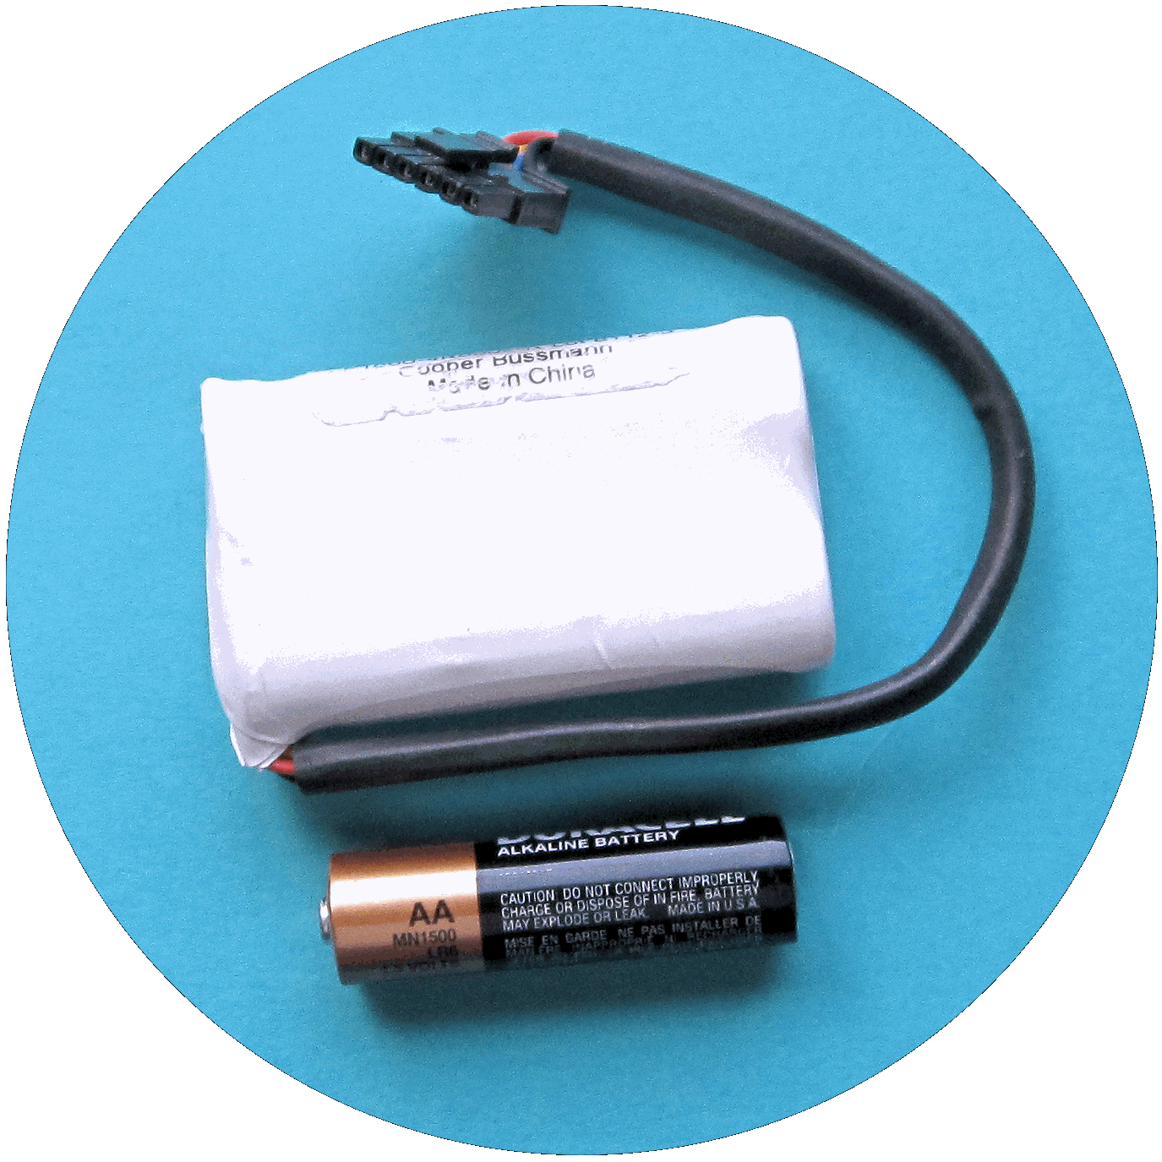
The Dot Hill ‘D’ – EcoStor - PERMANENT Cache Protection
Service
  10 year life
  No service calls
Monitoring
IP
  No wear cycle
  Voltage
  Temperature
Green
  RoHS
  Not Hazardous
Simple
  Recharge in minutes vs. hours with batteries
  Part of the controller FRU
Notes:
Keep

Slide 8
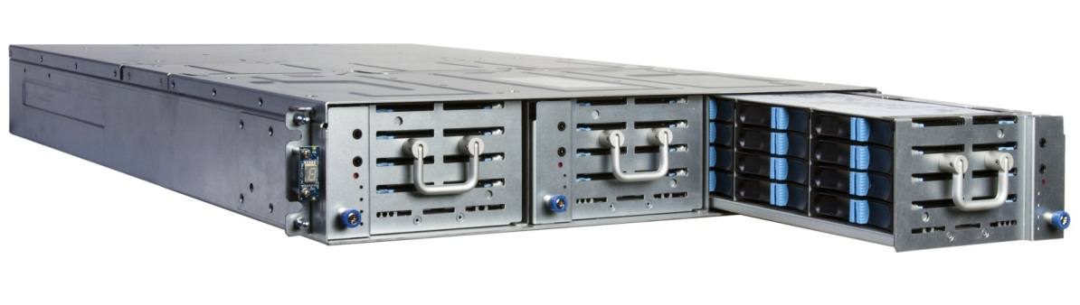
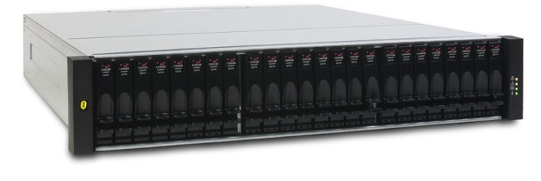
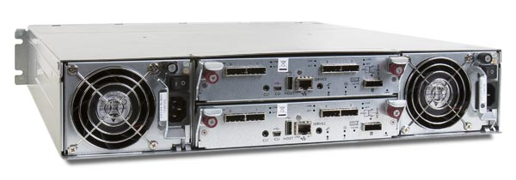
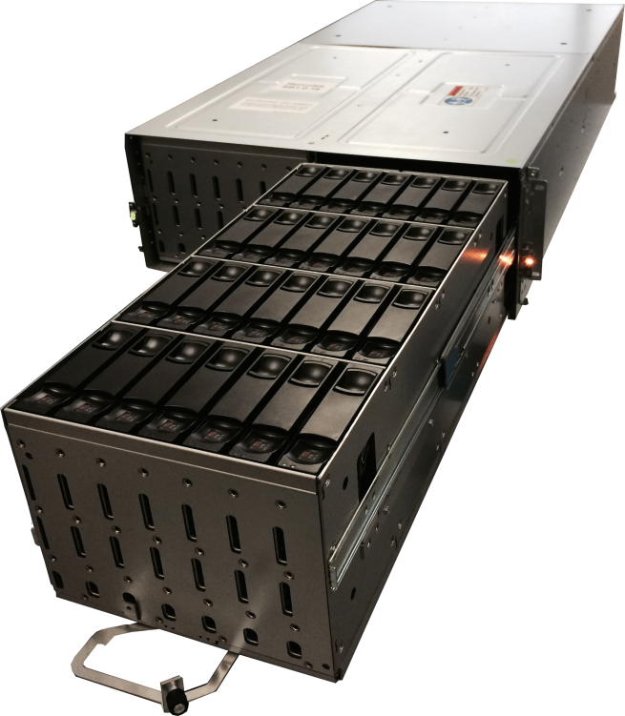
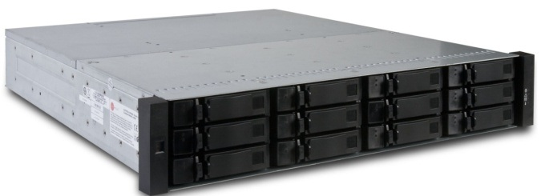
AssuredSAN Enclosures
2U-24 SFF
2U-48 SFF
Rear View Controller & IOM compatibility across enclosures
4U-56 LFF
2U-12 LFF

Slide 9
Controller/Chassis Combinations
 |  | 3004 Series | 4004 Series | 6004 Series
Chassis | 2U12 | Y | Y | N
 | 2U24 | Y | Y | N
 | 2U48 | N | Y | N (Y in Q4)
 | 4U56 | N | Y | Y
Notes:
Change to just controllers and interfaces

Slide 10
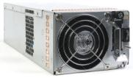
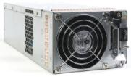
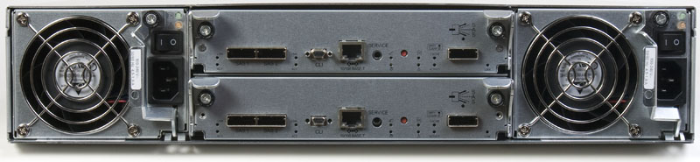
2U Common FRU Components
+
Common PSU FRU’s
  595 watt AC or DC PSU
Common DHS Controller FRU’s
  CNC (Fibre & iSCSI)
  SAS
  JBOD
Same rear chassis configuration regardless of drive size
+

Slide 11




NEBS & MIL-STD-810G
Network Equipment Building System (NEBS) & MIL-STD-810G
  Standards for ruggedness in Telco and Military/Govt. applications.
  Dot Hill products are conformant with these standards.
    Exception: 2U48 chassis is not yet conformant

Slide 12
Installation Considerations

Slide 13
What’s in the box
Chassis
  Controllers, Power supplies & Fans installed
Rail-Kit
Cables
  Power cords
  Expansion cables (JBOD only)
  USB Male to Mini-B 5-wire (CLI)
ESD Grounding strap
Bezel
Disk Drives
  Exceptions:
    4U56: NEVER ships with drives
    Sometimes, non-homogenous drives are needed; therefore, drives are shipped separately

Slide 14
What’s not in the box
SFP’s
  Always comes in separate 4-pack boxes
Ethernet cables for management
  Customer supplied
Host-facing cables
  Customer supplied

Slide 15
What’s sometimes in the box
Air Management Modules (AMM)
  Also called “Blanks”
  The 2U48 can ship with blanks installed
    But, they could come in a separate box
  The 2U12/2U24 won’t ship with blanks installed
    Blanks will always come in separate boxes
  4U56 – N/A
    Blanks aren’t necessary for this chassis

Slide 16
Learning Resources
Configuration Guides (Specs)
  https://www.dothill.com/wp-content/uploads/2015/02/4xx4-Config-Guide-2.23.15.pdf
  https://www.dothill.com/wp-content/uploads/2015/04/6xx4-Config-Guide-4.1.15.pdf
  Critical for planning (weight, power, dimensions, heat dissipation, operating temperature, etc.)
CRC ( https://crc.dothill.com/portal )
  Documentation
    Rackmount installation guides
    Setup guides
    FRU procedures
  Firmware images

Slide 17
Power

Slide 18
AC Power Requirements
Chassis | 2U12 | 2U24 | 2U48 | 4U56
Input Requirements | 100-240 V 50/60 Hz | 100-240 V 50/60 Hz | 100-240 V 50/60 Hz | 200-240 V 50/60 Hz
Max Input | 375 W maximum continuous | 400 W maximum continuous | 640 W maximum continuous | 1200 W maximum continuous
Heat Dissipation | 1488 BTU/hr | 1488 BTU/hr | 2245 BTU/hr | 4095 BTU/hr
  NOTE: 2U12/2U24/4U56 also support DC power; see configuration guides

Slide 19
Power Cables
2U12, 2U24, 2U48 Power Cord
4U56 Power Cord

Slide 20
Power guidelines
Plan for the unique requirements of the 4U56
  It must have 200-240V power; do not attempt 110
  Customer’s PDU receptacles must take a C20 connector or run dedicated circuits

Slide 21
Racks and Rails

Slide 22
Rack Requirements
2U12/2U24/2U48
  Fit into a standard 19-inch server rack
4U56
  Requires a deep enclosure rack (1 meter)
    Example: http://www.apc.com/products/resource/include/techspec_index.cfm?base_sku=AR3305

Slide 23
Chassis Weights
Chassis | 2U12 (lbs) | 2U24 (lbs) | 2U48 (lbs) | 4U56 (lbs)
Without Drives | 58.2 | 36.4 | 48 | 99
With Drives | 78.2 | 51.8 | 74.9 | 193
  CAUTION: Always load drives into the 4U56 after you’ve installed the chassis into the rack
  TIP: Encourage your customer to use anti-tip stabilizers for the 4U56

Slide 24
Rails
Rail kits come in the boxes with each chassis
Rails consist of a sleeve and insert held by a screw
Nuts, screws come for round-hole, square-hole, and pre-tapped racks
Chassis slides onto rails; rails act like a shelf
Chassis is secured to rails using side-brackets
  Side-brackets screw into rails
  NOTE: You will have to remove the power supplies to tighten this bracket; do so before power-up
Notes:
Key Point here: No universal quick-connect rails.
Why? Because our rails are custom-made to pass shock & vibration for NEBS; also to pass rigour of shipment for OEMs

Slide 25
Rail Kit installation guides
https://crc.dothill.com/access/content/group/CRC/Documentation/DH_Ultra56_RBKI_83-00006835-10-01-A.pdf
https://crc.dothill.com/access/content/group/CRC/Documentation/AssuredSAN%20Ultra48%20Series/DH_Ultra48_RBKI_83-00006754-10-01-A.pdf
https://crc.dothill.com/access/content/group/CRC/Documentation/DH_RBKI_83-00004524-13-01-B.pdf

Slide 26
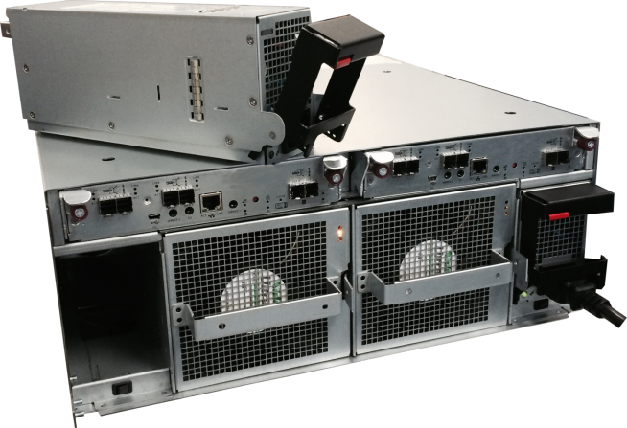
4U56 – Improper lift points
CAUTION: Do not lift by these fan handles; injury or damage can result

Slide 27
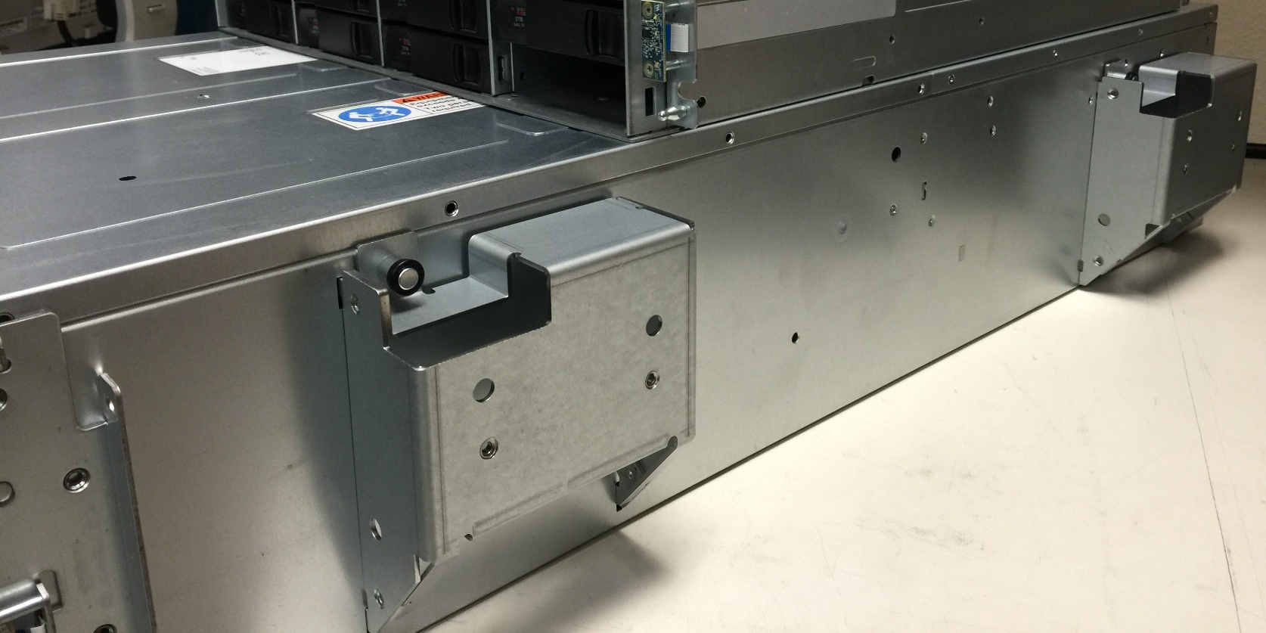
4U56 – Proper lift points
Option 1: Utilize the carrier handles
  Not part of the Top-Level-Assembly (TLA)
  They can be ordered and re-used

Slide 28
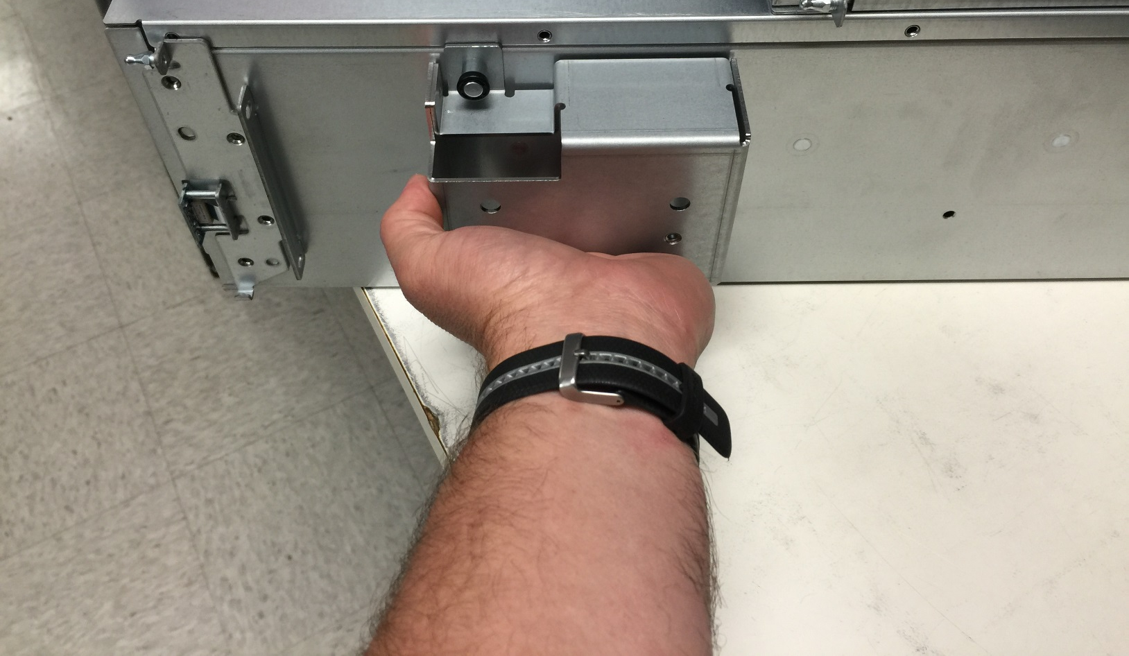
4U56 – Example

Slide 29
4U56 – Proper lift points
Option 2: Hand carry with 2 people
  This is the most-often used method

Slide 30
Drive insertion

Slide 31
Drives & chassis
2U12, 2U24, 2U48 can ship with drives
  4U56 never ships with drives
Chassis and drives can ship separately
  To meet configuration requirements (non-homogenous configurations)
Drives will come pre-sledded
LFF drives have a common sled among chassis
SFF drives have unique sleds between 2U24 & 2U48
  A unique sled exists to insert SFF drives into the 4U56 – “FrankenSled”
Notes:
Key Point here: No universal quick-connect rails.
Why? Because our rails are custom-made to pass shock & vibration for NEBS; also to pass rigour of shipment for OEMs

Slide 32

4U56 drive loading
If filled, then order doesn’t matter
If not, then ensure you load front of both drawers first, then backwards
  Ensures best cooling
14 drives is the current minimum drive count
  Load 7 per drawer at the front of the drawer
Notes:
Key Point here: No universal quick-connect rails.
Why? Because our rails are custom-made to pass shock & vibration for NEBS; also to pass rigour of shipment for OEMs

Slide 33
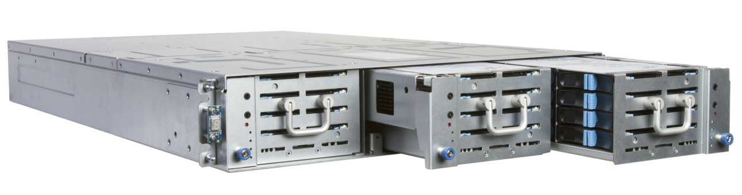
2U48 drive loading
If filled, then order doesn’t matter
If not, then starting at the front of the chassis
  Load left to right (first 4 slots in drawer 0, then first 4 slots in drawer 1, etc.)
  Fill next row in each drawer
  Ensures the best cooling
Air Management modules must be loaded in empty slots
Notes:
Key Point here: No universal quick-connect rails.
Why? Because our rails are custom-made to pass shock & vibration for NEBS; also to pass rigour of shipment for OEMs

Slide 34
Blanks and Bezels

Slide 35
Why do we need these?
Air Management Modules (AMM)
  Also known as blanks
  Ensures proper operating temperature within the chassis
Bezels
  Mostly decorative and branding, but…
  Provides EMI mitigation for the chassis
Notes:
Just put them on; it’s too easy to not do it

Slide 36
Blanks
Needed for the 2U12, 2U24, 2U48
  Not necessary for the 4U56
2U12/2U24
  Single blank per slot
2U48 has 2 types:
  Single blank per slot
  4x blank (covers 4 slots)

Slide 37
Expansion Cabling

Slide 38
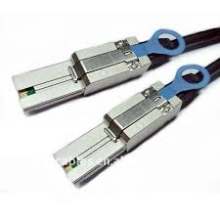
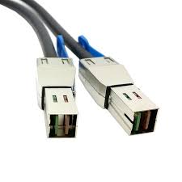
Expansion cables
Expansion units run at 6Gps
  3004/4004
    Always expand with SFF-8088
6004 Expansion runs at 12Gps
  2 each 8644 cables at 6Gbps per controller
SFF-8088
SFF-8644

Slide 39
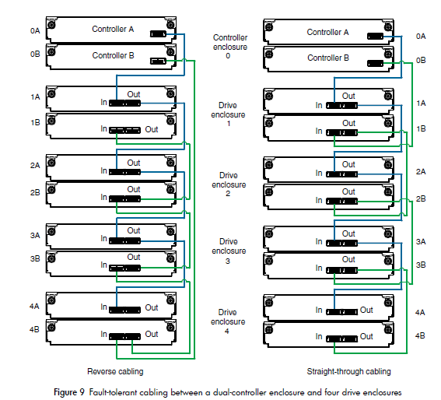
Cabling Considerations
Reverse
Lose one enclosure, and still have access to the other enclosures
Straight-through
Lose an enclosure, then lose access to all enclosures behind it

Slide 40
Do I really need reverse-cabling?
If the RAID sets are still fault-tolerant when an entire enclosure is down AND
If I’m not using virtual volumes
  Virtual volumes disperse data across all RAID sets
Then, it makes sense.

Slide 41
Controller Cabling

Slide 42
Controllers

Slide 43
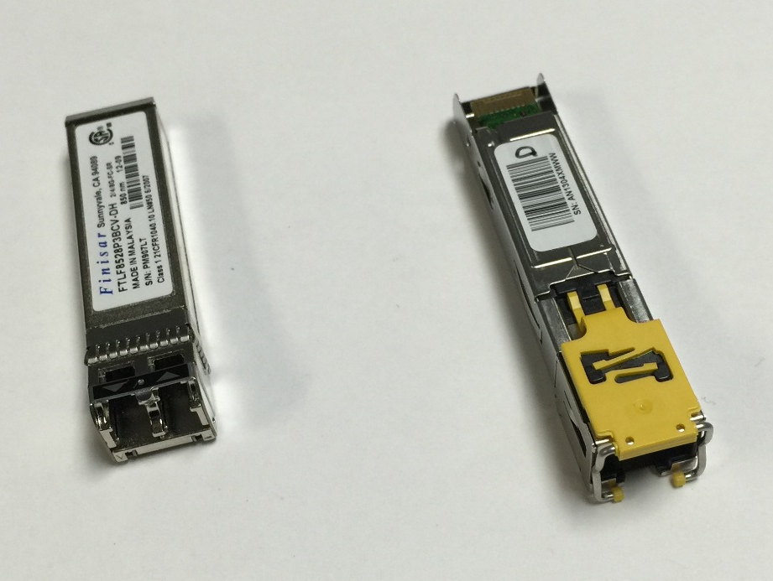
SFP
SFPs do not come in the chassis box
You will install these after you’ve racked the chassis
Default port settings are FC
  Change via CLI for iSCSI or combination
Syntax: Set host-port-mode [FC | iSCSI | FC-and-iSCSI]
# set host-port-mode FC-and-iSCSI
This command will change host port configuration, stop I/O, and restart both
controllers. Do you want to continue? (y/n) y

Slide 44
First-time Config

Slide 45
Power-on
Expansion Chassis first, then controller chassis
Allow 60-120 seconds for:
  Drive Discovery
  Health check

Slide 46
Out of box IP settings
Controllers IP Addresses
  IP
    Controller A: 10.0.0.2
    Controller B: 10.0.0.3
  Netmask: 255.255.255.0
  Gateway: 10.0.0.1
Changing the default IP
  Set your laptop to an address on the same subnet & connect (i.e. 10.0.0.5)
  Connect to the serial port:
    Baud: 115,200
    Data bits: 8
    Parity: None
    Stop Bits: 1
    Flow Control: None

Slide 47
Obtaining licenses
Save logs using the WBI
Open a support ticket with Dot Hill
Dot Hill support will send the license file to your customer’s email address
Use the WBI to install the license file
NOTE: It’s likely that Quantum will utilize a more efficient licensing process in the future.
Look on CRC for instructions on how to obtain a license

Slide 48
Safety Considerations

Slide 49
Safety tips
Recommended to use 2 people to rack all chassis; however, we’ve racked them with 1 before
EXCEPTION: Respect the weight of the 4U56
  It’s awkward to carry – even when empty
  Always use 2 people to carry this
  Consider using a mechanical lift
  NEVER carry it loaded with drives
  Encourage the customer to use anti-tipping devices for the racks

Slide 50
Q/A

