Slide 1
DXi V4000
Big Moss Creek Program
TOI for Global Service
July 25, 2013

Slide 2
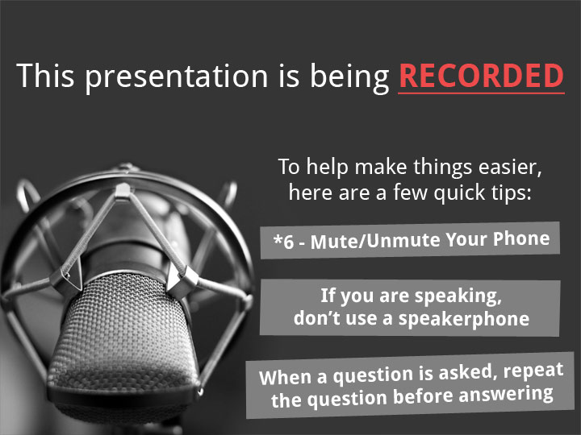

Slide 3
Agenda
Marketing Overview
Engineering Update
Known Issues
Performance Update
SW Fulfillment
Documentation and Training Updates
Service Model Updates
Note: Ask questions as we go. Q&A also at the end.

Slide 4
Marketing Overview
Mark Thacker

Slide 5
DXi V4000 Product Specifications
Target Edge to Core and Q-cloud deployments
Larger Capacity DXi V-Series based on DXi 2.2.1.3
  4TB to 24TB capacity in 1TB increments of capacity on demand
More capable ingest
  CIFS, NFS, OST, DXi Accent (no VTL) ingest on 4 virtual NICs
  Tested up to 50 CIFS, NFS and OST streams simultaneously on 1GbE
  Initial testing showing up to 899MBs (OST) on a single physical NIC
More replication support
  10 to 1 standard, adjustable for 20 to 1 with Service request
System Requirements
  VMware ESX 5.0 or 5.1 (no ESX 4.x and no VMware Workstation)
  Multi-core Intel processor, 8 virtual CPU cores required
  Minimum 4.5TB of thinly provisioned disk space; up to 24.5TB
  48GB of RAM allocated to VM at all capacity points
    Address in future release; reduce RAM requirement for <12TB

Slide 6
DXi V1000 vs DXi V4000
 | DXi V1000 | DXi V4000
DXi Base Release | 2.2.1 | 2.2.1
Capacity Range | 1TB to 2TB 1TB increments | 4TB to 24TB 1TB increments
Free Standard Edition | Yes – 1TB | No
30-day Trial & Cap. | Yes – 1TB | Yes – 4TB
Single protocol stream | 8 | 50
Ingest Performance (on same platform) | 343 MB/s (NFS) 265 MB/s (CIFS) 452MB/s (OST) 661 MB/s (Accent) | 417 MB/s (NFS) 854 MB/s (CIFS) 899 MB/s (OST) 1371 MB/s (Accent)
Protocols | CIFS, NFS, OST, Accent | CIFS, NFS, OST, Accent
Replication Fan-in | 1 | 10 to 1; up to 20 to 1
VMware Versions | ESX 4.x, 5.x, VMware Workstation | ESX 5.x
Processors | Intel; 2 virtual cores | Intel; 8 virtual cores
RAM Allocation | 4GB | 48GB
VMDK layout | 9 VMDK (9 x 256GB) | 14 VMDK (2 x 256GB + 12 x 2TB)

Slide 7


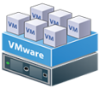


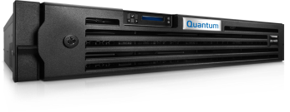


Use Case 1: Edge to Core and Core Replication
Physical
Backup ISV
Third party ISV
DXi4601
Bellevue, WA
V1000
New York, NY
DXi V4000
Dallas
San Francisco, CA
V4000
V1000
Hilton Head Island, SC
Invested in VMware infrastructure
Geographically diverse sites
Wants to match capacity with data growth rate
Local backup & recovery; remote DR

Slide 8


Use Case 2 : Q-Cloud BaaS / DRaaS Example
CV Simpana
Multiple DXi V1000’s
DXi4601
Customer 1
V1000
Q-Cloud
Customer 2
V1000
DXi V4000
VMware infrastructure
Dedicated DXi V-Series / customer
High efficiency of resource usage
Physical and virtual backup
Local backup & recovery
Customer 3
V4000

Slide 9
Release and Relationship to V1000
GA of product July 18, 2013
30-day Trial available with 90-day support
  Time-enforced license, will expire
  4TB Capacity; for use with Proof of Concepts
  Post GA release of 30-day Trial License
Not available in free Standard Edition form
Not upgradable from DXi V1000
  Totally different platform and disk layout
  Customers would need to replicate from V1000 to V4000
  Same procedure as a DXi 4000 moving to a DXi 6700
Licensing
  Initial Offering : Supports perpetual [on Quantum price book]
  Subscription [Sold through Q-cloud offering]
  Time-based [30-day demos]

Slide 10
Compliance and Certification
ISV Backup Application that were test are included below
  Backup Exec 2012R2
  NetBackup 7.5.0.5
  Simpana 10
  vmPro 3.1
  Veeam 6.5
  vRanger 6.0.2
  Security Scans – Nessus and Retina
Other ISVs that we have previously test with V1000. Plan of Record for V4000 Program is that we were leveraging V1000 results for these ISVs. No Test required/planned
  Networker
  ARCserve
  Data Protector
  Tivoli

Slide 11
Management and Reporting and Enablers
Vision 4.2 Support
  Tested and supported with currently shipping Vision 4.2
DART Version 2.1.2
  Integrated and delivered with product
Early Access Customer – Interconnekt
  Website : www.interconnekt.com.au
  Australia-based managed / hosted service provider
  3 locations: 2 in Melbourne and 1 in Sydney
  Will be a Quantum partner for Q-cloud-like hosted offerings
  Has used 2 instances of 12TB DXi V4000
  Local ingest and replication tested
  Customer happy with performance and stability using pre-release build
  No issues to report

Slide 12
Engineering Update
Jim Kahn

Slide 13
Key Features
Same features as in Moss Creek (version 2.2.1)
Network Throttling
DHCP Network Configuration
Multiple VLAN IDs
Installation/Boot Process
Secure File Shred
Health Check & Data Collection
Performance
Known Issues

Slide 14
Network Throttling
Throttling at ESXi vSwitch Level – Existing Solution
  Limits ALL Network Traffic
Replication Throttling in DXi V4000
  10 GbE and 1 GbE Networks Only

Slide 15
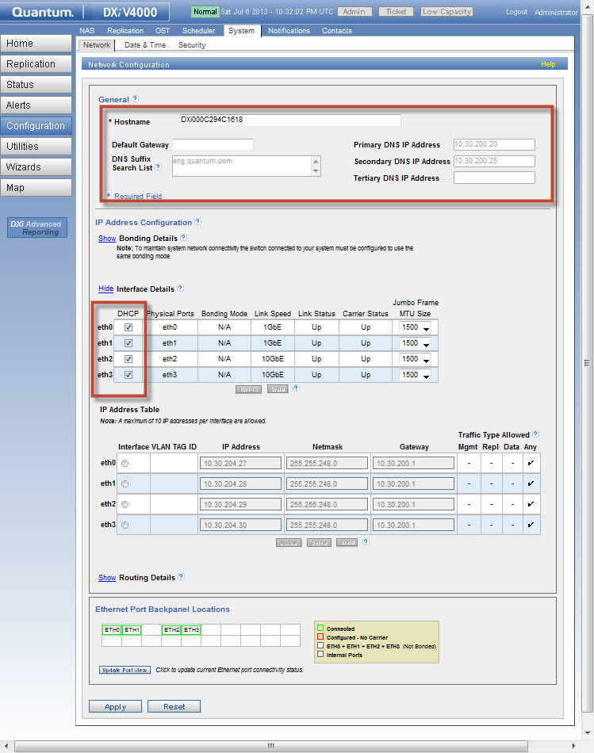
DHCP Network Configuration

Slide 16
DHCP Network Configuration (cont.)
DHCP Server owns the Lease Policy
  8 hours Typical Lease for Roaming Clients
  24 hours Typical Lease for Stationary Clients
If the DXi V4000 is powered down and fails to renew its DHCP lease, a new IP may be assigned on power up!
For Long-Term Usage
  Reserve IP using DNS
  Reserve IP using DHCP Reservation
  Use static IP

Slide 17
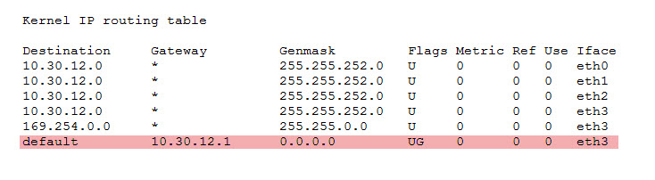
DHCP Network Configuration (cont.)
DHCP Assumes A Simple Network Topology
  One Subnet for All Network Interfaces
  One DHCP Server Handles the Subnet
Do not Mix DHCP and Static IPs
  Routing Table Conflict
  Resolv.conf not Persistent
For Complex Network Topologies use Static IPs

Slide 18
DHCP Network Configuration (cont.)
VLAN ID can only be Specified on Windows or Linux based DHCP servers
DHCP Spec. (RFC 2132) does not define a VLAN property.
Example for VLAN ID1922: 01:04:00:00:07:82
  Vendor Option Type: 01
  Length of Vendor Data: 04
  VLAN ID 1922: 00:00:07:82

Slide 19
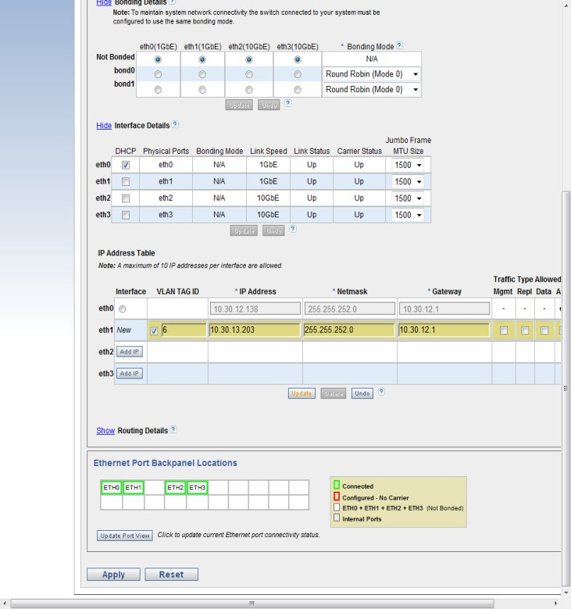
Multiple VLAN IDs
10 VLAN IDs per Network Interface Supported

Slide 20
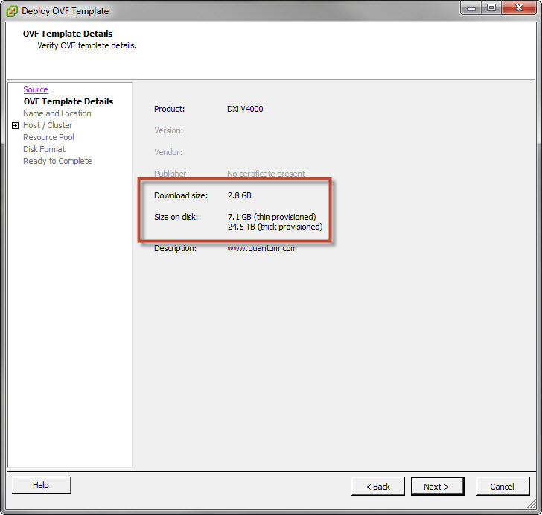
Installation/Boot Process
Regardless of licensed capacity
  Thin Provisioning
    Storage Provisioned to 7.1 GB
  Thick Provisioning, Lazy Zero
    Storage Fully Provisioned to 24.5 TB
  Thick Provisioning, Eager Zero
    Slow Import (>60 minutes) due to Storage Initialization
    Storage Fully Provisioned to 24.5 TB
OVF Import is unchanged

Slide 21
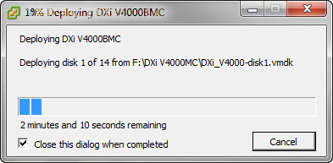
Installation/Boot Process (cont.)
OVF Import Time is Good Indicator of ESXi Datastore and Network Performance!
Configured Luns should be at least 8 disks per group

Slide 22
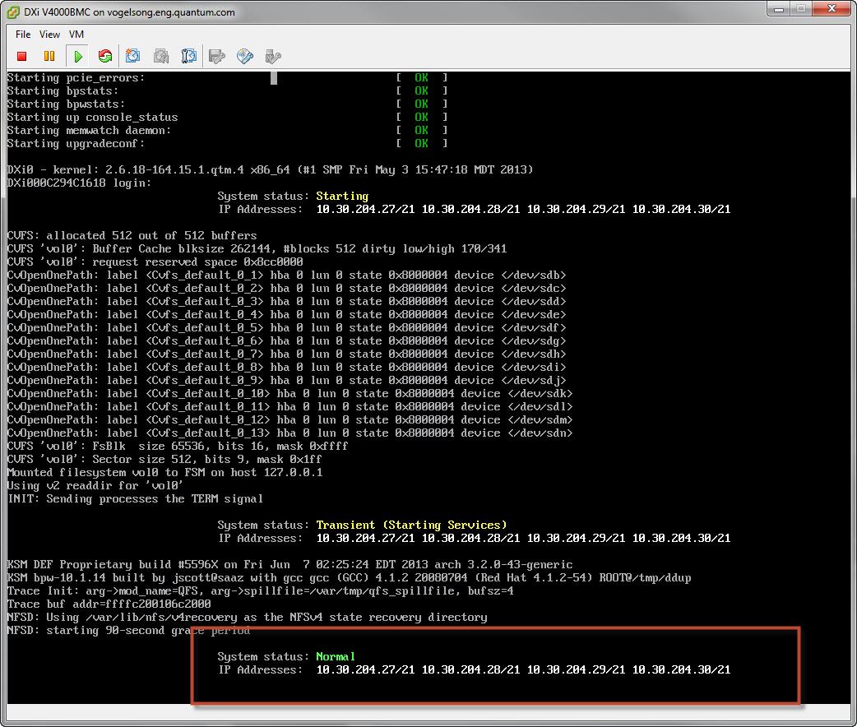
Installation/Boot Process (cont.)
Console displays:
  Assigned IP Addresses
  Boot State

Slide 23
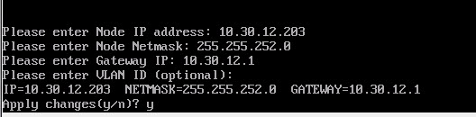
Installation/Boot Process (cont.)
Console is used to configure a Static IP for eth0 if Network Infrastructure has no DHCP Service
If Gateway IP specified, ICMP Ping is used to validate network connectivity
Network Configuration is persistent

Slide 24
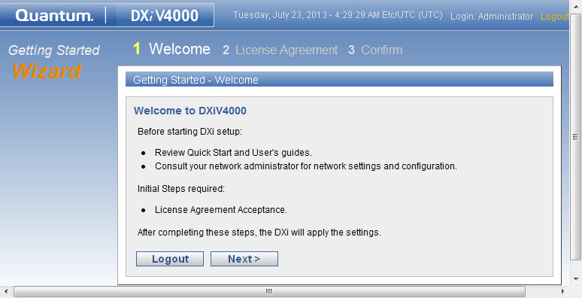
Installation/Boot Process (cont.)
Configuration same as DXi V1000

Slide 25
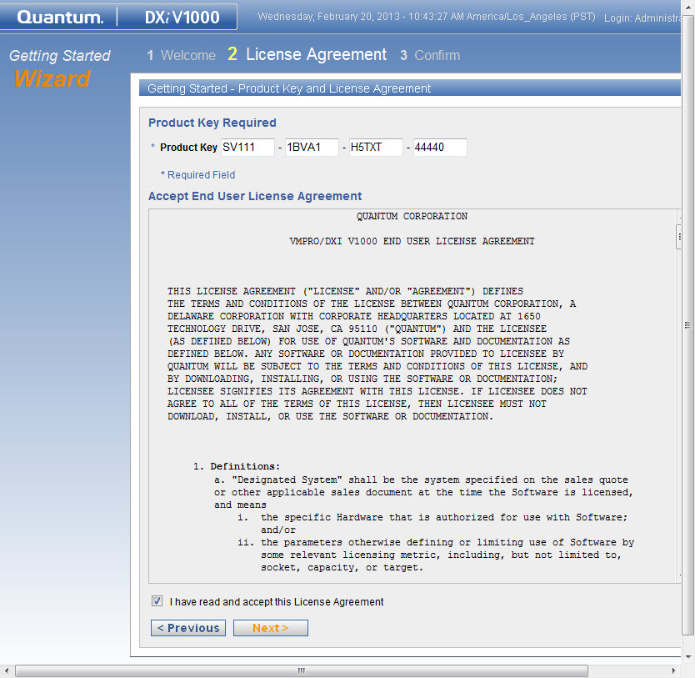
Installation/Boot Process (cont.)
New Product Key
  Key Divided into 4 groups of 5 digits for easy data entry
  Product Key is Checked

Slide 26
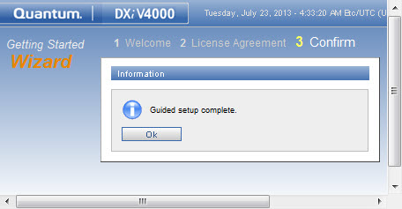
Installation/Boot Process (cont.)
Once Product Key Entered, Configuration is Done!

Slide 27
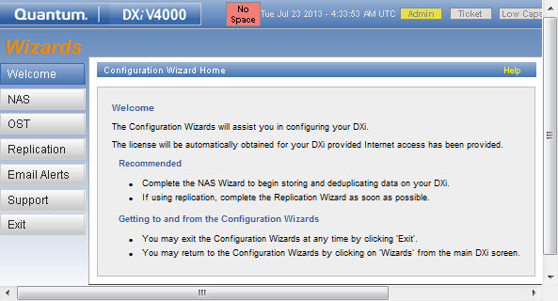
Installation/Boot Process (cont.)
License Key should be obtained within 120 seconds
  256 GB Evaluation used if License Server Contact Fails
Internet Access via HTTPS (Port 443) is Required

Slide 28
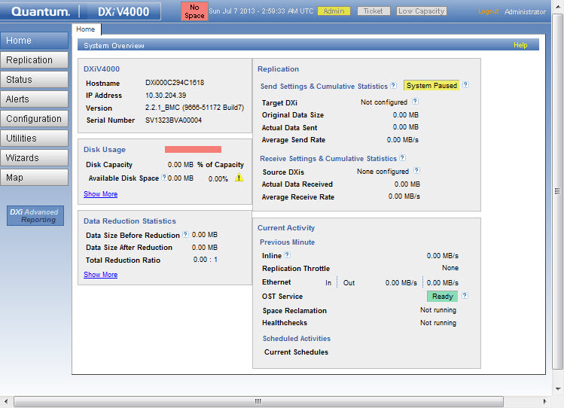
Installation/Boot Process (cont.)
Unlicensed State

Slide 29
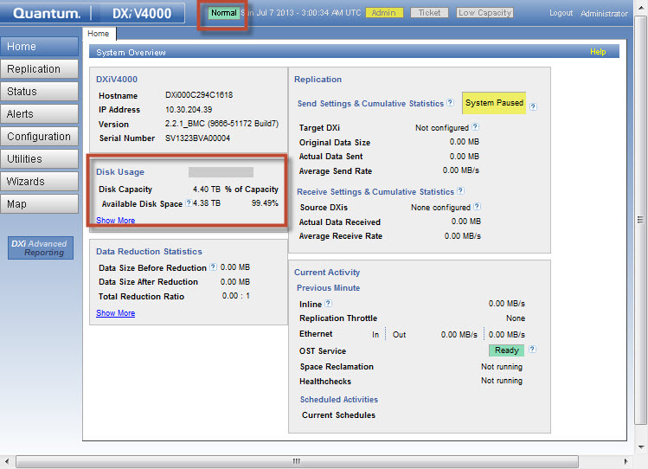
Installation/Boot Process (cont.)
Licensed State

Slide 30
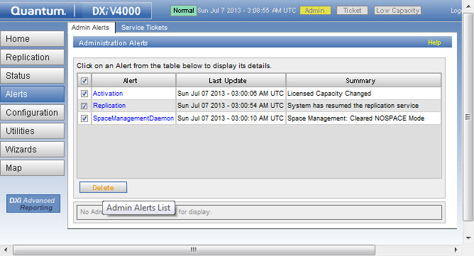
Installation/Boot Process (cont.)
Service Tickets generated at First Boot (harmless)

Slide 31
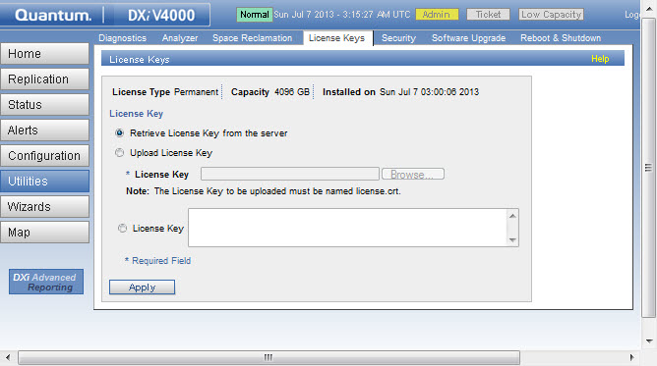
Installation/Boot Process (cont.)
Used if no Internet Access to License Server
(e.g. Dark Sites)
  Check mosaic.quantum.com for License Key
  Contact Global Call Center for License Key
Used for Immediate License Check
  Capacity Upgrade
  Automatic License Check is Performed Daily

Slide 32
Secure File Shred
Carried over from DXi SW version 2.2.1
  Run Space Reclamation Utility
  Run Secure File Shredding Utility
  Unique to DXi V-Series:
  Fully Inflates thin-provisioned storage to 24.5 TB regardless of licensed capacity
  Customers should remove old ESXi Snapshots

Slide 33
Health Check & Data Collection
Collect DHCP Information
  /etc/dhclient-eth*.conf
  /etc/dhcp6c.conf
  /var/log/dhclient/dhclient-eth*.leases
Collect License Information
  /opt/DXi/activation.txt
Collect Network Throttle Information
  /etc/sysconfig/network-scripts/tc-*
  /etc/sysconfig/network-scripts/global-tc
Same as DXi V1000

Slide 34
Known Issues
Jim Kahn

Slide 35
Known Issues
PTR | Description | Workaround
34684 | Emails don't show system serial number and show wrong Model number | No workaround.
34566 | Licensing: 4TB license on v4000 BMC confusing to users under Critical Low Space Condition | Only licensed capacity 4-24 TB supported.
34445 | License expired warning shows the "Model Name: DXi0" | No workaround.
34135 | BMC: Disk Usage does not match with State Indicator | At 85% of licensed capacity, yellow low-space warningin will be issue. After 90%, red critical space error will be issued.
34016 | DART BMC> Zooming, Forward and Start/End times do not work | No workaround.
33965 | MC 2.2.1 build 5 has mixed time zones, UTC & PDT. | Manually set timezone.
33830 | Unable to Edit/Start/Abort share replication and system busy page on heavy loaded system | Wait for load to drop before aborting.
33650 | Wizard: failed email server configuration causes subsequent attempt to configure recipient to fail with "Duplicate Recipient Name" | Delete user account and then try again.
33373 | Cannot power on second DXi V4000 | Vmware KB articl 1004424. Upgrade to ESXi 5.1, Update 1.
33274 | Disk Capacity displays in 1024 format instead of 1000 format | Virtual Storage is in Base-1024 units. Physical storage is in Base-1000 units.
Super bugs:
  33140 Super: Project Big Moss Creek. PTRs agreed to address in this program
  33141 Super: Big Moss Creek Bugs found in test
  33142 Super: Bugs deferred from the Big Moss Creek release
  Note: Known issues are documented in Release Notes/Quick Start Guide/User Guide

Slide 36
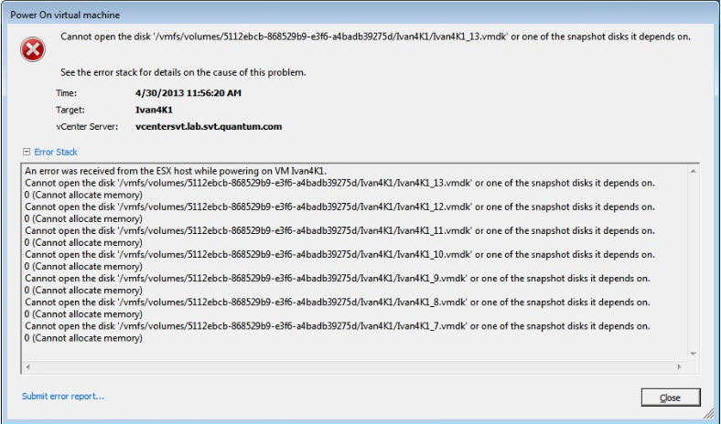
Known Issues: ESXi Storage
Issue: Cannot Start a VM…No Storage
  Cause: Too Many VMs running
    4 x DXi V1000
    1 x DXi V4000
8 TB Max Active Storage for ESXi 5.x/4.x
  http://kb.vmware.com/selfservice/microsites/search.do?language=en_US&cmd=displayKC&externalId=1004424

Slide 37
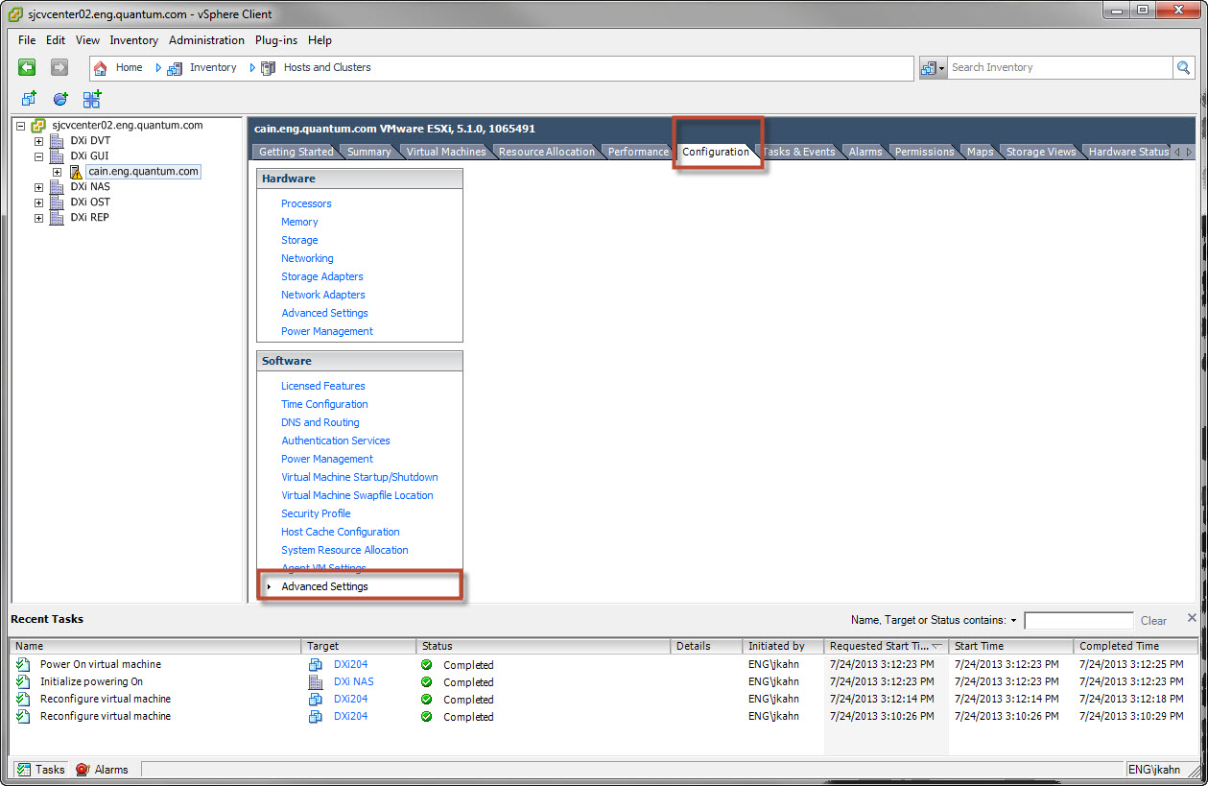
Known Issues: ESXi Storage (cont.)
Advanced Setting: VMFS3.MaxHeapSizeMB MUST be increased to support DXi V4000

Slide 38
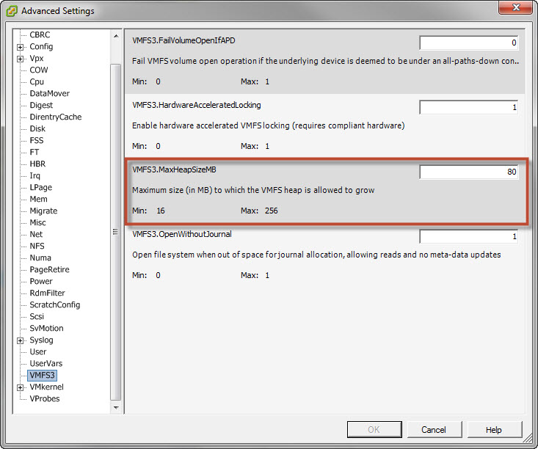
Known Issues: ESXi Storage (cont.)
ESXi 5.1/5.0/4.x can only support 1 VM in the class of a DXi V4000!
  Default: 8 TB
  Max: 24 TB

Slide 39
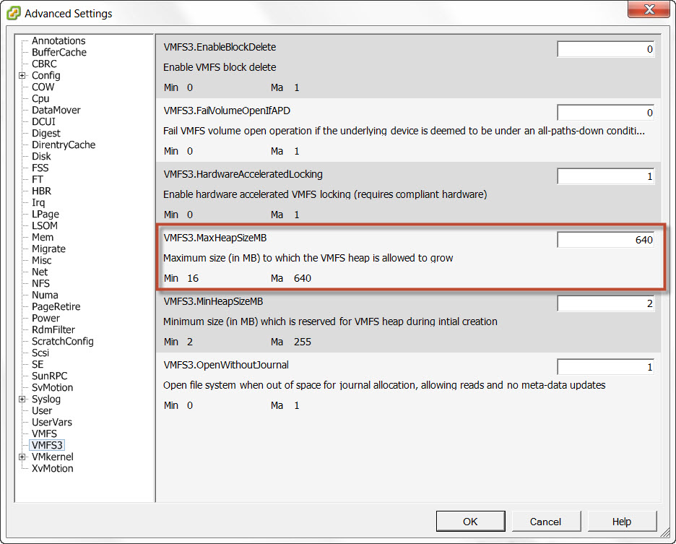
Known Issues: ESXi Storage (cont.)
ESXi 5.1 Update 1 Addresses Issue
  Min: 16 TB
  Max: 64TB (default)

Slide 40
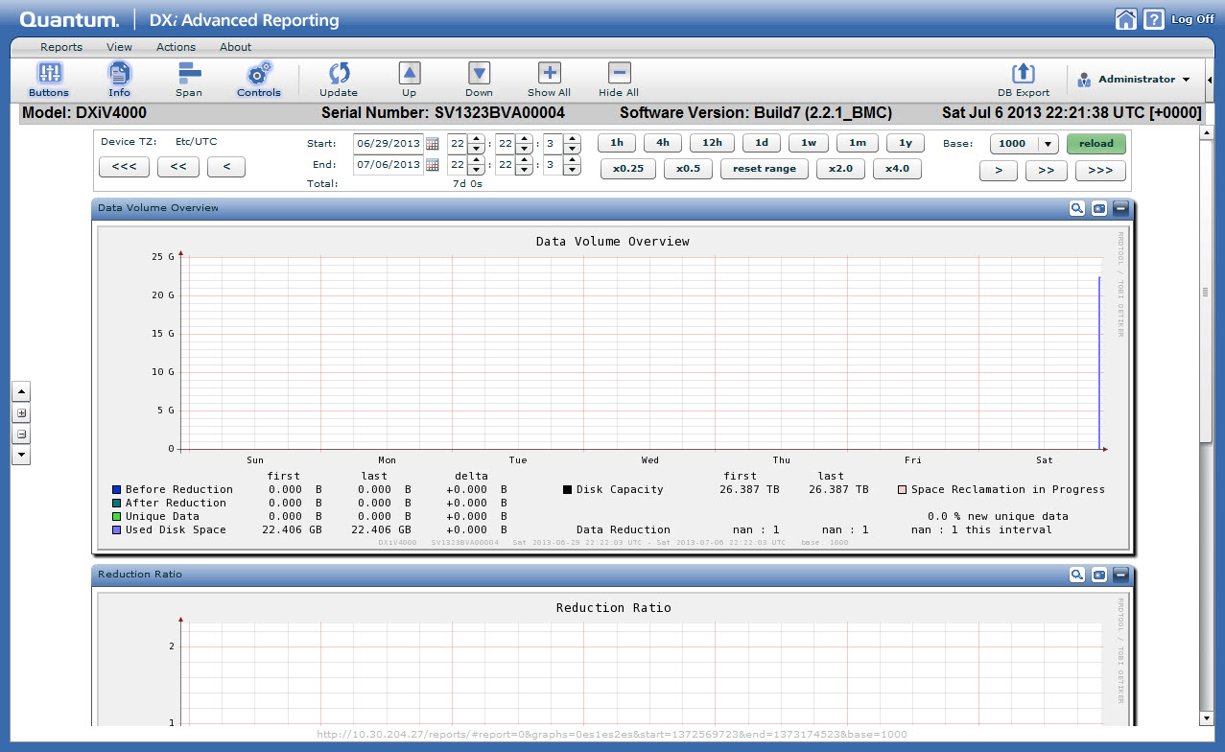
Known Issues: DART (cont.)
Regardless of Licensed Capacity - DART scale reflects full 24.5 TB of DXi V4000

Slide 41
Known Issues: Low-Space
Hard Limits
  Low Space: 500 GB
  Critical Space: 250 GB
  In practice never reached by DXi V4000
Percentage Limits:
  Low-Space: 85%
  Critical Space: >90%

Slide 42
Performance Update
Jim Kahn

Slide 43
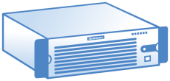
DXi V4000 Performance - Reference System
ESXi 5.1, Update 1
Dell R910
  2x E7540 CPUs
  128 GB RAM
  NIC
    1GbE: Intel 82576
    10GbE: Broadcom BCM57711
  HBA: 2x Qlogic QLE2562 2 x 8GbE
14 Datastores
  10xLSI Matterhorn Storage Servers
  20 LUNs
  16x1 TB 7200 rpm disks in each LUN
  RAID6 configuration

Slide 44
DXi V4000 Performance
Big Moss Creek DXi V4000 Up To Performance
Release: | 2.2.1 | Ingest Streams |  |  | Read Streams
Presentation |  | Host - Total Streams | Inline (MB/s) | Inline (TB/H) | Host - Total Streams | Inline (MB/s) | Inline (TB/H)
1 Datastore DXi V4000
NFS-Sync |  | 8H-8S | 417 | 1.5 | 6H-12S | 777 | 2.8
CIFS |  | 4H-32S | 849 | 3.1 | 8H-32S | 615 | 2.2
OST |  | 2H-8S | 899 | 3.2 | 6H-36S | 773 | 2.8
Accent |  | 8H-16S | 1371 | 4.9 | 6H-48S | 743 | 2.7
14 Datastores DXi V4000
CIFS |  | 4H-24S | 854 | 3.1 | NA | NA | NA
Accent is measured as Effective Rate, not Wire Rate
ESXi DataStore -- each Datastore is mapped to 1 physical LUN on array.
Additional datastores = more streams
  Up to 50 concurrent streams tested/supported with CIFS, NFS, OST
DXi Accent makes a difference!
  Virtual interfaces are always bandwidth constrained
V4000 has industry highest performance
  HP StoreOnce VSA (0.5 TB/hr)

Slide 45
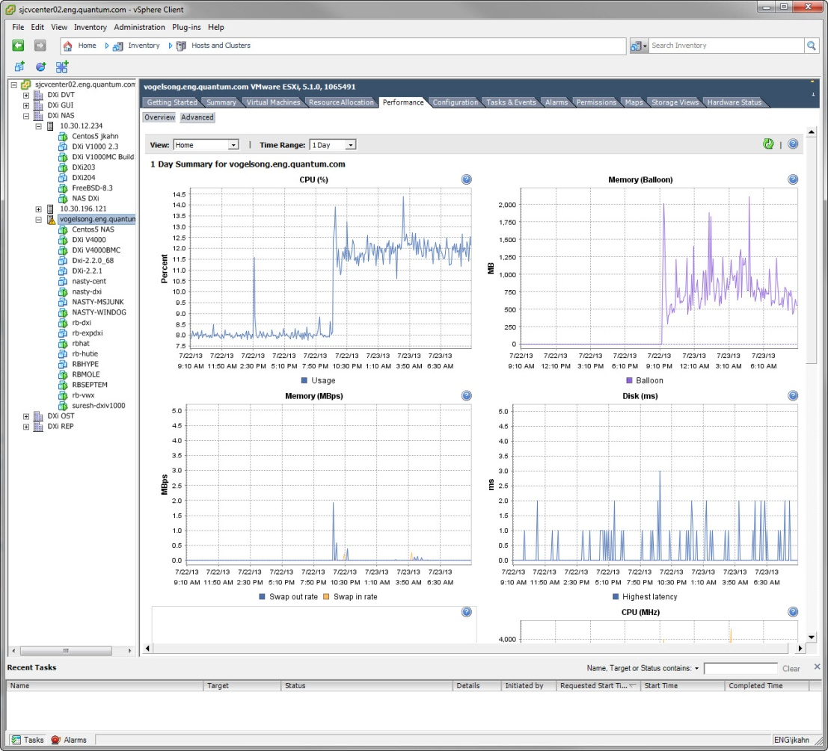
DXi V4000 Performance: Monitoring
ESXi has built-in Performance Tools in VMware vSphere
Can Monitor overall Server Performance

Slide 46
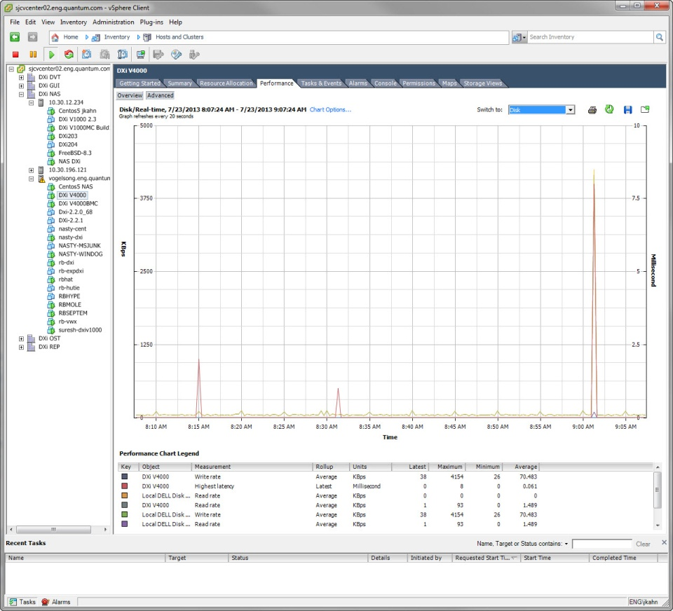
DXi V4000 Performance: Monitoring (cont.)
Can Drill-down to Monitor individual VM

Slide 47
SW Fulfillment
John Cramer

Slide 48
DXi V4000 SW Fulfillment
Releasing the DXi V4000 for commercial orders and subscriptions
  Commercial order uses Perpetual license
  Subscription uses Good Until Canceled license
  Both use same SW delivery and licensing processes
SW download and licensing processes are the same as used with the DXi V1000
  Download is from Flexera hosted website, https://quantum.subscribenet.com/
  Licenses are managed on https://mosaic.quantum.com

Slide 49
DXi V4000 Installation/Upgrade
Dark Site Installation process is the same as for the DXI V1000
  Only allowed for customers with a valid IB record and Service contract
  GCH looks up license key on mosaic.quantum.com and emails it to the customer
  Instructions for manually entering license key are in the Quick Start Guide
If the license does not exist on Mosaic when customer installs the product key the SW will default to trial mode. 256GB capacity, 60 day
Capacity upgrades are available in 1TB increments up to a maximum of 24TB capacity
  The customer’s DXi V4000 SN must be provided at the time of order for a capacity upgrade

Slide 50
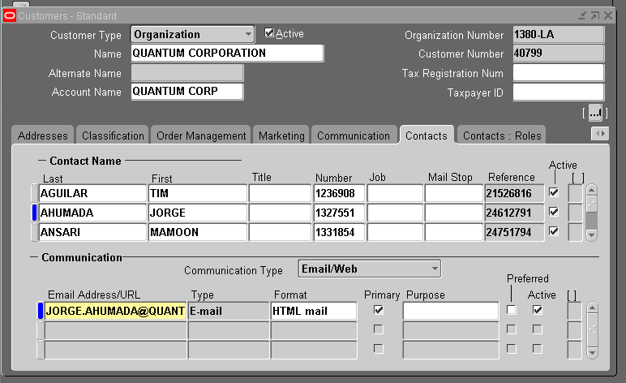
DXi V4000 Email delivery of Download Media Kit
Email delivery of Download Media Kit is available for the DXi V1000 & DXi V4000
  Enter customer contact name as Ship To Contact in Sales Order Header
  In the Customer Standard the customers email address must be added

Slide 51
DXi V4000 Email delivery of Download Media Kit
Customer will receive an email when the product ships.
  The email includes the contents of the Download Media Kit as .pdf attachments
Physical Download Media Kit will still be shipped unless we are requested not to send it.
  Order Manager uses the Shipping Instruction on the Sales Order to request that a kit not be shipped.

Slide 52
DXi V4000 Download Media Kit (DMK) Certificates
Initial Sale Serial Number Certificate

Slide 53
DXi V4000 Download Media Kit (DMK) Certificates
Initial Sale Product Key Certificate
Used during installation to license product

Slide 54
DXi V4000 Download Media Kit (DMK) Certificates
Initial Sale Download Authorization Code Certificate
Used to download application from https://quantum.subscribenet.com/

Slide 55
DXi V4000 Download Media Kit (DMK) Certificates
Capacity Upgrade Certificate
Upgrade Type:
  1TB to 20TB Capacity Upgrade
Product Key must match customer’s original Product Key for the software instance

Slide 56
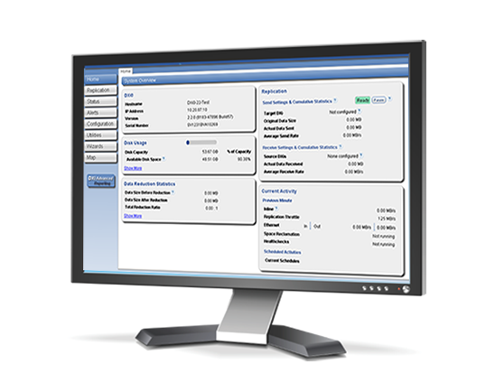
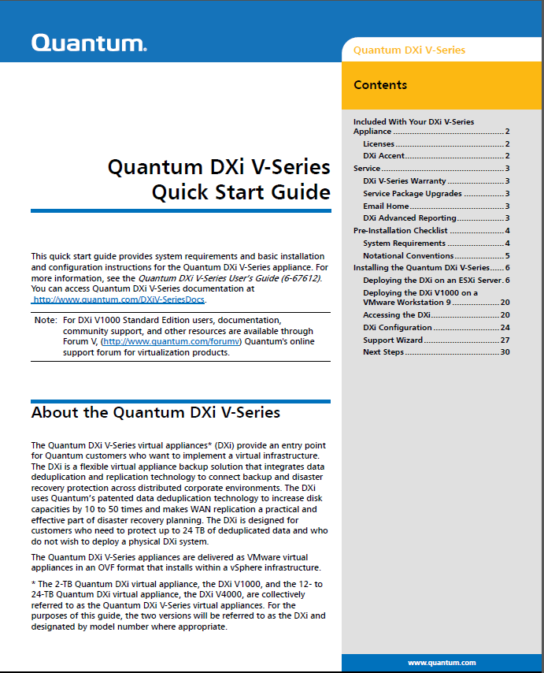
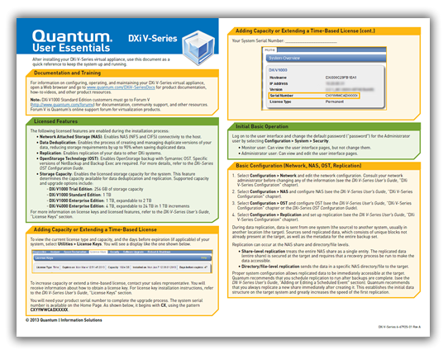
Documentation and Training Updates
Tom Sajbel and Mike Pavalus

Slide 57
Documentation Updates
DXi V-Series: DXi V1000 and DXi V4000
Virtual Appliances
DXi V-Series Quick Start Guide
DXi V-Series User’s Guide
DXi V-Series Online Help
DXi V4000 Release Notes
  Separate DXi V1000 vs. DXi V4000
DXi-Series Documents
  Command Line Interface (CLI) Guide
  OST Configuration Guide
  SNMP Reference Guide

Slide 58
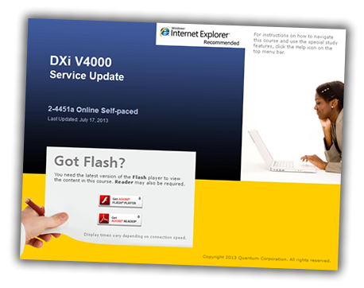
Training Updates –Service & Partners
StorageCare Learning:
  NEW: DXi V4000 Service Update (2-4451a Online Self-Paced)
  UPDATED: DXi V-Series Installation (2-3441 Online Self-Paced)
  UPDATED: DXi-Series 2.x Configuration Hands-On GUI Practice (3-2431 Virtual Classroom)
CSWeb and Qwikipedia docs:
  NEW: DXi V4000 At a Glance document
  UPDATED: DXi V-Series Status and Log Collection document
  UPDATED: DXi V-Series Log Locations & Descriptions document

Slide 59
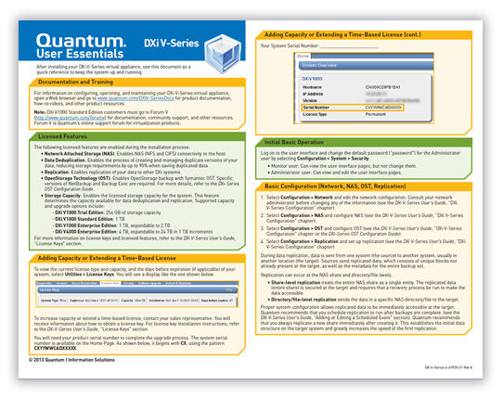
Training Updates – Customers
Quantum.com and CSWeb:
  UPDATED: DXi V-Series Installation and Initial Config video
  UPDATED: DXi V-Series Network Configuration video
  UPDATED: DXi 2.2.x User Interface Overview video
  UPDATED: DXi V-Series User Essentials document

Slide 60
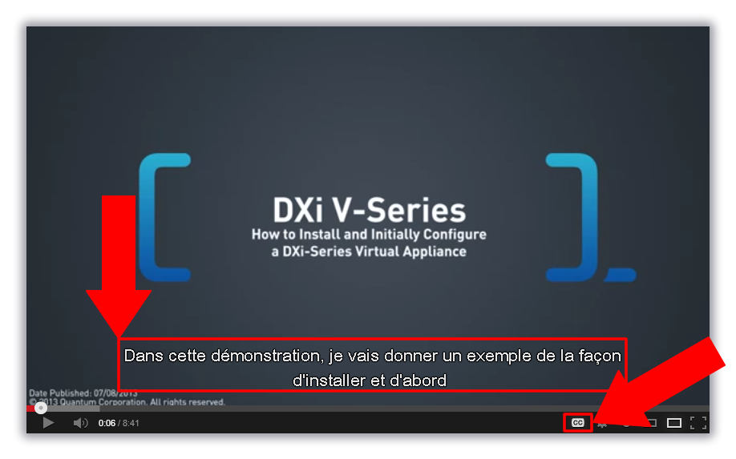
Video Closed Captioning
Closed captioning available in ~50 languages
Translations are NOT perfect
You can help make translations better (contact me)

Slide 61
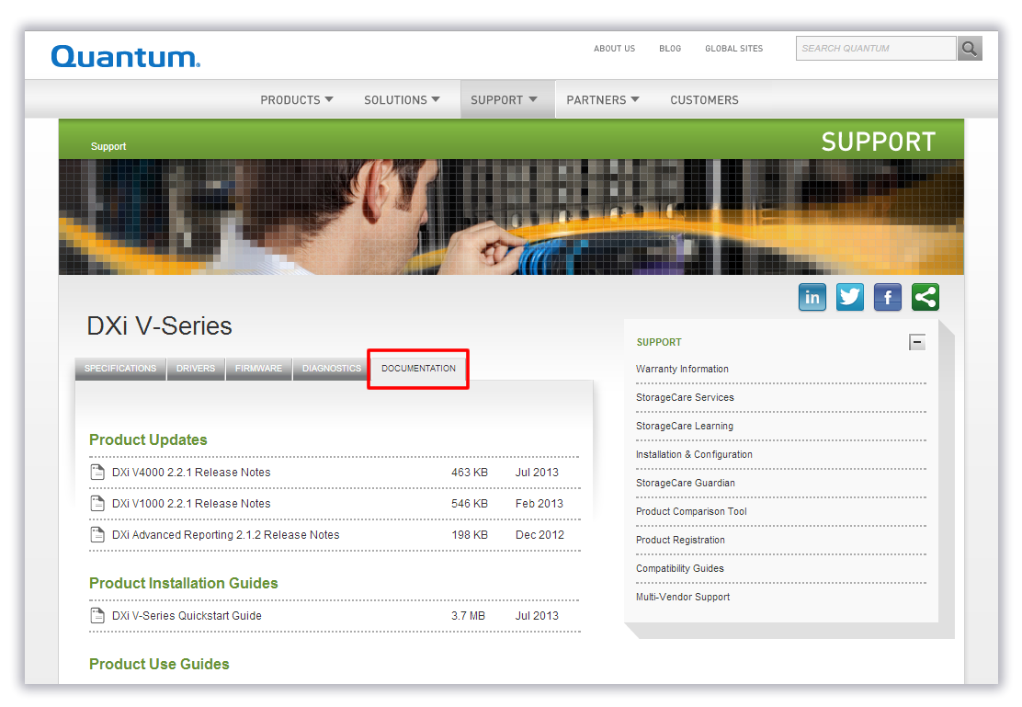
Access to Docs and Training Videos
Customers: Quantum.com Support page changed to DXi V-Series
  New vanity URL: www.quantum.com/DXiV-SeriesDocs
Service: CSWeb page updated to DXi V-Series

Slide 62
Service Model Updates
Jim Hibbard

Slide 63
Service Model
  Same support model as DXi V1000
  GCH takes first call
  ASPS provides technical support leveraging SES and DXi sustaining for escalation resources.
  No Field Support offered
  Warranty/Support Contracts
  Service Offerings
  Warranty/Contract renewals - Annual renewals are available for the various warranty offerings supported by this program (Silver and Gold).
  Installation and Integration Services – DXi V4000 is customer installable and Installation and Integration services are not available.
  Upgrade Services - Post sale capacity upgrades are available for DXi V4000 that are customer installable.
  DXi V-Series Service Plan is in Agile for approval (0-14506-01)
  DXi V1000 Service Plan updated to include DXi V4000 and rename to DXi V-Series Service Plan

