Slide 1

DXi V1000 & vmPRO Transfer of Information for Xerox Service
April 19, 2012
Notes:
© 2010 Quantum Corporation. Company Confidential. Forward-looking information is based upon multiple assumptions and uncertainties, does not necessarily represent the company’s outlook and is for planning purposes only.
1

Slide 2
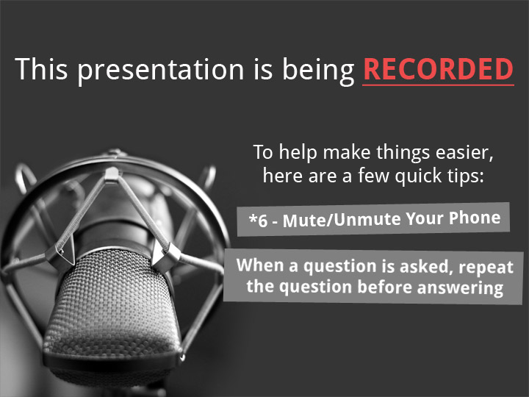
2
© 2011 Quantum Corporation. Company Confidential. Forward-looking information is based upon multiple assumptions and uncertainties, does not necessarily represent the company’s outlook and is for planning purposes only.

Slide 3
Agenda
Product Overview – John Cramer
Performance Issues/Guidelines – Mark Thacker
DXi V1000 Installations – Jim Kahn
Failure Isolation – Jim Kahn
ISV Updates – Mark Thacker
Known Issues – Jim Kahn
Service Strategy – Jim Hibbard
Training Strategy – Jim Hibbard
Note: Ask questions as we go. Q&A also at the end.
© 2012 Quantum Corporation. Company Confidential. Forward-looking information is based upon multiple assumptions and uncertainties, does not necessarily represent the company’s outlook and is for planning purposes only.

Slide 4
Product Overview
Xerox is providing BaaS and DRaaS leveraging advanced, patented data deduplication and virtual server protection technologies from Quantum
DXi V1000 – virtual deduplication appliance is used to provide backup and DR protection for distributed sites
vmPRO – lightweight virtual appliance that presents a file system view allowing backup of VMs or files within VMs
© 2012 Quantum Corporation. Company Confidential. Forward-looking information is based upon multiple assumptions and uncertainties, does not necessarily represent the company’s outlook and is for planning purposes only.

Slide 5
Protocols and Design
DXi V1000
Equivalent to a 2TB DXi using only 4GB of RAM
2TB Blockpool, up to 40TB Backup Capacity
  Assumes 20:1 data reduction ratio
  NOT based on any VMware limitations
Disk layout optimized for VMware file system compatibility and potential performance improvements
  Nine 256GB VMDKs – fully compatible with vSphere 4 and 5
  One system disk, one Metadata disk, seven data disks
  Customer can spread VMDKs to multiple, or high speed, storage pools
CIFS, NFS, OST, Accent ingest support
  Limited to 4 streams of ingest at a time
Replication
  Either in or out but not both at same time
  Single replication source
  Single replication target
© 2012 Quantum Corporation. Company Confidential. Forward-looking information is based upon multiple assumptions and uncertainties, does not necessarily represent the company’s outlook and is for planning purposes only.

Slide 6
ISV Compatibility
ISV | Paper Cert | Touch tests with the GA candidate | Support by
Quest NetVault | X |  | GA
EMC Networker | X |  | GA
NetBackup |  | X | April 30
Backup Exec |  | X | GA
Tivoli (RTF) |  | X** | GA
HP-DP |  | X** | Post GA
Commvault | X |  | GA
CA | X | X | GA
Atempo |  | X | GA
Note: ** SVT runs ISV touch test and submit results

Slide 7
Licensing - DXi V1000
Capacity-based – all features included
  2TB blockpool capacity license
  Deduplication, Replication, NAS, OST licenses
Three license types
  Full license
  30 Day Trial License
  Upgrade License to convert 30-day trail to a Full License
Time-based licensing coming in future
  Initial release includes a expiration of April 30, 2013
  Next release will be a mandatory upgrade for all customers
  Will include a 30 day grace period past expiration date
Trial licenses initially enforced by sales and service, given no time-based licensing
© 2012 Quantum Corporation. Company Confidential. Forward-looking information is based upon multiple assumptions and uncertainties, does not necessarily represent the company’s outlook and is for planning purposes only.

Slide 8
Licensing - DXi V1000 (cont.)
Full and Trial licenses supplied in license bundle file
  Require serial number and matching license bundle
  Example
    Serial number: AH1207CAD00495
    License bundle: DXIV0327120495.conf
  License bundle file must be renamed licensebundle.conf, all lower case, for installation in the SW
Trial to 2TB license supplied as license key
  Example: XAQF4LE67QGN93G7A4LNCTPNLNWD2E3Z357ML4E2
  40 characters
  Serial Number encoded in license key
© 2012 Quantum Corporation. Company Confidential. Forward-looking information is based upon multiple assumptions and uncertainties, does not necessarily represent the company’s outlook and is for planning purposes only.

Slide 9
Licensing - vmPRO
Target-based with expiration date
  Licensed for 1 target (DXi)
  Expiration date set as date generated + duration
  Initial Xerox licenses have 180 day duration
Three license types
  Full license
  30 Day Trial License
  Upgrade License to convert 30-day trail to a Full License
All licenses supplied as license key
  172 characters
  Serial Number encoded in license key
  Start aging the day created
Trial licenses initially enforced by sales and service, given actual duration of 180 days
© 2012 Quantum Corporation. Company Confidential. Forward-looking information is based upon multiple assumptions and uncertainties, does not necessarily represent the company’s outlook and is for planning purposes only.

Slide 10
Preliminary Performance
Two reference platforms for sizing
  Actual performance will vary at customer sites
  Small system == Dell R510 (i.e. DXi4510 hardware) 1GbE
  Large system == Dell R910 (i.e. DXi8500 Nehalem hardware) 10GbE
Position protecting 2TB of data within backup window
  Small reference platform w/1GbE ~5.5 hours
  Large reference platform w/10GbE ~2 hours
Some possible performance optimizations
  Increase CPU speed of host system
  Move metadata virtual disk to separate VMware storage pool
  Move each data virtual disk to separate VMware storage pools
© 2012 Quantum Corporation. Company Confidential. Forward-looking information is based upon multiple assumptions and uncertainties, does not necessarily represent the company’s outlook and is for planning purposes only.

Slide 11

Small Reference ESXi 5.0 Test System
Small System
Dell R510
2xE5620 CPUs
24 GB RAM
1 datastore
  LSI MegaRaid 9260
  8x1 TB 7200 rpm disks
  RAID6 configuration
Most sensitive performance configuration

Slide 12

Large Reference ESXi 5.0 Test System
Dell R910
2xE7540 CPUs
64 GB RAM
5 datastores
  10xLSI Matterhorn Storage Servers
  20 Luns
  16x1 TB 7200 rpm disks per lun
  RAID6 configuration

Slide 13
Sizing Considerations – Capacity Only
V1000 available in 3 sizes. 1900 GB is estimated max BP use before LCM
Faded numbers equal BP GBs
© 2012 Quantum Corporation. Company Confidential. Forward-looking information is based upon multiple assumptions and uncertainties, does not necessarily represent the company’s outlook and is for planning purposes only.
Notes:
My thought process
At full licensing, DXi GUI and DARt both show V1000 to have 1.92 TB (1000 bytes/KB)
So our marketing literature seems to take license by rounding up and claiming this is an “up to” 2 TB usable capacity
We’re talking about licensing in 256GB increments … so what does that mean for capacity if I can’t get to 8x 256 GB now ??
Are we licensing in 256GB increments or in 250 ?? (Since all numbers inside the DXi are base 10)
So I decided to increment the color coding of this pseudo “QuikFit” chart in 250 GB steps
“BU-BU RoC” means: what percentage of the (full) backup will be new and unique, before compression
Doesn’t matter if we’re talking about Full-only policy or Full + Incremental, or even CBT backups. The results will be the same because I’m measuring the amount of new data, no matter how delivered, as a portion of the Full BU. The type of policy will only affect the total reduction ratio, not the capacity consumption.
1 year Investment Protection with 10% growth expected in that year.
DTP – Data to Protect - how much data can I backup and retain for the specified period of time, assuming 1 BU per day.
This is more of a “Number of BU events” retention than a time-based retention, so may require some explanation to some audiences
Important/Critical Assumption: The dedupe pool cannot grow beyond 1900 GB (Given that max appears to be 1.92 TB)
The colored blocks change to numbers when the dedupe pool exceeds 1900 GB. This is intended to convey that this is not a supportable DTP point.
“BP is LEQ” – Blockpool is less than or equal to …

Slide 14
Reporting Tools
DXi Advanced Reporting
  Supported
Vision
  Releasing version 4.2 in May 2012
  Supports DXi V1000 and vmPRO
  Will require new DXi AR 2.0.3 – available at time of Vision release
    Field update required
© 2012 Quantum Corporation. Company Confidential. Forward-looking information is based upon multiple assumptions and uncertainties, does not necessarily represent the company’s outlook and is for planning purposes only.

Slide 15
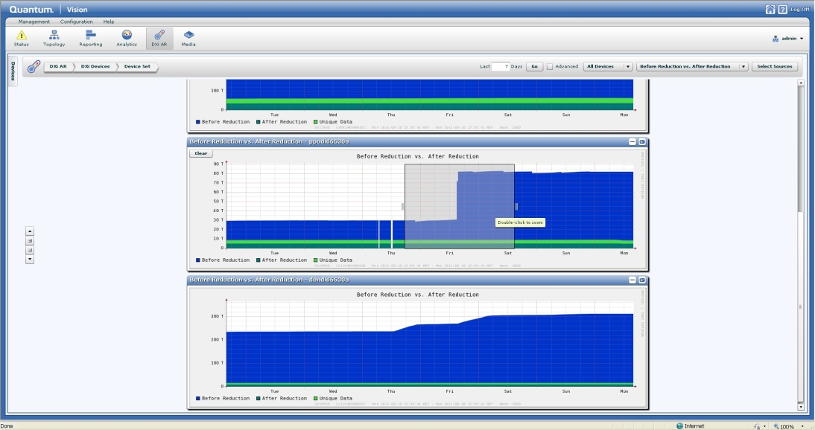
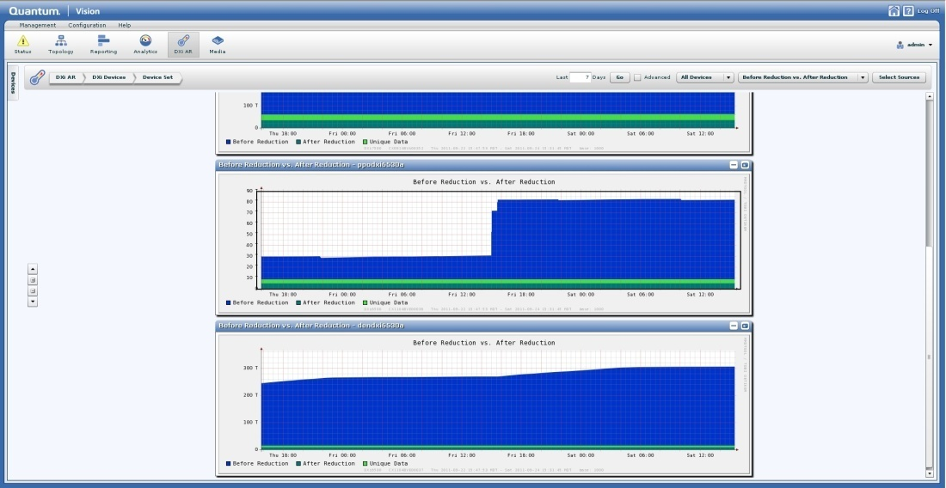
DXi Advanced Reporting Support
User AR reports are a subset of Service AR reports
DXi AR 2.0.3 required to support Capacity Upgrade Estimate in Vision

Slide 16
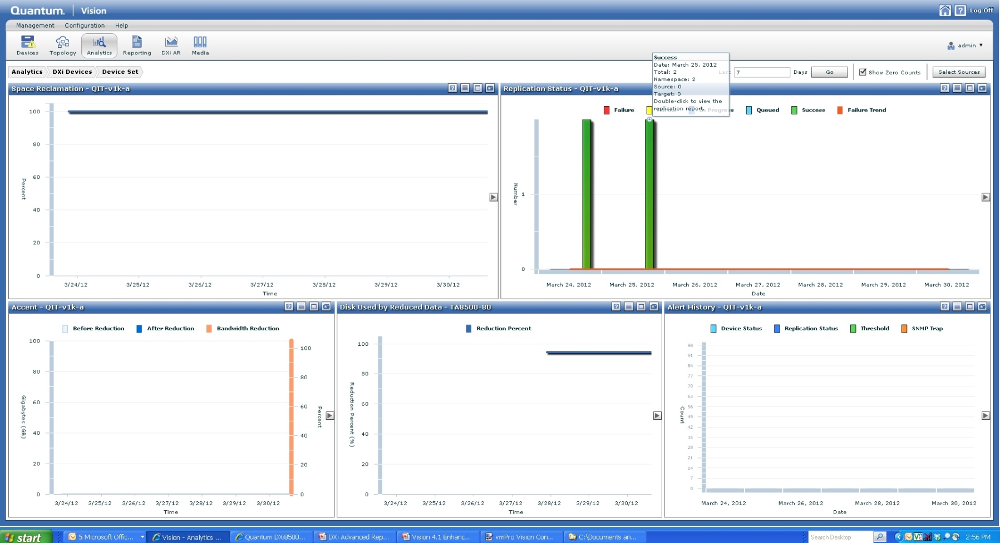
Vision 4.2 Analytics Support
Quick view of the most important information:
Used disk
Replication status
Reclamation percent complete
Alert history
Accent Inline Data

Slide 17
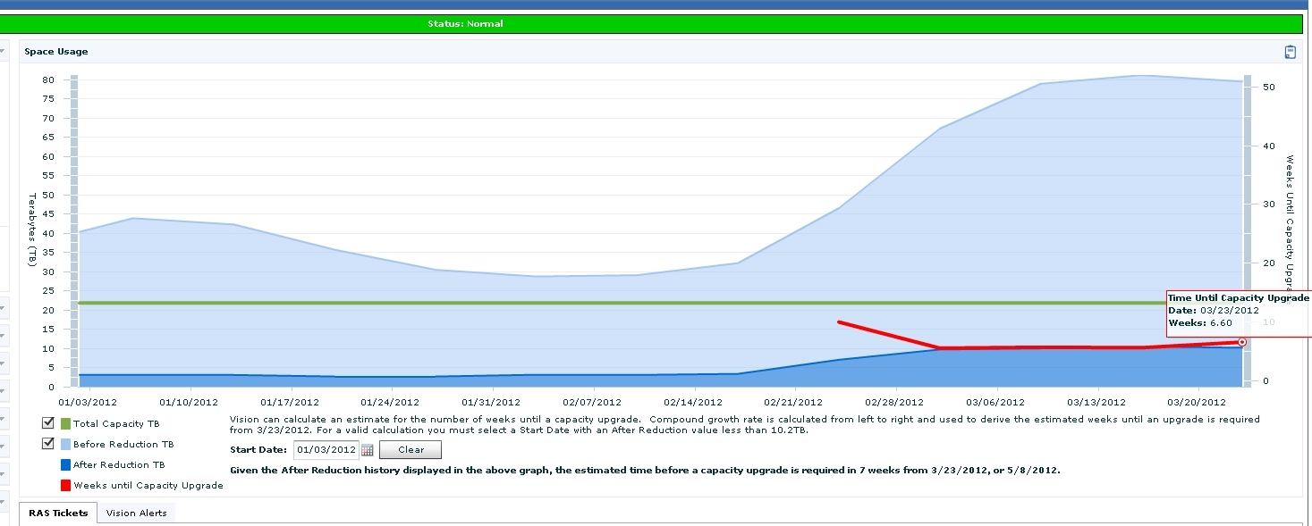
Vision 4.2 Capacity Upgrade Estimates
Predict when a capacity upgrade will be required

Slide 18
DXi V1000 Installations
Jim Kahn

Slide 19
Agenda
vSphere Recommendations
Restrictions & Limitations
Preparation (VMware Preparation)
DXi V1000 Installation & Configuration
DXi V1000 & vmPro Integration
Health Check & Data Collection
Service Menu Changes
Additional Resources

Slide 20
vSphere Recommendations
Supported vSphere versions
  Paid licensed versions are only supported!
  ESX 4.0 Update 4 – several issues
  ESX 4.1 – no issues
  ESXi 4.1-5.0 – no issues
vSphere server minimum configuration
  Single 1 GbE or 10 GbE NIC
  1 Intel i7 or E5500 CPU
  16 GB of RAM
vSphere server typical configuration
  Four 1 GbE or two 10 GbE NICs
  2 Intel i7 or E5500 CPUs
  48 GB of RAM

Slide 21
vSphere Recommendations (cont.)
vSphere datastore requirements
  1 TB of free storage
  External storage system with power-fail protection
    SAN
    NFS
    iSCSI
  Internal DAS storage is not recommended
    Other vSphere servers cannot access data
    Power protection
vSphere networking
  Only static port trunking for network bonding, no LACP
  Use “Route determined by IP hash” for best NIC teaming
  9K Jumbo Frames yield best throughput (90% efficiency)
  netPktHeapMaxSize limits
    64MB in ESXi4.1 (1 GbE)
    224MB in ESXi5.0 (10 GbE)

Slide 22
Requirements – DXi V1000
Web Browsers: Firefox, Internet Explorer (7.x and above) and Google Chrome
DXi V1000 Virtual Machine requirements
  2 CPU cores
  4 GB of RAM
  2 VMXNET3 NICs
  9x256 GB virtual SCSI disks (for vSphere4 compatibility)
Licensed storage capacity sizes
  256 GB (evaluation)
  1 TB
  2 TB
Disk organization
  Disk 1 – system disk (RAID5)
  Disk 2 – SNFS metadata disk (RAID1)
  Disks 3-9 – SNFS data disks (RAID5)

Slide 23
Restrictions & Limitations
Network DHCP support limited on DXi V1000
  All network ports initially using DHCP
  If no DHCP network support, static IP for eth0 requested
  No GUI/syscli configurability for DHCP
  Use static IPs for segmentation
Segmentation issues
  Replication port 1062 is open on data and replication segments
  http traffic is handled on all segments
Replication issues
  Throttling does not exceed max bandwidth
  Actual throttle data rate variable!
  Eliminated Replication Ping
Network bonding not supported on DXi V1000
  vNIC bonding mode 0 slower than single vNIC!
  Illegal loopback errors due to bonded Ethernet ports on same vSwitch
  Use VMware bonding

Slide 24
Restrictions & Limitations (cont.)
DXi V1000 modification is not supported
  RAM changes do no good and will disrupt normal startup
  Cannot add more disks; already at blockpool 2 TB limit
  RAM/CPU reservations essential for ESXi VM scheduler operation
  Adding more CPUs does not affect operation
Network issues
  Do not use NTP in DXi V1000 – time oscillation
  Hostname cannot be changed while DHCP is used
  Default hostname is “DXi” + eth0 MAC
  Ethernet stats problematic due to:
    Physical NIC driver sensitivity
    Unreliable on ESX4.0
Stream performance
  Function of vSphere server and its datastore
  Only guarantee 4 streams with 4 GB of RAM

Slide 25
Restrictions & Limitations (cont.)
DXi V1000 capacity licensing
  Created with full storage capacity
  Uses space manger daemon to manage licensed capacity
    GUI always reports max usable capacity = 1.92TB
  Capacity license checked every 5 minutes

Slide 26
Preparation (VMware Preparation)
Unfamiliar Terms
  OVF (Open Virtualization Format...open standard for packaging & distributing virtual appliances)
  VI Client (Virtual Infrastructure client...Management GUI for vSphere)
  vCenter (VMware Virtual Center)
  Persistent Independent Disk (Disks that cannot be snapshotted)
  Datastore (LUN created for a VM or DXi V1000 use)
  Thin Provisioned (Unallocated VMware disk space)
  Thick Provisioned (Allocated VMware disk space)
  Thick Provision Lazy Zeroed (allocate only what is needed now…allocate later)
  Thick Provision Eager Zeroed (Used for fault tolerance…allocated at creation)
Preparation
  Make sure a large enough Datastore has been created (At least 1TB Datastore)
  Download OVF (Obtain OVF and store where VI client will run or on a reachable network drive)
  Confirm Connection to ESX server or vCenter using VI client.

Slide 27
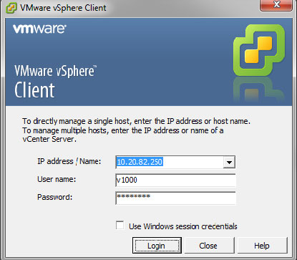
DXi V1000 Installation
Confirm by logging on to vSphere server using server name or IP address
Installation video URL: https://csweb.quantum.com/training/dxiv1000/v1000_install.html

Slide 28
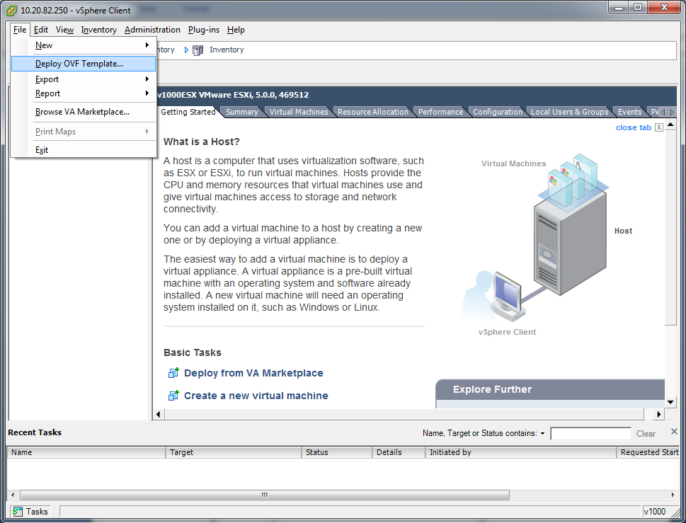
DXi V1000 Installation (cont.)
Then select "File" ==> "Deploy OVF Template" from VI Client GUI Menu.

Slide 29
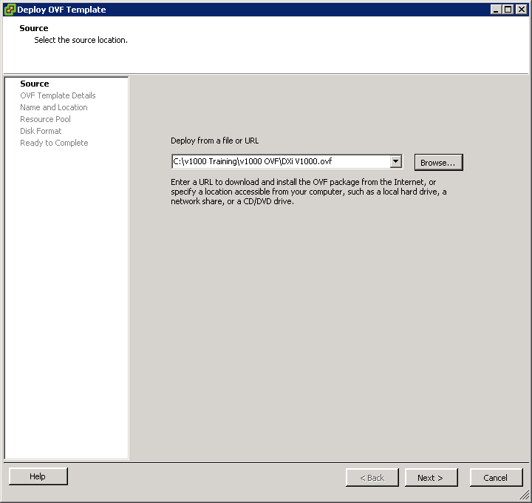
DXi V1000 Installation (cont.)
If DXi V1000 OVF is stored locally, browse to select OVF. If stored on a network drive, specify the location in the "Deploy from a file or URL" box.

Slide 30
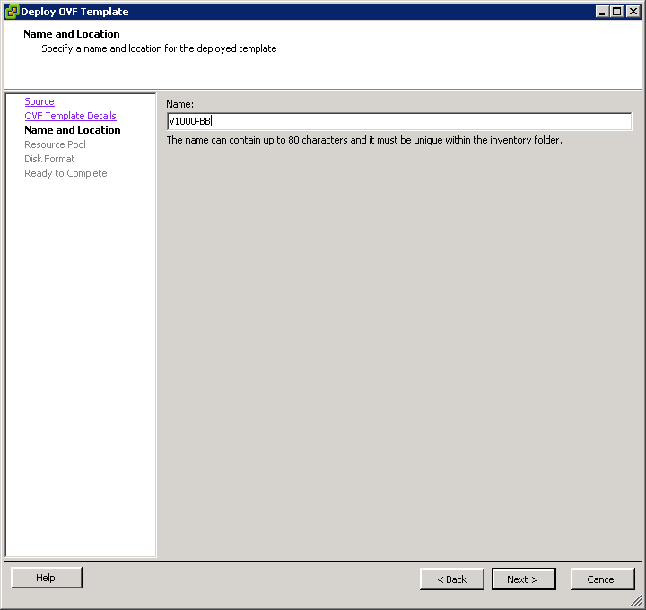
DXi V1000 Installation (cont.)
Specify a name for DXi V1000 VM. This name is for VMware inventory only.

Slide 31
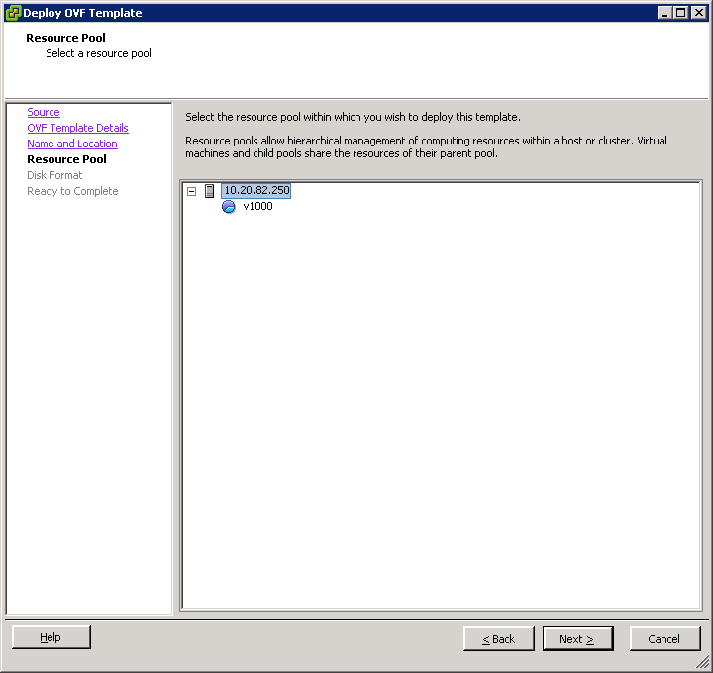
DXi V1000 Installation (cont.)
Select where to store DXi V1000 in your vSphere configuration (select a resources pools if it exists).

Slide 32
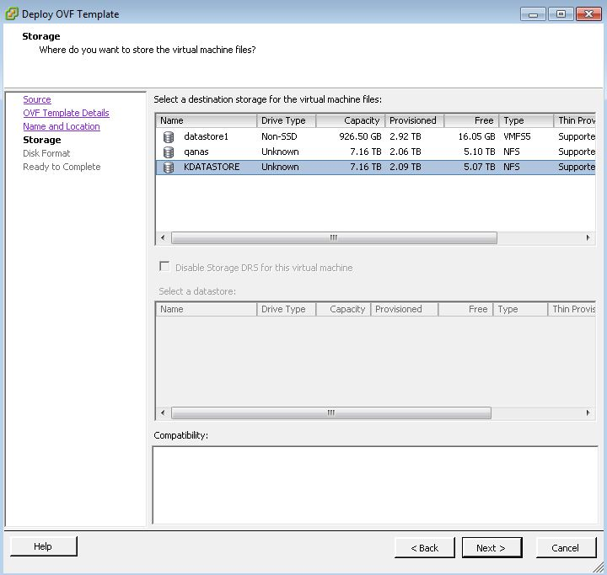
DXi V1000 Installation (cont.)
Select a Datastore (with at least 1 TB free)

Slide 33
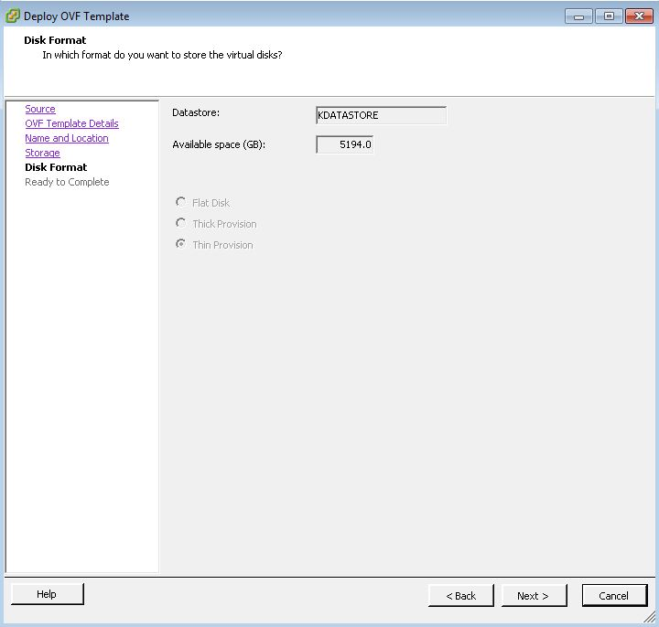
DXi V1000 Installation (cont.)
On the Disk Format window, select “Thin Provision”. Only “Thin Provision” will be available if Datastore is NFS mounted. Other Datastore types would allow you to select other Disk Formats, i.e. iSCSI

Slide 34
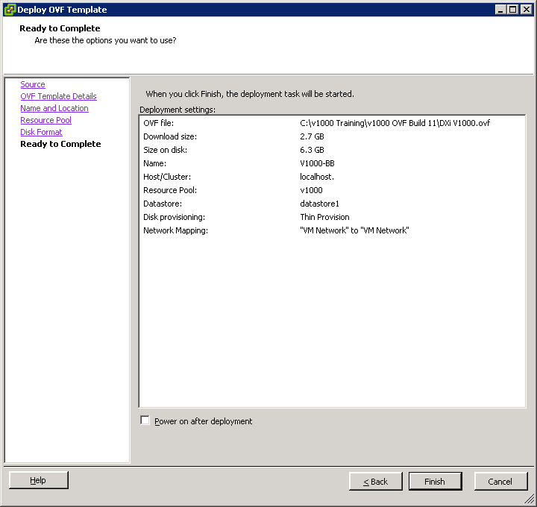
DXi V1000 Installation (cont.)
In the Ready to Complete window, review your settings and click Finish

Slide 35
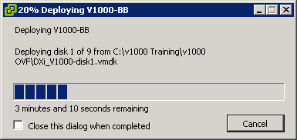
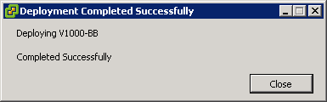
DXi V1000 Installation (cont.)
As shown below, a progress window displays while the DXi V1000 OVF template deploys. The process will take several minutes to complete. When the Completed Successfully message displays, the process is complete. Click Close.

Slide 36
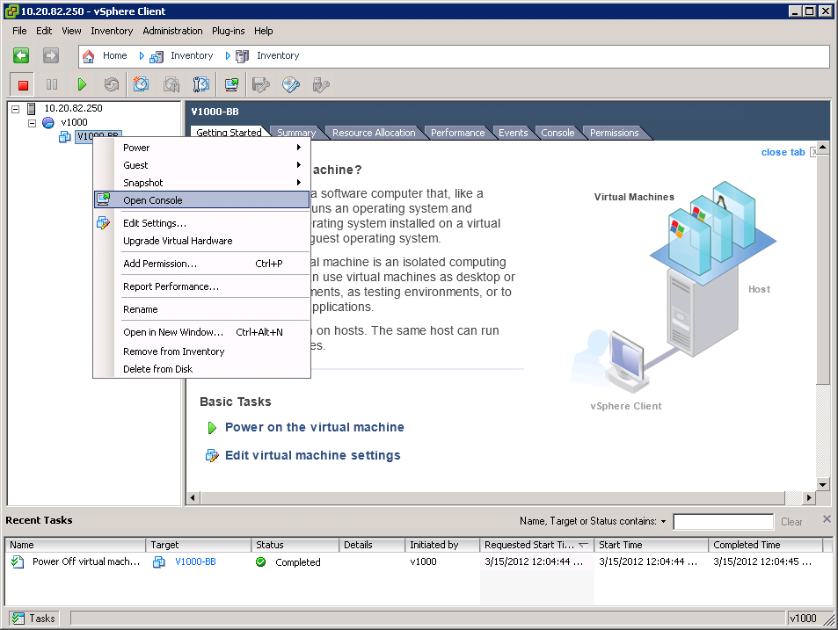
DXi V1000 Installation (cont.)
Power On the DXi V1000
In the vSphere client window, right-click on your newly deployed DXi V1000 virtual machine and click Open Console, as shown below.

Slide 37
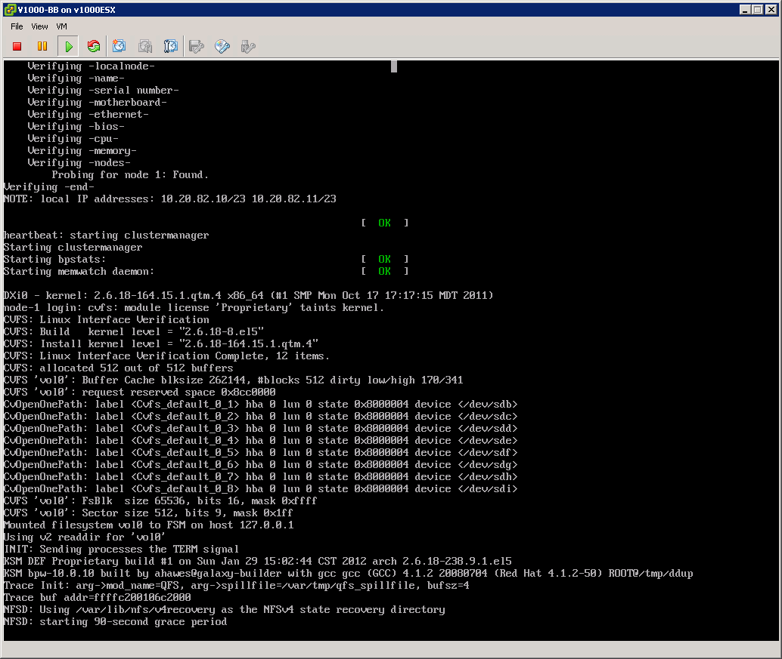
DXi V1000 Installation (cont.)
When the NFSD: starting the 90-second grace period message appears, the system startup is almost complete. It will take a few more minutes to complete the startup process.
Note: If necessary, press Ctrl + Alt to release your mouse from the virtual console window.

Slide 38
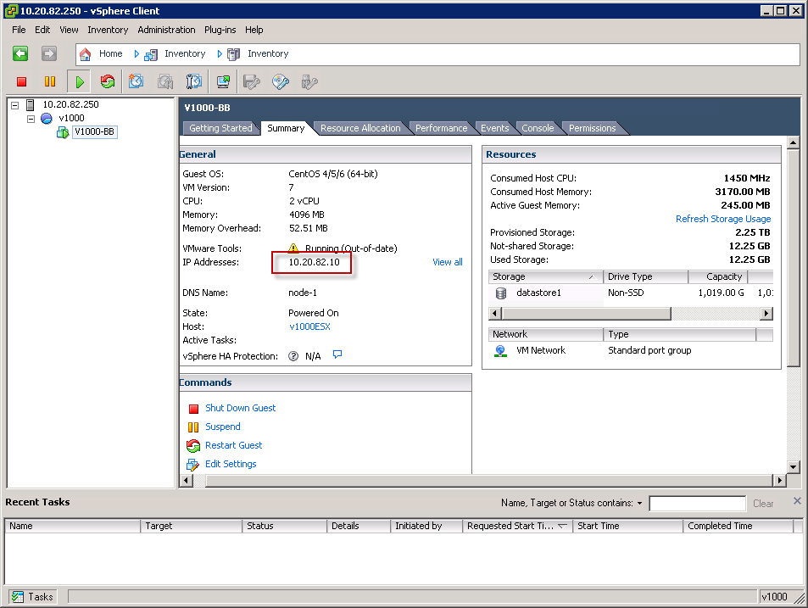
DXi V1000 Installation (cont.)
Identify the DXi V1000 IP address by selecting the summary tab on VM (DXi V1000 VM).

Slide 39
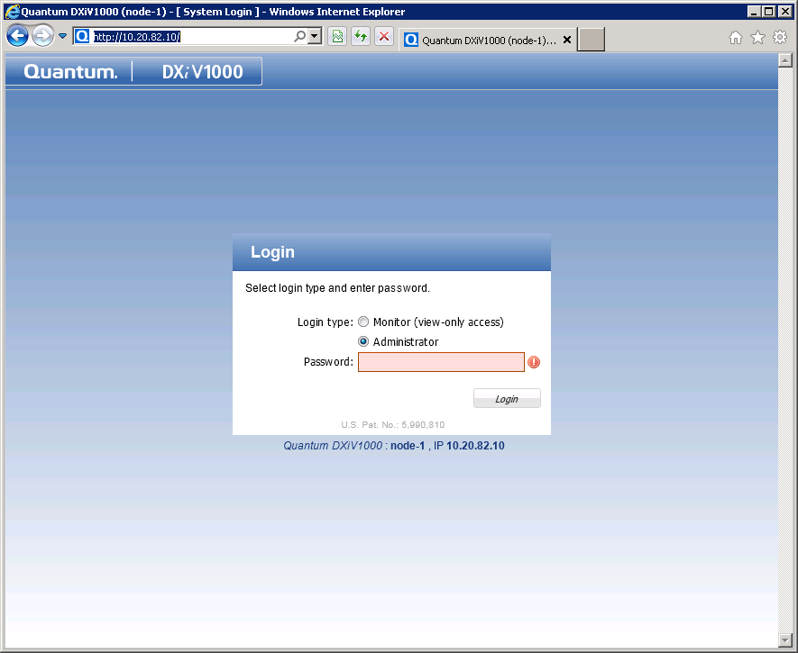
DXi V1000 Configuration
Launch a browser and supply the IP address
Login (password: "password")

Slide 40
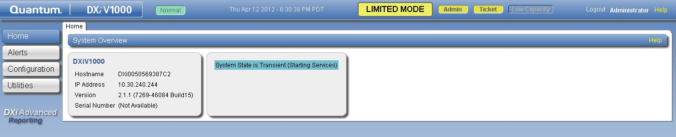
DXi V1000 Configuration (cont.)
Note: If you see the Limited Mode message when after logging back into the system, the system has not finished booting. Wait a few minutes for the system to finish booting, and log back in

Slide 41
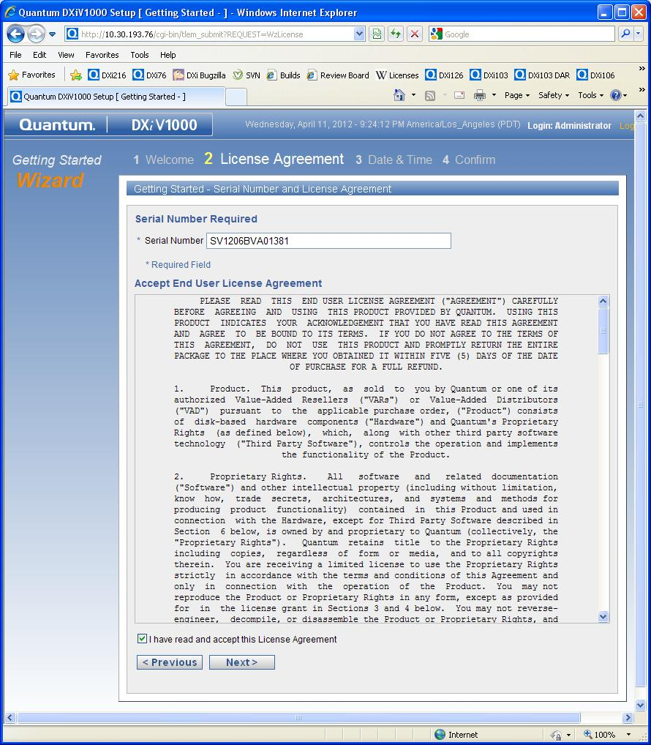
DXi V1000 Configuration (cont.)
Enter Serial Number and accept EULA.

Slide 42
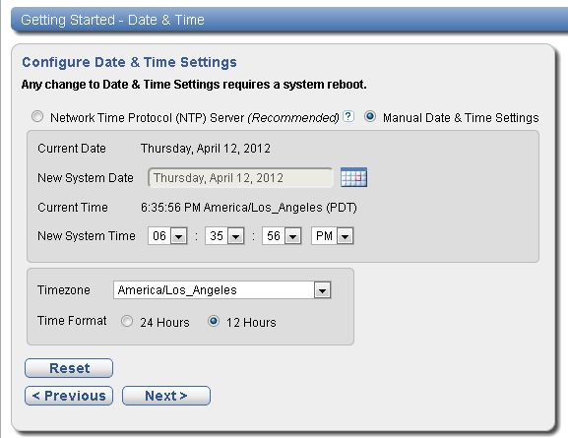
DXi V1000 Configuration (cont.)
Manually set date, time and time zone. NTP server is actually not recommended even though it is improperly noted as “Recommended” on the configuration wizard.

Slide 43
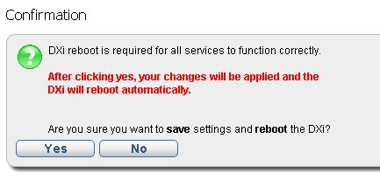
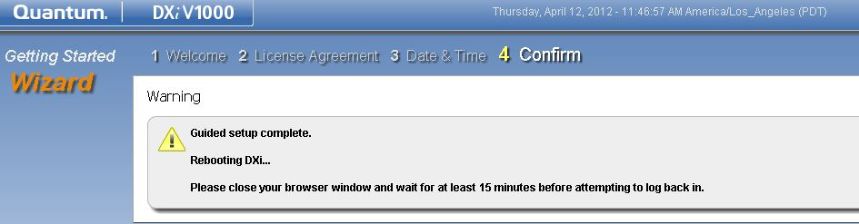
DXi V1000 Configuration (cont.)
Initial Configuration is saved and DXi V1000 is rebooted

Slide 44
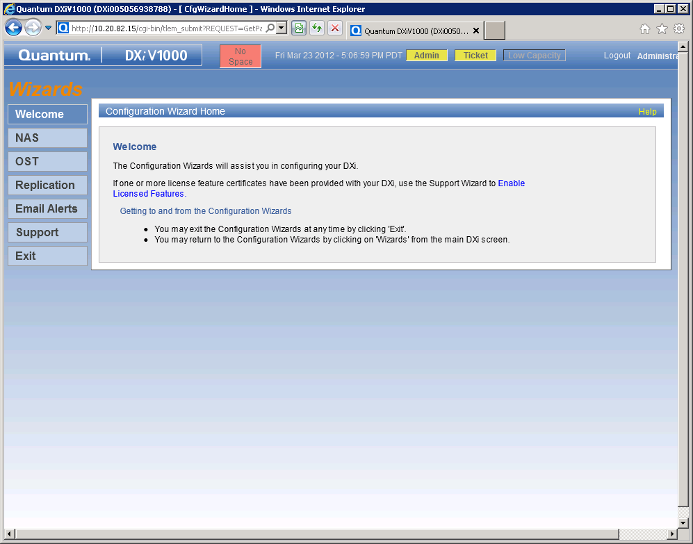
DXi V1000 Configuration (cont.)
Note the red No Space message at the topic of the screen. This message displays because you have not yet applied the Storage Capacity license to the system. The Storage Capacity license will get added to the system when you upload the license bundle file. You will do this when you complete the Support Wizard in the next procedure.

Slide 45
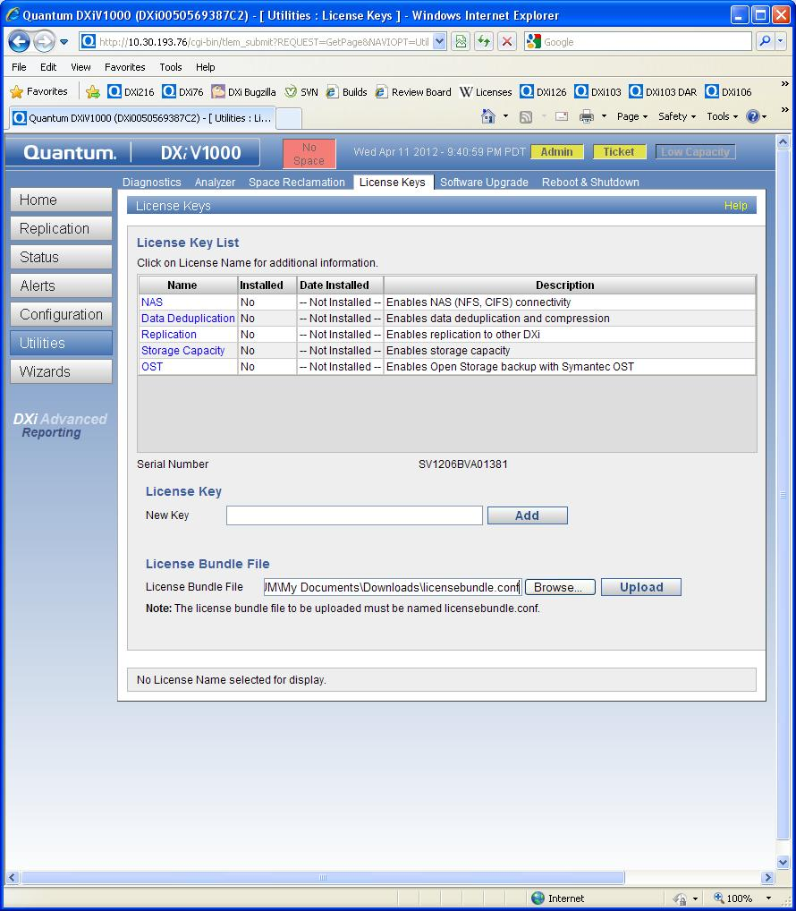
DXi V1000 Configuration (cont.)
.
On the Licensed Features page, locate your License Bundle File and upload it in the “License Bundle File” section.

Slide 46
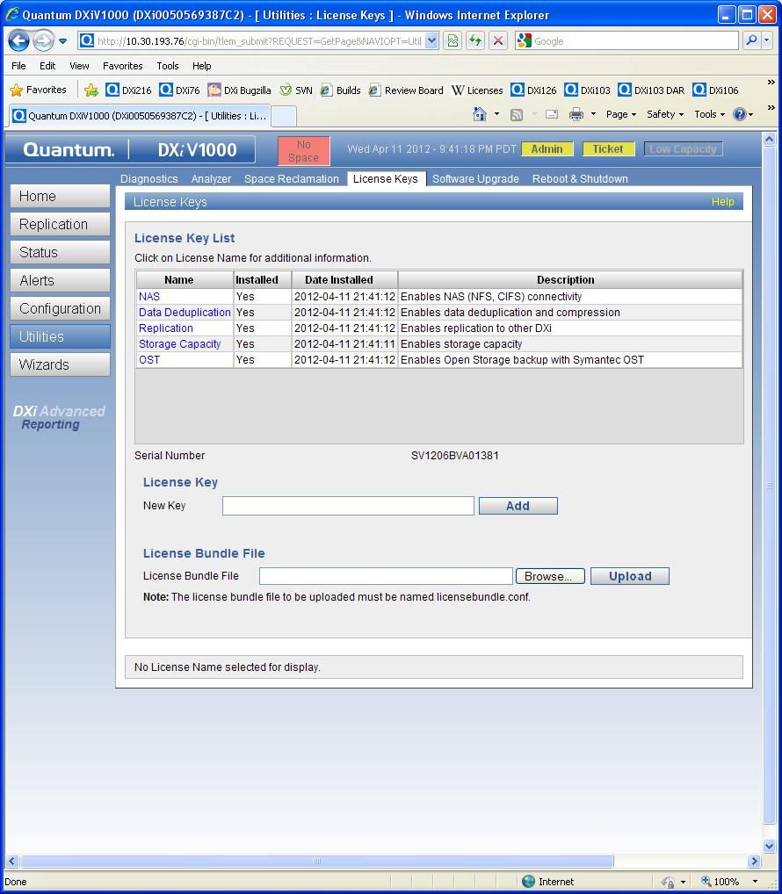
DXi V1000 Configuration (cont.)

Slide 47
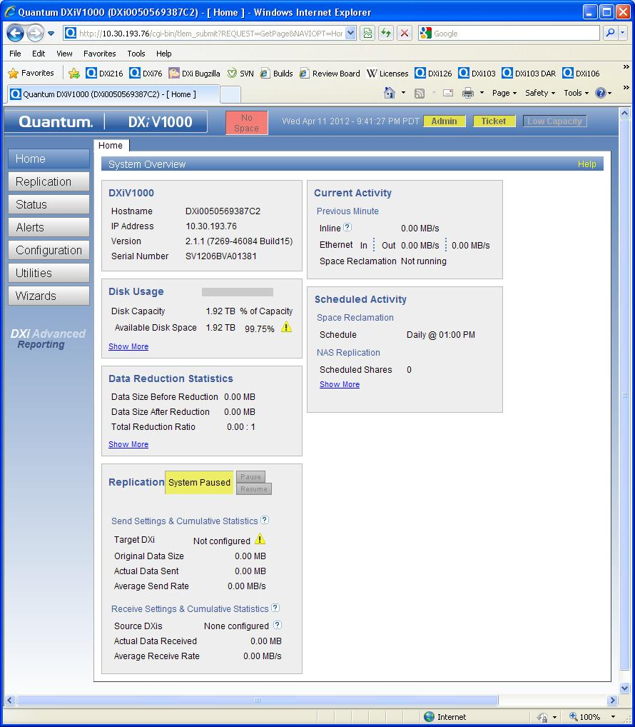
DXi V1000 Configuration (cont.)
Allow 5 minutes for license bundle to be applied.

Slide 48
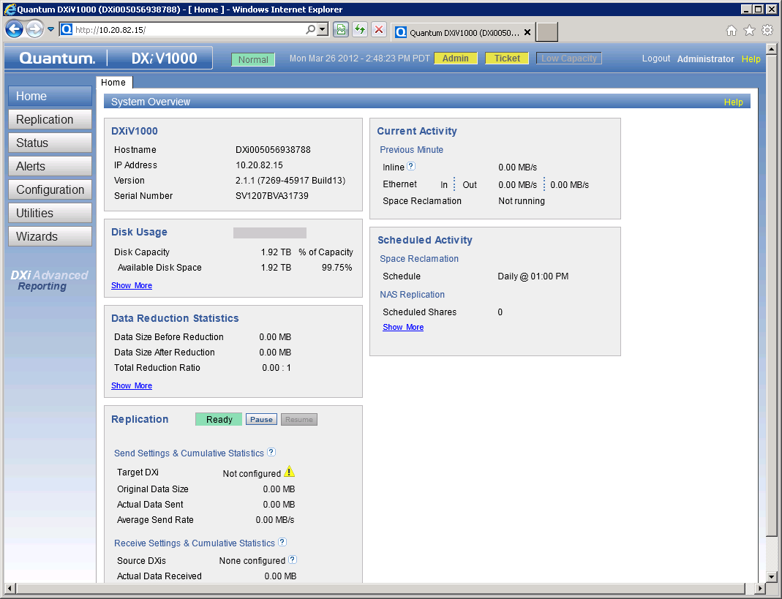
DXi V1000 Configuration (cont.)
From the Home screen in the DXi V1000 GUI, click Status, as shown below
Note that the Hardware tab does not display on the DXi V1000 GUI. Because the DXI V1000 uses virtual hardware, there is no need to report hardware failures. In addition, there is no VTL tab, because the DXi V1000 does not support the VTL presentation type.

Slide 49
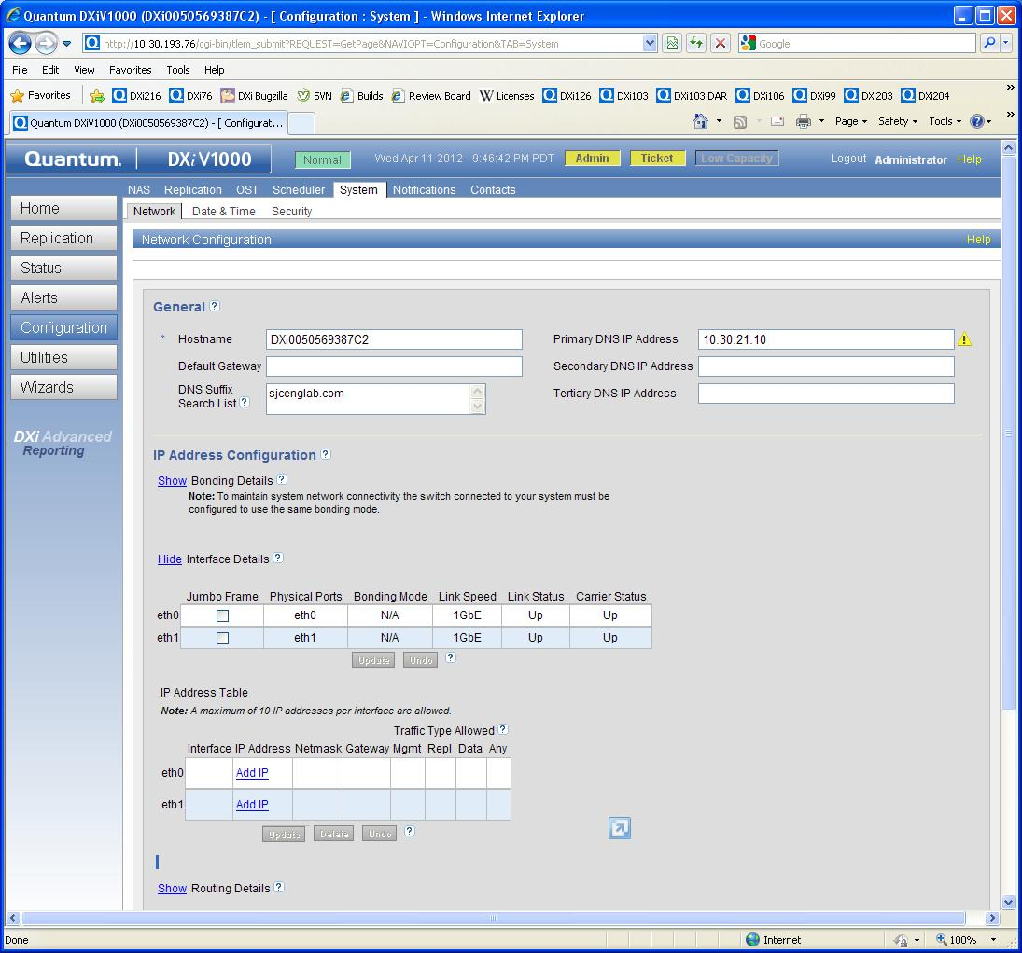
DXi V1000 Configuration (cont.)
System Network configuration page showing default DHCP behavior. Configure static IP addresses at this time.

Slide 50
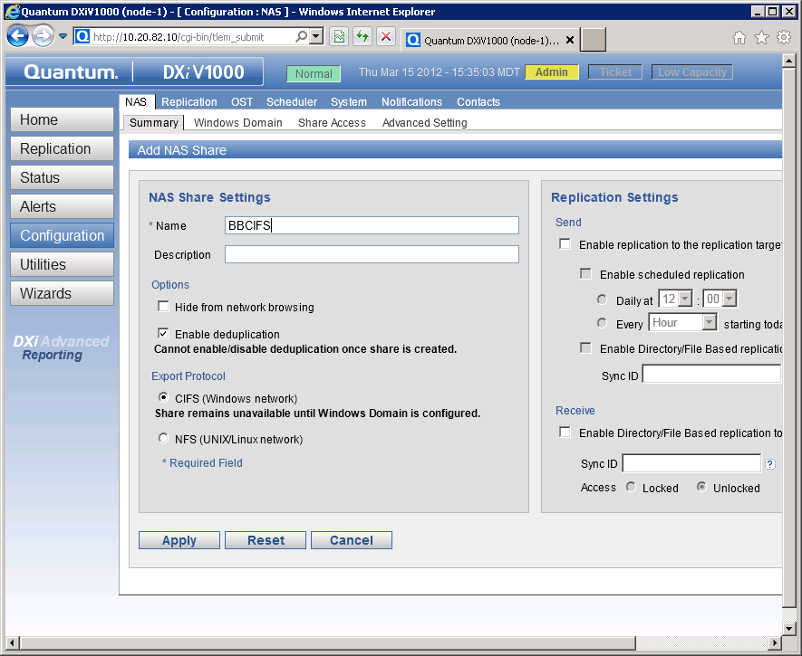
DXi V1000 Configuration (cont.)
In the DXi V1000 GUI, browse to the Configuration > NAS > Summary tab and click Add.
Enter a share name in the Name field, and click Apply.
Select CIFS as the export protocol, if you are in a Windows environment or NFS if you are on LINUX/UNIX Env.
Click Apply.

Slide 51
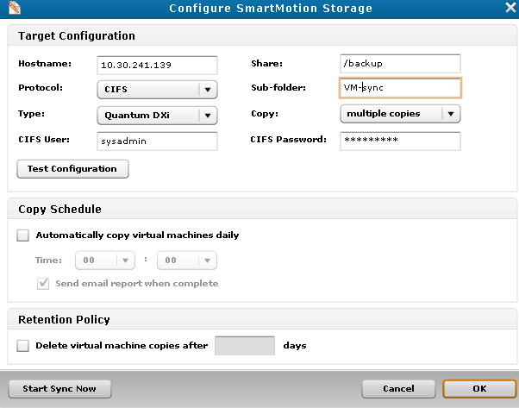
DXi V1000 & vmPRO Integration
How DXi V1000 Connects To vmPRO
DXi V1000 connects seamlessly with vmPRO
DXi V1000 is the primary target network storage for vmPRO
If DXi is configured with vmPRO, it would feature prominently on the vmPRO GUI.

Slide 52
Health Check & Data Collection
Standard data collection using the following log files:
  /var/log/DXi/tsunami.log
  /var/log/DXi/tsunami_trace.log
  /var/log/srvcLog.hist
  /var/log/DXi/service.log
  /var/log/messages
  /factory.config
  /changes.diff
Hardware logs:
  /opt/DXi/hwdetect/current.config
  /opt/DXi/hwdetect/factory.config
  /opt/Dxi/hwdetect/changes.diff
Refer to training materials for log collection mechanisms

Slide 53
Service Menu Changes
Service menu is not part of normal DXi V1000 configuration.
  No hardware to configure!
  DHCP networking eliminates static IP for eth0
  Not all cloud providers provide a console
  Still, it’s there in case of emergencies
Main GUI is primary configuration vehicle
  Used to convert from DHCP to static IP

Slide 54
Additional Resources
See additional self-paced online training in the “Training Strategy” section of this TOI.
Quick Start Guide
User Guides
Release Notes
Service Plan
Note: All postings on CSWeb

Slide 55
Failure Isolation
Jim Kahn

Slide 56
Failure Isolation
SNFS socket connection failure
  Failed to create SNFS correctly, aborting firstboot!
  Check network configuration
  Reinstall DXi V1000
DXi V1000 daemon fails to start
  ERROR - procmon ProcMonMain.cpp(341) [procmon] MonitorProcesses() - Getting status for service 'httpd' failed with status 3
  Check CPU/RAM reserved resources; may need more resources
  Check vSphere server VM workload

Slide 57
Failure Isolation (cont.)
vSphere server datastore exhaustion
  Low-space alarm in vCenter Console
  DXi V1000 suspended (ESX4/ESXi4.1)
  DXi V1000 ENOSPC error (ESXi5 option)
  Check vCenter Configuration->Storage panel free disk space
Unnamed DXi V1000 snapshots
  Low-space alarm in vCenter Console
  Unnamed snapshots cannot be deleted!
  Check vCenter Configuration->Storage panel free disk space
RAM exhaustion
  Normal condition when full storage capacity reached
  200 MiB of swap space can be consumed

Slide 58
Failure Isolation
License bundle fails to install
  Check that DXi V1000 serial number matches licensebundle serial number.
  Check for corrupt licensebundle.conf xml file

Slide 59
Known Issues
Jim Kahn

Slide 60
Known Issues

Slide 61
Known Issues (cont.)

Slide 62
Service Strategy
Jim Hibbard

Slide 63
Service Strategy
Introduction to Quantum’s Service Organization
  Global Call Handling (GCH) – first level technical support team that takes end user calls, opens SR, and routes to appropriate support team.
  Advanced Solutions Product Support (ASPS) – second level technical support team focused on DXi support. Does first level of triage for customer reported issues.
  Service Engineering Specialists (SES) – escalation team for ASPS.
  DXi Sustaining Engineering (DXi SUS) – escalation team for ASPS and SES.
Xerox OEM Service Model
  Support Level – Gold , 7x24 phone support
  Xerox is responsible for level 1 and level 2 technical support to their end users
  Quantum will provide level 3 support to Xerox
  Quantum will refer Xerox end users and RAS tickets to Xerox Tech Support
    (214) 530-2232/DL-Cloud-Support-BaaS@acs-inc.com
  Calls will come in through Quantum’s Global Call Handling (GCH) team . Service Requests get assigned to Quantum’s Advanced Solutions Product Support (ASPS) team.
  ASPS does quick look for obvious solution and verifies that detailed data was received.
  ASPS escalates SR to SES and SES to SUS as needed.
How Xerox engages Quantum Technical Support
  Xerox should use Quantum’s Online Service Request (OSR) portal.
  Online Service Requests can be opened at the following URLs.
  https://onlineservice.quantum.com/OA_HTML/xxibu/jtflogin.jsp or www.quantum.com/osr
  Alternatively, but not recommended for Xerox, Service Requests can be opened with Quantum Global Service by telephone : 800-284-5101

Slide 64
Service Strategy (cont.)
How Xerox engages Quantum Technical Support (cont.)
  DXi V1000 serial number required to open an SR
  In the event that Quantum Tech Support indicates and invalid serial number
    Interim DXi V1000 and vmPro Serial Numbers
      DXi V1000 Serial Number: XEROXV1000
      vmPro Serial Number: XEROXVMPRO
Information Required for Opening a Service Request with Quantum
  Customer related information
  Support related information
  Problem summary and description
  Error/failure entry from Log with Timestamp
  What has been analyzed by Xerox and what were the findings
  Steps how to reproduce
  Required logs, files and information
Uploading Logs via FTP
  Details contained in Xerox SR process doc.
Quantum Support Sites
  CSweb (http://csweb.quantum.com)
  Storage Care Learning (http://www.quantum.com/storagecarelearning)
  vmPro Support Site (http://mosaic.quantum.com)
SR Process documented for Xerox. Will handoff to Xerox soon.

Slide 65
Training Strategy
Jim Hibbard
Tom Sajbel

Slide 66
Training Courses
DXi V1000 Installation (2-3441 Online Self-paced)
DXi V1000 Status and Log Collection (Document)
DXi V1000 Log Location and Descriptions (Document)
DXi-Series Core Concepts for Service (2-0443 Online Self-paced)
DXi-Series 2.x Configuration (2-2482 Virtual Course)
DXi-Series 2.x Hands-On Practice Guide (Document)
DXi Advanced Reporting Service Training (2-2412 Online Self-paced)
DXi Theory of Operations: A Starting Point (Document)
DXi Log Reading Basics (Document)
vmPRO Installation
vmPRO Troubleshooting (Document
vmPRO Status and Log Collection (Document)
vmPRO Customer Support Web Site
Vision Training (Videos on Quantum.com)
List of Training courses is provided in the Xerox SR process doc
Note: Some training content applies to “DXi-Series” products, which include both DXi software and DXi hardware information. Xerox learners can ignore any DXi hardware content in these courses since it does not apply to the DXi V1000.

Slide 67
Q&A

