Slide 1

DXi V1000 Transfer of Information for Service
April 17, 2012
Notes:
© 2010 Quantum Corporation. Company Confidential. Forward-looking information is based upon multiple assumptions and uncertainties, does not necessarily represent the company’s outlook and is for planning purposes only.
1

Slide 2
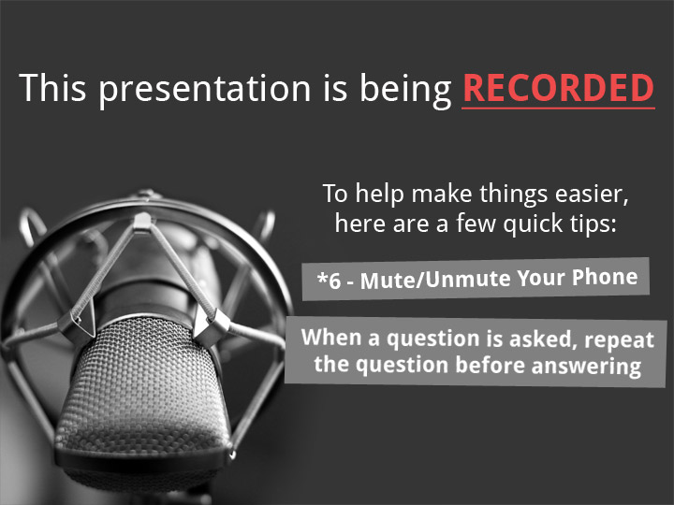
2
© 2011 Quantum Corporation. Company Confidential. Forward-looking information is based upon multiple assumptions and uncertainties, does not necessarily represent the company’s outlook and is for planning purposes only.

Slide 3
Agenda
Marketing Overview – Mark Thacker
DXi V1000 Installations – Jim Kahn
Failure Isolation – Jim Kahn
ISV Update– Ivan Tuma
Known Issues – Jim Kahn
Service Strategy – Jim Hibbard
Training Strategy – Tom Sajbel
Note: Ask questions as we go. Q&A also at the end.

Slide 4
Marketing Overview
Mark Thacker
4

Slide 5
Key Features – What the Product Is
Complete functionality of DXi system in a virtual machine
  Sell on existing key features of DXi systems
  Useful for both physical and virtual machine backups
Customer looking for low cost, flexible option for deduplication
2TB of blockpool capacity
  Think DXi4510
Optimized for CIFS, NFS, OST, DXi Accent ingest support
  No FC/VTL due to VMware limitation
Full replication and recovery to/from other DXi systems
  Limited to DXi 2.x source/target and only 1 active replication partner
Key Differentiator for DXi
  Edge to Core
  Combination of vmPRO and DXi V1000
Deployable OVF image for VMware vSphere / ESX 4.x and 5

Slide 6
Key Features – What the Product Is Not
Not a hardware appliance - customer provides:
  ESX infrastructure
  Server hardware
  No hardware included
Performance is not the play
  Many ecosystem variables effect total performance
  Focus on meeting backup window objectives
Scalability beyond 2TB in a single blockpool
Not for HyperV or XenServer environments

Slide 7




Use Case 1 : Regional Edge to Core
Regional edge to core pattern:
  Regional offices surrounded by small satellite offices
  DXi V1000 running in satellite offices
  Backups to DXi V1000 via third party application
  Replication to Regional office physical DXi
Target DXi V1000 size of less than 2TB per satellite
Use-case variants:
  1A: 100% Virtual Satellite site – DXi V1000+vmPRO at both sites
  1B: Traditional/Mixed Environment – DXi V1000+ISV/vmPRO at both sites
Chicago Datacenter Physical DXi Appliance
DXi V1000 Cleveland
DXi V1000 San Jose
vmPRO
vmPRO

Slide 8
Use Case 2 : Cloud Backup
Cloud-based backup and DR solution usage pattern:
  Customer with smaller budget
  No DR or sister site available
  Can replicate to Quantum Cloud Service Offering (DXi V1000 to physical DXi or DXi V1000)
Target DXi V1000 size of 2TB (initially)
Use-case variants:
  2A: Single-tenancy – one customer per DXi V1000
  2B: Multi-tenancy – multiple DXi V1000 instances
DXi V1000
Standalone
vmPRO
DXi V1000
DXi Appliance
vmPRO
OR

Slide 9
Use Case 3 : Small Site DR
Small backup sites needing DR protection:
  Offices with up to 2TB of data to protect, handful of VM’s
  Backup to local DXi V1000
  Replicate to similar sized off-site office
  Recover from offsite DXi V1000 in case of disaster
Target DXi V1000 size of less than 2TB per site
Use-case variants:
  3A : 100% Virtual Environment – DXi V1000+vmPRO at both sites
  3B : Traditional/Mixed Environment – DXi V1000+ISV/vmPRO at both sites
DXi V1000
Main Site
DXi V1000 Hot DR Site
vmPRO
vmPRO

Slide 10
Protocols and Design Points
Goal : Support a 2TB DXi with only 4GB of RAM
2TB Blockpool initially
  NOT based on any VMWare limitations
  Will increase over time, but requires more RAM for VM
Disk layout optimized for VMware file system compatibility and potential performance improvements
  Nine 256GB VMDKs – fully compatible with vSphere 4 and 5
  One system disk, one Metadata disk, seven data disks
  Customer can spread VMDKs to multiple, or high speed, storage pools
CIFS, NFS, OST, Accent ingest support
  Limited to 4 streams of ingest at a time
Replication
  Either in or out but not both at same time
  1 to 1 fan-in

Slide 11
Preliminary Performance
Two reference platforms for sizing
  Actual performance will vary at customer sites
  Small system == Dell R510 (i.e. DXi4510 hardware) 1GbE
  Large system == Dell R910 (i.e. DXi8500 Nehalem hardware) 10GbE
Performance memo available after launch
Position protecting 2TB of data within backup window
  Small reference platform w/1GbE ~5.5 hours
  Large reference platform w/10GbE ~2 hours
Some possible performance optimizations
  Increase CPU speed of host system
  Move metadata virtual disk to separate VMware storage pool
  Move each data virtual disk to separate VMware storage pools

Slide 12
Sizing Considerations – Capacity Only
V1000 available in 3 sizes. 1900 GB is estimated max BP use before LCM
Faded numbers equal BP GBs
Notes:
My thought process
At full licensing, DXi GUI and DARt both show V1000 to have 1.92 TB (1000 bytes/KB)
So our marketing literature seems to take license by rounding up and claiming this is an “up to” 2 TB usable capacity
We’re talking about licensing in 256GB increments … so what does that mean for capacity if I can’t get to 8x 256 GB now ??
Are we licensing in 256GB increments or in 250 ?? (Since all numbers inside the DXi are base 10)
So I decided to increment the color coding of this pseudo “QuikFit” chart in 250 GB steps
“BU-BU RoC” means: what percentage of the (full) backup will be new and unique, before compression
Doesn’t matter if we’re talking about Full-only policy or Full + Incremental, or even CBT backups. The results will be the same because I’m measuring the amount of new data, no matter how delivered, as a portion of the Full BU. The type of policy will only affect the total reduction ratio, not the capacity consumption.
1 year Investment Protection with 10% growth expected in that year.
DTP – Data to Protect - how much data can I backup and retain for the specified period of time, assuming 1 BU per day.
This is more of a “Number of BU events” retention than a time-based retention, so may require some explanation to some audiences
Important/Critical Assumption: The dedupe pool cannot grow beyond 1900 GB (Given that max appears to be 1.92 TB)
The colored blocks change to numbers when the dedupe pool exceeds 1900 GB. This is intended to convey that this is not a supportable DTP point.
“BP is LEQ” – Blockpool is less than or equal to …

Slide 13
SW and License Fulfillment Process
Download media kit shipped to customer
  Includes 3 Certificates with instructions
Customer follows instructions on Download Authorization Code certificate to access website and download SW
  https://quantum.subscribenet.com Same website used by Stornext.
Customer follows instructions on license key certificate to download their license bundle file
  www.quantum.com/licensekeys Standard DXi Licensing website.
  Must use serial number from the Serial Number Certificate
  All licenses delivered in a single “licensebundle.conf” file
Customer follows Quick Start Guide to install SW with serial number and license bundle
  Serial number is input during installation
  License bundle file installed via GUI during configuration

Slide 14
Reporting Tools
DXi Advanced Reporting
  Supported
Vision
  Releasing version 4.2 in April 2012
  Supports DXi V1000 and vmPRO 2.3
  Will require new DXi AR 2.0.3 – available at time of Vision release
Guardian
  No immediate support
  May require different access method than physical DXi
  May align with support of new DXi hardware
Sizing Tools
  Under consideration for initial Gunnison sizing tools release
  Quick Fit chart will likely be updated

Slide 15
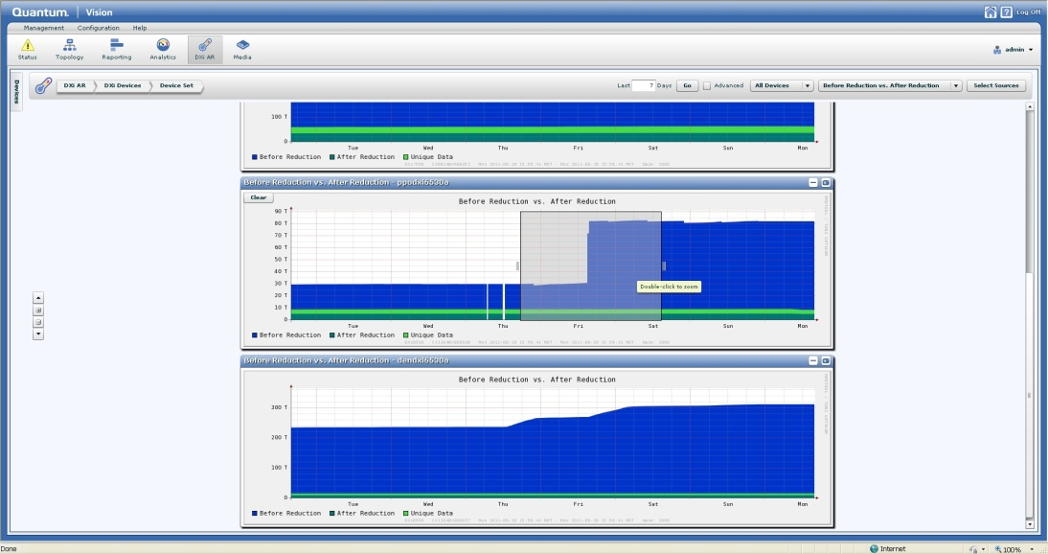
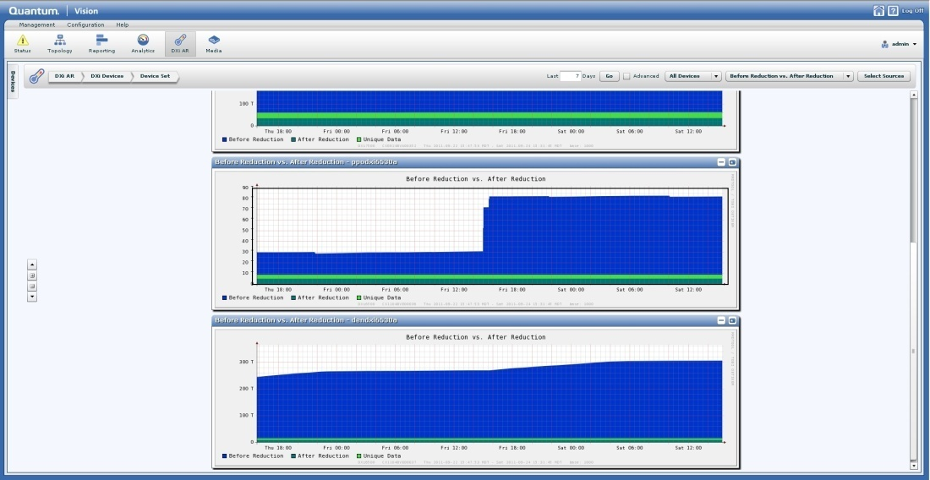
DXi v1000: DXi Advanced Reporting Support
Same AR reports available for AR including user and service login
All functions supported in v1000
LCR release (2.0.3 RC1) available for install to support Capacity Upgrade Estimate in Vision

Slide 16
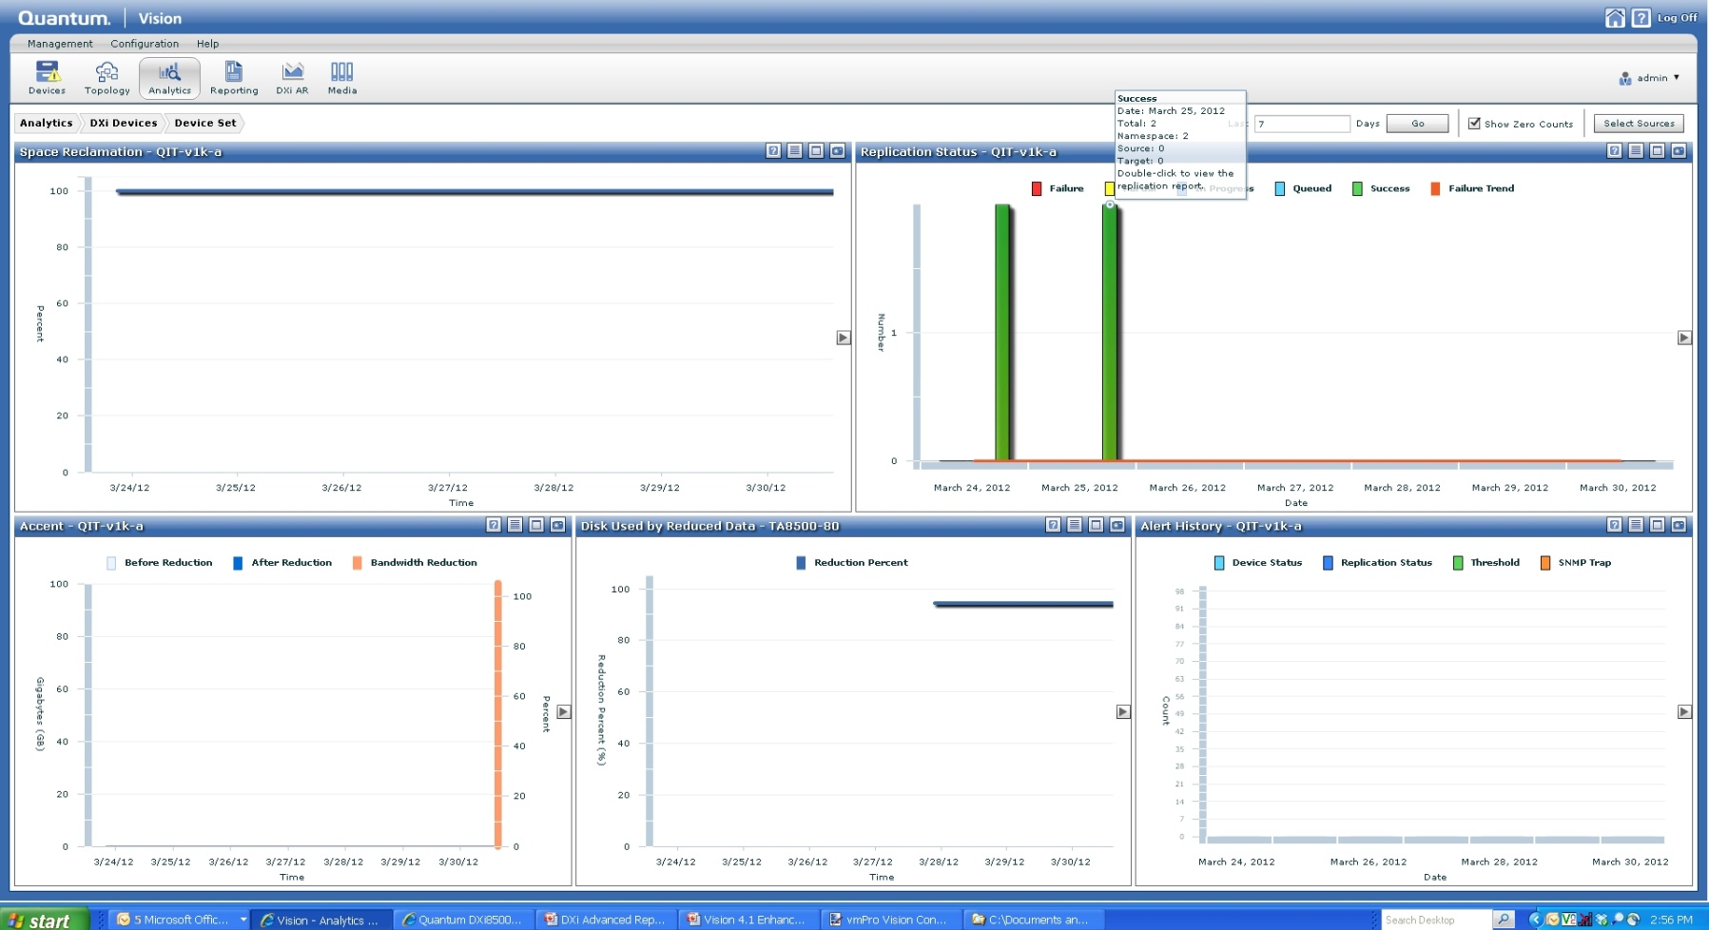
DXi v1000: Vision 4.2 Analytics Support
Quick view of the most important information:
Used disk
Replication status
Reclamation percent complete
Alert history
Accent Inline Data

Slide 17
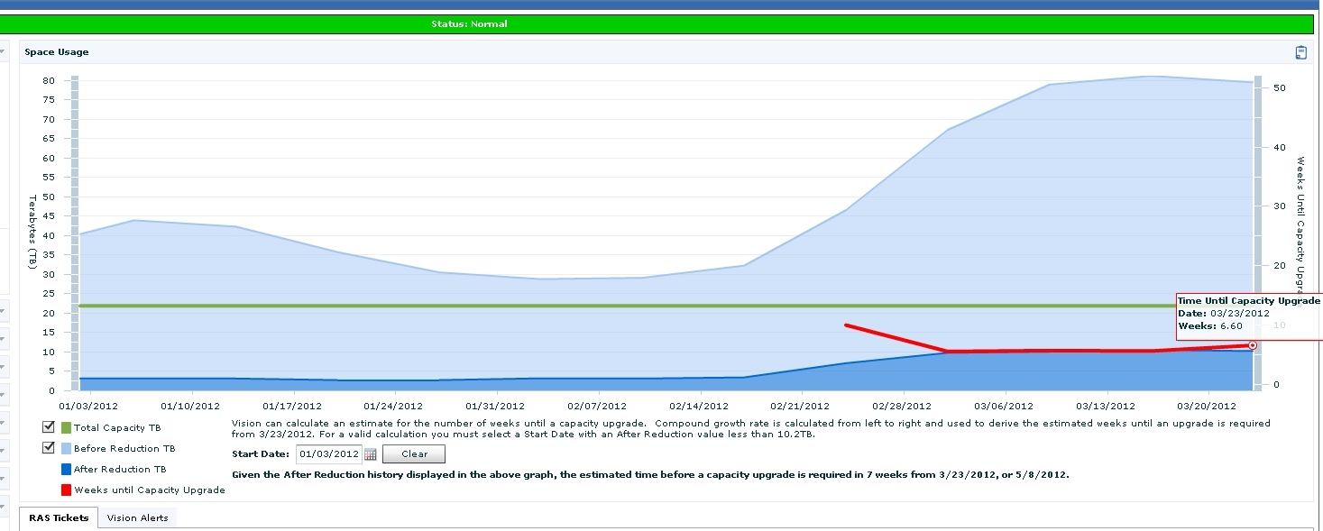
DXi v1000: Vision 4.2 Capacity Upgrade Estimates
Predict when a capacity upgrade will be required on the v1000

Slide 18
Marketing Questions?
18

Slide 19
DXi V1000 Installations
Jim Kahn

Slide 20
Agenda
vSphere Recommendations
Restrictions & Limitations
Preparation (VMware Preparation)
DXi V1000 Installation & Configuration
DXi V1000 & vmPro Integration
Health Check & Data Collection
Service Menu Changes
Reference Test Systems
Additional Resources
Q&A

Slide 21
vSphere Recommendations
Supported vSphere versions
  Paid licensed versions are only supported!
  ESX 4.0 Update 4 – several issues
  ESX 4.1 – no issues
  ESXi 4.1-5.0 – no issues
vSphere server minimum configuration
  Single 1 GbE or 10 GbE NIC
  1 Intel i7 or E5500 CPU
  16 GB of RAM
vSphere server typical configuration
  Four 1 GbE or two 10 GbE NICs
  2 Intel i7 or E5500 CPUs
  48 GB of RAM

Slide 22
vSphere Recommendations (cont.)
vSphere datastore requirements
  1 TB of free storage
  External storage system with power-fail protection
    SAN
    NFS
    iSCSI
  Internal DAS storage is not recommended
    Other vSphere servers cannot access data
    Power protection
vSphere networking
  Only static port trunking, no LACP
  Use “Route determined by IP hash” for best NIC teaming
  9K Jumbo Frames yield best throughput (90% efficiency)
  netPktHeapMaxSize limits
    64MB in ESXi4.1 (1 GbE)
    224MB in ESXi5.0 (10 GbE)

Slide 23
Requirements – DXi V1000
Web Browsers: Firefox, Internet Explorer (7.x and above) and Google Chrome
DXi V1000 Virtual Machine requirements
  2 CPU cores
  4 GB of RAM
  2 VMXNET3 NICs
  9x256 GB virtual SCSI disks (for vSphere4 compatibility)
Licensed storage capacity sizes
  256 GB (evaluation)
  1 TB
  2 TB
Disk organization
  Disk 1 – system disk (RAID5)
  Disk 2 – SNFS metadata disk (RAID1)
  Disks 3-9 – SNFS data disks (RAID5)

Slide 24
Restrictions & Limitations
Network DHCP support limited on DXi V1000
  All network ports initially using DHCP
  If no DHCP network support, static IP for eth0 requested
  No GUI/syscli configurability for DHCP
  Use static IPs for segmentation
Segmentation issues
  Replication port 1062 is open on data and replication segments
  http traffic is handled on all segments
Replication issues
  Throttling does not exceed max bandwidth
  Actual throttle data rate variable!
Network bonding not supported on DXi V1000
  vNIC bonding mode 0 slower than single vNIC!
  Illegal loopback errors due to bonded Ethernet ports on same vSwitch

Slide 25
Restrictions & Limitations (cont.)
DXi V1000 modification is not supported
  RAM changes do no good and will disrupt normal startup
  Cannot add more disks; already at blockpool 2 TB limit
  RAM/CPU reservations essential for ESXi VM scheduler operation
  Adding more CPUs does not affect operation
Network issues
  Do not use NTP in DXi V1000 – time oscillation
  Hostname cannot be changed while DHCP is used
  Default hostname is “DXi” + eth0 MAC
  Ethernet stats problematic due to:
    Physical NIC driver sensitivity
    Unreliable on ESX4.0
Stream performance
  Function of vSphere server and its datastore
  Only guarantee 4 streams with 4 GB of RAM

Slide 26
Restrictions & Limitations (cont.)
DXi V1000 capacity licensing
  Created with full storage capacity
  Uses space manger daemon to manage licensed capacity
    GUI always reports max usable capacity = 1.92TB
  Capacity license checked every 5 minutes

Slide 27
Preparation (VMware Preparation)
Unfamiliar Terms
  OVF (Open Virtualization Format...open standard for packaging & distributing virtual appliances)
  VI Client (Virtual Infrastructure client...Management GUI for vSphere)
  vCenter (VMware Virtual Center)
  Persistent Independent Disk (Disks that cannot be snapshotted)
  Datastore (LUN created for a VM or DXi V1000 use)
  Thin Provisioned (Unallocated VMware disk space)
  Thick Provisioned (Allocated VMware disk space)
  Thick Provision Lazy Zeroed (allocate only what is needed now…allocate later)
  Thick Provision Eager Zeroed (Used for fault tolerance…allocated at creation)
Preparation
  Make sure a large enough Datastore has been created (At least 1TB Datastore)
  Download OVF (Obtain OVF and store where VI client will run or on a reachable network drive)
  Confirm Connection to ESX server or vCenter using VI client.

Slide 28
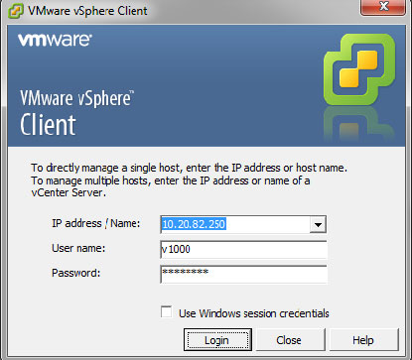
DXi V1000 Installation
Confirm by logging on to vSphere server using server name or IP address
Installation video URL: https://csweb.quantum.com/training/dxiv1000/v1000_install.html

Slide 29
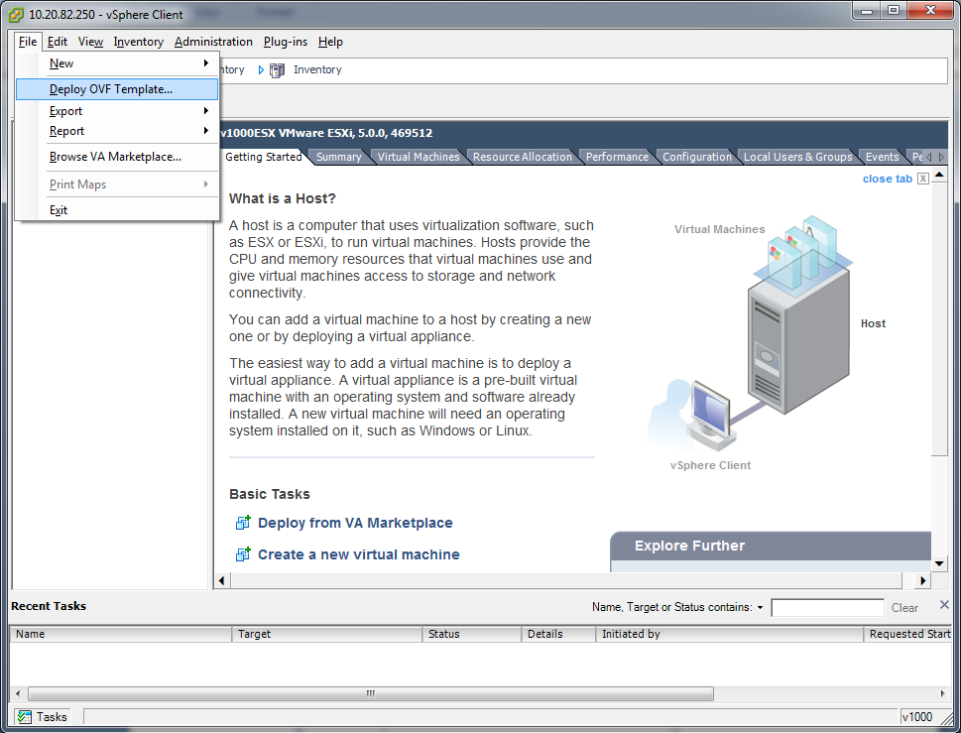
DXi V1000 Installation (cont.)
Then select "File" ==> "Deploy OVF Template" from VI Client GUI Menu.

Slide 30
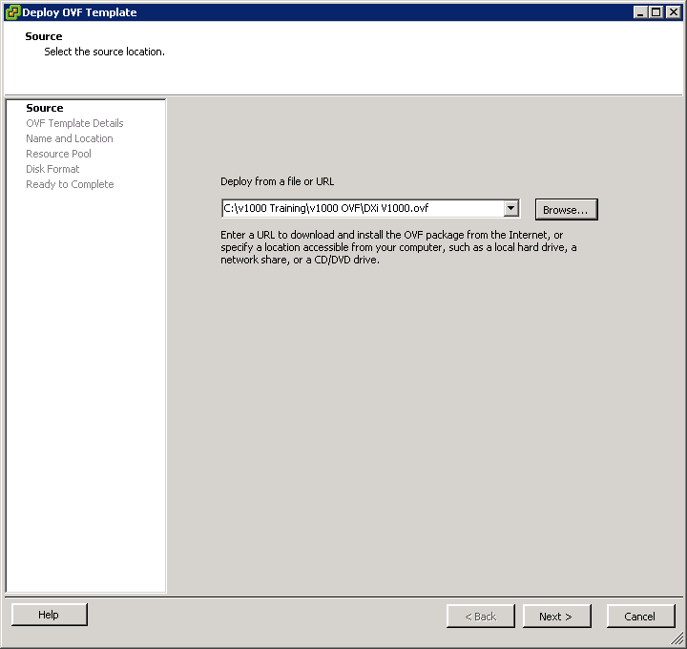
DXi V1000 Installation (cont.)
If DXi V1000 OVF is stored locally, browse to select OVF. If stored on a network drive, specify the location in the "Deploy from a file or URL" box.

Slide 31
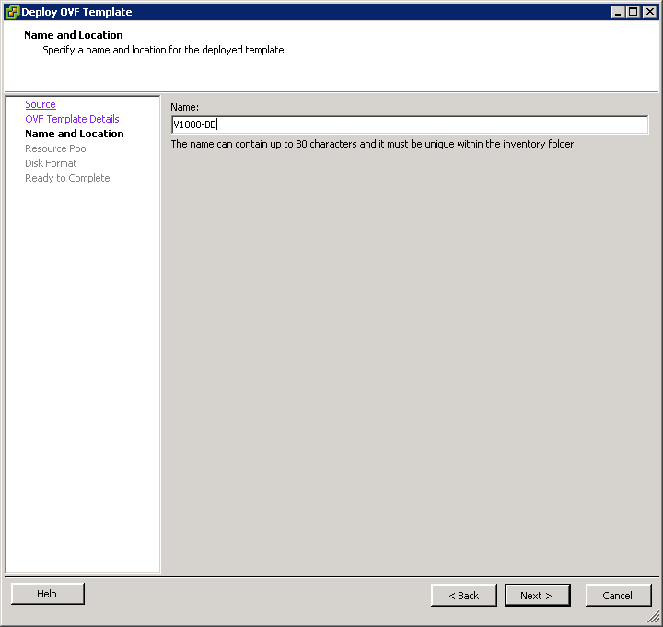
DXi V1000 Installation (cont.)
Specify a name for DXi V1000 VM. This name is for VMware inventory only.

Slide 32
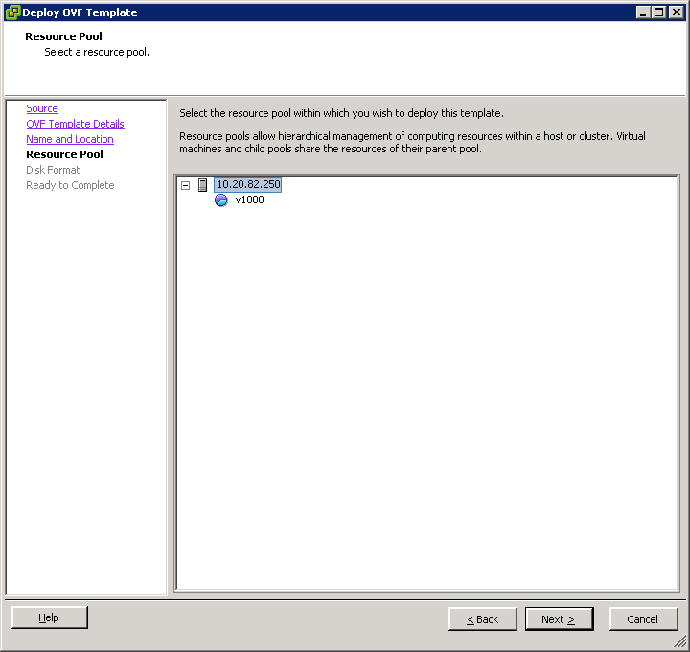
DXi V1000 Installation (cont.)
Select where to store DXi V1000 in your vSphere configuration (select a resources pools if it exists).

Slide 33
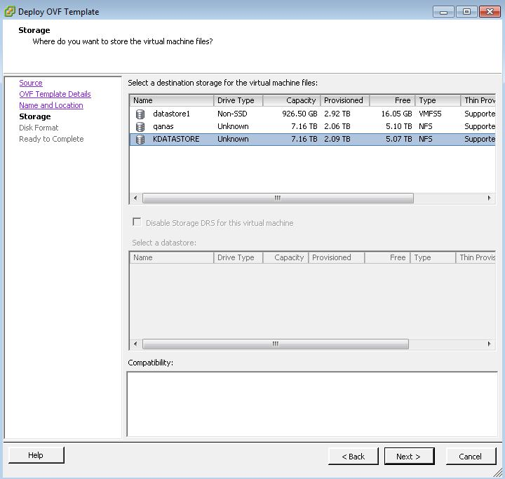
DXi V1000 Installation (cont.)
Select a Datastore (with at least 1 TB free)

Slide 34
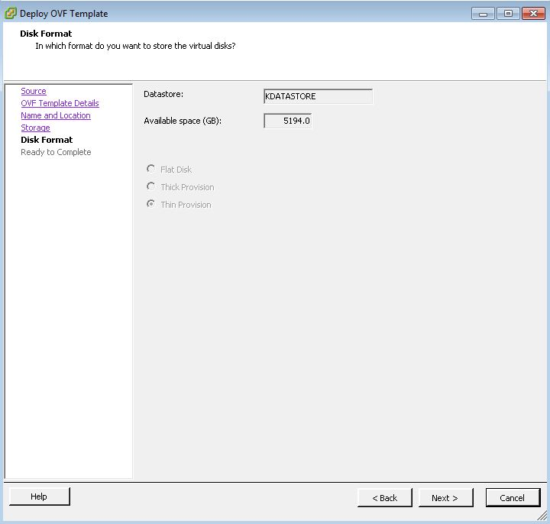
DXi V1000 Installation (cont.)
On the Disk Format window, select “Thin Provision”. Only “Thin Provision” will be available if Datastore is NFS mounted. Other Datastore types would allow you to select other Disk Formats, i.e. iSCSI

Slide 35
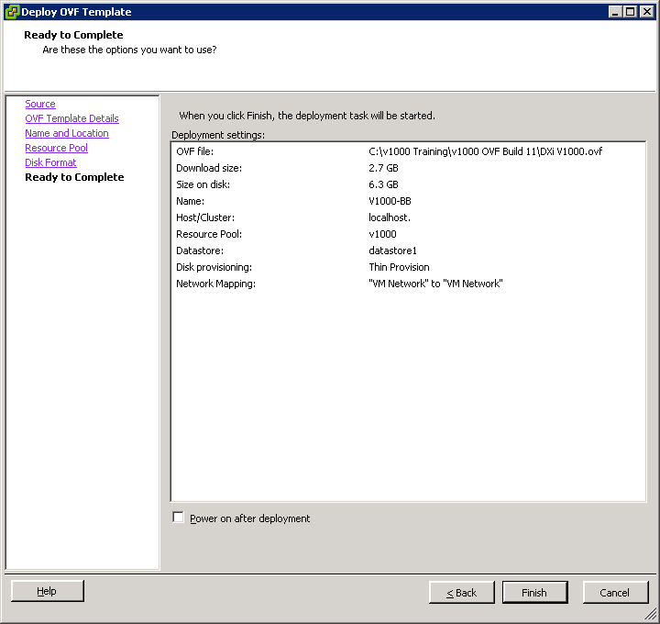
DXi V1000 Installation (cont.)
In the Ready to Complete window, review your settings and click Finish

Slide 36
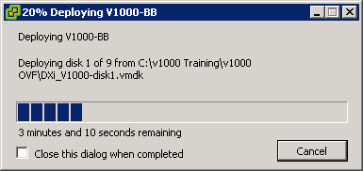
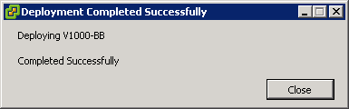
DXi V1000 Installation (cont.)
As shown below, a progress window displays while the DXi V1000 OVF template deploys. The process will take several minutes to complete. When the Completed Successfully message displays, the process is complete. Click Close.

Slide 37
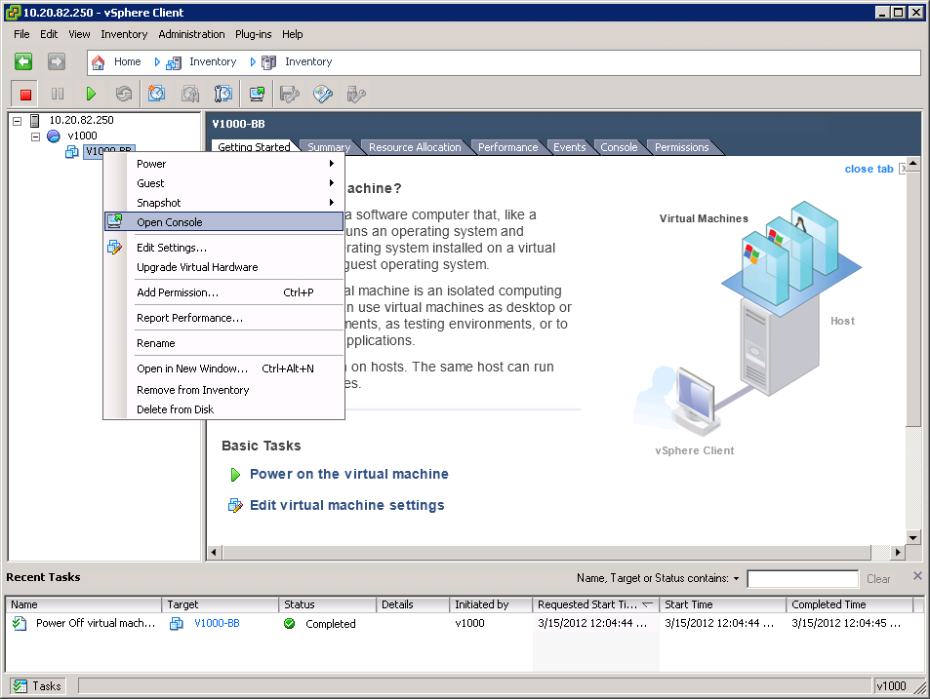
DXi V1000 Installation (cont.)
Power On the DXi V1000
In the vSphere client window, right-click on your newly deployed DXi V1000 virtual machine and click Open Console, as shown below.

Slide 38
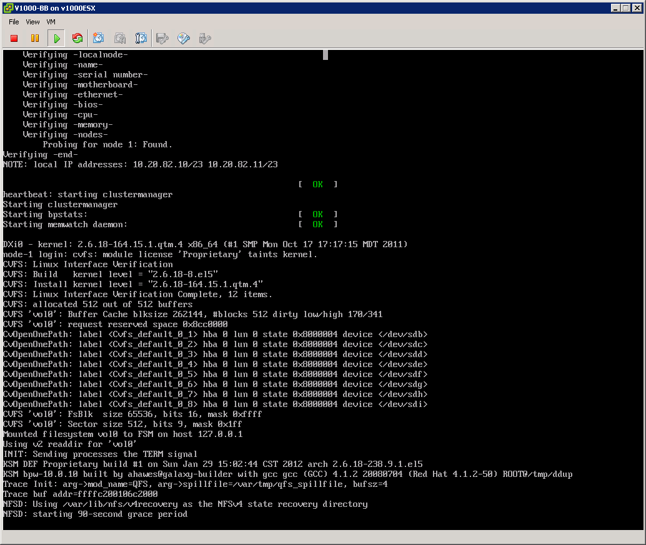
DXi V1000 Installation (cont.)
When the NFSD: starting the 90-second grace period message appears, the system startup is almost complete. It will take a few more minutes to complete the startup process.
Note: If necessary, press Ctrl + Alt to release your mouse from the virtual console window.

Slide 39
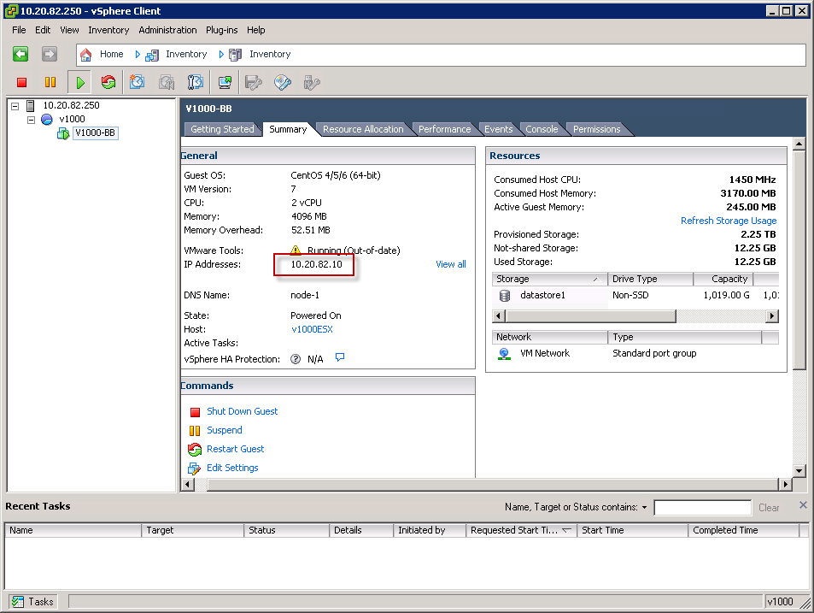
DXi V1000 Installation (cont.)
Identify the DXi V1000 IP address by selecting the summary tab on VM (DXi V1000 VM).

Slide 40
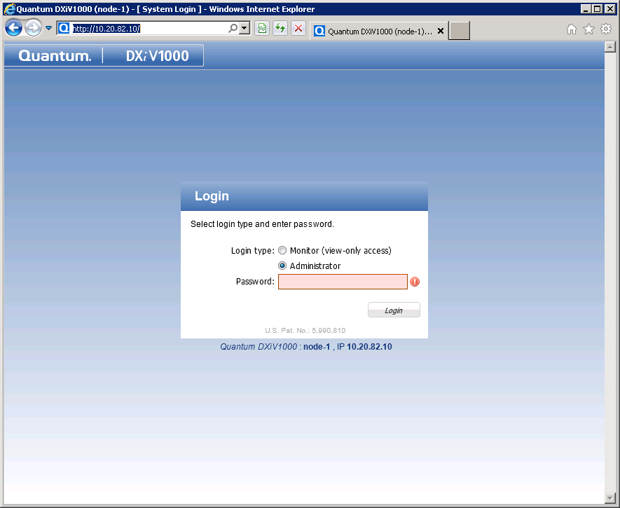
DXi V1000 Configuration
Launch a browser and supply the IP address
Login (password: "password")

Slide 41
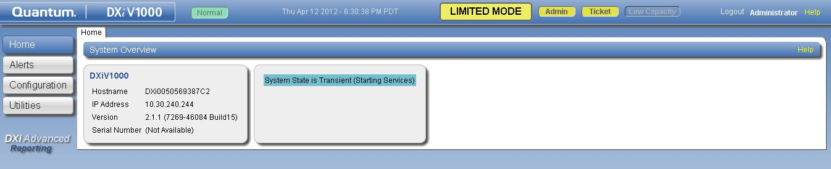
DXi V1000 Configuration (cont.)
Note: If you see the Limited Mode message when after logging back into the system, the system has not finished booting. Wait a few minutes for the system to finish booting, and log back in

Slide 42
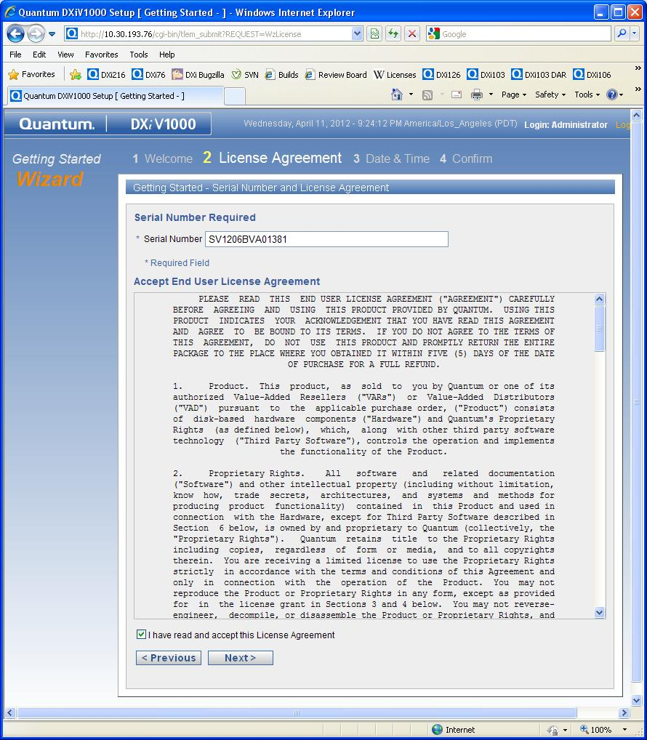
DXi V1000 Configuration (cont.)
Enter Serial Number and accept EULA.

Slide 43
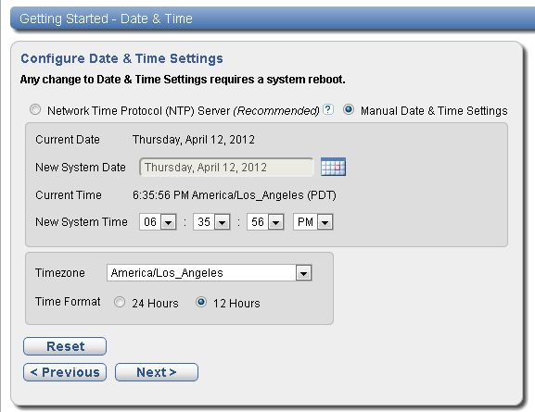
DXi V1000 Configuration (cont.)
Manually set date, time and time zone. NTP server is actually not recommended even though it is improperly noted as “Recommended” on the configuration wizard.

Slide 44
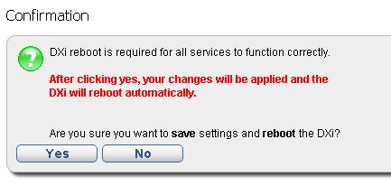
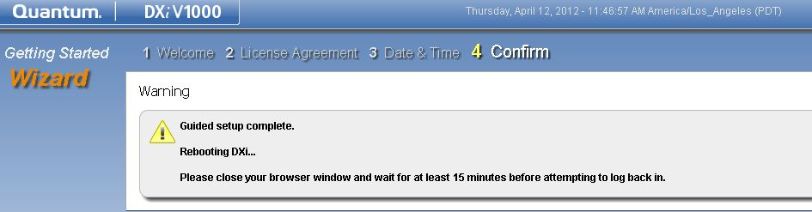
DXi V1000 Configuration (cont.)
Initial Configuration is saved and DXi V1000 is rebooted

Slide 45
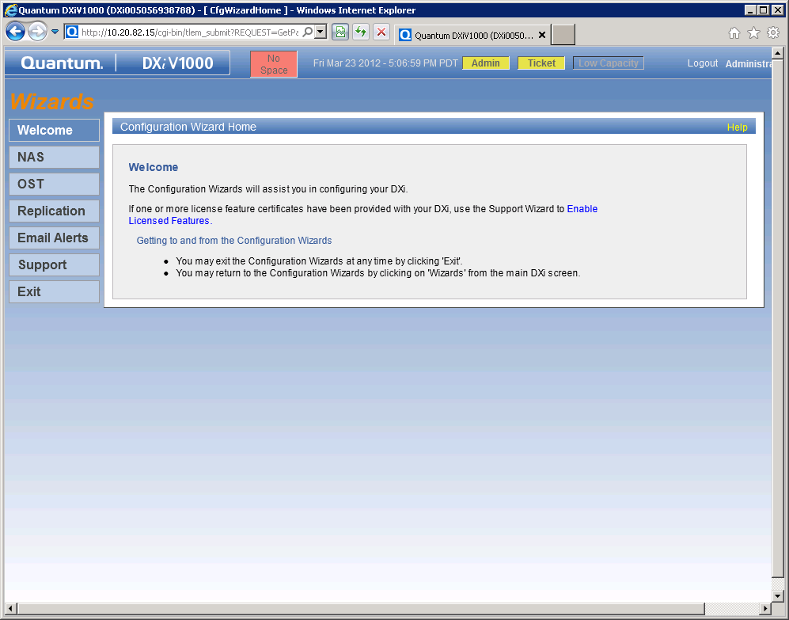
DXi V1000 Configuration (cont.)
Note the red No Space message at the topic of the screen. This message displays because you have not yet applied the Storage Capacity license to the system. The Storage Capacity license will get added to the system when you upload the license bundle file. You will do this when you complete the Support Wizard in the next procedure.

Slide 46
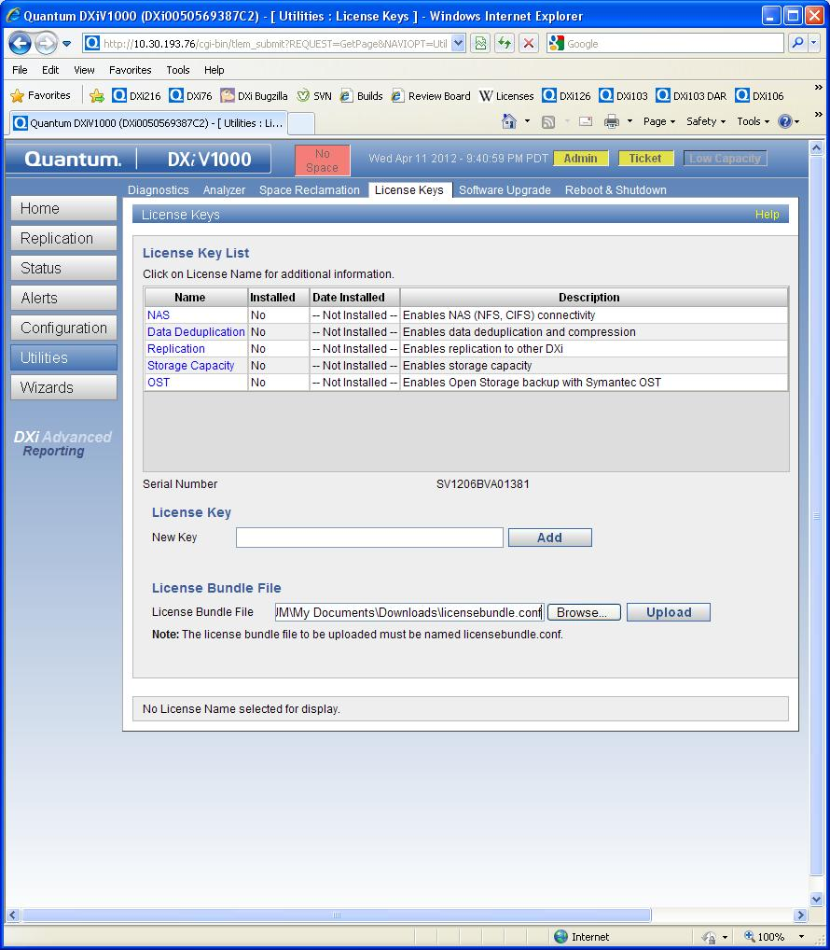
DXi V1000 Configuration (cont.)
.
On the Licensed Features page, locate your License Bundle File and upload it in the “License Bundle File” section.

Slide 47
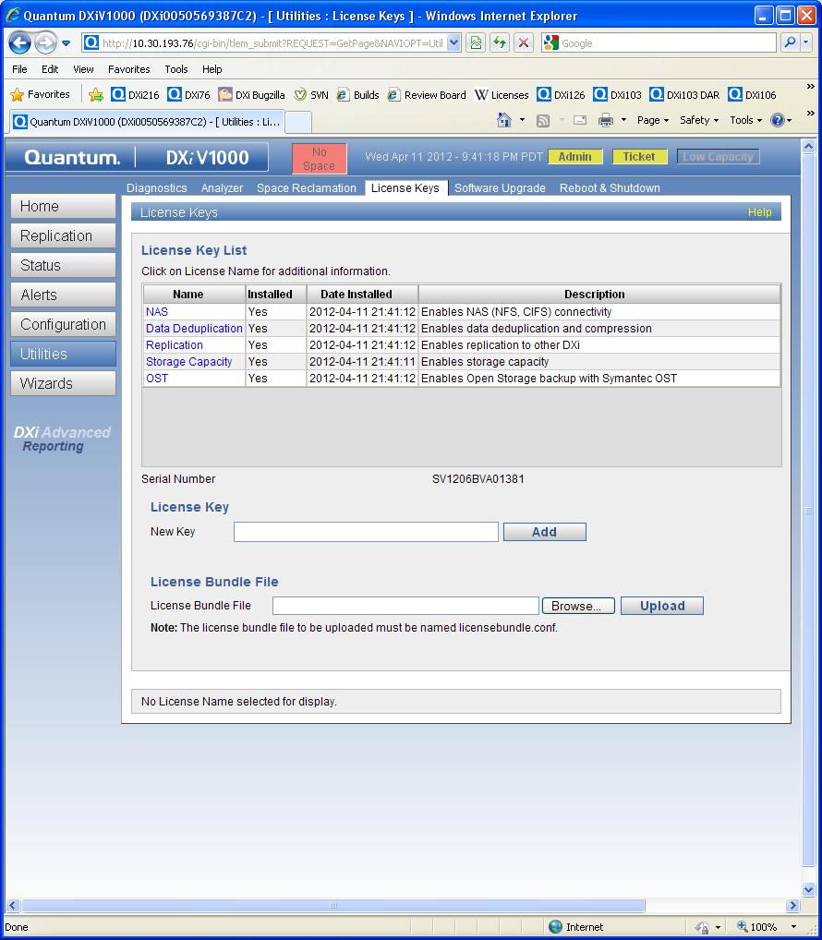
DXi V1000 Configuration (cont.)

Slide 48
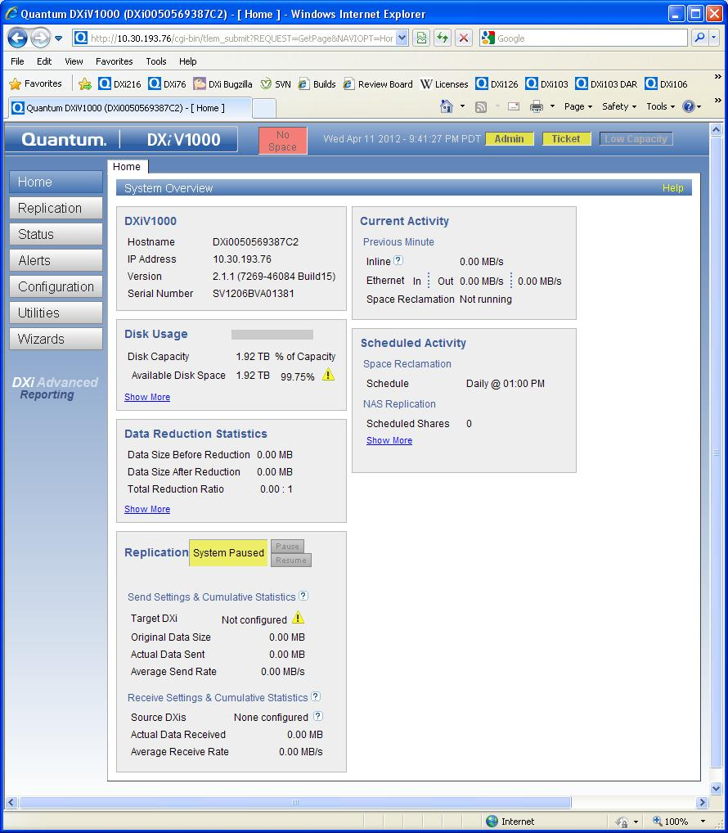
DXi V1000 Configuration (cont.)
Allow 5 minutes for license bundle to be applied.

Slide 49
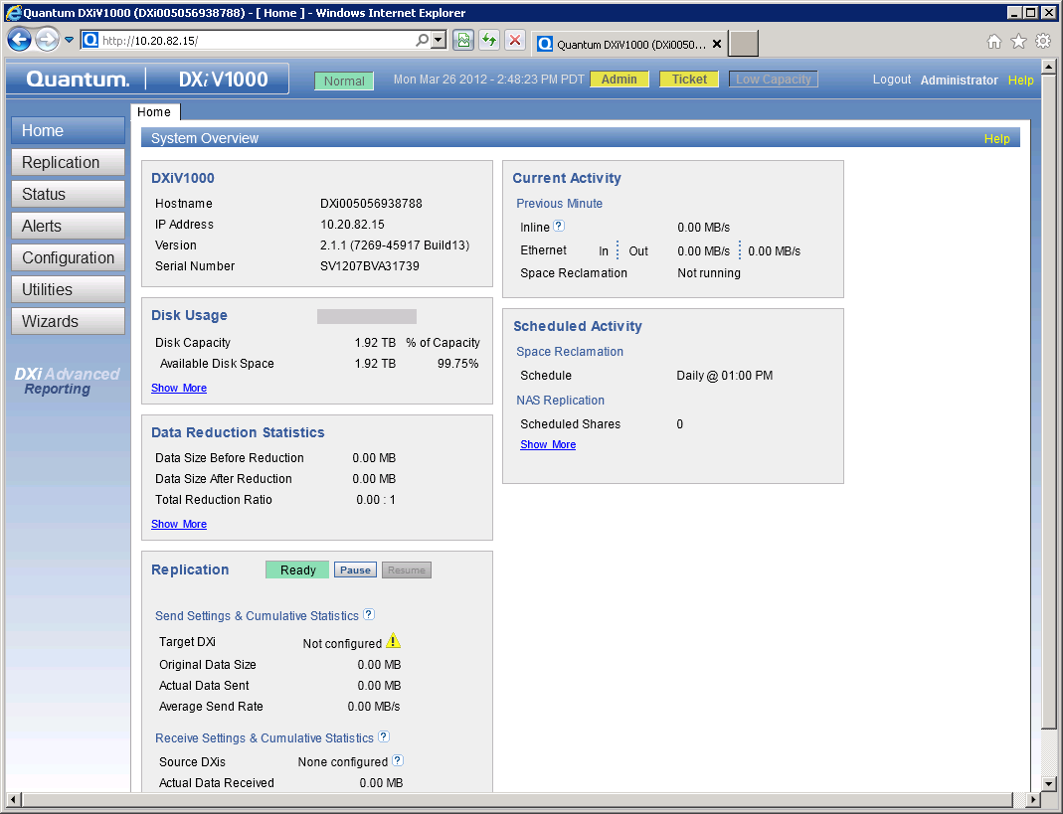
DXi V1000 Configuration (cont.)
From the Home screen in the DXi V1000 GUI, click Status, as shown below
Note that the Hardware tab does not display on the DXi V1000 GUI. Because the DXI V1000 uses virtual hardware, there is no need to report hardware failures. In addition, there is no VTL tab, because the DXi V1000 does not support the VTL presentation type.

Slide 50
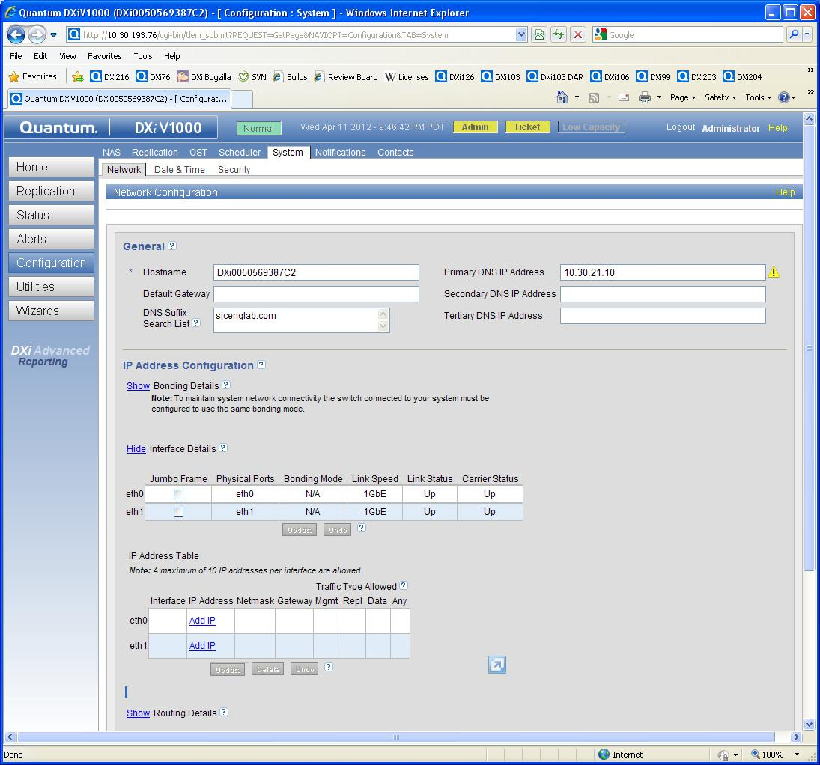
DXi V1000 Configuration (cont.)
System Network configuration page showing default DHCP behavior. Configure static IP addresses at this time.

Slide 51
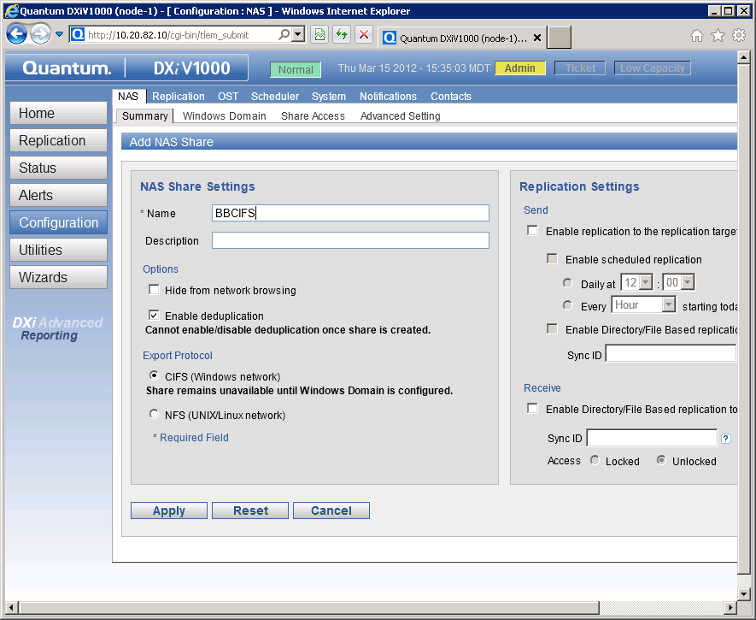
DXi V1000 Configuration (cont.)
In the DXi V1000 GUI, browse to the Configuration > NAS > Summary tab and click Add.
Enter a share name in the Name field, and click Apply.
Select CIFS as the export protocol, if you are in a Windows environment or NFS if you are on LINUX/UNIX Env.
Click Apply.

Slide 52
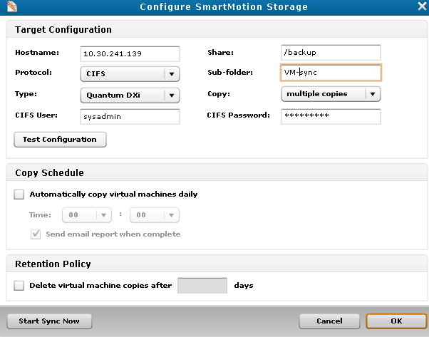
DXi V1000 & vmPRO Integration
How DXi V1000 Connects To vmPRO
DXi V1000 connects seamlessly with vmPRO
DXi V1000 is the primary target network storage for vmPRO
If DXi is configured with vmPRO, it would feature prominently on the vmPRO GUI.

Slide 53
Health Check & Data Collection
Standard data collection using the following log files:
  /var/log/DXi/tsunami.log
  /var/log/DXi/tsunami_trace.log
  /var/log/srvcLog.hist
  /var/log/DXi/service.log
  /var/log/messages
  /factory.config
  /changes.diff
Hardware logs:
  /opt/DXi/hwdetect/current.config
  /opt/DXi/hwdetect/factory.config
  /opt/Dxi/hwdetect/changes.diff

Slide 54
Service Menu Changes
Service menu is not part of normal DXi V1000 configuration.
  No hardware to configure!
  DHCP networking eliminates static IP for eth0
  Not all cloud providers provide a console
  Still, it’s there in case of emergencies
Main GUI is primary configuration vehicle
  Used to convert from DHCP to static IP

Slide 55
Small Reference ESXi 5.0 Test System
Small System
Dell R510
2xE5620 CPUs
24 GB RAM
1 datastore
  LSI MegaRaid 9260
  8x1 TB 7200 rpm disks
  RAID6 configuration
Most sensitive performance configuration

Slide 56
Large Reference ESXi 5.0 Test System
Dell R910
2xE7540 CPUs
64 GB RAM
5 datastores
  10xLSI Matterhorn Storage Servers
  20 Luns
  16x1 TB 7200 rpm disks per lun
  RAID6 configuration

Slide 57
Additional Resources
See additional self-paced online training in the “Training Strategy” section of this TOI.
Quick Start Guide
User Guides
Release Notes
Service Plan
Note: All postings on CSWeb

Slide 58
Installation Questions?
58

Slide 59
Failure Isolation
Jim Kahn

Slide 60
Failure Isolation
SNFS socket connection failure
  Failed to create SNFS correctly, aborting firstboot!
  Check network configuration
  Reinstall DXi V1000
DXi V1000 daemon fails to start
  ERROR - procmon ProcMonMain.cpp(341) [procmon] MonitorProcesses() - Getting status for service 'httpd' failed with status 3
  Check CPU/RAM reserved resources; may need more resources
  Check vSphere server VM workload

Slide 61
Failure Isolation (cont.)
vSphere server datastore exhaustion
  Low-space alarm in vCenter Console
  DXi V1000 suspended (ESX4/ESXi4.1)
  DXi V1000 ENOSPC error (ESXi5 option)
  Check vCenter Configuration->Storage panel free disk space
Unnamed DXi V1000 snapshots
  Low-space alarm in vCenter Console
  Unnamed snapshots cannot be deleted!
  Check vCenter Configuration->Storage panel free disk space
RAM exhaustion
  Normal condition when full storage capacity reached
  200 MiB of swap space can be consumed

Slide 62
Failure Isolation
License bundle fails to install
  Check that DXi V1000 serial number matches licensebundle serial number.
  Check for corrupt licensebundle.conf xml file
  Re-download if fails to install

Slide 63
Known Issues
Jim Kahn

Slide 64
Known Issues

Slide 65
Known Issues (cont.)

Slide 66
ISV Updates
Ivan Tuma

Slide 67
ISV Compatibility
ISV | Paper Cert | Touch tests with the GA candidate | Support by
Quest NetVault | X |  | GA
EMC Networker | X |  | GA
NetBackup |  | X | April 30
Backup Exec |  | X | GA
Tivoli (RTF) |  | X** | GA
HP-DP |  | X** | Post GA
Commvault | X |  | GA
CA | X | X | GA
Atempo |  | X | GA
Note: ** SVT runs ISV touch test and submit results

Slide 68
Service Strategy
Jim Hibbard

Slide 69
Service Strategy
Branded Service Model
  Same as DXi HW system aside from no field support offered.
  ASPS provides Technical Support leveraging SES and DXi sustaining for escalation resources.
  SW distribution model similar to StorNext (Flexara hosted site). Certificate with auth codes sent to customer with instructions for SW download from Flexara hosted site and feature license keys from DXi licensing URL.
  Service Offerings
    SILVER SOFTWARE SUPPORT PLAN: 5x9 Telephone Response
    GOLD SOFTWARE SUPPORT PLAN: 7x24 Telephone Response
    Warranty renewals - Annual renewals are available for the various warranty offerings supported by this program (Silver and Gold).
    Installation and Integration Services - DXiV1000 is customer installable and Installation and Integration services are not available.
    Upgrade Services - Post sale capacity upgrades are available for DXiV1000 that are customer installable.
ACS/Xerox OEM Service Model
  ACS is responsible for level 1 and level 2 technical support to their end users
  Quantum will provide level 3 support to ACS
  Quantum will refer ACS end users and RAS tickets to ACS Tech Support
  Calls will come in through GCH and SR gets assigned to ASPS
  ASPS does quick look for obvious solution and verifies that detailed data was received
  ASPS escalates SR to SES and SES to SUS as needed
  Oracle IB Records
    Bulk list of system serial numbers and feature license keys will be sent to ACS ahead of time for them to sell.
    Quantum Accounting team will audit ACS install base periodically to make sure we’re getting paid for what ACS has installed. Therefore, no contract will be included in the IB record.

Slide 70
Service Strategy (cont.)
ACS/Xerox SR process is in Agile (6-67657-01)
  Posted on CSWeb
DXiV1000 Service Plan is in Agile (0-14506-01)
  Posted on CSWeb
DXiV1000 SW, Release Notes, and Docs are posted on CSWeb

Slide 71
Training Strategy
Tom Sajbel

Slide 72
Training
StorageCare Learning
DXi V1000 Installation (2-3441 Online Self-paced)
  Online self-paced course with access to virtual sandbox where you can get hands-on practice installing and initially configuring a DXi V1000 virtual appliance.
DXi V1000 Installation and Configuration (C-2-3443 Curriculum)
  DXi V1000 Installation (2-3441 Online Self-paced)
  DXi-Series Core Concepts for Service (2-0443 Online Self-paced)
  DXi-Series 2.x Configuration (2-2482 Recorded Presentation)
  DXi-Series 2.x Hands-on Practice (3-2432 Virtual Course)
  DXi Advanced Reporting Service Training (2-2412 Online Self-paced)
  Stay Current: DXi-Series Service Updates and Configuration Demos (2-3420)
CSWeb
DXi V1000 Installation and Configuration Video
DXi V1000 At a Glance document (Document)
DXi V1000 Status and Log Collection (Document)
DXi V1000 Log Location and Descriptions (Document)

Slide 73
Training (cont.)
73
© 2011 Quantum Corporation. Company Confidential. Forward-looking information is based upon multiple assumptions and uncertainties, does not necessarily represent the company’s outlook and is for planning purposes only.
Qwikipedia
DXi V1000 / VMware Troubleshooting Topic (DXi-Series Page)
  ESX server log collection
  How to Identify ESX Disk Issues that Affect DXi V1000 Performance
eQuip - Quantum’s New IT Learning Library
Courses:
  VMware vSphere 4 training course
  VMware vSphere 5 training course
Access:
  URL: http://equip.quantum.com
  Username: quantum email address
  Password: welcome1

Slide 74
Q&A

