Slide 1
DXi V1000 Ver 2.2.1
Moss Creek Program
TOI for Global Service
March 6, 2013

Slide 2
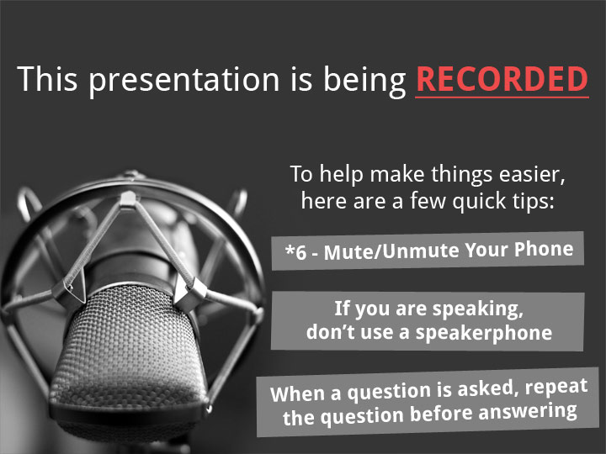

Slide 3
Agenda
Marketing Overview
Engineering Update
SW Upgrade Process
Documentation and Training Updates
Service Model Updates
Note: Ask questions as we go. Q&A also at the end.

Slide 4
Marketing Overview
Mark Thacker

Slide 5
DXi 2.2.1 Features in DXi V1000 Moss Creek
Moss Creek is essentially V1000 with the DXi 2.2.1 feature set
Security
  User audit log
  Secure data deletion of files
OST
  OST AIR support
  Concurrent Optimized Duplication
  Accent support for Windows for BE and NBU
  Accent Encryption
  Optimized Duplication on Replication ports
  Plug-in for AIX
Networking
  DHCP (specific to DXi V1000)
  VLAN Tagging
  Jumbo Frames
GUI
  “Mapping” pages for navigation
  Disk Space Reporting
  Port Layout Improvements
  Scheduler Improvements
Performance Improvements
  Namespace replication
  Space Reclamation
Released Friday, March 1, 2013
Available on CSWeb and externally
March 5, 2013

Slide 6
New License Capabilities
Today’s licenses : Perpetual, 30-day trial, subscription
  However, the actual time-enforcement does not happen
  Standard Edition and Enterprise Edition both use Perpetual licenses, not 30-day trials
New license server
  Used for all licenses issued for Moss Creek
  Running on Mosaic license server – same as vmPRO
  New features will also be used in vmPRO Santa Maria (a.k.a. vmPRO 3.1)
License types now include
  Time based with expiration upon a fixed date
  Subscription licenses that are good until canceled / revoked
    Initially only used for Cloud Service Providers
  Perpetual
  Offline manually issued licenses (still stored in license server)
License server checked daily
  Customer can request a license server check dynamically; i.e. when expanding capacity or renewals
Action upon expiration / revocation
  DXi detects license expiration and generates Admin alert
  System is placed into a Low Space condition
  No additional data can be ingested to the DXi
  Data present can continue to be read or deleted
  Renewal of license will re-instate full functionality
Existing licenses will be converted upon upgrade to V1000 Moss Creek

Slide 7
Install Base Summary
DXi V1000 available in two different licensing models
DXi V1000 Enterprise Edition
  What we normally sell – and what is on the price book
  Quantum only sells perpetual licenses to customers
  Subscription license is for use right now by cloud service providers only
  30-day trail available; 30-days will be enforced by Moss Creek – is not enforced by previous Red River release
  Capacity of 1TB or 2TB
  Approximately 30 paid customer to date
  Requires purchase of either Gold or Silver support contract
  IB consists of 32 customers with 115 licenses
  No active 30-day trial customers at this time
DXi V1000 Standard Edition
  Perpetual license
  1TB only
  Full functionality, no different than Enterprise Edition
  Upgradable to Enterprise Edition by purchase of support contract
  and/or capacity expansion
  Support through Forum V
  Over 500 customers
Support differences
  Enterprise Edition in Oracle Install Base – full support – have to carry either Silver or Gold software support
    Telephone support only, no on-site support
  Standard Edition customers receive support through Forum-V
    Monitored by 4 Support Services representatives
    No escalation path
    Not in Oracle Install Base record
    No phone, no Email support

Slide 8
DXi V1000 Minimum Requirements
VMware ESX 4 or 5.x
VMware Workstation 9
4GB of RAM allocated to the virtual machine
Intel core i5 or better processor
  No AMD processor support – none on the roadmap
Disk use is thinly provisioned, growing from 30GB to max size as needed
  1TB Capacity license requires a max of 1.3TB
  2TB Capacity license requires a max of 2.3TB
4 virtual NICs provided
  Can map to a host-only NIC, or 1 or more physical NICs per administrators choice

Slide 9
Engineering Update
Jim Kahn/Brian DeForest

Slide 10
Key Features
Network Throttling
DHCP Network Configuration
Multiple VLAN IDs
Installation/Boot Process
Secure File Shred
Health Check & Data Collection
Performance
Known Issues

Slide 11
Network Throttling
Throttling at ESXi vSwitch Level – Existing Solution
  Didn’t work well in initial release of DXi V1000 SW (ver 2.1.1)
Replication Throttling in DXi V1000 – New in Moss Creek

Slide 12
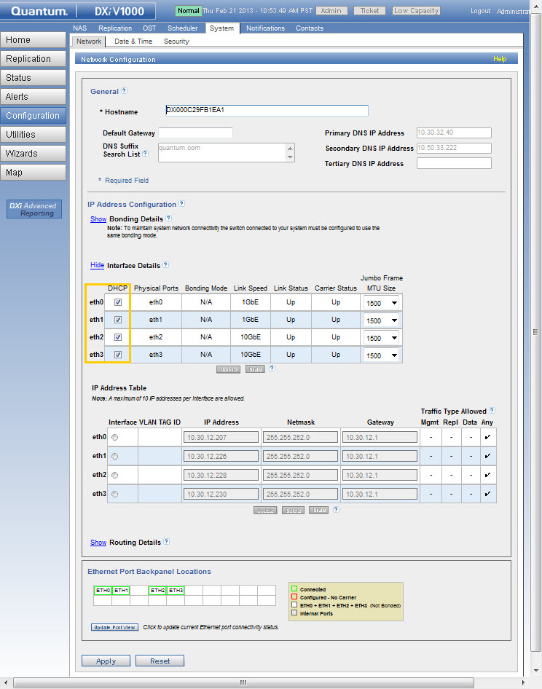
DHCP Network Configuration

Slide 13
DHCP Network Configuration (cont.)
DHCP Server owns the Lease Policy
  8 hours Typical Lease for Roaming Clients
  24 hours Typical Lease for Stationary Clients
If the DXi V1000 is powered down and fails to renew its DHCP lease, a new IP may be assigned on power up!
For Long-Term Usage
  Reserve IP using DNS
  Reserve IP using DHCP Reservation

Slide 14
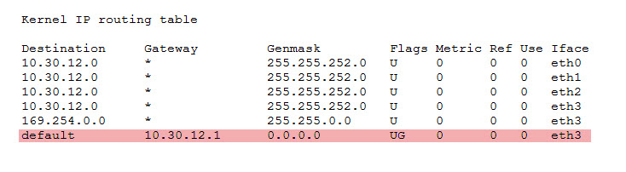
DHCP Network Configuration (cont.)
DHCP Assumes A Simple Network Topology
  One Subnet for All Network Interfaces
  One DHCP Server Handles the Subnet
Do not Mix DHCP and Static IPs
  Routing Table Conflict
  Resolv.conf not Persistent
For Complex Network Topologies use Static IPs

Slide 15
DHCP Network Configuration (cont.)
VLAN ID can only be Specified on Windows or Linux based DHCP servers
DHCP Spec. (RFC 2132) does not define a VLAN property.
Example for VLAN ID1922: 01:04:00:00:07:82
  Vendor Option Type: 01
  Length of Vendor Data: 04
  VLAN ID 1922: 00:00:07:82
There were two escalations from the field for this issue

Slide 16
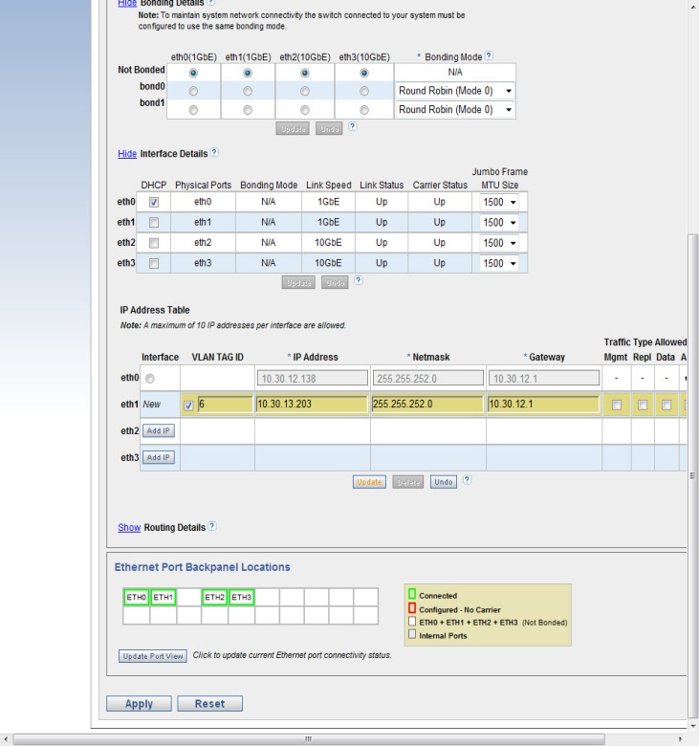
Multiple VLAN IDs
Up to 10 VLAN IDs per Network Interface Supported

Slide 17
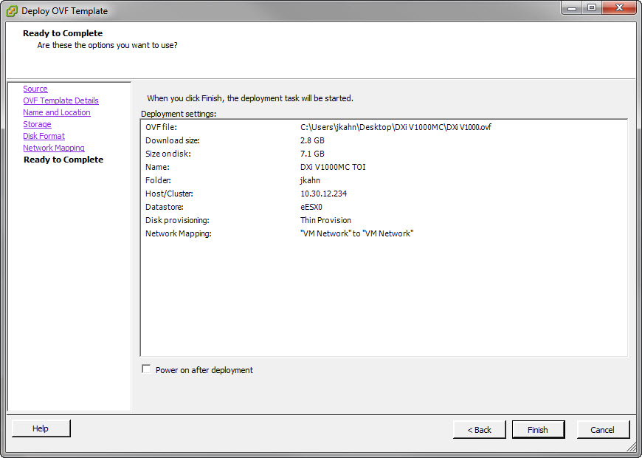
Installation/Boot Process
OVF Import is unchanged

Slide 18
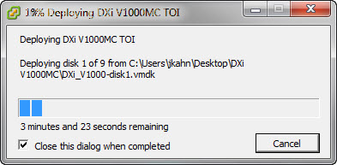
Installation/Boot Process (cont.)
Thin Provisioning
  Fast Import (<10 minutes for RAID storage)
  Minimizes storage footprint
Thick Provisioning, Lazy Zero
  Fast Import (<10 minutes for RAID storage)
  Storage Fully Provisioned to 2.3TB
Thick Provisioning, Eager Zero
  Slow Import (>60 minutes for RAID storage)
  Storage Fully Provisioned to 2.3TB & Initialized

Slide 19
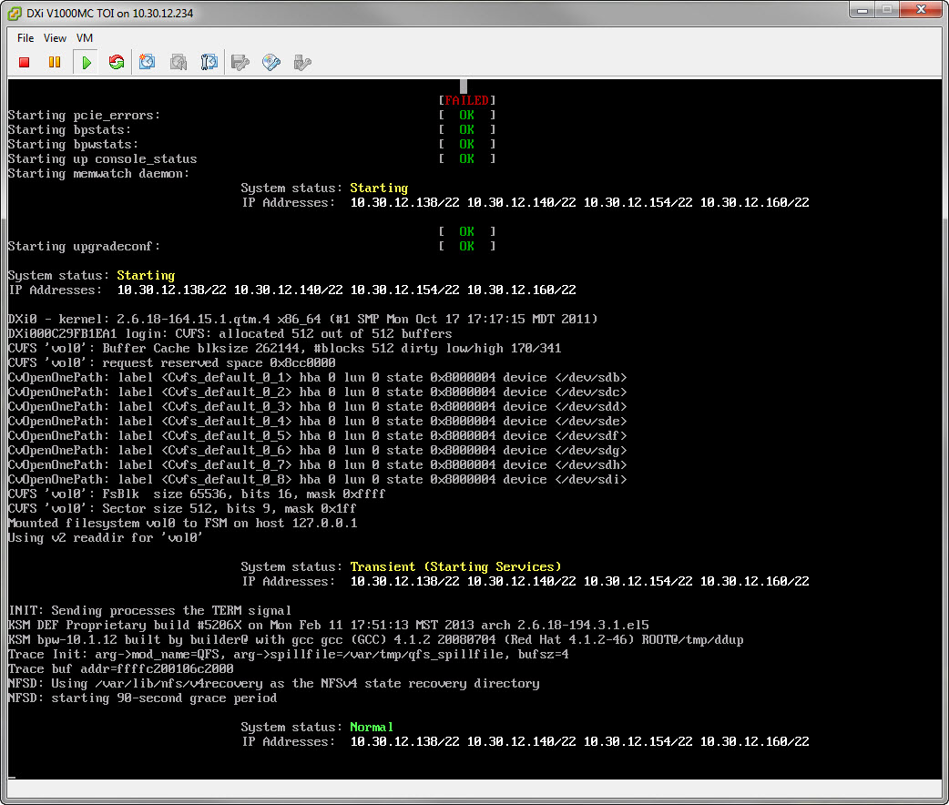
Installation/Boot Process (cont.)
Console displays:
  Assigned IP Addresses
  Boot State

Slide 20
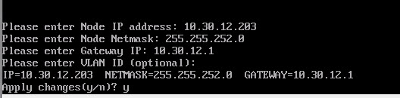
Installation/Boot Process (cont.)
Console is used to configure a Static IP for eth0 if Network Infrastructure has no DHCP Service
If Gateway IP specified, ICMP Ping is used to validate network connectivity
Network Configuration is persistent

Slide 21
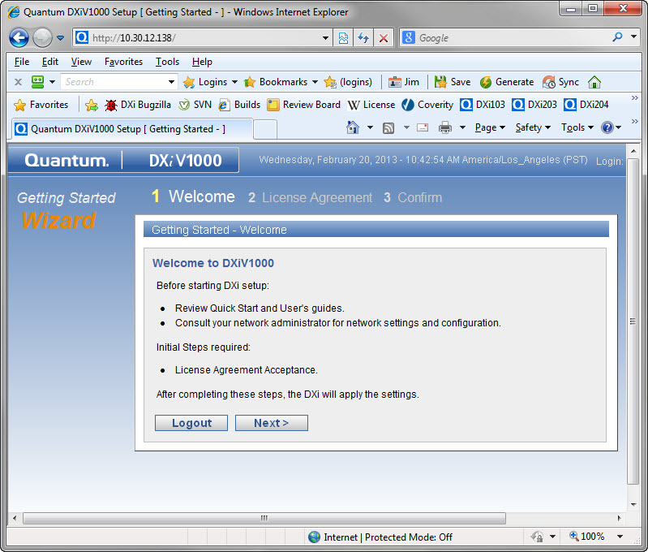
Installation/Boot Process (cont.)

Slide 22
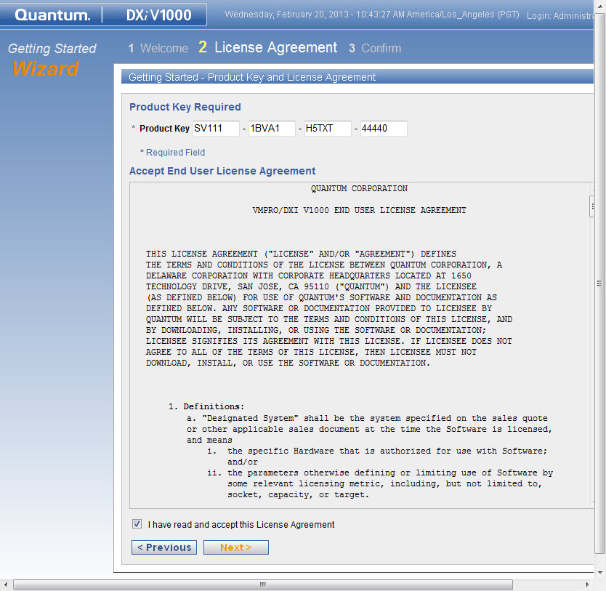
Installation/Boot Process (cont.)
New Product Key
  Key Divided into 4 groups of 5 digits to Minimize Data Entry Errors by Admin
  Product Key is Encoded for Further Protection

Slide 23
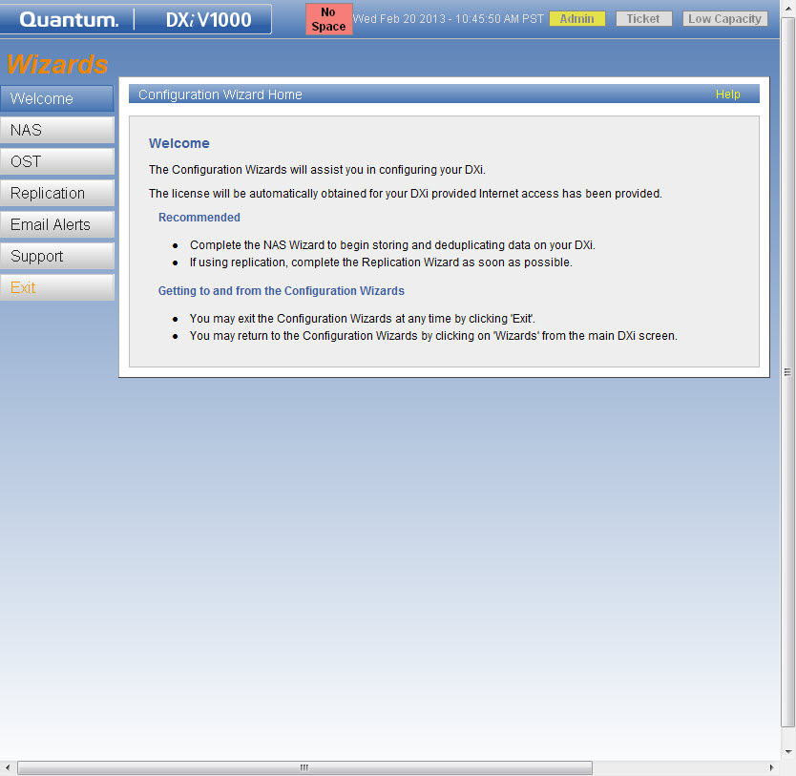
Installation/Boot Process (cont.)
License Key should be obtained within 60 seconds
Internet Access via HTTPS (Port 443) is Required

Slide 24
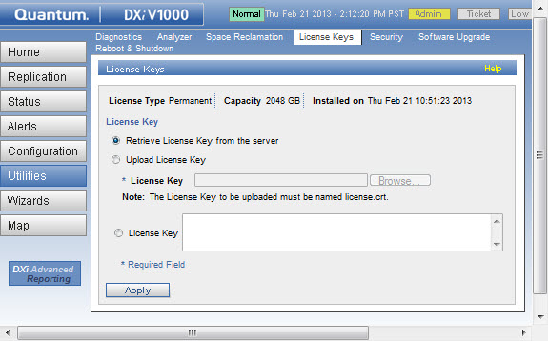
Installation/Boot Process (cont.)
Used for Immediate License Check
  Capacity Upgrade
  Automatic License Check is Performed Daily
Used if no Internet Access to License Server
  License Key is manually entered

Slide 25
Secure File Shred
Carried over from DXi SW version 2.2.1
  Run Space Reclamation Utility
  Run Secure File Shredding Utility
  Unique to DXi V1000:
  Fully Inflates thin-provisioned storage to 2.3TB
  Remove old ESXi Snapshots

Slide 26
Health Check & Data Collection
Collect DHCP Information
  /etc/dhclient-eth*.conf
  /etc/dhcp6c.conf
  /var/log/dhclient/dhclient-eth*.leases
Collect License Information
  /opt/DXi/activation.txt
Collect Network Throttle Information
  /etc/sysconfig/network-scripts/tc-*
  /etc/sysconfig/network-scripts/global-tc

Slide 27

Performance - Small Reference Test System
Small System
Dell R510
2xE5620 CPUs
24 GB RAM
1 datastore
  LSI MegaRaid 9260
  8x1 TB 7200 rpm disks
  RAID6 configuration
Most sensitive performance configuration
Performance unchanged from initial version 2.1.1 (Red River program)

Slide 28

Performance - Large Reference Test System
Dell R910
2xE7540 CPUs
64 GB RAM
5 Datastores
  10xLSI Matterhorn Storage Servers
  20 LUNs
  16x1 TB 7200 rpm disks in each LUN
  RAID6 configuration
Performance unchanged from initial version 2.1.1 (Red River program)

Slide 29
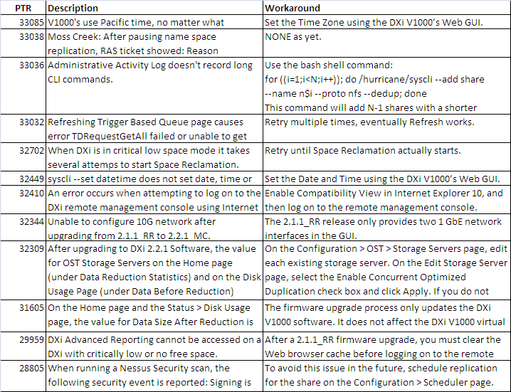
Known Issues

Slide 30
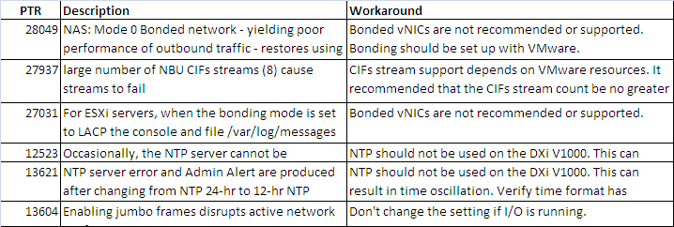
Known Issues (cont.)
Super bugs:
  31324 Super: Project Moss Creek. PTRs agreed to address in this program
  31325 Super: Moss Creek Bugs found in test (or others to be considered during test)
  31326 Super: Bugs deferred from the Moss Creek release

Slide 31
SW Upgrades
John Cramer

Slide 32
Version 2.2.1 (Moss Creek) Upgrade Plan
Moss Creek is a mandatory upgrade
  Current code expires on 4/30/2013
  2.1.1 code will not start after this date
    Network Interface Remains Operational
    All Other Services are Disabled
  TSB available with process to recover systems that are not upgraded prior to 4/30/13.
Notification emails to go out to the IB and Standard Edition customers starting on March 6th
Customer notifications are being driven through Salesforce
  Campaign will flag Inside Sales to call IB customers about upgrade
  Current IB includes 33 customers
  Standard Edition customers will get email only - about 500 customers
Information about upgrades will be posted on quantum.com, CSWeb, and Forum V
30-day Trial customers will not be notified
  All existing trials will expire prior to April 30.

Slide 33
Moss Creek Upgrade Process
V1000 code is Customer upgradable with a .fw file using same process as other DXi models
  Instructions for upgrading the SW are included in Users Guide
.fw upgrade image is located on CSWeb and at:
  http://forms.quantum.com/Software/V1000upgrade/
  Link will be active by March 5th
During the upgrade, SW contacts license server for new license key.
  Outbound HTTPS (Port 443) must be allowed in customer firewall to enable contact with license server
To upgrade dark sites (installations without internet access) GCH must be contacted to get the license key.
  Customer must provide SN so that IB record can be verified and license key retrieved
  No Dark Site customers are currently identified

Slide 34
Moss Creek Upgrade Process
Dark Site Upgrades
  Only allowed for customers with a valid IB record and Service contract
  Standard Edition(free SW) customers do not qualify for running SW on a dark site
    Standard Edition SN’s are not in the IB.
GCH looks up license key on mosaic.quantum.com and emails it to the customer
Instructions for manually entering license key are in the Quick Start Guide

Slide 35
Moss Creek Licensing
Mosaic.quantum.com is used for V1000 licensing
Actions that can be performed on Mosaic V1000 license page
  Look-up License Key
  Look-up Product Key
    Product Key is also located in IB record
Product Key is 20 characters (New to 2.2.1)
  Format: CX123-4CAD5-6789X-XXXXX
  First 14 digits are the product serial number
  Last 6 digits are alpha-numeric code
If the license does not exist on Mosaic when customer installs the product it will default to trail mode. 256GB capacity, 30 day

Slide 36
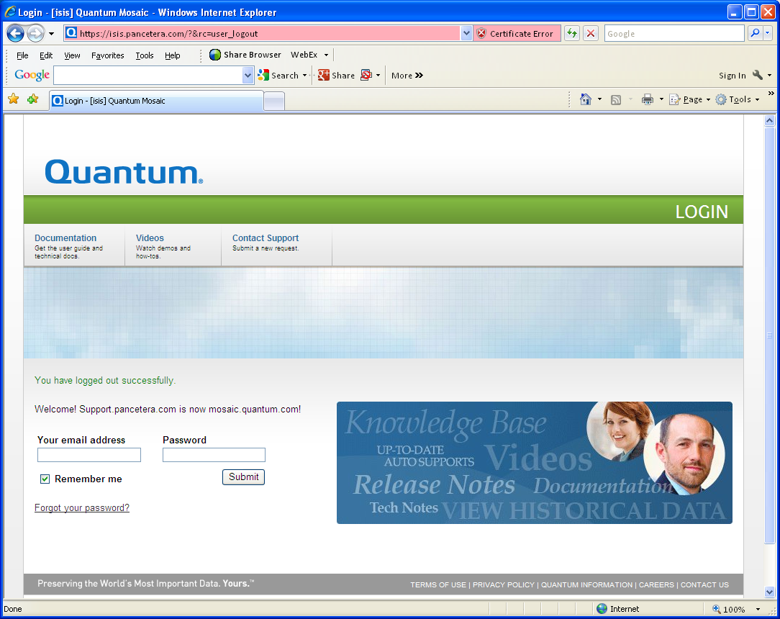
Moss Creek Licensing
Login page for mosaic.quantum.com
Staff or Admin privileges needed for V1000 Licensing

Slide 37
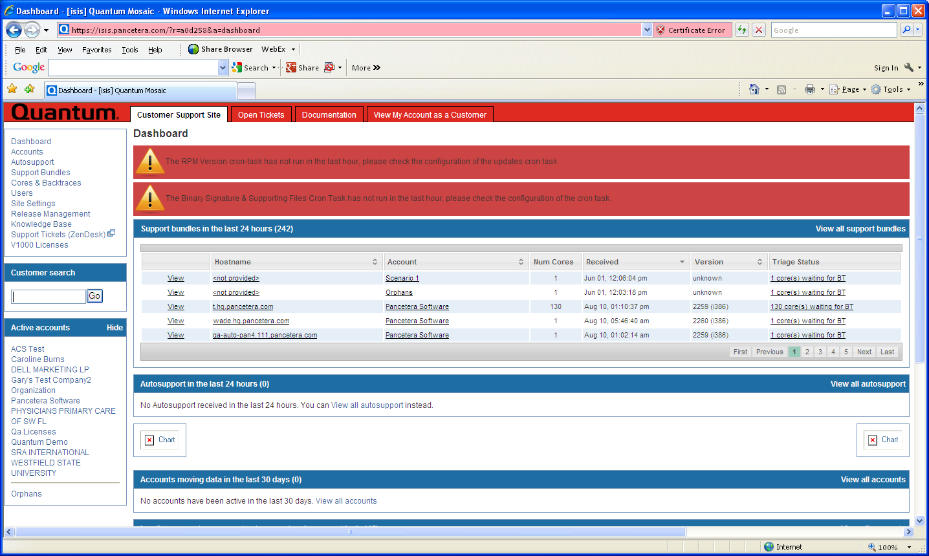
Moss Creek Licensing
Mosaic.quantum.com Dashboard
V1000 Licenses

Slide 38
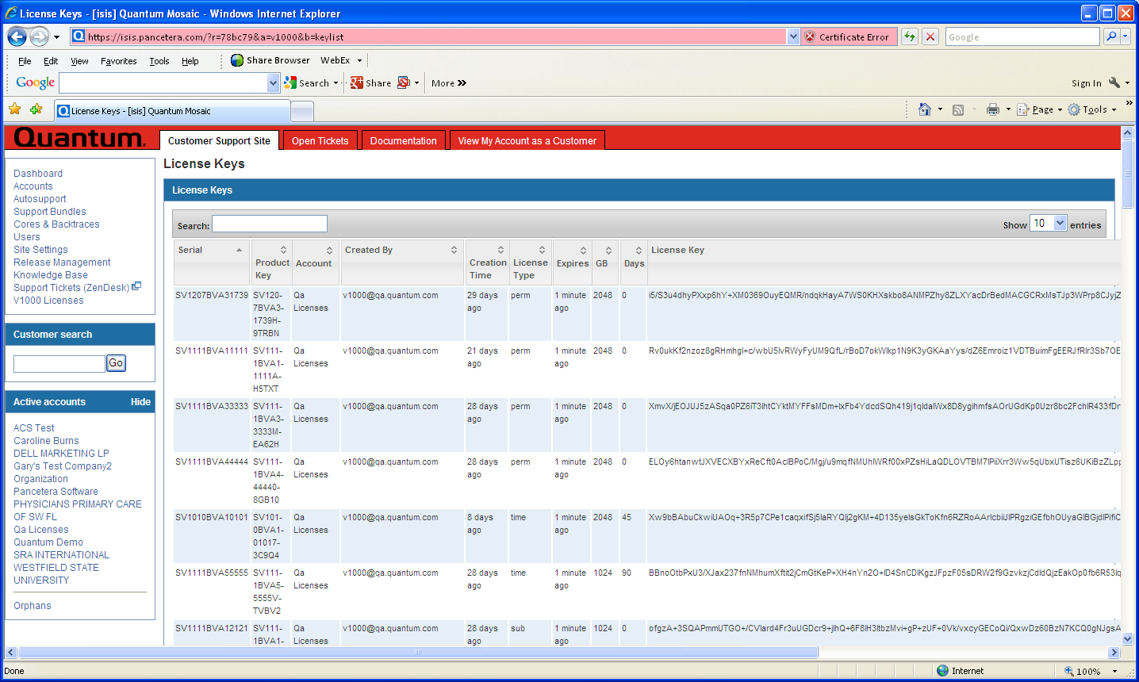
Moss Creek Licensing
V1000 Licenses Page
Can sort on SN, Product Key, Account, Created By fields to find Customer license key

Slide 39
Moss Creek Download Media Kit (DMK) Certificates
Initial Sale Serial Number Certificate

Slide 40
Moss Creek Download Media Kit (DMK) Certificates
Initial Sale Product Key Certificate
Used during installation to license product

Slide 41
Moss Creek Download Media Kit (DMK) Certificates
Initial Sale Download Authorization Key Certificate
Used to download application from https://quantum.subscribenet.com/

Slide 42
Moss Creek Download Media Kit (DMK) Certificates
Upgrade Certificate
Upgrade Types:
  30-day Trial to Enterprise Edition
  Standard Edition to Enterprise Edition
  1TB to 2TB Capacity
  Monthly Subscription 1TB Capacity Upgrade
Product Key must match customer’s original Product Key for the software instance

Slide 43
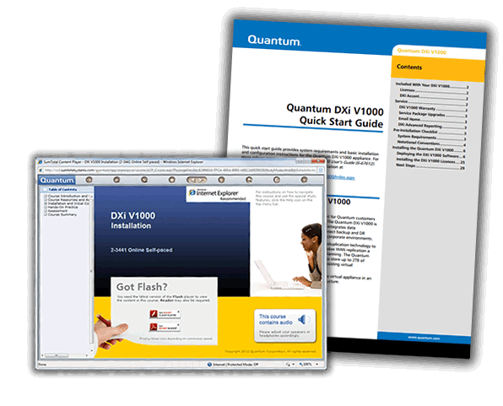
Documentation and Training Updates
Tom Sajbel

Slide 44
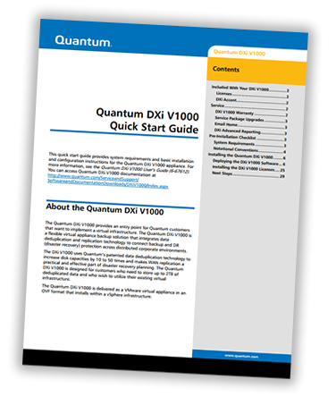
Documentation Updates
DXi V1000 Quick Start Guide
DXi V1000 User’s Guide
DXi V1000 Online Help
DXi V1000 Release Notes
DXi-Series Command Line Interface (CLI) Guide

Slide 45
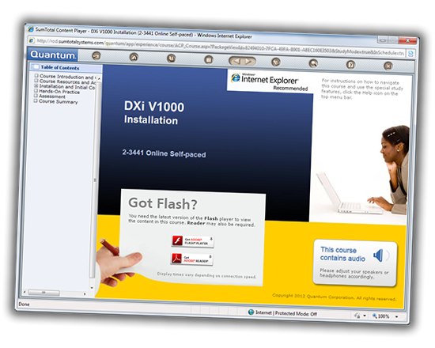
Training Updates
Quantum Service and Service Partners:
  DXi V1000 2.2.1 Service Update (2-4444a Online Self-Paced)
  DXi V1000 Installation (2-3441 Online Self-Paced)
    Practice deploying and initially configuring 2.2.1_MC software
  Status and Log Collection document
  Log Locations & Descriptions document
  At a Glance document
Customers
  Installation & Initial Configuration video
  Network Configuration Overview video
  User Essentials document

Slide 46
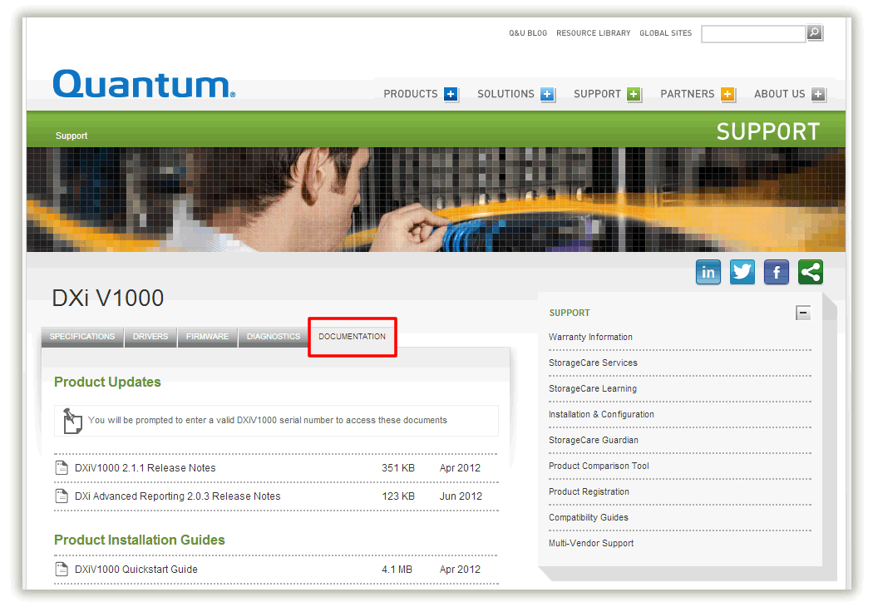
Accessing Docs and Training Videos
Documentation: www.quantum.com/v1000docs
How-to videos: www.quantum.com/v1000howtos
  *Standard Edition customers need to go to Forum V web site

Slide 47
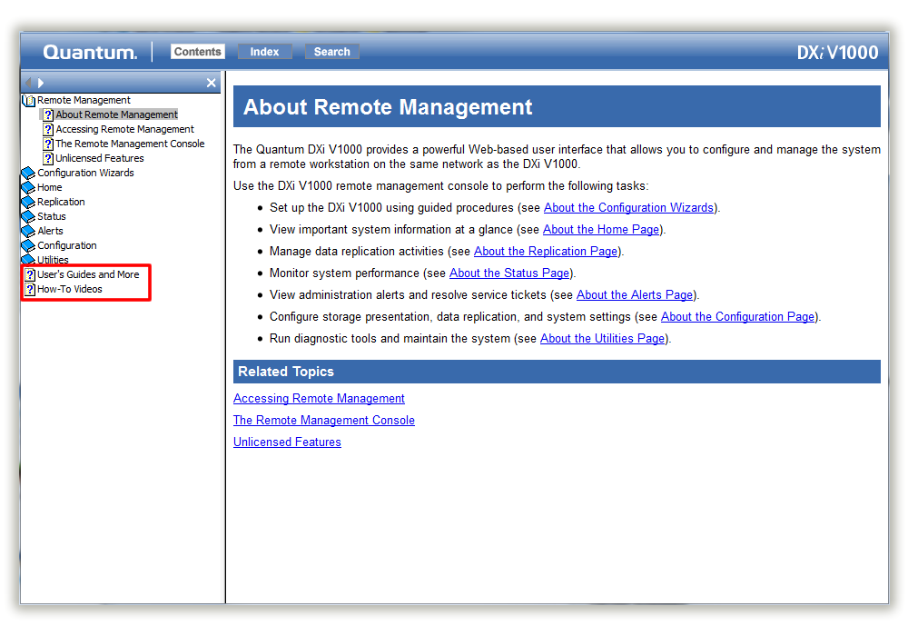
Accessing Docs and Training Videos (cont.)
Links are also in the Online Help

Slide 48
Service Model Updates
Jim Hibbard

Slide 49
Service Model
No Changes to existing service model
  Case Management: Global Call Handling (GCH), CDS
  Technical Support: Advanced Solutions Product Support (ASPS)
  Field Support: No field support is available.
  Escalation Support: Service Engineering Specialists (SES), Quantum Sustaining Engineering SUS
  Replacement Part Fulfillment: NA
Initial DXi V1000 SW version 2.1.1 had no time bound licensing and will expire on April 30, 2013. Moss Creek will deliver DXi SW version 2.2.1 to DXi V1000.
  Install base will require mandatory upgrade to version 2.2.1
  Product Management/Marketing will take care of communication to the install base
    IB consists of 33 customers with 115 licenses – Any IB customer calling in for support should be reminded of mandatory upgrade
    Approximately 500 Standard Edition customers
  Dark Site Licensing Process
  Service Plan Update – GCH Assistance
  Standard Edition (free version) support offered through Forum V only (http://forumv.co/)
  No recovery process for expired Standard Edition licenses. New installation of 2.2.1 required.

