Slide 1
DXi SW Version 2.3
Yukon 2.3 Program
TOI for Global Service
12DEC2013

Slide 3
Agenda
Marketing Overview
Data Path Improvements
1:2 Replication Fan-Out
Software Upgrade Infrastructure
Drive Replacement Utility
Other Notable SW Changes
Component Firmware and Hardware Qualifications
Enabler Product Updates (New Chargeback Feature)
Bug Fixes and Known Issues
Documentation and Training Updates
Service Updates
Q&A
Note: Ask questions as we go. Q&A also at the end.

Slide 4
Marketing Overview
Presenter – Mike Simone

Slide 5
DXi 2.3 Software: Goals
Cloud Enablement
Enhanced Disaster recovery options support on premise or cloud DR sites
Interoperability and Security Updates
Increased customer satisfaction

Slide 6
DXi Software 2.3: Feature and Benefits
Feature | Benefits
1:2 Replication Fan-out | Enhanced Disaster Recovery: target both internal IT data centers and cloud hosted DR
32 Replication snapshots | Enhanced Disaster Recovery: an entire month of snapshots for daily DR generations
Charge back statistics and per share/partition accounting | Cloud enablement: deduplication statistics per share/partitions, enables charge back
NAT IP Configuration | Cloud enablement: public addresses that allow access into Q-Cloud and MSP
Windows Server 2012 – OST plugin | Interoperability: operating systems and OST
NDMP PTT w/ LTO-6 | Interoperability: latest tape technology
SAMBA 3.6.12 | Security updates
Data Path improvements | Customer experience: improved NFS performance, reliable performance with aged blockpool
Software upgrade infrastructure | Customer experience: easier to add features, fix patches; reduce service costs
Disk as a CRU | Customer experience: ease and speed

Slide 7
Supported Products
Yukon 2.3 will support the following DXi Platforms:
  DXi4500
  DXi4601
  DXi6500
  DXi6700
  DXi6701 & DXi6702
  DXi6802
  DXi8500 (1TB)
  DXi8500 (2TB)
  DXi8500 (3TB)
  DXi V1000
Yukon 2.3 will not support the DXi V4000 Virtual Platform. DXi V4000 may be supported by a subsequent version 2.3+ program.

Slide 8
Release Strategy
Controlled Release
  DXi 2.3 software will initially be available as a controlled release for field upgrades beginning December 4, 2013. The controlled release will make the software available only to specific customers.
Factory General Availability
  Depending on the success of the controlled release, the software is scheduled to be generally available from the factory in mid-February 2013.
Software upgrade support
  Yukon 2.3 can be upgraded, in a single step, from any system that is running DXi Software 2.1 code or later.
  Earlier versions will require a 2 step upgrade; first step to version 2.1 and then to 2.3.

Slide 9
ISV Updates
Yukon 2.3 will support the current shipping versions of the Quantum-defined Tier 1 and Tier 2 ISV backup applications. These are defined in the “Quantum Disk & Automation Products ISV Partner Tiers” document (Agile document number 0-14611-10).
Yukon 2.3 will support NDMP’s use of Quantum Tape Libraries with LTO6 Tape Drives for Path-To-Tape (PTT).
Yukon 2.3 will include a new Blockpool filter for Luminex.
Backup Exec 2012 R2 will be supported upon release of that software by Symantec

Slide 10
Data Path Improvements – BFST and BPW
Presenters: Joshua Martin/Matt Dewey

Slide 11
Overview
DXi Software Version 2.3 will contain:
BFST v3.8
BPW 11 (10.1 in 2.2.x)
No significant upgrade time impact from either component
General performance and robustness improvements
Improvements in BLOB Tree Verify
BPW Stats hourly logging

Slide 12
Performance Improvements
Reduce IO Operations.
  Up to 20% higher throughput for specific operations, involving highly redundant ingest or inbound replication.
Boost to blocklet index performance when stored on non-SAS disks.
  Up to 120% higher throughput on mature systems.
  Seen on DXi4xxx, DXi65xx, DXi67xxx and upgraded DXi85xx systems, not DXi85xx factory installed DXi 2.2 and above or DXi68xx systems.
New Luminex mainframe VTL filter - better RDE.
Other small BLOB tree speed and concurrency improvements
Some BLOB store and stitching performance improvement, to avoid bpw deadman timeouts / cores.
BPW read-ahead fairness improvements, mostly for sync NFS ingest.
DXi Startup after an unclean shutdown no longer waits for the startup verify to complete.
Many other small things…

Slide 13
BFST Robustness Improvements
Various corner-corner-corner case issues fixed e.g.
  Data corruption
  Improved low memory handling
  Multiple unclean shutdowns rapidly in succession that resulted in journal corruption, long recovery
  Quarantine enhancements
  Statistics repair
Many other small things...

Slide 14
Back-end Changes
BFST/BPW Core file names change, watch out!
  Previously, BFST core files would always resemble the following format:
  "blockpool-1361352273-1002“
  With changes to our threading, the CentOS5 system sometimes does not
  use the process name correctly, some cores will be labeled with the
  internal thread name instead, perhaps like this:
    "Server thread-1361352273-1002“
  The core processing scripts have been updated to handle this, so
  coredumps are still correctly handled automatically. However, if you
  are looking for BFST cores manually, please note the file names may be
  different than expected.
Blockpool 'Hidden' reports (quick_, summary_, etc.) no longer require their '_‘.
BPWd now logs to /var/log/DXi/bpw.log
BPW stats are logged every hour in /var/log/DXi/bpw_stats_log.csv

Slide 15
BLOB Tree Repair
Note: A more detailed, follow-up Sustaining Engineering led discussion with ASPS/SES/RTS to be scheduled.
There are two ways a BLOB Tree Repair is initiated:
After an unclean shutdown. The subsequent Blockpool verify during startup detects the corruption. This is the most common.
Live in Production. The Blockpool can start a BLOB Tree verify and repair if it detects corruption during normal operation.
Prior to 2.3:
The system would be effectively offline until complete.
  which was on the order of hours to days
The customer would experience backup failures, DXi timeouts and deadman timeouts / cores in both cases, especially #2.

Slide 16
BFST Background BLOB Tree Repair (Now in 2.3)
The BLOB Tree Repair occurs in the background while system is in production.
The repair takes just as long (if not longer due to concurrent activity), but the DXi will still respond
The system state is changed from Normal to Attention while the repair is underway.
Backups that require reading of existing data will fail gracefully with a retry error code.
  Including, but not limited to: all VTL operations, Synthetic Fulls, TSM Space Reclamation, ingest verification
Customer will need to reattempt the jobs that have failed after the repair has completed.
If persistent corruption is found, a RAS ticket will be generated.
Online Help documents this behavior for a customer
  Remote Management > The Remote Management Console: Blockpool Verify Behavior
Progress/etc. still visible in blockpool_master.log.

Slide 17
BFST Background BLOB Tree Repair (cont.)
Scheduled operational behavior during a BLOB Tree repair:
  * Other forms of Namespace Replication will also fail in the same manner: Synchronize and Failback.
  ** For existing shares or partitions, if the sharition and all data has been created after the repair starts, the replication all should work fine with no errors.
  *** GC has an Admin alert that will be sent if it is not able to successfully reconcile after 24 hours.
Operation | Rep Out (NR) * | GC | HC
Error | Logs, GUI Failure** | Logs, GUI Failure | Logs, GUI Failure
RAS | Yes | No | No
Admin Alert | Yes | No*** | Yes

Slide 18
BFST Background BLOB Tree Repair (cont.)
Backlog activity while the BLOB Tree repair is running.
* Continuous will throw out the request after a number of retried failures.
** Trigger will put the event back at the end of the queue for future processing.
Operation | Rep: Continous* | Rep: Trigger**
Error | Logs | Logs
RAS | No | No
Admin Alert | No | No

Slide 19
BFST Background BLOB Tree Repair (cont.)
New I/O during a BLOB Tree repair.
  * NAS overwrite will fail
  ** Most operations on existing cartridges will fail as data has to be read to move or even append to the tape. For any cartridge operation to succeed, new VTL ingest must be to cartridges created after the repair has started.
  *** NR/Sync/Failback of new sharitions created and written to after the start of the repair will succeed.
  **** Cartridges created prior to the repair operation cannot be operated on, thus TBR will be N/A for these. However TBR will work for any cartridges created and written to after the repair started.
Operation | Ingest | Read | Rep In | NR/Sync/ Failback*** | TBR/ Continuous
Error | NAS: None* VTL: Various** OST: None | NAS: None VTL: Various** OST: None | None | Logs, GUI Failure | None****
RAS | No | No | No | Yes | No
Admin Alert | No | No | No | Yes | No

Slide 20
BFST Background BLOB Tree Repair (cont.)
Active operations may fail when a BLOB Tree repair starts during active production.
  This could be more likely with 2.3 as it no longer waits on the startup Blockpool verify to finish prior to starting DXi services.
  * Cartridges already mounted could be stuck in the drive in some scenarios. This is still being looked investigated.
  ** Replication in will succeed unless it is a TBR or Sync as the final unpack will fail. We were not able to determine how OST AIR will behave in time for the larger Service TOI.
  *** GUI Failures will be only visible for NR, Failback, and Sync failures.
Operation | Ingest | Read* | Rep In ** | Rep Out | GC | HC
Error | None* | Logs, Retry Error | None ** | Logs, Retry Error (OST), GUI Failure*** | Logs, GUI Failure | Logs, GUI Failure
RAS | No | No | No** | Yes (NR-based)
Admin Alert | No | No | No** | Yes | No | Yes

Slide 21
1:2 Replication Fan-Out
New Customer SW Feature
Presenter – Mary Hayes

Slide 22
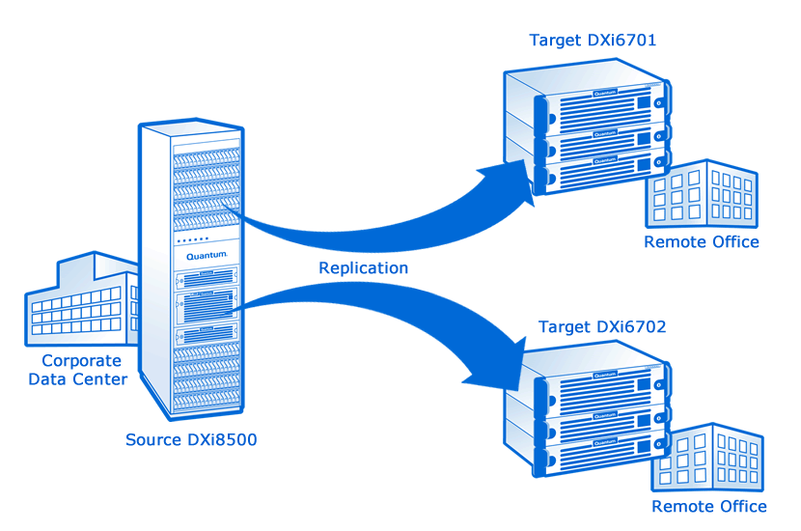
1:2 Replication Fan-Out
Support replicating any number of partitions or shares to up to 2 target DXi systems
  OST OpDup already does this
This feature will support all of the following:
  Namespace replication
  Trigger replication
  Concurrent OpDup
OST AIR replication
  Today it replicates only to the configured replication target
  In 2.3 you can select 1 of the 2 configured replication targets to do 1-1 OST AIR
Requests are put in a single replication queue and executed in order
Throttling will be at the system level and not configurable by target
New replication.conf entries

Slide 23
1:2 Replication Fan-Out (cont.)
What is the same?
  Namespace Replication
    Snapshot replication of entire share or VTL
    Related Features: Namespace Recovery, Failback
  File/Cartridge (Trigger) Replication
    Share: Files are replicated/removed as changes are made to the file system
    VTL: Cartridges are replicated/removed as they are dismounted from a tape drive or deleted
    Synchronization: Snapshot replication of entire share or VTL recovered to the target share/VTL
  OST Replication
    Optimized deduplication: replication to DXi configured or unconfigured targets
    AIR: replication to 1 configured replication target per storage server
  Continuous Replication
    Automatic replication of data as it is ingested
Notes:
The page includes tables for configuring target and source DXi systems. Previously, there were separate pages for configuring source and target systems. In the following example, notice that there are two target DXi systems configured in the Target DXis table.

Slide 24
1:2 Replication Fan-Out (cont.)
What is different?
  Maximum of 2 Replication Targets for 2.3 Release
    Architecture changes support a higher level fan-out for future releases
  Each Share/VTL can replicate to 0 to 2 of these targets
    Specification of target is made per share/VTL
  Pause/Resume replication is made per replication target
  Enable/Disable replication is made per share/VTL
    File/Cartridge replication is configured at the share/VTL level
  OST Replication
    OST requests to configured replication targets determined at run-time and use a higher performance path
    OST requests to unconfigured replication targets are accepted
    OST AIR must configure a single configured replication target per storage server
Notes:
The page includes tables for configuring target and source DXi systems. Previously, there were separate pages for configuring source and target systems. In the following example, notice that there are two target DXi systems configured in the Target DXis table.

Slide 25
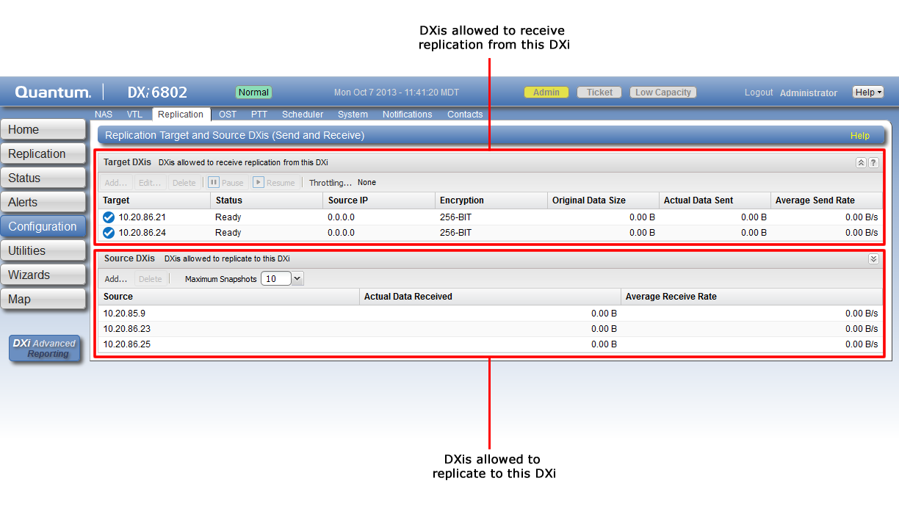
1:2 Replication Fan-Out (cont.)
A new Replication Target and Source DXis (Send and Receive) page (Configuration > Replication) has been created to support the process of adding and editing multiple replication targets.
Notes:
The page includes tables for configuring target and source DXi systems. Previously, there were separate pages for configuring source and target systems. In the following example, notice that there are two target DXi systems configured in the Target DXis table.

Slide 26
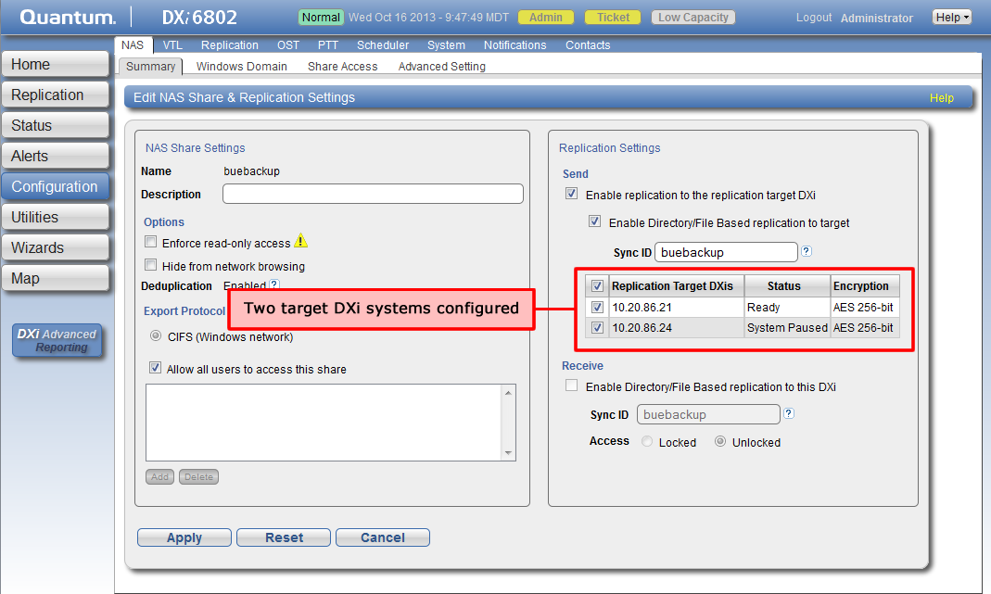
1:2 Replication Fan-Out (cont.)
If two target DXi systems are configured for replication, you will see both systems listed when adding and editing NAS shares and VTL Partitions.
Notes:
This example shows two target DXi systems configured in the Replication Settings section of the Edit NAS Share & Replication Settings page (Configuration > NAS > Summary). Both Continuous/Namespace and Directory/File Based replication are configured in this example.

Slide 27
replication.conf Log File Example
[root@<DXiname>-Src ~]# less /snfs/common/data/hurricane/replication.conf
[Share_1]
AllowedDestinations=10.20.86.21,10.20.86.24
DedupAge=60
DedupEnabled=true
DedupWindowDuration=0
DedupWindowScheduledTimes=
NodeId=
NodeName=buebackup
ReplicationEnabled=true
ReplicationInterval=
ReplicationRole=3
ReplicationScheduledTimes=
RetentionAge=120
ShareType=1
TriggerReplication=1
TriggerReplicationId=buebackup
TriggerReplicationLastSetting=1
[Target_1]
AttrBallVersion=3
EncryptionEnabled=false
EncryptionMethod=1
ProgramReplicationIsPaused=false
ReplicationDestination=10.20.86.21
ReplicationRevision=6
ReplicationSourceIP=10.20.86.22
TargetNASReplicationSupported=true
TargetVTLReplicationSupported=true
UserReplicationIsPaused=false
[Target_2]
AttrBallVersion=3
EncryptionEnabled=false
EncryptionMethod=1
ProgramReplicationIsPaused=false
ReplicationDestination=10.20.86.24
ReplicationRevision=6
ReplicationSourceIP=10.20.86.22
TargetNASReplicationSupported=true
TargetVTLReplicationSupported=true
UserReplicationIsPaused=true
Notes:
The replication.conf file is commonly used to troubleshoot issues with replication configuration. The file now includes details on multiple target DXis. This example shows a NAS share configured with two target DXis for Directory/File Based replication.

Slide 28
Software Upgrade Infrastructure
New Customer Serviceability Feature
Presenter – Byron Hack/Matt Dewey

Slide 29
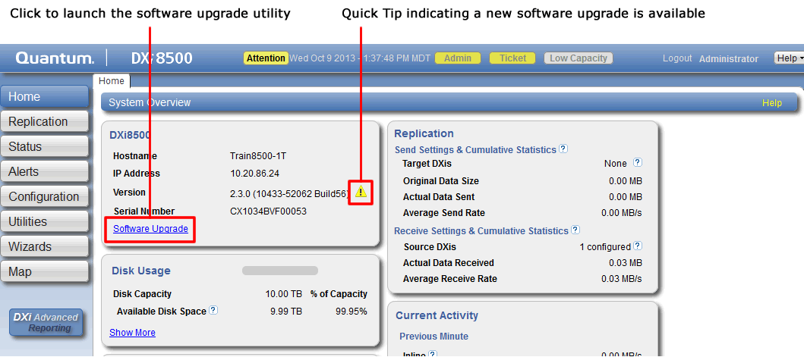
Software Upgrade Infrastructure
New Software Upgrade Utility available in the user interface and new CLI commands.
  Available from the 2.3 user interface
  Allows customers to update their DXi software
  Software upgrades can include new features as well as bug fixes

Slide 30
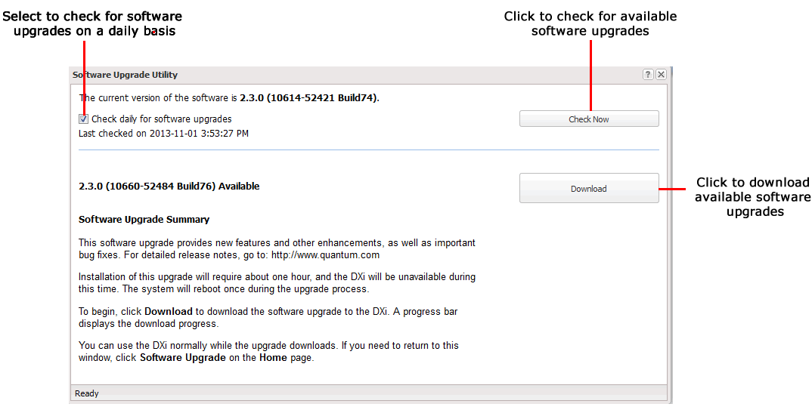
Software Upgrade Infrastructure (cont.)
Software Upgrade Utility supports the following functions
  Automatically check for software upgrades
  Manually check for software upgrades
  Download and install available software upgrades

Slide 31
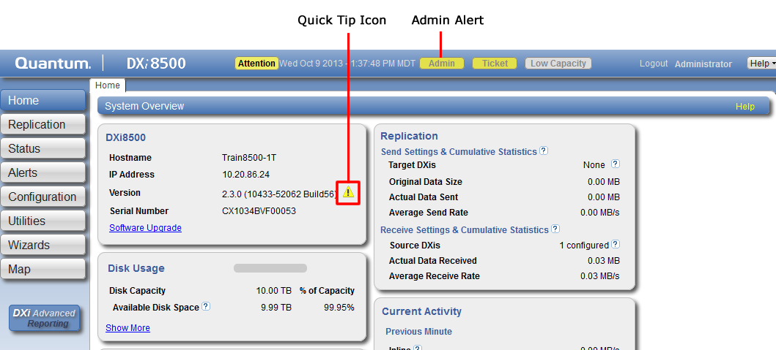
Software Upgrade Infrastructure (cont.)
If upgrade is available, user is notified by Admin alert and Quick Tip Icon

Slide 32
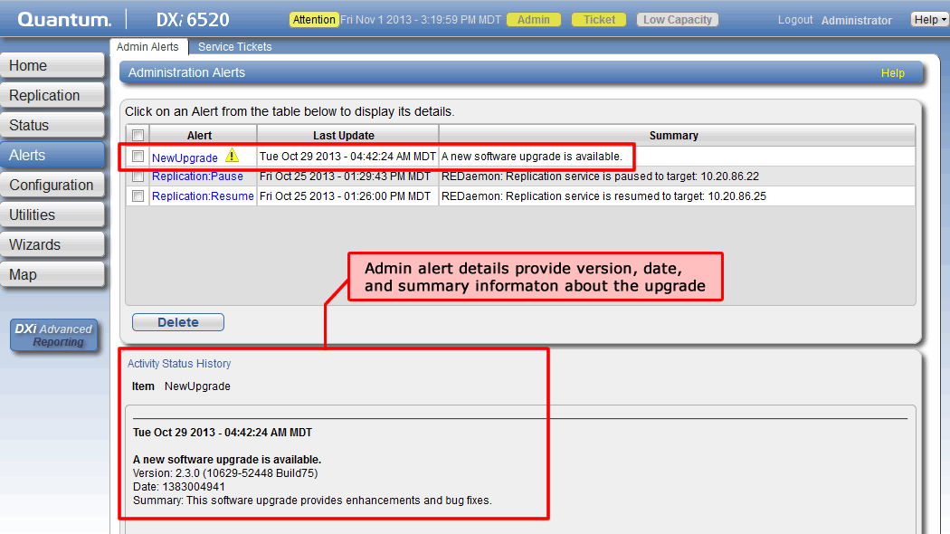
Software Upgrade Infrastructure (cont.)
Example of Admin Alert

Slide 33
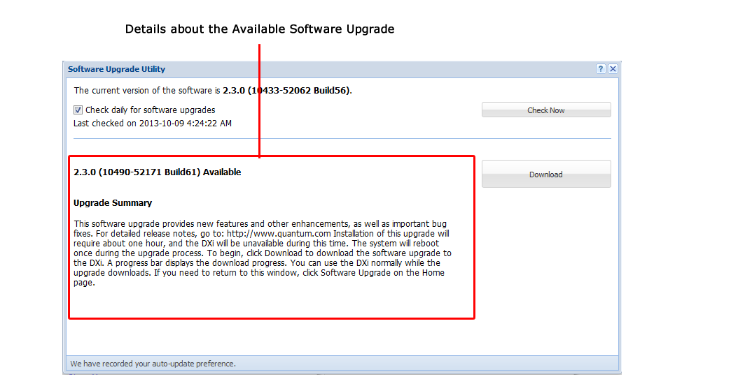
Software Upgrade Infrastructure (cont.)
Software Upgrade Utility shows details of available upgrade and selectable Download option
  Bottom Status Bar displays download progress
Notes:
The bottom status bar displays download progress. It will take several minutes to download the upgrade, depending on network speeds. You can use the DXi normally while the upgrade downloads.

Slide 34
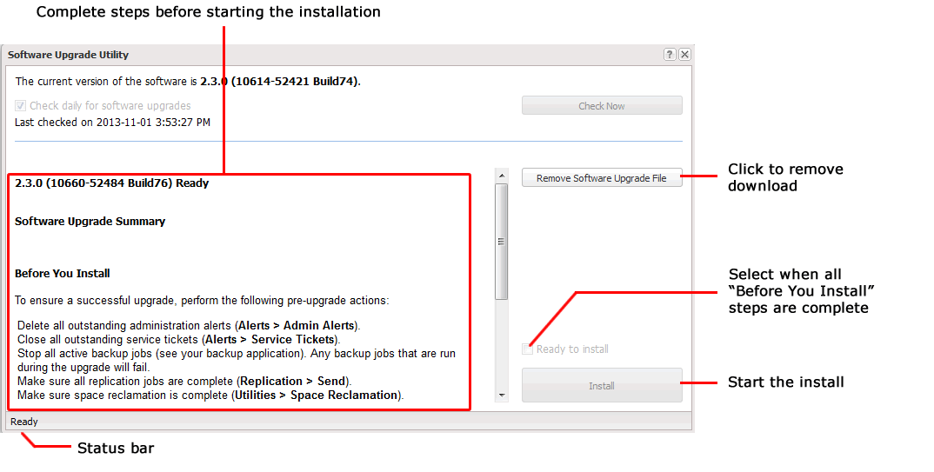
Software Upgrade Infrastructure (cont.)
When download completes, Software Upgrade Utility provides “Before You Install” instructions
Notes:
The instructions can differ depending on the type of upgrade, but typical actions include the following.
Required:
Delete all outstanding administration alerts (required).
Close all outstanding service tickets (required).
Optional, but recommended:
Stop all active backup jobs (see your backup application). Any backup jobs that are run during the upgrade will fail.
Make sure all replication jobs are complete or nearly complete.
Make sure space reclamation is complete or nearly complete.
Download a system diagnostics file and transfer the file to a safe repository off of the DXi.

Slide 35
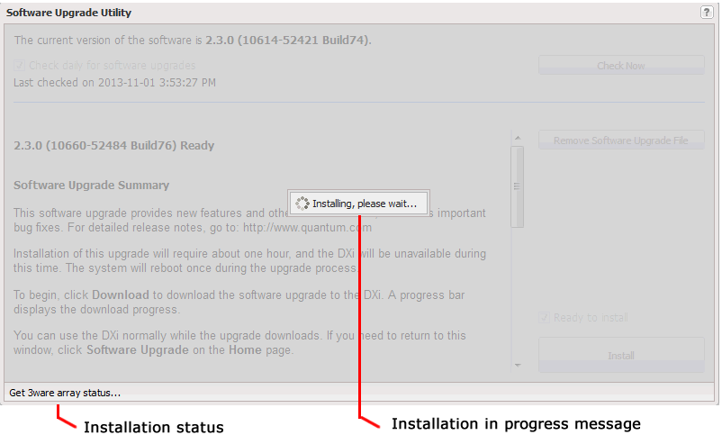
Software Upgrade Infrastructure (cont.)
“Installing, please wait” message displays during the installation

Slide 36
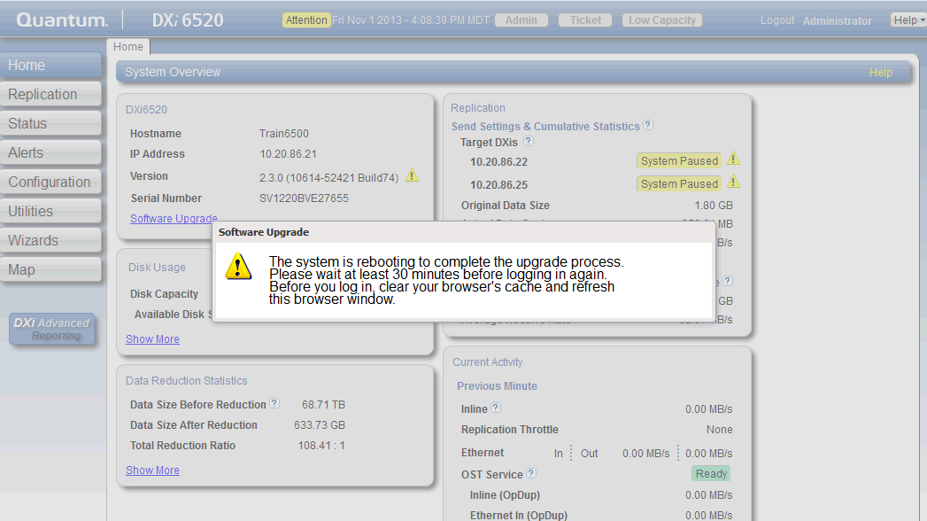
Software Upgrade Infrastructure (cont.)
The DXi will restart one or more times to complete the upgrade

Slide 37
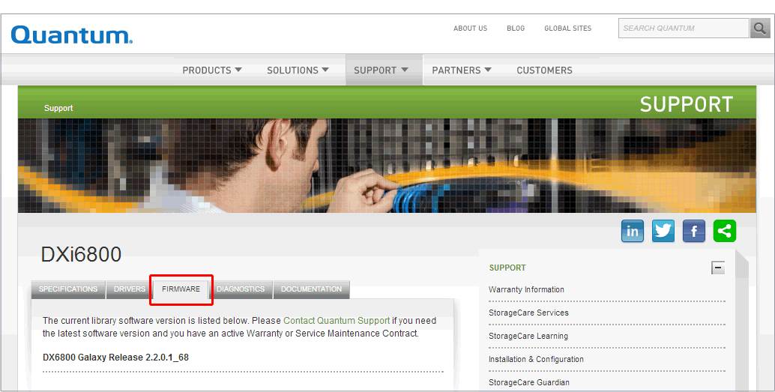
Software Upgrades for Dark Sites
Customers can manually upload a software upgrade file using the Upload New DXi Software Upgrade File page (Utilities > Software Upgrade), which is the same as in previous releases. However, the manual installation process now leverages the new Software Upgrade Utility.
Download the software upgrade file (.fw) from the Quantum Support Web site.
Notes:
If a DXi system is located at a secure site and is not connected to the Internet, customers cannot configure the system to automatically alert them when a new software upgrade is available and then download and install the software upgrade. They must upload a software upgrade file manually.
Turn polling off

Slide 38
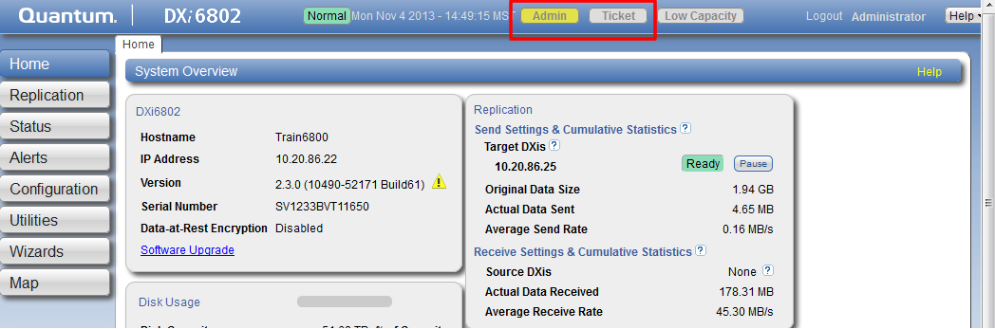
Software Upgrades for Dark Sites (cont.)
Save the software upgrade file to a location accessible to the DXi.
Resolve and close all open Admin Alerts and Service Tickets. These are both required tasks.

Slide 39
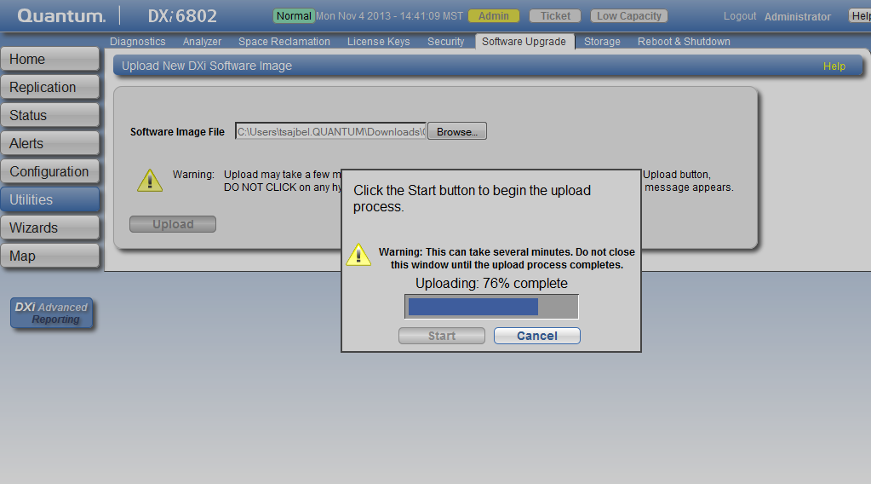
Software Upgrades for Dark Sites (cont.)
Navigate to Utilities > Software Upgrade.
Browse to the location where you saved your software upgrade file and select the file. An example software upgrade file name for a DXi6800 is QTM-DXi68xx-upd-2.3.0-10660-52510-Build77.fw.
Click Upload and then Start to upload the file to the DXi.

Slide 40
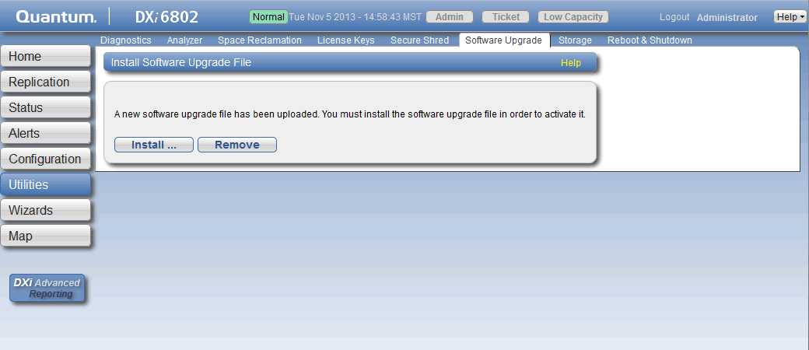
Software Upgrades for Dark Sites (cont.)
Click Install to start the software upgrade process. The DXi launches the Software Upgrade Utility.

Slide 41
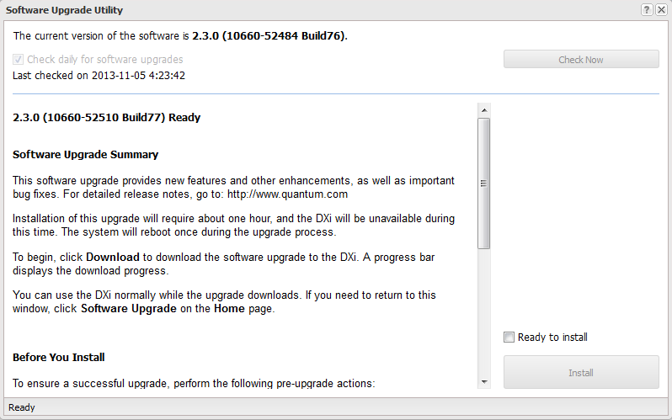
Software Upgrades for Dark Sites (cont.)
Read the “Before You Install” information and complete any recommended tasks before continuing. Similar to the other method, you must resolve and close all open Admin Alerts and Service Tickets before the Ready to install checkbox can be selected.
Select the Ready to install checkbox.
Click Install. The installation process begins and an “Installing, please wait” message appears.
Notes:
Depending on the type of upgrade, the DXi may be placed in service mode for up to two hours. While in service mode, the system will shut down all backup and replication services. If necessary, the DXi will restart one or more times to complete the upgrade, as described in the message below.

Slide 42
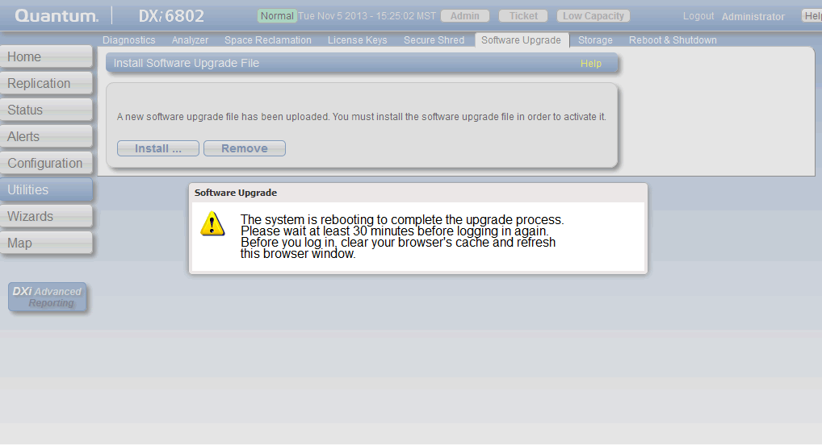
Software Upgrades for Dark Sites (cont.)
Step-by-step procedures on how to manually upload a software upgrade file are located in the “Uploading a Software Upgrade File” section in the DXi User’s Guides.
Notes:
You can log back into the system when the user interface is available. Clear your Web browser cache before logging on to the user interface. This will ensure the user interface displays correctly.

Slide 43

YUM & Automatic Change Notification
We implemented a YUM utility and RPM database to support the software upgrade infrastructure
Yum uses http, port 80
Updates.quantum.com hosted by QTM IT
  Virtual server backed-up by vmPro
  Established a separate internal test YUM server
Automatic Change Notification (ACN)
  This is how we define which DXi’s will get an upgrade alert
  Enables controls based on SNs, Platform, Software Version as well as customer scripting.
  Will be planned and managed in the program Core Team
  Supports frequent and changes (such as adding a serial number during a controlled release period)
  Could be used to “Block” serial numbers
  Considering options to control deployment to only customer with valid service contracts

Slide 44
Drive Replacement Utility
New Customer Serviceability Feature
Presenter – Chris Graves

Slide 45
Drive Replacement Utility
New Drive Replacement Utility added in 2.3
Customers can remove and replace disk drive CRUs using interactive utility that guides them through the process
Separate instructions are also available to replace a drive without the utility
  Available from CSSP and posted on Quantum.com
  Downloadable link on the utility page
2.3 release supports a single drive failure only
Products Supported
  DXi6500, DXi6700, and DXi6800
  DXi4000 is exclusively service by Dell
  DXi8500 support in a subsequent release
Notes:
Note: The Drive replacement instructions are also included in the DXi Field Service Manuals for Quantum Service and Service Partners.

Slide 46
Drive Replacement Utility – RAS tickets
Drive-related RAS tickets contain “right now” summary of drive issues, if any exist, in the details
  The information is generated on-the-fly when a RAS ticket is viewed.
  It is transient; once a drive returns to normal the RAS detail is no longer available.
  Email contains the same detail, generated when the email is sent.
  The detail is generated by new CLI: /opt/DXi/util/hddMgrUtil –report.
Notes:
Note: The Drive replacement instructions are also included in the DXi Field Service Manuals for Quantum Service and Service Partners.

Slide 47
Drive Replacement Utility – CLI example
>/opt/DXi/util/hddMgrUtil --report
System HDD Summary
Degraded Drives
Enclosure=System Node: c0e0, slot 0
Status=Missing, DrivesDegradedInVol=1
Volume=c0u0v0, VolStatus=Degraded
Model=WDC WD1002FBYS-02A6B0, SpecSize=1TB
Degraded Volumes
Enclosure=SAS Expansion
Volume=c1u0v0, VolStatus=Rebuilding
Rebuild stage 2/2 is 95% complete
Notes:
Note: The Drive replacement instructions are also included in the DXi Field Service Manuals for Quantum Service and Service Partners.

Slide 48
Drive Replacement Utility – GUI
Designed to replace a single drive only
  Will not open utility page if there are multiple failures.
  Exception: If a replacement is underway, and bad drive is already removed, the utility will open to monitor the ongoing drive replacement and rebuild.
The replacement process includes the following main steps:
  Overview
  Prepare for Removal
  Replace Drive
  Rebuild
The GUI utility does not have to be used for drive replacement
  A separate document can downloaded with instructions on drive replacement
Notes:
Note: The Drive replacement instructions are also included in the DXi Field Service Manuals for Quantum Service and Service Partners.

Slide 49
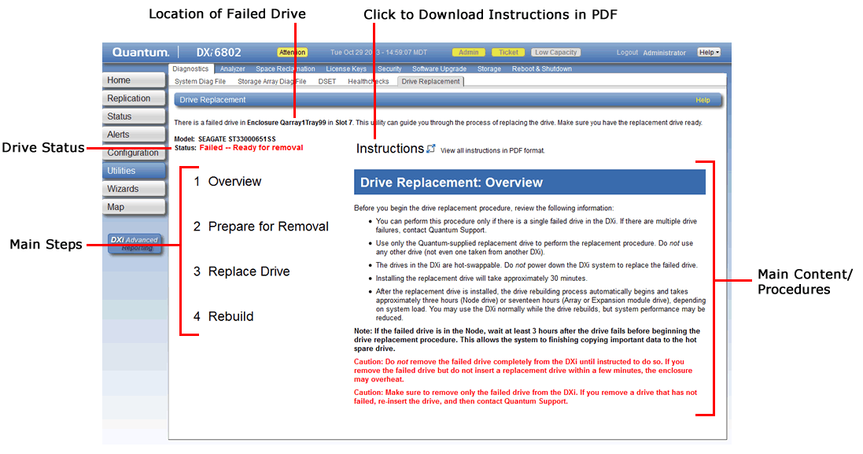
Drive Replacement Utility – Screen Layout
Notes:
The Drive Replacement: Overview page contains information a customer must read before starting the drive replacement process.

Slide 50
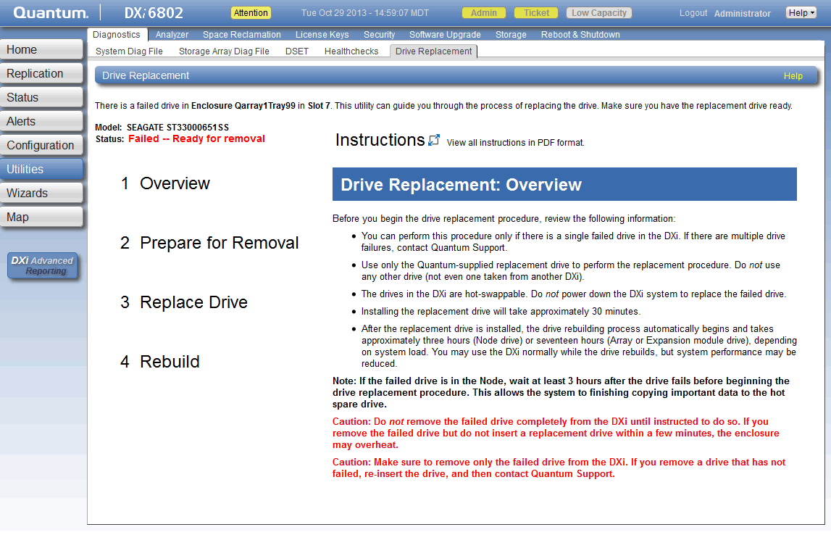
Drive Replacement Utility – Overview (cont.)
Notes:
The Drive Replacement: Overview page contains information a customer must read before starting the drive replacement process.

Slide 51
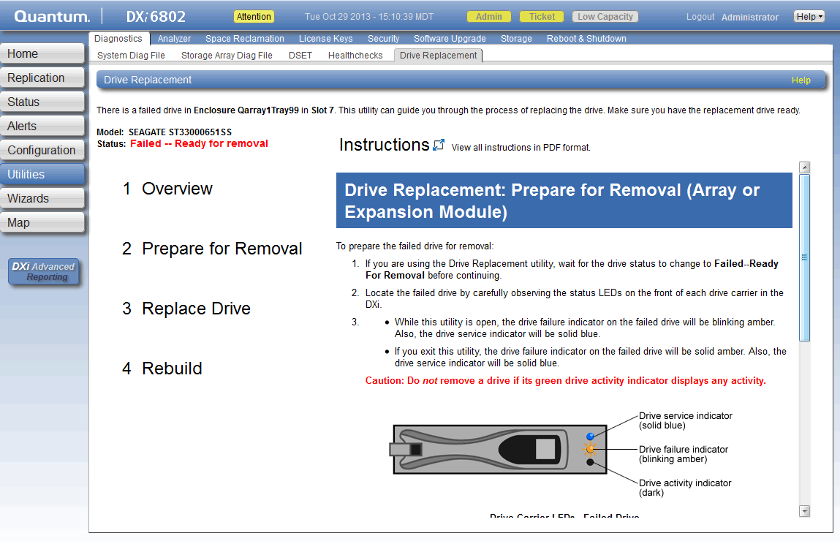
Drive Replacement Utility – Prepare for Removal
Notes:
The Drive Replacement: Prepare for Removal (Array or Expansion Module) page provides details on what needs to be done to prepare the drive for removal, including specific drive LED activity to observe and instructions on how to physically remove the drive. When the steps are complete, the utility automatically advances to the next main step.

Slide 52
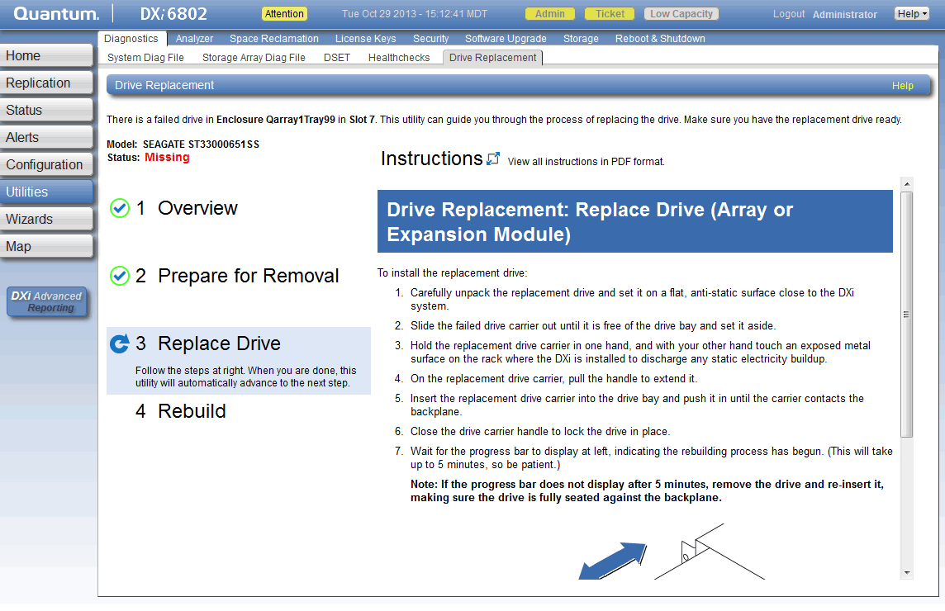
Drive Replacement Utility – Replace Drive
Notes:
The Drive Replacement: Replace Drive (Array or Expansion Module) page provides instructions on how to install the replacement drive. When the steps are complete, the utility automatically advances to the next main step.

Slide 53
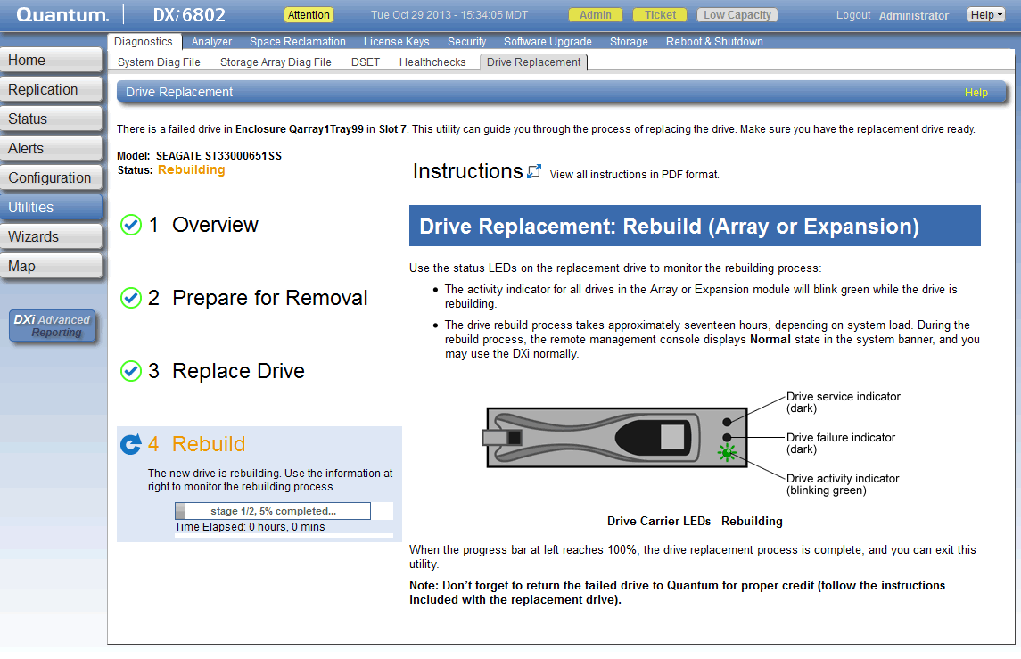
Drive Replacement Utility – Rebuild
Notes:
The Drive Replacement: Rebuild (Array or Expansion) page describes the status LEDs that the customer needs to monitor during the rebuild process. It also provides estimates on how long the rebuild process takes to complete. The following estimates are for a DXi6800 and may vary depending on the system load:
Three hours for a node drive
Seventeen hours for an array or expansion module

Slide 54
Other Notable SW Changes
Software Engineering
Presenters - Byron Hack/Shaun Hui/Sreevatsa Nagarajarao

Slide 55
Other Notable Software Changes - Overview
Increased Replication Snapshots
Replication Send Page Enhancements
Scheduler Enhancements
Network Configuration Enhancements
New OST Plug-in version 2.7.0
LTO-6 Support for Path to Tape
Miscellaneous Updates
  SAMBA update to 3.6.12
  Removal of MySQL and replace with PostgreSQL
  Removal of InnoDB Backup
  Security Enhancements
  Browser Support
  QuickMemen

Slide 56
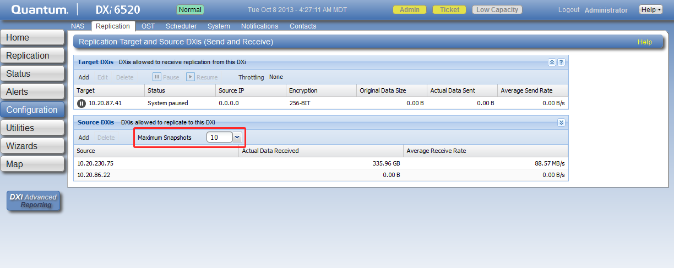
Increased Maximum Replication Snapshots
The maximum number of replication snapshots that a target DXi system can retain for a share or a partition has increased from 24 to 32. This number of snapshots can be changed at the system level. You cannot change the maximum snapshot number at the share or partition level.
DXi systems retain 10 snapshots by default. To change the maximum number of snapshots that the system retains:
On the target DXi system, go to Configuration > Replication.
In the Source DXis section, select the desired number of maximum snapshots to retain on the system from the Maximum Snapshots drop-down list.
Notes:
During scheduled or manual data replication, the DXi receives a snapshot from the source system. A snapshot contains all of the data necessary to fully recover or failback a NAS share or VTL partition to the point in time when the snapshot was saved. Once the maximum number of snapshots has been saved, the oldest snapshot is deleted to make room for each new snapshot that is received.
When working with customers, make sure they are aware that a large number of snapshots can consume a large amount of storage space. Increasing the number of snapshots may not be appropriate for all customers.

Slide 57
Replication Send Page Enhancements
The Replication Send page (Replication > Send) has been enhanced to let you easily manage outgoing data replication activities for all NAS shares or VTL partitions.
The Replication Send page allows you to do the following tasks:
  View replication information for shares or partitions
  Enable or disable replication for a share or partition
  Configure Directory/File or Cartridge Based Replication for a share or partition
  Initiate replication for a share or partition
  Synchronize a share or partition configured for Directory/File or Cartridge Based Replication
  View replication statistics for a share or partition configured for Directory/File or Cartridge Based Replication
  Schedule a share or partition for replication
  Manage replication targets
Notes:
Previously, you were required to manage NAS share and VTL partition replication activity on separate pages. The page also allows you to manage the target DXis configured on the system.
Refer to the “Replication” chapters in the DXi User’s Guides for step-by-step instructions on performing any of the tasks listed above.

Slide 58
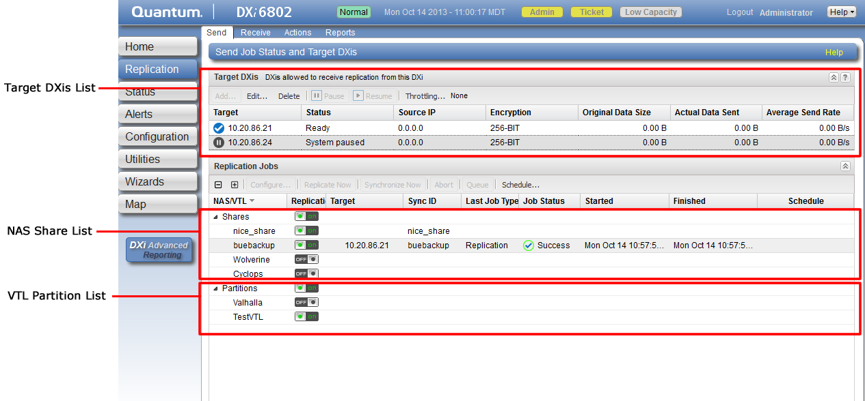
Replication Send Page Enhancements (cont.)
This Replication Send page example shows the location of the target DXi list along with a list of NAS share and VTL partitions.
Notes:
Previously, you were required to manage NAS share and VTL partition replication activity on separate pages. The page also allows you to manage the target DXis configured on the system.

Slide 59
Scheduler Enhancements
The redesigned Scheduler page (Configuration > Scheduler) page provides tools for quickly adding a new scheduled event, as well as for managing schedules for multiple shares or partitions.
The Scheduler page allows you to configure scheduled events for the following:
  NAS replication
  VTL replication
  Replication throttling
  Email reports
  HealthChecks
  Space reclamation
Schedule CLI Commands Have Been Deprecated
  The scheduler CLI commands have been deprecated, meaning that they will be phased out in the future and customers should be warned against using them. A “DEPRECATION” warning has been added to all scheduler commands documented in the DXi-Series Command Line Interface (CLI) Guide.

Slide 60
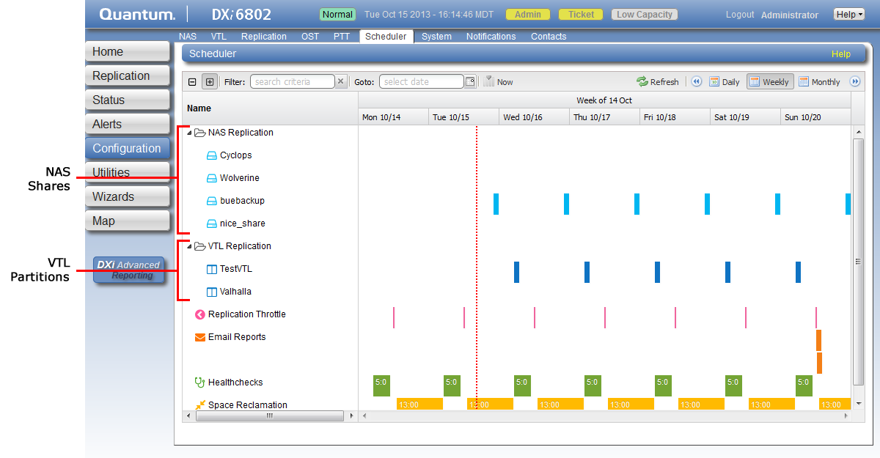
Scheduler Enhancements - Replication Schedules for NAS Shares and VTL Partitions
In the new Schedule page, the NAS and VTL tabs have been removed and the replication schedules for all NAS shares and VTL partitions display on the main calendar.
Notes:
In the example, notice the list of shares under NAS Replication and the list of partitions under VTL Replication.

Slide 61
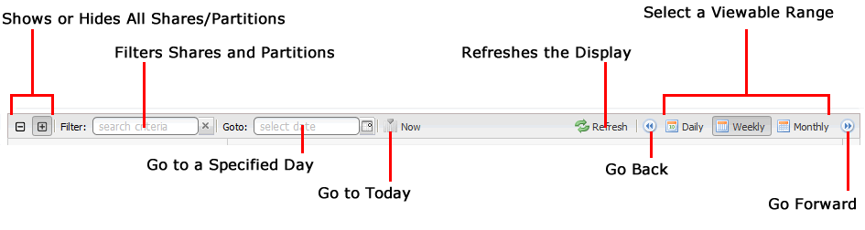
Scheduler Enhancements – Scheduler Toolbar
The Scheduler toolbar has been improved to include more functionality.
  Show or hide all shares or partitions, click the plus [ + ] or minus [ - ] icons.
  Filter shares or partitions based on name, begin typing in the Filter box. Click the x to clear the filter.
  View the schedule for a specific day, select it in the Goto pop-up calendar.
  View the schedule for today, click Now.
  Update the schedule view with the latest data, click the Refresh icon.
  Move the view backward or forward in time, click the arrows.
  Change the number of days displayed at a time, click Daily, Weekly, or Monthly.

Slide 62
Network Configuration Enhancements
Enhancements have been made to the Network page in the Getting Started Wizard and the Network page available from the Configuration menu (Configuration > System > Network).
The following settings have changed or been added in the 2.3 release:
  Virtual Local Area Network (VLAN) IDs
  External Host IP Addresses
  Network Address Translation (NAT) IP Addresses

Slide 63
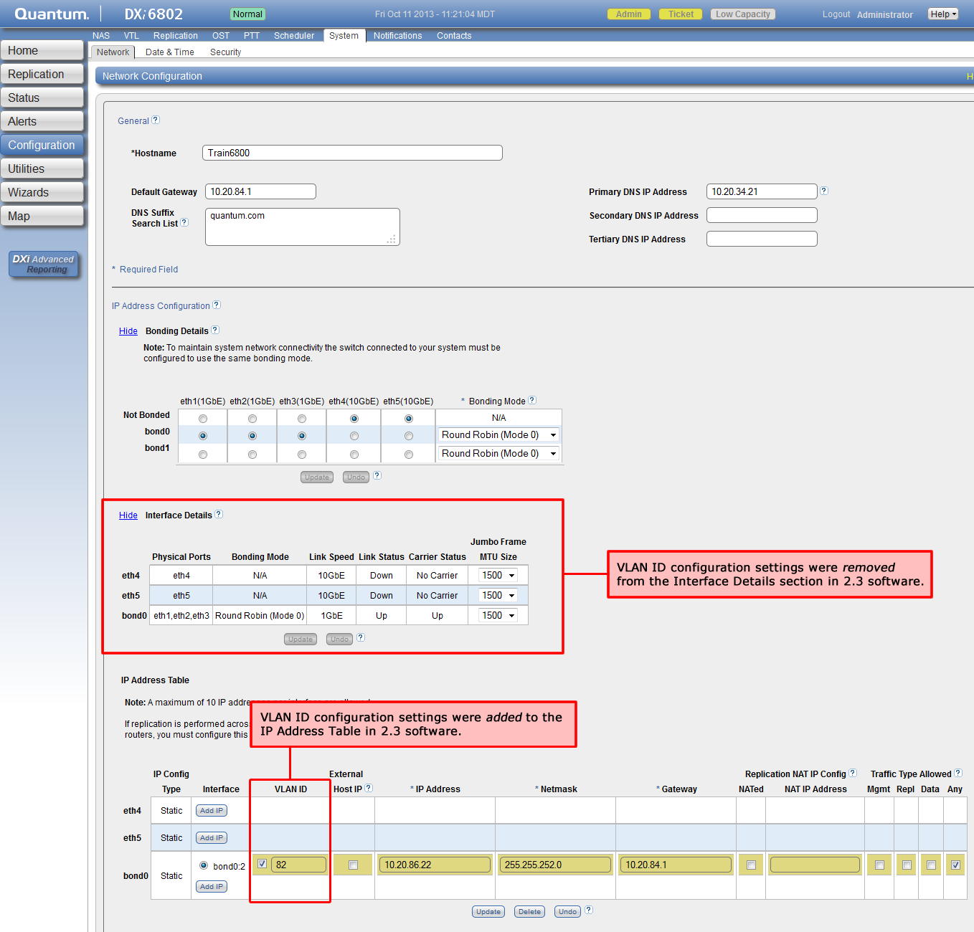
Network Configuration Enhancements (cont.)
VLAN ID Changes
Notes:
The VLAN configuration settings have moved from the Interface Details section to the IP Address table on the Networking pages. This an example of the updated Network page available from the Configuration menu.
For details on configuring VLAN IDs, refer to the network configuration procedures in the DXi User’s Guides.

Slide 64
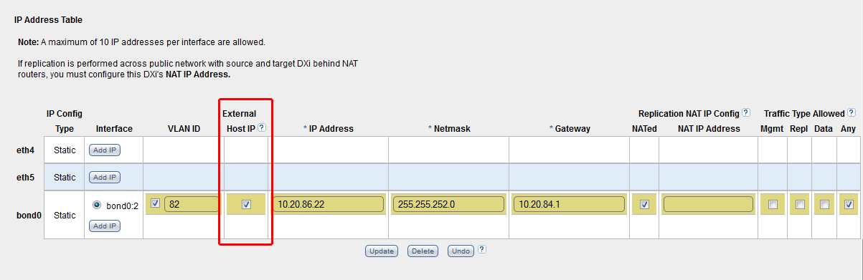
Network Configuration Enhancements (cont.)
New External Host IP Address Setting
  Only one external host IP address can be specified per network configuration. In addition, the following conditions must be met:
    Mgmt (management) or Any must be selected as the allowed traffic type
    The IP address must be on the same subnet as the Default Gateway to ensure external communication
  Customers should consult with their network administrator to identify which IP address to use as the external host IP address.

Slide 65
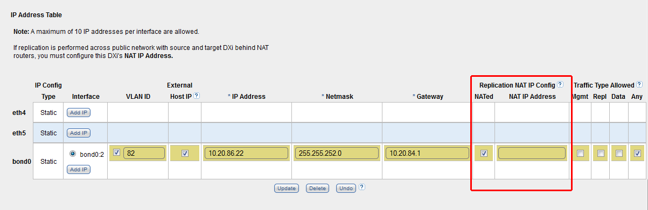
Network Configuration Enhancements (cont.)
Network Address Translation (NAT) Enhancements
  NAT IP address settings must be configured on a DXi system for replication to work if the following two criteria are met:
    The DXi is a replication target
    Replication is performed across a public network, with the source DXi and target DXi located behind NAT-enabled routers and firewalls
  The Replication NAT IP Config section has been added to the IP Address Table
Notes:
Network Address Translation (NAT) is the process where a network device, usually a firewall, assigns a public address to a computer inside a private network.
The NAT IP Address is the IP address used to access the DXi externally from a public network. A NAT-enabled router that connects the DXi to the public network performs the network address translation that maps the DXi internal IP to the NAT IP address. The target DXi presents the NAT IP to the source DXi as a valid replication interface.

Slide 66
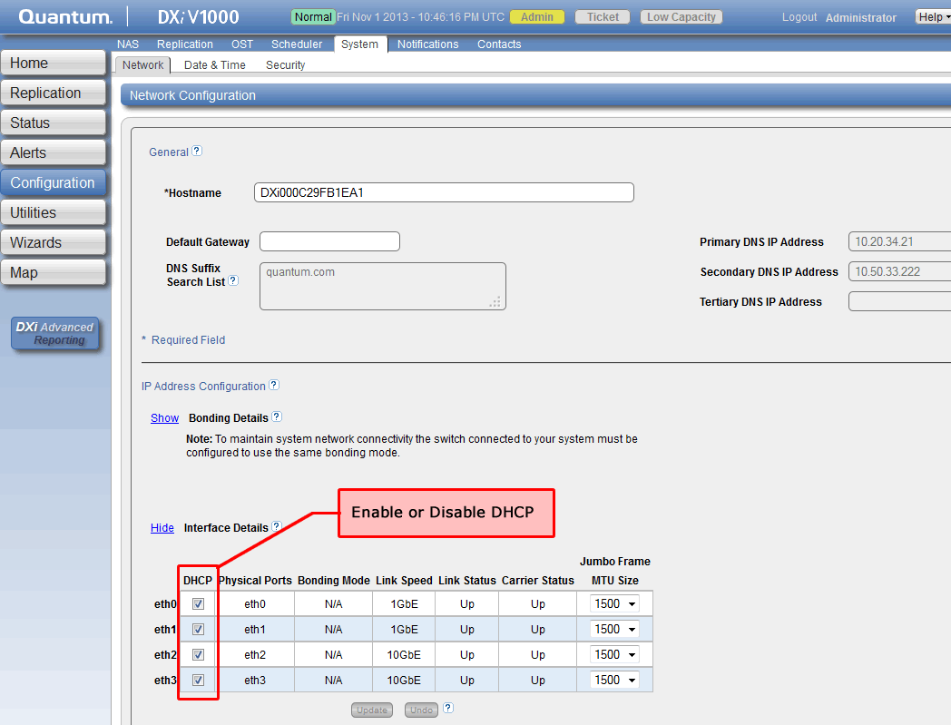
DXi V1000 Network Configuration Reminders
DHCP supported on virtual DXi systems only
Bonding of Ethernet ports not supported on virtual DXi systems
Notes:
Dynamic Host Configuration Protocol (DHCP) is supported on the DXi V1000; DHCP is NOT supported on any other DXi system with 2.3 software. DHCP allows the virtual Ethernet interfaces to automatically obtain an IP address from a DHCP server. If the customer uses DHCP in their environment but wants to assign a static IP address to one or more interfaces, you can disable DHCP at any time using the Network page.
Bonding virtual Ethernet ports is not supported on DXi V1000 virtual appliances with 2.3 software installed. This is important to communicate to the customer because the Network Configuration page will not prevent you from configuring a bonded device.

Slide 67
OST Plugin - Updates
Yukon 2.3 will support version 2.7.0 of the OST Plug-in
Notable features/enhancements:
  Chargeback support
  Large number of restore streams supported (64 streams tested)
  Cuts number of files created for OST in half
  Supports DXi hostname, as well as DXi IP address for storage server configuration on media server
  AIX version of the plug-in doesn’t require installation of gcc runtime package on the Media Server
  Yukon 2.3 will display OST Opdup statistics in the DXi GUI (Home page->Current Activity->OST Service) and CLI (syscli –-list oststats --all)

Slide 68
OST Statistics
# /opt/DXi/syscli --list oststats --all
Output data:
OST Statistics:
Total count = 2
[Client = 1]
Client id = AGGREGATE
Media Server count = 1
Time stamp = 1381789243 (Mon Oct 14 22:20:43 2013)
Measure period = 60000 ms
Accent Statistics: disabled
Optimized Duplication Statistics:
Images in-progress = 2
Remaining in rep-queue = 101326520320 bytes
Processed last 60 seconds = 1073741824 bytes
Unique last 60 seconds = 0 bytes
Processed to Unique ratio = 0.00:1
Ethernet bandwidth rate = 0.00 bytes/s
Virtual rate = 17895698.00 bytes/s
Bandwidth Reduction = 100.00
Ethernet In = 0.00 MB/s
Inline = 17.90 MB/s

Slide 69
OST Plugin Compatibility
Compatibility
  Yukon 2.3 will support version 2.6 of the plug-in (no Chargeback)
  Customers upgrading to Yukon 2.3, can remain on version 2.6 of the plug-in
  Plug-in upgrade to version 2.7 or DXi upgrade to Yukon 2.3 can happen in any order

Slide 70
OST Plugin – Compatiblity (cont’d)

Slide 71
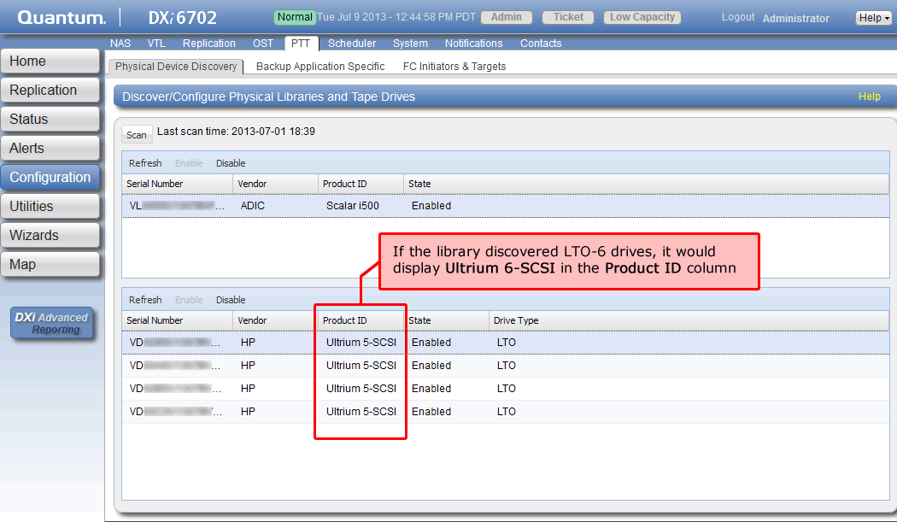
LTO-6 Support for Path to Tape
LTO-6 drives in Quantum Scalar libraries are now supported for use with path to tape (PTT) data movement.
Notes:
display on the Physical Device Discovery page (Configuration > PTT > Physical Device Discovery
The Physical Device Discovery page allows you to discover attached physical tape libraries and tape drives. After you discover the libraries and drives, you can use them for path to tape data movement.
In the example below, HP LTO-5 drives were discovered by the library. This is indicated by Ultrium 5-SCSI appearing in the Product ID column. If the library had HP LTO-6 drives installed, Ultrium 6-SCSI would display in the column.

Slide 72
Miscellaneous Updates
Samba update to version 3.6.12
MySQL Removal
  MySQL will be replaced by PostgreSQL to reduce the royalty costs.
  MySQL can be removed because we will not move to SNMS 4.3.2 but will continue to use the Linter database.
  PostgreSQL will be used by the user audit log and the scheduler in Yukon 2.3.
Removal of InnoDB Backup
Security Enhancements
  Software fixes as needed to address high security risks identified by the latest versions of the Retina and Nessus security scanners.
  Software fixes, if available, to address medium security risks identified by the latest versions of the Retina and Nessus security scanners
Browser Support
  GUI access from the following browsers:
    Firefox 10 or later
    Internet Explorer 8 and 9
    Google Chrome v21 or later (new)
  GUI access from Internet Explorer 10 will be supported in a future release

Slide 73
Miscellaneous Updates (cont.)
QuickMemen
  Utility for tracking memory usage of processes now installed on DXi systems
  Installed as /opt/DXi/util/qmem/QuickMemen.py
  Ran as /etc/cron.hourly/qmem
  It accesses the smaps of all processes, accounts for each memory section as shared library, unique library, unique memory and shared memory
  See http://dxwiki.quantum.com/dxwiki/QuickMemen for more information
  Process memory limits are defined for each platform
  Limit files are under /opt/DXi/util/qmem
  Data added to /var/log/DXi/QuickMemen.log and is included in collect.log
  QuickMemParse is a tool that parses/graphs QuickMemen output
  http://dxwiki.quantum.com/dxwiki/QuickMemParse for more information
Four types of warnings that would be seen in tsunami.log:
  1. Process quantity limit:
  WARN - 11/12/13-14:01:15 - root QuickMemen(0) [qlog] - Limit reached: /bin/ksh93 Count=73 MaxCount=1
  2. Process memory limit:
  WARN - 10/11/13-00:01:09 - root QuickMemen(0) [qlog] - Limit reached: /opt/DXi/procmon Puniq=2552 MaxKB=2486
  3,4. Untracked process, memory or quantity limit:
  WARN - 11/12/13-14:01:15 - root QuickMemen(0) [qlog] - Limit reached (untracked process): /opt/DXi/vtdOnline Puniq=756 MaxKB=500
  WARN - 11/12/13-14:01:15 - root QuickMemen(0) [qlog] - Limit reached (untracked process): /opt/DXi/vtdOnline Count=66 MaxCount=1

Slide 74
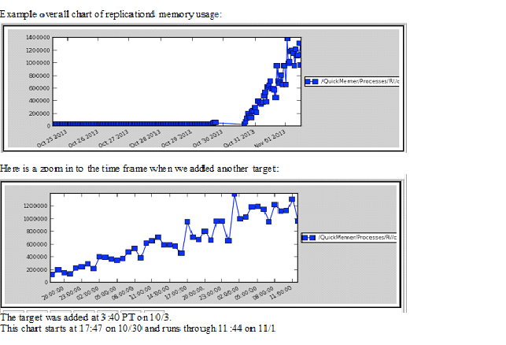
Miscellaneous Updates (cont.)
QuickMemen chart example

Slide 75
Component Firmware and Hardware Qualifications
Hardware Engineering
Presenter – Kempton Redhead

Slide 76
Component Hardware and Firmware Qualifications
Mandatory Manual FW updates with 2.3(details in SW install guide)
  DXi45xx/46xx Samsung HDD FW
  DXi65xx/67xx sTec SSD FW
DXi45xx/46xx
  BIOS: 1.11.0 <auto leveled>
  iDRAC: 1.92 A00 <auto leveled>
  C-States BIOS setting: Disabled by SW
  Samsung 500GB & 1TB HDD new FW 002 <manual update>
DXi65xx/67xx
  Backplane: support for FW 55.01.07.00 <manual update>
    Released to support new mfg build. –so they no longer have to down-rev FW
    Field update not required as 55.01.06.00 is also supported with 2.3
  Support for new Hitachi (HGST) 2TB HDD “Marks KP”
  Support for sTec SSD new firmware ver. 0400 <manual update>
  *Support for new WD 2TB HDD “RE SATA”
  *Support for new Toshiba 1TB HDD “Harrier”
  *Support for new Intel SSD’s (100GB & 200GB) “3700 series”
  *Support for new memory 2GB DIMM EOL replaced with 4GB DIMMS (same number of DIMMS so mem size will increase). New build only.
  *New 8GB DIMMs
*Note: these items qualification are planned to complete after GA of 2.3

Slide 77
Component Hardware and Firmware Qualifications
Mandatory Manual FW updates with 2.3(details in SW install guide)
  DXi68xx/8500 Seagate MantaRay 3TB HDD FW ver. MS04
  DXi68xx/8500 Seagate Mars K 3TB HDD FW FW (FDE = MS06, non-FDE = MS05)
DXi68xx
  BIOS: 1.6.0 <auto leveled>
  IDRAC FW 1.40.40 A00 <auto leveled>
  Seagate MantaRay 3TB HDD new FW MS04 <manual update>
  Hitachi Mars K 3TB HDD new FW (FDE = MS06, non-FDE = MS05) <manual update>
  *New Mars KP 3TB HDD
  *New Megalodon 3TB HDD
DXi8500
  R910 BIOS: Version 2.7.4 (QTM Custom 80D7) <auto upgrade>
  R910 iDRAC6: Version 1.92 <auto leveled>
  Broadcom 10GbE NIC: set disable_tpa=1 for the driver. <auto update>
  Seagate MantaRay 3TB HDD new FW MS04 <manual update>
  *New Mars KP 3TB
  *New Megalodon 3TB HDD
*Note: these items qualification are planned to complete after GA of 2.3

Slide 78
Enabler Products
Presenter – Mike Simone

Slide 79
DXi Advanced Reporting
The DXi 2.3 software release includes three major changes to DXi Advanced Reporting (DAR) software:
  Changes to installations, upgrades, and version numbering
  The new Chargeback Reporting feature
  The new Ingest & Delete report
Changes to Installations, Upgrades, and Version Numbering
  Starting with DXi 2.3 software, the DXi Advanced Reporting software is an integrated module of the DXi software. This means that:
  DXi Advanced Reporting will be updated as a part of future DXi software releases.
  DAR 2.3 is not backwards compatible and independent installation or upgrade of DXi Advanced Reporting software using a .fw file is no longer supported.
  DAR 2.3 will not be posted for download.
  All DXi Advanced Reporting upgrades will be done using the Software Upgrade Utility and will either be bundled with DXi software upgrades, or made available independent of a DXi release.
  The DXi Advanced Reporting code revision number will match the DXi software version number. For example, the latest version of DXi Advanced Reporting is 2.3.
  DXi Advanced Reporting version 2.2 was not released; the version numbering increments directly from 2.1 to 2.3.

Slide 80
DXi Advanced Reporting: Chargeback Reporting
Chargeback reporting is a new set of reports that provide an estimate of the amount of disk space a NAS share or VTL partition occupies.
  This allows backup service providers to identify how much DXi disk space is used by each customer during a user-specified time interval.
New Reports
  All Chargeback reports display in DXi Advanced Reporting 2.3 and Vision 4.3.
  Earlier versions of DXi Advanced Reporting or Vision do not support this new functionality. Although the statistics are captured by the DXi, none of the reports are visible in the DXi GUI.
Estimated Data
  The Chargeback reports process uses statistics that are captured by the DXi and presented through DXi Advanced Reporting 2.3.
  The Chargeback reports use estimates, because providing completely accurate calculations would require prohibitively large amounts of DXi system resources.
Statistics are reported for a user-specified interval:
  Total customer data in the share
  Customer data ingested into the share during the interval
  Unique data ingested into the share during the interval, before compression
  Unique data ingested into the share during the interval, after compression
Notes:
This assumes that one DXi share or partition would contain backup data for only one customer. It allows the provider to charge each customer for the amount of storage they have used, without having a DXi dedicated to each customer. Cloud-based storage providers are some of the prospective Chargeback report users.
In the Chargeback menus, reports, and exported csv files, the term “share” is used to refer to any of the following types of containers of data.
CIFS share
NFS share
VTL partitions
OST (the container is the storage server)
Directory/File Replication or Cartridge Based Replication target shares
Replication snapshots on a target
Chargeback reports statistics for all of these container types, up to a total of 256 “shares” (containers) per DXi.

Slide 81
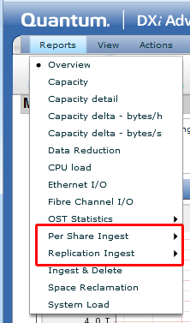
DXi Advanced Reporting: Chargeback Reporting (cont.)
Chargeback Report Examples
  Chargeback reporting includes three new graphical reports that can be exported to a csv file.
The following Chargeback reports and exports are available from the Reports menu:
  Per Share Ingest Report displays statistics related to data ingest from a data source into the DXi. Graphs are available for either the total ingest, or for a selected share. The ingest statistics may be exported to a comma-separated-value (csv) file.
  Replication Ingest Report displays statistics related to ingest of replication data from another DXi. Graphs are available for either the total replication ingest or for a selected share. The replication statistics may be exported to a csv file.

Slide 82
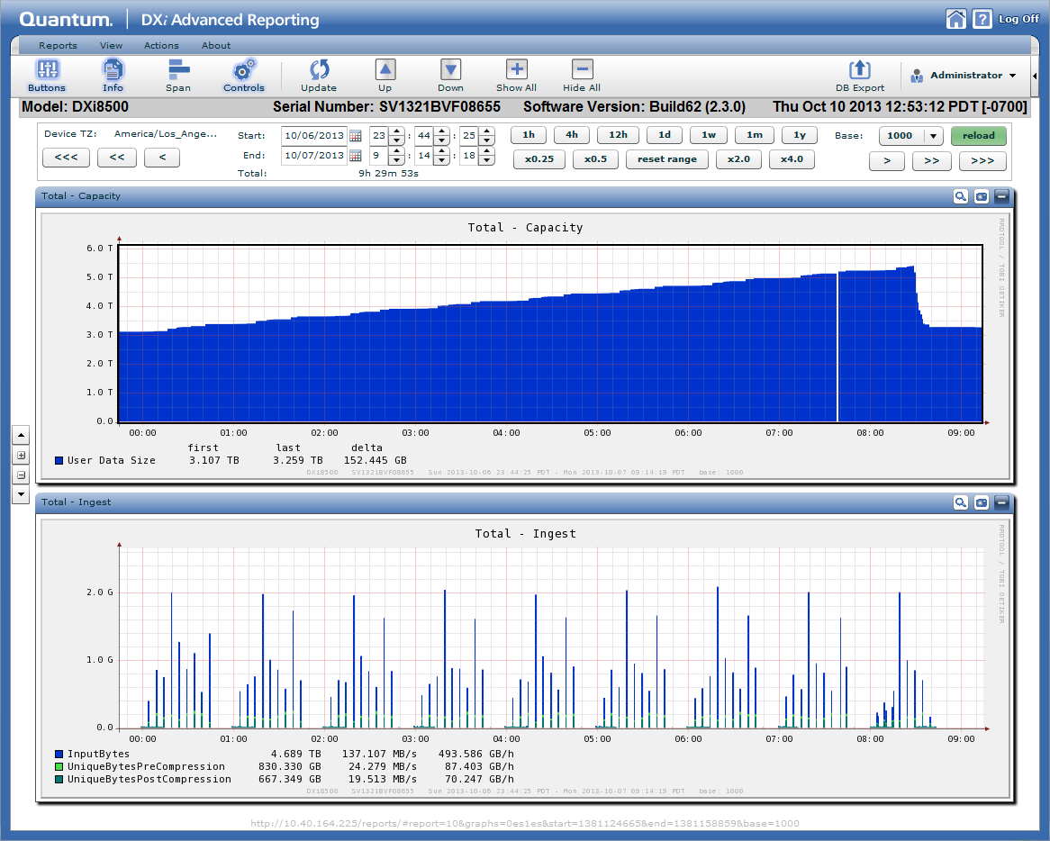
DXi Advanced Reporting: Chargeback Reporting (cont.)
Total Per Share Report Example
Notes:
This assumes that one DXi share or partition would contain backup data for only one customer. It allows the provider to charge each customer for the amount of storage they have used, without having a DXi dedicated to each customer. Cloud-based storage providers are some of the prospective Chargeback report users.
In the Chargeback menus, reports, and exported csv files, the term “share” is used to refer to any of the following types of containers of data.
CIFS share
NFS share
VTL partitions
OST (the container is the storage server)
Directory/File Replication or Cartridge Based Replication target shares
Replication snapshots on a target
Chargeback reports statistics for all of these container types, up to a total of 256 “shares” (containers) per DXi.

Slide 83
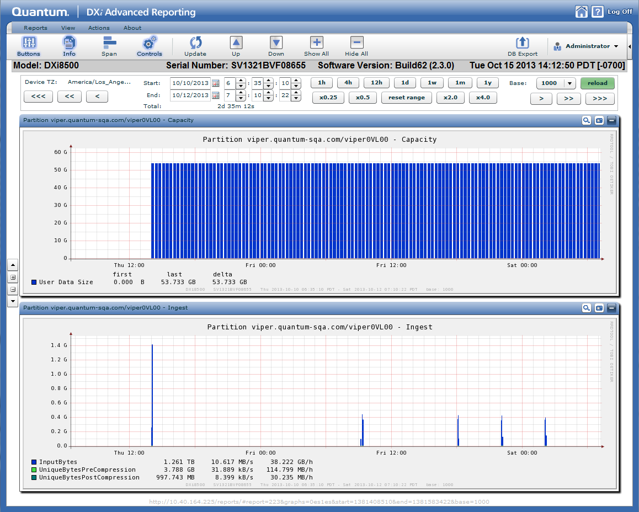
DXi Advanced Reporting: Chargeback Reporting (cont.)
Replication Ingest Report Example

Slide 84
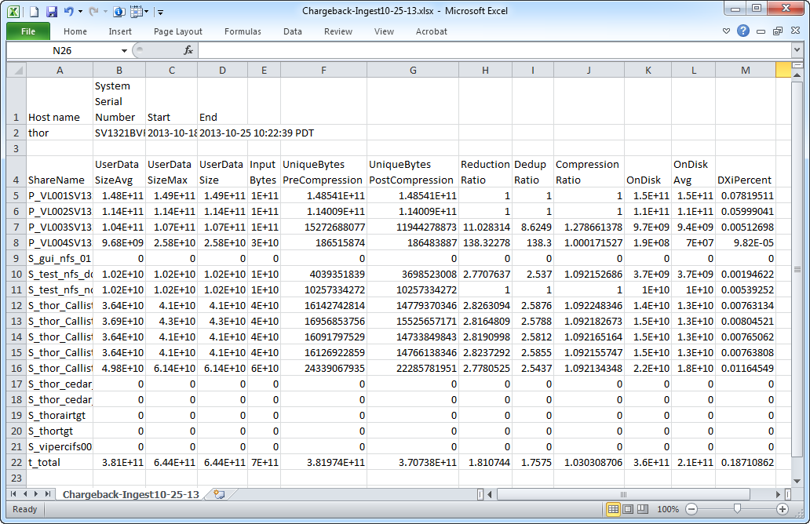
DXi Advanced Reporting: Chargeback Reporting (cont.)
Exported CSV File Example
Notes:
The data portion of the csv file includes the following columns:
ShareName: Names of all NAS shares or VTL partitions configured in the DXi for ingest or replication. A name with a P_ prefix is a VTL partition, or with an S_ prefix is a NAS or OST share.
UserDataSize: Cumulative user data size at the end of the selected time interval. Includes deletes and sparse portions of sparse files. The sum of all file sizes currently in the share prior to data reduction.
UserDataSizeAvg: A value calculated by dividing the sum of the UserDataSize values by the total number of observations during the selected time interval.
UserDataSizeMax: The maximum observed UserDataSize during the selected time interval.
InputBytes: Size of customer data as it arrives at the share during the user-specified interval. This is ingested data only, not taking into account deletes.
UniqueBytesPreCompression: Total amount of data ingested after deduplication during the user-specified interval. This does not take into account deletes. Data is counted as unique only for the first share to ingest it, not for matching data subsequently ingested into other shares.
UniqueBytesPostCompression: Total amount of data after deduplication and compression for the user-specified interval. This does not take into account deletes.
ReductionRatio: Ratio of input data to final stored data, accounting for both deduplication and compression for the user-specified interval.
DedupRatio: Ratio of input data to unique bytes prior to compression (deduplicated) data for the user-specified interval. UserData divided by UniqueBytesPostCompression.
CompressionRatio: Ratio of unique uncompressed data bytes to unique compressed data bytes for the user-specified interval. ReductionRatio divided by DeduRatio.
OnDisk: Effective disk usage at the end of the selected time interval.
DXiPercentOfTotalCapacity: Percentage of total the DXi capacity that the OnDisk data is using for the selected time interval.
Note: Non-deduplicated shares are not compressed, so they will have identical values for InputBytes, UniqueBytesPreCompression, and UniqueBytesPostCompression.

Slide 85
DXi Advanced Reporting: Chargeback Reporting (cont.)
Limitations in Chargeback Reporting
  The on-screen reports and the values exported to csv files are not intended for short time intervals such as one hour or one day. Reasonable results are obtained when statistics are accumulated for intervals greater than one week, and the longest intervals yield the best results.
  Statistics are available for a maximum of 256 shares (containers) per DXi; additional shares are not reported.
  Deleted data is not reflected in the statistics.
  Matching data in multiple shares is counted only in the first share into which it is ingested.
Notes:
The data portion of the csv file includes the following columns:
ShareName: Names of all NAS shares or VTL partitions configured in the DXi for ingest or replication. A name with a P_ prefix is a VTL partition, or with an S_ prefix is a NAS or OST share.
UserDataSize: Cumulative user data size at the end of the selected time interval. Includes deletes and sparse portions of sparse files. The sum of all file sizes currently in the share prior to data reduction.
UserDataSizeAvg: A value calculated by dividing the sum of the UserDataSize values by the total number of observations during the selected time interval.
UserDataSizeMax: The maximum observed UserDataSize during the selected time interval.
InputBytes: Size of customer data as it arrives at the share during the user-specified interval. This is ingested data only, not taking into account deletes.
UniqueBytesPreCompression: Total amount of data ingested after deduplication during the user-specified interval. This does not take into account deletes. Data is counted as unique only for the first share to ingest it, not for matching data subsequently ingested into other shares.
UniqueBytesPostCompression: Total amount of data after deduplication and compression for the user-specified interval. This does not take into account deletes.
ReductionRatio: Ratio of input data to final stored data, accounting for both deduplication and compression for the user-specified interval.
DedupRatio: Ratio of input data to unique bytes prior to compression (deduplicated) data for the user-specified interval. UserData divided by UniqueBytesPostCompression.
CompressionRatio: Ratio of unique uncompressed data bytes to unique compressed data bytes for the user-specified interval. ReductionRatio divided by DeduRatio.
OnDisk: Effective disk usage at the end of the selected time interval.
DXiPercentOfTotalCapacity: Percentage of total the DXi capacity that the OnDisk data is using for the selected time interval.
Note: Non-deduplicated shares are not compressed, so they will have identical values for InputBytes, UniqueBytesPreCompression, and UniqueBytesPostCompression.

Slide 86
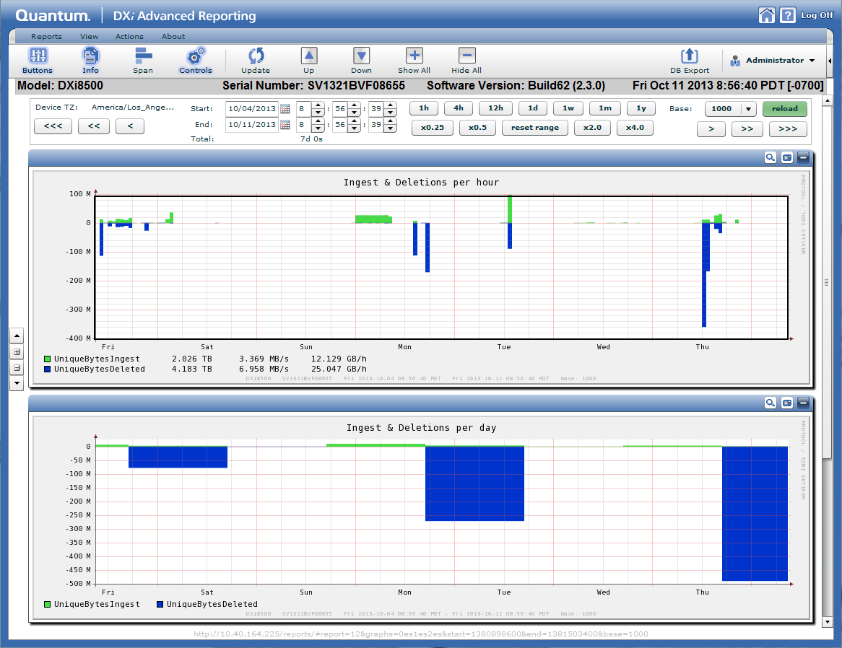
DXi Advanced Reporting: Chargeback Reporting (cont.)
Ingest and Delete Report Example
  The Ingest & Delete report consists of three graphs – Ingest and Deletions per hour, Ingest and Deletions per day, and Ingest and Deletions per week.
Notes:
The Ingest & Delete report consists of three graphs – Ingest and Deletions per hour, Ingest and Deletions per day, and Ingest and Deletions per week. Only the first two are visible in this example.
Each graph displays:
Unique Bytes Ingested – green
Unique Bytes Deleted – dark blue
These graphs allow you to see the amount of unique data (after deduplication and compression) that is backed up to and deleted from the DXi on an hourly, daily, and weekly basis. You can use this information to determine how close the DXi is to steady state (the balance between backup and expiration) during the selected timeframe. Some examples:
When the DXi is new and the expiration policies have not yet started running on a regular basis, you will see significantly more data ingested than deleted.
When the DXi is in steady state, the amount of data deleted and ingested over the period should be about the same.
The difference between ingest and deletion over long periods of steady state helps you estimate your true data growth or loss.
You can also use these graphs to determine how much data you are backing up to the DXi on a regular basis. This gives you total data arriving at the DXi and determines the overall DXi workload. Compare this to the Data Volume Overview graph which shows the net amount of data (ingest minus deletions) arriving at the DXi.

Slide 87
Vision 4.3 Overview
Chargeback Reporting
300+ devices
Vision software update notification and upgrade
vmPRO software update notification and upgrade

Slide 88
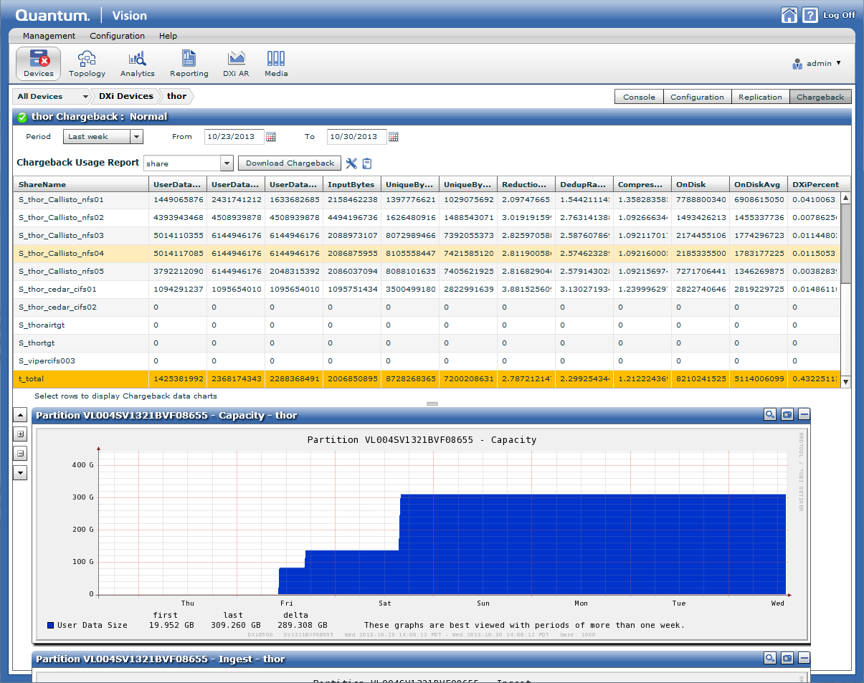
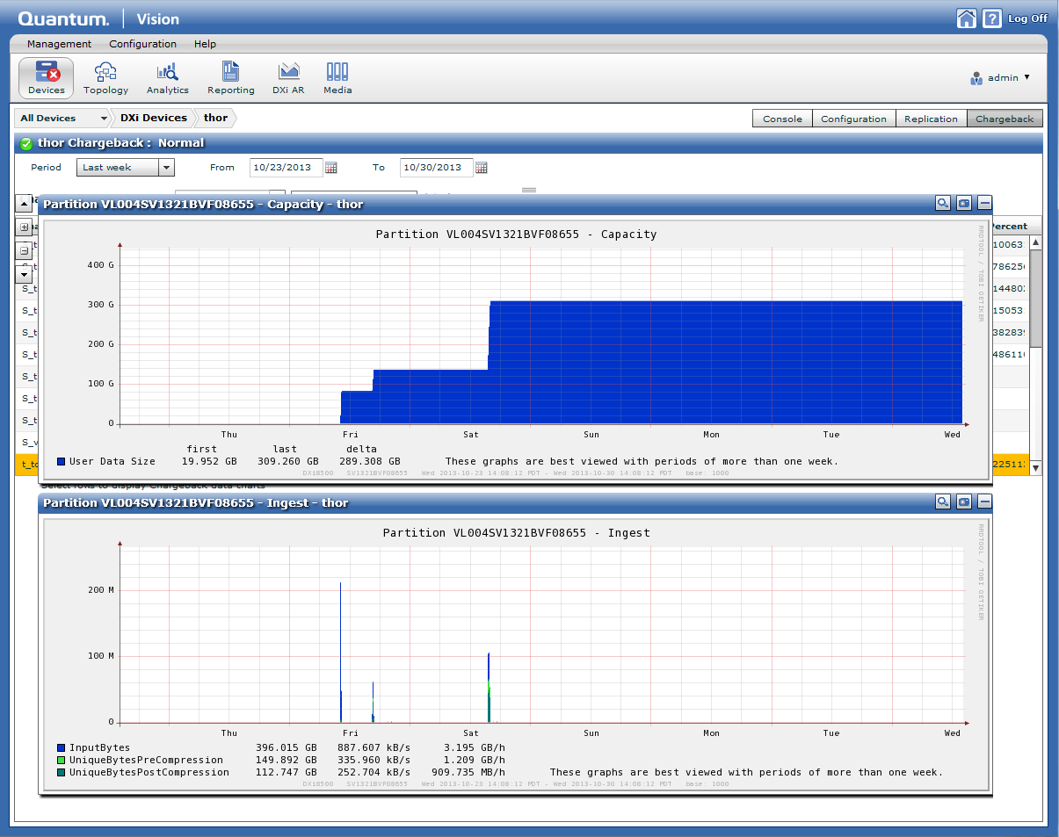
Vision 4.3: Chargeback Support
Select the timeframe and parttion/share to view the amount of data protected and reduction ratios. Save PDF for email/printed billing.

Slide 89
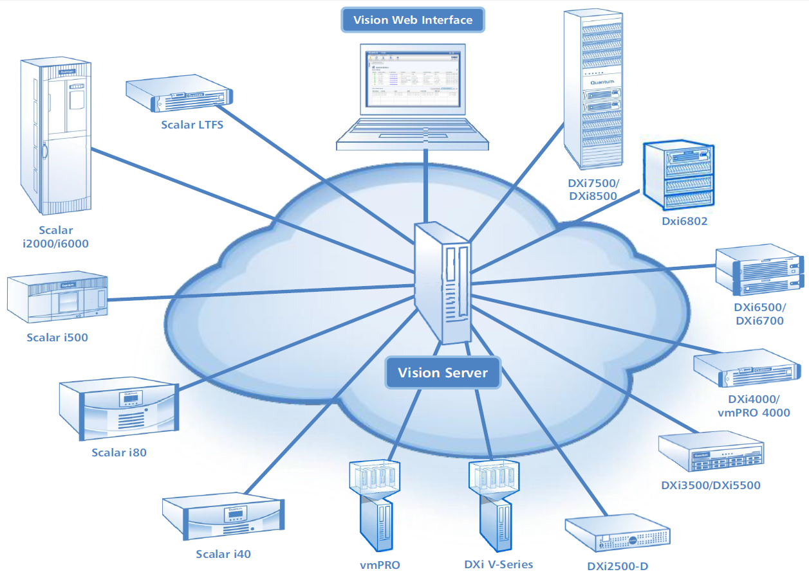
Vision 4.3: 300+ Devices
Monitor the health and status of 300+ data production devices

Slide 90
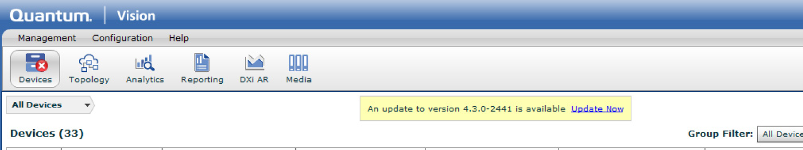
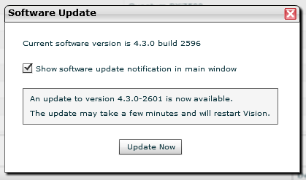
Vision 4.3: Upgrade Software for vmPRO and Vision
Vision now monitors for Vision updates as well as vmPRO software updates.

Slide 91
Guardian and Vision
Guardian
      No changes targeted for DXi SW version 2.3
Gunnison
      No updates planned for DXi SW version 2.3

Slide 92
Bug Fixes and Known Issues
Presenter – Sreevatsa Nagarajarao/Joshua Martin

Slide 93
Superbugs and Metrics
For visibility to all bugs fixed in 2.3, Quantum Service Team members can refer to the following superbugs in Bugzilla:
  DXi 2.3 Superbug: 32535
  DXi 2.3 Superbug for Bugs Found in Test: 32539
  DXi 2.3 Superbug for Bugs Deferred: 32537
Reminder: Superbug information is not available to Quantum Service Partners.
Bug fix metrics
  Resolved: 1967
  Deferred: 234 (11%)
  Bugs with external ticket numbers: 338
  Unique external ticket numbers: 494
Overall SR impact w/2.3
  DXi 8500: 0.20 SR/Sys/Yr Rate reduction (5.1%)
  DXi6500/6700: 0.08 SR/Sys/Yr SR Rate reduction (4.3%)
  DXi4000: 0.04 SR/Sys/Yr SR rate (6.8%)

Slide 94
Notable Customer Bug Fixes
Refer to the 2.3 Release Notes for additional bug fixes and known issues.

Slide 95
Notable Customer Bug Fixes (cont.)
Bpw deadman timer issues including: blob tree repair and blob stitching improvements
Blockpool can replicate corrupt data
tw_cli terminated with signal 11, segmentation fault
Robustness of install, upgrade, and capacity expansion scripts
Security issues: open manage, apache, and samba
Collect log: cleanup, overall size reduction, only one can be run at a time
Networking: /etc/host not being correctly updated, Reduce external DNS queries in DXi Networking
Upgrade: DX6xxx: during upgrade the 3ware cache is disabled causing prolonged upgrade duration
Corruption fixes during shutdown
Fixes for large trigger queues (GUI listing, historical status report now maxed at 10k)
OST performance optimizations
Various KDUMP, core, panic, and assertion fixes
Special character handling (share names, TBR unpack, TBR syscli listing, GUI/DAR password)
BPV reference count verify fixes (memory leak, memory cap, robustness)
Replication Throttle fix
BPWD historical statistics captured every hour (just like BPStats graphed in susrepo)
Memory monitoring and logging when Dxi processes exceed a defined threshold via the new utility quickmemn
Performance improvement: Blockpool index, blob index, journal moved from from /snfs to /bp
Add no_root_squash as an option for NFS shares on DXi
Disable continuous replication for shares having trigger replication enabled
Used disk space reporting / graphing improvements
SNMP MIB now available through the GUI
GUI Scalability: Large number of admin alerts or TBR entries

Slide 96
Documentation and Training Updates
Presenter – Tom Sajbel

Slide 97
Documentation Updates
Platform-Specific Documents
  User’s Guides
  Online Help
  User Essentials documents
  Drive CRU Instructions
  Site Planning Guides *
  Installation and Configuration Guides *
  Field Service Guides *
  Capacity Upgrade Guides *
  *Available in mid-December

Slide 98
Documentation Updates (cont)
DXi-Series Documents
  Release Notes
  Software Installation and Upgrade Guide
  OST Plug-in Installation Instructions
  OST Configuration Guide
  Command Line Interface Guide
  Backup Specific PTT Guide
  Core Concepts Explained document
  SNMP Reference Guide *
  Software Interface Guide *
  *Available in mid-December
Location
  All documents on CSWeb
  Customer documents on Quantum Web site
  CRU documents on CSSP Web site

Slide 99
Training Updates
Controlled Release
  DXi 2.3 Service Update (2-3437d) NEW
  DXi Core Concepts for Service course (2-0443)
  DXi 2.x Configuration course (2-2482)
  DXi 2.x Configuration Hands-on Practice course (3-2432)
  DAR Service Training course (2-2412)
  DXi and DAR At a Glance job aids
Video Release in Mid-February
  DXi 2.3 User Interface Overview video NEW
  Upgrading Software video NEW
  Replacing a Drive video NEW
  Configuring Replication videos
  Configuring Network Settings videos
  DAR Chargeback Reports video NEW

Slide 100
Training Updates (cont)
Factory GA Release
  DXi Installation courses
  DXi V-Series Installation video
  DAR Essential Training course
Location
  Training courses available in StorageCare Learning
  Videos available on Quantum Web site, CSWeb, and YouTube

Slide 101

Documentation CD - Retired
No longer ships with DXi systems
Action Required card serves as replacement
Help menu in GUI now links to documentation

Slide 102
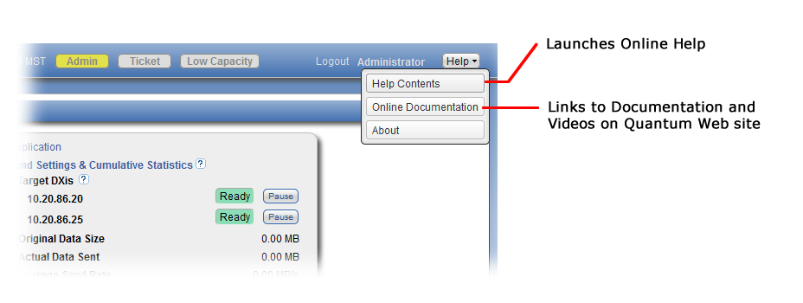
Help Menu Enhancements
DXi4000 | www.quantum.com/dxi4000docs
DXi6500 | www.quantum.com/dxi6500docs
DXi6700 | www.quantum.com/dxi6700docs
DXi6800 | www.quantum.com/dxi6800docs
DXi8500 | www.quantum.com/dxi8500docs
DXi V-Series | www.quantum.com/dxiv-seriesdocs

Slide 103
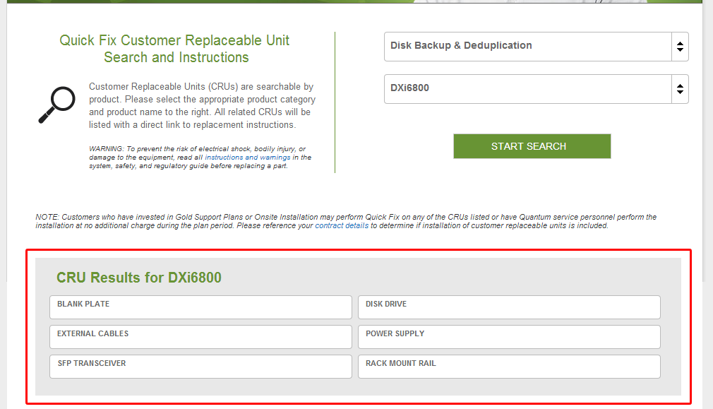
CRU Documents on CSSP Web Site

Slide 104
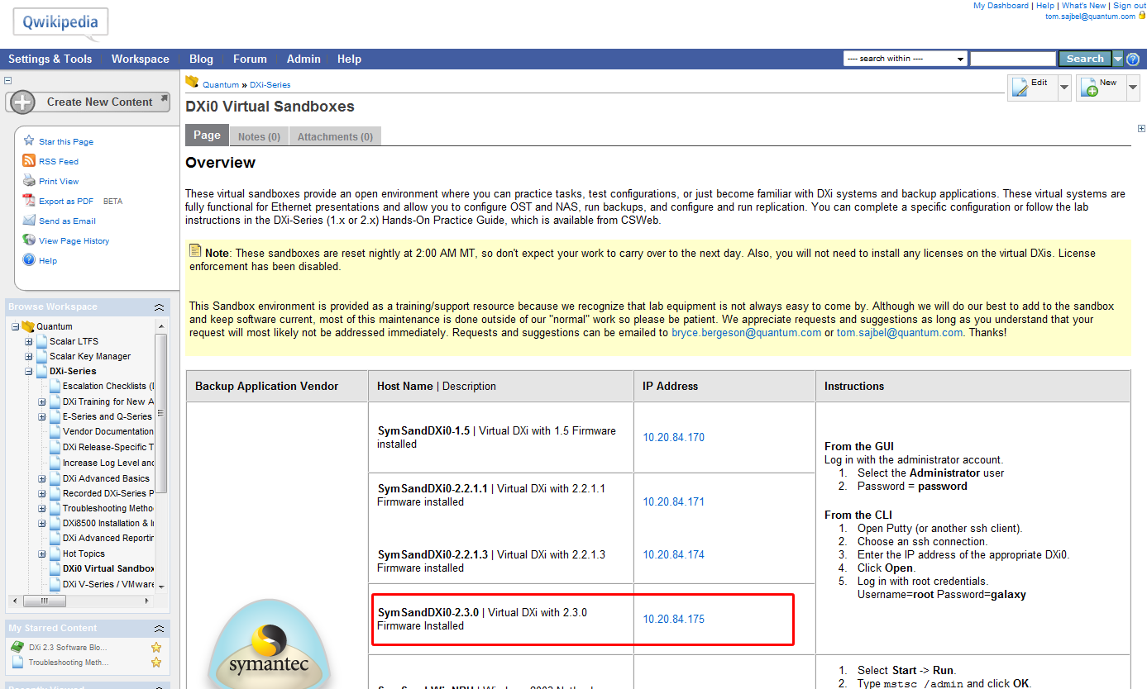
DXi Virtual Sandboxes on Qwikipedia
Added 2.3 sandbox
Notes:
Different versions of DXi software available (1.5, 2.2.1.1, 2.2.1.3, 2.3)
NetBackup version 7.5 and Backup Exec 2012 (Windows 2003 server)
NetBackup version 7.1 (Linux)

Slide 105
Service Updates
Presenter – Jim Hibbard

Slide 106
Field Upgrade Strategy
Controlled Release (starts 12/5/13)
  Strategy
    Targeting 40 Customers
    Customers who need bug fixes (vetted by service management)
    Working to find Customers who will exercise these new features:
      1:2 replication
      Chargeback
      OST for traditional NBU/BUE (Accent preferred)
      OST GRT
      Windows 2012 (any app)
      NBU 7.6 (note: 7.6 is only in limited release now, not sure we’ll have takers)
      LTO6 PTT (lower priority)
    Goal is 20k hours run-time (40 systems for 21 days)
    Findings will determine if a 2.3x code spin is needed prior to GA
    Will target as many upgrades in December as possible but it is unclear how many will be achieved due to holidays.
  Tactical management:
    Service Management will drive the upgrades
    Quality will gather and host review of feedback
    Considering how we can release V1000 in a controlled manor
Field Upgrade Strategy at GA (targeted for February 2014)
  Expect to aggressively upgrade the install base

Slide 107
Software Upgrade Compatibility
Upgrading from an earlier version of 2.x software
Upgrading from software version 1.4.x
  For DXi4500, DXi6500, and DXi6700 Families:
    Upgrade from 1.4.x to 2.1.3 then 2.1.3 to 2.3
  For DXi8500:
    Upgrade from 1.4.x to 2.1.1 then 2.1.1 to 2.3
  Upgrading to DXi 2.1.x Software from software version 1.4.x requires that specific conditions be met and pre-upgrade actions are performed.
Refer to the 2.3 Software Installation and Upgrade Guide (p/n 6-67321-08) for more details.
  Note that there are manual HDD FW upgrades steps for the various DXi platforms
  A new step has been added to make sure that Email Home is setup to schedule Status and Configuration reports weekly.

Slide 108
CRU Updates
New HDD CRU Replacement procedures are released with 2.3 and posted on CSSP.
  Support for DXi6800, 6700, and 6500
  Will replace current replacement procedures
  New procedures tell the user they can use the Drive Replacement Utility in the 2.3 GUI or the new replacement procedure doc.
  New procedure leverages the same process steps used in the 2.3 GUI Drive Replacement Utility

Slide 109
Q&A

Slide 110
Appendix

Slide 111
Replication – New CLI Commands
Adding a NAS Target: This CLI command allows the admin user to add a replication target to the NAS share.
  syscli --add nastarget --name <NAS share name> --target <host_name_or_ip>
Deleting a NAS Target: This CLI command allows the admin user to remove a replication target from the NAS share
  syscli --del nastarget --name <NAS share name> --target <host_name_or_ip>
Listing NAS Targets: This CLI command allows the admin user to list the replication targets of the NAS share.
  syscli --list nastarget --name <NAS share name>
Adding a VTL Target: This CLI command allows the admin user to list the replication targets of the NAS share.
  syscli --add vtltarget --name <vtl_name> --target <host_name_or_ip>
Deleting a VTL Target: This CLI command allows the admin user to remove a replication target from the partition.
  syscli --del vtltarget --name <vtl_name> --target <host_name_or_ip>
Listing VTL Targets: This CLI command allows the admin user to list the replication targets of the partition.
  syscli --list vtltarget --name <vtl_name>

Slide 112
Replication – Updated CLI Commands
Listing the Replication Targets for the Source:
  syscli --list targetrep
Initiating Source to Target Cartridge Synchronization:
  syscli --sync vtl --name <VTL_name> [--target <host_name_or_ip>]
    CLI command options:
      --sync: Requests system to synchronize the specified VTL.
      --name: Must be a valid VTL name for the system.
      --target: Target host name or IP of the replication sync job.
Initiating Source to Target File Synchronization:
  syscli --sync nas --name <NAS_share_name> [--target <host_name_or_ip>]
    CLI command options:
      --sync: Requests system to synchronize the specified NAS share.
      --name: Must be a valid NAS share name for the system.
      --target: Target host name or IP of the replication sync job.
Notes:
All of these commands and more are documented in the DXi-Series Command Line Interface (CLI) Guide. Refer to the guide for more details about the commands along with additional command options and output examples.

Slide 113
New Software Upgrade CLI Commands
Listing Available Upgrades from the Repository: This CLI command displays available upgrade(s) from the repository.
  syscli --list upgrades
Downloading Upgrades: This CLI command allows the admin user to download the latest upgrade from the repository.
  syscli --download upgrades --name <ID>
Installing Upgrades: This CLI command allows the admin user to install the downloaded upgrade(s) to the system.
  syscli --install upgrades --name <ID> [--sure]
Notes:
These commands have been added to the DXi-Series Command Line Interface (CLI) Guide. Refer to the guide for more details, including additional command options.

Slide 114
Maximum Replication Snapshots – New CLI Commands
Getting Snapshot per Share Partition Stats: This CLI command allows the user to retrieve the maximum, minimum, and current number of snapshots per Share/Partition
  syscli --get snapshotspersharepartition
Setting Snapshot per Share Partition Limits: This CLI command allows the admin user to set the current number of snapshots per Share/Partition.
  syscli --set snapshotspersharepartition --current <value>
Notes:
These commands have been added to the DXi-Series Command Line Interface (CLI) Guide.

Slide 115
Drive Replacement Utility – CLI usage
>/opt/DXi/util/hddMgrUtil
HDD Manager Utility
Usage:
--drive driveName : select a single drive
--help : print usage menu
--identify : returns LED status of the drive
--identify=<on|off> : turns LED on|off
--report : print report on degraded drives
--test : enable test mode commands
--refresh (-f) : (test) invoke refreshWizard for a specified drive
--wizard : (test) start a wizard monitor
--monitor : (test) start a simple drive state monitor
Notes:
Note: The Drive replacement instructions are also included in the DXi Field Service Manuals for Quantum Service and Service Partners.

Slide 116
Drive Replacement Utility – CLI example
>/opt/DXi/util/hddMgrUtil --report
System HDD Summary
Degraded Drives
Enclosure=System Node: c0e0, slot 0
Status=Missing, DrivesDegradedInVol=1
Volume=c0u0v0, VolStatus=Degraded
Model=WDC WD1002FBYS-02A6B0, SpecSize=1TB
Degraded Volumes
Enclosure=SAS Expansion
Volume=c1u0v0, VolStatus=Rebuilding
Rebuild stage 2/2 is 95% complete
Notes:
Note: The Drive replacement instructions are also included in the DXi Field Service Manuals for Quantum Service and Service Partners.

Slide 117
Drive Replacement Utility – CLI example
>/opt/DXi/util/hddMgrUtil --drive c0e0_0 --identify
Identify status -- drive: c0e0_0 -- Identify=off
>/opt/DXi/util/hddMgrUtil --drive c0e0_0 --identify=on
Identify -- drive: c0e0_0 -- Identify=on
>/opt/DXi/util/hddMgrUtil --drive c0e0_0 --identify=off
Identify -- drive: c0e0_0 -- Identify=off
Notes:
Note: The Drive replacement instructions are also included in the DXi Field Service Manuals for Quantum Service and Service Partners.

