Slide 1
DXi SW 2.2
TOI for Service
Jim Hibbard
September 6, 2012
Quantum Confidential

Slide 2
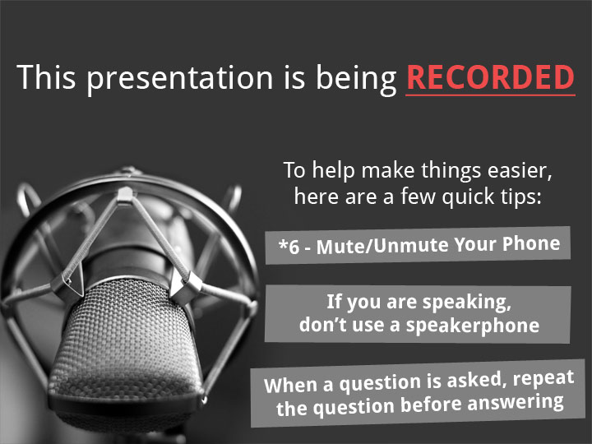

Slide 3
Agenda
Release Strategy
New Features/Enhancements
  Security
  OST
  Networking
  Flexibility (FC port role)
  GUI
Architectural Changes/Bug Fixes/Known Issues
Performance Enhancements
Enabler Updates
Training and Documentation Updates
Q&A

Slide 4
Release Strategy for DXi 2.2
Mark Thacker

Slide 5
DXi 2.2 Overview
Phased release model
  GA August 31; All platforms running DXi 2.2 by end of CY2012
DXi 2.2 featured in Segment Marketing
  Emphasis on the value of the features
  Tying multiple products together to better describe the whole offering
DXi 2.2 offers significant enhancements in
  Security
  OST
  Networking
  Flexibility
  GUI
  Performance

Slide 6
Release Strategy
2.2 Controlled release for 65xx/67xx field upgrade starting September 4, 2012
  Software for upgrade will have controlled distribution
  Phase 1: Initial phase 5 to 10 customers (defined in appendix)
    Will monitor for two weeks
  Phase 2: Upgrade an additional 5 to 10 customers
    Will monitor for an additional two weeks
  Posting for upgrade will be done after reviewing any issues reported in phase 1 and 2.
2.2 Initial GA on 670x from the factory starting early October 2012
2.2.x follow-on release GA + 90Days (alternative shorter schedules in review)
  8500
  4xxx
  65xx and 67xx
DXi6802 (Rocky)
  Based on 2.2
  GA targeted for October 31, 2012
DXi V1000
  Based on 2.2
  GA targeted for end of November 2012

Slide 7
New Features in DXi 2.2
Mark Thacker

Slide 8
New Features of DXi 2.2
Security
  Encrypted data at rest utilizing Self Encrypting Drives
  User audit log
  Secure data deletion of files
OST
  OST AIR support
  Concurrent Optimized Duplication
  Accent support for Windows for BE and NBU
  Accent Encryption
  Optimized Duplication on Replication ports
  Plug-in for AIX
Networking
  VLAN Tagging
  Jumbo Frames
Flexibility
  Fibre Channel Port Role Change
GUI
  “Mapping” pages for navigation
  Disk Space Reporting
  Port Layout Improvements
  Scheduler Improvements
Performance
  Namespace replication
  Space Reclamation

Slide 9
HW Updates
65xx/67xx
  9750 Controller FW update
    Cut-over anticipated to be Q4CY12
8500
  8500 no changes beyond 2.1.3_85
4xxx:
Server BIOS (no package version) | 1.9.0 Auto-Leveled
Bios Settings: | C-states = disabled Power Mode = Max Performance
Broadcom Embedded NIC Package version (Component versions) | 6.4.5 Rev A11 (BC 5.2.3 NCSI 2.0.11) Auto-Leveled
PERC H700 RAID Controller Package Version | 12.10.3-0001 Rev A09 Auto-Leveled
iDRAC6 (no package version) | 1.85 Rev A00 Auto-Leveled

Slide 10
Security Enhancements
Mark Thacker

Slide 11
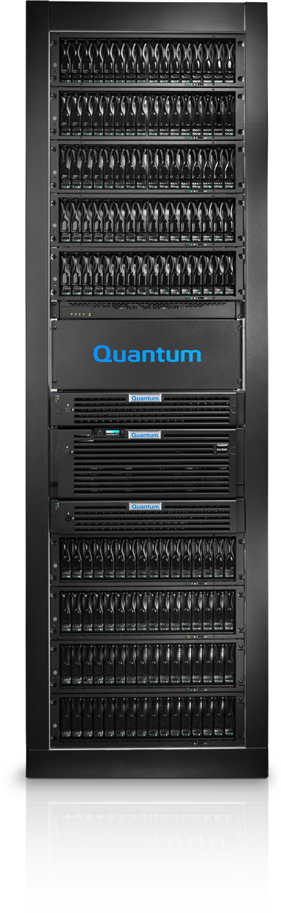
DXi8500 & 6800 Encryption of Data-at-Rest
    Protects against data breach from physical drive removal
Delivered with DXi 2.1.x_85, integrated into DXi 2.2
Encryption via 3TB SED / FDE drives
Hardware based
No performance impact
  Encryption within the HW is always on. Drives are always encrypting data
AES 256-bit algorithm
Encryption keys stored on the system
Sold as a license key for $30,000 List

Slide 12

Different Types of Secure Erasure
Whole system secure shredding
  Used for POC or return of demo equipment
  U. S. DoD generally accepted
  Whole system, including boot drives, are erased & overwritten
  Available today as a TSB process on 7500 (and 8500 classic)
  Being released as a separate utility for Service use on 4000, 6000 soon
    Performed at customer site by QFE
    8500-3T and 6800 support in the near future
Secure erase of a single disk drive
  Used anytime a disk drive is returned to Quantum directly
  Done at Quantum facility on a per-drive basis
  Logically erase and overwrite the disk
  Optionally, physical destruction of drive if it can not be erased or if customer requests it
  Some customers perform this themselves, paying to keep the disk on-site
Secure File Shred
  A secure form of Space Reclamation and free space erasure
  Used by a customer on a production system
  Leaves system completely usable with all data intact

Slide 13
DXi Secure File Shred
The Problem
  Responding to concerns in security-sensitive verticals, Fed & Financial
  Inadvertently backed up sensitive data onto a DXi
  Compliance standards mandate that sensitive data is securely deleted
  Need to delete, but can’t delete everything on the DXi (otherwise, physical destruction is an option)
  Importance of removing sensitive data is more important than remaining on-line
DXi Secure File Shred Operation
  First – from backup application, user deletes backup file(s) in question
  Start the secure file shred operation
    System will reboot in a limited mode with all backup and replication services stopped
  System performs a secure form of Space Reclamation and free space deletes
  System needs to be rebooted once completed, or terminated by customer
Works like ultra-secure form of space reclamation
  Everything marked for deletion is over-written with zeros – guaranteed
  Overwrites free space on drives – because files move over time
  May take DAYS to complete depending on size of system
  Can cancel at any time from GUI or CLI
No DoD standards for partial erasure of a drive

Slide 14
Secure File Shred Invocation
Use after deleting suspect backup jobs via backup app
Available via GUI, Utilities->Security->Secure Shred
Useful on any DXi
  Does NOT require Self Encrypting Drives

Slide 15
Secure Shred Status
When selected, the DXi reboots into Secure Shred mode.
Can Cancel at anytime and reboot to resume normal ops.

Slide 16
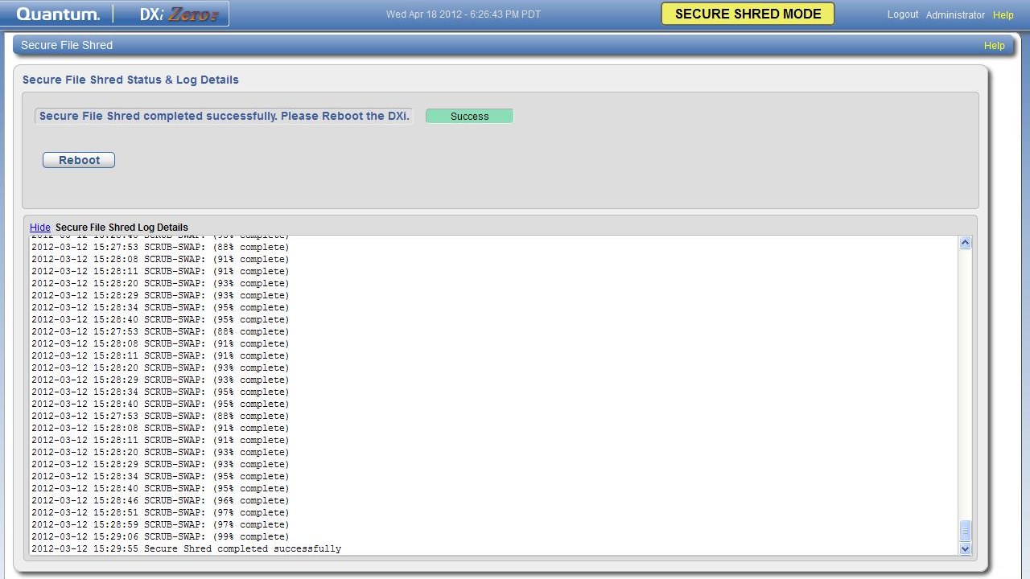
Secure Shred Completion
Secure Shred Log Details can be viewed as desired
Click Reboot to return to normal mode.

Slide 17
Administrator Activity Log
Focused on logging administrative actions performed via GUI and CLI
All configuration changes, as well as activities initiated from Replication, Alerts, Utility pages, and Wizards for Administrator and Service users are recorded Records the following information:
  User : Administrator, Service or root
  Date/Time : when it occurred
  Origin : GUI or CLI
  Action : Create, Update or Delete
  Category : Alert, Healthcheck, NAS, OST, PTT, Replication, Security, Utility
  Role : Admin (currently)
  Summary : Details about the action, including CLI command & arguments
Not logged/tracked – downloading files (i.e. collect logs), although generating collect logs is tracked.
No system impact
90-day rolling log
  Customer may clear individual events or whole log
Downloadable to XML file (via CLI and GUI)
  Email and/or Vision support in future release
Enabled by default

Slide 18
Administrator Activity Log GUI
Located under Status -> Logs -> Activity Log

Slide 19
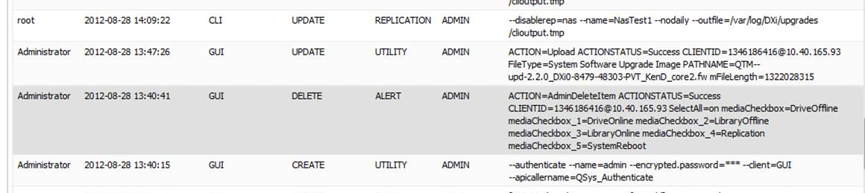
Administrator Activity Log GUI (cont.)
Example of GUI & CLI entries:

Slide 20
OST Enhancements
Aaron Laffin

Slide 21
OST Technologies
Today
  Optimized Synthetic Backup
  Optimized Duplication using OST server
  Optimized Duplication using Replication Engine
  Accent for RH Linux
Added in 2.2
  Concurrent Optimized Duplication
  OST AIR
  Accent Enhancement – extend support to Windows
OST LSU Reformat
  Converts LSU contents to 1024 subdirectories
  Hash location derived from image name
  Enables LSU to scale to millions of images
New OST Plugin version 2.6
  OST support for AIX
  Accent encryption
  Windows support (NBU and BUE)
  OST AIR
  Bug fixes

Slide 22
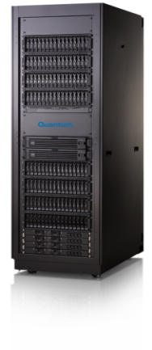

Standard OST Optimized Duplication
Local Site
Remote site
Storage
Lifecycle
Storage
Lifecycle
Standby master
NBU Domain
Second master must re-index the backup set for it to be usable
OST Optimized Duplication
(DXi Replication)

Slide 23
New OST Automatic Image Replication (AIR)
Local Site
Remote site
Second master has immediate use of backups
Storage
Lifecycle
Storage
Lifecycle
Storage
Lifecycle
Storage
Lifecycle
NBU Domain
NBU Domain
AIR Duplication
(DXi Replication)

Slide 24
OST AIR – Details
Activated by a Lifecycle Policy within NetBackup
  Requires NBU 7.1 or later
  Requires OST Plug-in 2.6.0
Eliminates the need for the DR master to re-index the backup to make it available.
Leverages the DXi Replication technology and transport
  Essentially the same as an Optimized Duplication is today
DXi maintains the relationship between the source and destination of the AIR command
  Symantec Lifecycle policy simply asks for data to be replicated with no specific destination specified
See TOI from Engineering for more detail (will be posted with this TOI recording)
NetBackup only (not supported by BackupExec).

Slide 25
OST AIR – Requirements
Two DXi Systems (Source & Target).
Two NetBackup domains (two master servers).
Do not configure the NetBackup servers to interact in any way.
Interaction between NetBackup domains is the responsibility of the DXi.
  Configure replication – replication configuration implies source and target DXi.
  On the source DXi, for each source LSU, configure a target LSU
NetBackup utilizes Storage Lifecycle Policy to drive AIR replications:
  Source domain SLP action is a duplication to remote master.
  Target domain SLP action is an import from remote master.

Slide 26
OST AIR – How it works
AIR source domain doesn’t know anything about the target domain. This is left to the DXi.
Things the DXi needs:
  Replication relationship: defines the data flow, source and target. Could be both directions.
  For a LSU with images on the source DXi in the source NBU domain, need to tell it where to send those images: storage server and LSU. This is done on the source DXi.
  Give the source DXi access to the target DXi through a credential.
Replication is unchanged for AIR. Utilizes Opt-Dup replication process.
Source DXi utilizes OST plug-in to initiate connections and remote procedure calls to the target DXi.

Slide 27
OST AIR – How it works (cont.)
GUI/CLI publish AIR target information in source LSU configuration on source DXi: /snfs/common/data/hurricane/conf/OSTStorageSrvrLsu.conf
OSTd picks that up and starts advertising to NBU that it is a replication source (allows SLP dup to remote master).
Initiates contact to remote DXi, telling the remote that it is a target. Remote DXi can then start advertising to NBU that it is a replication target (allows SLP import from remote master).
With SLP dup configured in the source domain, NBU may now start asynchronous copy operations:
  sts_async_copy_image() – one call per source image, target information explicitly left undefined (remember, this is left to the DXi). Summary: copy this image somewhere.

Slide 28
OST AIR – How it works (cont.)
  sts_async_wait () – called for each async copy operation, until success or failure. Busy if copy still in progress, repeats after 10 seconds.
  sts_async_cancel() – if any async copy or wait call for an image in the set fails, this is called to cancel each of the operations.
If all wait calls succeed, the copy is considered successful.
Inside OSTd, each async copy call is initiating:
  An image replication (like Opt-Dup).
  OST calls to remote DXi to create the new images and set properties on them.
NBU labels all the OST images of an NBU backup as part of a set, called an “imageset”.
  Upon success, OSTd calls the remote DXi to raise an event.
  The images in the set are a group, and NBU should know about them.
  NBU looks for events through a new OST feature called “OST Events”.

Slide 29
OST AIR – How it works (cont.)
In the target NBU domain, SLP import operation looks for events from AIR.
NBU consumes the event and initiates an import based on the event data.
The import is much faster than raw image import due to encapsulated backup metadata within the backup images.
Port details:
  Source DXi contacts target using OST: DM: 3095-3102, MI: 10002.
  Replication.
  Source NBU media server/plugin does not contact the target DXi.

Slide 30
AIR Configuration Summary
Configure Target DXi:
  Replication receive
  OST user credential for NBU
  OST user credential for source DXi
  Storage Server and LSU
Configure Source DXi:
  Replication send
  OST user credential for NBU
  OST remote user credential
  Storage Server and LSU
  Enable AIR for the LSU
  Fill in target Storage Server, LSU, and user credential
Configure Target NBU:
  Credential, Storage Server, LSU, and Storage Unit.
  SLP with import from remote domain
  SLP name must match SLP name in source domain
Configure Source NBU:
  Credential, Storage Server, LSU, and Storage Unit.
  SLP with duplication to remote domain
  SLP name must match SLP name in source domain
Note: For more details refer to the 2.6 OST Installation Guide

Slide 31
AIR Failure Modes
Unfortunately, its too silent about the cause of failures.
  OST API provides no native way to provide explanations.
  Identified as an enhancement too late for 2.2.
Clicking “Apply” in the GUI during configuration validates all the values.
  Changes on the target are not continuously evaluated/exposed at the UI.
Most likely:
  Target unavailable.
  Storage server, lsu, credential change on the target.
  Replication paused.

Slide 32
Concurrent Optimized Duplication
Reduces time to complete OST image replication.
Works with OST Optimized Duplication and OST AIR.
Begins copying image content to target DXi while OST backup ingest is occurring:
  Autonomously replicates new content to the target DXi.
  Leverages DXi Replication technology; Similar to traditional DXi continuous replication.
  Optimized Duplication or AIR still run after ingest is complete: Ties content to the OST image.
  Tags replicated but not tied to an OST image are aged out and GC’d.
Enabled on a per storage server basis:
  Cost/benefit requires a majority of the OST images to be replicated.
Unique to Quantum.

Slide 33
DXi Accent Enhancements
Supports Windows Media Servers
  Windows Server (or Small Business Server) 2003 R2 or 2008 R2
    32 or 64-bit
    2GB of RAM, 2 Core or more CPU
    No noted performance impact due to encryption
  NetBackup 7.1 and BackupExec 2010 R2
  Enabled by editing QuantumPlugin.conf file
Now supports up to 100 total streams
  previous limit of 20
  Streams are backups, restores and replications (rep. counts as 9 streams)
Encryption between Media Server & Target DXi
  AES 128-bit or AES 256-bit key length encryption
  Customer-supplied certificates for compliance with internal standards
    Certificate file
    Private key file
    Certificate authority file
    Rejection list file
Changing encryption settings requires a reboot to DXi

Slide 34
OST Support for IBM AIX
New with DXi 2.2 and OST plug-in 2.6.0
Provides AIX support for full OST functionality
  Note – does not support 1.X Dxi image
Not DXi Accent yet
AIX supported / tested OS versions:
  AIX 6.1
  AIX 7.1

Slide 35
General OST and 2.6.0 Enhancements
LSU format conversion:
  Moves image files into 1024 hashed subdirectories.
  Images are processed while ostd is online, except…
  Late breaking discovery that determining the list of images in the LSU on ostd startup and before the server comes online, takes a long time depending on the number of images.
  More images takes longer.
Target IP mapping exposed in GUI:
  For segmented configs, replication driven duplications.
  For opt-dup, NBU knows the data ip of target DXi. Gives ostd a direct mapping of that data ip to the rep ip of the target.
  For AIR, ostd knows the rep ip of the target DXi. Gives ostd a direct mapping of that rep ip to the data ip of the target.

Slide 36
Networking and Flexibility Enhancements
Charissa Willard/Bijan Tehrani

Slide 37
Networking Display, Jumbo Frames & VLAN Tagging
Graphically displays port assignment and status
  Easier, less error prone configuration
  Preserved across reboots and upgrades
Bonding – Adds Mode 1 Active Backup
  In addition to Mode 0 Round Robin & 4 LACP
VLAN Tagging – assigns interface to a VLAN ID
  No DXi Advanced Reporting stats gathered for VLAN, Ethernet port only stats
  No support for more than 1 VLAN tag per interface (ref PTR 30689).
  Maximum of 10 VLANs for entire system
  Valid VLAN IDs are 2 to 4094
  DXi VLAN uses only CoS 0. (Best Effort)
  Tcpdump will NOT show VLAN Tag due to old kernel (2.6.18)
  DAR does not work with VLAN
Jumbo Frames MTU displayed
  1500 and 9000 configured from GUI; all other sizes from CLI
  The NetworkConfig.conf file contains the allowable values.

Slide 38
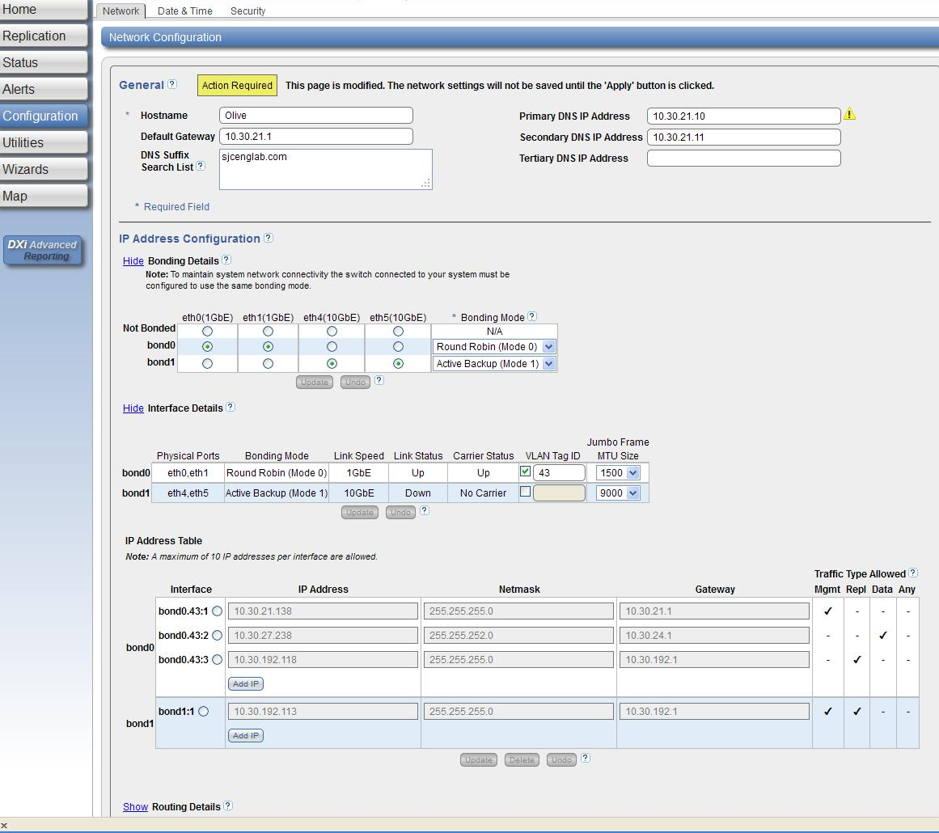
Networking Configuration page

Slide 39
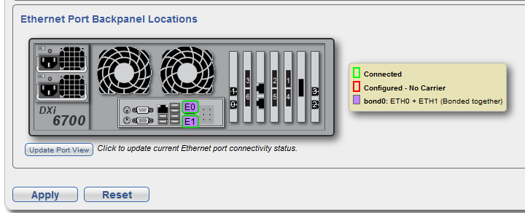
Networking Configuration page, Port Layout

Slide 40
Dynamic Fibre Channel Port Role Change
Allows for full utilization of all user designated FC ports by reconfiguring their role for the needed application at any time.
No reboot is required
Changes are persistent across reboots
Role change can be performed on “inactive” user FC ports only (DXi 67xx and DXi8500 only)
  No changes can be made on system owned FC ports
  DXi8500 has mixture of user and system owned FC ports
  DXi67xx has only user owned FC ports
  Before changing an FC port role to target, unplug its cable
  Before changing an FC port role to initiator, un-map any host mappings on the port, and unplug the cable from the port

Slide 41
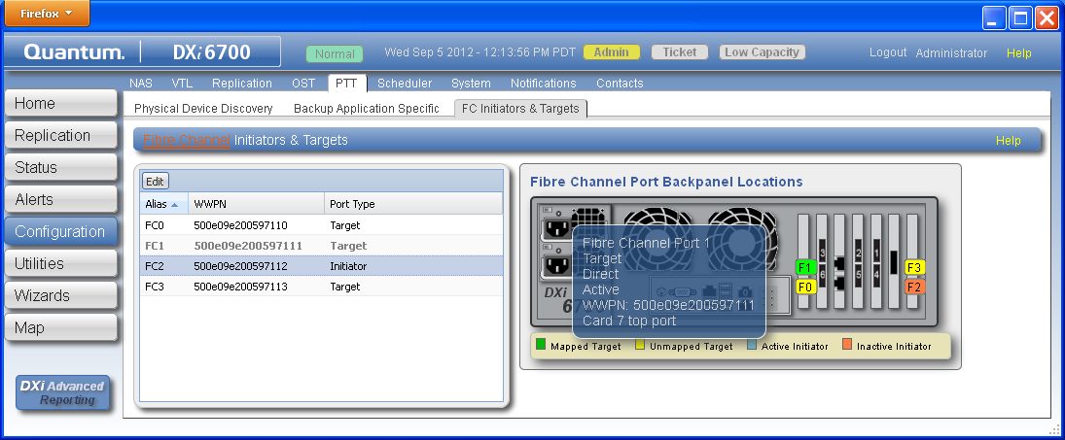
FC Port Role Configuration via GUI
Graphical display of status and configuration of FC ports
Color-coded connectivity and status information on backplane image
By mousing over an FC port on the right-side backplane image (e.g. over F1) a pop-up information window (in blue) will appear.
Ports currently unavailable for change, are grayed and bold-faced in the table (like FC1 on the left-side table below).

Slide 42
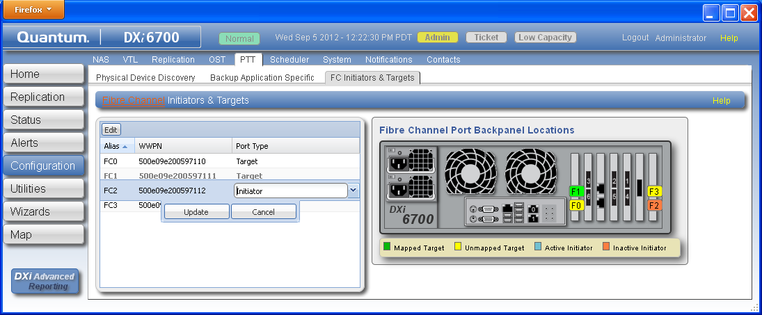
Fibre Channel Port Role Change via GUI
Double-click to select an FC port directly in the table on the left-side.
Choose either Target (VTL) or Initiator (PTT) Port Type
Click Update, and wait until finished
Plug back in cable to the FC port.

Slide 43
Fibre Channel Port Role Change via “gc”
FC port role change via “gc” command is safe. It does not allow for any improper changes to take place.
Get a detailed listing of FC ports, their role and owner information:
  “/opt/DXi/gc –list fcports”
Query an FC port for information regarding its state to decide its readiness for role change:
  /opt/DXi/gc –config fcport –port <FC#> --type query
Change an FC port
  “/opt/DXi/gc –config fcport –port <FC#> --type [initiator|target]
  Fails if port is not ready for role change
  Descriptive output for reason for failure to change the role.

Slide 44
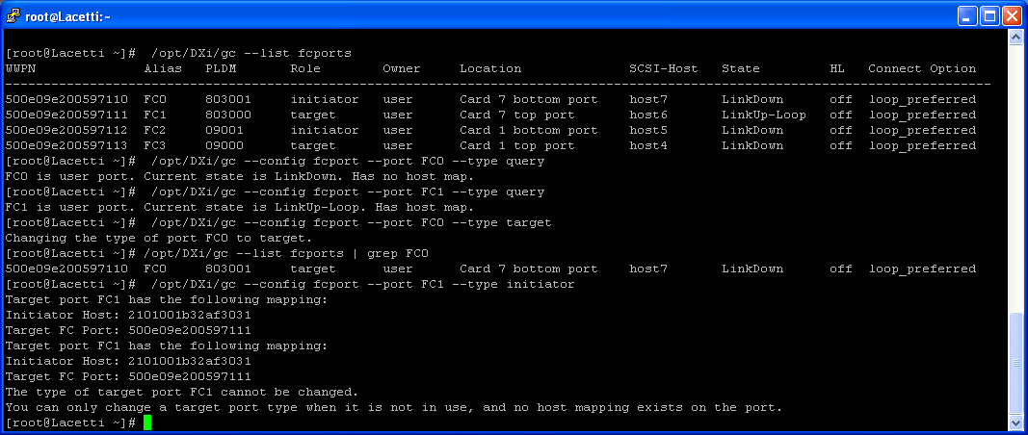
Fibre Channel Port Role Change via “gc”
Example of using “gc” command for FC port role change:

Slide 45
GUI Improvements
Ken Dickerson

Slide 46
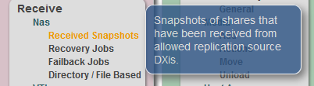
Map of Menus
Two Click Navigation to anywhere in the GUI
Hover mouse over page name to reveal tip

Slide 47
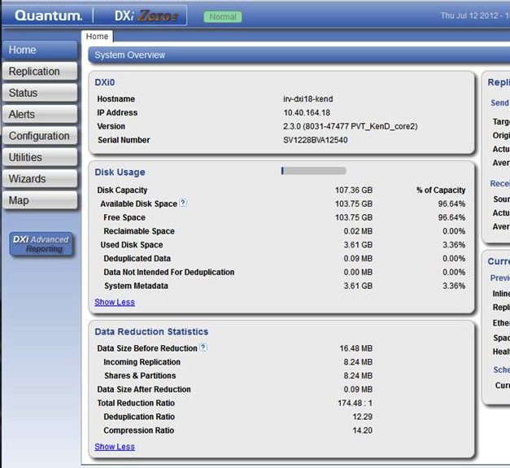
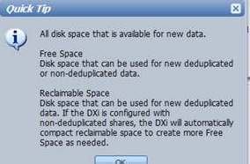
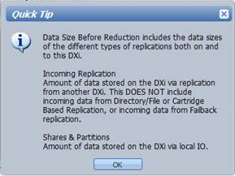
Disk Usage Home Page
Now breaking out different types of space usage
  Including replication disk usage
Helps to understand what is actually available for use

Slide 48
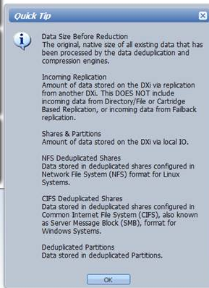
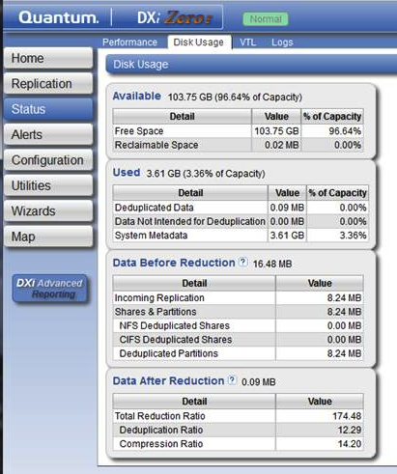
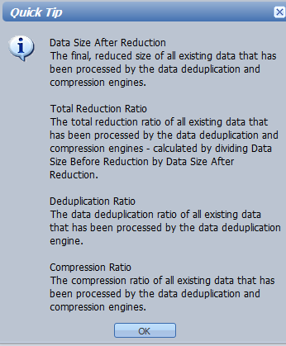
Disk Usage Details

Slide 49
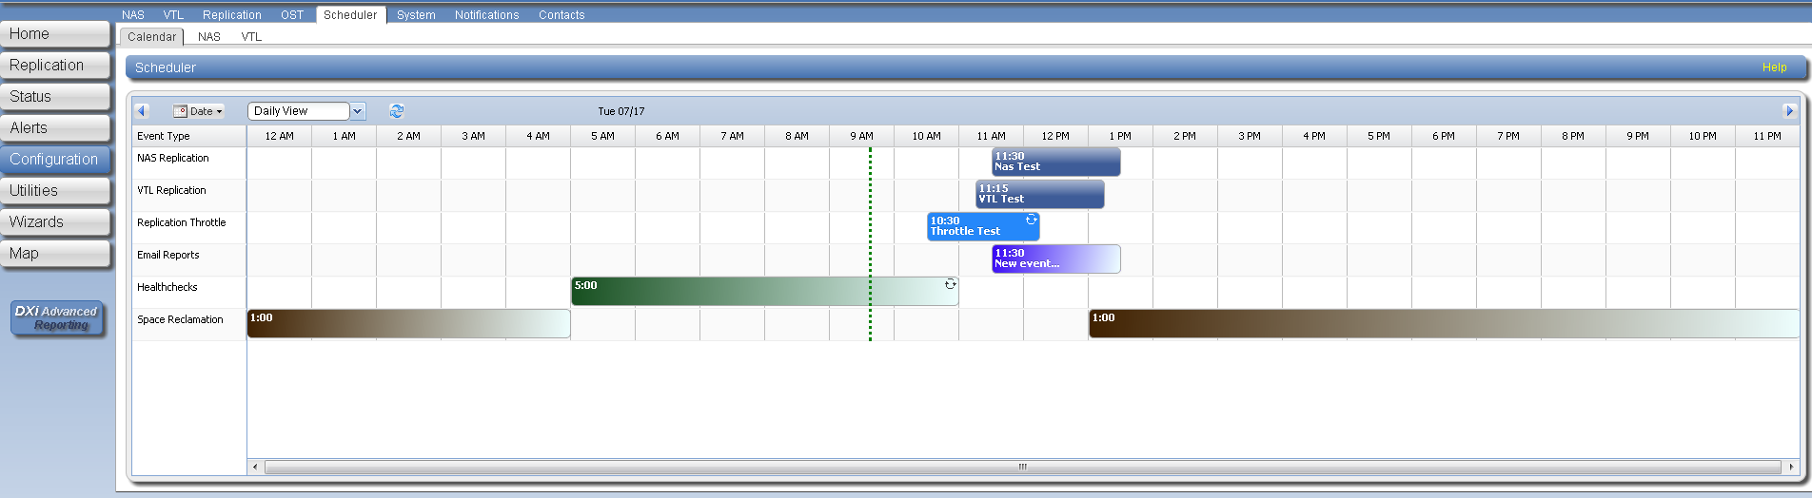
Scheduler Improvements
Adds new event types that can be centrally scheduled
  Share or Partition replication
  Email reports
  Healthchecks
  Space Reclamation
  Improved Replication Bandwidth Throttling
    Events no longer have a minimum 1 minute gap between them
Color gradient used to indicate open ended events.
Ability to edit/delete a single instance or all instances of a recurring event via right click context menus.
Ability to see all scheduled events for a particular NAS/VTL.
Supported via CLI commands

Slide 50
Architecture Changes/Bug Fixes/Known Issues
Brian DeForest

Slide 51
SW Architecture Changes
Garbage Collection – Dan Celidonio/Matt Dewey
Namespace Replication (Tag Protector) – Sridhar Kotturu
Streams increase – Brian DeForest
Miscellaneous software enhancements - Brian DeForest

Slide 52
2.2 GC Improvements
Only runs Stages 2 and 3 (Calculating and deleting Candidates) when manually run via the GUI or syscli or run as a scheduled event.
Automatic full four stage Space Reclamation run when disk space is low.
Manual running of Compaction via syscli only.
Legacy Mode: A way of configuring GC to execute in legacy mode. That is, always run four full stages of Space Reclamation as was done in pre-2.2 releases.
Wiki page for GC: http://dxwiki.quantum.com/dxwiki/GalaxySoftware/gc.status

Slide 53
2.2 GC Improvements
File system disk free space (via df command) will appear more full than in pre-2.2 releases. This is due to the BFST 3.7 compact-on-store feature. The reason is that unless a Compaction run is done, then that “logical free space” in the Blockpool will not appear in the file system free disk space pool. The “logical free space” will be reused by the Blockpool even if a Compaction run is not done. The amount of bytes that is considered “logical free space” can be obtained by viewing the file /mnt/rd0/BPWStats.xml file and looking at this line:
<SizeDeletedPendingCompaction>0</SizeDeletedPendingCompaction>
For more details see the Wiki page: http://dxwiki.quantum.com/dxwiki/BPWstats.xml

Slide 54
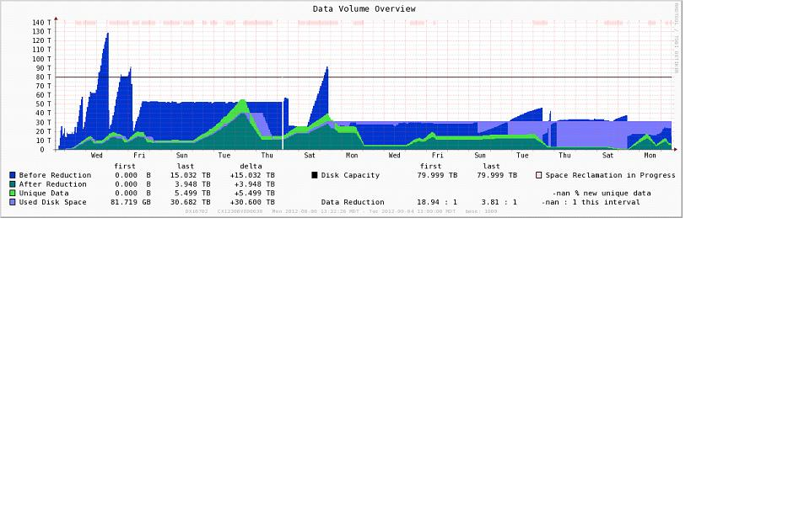
2.2 GC Improvements
“Space Reclamation in Progress”: Pink
“Before Reduction”: Dark Blue -- Customer’s data.
“After Reduction”: Dark Green
“Unique Data”: Light Green--Metadata
“Used Disk Space”: Light Blue -- Disk space not yet compacted.

Slide 55
2.2 GC Improvements
Continuing with the previous graph in (slide 51)
Note that on Friday the Light Blue color behavior changes. On Friday 2.2 was installed and previously 2.1 was installed. Prior to Friday the “Used Disk Space” (Light Blue) was changing quite a bit whereas after 2.2 was installed the “Used Disk Space” is pretty much constant.

Slide 56
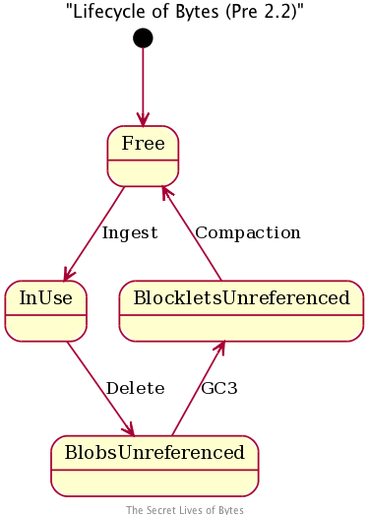
2.2 GC Improvements

Slide 57
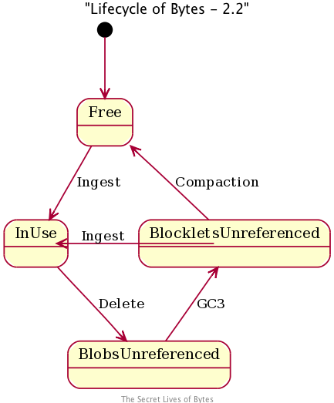
2.2 GC Improvements

Slide 58
2.2 GC Improvements – LifeCycle Of Cluster Bodies
File
Data
Ingest
FileQ
FileY
File
Data
More
Ingest
FileQ
FileY
File
Data
Delete

Slide 59
2.2 GC Improvements – LifeCycle Part 2
FileQ
FileY
File
Data
GC3
FileY
2.2 Skips
GC4
Data
GC4
FileY
FileZ
Data
New Data
More Ingest

Slide 60
NSR Improvements – Tag Protector
Reference Count
Bloom Filter
Bloom Filter tuning
High level design

Slide 61
NSR Improvements – Reference Count
In 1.x, reference count update is skipped for replicated tags. These replicated tags are protected from GC by re-syncing mechanism
If there are continuous replicated tags coming in while GC is running, resync mechanism could result in GC taking days to finish
In 2.x (pre-2.2), reference count is updated for replicated tags to protect from races and resync logic is removed in GC
Because of the reference count update in 2.x, namespace replication performance degraded (see bug 26708 for more details)
In 2.2, reference count update is skipped which is similar to 1.x, to get good namespace replication performance.
Tags that are replicated during GC’s run are protected on the target DXi by using a bloom filter
If the target DXi is either 1.x or 2.2, it utilizes skip-ref count to get good namespace replication performance

Slide 62
NSR Improvements – Bloom Filter
Bloom filter is memory efficient for storing the replicated tags. It has a possibility of false positives
False positives should be less than 10% in typical cases, but false positives worst case is 10%
When a tag list is pre-posted while GC is running, all these tags are entered in Bloom filter
During GC deletion phase while deleting a tag GC deletes the tag only if the tag is not present in the bloom filter
Because of false positives GC could skip a tag which actually needs to be deleted. It is not a data loss but postpones the tag deletion.
Open source implementation of bloom filter is used in 2.2

Slide 63
NSR Improvements – Bloom Filter Tuning
There are two parameters which determine the size of the bloom filter
First parameter is projected number of elements that will be stored in bloom
This is calculated as
(Maximum available storage * RDE) / Average BLOB size
Second parameter is false positive percentage (default value is 10%)
There are two seer variables for these two bloom parameters -
BPGCBloomFalsePositivePercentage and BPGCBloomProjectedElementCount.

Slide 64
NSR Improvements – High Level Design
During GC start-up bloom filter is allocated
Whenever pre-post of tags arrives to target DXi, re_message sends a vp message to GC to inform about pre-posted tags
Upon receiving vp message if GC is in Reconcile or Delete phase, vp message handler adds all the tags present in pre-post file to bloom filter
During GC deletion phase, GC checks bloom filter to determine whether to delete the tag or to skip the tag
At the end of GC deletion phase bloom filter is destroyed

Slide 65
DXi 2.2 Maximum Stream Counts
For 46XX and 6510, stream counts greater than 100 are not recommended.
For all other 6XXX and CS800/S4/64 variants, stream counts greater than 200 are not recommended.
For 8500 and CS800/S4/128, stream counts greater than 400 are not recommended.
Use of ingest stream counts greater than the allocated blockpool connections results internally in small blobs.
This will manifest itself in slow reads, replication and GC.
Further, the stream counts listed above represent: the maximum achievable stream count using the maximum number of drive spindles for the system; the drives are less than 50% storage utilized with minimal fragmentation; and no read streams, replication, non-dedupe shares, or compromised RAIDs.

Slide 66
Misc. Software Enhancements
RAS Enhancements
  Collect log: Bpwstats file added
  RAS emails: Additional files attached to RAS emails
    Requested by Service
Axis2 disabled
  3rd party code for Web Services, not used by any customers
  Being replaced by REST longer term
  Disabled to prevent coredump messages in tsunami log

Slide 67
Bug Fixes and Known Issues
Results related to Bugs:
  1227 Fixed
    194 with associated Service Requests (SR)
    39 with SR already released in 2.1.3
  1386 Resolved
  6 Open
  116 Deferred (8%)
    81 Found in Test
    35 Found in dev
    All deferrals approved by CRB
    Details in the superbug 27262
Refer to Release Notes for known issues
Deferred Profile
Sev \ Pri | P0 | P1 | P2 | P3 | P4 | P5 | Total
1 | - | - | 1 | - | - | - | 1
2 | - | - | 23 | 6 | - | - | 29
3 | - | - | 18 | 35 | 1 | - | 54
4 | - | - | 2 | 2 | 1 | - | 5
5 | - | - | 6 | 15 | 4 | - | 25
Total | 0 | 0 | 50 | 60 | 6 | 0 | 116

Slide 68
Bug Fixes – DXi65xx/67xx SR Impact

Slide 69
Performance Improvements in DXi 2.2
Jimmy Lee

Slide 70
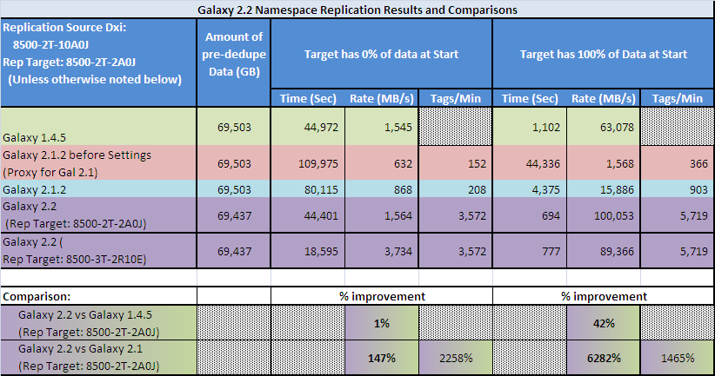
Namespace Replication Performance
Goal : Address a regression in namespace replication performance introduced in DXi 2.0 and remove a barrier of adoption for DXi 1.4.x customers.
Conclusion: Namespace Replication in Galaxy 2.2.0 is comparable to or greater than Galaxy 1.4.5
Notes:
© 2008 Quantum Corporation. Company Confidential. Forward-looking information is based upon multiple assumptions and uncertainties, does not necessarily represent the company’s outlook and is for planning purposes only.
70

Slide 71
Space Reclamation Improvements
Focus on improving the overall steady-state performance
DXi 2.2 saves time by avoiding extra work
  Only runs Stage 2&3 (Calculating Candidates & Deleting Candidates)
    When manually run or run as a scheduled event
  Full four stage Space Reclamation run if space is low
  Automatic re-use of empty blocks during ingest; saves time during GC
Results show up to 220% faster than DXi 2.1 Stage 3 + Stage 4
  Still evaluating impact on ingest and read impact
Space Reclamation testing being done with fragmentation
  More accurately reflects observed performance over time
Further improvements in future DXi releases

Slide 72
Space Reclamation Performance Improved w/ Fragmented Blockpool
Overall time GC faster than Gal 2.1.1 GC3 + GC4, up to 220% improvement
Test 30 backup cycles with Quanta up to 2.3 (Quanta up to 2 covers 98% of customers)
Notes:
© 2008 Quantum Corporation. Company Confidential. Forward-looking information is based upon multiple assumptions and uncertainties, does not necessarily represent the company’s outlook and is for planning purposes only.
72

Slide 73
Enabler Updates: DXi Advanced Reporting and Vision
Mike Simone

Slide 74
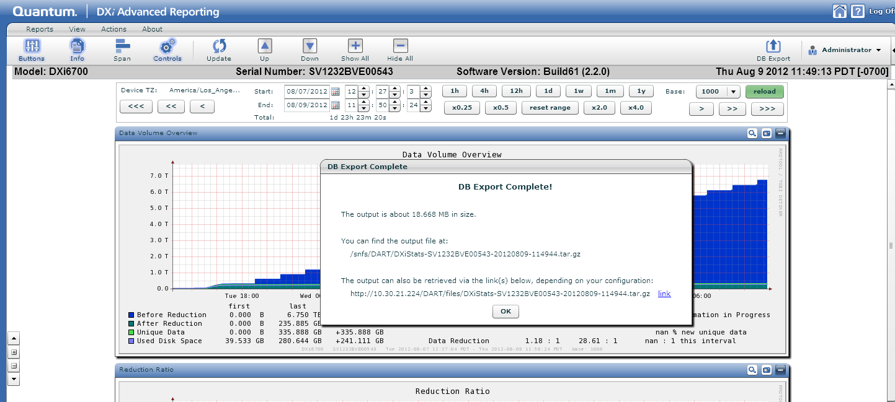
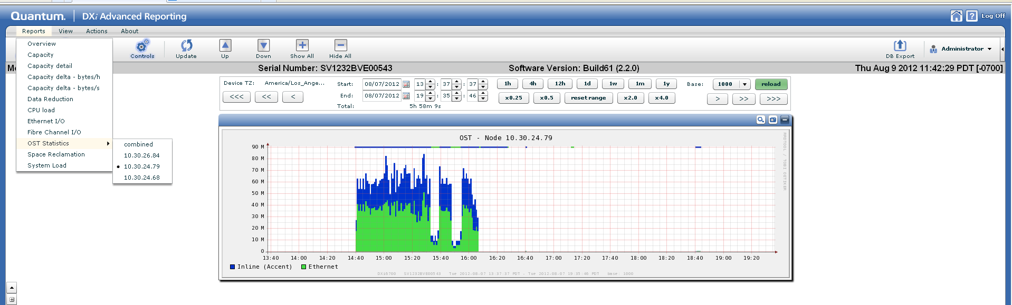
DXi 2.2 Enablers
DXi AR 2.1 was developed to support DXi 2.2:
  Updated Space Reclamation
  Report on individual OST and Accent servers
New features:
  Run dbexport from the GUI
  View dedup stats for individual OST and Accent servers
Notes:
- Dbexport from the DXi AR GUI, no need for root access to the command line
See dedup for each NBU or BUE server running Accent
See data transfer stats for each NBU or BUE server running OST

Slide 75
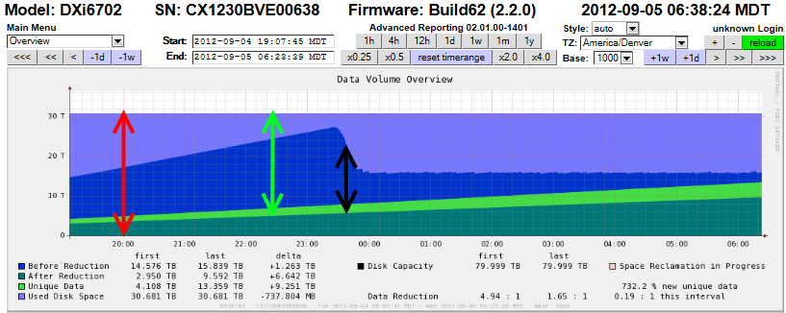
DXi 2.2 Enablers
Changes in DXi AR created by updates to Space Reclamation
  Disk space is allocated to the blockpool, but is not freed by Space Reclamation as it was in older versions of DXi
  Disk space is then reused by the blockpool as Space Reclamation is run
  Used Disk space on DXi AR is now the disk space allocated to the blockpool
  After Reduction and Unique data is referenced by the blockpool
  Space available for use by the blockpool is the difference between Used Disk space and After Reduction data
Remember: Expiration of data by b/u app will immediately reduced Before Reduction which changes RDE
Notes:
Space reclamation has changed, removed compaction from the standard GC process
Compaction is now run on ingest and is no longer reduces Used Space like in older versions of DXi
Used space will be more constant as it reflects the disk allocated to the blockpool for used and freed deduplicated data
Disk space allocated to the blockpool, but not used, is the difference between Used Disk and After Reduction data
Not new, but reminder: expiration of data is immediately seen on DAR, space reclamation must be run to see space reduced for After Reduction and Unique data – this can affect RDE shown on DXi AR!

Slide 76
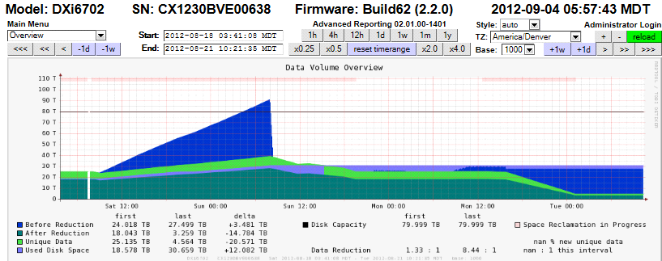
DXi 2.2 Enablers
DXi AR: Space reclamation now only has three stages, you WON’T see Disk Usage decrease during space reclamation
Vision
  No updates specific to DXi 2.2
  Vision 4.2 adds DXi Capacity Upgrade estimates for all DXi versions
  Vision 4.2 adds Accent reporting for DXi 2.0.1 and above
Notes:
Note: even though Space Reclamation is running there is NO affect on Before Reduction or Used Disk space; this is new behavior.
Note: After reduction and Unique data IS reduced by running Space Reclamation.
Nothing new for DXi 2.2 in Vision, but the latest release of Vision supports Capacity Upgrade Estimator as well as Accent reporting

Slide 77
Training and Documentation Updates
Jim Hibbard

Slide 78
Training Updates
Available for registration in StorageCare Learning:
  NEW: DXi 2.2 Software Service Update course (2-3437b)
  UPDATED: DXi6700 Installation course (2-2431)
  UPDATED: DXi-Series 2.x Configuration course (2-2482)
  UPDATED: DXi-Series 2.x Configuration Hands-on GUI Practice (3-2432)
Ships with the product and available on CSWeb, Quantum.com, and the Documentation CD:
  UPDATED: DXi6700 User Essentials document (6-67193-01)

Slide 79
Documentation Updates
DXi6000 User’s Guide
DXi6701 and DXi6702 Site Planning Guide
DXi6701 and DXi6702 Installation and Configuration Guide
Quantum DXi-Series 2.2 Software Installation and Upgrade Guide
  Ignore the upgrade step to install 2.0c BIOS
  An updated doc will be released by next week that removes the step
DXi-Series Command Line Interface (CLI) Guide
Quantum DXi6500 and DXi6700 Expansion Module Upgrade Instructions
DXi-Series SNMP Reference Guide
DXi-Series NetBackup and Backup Exec OST Configuration Guide
DXi-Series Backup Application Specific PTT Configuration Guide
DXi6500 Field Service Manual
DXi6700 Field Service Manual
DXi-Series 2.2 Release Notes
OST Plug-in 2.6.0 Installation Instructions

Slide 80
Questions
Quantum Confidential

Slide 81
Appendix
Quantum Confidential

Slide 82
DXi 8500 2.2 Multiprotocol Example
With VTL
  VTL = 1/2N
  MS CIFS = 1/6N
  NFS (async) = 1/6N
  OST = 1/6N
Without VTL
  MS CIFS = 1/3N
  NFS (async) = 1/3N
  OST = 1/3N
From the previous slide, N = 256 for the 8500, for empty drives and maximum spindle count
If protocols are unused, their capacity can be contributed to other protocols
Use of Async for NFS improves overall NFS throughput by approximately 50%, and only requires a backup verification to ensure completeness
(Note the absence of Linux CIFS)

Slide 83
DXi Multiprotocol Field Guidance
Mixed NFS/VTL Scenario
Simultaneous inline deduplication of VTL and NFS traffic represents the mixing of a heavy, intensive IO payload with an out-of-order, bursty, and response sensitive protocol
The DXi 2.1 shares configuration should change from the default (synchronous) to run asynchronous NFS shares in a mixed VTL and NFS environment
Additional notes
  All other multi-protocol combinations work well together
  Recommendation applies to all operating systems and applications
  Eliminates the backup timeouts/failures present with NFS/VTL in DXi 2.0.1
  Reduced VTL traffic may lessen the frequency of NFS timeouts with certain applications (e.g., NetBackup)
  Asynchronous NFS is customer configurable via CLI

Slide 84
DXi Multiprotocol Field Guidance
NFS Synchronous/Asynchronous Mode Background
The Synchronous setting requires all data written to be committed to physical storage; meaning protocol ‘stable writes‘ and ‘commits’ require all data to be written to disk for before the command is complete. This ensures that when a backup completes all the data resides on disk. The default setting is Synchronous. This setting can be altered through the CLI.
Asynchronous mode allows the system to acknowledge receipt of ‘stable write’ or ‘commit’ command without having the data (and related metadata) fully written to disk. This mode allows backups to be completed faster (from the backup application point of view) accepting the possibility of having an incomplete backup if the system fails (e.g., power is lost) before all the data gets flushed to disk.

