Slide 1

DXi 2.1 Transfer of Information for Service
December 8, 2011
Notes:
© 2010 Quantum Corporation. Company Confidential. Forward-looking information is based upon multiple assumptions and uncertainties, does not necessarily represent the company’s outlook and is for planning purposes only.
1

Slide 2
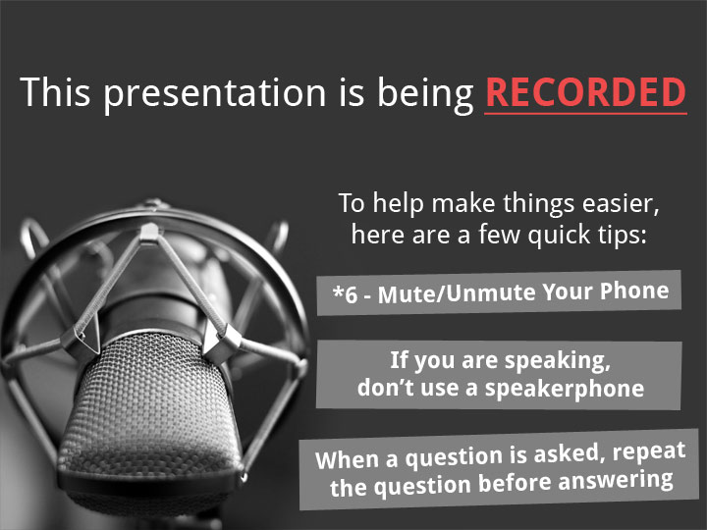
2
© 2011 Quantum Corporation. Company Confidential. Forward-looking information is based upon multiple assumptions and uncertainties, does not necessarily represent the company’s outlook and is for planning purposes only.
Notes:
© 2008 Quantum Corporation. Company Confidential. Forward-looking information is based upon multiple assumptions and uncertainties, does not necessarily represent the company’s outlook and is for planning purposes only.
2

Slide 3
Agenda
Marketing Overview
Performance Guidelines
Security Features
Replication Features
Networking Features
OST Features
Platform Changes
Quality and Serviceability Features
ISV Updates
Enabler Updates
Q&A
Note: Q&A will be at the end of the presentation. If we don’t get to your question, please send Jim Hibbard an email and we’ll answer offline.
3
© 2011 Quantum Corporation. Company Confidential. Forward-looking information is based upon multiple assumptions and uncertainties, does not necessarily represent the company’s outlook and is for planning purposes only.
Notes:
© 2008 Quantum Corporation. Company Confidential. Forward-looking information is based upon multiple assumptions and uncertainties, does not necessarily represent the company’s outlook and is for planning purposes only.
3

Slide 4
Marketing Overview
Mark Thacker
4

Slide 5
Agenda
Overview
Delivery Plans
Increased VTDs on 8500 & 6701/6702
Symbolic and Hard Link Support
Conclusion
© 2011 Quantum Corporation. Company Confidential. Forward-looking information is based upon multiple assumptions and uncertainties, does not necessarily represent the company’s outlook and is for planning purposes only.

Slide 6
DXi 2.1 Overview
Enhanced GUI for modern browsers
Improved DXi8500 performance (through use of inline dedupe)
Replication scheduling & throttling
Flexible network segmentation & multiple IPs per bond
Increased VTD’s for 8500 and 6700 (with 2.1.1)
NFS/VTL multiprotocol support
OST V11, Optimized Synthetic Fulls, HP-UX OST plugin
  Accent for 4601 and 8500
Security Enhancements
  Westmere encryption enhancements (8500 and 4500)
  256-bit encryption keys for replication
  Security banner & failed login attempt display
  Whole system data shredding
Symbolic and hard links supported
Critical bug fixes
6
© 2011 Quantum Corporation. Company Confidential. Forward-looking information is based upon multiple assumptions and uncertainties, does not necessarily represent the company’s outlook and is for planning purposes only.

Slide 7
DXi 2.1 Delivery Plans
7
© 2011 Quantum Corporation. Company Confidential. Forward-looking information is based upon multiple assumptions and uncertainties, does not necessarily represent the company’s outlook and is for planning purposes only.
First Release December 8, 2011
  8500 GA from factory and fresh installs
  No upgrades from 1.4.x
    Utilize side-by-side installations and/or replication until DXi 2.1.1 in Jan 2012
    Work with Product Management directly for transitions
  OST Plug-In for all platforms, including HP-UX
  512 VTDs max on DXi8500
  Max Usable Capacity Extension from 200TB to 320TB on new systems
Second Release: January 2012, Version 2.1.1
  Supports 4000/6000/8500
  Support for upgrades from 1.4.x and 2.x.
    1.4.x upgrades on 8500 still discouraged
    use side by side or fresh install after removing data
  8500 1TB base that want to upgrade to 2.1
    Characterization of upgrade times closer to launch
  DXi8500 IB Customers that want >200TB capacity or up to 512 VTDS
    Capacity Upgrade Kit provides increased memory to 128GB

Slide 8
Increased VTDs on 8500 & 6701/6702
8
© 2011 Quantum Corporation. Company Confidential. Forward-looking information is based upon multiple assumptions and uncertainties, does not necessarily represent the company’s outlook and is for planning purposes only.
In December DXi8500 release:
  8500 2TB systems; ships with160 VTD license by default
  512 VTD’s possible - 160 active simultaneously
  No cost license required to go above 160 VTD’s defined
  Customer must ensure they do not use more than 160 simultaneously
  Not all ISV apps respond well with drive in inactive state
  Product Management & Sales to qualify any 512 VTD customer
In January 2.1.1 release:
  DXi6701/6702 systems; ships with 80 VTDs by default
  256 defined VTDs with no cost license (80 active simultaneously)
  Product Management & Sales to qualify any 256 VTD customer
Install base DXi8500
  Requires Capacity Upgrade Kit to reach 512 VTDs
Install base DXi6700 classic remains at 80 VTDs

Slide 9
Symbolic and Hard Link Support
9
© 2011 Quantum Corporation. Company Confidential. Forward-looking information is based upon multiple assumptions and uncertainties, does not necessarily represent the company’s outlook and is for planning purposes only.
Useful for Veeam (& others) that create synthetic fulls
Available on NFS shares only
Customer selectable on a per share basis via CLI
No replication support for shares with this enabled
  If replication is enabled on a share, can not choose sym/hard links
  Will target for addressing in later DXi release

Slide 10
In Summary…
10
© 2011 Quantum Corporation. Company Confidential. Forward-looking information is based upon multiple assumptions and uncertainties, does not necessarily represent the company’s outlook and is for planning purposes only.
DXi 2.1 is a significant release for Quantum DXi
Two phase release strategy
  December for DXi8500 factory and new installs
  January for all other DXi-series & upgrades
Addresses major customer requests
  Fastest target-based dedup appliance with DXi8500
  Increased VTD’s
  Full multiprotocol support
  Replication scheduling and throttling
  Flexible networking that is both simple and advanced
  Enhance OST capabilities
  Security enhancements
  Symbolic and hard link support

Slide 11
Performance Guidelines
Jim Flom
11

Slide 12
DXi 8500 2.1 Performance Guidance
Fastest target-mode dedup appliance
  VTL Inline 2436 MB/s (8.8 TB/hr) – roughly 7% over DD 8.1 TB/hr
  Increases on all fronts when comparing 2.1 Inline versus 1.4.x_85 Adaptive Ingest
12
© 2011 Quantum Corporation. Company Confidential. Forward-looking information is based upon multiple assumptions and uncertainties, does not necessarily represent the company’s outlook and is for planning purposes only.

Slide 13
DXi 2.1 Stream Counts
For 46XX and 6510, stream counts greater than 100 are not recommended.
For all other 6XXX variants, stream counts greater than 200 are not recommended.
For 8500, stream counts greater than 400 are not recommended.
Use of ingest stream counts greater than the allocated blockpool connections results internally in small blobs.
This will manifest itself in slow reads, replication and GC.
13
© 2011 Quantum Corporation. Company Confidential. Forward-looking information is based upon multiple assumptions and uncertainties, does not necessarily represent the company’s outlook and is for planning purposes only.

Slide 14
DXi 8500 2.1 Multiprotocol Guidelines
With VTL
  VTL = 1/2N
  MS CIFS = 1/6N
  NFS (async) = 1/6N
  OST = 1/6N
Without VTL
  MS CIFS = 1/3N
  NFS (async) = 1/3N
  OST = 1/3N
From Slide 10, N = 200 for the 8500
If protocols are unused, their capacity can be contributed to other protocols
Use of Async for NFS improves overall NFS throughput by approximately 50%, and only requires a backup verification to ensure completeness
(Note the absence of Linux CIFS)
Examples:
VTL and OST: 100 of each
VTL, MS CIFS, and NFS: 100, 50, 50
VTL, MS CIFS, NFS, OST: 100, 33, 33, 33
Examples:
MS CIFS and NFS: 100 of each
MS CIFS, NFS, OST: 66, 66, 66
14
© 2011 Quantum Corporation. Company Confidential. Forward-looking information is based upon multiple assumptions and uncertainties, does not necessarily represent the company’s outlook and is for planning purposes only.

Slide 15
DXi Multiprotocol Field Guidance
Mixed NFS/VTL Scenario
Simultaneous inline deduplication of VTL and NFS traffic represents the mixing of a heavy, intensive IO payload with an out-of-order, bursty, and response sensitive protocol
The DXi 2.1 shares configuration should change from the default (synchronous) to run asynchronous NFS shares in a mixed VTL and NFS environment
Additional notes
  All other multi-protocol combinations work well together
  Recommendation applies to all operating systems and applications
  Eliminates the backup timeouts/failures present with NFS/VTL in DXi 2.0.1
  Reduced VTL traffic may lessen the frequency of NFS timeouts with certain applications (e.g., NetBackup)
  Asynchronous NFS is customer configurable via CLI
15
© 2011 Quantum Corporation. Company Confidential. Forward-looking information is based upon multiple assumptions and uncertainties, does not necessarily represent the company’s outlook and is for planning purposes only.

Slide 16
DXi Multiprotocol Field Guidance
NFS Synchronous/Asynchronous Mode Background
The Synchronous setting requires all data written to be committed to physical storage; meaning protocol ‘stable writes‘ and ‘commits’ require all data to be written to disk for before the command is complete. This ensures that when a backup completes all the data resides on disk. The default setting is Synchronous. This setting can be altered through the CLI.
Asynchronous mode allows the system to acknowledge receipt of ‘stable write’ or ‘commit’ command without having the data (and related metadata) fully written to disk. This mode allows backups to be completed faster (from the backup application point of view) accepting the possibility of having an incomplete backup if the system fails (e.g., power is lost) before all the data gets flushed to disk.
16
© 2011 Quantum Corporation. Company Confidential. Forward-looking information is based upon multiple assumptions and uncertainties, does not necessarily represent the company’s outlook and is for planning purposes only.

Slide 17
Security Features
Jim Flom/Byron Hack/Brian Deforest
17

Slide 18
Security Features
18
© 2011 Quantum Corporation. Company Confidential. Forward-looking information is based upon multiple assumptions and uncertainties, does not necessarily represent the company’s outlook and is for planning purposes only.
256-bit encryption for replication
  Does not apply to optimized duplication*
  No user-supplied certificates or keys to keep up with
  Enabled for DXi Accent
Westmere processor encryption performance
  For DXi8500 and 4500/4601. No benchmarking yet
Security banner display using user-supplied text
Failed login display at time of successful login

Slide 19
Security Features (continued)
Security banner display using user-supplied text
  GUI: Add text via Configuration->System->Security->Security Banner
  CLI: Add text via command
    syscli --set securitybanner --txtfile <file-name>
  Same security banner text is used for both GUI and CLI.
Failed login display at time of successful login
  Any failed login attempt for GUI or CLI increments the failed login counter.
  Any successful login attempt for GUI or CLI clears the failed login counter.
Encryption support for Replication and OST
  Replication - added radio buttons to select 128 vs 256 bit encryption.
  OST Accent – added check box to enable encryption, and radio buttons for 128 vs 256 bit encryption

Slide 20
Security Banner
20
© 2011 Quantum Corporation. Company Confidential. Forward-looking information is based upon multiple assumptions and uncertainties, does not necessarily represent the company’s outlook and is for planning purposes only.

Slide 21
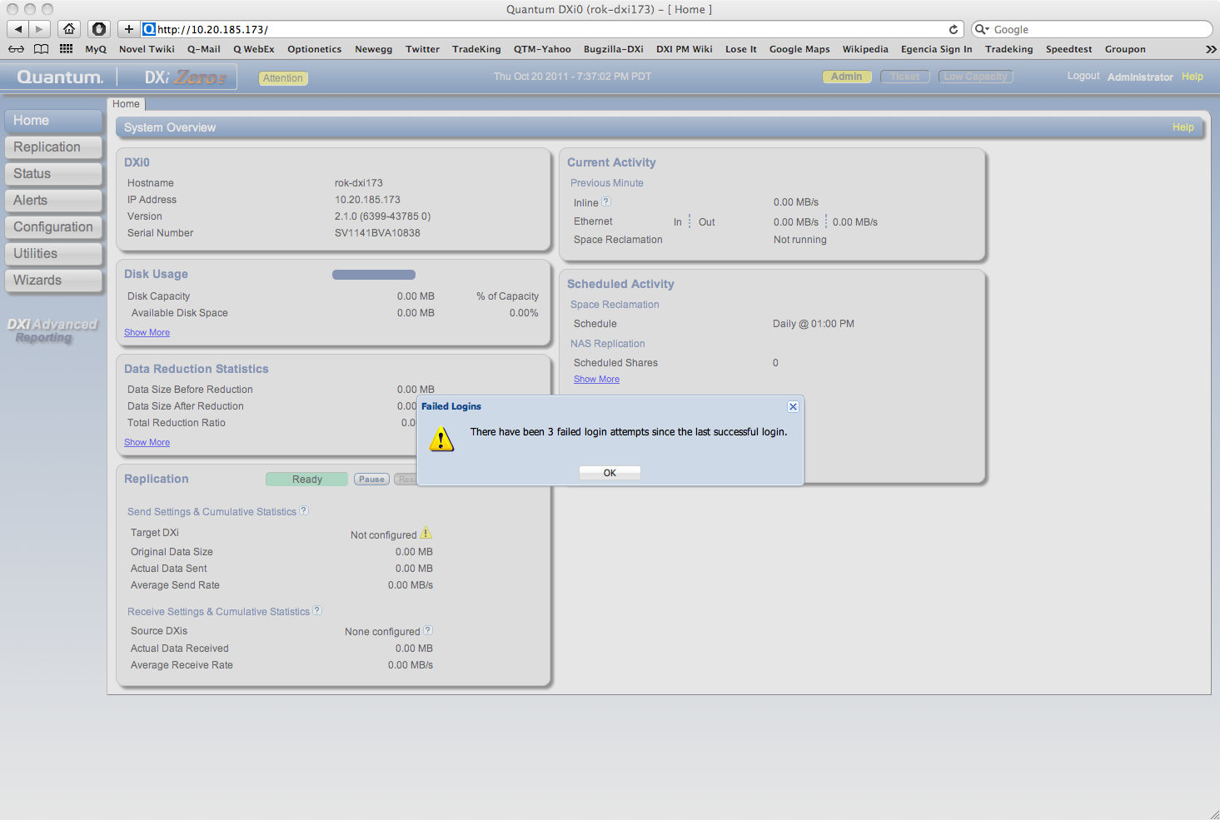
Failed Login Attempt
21
© 2011 Quantum Corporation. Company Confidential. Forward-looking information is based upon multiple assumptions and uncertainties, does not necessarily represent the company’s outlook and is for planning purposes only.

Slide 22
Security Features (continued)
22
© 2011 Quantum Corporation. Company Confidential. Forward-looking information is based upon multiple assumptions and uncertainties, does not necessarily represent the company’s outlook and is for planning purposes only.
Whole system shredding
  Bootable USB key
  DXi6000 Series
    "Secure Erase" - “minutes” instead of “hours”
    approx. 20 minutes per system
  DXi4000/8000 Series
    "Linux Shred"
    9 sec/GB
  Delivery by Quantum service
  GA Post 2.1

Slide 23
Security Features (continued)
23
© 2011 Quantum Corporation. Company Confidential. Forward-looking information is based upon multiple assumptions and uncertainties, does not necessarily represent the company’s outlook and is for planning purposes only.
Security Scanners
  eEye Retina and Tenable Nessus Network Scanner designated Scanner used for Quantum Products
  Target Criteria: No unresolved High issues
  DXi configured with items that utilized network per defined procedure
    Network bond all – Data, Mgmt, Replication
    NFS, CIFS, OST, Replication, Email, SNMP
    Passwords changed from default
  eEye Retina vulnerability report: 1 High, 22 Med, 9 Low, 11 Info
    High(1) Samba Multiple Unspecified Vulnerabilities (Zero-Day). DXi is exporting using samba. This as per current design
    Med(22) SSL Weak Cipher Strength Supported. Dell System Management web server daemon (PR 26001)
    Med(2) Scanner finds OpenSSH X11 Port Forwarding Session Hijack Vulnerability. DXI OpenSSH rpm contains the fix. False error (PTR 23445)
  Tenable Nessus vulnerability report: 0 High, 4 Med, 88 Low
    Med(1) Remote NFS server exports world readable shares. DXi is exporting NFS share without restricting access (based on hostname, IP, or IP range). This as per current design
    Med(3) SSL Weak Cipher Strength Supported. Dell System Management web server daemon (PR 26001)
Notes:
© 2010 Quantum Corporation. Company Confidential. Forward-looking information is based upon multiple assumptions and uncertainties, does not necessarily represent the company’s outlook and is for planning purposes only.
23

Slide 24
Replication Features
Byron Hack/Sridhar Kotturu/Mary Hayes
24

Slide 25
Replication Scheduling and Throttling
25
© 2011 Quantum Corporation. Company Confidential. Forward-looking information is based upon multiple assumptions and uncertainties, does not necessarily represent the company’s outlook and is for planning purposes only.
New centralized scheduler for more than just bandwidth
Replication bandwidth specified in KB/s, MB/s, GB/s
Applies to all replication-specific interfaces
Applies to all forms of replication & OST optimized duplication
Represents an maximum bandwidth used
  Not a guarantee for minimum bandwidth
Centralized scheduling GUI useful for other activities
  View scheduled events for Healthchecks and Garbage Collection
Throttling is applied to outbound traffic only
If you set throttle too low rep will fail. Best practices guide to be published around this after more testing by SEs.

Slide 26
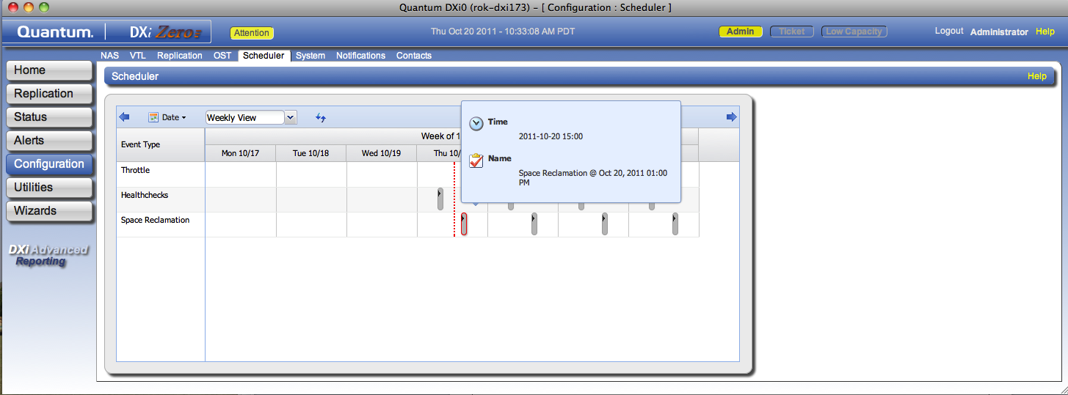
General Purpose Scheduler
26
© 2011 Quantum Corporation. Company Confidential. Forward-looking information is based upon multiple assumptions and uncertainties, does not necessarily represent the company’s outlook and is for planning purposes only.
Events can repeat
Throttle events should be scheduled with stop times.
Open ended throttle events may cause confusion and will not be supported in 2.1.1.
Additional schedulable events will be added in future releases

Slide 27
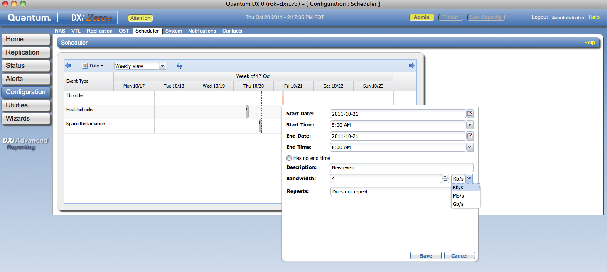
Replication Scheduling and Throttling
Default is no throttle; used when no event scheduled
27
© 2011 Quantum Corporation. Company Confidential. Forward-looking information is based upon multiple assumptions and uncertainties, does not necessarily represent the company’s outlook and is for planning purposes only.

Slide 28
Overlapping Events
Scheduling of overlapping throttle events will give unexpected results
Any stop action from any event will cause throttling to terminate.
28
© 2011 Quantum Corporation. Company Confidential. Forward-looking information is based upon multiple assumptions and uncertainties, does not necessarily represent the company’s outlook and is for planning purposes only.

Slide 29
Where to Debug Scheduled Throttle Events
The Scheduler Daemon and log is at
  /opt/quantum/scheduler/sbin/schedd
  /opt/quantum/scheduler/logs/schedd.log
The Scheduler Library log (included in collect log) is
  /opt/quantum/scheduler/logs/libschedapi.log
syscli commands for both scheduling and adding/deleting throttling in
  /var/log/syscli/syscli.log
Corresponding netcfg.sh add/del throttle commands in
  /var/log/messages
The netcfg.sh script adds tc files to the /etc/sysconfig/network-script directory, for example, for global throttling, you should see the global.tc file:
  [root@rok-dxi85 network-scripts]# cat global-tc
  SERVICE=1062 HOSTIP= BANDWIDTH=500K

Slide 30
File/Cartridge Replication w/Delete Propagation
Sridhar Kotturu

Slide 31
Agenda
Overview
Configuration
VTL cartridge deletes
NAS directory/file deletes
NAS directory/file rename
Trigger Deletes API
Design

Slide 32
Overview
Propagation of cartridge, directory/file deletes to target
Propagation of file/directory renames
Role of ‘Synchronization’
Provides API to BPW and VTL
No GUI or syscli interface

Slide 33
Configuration
By default Trigger Deletes feature is enabled
Controlled by Seer variable <TriggerDeletesEnabled>true</TriggerDeletesEnabled>
Config file is (reboot needed) /data/hurricane/conf/Common.conf

Slide 34
VTL cartridge deletes
On source, VTL notifies cartridge deletion to replicationd
Terms: Partition delete, Cartridge export, Cartridge delete
VTL only sends barcode. No partition name available
  'barcodes' for all the systems used should be unique. Otherwise trigger deletes feature needs to be disabled using seer variables. Currently there is no GUI/CLI interface for this.
  On target, delete the barcode present in either any trigger enabled partition or in Unassigned partition.
Cartridge exports/imports are not propagated to target

Slide 35
VTL Cartridge deletes (Cont)
In trigger replication of cartridge, if the cartridge is present in Unassigned partition on target, first import it to the required partition and then recover it
  Pre 2.1 did not do the import and recovery of the cartridge failed

Slide 36
NAS directory/file deletes
BPW calls replication API when there are any directory/file deletes in a share
BPW provides the share name and the relative path in the share

Slide 37
NAS Directory/file Renames
BPW calls replication API when there is a rename for a directory/file
  Replication turns this in to 2 trigger requests: a delete followed by a create
BPW provides share name, old path and new path
DXi does not support renames across a share

Slide 38
Trigger Deletes API
static triggerDelErr ReplicationAPI::oper_triggerDeletesPropagation(
NAS::Common::NodeType nodeType,
const std::string& nodeName,
const std::string& object);
static triggerDelErr
ReplicationAPI::oper_triggerRenamePropagation(
NAS::Common::NodeType nodeType,
const std::string& nodeName,
const std::string& oldPath,
const std::string& newPath);

Slide 39
Design
BPW and VTL calls replication API, which in turn sends a vp message to replicationd daemon
Replicationd queues the request in database along with other trigger requests and removes any duplicates
Requests are processed in the order of queuing
Sends RE message to target to process delete request
re_message receives it on target and sends vp message to AUD

Slide 40
Design (Cont)
AUD queues the request in database along with other requests. Removes any duplicates in the database.
Processes the requests in the order of queuing
Calls appropriate BPW/VTL APIs for actual delete of the cartridge or directory/file after pre-processing.
Trigger Deletes requests are not re-tried after a failure.

Slide 41
Replication Tag Prepost Aging
Mary Hayes

Slide 42
Agenda
Overview
Configuration
When Is It Applied
Design
Testing Suggestions

Slide 43
Overview
Prepost aging provides a method for preposted tags on the target to get automatically cleaned up
Removes need for Synchronization in a normal situation with trigger deletes active
Gives a period of time that tags are retained before their prepost reference is removed on the target

Slide 44
Configuration
Enabled/Disabled by Seer variable <EnablePrepostAging>true
</EnablePrepostAging>
Tag retention by Seer variable <PrepostRetentionHours>4
</PrepostRetentionHours>
Config file is (reboot needed) /data/hurricane/conf/Common.conf
By default prepost aging is enabled and retention is 4 hours
Age setting does not affect trigger deletes configuration

Slide 45
When It Is Applied
Prepost aging must be enabled
Prepost aging is applied:
  Only to Shares/VTLs that have trigger replication enabled
  Only if the target supports trigger deletes
    This means that the Galaxy software release on target must be at least 2.1

Slide 46
Design
Aging is done in the ReplicationContinuousFile class
  continuous.new file holds tags since last aging
  continuous.aging file holds time of last aging
DestinationQueue::inProcessTagQueueToDestinationQueues()
  This is the function that processes continuous tags periodically
  Also determines if aging should be done and initiates it
  continuous file is aged on source and then posted to target

Slide 47
Networking Features
Charissa Willard
47

Slide 48
Networking Enhancements
48
© 2011 Quantum Corporation. Company Confidential. Forward-looking information is based upon multiple assumptions and uncertainties, does not necessarily represent the company’s outlook and is for planning purposes only.
Mininet changes now in GUI
  Survives upgrades & reboots
  VLAN tagging supported (CLI only)
One GUI for configuration
  No more ‘modes’ selection
  Details are hidden for simplicity, easily revealed
Flexible network segmentation
  Can specify function of each interface/bond (Mgmt, Rep, Data, any)
Each bond can specify load balancing (LACP, round robin)
Bonds can be configured for Jumbo Frame
  GUI Configuration: Standard has MTU size 1500; Jumbo has MTU size 9000.
  MTU Sizes between 1500 and 9000 can be specified via CLI.

Slide 49
Networking Enhancements (cont.)
49
© 2011 Quantum Corporation. Company Confidential. Forward-looking information is based upon multiple assumptions and uncertainties, does not necessarily represent the company’s outlook and is for planning purposes only.
Each interface/bond can specify specific routes used
Improved connection display
  Indicates location of bonded interfaces
  Indicates link status of each port
Replication works over NAT firewalls
Replication IP Address Mapping
  GUI: Configure->Replication->Send
  Configure ‘Source IP Address’ corresponding to IP Address designated for Replication Traffic Type
  Also supported in CLI
OST IP Address Mapping
  Ability to map OST Target IP Address to IP Address designated for Replication Traffic Type
  Supported in CLI only, ‘opduptranslate’

Slide 50
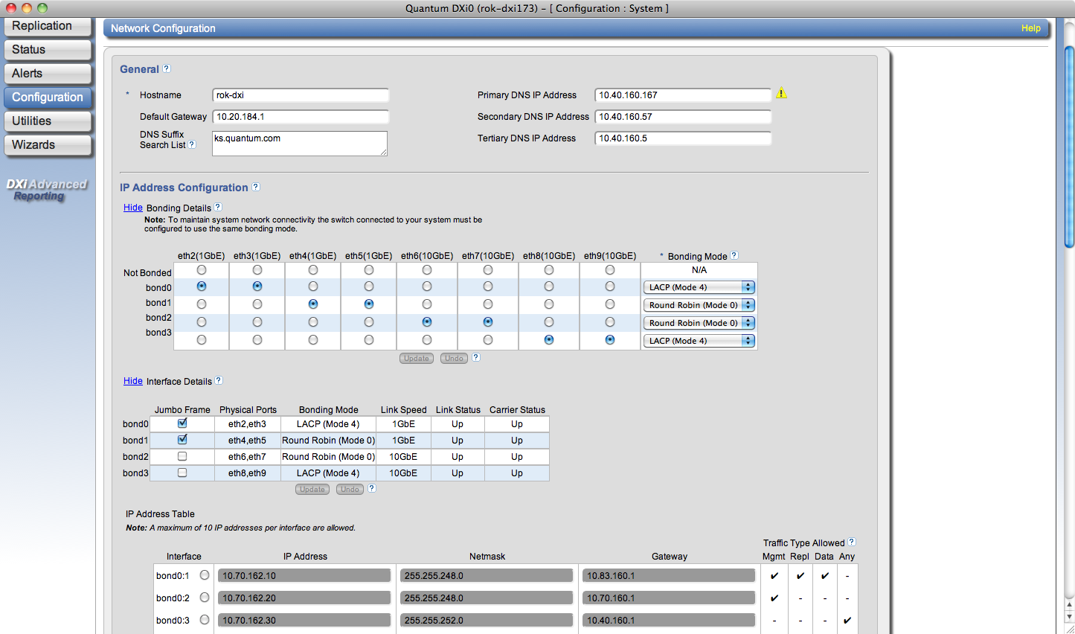
Network Segmentation
50
© 2011 Quantum Corporation. Company Confidential. Forward-looking information is based upon multiple assumptions and uncertainties, does not necessarily represent the company’s outlook and is for planning purposes only.

Slide 51
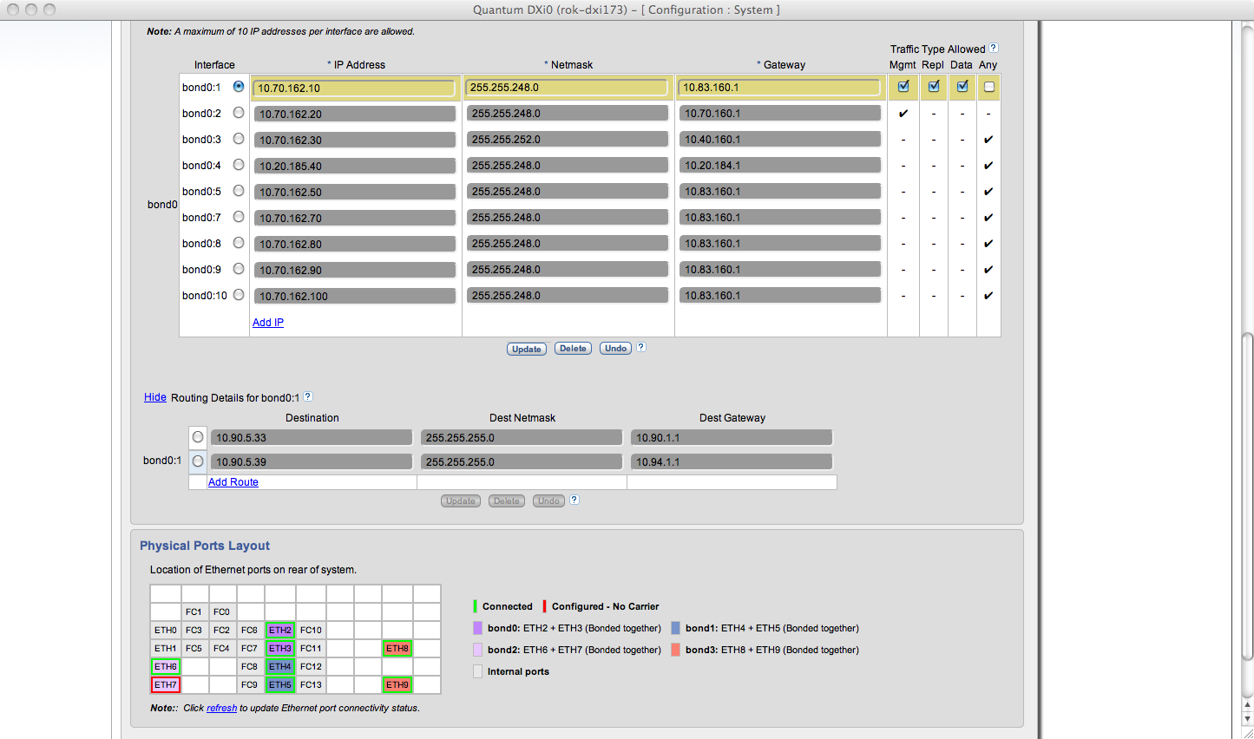
Network Routing
51
© 2011 Quantum Corporation. Company Confidential. Forward-looking information is based upon multiple assumptions and uncertainties, does not necessarily represent the company’s outlook and is for planning purposes only.

Slide 52
OST Enhancements
Mark Thacker
52

Slide 53
OST Enhancements
53
© 2011 Quantum Corporation. Company Confidential. Forward-looking information is based upon multiple assumptions and uncertainties, does not necessarily represent the company’s outlook and is for planning purposes only.
OSTv11 API
  Paves the way for AIR in future DXi release
OST HP-UX plugin
  Itanium platform only, no Accent support
OST Optimized Duplication uses Replication or Op Dupe IP Address at customer’s choice
DXi Accent added for DXi 4601 and DXi 8500
OST Optimized Synthetic Full backup creation support
OST Accent 256-BIT Encryption support
Note : All OST plugin platforms supported with Dec release
  Version 2.5

Slide 54

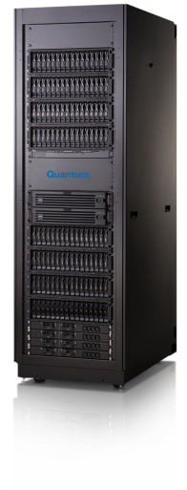
OST in 2.1 (Accent for DXi8500- DXi4600 JAN.
HP-UX Support and v11 API which includes Optimized Synthetics
Client
Optimized Synthetic
Full
Backup
Incremental
Backup
Incremental
Backup
Incremental backups
Lightening fast backups!
Load Balanced Media Servers
Today’s traditional synthetic full is created by pulling data through the media server then writing the new full image back to the device.
Zero data movement synthetic backups
Optimized Synthetic
Optimized synthetics are created by the storage server. NetBackup instructs which parts of previous backups to use. Storage server creates a pointer map.
54
© 2011 Quantum Corporation. Company Confidential. Forward-looking information is based upon multiple assumptions and uncertainties, does not necessarily represent the company’s outlook and is for planning purposes only.

Slide 55
OST V11
Sudhakar Paulzagade
55

Slide 56
Overview
V11
  Internal plug-in and ostd version update
  No external feature for customer
Why are we doing a version update?
  Symantec has released Version 11 last year and plans to release Version 12.
  When Version 12 comes out, we will be out of support (release -2)
Nature of change
  Significant, there are significant code changes
  Extensive qualification efforts as part of 2.1

Slide 57
V11 Requirements
Update OST SDK to V11
Implement new V10 & V11 entry points
Include support for optimized synthetic backups
NetBackup
  6.5.6 and 7.0 are at V10. They will communicate at V10 level to Quantum plug-in
  7.1 is at V11
BackupExec
  BE 2010 and BE 2010 R2 releases are at V9.
  BE 2010 R3 and above are at V11.

Slide 58
Compatibility
2.5.0 plug-in with new capabilities and entry points will work with existing releases
  Release 2.0 and 2.0.x
  Release 1.4.x
Will support the following Symantec Backup Applications
  NBU 6.5.x, 7.0.x and 7.1
  BE 2010, BE 2010R2, BE2010R3
Will expose new capabilities when interacting with Symantec Backup Applications at V10 and above levels
  Example optimized synthetics.

Slide 59
Backup Application executing at OST V9 Level with mixture of DXi Versions
DXi 1.4.x / DXi 2.0 / DXi 2.1 and Symantec Backup Applications at Version 9
OST Plug-in will return V9 entry points and capabilities to Backup Applications.
OSTD will set version 9 on the connection to plug-in
OSTD and plug-in behavior is same as it is today

Slide 60
Backup Application executing at OST V10 Level with DXi Versions < 2.1
DXi 1.4.x / DXi 2.0 and Symantec Backup Application Version 10
Plug-in operating version is set to V10 in this case
Plug-in return V10 entry points back to Backup Application
But since OSTD is at Version 9, connection version between plug-in and OSTD is set to 9
Cont…

Slide 61
Backup Application executing at OST V10 Level with DXi Versions < 2.1 (cont.)
But in this scenario, Symantec Backup Application will make following V10 calls into the plug-in.
  stspi_create_image_v10
  stspi_delete_image_v10
  stspi_open_image_v10
  stspi_list_image_v10
  stspi_get_image_prop_v10
  stspi_get_image_prop_byname_v10
Plug-in implements following conversions
  image_def_v10_to_v7
  image_info_v7_to_v10
  image_def_v7_to_v10
  image_info_v7_to_v10
and ends up calling V9 implementation.

Slide 62
Backup Application executing at OST V11 Level with DXi Versions < 2.1 (cont.)
DXi 1.4.x / DXi 2.0 and Symantec Backup Application Version 11
This use case is same as use case 2, except Symantec Backup Application will make two new calls to plug-in:
  stspi_open_lsu_list_v11
  stspi_get_lsu_prop_byname_v11
Plug-in will do following conversions
  lsu_def_v11_to_v9
  lsu_info_v9_to_v11

Slide 63
Backup Application executing at OST V9, V10 and V11 Level with DXi Version 2.1
DXi Version 2.1 and Backup Applications at Version 9
  Plug-in operating version will be at 9
  Same behavior as today
DXi Version 2.1 and Backup Applications at version 10
  Plug-in and ostd operating version will be at 10
  In this case new optimized synthetics capability is returned
DXi Version 2.1 and Backup Applications at version 11
  Plug-in and ostd operating version will be at 11
  In this case new optimized synthetics capability is returned

Slide 64
OST Optimized Synthetic Backups
Ajay Kushwah/Sudhakar Paulzagade
64

Slide 65
Overview
Optimized synthetic backups
  Very fast full backups with no data movement
  Requires at least one prior full and an incremental backup
  Full backup is current up to the last incremental
  Does not depend on the existing backups after creation.
  Has its own independent life cycle.
Nature of change
  Changes involve the OST plug-in, Ostd, BPW and BFST.
  Most of this is new code

Slide 66
Requirements
The feature is tied to OST v10 and higher.
OST Plug-in release 2.5.0 or higher
Galaxy release 2.1
NetBackup
  6.5 or higher
  6.5 is at (v10)
  7.0 is at V10
  7.1 is at V11
Full and incremental and the target synthetic backup must be from the same diskpool volume.

Slide 67
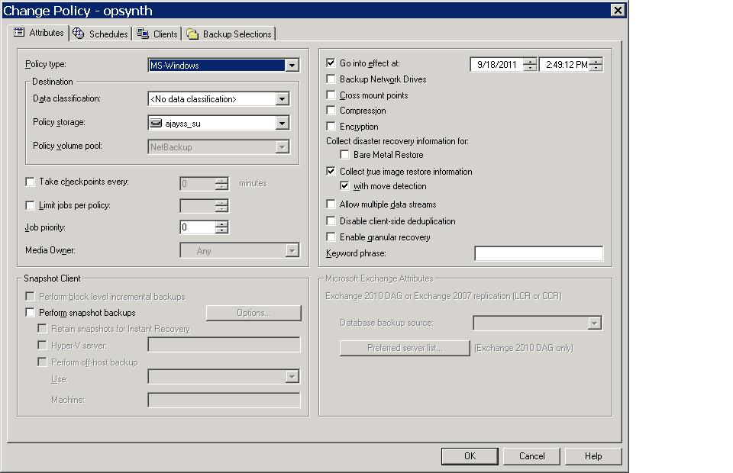
Requirements

Slide 68
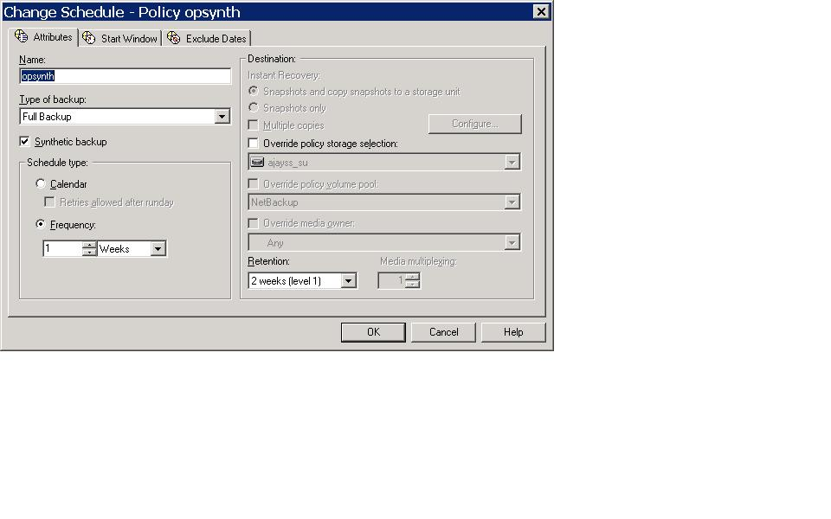
Requirements

Slide 69
Compatibility
2.5.0 plug-in will support the pre-existing DXi releases but wouldn't support newly exposed features.
Galaxy 2.1 release will work with the existing plug-ins but wouldn't support this new feature.
LSU spanning is supported as long as the spanned LSU is from same diskpool.

Slide 70
Compatibility (contd)
Galaxy 2.1 release will work with existing diskpools and storage servers that are now upgraded to DXi 2.1 and the Plug-in 2.5.0. The only caveat is, one may have to manually set NBU “OptimizedImage” attribute for these disk pools and storage servers. The detailed steps of doing this are discussed in a Quantum TB (PTR 26627) and Symantec KB http://www.symantec.com/business/support/index?page=content&id=TECH77767

Slide 71
Platform Changes
Jurgen van der Linden/Kempton Redhead
71

Slide 72
Platform Changes Overview
65xx/67xx new 9750 3ware Controller
65xx/67xx 100G & 200G SSD Support
8500 Max Storage capacity of 320TB
Firmware/Driver changes
Collect/Diagnostics changes
Installation changes
© 2010 Quantum Corporation. Company Confidential. Forward-looking information is based upon multiple assumptions and uncertainties, does not necessarily represent the company’s outlook and is for planning purposes only.
© 2010 Quantum Corporation. Company Confidential. Forward-looking information is based upon multiple assumptions and uncertainties, does not necessarily represent the company’s outlook and is for planning purposes only.
72
© 2010 Quantum Corporation. Company Confidential. Forward-looking information is based upon multiple assumptions and uncertainties, does not necessarily represent the company’s outlook and is for planning purposes only.
72
Notes:
© 2008 Quantum Corporation. Company Confidential. Forward-looking information is based upon multiple assumptions and uncertainties, does not necessarily represent the company’s outlook and is for planning purposes only.
72

Slide 73
65xx/67xx 9750 Controller
LSI 3Ware 9750 4i4e & 8e is a replacement for the 9690 4i4e & 8e which goes EOL end of 2011.
Software and Feature compatible.
  Support for (future) 3T drives
  Transparent to the DXi software
Only used in sets of 2 or 4 in new system, never in combination with any 9690 in a system.
Not a 9690 FRU (can not mix 9690’s with 9750’s) .
Both 9690 and 9750 run updated (latest) firmware
  We are now in-sync with the latest 3ware FW release
BBU PCB & Battery are now a combined module and connected by a cable to the 9750 card.
The new BBU Tray/Air Shroud improves air flow across HBA’s (up to 20C temp reduction at IC’s)
73
© 2010 Quantum Corporation. Company Confidential. Forward-looking information is based upon multiple assumptions and uncertainties, does not necessarily represent the company’s outlook and is for planning purposes only.

Slide 74
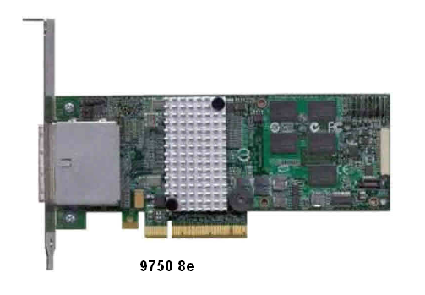
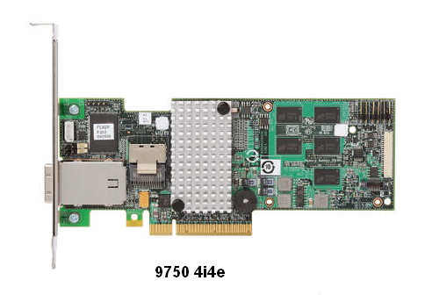
65xx/67xx 9750 Controller
74
© 2010 Quantum Corporation. Company Confidential. Forward-looking information is based upon multiple assumptions and uncertainties, does not necessarily represent the company’s outlook and is for planning purposes only.

Slide 75
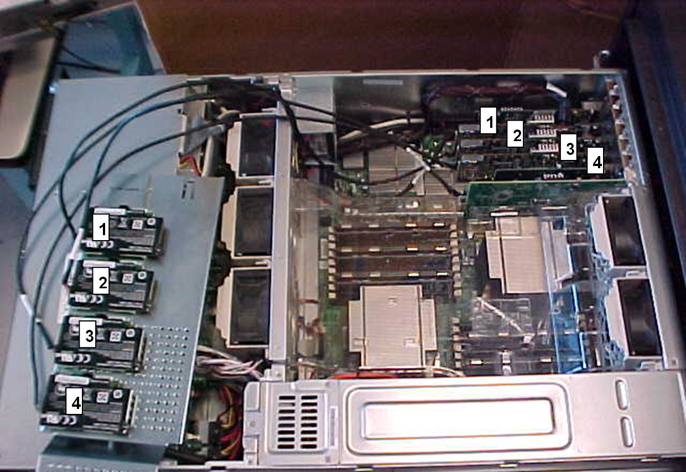
65xx/67xx 9750 Controller
75
© 2010 Quantum Corporation. Company Confidential. Forward-looking information is based upon multiple assumptions and uncertainties, does not necessarily represent the company’s outlook and is for planning purposes only.

Slide 76
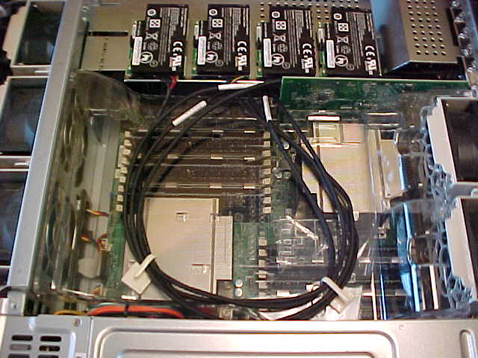
65xx/67xx 9750 Controller
76
© 2010 Quantum Corporation. Company Confidential. Forward-looking information is based upon multiple assumptions and uncertainties, does not necessarily represent the company’s outlook and is for planning purposes only.

Slide 77
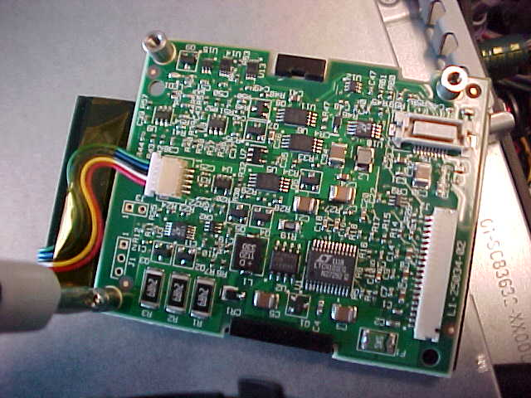
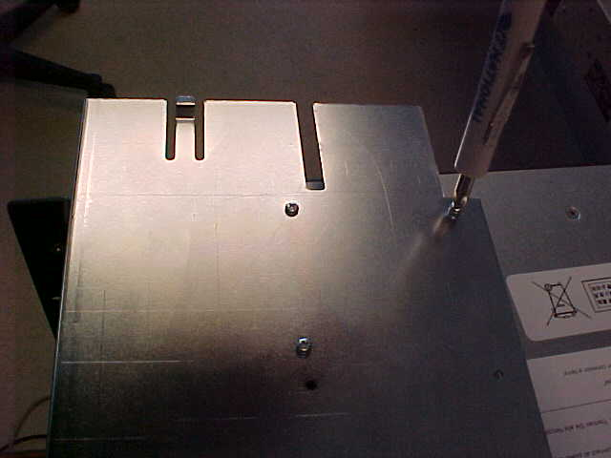
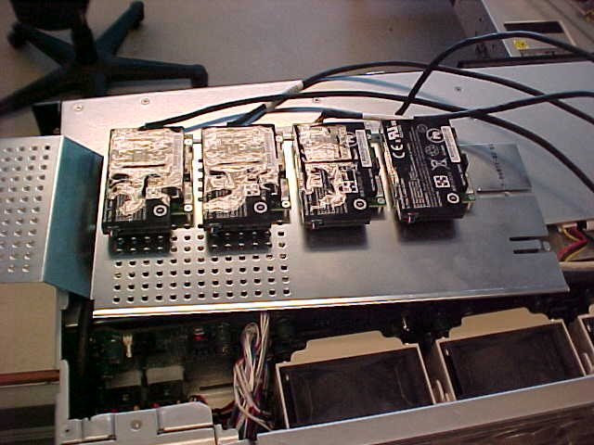
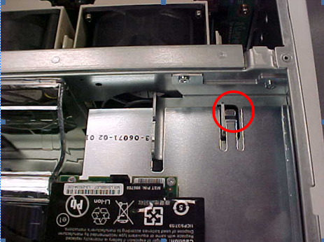
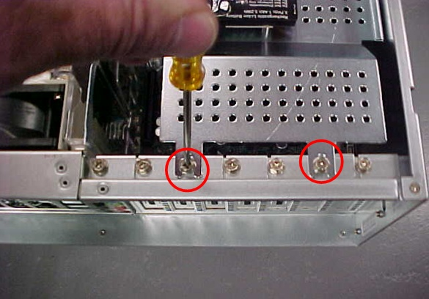
65xx/67xx 9750 Controller
77
© 2010 Quantum Corporation. Company Confidential. Forward-looking information is based upon multiple assumptions and uncertainties, does not necessarily represent the company’s outlook and is for planning purposes only.

Slide 78
65xx/67xx 100G & 200G SSD support
78
© 2010 Quantum Corporation. Company Confidential. Forward-looking information is based upon multiple assumptions and uncertainties, does not necessarily represent the company’s outlook and is for planning purposes only.
Current 64G Intel SSD goes EOL.
Replacement is 100G SSD Intel or STEC.
Can be used as a FRU for 64G or 100G.
  Obviously the 64G SSD cannot be used as a FRU for 100G SSDs.
  RAS ticket will indicate failed drive size.
100G & 200G support is already in 2.0.1 release for 1TB & 2TB JBODs respectively.
  But the 1TB based JBOD SSDs are split into 2x 50G LUNs.
DXi 2.1 supports:
  100G SSDs in head & 1TB based JBODs.
    New systems will no longer split the SSDs into 2x 50G LUNs.
  200G SSDs in 2TB based JBODs.
Currently STEC SSDs are stop ship, due to a corruption problem. A firmware fix is being qualified in 2.1.1.

Slide 79
8500 Max Storage capacity of 320TB
79
© 2010 Quantum Corporation. Company Confidential. Forward-looking information is based upon multiple assumptions and uncertainties, does not necessarily represent the company’s outlook and is for planning purposes only.
8500 classic: 64G of memory, max 200TB useable bulk storage.
8500 classic can be field upgraded to 128G of memory
  Plug and Play, add memory, and boot.
8500 classic + 128G can support up to 320TB of useable storage.
8500-2TB new: 128G of memory, max 320TB useable bulk storage.
8500E: 64G of memory, 1 array (used for Quantum internal)
Reminder:
  Supports both 1TB and 2TB drives.
  1 tray == 16 drives, used as 2x (5+2) + 2 hot spares
  1 tray with 1TB drives ➔ 16TB raw, 10TB useable
  1 tray with 2TB drives ➔ 32TB raw, 20TB useable
  Expand by 1-10 arrays first, than 1-10 JBODs
8500-2TB Installed Base: 128G of memory
  with 1.5_85 installed max 200TB useable bulk storage.
  Upgraded to 2.1 max 320TB useable storage
Updated PERC H700/H800 firmware to address prematurely failing BBUs will be in the next release, 2.1.1

Slide 80
Firmware/Driver Changes
80
© 2010 Quantum Corporation. Company Confidential. Forward-looking information is based upon multiple assumptions and uncertainties, does not necessarily represent the company’s outlook and is for planning purposes only.
4500, compared to 2.0.x
  Updated BIOS (updated at upgrade time)
  Updated iDRAC (updated at upgrade time)
  Updated PERC H700 firmware (updated at upgrade time)
  Updated MegaRAID device driver (updated at upgrade time)
6xxx
  Updated 3ware 9690 firmware and tools (updated at upgrade time)
8500, compared to 1.4_85:
  Updated FW for the Qlogic HBA (transparent, loaded when used)
  Updated firmware for the BroadCom 1G/10G NIC (updated at upgrade time)
  Updated BIOS version 2.2.3 (updated at upgrade time)
  Updated MegaRAID device driver (updated at upgrade time)

Slide 81
Collect/DiagnosticsLogs
81
© 2010 Quantum Corporation. Company Confidential. Forward-looking information is based upon multiple assumptions and uncertainties, does not necessarily represent the company’s outlook and is for planning purposes only.
Collect, some minor changes:
  The scheduler logs from MySQL DB was added
  3ware mini-collect added, include the diag logs from 3ware controller
Improved some RAS tickets
  Include failed drive type and size
  Include failed controller type
Manifest
  New functionality, to capture a snapshot off all files that should be present on a system. Auto generated as part of the product builds.
  For now experimental, but likely to grow more useful in next releases
  Run: /opt/DXi/scripts/verifyManifest and if it displays any missing files

Slide 82
Installation
82
© 2010 Quantum Corporation. Company Confidential. Forward-looking information is based upon multiple assumptions and uncertainties, does not necessarily represent the company’s outlook and is for planning purposes only.
ISO images too large for CD burning
  Use a DVD for Base, Extra, Application
  RAID CD still small enough to fit on a CD
All-in-one DVD image is recommened.
  Includes Base, Extra and Application.
  Starting from Base will auto-install Extra, and put App image on disk
  Faster new installs
USB stick installation
  Fastest install method
  All-in-one
  Used by Manufacturing
  Must remove the USB stick after use! (e.g. a CD/DVD is popped out)

Slide 83
Quality and Serviceability Features
John Morrison/ Byron Hack
83

Slide 84
SW Upgrade Rollback
SW Upgrade Rollback
  This feature sets the stage for future DXi releases. This feature will allow customers to upgrade to post 2.1 versions, try it, and elect to rollback.
84
© 2011 Quantum Corporation. Company Confidential. Forward-looking information is based upon multiple assumptions and uncertainties, does not necessarily represent the company’s outlook and is for planning purposes only.

Slide 85
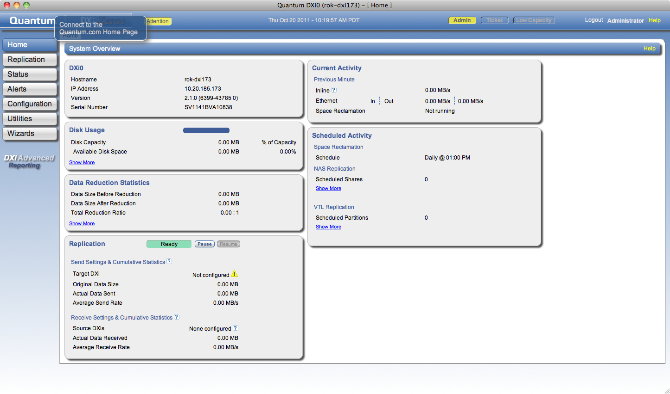
Enhanced GUI
Use of new HTML elements for modern browsers
Drop shadow, rounded elements, translucent fly-overs and buttons
IE will have traditional look; All others have enhanced GUI
Direct DXi Advanced Reporting launch button
85

Slide 86
Enhanced GUI and CLI (cont.)
GUI and CLI Changes
  GUI
    Fixed memory leaks related to running background tasks in the GUI (Add VTL, Add media, delete media, etc)
    Improved page response for Configuration VTL Summary and Media Actions and Status VTL Performance and Physical View pages
    Improvements for VTL Host Mapping
    Fixed coverity bugs and other minor usability improvements
  CLI
    Fixed coverity bugs, improved help text for commands as needed, removed deprecated commands
86

Slide 87
New OS/Utilities
87
© 2011 Quantum Corporation. Company Confidential. Forward-looking information is based upon multiple assumptions and uncertainties, does not necessarily represent the company’s outlook and is for planning purposes only.
Dxi 2.1 does update several component technologies
New OS/Utilities (CentOS, SAMBA, Apache, Kerberos, Open SSL, StorNext, etc.)
  StorNext updated to 4.2
  SAMBA updated to 3.6.0
  MySQL 5.5.12 – delivered with StorNext
  Java Script Ext Js
Areas not changing
  CentOS remains at 5.6
  Apache 2.21
  Kerberos unchanged
  Open SSL unchanged
  Java

Slide 88
Software Bug Status
Type \ Severity | 1 | 2 | 3 | 4 | 5 | Grand Total
Defect | 15 | 63 | 195 | 9 | 8 | 290
Enhancement Request |  | 3 | 41 | 5 | 22 | 71
Grand Total | 15 | 66 | 236 | 14 | 30 | 361
Priority \ Severity | 1 | 2 | 3 | 4 | 5 | Grand Total
P0 | 1 |  | 1 |  |  | 2
P1 | 9 | 23 | 48 |  | 4 | 84
P2 | 2 | 23 | 25 | 4 | 4 | 58
P3 | 3 | 20 | 161 | 5 | 16 | 205
P4 |  |  |  | 5 | 3 | 8
P5 |  |  | 1 |  | 3 | 4
Grand Total | 15 | 66 | 236 | 14 | 30 | 361
Managed 1207 bugs in program (as of 12/5 8am – detail in appendix)
  837 addressed
    611 Fixed, 86 Duplicates, 61 Not_A_Bug, 22 not_reproducible
  361 Deferred:
  9 Open bugs (under investigation, queued for deferral)
  Excludes “tasks” which does indicate additional code work
Deferred Defects 26% (290/1136)
  Excludes enhancement requests
  Profile (details in appendix)
    P0-P1:
      38 of 86 targeted for 2.1.1
    Severity 1:
      8 of 15 targeted for 2.1.1
      Detail in appendix
Notes:
© 2008 Quantum Corporation. Company Confidential. Forward-looking information is based upon multiple assumptions and uncertainties, does not necessarily represent the company’s outlook and is for planning purposes only.
88

Slide 89
ISV Updates
Mark Thacker
89

Slide 90
ISV Updates
ISV | Certification Effort | Certification Status | Presentation
Symantec - NBU | VTL, NAS & OST: Full Cert ~6 weeks | 99% Win, RHEL, SLES 50% HPUX, All complete by GA; ex SOL ~ 12/23 90% Windows | VLT, NAS,OST
Symantec - BE
CA, SyncSort,Tina | Paper certification Paper certification Paper certification See SVT bullet above or paper cert | 100% - paper certify agreed 100% - paper certify agreed SVT to complete test and submit As required by SVT | VTL & NAS VTL & NAS
CommVault, HP
Tivoli, Networker
Quantum to certify on all other ISVs
90
© 2011 Quantum Corporation. Company Confidential. Forward-looking information is based upon multiple assumptions and uncertainties, does not necessarily represent the company’s outlook and is for planning purposes only.
ISV Code Drop:
  Symantec NBU and BE 1st Drop Date: 10/25
  Symantec NBU and BE GA Candidate Drop Date: 11/18
  CA , Commvault and Tivoli GA Candidate Drop Date: 11/18
  Expected support completion at GA: 12/8
    8500 support 12/8
    4000,6000,6700 & 8500 MR 1/23
SVT VTL self certification and send certification test results
  BakBone, Oracle (Tier 2) GA +/- 60days

Slide 91
Enabler Updates
Mark Thacker
91

Slide 92
Enabler Updates
92
© 2011 Quantum Corporation. Company Confidential. Forward-looking information is based upon multiple assumptions and uncertainties, does not necessarily represent the company’s outlook and is for planning purposes only.
DXi AR Updates
  DXi AR 2.0.2 ships with DXi 2.1 from the factory
  Replication status reports back in (was removed in DXi 2.0.1)
DXi AR Launch Button
  Customer visible launching of DXi AR
  Easy access to a Quantum differentiated feature
Vision
  V4.1 offers many new features – covered separately
  Integrated multi-system DXi AR
    For unified view of DXi AR screens synchronized on multiple systems
Guardian Updates
  No changes were made to Guardian for compatibility with Galaxy 2.1. Tests were run to verify Galaxy 2.1 was compatible with Guardian with successful results.

Slide 93
Q&A
93

