Slide 1

1
© 2011 Quantum Corporation. Company Confidential. Forward-looking information is based upon multiple assumptions and uncertainties, does not necessarily represent the company’s outlook and is for planning purposes only.
Notes:
© 2008 Quantum Corporation. Company Confidential. Forward-looking information is based upon multiple assumptions and uncertainties, does not necessarily represent the company’s outlook and is for planning purposes only.
1

Slide 2
Service Transfer of Information
- DXi 2.0.1
- Campari2 (DXi6701/6702)
July 26 & 27, 2011
© 2011 Quantum Corporation. Company Confidential. Forward-looking information is based upon multiple assumptions and uncertainties, does not necessarily represent the company’s outlook and is for planning purposes only.
Notes:
© 2008 Quantum Corporation. Company Confidential. Forward-looking information is based upon multiple assumptions and uncertainties, does not necessarily represent the company’s outlook and is for planning purposes only.
2

Slide 3
Agenda
2.0.1 and Campari2 Overview
GUI Improvements
Galaxy 2.0.1 VTL Topics
Deduplication Features
OST & Accent
Mini Net
DXi SW Upgrades
Known Issues
Note: Q&A will follow each section. If you have questions during the presentation, use the WebEx chat window.
3
© 2011 Quantum Corporation. Company Confidential. Forward-looking information is based upon multiple assumptions and uncertainties, does not necessarily represent the company’s outlook and is for planning purposes only.
Notes:
© 2008 Quantum Corporation. Company Confidential. Forward-looking information is based upon multiple assumptions and uncertainties, does not necessarily represent the company’s outlook and is for planning purposes only.
3

Slide 4
2.0.1 & Campari2 Overview
Mark Thacker
4
© 2010 Quantum Corporation. Company Confidential. Forward-looking information is based upon multiple assumptions and uncertainties, does not necessarily represent the company’s outlook and is for planning purposes only.

Slide 5
DXi 2.0.1: Key Features
Inline deduplication for VTL
GIO updates (from 1.4.3 now ported to DXi 2.0.1)
Support for LTO-5/i40/i80/i6000 for VTL and PTT
Critical customer bug fixes
  Including the 2012 bug – 2.0.1 is to be a mandatory upgrade for DXi running 2.0.x
Accent Dedupe for DXi6701/6702, Linux NBU only
GUI for mini-net
OST and VTL installation wizards
Supported platforms: DXi6701, 6702, 6700, 6500, 4500
F5 Certification: under investigation
5
© 2011 Quantum Corporation. Company Confidential. Forward-looking information is based upon multiple assumptions and uncertainties, does not necessarily represent the company’s outlook and is for planning purposes only.
Notes:
© 2008 Quantum Corporation. Company Confidential. Forward-looking information is based upon multiple assumptions and uncertainties, does not necessarily represent the company’s outlook and is for planning purposes only.
5

Slide 6
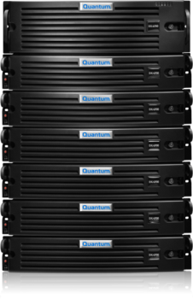
New DXi6700 Series
Leading Performance, Multi-protocol, Highly Scalable
Seamless scalability from 8 to 80 TB’s
DXi 2.0 software for leading performance
  Up to 5.8TB/hr VTL, OST
  Up to 5.0TB/hr NAS
  In-line operation, performance specs for target mode
Multi-protocol support on all models
  NAS, OST, and FC VTL
Simple model structure
  6701: 6xGbE and 4x8Gb FC
  6702: 2x10GbE, 2x1GbE, 4x8Gb FC
  6701 can convert to 6702 in field
  Node configuration remains the same
All licenses included in all models
  VTL, NAS, OST, Integrated Path to Tape, replication, DXi Accent
DXi Accent for Collaborative Dedupe and Extensibility
6

Slide 7
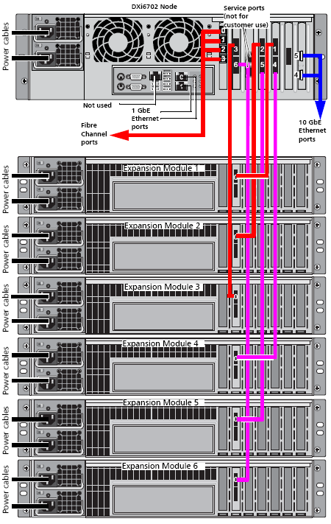
DXi6701/02 Specifications
6701 for GbE and FC
  6xGbE and 4x8Gb FC (2 ingest, 2 PTT)
  Quad-port FC card in both 6701 & 6702
6702 for 10GbE and FC
  2xGbE, 2x10GbE, 4x8Gb FC
Scalable from 8 to 80 TB’s
  Base configuration – 8 TB in system node (3U)
  Up to 9 Exp Modules connected via SAS - 8TB per unit (2U)
  Up to 4 Internal RAID controllers depending on capacity
  Modules 7 thru 9 connect via SAS to modules 4 thru 6
Retains SSD and SATA for performance
7 | Quantum Confidential and Proprietary
Notes:
© 2008 Quantum Corporation. Company Confidential. Forward-looking information is based upon multiple assumptions and uncertainties, does not necessarily represent the company’s outlook and is for planning purposes only.
7

Slide 8
DXi6500 With DXi 2.0.1
8
© 2011 Quantum Corporation. Company Confidential. Forward-looking information is based upon multiple assumptions and uncertainties, does not necessarily represent the company’s outlook and is for planning purposes only.
Expandable to 80 TB’s
  DXi6530,40 and 50 only
  Requires an upgrade kit with RAM swap to go beyond 56TB
  Price $5,000
  Available July 27, 2011
Base systems to remain on pricelist 90 days post GA
  DXi6701/02 will be our primary mid-range dedupe appliance
Capacity expansions remain on pricelist for foreseeable future
  Same expansion units as new DXi6701/02
EOL not announced

Slide 9
DXi6700 with DXi 2.0.1
9
© 2011 Quantum Corporation. Company Confidential. Forward-looking information is based upon multiple assumptions and uncertainties, does not necessarily represent the company’s outlook and is for planning purposes only.
Bringing great value to our most popular mid-range system
Multi-protocol enabled
  Service install of DXi 2.0.1 required for install base customers
  Adds NAS, CIFS, OST licenses
    OST license installed for customers running NBU or BE
    OST license key added to Install Base record for customer’s later use
  Utilize existing two 1GbE interfaces
    Performs at line speed (0.9 TB/hr)
Capacity still 24TB-56TB
  Upgrades beyond 56TB require Conversion Kit to 6701 or 6702
Significant performance increase
  Up to 5.8 TB/hr VTL ingest
    Previously 2.3 TB/hr inline, 3.2 TB/hr adaptive with DXi 1.4.1
  Up to 3.8 TB/hr VTL read
    Previously 2.2 TB/hr dedup read, 4 TB/hr untruncated with DXi 1.4.1

Slide 10
DXi6700 Conversion Kits
10
© 2011 Quantum Corporation. Company Confidential. Forward-looking information is based upon multiple assumptions and uncertainties, does not necessarily represent the company’s outlook and is for planning purposes only.
Three Ways to Convert DXi6700 Classic
  Upgrade software for multi-protocol: uses 2 existing Ethernet ports
  Convert to 6701 for 1GbE - $15,000
  Convert to 6702 for 10GbE (Twinax copper or SFP+ Optical) - $20,000
Conversion Considerations
  Service call required for conversion, either software only or Conversion Kit
  Conversions available on July 27, 2011
  Expanding 6700 Classic >56TB requires conversion to 6701 or 6702
DXi6700 Classic Lifecycle Planning
  6700 classic to remain on pricelist 90 days post GA
  Capacity expansions to remain on pricelist for foreseeable future
  No formal EOL plan as of this time
Notes:
NTE pricing of ~$XYZ (TBD Claire)
© 2010 Quantum Corporation. Company Confidential. Forward-looking information is based upon multiple assumptions and uncertainties, does not necessarily represent the company’s outlook and is for planning purposes only.
10

Slide 11
VTL / NAS Ingest Constraints
11
PTR 24341 – VTL Load causes NAS failures
VTL workload does not throttle in the face of NAS ingest
  Causes NAS timeouts and backup failures
  Simultaneous VTL and NAS (NFS/CIFS) ingest is not supported in 2.0.1
Fix will be delivered in subsequent release of Galaxy (2.0.x)
Other mutli-protocol ingest are great
  NFS and CIFS
  OST and NFS
  OST and CIFS
  OST and VTL
Multi-protocol replication also great
  Supports Edge to Core concept
  NFS at the edge, VTL in the core, edge replicating to core

Slide 12
Campari2: Model Summary
DXi6500 and DXi6700 model consolidation
DXi670X series includes the following additional features:
  Add NAS and OST
  Storage Capacity: 8 to 80 TB
  additional 1GbE ports
  additional 10GbE ports
DXi6500 models with up to 80TB of storage expansion
  6530 – 6550 up to 80 TB of storage capacity by adding memory to 60GB
DXi6700 models storage expansion
  6701-4R = 6701-2R + 2R: add 2 RAID controllers
  6702-4R = 6702-2R + 2R: add 2 RAID controllers
  6530 – 6550 up to 80 TB of storage capacity by increasing memory to 60GB
Notes:
© 2008 Quantum Corporation. Company Confidential. Forward-looking information is based upon multiple assumptions and uncertainties, does not necessarily represent the company’s outlook and is for planning purposes only.
12

Slide 13
Campari2: 67xx Models Overview
 | 6700 Classic | 6701 | 6702
Presentations | NAS, OST, VTL (2.0.1 added NAS) | NAS, OST, VTL | NAS, OST, VTL
Ports | 2 Dual FC | Remove 2 Dual 8Gb FC 1 Quad 8Gb FC 1 Quad 1GbE | Remove 2 Dual 8Gb FC 1 Quad 8Gb FC 1 Dual 10GbE
Storage | 4R: 24 to 56 TB | 2R: 8 to 16 TB 4R: 24 to 80 TB | 2R: 8 to 16 TB 4R: 24 to 80 TB
Memory | 48GB: 12x4GB DIMMs | 60GB: 6x8GB + 6x2GB DIMMs | 60GB: 6x8GB + 6x2GB DIMMs
Upgrade | Campari2 SW from 2.0.1 only | n/a | n/a
Conversions | to 6701 or 6702 | from 6700 to 6702 | from 6700 from 6701 to 6701 NOT supported
Notes:
© 2008 Quantum Corporation. Company Confidential. Forward-looking information is based upon multiple assumptions and uncertainties, does not necessarily represent the company’s outlook and is for planning purposes only.
13

Slide 14
Campari2: 65xx Models Overview
 | 6510 | 6520 | 6530 | 6540 | 6550
Presentations | NAS & OST (no change) | NAS & OST (no change) | NAS & OST (no change) | NAS & OST (no change) | NAS & OST (no change)
Ports | no change | no change | no change | no change | no change
Storage | no change | no change | + 64TB, 72TB & 80TB | + 64TB, 72TB & 80TB | + 64TB, 72TB & 80TB
Memory | 24 GB (no change) | 48 GB (no change) | 48 GB or 60 GB (only for new capacity pts) | 48 GB or 60 GB (only for new capacity pts) | 48 GB or 60 GB (only for new capacity pts)
Upgrade | Campari2 SW (no new HW or features) from 2.0.1 only | Campari2 SW (no new HW or features) from 2.0.1 only | Campari2 SW (enables new capacity pts) from 2.0.1 only | Campari2 SW (enables new capacity pts) from 2.0.1 only | Campari2 SW (enables new capacity pts) from 2.0.1 only
Conversions | none | none | none | To 6550 | From 6540
Notes:
© 2008 Quantum Corporation. Company Confidential. Forward-looking information is based upon multiple assumptions and uncertainties, does not necessarily represent the company’s outlook and is for planning purposes only.
14

Slide 15
Campari2: Models Overview
6701:
  6 1GbE ports
  Multi-Protocol software (adding NAS and OST)
  - 2R: 8-16TB 2 RAID Controllers
  - 4R: 24-80TB 4 RAID Controllers
  Quad-port FC HBA (2 VTL, 2 PTT), 80 VTDs
  60GB Memory Configuration (6x8GB + 6x2GB DIMMs)
6702:
  2 1GbE Ports
  2 10GbE Ports
  Multi-Protocol software (adding NAS and OST)
  -2R 8-16TB 2 RAID Controllers
  -4R 24-80TB 4 RAID Controllers
  10GbE host cabling option: SFP+ Twinax or Optical
  Quad-port FC HBA (2 VTL, 2 PTT), 80 VTDs
  60GB Memory Configuration (6x8GB + 6x2GB DIMMs)
6700:
  Multi-Protocol software (adding NAS and OST)
  Convertible to 6701 or 6702
  EOL some time after Campari2 GA
Notes:
© 2008 Quantum Corporation. Company Confidential. Forward-looking information is based upon multiple assumptions and uncertainties, does not necessarily represent the company’s outlook and is for planning purposes only.
15

Slide 16
Performance
Highest level of performance of any mid-range appliance
  5.8TB/hr for OST and VTL
  5TB/hr for NFS and CIFS
  Wire-speed performance on systems with only two 1GbE ports
  Num. of RAID impacts read performance, but not ingest

Slide 17
DAR, Vision, Guardian
DXi Advanced Reporting (DAR)
  DXi Advanced Reporting 2.0 runs only on Galaxy 2.x
    DXi AR 1.0.x will NOT run on Galaxy 2.0.1
    DXi AR 2.0 will NOT run on Galaxy 1.4.X
  DXi Advanced Reporting 2.0 adds Accent support for DXi 2.0.1
  Field upgrades to Galaxy 2.0.1 require DAR 2.0 field upgrade
    Factory shipments with Galaxy 2.0.1 have DAR 2.0 installed
Vision
  Vision 4.0.3 and 4.0.4 support DXi 2.0.1
  Vision 4.1 releases in September and supports DXi 2.0.1
Guardian
  Guardian 2.0.5 (released 7/15)
  Added generic model numbers of DXi67xx and DXi85xx
  These model numbers will be able to support all DXi67xx models (6700/01/02) and DXi85xx models (8502)

Slide 18
Q & A

Slide 19
GUI Improvements
Byron Hack
19
© 2010 Quantum Corporation. Company Confidential. Forward-looking information is based upon multiple assumptions and uncertainties, does not necessarily represent the company’s outlook and is for planning purposes only.

Slide 20
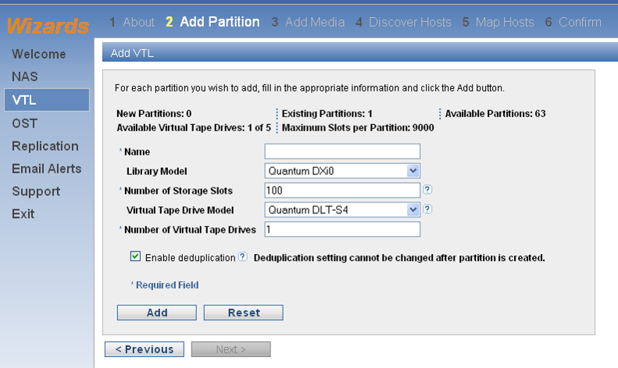
2.0.1 GUI Improvements – VTL Wizard
VTL Wizard

Slide 21
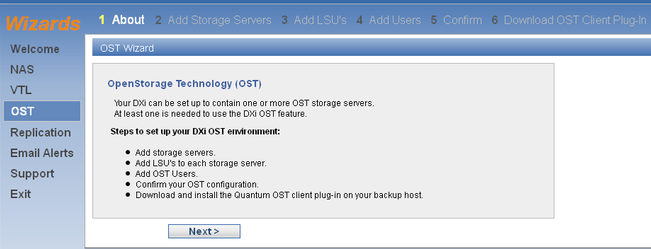
2.0.1 GUI Improvements – OST Wizard
OST Wizard

Slide 22
2.0.1 GUI Improvements – VTL Configuration
VTL Configuration Improvements
  Simplified sub-navigation (Partitions, Media, Host Access)
  Eliminated confirmation pages (except Delete VTL, Media, Host Access Group).
  Summary page includes replication, host access mapping information.
    Action Required Indicator if Partition not completely configured.
  VTL Add/Edit page includes replication settings.
  Simplified VTL Media Actions page
  VTL Host Access pages

Slide 23
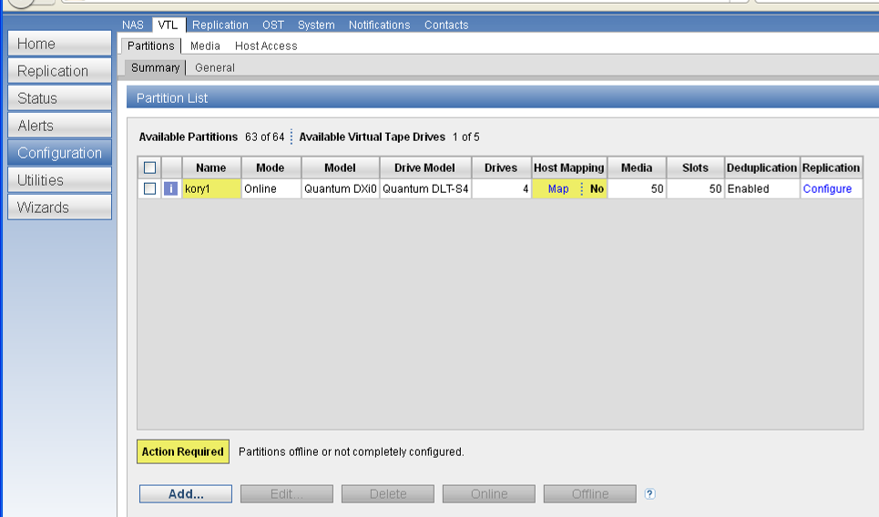
2.0.1 GUI Improvements – VTL Summary

Slide 24
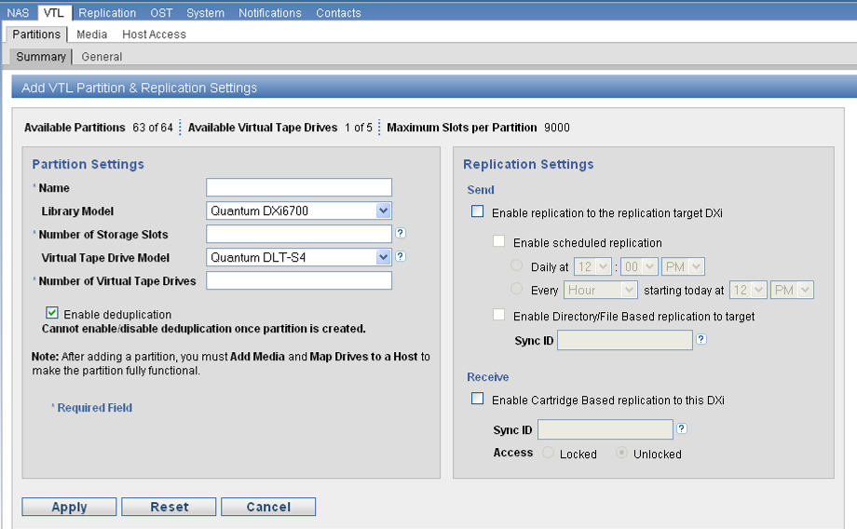
2.0.1 GUI Improvements – VTL Add Partition

Slide 25
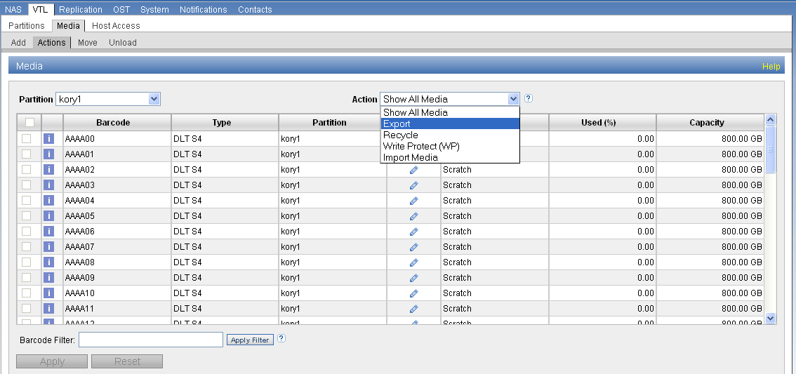
2.0.1 GUI Improvements – VTL Media Actions

Slide 26
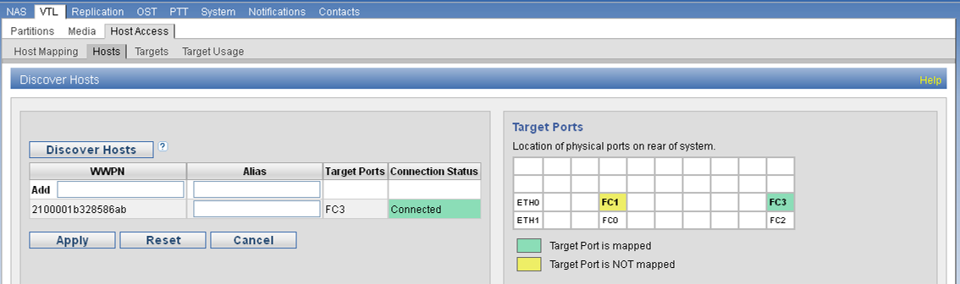
2.0.1 GUI Improvements – VTL Host Access

Slide 27
Q & A

Slide 28
Galaxy 2.0.1 VTL Topics
Chris Graves
28
© 2010 Quantum Corporation. Company Confidential. Forward-looking information is based upon multiple assumptions and uncertainties, does not necessarily represent the company’s outlook and is for planning purposes only.

Slide 29
Agenda
29
© 2011 Quantum Corporation. Company Confidential. Forward-looking information is based upon multiple assumptions and uncertainties, does not necessarily represent the company’s outlook and is for planning purposes only.
NewGIO
VTD Device
DataPath script
Cartridge Data
Utilities
Notes:
NTE pricing of ~$XYZ (TBD Claire)
© 2010 Quantum Corporation. Company Confidential. Forward-looking information is based upon multiple assumptions and uncertainties, does not necessarily represent the company’s outlook and is for planning purposes only.
29

Slide 30

GIO for 2.0.1 Overview – Components / Cmd Flow
NDMP/Internal Cmds
SCSI MID LAYER
SML Adapter
(smladapt.ko)
FC Target Driver
(ql24tgt.ko)
SCST
(scst.ko)
PSCSI
(pscsi.ko)
VTL
External Commands
Internal Commands
30
© 2011 Quantum Corporation. Company Confidential. Forward-looking information is based upon multiple assumptions and uncertainties, does not necessarily represent the company’s outlook and is for planning purposes only.
Notes:
NTE pricing of ~$XYZ (TBD Claire)
© 2010 Quantum Corporation. Company Confidential. Forward-looking information is based upon multiple assumptions and uncertainties, does not necessarily represent the company’s outlook and is for planning purposes only.
30

Slide 31
GIO for 2.0.1 Overview – What’s new?
31
© 2011 Quantum Corporation. Company Confidential. Forward-looking information is based upon multiple assumptions and uncertainties, does not necessarily represent the company’s outlook and is for planning purposes only.
A limited release (1.4.0.3 GIO-LCR) has been field tested
  It was deployed at problematic FC VTL sites to validate design/implementation
Improved compliance with the T-10/T-11 standards:
  SPC-2, SPC-3, FCP-2, FCP-3 and FC-Tape
Stability Improvements over 1.4.0.3
  Fixes for ERROR detection/recovery
    Target Reset, LUN_Reset, Abort, IT Nexus Loss
    most SRR requests are accepted
  Support for large SAN eco-systems (up to 128 hosts)
  Includes later QLogic ISP firmware (release 5.04.00)
  Logging improvements (should help indicate/diagnosis issues)
Notes:
NTE pricing of ~$XYZ (TBD Claire)
© 2010 Quantum Corporation. Company Confidential. Forward-looking information is based upon multiple assumptions and uncertainties, does not necessarily represent the company’s outlook and is for planning purposes only.
31

Slide 32
GIO for 2.0.1 Overview – Testing
32
© 2011 Quantum Corporation. Company Confidential. Forward-looking information is based upon multiple assumptions and uncertainties, does not necessarily represent the company’s outlook and is for planning purposes only.
Comprehensive and thorough test plan. By far, more rigorous than anything done previously.
  Baseline test
  Cable Pull Test
  SRR Loop Test
  Stability / RDT Test
  Error Injection / FC Frame Jamming
  Multi-Initiator
  Negative
  Adhoc
Notes:
NTE pricing of ~$XYZ (TBD Claire)
© 2010 Quantum Corporation. Company Confidential. Forward-looking information is based upon multiple assumptions and uncertainties, does not necessarily represent the company’s outlook and is for planning purposes only.
32

Slide 33
GIO: Qlogic firmware dump utility
33
© 2011 Quantum Corporation. Company Confidential. Forward-looking information is based upon multiple assumptions and uncertainties, does not necessarily represent the company’s outlook and is for planning purposes only.
New qlogic fw dump utility
  A few remaining GIO bugs uncovered during error-inject testing point to qlogic firmware (fw), e.g: 22970, 22843, 22976, 23712.
  qlogic requires a fw dump to analyze any fw-related issue.
Collect now includes fw dump(s) if found
  Under some conditions the qlogic card will initiate a dump on its own.
  The fw dump is stored in a temp buffer on the card until retrieved.
  The fw dump does not survive a reboot.
  In the collect it will be under hw-info, with included summary file fw_dump.txt.
  Manual dump/retrieval instructions at /opt/DXi/scripts/qla_dmp.txt.
Take-away:
  Collect before reboot is better-- captures fw dump if it exists.
  No value in standalone fw dump at this time.
  This is primarily a tool to be used in-house, during specific scenario testing, when also capturing an FC trace.
Notes:
NTE pricing of ~$XYZ (TBD Claire)
© 2010 Quantum Corporation. Company Confidential. Forward-looking information is based upon multiple assumptions and uncertainties, does not necessarily represent the company’s outlook and is for planning purposes only.
33

Slide 34
VTD Device
34
© 2011 Quantum Corporation. Company Confidential. Forward-looking information is based upon multiple assumptions and uncertainties, does not necessarily represent the company’s outlook and is for planning purposes only.
Same emulations as 1.4.x
  DXi6700, DXi8500
Internally, code is the same except for interface to Pcache/BPW.
  VTD requests 1MB pcache pages in which GIO places the data.
Stability improvements
  Abort handling improved
  “out of trackers” issue is resolved. VTD will no longer self-core when 20 commands stack up. Instead will report busy.
Notes:
NTE pricing of ~$XYZ (TBD Claire)
© 2010 Quantum Corporation. Company Confidential. Forward-looking information is based upon multiple assumptions and uncertainties, does not necessarily represent the company’s outlook and is for planning purposes only.
34

Slide 35
VTD & DataPath Script
35
© 2011 Quantum Corporation. Company Confidential. Forward-looking information is based upon multiple assumptions and uncertainties, does not necessarily represent the company’s outlook and is for planning purposes only.
VTDs are now started and stopped by the DataPath script introduced in 2.0 for I/O related processes.
  procmon starts and stops DataPath; DataPath invokes VTD_Control.
  procmon monitors DataPath for status treating it the same as other processes under procmon control.
  A VTD instance will no longer be individually restarted if it cores or otherwise exits in error.
DataPath controls all I/O processes that utilize pcache. A failure of any one process invokes a restart of all.
  Processes under DataPath control include OST, NDMP, NFS, SAMBA, VTD, bpwd, bpwapid, qfsd
  In 2.x any VTD failure invokes complete DataPath restart.
  this is why VTD “out-of-trackers” core dump issue had to be cleared in 2.0.1.
  If a vtd core is found, please raise the issue to engineering.
Notes:
NTE pricing of ~$XYZ (TBD Claire)
© 2010 Quantum Corporation. Company Confidential. Forward-looking information is based upon multiple assumptions and uncertainties, does not necessarily represent the company’s outlook and is for planning purposes only.
35

Slide 36
Cartridge Data
36
© 2011 Quantum Corporation. Company Confidential. Forward-looking information is based upon multiple assumptions and uncertainties, does not necessarily represent the company’s outlook and is for planning purposes only.
Partitions can still be created as dedupe or non-dedupe
Cart data is located at /snfs/ddup/partitions instead of /snfs/Q/partitions.
  Same directory structure from this point
  Both dedupe and non-dedupe partitions are located here.
  Note that the unassigned partition dirs are not created until first use
    /snfs/ddup/partitions/UnassignedDedup
    /snfs/ddup/partitions/UnassignedNonDedup
Cart metadata files are also deduped.
Cart files can be accessed with the same tools used for NAS files.
Notes:
NTE pricing of ~$XYZ (TBD Claire)
© 2010 Quantum Corporation. Company Confidential. Forward-looking information is based upon multiple assumptions and uncertainties, does not necessarily represent the company’s outlook and is for planning purposes only.
36

Slide 37
Utilities
37
© 2011 Quantum Corporation. Company Confidential. Forward-looking information is based upon multiple assumptions and uncertainties, does not necessarily represent the company’s outlook and is for planning purposes only.
Use bwcat to look in the cart files: e.g:
/opt/DXi/bpw/bin/bwcat /snfs/ddup/partitions/…/config.xml
<?xml version="1.0"?>
<root>
<Barcode>ND1004</Barcode>
<Capacity>800000000000</Capacity>
<Compression>1</Compression>
<DataFormat>0</DataFormat>
<DensityCode>27</DensityCode>
<MediaType>7</MediaType>
<VersionNumber>103</VersionNumber>
<WriteProtect>false</WriteProtect>
</root>
Same for data or cmd files:
/opt/DXi/bpw/bin/bwcat
/snfs/ddup/partitions/…/cmd1 > cmd1
/opt/DXi/cmd_decoder -d cmd1
Type countRT Blocks size RT Bytes
Block 32252 32252 49152 1585250304
End of CMD
Total Blocks Total Count
32252 1585250304
Notes:
NTE pricing of ~$XYZ (TBD Claire)
© 2010 Quantum Corporation. Company Confidential. Forward-looking information is based upon multiple assumptions and uncertainties, does not necessarily represent the company’s outlook and is for planning purposes only.
37

Slide 38
Utilities (cont.)
38
© 2011 Quantum Corporation. Company Confidential. Forward-looking information is based upon multiple assumptions and uncertainties, does not necessarily represent the company’s outlook and is for planning purposes only.
Use blobstat for blobtags, e.g:
/opt/DXi/bpw/bin/blobstat /snfs/ddup/partitions/…/data
File Offset BLOB Offset Length BLOB Tag
0000000000000000 0000000000000000 0000000010000000 2758E6BCBE04F62D457BE1E4BBBB89F8
0000000010000000 0000000000000000 0000000010000000 3A2EEBAD743422D5F70E9DD2253E4273
0000000020000000 0000000000000000 0000000010000000 85F6E98E7BD375CD917936BE95B4BF87
0000000030000000 0000000000000000 0000000010000000 352166796BF0C9F941297502D0999E66
0000000040000000 EOF
/opt/DXi/bpw/bin/bpwutil share_stats
----------------------------
BPWD Share Statistics:
----------------------------
Share: partitions/UnassignedNonDedup. Is Deduped? No
Inode: 1924201 Gen: 5 Bytes_written: 0 Bytes_read: 0 Total_bytes: 0
----------------------------
Share: partitions/UnassignedDedup. Is Deduped? Yes
Inode: 1924198 Gen: 5 Bytes_written: 0 Bytes_read: 0 Total_bytes: 218771419998
----------------------------
Share: partitions/VL01SV0936BVE10789. Is Deduped? Yes
Inode: 1287002 Gen: 0 Bytes_written: 38466791407616 Bytes_read: 30817845772288 Total_bytes: 3101248846848
Notes:
NTE pricing of ~$XYZ (TBD Claire)
© 2010 Quantum Corporation. Company Confidential. Forward-looking information is based upon multiple assumptions and uncertainties, does not necessarily represent the company’s outlook and is for planning purposes only.
38

Slide 39
RAS in Diagnostic Mode
39
© 2011 Quantum Corporation. Company Confidential. Forward-looking information is based upon multiple assumptions and uncertainties, does not necessarily represent the company’s outlook and is for planning purposes only.
linter DB files moved from shared storage to local disk in 2.0.1.
  Enables linter DB and RAS daemons to run in diagnostic mode, without SNFS up.
  RAS pages are accessible on the GUI in diagnostic mode.
  linter DB is now backed up to shared storage
  Bonus: linter inl command line SQL queries can be executed in diagnostic mode.
Notes:
NTE pricing of ~$XYZ (TBD Claire)
© 2010 Quantum Corporation. Company Confidential. Forward-looking information is based upon multiple assumptions and uncertainties, does not necessarily represent the company’s outlook and is for planning purposes only.
39

Slide 40
Q & A

Slide 41
Dedupe Features
Mahesh Patil
41
© 2010 Quantum Corporation. Company Confidential. Forward-looking information is based upon multiple assumptions and uncertainties, does not necessarily represent the company’s outlook and is for planning purposes only.

Slide 42
Out of Band Dedup (1.4.x) versus inline Dedup (2.0)
Out of Band 1.4.x architecture:
  In line raw backup data written to SNFS filesystem
  Later, out of band same data read from SNFS and deduped by blockpool
  And deduped data is written back to SNFS filesystem to replace raw backup data
In Line 2.0 architecture
  Inline raw backup data lands in shared memory
  Data in share memory is deduped and dedup is written to Backup data
Advantage of 2.0 over 1.4.x architecture
  Three IOs in 1.4.x verses one IO for 2.0
  One IO in simaller in 2.0 verses 1.4.x
42
© 2010 Quantum Corporation. Company Confidential. Forward-looking information is based upon multiple assumptions and uncertainties, does not necessarily represent the company’s outlook and is for planning purposes only.

Slide 43
Q & A

Slide 44
Component: OST & Accent
Presenter: Mahesh Patil and Ajay Kushwah
44
© 2010 Quantum Corporation. Company Confidential. Forward-looking information is based upon multiple assumptions and uncertainties, does not necessarily represent the company’s outlook and is for planning purposes only.

Slide 45
Agenda
45
© 2010 Quantum Corporation. Company Confidential. Forward-looking information is based upon multiple assumptions and uncertainties, does not necessarily represent the company’s outlook and is for planning purposes only.
Architecture and Differences from 1.x (LCR and 2.0)
How it should work
What to do if it is not working
References
Ost Optimised duplication (OpDup) up using replication path
Accent

Slide 46
Architecture
46
© 2010 Quantum Corporation. Company Confidential. Forward-looking information is based upon multiple assumptions and uncertainties, does not necessarily represent the company’s outlook and is for planning purposes only.
What is the same from 1.4.x?
  Plug-in installation. DXi ostd server still used.
What is different from 1.4.x?
  DXi Storage Server user-credentials required for Media Server authentication.
  No separate DXi dm_srvr(s), now run within ostd as separate threads.
  DXi ostd and dm both log to same location (tsunami.log)
  Automatic load balancing of dm_srvr connections.
  “Physical” LSU option (all available capacity). Automatically sized to available DXi freespace. Eliminates need for multi-LSU spanning.
  DXi memory cache (Pcache) shared with other protocols (CIFS/NFS).
  Improved performance: ingest and replication (optimized duplication)
What is different from 2.0 ?
  Introduction of Accent
  OST wizards

Slide 47
Architecture
Galaxy 1.X
OST Plugin
XCOMM
XDR/RPC
NAS
WriteReserve
Authenticate
Read-Write
Create-Delete-Report-Replicate
DM_SRVR
OSTD
CIFS/NFS
QBFS
STORNEXT
47
© 2010 Quantum Corporation. Company Confidential. Forward-looking information is based upon multiple assumptions and uncertainties, does not necessarily represent the company’s outlook and is for planning purposes only.

Slide 48
Architecture
Galaxy LCR/2.0
OST Plug-in 1
OST Plug-in 2
XCOMM
XCOMM
Read / Write
Read / Write
Create / Delete / Report / Replicate / Authenticate
OSTD
DM_SRVR
Thread 1
DM_SRVR
Thread 2
Authenticate
Write Reserve
Logging
Shared Pcache
BPW
48
© 2010 Quantum Corporation. Company Confidential. Forward-looking information is based upon multiple assumptions and uncertainties, does not necessarily represent the company’s outlook and is for planning purposes only.

Slide 49
What the User Sees
49
© 2010 Quantum Corporation. Company Confidential. Forward-looking information is based upon multiple assumptions and uncertainties, does not necessarily represent the company’s outlook and is for planning purposes only.
The DXi GUI
  Configuration
    OST Storage Server
    Connection thresholds
    LSU
    User Credentials
Symantec GUI (NBU/BE)
Plug-in Config
  /usr/Quantum/QuantumPlugin.conf (Unix)
  C:\Windows\libstspiQuantum.ini (Windows)

Slide 50
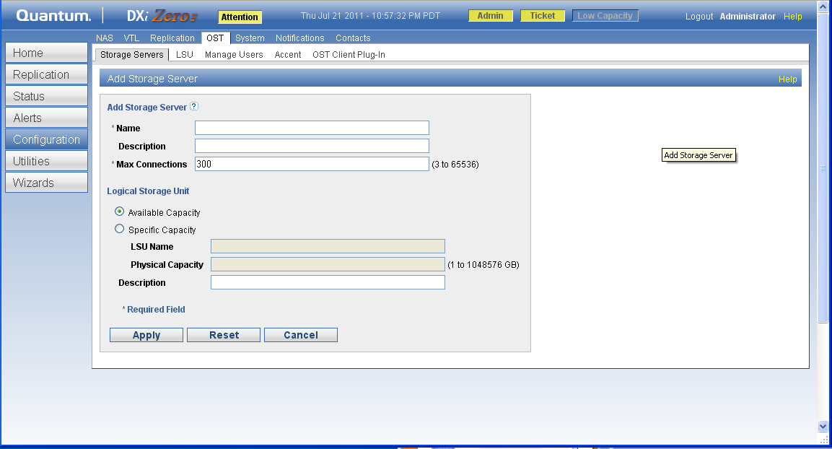
What the User Sees
50
© 2010 Quantum Corporation. Company Confidential. Forward-looking information is based upon multiple assumptions and uncertainties, does not necessarily represent the company’s outlook and is for planning purposes only.

Slide 51
What the User Sees
51
© 2010 Quantum Corporation. Company Confidential. Forward-looking information is based upon multiple assumptions and uncertainties, does not necessarily represent the company’s outlook and is for planning purposes only.
Command Line
  /hurricane/ostd
Syscli
  syscli –-add_backup_user --password
  syscli –edit_backup_user --password

Slide 52
How It Works - Internally
52
© 2010 Quantum Corporation. Company Confidential. Forward-looking information is based upon multiple assumptions and uncertainties, does not necessarily represent the company’s outlook and is for planning purposes only.
Operations
  All OSTD data file-access routed through BPW API.
  OST TCP Ports
    10001 (RPC), 10002 (XCOMM/MI)
    3095 (DM1), 3096 (DM2), 3097 (DM3), …
Logging
  /hurricane/tsunami.log (ostd/dm)
  /opt/DXi/log-common.conf
    log4cplus.logger.ost = INFO, DEBUG, ALL_APP
    /etc/init.d/log4cplus-server restart
  Plug-in log
    /var/log/ostlog/client/ost_client*.log (Unix)
    C:\Windows\libstspiQuantum.log

Slide 53
How It Works - Internally
53
© 2010 Quantum Corporation. Company Confidential. Forward-looking information is based upon multiple assumptions and uncertainties, does not necessarily represent the company’s outlook and is for planning purposes only.
Starting / Stopping
  service ost stop/start/reload/forcestop
  /etc/init.d/ost
  /hurricane/ostd –S [#dm servers] –d [debug level] –f (foreground)
DXi Configuration Files
  /data/hurricane/conf/OSTStorageSrvrLsu.conf

Slide 54
What to do when it breaks
54
© 2010 Quantum Corporation. Company Confidential. Forward-looking information is based upon multiple assumptions and uncertainties, does not necessarily represent the company’s outlook and is for planning purposes only.
Debugging Steps?
  Enable plugin debug logging using plug-in config
    DEBUG_LEVEL=DEBUG
  Enable ostd DEBUG logging for tsunami.log
Triage Tricks
  Identify the pid of the NBU process using the plug-in where the problem occurred from the NBU activity log
    NBU backups/restores use process “bptm”
    NBU monitoring of DXi uses process “bpstsinfo”
    NBU configuration uses process “nbrmms”
    NBU optimized-duplication uses “bpdm”.
    NBU deletion uses “bpdm”
  Correlate the pid with the plug-in log.

Slide 55
Best Practices
Avoid multiple LSUs. Select single “available capacity” LSU.
Use NBU Storage Unit Maximum-Concurrent-Jobs to control number of active streams.

Slide 56
Overview of OST- Replication
Source Dxi
Target Dxi
replicationd dupilication path
OSTD
Replicationd
regular replication path
ostd duplication path
Blockpool
Blockpool

Slide 57
Ostd duplication path
For every CopyExtent() call from NBU
  Establish Blockpool connection to target machine
  Transfer Tag corresponding to Data in CopyExtent () argument
  Break Blockpool connection
Analogous to make road using it and then destroying it
  Duplication of an image involves hundreds of CopyExtent() . So it can be expensive.
Controlled by blockpool connection limit.

Slide 58
Replicationd duplication path
Replicationd always have multiple blockpool connections to target
  analogous to freeway always there.
Ostd checks if the replicationd is connected to duplication target for NBU source. If it is connected
  It asks replicationd to duplicate entire image file.
Performance improves by 6 to 10 times
Available for 2.0. Not Available since BackupExec

Slide 59
Tsunami Log
If Ostd is using replicaitond duplication path:
  Each duplication job will be assinged <job id>
  tsunami log will have message like:
“<job id> being duplicated to <target ip> using Replicationd Channel.”
  grep for “RequestId <JobId>” will show logs associated with that job id.
If Ostd is using ostd duplication path:
  tsunami log will have message like:
“<job id> being duplicated to <target ip> using Ostd Channel.”

Slide 60
Future Enhancements
Symantec OST version 11 upgrade
Optimized Synthetics
Asynchronous Image Replication

Slide 61
References
61
© 2010 Quantum Corporation. Company Confidential. Forward-looking information is based upon multiple assumptions and uncertainties, does not necessarily represent the company’s outlook and is for planning purposes only.
Team
  Brian Deforest, John Morrison (Managers)
  Michael Zeis, OST Team Lead
  Team Members: Mahesh Patil, Madhu Dugasani, Aaron Laffin, Sudhakar Paulzagade
Documentation
  http://dxwiki.quantum.com/dxwiki/OST
  \\hawaii.irvlab.quantum.com\utilities\Tech_Pubs\JNeumann\Galaxy\6-66755-03_RevB_NetBackupOSTGuide_DXi-Series.pdf
Source Tree
  svn://svn.quantum.com/repo/ost/src/branches/OST-2.4.0-Product
  svn://svn.quantum.com/repo/galaxy/src/branches/Galaxy-2.0.1-Product/app/tsunami/ostd

Slide 62
Q & A

Slide 63
What is Accent?
Data is deduped and compressed on OST Media server
  only unique data is sent to the target DXi
  saves network bandwidth
Uses Standard BNP paradigm already used in replication

Slide 64

DXi Accent Offers Flexibility
Q OST Plugin
w/ Accent Dedupe
Accent OFF
Send All data
NetBackup
Standard Backup Server or
Backup Server running Exchange
Send Only Unique & Compressed data
Accent ON
Q OST Plugin
w/ Accent Dedupe
Accent ON
NetBackup
Distributed Deduplication
Delivered with Galaxy 2.0.1
Initially 8500; 6701/02; others added later
Initially Linux NetBackup only; others later
Accent engine future use independent of OST
Fast Backup Server running Linux
64
© 2011 Quantum Corporation. Company Confidential. Forward-looking information is based upon multiple assumptions and uncertainties, does not necessarily represent the company’s outlook and is for planning purposes only.

Slide 65
Accent Installation and Configuration
65
© 2011 Quantum Corporation. Company Confidential. Forward-looking information is based upon multiple assumptions and uncertainties, does not necessarily represent the company’s outlook and is for planning purposes only.
No workflow changes at all
  Accent works without changing any NetBackup configurations at all
Installation order is important
  Accent ENABLED on the plugins by Default; DISABLED on DXi by Default
  Suggest:
    Upgrade OST plugins to latest version with Accent support (2.4.x or later)
    Upgrade DXi to 2.0.1
    Then ENABLE Accent on DXi
Traffic to/from DXi via OST and TCP 1062
  Same port number as Replication, but coming in over ingest interfaces
Can disable accent on a per-media server basis
  Edit /usr/Quantum/QuantumPlugin.conf on media server
  IO_PATH=1 for DISABLED Accent, traditional OST
  IO_PATH=4 for ENABLED Accent

Slide 66
How can Accent be enabled?
Accent can be enabled/disabled on a whole-DXi basis through the DXi GUI/CLI
  by default it is disabled on the DXi
Individual client-side plugins can also disable it if desired
Apart from this, Accent is transparent to the user

Slide 67
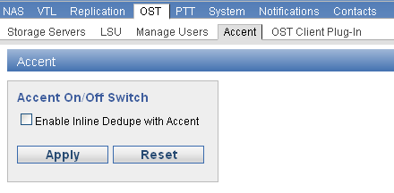
Accent GUI Enable/Disable
OST Improvements
  Manage Users tab under OST.
  Support for Accent

Slide 68
Advantages
Reduces Network utilization:
the first release at least is *not* targeted to necessarily increase performance
Statistics available from Accent are better than those obtained with vanilla OST
Each media server reports whether Accent is enabled, together with the virtual data volume & rate, as well as the actual (on the wire) data volume & rate, in both directions

Slide 69
Accent Performance
Network Reduction single-stream over 10GbE:
  OST: 338 MB/s, Accent: 20.8 MB/s: 93.85% reduction
WAN Performance
  Accent Improves Effective Backup Rate over WAN, by using lower network bandwidth to do the same amount of work.
  Accent is more effective than standard OST as network latencies increases
Notes:
© 2008 Quantum Corporation. Company Confidential. Forward-looking information is based upon multiple assumptions and uncertainties, does not necessarily represent the company’s outlook and is for planning purposes only.
69

Slide 70
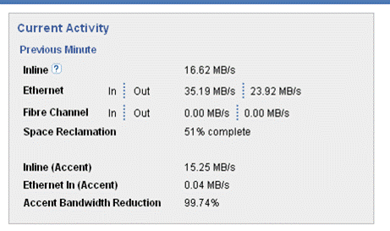
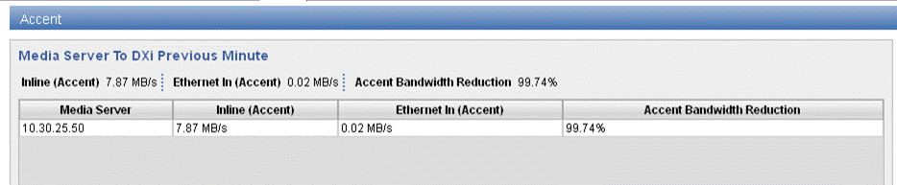
Accent Statistics
From Home page - aggregate stats in previous minute for all media servers:
From Status Accent - per media server stats, aggregate above table:

Slide 71
Compatibility
Old client to new server
a RAS ticket will be raised on the DXi instructing the customer to upgrade the client, a message will appear in the DXi server log, and the client will use the non-Accent aware transport.
New client to old server
Accent-aware client will silently use the non-Accent aware transport

Slide 72
Impact on Media server boxes:
CPU utilization on Media servers
CPU load on the media server will increase due to the extra parsing done as part of the client side deduplication, this will be proportional to the number of streams.
No additional Disk Requirement
Small memory requirement
around 32MB per stream

Slide 73
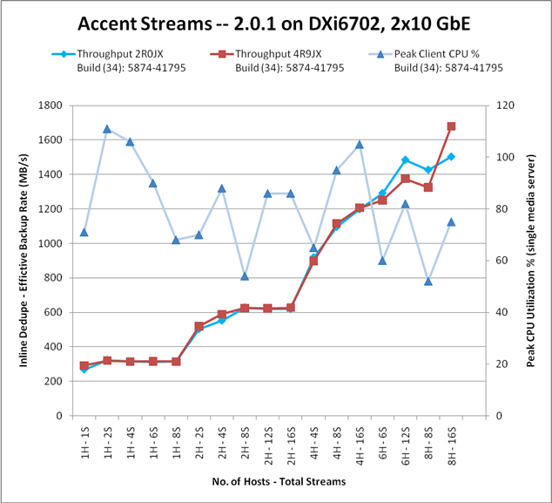
Accent Impact on Media Server
Minimum dual-core processor
More guidance under development
Notes:
© 2008 Quantum Corporation. Company Confidential. Forward-looking information is based upon multiple assumptions and uncertainties, does not necessarily represent the company’s outlook and is for planning purposes only.
73

Slide 74
Limitations
Platforms Supported
2.0.1 limits client platforms to linux+NBU, later releases will support other platforms
Maximum numbers of streams
2.0.1 ships with a maximum of 20 Accent streams per DXi (10 on the smaller systems eg. DXi4510).

Slide 75
FAQ: for Accent
No new files for client existing conf file and plugin file
Accent can dedup statistics, can be seen on Media Server GUI
Accent uses standard tar filter on client side.
From config we can find if Dxi Supports Accent:
  The /data/hurricane/conf/OSTStorageSrvrLsu.conf file shows whether DXi Accent software is enabled or disabled.
  EXAMPLE of Accent software being enabled: <global_hybrid_dedupe_enabled>true</global_hybrid_dedupe_enabled>
From debug logs on clients:
  DEBUG - 20110707 19:10:01 30832 /pgnimage.cpp:647 sh->ssh_connection->server_version = 3 sh->ssh_connection->sh_ostIOPath = ACCENT

Slide 76
Q & A

Slide 77
MiniNet
Rob LaRiviere
77
© 2010 Quantum Corporation. Company Confidential. Forward-looking information is based upon multiple assumptions and uncertainties, does not necessarily represent the company’s outlook and is for planning purposes only.

Slide 78
Agenda
78
© 2010 Quantum Corporation. Company Confidential. Forward-looking information is based upon multiple assumptions and uncertainties, does not necessarily represent the company’s outlook and is for planning purposes only.
Architecture and Difference
GUI Screen shot
Syscli netcfg commands
Netcfg.sh script
How it works
What to do if it is not working
References

Slide 79
Architecture
A Bit of History
  DXi’s ship with all ports bonded
    bond0 is for the 1GbE ports
    bond1 is for the 10 GbE ports
    All ports bonded together (considered Basic mode)
  Network configuration
    Initial configuration done using service.sh script
    More extensive configuration handled by confignetseg.sh and
    confignetip.sh scripts
Mininet
  Custom Network Configuration
    Allows individual Ethernet port configuration or bonding of multiple ports.
  Advantages:
    Bonding of two or more ports is not based on traffic type.
    Each bond or port can be assigned its own set of network configuration parameters.
79
© 2010 Quantum Corporation. Company Confidential. Forward-looking information is based upon multiple assumptions and uncertainties, does not necessarily represent the company’s outlook and is for planning purposes only.

Slide 80
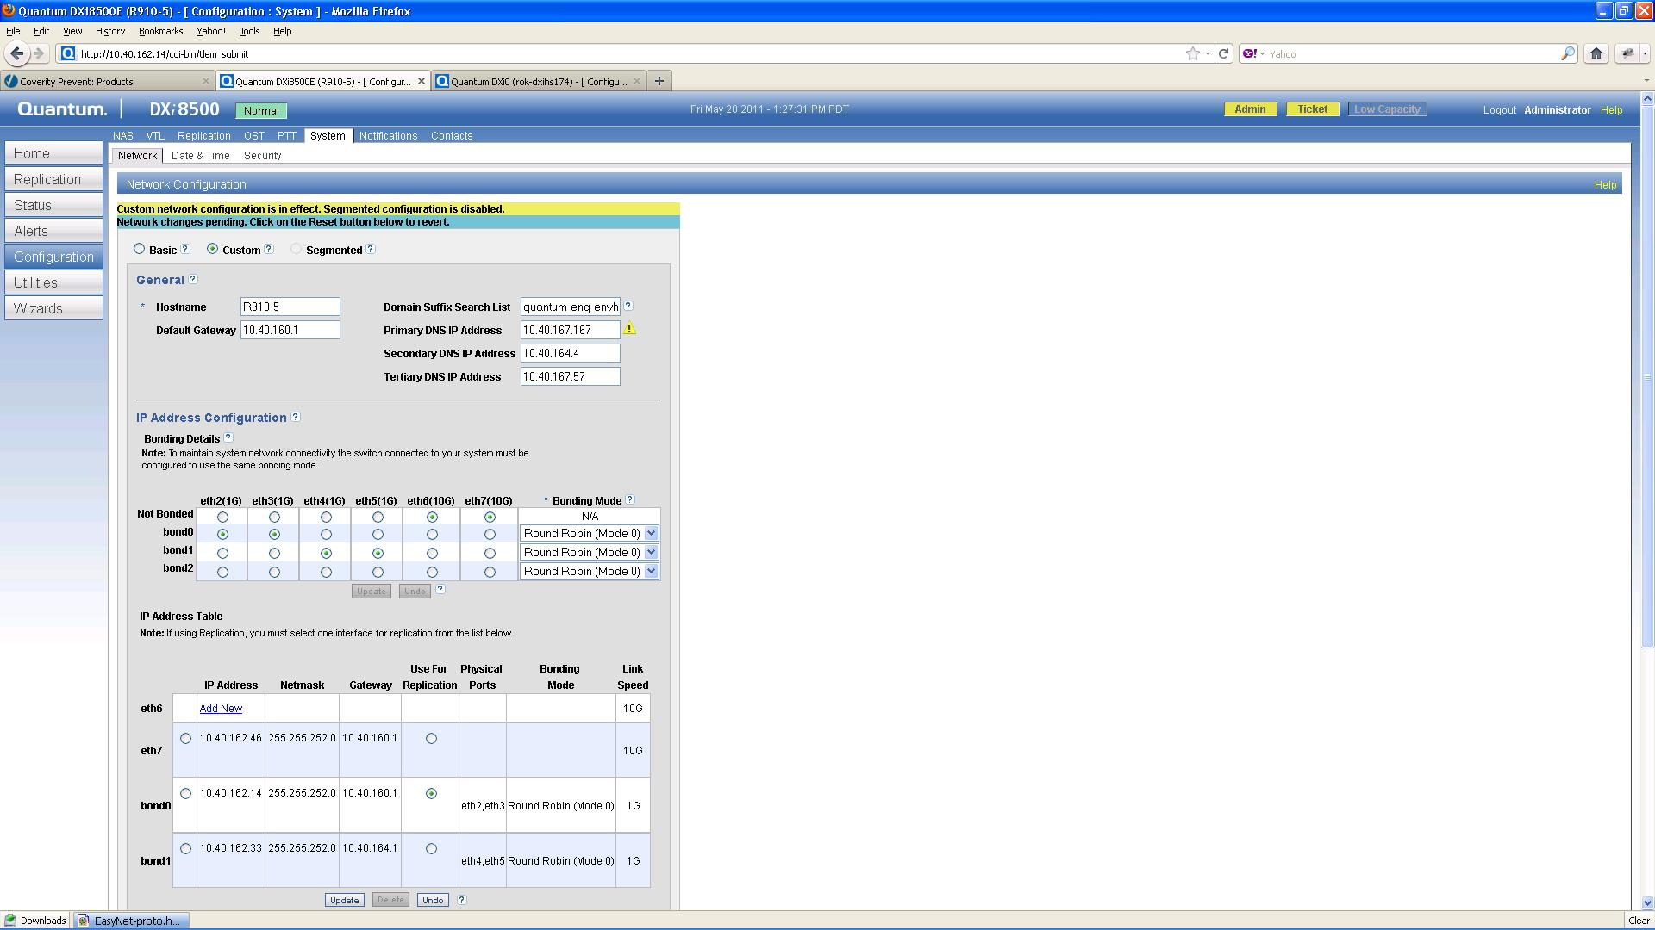
GUI Screen Shot
80
© 2010 Quantum Corporation. Company Confidential. Forward-looking information is based upon multiple assumptions and uncertainties, does not necessarily represent the company’s outlook and is for planning purposes only.

Slide 81
Syscli netcfg commands
[root@rok-dxi148 ~]# /opt/DXi/syscli --help netcfg
  1. syscli --add netcfg --devname <DEVNAME>
  --ipaddr <IPADDR> --netmask <NETMASK>
  --gateway <GATEWAY> [--policy REP]
  [--slaves <DEV1>,<DEV2>,<...>]
  [--mode LACP|RR] [--sure]
  Adds and configures network device.
  2. syscli --del netcfg --devname <DEVNAME> [--sure]
  Deletes network device configuration.
  3. syscli --show netcfg [--devname <DEVNAME>]
  Shows network configuration.
  4. syscli --backup netcfg
  Backs up custom network configuration.
  5. syscli --restore netcfg [--sure]
  Restores previous custom network configuration.
  6. syscli --undo netcfg [--sure]
  Undoes custom network configuration.
  Note: Sets network configuration back to BASIC mode

Slide 82
Netcfg.sh script
[root@rok-dxi148 ~]# /opt/DXi/scripts/netcfg.sh
  netcfg.sh add --devname <DEVNAME>
  [--slaves <DEV1,DEV2,...>] --ipaddr <IPADDR>
  --netmask <NETMASK> --gateway <GATEWAY>
  [--policy REP ] [--mode <LACP>|<RR>]
  netcfg.sh del --devname <DEVNAME>
  netcfg.sh show --devname <DEVNAME|ALL>
  netcfg.sh --undo
  netcfg.sh --backup
  netcfg.sh --restore

Slide 83
Mininet from 2.0 to 2.0.1
Fix problems/shortcomings in Mininet 2.0
  Basic functionality working as of netcfg.sh script rev 88 (Jan 17, 2011)
  Added command to UNDO mininet
  The --restart option was removed
    ifdown/ifup not sufficient to configure networking service
    Require reboot for now (TODO: determine network config dependencies)
  Added support for LACP bonding mode
83
© 2010 Quantum Corporation. Company Confidential. Forward-looking information is based upon multiple assumptions and uncertainties, does not necessarily represent the company’s outlook and is for planning purposes only.

Slide 84
How it Works
The netcfg.sh script is the Foundation
  Serves as mininet library
  Located in /opt/DXi/scripts
  Mininet files stored in /usr/local/etc/mininet directory
    Mininet/custom configuration is indicated by presence of custom.cfg file
    Note: but use UNDO to remove mininet
    Basic/shipped configuration is in the initialcfg subdirectory
    Backup configuration is in the snapshot subdirectory
  GUI calls QSysApi (syscli) which calls this script
Logging
  Syscli stores commands in /var/log/syscli/syscli.log
  For other GUI messages, check tsunami.log
    GUI stores calls to confignetseg.sh in /var/log/DXi/confignetseg.log
Configuration Files
  No longer use the Network.conf file
    It only has support/tags for bonding and segmentation
  Store configuration in /etc/sysconfig/network-scripts directory

Slide 85
How it works (syscli support for GUI)
1.) Gets all customer facing Ethernet ports and link speeds
(1 & 10 GbE):
  /opt/DXi/<MODEL>-Network.conf file.
2.) Gets current runtime state from /sys/class/net directory:
  current list of bonds:
    /sys/class/net/bonding_masters file.
  current operational state:
    Bonds: /sys/class/net/bond0/operstate
    Ethernet ports: /sys/class/net/ethX/operstate
  current list of slaves for bond:
    /sys/class/net/bondX/bonding/slaves.
  current bond mode/algorithm:
    /sys/class/net/bondX/bonding/mode.
3.) Get bond and Ethernet interface configuration
  /etc/sysconfig/network-scripts directory

Slide 86
Syscli commands (secret for now)
[root@garlic DXi]# syscli --list bonds
  Output data:
  List of bonds:
  Total bonds = 1
  [bond = 1]
  Bond Name = bond0
  State = up
  Slaves = eth0 eth1
  Algorithm = balance-rr 0
  IP Address = 10.30.27.120
  Netmask = 255.255.252.0
  Gateway =
  Command completed successfully.

Slide 87
Syscli commands (secret for now)
[root@garlic DXi]# syscli --list ethports
  Output data:
  List of IP Ethernet devices:
  Total ethernet device count = 2
  [eth = 1]
  Device Name = eth0
  Maximum Speed = 1000
  State = up
  Bond Owner = bond0
  IP Address =
  Netmask =
  Gateway =
  [eth = 2]
  Device Name = eth1
  Maximum Speed = 1000
  State = up
  Bond Owner = bond0
  IP Address =
  Netmask =
  Gateway =
  Command completed successfully.

Slide 88
What to do when it breaks
88
© 2010 Quantum Corporation. Company Confidential. Forward-looking information is based upon multiple assumptions and uncertainties, does not necessarily represent the company’s outlook and is for planning purposes only.
Check the syscli command that was issued by the QSysApi call from the GUI in:
  /var/log/DXi/syscli/syscli.log
Check for confignetseg.sh script calls in:
  /var/log/DXi/confignetseg.log
  Note: mininet_confignetseg.sh is copied to confignetseg.sh on mininet init
Run the command using the netcfg.sh script directly
  May need to add “set –x” to debug the script

Slide 89
What to do when it breaks (cont.)
Check the netcfg port status and routing info:
  syscli --show netcfg
  netcfg.sh show --devname <DEVNAME|ALL>
  note: “ip addr” will show bond masters for ports
Verify Ethernet port connectivity in /sys/class/net
  [root@mint net]# grep "" eth*/carrier
    eth0/carrier:1 ⬅cable connected
    eth1/carrier:1 ⬅ cable connected
    grep: eth2/carrier: Invalid argument ⬅ internal interface
    eth3/carrier:0 ⬅ internal interface

Slide 90
Best Practices
Backup the current configuration
Delete the current network configuration that is no longer desired
Add the desired configuration
Reboot the system for the configuration info to become the runtime info (i.e. used by the “network” service).

Slide 91
Best Practices (cont.)
Example:
1.) Backup the current configuration
    [root@rok-dxi92 DXi]# syscli --backup netcfg
  2.) Remove bond0 (which contains eth0 and eth1 as slaves)
    [root@rok-dxi92 DXi]# syscli --del netcfg --devname bond0
      You have specified the following data for command "DelNetcfg":
      --devname = bond0
      Are you sure you want to proceed? [yes|no] > yes
      Command completed successfully.
    Note: this will not change the output of “syscli –show netcfg” because the add and delete netcfg commands only affect the network configuration files and not the runtime values.
  3.) Add eth0 back as standalone port
    [root@rok-dxi92 DXi]# syscli --add netcfg --devname eth0 --ipaddr 10.20.185.92 --netmask 255.255.248.0 --gateway 10.20.184.1
    You have specified the following data for command "AddNetcfg":
    --devname = eth0
  --ipaddr = 10.20.185.92
  --netmask = 255.255.248.0
  --gateway = 10.20.184.1
  Are you sure you want to proceed? [yes|no] > yes
  Command completed successfully.
  4.) Reboot system (can use “syscli –-nodemanage reboot”)

Slide 92
Known Issues
Require specifying a gateway for all interfaces due to Linux kernel routing bug
  Ref. PTR 23073 (outgoing traffic uses only 1 port for multiple ports in a subnet)
  For directly connected ports, gateway IP address = DXi device IP address, e.g.
  /opt/DXi/syscli --add netcfg --devname eth5 --ipaddr 10.10.10.101 --netmask 255.255.255.0 --gateway 10.10.10.101
Still need a default GATEWAY in /etc/sysconfig/network file

Slide 93
Future Enhancements
Remove confignetseg.sh and confignetip.sh scripts and add functionality to netcfg.sh or mininet library
Extend syscli commands to give basic network configuration for cliadmin

Slide 94
References
94
© 2010 Quantum Corporation. Company Confidential. Forward-looking information is based upon multiple assumptions and uncertainties, does not necessarily represent the company’s outlook and is for planning purposes only.
Team
  Rob LaRiviere (Tech Lead)
  Charissa Willard (syscli netcfg/network commands)
  Lei Wang (netcfg.sh script)
  Hatem Saidane (Mininet GUI)
  Mark Anthony (Mininet documentation)
Documentation
  For netcfg.sh script – display usage
  For GUI – display online help
  For syscli – display “syscli --help netcfg” or
  “syscli --help --[add,del. …] netcfg”
  More content for syscli netcfg commands along with examples added to the
  CLI Guide DXi-Series v2.0.1
Source Tree
  http://10.40.164.47/viewvc/projects/components/mininet/src/

Slide 95
Q & A

Slide 96
DXi SW Upgrades
Perry Ross
96
© 2010 Quantum Corporation. Company Confidential. Forward-looking information is based upon multiple assumptions and uncertainties, does not necessarily represent the company’s outlook and is for planning purposes only.

Slide 97
Software Upgrades
97
© 2011 Quantum Corporation. Company Confidential. Forward-looking information is based upon multiple assumptions and uncertainties, does not necessarily represent the company’s outlook and is for planning purposes only.
Upgrades from 1.4.x to 2.x require the pre-upgrade script.
Upgrades from 2.x to 2.x is the same process as the traditional 1.x to 1.x upgrades.
Starting with 2.0.1 a discrete SW Upgrade document will be released. SW upgrade instructions will be removed from Release Notes and FSM.
Steps to take before upgrading to 2.0.1 to minimize probabilities of failure
  Ensure proper versions of .fw and/or DVD
  Run pre-upgrade procedure
Upgrade process
  Upload .fw file
  For 1-to-2 upgrade, insert DVD
  activate firmware
Notes:
NTE pricing of ~$XYZ (TBD Claire)
© 2010 Quantum Corporation. Company Confidential. Forward-looking information is based upon multiple assumptions and uncertainties, does not necessarily represent the company’s outlook and is for planning purposes only.
97

Slide 98
SW Upgrades (cont.)
Potential Issues
  If “Error: Could not upgrade to the new version from the current version” is displayed, check for the correct platform of (.fw) firmware file to be uploaded.
  If “Error; invalid upload filename” is displayed, check the proper (.fw) firmware file to be uploaded.
  If the FW uploading is slow, check for network issues.
  If fw activation fails:
    Remove Alert tickets.
    Check for any hardware issues or system normal status.
  1-to-2 upgrade tolerates power loss.
    If the DVD has been ejected, don’t push it back in
  2-to-2 upgrade does not survive power loss
Numerous bugs fixed since 2.0
  .fw version must match DVD version
  failure to reboot on some platforms
  handling unusual network configurations
  many qbfs conversion and replication issues
  improved logging/forensics
98
© 2011 Quantum Corporation. Company Confidential. Forward-looking information is based upon multiple assumptions and uncertainties, does not necessarily represent the company’s outlook and is for planning purposes only.
Notes:
NTE pricing of ~$XYZ (TBD Claire)
© 2010 Quantum Corporation. Company Confidential. Forward-looking information is based upon multiple assumptions and uncertainties, does not necessarily represent the company’s outlook and is for planning purposes only.
98

Slide 99
Pre Upgrade Script Summay
Pre Upgrade Script Objective
  The success of the upgrade depends on ensuring that the system is in a healthy state and no known issues are present that will prevent the upgrade from completing successfully.
  In previous releases, all of this upgrade information was documented in both the Pre-Upgrade Script document and the Field Service Manual. Now, the DXi-Series Software Upgrade Guide is the only location for the upgrade instructions.
Pre Upgrade Script Summary (Refer to process posted on CSWeb process for more details)
  Step 1 – Prior to Upgrade
    Save off the 1.4.x diagnostic files
    Delete unsupported special files
    OST/Symantec Backup Exec interactions
    Upgrading systems with non-deduplicated shares
    Removing UnTruncated Data
    Determine space for non-deduplicated shares
    Determine the state of the system
    Check for System Issues
    Determine how long the upgrade will take
  Step 2 – Upgrade
    Place DVD into DXi
    Start the upgrade process
    Remove the DVD from the DXi DVD drive
  Step 3 – Finishing up
    Alter Blockpool Configuration Settings
    Reset the system to prior state
    Determining how much space is on the DXi
    OST
99
© 2011 Quantum Corporation. Company Confidential. Forward-looking information is based upon multiple assumptions and uncertainties, does not necessarily represent the company’s outlook and is for planning purposes only.
Notes:
NTE pricing of ~$XYZ (TBD Claire)
© 2010 Quantum Corporation. Company Confidential. Forward-looking information is based upon multiple assumptions and uncertainties, does not necessarily represent the company’s outlook and is for planning purposes only.
99

Slide 100
Q & A

Slide 101
Known Issues
Mahesh Patil and Chris Graves
101
© 2010 Quantum Corporation. Company Confidential. Forward-looking information is based upon multiple assumptions and uncertainties, does not necessarily represent the company’s outlook and is for planning purposes only.

Slide 102
Galaxy 2.0.1 – Bug Profile Review
Customer facing Release Notes are posted on CSWeb. Known issues are not all deferred bug but ones customer may encounter.
Significant bug/development challenges (deferred)
  F5 certification blocked: need minimum migration rate of 80 files/sec (24153)
    will continue testing at F5 on GA candidate code so we know what to fix in Galaxy 2.1
  VTL Load Causes NAS Failures -- Limit VTL Load (24341)
  System very slow, reported swap usage at: 3397460K- Dark Memory (24478)
  Blockpool "pauses" causing other operations to time out (23465)
    2.0 bug
    Added a debug timer in 2.0.1 to help isolate root cause
    Seen at multiple customer sites

Slide 103
Galaxy 2.0.1 – Bug Profile Review (as of 7/15)
Bug Totals:
  1526 Total managed
  272 deferred (18%)
All deferred bugs have been reviewed by the Galaxy 2.0.1 CRB
Sev1 list included on following slide
Severity of deferred
1 | 2 | 3 | 4 | 5 | Total
30 | 44 | 160 | 21 | 17 | 272

Slide 104
Galaxy 2.0.1 – Bug Profile Review
bug_id | bug_severity | short_desc
24183 | 1 | VTL/VTD: IO slows in the VTD - host aborts
24299 | 1 | kernel panic: scst_hw_pending_work_fn+317
23865 | 1 | Create VTL not cleaning up after error.
23465 | 1 | Blockpool "pauses" causing other operations to time out
22007 | 1 | tw_cli: page allocation failure. order:0, mode:0x10d0
24069 | 1 | After BFST crash replication of VTL failed with missing tags
24327 | 1 | Campari2: System comes up in Diagnostic after power loss during creation of nas shares
24156 | 1 | NBU7.1 OST backups on Solaris are slow. ~10mb/sec
24341 | 1 | VTL Load Causes NAS Failures -- Limit VTL Load
24112 | 1 | Restore of OST Direct Copy (PTT) backup hangs
24443 | 1 | Healthcheck operation failure of missing tags after 5+ days of running on maturity system
24298 | 1 | space reclaimation stuck due to many directories being renamed during FS scan
24528 | 1 | Blockpool: Cores dumping on system with low space
22970 | 1 | NBU & jammer (drop write xfer rdy); read threads returned 'data phase error' failed
17915 | 1 | DXi had a VTD core durring baseline test - ran out trackers
22937 | 1 | Rebuild hold list file if it is corrupt
23712 | 1 | FCP commands processed after initiator LOGO
24196 | 1 | Initial setup, failure DXRealTimeClock.cpp(736) [webguid] setTimeZone().
24355 | 1 | fsdevice core on PTT scan while injecting hardware errors
24586 | 1 | NBU over NFS times out with small VTL load
24541 | 1 | RDT DXi6550 GUI displays wrong Disk Usage Status after power cycle
22843 | 1 | QL FW crash during SRR loop test with I/O
24319 | 1 | DXi4520 had a axis2_http_serv-1308832140-12640 core while idle.
24120 | 1 | Cannot recover from sudden power loss
22844 | 1 | truncated FCP cmd indefinitely hangs target ISP
23213 | 1 | Replication should hook up new cancellable AttrBall API
24323 | 1 | DXi failing Symantec Backup Exec GRT (Granular Recovery Technology) certification, unable to support 10,000 open file handles
22434 | 1 | Base install CD & DVD auto-install after a brief timeout
24338 | 1 | 2.x replication to 1.x may insert dummy zero-length BLOB but not replicate it.
22334 | 1 | Collect Log: CLI collect log failed with error and ended up with incomplete .zip file in /scratch/collect on 8500 system
Notes:
© 2008 Quantum Corporation. Company Confidential. Forward-looking information is based upon multiple assumptions and uncertainties, does not necessarily represent the company’s outlook and is for planning purposes only.
104

Slide 105
Galaxy 2.0.1 – Bug Profile Review
Basic deferral criteria/questions
  Is the bug a regression?
  What is the customer impact?
  What is the likelihood of a customer encountering the bug?
Criteria are documented in bugzilla database and reviewed by cross-functional CRB for final disposition

Slide 106
Breakdown of Severity 1 deferrals
Enhancement request (Sev 5) or fixed in a duplicate bug (22334, 24338, 22434, 24541, 23213)
Not a regression and attributed to HW/FW (22844, 24120, 22970)
Duplicates of NAS+VTL multi-protocol issue (24586, 24341)
Ecosystem or ISV issues (24112, 24156)
Pre-existing field bugs requested for inclusion during 2.0.1 but not fixed due to risk, schedule, and/or technical feasibility (17915, 22007, 23465)
Balance deferred based on criteria/questions reviewed in CRB with details logged in database

Slide 107
VTL / NAS Ingest Constraints
107
PTR 24341 – VTL Load causes NAS failures
VTL workload does not throttle in the face of NAS ingest
  Causes NAS timeouts and backup failures
  Simultaneous VTL and NAS (NFS/CIFS) ingest is not supported in 2.0.1
Fix will be delivered in subsequent release of Galaxy (2.0.x)
Other mutli-protocol ingest are great
  NFS and CIFS
  OST and NFS
  OST and CIFS
  OST and VTL
Multi-protocol replication also great
  Supports Edge to Core concept
  NFS at the edge, VTL in the core, edge replicating to core

Slide 108
VTL / NAS Ingest Constraints (cont.)
108
VTL Load causes NAS failures(PTR 24341) - Release Note Entry
  Description: Backup jobs to NAS shares may fail if they are run simultaneously with heavy or continuous VTL ingest.
    Note: This issue only occurs during simultaneous NAS and VTL ingest. Other protocol combinations are unaffected. For example, you may perform simultaneous OST and VTL ingest, OST and NAS ingest, or any type of replication in combination with VTL, NAS, or OST ingest.
  Workaround: Do not perform simultaneous NAS and VTL ingest. You may perform both types of ingest, but you should schedule them to occur at different times.

Slide 109
2.0.1 Technical Service Bulletins (TSBs)
ID | Summary
22100 | OST: Plug-in for NBU 7.1 on RH6 64bit does not load during runtime
22795 | Network: Solaris 10GbE performance allowing only "1/10" throughput of comparable Linux system
23227 | DXi QL fw crash producing unreadable dumps for Qlogic
24305 | following kernel panic, system stuck in transient state, blockpool core on initialization
22122 | NDMP operations with Oracle Secure backup is producing errors with 0x100 NDMP_CONFIG_GET_HOST_INFO commands
22691 | GIO: DXi Initiator Ports erroneously logging into external FC switch as Target ports
23788 | CA ArcServe can not auto configure VDT's to DXi emulated VTL's.
24600 | OST/NBU: bpwd cored while restarting ostd during duplication
24357 | DXi did not reboot after activated upgrade from 1.4.1 to ...
24151 | GUI status shows low space (Critical Low Space) while sys...
24111 | Concurrent OST restore fail with socket read fail NBU 7.1...
22624 | Replication: Got this AUD CreateSNFSFile() error on targe...
22183 | OST: Intermittent failures seen on Opdup Netbackup Jobs.
21734 | Failed to process unpack request: [TID 22] blockpool comm...

Slide 110
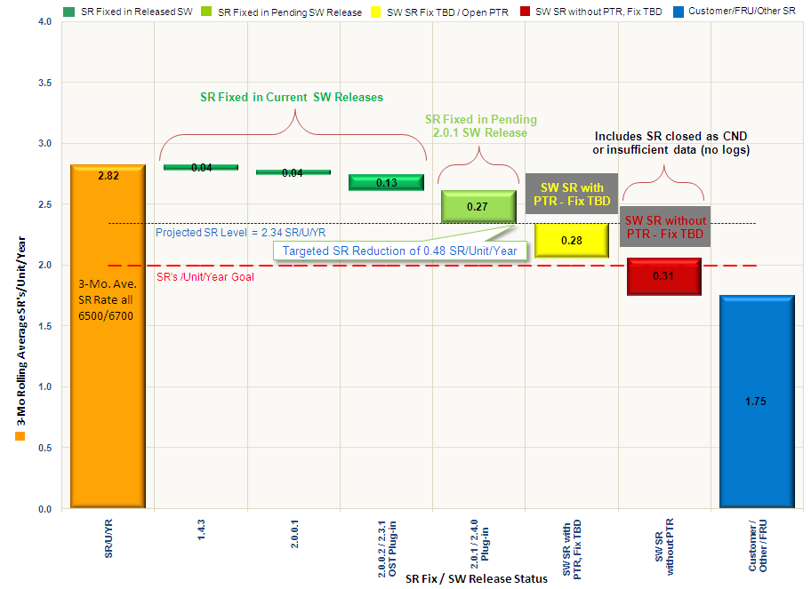
Galaxy 2.0.1 – Bug Profile Review
SR Rate Impact Waterfall by SW Release

Slide 111
Q & A

