Slide 1
DXi6902
TOI for Global Service
Jim Hibbard
July 31, 2014

Slide 2

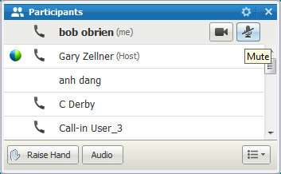
Please Mute Your Phone Line
Please note that we are now using WebEx Audio for the Service NPI con calls.
Here are some things you need to know about WebEx Audio:
  Using “*6” does not work on WebEx Audio to mute/un-mute your line.
  You can mute your phone in two ways when using WebEx Audio:
    You can mute your phone from your end (using the mute feature on your phone)
    Within the WebEx, in the participants list, use the button next to your name showing a microphone. Press once to mute. Press again to un-mute.
    If we need to mute all lines, use the “Raise Hand” feature to let us know you need to speak and we will un-mute your line.

Slide 3
Agenda
Product Overview
HW Engineering
SW Engineering
Manufacturing, Installation & Upgrade
Quality
Documentation and Training Updates
Service Model

Slide 4
Product Overview
Product Management – Matthew Apodaca

Slide 5
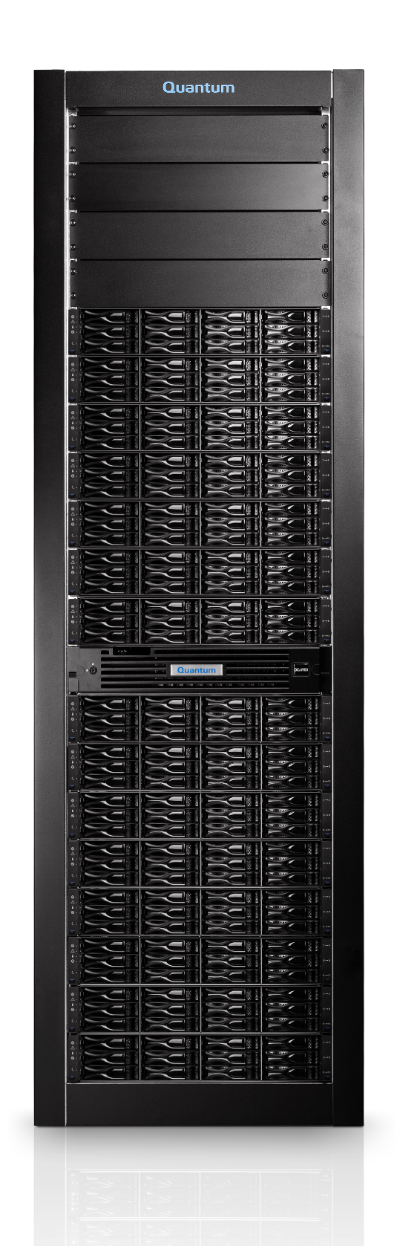

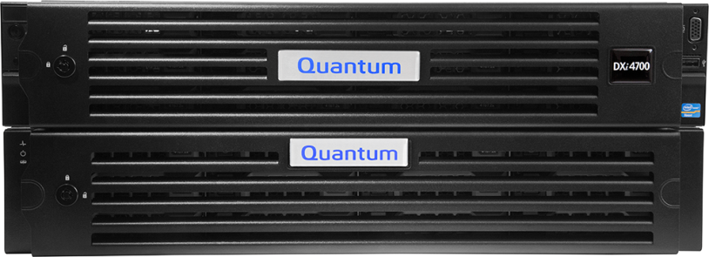
DXi Deduplication
Intelligent. Simple. Powerful.
Maximize Disk Storage
Improve Backup & Restore Times
Protect Data Across Sites &
In the Cloud
Increase IT Staff Productivity
Scale on Your Terms
Provide Extra Layers of Security
Notes:
Maximize disk storage density | Patented variable block deduplication minimizes disk storage as data grows over time
Improve backup windows and restore SLA’s | Using StorNext 5, the world’s fastest file system, to power our deduplicated block pool means faster data deduplication and faster access to your backup data
Increase IT Staff Productivity| Proactive monitoring and reporting enables precise business decision making, configuration wizards and speeds resolution time, even from your mobile device. Allow your staff to focus on more strategic projects versus manage a device all day long.
Protect Data Across Sites & In the Cloud | Using Quantum’s WAN-optimized replication to minimize network bandwidth and Q-Cloud Protect, DXi provides secure offsite data protection for as little as pennies per GB per month.
Scale on Your Terms | Physical and virtual appliances that scale from 1TB to over 500TB using DXi’s unique capacity-on-demand approach with minimal or no downtime, and as simple as activating a license key.
Provide Extra Layers of Security | Military-grade, hardware based AES-256 bit encryption at rest and in flight provides security without sacrificing performance

Slide 6
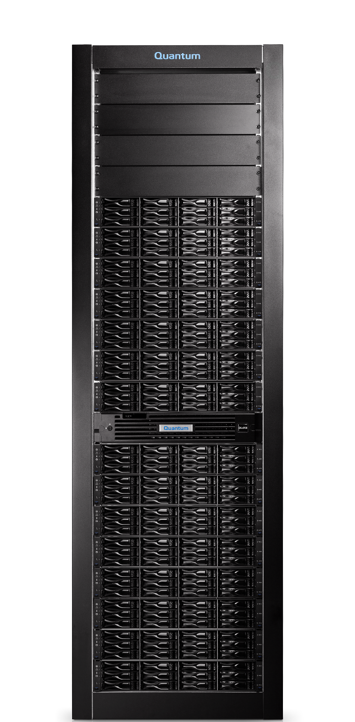

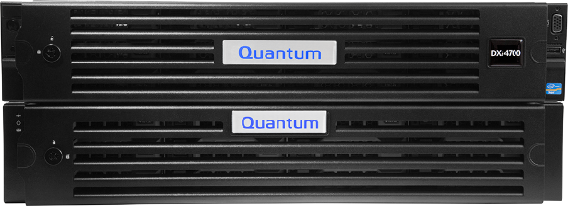
DXi Deduplication Series
DXi V-Series
1-24TB
DXi4700
5-135TB
DXi6900
17-510TB
Notes:
DXi V-Series
1-24 Usable Capacity
15-360TB Logical Capacity
4.9TB/hr ingest
DXi4700
5-135TB Usable Capacity
75-2PBs Logical Capacity
11TB.hr ingest
DXi6900
17-510TB Usable Capacity
255TB-7.7PBs Logical Capacity
18TB/hr Ingest

Slide 7
DXi6900 Deduplication Series
New Enterprise DXi Appliance
  Pay-as-You-Grow Scalability
  4TB Self-Encrypting Drives
  Dual Controllers
  Enterprise Performance
  New DXi 3.0 Software
    New operating system
    StorNext 5 File System
  Dynamic Disk Pools
  Multiprotocol Support
DXi6900
17-510TB
Notes:
DXi V-Series
1-24 Usable Capacity
15-360TB Logical Capacity
4.9TB/hr ingest
DXi4700
5-135TB Usable Capacity
75-2PBs Logical Capacity
11TB.hr ingest
DXi6900
17-510TB Usable Capacity
255TB-7.7PBs Logical Capacity
18TB/hr Ingest

Slide 8
DXi6902 List Price Comparison
*Comparison is against EMC DD list price and does not include DD licensing

Slide 9




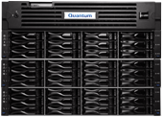
DXi6900 Competitive Comparison
Model | DD4200 | DXi6900 | DD4500 | DD7200 | DD990
Usable Capacity (TB) | 36 – 180 | 17 - 510 | 72 – 288 | 108 – 432 | 144 – 576
Dual Controllers | YES | YES | YES | YES | YES
List Price* | $147,000 - $647,000 | $88,000 | $419,000 - $1,169,000 | $718,000 - $1,843,000 | $885,000 - $2,475,008
*EMC pricing includes replication license and either OST or VTL license to reflect standard use case.
Quantum does not charge separately for these features.

Slide 10
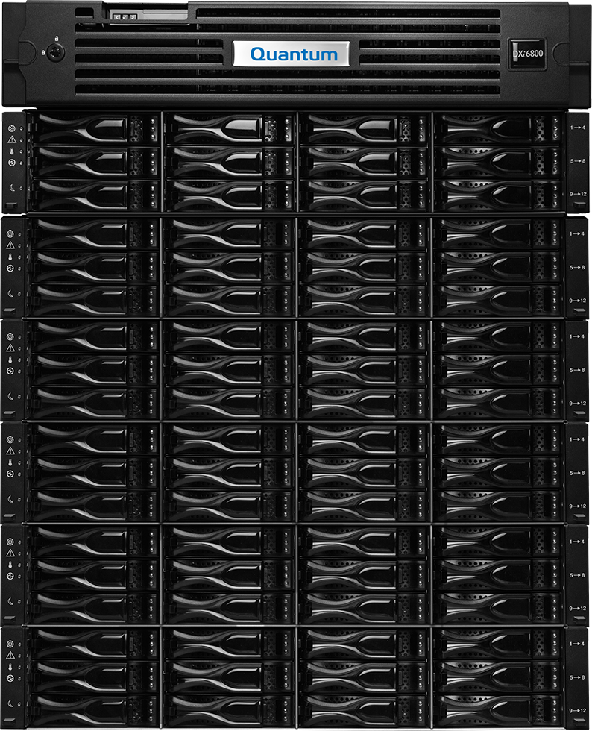
Scale on Your Terms
17TB to over 510TB
Unique Capacity-on-Demand
CoD Capacity (TB)
17 or 34
51 or 68
65 or 78
91 or 104
117 or 130
Up to 510
17TB expansion ordered, 34TB shipped*
UNUSED STORAGE
Notes:
Pay-as-you-grow scalability provides simple, predictable & easy-to-install storage capacity. This allows users to increase the capacity of their DXi in 17TB increments by simply unlocking capacity through the addition of a license key – no additional on-site installation needed. The benefit of this approach is that it allows users to not have to overprovision their storage and purchase more capacity than they need. With pay-as-you-grow, users can now buy what they need today, and then as their storage needs grow, the DXi6900 will grow with them.
Each expansion shelf contains 34TB of usable capacity with a maximum of six expansion shelves for a total of 510TB usable capacity – that’s over 7PB of logical capacity in only 32U of space. The base system ships with 17TB usable capacity. If the user needs more storage than that, they simply add the number of 17TB increments they need to achieve the desired total system capacity.

Slide 11
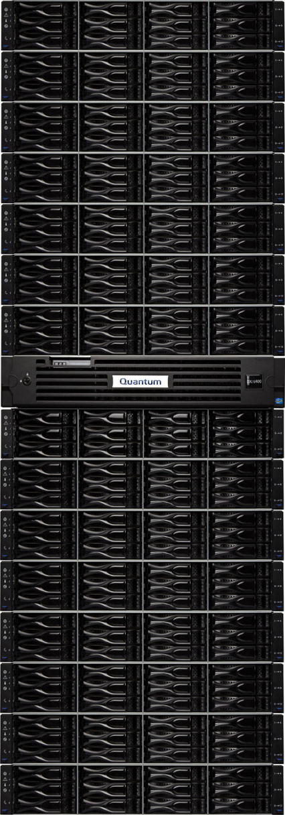
DXi6902 Simple Ordering Architecture
Base Configuration
17TB usable entry capacity
6x 8Gb FC / 2x 10GbE / 3x 1GbE
2U Node + 2U Expansion
Capacity
Up to 510TB
Up to 15 expansion modules
Ordered in 17TB Increments
Complete Protection
Onsite Installation
Superior Service and Support
Options
4 Port 1GbE
2 Port 10GbE
Data-at-rest encryption

Slide 12
DXi6902
Description | NA, EMEA, LA, Russia List Price | APAC List Price | China List Price
Quantum DXi6902 Disk Deduplication Backup Appliance, 17TB Usable Capacity | $88,000 | $147,480 | $480,480
Quantum DXi6902 Capacity Expansion, 17TB Usable Capacity | 60,000 | 100,800 | 327,600
Quantum DXi6902 Dual Port 10GbE SFP+ Adapter, Optical | 5,000 | 8,400 | 27,300
Quantum DXi6902 Dual Port 10GbE SFP+ Adapter, Twinax | 5,000 | 8,400 | 27,300
Quantum DXi6902 Quad Port 1GbE Adapter | 5,000 | 8,400 | 27,300
Data-at-Rest Encryption | 10,000 | 16,800 | 54,600

Slide 13
Performance
Presentation | DXi6802 | DXi6900 | DXi8500
VTL | 11.9 TB/hr. | 11.8 TB/hr. | 11.3 TB/hr.
VTL+2 | 15.0 | 13.4 | 14.2
NFS-S | 7.5 | 7.1 | 6.0
CIFS | 13.5 | 13.3 | 8.7
OST | 16.3 | 15.2 | 11.8
Accent | 12.1 | 13.8 | 10.4
Stream count design point same as DXi8500
DXi6900 / 3.x performance is more stable as blockpool ages vs. DXi6802
‘Up-To’ doesn’t tell the whole story…

Slide 14
Performance – Let’s Look Deeper - VTL

Slide 15
Enabler Updates
DAR – Embedded in DXi software
Vision – Fully supported
Gunnison/Sizing Tool – Fully supported
Guardian –
  Not currently supported but may come at a later time
  PdM is investigating best investment choice

Slide 16
Hardware Engineering
Hardware Engineers – Kempton Redhead

Slide 17
DXi 6902 Hardware Strategy
The architecture strategy carried these tenants:
  Build on the knowledge and technology of 6802
  Use existing Tier 1 suppliers (Dell and NetApp)
  Maintain performance levels comparable to 6802
  Scale over 500TB usable capacity
  Incorporate 4TB density HDDs
  Increased redundancy over 6802
  Increased data protection/verification to/from backend storage
Moved to the latest NetApp Controller technology and FW level
Increased supplier qualification efforts where possible.

Slide 18
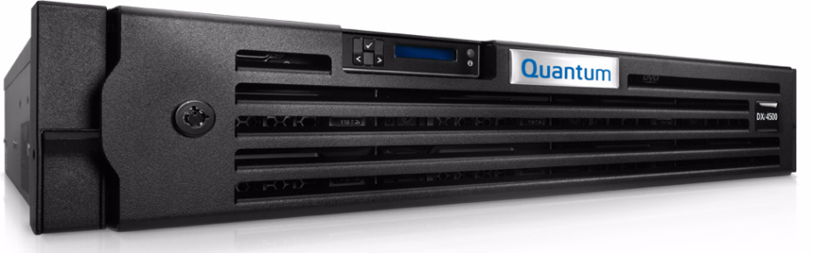
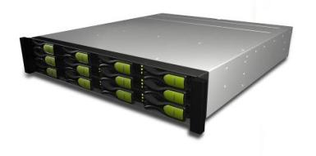
Hardware Details
DXi6902 Node
  Dell R720 XL Server
  CPU: Ivy Bridge E5-2670V2 x2 10 Core 2.50GHz, HT, 25M Cache 1866MHz memory
  Memory: 128GB or 256GB Total (16GB x 8 or 16) Dual ranked 1866MHz
  16HDD 2.5" backplane
  Boot HDD: 2 x 900GB 10K RPM
  META Data HDD 14 x 900GB 10K RPM
  Internal PERC H710 RAID Controller (512MB NV Cache version)
  Dual 750 Watt P.S. (1 + 1)
  Built in NDC Quad Port 1GbE
  IDRAC service port
  HBA’s and NIC’s:
    Standard Intel X520 10GbE NIC x1 (SFP+) PCIe Slot 1
    Standard Dual 8Gb QLogic FC x1 PCIe Slot 3
    Standard Quad 8Gb QLogic FC x1 PCIe Slot 7
    Quad 6Gb LSI-9602 SAS x1 PCIe Slots 5 & 6
    Optional Quad Intel 1GbE card X1 or Intel X520 10GbE NIC x1 (SFP+) PCIe Slot 2
Bulk Storage
  Up to 510TB total Storage
  Net App Tahoe RAID Controller w/Ebbets Enclosure
    RBOD X2 with 4TB HDD’s
  Net App Ebbets Expansion Modules
    EBOD x 13 with 4TB HDD’s

Slide 19
Hardware Overview
Deltas from 6802:
System Node
  CPUs: E5-2670 V2
  Memory 128 or 256 GB
  Two Quad SAS Controllers
Expansion: JBOD & EBOD
  4TB HDDs
  Dual Tahoe Controllers
  Illinois Controller Firmware
  FIPS Compliancy
    In the R720 node
    Not in the RBOD/EBOD
Additional data integrity checks between the SAS HBA and the NetApp Tahoe controllers via T10 - PI/DIF

Slide 20
System Block Diagram

Slide 21
System Block Diagram

Slide 22
System Block Diagram

Slide 23
DXi6802 vs. DXi6902

Slide 24
Hardware Configuration Overview
Table shows the hardware elements as the system grows.
Useable Capacity (TB) | Dell R720 | Dell Memory | NetApp RBOD | NetApp EBOD | Turbo PFK (included) | Encryption PFK (Option)
17 or 34 | 1 | 128GB | 1 | 0 | 1 | 1
51 or 68 | 1 | 128GB | 1 | 1 | 1 | 1
85 or 102 | 1 | 128GB | 1 | 2 | 1 | 1
119 or 136 | 1 | 256GB | 1 | 3 | 1 | 1
153 or 170 | 1 | 256GB | 1 | 4 | 1 | 1
187 or 204 | 1 | 256GB | 1 | 5 | 1 | 1
221 or 238 | 1 | 256GB | 1 | 6 | 1 | 1
255 or 272 | 1 | 256GB | 1 | 7 | 1 | 1
289 or 306 | 1 | 256GB | 2 | 7 | 2 | 2
223 or 340 | 1 | 256GB | 2 | 8 | 2 | 2
357 or 374 | 1 | 256GB | 2 | 9 | 2 | 2
391 or 408 | 1 | 256GB | 2 | 10 | 2 | 2
425 or 442 | 1 | 256GB | 2 | 11 | 2 | 2
459 or 476 | 1 | 256GB | 2 | 12 | 2 | 2
493 or 510 | 1 | 256GB | 2 | 13 | 2 | 2

Slide 25
Dell R720 XL Server
2U, Rack-mount
Redundant Power
TPM and non-TPM versions offered
Sixteen 2.5” hard disk drives.
900 GB, 10,000 rpm, SATA 2.5 inch hard drive model.
MetaData RAID is populated with 2 hot spare drives and 7 RAID 1 pairs
FIPS compliant SED disk drives from Dell for metadata and system data storage.

Slide 26
Server Front and Rear Panel Views
Same as
6802
Descriptions for the following figures reside in the FSM
Front Panel
Rear Panel

Slide 27
PCI-E Slots
Same as
6802
Quantum’s R720 provides 7 PCI Express Slots.
Below is Quantum’s R720 showing the 7 slot locations and Ethernet connections:

Slide 28
DXi 6902 PCI-E Layout (3 options for slot 2)
 |  | Server Slot Characteristics |  |  |  |  | Card Slot Requirements
PCI-e slot number | Count | Slot Width | Height/Length | Card Description | MFG P/N | Dell SKU | Height/Length | Card bracket Req'd | Port Usage
Internal |  |  |  | Quad 1 GbE Daughter | Dell Intel i350 QP | 430-4447 |  |  | x1 port for service x3 ports for NAS, OST, Repl & Mgmt
Internal |  |  |  | Internal Storage Card | Dell PERC H710 | 342-3529
1 (top left) | x8 | x16 | H/H | Dual 10 GbE | Dell X520 DP SFP+ | n/a | H/H | HH | NAS, OST, Repl & Mgmt - Twinax or Optical
2 (optional) slot location | x8 | x16 | H/H | None or Quad 1 GbE or Dual 10 GbE | n/a or Dell i350 QP or Dell x520 DP SFP+ | n/a | H/H | HH | Network - 10Gb supports - Twinax or Optical
3 | x8 | x16 | H/H | Dual 8 Gb FC | Qlogic QLE 2562 | 430-4446 | H/H | HH | VTL or PTT
4 | x16 | x16 | F/F | not used | not used | n/a |  |  | Spare
5 | x8 | x16 | F/F | Quad 6 Gb SAS | LSI 9201 QP SAS | n/a | F/H | FH | Primary Storage
6 | x8 | x16 | F/F | Quad 6 Gb SAS | LSI 9201 QP SAS | n/a | F/H | FH | Primary Storage
7 | x8 | x16 | F/F | Quad 8 Gb FC | Qlogic QLE 2564 | n/a | F/H | FH | VTL

Slide 29
Power Supply Indicators
Same as
6802
The PSUs on the R720 XL have one status bi-color LED which illuminates the handle: green for AC power present and amber for a fault.
LED | Power Supply Status
 | AC Power is not present (when no illumination of LED/handle)
 | AC Power is present (Green)
 | Flashing Amber means a Fault of any kind is detected
 | DC Power is applied to the system
 | Flashing Green means PSU mismatch (when hot-added/swapped)

Slide 30
Server Storage RAID
Same as
6802
R720 XL system provides slots for up to sixteen 2.5”, 900GB, 10,000 rpm, SATA hard disk drives. We populate all 16 drives.
MetaData Server RAID is populated with 2 hot spare drives and 7 RAID 1 pairs for a total of 16 drives.
Drives are hot-pluggable.
SED disk drives for user data, metadata and system data storage for TPM models.
Non-SED disk drives for user data, metadata and system data storage for non-TPM models.
FIPS compliant SED disk drives from Dell for metadata and system data storage.
Will not use FIPS compliant SED disk drives for user data storage as they are not available from NetApp.
Hard-Drive Indicator Patterns for RAID
  Drive-activity indicator (green)
  Drive-status indicator (green and amber)
Drive-Status Indicator Pattern (RAID only) | Condition
Blinks green 2 times per second | Identify drive/preparing for removal
Off | Drive ready for insertion or removal
Blinks green, amber, and off | Drive predicted failure
Blinks amber 4 times per second | Drive failed
Blinks green slowly | Drive rebuilding
Steady green | Drive online
Blinks green three seconds, amber three seconds, and off six seconds | Rebuild aborted

Slide 31
Memory Slots
The Memory configuration options are to be 128 GB up to 256 GB.
The R720 XL has 24 memory slots split into 2 sets (A and B) of 12 slots each. Each set (A or B) is for one processor. The DXi 6902 has two memory configurations using 16GB Dimms, 128GB and 256GB.
  128GB: Populate memory slots à A1-A4 + B1-B4 (8 slots)
  256GB: Populate memory slots à A1-A8 + B1-B8 (16 slots)

Slide 32
Server BIOS and Component FW
Server BIOS
  Quantum has a Dell OEM BIOS. Details of the BIOS settings are shown in the DXi6902 FSM.
  After replacing the system board, the BIOS is automatically updated to the correct Quantum version when the system boots up. There is no need to manually update the BIOS.
  After replacing the system board, you must verify that the BIOS settings are set correctly.
  BIOS settings are show in the DXi6902 System Hardware Specification (0-15329-01).
Component FW Versions
  On FRU/CRU replacement component FW versions are Auto-leveled, Auto-upgrade, or don’t care.
  Qualified Component FW versions are shown in document 0-15238-01. Document is posted on CSWeb.

Slide 33
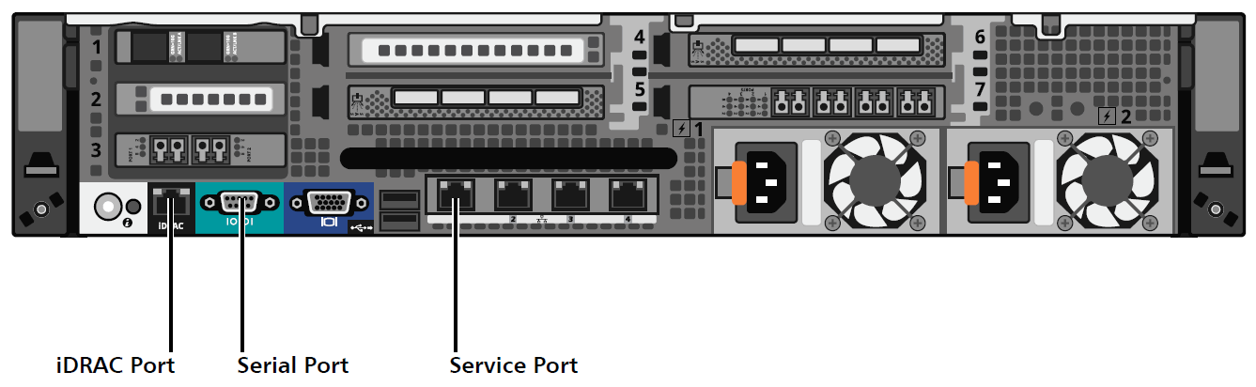
Connecting to the DXi6902 Node
Service Port
  Connecting to the service port allows access to the root command prompt and the Service Menu.
iDRAC Port
  Connecting to the iDRAC port allows access to the iDRAC main console, which provides access to the root command prompt and the Service Menu. The iDRAC main console also allows you to view the boot process, and access the motherboard and RAID controller BIOS settings.
Serial Port
  Connecting to the serial port allows access to the root command prompt and the Service Menu.
Refer to the DXi6902 FSM for setup/connection details.
Note: You can also directly connect a monitor and keyboard.

Slide 34
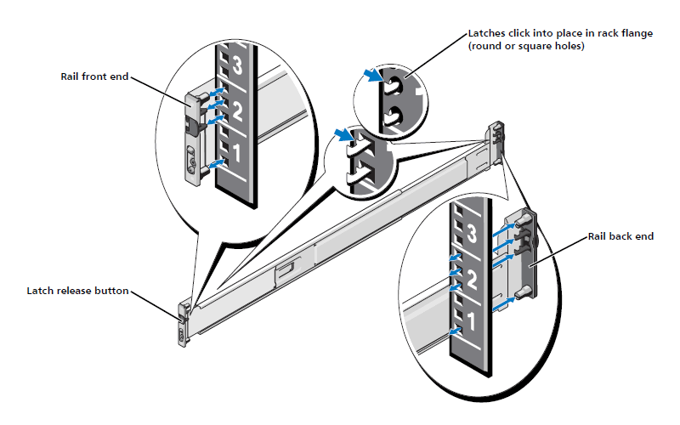
New Rails
Eliminated the NetApp Rail that requires on-site assembly and adjustments for round/square rack types
Dell “ReadyRails” are used on both Dell server and NetApp bulk storage
  Sliding Rails on Dell Server
  Static Rails on NetApp Storage
Dell Rails accommodate square and round rack holes without reconfiguring the rails
Same rails used on DXi4701
A screw assembly is required to secure the Static Rail to on the NetApp Storage
Orderable FRU PN: 9-03803-01

Slide 35
Bulk Data Storage Subsystem
NetApp Tahoe Controller RBOD and EBOD using Ebbets Chassis
NetApp Illinois firmware in the Tahoe controllers.
NetApp turbo PFK pre-installed from the factory.
Does NOT use FIPS compliant disk drives for user data storage (not available from NetApp)

Slide 36



Bulk Data Storage Subsystem – Left side Indicator Details
Enclosure Locate LED
Service Action Required LED
Over Temperature LED
Power LED
Standby LED
LED | Icon | Color | “ON” Behavior
Enclosure Locate |  | White | Indicates the location of the enclosure within the system.
Service Action Required (Summary Fault) |  | Amber | Indicates at least one of the components within the enclosure has detected a fault.
Over-Temperature |  | Amber | Indicates the environmental temperature has reached an unsafe level.
Power |  | Green | Indicates the enclosure has main power.
Standby Power |  | Green | Indicates that the enclosure is in standby mode.

Slide 37
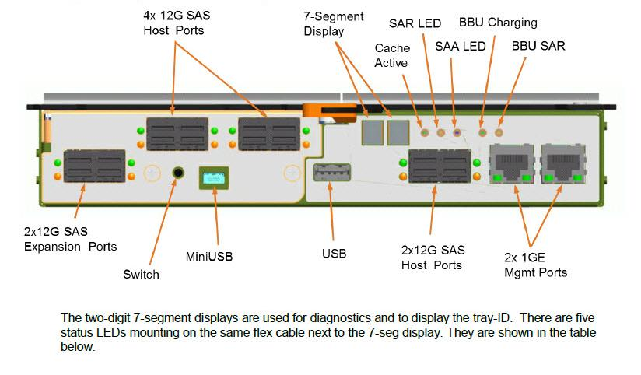
Tahoe Controller Status Display

Slide 38
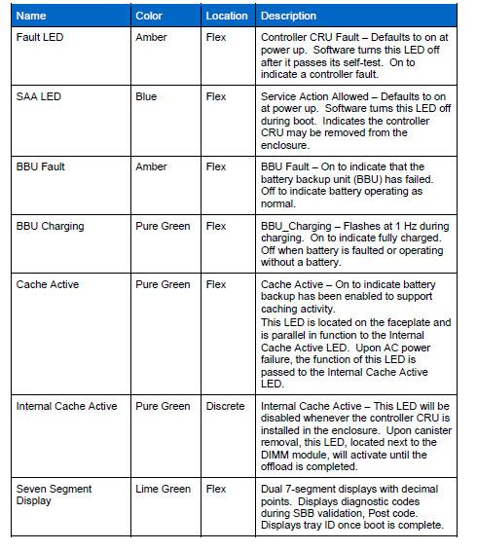
Tahoe Controller LEDs

Slide 39
Tahoe Controller Power Supply Indicators
Standby Power LED glows green to indicate the main DC power is off and that the 5V standby power is on.
DC OUT Good LED glows green to indicate the DC power rails (5V, 12V and 5V standby) are within specified limits.
Service Action Required LED glows amber to indicate a fault when (a) the power cord is plugged in, the power switch is on and the power supply is not correctly connected to the midplane, or (b) power cord is plugged in, the power switch is on, the power supply is correctly seated in the midplane, and a power supply or blower fault or over temperature condition exists.
Service Action Allowed LED glows blue to indicate the power supply can safely be replaced. This LED is not controlled by the power supply but by the enclosure.
DC IN Good LED glows green to indicate input power is being applied to the power supply and the power switch is on.

Slide 40
NVSRAM Secondary Drive SPFA & PFA
The following are the NVSRAM Secondary drive SPFA and PFA errors table. The parameters are very conservative for the original DXi 6902 release and maybe adjusted at a future time of collecting customer data.
# | Error | Enabled? | Fail HDD? | Threshold | Response Time | Time Window
 | SPFA Error:
1 | Sec Drive Recovered Err | y | y | 750 |  | 24 hrs
2 | Sec Drive Media Err | y | y | 8 |  | 24 hrs
3 | Sec Drive HW Err | y | y | 1 |  | 1 hr
4 | Sec Drive Stagnant IO | y | y | 30 | 9 sec | 1 hr
5 | Sec Drive Fast IO Timeout | y | y | 8 | 11 sec | 24 hrs
 | Drive PFA:
a | Drive PFA Err | y | y | n/a |  | n/a

Slide 41
SAS Interconnect – DXi6902 MD Server to RBOD
The SAS cables used are the 8088 to 8644 cable. The RBOD end is 12Gb SAS and the SAS HBA inside the server is 6Gb SAS.
Net App | Net App | 6902 | Cable Length | Cable P/N
RBOD | RBOD | Node | (FT or m)
A | B | Dell
(SAS Ch 1) | (SAS Ch 1) | R720
RBOD1 |  | slot 5 - Port 1 (top connector) | 2 meter
 | RBOD1 | slot 6 - Port 1 (top connector) | 2 meter
RBOD2 |  | slot 5 - Port 2 (2nd connector from top) | 2 meter
 | RBOD2 | slot 6 - Port 2 (2nd connector from top) | 2 meter
FRU Part Number: 9-03804-01

Slide 42
RBOD to Expansion (EBOD) SAS Connection
The SAS cables used are the 8088 to 8644 cable. The RBOD end is 12Gb SAS and the Expansion EBOD end is 6Gb SAS. Cable supplied with RBOD.
Net App RBOD A SAS Drive Expansion PORT1 | Net App RBOD B SAS Drive Expansion PORT1 | Net App EBOD A SAS Host Connector 1 | Net App EBOD B SAS Host Connector 1 | Cable Length (m) | Cable P/N
RBOD1 |  | EBOD1-1 |  | 2 meter
 | RBOD1 |  | EBOD1-1 | 2 meter
RBOD2 |  | EBOD2-1 |  | 2 meter
 | RBOD2 |  | EBOD2-1 | 2 meter
FRU Part Number: 9-03804-01

Slide 43
Expansion (EBOD) to Expansion (EBOD) SAS Connection (cont.)
Same as
6802
DXi6902 uses a standard 6Gb/s (SAS 2.0) 1 meter Mini-SAS cable (SFF 8088) to connect between the Expansion EBODs and Expansion EBODs.
Following is a picture of a typical DXi SAS cable.
FRU Part Number: 9-02217-01

Slide 44
Dynamic Disk Pooling
Same as
6802
DXi6902 will use Dynamic Disk Pools (DDP) for user storage allocation.
Each RBOD or EBOD will have a separate Pool.
Each Pool will be divided into two equal-sized volumes.
Each volume will be represented by a separate SNFS Stripe Group.

Slide 45
AC Power Connection
The following diagram defines the system AC power connection showing only 1 EBOD (as an example).

Slide 46
Power Ratings for complete DXi 6902 System
DXI 6902 Ratings
Item | Value
Input Voltage (volts) | 100-240
R720 Rated Current (amps) | 12-6.5
RBOD/EBOD Rated Current (amps) | 7.0-2.9
R720 Node Operating Current (amps) | 5.9-2.3
NetApp RBOD Operating Current (amps) | 3.3-1.4
NetApp EBOD Operating Current (amps) | 2.3-1.0
R720 Node Operating Power (watts) | 586
NetApp RBOD Operating Power (watts) | 334
NetApp EBOD Operating Power (watts) | 228
System Rated Operating Current (amps) | 43.8-17.5
System Rated Operating Power (watts) | 4076
System Rated Operating BTUs | 13910
Maximum Inrush Current (amps) | 42

Slide 47
DXi SW Version 3.0.0_69
Software Engineers – Jurgen van der Linden

Slide 48
New Software Features
  Based on the DXi 2.3 feature set
  Includes CentOS 6.5 Linux distribution
  Includes StorNext 5.0 file system
  E-Mail Home Changes
  Sends regular status emails to Quantum unless internet connectivity is not available
  Generates an Admin Alert if sending the status email fails
  Provides a mechanism to disable and re-enable sending the status email for situations where internet connectivity is not available.
  Data capture features to enable better Quality metrics
  When the system was first powered up after install
  Downtime and uptime that impact data availability
  Data-in-Flight Encryption (details to follow)

Slide 49
New Software Features
  Supports IBM and HP LTO-6 tape drives for use by Path-To-Tape
  Same as the 8500 on the following configuration limits
  Partitions (64)
  VTDs (512 with 160 active)
  Cartridges (9000 per partition)
  Path-to-Tape Devices (24)
  Maximum Stream Counts (table included in the PRD)
  Will support the stand-alone Full Data Shred utility as implemented in DXi6802 (Encryption based)
  This will be delivered post-GA.

Slide 50
Licensing
Factory enabled features
  NAS: CIFS & NFS
  OST
  VTL with 160 VTDs
  Replication
  Deduplication
  NDMP Path to Tape with 24 PTD
  Base Capacity of 17 TB
Optional Licenses to be installed at Customer site*
  Additional capacity
    Sold as 17TB increments
    Will be a single Auth Code Certificate for total ordered capacity
  Data-at-Rest Encryption (Not available for restricted countries)
    Same license enablement as 6802 (license key and PFK for each RBOD)
  Expanded VTD (special request to service only)
*Note: Actual license is obtained on Quantum.com
http://www.quantum.com/licensekeys/upgrades/index.aspx

Slide 51
Licensing
Data-in-Flight Encryption License
  Existing Feature now enabled by a DXi license
  Enables an ability to turn off encryption capability for systems sold into Russia. This is new Russian restriction.
  The license enables encryption for NAS, OST, Accent, replication, opt-dup and failback.
  We tied this option to TPM vs. non-TPM TLAs
    TPM systems will have this new license installed in the factory.
    Non-TPM systems will not have this new license installed in the factory
  For non-TPM* markets that allow Data-in-Flight Encryption we allow them to select this option and then will deploy an Auth Code Certificate for use at the customer site.
  We append “.nenc” to the software version displayed by the GUI if this license is not installed. This is a Russian requirement.
*Note: To make matters terribly confusing non-TPM restricted countries do not allow Data-at-Rest Encryption but China does allow and desire Data-in-Flight Encryption.

Slide 52
Deduplication Highlights
Improved BLOB stitching performance via deferring BLOB stitching
  PTR 38584 - Reduces the need to disable BLOB stitching
Cluster Verification improvements
  PTR 33064 - cluster header may not correctly rebuild
Performance Improvements
  Improved index disk cache performance for random reads
  Boot-time index load is now done in the back ground. Significantly faster reboots and availability for start of ingest

Slide 53
Deduplication Highlights (cont)
Robustness Improvements
  Reference count verify adds a placeholder for missing blocklets, preventing replication of known corrupt data - PTR 35895
  Remove clusters from integrity journal once verified successfully, improves system usability during blobtree repair

Slide 54
PTO Software
New boot time installer menu, perform a PTO install.
  Installs Base and App as usual, but DXi software will not activate/configure as it normally would after an App install.
System will boot into PTO mode, regular Linux command line, DXi stack will not run.
MFG does their node tests, shutdown, shelf or ship.
At customer site,
  assemble,
  boot,
  use service PTO menu to
    detect hardware,
    check hardware,
    RAID init,
    activate the DXi software
    start the DXi stack.

Slide 55
Service Menu PTO
*** Pick to Order Menu ***
0) Discover Hardware - Step 0.
1) Check Hardware >>> - Step 1.
2) RAID initialize - Step 2.
3) Software initialize - Step 3.
4) Finalize PTO - Step 4.
5) -----------------------------
6) Enable PTO - Stop DXi stack, switch into PTO mode.
7) Disable PTO - Turn off PTO mode, enable DXi stack.
8) Reset PTO - Start over with PTO.
9) -----------------------------
10) Show Tickets - Show Admin and RAS Tickets.
11) Clear Tickets - Delete Admin and RAS Tickets.

Slide 56
Maximum Stream Counts

Slide 57
Manufacturing
Installation & Upgrade
Program Management – Bill Weakley

Slide 58
Manufacturing Build Strategy
Pick to Order (PTO) is our strategy that enables generic modules to be pre-built to support short lead-time order fulfillment.
  Introduced on the 4701
  Fixed BOMs (not configurable) that can be pre-built
  Each building block will be prebuilt into finished goods.
  Once customer order arrives, the factory pulls the needed finished good assemblies to complete the order.
  At the customer site, the assemblies are installed and configured into the customer’s final configuration.
  Leverages the same modules for field upgrades and new systems
Configure To Order (CTO) is used on older existing products which drives a complete system build to specific sales order
  DXi6700, DXi6802, DXi8500
  Limits manufacturing capacity
  Increases lead-times
  Requires separate field upgrades from new systems

Slide 59
PTO Generic Modules Built in Factory
New system
    Node
    Node (non-TPM, non-SED)
    RBOD Storage
    RBOD Storage (non-SED)
    EBOD Storage
    EBOD Storage (non-SED)
New and Optional Items
    Additional Quad 1GbE HBA
    Additional Dual 10GbE HBA with SPF+Optical
    Additional Dual 10GbE HBA with Twinax
    Data-at-Rest Encryption Certificate (TPM BOM only)
    Data-in-Flight Encryption Certificate (non-TPM BOM only)
Memory DIMMS
Capacity license authorization codes
Cabling Kits

Slide 60
Order & Delivery Details – System
 | Customer Orders This: |  |  |  | Customer Receives This:
 | Select Base |  | DXi6902, 17TB Licensed |  | DXi6902, 17TB Licensed Base (without storage array)
 |  |  | DXi6902, 17TB Licensed, non-TPM
 | Add additional capacity |  | 17 TB Capacity Increment Quantity 0 to 29 |  | A single Capacity License Authorization Certificate with the total Capacity (17TB, 34TB, 51TB, 68TB... …476TB, 493TB)
 |  |  |  |  | RBOD (Encryption or non-encryption) (34TB Expansion HW) Qty 1 or 2
 |  |  |  |  | EBOD (Encryption or non-encryption) (34TB Expansion HW) Qty 0 to 13
 |  |  |  |  | 128GB Memory Upgrade Qty 0 or 1
 | Select 10GbE Cable type |  | 10 GbE Optical |  | Two Cables either Twinax or Optical used with the two 10GbE ports always resident on the base
 |  |  | 10 GbE Twinax
All separate components to be
installed at customer site
Hardware added to the kit based on capacity ordered

Slide 61
Order & Delivery Details – Optional Items
Customer Orders This:
Customer Receives This:
Optional Items |  | 10 GbE Dual Port Optical |  | 10 GbE Optical or Twinax with two corresponding cables included; or 1 GbE quad port NIC
 |  | 10 GbE Dual Port Twinax
 |  | 1 GbE Qaud Port
 |  |  |  | Data-at-Rest Encryption License Authorization Certificate 272TB of Less
 |  | Data-at-Rest Encryption (not available on non-TPM BOM) |  | OR
 |  |  |  | Data-at-Rest Encryption License Authorization Certificate 289TB or More
 |  | Data-in-Flight Encryption (non-TPM BOM only, Russia can't have this; default is "not included" for restricted countries. Other restricted countries, such as China, can order and enable during install) |  | Data-in-Flight Encryption License Authorization Certificate
All separate components to be installed at customer site

Slide 62
Manufacturing the Server Assembly
Server components are purchased from Dell
Integration takes place at Avnet
Quantum developed the Manufacturing test software
Mfg Test powers, levels FW, validates the integration, loads the DXi software and applies factory licensing
Purchased Components | Qty | Supplier | Factory Strategy
R720XL server (No PCI cards) | 1 | Dell | Purchased
Dual 8Gb FC HBA | 1 | Dell | Integrated in mfg
Quad 8Gb FC HBA | 1 | Dell | Integrated in mfg
Quad 6Gb SAS HBA | 2 | Dell | Integrated in mfg
Optional Dual 10GbE SFP+ NIC | 1 | Dell | Integrated in mfg
Optional Quad 1G NIC | 1 | Dell | Separate Customer Kit
Licensing | 1 | QTM Test | Various
DXi6902 Bezel | 1 | Dell | Added to the Accy Kit
Labels | Few | Avnet | Integrated in mfg
Document | Few | Avnet | Added to the Accy Kit
Cables | Few | Avnet | Added to the Accy Kit

Slide 63
Manufacturing the Storage Assemblies
Storage components are purchased from NetApp
Integration takes place at Avnet
Quantum developed the Manufacturing test software
Mfg Test powers, levels FW and validates the integration
Purchased Components | Qty | Supplier | Factory Strategy
RBOD Dual Controllers | 1 | NetApp | Purchased
EBOD Dual ESM | 1 | NetApp | Purchased
Drives | 12 | NetApp | Integrated in mfg
Turbo PFK | 1 | QTM KIOSC | Integrated in mfg
Rails | 1 | Dell | Added to the Accy Kit
Labels | Few | Avnet | Integrated in mfg
Document | Few | Avnet | Added to the Accy Kit
Power Cords | 4 | NetApp | Purchased w/BODs
Cables SAS mini cable | 2 | Avnet | Purchased w/BODs

Slide 64
Installation Engagement
  Full systems require service installation
  Physical storage expansions require service installation
Customer installable options include:
  Additional Quad 1GbE HBA
  Additional Dual 10GbE HBA with SPF+Optical or Twinax
  Data-at-Rest Encryption
  CoD Storage License (no HW needed)
  Future Software Upgrades
  Data-in-Flight Encryption
  Expanded VTDs

Slide 65
Installation Highlights
All the hardware can be built together before initial power-up
  Including multiple expansion trays being connected at once
Initial bring-up will include initializing the expansion disk pools
Initializing the disk pools will happen in the back-ground with minimal performance impact
All the expansion storage will be available for use while initializing
Initialization takes place generally in the first 24 hours.
A single capacity license can be applied after expansion
No system rack is included

Slide 66
Installation Process: Whole System
Unpack and Prepare
  Verify all necessary components are present (more segregated with PTO)
  There is a component table in the Installation Guide
Install Additional Hardware in the Node
  Systems 119 TB or greater, add an additional 128 GB of memory
  Install optional Ethernet cards
Integrate all the modules into the Rack
  Determine the order and locate the mounting positions
  Cable per instruction diagrams
  Notice the improved (Dell) rails on the NetApp storage modules
Initialize the Software and Storage
  Access the Service Menu
  Perform Pick to Order (PTO) configuration
Perform Initial Configuration
  Getting started wizard
  Connect Ethernet
  Install licensing
Refer to the Installation Guide part number 6-68160-01 RevB

Slide 67
Capacity Expansion Strategy
Distinction between two types of capacity
  Physical storage capacity
  Licensed storage capacity
Physical Storage Capacity
  Determined by the number of RBODs and EBODs installed in the system
  Each module provides 34 TB of formatted storage capacity
Licensed Storage Capacity
  The amount of storage capacity the customer is allowed to access and use
  Storage capacity is licensed in 17 TB increments
  2 per physical storage module
Most upgrades will require additional physical storage capacity
  “Capacity on Demand” License only if they have unlicensed storage already attached (should only be 17TB)
Additional memory for the node for 1R3E and above

Slide 68
Capacity Points
Useable Capacity (TB) | Dell R720 | Dell Memory | NetApp RBOD | NetApp EBOD | Turbo PFK (included) | Encryption PFK (Option)
17 or 34 | 1 | 128GB | 1 | 0 | 1 | 1
51 or 68 | 1 | 128GB | 1 | 1 | 1 | 1
85 or 102 | 1 | 128GB | 1 | 2 | 1 | 1
119 or 136 | 1 | 256GB | 1 | 3 | 1 | 1
153 or 170 | 1 | 256GB | 1 | 4 | 1 | 1
187 or 204 | 1 | 256GB | 1 | 5 | 1 | 1
221 or 238 | 1 | 256GB | 1 | 6 | 1 | 1
255 or 272 | 1 | 256GB | 1 | 7 | 1 | 1
289 or 306 | 1 | 256GB | 2 | 7 | 2 | 2
223 or 340 | 1 | 256GB | 2 | 8 | 2 | 2
357 or 374 | 1 | 256GB | 2 | 9 | 2 | 2
391 or 408 | 1 | 256GB | 2 | 10 | 2 | 2
425 or 442 | 1 | 256GB | 2 | 11 | 2 | 2
459 or 476 | 1 | 256GB | 2 | 12 | 2 | 2
493 or 510 | 1 | 256GB | 2 | 13 | 2 | 2

Slide 69
Upgrade Kits Built in Factory
Capacity Upgrade Items
    RBOD Storage
    RBOD Storage (non-SED)
    EBOD Storage
    EBOD Storage (non-SED)
    Memory DIMMS
Other Install Base Upgrade options
    Additional Quad 1GbE HBA
    Additional Dual 10GbE HBA with SPF+Optical
    Additional Dual 10GbE HBA with Twinax
    Data-at-Rest Encryption Certificate (TPM only)
    Data-in-Flight Encryption Certificate (non-TPM only)
    VTD (352) Upgrade License (Service deployment only)
Capacity license authorization codes
Capacity Upgrade Accessory kit
  (Doc Guide, ESD Strap)
Capacity Upgrade Cable Kit
Data-at-Rest Encryption PFK
  (if they already have the feature)

Slide 70
Installation Process: Capacity Upgrade
Shut Down the System
  Before adding the Storage modules
Install Additional Memory in the Node
  Systems 119 TB or greater, add an additional 128 GB of memory
Unpack and Prepare the Storage Modules
  Verify all necessary components are present (more segregated with PTO)
  There is a component table in the Capacity Upgrade Guide
Integrate all the modules into the Rack
  Determine the order and locate the mounting positions
  Cable per instruction diagrams
Add the new Storage to the System
  Access the Service Menu
  Perform Hardware configuration: Setup Storage
  The system will detect the storage and begin background initialization
  Install licensing
Refer to the Capacity Upgrade Guide part number 6-68162-01

Slide 71
Installation Process: Licensing
Storage Capacity License
  Certificate included with the delivered kit
  Certificate will be for the total additional system capacity
    Base already has 17TB licensed
  Continues to use the Quantum.com licensing website
  Storage is only available after the license is installed
Data-at-Rest Encryption License
  Certificate included with the delivered kit
  Will need to apply a DXi license key and upload a PFK file
Data-at-Rest Encryption License: Upgrade
  If Data-at-Rest Encryption is enabled on the DXi6902 and you added a new RBOD to the system, you must upload a Data-at-Rest Premium Feature Key (PFK) file to the new Array Module. The PFK file is required to encrypt the hard drives in the new Array Module and in any attached EBODs.
Data-in-Flight Encryption License
  Certificate included with the delivered kit
  Will need to apply a DXi license key (no PFK)

Slide 72
Quality
Supplier Quality Manager – Rick Courrau
Product Quality Manager – Dave Thomas

Slide 73
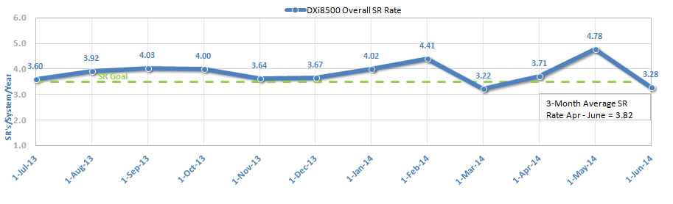
Metrics
DXi6902 First Year SR Rate Goal is <3.0 SR/SYS/YEAR
  DXi8500 goal is <3.5 (currently 3.82), DXi6802 goal is <2.5 (currently 1.94)

Slide 74
Bug Fixes, Improvements
  RCV Improvements, Bugs 39796, 39797, 39798, 39799:
  When a negative Reference Count is detected, 3.0 will limit tenure to the immediate cluster only (which is up to 12 MB for the affected blocklet). Previous releases tenured the entire Blockpool.
  RAS ticket text toned down to reflect lower urgency (still a severity 1 alert)
  Forensic logging added to help diagnose the source of RC inconsistencies
  Multi-threaded RCV significantly improves RCV run time (30%+ reduction)
  Serviceability Enhancement, Capacity Exp Bug 38703:
  EBOD addition won’t be permitted if Qarray RBOD has not been added
  Factory Process Improvement, DOA BBU Bug 37573:
  Sleep Mode set after system test to prevent premature BBU discharge

Slide 75
Known Issues
  335 of 418 Bugs Found in Eng Tests Fixed or Resolved
  See 3.0 Release Notes for deferred bugs & known issues, PN 6-68166-02
  BBU Failures Reported in DVT, Bug 39261
  BBUs failed during course of tests, unlike DXi6802 DOA field failures
  1 BBU failed for “cell imbalance” issue. Balancing function is now disabled.
  Suspect BBU have been quarantined at Avnet Fresh-lot and FRU stock
  4 failed due to false overcharge error. Controller FW fix will be in next MR.
  TSBs will be issued for 6 Bugs
  27486: Request for mechanism to reset the GUI admin password
  37652: Deleting user via syscli with CIFS mounted, can’t add/del user
  39053: OST NBU jobs may fail under heavy loads on Unix media servers
  39728: NBU reports “External event caused rewind during write, data lost”
  39766: GUI has wrong storage array controller status for SAS cable pull
  39853: Kernel stack trace from 10G igxbe driver & NS replication failure

Slide 76
Quality Initiatives
  Knowledgebase, Customer Self-Help Improvements
  KB Content: Address top 20% of customer issues to resolve 80% of calls
  KB Tools: Effective search engine, ease of accessibility and usability
  KB Metrics: Track page views, search engine accuracy, customer sat.
  Request Service/Support teams’ help to identify top issues and content
  Share information used to resolve issues and get customers back on track
  Product Caused versus Non-Product Caused SR
  Product Quality Metrics traditionally discounted non-product related issues
  Focus shifting from product caused SR to all issues impacting experience
  General questions, customer caused, duplicate SRs impact TS resources
  Need details in Resolution Summary that clearly define SR cause/actions
  Example: “Fixed AIX/TSM config +IBM TSM support provided procedure for detecting robots and proper device drivers to customer + using hp drives emulation.”

Slide 77
Avnet Executive Dashboard Summary
Disk Products
Product | Fresh Lot |  | Comments
Product Line | Yield | Status | Notes
DXi4701 | 87% | Green
DXi6700 | 72% | Green | ↑ 2%
DXi6802 | 73% | Green | ↑ 3%
DXi8500 | 13% | Yellow | Low volumes
StorNext G-Series | 63% | Green
StorNext Q-Series | - | N/A
StorNext M-Series | 52% | Green
Scalar LTFS | - | N/A

Slide 78
Documentation and Training Updates
Information Solutions – Mark Anthony

Slide 79
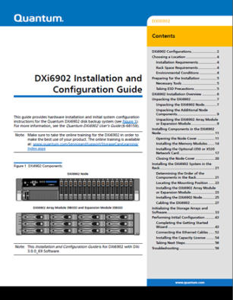
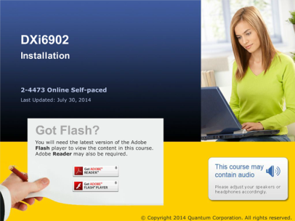
Information Solutions Updates
Mark Anthony, Alex Duncan,
and Jim Bell

Slide 80
Documentation for Customers and Service
DXi6902 Site Planning Guide (New)
DXi6902 Installation and Configuration Guide (New)
DXi6902 User’s Guide (New)
DXi6902 Online Help (New)
DXi6902 User Essentials (New)
DXi-Series 3.0.0_69 Release Notes (New)
DXi6802 and DXi6902 CRU Instructions (Updated)
  Hard Drives, Power Supply, and Rack Mount Rails
DXi Advanced Reporting Documentation (Updated)
  User’s Guide, Online Help

Slide 81
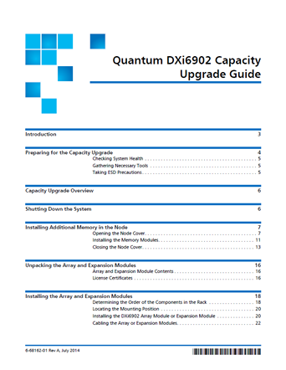
Documentation for Service Only
DXi6902 Capacity Upgrade Guide (New)
DXi6902 Field Service Manual (New)
DXi-Series 3.0.0_69 Software Installation and Upgrade Guide (Updated)
  Fresh installs of 3.0.0_69
DXi6902 At a Glance document (GCH) (New)

Slide 82
Training Resources for Customers
DXi-Series Customer Orientation (1-4456 Virtual Class)
  Introduction to DXi systems including core concepts, best practices, Quantum tech support, resources on quantum.com, use of Quantum DXi technical documents, configuration videos, online service tools.
DXi-Series Configuration and How-To videos (2.3.x)
  12 videos on YouTube QuantumKnowHow channel
DXi-Series Core Concepts Explained
(6-66757-02 document) (Updated)

Slide 83
Training Resources for Service
DXi6902 Installation (2-4473 Online Self-Paced) (New)
  Hardware installation
  Initial configuration
  Troubleshooting the installation
  Customer handoff
DXi6902 Curriculum (C-2-4474):
  DXi6902 Installation (2-4473 Online Self-Paced) (New)
  DXi-Series Core Concepts (2-0443 Online Self-Paced) (Updated)
  DXi-Series Installation and Hardware Replacement (2-0413 Classroom) (Updated)
  DXi-Series 2.x Configuration (2-2482 Online Self-Paced)
  DXi-Series 2.x Configuration Hands-on Practice (3-2432 Virtual Class)
  DXi-Series Linux CLI Basics (2-4453 Online Self-Paced)
  DXi Advanced Reporting Service Training (2-2412 Online Self-Paced)
  Stay Current: DXi-Series Service Updates and Configuration Demos
  (2-3420 Online Document)

Slide 84
Training Resources for Service Partners (TPMs)
DXi6902 Installation (2-4473 Online Self-Paced) (New)
  Hardware installation
  Initial configuration
  Troubleshooting the installation
  Customer handoff
DXi-Series Service Partner Training (2-4459 Virtual Class) (Updated)
DXi-Series Core Concepts (2-0443 Online Self-Paced) (Updated)
DXi-Series Linux CLI Basics (2-4453 Online Self-Paced)

Slide 85
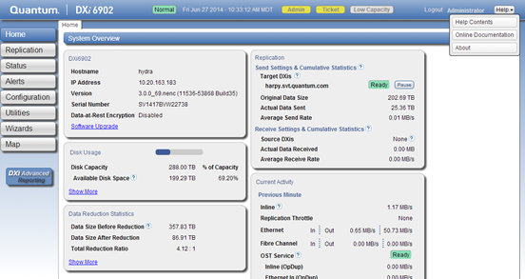
Accessing Resources from GUI
In DXi6902 GUI, click Help > Online Documentation
Links to DXi6900 Series Support Page at:
  http://www.quantum.com/dxi6900docs

Slide 86
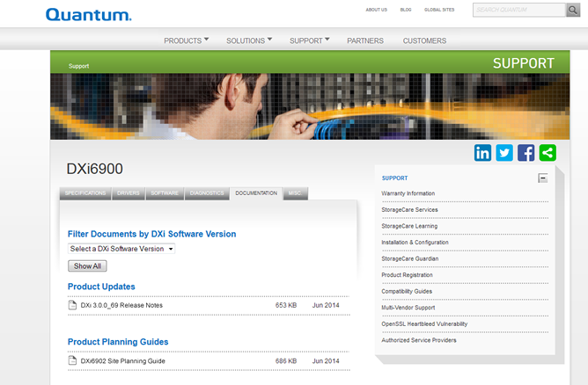
DXi6900 Series Support Page
Product documentation
How-to videos

Slide 87
Service Model
Service NPI – Jim Hibbard

Slide 88
Service Model Summary
Case Management:
  Global Call Handling (GCH), CDS, Kuala Lumpur
Technical Support:
  Advanced Solutions Product Support (ASPS)
  Dell and NetApp Technical Support can be leveraged for diagnostics assistance.
Field Support:
  We will entitle field support with the TPMs.
  QFEs will be leveraged for onsite installations.
Escalation Support:
  Dell Technical Support, NetApp Technical Support, Service Engineering Specialists (SES), DXi Sustaining Engineering (SUS), Regional Technical Specialists (RTS)
Replacement Part Fulfillment:
  Mixed CRU and FRU model
  Dell server node FRUs are ordered from Dell.
  NetApp Storage Modules are ordered from Quantum (Choice Logistics)
  Refer to the Logistics Parts Catalogue or Customer Self Service Portal (CSSP) for a list of FRUs and CRUs.
Refer to the Service Plan for details.

Slide 89
Third Party Maintainer (TPM) Engagement
TPMs will be used more and more for onsite efforts.
TPMs will charge T&M for activities they’re not contracted to do.
Our Strategy
  Avoid time and materials TPM engagement
Guidelines for what is currently covered by TPM maintenance contracts:
  TPMs are contracted for onsite break fix activity. This is basically the replacement of FRUs and CRUs deemed necessary by Quantum ASPS.
  FW upgrades for known bug fixes. (TBD, currently under negotiation)
Guidelines for what is NOT currently covered by TPM contracts:
  Onsite installations. Instead QFEs/TAMs will be leveraged.
  Proactive SW/FW Upgrades
  Onsite Troubleshooting/Diagnostics – If ASPS requires additional onsite troubleshooting, QFE/TAM should be dispatched to site.

Slide 90
Service Offerings
Standard Warranty
  WARRANTY – One-Year Warranty. Service Requests (SRs) can be submitted via Quantum's Online Service Request Form or telephone 24x7x365. SRs will receive a response no later than the next business day. Telephone support will include diagnosis of covered warranty issues and parts replacement. Replacement Parts will be shipped within one business day of Quantum's determination that a replacement part is required. Customer will perform the replacement and return of all identified CRU components. Identified FRU components will be replaced onsite by a QFE/TPM with a next business day onsite response.
Warranty Uplifts, Extensions, and Renewals (all CRU based)
  BRONZE SUPPORT PLAN
  NEXT BUSINESS DAY GOLD
  GOLD SUPPORT PLAN
  Supplemental Uplift: Bronze and NBD Gold Support Contract uplift for customers that require Quantum resources to replace all field replaceable components independent of CRU vs. FRU.
  Annual renewals and extensions are available (Bronze, NBD Gold, and Gold)
Installation and Integration Services
  DXi6902 is not customer installable. Installation and Integration services will be offered for a fee.
NOTE: Quantum’s standard warranty from Dell on every R720 System Node and parts will be 3 years of ProSupport for OEM w/4hour Onsite.

Slide 91
FRU/CRU Strategy
Component / Module | Hot Swap CRU | CRU | FRU
Server PSU | Y
External Storage (RBOD/EBOD) PSU | Y
Server HDDs | Y
External Storage HDDs | Y
External cables |  | Y
DXi software updates |  | Y
Data-at-Rest Encryption License |  | Y
RBOD Controllers |  |  | Y
EBOD ESM |  |  | Y
Server Fans |  |  | Y
Ethernet interface cards |  |  | Y
FC Interface cards |  |  | Y
SAS HBA |  |  | Y
Internal RAID Controllers |  |  | Y
Battery Backup for RBOD Controller |  |  | Y
Memory Modules |  |  | Y
Chassis: Server |  |  | Y
Chassis: External Storage |  |  | Y
Various Server components defined by Dell |  |  | Y
FRU/CRU list posted on CSWeb ( part number 6-68158-01)
Most CRUs are limited by a single failure in the system. Multiple simultaneous failures require service support as a FRU.

Slide 92
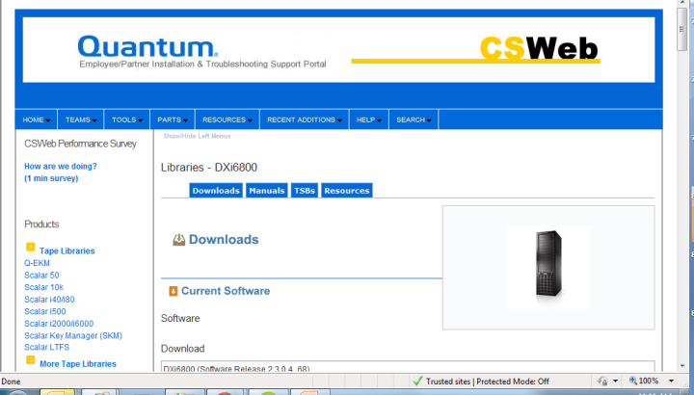
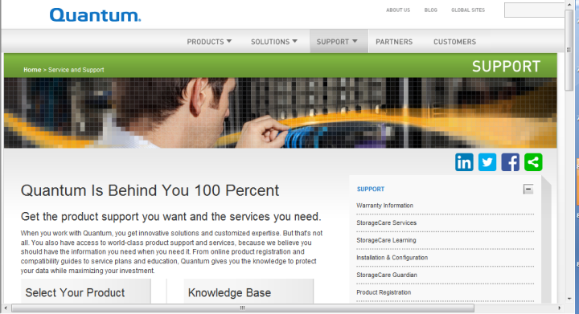
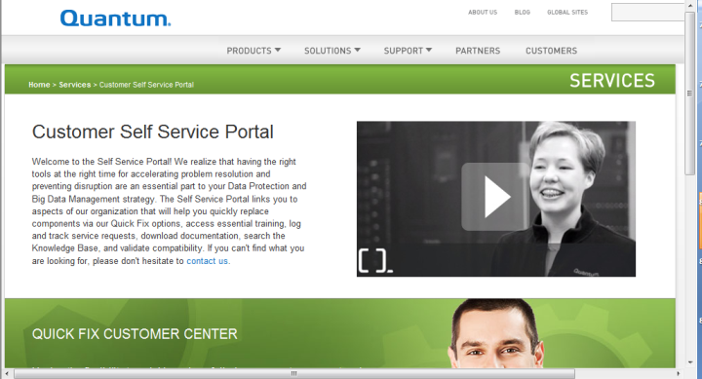
Online Postings
CSWeb
  Docs, SW, Utilities, Training Courses
  Service Plan
Quantum.com
  Customer-facing Docs
  DXi SW with serial number validation and contract check
Customer Self Service Portal (CSSP)
  CRUs with access to replacement procedures
  Continue to evangelize with Customers…

Slide 93
DXi SW Upgrades (reminder)
Recall that DXi SW is customer upgradeable via the GUI SW Upgrade Utility (introduced in DXi SW version 2.3).
  Customers connected to the internet can receive alerts, download .FW upgrade files, and initiate a DXi SW upgrade from the DXi SW GUI
  OR (if not connected to the internet)
  Customers can download .FW files, from an internet-connected machine, on Quantum.com and point the GUI SW Upgrade Utility to the .FW file to upgrade their system
We should continue to evangelize this with customers and remind/recommend customers that they can upgrade their DXi SW.

Slide 94
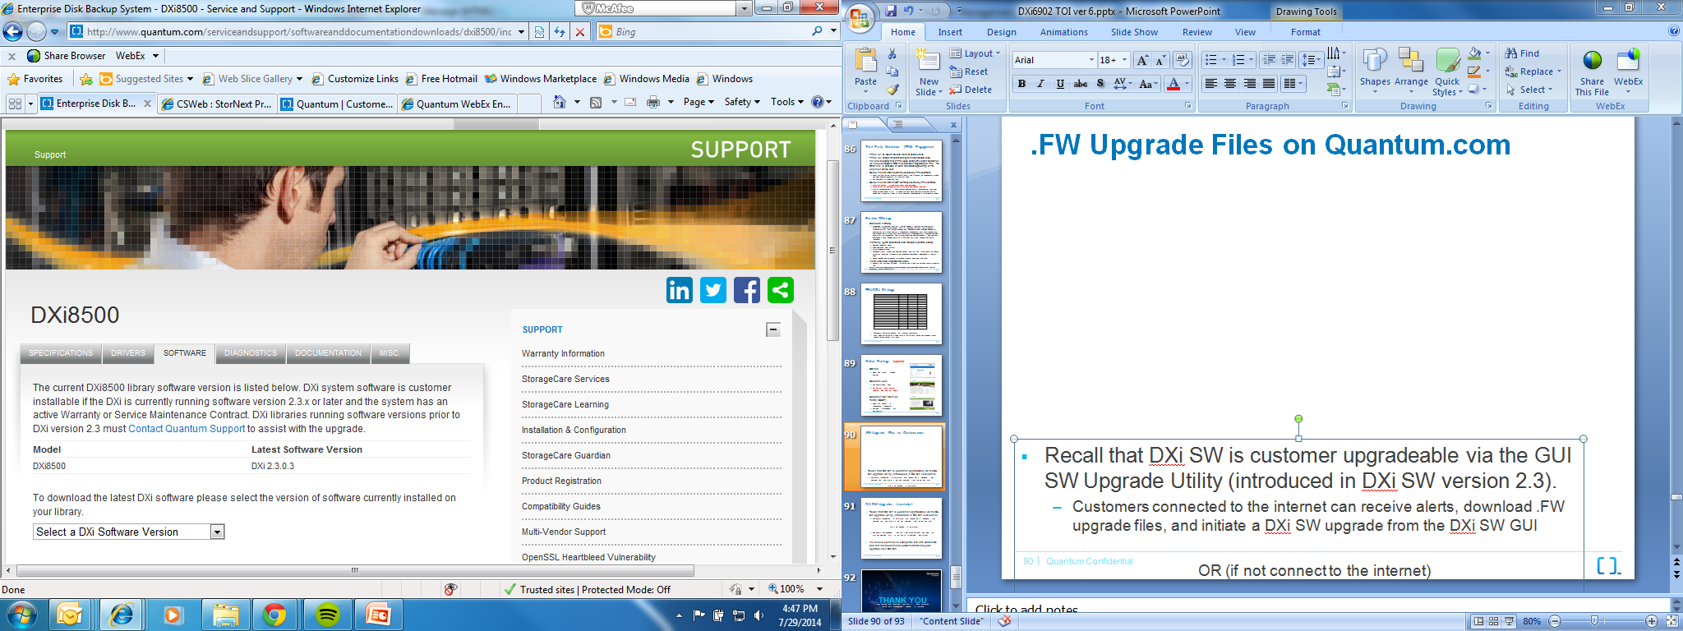
.FW Upgrade Files on Quantum.com
.FW upgrade files are now located on Quantum.com
Customers are advised that minimum required version is 2.3
Customers will need to enter a valid DXi serial number
  Service contract is validated. If valid, access to the .FW file is granted.

Slide 95
THANK YOU
For meeting with Quantum, the LARGEST Data Protection
and Big Data management specialist in the world.
© 2013 Quantum Corporation. Company Confidential. Forward-looking information is based upon multiple assumptions and uncertainties,
does not necessarily represent the company’s outlook and is for planning purposes only.

