Slide 1
DXi6900-S TOI for Global Service
(Red Rock Program)
September 2016

Slide 2
Agenda
Product Overview
Technical Overview
  DXi6900-S
  RMAN Plugin
  RMAN and LDAP
Training and Documentation Updates
Service Model
Notes:
  Please ask questions as we go
  Please mute your phone line unless asking a question
  Recording will be posted on Qwikipedia

Slide 3
Product Overview
Mike Simone– Product Management

Slide 4
DXi6900-S and Red Rock Software Schedule
 | v3.2.4 | v3.2.4.1 | V3.2.5
When Released | 2 SEP 2016 | 21 SEP 2016 | Late Nov-Early Dec ‘16
Platform | DXi6900-S | DXi6900-S | DXi6900-S DXi6900 DXi4700
New Features | DXi6900-S platform | RMAN | RMAN LDAP/AD

Slide 5

DXi6900-S Red Rock Program Objectives
Introduce a DXi6900 model with SSDs for High-Performance: at least 3X sustained performance gains over the DXi6900
Reduce footprint and Power requirements by introducing 8TB HDD for bulk storage
  Accent for Oracle Recovery Manager (RMAN) integrating DXi with the most popular enterprise class database
  Plugin at the Oracle server provides tighter integration for DB administrators
  Adds to current DXi + RMAN support via:
    NAS for native RMAN backup
    NAS and VTL when RMAN is used in conjunction with a tier-one backup application
  Adds flexibility to move to all RMAN solution rather than use a tier-one backup app
  Reduced bandwidth and increased performance because data is deduplicated at the Oracle server rather than at the DXi
  Creates feature parity with our biggest competitors that provide plug-in for RMAN

Slide 6
DXi6900-S Red Rock Program Objectives (cont.)
LDAP/AD Support
  Lightweight Directory Access Protocol/Active Directory
  LDAP allows integration with enterprise-wide account and role management, enabling centralized management of any user authorized for DXi administration or monitoring
  LDAP/AD supports security conscious customers who wish to minimize local account management and account sharing
  LDAP (Linux) or AD (Windows/Microsoft) servers are supported

Slide 7
Product Overview – 6900-S High Performance System
High performance node with SSD
Higher capacity storage shelves: 68TB useable licensed in 34TB increments
Fewer shelves because of higher capacity per self
No memory expansion required; all memory delivered in initial install
New maximum capacity of 544TB

Slide 8
Product Overview – General Software Requirements
8TB HDD in the NetApp Raid requires a new RAID initialization on the drives in the node and supports a maximum of 544TB
New Blockpool to support
  SSD RAID configuration
  Metadata space to enable the 8TB storage architecture
Upgrade expansion improvements
  Reduce the number of reboots
  Will allow faster and easier expansion of any combination for multiple trays.
New Model Brand on GUI is 6900-S

Slide 9
Red Rock Software Deployment by Platform
 | v3.2.4 | v3.2.4.1 | V3.2.5
6900-S | Factory FRU image | .FW upgrade from FRU image | .FW upgrade for controlled release YUM upgrade available at GA
DXi4700 and DXi6900 | Not Supported | Not Supported
Any DXi Running v1.X or v2.X SW | Not Supported | Not Supported | Not Supported

Slide 10
DXi6900-S Licensing
Changes:
  New Model Brand on GUI is 6900-S
  Base node and capacity starting at 34TB
  Capacity expansion in 34TB increments
  Data in Flight – license now field installed
Not Changing:
  Data-at-Rest Encryption
  One, two, or three interface cards of any of the following:
    10GbE Optical
    10GbE twinax
    10GbE 10GbaseT
    16Gb FC
  Dedup, NAS, VTL, Replication, PTT, OST included

Slide 11
DXi6900 Product Family at a Glance
 | DXi6900 | DXi6900-S
Daily sustained backup performance at steady state | Up to 30TB/day | Up to 90TB/day
Maximum capacity | 510TB | 544TB
Minimum capacity | 17TB | 34TB
COD | Yes, 17TB increments | Yes, 34TB increments
Rack Units for Max. Capacity | 32U (1 Node, 2 RBOD, 13 EBOD) | 18U (1 Node, 2 RBOD, 6 EBOD)
Disk Size | 4TB | 8TB
Dynamic Disk Pooling in External Storage | Yes
Encryption at Rest | Yes, option
Connectivity | 6 optional ports available for any combination of 16Gb FC, 10GbE optical/twinax/10GbaseT
Power | Node: 613 Watts, 6.1A @100 VAC 2000 BTU/hr 613 Watts, 2.6A @240 VAC 2000 BTU/hr Array Module (JBOD): 334 Watts, 3.3A @100 VAC 1140 BTU/hr 334 Watts, 1.4A @240 VAC 1140 BTU/hr Expansion Module (EBOD): 228 Watts, 2.3A @100 VAC 780 BTU/hr 228 Watts, 1.0A @240 VAC 780 BTU/hr | Node: 468 Watts, 4.7A @100 VAC 1597 BTU/hr 468 Watts, 1.9A @240 VAC 1597 BTU/hr Array Module (RBOD): 276 Watts, 2.8A @100 VAC 942 BTU/hr 276 Watts, 1.2A @240 VAC 942 BTU/hr Expansion Module (EBOD): 168 Watts, 1.8A @100 VAC 780 573 BTU/hr 168 Watts, 0.8A @240 VAC 780 573 BTU/hr

Slide 12
DXi6900 Co-brand Update
DXi6900 co-brand is an option that includes DXi6900 node installed with NetApp 4TB branded HDD primarily in EMEA
Not supported on the DXi6900-S
NetApp has EOL’d 4TB NetApp SED drives which forces Quantum to EOL the DXi6900 SED and data-at-rest encryption for co-branded
Co-branded DXi6900 will still be sold with NetApp 4TB non-SED drives
Capacity Expansions will be provided with non-SED expansions made possible because there are no data-at-rest encryption co-branded systems installed
FRU disk will be available for NetApp non-SED and Quantum branded SED drives

Slide 13
Technical Overview
Jurgen van der Linden/Felix Blyakher/Byron Hack/Ken Dickerson

Slide 14
Technical Overview Agenda
DXi6900-S
RMAN Plugin
RMAN and LDAP

Slide 15
6900 Family Hardware Configuration Summary
6902 | 6900 G2 (Configurable Connectivity) | 6900-S (High-Performance)
Connectivity Included with some optional 10GbE | G2 indicates introduction to new Configurable Connectivity & 16GB FC | Indicates High-Performance with 8TB Storage
Base System: Node R720 w/900GB HDD (16) 17TB licensed RBOD – 4TB | Base System: Node R730 w/1.2 TB HDD (16)(6or12Ggbs) 17TB licensed RBOD – 4TB | Base System: Node R730 w/800GB SSD (13) 34TB licensed RBOD – 8TB
Processor: Original | Processor: Existing | Processor: Existing
Memory: Expandable 128GB min to 256GB total @3rd EBOD | Memory: Expandable 128GB min to 256GB total @3rd EBOD | Memory: All included 256GB
Factory SW: EOL | Factory SW: 3.2.0.2 FRU-Image | Factory SW: Red Rock FRU-Image
IB Record: “6902” Node Description | IB Record: “G2” Node Description | IB Record: “6900-S” Node Description
Capacity Upgrades: 17TB license increments RBODs/EBODs - 4TB HDDs 510TB Max R+7E+R+6E | Capacity Upgrades: 17TB license increments RBODs/EBODs - 4TB HDDs 510TB Max R+7E+R+6E | Capacity Upgrades: 34TB license increments RBODs/EBODs - 8TB HDDs 544TB Max R+E+R+E+E+E+E+E
Conversion: 8Gb to 16Gb | Conversion: none | Conversion: none
Co-Brand Support | Co-Brand Support | No Co-Brand Support

Slide 16
6900 Family Configuration Comparison

Slide 17
DXi6900-S Building Blocks

Slide 18
DXi6900-S System Block Diagram

Slide 19
6900-S Node RAID
6900 G1/G2:
  7x RAID1 + 2 hotspares. 1x RAID1 for boot, 6x RAID1 for metadata
6900-S:
  (11+2) RAID6, LUN carving (similar as the 4700)
    Boot LUN
    StorNext blockpool journal LUN
    StorNext bulkdata journal LUN
    StorNext blockpool metadata LUN
    StorNext bulkdata metadata LUN
    Blockpool metadata LUN
  SSD quantity and RAID selected based on:
    Required amount of disk space
    Sufficient over-provisioning (combat wear)
    Performance

Slide 20
6900-S SSD wear-out
SSD wear out study
  Dell variant of Intel S3610 SSD, 800 GB (SSDSC2BX800G4R)
  S3610 endurance is 3 Drive Writes Per Day (DWPD) for 5 years (2.4 TB/day/drive)
  Design goal for DXi is 5 year wear out life for SSDs
Intel supplies internal SSD wear prediction counters:
  3 cycles of worst case ingest and GC in parallel
  The returned values indicated 0.000653% to 0.000654% wear per hour
  Wear out would occur in 17 years
  The largest system showed 1.22 times the metadata load of our test system => 14 years life expectation worst case
Monitoring Field
  On 6500/6700, wear out RAS warning at 5%, RAS error at 1%
  Wear Out Data is in Collect logs (@ 1% granularity)

Slide 21
Bulkdata Expansion
6900 expansion:
  RBOD1, add 1-7 EBODs
  RBOD2, add 1-6 EBODs
6900-S expansion:
  RBOD1, add EBOD
  RBOD2, add EBOD
  Add EBOD to alternating RBOD1 or RBOD2
Not enforced, other combination should work, not tested.
Expansion is improved:
  Previous: do 1 tray at a time and reboot.
  Now: hook up all new storage, and reboot.

Slide 22
DXi6900 G2 and DXi6900-S PCI-E Layout

Slide 23
Product Overview – 6900SSD High Performance System
R730-SSD Node
  SSDs (13): Dell Branded Intel 800GB (All Countries)
  Memory 256GB included, no expansion needed
Storage & Expansion
  8TB NetApp Storage Only (FDE & non-FDE)
  Compatible with current E2700 Raid from NetApp
  Expansion Configuration (Diagram)
    R+E+R+E+E+E+E+E w/alternating E to R connections
    Optimized for high performance
  Co-Brand NOT supported
  Performance PFK added with each RBOD
Standard 6900 to 6900SSD conversion NOT supported
Data-at-Rest Encryption
  Supported on the NetApp arrays but not on the SSD node
    (No Dell supported SATA SSD available in the market)
  No GUI changes
Sustained Daily Performance
  3X increase on ingest over standard 6900 in Aged Blockpool (all interfaces)

Slide 24
Product Overview – R730 Node Updates
6900 R730 Node updates for existing 6900 product
  Memory: Dell has moved to a new version in today’s node; this program will formally test it.
  Will integrate 12Gbps 1.2TB HDD’s (6Gbps no longer available as alternate source).
    Supports release of T-10PI on these drives (Future SW)
  New BIOS

Slide 25
6900-S RAID rebuild times
8T RAID:
  8T RAID Init time with I/O approximately 67 hours
  RAID rebuild time when 2 HDD failed on different trays and system idle: 58 hours and 20 min
  RAID rebuild time when 2 HDD failed on the same tray and system idle: 30 hours and 10 in
SSD rebuild time:
  SSD RAID rebuild time with 1 drive failed and system idle approximately: 43 min
  SSD RAID rebuild time with 1 drive failed and system with I/O in progress : 46 min
  SSD RAID rebuild time with 2 drives failed and system idle approximately: 88 min
  SSD RAID rebuild time with 2 drives failed and system with I/O in progress: 104 min

Slide 26
TOI Addendum Slide
This slide was not presented in the live TOI but Kempton Redhead did speak to the following points:
6900-S node uses RAID6, not RAID1.
6900-S node uses non-SED SSD, cleared for shipping worldwide.
6900-S node does not uses data-at-rest encryption for the SSD drives (they are non-SED), only for backend NetApp storage
    (regular 6900 will have data-at-rest encryption for the node drives and backend storage)

Slide 27
RMAN Plugin Facts
For RMAN we added a new share type – Application specific. This holds open the possibility of other future integrations, although none are planned currently.
Application specific shares support Trigger-based replication only
Will support the following server OSes': RHEL 7, OL 7
OST and RMAN running on one client at the same time is not supported
The RMAN plug-in will be separate from the OST Plug-in
Support the RMAN API version 2.1
Support RMAN compatible with Oracle v11
Oracle v11 RAC is not supported
RMAN Self-certification submittal and Oracle site posting is in progress
  See test certification testing performed in Appendix

Slide 28
RMAN Plugin secure connection and authentication
RMAN client communicates with DXi over secure TLS connection.
  Certificate and key are provided in RMAN Plugin package
RMAN client is authenticated by the DXi with user’s credentials.
Credentials are created using the run block –set creds command (set step is run once)
For backup and restore credentials are specified via the parms section of the allocate channel call as “BACKUP_CREDID=<credid>”
Optionally username and password can be passed directly instead, mostly for testing
Details on setting up user credentials are provided in RMAN Configuration Guide.

Slide 29
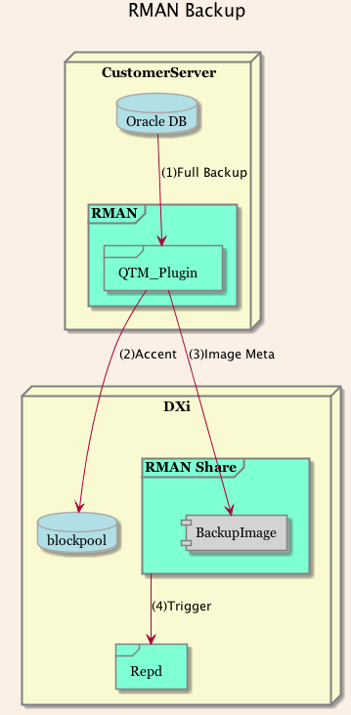
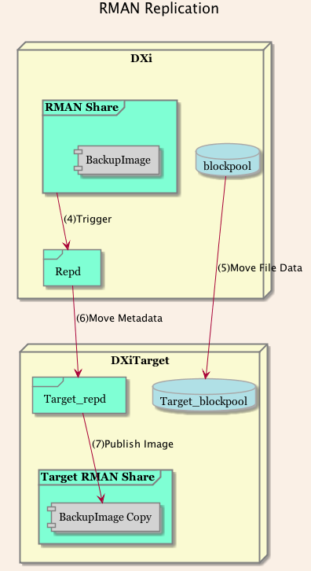
RMAN Feature – Accent (Client Side Dedupe)
Will support Client Side Dedupe
  See Diagram A.
Will support incremental recovery through the plug-in to make that process as simple and problem free as possible.
  Internally this is part of the ‘Restore from Backup’ design.
Will support an RMAN share on a DXi source performing replication to a DXi target that has RMAN share capability
  See Diagram B.
Diagram A
Diagram B

Slide 30
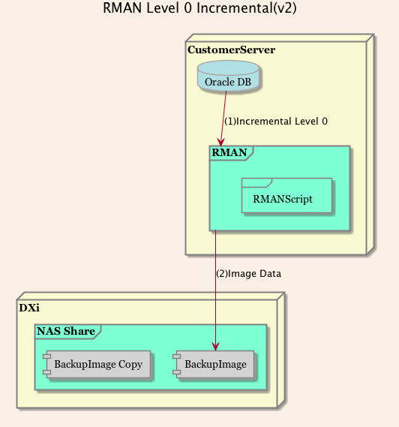
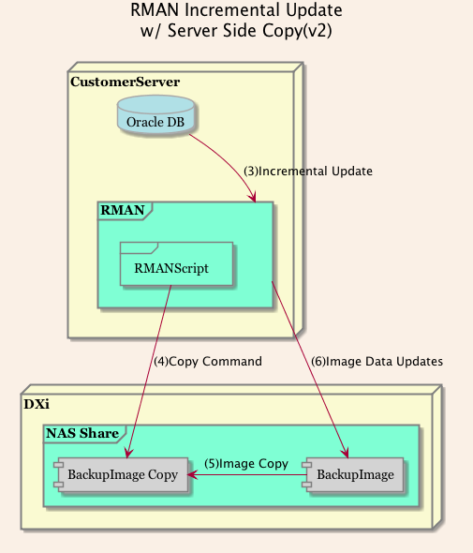
RMAN Feature – Server Side Copy (DXi 3.2.5)
Used with Oracle RMAN Incrementally Updated Backups
Provides CLI and RESTful interfaces
Prior to Incremental Update use Server Side Copy
  Fast operation and storage is deduped
Provides a restore path to the original image
Net effect is similar to using “synthetic full”
  multiple full images created
  only the new data sent to the DXi

Slide 31
RMAN Limitations (vs. NAS/local disk)
Oracle imposed limitations
  when using SBT storage (including RMAN Plugin), Oracle prohibits backup as copy, and/or Incrementally Updated Backups (must be a disk target)
  catalog recovery with SBT storage (including RMAN Plugin) requires special instructions (well beyond the local disk procedure)
  in DR scenario where data needs to be recovered from a TBR target, Oracle host needs to catalog backup files
  backup block size parameters should be the same for restore (applies to SBT storage only)
  RMAN client side encryption – not supported without Oracle Secure Backup
DXi imposed limitations and Best Practices
  backup format outlay - currently absolute path must be avoided when specifying format. DXi will not create recursive directories from a plugin invoked backup
  replication - only trigger based replication is supported for application specific shares
  replication - target must be at supported DXi revision to enable TBR receive (must support application specific share)
  RMAN client side compression – Discouraged as best practice, as it causes performance/deduplication penalty
  OST Plugin and RMAN plugin residing on same client is prohibited - for initial release OST and RMAN plugin co-existence on the same host is not supported
  Server Side Copy - Only useful for RMAN stored DXi NAS shares (not via plugin) due to Oracle limitation.

Slide 32
RMAN Plugin Logging
Service may access the rman logs (contained in the /usr/Quantum/log directory).
Log level is controlled similarly to OST plugin with different settings modified in the QuantumPlugin.conf file.
The rman log will also identify an Oracle trace file to review:
INFO - 20160922 11:29:51.374 23644 rman_pgn_api.cpp:868 tracing to file '/home/oracle/app/oracle/diag/rdbms/orcl/orcl/trace/sbtio.log' at level 0
This can be accomplished by adding a trace <0-2> to the end of the allocate channel call when setting up the data transfer. This sbtio.log will be needed when troubleshooting RMAN failures.
Its usefulness depends on the trace level set by the user during the allocate channel call. If an operation repeatedly fails, the trace level should be increased to help identify the root cause of the issue.
By default tracing occurs at level 0, which logs errors only.

Slide 33
Oracle Client Plugin Installation Process
RPM installation instead of manual by customer used with OST Plugin.
Plugin packaged in ZIP file downloaded from Quantum Website (same page as OST).
RPM signed with Quantum Public Key and can be verified.
Refer to the Plugin Installation Guide for specific Plugin RPM installation instructions.
Plugin is installed with the following commands:
  unzip <RMAN-Plugin.zip>
  rpm --import QTM-DXi-Public-GPG-Key.txt
  rpm -ivh QuantumRMANPlugin-1.0.0-3204.x86_64.rpm

Slide 34
Oracle Client Plugin Installation Verification Process
After the plugin is successfully installed, a quick method to verify plugin to DXi communication is to run sbttest, the utility in standard Oracle installation. In order to run sbttest:
  1. log in as oracle, export the following environment variables:
  export BACKUP_HOST=<ip address of DXi>
  export BACKUP_SHARE=<application specific share on DXi>
  export BACKUP_USERNAME=<user name>
  export BACKUP_PASSWORD=<password>
  Note, share, user and password should already exist on DXi specified in BACKUP_HOST.
  2. invoke the following command:
  sbttest <arbitrary string used to identify test> -libname libQuantumobk.so
  3. verify the test passes without any reported errors

Slide 35
Oracle Client Plugin Installation Verification Process Results
[oracle@rman1 ~]$ sbttest test -libname libQuantumobk.so
The sbt function pointers are loaded from libQuantumobk.so library.
-- sbtinit succeeded
-- sbtinit (2nd time) succeeded
sbtinit: vendor description string=Quantum MMS for RMAN 1.0.0.3204
sbtinit: Media manager is version 1.0.0.132
sbtinit: Media manager supports SBT API version 2.0
sbtinit: allocated sbt context area of 3888 bytes
-- sbtinit2 succeeded
-- regular_backup_restore starts ................................
-- sbtbackup succeeded
write 100 blocks
-- sbtwrite2 succeeded
-- sbtclose2 succeeded
sbtinfo2: SBTBFINFO_NAME=test
sbtinfo2: SBTBFINFO_METHOD=stream
sbtinfo2: SBTBFINFO_SHARE=multiple users
sbtinfo2: SBTBFINFO_CRETIME=Wed Sep 21 13:42:47 2016
sbtinfo2: SBTBFINFO_LABEL=10.20.165.14_sdk
-- sbtinfo2 succeeded
-- sbtrestore succeeded
file was created by this program:
seed=457752398, blk_size=16384, blk_count=100
read 100 buffers
-- sbtread2 succeeded
-- sbtclose2 succeeded
-- sbtremove2 succeeded
-- regular_backup_restore ends ................................
-- sbtcommand succeeded
proxy copy is not supported
-- sbtend succeeded
*** The SBT API test was successful ***

Slide 36
Oracle Client Plugin Installation Verification Process – Failure
In this case the exported password was incorrect, so authentication fails (useful troubleshooting tool):
  [oracle@oel72rman1 temp]$ sbttest fail -libname libQuantumobk.so
  The sbt function pointers are loaded from libQuantumobk.so library.
  -- sbtinit succeeded
  -- sbtinit (2nd time) succeeded
  sbtinit: vendor description string=Quantum MMS for RMAN 1.0.0.3204
  sbtinit: Media manager is version 1.0.0.132
  sbtinit: Media manager supports SBT API version 2.0
  sbtinit: allocated sbt context area of 3888 bytes
  MMAPI error from sbtinit2: 7501, sbtinit2: authentication to server 10.20.165.14 username = chuck failed: MI_STS_EAUTH
  -- sbtinit2 failed

Slide 37
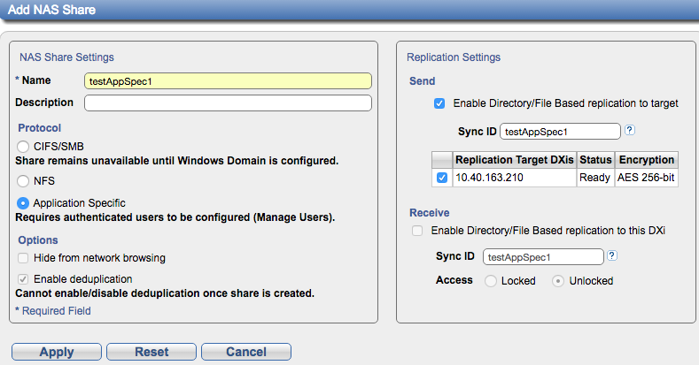
RMAN impact on DXi GUI
Configuring an Application Specific (RMAN) share (Configuration > NAS Add)
Only Directory/File (Trigger) Based Replication
CIFS changed
to CIFS/SMB throughout GUI and CLI
Selection for App Specific Shares, Requires Dedup Enabled (Dedup setting checked, cannot be changed).

Slide 38
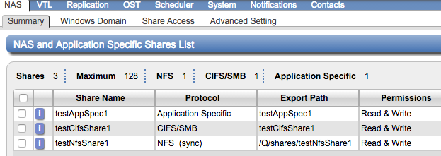
NAS Summary Page
Application Specific Shares count against maximum of 128 shares

Slide 39
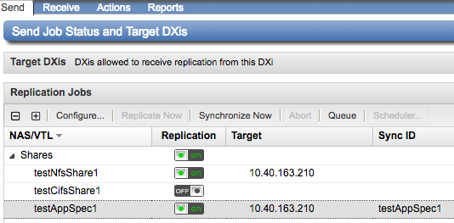
RMAN DXi GUI
Send Replication
  Replicate Now and Scheduler buttons disabled for Application Specific shares
  Can only configure Dir/File (Trigger) Based replication for Application Specific shares

Slide 40
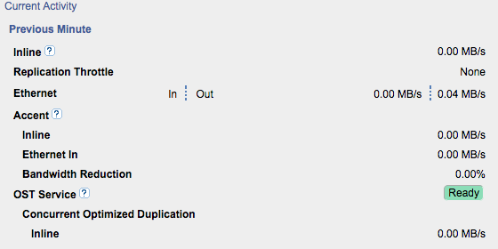
RMAN DXi GUI
Home page – Current Activity
Includes Application Specific share data. Previously under OST, and only displayed if OST Accent enabled.

Slide 41
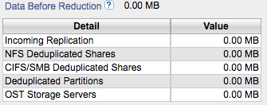
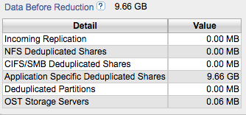
RMAN DXi GUI
Data Reduction Statistics
  Data for Application Specific shares not included in Data Reduction Statistics in 3.2.4.1 on Home page and Status > Disk Usage page
  Documented in Release Note for 3.2.4.1
  Will be fixed in 3.2.5
3.2.4.1
3.2.5

Slide 42
RMAN DXi GUI – Configuration Wizards
NAS Wizard
  Remove Protocol step
  Add Application Specific share to Add Share step
  Added Download Client Plug-In as last step (similar to OST Wizard)
Replication Wizard
  Modified to support Application Specific shares
  Can only enable Dir/File (Trigger) Based replication for Application Specific Shares
Users Wizard (coming in 3.2.5)
  One stop shopping to configure
    Workgroup users
    Manage users for Application Specific shares, local users for OST AIR, backup application specific users for PTT
    Remote users for OST AIR
    Share administrators

Slide 43
RMAN DXi GUI – Other modified pages
Client Plugins: Configuration > System > Client Plug-Ins
  Previously under Configuration > OST
  Download both OST and App Specific Plug-Ins
Manage Users: Configuration > System > Manage Users
  Previously under Configuration > OST and PTT Backup Applications
  Used to configure local users for OST AIR, manage users for Application Specific shares, and PTT Backup Application users.
Application Specific share data displayed as part of Accent statistics.
  Status > Accent
  Previously under Status > OST
  Displays data for OST Accent and Application Specific shares
Changes to MAP page for navigation as needed

Slide 44
RMAN CLI Changes
syscli --add share (--name <sharename> --proto {cifs|nfs|app_specific} [--desc <description>] [--ro] [--dedup] [--hidden] [--namecase lower|default] [--squash [root]|none] [--anonuid <anonymous_uid>] [--anongid <anonymous_gid>])
syscli --list share [{--proto cifs|nfs|app_specific} | {--name <share name>}] [--namematch <pattern>]
syscli --deleteall share [--proto {cifs|nfs|app_specific}] [--namematch <pattern>] [--sure]
syscli --list sharename [--proto cifs|nfs|app_specific] [--namematch <pattern>]
syscli --getcount share [--proto cifs|nfs|app_specific] [--namematch <pattern>]

Slide 45
RMAN CLI Changes (cont.)
syscli --replicate nas --name <NAS share name> [--target <host_name_or_ip>] [--namespace]
  This command cannot be used with application specific shares (use syscli --sync nas instead).
  namespace is optional and available for backwards compatibility
syscli --replicate vtl --name <vtlname> [--target <host_name_or_ip>] [--namespace]
  namespace is optional and available for backwards compatibility
syscli --enablerep nas --name <nas_share>] [--filedirbase] [--syncid <sync_id>]
  for app_specific shares, enables filedirbase (trigger) rep even if user doesn't include parameter
backupuser commands (add, edit, list, delete, delete all)
  update help text to include application specific shares.

Slide 46
LDAP – 3.2.5 Release, NOT 3.2.4.1
Acronyms
  LDAP/AD: Lightweight Directory Access Protocol/Active Directory
  LDAPS/AD: Lightweight Directory Access Protocol Secure/Active Directory
    Also known as "Secure LDAP", or "LDAP over SSL“,
  StartTLS: Transport Layer Security
  PCI DSS standard : Payment Card Industry Data Security Standard
Why LDAP?
  LDAP allows IT to set up usernames, passwords, and policies on their LDAP or AD server.
  For applications that support LDAP, the user can log into the application (Outlook, Cisco AnyConnect, soon DXi) with their corporate username/password.
    If the username and password are found on the LDAP server, and the user has permission to use the application, login succeeds
  Allows for tracking individual users in Admin Activity log (User Audit Log)
  Typical customer demands for LDAP include PCI DSS Standard
    Shall not use customer default passwords
    All users need to use a unique user id
    Need to adhere to PCI DSS standard- anyone who holds credit card info about a customer
    From https://www.pcisecuritystandards.org/about_us/: “The Council maintains, evolves, and promotes the Payment Card Industry Security Standards.”
  Shortfalls of DXi software 3.2.4.1 and below:
    Only have defined user ids (admin, monitor, etc)
    Cannot set password policy for length, strength, or expiration

Slide 47
LDAP (cont.)
Implementation Details
  Support for LDAP/AD with StartTLS
    We are using OpenLdap which supports both LDAP and Active Directory, so our implementation will work with both LDAP servers (Linux) and Active Directory servers (Windows/Microsoft)
    LDAP with StartTLS uses the LDAPv3 Transport Layer Security (TLS) extension for a secure connection. It’s a newer and better compared to LDAPS, and downloads a certificate from the LDAP or AD Server
  Support for LDAPS/AD
    LDAPS (S stands for secure and basically encrypts the password before sending it over the wire to the LDAP server, kind of like the difference between http and https).
    LDAPS differs from LDAP in two ways:
      1) upon connect, the client and server establish TLS before any LDAP messages are transferred (without a StartTLS operation) and
      2) the LDAPS connection must be closed upon TLS closure.
  Unencrypted LDAP is not supported
    Passwords are not encrypted when sent to the LDAP server.
    Should only be used in conjunction with Kerberos.
    Kerberos provides authentication of usernames and passwords but is NOT supported in this release.
    Note this is the same as LDAP support for Scalar i6K.
  Also - SSL (Secure Socket Layers, https://ipAddress ) is now configured by default on fresh installations
    Provides additional security
    Recommended for all DXi users
    CLI command to enable/disable SSL: syscli --set tls --enabled | --disabled

Slide 48
LDAP (cont.)
Additional Details
  Requires OpenLDAP slapo-member Plug In to be installed on the Open LDAP Server
    slapo-member of is a plug-in (an overlay in LDAP terminology).
      It is not required for security, it provides the cross referencing necessary for determining user roles.
      With the overlay enabled, the user records will contain a list of groups they are members of.
      Used to determine if a user has administration rights on the DXi, or is only a monitor (read-only) user.
      It is installed on the LDAP server (not the DXi).
    Scalar i6000 implementation of LDAP has been in the field for years with this same requirement.
  Does NOT include ability to configure password policies for local users (i.e. passphrases, length, strength, or expiration)
  LDAP Admin users
    ARE able to modify passwords of local users (including GUI admin)
    CAN disable all local accounts except Local GUI Admin
    Have same permissions as Local Admin GUI and CLI Admin users
  Reminder (not new): Changing Local Admin GUI password requires Vision Admin to change Admin password for DXi GUI
    Vision uses Local Admin GUI username and password to obtain data from DXi..
  Failed login attempts will be counted for LDAP users.
  Admin logins will now report failed login attempts for the current user AND a total of all failed login attempts.
  The Admin user will be able to clear the count of all failed login attempts.

Slide 49
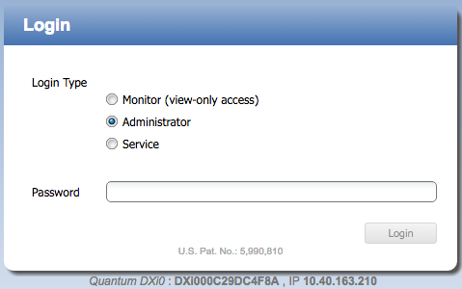
LDAP (cont.)
Login Screen, LDAP disabled

Slide 50
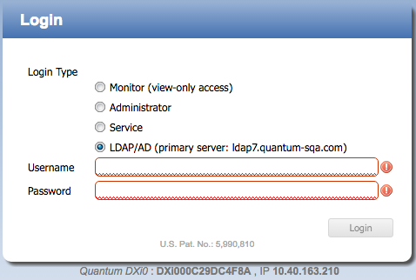
LDAP (cont.)
Login Screen, LDAP enabled

Slide 51
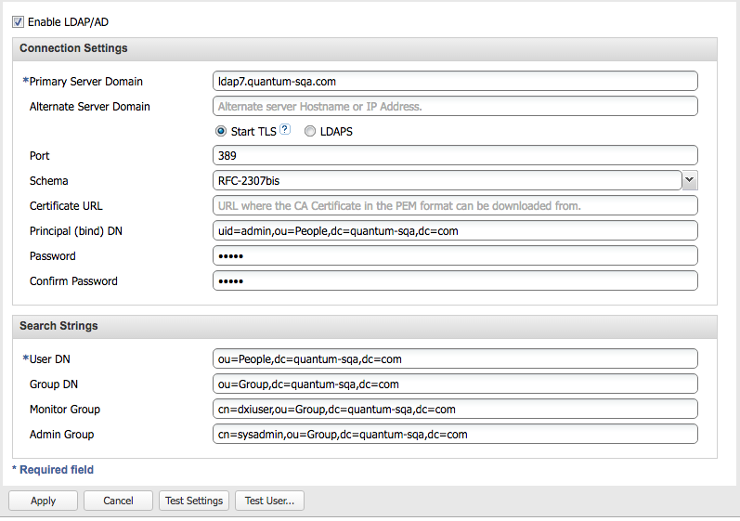
LDAP (cont.)
LDAP/AD Configuration Screen (Configure > System > Security > LDAP/AD)

Slide 52
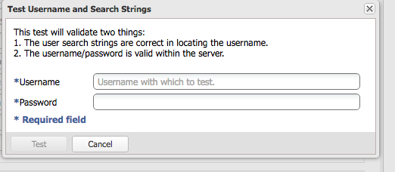
LDAP (cont.)
Clicking the Test User button launches a dialog window

Slide 53
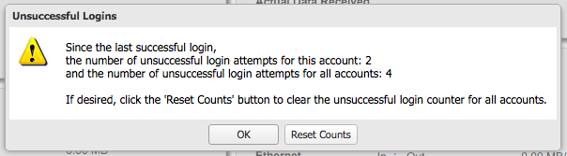
LDAP (cont.)
Login by an Admin user with failed login attempts by this user (account) AND other accounts would see this message. Notice the button to reset all counts…

Slide 54
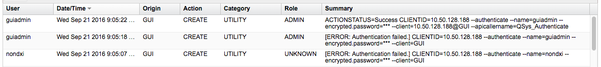
LDAP (cont.)
Activity log will report failed login attempts by username. Notice that the LDAP user “nondxi” could not log in. Role is UNKNOWN and authentication failed. The LDAP Admin user “guiadmin” entered his password wrong the first time then correctly the second time.

Slide 55
Documentation and Training
Updates
Jim Bell and Neal Menke – Training and Documentation

Slide 56
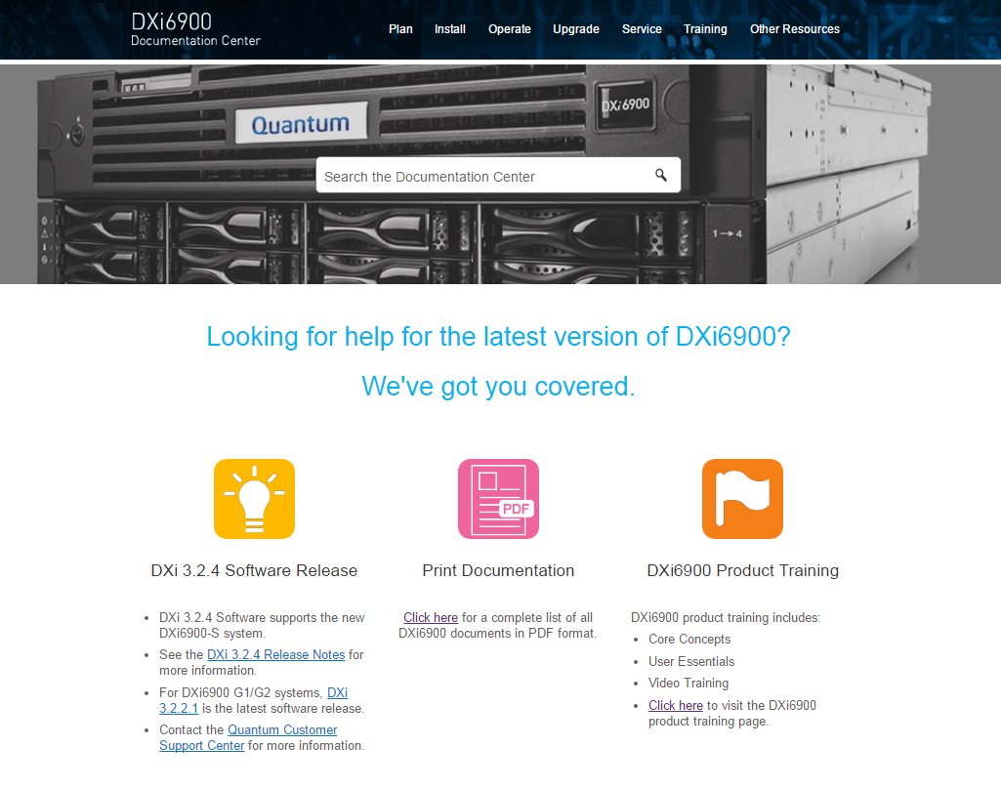
Documentation Deliverables – DXi 3.2.4 (6900-S)
Release: Sept. 7th.
New: DXi6900-S 3.2.4 Release Notes
New: DXi6900-S User Essentials
New: DXi6900-S Online Help
New: DXi6900-S Installation and Configuration Guide
New: DXi6900-S Storage Capacity Upgrade Guide
New: DXi6900-S Field Service Manual
Updated: DXi6900 User’s Guide
Updated: DXi6900 Site Planning Guide
Updated: DXi6900 Optional Network Card Installation Instructions
Updated: DXi6802 and DXi690x: Drive Replacement CRU
Updated: DXi6900 Software Install & Upgrade Guide

Slide 57
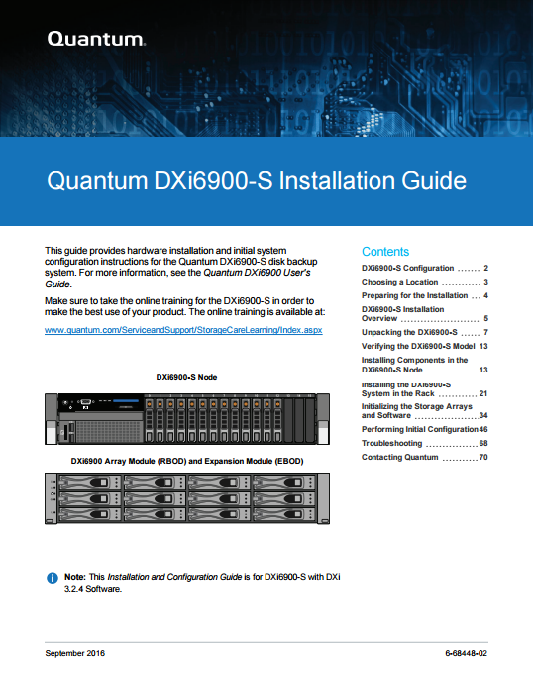
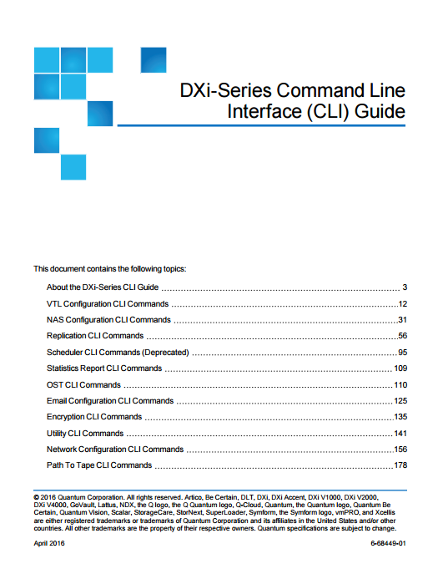
Documentation Deliverables – DXi 3.2.4 (6900-S RMAN)
Release: GA Oct. 7th. Contact Service for LCR of DXi 3.2.4.1 documentation.
New: DXi6900-S 3.2.4.1 Release Notes
New: RMAN Plug-in Installation Instructions
New: RMAN Configuration Guide
Updated: DXi6900-S Online Help
Updated: DXi6900 User’s Guide
Updated: DXi-Series CLI Guide
Updated: DXi6900 Software Install and Upgrade Guide

Slide 58
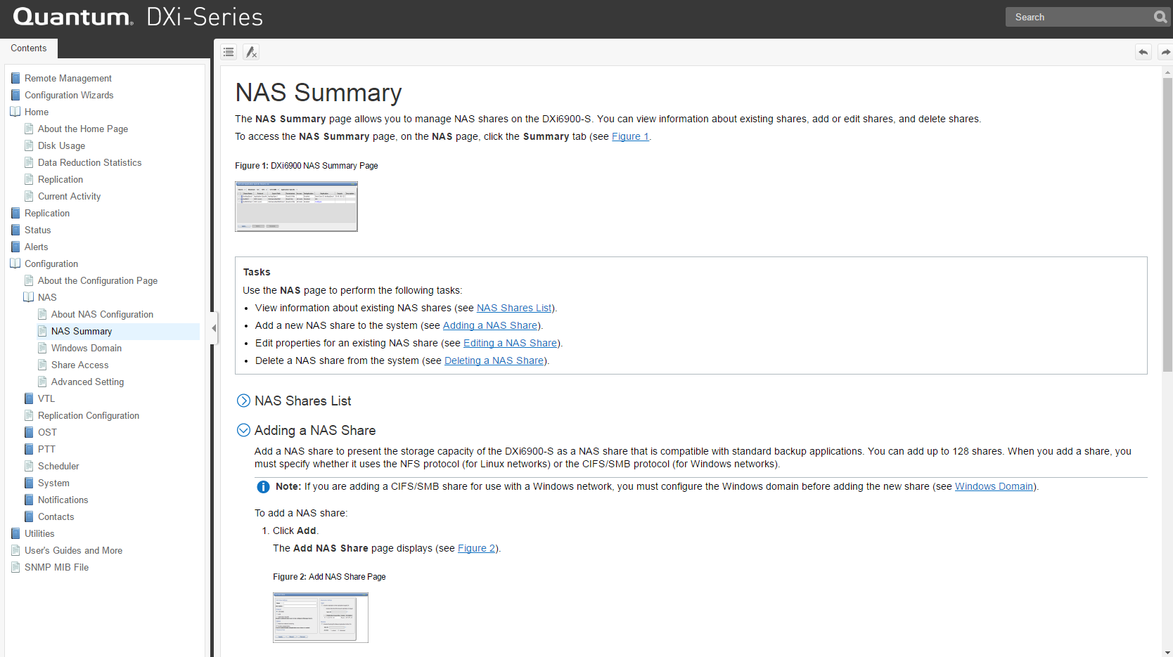
Documentation Deliverables – DXi 3.2.5 (RMAN/LDAP)
Release: Nov. – Dec.
New: DXi6900/DXi4700 3.2.5 Release Notes
Updated: DXi6900-S Online Help
Updated: DXi6900 Online Help
Updated: DXi4700 Online Help
Updated: DXi6900 User’s Guide
Updated: DXi4700 User’s Guide
Updated: DXi-Series CLI Guide
Updated: DXi6900 Storage Capacity Upgrade Guide
Updated: DXi6900 Software Install and Upgrade Guide
Updated: DXi4700 Software Install and Upgrade Guide

Slide 59
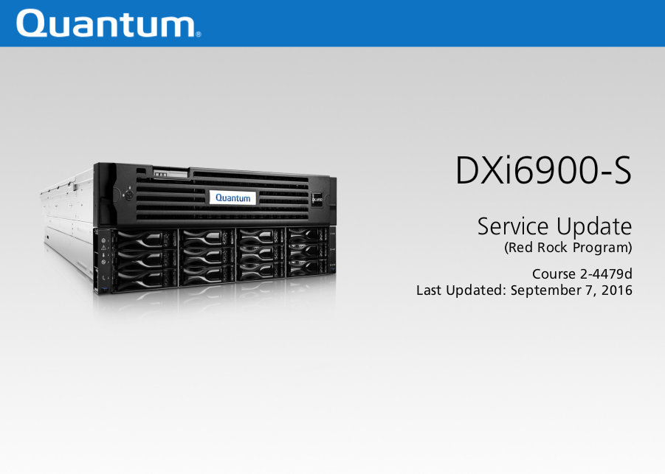
Training Deliverables
Release: Sept. 7th
New: DXi6900-S Service Update (2-4479d Online Self-Paced)
Updated: DXi6900-Series Installation (2-2473 Online Self-Paced)
Updated: DXi-Series Service Partner Training
(4-4459 Virtual Course)
Updated: DXi6900-Series At a Glance

Slide 60





Training Deliverables (2)
Release: Oct. 7th
New: DXi6900-S RMAN Service Update (2-4479e Online Self-Paced)
Updated: DXi-Series Core Concepts Explained
Updated: DXi-Series Installation and Hardware Replacement (2-0413 Classroom)
Updated: DXi-Series Core Concepts (website)

Slide 61
Service Model
Jim Hibbard – Service NPI

Slide 62
DXi6900-S Service Update
No change to DXi6900 Service Model
Version 3.2.4 initially posted on CSWeb only and since replaced with version 3.2.4.1 (supports RMAN plugin)
  Version 3.2.4.1 is not currently posted on Quantum.com.
  Install teams will need to download the .FW file from CSWeb to upgrade the FRU image that ships from the factory
  .FW is posted on CSWeb
  Version 3.2.4.1 is not supported by YUM. Next YUM support coming in 3.2.5.
  First order received for 9 units for BNPI/BP2i to be shipped late Sept.
RMAN Plugin is posted along side the OST Plugin on Quantum.com under the Drivers tab for DXi6900
  Reminder that this plugin is supported on DXi6900-S only and requires DXi software version 3.2.4.1.

Slide 63
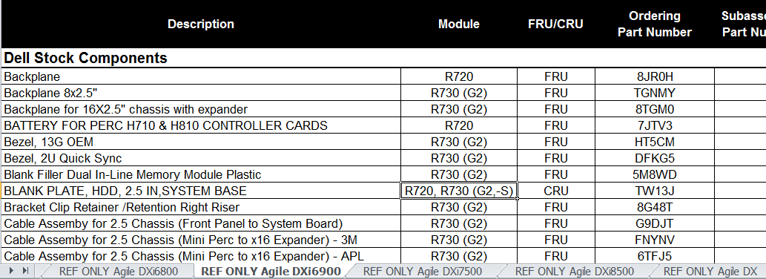
FRU/CRU List
The DXi6900 FRU/CRU list has been updated to include DXi6900-S.
Pay attention to the “Module” column that identifies where the component is used

Slide 64
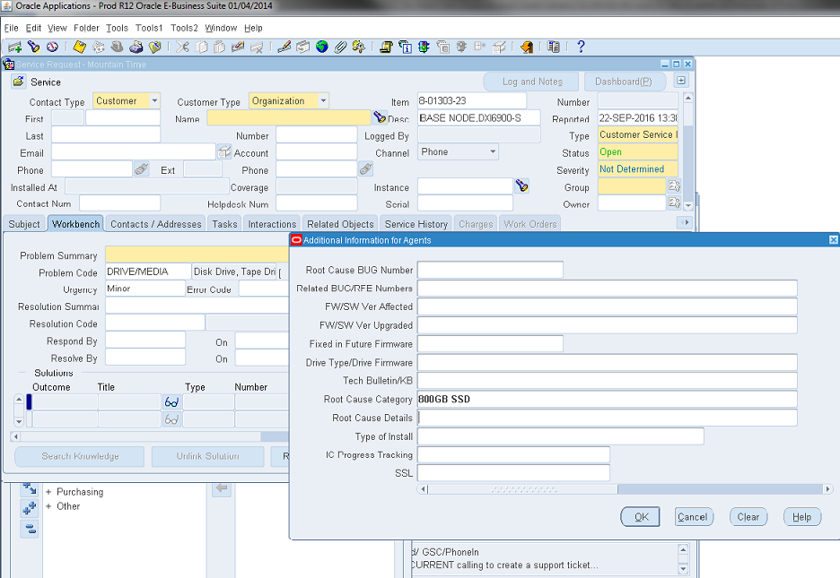
New SR Root Cause Category Selection Added for 800GB SSD
Identify SSD related SRs using updated Root Cause Category list

Slide 65
Appendix

Slide 66
RMAN Plugin Certification
Oracle SDK/QA test suite
  Contains API specification for SW development
  Contains source code for simple API “checker”, executes simple permutations of all required functions as specified by API
  Contains QA test suite for basic testing of API implementation
  QA test suite contains 15 test cases (not including subtests)
  Only 12 are applicable to the RMAN plugin as it does not support proxy copy
  Tests range from simple to complex and exercise every required function in the Oracle API
Certification Submittal
  Link to Oracle Backup Solutions Program Website:
  http://www.oracle.com/technetwork/database/features/availability/bsp-088814.html
  Information is provided to Oracle to certify the product by the program manager including, Company Name, Product(s), Contact, Email address (alias in our case), and any links to documentation/White Papers (Vendor Discretionary)
  This is where we will point customers to confirm we have certified the plugin with Oracle
  Quantum is the first line technical support for Oracle issues with the Media Management Software
Supplemental Internal Testing
  An OpenSource real world RMAN backup script suite was modified and implemented to facilitate additional stability style testing as well as additional functional testing exercising all relevant methods of database backups solely using RMAN (no ISV) and Media Management Software (Plugin). Script structure follows several Oracle Best Practices (where applicable).
  Not all Best Practices are implemented because of performance constraints with a deduplication appliance. IE no encryption or compression at the RMAN level.
  Database is introduced to varying levels of change in the form of overwrite and append between each cycle
  More details available upon request

Slide 67
THANK YOU
For meeting with Quantum, the LARGEST Data Protection
and Big Data management specialist in the world.
© 2013 Quantum Corporation. Company Confidential. Forward-looking information is based upon multiple assumptions and uncertainties,
does not necessarily represent the company’s outlook and is for planning purposes only.

