Slide 1
DXi6802 (Rocky)
TOI for Global Service
December 20, 2012

Slide 2


Slide 3
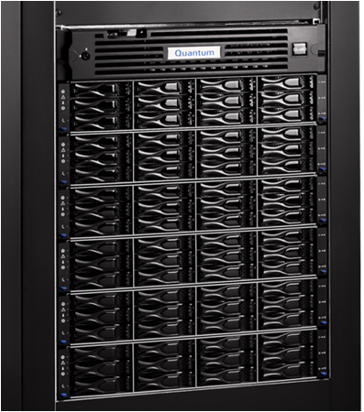
Agenda
Marketing Overview
HW Configurations
Capacity Expansions
SW Engineering
Dynamic Disk Pooling (DDP)
Data Assurance (DA)
Data-at-Rest Encryption
Performance
Enabler Updates (DAR, Vision, Guardian, Gunnison)
Training Strategy
Documentation Updates
Service Strategy
Appendix
Note: Ask questions as we go. Q&A also at the end.

Slide 4
Marketing Overview
Presented By: Matthew Apodaca

Slide 5

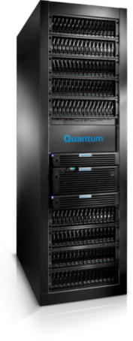

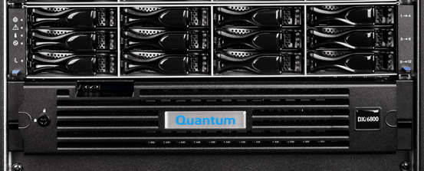
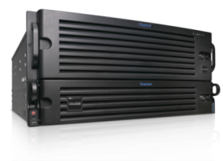

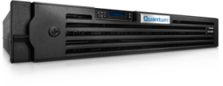




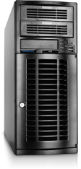

DXi Product Portfolio
DXi8500
DXi6802
DXi6701/02
Comprehensive Solutions
DXi4000, vmPRO 4000,
& DXi V1000
vmPRO
NDX and RDX
Quantum Vision
1
8
2
12
8
156
45
330
Capacity (TB)
Notes:
Is there any upgrade path from DXi6701/02 to DXi6802?
No, these are two distinctly different products with no storage or controller commonality.
Per DXi deduplication appliances, replication compatibility exists with existing DXi deduplication products.

Slide 6
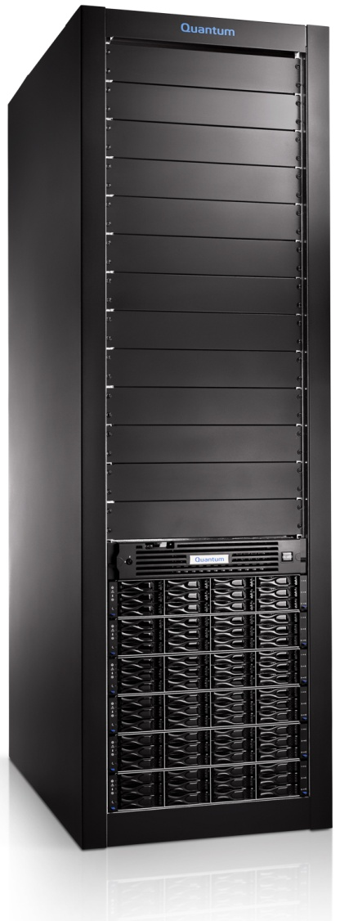
DXi6802 – Product Overview
Most scalable, efficient, & highest performing disk backup & deduplication solution
  Pay-as-you-Grow Scalability
  13TB licensable capacity-on-demand (CoD) increments
  Delivering higher customer ROI
Higher Density & Capacity: 13TB to 156TB Useable
  95% denser footprint, 25% more power-efficient than DXi6700
  Proactively manages data growth with non-disruptive capacity upgrades
  Higher Performance: 16.3TB/hr.
  Meet evolving backup windows with predictable performance improvements
  Higher Storage Availability
  Via Dynamic Disk Pools (DDP) and data integrity checking
  Increased Data Security
  Hardware-based Data-at-Rest Encryption with optional Disk Security license
Mid-Range Extension
  Does not replace the DXi6701 or DXi6702
Notes:
Not a replacement for the DXI6701/02, those will continue to be offered for the foreseeable future.
Upgrade path? No, this is an all-new product. Different disk, different head.
Initial system is customer-installable
Capacity expansions
Product Overview
The new DXi6800-series is an extension of Quantum’s DXi midrange deduplication appliances. The DXi6802, which is the first model in the DXi6800-series product line, represents a major new release which significantly increases Quantum’s scalability, performance, availability and security capabilities.
DXi6802 Deduplication Appliance Description
The new DXi6802 appliance provides deduplication without compromise, combining the broadest scalability and highest performance with increased security, higher availability and unique extensibility supporting the full range of midrange and enterprise presentation options: NAS, VTL and OST. Built on Quantum's DXi software, the DXi6802 provides up to 16.3TB/hour performance and cost-effective capacity-on-demand (CoD) scalability with 3TB self-encrypting drives (SED) from 13 to 156TB of usable capacity in a single system. The DXi6802 provides maximum flexibility and value for investment protection in evolving backup environments and includes all software licenses in its base price, including: NAS, VTL, OST, deduplication, replication, path-to-tape (PTT) and DXi Accent™ software for hybrid deduplication.
Primary Benefits of the DXi6802 Deduplication Appliance
Cost-effective Scalability through capacity-on-demand (CoD) to provide simple and predictable data growth management
Higher Capacity through the use of 3TB drives provides a 95% denser footprint resulting in significant power savings
Increased Performance (up to 16.3TB/hour) provides a faster system to alleviate the pressure on the backup window – which is increasing as data volumes continue to increase
Increased Security through data-at-rest encryption via self-encrypting drives (SED) protects against data breach from physical removal of disk drives
Higher Data Availability with the addition of hot spare drives (one per shelf) enables continued backup and restore operations without unplanned system degradation

Slide 7
DXi Comparison
attribute | DXi4601 | DXi6701/02 | DXi6802 | DXi8500
Usable Capacity (TB) | 4, 8 or 12TB | 8..80TB | 13..156TB | 45..330TB
Expansion (TB) | 4TB (CoD) | 8TB / 16TB | 13TB (CoD) | 30TB
Disk Drives | 2TB | 1TB; 2TB | 3TB | 3TB [2TB]
Presentation | NAS / OST | NAS / OST / VTL | NAS / OST / VTL | NAS / OST / VTL
Performance (TB/hr) | 1.7 (NAS) | 5.0TB (NAS) 5.8TB (OST) 5.8TB (VTL) | 13.5 (NAS – 4 ports) 16.3 (OST – 4 ports) 11.9 (VTL -4 ports) | 9.0 (NAS – 4 ports) 10.1 (OST – 4 ports) 11.1 (VTL – 4 ports)
Connectivity | 4 x 1GbE | 4 x 8Gb FC DXi6701: 6 x 1GbE DXi6702: 2 x 10GbE 2 x 1GbE | 6 x 8Gb FC 2 x 10GbE 2 x 1GbE Options: 2x 10GbE or 4x 1GbE | 6 x 8Gb FC Ports 2 x 10GbE 4 x 1GbE Option: 2 x 10GbE
VTL and PTT | N/A | VTL: 256 VTD; 9000 VTC 2x PTT and 2x VTL | VTL: 256 VTD; 9000 VTC 2x PTT (configurable) and 4x VTL | VTL: 512 VTD; 40,000 VTC 2x PTT and 4x VTL
Data Availability | RAID-6 Hot Swap Drives | RAID-6 Hot Swap Drives | Dynamic Disk Pooling (DDP) Hot Spares (Per Storage Shelf) T10DIF | RAID-6 Global Hot Spares Redundant RAID Controllers Redundant Interconnect and [Internal] Path Failover
System Availability | Redundant PSU/Fans | Redundant PSU/Fans | Redundant PSU/Fans | Redundant PSU/Fans

Slide 8
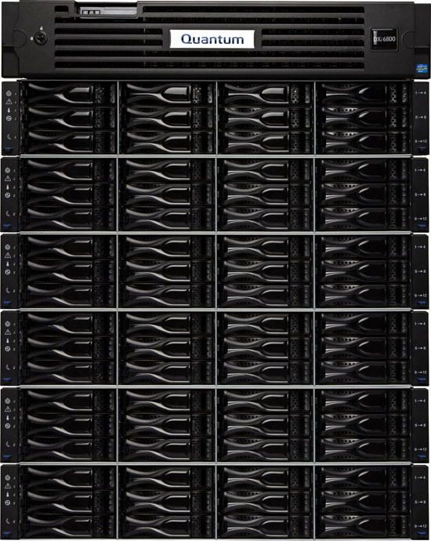

DXi6802 Simple Ordering Architecture
Base Configuration: Node + 1 Storage Expansion Module
13TB usable entry capacity
2U node includes 6x 8Gb FC, 2x 10GbE, 3x 1GbE
2U storage expansion module supports up to 26TB usable
Capacity Expansions
Order 13TB capacity increments up to 156TB usable capacity.
Optional
2x 10GbE (Twinax or Optical)
4x 1GbE
10GbE
1GbE
or
Optional Encryption License
Applied on a per system basis not tiered pricing
Notes:
Is the DXi6802 customer installable?
New DXi6802 installations are customer installable
Are capacity expansion upgrades customer installable?
Capacity expansion upgrades are only Quantum service installable

Slide 9
Hardware Configuration
Presented By: Jurgen van der Linden

Slide 10
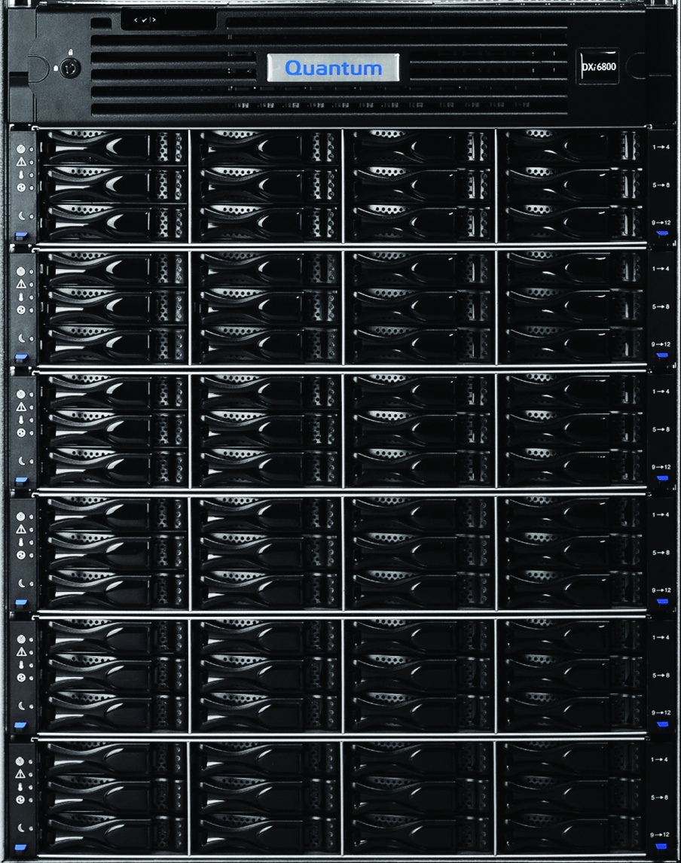
DXi6802 System Configuration
Physical & CoD
Capacity Points
Base System
  Node + RBOD
  13TB Capacity License
  26TB Available with CoD
13-26TB
39-52TB
65-78TB
Licensed in 13TB increments
91-104TB
117-130TB
143-156TB

Slide 11
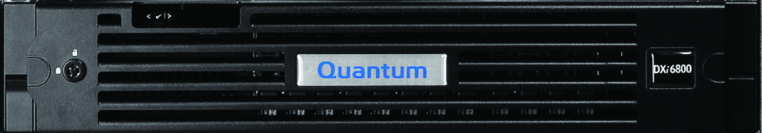
DXi6802 System Node
Dell R720 server
  TPM and non-TPM options
  2U rack mount enclosure
  Dual Intel Xeon E5-2670 (Sandy Bridge)
  128 GB memory
  Internal PERC H710 RAID controller
    All drives connect to the controller through the SAS backplane board.
    No user data
  16 x 900GB SAS HDDs (No SSDs)
  No integrated DVD, use front USB ports with flash drive or external DVD. (USB ports and the back do not work)

Slide 12
“Designed In” Extensibility: Future-proofing
A high performance and extensible architecture is a key feature
  Confidently delivers the GA feature set with room for growth
  Ensures that GA+1yr; GA+2 yr “future features” will be supported
    Also provisioned for PCIe expansion
The new Dell 720 server delivers a powerful combination of processor power + memory + memory bandwidth
DXi6802 Node
Dual Intel Xeon E5-2670
16 Core
2.66GHz
20MB L1 Cache
128GB RAM @ 1600MHz
7x PCIe 3.0 Slots
PCIe Expansion Available 2 to 3 slots
CPU Performance Benchmark* 28,459
DXi6702 Node
Dual Intel Xeon E5540
8 Core
2.53GHz
8MB L1 Cache
60GB RAM @ 1066MHz
7x PCIe 2.0 Slots
PCIe Expansion Available 0 slots
CPU Performance Benchmark* 10,036
Notes:
Note since it’s a dual CPU, highlight that cores/threads are 2x that of a single cpu.
The CPU performance benchmark used by our team is referenced at:
http://www.cpubenchmark.net/multi_cpu.html

Slide 13
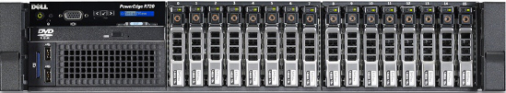
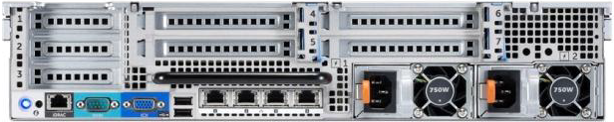
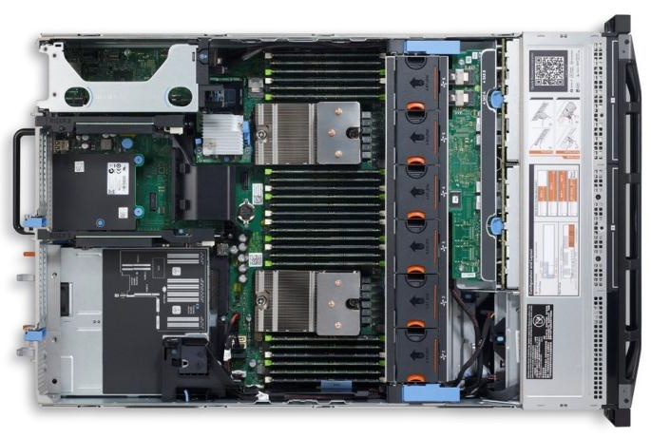
DXi6802 System Node Key Features
3x Low Profile x8 Slots
3x Full Length x8 Slots
16x 900GB 2.5” NL SAS Drives
1x Full Length x16 Slot
3x NDC 1GbE Ports
24 DIMM Slots
Hot-swap Fan Packs
PCI Riser Slots
CPU1
Hot-swap HDD Bays
Hot-swap Power Supplies
CPU2

Slide 14
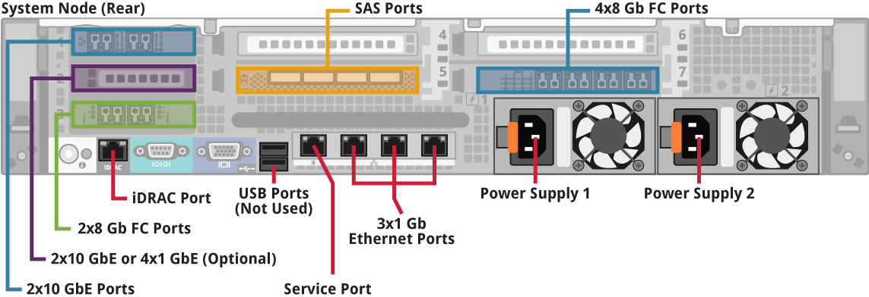
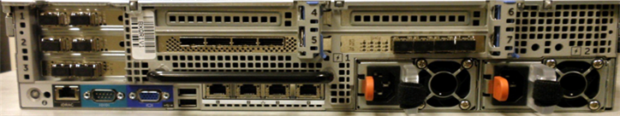
DXi6802 System Node Rear Connectivity
- RBOD
- VTL
- PTT
- NAS
- NAS
- NAS
Extensive front and rear features and indicators information can be found in the product documentation
Notes:
Single HBA controller

Slide 15
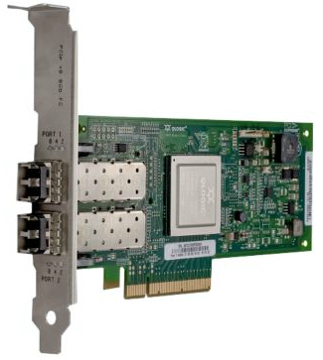
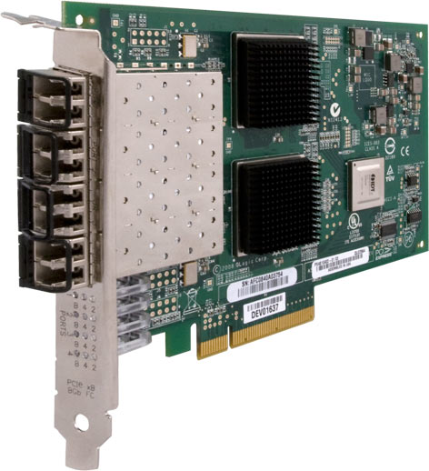
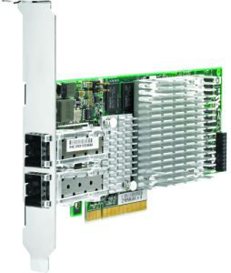
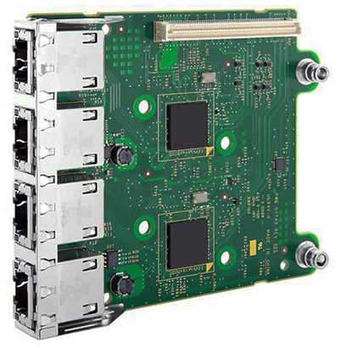
DXi6802 System Node Connectivity
DXi6802 supports user I/O connectivity with concurrent multi-protocol support
  2x 8Gb FC ports for Path-To-Tape (also configurable for ingest and read)
  4x 8Gb FC ports for VTL
  3x 1GbE ports for ingest and read
  1x 1GbE port for service connectivity
  2x 10GbE SFP+ ports for ingest and read (Optical or Twinax)

Slide 16
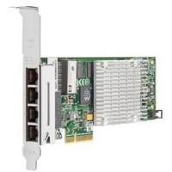
DXi6802 System Node Connectivity Options
The DXi6802 supports two different factory or field network connectivity upgrades
    2x 10GbE SFP+ ports for ingest and read
Or
    4x 1GbE ports for ingest and read

Slide 17
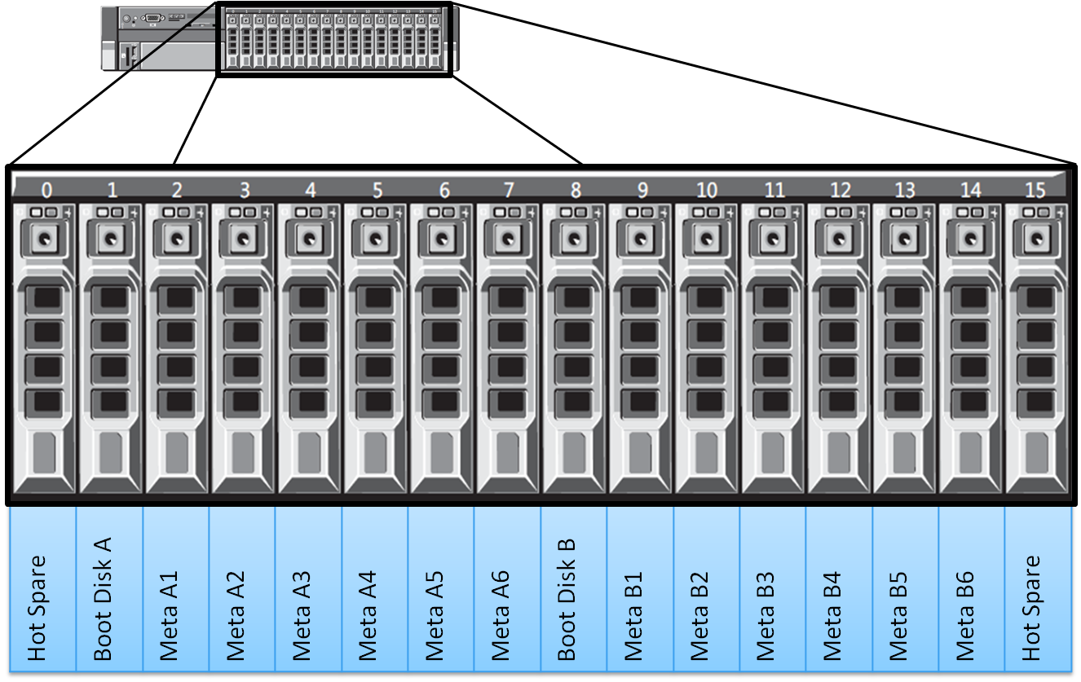
System Node Disks
16 hot-swap SED or non-SED drives
  2 drives for boot, system, and SNFS Journal – No User Data
  6 RAID1 pairs for SNFS Metadata and Blockpool Cluster Headers
  2 hot spares

Slide 18
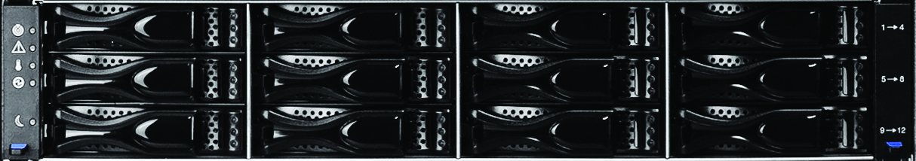
DXi6802 Array and Expansion Modules
2U NetApp Ebbets Chassis
  Same used in 8500-3TB
Single Snowmass controller per Array
12 x 3TB SED HDDs
26 TB useable capacity
RBOD connected to node SAS ports
Dynamic Disk Pool (DDP) configuration
  Hot spares managed in the Disk Pool
Expansion Module connects to the Array Module via SAS port
  Each EBOD permanently paired with one RBOD
  EBOD ESM controller connects to RBOD Snowmass controller
DXi6802 is similar to the DXi8500-3TB hardware
Different initialization technology
DXi8500-3TB in duplex mode, DXi6802 in simplex mode

Slide 19
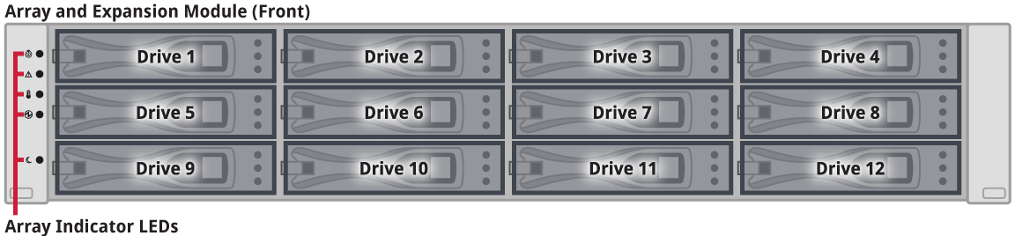
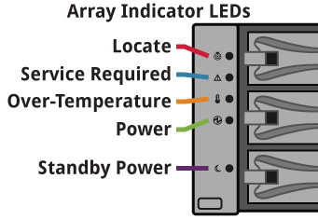
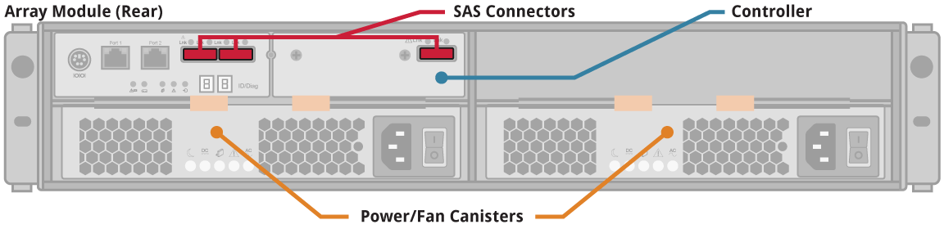
DXi6802 Array Module
Extensive front and rear features and indicators information can be found in the product documentation

Slide 20
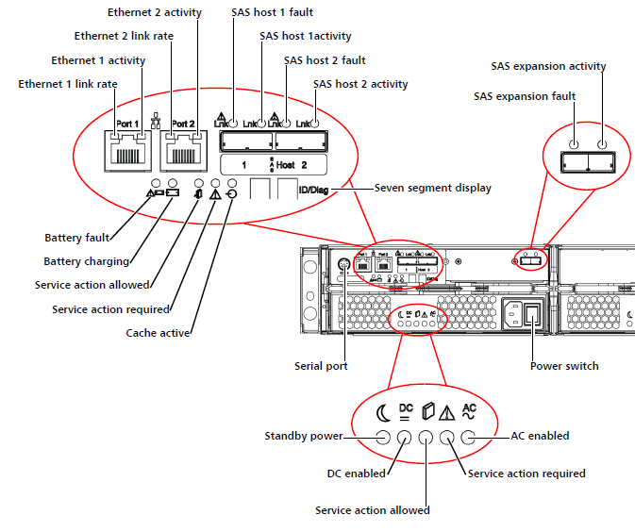
DXi6802 Array Module
Extensive front and rear features and indicators information can be found in the product documentation

Slide 21
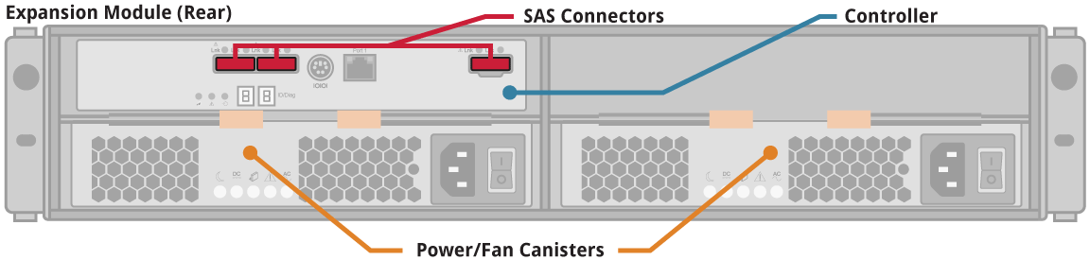
DXi6802 Expansion Module
Extensive front and rear features and indicators information can be found in the product documentation

Slide 22
Storage Details and Hot Spares
Each Array and Expansion Module (RBOD or EBOD)
  Implemented as 2 logical volumes of 13TB (12.91TB) usable capacity
  Equivalent of 1 hot spare drive per expansion
  12 drive expansion roughly equivalent to 9D+2P+1 spare
  Implementation subtleties result in
    All drives are always “in-use” i.e. each volume is striped across all 12 drives
    NetApp uses a distributed capacity approach to “hot spare” – the hot spare capacity is distributed within the 12 drive pool rather than a conventional hot spare which is typically pressed into usage only when the hot spare is needed
Hot spare is “local” to storage expansion (RBOD or EBOD)
  Can’t “spare” a drive in another expansion i.e. it is not a Global Hot Spare
  Automatic rebuild to hot spare is engaged on detection of a drive failure
  Provides hot spare ratio of 1 spare per 12 drive expansion
    6 hot spares for a 156TB usable system

Slide 23
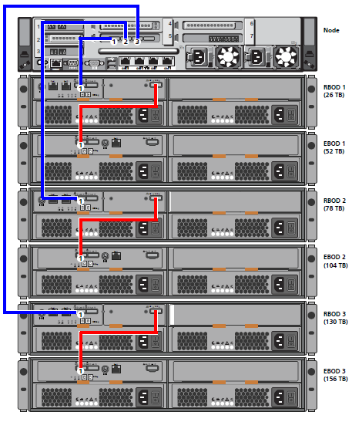
DXi6802 SAS Cabling Summary
Node to Array (RBOD) Interconnect
Array to Expansion Module (RBOD to EBOD) Interconnect
Additional information in the DXi6800 Installation and Configuration Guide

Slide 24
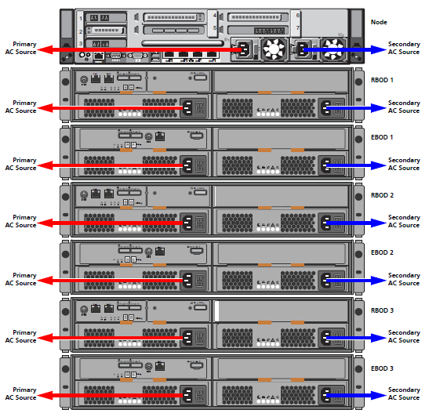
DXi6802
Power
Cabling Summary
Additional information in the DXi6800 Installation and Configuration Guide

Slide 25
Hardware misc.
DXi6802 reliability
  Per standard policy, Quantum does not quote an MTBF nor do other mainstream vendors.
  With hot spares, T10DIF and RAID-6 protection in addition to Quantum’s experience in delivering enterprise-class systems customers can expect excellent data protection when deploying DXi6802.
  DXi8500 has more hardware redundancy, higher complexity/price
FC port flexibility
  Default 4x FC for ingest, 2x for PTT.
  With DXi2.2 and higher software, allow each FC port to be configured as target or initiator to improve FC fan-in when customers are not utilizing PTT functionality.
  This port re-configurability does not increase FC ingest or PTT performance, it is intended to provide increased host/DXi connectivity.

Slide 26
Capacity Expansions
Presented By: Jurgen van der Linden

Slide 27
DXi6802 Capacity Model
Max Useable Capacity (TB) | “Stack-up” Summary | CoD Levels (TB) | Array Module (RBOD) 12 HDDs | Expansion Module (EBOD) 12 HDDs | Physical Capacity (TB)
26 | R720 + 1st expansion tray | 13, 26 | 1 | 0 | 36
52 | R720 + 2nd expansion tray | 39, 52 | 1 | 1 | 72
78 | R720 + 3rd expansion tray | 65, 78 | 2 | 1 | 108
104 | R720 + 4th expansion tray | 91, 104 | 2 | 2 | 144
130 | R720 + 5th expansion tray | 117, 130 | 3 | 2 | 180
156 | R720 + 6th expansion tray | 143, 156 | 3 | 3 | 216
The CoD model allows licensing either half or all of the usable capacity within a tray. Once that tray is fully licensed then we expand to the next tray
The customer will purchase a base system which includes a 13TB license in combination with a quantity of additional 13TB increments making up the total system size.
Notes:
© 2008 Quantum Corporation. Company Confidential. Forward-looking information is based upon multiple assumptions and uncertainties, does not necessarily represent the company’s outlook and is for planning purposes only.
27

Slide 28
Capacity Expansion Follows Simple Rule
User data is stored in expansion
  No bulk user data in the node, stored only in arrays and expansion modules (RBOD/EBOD)
Rule is governed by capacity points
  Think alternating pattern: RBOD -> EBOD; RBOD -> EBOD; RBOD -> EBOD
  Transparent sales/customer when a system is configured for sale or for field expansion
26TB / Node + 1 RBOD
52TB / 1 RBOD + 1 EBOD
78TB / 2 RBOD + 1 EBOD
14U
104TB / 2 RBOD + 2 EBOD
130TB / 3 RBOD + 2 EBOD
156TB / 3 RBOD + 3 EBOD

Slide 29
DXi6802 Capacity Points
Licensed in 13TB increments
Each Tray is made up of two 13TB LUNs, allowing for Capacity on Demand (CoD)
CoD Capacity (TB) | Total Useable Capacity (TB)
13, 26 | 26
39, 52 | 52
65, 78 | 78
91, 104 | 104
117, 130 | 130
143, 156 | 156

Slide 30
Capacity Expansion Licensing Information
The Expansion kit will include an Authorization Code Certificate for the total capacity being added.
Turbo PFK needed on the Array Module (RBOD) when you attach an Expansion Module (EBOD)
  Each RBOD getting paired with an EBOD needs the Turbo PFK file added.
  An Authorization Code Certificate for the Turbo PFK will be included in the Expansion kit (obtained via QuIL) when needed.
System w/Encryption
  Encryption PFK file is needed for each new RBOD being added during expansion.
  An Authorization Code Certificate for the additional PFK will be included in the Expansion kit (obtained via QuIL) when needed.
System w/o Encryption
  No Encryption PFKs need to be added
PFKs are only resident on RBODs

Slide 31
SW Engineering
Presented By: Jurgen van der Linden

Slide 32
DXi 2.2_68 Software
Features based on 2.2 release
2.2_68 and 2.2.1 developed in parallel
  Same feature changes and bug fixes
  See Appendix for 2.2.1 code metrics
2.2 features covered in 2.2 TOI
Complete DXi Replication Compatibility
  See Appendix for details

Slide 33
Bug Metrics for Rocky Release
Results related to Bugs:
  495 bugs managed
  48 Deferred (10%)
    All deferrals approved by CRB
    Details in the superbug 28782
  2.2.0_68 Release Notes posted on CSWeb
    Customer facing
    Bugs fixed
    Known Issues with Workarounds
  No Rocky specific TSBs.
Bugzilla Saved Searches
Deferred Profile
Sev \ Pri | P0 | P1 | P2 | P3 | P4 | P5 | Total
1 | - | 1 | 3 | - | - | - | 4
2 | - | 1 | 7 | 2 | - | - | 10
3 | - | 4 | 11 | 7 |  | - | 22
4 | - | - | 1 | 1 | - | - | 2
5 | - | - | 2 | 4 | 4 | - | 10
Total | 0 | 6 | 24 | 14 | 4 | 0 | 48

Slide 34
Notable Issue
Fresh install of DXi6802
  Use the “Fedora tool” to create bootable USB flash drive for the RAID image. This is actually a bootable Live Linux CD.
  Use the Quantum ‘imager” tool to create a bootable USB flash drive for the DXi SW from the DXi 2.2_68 DVD image.
  Fresh install does not require to run the RAID init image!
  You can fresh install a system with Encryption enabled.
  Details documented in 2.2.1/2.2_68 SW Installation Guide

Slide 35
Dynamic Disk Pooling (DDP)
Presented By: Jurgen van der Linden

Slide 36
Dynamic Disk Pooling
Dynamic Disk Pooling (DDP)
  New technology released by NetApp April 2012
  Implemented in the Array Module controller firmware
  Alternative to traditional RAID sets
  For all practical purposes looks as a normal RAID6
    Can sustain 2 physical drive failures
  Parity and hot spares distributed across disk sets
  Provides
    Easier storage expansion (pool expansion not used for DXi)
    Dynamic data rebalancing across drives

Slide 37
Dynamic Disk Pooling – Rebuild Times
DXi6802-1R0E 26TB
  Ingest degraded -19% to 24% during rebuild to reserve and copy back
  Single drive rebuild time 41 hrs on rebuild to reserve space and 23 hrs on copy back after replacement
  Note, no Turbo PFK in RBOD, lower overall performance.
DXi6802-1R1E 56TB
  Ingest degraded -7% to 23% during rebuild to reserve and copy back
  Single drive rebuild time 19 hrs on rebuild to reserve space and 13 hrs on copy back after replacement
  Note, Turbo PFK in RBOD, better overall performance.
DXi 6702-1R0J 8TB Comparison Point
  Ingest degrade -27% during rebuild after replacement
  Rebuild time 21 hrs after replacement

Slide 38
Overview
DDP dynamically distributes data, spare capacity, and protection information across a pool of drives
Intelligent algorithm defines which drives should
be used for segment placement
  Segments are dynamically recreated/redistributed
  as needed to maintain balanced distribution
  Additional technical docs coming from Marketing

Slide 39
How it works – High Level
Traditional RAID Volumes
  Disk drives organized into RAID groups
  Volumes reside across the drives in a RAID group
    Performance is dictated by number of spindles
  Hot spares sit idle until a drive fails
  Spare capacity is “stranded”
24-drive system with (2) 10-drive groups (8+2) and (4) hot spares

Slide 40
How it works – High Level (cont.)
Traditional RAID Drive Failure
  Data is recreated on hot spare
    Single drive responsible for all writes (bottleneck)
    Recreation happens linearly (one stripe at a time)
  All volumes in that group are significantly impacted
24-drive system with (2) 10-drive groups (8+2) and (4) hot spares

Slide 41
How it works – High Level (cont.)
DDP Volumes
  Each volume’s data, protection information and spare capacity is distributed across all drives in disk pool
  All drives are active; none are idle
  Spare capacity is available to all volumes
  DXi uses a single pool for each tray with 12 drives.
  DXi adds Capacity on Demand, by dividing the pool into 2 LUNs, DXi license is used to limit usable LUNs.
  Small pools less effective for DDP.
12-drive system with single 12-drive pool

Slide 42
How it works – High Level (cont.)
DDP Drive Failures
  Data is reconstructed throughout the disk pool
    All drives share responsibility for writes
    Operations run in parallel
    Single drive failure results in a rebuild to the reserved spare space. (DXi reserves space for size of 1 drive)
    Dual drive failure results in rebuild of both drives to reserved spare space, stops at about 50% complete, until FRU.
12-drive system with single 12-drive pool

Slide 43
How it works – High Level (cont.)
Comparison Summary
 | Traditional | DDP | End User Benefit
RAID Groups and Volumes | Typically optimized for enclosure utilization Spare capacity limited to that group’s volumes | Data, protection information and spare capacity is spread across all drives in the disk pool Spare capacity available to all volumes | Easier administration Better utilization of purchased capacity
Drive Rebuild | Single drive (hot spare) responsible for all rebuild writes (slow process) All volumes in the group are impacted (up to 40%) | All drives share in the reconstruction Minor impact to all volumes in disk pool (< 15%) | Reduced impact following a drive failure 10X faster return to optimal protection
RAID Group Expansion | Volumes are restriped across new group Creates new stripe width | Data is dynamically redistributed to new drives No impact to stripe width | Back to optimal in less time Stripe width stays optimized

Slide 44
Data Assurance (DA)
Presented By: Jurgen van der Linden

Slide 45
Data Assurance
Always on, not optional or user-configurable on DXi6802
Open standard for assuring end-to-end data integrity in SCSI and FC storage systems
“T10 DIF”
  T10 is the INCITS organization that sets SCSI protocols
  DIF acronym for Data Integrity Field
Adds data descriptor metadata to data streams sent to disk storage, checked on retrieval
  Metadata called “Data Integrity Field” or DIF
  Standard implementation is 8 bytes DIF added to 512 data bytes
  Increases SCSI sector size from 512 to 520 bytes
    Special disk formatting
DIF calculated on and appended to every 512 data bytes prior to transmission to array controllers
Allows verification of the entire data path from RAID controller to disk and back
  Can be implemented to check at multiple points along path
Errors show up as I/O error on the DXi side.

Slide 46
T10 Protection Information Model
Each logical block of user data protected by protection information (PI)
  Logical Block Guard (2 bytes)
  Logical Block Application Tag (2 bytes)
  Logical Block Reference Tag (4 bytes)
Protection information is transmitted and stored with user data
Guard
  16-bit CRC
  Receiver computes CRC on received data and compares to received CRC
Application Tag
  May be owned by application client (initiator) or device server (target)
  Checked only by the owner
Reference Tag
  Receiver optionally checks against expected value
  Type 1: Ref Tag equal to the lower 4 bytes of the LBA
  Type 2: Ref Tag defined by the application client (base value in 32-byte CDB)

Slide 47
Data-at-Rest Encryption
Presented By: Jurgen van der Linden

Slide 48
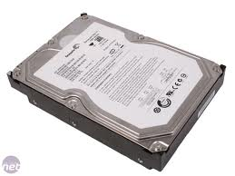
DXi6802 Data-at-Rest Encryption
Similar implementation to DXi8500-3TB
3TB Seagate SED or Hitachi FDE
What Users See: What’s Happening Inside the System:
DXi6802 System
RAID Controllers
SED/FDE Drives
DXi Data-at-Rest Encryption License
Authentication
Key A
Authentication
Key B
Unique Data Encryption Key
(each drive has unique DEK)
Not accessible
Password to Keys Recovery File
Authentication
Key C
256-bit AES
Authentication Keys
Recovery File
(Can be stored anywhere)
Each RAID controller is unique with the authentication key
Do not swap RAID controllers without reloading authentication key

Slide 49
Data-at-Rest Encryption
A Self Encrypting Drive will always encrypt any data written, and will always decrypt any data read.
By default this is completely transparent to the controller.
Optionally the controller can limit the access to the encrypted data on the drive.
  If enabled, this ties an SED drive to a specific controller by use of an encryption key, agreed between drive and controller.
  No other controller can get to the drive data without the encryption key.
  If such a configured drive gets “lost”, nobody can read the data.
    In fact drive is unusable, unless secure erased.
  Encryption keys managed by controllers (invisible).
  Keys can be optionally saved to a Recovery File (in encrypted form!) to be used for recovery. A password is used to secure the Recovery file.
  The Recovery File is needed for FRU replacement of a simplex Array Controller when encryption is enabled.
    Not applicable to an encrypted 8500-3TB because they are duplex controller systems
  The passphrase (also present inside the Recovery File) is needed for FRU replacement of a PERC H710 Node Controller when encryption is enabled.
Detailed process documented in FSM

Slide 50
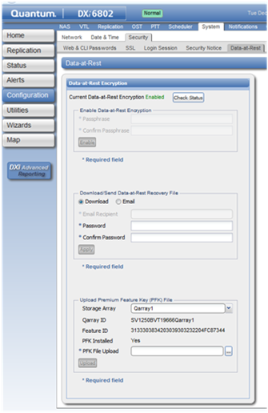
Data-at-Rest Encryption GUI, 3 Actions
STEPS:
Load PFK files for DATA arrays
Setup passphrase, Enable Encryption
Save Recovery File
USAGE:
Once per first setup of data RAID
Once
Multiple times

Slide 51
Data at Rest Encryption
Service menu also supports Encryption commands:
  0) Verify Disk Security Capability - Check if Disk Security is supported.
  1) Show Status of Disk Security - Is each LUN Encrypted?
  2) Show Hardware Information - Info needed to create PFK files.
  3) Show Premium Feature Status - Shows Premium Feature in RBODs
  4) Download Premium Feature file - Sent PFK file to an RBOD.
  5) Backup Disk Security Keys - Export Encryption keys info in a ZIP-file.
  6) Enable Disk Security - Turn on Encryption for all LUNs.

Slide 52
FRU handling and Encryption
Storage Array Controller Replacement requires an extensive procedure when Data-at-Rest Encryption is Enabled
  Before beginning the procedure, get a copy of the Recovery File.
  The Recovery File contains keys for the integrated storage controller (PERC H710) and the Array module (RBOD) controllers.
  Follow the procedure defined in the Field Service Manual
  Use the Recovery File on disk, see /opt/DXi/RAID/KeysInfo.
  PERC H710 Controller Replacement requires the Passphrase if Data-at-Rest Encryption is Enabled
  Follow the procedure defined in the Field Service Manual, e.g. enter passphrase in H710 controller BIOS.
  If the user does not have external Recovery File (which holds the passphrase), and the user does not otherwise know the passphrase, no access to any Node disks is possible, and all data on the system must be considered lost.
No special FRU instructions when no Data-at-Rest Encryption Enabled

Slide 53
FRU handling and Encryption
Drive Replacement:
  Required strategy is “like for like”
  If a non-SED drive is used in a SED tray:
    If encryption was enabled ➔ continues to encrypt, but the non-SED drive will not have its data encrypted. This is not flagged!
    If encryption was not enabled ➔ continues to work as usual, but enabling encryption will fail due to the non-SED drive.
  If a SED drive is used in a non-SED tray:
    Will operate as usual, transparent.
  Applies to both Node (Dell) and Storage (NetApp) Modules
Re-using Drives:
  If encryption was enabled, drive will not work with any other controller.
  If encryption was not enabled, drive would work.
Use “System Shred” to completely wipe an Encrypted system.

Slide 54
Performance
Presented By: Jim Peters/Jimmy Lee

Slide 55
Performance
Metric | PRD (TB/hr) | 6802 Results Mirror Cache=Disable (TB/hr) | 6702 UpTo Comparison (TB/hr) | 8500-3T UpTo Comparison (TB/hr)
Ingest UpTo
VTL | 7.8 | 11.9 | 5.8 | 11.1
OST | 7.8 | 16.3 | 6.7 | 10.1
NFS | 6.1 (Async) | 10.1 (Async) | 5.3 | 6.8
 | 4.2 (Sync) | 7.5 (Sync) | 3.7 | 5.4
CIFS | 6.8 | 13.5 | 5.0 | 9.0
VTL- Single Strm | 1.1 | 1.2
OST-Single Strm | 1.1 | 1.2
Read UpTo
VTL | 6.2 | 9.7 | 4.8 | 7.1
OST | 6.2 | 9.1 | 6.2 | 7.4
NFS | 3.5 (Async) | 6.5 (Async) | 3.8 | 3.4
 | 3.3 (Sync) | 6.3 (Sync) | 3.8 | 3.4
CIFS | 6.0 | 8.4 | 5.6 | 5.8
VTL- Single Strm | 0.8 | 0.7
OST-Single Strm | 0.8 | 1.9
PTT UpTo
PTT (MB/s per Drive) | 70.0 | 78

Slide 56
Enabler Products
Presented By: Jim Hibbard

Slide 57
Enabler Product Updates
Guardian Support 2.0.7
  Internal testing of new version expected in early January
  Support for additional products in version 2.0.7 will follow
Vision 4.2 supports DXi6802
  Regression tested by SVT
DAR 2.1.2 version embedded
  Fixes missing diagrams for 10GbE interfaces (PTR31496)
  Addresses GC free space metrics (PTR32039)
DXi Sizing Tool 3.0.2 release planned to support new DXi6802 data
  LA version could be available early January
  GA version planned for 1/28
    XML data from the performance team planned for 1/23
    Includes retesting to cover the expected performance gains
System Data Shred 1.1.0 release planned for 1/11/13
  Updates version 1.0.0 that currently supports 4000 and 65/67 – released 9/7/2012
    Posted on CSWeb
  Adds support to shred 8500-3TB and 6802 based on Encryption Technology (shreds in 1 hour)

Slide 58
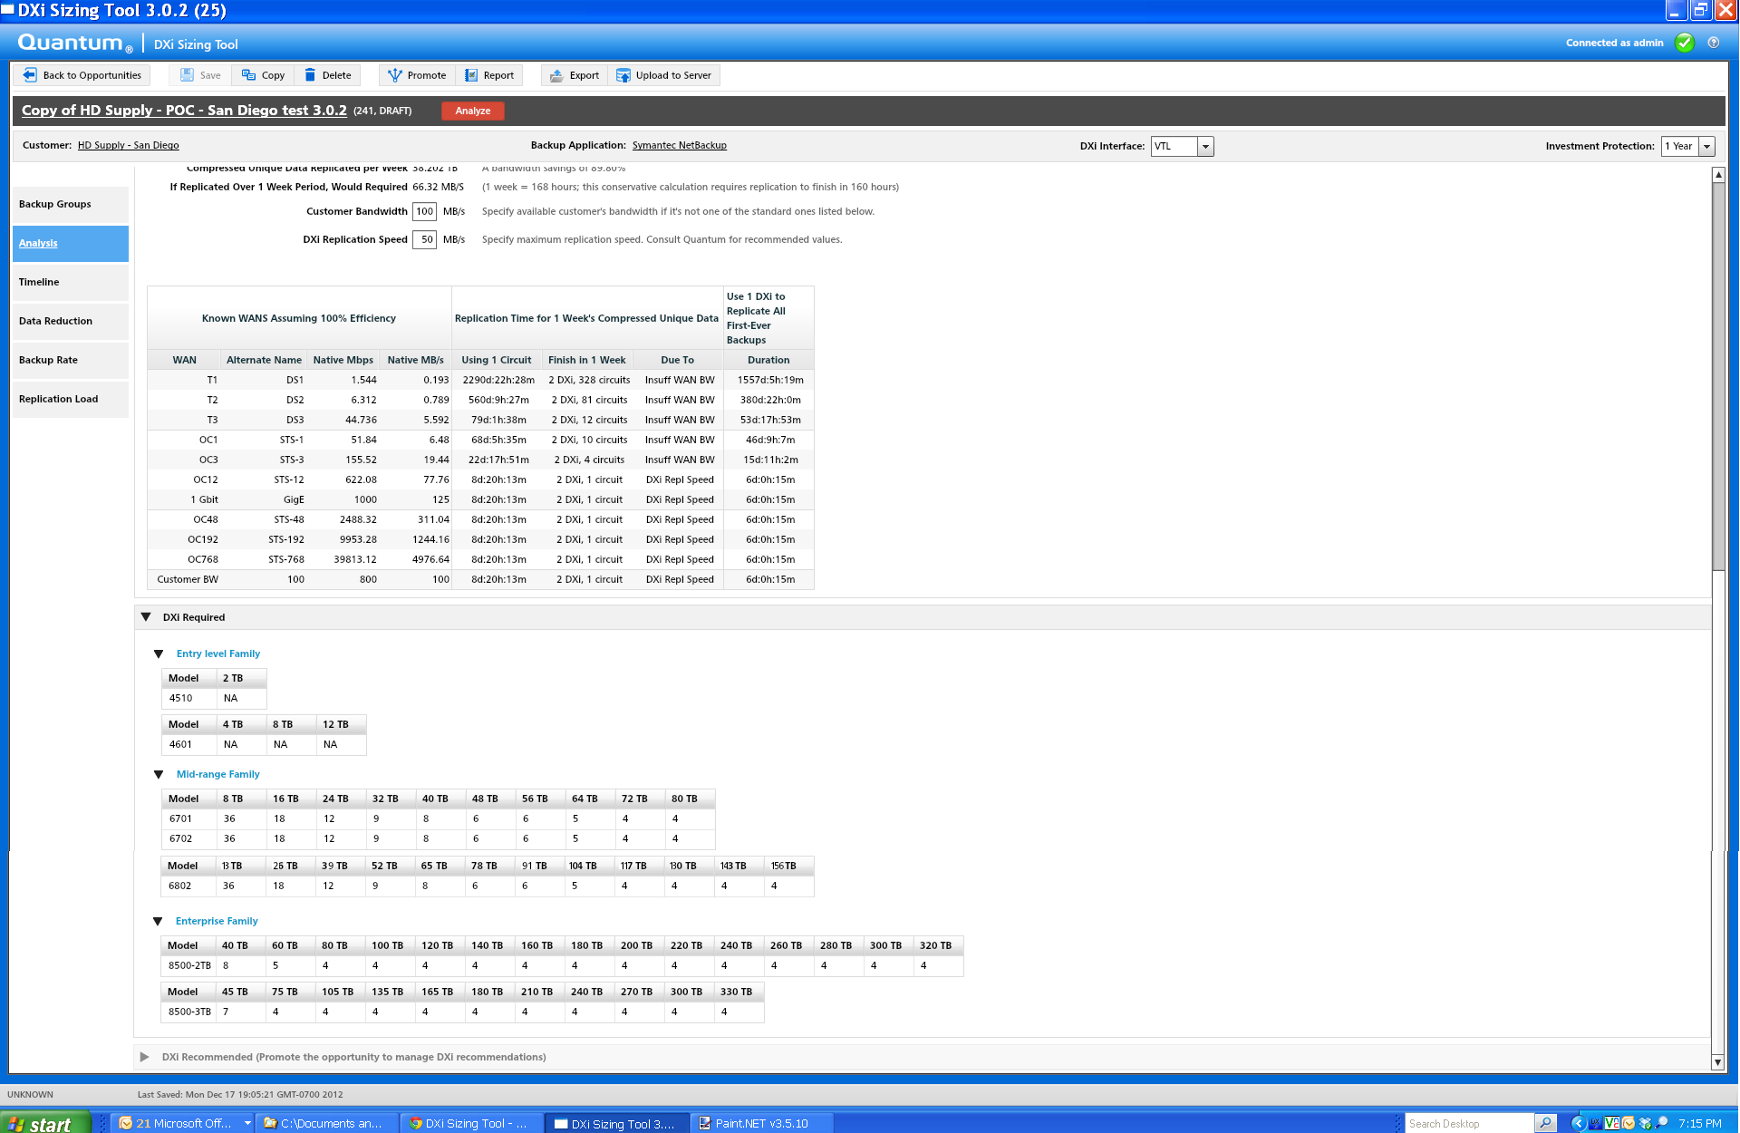

DXi Sizing Tool: Updated for 6802

Slide 59
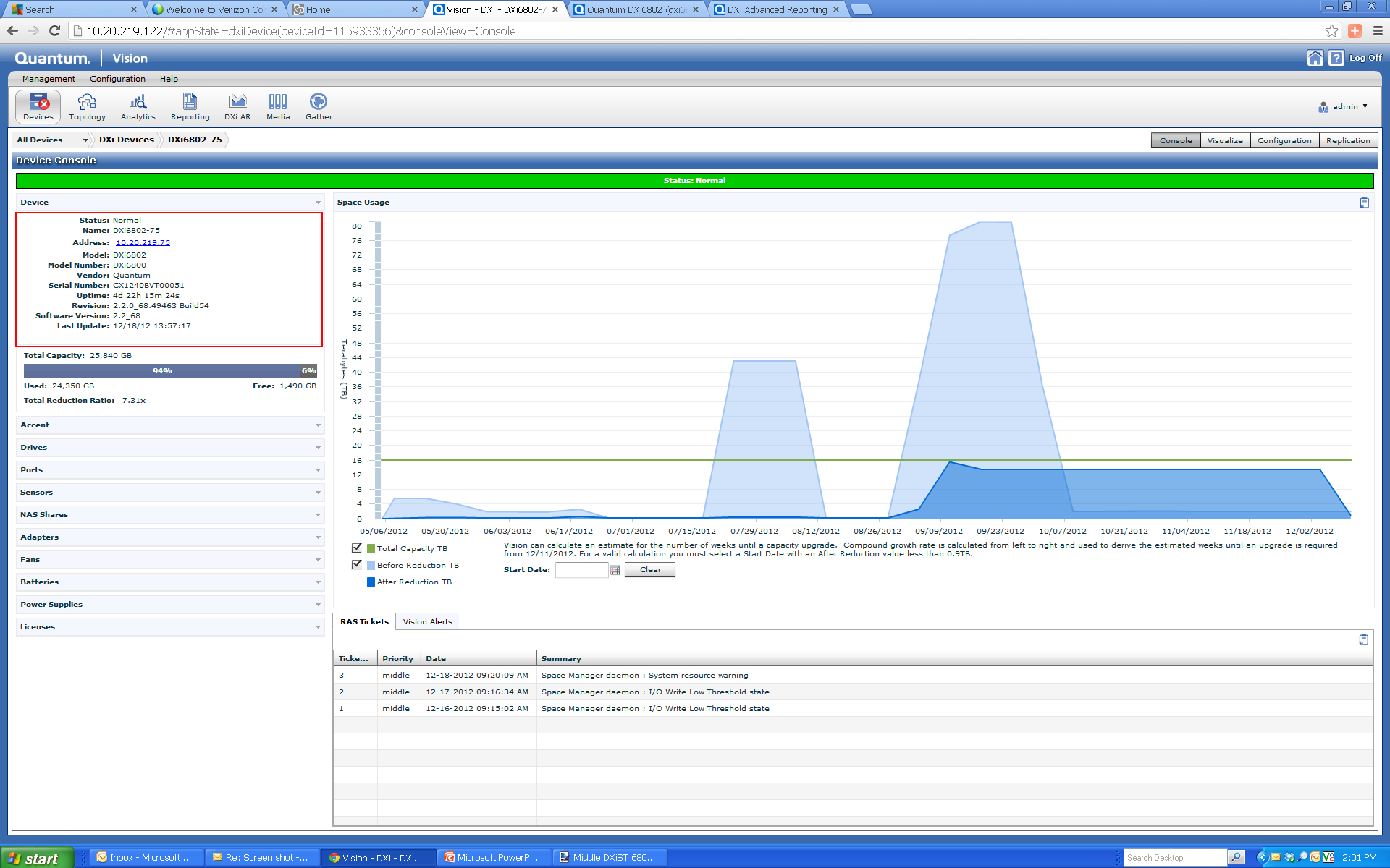
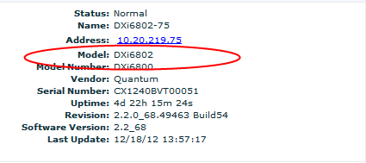
Vision: Support for 6802

Slide 60
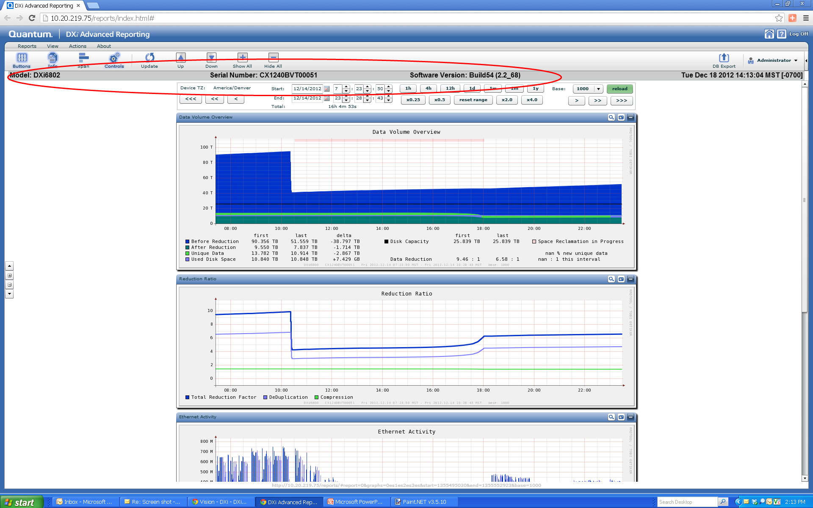
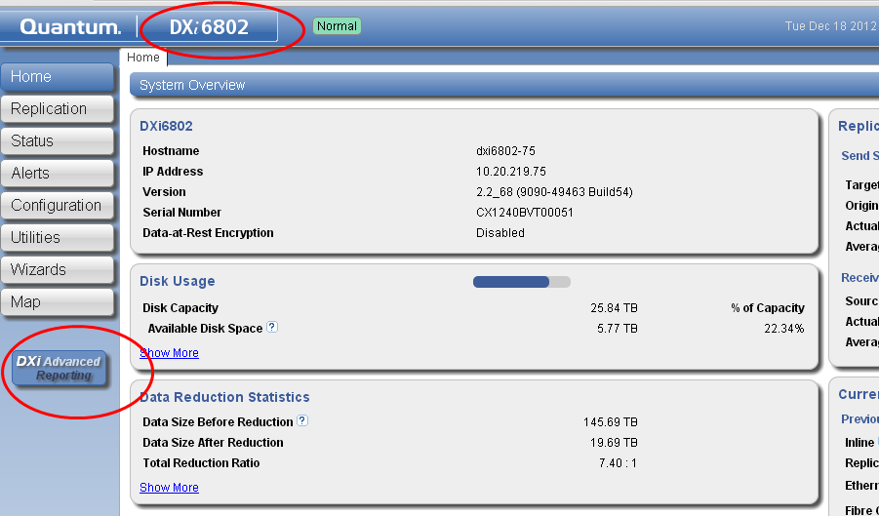
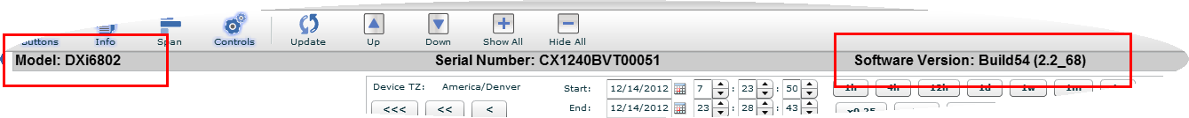
DAR: Support for 6802

Slide 61
Training Strategy
Presented By: Jim Bell

Slide 62
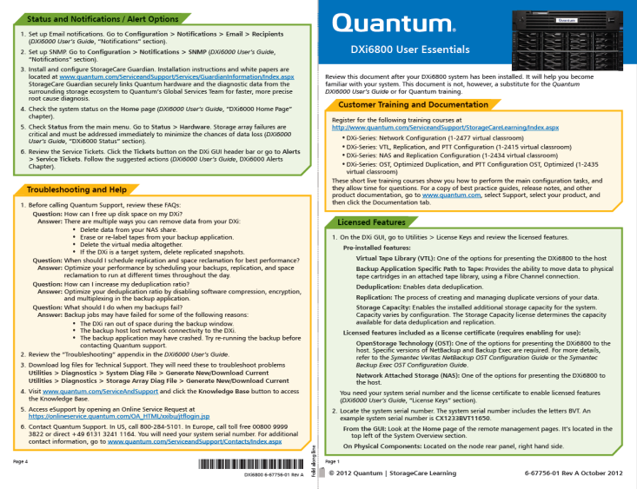
Customer Training
Customer Virtual Classroom Demo Courses on quantum.com – updated for DXi 2.2
  DXi-Series: Network Configuration
  DXi-Series: VTL, Replication, and PTT Configuration
  DXi-Series: NAS and Replication Configuration
  DXi-Series: OST, Optimized Duplication, and Direct to-Tape Configuration
The new DXi6800 User Essentials
  Customer-facing quick reference
  Helps familiarize a customer with a
  DXi6800 after installation

Slide 63
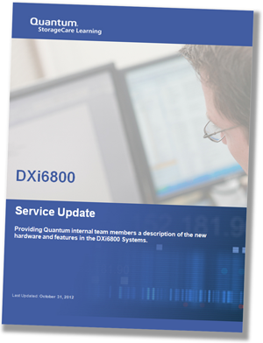
Service Training
These courses support the DXi6800 release and are available in StorageCare Learning:
NEW: DXi6800 Service Update
(2-4414a Online Self-Paced)
NEW: DXi6800 Installation
(2-4415 Online Self-Paced)
UPDATED: DXi-Series Installation
and Hardware Replacement
(2-0413 Classroom)

Slide 64
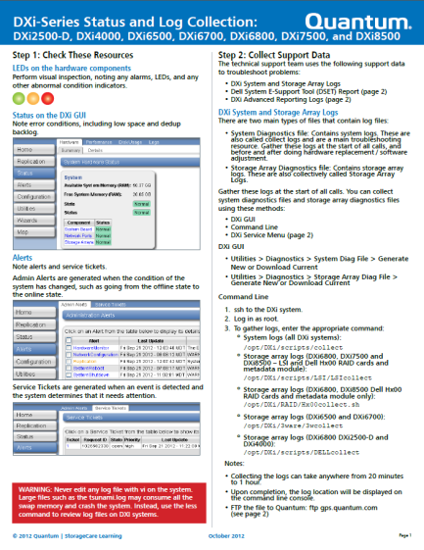
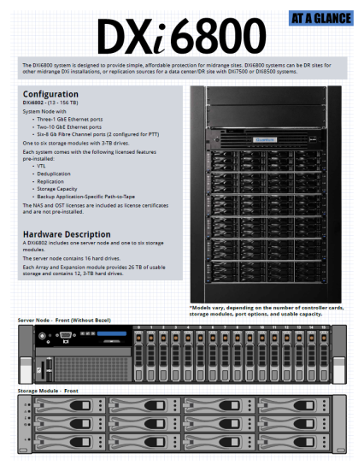
Training Resources
These documents ship with the product or are available on CSWeb:
NEW: DXi6800 User Essentials
NEW: DXi6800 At A Glance
UPDATED: DXi-Series Status
and Log Collection
UPDATED: DXi-Series Service and iDRAC Port Locations

Slide 65

eQuip Training Courses
eQuip – Global Services Extended Learning Library
Related courses
  RH 033 Linux Essentials Part 1 (2:46)
  RH 033 Linux Essentials Part 2 (2:14)
  RH 033 Linux Essentials Part 3 (2:33)
Access
  URL: http://equip.quantum.com
  Login with your email & password if you have an account
  or
  Create a New Account

Slide 66
Documentation Updates
Presented By: Jim Hibbard

Slide 67
Documentation Updates for Rocky
New documents to support DXi6800
  Customer facing documentation (posted on CSWeb and Quantum.com)
    DXi6800 Installation and Configuration Guide (6-67757-01)
    DXi6000 User’s Guide (6-67199-04)
    DXi6800 Site Planning Guide (6-67758-01)
    DXi 2.2_68 Release Notes (6-67763-01)
  Internal Service documentation (posted on CSWeb)
    DXi6800 Field Service Manual (6-67764-01)
    DXi-Series Software Installation and Upgrade Guide (6-67321-06)
    DXi6800 Capacity Upgrade Guide (6-67762-01)
    DXi6800 Optional Network Card Installation Instructions (6-67765-01)
  CRU Instructions (posted on CSWeb and ships with CRUs)
    Power Supply CRU Instructions (6-67759-01)
    Hard Disk CRU Instructions (6-67760-01)
    External Cable CRU Instructions (6-67761-01)
    Rack Mount Rails CRU Instructions (6-67793-01)
DXi-Series documents updated for 2.2.1 and DXi6800:
  DXi-Series NetBackup and Backup Exec Configuration Guide (6-67079-06)
  DXi-Series Command Line Interface (CLI) Guide (6-67081-08)
  DXi-Series Backup Application Specific Path To Tape Configuration Guide (6-67211-04)
  DXi-Series SNMP Configuration Guide (6-67082-06)

Slide 68
Service Strategy
Presented By: Jim Hibbard

Slide 69
Service Model – Roles and Responsibilities
DXi6800 Service Plan p/n 0-14662-01
  No change to current DXi Support Model
Global Call Handling (GCH)
  Takes first call, validates contract, and opens SR
Advanced Solutions Product Support (ASPS)
  Provides technical support via phone
  Dispatches QFE/TPM for any onsite efforts
  Escalation resources are SES and SUS
Quantum Field Engineer (QFE)
  Provides onsite FRU/CRU replacement
  Provides optional installation services
  TPMs leveraged in certain regions
  Escalation resources are RTS
Regional Technical Specialists (RTS)
  Provide escalation resources to QFE
  Escalation resources are SES/SUS
Service Engineering Specialists (SES)
  Provide escalation resources to ASPS and RTS
  Escalation resources are SUS
DXi Sustaining Engineer (SUS)
  Provide escalation resources to SES and ASPS
Approved Service Provider (ASP)
  Requires Quantum certification
  Escalation Resources are ASPS

Slide 70
Service Model – Product Service Offerings
Standard Warranty/Support Plan
  Product sold into a Quantum designated Zone 1 & 2 country will include a one year Bronze Support Plan. Product sold into a Zone 3 designated country will include one year of phone support with the customer being required to purchase at minimum a Bronze Support Plan in the first year (subject to availability).
    Initial 1 & 3 year support plans or Annual Renewal
    Extension (zones 1 & 2) / Uplift (zone 3)
Warranty uplifts & extensions
  Next Business Day Gold: Includes 5x9 Next Business Day on-site support, 24 telephone support, priority call handling and online resources.
    Initial 1 & 3 year support plans or Annual Renewal
    Uplift
  Gold Support Plan: Includes 24x7 on-site support, four-hour on-site target response time, 24-hour telephone support, priority call handling and online resources.
    Initial 1 & 3 year support plans or Annual Renewal
    Uplift
Installation and Integration Services
  DXi6800 is marketed as customer installable and thus Installation and Integration services are optional for a fee.
  Post sale capacity upgrades. All post sale capacity upgrades that require additional hardware be installed will require an onsite QFE.
  Post sale HBA NIC installation for additional Ethernet ports.
Non-Returnable Disk Drive Service Charge, Annual, all zones
  Designed for Secure Sites (Government / Military / …)
    Parts are not to leave the site
    Concerns about data security
  Disk Drive diagnosed as Failed and replacement required
    Quantum ships advance exchange of replacement drive without requirement for faulty drive return
Quantum Authorized Service Provider Programs (ASP) – refer to the Appendix for more details
  Authorized First Call Provider
  ASP Onsite Program
  ASP Owned Spares Program

Slide 71
Service Model – FRU/CRU Strategy
DXi6800 FRU/CRU List p/n 6-67727-01
  Dell FRUs/CRUs ordered from Dell
  Non-Dell FRUs/CRUs ordered from Quantum (Choice Logistics)

Slide 72
Service Model – Online Postings
CSWeb Postings complete
Quantum.com Postings complete

Slide 73
Q&A

Slide 75
Appendix
Presented By: Matthew Apodaca

Slide 76
DXi SW Version 2.2.1 PTR Metrics
Results related to Bugs:
  85 Fixed
    19 with associated Service Requests (SR)
  118 Resolved
  39 Deferred (%)
    118 Found in Test
    39 Found in dev
    All deferrals approved by CRB
    Details in the superbug 31101
Deferred Profile
Sev \ Pri | P0 | P1 | P2 | P3 | P4 | P5 | Total
1 | - | 1 | - | - | - | - | 1
2 | - | 3 | 2 |  | - | - | 5
3 | - | 2 | 11 | 15 | 4 | - | 32
4 | - | - | - | 1 | - | - | 1
5 | - | - | - | - | - | - | 0
Total | 0 | 6 | 13 | 16 | 4 | 0 | 39

Slide 77
Replication Compatibility
Source: Target: | DXi 1.4.4 | Fujitsu releases 1.4.1.2 & 2.0.2 | DXi 2.0.0.2 & 2.0.1 | DXi 2.1.x | DXi2.2 | DXi6802
DXi 1.4.4 | Yes | Yes | Yes | Yes | Yes | Yes
Fujitsu 1.4.1.2 & 2.0.2 | Yes | Yes | Yes | Yes | Yes | Yes
DXi 2.0.0.2 & 2.0.1 | Yes | Yes | Yes | Yes | Yes | Yes
DXi 2.1.x | Yes | Yes | Yes | Yes | Yes | Yes
DXi 2.2 | Yes | Yes | Yes | Yes | Yes | Yes
DXi6802 | Yes | Yes | Yes | Yes | Yes | Yes

Slide 78
IHV/ISV Compatibility
Presented By: Jurgen van der Linden

Slide 79
Compatibility
FC Switches/HBAs | 1 GbE and 10GbE Switches | Tape Libraries | Tape Drives
Brocade Silkworm 8Gb Fibre Channel Switches | HP’s Pro Curve (1GbE and 10GbE) 5406zl, 3400cl | Quantum Scalar i500 | IBM LTO-3, LTO-4, and LTO-5
QLogic SANBox 8Gb Fibre Channel Switches and HBAs | Aristra Networks (10GbE) 7124S, 7148S | Quantum Scalar i2000 and i6000 | HP LTO-3 LTO-4, and LTO-5
Cisco MDS9513 | Cisco/LinkSys (1GbE and 10GbE) Nexus 5010, Nexus 5020, SLM2048, SRW2024 | Quantum Scalar i40 and i80 | n/a
Emulex LPe 8Gb Fibre Channel HBAs | Fujitsu (10GbE) XG1200, XG2000 | n/a | n/a
Brocade 8Gb Fibre Channel HBAs | Netgear (1GbE) GSM7224 | n/a | n/a

Slide 80
Application Support
Backup SW Tier 1 | Backup SW Tier 2 | Host OS Tier 1 | Host OS Tier 2
Symantec Backup Exec VTL and OST including OST to tape | Atempo Time Navigator | Windows | HP-UX
CA ArcServe | Quest NetVault (formerly Backbone) | Solaris | IBM-AIX
Symantec NBU VTL and OST including OST to tape | Oracle Secure Backup | RH Linux | SUSE Linux
CommVault Simpana | HP Data Protector |  | NetApp Data ONTAP
EMC Networker
IBM Tivoli Storage Manager
Notes:
Tier 1 ISV supported at GA, all others staged per standard release policy (GA + 3 months). Ref Tom Merkle.

Slide 81
FAQ

Slide 82
FAQ
Does this mean the new DXi6802 is Generally Available (GA) for orders?
  Yes, Limited Availability for the DXi6802 began on December 18, 2012. Effective earrly Febuary 2013, the DXi6802 will become Generally Available for all geographies worldwide and all shipments will qualify for Path-to-Forecast revenue.
Is the DXi6802 customer installable?
  Yes, all new DXi6802 installations (spanning any initial capacity: 13TB to 156TB usable) are customer installable
Are capacity expansion upgrades customer installable?
  No, capacity expansion upgrades are only Quantum service installable
What is the minimum capacity expansion for the DXi6802?
  All capacity expansions are added in multiples of 13TB usable up to the system maximum configuration of 156TB usable.
Since the DXi6802 uses two types of expansion shelves (RBOD and EBOD), how are field expansions tracked/managed?
  The type of expansion shelf being used is transparent to the user. The necessary expansion personality is governed by the capacity and will automatically be managed through manufacturing.
What 10GbE interface flavors will be offered?
  Optical and copper per previous practice
What is the MTBF of the DXi6802?
  Per standard policy, Quantum does not quote an MTBF nor do other mainstream vendors with hot spares, T10DIF and RAID6 protection in addition to Quantum’s experience in delivering enterprise-class systems customers can expect excellent data protection when deploying DXi6802.

Slide 83
FAQ
What is the MTBF of the DXi6802?
  Per standard policy, Quantum does not quote an MTBF nor do other mainstream vendors with hot spares, T10DIF and RAID6 protection in addition to Quantum’s experience in delivering enterprise-class systems customers can expect excellent data protection when deploying DXi6802.
Is there any upgrade path from DXi6701/02 to DXi6802?
  No, these are two distinctly different products with no storage or controller commonality. Per DXi deduplication appliances, replication compatibility exists with existing DXi deduplication products
Will the new DXi6802 deduplication appliance be offered through Quantum’s channels?
  Yes, as with all Quantum products, the new DXi6802 will be available worldwide through Quantum Field Sales Representatives and channel partners.
Will support for encryption and 3TB disk drives be made available on the DXi6701/02 platform?
  No, neither encryption nor 3TB disk drives will be supported on the DXi6701/02. For those customers that need either (or both) of those capabilities in a midrange platform, customers will need to purchase a DXi6802 deduplication appliance.
Since the DXi6802 offers Capacity-on-Demand (CoD) expansion, will it ship with all drives (156TB usable) even if the customer doesn’t purchase the maximum configuration?
  No, unlike Capacity-on-Demand with the DXi4601, the DXi6802 will not ship with its maximum configuration of storage. Each disk shelf contains 26TB usable capacity and the amount shipped to the customer will depend upon the capacity purchased

Slide 84
FAQ
What are the target applications for the new DXi6802 deduplication appliance?
  Replication of Backup Data for Automated DR Protection
    Simplified DR and reduced media management
    Deduplicates data across multiple sites and applications before data is sent
    Replication with deduplication sends only new blocks Provides automated, encrypted asynchronous background process
    Bi-directional protection — units can be both source and target
Distributed LAN/WAN-based DR Protection for Local and Remote Media Servers
  Provides differentiated, flexible deduplication
  Enables deduplication at remote sites without local dedupe appliance
  Reduces network traffic for both backup & DR
  Supports backup over WANs as alternative to local appliance
  Enabled server-by-server
  Included in base-price

Slide 85
FAQ
Potential Pitfalls for Customer Installations – OBE Notes:
  SN label sleeve on rear of Node chassis may become dislodged on install
    Check to verify the label remains affixed to the chassis after mounting in a rack
    Engineering is reviewing options for more secure attachment of the label sleeve
  Replacing Expansion Module slide rail mount spacer for square hole racks
    Small spacer needs to be replaced by larger spacer, easy to drop / lose small HW
    No spare screws or spacers in current kit, spare parts on order for future builds
  SAS cable not fully seated on EM connector, system booted to Limited Mode
    Failure observed in OBE – cable appeared to be plugged into EBOD, but was not
    Caution note added to Install Guide; listen for click, slight tug to verify seating
  Need to use supported web browser in order to load PFK activation file
    Can’t upload PFK file via DXi remote management console on PC using MS IE 7
    Supported web browsers include MS IE 8.x or higher, Mozilla Firefox 7.x or higher
Complete List of OBE Findings:

