Slide 1
DXi4701 2.3.1_47
(Blue Program)
TOI for Global Service
20MAR2014

Slide 2

2

Slide 3
Agenda
Marketing Overview – Matthew Apodaca
HW Engineering – Maged Motaweh
Storage Expansion – Brian Grove
SW Engineering & Known Issues – Brian Grove
Enabler Updates – Mike Simone
Documentation and Training Updates – Jim Bell/Mark Anthony
Service Model – Jim Hibbard
Note: Ask questions as we go. Q&A also at the end.

Slide 4
Marketing Overview
Presented By: Matthew Apodaca

Slide 5
DXi4700 Summary
New entry / midrange scalable DXi
  Two models to choose from
    NAS / OST model with 3x 1GbE ports and 2x 10GbE optional ports
    VTL model with 3x 1GbE ports 2x 8GB FC ports and 2x 10GbE optional ports
  Customer Installable – new installs and upgrades
  5TB to 135TB with CoD
  4TB SEDs* deliver best density in the market, largest config is 8U!
  Data-at-rest encryption
  Up to 5TB / hr ingest
Positioning
  Designed to compete against EMC DD2500, Symantec, HP, etc.
*Not available in China, Russia, Belarus or Kazakhstan

Slide 6
DXi4701 & FIPS
FIPS = US Federal Info Processing Standard 140-2
  A set of standardized codes for data security
  Compliance gaining increasing importance in finance, medical and
Level 1 “FIPS Certified algorithm”
  EMC/DD, FalconStor, IBM (FalconStor), NEC…
Level 2 “FIPS Certified Hardware”
  ExaGrid (select models)
DXi4701 has FIPS 140-2 Level 2 certified SEDs – node & expansions
    MAJOR competitive advantage

Slide 7
DXi4701 Capacity and Hardware
5TB
(6x4TB)
Usable Capacity
Upgrade Parts
+ 18TB license
+ JBOD1
+ 32GB RAM
+ SAS HBA
+ 18TB license
+ 6TB license
99TB
11TB
+ 18TB license
+ JBOD3
+ 32GB RAM
All capacities available as VTL or NAS/OST
JBODs ship fully populated w/12x 4TB
Hardware included with capacity upgrade licenses
All upgrades customer-installed
45TB
+ 8TB license
+ 6x4TB disks
+ 18TB license
117TB
63TB
19TB
(12x4TB)
+ 18TB license
+ 18TB license
+ JBOD2
+ 8TB license
135TB
81TB
27TB
Notes:
Speaker Notes:
Yeah it’s ugly. Blame the bean counters.
Base system comes with 32GB

Slide 8




DXi4701 Competitive Comparison
Spec | EMC DD620 | Quantum DXi4701 | EMC DD2500 | SYMC NBU5230
Useable Capacity | 5TB or 9TB | 5TB to 135TB | 12TB to 156TB | 4TB to 76TB
Max Performance | 1.1 TB/hr (2.4TB/hr Boost) | 5.9 TB/hr (11.5TB/hr Accent) | 5.3 TB/hr (13.4TB/hr Boost) | 7 TB/hr Measured @ 100 streams
Hard Drives | 1 TB 12 x 3.5” SATA | 4 TB 6 or 12 x 3.5” NL-SAS, external JBODs | 3 TB 12 x 3.5” SAS, external JBODs | 2 TB or 3 TB 16 x 3.5” SAS, external JBODs
Hot Spares | Yes (1 per system) | Yes (1 per shelf) | Yes (2+ per system) | Yes
List Price | Starts at $26,486 ($5,297/TB) | Starts at $16,000 ($3,200/TB) | Starts at $45,000 ($3,750/TB) | Starts at $24,650 ($6,163/TB)

Slide 9
DXi Comparison
attribute | DXi4601 | DXi4701 | DXi6701/02 | DXi6802 | DXi8500
Usable Capacity (TB) | 4, 8 or 12TB | 5TB…135TB | 8..80TB | 13..156TB | 45..330TB
Expansion (TB) | 4TB (CoD) | 5,8 or 18TB (CoD) | 8TB / 16TB | 13TB (CoD) | 30TB
Disk Drives | 2TB | 4TB | 1TB; 2TB | 3TB | 3TB [2TB]
Presentation | NAS / OST | NAS / OST / VTL No Multi-Protocol | NAS / OST / VTL Multi-Protocol | NAS / OST / VTL Multi-Protocol | NAS / OST / VTL Multi-Protocol
Performance (TB/hr) | 1.7 (NAS) | 5.9TB/hr (VTL) 5.8TB/hr (OST) | 6.5TB (NAS) 6.4TB (OST) 9.1TB (VTL) | 13.5 (NAS – 4 ports) 16.3 (OST – 4 ports) 11.9 (VTL -4 ports) | 9.0 (NAS – 4 ports) 11.8 (OST – 4 ports) 14.2 (VTL – 4 ports)
Connectivity | 4 x 1GbE | 3 x 1GbE 4 x 8Gb FC Option: 2 x 10GbE | 4 x 8Gb FC DXi6701: 6 x 1GbE DXi6702: 2 x 10GbE 2 x 1GbE | 6 x 8Gb FC 2 x 10GbE 2 x 1GbE Options: 2x 10GbE or 4x 1GbE | 6 x 8Gb FC Ports 2 x 10GbE 4 x 1GbE Option: 2 x 10GbE
VTL and PTT | N/A | VTL: 64 VTD; 9000 VTC No PTT | VTL: 256 VTD; 9000 VTC 2x PTT and 2x VTL | VTL: 256 VTD; 9000 VTC 2x PTT (configurable) and 4x VTL | VTL: 512 VTD; 40,000 VTC 2x PTT and 4x VTL
Data Availability | RAID-6 Hot Swap Drives | RAID 6 Hot Swap Drives Hot Spares | RAID-6 Hot Swap Drives | Dynamic Disk Pooling (DDP) Hot Spares (Per Storage Shelf) T10DIF | RAID-6 Global Hot Spares Redundant RAID Controllers Redundant Interconnect and [Internal] Path Failover
System Availability | Redundant PSU/Fans | Redundant PSU/Fans | Redundant PSU/Fans | Redundant PSU/Fans | Redundant PSU/Fans
Data-at-Rest Encryption | N/A | Yes | N/A | Yes | Yes

Slide 10
DXi Portfolio Strategy
DXi8500
DXi6900
Available July2014
16TB to 512TB
16TB/hr
Dual Controllers
Compete against EMC DD4200, DD4500, DD7200 & DD990
DXi6800
DXi6700
DXi4701
Available Now
5TB to 135TB
5TB/hr
‘Scale with Simplicity’
Compete against EMC DD2500, SYMC & HP
DXi4600
DXi V-Series
Virtual Appliances
1-2TB, 4-24TB

Slide 11

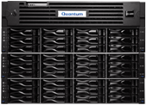

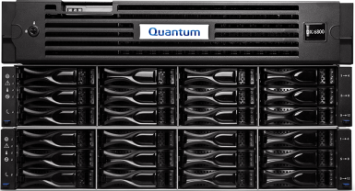

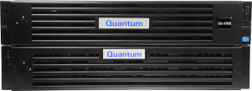




DXi Product Portfolio
DXi6902
Enterprise
NEW
DXi6802
Midrange
Performance
DXi4701
NEW
Comprehensive Solutions
Entry
DXi V-Series
Quantum Vision
1
24
5
135
8
156
16
512
20
480
100
2,700
160
3,120
320
10,240
Usable / Logical* Capacities (TB at 20:1 dedupe rate)
= Data-at-Rest Encryption

Slide 12
DXi4701 Performance
DXi4701 Up To Performance
Release: |  | Inline Ingest | Blockpool Read
Presentation |  | Measured (MB/s) | Measured (MB/s)
NFS-Sync |  | 1180 | 778
NFS-Async |  | 1336 | 699
CIFS |  | 1437 | 838
OST |  | 1601 | 963
OST Accent |  | 3065 | 1387
VTL |  | 1650 | 992

Slide 13
DXi4701 Performance Improvements
Protocol | DXi 4601 Performance Numbers | DXi4701 Performance Numbers*
OST | 1.7TB/hr | 5.8TB/hr
NAS | 1.7TB/hr | 5.3TB/hr
DXi Accent | 5.1TB/hr | 11.5TB/hr
VTL | N/A | 5.9TB/hr
241% Faster
212% Faster
125% Faster
100% Faster
Notes:
DXi6701: 2.7TB/hr (Ethernet only). 8.8TB/hr Accent
DXi6702:
5.8 TB/hr VTL
9.1 TB/hr VTL+2
6.4 TB/hr OST
5.4 TB/hr NFS (a)
6.5 TB/hr CIFS
8.0 TB/hr Accent

Slide 14
HW Engineering
Presented By: Maged Motaweh

Slide 15
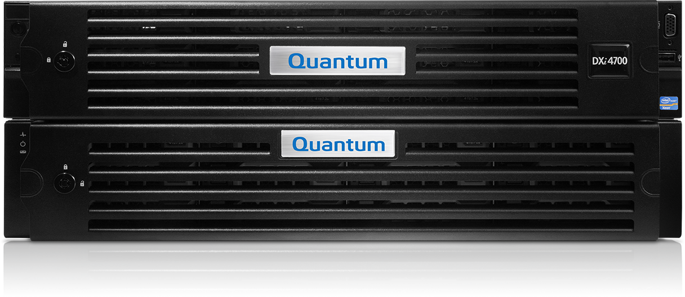
DXi4701 System Configuration
Dell R720xd 2U server
Shipped with six 4-TB hard disk drives
Standard Features Included
  RAID 6 with hot-swap drive support (GUI visible)
  Redundant, hot-swap 750 watt power supplies
  Standard rack-mountable 2U chassis
  Rack mount kit with no cable management arm
  North American and C13-C14 power cables
  Three CAT5e 10’ cables
No integrated DVD (front USB ports for use with flash drive or external DVD)
No system rack included
Up to three Dell MD1200s for external storage

Slide 16
Hardware Architecture

Slide 17
Server Comparisons
DXi4601 (Node & Storage) | DXi4701 2.3 (Node) | DXi6802 (Node)
Dual socket Intel Xeon 5620 | Dual socket Intel Xeon E5-2603 V2 | Dual socket Intel Xeon E5-2670
4 Cores each & dual threads | 4 Cores each & single thread | 8 Cores each & dual threads
2.40GHz | 1.8GHz | 2.66GHz
12MB L3 Cache/socket | 10MB L3 Cache/socket | 20MB L3 Cache/socket
32GB RAM @ 1066MHZ | 32GB, 64GB, or 96GB RAM @ 1333MHZ | 128GB RAM @ 1600MHz
3 x PCIe 2.0 Slots | 7 x PCIe 3.0 Slots | 7 x PCIe 3.0 Slots
PCIe Expansion Available 3 slots | PCIe Expansion Available 2 slots | PCIe Expansion Available 2 or 3 slots
8 x 3.5” 2TB SATA HDD | 12 x 3.5” 4TB SATA HDD | 2.5” 900GB NL-SAS Meta data storage.
Notes:
Note since it’s a dual CPU, highlight that cores/threads are 2x that of a single cpu.
The CPU performance benchmark used by our team is referenced at:
http://www.cpubenchmark.net/multi_cpu.html

Slide 18
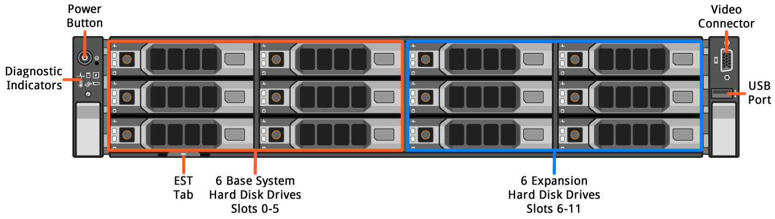
DXi4701 Server Node Front View
Drive Slot Numbering
0 | 3 | 6 | 9
1 | 4 | 7 | 10
2 | 5 | 8 | 11
Six 4-TB HDDs base configuration
  RAID 6 set (3+2+1) with single hot spare
  Six 4-TB HDDs capacity expansion
    RAID 6 set (4+2)

Slide 19

DXi4701 Node Diagnostic Indicators
Icon | Indicator/Button | Condition
 | NMI Button | Not used
 | Health | Solid blue - The system is on and in good health Blinking amber - The system is on and an error exists
 | Hard Drive | Blinking amber - A hard drive error has occurred
 | Electrical | Blinking amber - An electrical error has occurred
 | Temperature | Blinking amber - A thermal error has occurred.
 | Memory | Blinking amber - A memory error has occurred
 | PCIe | Blinking amber - A PCIe card error has occurred
 | System ID button | Press to toggle the front & rear system ID indicators

Slide 20
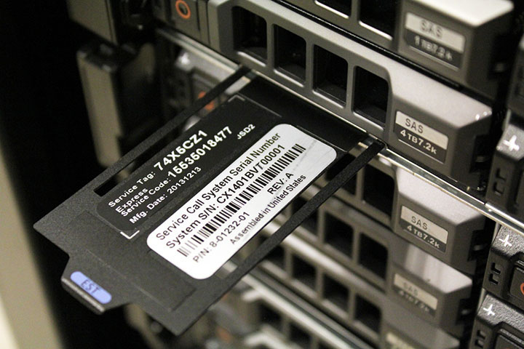
EST Tab – Serial Number & Service Tag

Slide 21
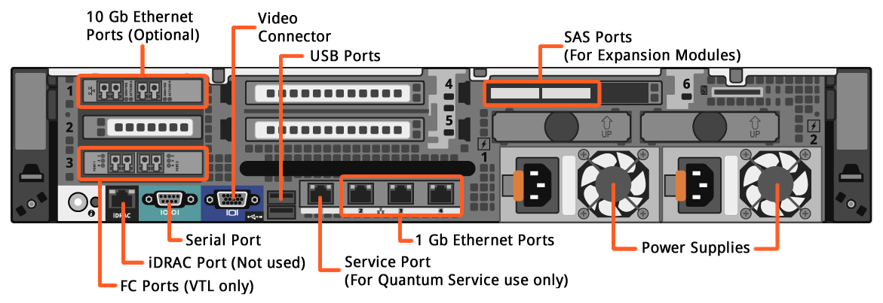
DXi4701 Server Node Rear View
Three 1 GbE ports
One 1 GbE service port
Perc H810, Two SAS ports (with expansion modules)
Two 10 GbE ports (optional)
Two FC ports (VTL only)
Two power supplies
iDRAC port NOT used

Slide 22
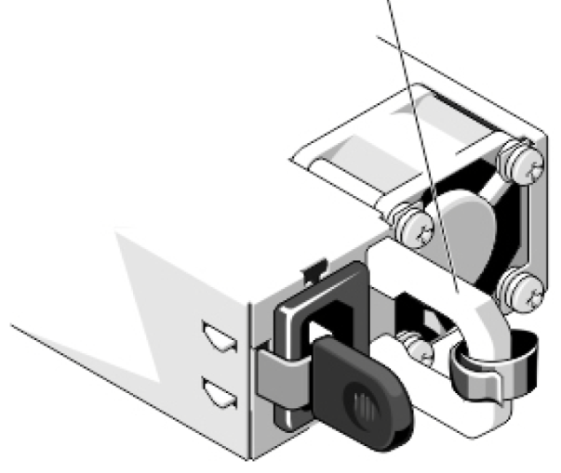
DXi4701 Node Power Supply Indicators
The handle on the R720xd Power Supply illuminates to indicate the supply status
  Green indicates AC power present
  Flashing amber or green indicates a fault.
Power Supply Status Indicator/handle
Handle Illumination | Power Supply Status
None | AC power not present
Green | AC power present
Flashing Amber | Power supply fault
Flashing Green | Power supply mis-match (when hot-swapped)

Slide 23
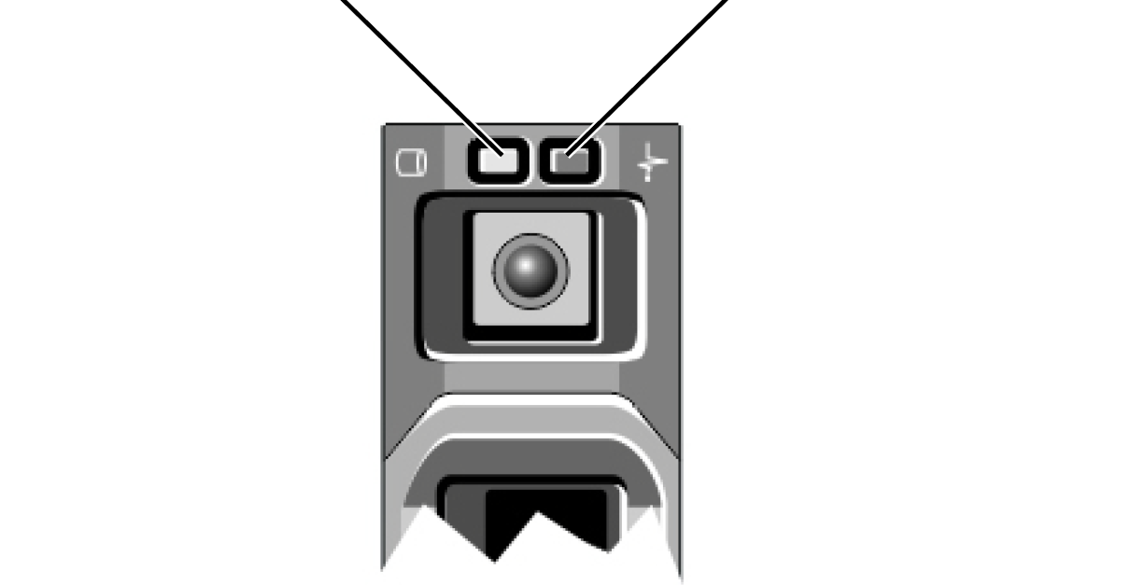
DXi4701 Node and Array HDD Indicators
Drive Activity Indicator (green)
Drive Status Indicator (green and amber)
Drive-Status Indicator Pattern (RAID only) | Condition
Blinks green 2 times per second | Identify drive/preparing for removal
Off | Drive ready for insertion or removal
Blinks green, amber, and off | Drive predicted failure
Blinks amber 4 times per second | Drive failed
Blinks green slowly | Drive rebuilding
Steady green | Drive online
Blinks green three seconds, amber three seconds, and off six seconds | Rebuild aborted

Slide 24
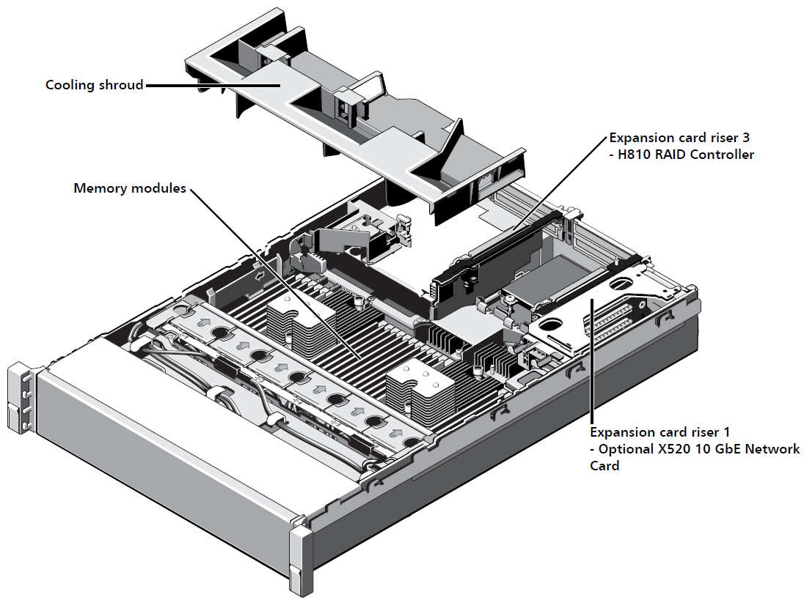
DXi4701 Internal Chassis

Slide 25
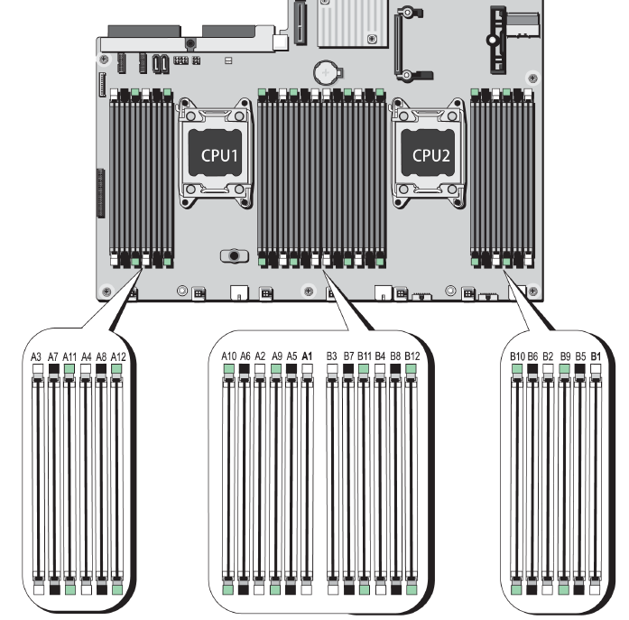
DXi4701 Memory Configurations
Configuration (Capacity) | Memory Required
All (factory) | White sockets, 32 GB total
45-135 TB | Black sockets, 64 GB total
117 & 135 TB | Green sockets, 96 GB total

Slide 26
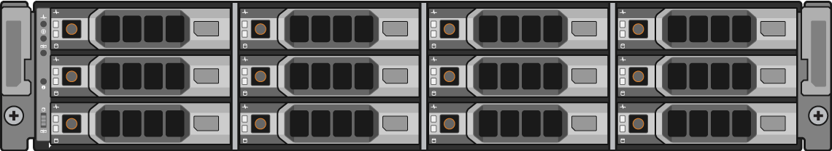
DXi4701 External Storage – Dell MD1200 Front Panel
Diagnostic
Indicators
Drive Slot Numbering
0 | 3 | 6 | 9
1 | 4 | 7 | 10
2 | 5 | 8 | 11
Icon | Indicator/Button | Condition
 | Enclosure Status | Solid blue - The system is on and in good health Blinking blue – The system ID button is pressed Solid amber – Power up or reset Blinking amber – A fault state exists
 | Power | Lights when at least one power supply is providing power
 | Split Mode | Not Used
 | System ID button | Press to toggle the front & rear system ID indicators

Slide 27
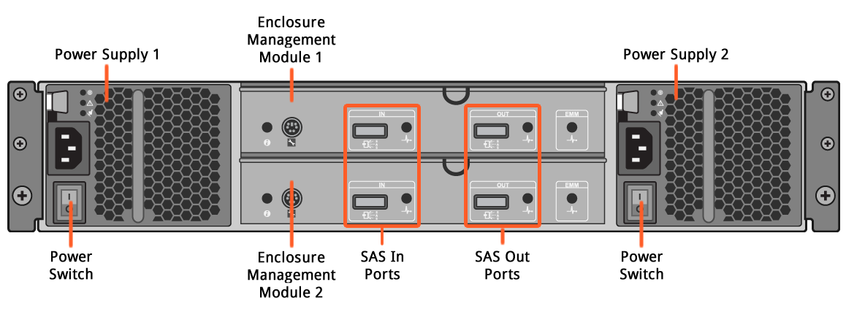
DXi4701 External Storage – Dell MD1200 Rear Panel

Slide 28
DXi4701 BIOS/FW Versions and Settings
No custom BIOS or component FW versions.
Embedded FW Docs is posted on CSWeb
DXi4701 SW Version 2.3.1_47
Node: Dell R720xd
Component | Auto-Level/ Auto-Upgrade/ Version Check
R720 Motherboard Rev | N/A
R720 SAS BP Expander | N/A
R720 Backplane firmware | N/A
R720 on-board Intel i350 NDC 1G Ethernet | AL
Standard Intel X520 10GbE HBA card | AL
Qlogic 8GB Fibre Channel QLE25xx (Loaded with Driver) | AL
H710 RAID Controller | AL
H810 RAID Controller | AL
R720 BIOS | AL
R720 iDRAC7 | AL
Expansion Module: Dell MD 1200
Enclosure Management Module | AL

Slide 29
DXi4701 Configuration Summary
Configuration (DXi4701 Installation Guide has detailed hardware lists for each configuration) | Licensed Usable Capacity | Nominal Capacity | Node HDDs | System Memory | Expansion Modules (JBODs)
DXi4701 (NAS/OST) 1 Node 3 X 1 GbE Ethernet Ports (Optional) 2 X 10 GbE (SFP+) Ethernet Ports TPM or non-TPM | 5 TB/11 TB | 12 TB | 6 | 32 GB | 0
 | 19 TB/27 TB | 28 TB | 12 | 32 GB | 0
 | Install H810 RAID Controller (2 X 6 Gb SAS Ports) in Node
 | 45 TB/63 TB | 64 TB | 12 | 64 GB | 1
 | 81 TB/99 TB | 100 TB | 12 | 64 GB | 2
 | 117 TB/135 TB | 136 TB | 12 | 96 GB | 3
DXi4701 (VTL) 1 Node 3 X 1 GbE Ethernet Ports 2 X 8 Gb Fibre Channel Ports (Optional) 2 X 10 GbE (SFP+) Ethernet Ports TPM or non-TPM | 5 TB/11 TB | 12 TB | 6 | 32 GB | 0
 | 19 TB/27 TB | 28 TB | 12 | 32 GB | 0
 | Install H810 RAID Controller (2 X 6 Gb SAS Ports) in Node
 | 45 TB/63 TB | 64 TB | 12 | 64 GB | 1
 | 81 TB/99 TB | 100 TB | 12 | 64 GB | 2
 | 117 TB/135 TB | 136 TB | 12 | 96 GB | 3

Slide 30
DXi4701 RAID Configurations
Starting at the 45 TB capacity point, the first JBOD and PERC H810 Controller are added
Additional RAM is required at 45 TB and 117 TB capacity points
Licensed Capacity (TB) | Server RAID Configuration | JBOD RAID MD-1200 Configuration | Unformatted Capacity (TB) | Capacity Increments (TB)
5 | 3+2+1 |  | 12 | 5
11 | 3+2+1 |  | 12 | 5+6=11 (COD)
19 | (3+2+1)+(4+2) |  | 12+16=28 | 11+8=19
27 | (3+2+1)+(4+2) |  | 12+16=28 | 19+8=27 (COD)
45 | (3+2+1)+(4+2) | 9+2+1 | 12+16+36=64 | 27+18=45
63 | (3+2+1)+(4+2) | 9+2+1 | 12+16+36=64 | 45+18=63 (COD)
81 | (3+2+1)+(4+2) | (9+2+1)+(9+2+1) | 12+16+36+36=100 | 63+18=81
99 | (3+2+1)+(4+2) | (9+2+1)+(9+2+1) | 12+16+36+36=100 | 81+18=99 (COD)
117 | (3+2+1)+(4+2) | (9+2+1)+(9+2+1)+(9+2+1) | 12+16+36+36+36=136 | 99+18=117
135 | (3+2+1)+(4+2) | (9+2+1)+(9+2+1)+(9+2+1) | 12+16+36+36+36=136 | 117+18=135 (COD)

Slide 31
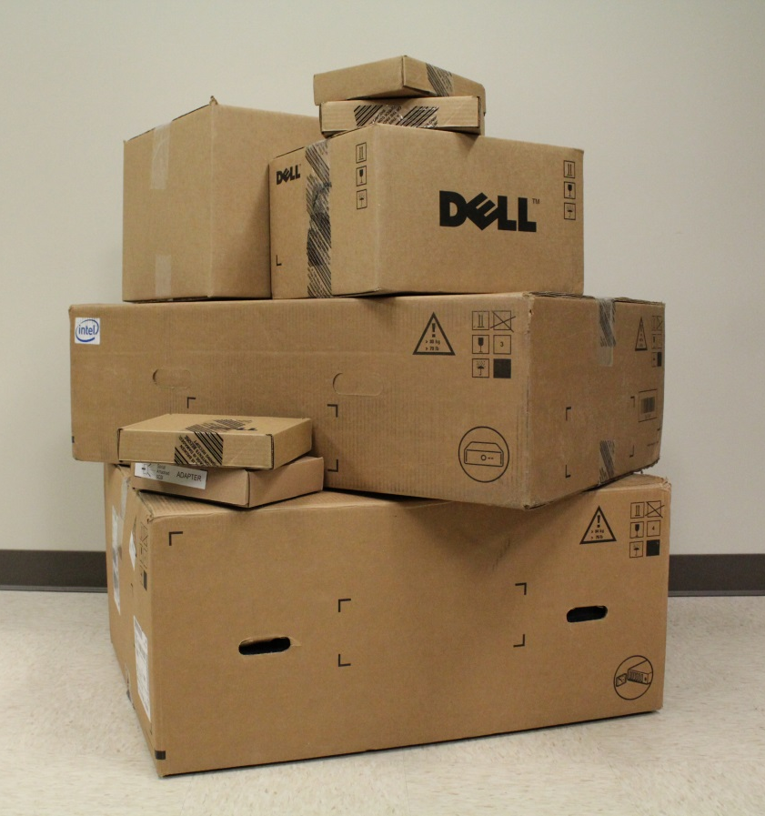
DXi4701 Factory Shipments
Base server with licensing
  NAS/OST OR VTL
  Replication
  Deduplication
  5 TB Base capacity
Depending on configuration:
  Additional hardware
    Additional 6 node HDDs
    Node memory
    Expansion modules
    H810 RAID controller
    Network Interface card with 2 X10 GbE Ethernet ports
    (VTL only) Fibre Channel card with 2 X 8 Gb ports
  Licensing above 5 TB base capacity
    COD points need license only
Manufacturing facility
  Initial release fulfilled from PPO manufacturing
  Transition to Avnet will occur later (TBD)

Slide 32
Storage Expansion
Presented By: Brian Grove

Slide 33
Storage Expansion Summary
Expandable data storage is supported through the head as well as one or more external JBODs.
The expansion is designed to be automatic and performed at boot time of the system which is performed in two steps:
  First , if the new storage is not configured, then RAID sets are created for each new non-configured storage block.
  Secondly, upon a successful RAID expansion (or if RAID expansion was not required) we will the perform expansion of the file system.
For the DXi4701, the expansion of either RAID sets or file system are not limited or controlled by the currently installed storage capacity license as with other products (e.g. RAID and/or file system expansion will occur irrelevant of the licensed storage capacity).
See Appendix for Storage Expansion RAS tickets

Slide 34
Storage Expansion and Licensing
Storage expansion is not limited to the installed licensed storage capacity.
The storage available to the user is now controlled by the spaced daemon.
The spaced daemon limits the amount of physical user data space available based upon the installed licensed storage capacity vs. total available capacity.
So you can have more available user data space on a system than what you are allowed to use based upon the total installed licensed storage capacity value and vice versa (e.g. you can have a total licensed storage capacity that is greater than the currently available user data space).

Slide 35
Expanding Storage
The storage is expanded upon boot of the system through the systemupgrade init script. The systemupgrade init script will call AutoFilesystemExpansion script to perform any RAID and or File System expansion. The expansion of storage is performed in two steps:
  RAID storage expansion.
  File System expansion.
Caveats to the above steps:
  If you have storage attached to the system that already has pre-configured RAID sets, then on the next boot of the system, all configured RAID sets will automatically be mapped to the file.
  You can disable the expansion of RAID and File System expansion by creating the /opt/DXi/NoAutoStorageExpand file. If that file exists, then no RAID or File System expansion is performed.

Slide 36
RAID Storage Expansion
If we detect that there is non-configured storage, then we will create the appropriate RAID set(s) for that storage if and only if we have verified conditions which allow creation of RAID sets.
If the pre-conditions for RAID storage expansion are not met, then we will abort with an error and notify the user of that error condition. Therefore no file system expansion will be performed if there are issues with performing any RAID expansion.
Note that we will first perform RAID expansion in the DXi Server/Head. If successful, and there also exists non-configured JBODs attached to the expansion RAID controller, we will then perform RAID expansion on each un-configured JBOD on the system.
The RAID storage expansion is performed in three steps:
  Pre-RAID expansion checks.
  Expansion of the RAID set on the DXi Server/Head.
  Expansion of RAID sets on any un-configured attached JBODs to the expansion RAID controller.

Slide 37
RAID Storage Expansion – Pre RAID Expansion Checks
The following checks are performed by the RAID storage expansion script, irrelevant if any RAID storage expansion is required. If all checks are OK, then we will then perform any necessary RAID expansion.
  Check Head for invalid RAID sets
  Unsupported JBOD
  Too many JBODs
  JBODs that have duplicate Volume Names
  Check JBODs for Invalid RAID sets

Slide 38
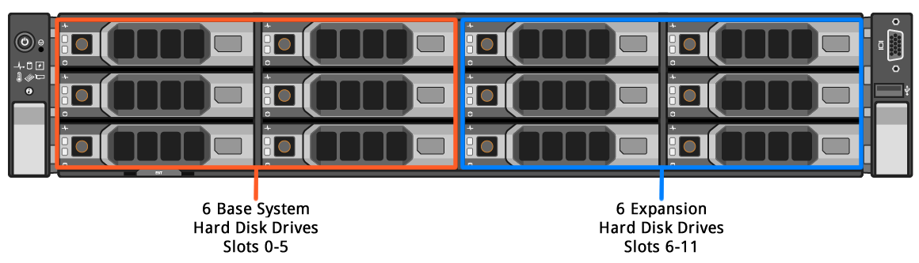
Server RAID Storage Expansion
For the DXi4701, the initial shipping configuration will have only 6 drives installed and configured as a 3+2+1 RAID set in slots 0-5 of the enclosure.
The remaining 6 slots will be empty (slots 6-11). If the user has purchased additional storage for the Head, then the user will receive 6 disk drives and one or more license authentication code which are used to generate storage capacity licenses from the Quantum Licensing Web site and then installed by the customer through the Web UI.
There is no specific order required for when storage is added vs. when licenses are installed. However the additional storage is not available to the user until the storage has been installed and licenses have been generated and installed.
  See the DXi4701 Capacity Upgrade Guide (6-68107-01 Rev A) for the proper order of adding additional storage to the system.

Slide 39
Server RAID Storage Expansion – Pre Conditions
When performing storage expansion for the DXi Server/Node, the following pre-conditions must be satisfied:
  There is only 1 RAID group defined on the DXi Server/Node RAID controller. That RAID set is defined as a 3+2+1, which is created during the RAID CD configuration. If we detect 2 RAID groups that are valid for the Server/Node RAID controller, then RAID expansion for the Server/Head is skipped.
  If there are 0 drives in slots 6-11, then we do not perform any RAID DXi Server/Node RAID expansion.
  If there are >=1 drives present in slots 6-11, then the existing RAID set on the DXi Server/Node must be in an optimal state. We test for the following conditions of the existing RAID set on the Dxi Server/Node:
    Drive is missing – If true, skip following tests
    Drive is Foreign – If true, skip following tests
    Drive size is less than 4TB
    Drive is not FDE capable (if required)
    Drive F/W state is not one of the following: Spunup, Hotspare, Ready, Rebuild, Online, Unconfigured(Good)

Slide 40
Server RAID Storage Expansion – Pre Conditions (cont.)
The existing RAID set in the DXi Server/Node is in an optimal state as defined above and there are >= 1 disks present in slots 6-11, then the following conditions must be satisfied to add a new RAID set to the DXi Server/Node for the drives in slots 6-11:
  Drive missing – if true skip remaining tests
  Drive is Foreign – if true skip remaining steps
  Drive size is less than 4TB
  Drive is not FDE Capable (if required)
  Drive F/W state is NOT Unconfigured(Good), Spunup

Slide 41
Performing DXi Server RAID Storage Expansion
If all pre-conditions have been satisfied as defined above, then we will perform a RAID creation on the additional 6 drives in the head (slots 6-11) using the Dxi Server/Node RAID expansion script. The Dxi Server/Node RAID expansion script performs these operations:
  Create the Meta LUN configuration (e.g. LUN name, cache settings, etc.).
  Create the Data LUN configuration (e.g. LUN name cache settings, etc.).
If any of the above steps fail, then upon exit of the head RAID expansion script, we will delete each LUN created in the new RAID group. Once all LUNs in the new RAID group have been deleted, that new RAID group is removed from the RAID controller. The following RAS ticket will be generated:
  *send_ticket_raid_creation_failed (*see appendix for RAS ticket information).
  Severity: Failure
  Resulting System State: Normal.
  Service will need to look at the logs to find the specific error that occurred on why the RAID set failed.

Slide 42
JBOD RAID Storage Expansion
JBOD RAID storage expansion is performed after any DXi Server/Node RAID storage expansion, if required and was successful.
We will not perform any JBOD RAID expansion until all storage in the DXi Server/Node has been expanded.
Note that JBOD RAID storage expansion does not require that the DXi Server/Node RAID sets be in an optimal condition, we only require that the DXi Server/Node has been expanded (which means that there are two RAID sets defined on the DXi Server/Node).

Slide 43
Pre-Conditions for JBOD RAID Storage Expansion
When performing any RAID storage expansion for JBODs, we first test for the existence of the expansion RAID controller, and if present, we then see if there are any attached JBODs.
  If either of these tests fail, then skip JBOD RAID storage expansion.
If the expansion RAID controller is present, and there exists >= 1 and <= 3 JBODs attached to that controller, then the following pre-conditions must be satisfied to perform JBOD RAID storage expansion:
  >= 1 un-configured JBODs attached and DXi Server/Node has 2 valid RAID sets.
  <= 3 JBODs are attached

Slide 44
Pre-Conditions for creating a RAID set on a un-configured JBOD
When performing RAID storage expansion for an un-configured JBOD, we will test for the following conditions on that JBOD. If all of the below conditions are OK, then we will create a 9+2+1 RAID set on that JBOD. If any of the conditions below fail, then skip that JBOD and all remaining JBOD RAID storage expansion as well as File System expansion.
  Test if JBOD is supported
  Test for missing drives – if true skip remaining tests
  Test for foreign drive – if true skip remaining tests
  Test the size of the drive >= 4000GB
  Test if a drive is FDE Capable (if required)
  Test that the drive has this f/w state: Unconfigured(Good), Spunup
Note that we will test all above conditions and generate a notification message for each failed case on all drives. If any of the above conditions fail we will abort any additional JBOD RAID storage expansion as well as File System expansion, even though we could have created RAID sets on one or more JBODs previously.

Slide 45
Performing JBOD RAID Storage Expansion
If all pre-conditions have been satisfied as defined above, then we will perform a RAID creation on an un-configured JBOD using the JBOD RAID expansion script. The JBOD RAID expansion script performs these operations:
  Create the Meta LUN configuration (e.g. LUN name, cache settings, etc.).
  Create the Global Hot Spare and set its configuration.
  Create the Data LUN configuration (e.g. LUN name cache settings, etc.).
If any of the above steps fail, then upon exit of the JBOD RAID expansion script, we will delete each LUN that was created on that JBOD and delete the Hot Spare if created. A RAS ticket will be generated by the main storage expansion script upon any RAID creation failure. However there is no specific error defined in the RAS ticket, just that the RAID expansion failed.
  *send_ticket_raid_creation_failed (*See the appendix for RAS ticket information).
  Severity: Failure
  Resulting System State: Normal.
  Service will need to look at the logs to find the specific error that occurred on why the RAID set failed.
  Service will need to look at the logs to find the specific error that occurred on why the RAID set failed.

Slide 46
File System Expansion
If RAID expansion was performed, and was successful, or if no RAID expansion was performed, then expand the file system if needed. This case handles pre-configured storage where the RAID sets have already been created but have not been mapped to the file system. We will keep track of each LUN that has been mapped to the file system which will be used to test for duplicate and foreign labels.
When performing any File System Expansion, the following pre-conditions are tested:
  Duplicate SNFS Labels
  Foreign SNFS Labels
If all pre-condition tests are satisfied, then we will add all unlabeled LUNs to the file system.

Slide 47
Service Script, RAID CD, and GUI Support
Service Script
  To support both manufacturing and test, the following services are available through the service script:
    Resetting the storage expansion. This will clear all SNFS labels and all expanded RAID sets (both on the second 6 drives in the DXi Server/Node as well as all attached JBODs). This is useful when exporting a JBOD from a system for testing purposes only!
    Clearing RAID sets on the second set of 6 drives in the DXi Server/Node or on any attached JBOD.
    Creating RAID sets on the second set of 6 drives in the DXi Server/Node or on any of the attached JBODs.
RAID CD
  See the DXi47xx RAID Storage document for the options available for creation/deletion of RAID sets.
GUI Support
  Upon login to the DXi GUI, if there is one or more opened RAS tickets a pop up dialog box will appear indicating there are issues that need to be addressed. The user can then click on the ‘OK’ button and the GUI will then show the opened RAS tickets. Clicking on the ‘Cancel’ button will go to the home page of the DXi GUI.

Slide 48
Memory Capacity Checks
Upon boot of the DXi system, the procconfig init script will perform the following checks to ensure that there is enough memory installed for the blockpool to support the currently attached storage capacity.
  <= 12 disks and < 32GB of memory
  Number of disks is > 12 and <= 36 and < 64GB of memory
  Number of disks is > 36 and < 96 GB of memory.
Note that we do not actually compare the total installed storage capacity against the currently installed memory size, but rather compare the number of drives present verse the installed memory size.

Slide 49
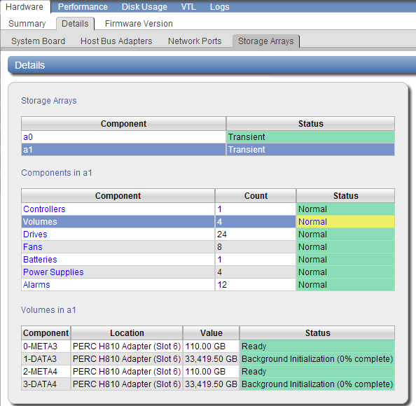
Background Initialization Screenshot

Slide 50
SW Engineering
Bug Fixes and Known Issues
Presented By: Brian Grove

Slide 51
Software Ver 2.3.1_47
DXi4701 SW Version 2.3.1_47
Feature and Bug fix equivalent to DXi 2.3.0.1 code level
Replication compatible with 4xxx, 6xxx, 8500, Vx000 and Fujitsu
Open Manage 7.1
DSET 3.3
Blockpool 3.8.7 for DXi4701
Blockpool Wrapper 11.7

Slide 52
Superbug PTRs and Bug Fix Metrics
PTR 33679 – Project Superbug (bugs fixed)
PTR 34122 – Deferred Superbug
  Deferred Bug Count as of 3/7: 64 (~15% of total managed in program)
Refer to Release Notes for more details.

Slide 53
Deferred PTR with Release Notes and/or TB Keyword

Slide 54
Enabler Updates
Presented By: Mike Simone

Slide 55
Enabler Products
Vision 4.2.X and 4.3.X supported
Guardian support, no agent update required
DAR Updated and Embedded
Gunnison Updated
  Performance and capacity point updates planned approximately one week after GA

Slide 56
Information Solutions Updates
Mark Anthony and Jim Bell

Slide 57
Documentation for Customers and Service
DXi4701 Site Planning Guide (New)
DXi4701 Installation and Configuration Guide (New)
DXi4701 User’s Guide (New)
DXi4701 Online Help (New)
DXi4701 Capacity Upgrade Guide (New)
DXi4701 Optional Network Card Installation Instructions (New)
DXi4701 User Essentials (New)
DXi-Series 2.3.1_47 Release Notes (New)
DXi-Series Documentation (Not Updated)
  For OST, CLI, SNMP, see existing 2.3 documentation

Slide 58
Documentation for Service Only
DXi4701 Field Service Addendum (New)
  Quantum-specific procedures
  Special steps for encrypted controller replacement
  Node replacement procedure
  JBOD replacement procedure
DXi-Series Software Installation and Upgrade Guide (Updated)
  Fresh installs of 2.3.1_47
DXi4701 At a Glance document (New)
Dell PowerEdge R720 and R720xd Owner’s Manual

Slide 59
Training Resources for Customers
DXi4701 Installation and Initial Configuration video (New)
  Main steps to install and initially configure the system
DXi4701 Capacity Upgrade video (New)
  Overview of several capacity upgrade options
DXi4701 Installing a 10 GbE NIC video (New)
  Overview of the network interface card (NIC) installation process
DXi-Series Customer Orientation (1-4456 Virtual Class)
  Introduction to DXi systems including core concepts, best practices, Quantum tech support, resources on quantum.com, use of Quantum DXi technical documents, configuration videos, online service tools.
DXi-Series Configuration and How-To videos (2.3.x) (Updated)
  12 videos on YouTube QuantumKnowHow channel

Slide 60
Training Resources for Service
DXi4701 Installation (2-4455 Online Self-Paced) (New)
  Hardware installation
  Initial configuration
  Troubleshooting the installation
  Customer handoff
DXi4000 Curriculum (C-2-2483):
  DXi4701 Installation (2-4455 Online Self-Paced) (New)
  DXi4601 Installation (2-2430 Online Self-Paced)
  DXi-Series Core Concepts (2-0443 Online Self-Paced)
  DXi-Series 2.x Configuration (2-2482 Online Self-Paced)
  DXi-Series 2.x Configuration Hands-on Practice (3-2432 Virtual Class)
  DXi-Series Linux CLI Basics (2-4453 Online Self-Paced)
  DXi Advanced Reporting Service Training (2-2412 Online Self-Paced)
  Stay Current: DXi-Series Service Updates and Configuration Demos
  (2-3220 Online Self-Paced)

Slide 61
Recent Changes
Documentation CD no longer ships with DXi systems
Replaced by new Registration (Warranty) card

Slide 62
Accessing Resources from Help
Launch Help and click User's Guides and More
References DXi4000 Series Support Page at:
  http://www.quantum.com/dxi4000docs

Slide 63
DXi4000 Series Support Page
Product documentation
How-to videos

Slide 64
Service Strategy
Presented By: Jim Hibbard

Slide 65
DXi4701 Service Model
Service Model Summary:
  Product Category: Disk-Based Products
  Case Management: Global Call Handling (GCH), CDS, Kuala Lumpur
  Technical Support: Advanced Solutions Product Support (ASPS)
    Dell Technical Support can be leveraged for diagnostics assistance.
  Field Support: Dell field service resources will be leveraged exclusively for onsite parts replacement. QFEs are not expected to provide field support.
    TPMs will not be entitled
  Escalation Support: Dell Technical Support, Service Engineering Specialists (SES), DXi Sustaining Engineering (SUS)
  Replacement Part Fulfillment: Field Replaceable Units (FRUs) only.
    There are no Customer Replaceable Units (CRUs) defined for the DXi4701.
    All field replaceable parts are ordered from Dell. There are no Quantum custom FW/BIOS versions that would preclude Dell field service.
Installation Strategy
  Customer installable, configurable, and upgradeable.
    Capacity upgrades may consist of RAID controller, memory, and external JBODs.
    Capacity expansions will require disk initialization in the field .
    Details are documented in the Capacity Upgrade Guide.
  Onsite and Phone based installation services will be offered for a fee.

Slide 66
DXi4701 Service Model (cont.)
Service Offerings
  Standard Warranty (new standard warranty covers hardware defects only)
    WARRANTY – One-Year Warranty. Service Requests (SRs) can be submitted via Quantum's Online Service Request Form or telephone 24x7x365. SRs will receive a response no later than the next business day. Telephone support will include diagnosis of covered warranty issues and parts replacement. Replacement Parts will be shipped within one business day of Quantum's determination that a replacement part is required. Customer will perform the replacement and return of all identified CRU components. Identified FRU components will be replaced onsite by a QFE/TPM with a next business day onsite response.
  Warranty uplifts, extensions, and renewals (These are all the new CRU based contracts.)
    BRONZE SUPPORT PLAN
    NEXT BUSINESS DAY GOLD
    GOLD SUPPORT PLAN
    Annual renewals and extensions are available (Bronze, NBD Gold, and Gold)
    Although these are the new CRU based Service contracts, there are no CRUs since we are purchasing 4 hour onsite support from Dell on every system.
  Installation and Integration Services
    DXi4701is marketed as customer installable and thus Installation and Integration services are optional for a fee.
  NOTE: Quantum’s standard warranty from Dell on every R720 System Node and parts will be 3 years of ProSupport for OEM w/4hour Onsite therefore no uplift with Dell is necessary if a customer uplifts to GOLD.

Slide 67
Q&A

Slide 69
Appendix

Slide 70
Storage Expansion RAS Tickets
send_ticket_disk_not_present
  Indicates a disk is not present.

Slide 71
Storage Expansion RAS Tickets (cont.)
send_ticket_disk_bad_fw_state
  Indicates a disk has a bad firmware state:

Slide 72
Storage Expansion RAS Tickets (cont.)
send_ticket_disk_foreign_state
  Indicates a disk has a foreign state:

Slide 73
Storage Expansion RAS Tickets (cont.)
send_ticket_disk_size_too_small
  Indicates a disk size is too small:

Slide 74
Storage Expansion RAS Tickets (cont.)
send_ticket_disk_non_fde
  Indicates a disk is not FDE capable:

Slide 75
Storage Expansion RAS Tickets (cont.)
send_ticket_non_supported_jbod
  Indicates a JBOD is not supported:

Slide 76
Storage Expansion RAS Tickets (cont.)
send_ticket_invalid_raid_set_on_head
  Indicates an invalid RAID set on the Head:

Slide 77
Storage Expansion RAS Tickets (cont.)
send_ticket_invalid_raid_set_on_jbod
  Indicates an invalid RAID set on a JBOD:

Slide 78
Storage Expansion RAS Tickets (cont.)
send_ticket_jbod_dup_lun_labels
  Indicates duplicate volume labels on JBODs:

Slide 79
Storage Expansion RAS Tickets (cont.)
send_ticket_too_many_jbods
  Indicates too many JBODs exist:

Slide 80
Storage Expansion RAS Tickets (cont.)
send_ticket_jbods_exist_wo_head_expansion
  Indicates that JBODs exist without having first performed RAID expansion on the Head:

Slide 81
Storage Expansion RAS Tickets (cont.)
send_ticket_raid_creation_failed
  Indicates creation of a RAID set failed:

