Slide 1
Day # 1
Quantum wide area storage
Intro for Big Data SERVICE Training
Aug 01, 2012
Quantum Confidential, shared under Confidential NDA

Slide 2
Wide Area Storage Service Training OBJECTIVES
1
Empower service team to service existing POC installs and internal deployments
with AC1 controllers and AS30 storage nodes
Empower service team to understand diffs between older HW and SW vs. newer HW and SW
Empower key personnel to ramp on technology and product, so they can devise effective JIT service training for rest of org
2
3

Slide 3
THE PROBLEM—New Technology Needed
protect against data loss on high-density disk drives
Storing multiple full copies of data $$$$
mirrored RAID, 3-copies
Vulnerable to bit errors
Hardware RAID inefficient on TB+ drives
Long rebuilds. Poor performance.
SCALE to PETABYTES and beyond
Single-site and/or multi-geo
REDUCE Operation Costs
Administrative/operational costs going up
Need for self-managing, self-healing
Need to reduce power and cooling

Slide 4
"Wide Area Storage" Press Release May 2012

Slide 5
What is Quantum WIDE AREA STORAGE?
New class of storage based on Forward Error Correction
“Fountain” erasure coding
Mature technology used in communications (e.g. space missions)
Designed with failure in mind – assumes components WILL fail
Higher durability at significantly lower CAPEX and OPEX
HTTP REST
Low-cost, low-power, low-cooling disk
Durability protection from geographic distribution as well
Archive starts at ½ PB with virtually unlimited scalability
WIDE AREA STORAGE is next-generation object storage – a perfect fit for Quantum’s BIG DATA solutions

Slide 6
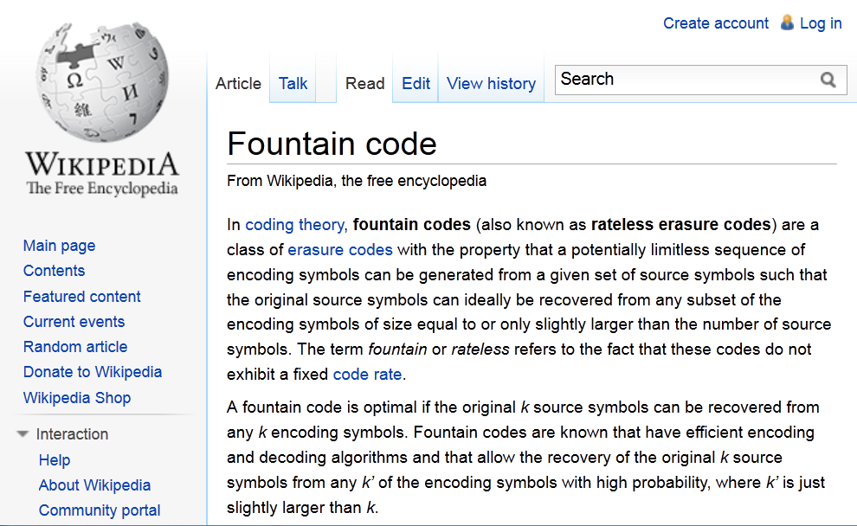
Fountain erasure codes? HUH? DIFFERENTIATED and MORE EFFECTIVE
WIDE AREA STORAGE = massive scalability + durability + efficiency + multi-site-protection + performance + self-healing =
TCO Reduction ($$$)

Slide 7
Quantum Wide Area Storage SOLUTION
Designed for MASSIVE SCALE
Scales from 500TB to PBs and beyond with Global Object Namespace
“Ten 9’s” of DURABILITY (99.99999999%)
Policy-driven
Improvements in Efficiency
70% reduction in footprint vs. “3 copies in cloud”
50% reduction in footprint vs. mirrored RAID
Significant reductions in power & cooling
Data easily spread across MULTIPLE SITES
High Performance for Big Data
GB/s throughput for big files
Manageable and SELF-HEALING
Self-healing manages data integrity
TCO REDUCTIONS of 50-70%
7

Slide 8
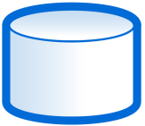
THREE Quantum Wide Area Storage Offerings
NAS Access
StorNext Managed
Cloud Archive
StorNext Clients
StorNext
NAS Access
NAS Access
StorNext
Wide Area Storage
Other Apps
Tier 1 Disk
CLOUD
APP
HTTP://REST
HTTP REST
Wide Area Storage
Wide Area Storage
SDisk
Wide Area Storage

Slide 9
TYPE of Big Unstructured Data
Remember: Wide Area Storage is for ARCHIVE
YES “StorNext-Like” files
Files bigger than 1MB
Video editing
Video/Sensor Surveillance
Genomic/Molecular analysis
Natural data analysis
NO Analytical/Transactional Data
No email
No homedirs, no shared folders
No database

Slide 10
Customers SAY…
I believe in the “secret sauce” of next-generation object storage – and believe it will take me and my massively growing data archives where I need to go.
–Large U.S. Life Sciences Research Institute
SELL: Wide Area Storage—with application ported to use http REST

Slide 11
Customers SAY…
I have 50 applications that speak CIFS and NFS. I want the economic benefits of next-gen object storage to solve my archive needs – but I do not have the developer cycles to port my applications to http REST!
–Large U.S. Publisher
SELL: Wide Area Storage with NAS Access

Slide 12
Customers SAY…
I need a scalable, affordable archive—integrated with StorNext—that has better latency than tape.
–Major U.S. M&E customer
SELL: Wide Area Storage that is StorNext Managed.

Slide 13
Customers SAY…
I would like one of my StorNext Archive tiers to be managed in someone else’s data center – so I can sleep knowing that the archive is there if I need it, but I don’t have to manage the 2nd copy.
–Major EMEA M&E production house
SELL: StorNext Managed Wide Area Storage—that is eventually available as a “Cloud Archive”

Slide 14
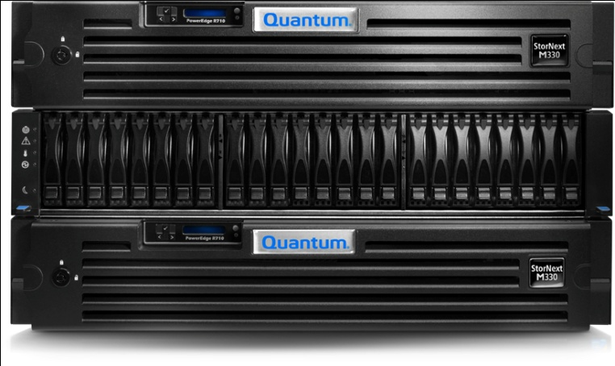
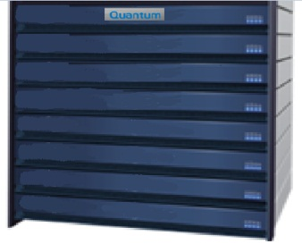
Wide Area Storage Building Blocks
StorNext MDC
A10 Access Node (or other)
HTTP
http/REST
http/REST
C10 Controller Nodes
10GbE
10GbE
“Rack” Switches
Gigabit
Ethernet
Fabric
1 GbE
S10 Storage Nodes
Scalable
Storage

Slide 15
Wide Area Storage Building Blocks
StorNext MDC
A10 Access Node (or other)
HTTP
C10 Controller Nodes
http / REST object interface
Globally shared access
Application can failover to any controller
Metadata & data read cache
Assured coherency
High-throughput per node
http/REST
http/REST
10GbE
S10 Storage Nodes
½ PB – 100’s PBs
Space allocated across all nodes
On-the-fly capacity upgrades
No volume configuration
Automated data migration
Mixed density operation
Simple decommissioning
Low-power / high-density
10GbE
Gigabit
Ethernet
Fabric
1 GbE
Scalable
Storage

Slide 16
QSpread Algorithm – HOW IT WORKS
QSpread encodes data in encoded chunks (equations)
Distributes equations across disks, storage nodes, racks, data centers
Original data can always be uniquely derived from subset of equations
Encodes. Distributes. Original data can always be uniquely derived from subset of equations
Simplified mathematics
Original Object
75
Decomposed Object
7
5
QSpread
Series of Equations
X+Y=12
X-Y=2
2X+Y=19
Any 2 out of 3 equations uniquely determine object
7
5
7
5
7
5

Slide 17
DURABILITY Policies Give Customer Choice
Durability Policy Example: 20/4
20/4 means: files spread across 20 drives/nodes/racks
Data protected even with as many as 4 failures
20/4 policy delivers
Five drive failures must occur before any probability of data loss
20/4
20/11
18/7
Customer gets to DECIDE their durability policies – with help from YOU – balancing COST vs. PROTECTION LEVEL

Slide 18
Quantum Wide Area Storage OVERHEAD
50-70% improvement in Storage Efficiency
70% reduction in footprint compared to “3 copies in the cloud”
50% reduction in footprint compared to mirrored RAID
Technology | 6+2 RAID 6 + Replica | 3 Copy Cloud Store | 20/4 QSpread
Source | 1.00 | 1.00 | 1.00
Raw | 2.67 | 3.00 | 1.43
Overhead | 167% | 200% | 43%
50-70%
lower
18

Slide 19
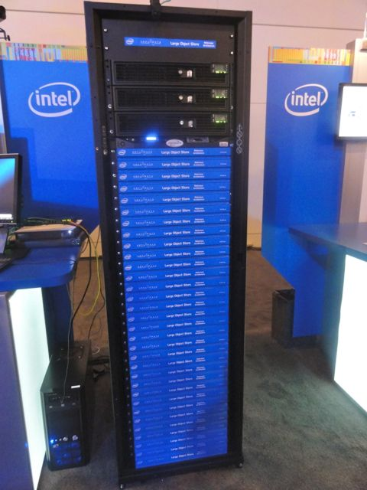
Intel Selects Amplidata Technology after canvassing market of object storage
Amplidata BitSpread was Erasure Coding software for Intel’s Reference Architecture —announced at IDF in Sep 2011
Intel and Amplidata collaborating tightly
Intel using this as IT storage backbone in production.
Intel has validated the same innovative WIDE AREA STORAGE technology as Quantum
Copyright © - Amplidata 2011-2012

Slide 20
Super Granular BIT ERROR PROTECTION
Every object can tolerate 1000+ bit errors and still be accessed and assured data integrity—UNLIKE the competition

Slide 21
QDynamics SELF-HEALING storage
QDynamics Agent
Runs on each storage node—scales processing with capacity
Out-of-band—for low-performance impact
Continuous integrity checking
Performs proactive self verification of disk bit errors
If data corrupted, automatically heals

Slide 22
Leading Performance Optimized for streaming reads/writes of large objects
Single Stream performance
450 MB/s per single stream
Aggregate Throughput
~800 MB/s WRITE ingest per controller with 4 x 10GbE ports
~1000 MB/s READ ingest per controller with 4 x 10GbE ports
Scale-out performance *
Ethernet
2.4 GB/sec*
Throughput
Ethernet
Controller node
Controller node
Controller node
Storage node
Storage node
Storage node
Storage node
Storage node
Storage node
Storage node
Storage node
Storage node
Storage node
Storage node
Storage node
Storage node
Storage node
Storage node
Storage node
Storage node
Storage node
Storage node
Storage node
Storage node
Storage node
Storage node
Storage node
Storage node
Storage node
Storage node
Measured using version 3.0 with 32MB superblocks
Storage node
Storage node

Slide 23
TIMELINE
POCs Available Now (30TB node)
NAS Access
StorNext Managed
Cloud Archive
StorNext Clients
StorNext
NAS Access
NAS Access
StorNext
Wide Area Storage
Other Apps
Tier 1 Disk
CLOUD
APP
HTTP://REST
HTTP REST
Wide Area Storage
Wide Area Storage
SDisk
Wide Area Storage
CQ4 2012
CQ1 2013
TBD

Slide 24
Wide Area Storage BASE CONFIGURATION
20 storage nodes
3 controller nodes
1 SSD per controller node
2 rack switches
1 access node
Cables included
44U rack – optional
720 TB raw
503 TB usable with 20/4 durability

Slide 25
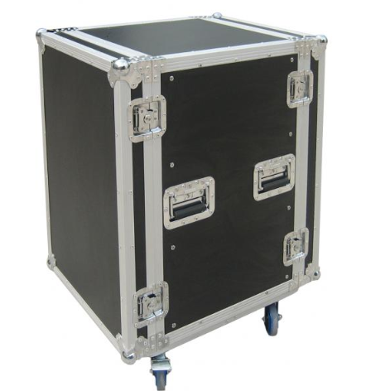
Quantum Wide Area Storage POC KITS
8 storage nodes
3 controller nodes
2 rack switches
1 flight case
1 access node
AT GA: 288 TB raw
201 TB usable with 20/4 durability

Slide 26
Advantages of QTM’s Wide Area Storage
Ultra-durable platform. Unbreakable.
10 x 9’s of durability for 2TB+ drive
Massive SCALE—across geographies, too
Supports PBs of storage, Billions of objects
Low-Power, Low-Cooling & Efficient
Vs. traditional solutions
Pricing & TCO
50-70% reduction in capital expense, lower opex
Performance
Multiple GB/s per rack with low latency
Integrated with #1 high-performance file system and integrated archive: STORNEXT

Slide 27
Wide Area Storage Service Training OBJECTIVES
1
Empower service team to service existing POC installs and internal deployments
with AC1 controllers and AS30 storage nodes
Empower service team to understand diffs between older HW and SW vs. newer HW and SW
Empower key personnel to ramp on technology and product, so they can devise effective JIT service training for rest of org
2
3

Slide 28
Q&A with Claire & Greg

