Slide 1
AmpliStor Optimized Object Storage for Big Data Technical Overview

Slide 2
Agenda
Introduction to AmpliStor
DSS Components
Management Components
Protection Concepts and Terminology
Protection Policies Explained
Planning and Installation
Configuration and Management

Slide 3
Introduction
Introduction

Slide 4
Amplidata Introduction
Amplidata Incorporated in 2008
Technology was incubated since 2005 at technology parent Incubaid (www.incubaid.com)
Europe Headquarters in Lochristi, Belgium; R&D, support center and EMEA Sales
US Headquarters in Redwood City, CA; US Sales and support center
Asia office in Taipei, Taiwan; production, APJ Sales and support center
Development and support in Germany, Egypt
Storage Veterans from DCT, Veritas, Symantec, IBM
Wim De Wispelaere – founder, CEO (DCT/Symantec NetBackup)
Wouter Van Eetvelde – founder, COO & VP Engineering (DCT Symantec NetBackup)
Craig Stevens – VP Business Development US (VP Asia/Pac Veritas, OpenVision, IBM)
Paul Speciale – VP Products (Q-layer, Agami, Oracle, IBM, ODI)
Peter Snauwaert – Director Sales EMEA (IBM, Symantec, DCT)
CP Wang – Director Asia (Foxconn, Logitech, China Venture Mgt, AIA Capital, IBM)
Deployed in more than 1000 end-user installs to date
through OEM partners Zenith Infotech and Dacentec
Investors
SwissCom Ventures (CH), Endeavour Vision (CH), Hummingbird Ventures (BE)

Slide 5
Challenges with traditional storage
Protect against data loss on large capacity (2TB+) disk drives
RAID technology does not work effectively on 1TB+ drives
Rebuild times of multiple days
Failures because of unrecoverable bit errors on disks
Storing multiple full copies of data across drives is expensive
1TB of data requires 3-4TB disk capacity
Scaling to petabytes and beyond
Efficiently addressing the needs of Big unstructured data for new applications
Traditional storage systems do not offer on-line scalable global namespace
Rising administrative and operations costs for petabyte-scale data
Managing storage systems is complex and expensive
High operational costs; power, cooling, floor space
Rising total cost of ownership for petabyte-scale storage

Slide 6
Core Technology Components
BitSpread – Distributed Encoder/Decoder
RAID replacement technology based on unique variant of Erasure Coding
“Dial-in” fault tolerance through namespace level policies
Namespace1: 16/4 policy protects against any 4 failures in 16 disks
Namespace2: 18/6 policy protects against any 6 failures in 18 disks
Provides availability and reliability even during failures
Policies can be dynamically changed
BitDynamics – Maintenance & Self-Healing Agent
Out of band operations agent for disk monitoring, integrity verification & object self-healing
Performs automated tasks: scrubs, verifies, self-heals, repairs & optimizes data on disk
* Software modules are hardware independent

Slide 7
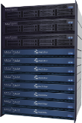
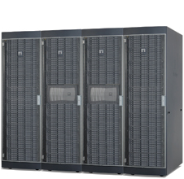
Object Storage System Topology
End-User
Applications
App
App
BitSpread
BitDynamics
HTTP
Cloud
REST API
REST API
10GbE
Scale-out
IO controllers
Gigabit
Ethernet
Fabric
High-density,
low-power
Storage modules
Scalable
Storage
Pool

Slide 8
Amplidata’s BitSpread technology
BitSpread – Distributed Encoder / Decoder
Amplidata’s unique Erasure Coding (EC) implementation
Similar in principle to rate-less erasure codes*
Designed for ultra-high durability, performance & storage policy flexibility
Leverages low-level Intel CPU instruction sets for 10x faster performance & rebuilds than other EC implementations
Not based on Reed-Solomon codes, Cauchy-RS or variants thereof
Advanced bitrot (Unrecoverable Read Error) protection
Key Capabilities
Dynamic spread selection – utilizes all spindles in the entire storage pool for performance and leverages newly added capacity immediately
Order independent: order & location of check blocks do not matter for object recall
Extra blocks can be generated out of previous ones without knowing what is missing
Hierarchy aware - data can be spread widely across hierarchy even if asymmetric
Scalable distributed metadata storage; no performance bottleneck

Slide 9
The BitSpread Algorithm – Simple Example
BitSpread Encodes data in unrecognizable chunks (actually a series of equations)
Distributes the equations across disks, storage nodes, racks, data centers
Original data can always be uniquely determined from a subset of the equations
BitSpread codec actually uses 4K variables & equations independent of object size
Simplified mathematics
Original Object
75
Decomposed Object
7
5
BitSpread
Series of Equations
X+Y=12
X-Y=2
2X+Y=19
Any 2 out of 3 equations uniquely determine object
7
5
7
5
7
5

Slide 10
BitSpread Implementation Details
Large objects divided into 64MB Superblocks, Superblocks divided into 4000 message blocks
Message blocks encoded into 6K – 7K equations (Policy dependent)
Each equation is individually CRC protected on disk for bit error protection
Equations are written to dynamically selected set of disks (“spread”) across the entire pool
Object sliced in
Superblocks
4000 Message blocks
Object
Superblock: up to 64MB
Superblock
1
2
3
4
5
6
4K
Encoding
BitSpread
1
2
3
4
5
6
7
8
9
10
7K
Distributed on storage nodes
1
800
801
1600
1601
2400
6K
7K
Disk 1
Disk x
Disk y
Disk z
Different paths to decode
Any subset of 4K blocks allows to decode the superblock

Slide 11
Dynamic Spreading
BitSpread Policy: 16/4
Spreading across disks only
OBJECT 1
OBJECT 2
Even 5 disk failures don’t generate dataloss in this example.
Object 2
Object 2
12K
13K
1
800
801
1600
1601
2400
12K
13K
1
800
801
1600
1601
2400
Object 1
Object 1
Object 2
Object 1
Object 2
Object 2
Disk 1
Disk x
Disk y
Disk z
Disk 1
Disk x
Disk y
Disk z
Object 2
1
800
801
1600
1601
2400
12K
13K
1
800
801
1600
1601
2400
12K
13K
Object 2
Object 1
Object 1
Object 2
Object 1
Object 2
Object 1
Object 1
Disk 1
Disk x
Disk y
Disk z
Disk 1
Disk x
Disk y
Disk z
Object 2
Object 2
Object 2
1
800
801
1600
1601
2400
12K
13K
1
800
801
1600
1601
2400
12K
13K
Object 1
Object 1
Object 1
Object 1
Object 1
Disk 1
Disk x
Disk y
Disk z
Disk 1
Disk x
Disk y
Disk z
Object 2
Object 2
1
800
801
1600
1601
2400
12K
13K
1
800
801
1600
1601
2400
12K
13K
Object 2
Object 2
Object 1
Object 1
Object 1
Disk 1
Disk x
Disk y
Disk z
Disk 1
Disk x
Disk y
Disk z

Slide 12
Advantages of BitSpread
 | RAID 5/6 | BitSpread
Maximum Disk Failure Protection | 1 or 2 | Any
Data Protection due to bit rot (undetected disk errors) | No | Yes
Data access | Fixes set of disks | Any sufficient set of disks
Flexible disk allocation | No | Yes, new spread for each object
Impact of rebuilds on performance | High | Low
Data protection during rebuilds | Writes to degraded disks | Writes only to fully protected disks
Encoding performance | RAID 5/6 performance penalty | Fast X64 CPU optimized
Rebuild performance | Shares RAID controller resources | Out-of-band on storage nodes
Dynamic reliability policies On-the-fly policy enhancement | No | Yes

Slide 13
Advantages of BitSpread
 | Erasure Coding (e.g. Reed Solomon) | BitSpread
Maximum Disk Failure Protection | Any Number Cannot be changed | Any Policy Can be changed
Data Protection due to bit rot (undetected disk errors) | If checksum is implemented | Yes checksum
Encoding performance | Slow: performance penalty as only applicable on small dataset: metadata overhead | Fast X64, SSE4 optimized Supports large objects
Rebuild performance | Slow as RS is position dependent: Exact missing data needs to be identified and rebuilt | Fast, Parallel, Out-of-band rebuilds on storage nodes As simple as generating additional redundant blocks
Dynamic reliability policies On-the-fly policy enhancement | No Fixed at config | Yes Additional redundant data can be generated any time
Hierarchy aware | No, typically all disks are treated equal | Yes, spread will consider node, rack, datacenter, …

Slide 14
BitDynamics: Scalability and Self healing storage
BitDynamics Agent
Agent runs on each AmpliStor node: scale processing performance with capacity
Provides out-of-band storage management tasks
Continuous integrity checking
Performs proactive self verification of disk bit errors and automatic healing
If data is corrupted due to write errors or bit rot, redundancy data will be regenerated
Self monitoring and repair (healing)
Bit Dynamics agents across multiple nodes will regenerate data in parallel to shorten repair time
This happens out-of-band on storage nodes for low performance impact
No immediate on-site hardware maintenance intervention required
New stored data is written to a good set of disks (spread)
Decommission node and rebalance data
Move data off node to other disks before decommissioning
Rebalance data after nodes have been added (small setups)
Change policy
BitDynamics agent can generate additional data at any time to improve redundancy policy

Slide 15
DSS Components
DSS Components

Slide 16
DSS Overview
Client Daemons
REST API
BitSpread Encoder
Cache Daemons
Metadata Stores
Storage Daemons
Maintenance Agents
Client Daemon 1
Cache Daemon 1
Client Daemon n
Cache Daemon n
CONTROLLER NODE
Distributed Metadata Store 1
Distributed Metadata Store n
Storage Node 1
Storage Node n
STORAGE NODE
Storage
Daemon
Maintenance
Agent
Storage
Daemon
Maintenance
Agent
Blockstore 1
Blockstore 1
Blockstore n
Blockstore n
* 1 Blockstore = storage space on 1 physical disk

Slide 17
DSS Architecture
Client daemons
The DSS Client daemon is a service/process/daemon running on each controller node.
Handles REST read, write, update, delete requests for data.
Encodes and decodes data as requested from applications external to the storage system.
A single controller can have one or more client daemons running.
Each client daemon has the same view of the underlying storage.
Each client daemon listens for REST requests on all public networks, but on a unique port to that controller (8080, 8081, etc…).
Each client daemon communicates internally on a unique port (23510, 23511, etc…).
Cache daemons
The DSS cache daemon is a service/process/daemon running on each controller node.
Caches superblocks (data) for frequently read objects.
Every cache daemon can read from any physical cache location.
The actual cache resides on one or more SSD on one or more controller and is configurable in size.
The client daemon process will check for cached data from the cache daemons before requesting the data from backend storage.

Slide 18
DSS Architecture
Metadata stores
A system of processes to store metadata of objects, superblocks, spreads, policies and namespaces.
The underlying technology is the distributed key-value store arakoon (http://www.arakoon.org/).
Metadata stores are placed on SSDs for high IOPS.
Each Metadata store consists of 3 or more SSD’s on controller nodes for high availability. The store is considered a “cluster”, each participating controller is considered a “node”, and each service is considered an “instance”.
To write and retrieve data from a metadata store, we need a majority of the participating instances available. This means for a Metadata store that spans three nodes, two instances need to be running.
Each instance also has an associated transaction log, called a tlog, which resides on an HDD.
We only need 1 intact copy of the database or tlogs to rebuild the entire arakoon array, guaranteeing data safety when multiple components fail.
Each Namespace will have one associated metadata store. A Metadata store can service one or more Namespaces.

Slide 19
DSS Architecture
Storage daemons
The DSS Storage daemon is a service/process/daemon running on each storage node.
It receives requests from the client daemon(s) and maintenance agent(s) and acts as a gateway for requests to blockstores.
A storage node has by default 2 storage daemons running. Each daemon is responsible for a set of blockstores on the node. Every storage daemon listens on all network segments, but listens on a unique port on that storage node (23520, 23521).
Each Namespace has one storage daemon that acts as an entry point for management information on that Namespace. This is referred to as the master storage daemon for that Namespace.
The responsibilities for a master storage daemon for a Namespace include troubleshooting information as well as keeping a list of objects that need to be repaired or deleted. It enumerates objects to be repaired every 4 hours.
A storage daemon can be the master for more than one Namespace.

Slide 20
DSS Architecture
Maintenance Agents
The DSS maintenance agent is a service/process/daemon running on each storage node.
Reside on storage nodes by default but can be configured for any node in the environment.
Responsible for the self-repairing nature of the DSS storage backend.
Polls storage daemons for objects to be repaired every afternoon.
To poll the Storage Daemons for data that needs to be deleted, it then instructs the storage daemon responsible for the namespace to conduct the actual deletion process.
The polling for repair work is done every 15 minutes.
An important fact to take away is that the maintenance agent works closely with the storage daemon, as it in no way needs the client daemon to get access to the DSS backend.
Blockstores
A blockstore is a logical representation of the disk mount points (ext4 partitions) on which the encoded data is stored.
Each blockstore represents a single storage disk.
Blockstores can change states by manual intervention or by the DSS system itself.
Mountpoints for blockstores are located at /mnt/dss/dssX, where X is a number that unique that storage node.
Blockstores also have a unique ID across the entire storage system.
Metadata for the data being stored on the blockstore is stored in a separate file, called a block store tlog (transaction log).

Slide 21
Notes on DSS components
These notes apply to the Client daemon, Storage daemon, and maintenance agent services.
Configuration details are cached. Configuration changes require daemon restarts.
All three daemon types (client / storage / maintenance) are spawned using the same binary.

Slide 22
Protection Concepts and Terminology
Protection Concepts and Terminology

Slide 23
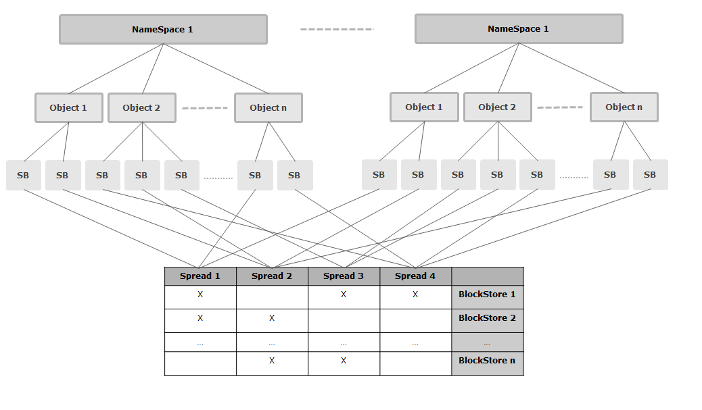
AmpliStor Data Structure
NameSpace
Object
SuperBlock
Spread

Slide 24
Namespaces
A Namespace is a logical partitioning of the backend storage to provide organization.
A highly simplified analogy for a NameSpace would be a folder in which we group files belonging together.
Currently no storage size limits or boundaries to the namespace. All namespaces will use the entire storage.
A Namespace doesn’t relate to a defined physical distribution of data on disks. Each object stored to a NameSpace may have a different grouping of blockstores that make up its physical location.
Each Namespace has an associated DSS Policy, which determines the level of protection for the files being stored.

Slide 25
Objects
Whatever you store in the DSS storage backend (a file, data stream), everything is logically defined as an object and belongs to a specific NameSpace.
An object is limited to be maximum 4TB.
An object’s name must be unique within the namespace.
An object will stored across a spread of block stores that satisfy the spreading requirements of DSS policy being written to.

Slide 26
Superblocks
When an object is stored in DSS, the client daemon divides it in one or more Superblocks before encoding this data.
Superblocks are to be considered the logical storage unit of the DSS backend. They are not visible to the API, which makes requests based on an object-namespace pair.
The maximum size is 64MB but configurable.
Superblocks are assigned on a per DSS policy basis.
All superblocks of a single object will have the same block store spread.

Slide 27
Protection Policies In-depth
Protection Policies In-Depth

Slide 28
Spread Width
A stored object in DSS is encoded and distributed across a defined number of blockstores. The spread width parameter dictates the number of blockstores amount of blockstores that are in the spread.
For example: A spread width of 10 means the object data will be spread over 10 different blockstores.
The maximum supported spread width is 20.

Slide 29
Storage Safety
The Storage Safety indicates the number of BlockStores that can be lost while still being able to recover the original data.
A lower Storage Safety will equate to less storage overhead but also increases risk. Conversely, a higher Storage Safety will require higher storage overhead but reduces risk.
The overhead ratio can be calculated with the following equation:
( 1.2 * 1.0267 * spread_width )
-------------------------------------------------------- = overhead_ratio
(spread_width – storage_safety)

Slide 30
Safety Strategy
The Safety Strategy defines the behavior during write operations when block stores are unavailable.
RepairSpread | If a blockstore from the spread is offline during a put operation, we will immediately select a new spread (that preferably matches the storage deamons that have already received checkblocks for the object) and try using this one to satisfy the policy.
DynamicSafety | If a blockstore from the spread is offline during a put operation, we will not generate additional data in order to satisfy the disksafety. For the next SuperBlocks we will no longer use this storage daemon.
Stop on Failure | If a blockstore from the spread is offline during a put operation, we will stop the put operation and return a failure response over the REST API.

Slide 31
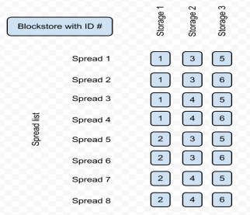
Spreads and Spread Lists
A spread is simply a grouping of blockstores on which a given object is stored.
Spreads are automatically generated by an algorithm based on the protection policy settings.
The spreads are generated so that data is distributed equally over the backend storage
A spread list is the total number of defined spreads that created for a protection policy.
Simple example

Slide 32
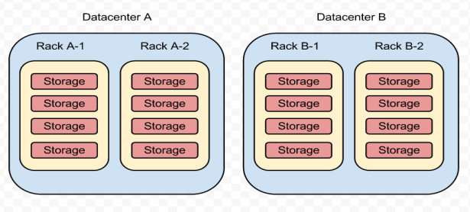
Data Balance
The Data Balance settings define how data is spread across various levels in the environment.
The user can choose to spread data at any level (datacenter, rack, or node) independent of the other level choices.

Slide 33
Hardware details
Hardware Details

Slide 34
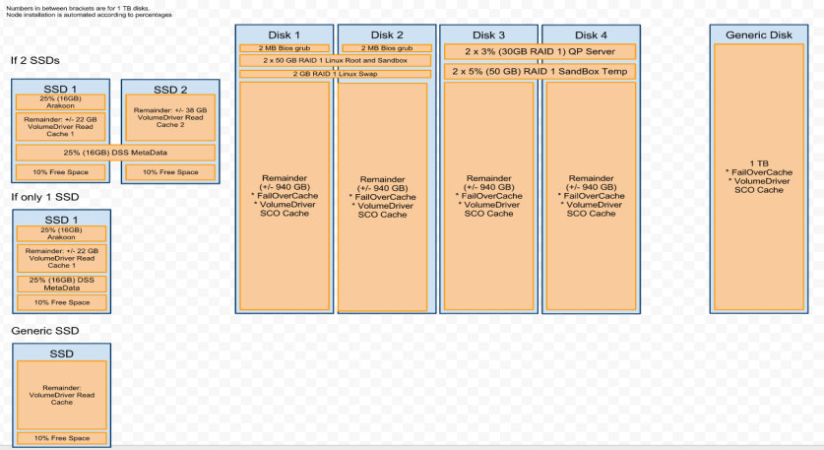
Anatomy of a Controller Node

Slide 35
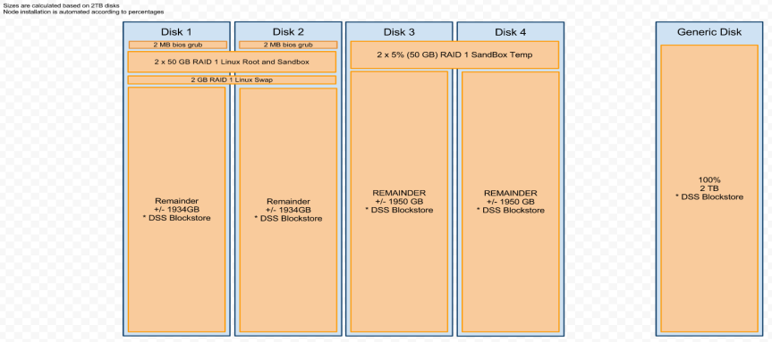
Anatomy of a Storage Node

Slide 36
Planning An Installation
Planning an installation

Slide 37
Planning: Environmental Constructs
Overview
Constructs for LANs, Datacenters, and Racks can be configured in the management UI.
LANs
Three LAN segments need to be defined for each datacenter.
One public (used for user and/or application communication)
Two private (used for storage and environmental communication)
Of the two private lans, one is used for environmental communication and storage (management private LAN) and one is used for storage only (secondary storage LAN).
A fourth LAN type, called an install LAN, is automatically created on the management private lan segment.
LAN segments of a certain type need to be routable to all other networks of the same type.
These LAN constructs can be configured for limited IP ranges depending upon site requirements and availability.

Slide 38
Planning: Environmental Constructs
IPs
The management controller node will need two IPs on each of the public lan, management storage lan, and secondary storage lan. Of the two IPs on any given lan segment, one will be unique to the host and the other will be virtual for failover purposes.
All other controllers will need at least one IP on each of the public lan and one on both the management storage lan and secondary storage lan.
All storage nodes will need one IP on each of the management storage lan and secondary storage lan.
Datacenters and racks
Datacenters and racks can be defined the management GUI.
When nodes are added to the environment, the user can specify in which datacenter and rack the node is located. Impacts spread.

Slide 39
Installation Overview
Installation Overview

Slide 40
Environment installation overview
Basic installation workflow
1) Install the management controller node
2) Create LAN constructs
3) Initialize the management controller node.
4) Create datacenter and rack constructs
5) Install additional controller and storage nodes.
6) Initialize additional controller and storage nodes.
7) Expand the Framework metadata store across additional SSDs.
The installation process for any node consists of two parts.
OS installation
The same OS will be laid down for all nodes. Two available methods in PXE and USB/DVD installation.
Node initialization
Gives the node an identity and role in the environment.

Slide 41
OS Installation Methods
PXE Installs
Prerequisites
The management controller node is completely installed and initialized.
The node to be installed is configured to boot off of the LAN segment.
Servers boot up and automatically get an IP on a private LAN segment.
OS installation is kicked off via the management UI.
USB/DVD Installs
Nodes need to be configured to boot from the install media.
A temporary IP address needs to be defined on the private LAN segment
The node is discovered and added to the environment through actions taken in the management UI.
Two installation options:
Management node: This mode installs all the framework components for managing the environment (apache, dhcpd, tftpd). Use only on the management controller.
Remote node: Just installs the basic OS. Used on every other controller and storage node.

Slide 42
Node initialization
Node initialization
Process to create an identity for a node.
User specifies the following details about a node.
Hostname
Role (controller or storage)
Location (datacenter and rack)
Description (optional)
IP addresses for public, private management, and secondary private lans.
Performed in the management GUI.
Nodes can be initialized immediately or added to a queue.
Once initialization is finished, nodes are immediately ready for use.

Slide 43
USB / CD Installation
USB / CD Installation

Slide 44
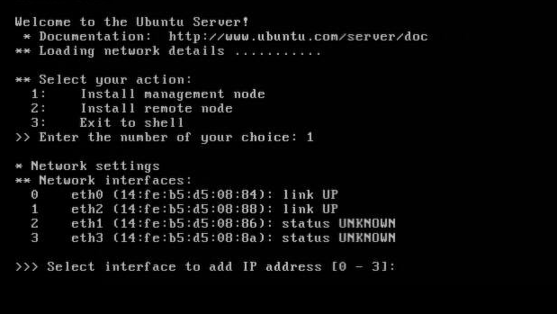
USB Installation: Management node
Select the network device that corresponds to the public IP address.

Slide 45
USB Installation: Management node
For management node installations, wait until the reboot completes. Then log into the web GUI with your browser with the credentials admin/admin to begin LAN creation.

Slide 46
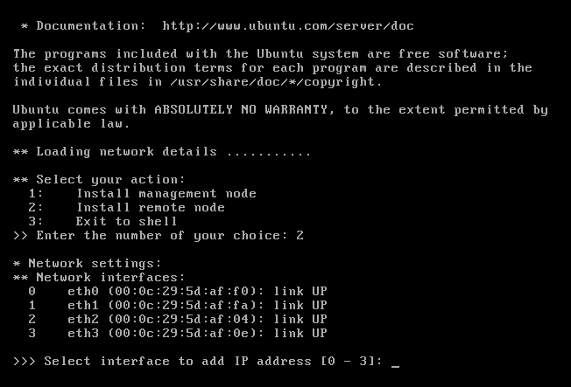
USB Installation: Remote node
Select the network device that is cabled to the management private lan where the DHCP server resides on the management controller. On the next prompt, you will get an option to allow the node to get an IP address via DHCP or to set it manually. When setting it manually, the IP must reside within the install LAN range.

Slide 47
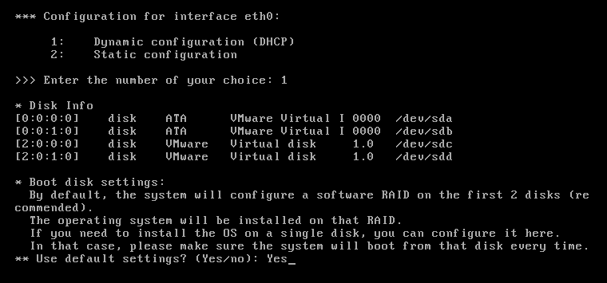
USB Installation: Remote node
For remote node installations, wait until the reboot completes. Then log into the web GUI with your browser and begin the add device wizard.

Slide 48
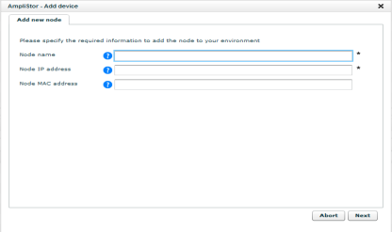
Add Device
This action only needs to happen for nodes that are installed with the “remote node” option during the USB install method. PXE installs do not need this step.
The Add Device wizard is located under Dashboard -> Administration -> Hardware -> Servers -> Uninitialized Devices -> Uninitialized -> Add Device
Specify the Node Name and Node IP address. If the node requires routing to reach, also enter the node MAC address.
After completing this wizard, the node status will be ACTIVE and ready for initialization.

Slide 49
PXE Installation
PXE Installation

Slide 50
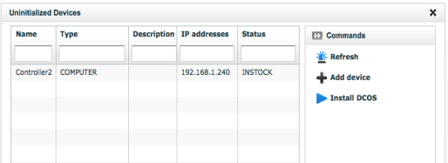
PXE Installation
After ensuring the node is cabled to the private installation LAN, power up the node.
Node boots to NFS via the PXE services (DHCP / TFTP) running on the management controller.
The node will now appear in the management GUI in the Dashboard -> Administration -> Hardware -> Servers -> Uninitialized Devices -> Uninitialized with the status “INSTOCK”.
Click the check box next to the node and click Install OS. A job will kick off to install the OS and reboot the node.
Once the job completes, the node’s status will be “ACTIVE”.

Slide 51
LAN, Datacenter, RACK Creation
LAN, Datacenter, Rack Creation

Slide 52
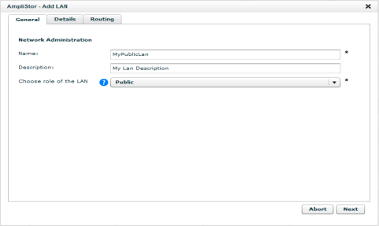
Configuring LANs – General Tab
LAN configuration is handled under Dashboard -> Administration -> AmpliStor Management -> Network -> Add Lan
LAN configuration options will change based upon the its role in the environment, public or storage.
On the General tab, specify the Name of the network and the LAN role.

Slide 53
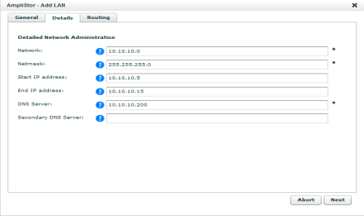
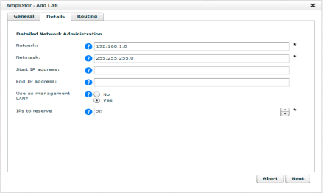
Configuring LANs – Details Tab
Public LAN
Storage LAN
On the details tab, specify the Network, Netmask, Start and End IP addresses, and the DNS server(s).
If the Storage LAN is designated as a management LAN, also specify the number of IPs to reserve for DHCP.

Slide 54
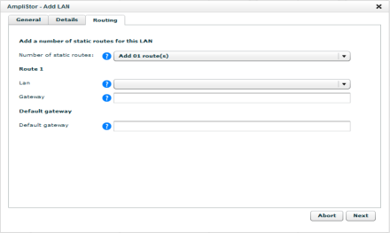
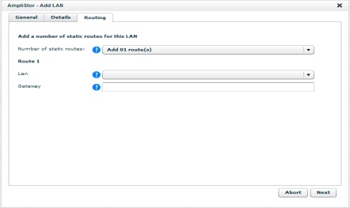
Configuring LANs– Routing Tab
Public LAN
Storage LAN
On the Routing tab, specify any static routes necessary for nodes on the LAN and the default gateway.
Routes can only be added to for LANs of the same type.

Slide 55
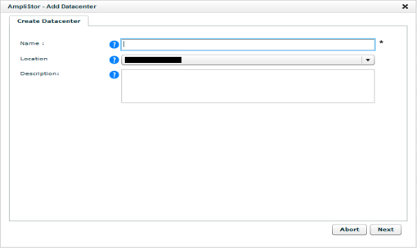
Configuring Datacenters
Datacenters configuration is handled under Dashboard -> Administration -> AmpliStor Management -> Locations -> Datacenter Management -> Add Datacenter
Specify the Name and an optional Description for the Datacenter.

Slide 56
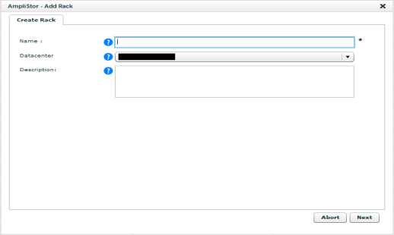
Configuring Racks
Datacenters configuration is handled under Dashboard -> Administration -> AmpliStor Management -> Locations -> Rack Management -> Add Rack
Specify the Name and an optional Description for the Rack.

Slide 57
Expanding Metadata stores
Expanding the Framework MetadataStores

Slide 58
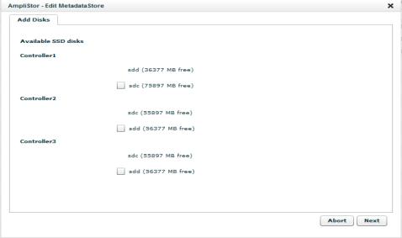
Expanding the Framework Metadata Store
In the web GUI, click on the “framework” Metadata Store, found in Dashboard -> Administration -> Storage Management -> Metadata Stores.
Click the “Edit MetadataStore” button.
Specify the new SSDs to include in the Metadata Cluster.

Slide 59
Configuration
Configuration

Slide 60
Configuration Overview
Installing and initializing the environment nodes, additional work needs to be done to setup the organize the storage.
The following slides show
Configuring Metadata Stores
Configuring Storage Policies
Configuring Namespaces
Configuring SNMP
Configuring Call home

Slide 61
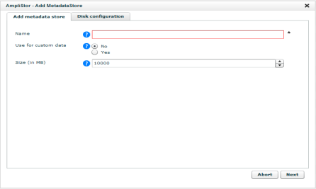
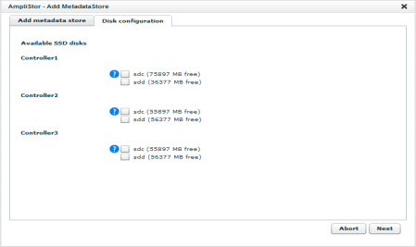
Configuring Metadata Stores
Metadata stores are created in the management GUI under Dashboard -> Administration -> Storage Management -> Metadata Stores -> Add MetadataStore.
Specify a name, size, and the SSDs for the Metadata Store.

Slide 62
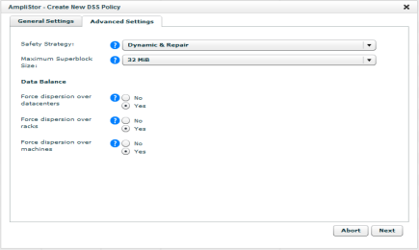
Configuring Storage Policies
Storage Policies are created in the management GUI under Dashboard -> Administration -> Storage Management -> Storage Policies -> Add DSS Policy
Specify a name, spread width, storage safety, safety strategy, superblock size, and data balance rules for the Storage Policy.

Slide 63
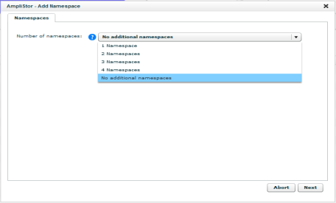
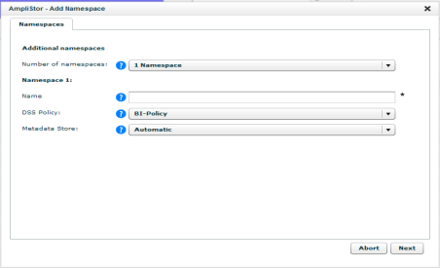
Configuring Namespaces
Namespaces are created in the management GUI under Dashboard -> Administration -> Storage Management -> Namespaces -> Add namespace
Specify a name, spread width, storage safety, safety strategy, superblock size, and data balance rules for the Storage Policy.

Slide 64
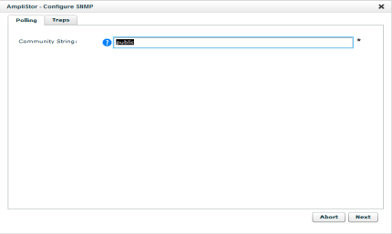
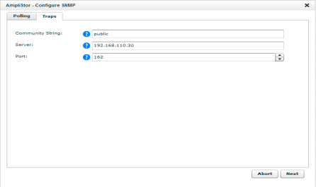
Configuring SNMP
SNMP configuration is handled under Dashboard -> Administration -> AmpliStor Management -> Installation -> Configure SNMP
Specify the Community String for SNMP polling and the Community String, Server, and Port for SNMP trapping.

Slide 65
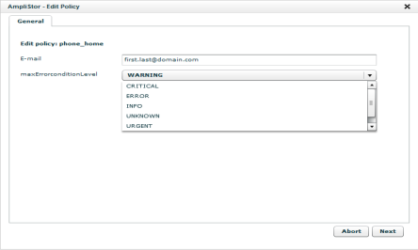
Configuring Call Home
Call Home functionality is configured under Dashboard -> Administration -> AmpliStor Management -> Policies
Click on the policy “Send a report of the highest severity events”.
Click Edit Policy and specify the E-mail address and maximum error level to be included.
Click Start Policy to immediately generate a report.

Slide 66
Failure management
Failure Management

Slide 67
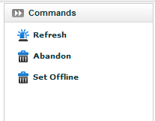
Handling a failed disk
Failed disks will appear in the section Dashboard -> Administration -> AmpliStor Management -> Hardware -> Disks -> Degraded. Notifications will also be made via SNMP and Call Home.
Diagnose will run a short SMART test on the disk and provide error details.
Depending upon the state of the disk, the user can abandon or offline the disk by clicking on the partition and selecting the appropriate command.

Slide 68
Replacing a failed storage node
Node replacement will
Decommission the failed nodes storage daemons and blockstores.
Initialized the ACTIVE node into the storage environment.
Requires a uninitialized node in an ACTIVE state standing by.
Node replacement can be initiated from the command actions at the storage node level for a node that is halted.

Slide 70
Failure management
Troubleshooting

Slide 71
Qpackages Repository System
Package management is handled through “qpackages”, a repository system.
The repository is located at /mnt/qpackagesserver on the management controller node. All nodes will install new and updated packages from this location.
The repository location is divided into “domains”, each of which is responsible for various components of the overall system.
Each domain consists of two elements:
Bundles: Individual tarballs, one or two for each package.
Metadata: A single tarball, called default.branch.tgz, which includes metadata for every bundle.
Each node will receive packages from the same qpackage server repository.
Each node’s interaction with the repository is configured at /opt/qbase3/cfg/qpackage4/sources.cfg
Each node retains its cache of repository metadata. When packages are updated, each node must have its repository metadata cache updated.

Slide 72
Introduction to the Qshell
Python based API
Invoked by `/opt/qbase3/qshell` and allows interaction with most OS and AmpliStor components.
The <TAB> key can be used to show available options at any level.
Function calls can be made using a questions mark “?” as the first and only argument to show help information if available.
q.dss.manage.listNameSpaces(?
Supports the creation of python objects, which have their own properties and methods.
In [4]: myDiskObj = api.disk.getObject('beb776f0-dc62-4bf3-907d-d501f5223b8c')
In [5]: myDiskObj.dss
myDiskObj.dssnamespaceguid myDiskObj.dsspolicyguid
API exists on all nodes regardless of role, though not all commands can be run on every node.
Not all functions are related to this product.

Slide 73
Qshell
Major qshell extensions to be familiar with
cloudapi – Allows interaction with an instance of the DRPDB
q.dss. – Interaction with and management of DSS components
q.manage. – Interaction with non DSS services. Arakoon, Application Server
q.qp – Extension to list installed qpackages, manually update new qpackages
i.qp – Updating qpackages metadata on individual nodes.
q.cluster. - Creates “clusters” of servers for doing manipulation
q.drp – Extension to save objects back into the DRPDB
q.cmdtools – Interaction with many linux tools (parted, smartctl, etc…)
Scripting
The qshell binary allows you to pass a file with qshell extensions contained within to script multiple calls within the qshell. /opt/qbase3/qshell –f <script file>
The qshell also allows you to pass a qshell command directly from the bash CLI. /opt/qbase3/qshell –c “<command>”

Slide 74
Monitoring
UI
Dashboard: Disk safety, Latest events, Capacity
Logging: Jobs, Events, Application policies
Per node: CPU / Mem / Net monitoring
Per disk: SMART monitoring
Analytics server: Statistical monitoring (if installed)
Qshell
q.dss.manage.monitorStoragePool() – DSS statistics for all namespaces
q.dss.manage.monitorNamespace() – DSS statistics for individual namespaces

Slide 75
Logging
Logging
/var/log – System / OS level logging
/var/crash – Core dumps
/opt/qbase3/var/log/ – AmpliStor logging
Amplistor logging examples
/opt/qbase3/var/log/dss – All clientdaemon, cachedaemon, storagedaemon, maintenanceagents
/opt/qbase3/var/log/arakoon – Arakoon logging
/opt/qbase3/var/log/postgres
/opt/qbase3/var/log/apache
GDB - Not installed by default, but can be installed with qpackages.

Slide 76
Services
Client daemons
Configuration: /opt/qbase3/cfg/dss/clientdaemons/
Log: /opt/qbase3/var/log/dss/clientdaemons/
Process example: /opt/qbase3/bin/dss -d --clientdaemon /opt/qbase3/cfg/dss/clientdaemons/2fa78455-0b15-4b12-bbfe-690ef0eb3929.cfg
Storage daemons
Configuration: /opt/qbase3/cfg/dss/storagedaemons/
Log: /opt/qbase3/var/log/dss/storagedaemons/
Process example: /opt/qbase3/bin/dss -d --storagedaemon /opt/qbase3/cfg/dss/storagedaemons/d35ac9f7-2ad1-4236-94db-44b8e72010b6.cfg
Maintenance Agents
Configuration: /opt/qbase3/cfg/dss/maintenanceagents/
Log: /opt/qbase3/var/log/dss/maintenanceagents/
Process example: /opt/qbase3/bin/dss -d --maintenanceagent /opt/qbase3/cfg/dss/maintenanceagents/d52cde10-ccb0-4c14-81ac-df8e82992c31.cfg

Slide 77
Services
Cache daemons
Configuration: /opt/qbase3/cfg/dss/cachedaemons/
Log: /opt/qbase3/var/log/dss/cachedaemons/
Process example: /opt/qbase3/bin/dsscached -d /opt/qbase3/cfg/dss/cachedaemons/fa1e970e-95cb-4ddf-9380-4d1a17984307.cfg
Monitoring Agent
Configuration: /opt/qbase3/cfg/qconfig/monitoringAgent.cfg
Log: /opt/qbase3/var/log/
Process example: /opt/qbase3/bin/dss -d --storagedaemon /opt/qbase3/cfg/dss/storagedaemons/d35ac9f7-2ad1-4236-94db-44b8e72010b6.cfg
Apache
Configuration: /opt/qbase3/apps/apache/conf/httpd.conf
Logs: /opt/qbase3/var/log/apache
Process example: /opt/qbase3/apps/apache/bin/httpd -f conf/httpd.conf -k start

Slide 78
Services
Arakoon
Configuration: /opt/qbase3/cfg/qconfig/arakoon
Log: /opt/qbase3/var/log/arakoon/<metadataStoreName>/
Process example: /opt/qbase3/apps/arakoon/bin/arakoon --node node_0_9001 -config /opt/qbase3/cfg/qconfig/arakoon/framework/framework.cfg –daemonize
Application Server
Configuration: /opt/qbase3/cfg/qconfig/applicationserver.cfg, /opt/qbase3/cfg/qconfig/applicationserverservice.cfg
Log: /opt/qbase3/var/log/applicationserver.log, /opt/qbase3/var/log/pylabslogs/applicationserver
Process example: /opt/qbase3/bin/python /opt/qbase3/bin/twistd --pidfile=/opt/qbase3/var/pid/applicationserver.pid -y /opt/qbase3/apps/applicationserver/lib/applicationserver.tac --savestats
Workflow Engine
Configuration: /opt/qbase3/cfg/qconfig/Workflowengine.cfg
Logs: /opt/qbase3/var/log/pylabslogs/workflowengine/
Process example: /opt/qbase3/bin/python /opt/qbase3/apps/workflowengine/bin/main.py

Slide 79
Services
TFTP
Configuration: N/A
Log: /var/log/syslog, /var/log/daemon.log, /var/log/boot.log
Process example: /opt/qbase3/apps/tftpd/sbin/in.tftpd -l -a 0.0.0.0:69 -s /opt/qbase3/var/cloudinstallservice/tftpboot/
DHCP
Configuration: /opt/qbase3/cfg/dhcpd/dhcpd.conf
Log: /var/log/syslog, /var/log/daemon.log, /opt/qbase3/var/log/apache/access.log
Process example: /opt/qbase3/apps/dhcpd/dhcpd -cf /opt/qbase3/cfg/dhcpd/dhcpd.conf -lf /opt/qbase3/cfg/dhcpd/dhcpd.leases -p 67 -pf /opt/qbase3/var/pid/dhcpd.pid
Rsync
Configuration: /opt/qbase3/cfg/rsync/rsync.cfg
Logs: /opt/qbase3/var/log/rsync.log
Process example: /opt/qbase3/bin/rsync --daemon --config=/opt/qbase3/cfg/rsync/rsync.cfg --port=873

