Slide 1
Wide Area Storage
Service and Support Training
Paul Winzenburg
August 2012

Slide 2
Agenda
Day 1
Technical deep dive
GUI Demonstration
CLI (Python and OSMI)
Service logins, remote access, and passwords
Troubleshooting and Logs
Day 2
Network Switches
Phone Home
Monitoring and service warnings
FRUs and CRUs
Controller, Storage node, Disk, NIC / Motherboard replacement
Tools and scripts
Future hardware / software releases
Documentation Overview
Installation Demo
Open Discussion

Slide 3
Wide Area Storage Service Training OBJECTIVES
1
Empower service team to service existing POC installs and internal deployments with AC1 controllers and AS30 storage nodes
2
Empower service team to understand diffs between older HW and SW vs. newer HW and SW
3
Empower key personnel to ramp on technology and product, so they can devise effective JIT service training for rest of org

Slide 4
Overview
Core technology principles and concepts

Slide 5
Challenges with traditional storage
Protect against data loss on large capacity (2TB+) disk drives
  RAID technology does not work effectively on 1TB+ drives
    Rebuild times of multiple days
    Failures because of unrecoverable bit errors on disks
  Storing multiple full copies of data across drives is expensive
    1TB of data requires 3-4TB disk capacity
Scaling to petabytes and beyond
  Efficiently addressing the needs of Big unstructured data for new applications
  Traditional storage systems do not offer on-line scalable global namespace
Rising administrative and operations costs for petabyte-scale data
  Managing storage systems is complex and expensive
High operational costs; power, cooling, floor space
Rising total cost of ownership for petabyte-scale storage

Slide 6
Core Technology Components
BitSpread – Distributed Encoder/Decoder
  RAID replacement technology based on unique variant of Erasure Coding
  “Dial-in” fault tolerance through namespace level policies
    Namespace1: 16/4 policy protects against any 4 failures in 16 disks
    Namespace2: 18/6 policy protects against any 6 failures in 18 disks
  Provides availability and reliability even during failures
  Policies can be dynamically changed
BitDynamics – Maintenance & Self-Healing Agent
  Out of band operations agent for disk monitoring, integrity verification & object self-healing
  Performs automated tasks: scrubs, verifies, self-heals, repairs & optimizes data on disk
* Software modules are hardware independent

Slide 7
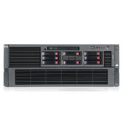
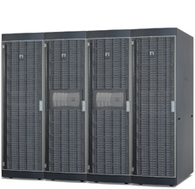
Object Storage System Topology
End-User
Applications
App
App
HTTP
Cloud
REST API
REST API
10GbE
Scale-out
IO controllers
Gigabit
Ethernet
Fabric
High-density,
low-power
Storage modules
Scalable
Storage
Pool

Slide 8

Amplidata’s BitSpread technology
BitSpread – Distributed Encoder / Decoder
  Amplidata’s unique Erasure Coding (EC) implementation
  Similar in principle to rate-less erasure codes*
  Designed for ultra-high durability, performance & storage policy flexibility
  Leverages low-level Intel CPU instruction sets for 10x faster performance & rebuilds than other EC implementations
  Not based on Reed-Solomon codes, Cauchy-RS or variants thereof
  Advanced bitrot (Unrecoverable Read Error) protection
Key Capabilities
  Dynamic spread selection – utilizes all spindles in the entire storage pool for performance and leverages newly added capacity immediately
  Order independent: order & location of check blocks do not matter for object recall
  Extra blocks can be generated out of previous ones without knowing what is missing
  Hierarchy aware - data can be spread widely across hierarchy even if asymmetric
  Scalable distributed metadata storage; no performance bottleneck

Slide 9
The BitSpread Algorithm – Simple Example
BitSpread Encodes data in unrecognizable chunks (actually a series of equations)
Distributes the equations across disks, storage nodes, racks, data centers
Original data can always be uniquely determined from a subset of the equations
BitSpread codec actually uses 4K variables & equations independent of object size
Simplified mathematics
Original Object
75
Decomposed Object
7
5
BitSpread
Series of Equations
X+Y=12
X-Y=2
2X+Y=19
Any 2 out of 3 equations uniquely determine object
7
5
7
5
7
5

Slide 10
BitSpread Implementation Details
Large objects divided into 64MB Superblocks, Superblocks divided into 4000 message blocks
Message blocks encoded into 6K – 7K equations (Policy dependent)
Each equation is individually CRC protected on disk for bit error protection
Equations are written to dynamically selected set of disks (“spread”) across the entire pool
Object sliced in
Superblocks
4000 Message blocks
Object
Superblock: up to 64MB
Superblock
1
2
3
4
5
6
4K
Encoding
BitSpread
1
2
3
4
5
6
7
8
9
10
7K
Distributed on storage nodes
1
800
801
1600
1601
2400
6K
7K
Disk 1
Disk x
Disk y
Disk z
Different paths to decode
Any subset of 4K blocks allows to decode the superblock

Slide 11
Dynamic Spreading
BitSpread Policy: 16/4
Spreading across disks only
OBJECT 1
OBJECT 2
Even 5 disk failures don’t generate dataloss in this example.
Object 2
Object 2
12K
13K
1
800
801
1600
1601
2400
12K
13K
1
800
801
1600
1601
2400
Object 1
Object 1
Object 2
Object 1
Object 2
Object 2
Disk 1
Disk x
Disk y
Disk z
Disk 1
Disk x
Disk y
Disk z
Object 2
1
800
801
1600
1601
2400
12K
13K
1
800
801
1600
1601
2400
12K
13K
Object 2
Object 1
Object 1
Object 2
Object 1
Object 2
Object 1
Object 1
Disk 1
Disk x
Disk y
Disk z
Disk 1
Disk x
Disk y
Disk z
Object 2
Object 2
Object 2
1
800
801
1600
1601
2400
12K
13K
1
800
801
1600
1601
2400
12K
13K
Object 1
Object 1
Object 1
Object 1
Object 1
Disk 1
Disk x
Disk y
Disk z
Disk 1
Disk x
Disk y
Disk z
Object 2
Object 2
1
800
801
1600
1601
2400
12K
13K
1
800
801
1600
1601
2400
12K
13K
Object 2
Object 2
Object 1
Object 1
Object 1
Disk 1
Disk x
Disk y
Disk z
Disk 1
Disk x
Disk y
Disk z

Slide 12
Advantages of BitSpread
 | RAID 5/6 | BitSpread
Maximum Disk Failure Protection | 1 or 2 | Any
Data Protection due to bit rot (undetected disk errors) | No | Yes
Data access | Fixes set of disks | Any sufficient set of disks
Flexible disk allocation | No | Yes, new spread for each object
Impact of rebuilds on performance | High | Low
Data protection during rebuilds | Writes to degraded disks | Writes only to fully protected disks
Encoding performance | RAID 5/6 performance penalty | Fast X64 CPU optimized
Rebuild performance | Shares RAID controller resources | Out-of-band on storage nodes
Dynamic reliability policies On-the-fly policy enhancement | No | Yes

Slide 13
Advantages of BitSpread
 | Erasure Coding (e.g. Reed Solomon) | BitSpread
Maximum Disk Failure Protection | Any Number Cannot be changed | Any Policy Can be changed
Data Protection due to bit rot (undetected disk errors) | If checksum is implemented | Yes checksum
Encoding performance | Slow: performance penalty as only applicable on small dataset: metadata overhead | Fast X64, SSE4 optimized Supports large objects
Rebuild performance | Slow as RS is position dependent: Exact missing data needs to be identified and rebuilt | Fast, Parallel, Out-of-band rebuilds on storage nodes As simple as generating additional redundant blocks
Dynamic reliability policies On-the-fly policy enhancement | No Fixed at config | Yes Additional redundant data can be generated any time
Hierarchy aware | No, typically all disks are treated equal | Yes, spread will consider node, rack, datacenter, …

Slide 14
BitDynamics:
Scalability and Self healing storage
BitDynamics Agent
  Agent runs on each AmpliStor node: scale processing performance with capacity
  Provides out-of-band storage management tasks
Continuous integrity checking
  Performs proactive self verification of disk bit errors and automatic healing
  If data is corrupted due to write errors or bit rot, redundancy data will be regenerated
Self monitoring and repair (healing)
  Bit Dynamics agents across multiple nodes will regenerate data in parallel to shorten repair time
  This happens out-of-band on storage nodes for low performance impact
  No immediate on-site hardware maintenance intervention required
  New stored data is written to a good set of disks (spread)
Decommission node and rebalance data
  Move data off node to other disks before decommissioning
  Rebalance data after nodes have been added (small setups)
Change policy
  BitDynamics agent can generate additional data at any time to improve redundancy policy

Slide 15
DSS Components
Distributed Storage System
Services and Components

Slide 16
Object Storage System Topology
End-User
Applications
App
App
HTTP
Cloud
REST API
REST API
10GbE
Scale-out
IO controllers
Gigabit
Ethernet
Fabric
High-density,
low-power
Storage modules
Scalable
Storage
Pool

Slide 17
Advantages of BitSpread
 | Erasure Coding (e.g. Reed Solomon) | BitSpread
Maximum Disk Failure Protection | Any Number Cannot be changed | Any Policy Can be changed
Data Protection due to bit rot (undetected disk errors) | If checksum is implemented | Yes checksum
Encoding performance | Slow: performance penalty as only applicable on small dataset: metadata overhead | Fast X64, SSE4 optimized Supports large objects
Rebuild performance | Slow as RS is position dependent: Exact missing data needs to be identified and rebuilt | Fast, Parallel, Out-of-band rebuilds on storage nodes As simple as generating additional redundant blocks
Dynamic reliability policies On-the-fly policy enhancement | No Fixed at config | Yes Additional redundant data can be generated any time
Hierarchy aware | No, typically all disks are treated equal | Yes, spread will consider node, rack, datacenter, …

Slide 18

DSS Overview
Client Daemons
  REST API
  BitSpread Encoder
Cache Daemons
Metadata Stores
Storage Daemons
Maintenance Agents
Client Daemon 1
Cache Daemon 1
Client Daemon n
Cache Daemon n
CONTROLLER NODE
Distributed Metadata Store 1
Distributed Metadata Store n
Storage Node 1
Storage Node n
STORAGE NODE
Storage
Daemon
Maintenance
Agent
Storage
Daemon
Maintenance
Agent
Blockstore 1
Blockstore 1
Blockstore n
Blockstore n
* 1 Blockstore = storage space on 1 physical disk

Slide 19
DSS Architecture
Client daemons
The DSS Client daemon is a service/process/daemon running on each controller node.
Handles REST read, write, update, delete requests for data.
Encodes and decodes data as requested from applications external to the storage system.
A single controller can have one or more client daemons running.
Each client daemon has the same view of the underlying storage.
Each client daemon listens for REST requests on all public networks, but on a unique port to that controller (8080, 8081, etc…).
Each client daemon communicates internally on a unique port (23510, 23511, etc…).
Cache daemons
The DSS cache daemon is a service/process/daemon running on each controller node.
Caches superblocks (data) for frequently read objects.
Every cache daemon can read from any physical cache location.
The actual cache resides on one or more SSD on one or more controller and is configurable in size.
The client daemon process will check for cached data from the cache daemons before requesting the data from backend storage.

Slide 20
DSS Architecture
Metadata stores
A system of processes to store metadata of objects, superblocks, spreads, policies and namespaces.
The underlying technology is the distributed key-value store Arakoon (http://www.arakoon.org/).
Metadata stores are placed on SSDs for high IOPS.
Each Metadata store consists of 3 or more SSD’s on controller nodes for high availability. The store is considered a “cluster”, each participating controller is considered a “node”, and each service is considered an “instance”.
To write and retrieve data from a metadata store, we need a majority of the participating instances available. This means for a Metadata store that spans three nodes, two instances need to be running.
Each instance also has an associated transaction log, called a tlog, which resides on an HDD.
We only need 1 intact copy of the database or tlogs to rebuild the entire arakoon array, guaranteeing data safety when multiple components fail.
Each Namespace will have one associated metadata store. A Metadata store can service one or more Namespaces.

Slide 21
DSS Architecture
Storage daemons
The DSS Storage daemon is a service/process/daemon running on each storage node.
It receives requests from the client daemon(s) and maintenance agent(s) and acts as a gateway for requests to blockstores.
A storage node has by default 2 storage daemons running. Each daemon is responsible for a set of blockstores on the node. Every storage daemon listens on all network segments, but listens on a unique port on that storage node (23520, 23521).
Each Namespace has one storage daemon that acts as an entry point for management information on that Namespace. This is referred to as the master storage daemon for that Namespace.
The responsibilities for a master storage daemon for a Namespace include troubleshooting information as well as keeping a list of objects that need to be repaired or deleted. It enumerates objects to be repaired every 4 hours.
A storage daemon can be the master for more than one Namespace.

Slide 22
DSS Architecture
Maintenance Agents
The DSS maintenance agent is a service/process/daemon running on each storage node.
Reside on storage nodes by default but can be configured for any node in the environment.
Responsible for the self-repairing nature of the DSS storage backend.
Polls storage daemons for objects to be repaired every afternoon.
To poll the Storage Daemons for data that needs to be deleted, it then instructs the storage daemon responsible for the namespace to conduct the actual deletion process.
The polling for repair work is done every 15 minutes.
An important fact to take away is that the maintenance agent works closely with the storage daemon, as it in no way needs the client daemon to get access to the DSS backend.
Blockstores
A blockstore is a logical representation of the disk mount points (ext4 partitions) on which the encoded data is stored.
Each blockstore represents a single storage disk.
Blockstores can change states by manual intervention or by the DSS system itself.
Mountpoints for blockstores are located at /mnt/dss/dssX, where X is a number that unique that storage node.
Blockstores also have a unique ID across the entire storage system.
Metadata for the data being stored on the blockstore is stored in a separate file, called a block store tlog (transaction log).

Slide 23
Notes on DSS components
These notes apply to the Client daemon, Storage daemon, and maintenance agent services.
Configuration details are cached. Configuration changes require daemon restarts.
All three daemon types (client / storage / maintenance) are spawned using the same binary.

Slide 24
Protection Concepts and Terminology
Where is data stored?

Slide 25
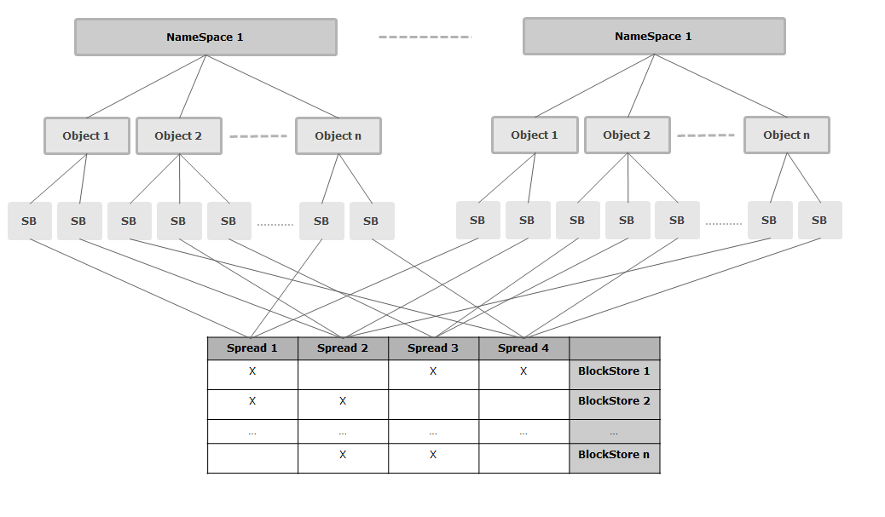
AmpliStor Data Structure
NameSpace
Object
SuperBlock
Spread

Slide 26
Namespaces
A Namespace is a logical partitioning of the backend storage to provide organization.
A highly simplified analogy for a NameSpace would be a folder in which we group files belonging together.
Currently no storage size limits or boundaries to the namespace. All namespaces will use the entire storage.
A Namespace doesn’t relate to a defined physical distribution of data on disks. Each object stored to a NameSpace may have a different grouping of blockstores that make up its physical location.
Each Namespace has an associated DSS Policy, which determines the level of protection for the files being stored.

Slide 27
Objects
Whatever you store in the DSS storage backend (a file, data stream), everything is logically defined as an object and belongs to a specific NameSpace.
An object is limited to be maximum 4TB.
An object’s name must be unique within the namespace.
An object will stored across a spread of block stores that satisfy the spreading requirements of DSS policy being written to.

Slide 28
Superblocks
When an object is stored in DSS, the client daemon divides it in one or more Superblocks before encoding this data.
Superblocks are to be considered the logical storage unit of the DSS backend. They are not visible to the API, which makes requests based on an object-namespace pair.
The maximum size is 64MB but configurable.
Superblocks are assigned on a per DSS policy basis.
All superblocks of a single object will have the same block store spread.

Slide 29
Protection Policies
How is data actually saved

Slide 30
Spread Width
A stored object in DSS is encoded and distributed across a defined number of blockstores. The spread width parameter dictates the number of blockstores amount of blockstores that are in the spread.
For example: A spread width of 10 means the object data will be spread over 10 different blockstores.
The maximum supported spread width is 20.

Slide 31
Storage Safety
The Storage Safety indicates the number of BlockStores that can be lost while still being able to recover the original data.
A lower Storage Safety will equate to less storage overhead but also increases risk. Conversely, a higher Storage Safety will require higher storage overhead but reduces risk.
The overhead ratio can be calculated with the following equation:
( 1.2 * 1.0267 * spread_width )
-------------------------------------------------------- = overhead_ratio
(spread_width – storage_safety)

Slide 32
Safety Strategy
The Safety Strategy defines the behavior during write operations when block stores are unavailable.
RepairSpread | If a blockstore from the spread is offline during a put operation, we will immediately select a new spread (that preferably matches the storage deamons that have already received checkblocks for the object) and try using this one to satisfy the policy.
DynamicSafety | If a blockstore from the spread is offline during a put operation, we will not generate additional data in order to satisfy the disksafety. For the next SuperBlocks we will no longer use this storage daemon.
Stop on Failure | If a blockstore from the spread is offline during a put operation, we will stop the put operation and return a failure response over the REST API.

Slide 33
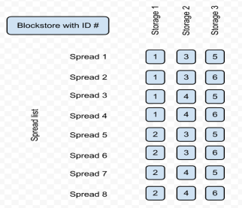
Spreads and Spread Lists
A spread is simply a grouping of blockstores on which a given object is stored.
Spreads are automatically generated by an algorithm based on the protection policy settings.
The spreads are generated so that data is distributed equally over the backend storage
A spread list is the total number of defined spreads that created for a protection policy.
Simple example

Slide 34
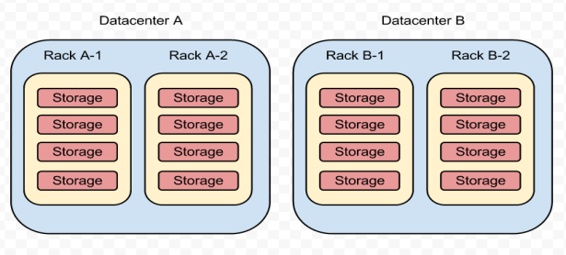
Data Balance
The Data Balance settings define how data is spread across various levels in the environment.
The user can choose to spread data at any level (datacenter, rack, or node) independent of the other level choices.

Slide 35
AMIF and Qpackages
Amplidata Management and Integration Framework

Slide 36
AMIF
Agent
An agent is a service connected to the ejabberd service. Agents are responsible for executing rscripts which use tasklets installed on the system. Every node has a running agent service, which runs as part of the Application Server.
Application Server
The application server is the component responsible for exposing various services over XML-RPC. The definition and implementation of an Application Server service is 100% separated from the underlying transport. Each node has a running application server, though not all nodes have the same application server services running.
Arakoon
Arakoon is a key/value store of objects. This database is used to store the actual objects of your application. Although Arakoon is a database, it is non-queryable nor it is a relational database.

Slide 37
AMIF
ejabberd
ejabberd is an XMPP application service. The ejabberd service only runs on the management controller node. ejabberd is used in PyLabs as communication platform between the PyLabs agents and the agent controller.
Monitoring Agent
The monitoring agent is a Python application that contains a scheduler. This scheduler is responsible for starting tasklets which gathers system (CPU, Mem, Network) monitor information at 10 minute intervals. The monitor information is saved in rrd stores.
OSIS
Object Storage and Indexing System. OSIS is a layer on top of Arakoon and PostgreSQL. OSIS services run only on the management controller node as part of the Application Server. It has two functions: store and retrieve objects in and from Arakoon, and store and update views in PostgresSQL.

Slide 38
AMIF
PostgreSQL
PostgreSQL is an open source relational database which is fast and queryable. This database is used to store views on objects in the DRPDB. PostgreSQL only runs on the management controller node.
DRP
Datacenter Resource Planning. This is the database which comprises the sum of OSIS, PostgreSQL, and Arakoon. All environmental information is stored in this database.
Tasklets
The tasklets framework provides an easy and modular way to execute small pieces of reusable Python code which are loaded into memory. These are the executed by the Agent service.
Workflow Engine
The Workflow Engine is responsible for the dispatching and monitoring of jobs across all the agents in the domain.

Slide 39
Qpackages Repository System
Package management is handled through “qpackages”, a repository system.
The repository is located at /mnt/qpackagesserver on the management controller node. All nodes will install new and updated packages from this location.
The repository location is divided into “domains”, each of which is responsible for various components of the overall system.
Each domain consists of two elements:
  Bundles: Individual tarballs, one or two for each package.
  Metadata: A single tarball, called default.branch.tgz, which includes metadata for every bundle.
Each node will receive packages from the same qpackage server repository.
Each node’s interaction with the repository is configured at /opt/qbase3/cfg/qpackage4/sources.cfg
Each node retains its cache of repository metadata. When packages are updated, each node must have its repository metadata cache updated.

Slide 40
GUI Demo
Configuration, Management, Monitoring

Slide 41
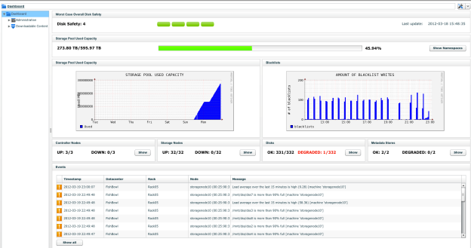
Management Features
Central Web Based Management interface
SNMP trapping support & MIB
Trending information on disk capacity, CPU, rebuilds, disk failures…
Call-Home feature: Amplidata analyses information daily
192.168.107.221

Slide 42
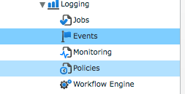
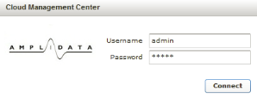
Management Framework
Management services running on one of the controller nodes
  Possible to failover to other controller in case of disaster
  Always accessible on the same IP address
The management framework provides:
  Web-GUI for easy administration and configuration
  Installation framework for automated installation of controllers and storage nodes
  Monitoring and Event reporting framework
    E-mail escalation of events
    Phone-home reporting to Amplidata support (Platinum support contract)
    Escalation of events via SNMP Traps
    SNMP MIB for pulling monitored data

Slide 43

Management Framework
192.168.107.221
192.168.107.221

Slide 44
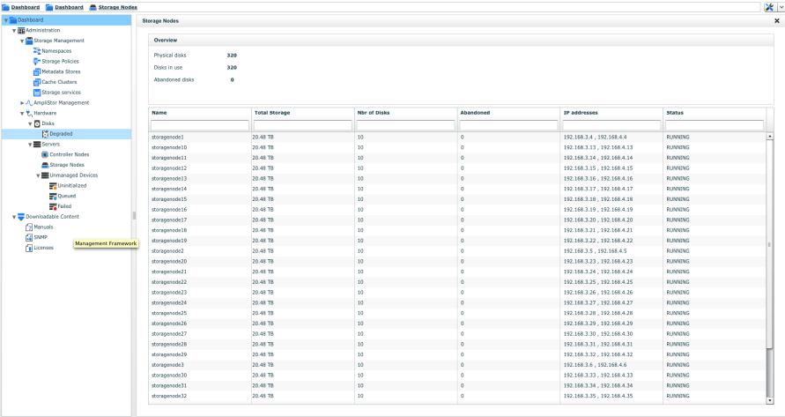
Management Framework

Slide 45
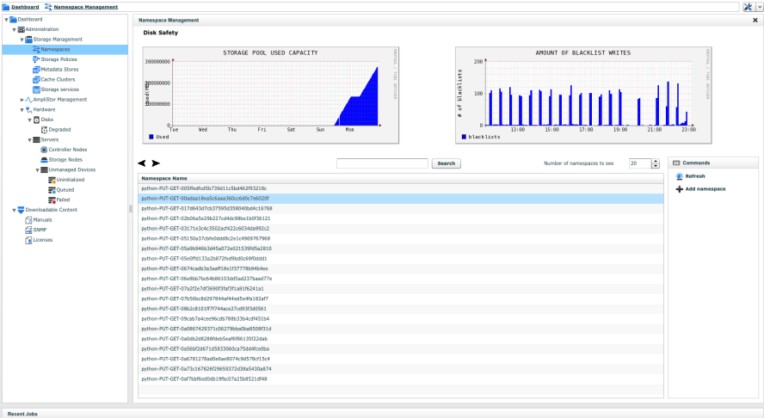
Management Framework

Slide 46
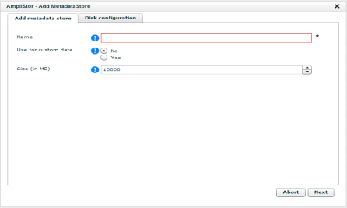
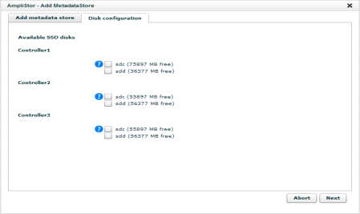
Configuring Metadata Stores
Metadata stores are created in the management GUI under Dashboard -> Administration -> Storage Management -> Metadata Stores -> Add MetadataStore.
Specify a name, size, and the SSDs for the Metadata Store.

Slide 47
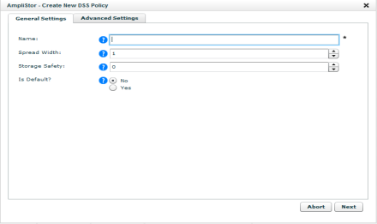
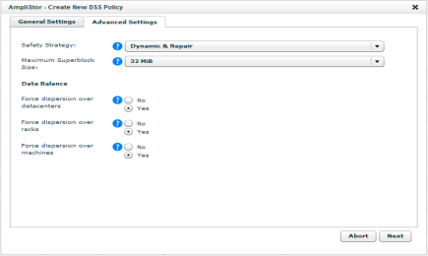
Configuring Storage Policies
Storage Policies are created in the management GUI under Dashboard -> Administration -> Storage Management -> Storage Policies -> Add DSS Policy
Specify a name, spread width, storage safety, safety strategy, superblock size, and data balance rules for the Storage Policy.

Slide 48
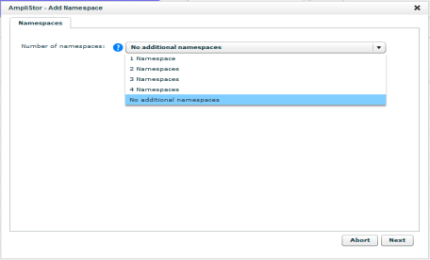
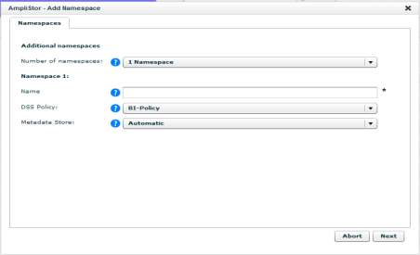
Configuring Namespaces
Namespaces are created in the management GUI under Dashboard -> Administration -> Storage Management -> Namespaces -> Add namespace
Specify a name, spread width, storage safety, safety strategy, superblock size, and data balance rules for the Storage Policy.

Slide 49
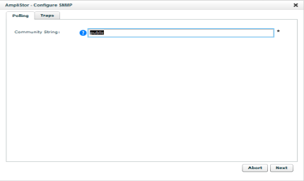
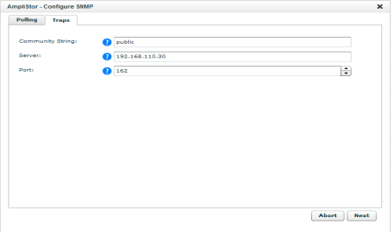
Configuring SNMP
SNMP configuration is handled under Dashboard -> Administration -> AmpliStor Management -> Installation -> Configure SNMP
Specify the Community String for SNMP polling and the Community String, Server, and Port for SNMP trapping.

Slide 50
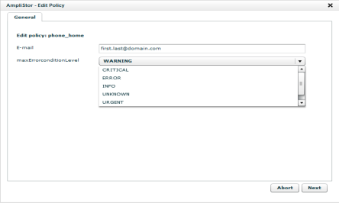
Configuring Call Home
Call Home functionality is configured under Dashboard -> Administration -> AmpliStor Management -> Policies
Click on the policy “Send a report of the highest severity events”.
Click Edit Policy and specify the E-mail address and maximum error level to be included.
Click Start Policy to immediately generate a report.

Slide 51
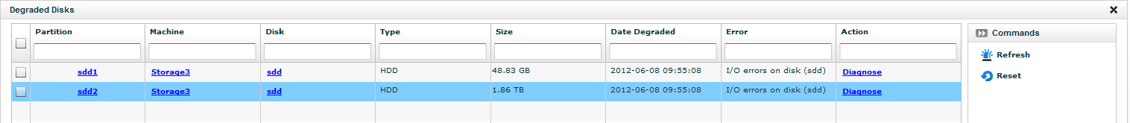
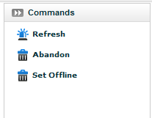
Handling a failed disk
Failed disks will appear in the section Dashboard -> Administration -> AmpliStor Management -> Hardware -> Disks -> Degraded. Notifications will also be made via SNMP and Call Home.
Diagnose will run a short SMART test on the disk and provide error details.
Depending upon the state of the disk, the user can abandon or offline the disk by clicking on the partition and selecting the appropriate command.

Slide 52
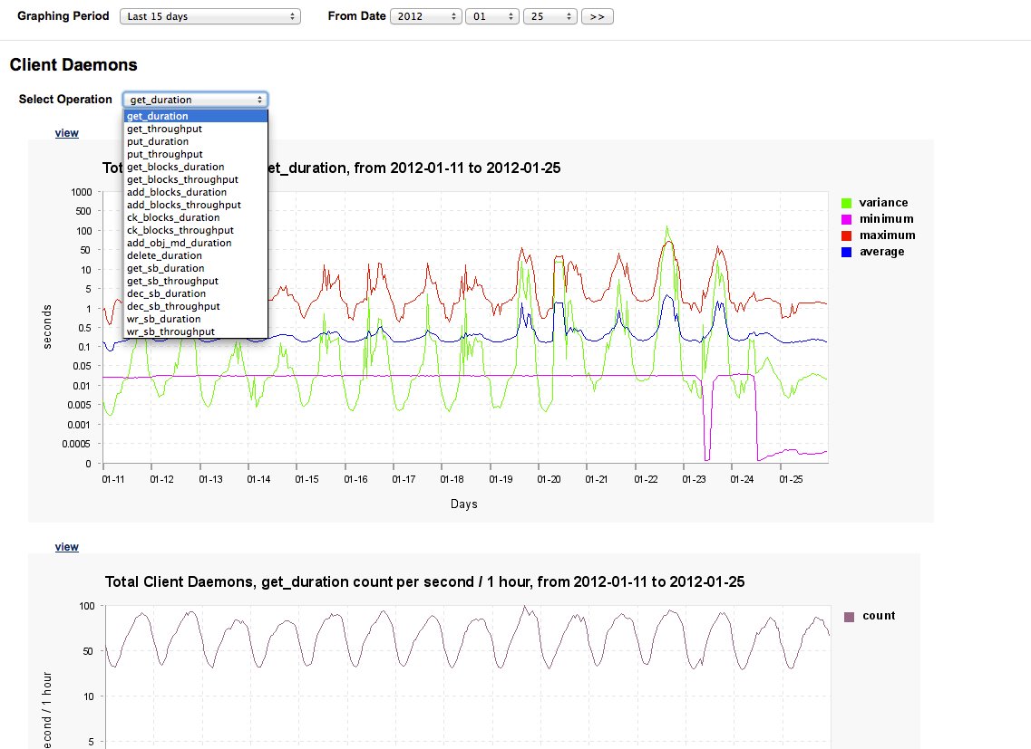
Performance and Trending Graphs

Slide 53
CLI
Qshell and OSMI

Slide 54
Introduction to the Qshell
Python based API
Invoked by `/opt/qbase3/qshell` and allows interaction with most OS and AmpliStor components.
The <TAB> key can be used to show available options at any level.
Function calls can be made using a questions mark “?” as the first and only argument to show help information if available.
  q.dss.manage.listNameSpaces(?
Supports the creation of python objects, which have their own properties and methods.
  In [4]: myDiskObj = api.disk.getObject('beb776f0-dc62-4bf3-907d-d501f5223b8c')
  In [5]: myDiskObj.dss
  myDiskObj.dssnamespaceguid myDiskObj.dsspolicyguid
Qshell exists on all nodes regardless of role, though not all commands can be run on every node.
Not all functions are related to this product.
All DSS extensions are located under the “/opt/qbase3/lib/pymonkey/extensions/dss” directory
All Arakoon functions are located under the “/opt/qbase3/lib/pymonkey/extensions/dss” directory

Slide 55
Qshell
Major qshell extensions to be familiar with
cloudapi – Allows interaction with an instance of the DRPDB
q.dss. – Interaction with and management of DSS components
q.manage. – Interaction with non DSS services. Arakoon, Application Server
q.qp – Extension to list installed qpackages, manually update new qpackages
i.qp – Updating qpackages metadata on individual nodes.
q.cluster. - Creates “clusters” of servers for doing manipulation
q.drp – Extension to save objects back into the DRPDB
q.cmdtools – Interaction with many linux tools (parted, smartctl, etc…)
Scripting
The qshell binary allows you to pass a file with qshell extensions contained within to script multiple calls within the qshell. /opt/qbase3/qshell –f <script file>
The qshell also allows you to pass a qshell command directly from the bash CLI. /opt/qbase3/qshell –c “<command>”

Slide 56
Qshell DRP connections
Through the Qshell, the engineer can interact with query objects in the DRP database.
This is dangerous! Adding / deleting / updating the wrong thing will cause severe consequences.
The connection can be created using the following command
  api = i.config.cloudApiConnection.find('main')
Once the connection is made, the user can list elements in the DRPDB and create objects representing the properties of those elements using its GUID.
  machineObj = api.machine.getObject(‘guid’)
The objects have method and properties to interact with.
  In [14]: machineObj.hostname
  Out[14]: 'Storage03'
Once an object is updated, it must be saved back into the DRPDB.
  q.drp.machine.save(machineObj)

Slide 57
Important Qshell Examples
Pool level monitoring
  q.dss.manage.monitorStoragePool()
    Checks the status of the entire storage pool
    Does not update in real time
  q.dss.manage.monitorNamespace(‘[NS-NAME]’)
    Checks the status of
  q.amplistor.healthCheck(printSystemInfo=True,interactive=False)
    Will first check state of local node
    Then all remote nodes
    Interactive=false
  q.amplistor.systemCheck(printSystemInfo=True,interactive=False)
    Shows connectivity between systems
    Cabling between public & management networks
    Default gateways, System times, MAC address consistency
Namespaces
  q.dss.manage.checkIfNameSpaceExists('[NS-NAME]')
    true if it exists, otherwise false
  q.dss.manage.listNameSpaces()
    Lists all available NS’s
    Find NS to monitor
  q.dss.manage.showNameSpace(‘[NS-NAME]’)
    Returns ID, name, policy ID and status
  q.dss.manage.listNamespaceObjects(‘[NS-NAME]’)
    List all objects in NS

Slide 58
Important Qshell Examples
Pool level monitoring
  q.dss.manage.monitorStoragePool()
    Checks the status of the entire storage pool
    Does not update in real time
  q.dss.manage.monitorNamespace(‘[NS-NAME]’)
    Checks the status of
  q.amplistor.healthCheck(printSystemInfo=True,interactive=False)
    Will first check state of local node
    Then all remote nodes
    Interactive=false
  q.amplistor.systemCheck(printSystemInfo=True,interactive=False)
    Shows connectivity between systems
    Cabling between public & management networks
    Default gateways, System times, MAC address consistency
Namespaces
  q.dss.manage.checkIfNameSpaceExists('[NS-NAME]')
    true if it exists, otherwise false
  q.dss.manage.listNameSpaces()
    Lists all available NS’s
    Find NS to monitor
  q.dss.manage.showNameSpace(‘[NS-NAME]’)
    Returns ID, name, policy ID and status
  q.dss.manage.listNamespaceObjects(‘[NS-NAME]’)
    List all objects in NS

Slide 59
Important Qshell Examples
Block stores
  q.dss.manage.listBlockStores()
    Show all blockstores
  q.dss.manage.showBlockStore(‘[BLOCKSTORE-ID]’)
    Show info about a specific blockstore
Policy
  q.dss.manage.listPolicies()
    Returns ID, spreadwidth, BS safety, data balance rule
  q.dss.manage.showPolicy(‘[POLICY-ID]’)
    Lists policy parameters
Storage Daemons
  q.dss.manage.listStorageDaemons()
    Lists all SD’s
  q.dss.manage.showStorageDaemon(‘[SD-ID]’)
    Returns SD configuration parameters
Syncstores
  q.dss.manage.listSyncstores()
    Lists all syncstores

Slide 60
Important Qshell Examples
User
  q.dss.manage.listUsers()
    Lists all users
  q.dss.manage.showUser(‘USER-NAME’)
    Returns User configuration
Permissions
  q.dss.manage.setPermissions('PATH' , 'USER-NAME', [PERMISSIONS])
    Set Specified permissions to the user on the path
  q.dss.manage.showPermissionSettings('PATH')
    Returns permission settings
Abandon a BlockStore
  q.dss.manage.abandonBlockStore(‘[BS-ID]’)
    With this option you can abandon remote BS
Abandon a StorageDaemon
  q.dss.manage.abandonStoragedaemon(‘[SD-ID]’)
    With this option you can abandon remote SD

Slide 61
Qshell Examples
DSS Daemons
  q.dss.clientdaemons.getStatus()
  q.dss.storagedaemons.start()
    Start all storagedaemons on local node
  q.dss.maintenanceagents.stop()
    Stop all maintenanceagents on local node
  q.dss.clientdaemons.restart()
    Restart all clientdaemons on local node
  q.dss.clientdaemons.StopOne([DAEMON-ID])
    Stop client daemon with ID DAEMON-ID
Arakoon
  q.manage.arakoon.listClusters()
    Lists all arakoon clusters
  q.manage.arakoon.start()
    Start all arakoon clusters local node
  q.manage.arakoon.stop()
    Stop all arakoon clusters local node
  ac = q.manage.arakoon.getCluster(‘<arakoon name>’)
    Create an object of cluster framework to start and stop a specific cluster
  ac.start()
    Start framework arakoon cluster local node
  ac.stop()
    Stop framework arakoon cluster local node

Slide 62
Qshell Clusters
Summary
Clusters is a built-in extension in Qshell used for executing commands on multiple nodes from a the management controllers qshell.
Clusters help in monitoring and management tasks which had to be done on some or all environment nodes.
To access the cluster extension you use the following entry from Qshell
Manipulating clusters
q.cluster.list()
  Lists available clusters names
myCluster = q.cluster.get(clustername='<cluster-name>')
  Gets a cluster object from already created cluster
q.cluster.create(?
  Creates a new cluster. At this step the user provides a list of IP addresses for nodes to include.
q.cluster.delete(clustername='<cluster-name>')
  Delete a cluster

Slide 63
Qshell Clusters
Using clusters
myCluster.listnodes()
  Lists nodes in the cluster
myCluster.ping()
  Performs a ping test to all nodes in the cluster
myCluster.execute('<command>', myCluster .listnodes())
  Executes a bash command on all nodes in the cluster.
myCluster.executeQshell('<command>', myCluster .listnodes())
  Executes a qshell command on all cluster nodes

Slide 64
Qshell Clusters
Example
In [11]: cu.execute('cat /etc/hostname', cu.listnodes())
* Execute cat /etc/hostname on cluster.
* Execute cat /etc/hostname on node 10.0.1.101 10.0.1.101
AmpliHead001
* Execute cat /etc/hostname on node 10.0.1.102 10.0.1.102
AmpliHead002
* Execute cat /etc/hostname on node 10.0.1.103 10.0.1.103
AmpliHead003
Out[11]:
{'10.0.1.101': [0, 'AmpliHead001\n'],
'10.0.1.102': [0, 'AmpliHead002\n'],
'10.0.1.103': [0, 'AmpliHead003\n']}

Slide 65
OSMI
Introduction
The Object Store Management Interface is a tool to facilitate Amplistor management for user who are not familiar with Qshell and interactive Python. It provides a means to execute tasks and get information from an environment, by menu-based selections.
How To run OSMI
/opt/qbase3/apps/osmi/osmi
Options
-h, --help show this help message and exit
-p, --preload preload daemon configuration files at startup
-d, --debug enable debug logging
-v, --version display version information
-l, --list List menu and exit

Slide 66
OSMI
Preloading configuration files
The "preload daemon configuration" will contact all running storage and controller nodes and build an in-memory cache of configuration files for all daemons. Still will make listing of the daemons in OSMI faster at run-time, but will make start-up slower.
If preload is not specified, the configuration file is loaded on each listing done.
Specifying this option will depend on the number of nodes in the environment and the amount of daemon actions that need to be executed in OSMI.
Making menu selections
Making a selection is possible by three inputs:
A single numeric value (e.g: 2)
A comma-separated list of values (e.g.: 1,4,5)
The letter 'a', indicating all items

Slide 67
OSMI
Main menu
  Object Store Management Interface
  1) Environment
  2) Policies and Namespaces
  3) Machines and services
  4) Users and permissions
  5) Events and logging
  0) Exit
Environment menu
  Environment
  1) List installed packages
  2) List management policy
  3) Execute management policy
  4) Show repair information
  0) Return to Main Menu

Slide 68
OSMI
Selection Menu
  ------------
  - Machines -
  ------------
  1) Machine cpunode1 (type: cpunode, status: RUNNING)
  Components: 1 management framework(s), 1 client daemon(s)
  2) Machine ASStorage (type: storagenode, status: HALTED)
  Components: 2 storage daemon(s), 1 maintenance agent(s), 4 block store(s)
  3) Machine ASController (type: cpunode, status: HALTED)
  Components: 1 client daemon(s)
  Select machine (1-3):

Slide 69
Access and authentication
GUI, CLI, Namespace

Slide 70
Introduction
AmpliStor environments can be accessed by:
GUI – A.K.A the Cloud Management Center "CMC"
A web interface accessible only from the management node which provides an overall control, management and monitoring for the whole environment.
Command line interface "CLI"
A console shell access which is accessible from all nodes providing more in-depth and advanced control over environment nodes as well as all the management done from the CMC interface.

Slide 71
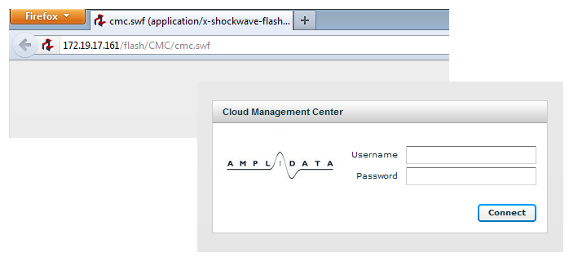
GUI Web Access
Use your web browser to open your Amplistor environment CMC web interface running on the management node.
http://<ip address or domain name>/
defaults
- username: admin
- password: admin

Slide 72
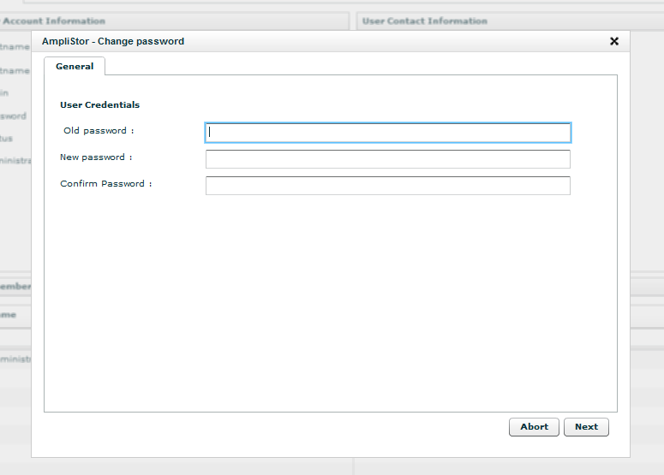
GUI Web Access
After login you can change default access by going to the menu under
Dashboard > Administration > Amplistor Management > Groups & Users > Users
To change the information and password for the "admin" account, select the user "admin" from "all users" list.
You will find in the right menu all available options including "Change Password"

Slide 73
CLI Access
Overview
Command line access is provided through SSH connection to any node.
Controller Nodes Access
  Open SSH connection on the public LAN network interface for node.
Storage Nodes Access
  First connect to any of the controller nodes.
  Then connect to the storage node from any of the Amplistor internal "Controller-Storage" networks (management LAN, storage LAN)
Default credentials are root / rooter
Making changes
The root password must be changed on both the system and in the DRPDB.
At the system level, login to the server and use the command ‘passwd’ which will request you to enter the new password and confirm it.
In the database, use the Qshell to create an connection to the DRPDB. Use the following command to make the change
  api.machine.changePassword(‘<machine guid>’)
Using the qshell cluster’s makes this a much more manageable task.

Slide 74
Namespace authentication
Overview
Authentication for Namespace’s can be configured in the Qshell
Authentication can only be set at the ‘/’, ‘/namespace’, ‘/manage’, ‘/namespace/<namespace>’ levels.
Related Commands
q.dss.manage.addUser(
  Creates a new user
q.dss.manage.deleteUser(
  Removes a user
q.dss.manage.changeUser(
  Method to change a user’s password
q.dss.manage.setPermissionFlags(
  “Inherit”
q.dss.manage.setPermissions(
  "Read", "Create", "Delete", "List", "Update".
q.dss.manage.showPermissions(
  Show permissions for a specific username and path
q.dss.manage.showPermissionFlags(
  Show permission flags for a specific username and path
q.dss.manage.listNameSpaces(
  List all namespaces as well as all permission settings for that namespace

Slide 75
Troubleshooting
Logs and log collection

Slide 76
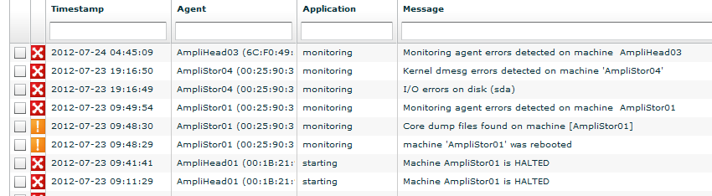
Troubleshooting – First places to look
Qshell: q.dss.amplistor.healthcheck()
  Automated environment test
  Service checks
  Availability checks (all nodes online?)
  Model vs Reality checks (mac address identical?)
GUI: Dashboard and Event log

Slide 77
Troubleshooting – Log data
Application log files are generally stored in /opt/qbase3/var/log/
ls –al /opt/qbase3/var/log/
-rw-r--r-- 1 root root 186799 2012-06-25 16:25 AmpliStor_2.5.1_k_2012-06-25.log
-rw-r--r-- 1 root root 1750 2012-07-16 15:25 AmpliStor_2.5.2_2012-07-16.log
drwxr-xr-x 2 root root 4096 2012-07-26 07:58 apache
-rw-r--r-- 1 root root 23920437 2012-07-26 14:43 applicationserver.log
drwxr-xr-x 3 root root 4096 2012-04-16 11:42 arakoon
drwxr-xr-x 3 root root 4096 2012-04-16 11:42 dss
drwxrwxrwx 4 root root 4096 2012-07-25 08:03 errors
-rw-rw-rw- 1 root root 13 2012-07-26 14:42 monitoring_agent.initSuccess
-rw-rw-rw- 1 root root 4392121 2012-07-26 14:43 monitoring_agent.log
-rw-rw-rw- 1 root root 4999984 2012-07-25 22:27 monitoring_agent.log.1
-rwxr-xr-x 1 root root 124885499 2012-07-26 14:43 monitoring_agent.stderr
-rwxr-xr-x 1 root root 102595837 2012-07-26 14:41 monitoring_agent.stdout
drwxr-xr-x 2 qbase qbase 4096 2012-04-16 11:26 postgresql
drwxrwxrwx 11 root root 4096 2012-07-26 07:58 pylabslogs
-rw-r--r-- 1 root root 83292 2012-07-26 02:09 rsync.log
-rw-r--r-- 1 root root 23 2012-06-25 16:47 snmpd.log
-rw-r--r-- 1 root root 3926 2012-06-25 16:47 twistd_dnsserver.log
-rw-rw-rw- 1 root root 0 2012-06-25 16:47 workflowengine.initSuccess
-rwxr-xr-x 1 root root 53 2012-07-16 15:02 workflowengine.stderr
-rwxr-xr-x 1 root root 610804 2012-07-26 14:24 workflowengine.stdout

Slide 78
Troubleshooting – Main log Overview
Clientdaemons
/opt/qbase3/var/log/dss/clientdaemons/clientx.log
Storagedaemons
/opt/qbase3/var/log/dss/storagedaemons/?/node.log
Each storagenode runs two storagedaemon services.
The path is based on the storagedaemon its ID.
Maintenanceagents:
/opt/qbase3/var/log/dss/maintenanceagents/*
Notes
Dss stores and monitors performance statistics and will output this info in the log every 5 minutes. You can retrieve this information by using “grep Statistics” on DSS log files
You can change the log level to debug in the dss configuration files. This requires a service restart.

Slide 79
Troubleshooting – Arakoon Log data
Arakoon
/opt/qbase3/var/log/arakoon/framework/node_*
The log file and path naming depends on the metadatastore and the node id.
The framework metadatastore is a default primairy metadatastore used by the framework.
When an arakoon node is having problem it will log the specific problem.
Arakoon has statistic information in its logs aswell.
Use “grep stats” to get this info from log.
The Arakoon JIRA is available online at http://jira.incubaid.com/browse/ARAKOON

Slide 80
Troubleshooting – Other useful log info
/var/log/kern.log
  May contains hints of hardware issues
/var/log/daemon.log
  Contains dhcpd log data. Useful for troubleshooting PXE boot issues.
/opt/qbase3/var/log/apache/access.log
  POST & GET requests to the appliation server. Can be useful to troubleshoot PXE boot issues as well.
/opt/qbase3/var/log/monitoring_agent.log.
  Holds monitorring agent info for the node it runs on.
/var/log
  System / OS level logging
/var/crash
  Core dumps
  GDB - Not installed by default, but can be installed with qpackages.
Logs are rotated using the logrotate service.

Slide 81
Services
Client daemons
Configuration: /opt/qbase3/cfg/dss/clientdaemons/
Log: /opt/qbase3/var/log/dss/clientdaemons/
Process example: /opt/qbase3/bin/dss -d --clientdaemon /opt/qbase3/cfg/dss/clientdaemons/2fa78455-0b15-4b12-bbfe-690ef0eb3929.cfg
Storage daemons
Configuration: /opt/qbase3/cfg/dss/storagedaemons/
Log: /opt/qbase3/var/log/dss/storagedaemons/
Process example: /opt/qbase3/bin/dss -d --storagedaemon /opt/qbase3/cfg/dss/storagedaemons/d35ac9f7-2ad1-4236-94db-44b8e72010b6.cfg
Maintenance Agents
Configuration: /opt/qbase3/cfg/dss/maintenanceagents/
Log: /opt/qbase3/var/log/dss/maintenanceagents/
Process example: /opt/qbase3/bin/dss -d --maintenanceagent /opt/qbase3/cfg/dss/maintenanceagents/d52cde10-ccb0-4c14-81ac-df8e82992c31.cfg

Slide 82
Services
Cache daemons
Configuration: /opt/qbase3/cfg/dss/cachedaemons/
Log: /opt/qbase3/var/log/dss/cachedaemons/
Process example: /opt/qbase3/bin/dsscached -d /opt/qbase3/cfg/dss/cachedaemons/fa1e970e-95cb-4ddf-9380-4d1a17984307.cfg
Monitoring Agent
Configuration: /opt/qbase3/cfg/qconfig/monitoringAgent.cfg
Log: /opt/qbase3/var/log/
Process example: /opt/qbase3/bin/dss -d --storagedaemon /opt/qbase3/cfg/dss/storagedaemons/d35ac9f7-2ad1-4236-94db-44b8e72010b6.cfg
Apache
Configuration: /opt/qbase3/apps/apache/conf/httpd.conf
Logs: /opt/qbase3/var/log/apache
Process example: /opt/qbase3/apps/apache/bin/httpd -f conf/httpd.conf -k start

Slide 83
Services
Arakoon
Configuration: /opt/qbase3/cfg/qconfig/arakoon
Log: /opt/qbase3/var/log/arakoon/<metadataStoreName>/
Process example: /opt/qbase3/apps/arakoon/bin/arakoon --node node_0_9001 -config /opt/qbase3/cfg/qconfig/arakoon/framework/framework.cfg –daemonize
Application Server
Configuration: /opt/qbase3/cfg/qconfig/applicationserver.cfg, /opt/qbase3/cfg/qconfig/applicationserverservice.cfg
Log: /opt/qbase3/var/log/applicationserver.log, /opt/qbase3/var/log/pylabslogs/applicationserver
Process example: /opt/qbase3/bin/python /opt/qbase3/bin/twistd --pidfile=/opt/qbase3/var/pid/applicationserver.pid -y /opt/qbase3/apps/applicationserver/lib/applicationserver.tac --savestats
Workflow Engine
Configuration: /opt/qbase3/cfg/qconfig/Workflowengine.cfg
Logs: /opt/qbase3/var/log/pylabslogs/workflowengine/
Process example: /opt/qbase3/bin/python /opt/qbase3/apps/workflowengine/bin/main.py

Slide 84
Services
TFTP
Configuration: N/A
Log: /var/log/syslog, /var/log/daemon.log, /var/log/boot.log
Process example: /opt/qbase3/apps/tftpd/sbin/in.tftpd -l -a 0.0.0.0:69 -s /opt/qbase3/var/cloudinstallservice/tftpboot/
DHCP
Configuration: /opt/qbase3/cfg/dhcpd/dhcpd.conf
Log: /var/log/syslog, /var/log/daemon.log, /opt/qbase3/var/log/apache/access.log
Process example: /opt/qbase3/apps/dhcpd/dhcpd -cf /opt/qbase3/cfg/dhcpd/dhcpd.conf -lf /opt/qbase3/cfg/dhcpd/dhcpd.leases -p 67 -pf /opt/qbase3/var/pid/dhcpd.pid
Rsync
Configuration: /opt/qbase3/cfg/rsync/rsync.cfg
Logs: /opt/qbase3/var/log/rsync.log
Process example: /opt/qbase3/bin/rsync --daemon --config=/opt/qbase3/cfg/rsync/rsync.cfg --port=873

Slide 85
Troubleshooting – NFS Recovery mode
Configure machine to reboot into NFS recovery mode by executing the following qshell commands
Machinename = “AmpliHead003” cloud_api = i.config.cloudApiConnection.find('main') machineguid = cloud_api.machine.find(name=machinename)['result'][0] cloud_api.machine.bootInRecoverMode(machineguid)
Reboot the machine (or power cycle when needed) to PXE boot into NFS recovery mode.
What can be done in NFS recovery mode?
  Chroot into the storagenode OS and Sandbox
mdadm --assemble --scan mount some required parts and chroot: mount /dev/md0 /mnt mount -t proc /proc /mnt/proc mount -o dev /dev /mnt/dev chroot /mnt source /etc/profile
  You can now run qshell and even start AmpliStor services.
  (Some services will require additional partitions to be mounted.
  For example: The storagedaemon requires its blockstores to be mounted on /mnt/dss/* )
  You can change grub (/etc/default/grub) or reinstall grub
  You can alter /etc/fstab

Slide 86
Troubleshooting – NFS Recovery mode
What can be done in NFS recovery mode?
  Chroot into the storagenode OS and Sandbox
mdadm --assemble --scan mount some required parts and chroot: mount /dev/md0 /mnt mount -t proc /proc /mnt/proc mount -o dev /dev /mnt/dev chroot /mnt source /etc/profile
  You can now run qshell and even start AmpliStor services.
  (Some services will require additional partitions to be mounted.
  For example: The storagedaemon requires its blockstores to be mounted on /mnt/dss/* )
  You can change grub (/etc/default/grub) or reinstall grub
  You can alter /etc/fstab

Slide 87
Log collector
Introduction
Log collector tool collects logs from all environment nodes. The tool collects any DSS daemon logs or arakoon logs. The tool also collects system logs and pylabs logs; in any date or date range you may specify.
Structure
Consists of two python scripts log_collector.py and log_collector_trigger.py
log_collector
  This script will be installed on all environment nodes. It collects logs from node residing on, and sends it to the management node (as a .tgz) or upload it to the local DSS
log_collector_trigger
  This script has two major functions. The first is to install the tool, and the second to call log_collector script on all nodes. This script will be installed only on the management node

Slide 88
Log collector installation
Installation
Tool installation will prepare environment for log collection. It will distribute needed scripts to nodes. During installation process if more options are added it can add a cron file for daily run and create new namespace to use it in log collection. Using more options to select or exclude nodes from tool installation.
Usage
log_collector_trigger.py -i [-c] [-w, -o POLICY] [-n NODE... | -x EXCLUDE...] [-l LOGGING]
Options
-i, --install : install log collector tool on all environment running nodes
-c, --crontab : Add cron file in cron.daily directory for daily run
-w, --createnamespace : Create a DSS namespace with the name log_collector when installing if -o isn't specified use default policy specified by the framework
-o, --policy : Policy name used to create log_collector namespace. Enter policy name. This option is used only when (-w) option is used

Slide 89
Log collector usage
Log Collection
Tool collect all DSS logs, arakoon cluster logs and system logs.Tool can run in three modes alllogs to collect all logs, error logs to collect only error logs from log files and keyword to specify any keyword to be collected from log files. All log collection must be for a specific date or within a date range. By default tool collect logs from all running nodes, but you may specify node to collect from it only or exclude some nodes from logs collection. Tool send output files to the management node by default unless specified to upload it to local DSS.
Usage
log_collector_trigger.py -t LOGTYPE... [-m MODE | -k KEYWORD...] [-I DAEMONID...] [-d LOGDATE | -F FROMDATE, -T TODATE] [-u UPLOAD, [-N NAMESPACE]] [-s] [-n NODE... | -x EXCLUDE...] [-l LOGGING] [-f NUMBEROFFILES]
Options
-t, --type : Which logs will be collected. Choose between dssclientdaemons, dsscachedaemons, dssstoragedaemons, dssmaintenanceagents, arakoonclusters, alldaemons, system, all, backuparakoontlog and pylabs. Must specify at least one log type to run the tool in collection mode and may specify more than log type
-m, --mode : Logs mode, choose between errorlogs to collect ERROR logs only and alllogs to collect ALL logs. if logs mode wasn't specify, tool will run in errorlogs mode as default value

Slide 90
Log collector usage continued
log_collector_trigger.py -t LOGTYPE... [-m MODE | -k KEYWORD...] [-I DAEMONID...] [-d LOGDATE | -F FROMDATE, -T TODATE] [-u UPLOAD, [-N NAMESPACE]] [-s] [-n NODE... | -x EXCLUDE...] [-l LOGGING] [-f NUMBEROFFILES]
Options
-k, --keyword : Type any keyword to collect from log files. May specify more than one keyword. If keyword is specified log collection mode will be keyword by default. No need to specify logs mode when using keyword option
-I, --id : Daemon ID for log collection. Can't use more than one log type when using this option. This option is used only with the following log types ( dssclientdaemons, dsscachedaemons, dssstoragedaemons, dssmaintenanceagents, arakoonclusters)
-d ,–date : Logs date to collect. Choose between today, yesterday or enter any date in "yyyy-mm-dd" format. If no date entered tool will collect logs with yesterday date as default value.
-F, --from : Use to specify from date range, from date must be in "yyyy-mm-dd" format and must be prior than To date
-T, --to : Use to specify to date range, to date must be in "yyyy-mm-dd" format
-u, --upload : Where tool will upload the output file (upload destination). Choose between management to send output file to the management node and localdss to upload output files to DSS. If no option specified it will upload output files to the management node by default under /opt/qbase3/var/log/log_collector directory

Slide 91
Log collector usage continued
log_collector_trigger.py -t LOGTYPE... [-m MODE | -k KEYWORD...] [-I DAEMONID...] [-d LOGDATE | -F FROMDATE, -T TODATE] [-u UPLOAD, [-N NAMESPACE]] [-s] [-n NODE... | -x EXCLUDE...] [-l LOGGING] [-f NUMBEROFFILES]
Options
-N, --namespace : DSS Namespace where output log files will be uploaded to. This option should be used when specifying upload option (-u) with localdss parameter, else namespace parameter will be ignored
-s, --skipcheck : Skip tool existence check on environment nodes. Should not be used unless you are certain of tool existence on environment nodes that will collect logs from
-n, --node : Specify node for log collection. May specify more than one node
-x, --exclude : Specify node to be excluded from log collection. May specify more than one node
-l, --logging : Set logging level, choose between info and debug. INFO is the default logging level. Specify debug when detailed logs is needed
-f, --filescount : Number of files to collect from.

Slide 92
Log collector upload
Upload to evidence
After log collection, tool can upload collected log files to amplidata evidence environment. Log files must be collected and uploaded on management node to be able to upload it to evidence environment.
Usage
log_collector_trigger.py -H -N NAMESPACE -U USER -P PASSWORD -D DIRECTORY [-S SERVER, -p PORT] [-d LOGDATE | -F FROMDATE, -T TODATE] [-n NODE... | -x EXCLUDE...] [-l LOGGING]
Options
-H, --http : Upload log files to amplidata evidence environment through http
-N, --namespace : Namespace where log files will be uploaded to
-U, --user : User name on amplidata evidence environment
-P, --password : Password on amplidata evidence environment
-S, --server : Server where tool will upload log files to. If you didn't specify server, log files will be uploaded to amplidata evidence environment by default
-p , --port : Port to connect to server through
-D, --directory : Directory where log files will be uploaded under
-d ,–date : Log date files to upload to evidence environment. Choose between today, yesterday or enter any date in "yyyy-mm-dd" format. If no date entered tool will collect logs with yesterday date as default value.

Slide 93
Log collector upload
log_collector_trigger.py -H -N NAMESPACE -U USER -P PASSWORD -D DIRECTORY [-S SERVER, -p PORT] [-d LOGDATE | -F FROMDATE, -T TODATE] [-n NODE... | -x EXCLUDE...] [-l LOGGING]
Options
-F, --from : Use to specify from date range, from date must be in "yyyy-mm-dd" format and must be prior than To date
-T, --to : Use to specify to date range, to date must be in "yyyy-mm-dd" format
-n, --node : Specify node for to upload its log files to evidence environment. May specify more than one node
-x, --exclude : Specify node to be excluded from uploading its log files to evidence environment. May specify more than one node
-l, --logging : Set logging level, choose between info and debug. INFO is the default logging level. Specify debug when detailed logs is needed

Slide 94
Log collector tool management
Tool management
Using tool management options, tool can monitor log collection status on environment nodes and can stop it.
Usage
log_collector_trigger.py -G |-X [-R] [-n NODE... | -x EXCLUDE...] [-l LOGGING]
log_collector_trigger.py -O [-n NODE... | -x EXCLUDE...] [-l LOGGING]
Options
-G, --getstatus : Get log collection status on environment nodes. If log collection is running it will print Running, if not it will print NOT Running.
-X, --stop : Stop log collection on environment nodes. May specify node with -n option to stop collection on this node only or specify nodes to exclude from log collection stopping with -x option
-R, --running : Used with -G and -X options only, to print running nodes status only
-O, --gettoollog : Collect tool log files from environment nodes.

Slide 95
Log collector output
Output
Tool output files will be uploaded to local DSS or management node depend on options given when it run.
Tool output on the management node will be under /opt/qbase3/var/log/log_collector directory
Tool output on local DSS will be under log_collector namespace if didn't specify other namespace with option (-N) when the tool run
Output tar file name will reflect the options you entered when running the tool
Tar file name
logsDate_mode_nodeName_logsCode.tgz
(e.g. 2012-05-30_alllogs_AmpliHead001_acsm.tgz)
parameter | Description
logDate | log date/s
mode | collection mode, error logs or all logs or keyword
nodeName | Node name
logsCode | this code indicate what logs type included in this tar file

Slide 96
Log collector output
Output
Tool output files will be uploaded to local DSS or management node depend on options given when it run.
Tool output on the management node will be under /opt/qbase3/var/log/log_collector directory
Tool output on local DSS will be under log_collector namespace if didn't specify other namespace with option (-N) when the tool run
Output tar file name will reflect the options you entered when running the tool
Tar file name
logsDate_mode_nodeName_logsCode.tgz
(e.g. 2012-05-30_alllogs_AmpliHead001_acsm.tgz)
parameter | Description
logDate | log date/s
mode | collection mode, error logs or all logs or keyword
nodeName | Node name
logsCode | this code indicate what logs type included in this tar file

Slide 97
Log collector output
Log code
Parameter | Description
c | refer to dssclientdaemons
s | refer to dssstoragedaemons
m | refer to dssmaintenanceagents
a | refer to arakoonclusters
C | refer to dsscachedaemons
d | refer to alldaemons
p | refer to pylabs
S | refer to system
b | refer to backuparakoontlog
A | refer to all

Slide 98
Log collector tool troubleshooting
Tool Troubleshooting
On the management node there are two log files called log_collector_trigger.log and log_collector.log both are under /opt/qbase3/var/log directory
On each node tool log file called log_collector.log under /opt/qbase3/var/log directory
To get detailed logging, specify (-l debug) when run the tool.
To collect all log files from all/any node(s) run the tool with -G option
Limitations
Tool can't collect more than one month (31 days) logs when collecting in date range mode.
Tool can't collect logs from more than 100 log files for each daemon
Tool by default can't collect more than 10 keywords in each run
Tool can't collect date range and specific date in a single run
Tool can collect only one date or one date range in a single run
Tool can't collect logs than upload it to evidence in a single run. It should be done on 2 steps first collect logs and send it to management node then upload it to evidence
Can't specify -n and -x options together

Slide 99
Networking
Switches and topology

Slide 100
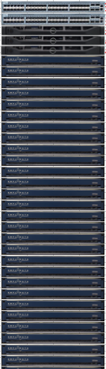
Wide Area Storage Single Rack
Rack Definition
  44U rack
  3 x Controllers Nodes (3U)
  39 x Storage Nodes (39U)
  2 x Ethernet Switches (2U)
Network Fabric
  2 x 48 Port GbE Switches (redundant fabric)
  6-12 x 10GbE ports to controllers
Rack Level Storage Density
  390 disk drives per rack (39 x 10)
  1170TB (3TB disks) raw capacity
  26.6 TB per U
Performance
  3-6 x 10GbE ports to customer network
  2.1 GB/sec aggregate throughput per rack
6 x 10GbE
To customer
network

Slide 101
Controller Node – Network Configuration
NICs are configured in active/active state (managed by WAS Storage)
Full redundancy: tolerates NIC and even complete switch failure
IF 1 NIC fails, performance will drop by 50%, but
No special switch configuration required such as bonding => EASY
NIC 1
10Gb/s
Controller Node
NIC 2
10Gb/s
DATA INGEST
FROM APPLICATIONS
OVER PUBLIC NETWORK 1
Encoder
DATA INGEST
FROM APPLICATIONS
OVER PUBLIC NETWORK 2
ENCODED DATA TRAFFIC
TO STORAGE NODES
OVER PRIVATE LAN 1
ENCODED DATA TRAFFIC
TO STORAGE NODES
OVER PRIVATE LAN 2
NIC 3
10Gb/s
NIC 4
10Gb/s

Slide 102
Storage Node – Network Configuration
NICs are configured in active/active state (managed by WAS Storage)
Full redundancy: tolerates NIC and even complete switch failure
IF 1 NIC fails, performance will drop by 50%, but
No special switch configuration required such as bonding => EASY
NIC 1
1Gb/s
Storage Node
NIC 2
1Gb/s
Storage
Daemon 1
Maintenance
Agent
Storage
Daemon 2
DATA INGEST
FROM CONTROLLERS
Through Switch 1
DATA INGEST
FROM CONTROLLERS
Through Switch 2
Drive 1
Drive n

Slide 103
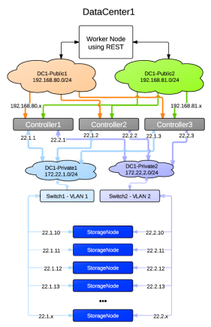
Network Layout – Single Site
Completely redundant architecture
Tolerates following failures
  Single NIC on the Controller
  Complete Controller
  Complete Switch
  Multiple Racks (policy based)
  Multiple Storage Nodes (policy based)
  Single NIC on the Storage Node
  Multiple drives on the storage nodes

Slide 104
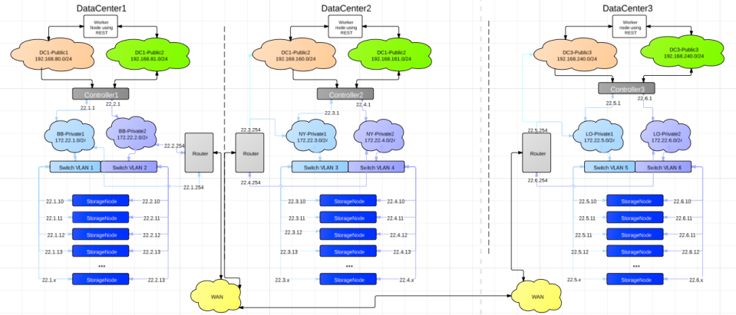
Network Layout – Three Site

Slide 105
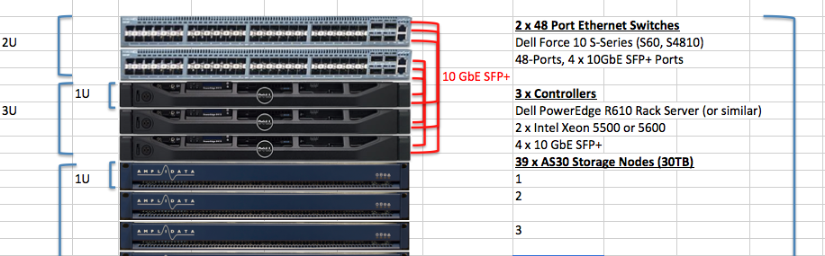
Top of Rack Switch Example
Dual redundant switch fabric
  2 x Dell Force10 S60 or Arista 7048T-A (44 x 1GbE ports, 4 x 10GbE SFP+ ports)
  Storage pool connectivity: 70 – 78 x 1GbE ports (35-39 per switch to storage nodes)
  Controller Connectivity:
    Eight (8) x 10GbE/SFP+ ports total (4 per switch)
    6 ports: 2 ports to each of 3 controllers
    2 additional ports: to aggregation switch (for multi-rack configurations)

Slide 106
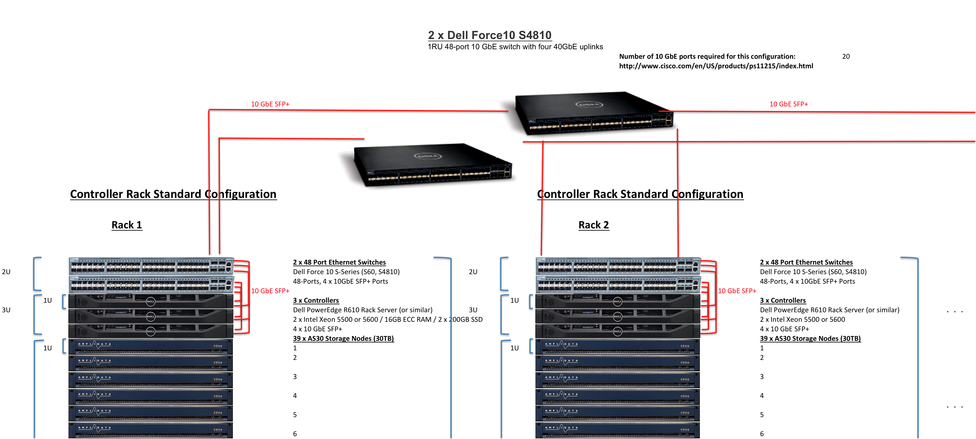
Aggregation Switch Requirements
AmpliStor scalable to multiple racks
  Multiple racks can be connected via remaining ports on ToR switches
  Cross-rack throughput will be limited to 2 x 10GbE ports max
Aggregation switches
  Arista 7050S-52 or Dell Force10 S4810 (10GbE switches)
  Required for systems > 3 racks with high-throughput requirements
  Controller 10GbE uplinks connected to switches in a redundant star configuration
Copyright © - Amplidata 2011-2012

Slide 107
Phone home
Email alerts

Slide 108
Phone Home
Summary
  Sends a summary of recorded events since the last phone home event including
  Application raising the event
  The source of the event
  The number of occurrences including the time of the first and last recorded
  A message describing the event
Example messages
  Backup of application <applicationname> failed
  Collapsing of arakoon transaction logs failed for the following applications <applicationguids>
  The number of keys in the <metadatastorename> MetaData Store exceeds x %
  DSS blockstore using mountpoint <mountpoint> reached maximum capacity
  DSS storagepool is exceeding 70% of used space
  DSS storagepool is exceeding 80% of used space
  DSS storagepool is exceeding 90% of used space
  Machine <machinename> is HALTED
  Nic <nicguid> in half duplex mode
  <mountpoint> is more than <80-85-90>% full [machine '<machinename>']
  Swap usage is over 5% [machine '<machinename>']
  "CPU usage is over the 90% for last 10min [machine '<machinename>'] CPU usage is over the <80-90--95% for last 1h [machine '<machinenename>']"

Slide 109
Phone Home
Example messages continued
  Memory usage is over 90%
  Interface <interfacename> with MAC address <macaddress> has network errors [machine '<machinename>']
  Interface with MAC address <macaddress> is overloaded for <85-90-95>% [machine '<machinename>']
  CPU temperature is way too high (above <50-60> degree)
  Case temperature is too high (above <40-50> degree)
  CPU fan not spinning
  Disk '<diskname>' ['<machinename>'] has SMART failures Overall Status 'UNKNOWN'
  Partition '<partitionname>' failed on machine '<machinename>'
  Software RAID array <arrayname> has status <recovering-degraded> on machine <machinename>
  Kernel dmesg errors detected on machine '<machinename>'
  Read-only partition '<partitionname>' [machine '<machinename>'] detected [mountpoint '<mountpoint>']
  Unable to start application <applicationname>. Error: <exception>
  Interface <interfacename> with MAC address <macaddress> is down [machine '<machinename>']
  Load average over the last 15 minutes is high (<load>) [machine '<machinename>']
  The SMART control on disk '<diskname>' ['<machinename>'] is disabled [Overall status: 'DIABLED']
  Machine '<machinename>' was rebooted

Slide 110
Phone Home
Other important notes
  To send to multiple email addresses, a email group needs to be configured as the recipient.
  To make modifications to the SMTP server, the cloud root object in the Qshell must be updated.
  To make modifications to the recipient or maximum error condition level to include in emails, the policy can be edited in the GUI.
  Current maximum error condition levels are Critical, Urgent, Error, Warning, Info, Unknown
  To test the policy immediately, open the policy and click “Start Policy Now”
  By default, phone home events are set once a day.
Example
  Application: monitoring
  Agent: AmpliStor011 (00:25:90:08:A5:A0)
  Severity: WARNING
  Occurences: 8
  First occurence: 2012-07-25 15:14:47
  Last occurence: 2012-07-26 01:26:05
  Message: CPU usage is over the 95% for last 1h

Slide 111
SNMP and Events
Monitoring and warnings

Slide 112
Management Features
Central Web Based Management interface
SNMP trapping support & MIB
Trending information on disk capacity, CPU, disk failures…
192.168.107.221

Slide 113
SNMP
SNMP Service
  Supports SNMP v2
  Executes on controller nodes – accepts statistics from remote nodes & stores in monitoring database
  Provides a set of pollable statistics through Amplidata MIB variables
  Issues that require immediate attention will be trapped through SNMP and not pollable
  Tunable update frequency to 15 min granularity
Pollable MIB
  Storage consumption statistics (used, free, #objects, object status)
  Storage node performance (ingest, outgest MB/sec)
  Controller performance (PUTS, GETS, #connections, ingest & outgest to public network, ingest & outgest to storage network, CPU usage, CPU load)
Copyright © - Amplidata 2011-2012

Slide 114
SNMP MIB
MIB Parameters
  amountOfBackendStorageUsed
  amountOfBackendStorageFree
  totalNumberOfObjects
  totalNumberOfObjectsinStatusRepair
  totalDisksafety
  totalNumberOfOnlineBlockstores
  totalNumberOfReadonlyBlockstores
  totalNumberOfAbandonedBlockstores
  totalNumberOfOfflineBlockstores
  totalIngest
  totalOutgest
  totalPuts
  totalGets

Slide 115

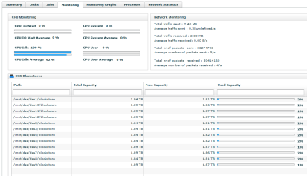
GUI
The GUI dashboard will inform the user of the latest events and status for all nodes in the storage pool.
Additional system monitoring is captured and available on a per-node level. This is accessible by browsing into the node via Dashboard -> Administration -> Hardware -> Servers -> Controller/Storage nodes and selecting a node.

Slide 116
Hardware
FRU / CRU

Slide 117
AC1 and AS30 FRU / CRU
CRU
HDD
  Requires post-replacement action from support
SSD
  Requires post-replacement action from support
Power supply
FRU
Network adapters
  Requires post-replacement action from support
Motherboard
  Requires post-replacement action from support
Fans
Memory

Slide 118
AC2 and AS36 FRU / CRU
CRU
HDD
SSD
Power supply
FRU
Network adapters
  Requires post-replacement action from support
Motherboard
  Requires post-replacement action from support
Fans
Memory

Slide 119
Hardware Replacements
Controllers, Storage nodes, Disks, NICs

Slide 120
Replacing a controller node
If the controller node is a management node:
Failover the management node to another controller
Basic replacement workflow
Shutdown the node to be replaced
Remove the node to be replaced from the rack
Install the new node into the rack
Install DCOS on the new node
Open the old node's info from GUI
Click the “Replace” button
Enter information about the new node including the hostname, IPs, datacenter, and rack
Watch job as it progresses

Slide 121
Failover in detail
Management node failover is done when hardware or software failures occurs with the amplistor environment management node (ex. hard-disks failure, power unit or controllers failure)
This manual procedure transfers the management role to another controller node so GUI operations can be resumed normally.
Some affected services when management node is down
  No GUI
  No monitoring or events
  No cloud API connections
  No postgres database

Slide 122
Failover in detail
Select another controller node for failover and backup the following config files: (ex. cpunode02)
  /opt/qbase3/cfg/qconfig/applicationserverservice.cfg
  /opt/qbase3/cfg/qconfig/autostart.cfg
  /opt/qbase3/cfg/qconfig/autostop.cfg
Execute failover script on new selected controller node.
  #/opt/qbase3/bin/python /opt/qbase3/utils/executeFailoverScript.py
After few minutes, you will have an indication message on console that CMC is now accessible on new controller node where you can login and follow up rest of failover procedure.
The script takes the following steps
  1. Migrate virtual IPs to new node - All IPs for public, management and storage LANs are migrated to new controller node as all services are configured to use these virtual IPs.
  2. Install management node extra Qpackages - Since management node has extra qpackages for its services (ex. webserver CMC, postgresql database, application server ....), all these qpackages are installed on new controller node from the local backup qpackage server in the amplistor environment.
  3. Restore configuration files from Arakoon - Config files for services and daemons on management node are restored from the arakoon cluster.
  4. Restore postgre database from Arakoon - Postgre model database is restored from the arakoon cluster to new postgre database installed on new node.
  5. Complete configurations of services and daemons on new node - Complete extra config required for new management node like deactivating applications related to old management node and activating new applications created on new node.
  6. Extend Arakoon clusters - Mainly a manual step is required to extend any arakoon clusters having nodes on the failed management node to other controller nodes, which is done from CMC after failover is done.

Slide 123
Replacing a storage node
Basic replacement workflow
Shutdown the node to be replaced
Remove the node to be replaced from the rack
Install the new node into the rack
Install DCOS on the new node
Open the old node's info from GUI
Click the “Replace” button
Enter information about the new node including the hostname, IPs, datacenter, and rack
Watch job as it progresses
What does replacement do
Abandon’s all the blockstores and storage daemons on the old storage node.
Inventory and create the necessary partitions, disk labels, and
Start and initialize the new blockstores and storage daemons.
Notes:
Known Issue:
Replacing the last storagenode will result in an issue when initializing storagedaemons and blockstores. That is due to that the framework will do getNextID() on the last id it knows of which is already abandoned in the DSS database.
Get around this by editting the tasklet root object getNextID() to do increments larger than the last DSS id
so for example if the last blockstore ID in the database is 20 and we have abandoned 16-20 we want the root object to return at least 16+5

Slide 124
Drive replacement
General comments
All drives and partitions are recorded in the DRPDB and can be accessed viewed in the qshell
Every controller has a postgre partition on one SSD. The postgre data however only exists on the management controller.
If the postgre data SSD is lost, this needs to be recovered first.
Partitions are given labels with e2label and mounted based on that information.
Restoring postgre data
Using `parted`, recreate partitions on the spare SSD
Using `e2label`, to relabel the partitions
Using `mkfs`, recreate the ext4 file system
Mount the new partition
Remove the “lost + found” directory created by ext4
Use the postgre restore script: /opt/qbase3/utils/restore_postgresql.py

Slide 125
Replacing an SSD - Spare
Pre-steps
Get the partition information of the broken SSD from the DRPDB
Stop any impacted Arakoon services on the broken node
Stop the monitoring agent on node with the broken SSD
Remove the old disk from the arakoon application list in the qshell
Remove the old disk from the DRPDB
Remove the Arakoon mountpoints from the /etc/fstab
If the disk contained a non-data postgre partition
Create the partition on the spare SSD in the qshell
If the disk contained a Metadata Store partition
Remove the old disk from the arakoon application list in the qshell
Add the new SSD in to the MetadataStore
Post-steps
Restart the monitoring agent on the node
Notes:
A few notes and issues:
1- If an SSD has both a postgres and an arakoon partition. Losing that SSD will result in us using the spare SSD for postgres, and the replacement SSD
2- Regarding step 2:
How to get partition configuration of a specific disk:
mguid=ca.machine.find(name='cpunode02r')['result'][0]
dguid=ca.disk.find(name='sdc', machineguid=mguid)['result'][0]
(sizes are in MiB)
ca.disk.listPartitions(dguid)
Out[16]:
{'jobguid': None,
'result': [{'backup': False,
'boot': False,
'devicename': '/dev/sdc',
'filesystemtype': 'EXT4',
'guid': 'a4daf641-508d-4aef-9bea-5220fcc6e167',
'imagechecksum': None,
'imagepath': None,
'label': 'postgresql',
'mountpoint': '/mnt/postgresql',
'order': 1,
'size': 19531,
'statistics': {},
'status': 'TAINTED'},
{'backup': False,
'boot': False,
'devicename': None,
'filesystemtype': 'EXT4',
'guid': '34d0bb04-d3eb-44bd-a639-1504120433a0',
'imagechecksum': None,
'imagepath': None,
'label': 'ar_sdc2',
'mountpoint': '/mnt/arakoon_framework_sdc',
'order': 2,
'size': 20000,
'statistics': {},
'status': 'None'}]}

Slide 126
Replacing an SSD - Swap
Pre-steps
Get the partition information of the broken SSD from the DRPDB
Stop any impacted Arakoon services on the broken node
Stop the monitoring agent on node with the broken SSD
Comment the Arakoon mountpoints from /etc/fstab
Remove the broken partitions from the DRPDB
Update the Qbase3 start-up script to prevent it from running at boot time
Shutdown the node, swap the SSD, and power on the node.
If the node had postgre or arakoon partitions
Recreate the partitions on the spare SSD in the qshell
Post-steps
Update /etc/fstab
Mount all partitions
Update the Qbase3 start-up script to run at boot time
Start all services
Notes:
A few notes and issues:
1- If an SSD has both a postgres and an arakoon partition. Losing that SSD will result in us using the spare SSD for postgres, and the replacement SSD
2- Regarding step 2:
How to get partition configuration of a specific disk:
mguid=ca.machine.find(name='cpunode02r')['result'][0]
dguid=ca.disk.find(name='sdc', machineguid=mguid)['result'][0]
(sizes are in MiB)
ca.disk.listPartitions(dguid)
Out[16]:
{'jobguid': None,
'result': [{'backup': False,
'boot': False,
'devicename': '/dev/sdc',
'filesystemtype': 'EXT4',
'guid': 'a4daf641-508d-4aef-9bea-5220fcc6e167',
'imagechecksum': None,
'imagepath': None,
'label': 'postgresql',
'mountpoint': '/mnt/postgresql',
'order': 1,
'size': 19531,
'statistics': {},
'status': 'TAINTED'},
{'backup': False,
'boot': False,
'devicename': None,
'filesystemtype': 'EXT4',
'guid': '34d0bb04-d3eb-44bd-a639-1504120433a0',
'imagechecksum': None,
'imagepath': None,
'label': 'ar_sdc2',
'mountpoint': '/mnt/arakoon_framework_sdc',
'order': 2,
'size': 20000,
'statistics': {},
'status': 'None'}]}

Slide 127
Replacing an HDD
Pre-steps
Get the partition information of the broken HDD from the DRPDB
Abandon the blockstores on the broken drive, if any
If the HDD contains a RAID partition
Ensure the other member of the RAID is in good standing
Use mdadm to fail and remove the broken disk’s partition out of each RAID group
Shutdown the node, swap the SSD, and power on the node.
If the HDD contains a RAID partition
Recreate the partitions on the new HDD in the QSHELL
Use mdadm to add the new partition member back to the RAID group.
If the HDD contained a DSS blockstore
Recreate the partitions on the spare HDD in the qshell
Initialize the blockstore
Update the DRPDB to update the blockstore application.

Slide 128
Replacing a NIC / Motherboard
Explanation
Systems are tracked by their MAC addresses in the DRPDB. When a NIC or motherboard is replaced, the changes in MAC addresses need to be updated in the model.
If the changes aren’t made correctly, the consequences can range from monitoring errors being elevated to the end-user to a node not booting correctly.
Steps
Update the udev network rules that assign ethernet device IDs.
Update the node’s machine object in the DRPDB so that machine NICs in the model match the new reality.
Update the node’s device object in the DRPDB.
Update the /opt/qbase3/cfg/qconfig/main.cfg file if the MAC for management storage LAN has changed.

Slide 129
Tools
Utilities for validation

Slide 130
Performance script
Invoked by “./python-PUT-GET-standalone.sh --help”
Requires
  Must be run from bash
  Requires python 2.6 or higher to be installed on the system
  Requires the /namespace/manage AmpliStor directory to be accessible to any user
Generates data on the fly which removes client I/O bottlenecks
Can target multiple client daemons with a single invocation.
Use --help for a complete list of options.
Supports
  Configurable file sizes to read and write.
  Configurable number of streams.
  Offset reads and writes.

Slide 131
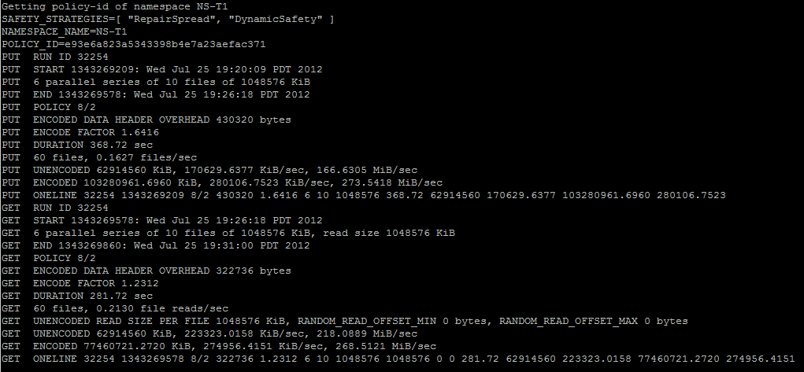
Performance script example
Example Command
./python-PUT-GET-standalone.sh --namespace "NS-T1" --allow-all-strategies --client-daemons-http "192.168.110.1:8080 192.168.110.2:8080 192.168.120.1:8080" --tests "PUT GET" --num-series "6" --num-files-per-series "10" --file-size-mib "1024“
Example Output

Slide 132
Uploader script
Moves real file system data to the AmpliStor pool. Useful for initially seeding an environment.
Invoked by “python AmpliStorUploader.py”
Requirements
  Python 2.6 or above
  The configuration file amplistor_uploader.cfg in the same directory
Supports
  Multiple streams
  Authenticated writes
  Logs all output to a specific file

Slide 133
Uploader script configuration example
[startup_parameters]
number_of_parallel_uploaders=10
amplistor_daemons_ip_port=192.168.110.1:8080,192.168.110.2:8080,192.168.120.1:8080
amplistor_username=myusername
amplistor_password=mypassword
destination_path=test
data_path=/mydata
allow_overwrite=true
maximum_errors_stop=10
output_log_file_name_suffix=uploader.log
exclude_directories=qpackages
upload_description=Description of the purpose of this upload

Slide 134
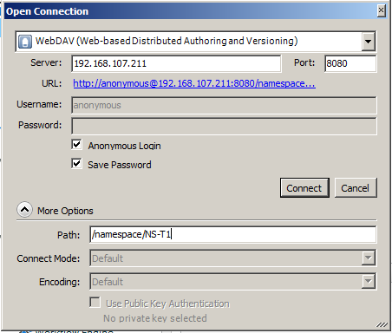
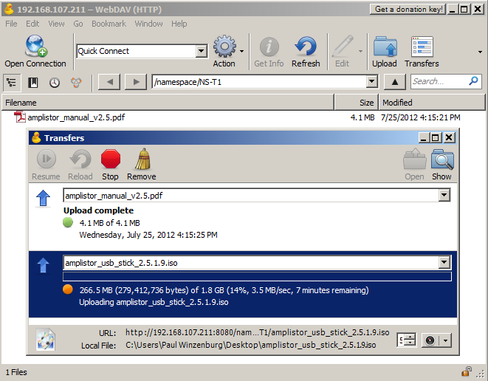
Webdav Tools
Cyberduck - Presents a Filezilla type interface to drag and drop files from a browser (Windows, Mac, Linux)

Slide 135
Webdav Tools - Cyberduck
Presents a Filezilla type interface to drag and drop files from a browser (Windows, Mac, Linux)
Not certified for production use. Useful for demonstration and validation.

Slide 136
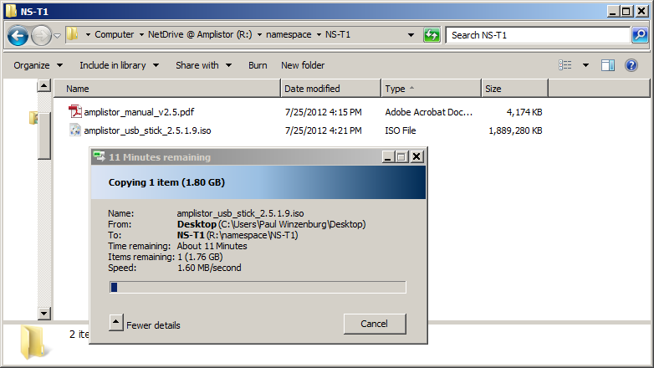
Webdav Tools - NetDrive
Presents the Amplistor storage as a local drive letter.
Not certified for production use. Useful for demonstration and validation.

Slide 137
Performance Metrics
MetaStore Cluster
  100 objects PUTs/s
  1000 objects GETs/s
  Add extra clusters for added performance
Controller
  ~750MB/s Aggregate throughput (current version)
  ~450MB/s single stream performance
Storage Node
  AS30, 150MB/s throughput, 1000 IOPS
  AS36, 200MB/s throughput, 1200 IOPS
BitSpread Policy
  1 object write => 16 writes (with 16/x policy)
  Each write on disk requires 3-4 IOPs, each read 4 IOPS

Slide 138
The Present and Future
Products side-by-side

Slide 139
Product Overview
2011 | Q1 2012 | July 2012
R 2.3 | R 2.5 (AmpliStor XT) | Release 3.0
Low-power platform (AS20 storage nodes) & controllers | Throughput 2X to 750 MB/sec per controller | Faster throughput (multi-threading)
Full object storage features: REST interface | AS30 – 1U/10-drive 30TB storage nodes | Reduced overhead for BitSpread encoder
Technology partner integrations (Panzura, Qstar, Oxygen Cloud) | Mgmt enhancements: SNMP MiB & traps, performance monitoring, call home | Storage rebalancing
Synchronous Geo-Spreading across multiple sites | Secure http/REST authentication | Certify controllers on Intel Sandy-Bridge platform / E5 CPUs (e.g. Dell R620)
Decommission storage nodes | Object caching on controllers (in SSD) | AS36 – 1U/12 drive storage module (E3 CPU, IPMI)
 | Enhanced, automated installation & upgrades | Support for cold-swap disk drives
 | GUI reporting & monitoring enhancements | Amazon S3 compatible REST interface (3.0.1)
 | Rolling upgrades | Client drive tool for MacOS & Windows based on S3 (3.0.1)

Slide 140
More Features
Software support for Intel Sandy-Bridge Architecture based controllers
  Intel E5 processors on Dell R620
Faster throughput
  BitSpread leverages multi-threading & multi-cores for faster PUTs & GETs
  Aggregate: PUTs at 800 MB/sec, GETs at 1000 MB/sec
  Single-stream: PUTs at 480 MB/sec, GETs at 340 MB/sec
Object rebalancing
  Spread algorithm now automatically prefers lower-utilized block stores for new allocations
  Can rebalance existing stored data across newly added capacity – especially useful for small capacity upgrades
Support for cold-swap disk drives
  In support of customer drive cold-swap on both AS36 & controllers (HDD & SDD)
  In preparation for supporting hot-swap on “fat node” storage modules to be certified later
Large Objects
  Support for 16TB objects
OSMI –
  Object Store Management Interface – menu based command line for executing common commands without q-shell
Supportability
  Lots of enhancements: log collectors, network interface improvements

Slide 141
Old vs. New Platform
Controller Model - SuperMicro
  Dual Quad Westmere Xeon 2.4Ghz
  1 x 200GB SSD (5 extra optional)
  2 x 600 GB SAS HDD
  48 GB RAM
  4 x 10GE SFP+ Intel ports
30TB Storage Nodes
  1U / 10-drive storage nodes
  Intel Atom processor
  3TB “Green” Western Digital drives
  Single cold swappable power supply
Controller Model - Dell R620 controllers
  Dual Intel E5-2650 processors
  1 x 200GB SSD (5 extra optional)
  2 x 900 GB SAS HDD
  64 GB RAM
  4 x 10GE SFP+ Intel ports
36TB Storage Nodes
  1U / 12-drive storage nodes
  Intel E3-1220LV2 processor (V2 is higher MhZ, remains ~17 Watts)
  3TB “Green” Western Digital drives
  IPMI support
  Dual hot-swap power supplies

Slide 142
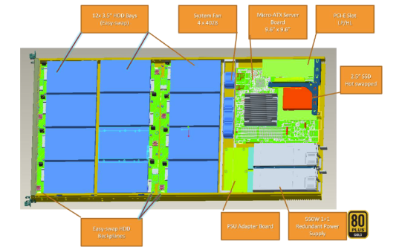
NEW Storage Node
36 TB RAW Capacity
12 drives – 3TB
Redundant power supply (Hot)
Intel E3 CPU
Easy swappable HDDs (Cold)
2 x 1 Gb/s NIC
VGA port on the back
IPMI support Integrated in
one of the 2 NICS

Slide 143
Platform Updates
Intel E5 based Controllers
  Dell R620 controllers certified & supported in Silver Eagle
    Dual Intel E5-2650 processors, 1 x 200GB SSD (5 optional), 2 x 900 GB SAS HDD, 64 GB RAM
AS36 Storage Nodes
  1U / 12-drive storage nodes
  Intel E3-1220LV2 processor (V2 is higher MhZ, remains ~17 Watts)
  3TB “Green” Western Digital drives
    Now investigating the newly announced Western Digital RED NAS hard drive
  IPMI support
  Dual hot-swap power supplies
Certified Switches
  Dell Force10 S60
  Interface Masters Niagara 2924-24TG

Slide 144
Release 3.0 (Silver Eagle) Details
Software support for Intel Sandy-Bridge Architecture based controllers
  Intel E5 processors on Dell R620
Faster throughput
  BitSpread leverages multi-threading & multi-cores for faster PUTs & GETs
  Aggregate: PUTs at 800 MB/sec, GETs at 1000 MB/sec
  Single-stream: PUTs at 480 MB/sec, GETs at 340 MB/sec
Reduced overhead for BitSpread encoder
  Previously BitSpread reserved a 1.236 X internal overhead factor
  This has been reduced to 1.145 internal overhead factor
  This reduces overall policy overhead, e.g., 16/4 is now 1.51 X (down from previous 1.64 X)
Object rebalancing
  Spread algorithm now automatically prefers lower-utilized block stores for new allocations
  Can rebalance existing stored data across newly added capacity – especially useful for small capacity upgrades
Support for cold-swap disk drives
  In support of customer drive cold-swap on both AS36 & controllers (HDD & SDD)
  In preparation for supporting hot-swap on “fat node” storage modules to be certified later
Large Objects
  Support for 16TB objects
OSMI
  Object Store Management Interface – menu based command line for executing common commands without q-shell
Licensing
  Make LGPL separation clearer
Supportability
  Lots of enhancements: log collectors, network interface improvements

Slide 145
Documentation
Overview of 3.0 Documentation

Slide 146
Documentation Preview
Installation Guide
Introduction
  Reference Architectures
Preparing for the Installation
  Networking requirements
  Power & Cooling requirements
  Rack Requirements
  Out of Bound Management
  Other IT Infrastructure Requirements
Installing AmpliStor
  Overview
  Management Node Install
  Adding Controller Nodes
  Configuring Metastores
  Adding StorageNodes
  Configuring out of Bound Management
  Validating the Install
  Licensing

Slide 147
Documentation Preview
Administation Guide
Introduction
AmpliStor Architecture Overview
  Storage node
  Controller
  Management Node
  Client Daemon
  Maintenance Agent
  Storage Daemon
  MetaStore
Managing AmpliStor
  Management Architecture
  Connection to the Central Management Console
  Central Management Console WebGUI
Configuring AmpliStor
  Configuring MetaStores
  Configuring Storage Policies
  Configuring NameSpaces
  Configuring Cache Clusters
  Configuring Operating System Accounts
  Configuring ClientDaemons
  Configuring StorageDaemons
  Configuring Maintenance Agents

Slide 148
Documentation Preview
AmpliStor Monitoring
  Monitoring Architecture
  CMC Dashboard
  Event Viewer
  Node Monitoring
  Configuring Event Escalation
  SNMP Polling
  Performance Reporting
Responding to AmpliStor
  Complete list of events
  Controller Node Failure
  Storage Node Failure
  Management Node Failure
  ControllerNode Disk Failure
  StorageNode Disk Failure
  MetaStore Failure
Maintenance Policies
  Backing up the Software Repository
  Internal Maintenance Policies
  Optimizing the metastores
  Phone Home
  Shutting down your Amplistor

Slide 149
Documentation Preview
Troubleshooting
  List of Error Codes
  List of Arakoon Error Codes
  List of DSS Error Codes
  List of Management Error Codes
  HealthChecker
  Using IPMI
  Collecting Logfiles
REST API User Guide
CLI Reference Guide

Slide 150
Installation
Overview and Workflow

Slide 151
Planning: Environmental Constructs
Overview
Constructs for LANs, Datacenters, and Racks can be configured in the management UI.
LANs
Three LAN segments need to be defined for each datacenter.
  One public (used for user and/or application communication)
  Two private (used for storage and environmental communication)
Of the two private lans, one is used for environmental communication and storage (management private LAN) and one is used for storage only (secondary storage LAN).
A fourth LAN type, called an install LAN, is automatically created on the management private lan segment.
LAN segments of a certain type need to be routable to all other networks of the same type.
These LAN constructs can be configured for limited IP ranges depending upon site requirements and availability.

Slide 152
Planning: Environmental Constructs
IPs
The management controller node will need two IPs on each of the public lan, management storage lan, and secondary storage lan. Of the two IPs on any given lan segment, one will be unique to the host and the other will be virtual for failover purposes.
All other controllers will need at least one IP on each of the public lan and one on both the management storage lan and secondary storage lan.
All storage nodes will need one IP on each of the management storage lan and secondary storage lan.
Datacenters and racks
Datacenters and racks can be defined the management GUI.
When nodes are added to the environment, the user can specify in which datacenter and rack the node is located. Impacts spread.

Slide 153
Environment installation overview
Basic installation workflow
Install the management controller node
Create LAN constructs
Initialize the management controller node.
Create datacenter and rack constructs
Install additional controller and storage nodes.
Initialize additional controller and storage nodes.
Expand the Framework metadata store across additional SSDs.
The installation process for any node consists of two parts.
OS installation
The same OS will be laid down for all nodes.
Two available methods in PXE and USB/DVD installation.
Node initialization
Gives the node an identity and role in the environment.

Slide 154
OS Installation Methods
PXE Installs
Prerequisites
  The management controller node is completely installed and initialized.
  The node to be installed is configured to boot off of the LAN segment.
Servers boot up and automatically get an IP on a private LAN segment.
OS installation is kicked off via the management UI.
USB/DVD Installs
Nodes need to be configured to boot from the install media.
A temporary IP address needs to be defined on the private LAN segment
The node is discovered and added to the environment through actions taken in the management UI.
Two installation options:
  Management node: This mode installs all the framework components for managing the environment (apache, dhcpd, tftpd). Use only on the management controller.
  Remote node: Just installs the basic OS. Used on every other controller and storage node.

Slide 155
Node initialization
Node initialization
Process to create an identity for a node.
User specifies the following details about a node.
  Hostname
  Role (controller or storage)
  Location (datacenter and rack)
  Description (optional)
  IP addresses for public, private management, and secondary private lans.
Performed in the management GUI.
Nodes can be initialized immediately or added to a queue.
Once initialization is finished, nodes are immediately ready for use.

Slide 156
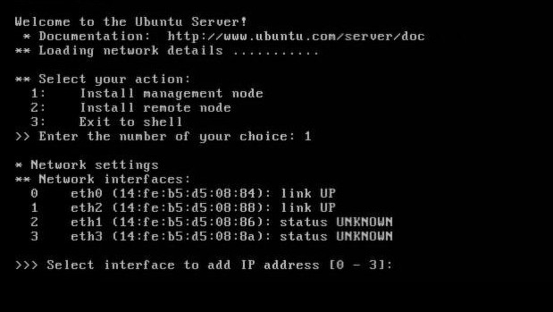
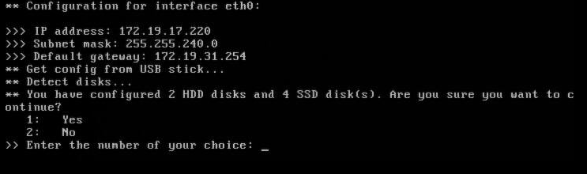
USB Installation: Management node
Select the network device that corresponds to the public IP address.

Slide 157
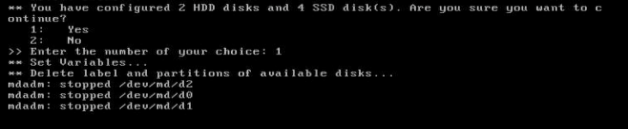
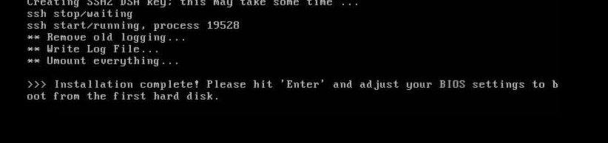
USB Installation: Management node
For management node installations, wait until the reboot completes. Then log into the web GUI with your browser with the credentials admin/admin to begin LAN creation.

Slide 158
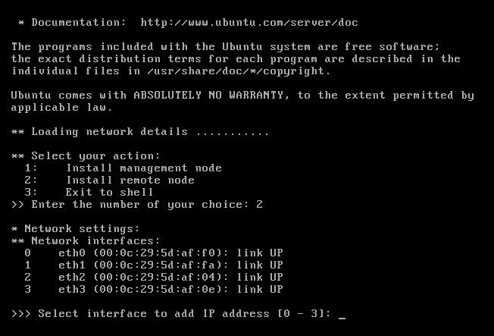
USB Installation: Remote node
Select the network device that is cabled to the management private lan where the DHCP server resides on the management controller. On the next prompt, you will get an option to allow the node to get an IP address via DHCP or to set it manually. When setting it manually, the IP must reside within the install LAN range.

Slide 159
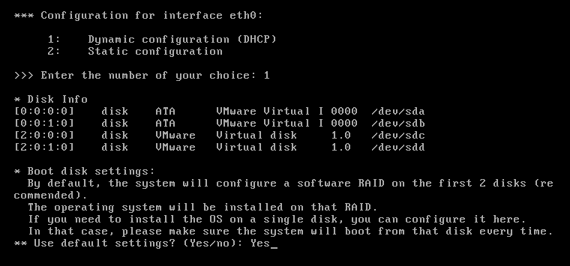
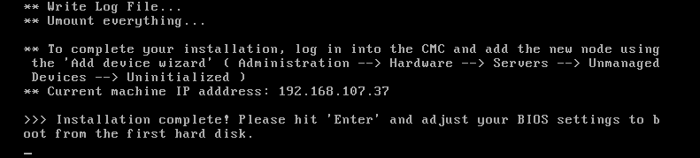
USB Installation: Remote node
For remote node installations, wait until the reboot completes. Then log into the web GUI with your browser and begin the add device wizard.

Slide 160
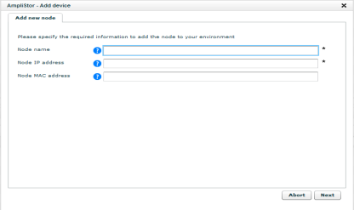
Add Device
This action only needs to happen for nodes that are installed with the “remote node” option during the USB install method. PXE installs do not need this step.
The Add Device wizard is located under Dashboard -> Administration -> Hardware -> Servers -> Uninitialized Devices -> Uninitialized -> Add Device
Specify the Node Name and Node IP address. If the node requires routing to reach, also enter the node MAC address.
After completing this wizard, the node status will be ACTIVE and ready for initialization.

Slide 161
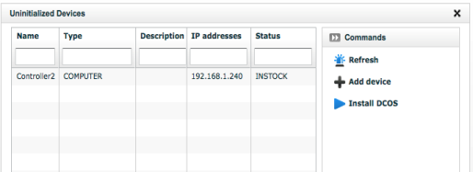
PXE Installation
After ensuring the node is cabled to the private installation LAN, power up the node.
Node boots to NFS via the PXE services (DHCP / TFTP) running on the management controller.
The node will now appear in the management GUI in the Dashboard -> Administration -> Hardware -> Servers -> Uninitialized Devices -> Uninitialized with the status “INSTOCK”.
Click the check box next to the node and click Install OS. A job will kick off to install the OS and reboot the node.
Once the job completes, the node’s status will be “ACTIVE”.

Slide 162
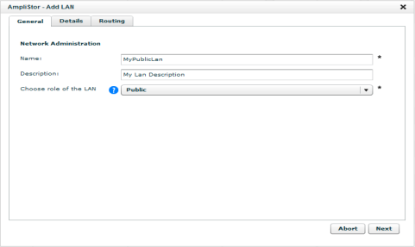
Configuring LANs – General Tab
LAN configuration is handled under Dashboard -> Administration -> AmpliStor Management -> Network -> Add Lan
LAN configuration options will change based upon the its role in the environment, public or storage.
On the General tab, specify the Name of the network and the LAN role.

Slide 163
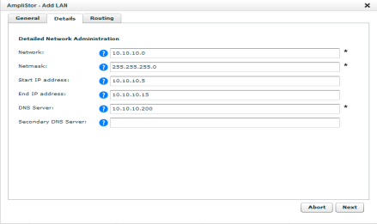
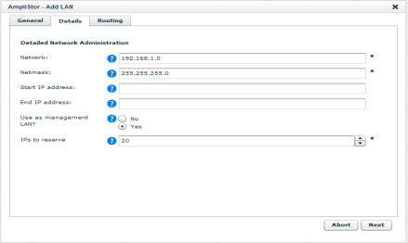
Configuring LANs – Details Tab
Public LAN
Storage LAN
On the details tab, specify the Network, Netmask, Start and End IP addresses, and the DNS server(s).
If the Storage LAN is designated as a management LAN, also specify the number of IPs to reserve for DHCP.

Slide 164
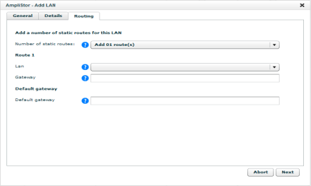
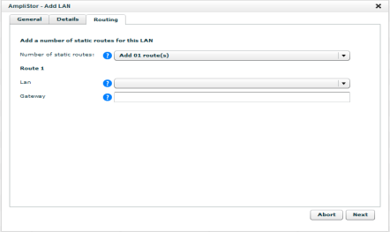
Configuring LANs– Routing Tab
Public LAN
Storage LAN
On the Routing tab, specify any static routes necessary for nodes on the LAN and the default gateway.
Routes can only be added to for LANs of the same type.

Slide 165

Configuring Datacenters
Datacenters configuration is handled under Dashboard -> Administration -> AmpliStor Management -> Locations -> Datacenter Management -> Add Datacenter
Specify the Name and an optional Description for the Datacenter.

Slide 166

Configuring Racks
Datacenters configuration is handled under Dashboard -> Administration -> AmpliStor Management -> Locations -> Rack Management -> Add Rack
Specify the Name and an optional Description for the Rack.

Slide 167


Initialization
To initialize a node, click on a node with active status in the UI. In the command bar, click Initialize node to launch the wizard.

Slide 168

Queuing
The internal system hands out IDs to disks and services that are being initialized. Running multiple initializations in parallel will cause failures. Thus the queuing mechanism.
Nodes added to the queue will appear in Dashboard -> Administration -> Hardware -> Servers -> Unmanaged devices -> Queued
Nodes are also found in a command line CSV file. /opt/qbase3/cfg/initialize_queue.csv
root@cpunode1:~# cat /opt/qbase3/cfg/initialize_queue.csv
'Serial','Node Name','Description','Node Type','Datacenter','Rack','MAC1','Lan1','IP1','MAC2','Lan2','IP2','MAC3','Lan3','IP3'
,Storage01,,STORAGE,San Francisco,SF-R1,00:25:90:31:43:15,San Francisco - Private2,192.168.112.3,00:25:90:31:43:14,San Francisco - Private1,192.168.111.3
,Storage02,,STORAGE,San Francisco,SF-R1,00:25:90:0C:81:09,San Francisco - Private2,192.168.112.4,00:25:90:0C:81:08,San Francisco - Private1,192.168.111.4
,Storage03,,STORAGE,San Francisco,SF-R1,00:25:90:0C:81:FD,San Francisco - Private2,192.168.112.5,00:25:90:0C:81:FC,San Francisco - Private1,192.168.111.5
….

Slide 169

Initialization on large environments
The UI allows the user to upload a previously prepared csv file rather than going through the wizard.
Navigate to Nodes added to the queue will appear in Dashboard -> Administration -> Hardware -> Servers -> Unmanaged devices

Slide 170

Expanding the Framework Metadata Store
In the web GUI, click on the “framework” Metadata Store, found in Dashboard -> Administration -> Storage Management -> Metadata Stores.
Click the “Edit MetadataStore” button.
Specify the new SSDs to include in the Metadata Cluster.

Slide 171
Open Discussion
Questions, Follow ups

