Slide 1
NAS Documentation
Tabar Smith and Andrea O’Brien

Slide 2
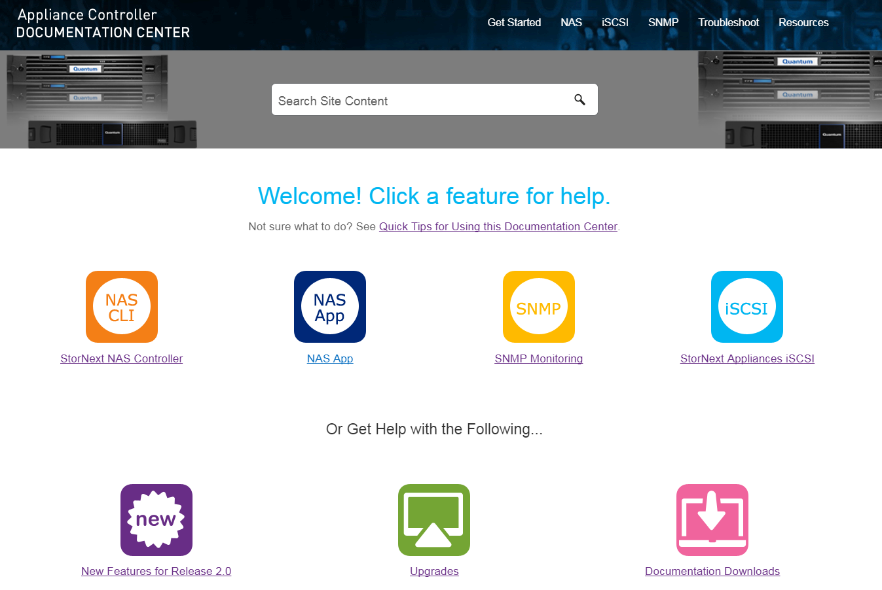
Appliance Controller 2.0 Documentation Center
Available at www.quantum.com/accdocs
New Content | Link
Scale-Out NAS Clustering | http://qsupport.quantum.com/kb/flare/Content/ACC_DocSite/NAS%20CLI%20Guide/NAS_CLI_NASClusters.htm
AD Authentication Improvements | http://qsupport.quantum.com/kb/flare/Content/ACC_DocSite/NAS%20CLI%20Guide/NAS_CLI_ADAuthentication.htm#Apply
Additional SMB Supported Options | http://qsupport.quantum.com/kb/flare/Content/ACC_DocSite/NAS%20CLI%20Guide/NAS_CLI_SMBShareOptions.htm
Upgrade Instructions | http://qsupport.quantum.com/kb/flare/Content/ACC_DocSite/Upgrades/ACC_Upgrades.htm
Release Notes | http://qsupport.quantum.com/kb/flare/Content/ACC_DocSite/Release%20Notes/RN_Intro_TopNav.htm
Troubleshooting | http://qsupport.quantum.com/kb/flare/Content/ACC_DocSite/Troubleshoot/ACC_TS_TipsAndFAQs.htm

Slide 3
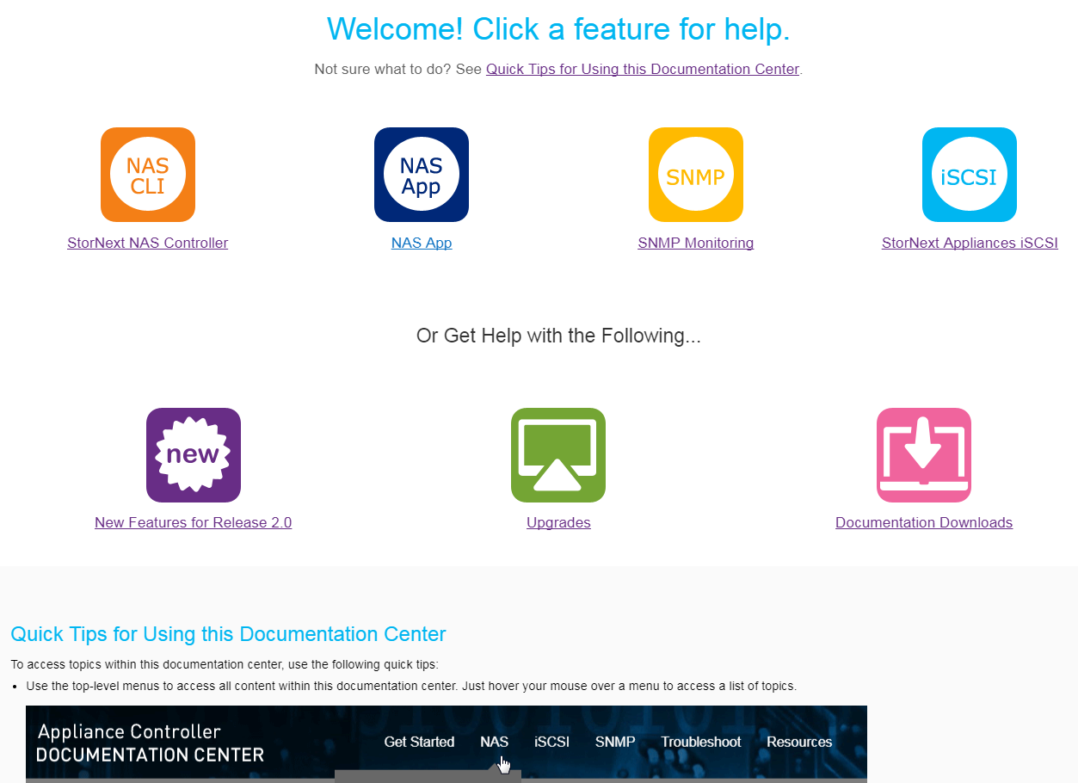
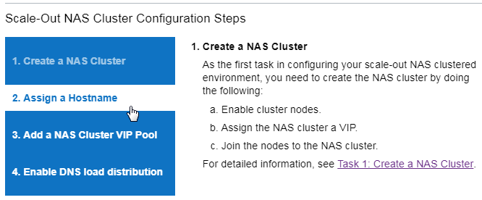
New Navigation Features
Topic-Level Task Flow Guides
Topic Section Links and Expand/Collapse Function
Home Page Redesign to Assist with Quicker Content Access
Interactive Workflow

Slide 4
StorNext Connect Documentation Center StorNext Connect Service Documentation Center
Customer version available at www.quantum.com/sncdocs
Service version available at qsweb.quantum.com/sncdocs
New Content | Link – Customer Link – Service
Which App Should I Use for NAS? | http://qsupport.quantum.com/kb/flare/Content/connect/DocSite/Connect_Reference_Task_Topics/Which-NAS-App.htm http://qsweb.quantum.com/kb/flare/content/connect/DocSite_Service/Connect_Reference_Task_Topics/Which-NAS-App.php
About the NAS App | http://qsupport.quantum.com/kb/flare/Content/connect/DocSite/Connect_Reference_Task_Topics/NAS.htm http://qsweb.quantum.com/kb/flare/content/connect/DocSite_Service/Connect_Reference_Task_Topics/NAS.php
Connect Release Notes | http://qsupport.quantum.com/kb/flare/Content/connect/DocSite/Connect_Release_Notes/Release_Purpose.htm http://qsweb.quantum.com/kb/flare/content/connect/DocSite_Service/Connect_Release_Notes/Release_Purpose.php

Slide 5
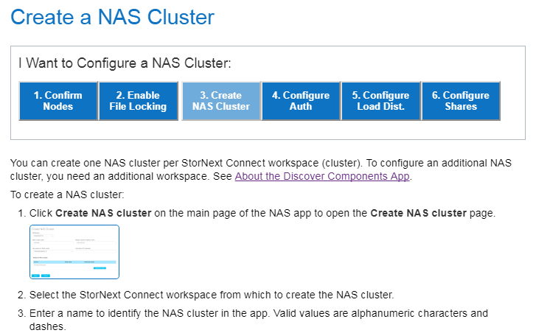
StorNext Connect Documentation Center StorNext Connect Service Documentation Center
New Section for the NAS App
Interactive workflows

