Slide 1
aiware for Xcellis TRAINING & DOCUMENTATION
Keith Lenehan Steve Ino Matthew Howell

Slide 2
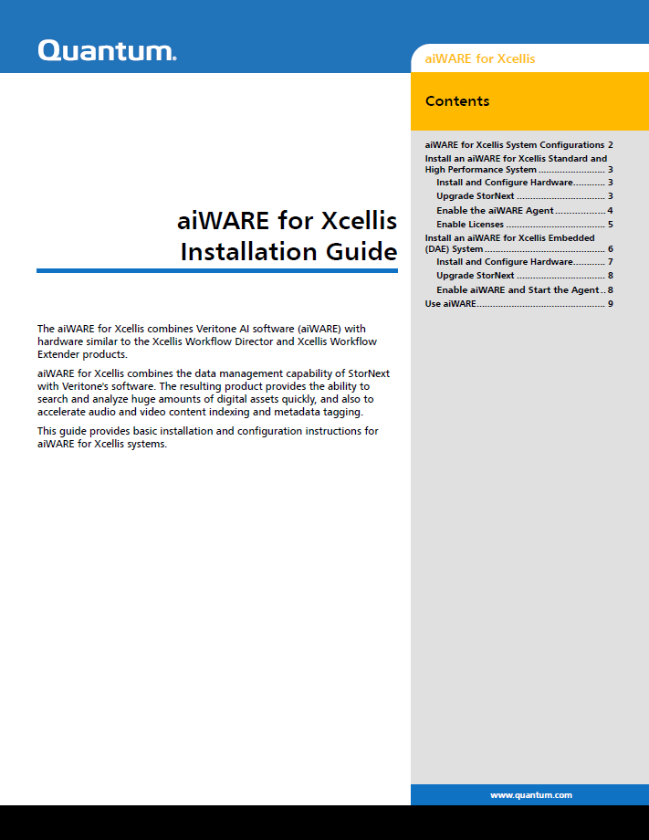
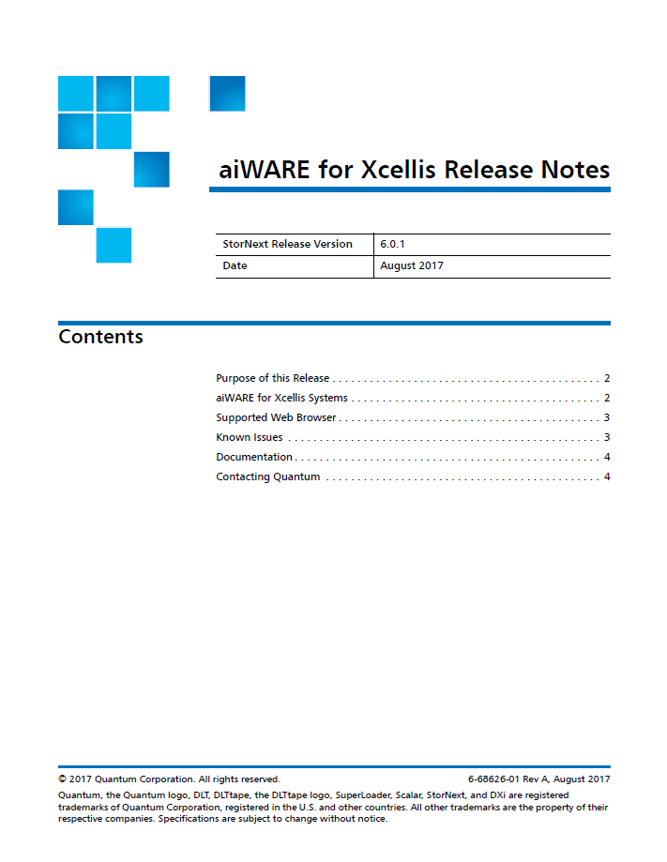
aiWARE for Xcellis Training & Documentation
Documentation for the initial release of aiWARE for Xcellis:
Determined that we can leverage existing documentation that already exists. Since this product is professionally installed, and to save development time, we created a single pointer-type install guide, titled the aiWARE for Xcellis Installation Guide, which will be located in a new location on CSWeb. We are also releasing Release Notes for this appliance.
Since Embedded is based on the Xcellis Workflow Director, we are able to refer to and leverage existing Xcellis Workflow Director installation instructions, pointing out minor differences in the install guide, and include the steps for configuring the system to support Veritone.
Since Standard and High Performance are based on and most similar to the Xcellis Workflow Extender, we are able to refer to and leverage existing Xcellis Workflow Extender installation instructions, pointing out minor differences in the install guide, and include the steps for configuring the system to support Veritone.
In addition, we have covered the new appliance in several Documentation Centers, covering both Service and customer-facing locations.

Slide 3
aiWARE for Xcellis Training & Documentation
Training
This TOI is being recorded and will serve as the initial training provided on Qwikipedia, because not being shared out to partners. No courses or assessments will be provided for the initial release.
For future, once we’ve had a few installations, we’ll do further analysis to determine what should be provided in a Quantum Service-only installation training, and analysis of what customer-facing training is needed.

Slide 4
aiWARE for Xcellis Training & Documentation
<demo of aiWARE Install Guide and Doc Center updates>

