Slide 1
Welcome to StorNext 6.0.1 TOI

Slide 2
Veritone Aiware for Xcellis
John LaRue and Brian Raccuglia

Slide 3
Veritone aiWARE: Background
What does Veritone do?
Provides a cloud-based content processing ecosystem for extracting metadata from media files
Transcription, Object Detection, Optical Character Recognition, Face Detection, Logo Recognition, etc.
Unique in that they aggregate processing tools from multiple different sources/vendors and aggregate them in to a single platform
Rather than a customer being bound to a single vendor (e.g. IBM Watson), Veritone customers can leverage their choice of engines from various vendors in multiple different workflow combinations
Provides an end-user interface similar to YouTube or Google but augmented to show extracted metadata alongside customer media

Slide 4
aiWARE for Xcellis: Stack Implementation
aiWARE extends the Veritone platform to integrate with Xcellis
Allows for data within StorNext to be made available for processing directly without requiring manual uploading of files to Veritone’s web site
Before the aiWARE/Quantum integration, Veritone could only process media which was uploaded to them and/or available on a public source like YouTube or Vimeo
Allows for a subset of Veritone’s engines to be run locally on Xcellis rather than in the cloud aka ‘hybrid cloud’
All Veritone stack components and engines are implemented as Docker containers
Docker container platform added to Xcellis to allow for engines to operate natively within the appliance
aiWARE stack is launched via a ‘bootstrap’ process which downloads the latest agent and engine containers at runtime

Slide 5
aiWARE for Xcellis: Hard Requirements
Unlike a typical Xcellis deployment, aiWARE for Xcellis absolutely needs access to the public internet in order to operate
A routable interface and functional default gateway are required
Functional DNS is a must!
aiWARE agent on Xcellis opens up access to port 9000/tcp on each node
This is used for the ‘aiWARE Media Service’, an S3 object store based on Minio which serves files from StorNext as objects to the processing engines
Routable interface will be used to download all aiWARE agent components and engines
Some engines are large; Speechmatics transcription is biggest at 8 GB

Slide 6
aiWARE for Xcellis: Network Considerations
Engines are downloaded only when a task requiring them is submitted to a node, and then cached locally for successive processing runs
Because the aiWARE agent and engines are downloaded at runtime, there can be initial delays the first time each is started while components download
Upon starting the agent for the first time, it is common to wait up to five minutes before the node ID (aka UUID) is ready
If there is a firewall on the customers premises which blocks outbound connectivity, it will need to be relaxed for the Xcellis nodes using aiWARE
All required outbound traffic is using https port 443/tcp
Targeting https://*.veritone.com, https://*.iron.io, https://*.docker.com

Slide 7
aiWARE for Xcellis: Appliance Models
aiWARE for Xcellis “Embedded”
Dual node XWD system with the ability to run Veritone aiWARE software on node 2.
Entry-level aiWARE processing rate due to CPU and memory constraints of an XWD node; using ~150 GB from /scratch for disk cache
Mutually exclusive of existing KVM-based DAE feature
aiWARE for Xcellis “Standard”
Based on XWE HW and SW platform but with 128 GB of RAM
Dedicated compute node for aiWARE processing w/ additionall 10 TB internal RAID 5 cache volume
Veritone aiWARE uses the existing StorNext client software to access StorNext volumes to perform processing jobs
aiWARE restricted to %90 RAM and %90 CPU by default

Slide 8
aiWARE for Xcellis: Appliance Models (contd)
aiWARE for Xcellis “High Performance”
Based on XWE HW and SW but with much more powerful Xeon E5-2699 CPUs (44 cores total) and 384GB of RAM
Dedicated compute node for aiWARE processing with ‘extreme’ workload capabilities
Veritone aiWARE uses the existing StorNext client software to access StorNext volumes to perform processing jobs
Very powerful server designed to handle many engine concurrent processing jobs

Slide 9
aiWARE for Xcellis: Agent Package
Aka: quantum-SNVERITONE-1.2-47888.noarch.rpm
The core additions to the Xcellis platform which comprise the aiWARE functionality are the following:
Docker CE 17.03
aiware-env.service
aiware-agent.service
/opt/aiware/etc/config
/opt/aiware/bin/nodenv.sh
Agent services are implemented as SystemD unit files
aiware-agent.service is responsible for initiating the bootstrap procedure and starting the related agent containers

Slide 10
aiWARE for Xcellis: Agent Package (contd)
aiware-env.service
Triggers /opt/aiware/bin/nodenv.sh
nodenv.sh reads settings from /opt/aiware/etc/config and uses them to populate /etc/environment.aiware
/etc/environment.aiware parameters are loaded by aiware-agent.servce at startup and fed in to the bootstrap routine
aiware-env.timer
Causes aiWARE agent environment intervals to be automatically refreshed every 60 seconds
aiware-agent.service
Executes the bootstrap routine and starts the agent
Restarts automatically on failure, can be restarted with: systemctl restart aiware-agent

Slide 11
aiWARE for Xcellis: Agent in Action & Initialization
When the aiware-agent.service is first started on an appliance it attempts to register with the Veritone API anonymously, identifying itself as a new node available for processing
When this completes a ‘nodeid.txt’ file is generated in /home/aiware with a unique ID for the node assigned by the Veritone API
Starting the agent alone and generating a node ID does not require any pre-existing credentials on the Veritone web site
Agent then enters a standby mode running a single active container where it polls the API on a timed interval to see if that node ID gets registered to a customer’s account
Upon registering that node ID in the Veritone website, the agent will fully initialize and start its remaining services

Slide 12
aiWARE for Xcellis: Agent in Action & Initialization
After registration is complete, the /home/aiware directory is populated with the following key files
config.json
Registration parameters and secrets that associate the node with the Veritone API endpoint
nodeconfig.json
Configuration state of the services within the agent stack
nodeid.txt
The node ID assigned to the appliance by the Veritone API
./log directory also gets created, storing the following key log files:
agent.log (primarilly agent startup, registration & shutdown events)
syslog (useful log of all job dispatch and engine activity)

Slide 13
aiWARE for Xcellis: /opt/aiware/etc/config in depth
This is the configuration file for the agent
Not user-editable, but can be adjusted by service if necessary
Key adjustable parameters:
INTERFACE_AUTOSET (default true) allows the agent to automatically discover the routable interface to use on the appliance
If necessary this can be set to false, and the desired interface can be defined in /etc/environment.aiware
STORAGE_AUTOSET (default true) allows the agent to automatically discover the root path of the mounted StorNext filesystems to be made available for processing
If necessary this can be set to false, and the desired path can be defined in /etc/environment.aiware
ENFORCE (default true) controls whether or not resource limits should be enforced on aiWARE (via Docker)

Slide 14
aiWARE for Xcellis: Assumptions & Limitations
All StorNext filesystems desired for processing must be mounted under a common root
E.g. /stornext – this root location is tunable, but you cannot use more than one root!
Having /stornext/snfs1 and /stornext/media2 is fine, but having /stornext/snfs1 and /media/snfs2 will allow only one to be used at a time

Slide 15
Service Menu
Service menu aka /opt/DXi/scripts/service.sh updated with aiWARE options
Enable/Disable aiWARE
enable/disable the Docker services
Not necessary to be run on Standard and High Performance systems since docker services are enabled by default
Start/Stop aiWARE Agent
start and stop the aiware-agent service which communicates to the Veritone site
Display aiWARE UUID
Displays the unique UUID for the aiWARE node generated by the aiWARE agent
Required by the Veritone CMS application when adding nodes to a cluster

Slide 16
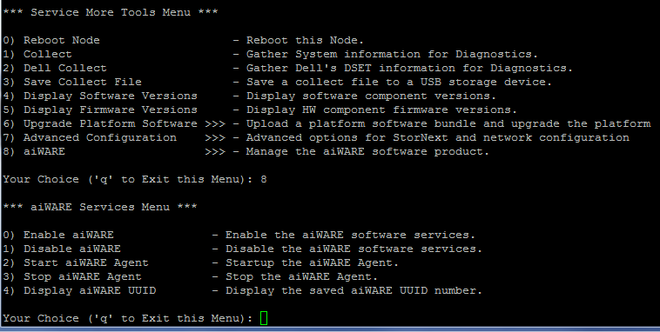
Software Configuration
Service Menu

Slide 17
aiWARE agent in idle polling mode pre-registration
You can confirm this state by looking at the output of ‘docker ps’
Only a single instance of veritone/aiware and veritone/logger running

Slide 18
aiWARE agent in idle polling mode pre-registration
Can also confirm by looking at ~aiware/log/agent.log
Will remain in this state until node ID is registered to Veritone web site

Slide 19
aiWARE agent in active mode following registration
You can confirm this state by looking at the output of ‘docker ps’
Three instances of veritone/aiware, one veritone/logger and one iron/runner running

Slide 20
aiWARE agent in active mode following registration
Can also confirm by looking at ~aiware/log/agent.log
Will now remain registered indefinitely upon successive system boots

Slide 21
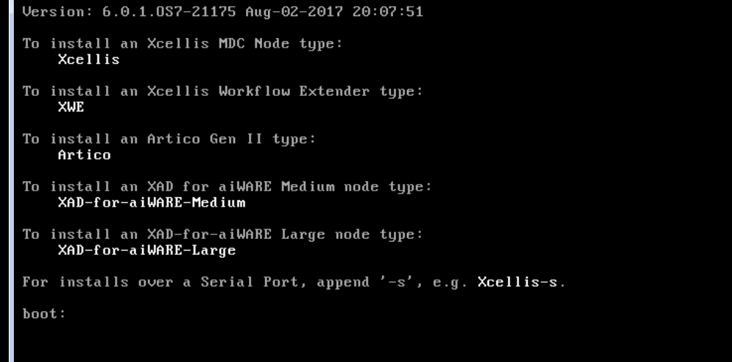
Install Menu Changes
Two new install options are available for fresh install of a Standard (Medium) or High Performance (Large) aiWARE for Xcellis node

Slide 22
Install Menu Changes
To install an XWD “Embedded” system just use the “Xcellis” option

Slide 23
Interaction with DAE
The aiWARE implementation does not use the existing DAE (KVM) virtualization environment
The aiWARE software runs inside of Docker as a set of containers
If DAE is licensed and potentially running, when aiWARE is enabled from the service menu, DAE VMs will be suspended and DAE will be disabled.
DAE and aiWARE services are both utilizing extra resources on node 2 and there is not enough resources available to run both
DAE will be reenabled if licensed and aiWARE services are disabled from the service menu

Slide 24
Interaction with DAE
If DAE is licensed but disabled because aiWARE has been enabled, then the following error will display on the StorNext DAE page

Slide 25
Veritone aiWARE for Xcellis Demo
Demo

Slide 26
Troubleshooting
How to determine the aiWARE agent status?
systemctl status aiware-agent.service
journalctl -u aiware-agent.service
How to look at the Docker statuses?
docker ps
Where are the logs in the collect logs and what is required by Veritone support for help?
Veritone logs are in /home/aiware/log
All logs from this directory are included in the standard platform collect log
There will be an /usr/adic/tmp/platform/aiware/ directory inside the compress collect log
Veritone support will want these logs in the aiware directory

