Slide 1
DXi Software Version 3.4
TOI for Global Service
(ETNA Program)
August 2017

Slide 2
Agenda
Product Overview
Technical Overview
Training and Documentation Updates
Service Model
Notes:
  Please ask questions as we go. Your lines are muted on entry so *6 to unmute
  Recording will be posted on Qwikipedia

Slide 3
Product Overview
Mike Simone – Product Management

Slide 4
DXi v3.4: What’s New
Support integration with Veeam v9.5
  Enable data mover onto DXi to work with Veeam server and proxy server
  Added value: ease of configuration, synthetic full optimizations, VM instant recovery, certified as Veeam backup repository
Extends the OST plug-in to support concurrent Accent and Accelerator backups
OST certification for NBU v8 and Backup Exec 16 on Windows 16 OS
Extend RMAN plug-in to:
  Support RHEL and Oracle Linux 6
  Support SLES v12
  Oracle v12
  Windows 2012/2016 (depends on Oracle’s ability to support Windows SDK)

Slide 5
DXi v3.4: What’s New
Support Dynamic Application Environment
  Adds the capability to install a virtual environment on the DXi to support backup and other software
  Initial go-to-market includes Veritas NetBackup
  Support upgrade from any proof of concept appliances
Enhancements specific to DXi platforms:
  Increase the number of VTD concurrent mounts on DXi6900
  Support additional backup streams on the DXi6900-S
  Increase the number of supported slots on both DXi6900 and DXi6900-S

Slide 6
DXi v3.4: Market Needs and Competitive Gaps
DXi lacks tight integration with Veeam
DXi6900-S has fewer concurrent backups than other enterprise-class backup appliances
RMAN plug-in lacks support for popular Linux and Windows OS and Oracle database versions
DXi needs a separate server to run backup software. Customers implementing backup in small offices outside of the main data center want to make it cheaper and easier.

Slide 7
DXi v3.4: Addressing Market Needs and Competitive Gaps
Support DXi integration with Veeam
Enable 50% - 100% more backup streams on all DXi6900-S interfaces
Support the RMAN plug-in on :
  Red Hat v6
  Oracle Linux v6
  Windows 2012/2016
  Oracle v10 and v12
Support Dynamic Application Environment on DXi4700

Slide 8
DXi v3.4: Platforms
Etna must support the following platforms:
  DXi6900-S
  DXi6900
  DXi4700 v3.X
Etna will not be supported on and platform that is not on v3.X software:
  DXi8500
  DXi6800
  DXi6700
  DXi V-series
  DXi4700 v2.3.X

Slide 9
Techincal Overview
DXi Engineering

Slide 10
Technical Overview
New Feature Details
  DAE & Veeam Configurations and Installation
  Encrypted Replication Control Traffic/Replication Encryption with TLS (Bugs 46462, 44875, 44982, 45821)
  Redirect Dxi logging to an Enterprise Logging tool (Bug 41811)
  VTL/VTD improvements
  OST Enable concurrent Accelerator and Accent support (Bugs 39413, 41186, 43541, 46617)
  Support LTO7 drives with PTT
  Ability to update severity of SNMP traps (Bugs 35589, 44528) – CAIRN 38583
  CLI support to create and ftp DAR DB export file (Bug 46314)

Slide 11
Technical Overview (continued)
  RAS Updates
  SN Release 5.4
  Samba upgrade (Bug 45144)
  Removed Status “strip charts” from GUI for CPU, Eth, FC, RAID – See DAR Charts instead
    Perfmon (Performance Monitor) deprecated and removed
  SSD EOL
  Memory Upgrades
  YUM Reporting (Bugs 46249, 46560)
    DXi systems to report basic details about the system when they download a release from YUM and return this data along with YUM statistics to a Quantum repository

Slide 12
Customer/Service Related Bugs Addressed in Etna
Bug 32863, GUI: show the VTL SCSI element address for tape drives
  Customers: Deutsche Telekom AG, CONTINENTAL TEVES AG, Gazprombank
Bug 41683 - Add the list of currently installed Cairns to motd
Bug 41811 - Provide Ability to Redirect DXi logging to an Enterprise Logging tool
  Customers: FRB, Federal Reserve Bank, Sullivan and Cromwell
Bug 46188 - GUI/UAL: setting VTL online/offline called from some pages not logged in the User Audit Log
  Customer: CONTINENTAL TEVES AG & Co. oHG
Bugs 35589 & 44528- SNMP Enhancement: Customers want to change severity of traps
  Customers: Tokyo Electronic Device, UNIADEX
  Service is responsible for making changes to /etc/snmp/snmptrap-severity-overrides.conf on customer request.
Cairns: 38583, 46335

Slide 13
Security Related Issues Addressed in Etna
21 security related bugs, including several Samba vulnerabilities, were addressed in Etna
Includes 10 bugs related to Nessus/Nexpose security scans
Bugs fixed (for reference):
  41080, 44582, 44709, 44866, 44966, 44972, 45005, 45144, 45374, 45495, 45496, 45497, 45564, 45595, 46131, 46602, 46604, 46605, 47266, 47421, 47424
Customer sites where security bugs reported:
  Suncorp Credit Union, Bank of Singapore, Independence Blue Cross, U.S. Dept of Labor, Verizon

Slide 14
New Licensing
Two new licenses are available to purchase: Veeam & DXi DAE
  The Veeam and DXi DAE features cannot run concurrently, due to memory constraint
  Oracle configurator will query to identify this constraint upon license purchase
  Will not allow customers to switch back and forth between Veeam and DAE; if there is a request, could handle it via eXpress process
Existing VTD license
  This license is free, not for purchase
  Evaluating possibility to implement new process to factory install Maximum VTDs
    May need to defer this until next Factory FRU image update
    Factory install max will eliminate need to request VTD upgrades from Service for Etna forward

Slide 15
Dynamic Application Environment
What it is DAE (Dynamic Application Environment)
  Provides the ability to manage a single appliance for both backup policy and storage
  Provides:
    Storage, processing power, and connectivity to the DXi are all handled by the DXi appliance
    No separate hardware administration is required for the backup software
    This can be very important in distributed backup sites where space and networks are at a premium.
  Feature targeted for backup administrators
History of DAE
  First implemented on the StorNext appliance.
  CAIRN implementation for DXi4700 using v3.2.2.1 of DXi S/W.

Slide 16
DAE – Dynamic Application Environment
Must have 3.4.0 or greater of DXi s/w installed.
  Platforms Supported, DXi4700 NAS or MP, DXi6900
  For DXi4700 running 3.2.2.1 with DAE POC CARIN, v3.4.x upgrade will handle this CARIN.
May require a memory expansion kit
  DXi6900 requires 256GB of memory, so for 128GB systems, service would install extra 128GB of memory.
  DXi4700 requires an extra 32GB of memory beyond the memory requirements for storage. User installs memory upgrade kit (just like for storage expansion).
Requires a DAE license and a non-dedup NFS share, named VM.
Customer must have:
  Their own Linux RedHat 7 or CentOS 7 installation ISO image for the VM host.
  Knowledge on VMs and Linux setup/installation/configuration.
  A Linux/Windows host that supports X/11 Windows client to complete VM host OS install.

Slide 17
Dynamic Application Environment – Overview using NBU

Slide 18
Dynamic Application Environment
Customers use the cliadmin account along with syscli commands to manage a DAE VM.
Syccli commands provide for:
  Creation/Deletion/Management of a VM host on the DXi.
  Viewing state and configuration of a VM host.
  Can change a VM’s VCPUs, RAM, Autostart, and NIC ports to use for a VM.
  Can export and import a VM image from one system to another (e.g. set up VM once on a system and then export that image to another like system). Importing a VM to another system may require some VM Host networking configuration (e.g. VM host name).
May create more than one VM but only one VM can be running at a time.
A VM can be made to start on boot, controlled through procmon.

Slide 19
DAE Setup Work Flow

Slide 20
Dynamic Application Environment
Log files:
  /var/log/DXi/aemgt.log – defines the calls to the /opt/DXi/script/aemgt script that the GUI and syscli call for enabling/disabling/querying both DAE and Veeam status.
  /var/log/DXi/VMLog – defines the output to commands to the /opt/DXi/script/vmmgt script for all VM management commands.
  /var/log/libvirtd – generated by the KVM services
  /var/log/messages – contains procconfig log information and other system log info
  /var/log/syscli.log – contains the log info for syscli commands.

Slide 21
Dynamic Application Environment - Gotchas
VM Virtual Networking – user is responsible for setting up the network interfaces for DXi NIC ports assigned to that VM.
  User defines which available DXI NIC ports to use for the VM. Once assigned, those DXI NIC ports cannot be used by DXi until that VM is deleted.
  Using Network Manager can cause issues when re-assigning NIC ports due to hardcoded VMAC addresses in the VM Host.
Orderly shutdown of a VM Host requires ACPI support in the VM Host.
  User may have to install and configure ACPI if not installed in order to perform a orderly shutdown of the VM Host.
User is responsible for creating their own firewall with-in the VM Host.

Slide 22
DAE Additional Information
See the DAE Setup/Installation guide
See the DAE Feature DXi Wiki page for technical documents (http://dxwiki.quantum.com/dxwiki/Dae_feature).

Slide 23
Veeam Application Environment
Veeam Integration in a nutshell
Veeam is a Windows based backup application designed to protect virtual machines hosted on either VMware or MS Hyper-V servers
A Veeam Linux Repository hosted on the DXi offers better performance than the traditional CIFS NAS repository. Network transport protocol overhead is removed as the Veeam Data Mover allows local synthetic operations. Performance improvement: from nearly 41 min to 7 min (using veeam cert VM with 5 restore points single stream).

Slide 24
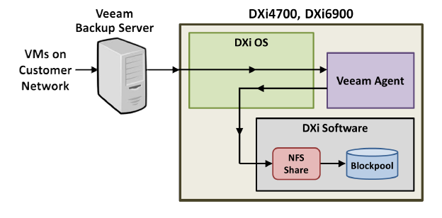
Veeam Application Environment
Basic model

Slide 25
Veeam Application Environment
Certain memory restrictions exist to enable feature. Some models will require a memory expansion kit.
Review installation guide for additional installation pre-requisites
DXi system changes implemented to support Veeam (only enabled when Veeam feature is active and running)
  SSHD config changes (to allow more ssh sessions)
  Security limits
  Chroot jail (read and r/w bindmounts, started by procmon, limits veeam access)
  Cgroups memory resource protection (enforces a 30GB mem threshold for veeam procs)
  Veeam user added
  Firewall ports (data segment, ssh, 2500-3090)

Slide 26
Veeam Application Environment
How Veeam Data Mover Works (high level)
  Veeam Server establishes SSH session to DXi -> sudo
  scp tar file to DXi /tmp directory, unpacks (data mover)
  Uses perl to start agent process, and logging for job
  file is then deleted from filesystem yet remains resident in memory until task is complete
  Data transfer begins using ports 2500-3090 (one port per stream)
  Job completes
  Logs remain resident on DXi for client operations

Slide 27
Veeam Application Environment
DXi Veeam logging (included in collect log)
  Veeam config log
    /var/log/DXi/veeam_config.log
    Updated every time Veeam is enabled or disabled by the user
  Procmon chroot jail log
    /var/log/DXi/procmon-veeam_chroot.log
    Updated every boot/reboot tracks standup of chroot environment for veeam user
  Veeam Backup logs
    /var/log/VeeamBackup
    Updated by Veeam to track job progression
    Veeam employs a log compression algorithm independent of DXi
    Logs are retrieved by Veeam Backup and Replication Server

Slide 28
Veeam Application Environment
Optimizations
  Non-Linear Read I/O performance improvement
    Retrieve_linearity_threshold and retrieve_linearity_window are tunables to identify random read patterns
    If a non-linear read is detected, the BFST retrieve context switches to unbuffered (this nets a 1MB readahead as opposed to 30MB)
    Linear reads continue to use buffered BFST retrieve context
    Supports improved performance for Veeam “Instant Recovery” feature (required for Veeam Certification as well)
    Veeam Instant recovery facilitates a virtual machine hosted on storage target (reads only)
    More details in PTR 47012

Slide 29
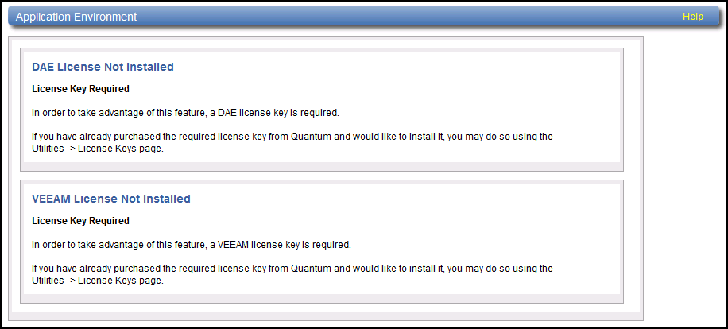
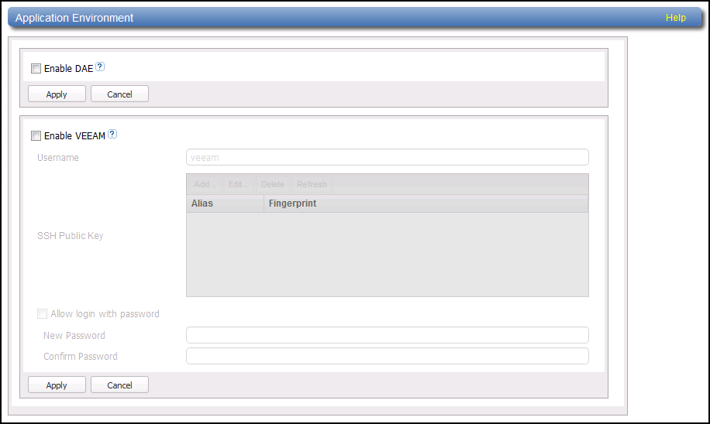
DAE/Veeam GUI
A Customer would not see the lower view because only one of the features can be licensed.
Veeam must be enabled with a password because the account does not exist until after reboot.
Public keys can be added and the password disabled after reboot.

Slide 30
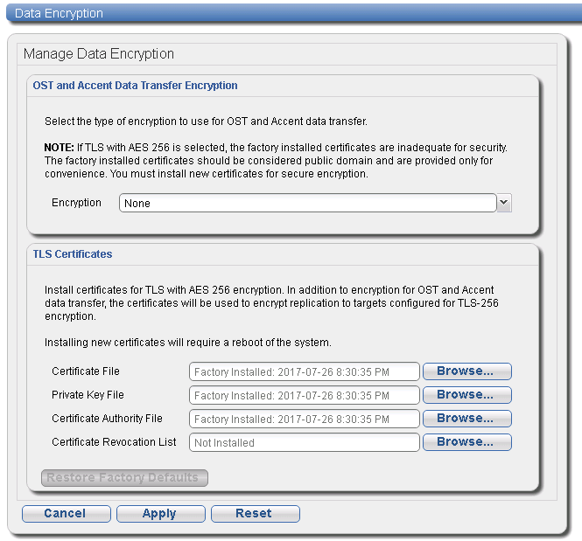
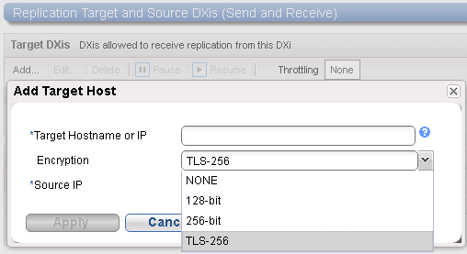
Replication with TLS Encryption
Certificates are for both OST Data Transfer and Replication.
The TLS Certificates panel is available if not licensed for OST.

Slide 31
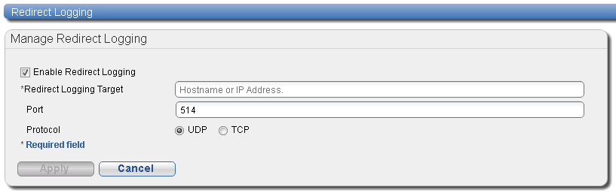
Redirect Logging
Affects messages routed by rsyslog: only messages written to /var/messages are redirected to remote host, not any application specific messages such as messages to tsunami.log or syscli.log.

Slide 32
VTL & VTD Improvements – Mike Donohoe
Allow All VTDs to be used within a single VTL (Bugs 44921, 45184)
Increased Max VTD mounts (Bug 44726)
      6902 (256GB) 160 -> 256
      6900-S (256GB) 160 -> 512
Improvements to Add/Edit Host Access Group for assigning drives with large number of drives

Slide 33
VTL & VTD Improvements Continued…
Allow up to 61,000 slots (and media) per VTL (Cairn 46335)
  Efficiency improvements for creating, listing, deleting, and other media actions.
  GUI improvements
    Addresses GUI VTL performance bugs (15310, 26174)
    Wizard media creation limit (61K for all VTLs).
  Syscli list command improvements to handle large number of cartridges
    Option “sure”
    Filter parameter
    Pagination (start/count)
    Duplicate checking
  Limit total media to 4148000.
  Forbid replication of VTL with more than 9K slots to systems that don’t support 61K slots.

Slide 34
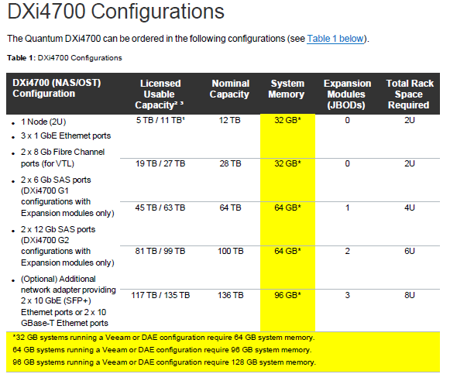
Hardware: Memory Upgrade Requirements for DAE/Veeam

Slide 35
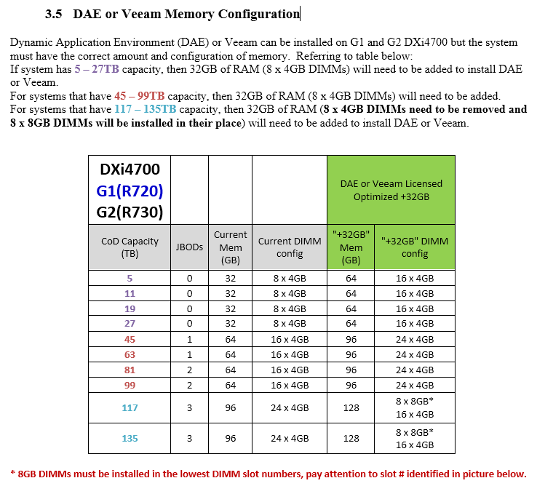
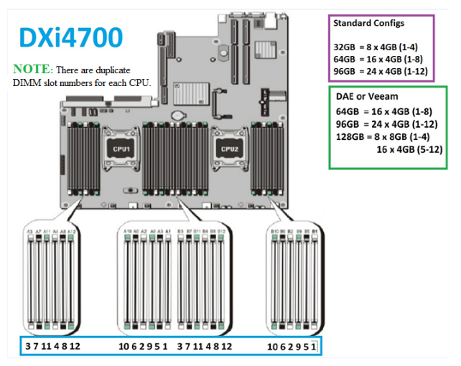
Memory Upgrade Requirements for DAE/Veeam – DXi4700
0-15088-01 HW Spec

Slide 36
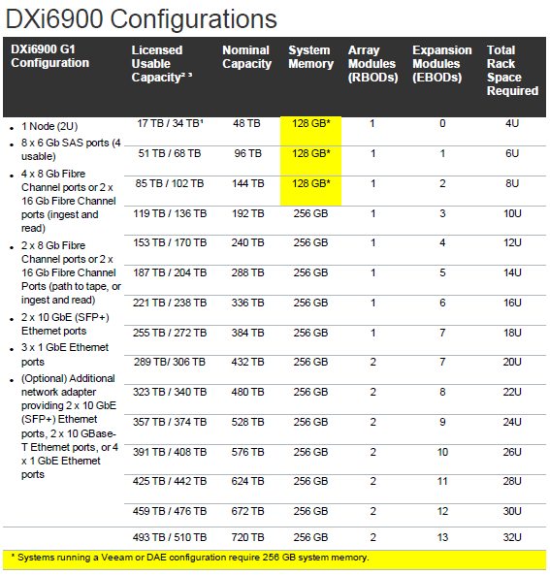
Hardware: Memory Upgrade Requirements for DAE/Veeam

Slide 37
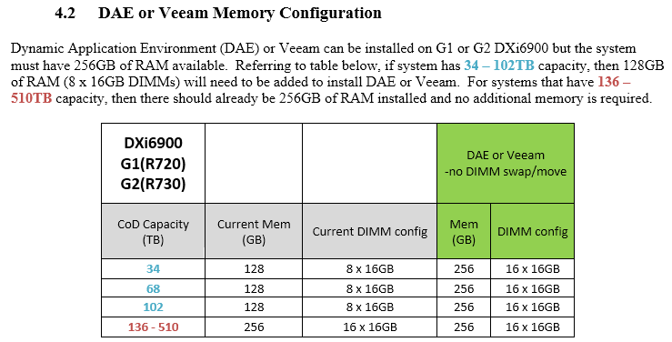
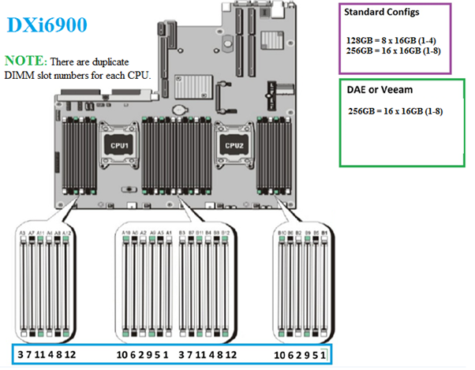
Memory Upgrade Requirements for DAE/Veeam – DXi6900
0-15329-01 HW Spec

Slide 38
Software Deployment
Upgrades are supported from 3.x
YUM upgrades are supported at GA
YUM will introduce serial number checking for 3.x. For all previous 3.x releases on YUM, serial number checking was not enforced.

Slide 39
YUM Reporting
Starting with 3.4.0, each time a DXi interacts with the YUM server a new webservice hosted on the YUM server records additional details
The system serial, f/w version, model, and date/time are captured for:
  The daily poll to check if new firmware is available
  Firmware download from YUM
  After a successful system upgrade (regardless of YUM or .FW)
After ETNA, a new Website will be created to view/search the new data
  Website GA ETA, after September 1st

Slide 40
Documentation and Training
Jim Bell and Neal Menke – Training and Documentation

Slide 41
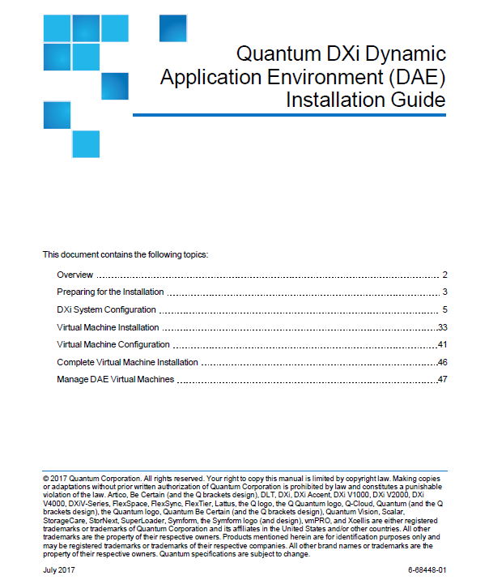
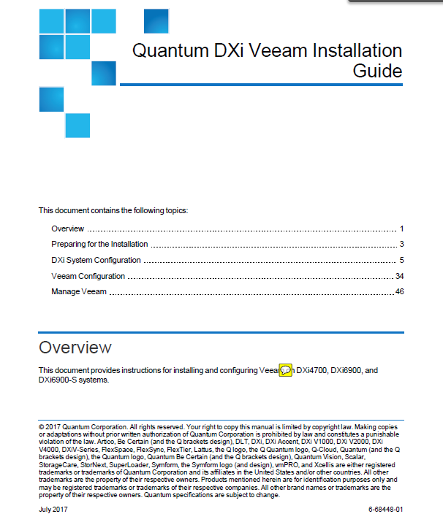
Documentation Deliverables – DXi 3.4.0
Release Date:
Highlights:
New DAE Installation Guide
New Veeam Installation Guide
CLI Guide Updates

Slide 42
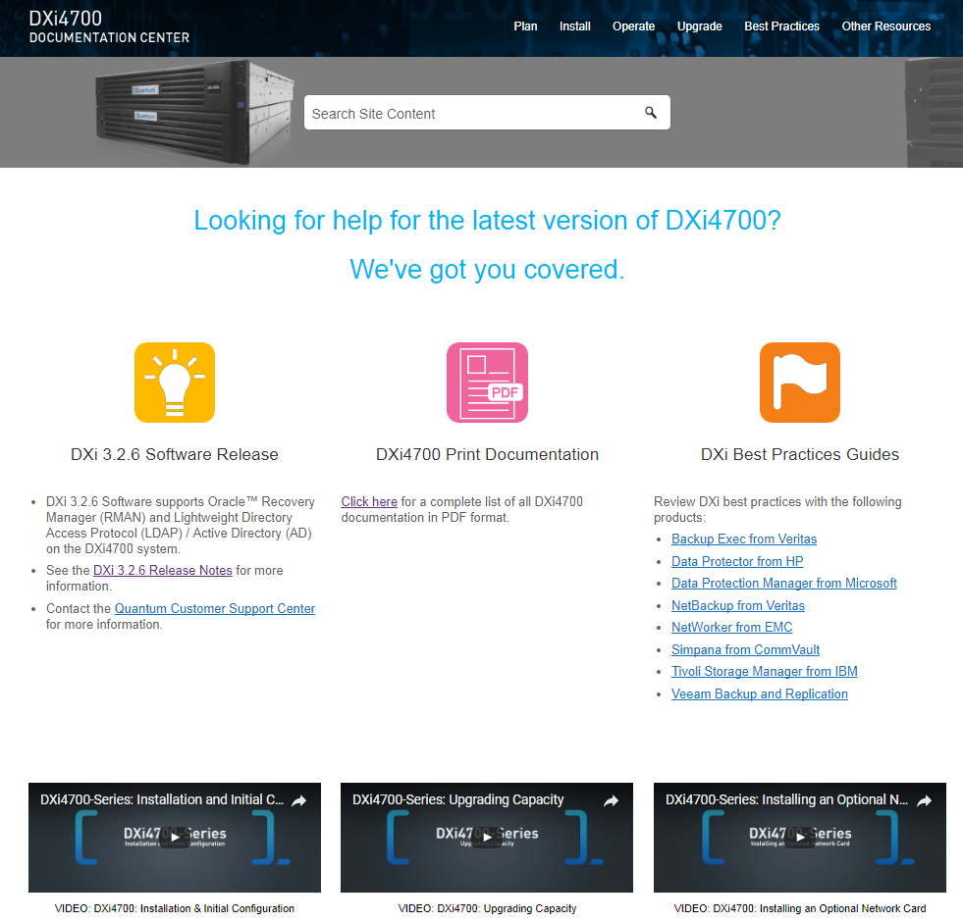
Documentation Deliverables – DXi4700 Documentation
New: DXi 3.4.0 Release Notes
New: DXi4700 Online Help
New: DAE Installation Guide
New: Veeam Installation Guide
Updated: DXi4700 Site Planning Guide
Updated: DXi4700 Installation Guide
Updated: DXi4700 User’s Guide
Updated: DXi4700 Capacity Upgrade Guide
Updated: DXi4700 Software Install and Upgrade Guide

Slide 43
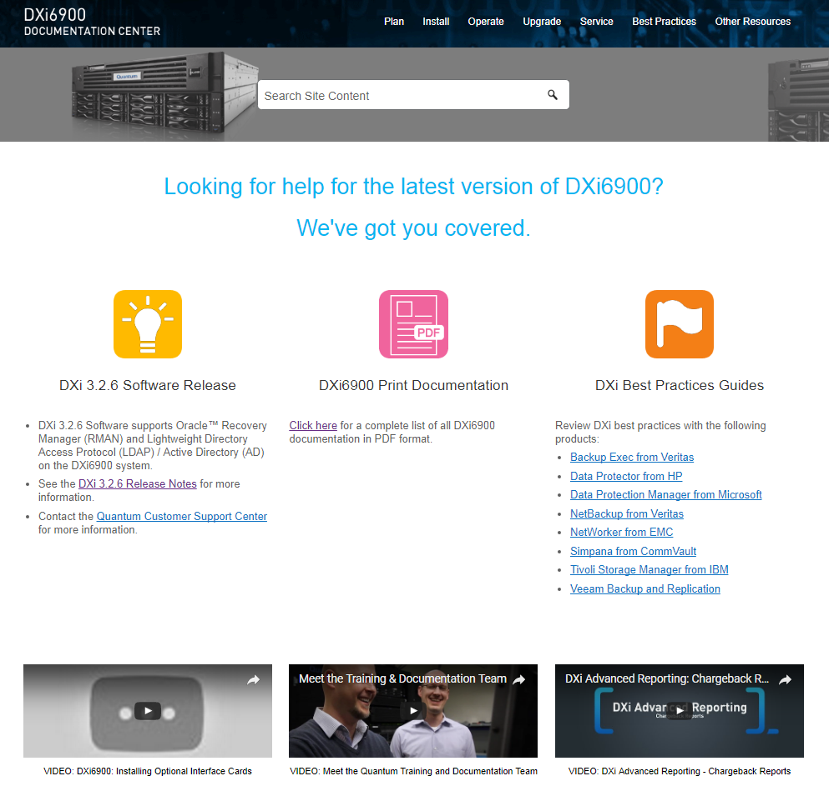
Documentation Deliverables – DXi6900 Documentation
New: DXi 3.4.0 Release Notes
New: DXi6900 Online Help
New: DAE Installation Guide
New: Veeam Installation Guide
New: DXi6900 G2 3 FC Card Installation
Updated: DXi6900 Site Planning Guide
Updated: DXi6900 Installation Guide
Updated: DXi6900 User’s Guide
Updated: DXi6900 Capacity Upgrade Guide
Updated: DXi6900 Software Install and Upgrade Guide

Slide 44
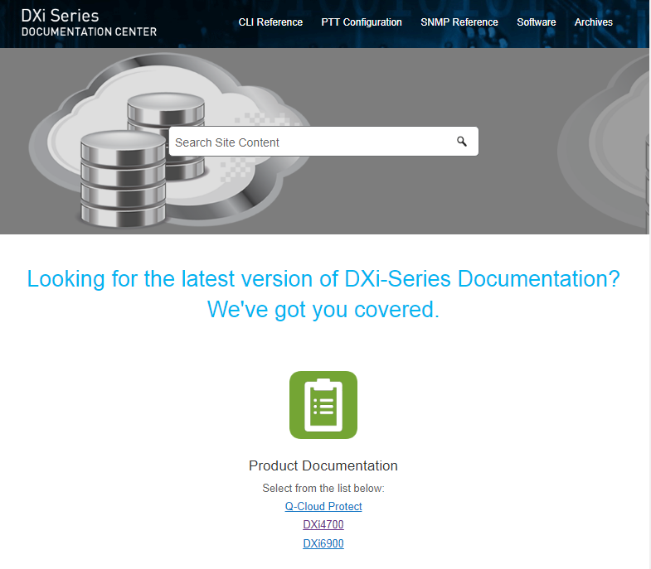
Documentation Deliverables – DXi-Series Documentation
Updated: Command Line Interface (CLI) Guide
Updated: Advanced Reporting (AR) Guide
Updated: OST Plug-in Installation Guide
Updated: OST Configuration Guide
Updated: RMAN Plug-in Installation Guide
Updated: RMAN Configuration Guide

Slide 45





Training Deliverables
New: DXi 3.4 Software Update for Service
(2-3437f Online Self-Paced)
New: DXi4700 and DXi6900: Installing Additional
  Memory Customer Video
Updated: DXi4700-Series Installation
(2-4455 Online Self-Paced)
Updated: DXi6900-Series Installation
(2-4473 Online Self-Paced)
Updated: DXi-Series Installation and Hardware
  Replacement (2-0413 Instructor-Led)
Updated: DXi-Series Service Partner Training
(4-4459 Instructor-Led)

Slide 46
Service Model
Jim Hibbard – Service NPI

Slide 47
Agenda
Version 3.4 Upgrade Campaign Objectives
Version 3.4 Talking Points
  RAS Tickets for failed HDDs
  Security Improvements
  Bug Fixes
RAS Ticket Examples
HDD Dispatch Process
  Dell
  NetApp
ACN Text
Controlled Release

Slide 48
Version 3.4 Upgrade Campaign Objectives
This Service initiated upgrade campaign is to get customers to upgrade to the latest DXi SW Version 3.4. Getting customer to upgrade is all about minimizing efforts for the customer to get replacements. In Version 3.4, HDD RAS tickets will contain all necessary information to dispatch the correct HDD without having the customer to pull logs resulting in reduced Time to Resolution (TTR) for HDD replacements.
  An internal goal is in place to dispatch a replacement HDD within 30 minutes of receipt of RAS ticket.
Version 3.4 Talking Points
  When working with customers to dispatch a replacement drive for a system that is not running DXi SW version 3.4, we need to strongly encourage the customer to upgrade to version 3.4 for the following reasons:
    For failed HDDs, we will not ask you to send logs since the RAS ticket improvements in DXi SW version 3.4 provides all the details needed.
    There are a number of industry standard Security fixes introduced in 3.x versions.
    There are 100s of bug fixes in DXi SW version 3.4 from earlier 3.x versions.
Note: Print this slide and post to your cube wall.

Slide 49
Version 3.4 Talking Points – RAS Ticket Improvements for Failed HDDs
RAS Ticket Improvements for HDD failures
  Automated phone home emails will now contain information reducing the time Quantum needs to spend with the customer to understand Disk Failures, below are examples
  Dell Servers & MD Arrays
    For 6900 and 4700, RAS tickets now contain the details from OpenManage such that the RAS ticket details can be provided to Dell (instead of an entire DSET log) to dispatch a drive.
  NetApp Disk
    For 6900, RAS tickets show Vendor Model IDs
    These Vendor Model IDs have been added to the FRU/CRU list (Reference Tab)
  Results: No longer have to burden the customer with running and sending logs for determining the drive needed.

Slide 50
Version 3.4 Talking Points – Security Improvements
Security/Vulnerability Fixes from 3.0 to 3.4
  Security fixes is of upmost importance to our customer and Quantum alike, multiple fixes are contained in the latest code hence why the recommendation is being made, a few specifics if needed are below
  Shellshock vulnerability in the Bash shell (CVE-2014- 6271, CVE-2014-6277, CVE-2014-6278, CVE-2014-7169, CVE-2014-7186, and CVE-2014-7187)
  New Access Control (enable/disable GUI Monitor, CLI Admin, CLI Viewer, Service GUI accounts. SSH for Service Login and CLI Admin accounts)
  Enhancements to Secure Shell (SSH) ciphers and media access control (MAC) algorithms.
  LDAP/AD support

Slide 51
Version 3.4 Talking Points – Bug Fixes
100s Bug Fixes in the various 3.x releases from 3.0 to 3.4
  Getting to a release that is our most stable should be a talking point to the customers.
  When talking to customers, use verbiage of 100’s of fixes have been rolled into the latest version of code.
  Refer to Release Notes for details

Slide 52
Failed HDD RAS Ticket Examples
Slide 53: DXi6902 w/version 3.2.0.2, failed HDD in Dell server
  RAS Ticket does not contain OpenManage/DSET details for the failed HDD
  DSET needs to be run, log collected and sent to Quantum support, then Quantum support sends DSET log to Dell for dispatch request
Slide 54: DXi4700 w/version 3.4, failed HDD in Dell server
  RAS ticket includes OpenManage/DSET details for failed HDD (in red)
  Copy/paste OpenManage/DSET details from RAS ticket and send to Dell for dispatch request
  RAS Ticket also contains the Controller Log that shows the same HDD failure detail in case Dell wants a log
  No need to run and collect DSET log
Slide 55: DXi6902 w/version 3.2.5, failed HDD in NetApp Array
  RAS tickets shows vendor name an model (SEAGATE ST4000NM0043)
  Vendor name an models have been added to the 6900 FRU/CRU list (NA for 4700)
  Copy vendor string from RAS ticket and order part from Choice Logistics per standard process
Slide 56: Slide 9: DXi6902 w/version 3.4, failed HDD in NetApp Array
  RAS tickets shows vendor name an model (SEAGATE ST4000NM0043)
  Vendor name an models have been added to the 6900 FRU/CRU list (NA for 4700)
  Copy vendor string from RAS ticket and order part from Choice Logistics per standard process
Note 1: NetApp HDD vendor model string has been in RAS tickets since early 3.x.
Note 2: Early response from Dell EMEA indicated they want a Controller log also but we have successfully tested with Dell by just providing OpenManage/DSET details from the RAS ticket.

Slide 53
Failed HDD RAS Ticket for DXi SW Version < 3.4 (Dell Server)
Quantum SERVICE REQUEST INFORMATION
SR Ticket Date: 09.04.2017:15:05:22.00
SR Ticket Number: 67
SR Serial Number: AV1604BVW00027
SR Product: DXi6902
SR FW level: 3.2.0.2
SR Problem Summary: storage subsystem chassis PERC_H730_MINI_(EMBEDDED) drive PHYSICAL_DISK_0:1:3 : Drive failure
SR Problem Code: 0302 : 22
SR Error Code: Drive failure
SR Severity: 1
SR Notes: ST1200MM0108 (15:00:24)
System HDD Summary
Degraded Drives
Enclosure=System Node: PERC, slot 3
Status=Failed, DrivesDegradedInVol=1
Volume=PERC6-BPMD_2, VolStatus=Degraded
Model=ST1200MM0108, Size=1,117.25GB, SpecSize=900GB
SSD=false, SED=false
Rebuild stage 1/2 is 0 percent complete

Slide 54
Failed HDD RAS Ticket for DXi SW Version 3.4 (Dell Server)
Quantum INFORMATION
Ticket Date: 13.04.2017:10:29:33.00
Ticket Number: 11
Serial Number: SV1705BVT29658
Product: DXi4700
FW level: 3.4.0
Problem Summary: storage subsystem chassis A0 drive PHYSICAL_DISK_0:1:5 : Drive failure
Problem Code: 0302 : 22
Error Code: Drive failure
Severity: 1
Notes: ST4000NM0063 (10:24:12)
Dell 4000 GB drive failure in server head service tag 2LRDHY1:
ID:0:1:5, Status:Unknown, State:Spinning Down, T10 PI Capable:No, SED/FDE:Yes, Encrypted:No, Capacity: 4000 GB (4000225165312 bytes), Product ID:ST4000NM0063
Recent alerts for this drive:
Severity : Non-Critical
ID : 2050
Date and Time : Thu Apr 13 10:21:17 2017
Category : Storage Service
Description : Physical disk offline: Physical Disk 0:1:5 Controller 0, Connector 0
Disk inventory of controller 0:
ID:0:1:0, Status:Ok, State:Rebuilding, T10 PI Capable:No, Encryption Capable:Yes, Encrypted:No, Capacity: 4000 GB (4000225165312 bytes), Product ID:ST4000NM0063
ID:0:1:1, Status:Ok, State:Online, T10 PI Capable:No, Encryption Capable:Yes, Encrypted:No, Capacity: 4000 GB (4000225165312 bytes), Product ID:ST4000NM0063
ID:0:1:2, Status:Ok, State:Online, T10 PI Capable:No, Encryption Capable:Yes, Encrypted:No, Capacity: 4000 GB (4000225165312 bytes), Product ID:ST4000NM0063
ID:0:1:3, Status:Ok, State:Online, T10 PI Capable:No, Encryption Capable:Yes, Encrypted:No, Capacity: 4000 GB (4000225165312 bytes), Product ID:ST4000NM0063
ID:0:1:4, Status:Ok, State:Online, T10 PI Capable:No, Encryption Capable:Yes, Encrypted:No, Capacity: 4000 GB (4000225165312 bytes), Product ID:ST4000NM0063
ID:0:1:5, Status:Unknown, State:Spinning Down, T10 PI Capable:No, Encryption Capable:Yes, Encrypted:No, Capacity: 4000 GB (4000225165312 bytes), Product ID:ST4000NM0063
ID:0:1:6, Status:Ok, State:Online, T10 PI Capable:No, Encryption Capable:Yes, Encrypted:No, Capacity: 4000 GB (4000225165312 bytes), Product ID:ST4000NM0063
ID:0:1:7, Status:Ok, State:Online, T10 PI Capable:No, Encryption Capable:Yes, Encrypted:No, Capacity: 4000 GB (4000225165312 bytes), Product ID:ST4000NM0063
ID:0:1:8, Status:Ok, State:Online, T10 PI Capable:No, Encryption Capable:Yes, Encrypted:No, Capacity: 4000 GB (4000225165312 bytes), Product ID:ST4000NM0063
ID:0:1:9, Status:Ok, State:Online, T10 PI Capable:No, Encryption Capable:Yes, Encrypted:No, Capacity: 4000 GB (4000225165312 bytes), Product ID:ST4000NM0063
ID:0:1:10, Status:Ok, State:Online, T10 PI Capable:No, Encryption Capable:Yes, Encrypted:No, Capacity: 4000 GB (4000225165312 bytes), Product ID:ST4000NM0063
ID:0:1:11, Status:Ok, State:Online, T10 PI Capable:No, Encryption Capable:Yes, Encrypted:No, Capacity: 4000 GB (4000225165312 bytes), Product ID:ST4000NM0063
Items in Red are New

Slide 55
Failed HDD RAS Ticket for DXi SW Version < 3.4 (NetApp Array)

Slide 56
Failed HDD RAS Ticket for DXi SW Version 3.4 (NetApp Array)
Quantum INFORMATION
Ticket Date: 14.06.2017:13:11:56.00
Ticket Number: 11
Serial Number: SV1646BVW12561
Product: DXi6902
FW level: 3.4.0
Problem Summary: storage subsystem chassis QARRAY1 drive TRAY_99_SLOT_5 : Drive failure
Problem Code: 0302 : 22
Error Code: Drive failure
Severity: 1
Notes: TRAY_99_SLOT_5 [HGST HUS724040ALS640] (13:05:22)
System HDD Summary
Degraded Drives
Enclosure=System Node: PERC, slot 12
Status=Impending Failure, DrivesDegradedInVol=1 Volume=PERC10-BPMD_4, VolStatus=Ready Model=ST900MM0007, Size=837.75GB, SpecSize=900GB SSD=false, Drive is non-SED/FDE
Enclosure=SAS Expansion: Qarray1Tray99, slot 5 Status=Failure, DrivesDegradedInVol=1 Volume=Qarray1TRAY_99_VOL_1, VolStatus=Rebuilding Model=HGST HUS724040ALS640, Size=3719GB, SpecSize=4.000TB SSD=false, Drive is non-SED/FDE Rebuild stage 1/2 is 1 percent complete

Slide 57
HDD Dispatch Process - Dell
When dispatching replacement components from Dell, Dell previously wanted us to send them a DSET log. This means that the customer has to run DSET to generate the log, send it to Quantum, then Quantum sends it to Dell to qualify the failure and send the replacement.
We have agreement from Dell that we can simply send the DSET details for a failed drive for Dell to send a replacement.
DSET details for a failed drive are now included in failed drive RAS tickets
  Actually we are getting the analogous DSET failed drive details from OpenManage
High level process for dispatching a drive from Dell
  DXi SW Version < 3.4
    Failed HDD details from DSET are not in the RAS Ticket
    Collect DSET log and provide to Dell per current Dell Dispatch process
  DXi SW Version >= 3.4
    Send Dell the failed HDD details from the RAS Ticket
    Send the red-highlighted text (shown on slide 54) to Dell that should suffice Dell dispatch requirements

Slide 58
HDD Dispatch Process - NetApp
When dispatching an HDD for a NetApp array, use our current Choice Logistics parts ordering process.
Vendor models have been added to the 6900 FRU/CRU list (6900 Reference Tab)
Simply copy the model from the RAS ticket and search for it on the Reference FRU/CRU list
Order the replacement HDD from Choice Logistics per standard process

Slide 59
DXi 6900 Automatic Change Notification (ACN) Text
This release provides upgrades to existing DXi 3.0 and higher software and includes the following enhancements:
  Dynamic Application Environment (DAE) support.
  Oracle Recovery Manager (RMAN) Oracle 12 support.
  Path to Tape (PTT) LTO-7 drive support.
  Replication encryption with Transport Layer Security (TLS).
  Samba 4.5.3
  Veeam integration.
  RAS enhancements for quick dispatch of drive FRU without customer provided logs
  Please see the release notes at http://www.quantum.com/dxi6900docs for details on all issues resolved by this release.
Important Software Upgrade Actions
  Once the software upgrade is complete, it is important to do the following:
  Clear your web browser cache before logging in to the DXi system.
Installation Times
  Installation time of this upgrade depends on the total number of Array and Expansion modules in the DXi system. Times will range from less than 1 hour (1 Array module) up to 5 hours (maximum 15 Array and Expansion modules).The DXi GUI will not be accessible during this time.

Slide 60
DXi 4700 Automatic Change Notification (ACN) Text
This release provides upgrades to existing DXi 3.0 and higher software and includes the following enhancements:
  Dynamic Application Environment (DAE) support.
  Oracle Recovery Manager (RMAN) Oracle 12 support.
  Path to Tape (PTT) LTO-7 drive support.
  Replication encryption with Transport Layer Security (TLS).
  Samba upgrade (4.5.3).
  Veeam integration.
  RAS enhancements for quick dispatch of drive FRU without customer provided logs
  Please see the release notes at http://www.quantum.com/dxi4700docs for details on all other enhancements and issues resolved by this release.
Important Software Upgrade Actions
  Once the software upgrade is complete, it is important to do the following:
  Clear your web browser cache before logging in to the DXi system.
  If you are upgrading from DXi 3.1.x Software and below, the software upgrade will disable the GUI Monitor, CLI Administrator, CLI Viewer, and Service GUI user accounts. The Access Control page will appear the first time you log in to the DXi system after the upgrade. Enable the user accounts and reset passwords.
Installation Times
  Installation of this upgrade will require about one hour, and the DXi will be unavailable during this time. The system may reboot more than once during the upgrade process.

Slide 61

Misc.
      Controlled Release
  Monitor for issues on initial installations and upgrades while ramping usage on as many system as possible
  Upon Agile release will post 3.4 on both CSWeb and Q.com
    Posting was completed on 8/7
  Service will use and recommend 3.4 for new installations and SW upgrades performed by Quantum TAMs, TPMs/ASPs
  Customers using YUM will continue receiving 3.2.6, but can access 3.4 on Q.com for DXi4700 self-installations and upgrades
  Will post to YUM with new ACN once Controlled Release is completed (~3-4 weeks)
      Updated Service Plan Updates (DXi4700 and DXi6900)
  Release and posted on CSWeb
    DXi4700, 0-15154-01
    DXi6900, 0-68158-01

Slide 62
Q&A

