Slide 1

Quantum SureStaQ for Commvault
TOI for Global Service
Converged Commvault Solution from Compute to Cloud
August 2017

Slide 2
Agenda
Product Overview
Training and Documentation
Service Model
Notes:
  Please ask questions as we go. Your lines are muted on entry so *6 to unmute
  Recording will be posted on Qwikipedia

Slide 3
Product Overview
Terry Grulke – Principal Technical Advisor

Slide 4
We do have a history with Commvault
Way back when we sold Scalar to Commvault customers and we still do
Not quite so much way back when, before Commvault had integrated software based deduplication, we were selling DXi deduplication appliances
Commvault released their integrated deduplication and made us the enemy pushing their customers to their deduplication, in many cases for FREE
We countered with a technical comparison between their dedup and ours
  DXi does a much better job reducing capacity
  For many data types Commvault is not getting anything better than compression
  We battled each other for the past 5 years
What changed? QXS was a very affordable disk target for their deduplication
  We have servers specific for Commvault eliminating other hardware competition
  We have minimized/eliminated use of our competitive technical comparison

Slide 5
The Quantum / Commvault Opportunity
We don’t care who does the deduplication
We don’t have a backup application
We are an end to end hardware platform vendor, dedicated to data protection, with a recently refreshed hardware stack including servers, networking, storage, object, and tape
Like Commvault, we are embracing the flash and cloud transition in the market building alliances with AFA and Cloud vendors
Veritas and Dell/EMC are now clearly competitors
This solution has already generated massive buzz in the channel, with the Commvault field teams, and with end users where we have piloted the message
Notes:
Lets step back a minuted, might be some history
I am introduced the surestaq – clear the air
Why CV and QTM are good partners.
Quantum can:
Provide a complete hardware stack from Compute, Networking, and Storage all the way to the Cloud
Will invest with Commvault in Marketing and Lead Generation
Provide relationships and install-base targets
Deliver a Common message to customers and channel partners
Provide a best in class customer experience
Provide unmatched ROI and lower architecture costs vs. what customers use today with primary storage focused vendors
Provide no competitive threat and will help solidify your position vs. the competitive appliance markets

Slide 6
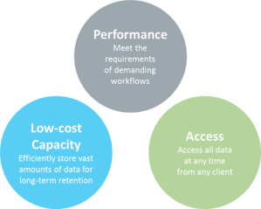
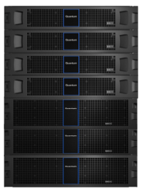

Introducing the Quantum SureStaQ™ for Commvault
Converged solution for Commvault from Compute to Cloud
  Built off Commvault reference architectures and best practices
  Independently scalable with a flexible set of building blocks to customize for any environment
  Purpose built for data protection with best in class technology and customer experience
  Provides unmatched ROI and lower architecture costs, under $200/TB at scale
  Now gives Commvault an “easy button”
“Our goal with this product is to build the most complete and compelling solution on the planet for Commvault. The Quantum SureStaQ will enable Commvault to win more customers and solidify their position in install base accounts. We want to help them double in size over the next few years” – Jon Gacek, Quantum CEO
Notes:
SureStaQ is a complete infrastructure solution for commvault - an easy way, an easy button to get commvault up and running
It provides everything a customer needs to run commvault –
A converged soltuion
Tested and verified via reference architectures and best practices base on Commvaults specs
Converged is key - idenpendtenly stcalable.
And most eye catching is the unmatched ROI - $200/TB at scale, this compares to $300, $400 or even $500/TB which is what we have seen an isilon come in at
The rason we can get this low $/TB is in is not general purpose or repurposed storage – it is block strage designed for backup with the rapid ingest needed and customized application directors.

Slide 7


Quantum SureStaQ for Commvault
Xcellis Application Directors with Flash for CommServe (XL and L/M) and MediaAgents (Extended Model XL, Extended Model L, XL, L and M/S) servers
Internal networking for storage scale and connectivity
QXS Storage De-Dupe Targets up to 1.9PB per SureStaQ and typically around $200/TB to customers
Faster to Deploy. Easier to Support. Independently Scalable.
Notes:
Internal networking – Brocade,
Xcellis or Artico, if needed, we can do this, use win room

Slide 8









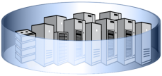

SureStaQ™ is Aligned To Commvault’s Architecture
CommServe
Unified Console
Xcellis Application Director
for X-Large or Large/Small CommServe
Client Systems
MediaAgents
Xcellis Application Director
for Extended Model X-Large, Extended Model Large, X-Large, Large or Medium
MediaAgents
Backup Storage
QXS High Performance Disk Storage
Purpose-built for Commvault
Notes:
Commvaults architecture
Reinforce
Meta data, client systems actually being backup
MA between LAN and SAN, DDB, work horses of the solution
How we align…..

Slide 9

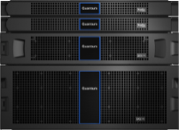




Quantum Enables Commvault from Compute to Cloud, and supports flash technologies
InteliSnap to QXS for DR Snapshot Recoveries
AuxCopy to Scalar Tape for low cost or offline retention
DashCopy to QXS or Offsite Backup Protection
OnePass to Lattus, StorageGrid, or Public Cloud for Application Aware Archiving

Slide 10
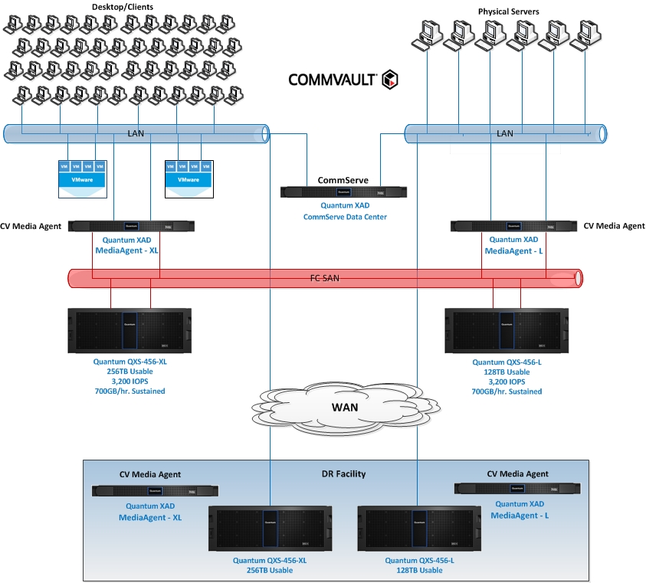
Quantum SureStaQ for Commvault
Solution Overview
Problems Solution is Designed to Address
High performance block storage for Commvault backup data
Commvault deduplication database (“DDB”) stored in MediaAgent
Immediate copy of all backups to be stored in separate DR facility using DASH copy
Solution Selection Criteria
Single vendor for CommServe, MediaAgent, and backup repository storage
Fast streaming performance to minimize backup windows
Cost of storage versus performance tradeoff
Support Commvault requirements for user backup data
Benefits and Quantum Differentiators
Q-Turbo enables writing data 50% faster than competition
Add JBODs at low cost, no need to buy new controllers.
Easy “1-button” configuration
Tested using Commvault recommended utilities to ensure solution meets performance criteria

Slide 11
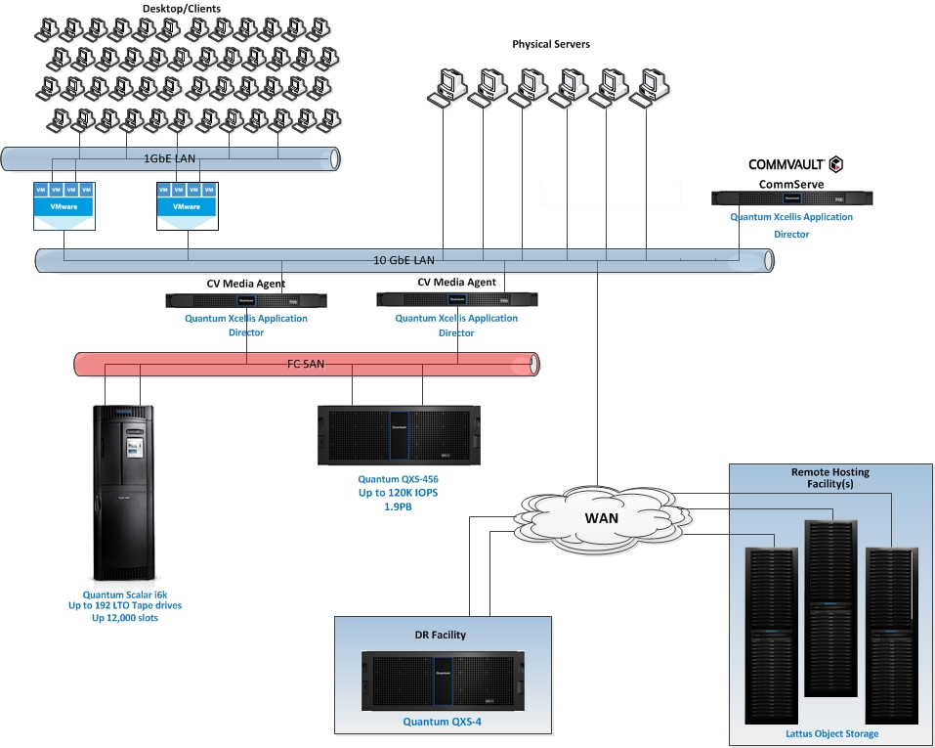
Quantum Portfolio for Commvault
Solution Overview
Problems Solution is Designed to Address
High performance block storage for Commvault backup data
Commvault deduplication database (“DDB”) stored in MediaAgent
Immediate copy of all backups to be stored in separate DR facility using DASH copy
Solution Selection Criteria
Fast streaming performance to minimize backup windows
Cost of storage versus performance tradeoff
Support Commvault requirements for user backup data
Optional Lattus to used as “Archive Disk”
Benefits and Quantum Differentiators
Q-Turbo enables writing data 50% faster than competition
Add JBODs at low cost, no need to buy new controllers.
Easy “1-button” configuration

Slide 12
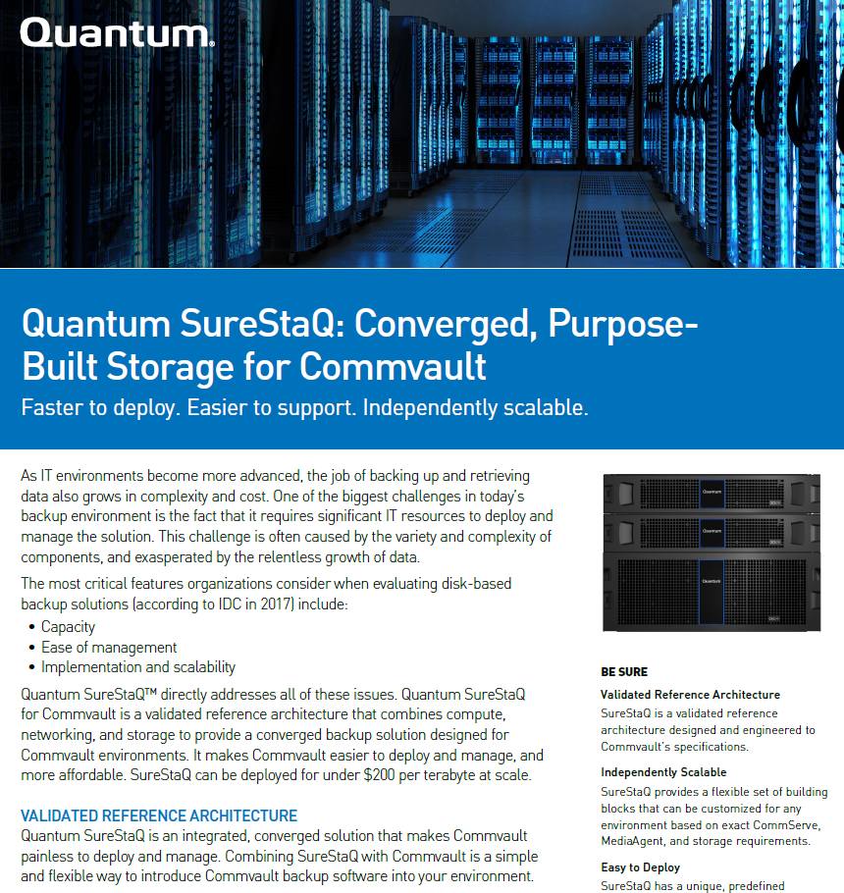
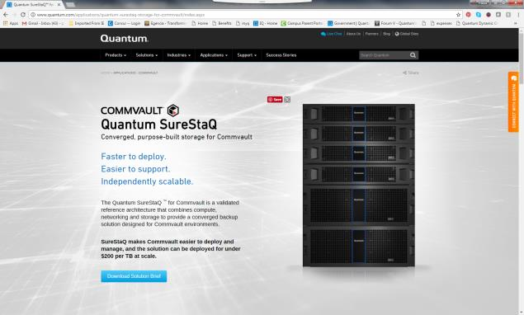
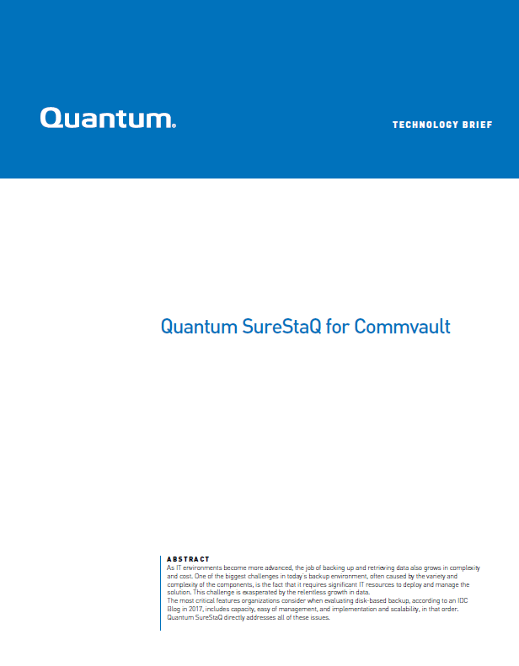
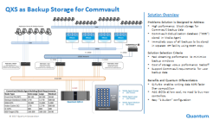
SureStaQ for Commvault Assets
http://www.quantum.com/applications/quantum-surestaq-storage-for-commvault/index.aspx
Notes:
For the QXS Hybrid Storage for Commvault backup campaign, we have sales enablement tools to leverage for customers or VARs with strong Commvault solutions where QXS hybrid storage is the right solution. We have a new technical brief, 2 new reference architectures and a trade up offer for this campaign. All assets are located on iQ.

Slide 13
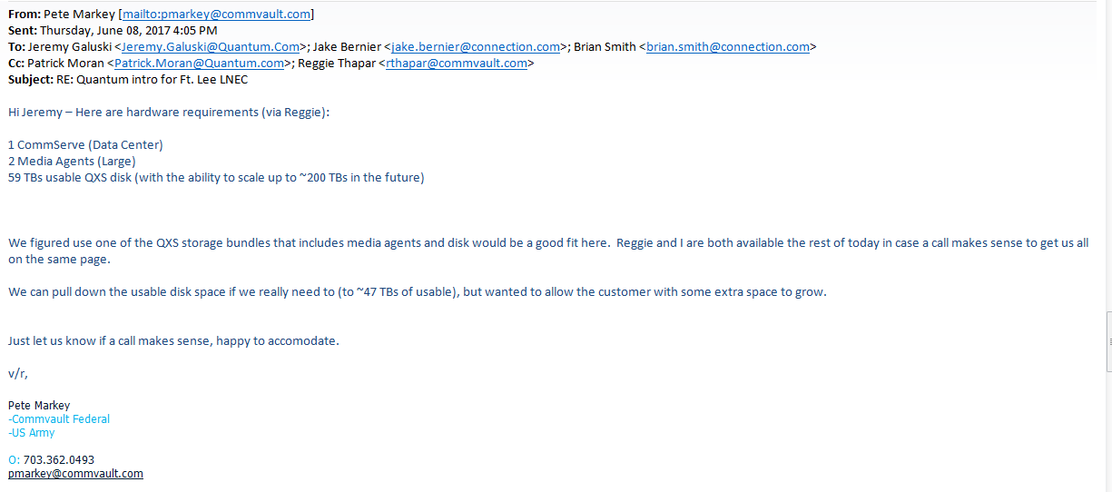
How do we get the request and how much detail is provided?

Slide 14
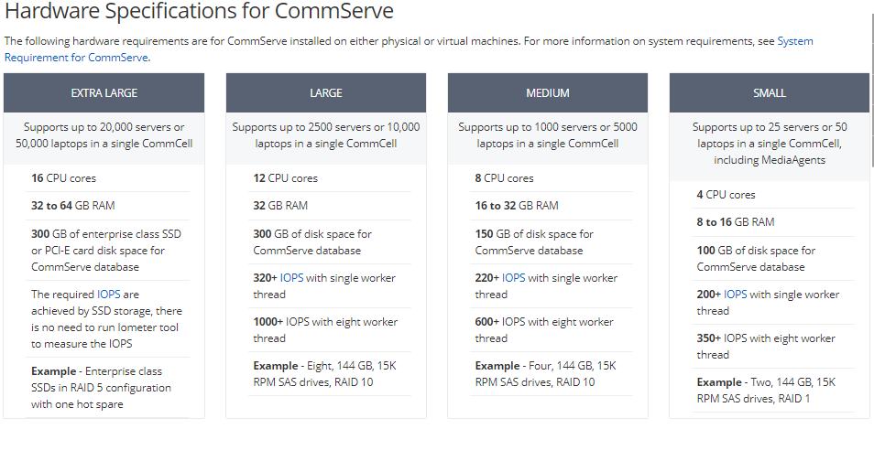
Commvault CommServe

Slide 15
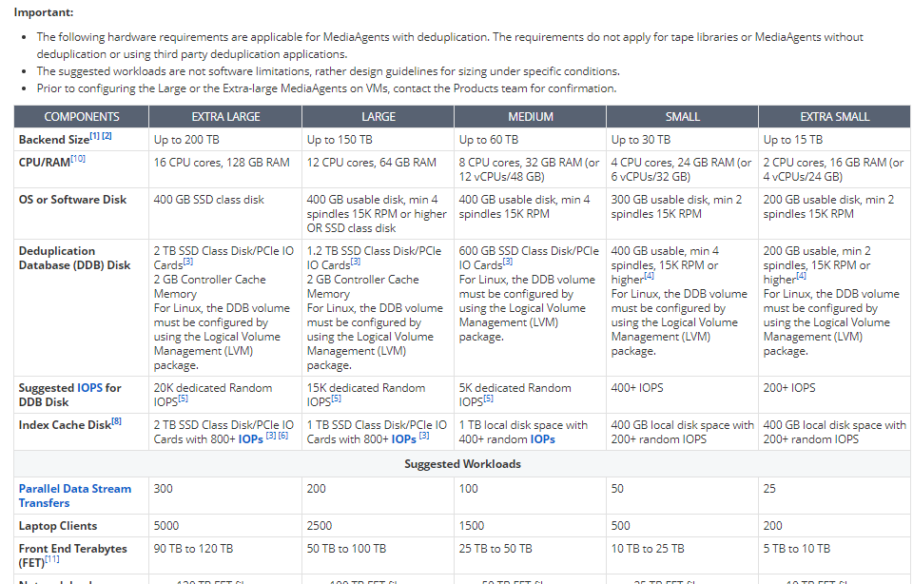
Commvault MediaAgent

Slide 16
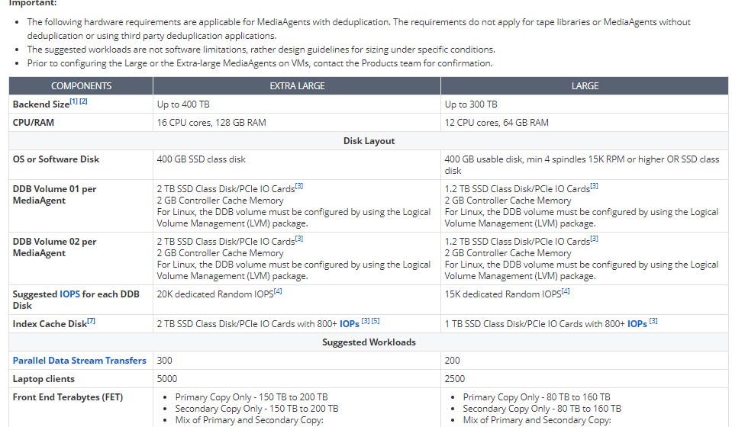
Commvault Media Agent Extended Mode

Slide 17
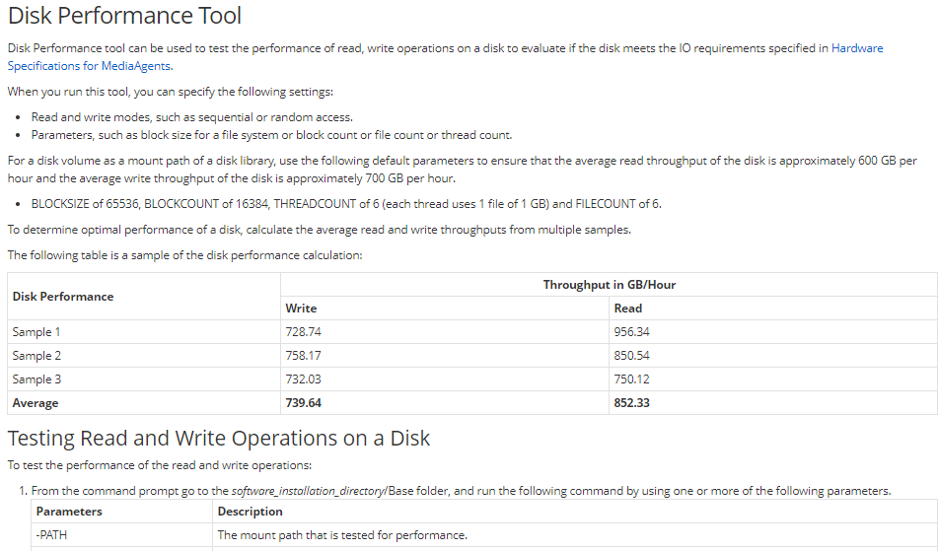
Disk Performance – Sustained Random Write/Read

Slide 18
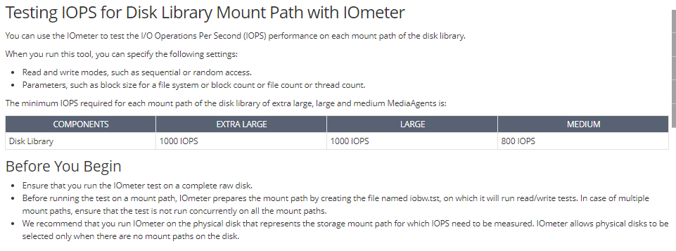
Disk Performance - IOPS

Slide 19
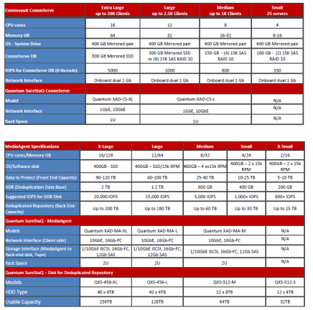
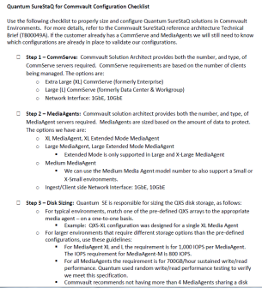
We have learned to speak Commvault-ese
Commvault or their partners collect data about the customer environment
They communicate to Quantum Sales/SE team using Commvault terminology

Slide 20
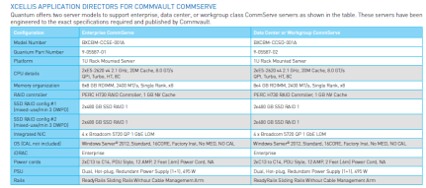
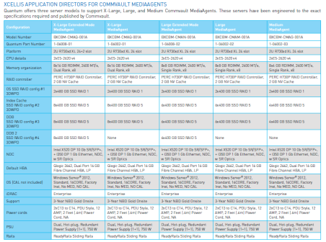
We have learned to speak Commvault-ese
CommServe –
  XAD-CS-XL
  XAD-CS -L
MediaAgent –
  XAD-MA-XL
  XAD-MA-XL-EXT
  XAD-MA-L
  XAD-MA-L-EXT
  XAD-MA-M
  XAD-MA-S
QXS
  QXS-456-XL 256 TB usable (8 TB disks)
  QXS-456-L 128 TB usable (4 TB disks)
  QXS-312-XL 64 TB usable (8 TB disks)
  QXS-312-XL 32 TB usable (4 TB disks)

Slide 21
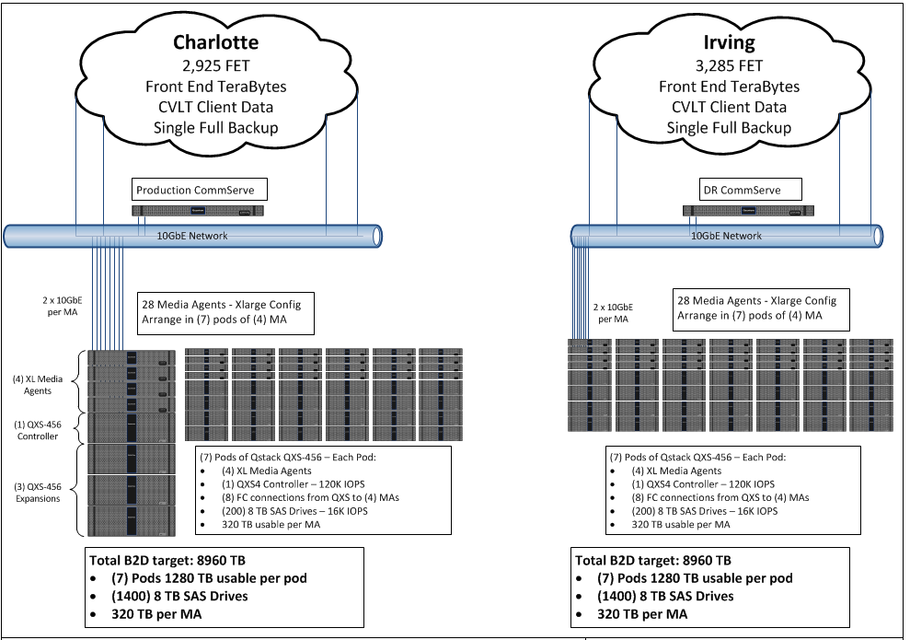
Atos Commvault & The Quantum SureStaQ for Allscripts
Solution Summary:
  2 Enterprise CS XADs
  56 X-Large MA XADs
  17.5 PB usable QXS storage
Deployment is in SureStaQs
  7 SureStaQs per site
  4 MA XADs and 1 QXS-4 with 1280 TB usable per SureStaQ
  320 TB usable per MA XAD
  8960 TB usable per site
  28 MA XADs per site
Commvault responsible for all sizing
Notes:
From cv se
FET estimated change rate, retention, frequency of backup dictate size.

Slide 22
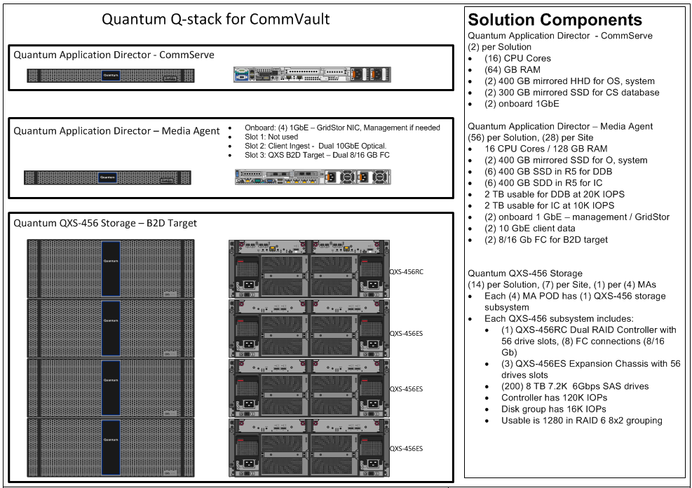
Atos Commvault & The Quantum SureStaQ for Allscripts
The Quantum SureStaQ for Commvault matches up out of the box
XAD Media Agents are customized by HBA and NICs to a specific solution
QXS is customized by usable TB per MA XAD or Groups of MA XADs

Slide 23

SureStaQ vs Purpose Built Backup Appliances (Data Domain)
Backup 400 TB w/Existing Commvault to Data Domain Customer
4x MediaAgents x 4 TB / hour per MediaAgent = 16 TB / hr aggregate
Each media agent costs $12,000 based on Commvault DDB requirements.
6x media agents x 2 TB / hour per media agent = 12 TB / hr aggregate.
Each media agent costs $8,000. Less expensive because don’t need to do the dedupe
Media agent throughput is lower in this option because Ccommvault is not compressing data on the network before sending to storage
16 TB / hour
12 TB / hour
8Gb Fiber
NAS
1 x QXS-456
80 each - 8TB Drives, 8+2 RAID-6, Hot Spare, 512TB usable
 | SureStaQ | Dell/EMC Components
SureStaQ XAD XL MA vs. Dell Windows Servers | $48,000 (4 x $12,000 ea.) | $48,000 (6 x $8,000 ea.)
SureStaQ Storage vs. DD | $102,400 | $714,300 (70% Discount.)
Total Price (Street) | $150,400 | $762,300
DD9300
510TB usable,
Notes:
Total Data to Protect = 400TB. Calculations based on retention of 4 Weekly Full images, 25 Daily Incremental images

Slide 24

SureStaQ vs Dell/EMC (Dell Isilon)
Backup 500TB w/Commvault DeDupe
4x MediaAgents x 4 TB / hour per media agent = 16 TB / hr aggregate
Each MediaAgent costs $12,000 based on Commvault DDB requirements.
4x media agents x 4 TB / hour per media agent = 16 TB / hr aggregate
Each media agent costs $12,000 based on Commvault DDB requirements.
16 TB / hour
16 TB / hour
8Gb Fiber
Dell Isilon
576TB usable (2x 288ea.)
1 x QXS-456
90 each - 8TB Drives, 8+2 RAID-6, Hot Spare, 576TB usable
 | SureStaQ | Dell/EMC Components
SureStaQ XAD XL MA vs. Dell Windows Servers | $48,000 (4 x $12,000 ea.) | $48,000 (4 x $12,000 ea.)
1x SureStaQ Storage vs. 2x EMC Isilon NL Nodes | $102,400 | $210,600
Total Price (Street) | $150,400 | $249,600
Notes:
Total Data to Protect = 400TB. Calculations based on retention of 4 Weekly Full images, 25 Daily Incremental images

Slide 25
SureStaQ™ Savings | Real World Example (PB-scale)
Configuration Options ->
Current Proposed Costs
Hardware | $ 1,985,360.00
Software | $ 126,500.00
Support | $ 434,898.00
Professional Services | $ 2,275.00
Installation | $ 99,500.00
Total Investment | $ 2,648,533.00
Approved Discounts | Expires 6/30/17
Platinum MSP Volume Discount | $ 900,332.05
(ATOS-2017)
Commvault Partner Program | $ 397,279.95
(IL-FS693)
Trade Up/Trade Out | $ -
District Marketing Funds | $ 50,000.00
(IL-MFQ101)
Total Discount | $ 1,347,612.00
Total Net Investment | $ 1,300,921.00
SureStaQ =
$260 per TB
Isilon =
$470 per TB

Slide 26
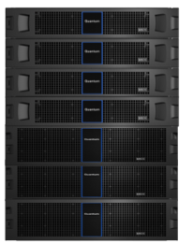
The Quantum SureStaQ for Commvault | Summary
The Quantum SureStaQ provides a converged solution for Commvault
The SureStaQ supports Compute to Cloud, built off Commvault Reference Architectures
Quantum is investing with Commvault in Marketing and Lead Generation
Quantum is providing 1000’s of install-base targets from Dell/EMC and Veritas to jointly attack
Quantum delivers best in class technology and customer experience
Quantum SureStaQ provides unmatched ROI and lower architecture costs based on leveraging cloud storage methodologies in the data center
We have platforms to enable ALL Commvault capabilities

Slide 27
Training and Documentation
Joe LaRoue – Senior Technical Writer

Slide 28
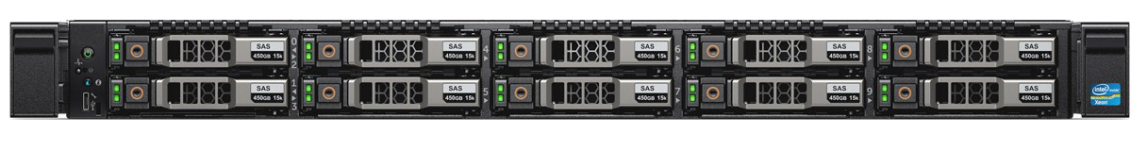
DOCUMENTATION: SureStaQ R430 Server
R430 Server: 1U
R430 Server | Enterprise | Data Center/Workgroup
Platform | R430 2.5” SSD (10 max) | R430 2.5” SSD (10 max)
OS - System Drive | 2x400GB SSD RAID 1 | 2x400GB SSD RAID 1
CommServe DB | 2x400GB SSD RAID 1 | 2x400GB SSD RAID 1

Slide 29
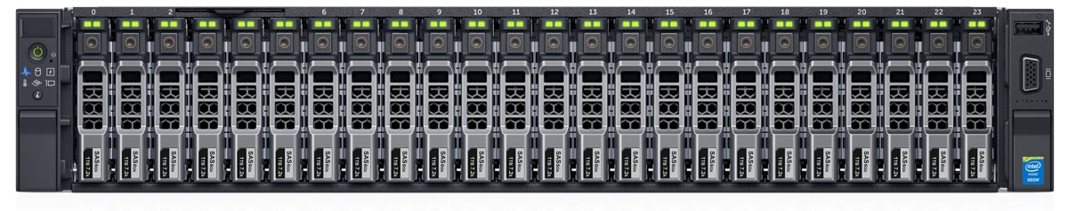
DOCUMENTATION: SureStaQ R730xd Server
R730xd Server: 2U
R730 Server Size | Medium | Large | Large Extended Mode | X-Large | X-Large Extended Mode
OS SSD RAID Config #1 3DWPD | 2x400GB SSD RAID 1 | 2x400GB SSD RAID 1 | 2x400GB SSD RAID 1 | 2x400GB SSD RAID 1 | 2x480GB SSD RAID 1
Index Cache SSD RAID Config #2 3DWPD | 4x400GB SSD RAID 5 | 6x400GB SSD RAID 5 | 6x400GB SSD RAID 5 | 8x400GB SSD RAID 5 | 8x400GB SSD RAID 5
DDB SSD RAID Config #3 3DWPD | 4x400GB SSD RAID 5 | 6x400GB SSD RAID 5 | 6x400GB SSD RAID 5 | 8x400GB SSD RAID 5 | 8x400GB SSD RAID 5
DDB 2 SSD RAID Config #4 3DWPD | None | None | 6x400GB SSD RAID 5 | None | 8x400GB SSD RAID 5

Slide 30
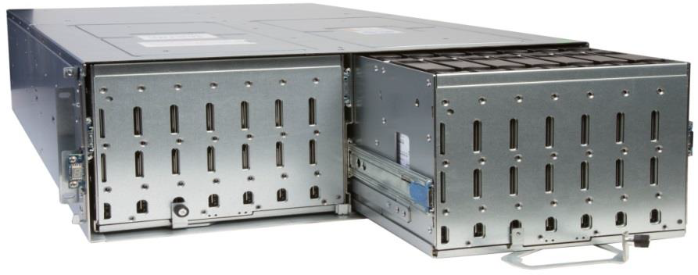
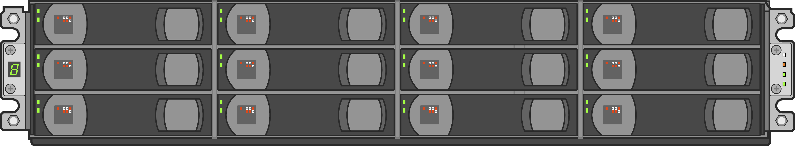
DOCUMENTATION: SureStaQ QXS Systems
2U12
4U56
Configuration | Small | Medium | Large | X-Large
Base Chassis | QXS-312 | QXS-312 | QXS-456 | QXS-456
Max # Drives | 12 | 12 | 56 | 56
Drives | 48TB (12x 4TB non-SED HDDs) | 96TB (12x 8TB non-SED HDDs) | 160TB (40x 4TB non-SED HDDs) | 320TB (40x 8TB non-SED HDDs)
RAID | RAID 6 8+2 virtual | RAID 6 8+2 virtual | RAID 6 8+2 virtual | RAID 6 8 + 2 (x4)
Hot Spares | 2 | 2 | 2 | 2
*Note: The QXS-456 has 56 drive slots. There will be 14 empty drive slots with this configuration.

Slide 31
DOCUMENTATION: Docs on Web
Doc Title/Number | Provides information on: | Customer | Service & Support
SureStaQ Quick Start Guide 6-68619-01 Rev A | Introduction R430 and R730xd Server Configurations QXS System Configurations Server and QXS Install Documentation Server and QXS Installation Process Contacting Quantum | www.quantum.com/surestaqdocs | https://qsweb.quantum.com/files_plugin_files1.php?mycategory=2256
SureStaQ Users Guide (R430) 6-68617-01 Rev A (Dell PowerEdge R430 Owner’s Manual) | About Your System Performing Initial System Configuration Pre-operating System Management Applications Installing& Removing System Components Troubleshooting Your System Using System Diagnostics Jumpers and Connectors Technical Specifications Getting Help | www.quantum.com/surestaqdocs | https://qsweb.quantum.com/files_plugin_files1.php?mycategory=2256

Slide 32
DOCUMENTATION: Docs on Web
Doc Title/Number | Provides information on: | Customer | Service & Support
SureStaQ Users Guide (R730) 6-68618-01 Rev A (Dell PowerEdge R730 Owner’s Manual) | System Overview Technical Specifications Initial System Setup & Configurations Pre-operating System Management Applications Installing& Removing System Components Using System Diagnostics Jumpers and Connectors Troubleshooting Your System Getting Help | www.quantum.com/surestaqdocs | https://qsweb.quantum.com/files_plugin_files1.php?mycategory=2256
One Button Configuration QXS Profile Bundle Installation 6-68599-01 Rev A | Introduction QXS Profile Bundle (QPB) Installation Global Hot Spares Contacting Quantum | N/A | https://qsweb.quantum.com/downloads/qxs_surestaq_obc.html

Slide 33
Service Model
Jim Hibbard – Service Program Manager

Slide 34
Support Model
Executive Staff wants to make sure that Service has visibility to a SureStaQ for Commvault component when taking calls.
  We want to be aware that customer is using SureStaQ components with Commvault backup application
  We don’t want to ping pong customers between Quantum and Commvault Support
We will support the QXS disk and XAD servers per our standard support models.
  QXS Service Plan: 0-16037-01
  XAD Service Plan: 0-16745-01
New Service Plan release for the SureStaQ for Commvault solutions.
  Describes the solution components for the various bundles
  SureStaQ for Commvault Solution Service Plan: 0-16257-01
There is concern that performance related calls may get referred to Commvault immediately.
  Quantum support should always confirm proper functionality for the QXS and XAD components
  When Quantum support triages the QXS and XAD components with no problem found, we need to refer customers to Commvault support letting them know that we are receptive to working with Commvault support as necessary towards fixing the customer problem.

Slide 35
IB Records
Standard QXS part numbers and descriptions will populate in support Case
“SureStaQ…” XAD specific part number and description will populate in Case
Flash is setup for all QXS and XAD components used in SureStaQ bundels
  This component is used in a “SureStaQ for Commvault” solution. Refer to service plan, 6-16257-01 on CSWeb for support details.
Sure StaQ for Commvault TLAs:

Slide 36
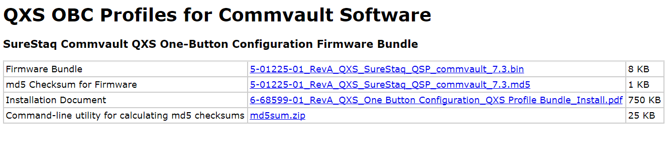
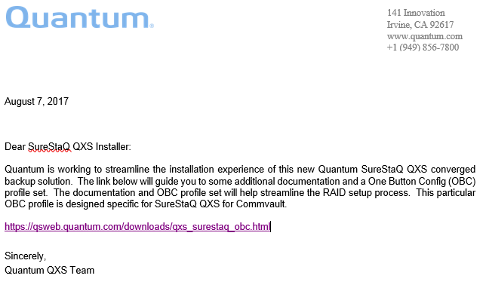
QXS OBC Profiles and Customer Letter
QXS OBC posted on hidden CSWeb page:
Customer Letter:

Slide 37
SureStaQ for Commvault Docs on IQ
Additonal documentation posted on IQ and referenced in service plan

