Slide 1
StorNext Connect 1.1 /Xcellis TOI
SNConnect Troubleshooting
Mark Reinhardt
January 2016

Slide 2
SNConnect Troubleshooting
Operations Overview
Trouble Shooting from recent experiences
Xcellis Customer Install Troubleshooting

Slide 3
SNConnect Troubleshooting
SNConnect 1.0 TOI
Troubleshooting w/ AJ Lewis
- StorNext Connect - Service Reference Guide
- CsWeb: StorNext Products -> StorNext Connect
6-68342-01 Rev A

Slide 4
SNConnect Troubleshooting - Monitor Overview
Linux Client
MDC Node-2
SNConnect System
Windows Client
Mac Xsan Client
MDC-1
Linux DLC Gateway

Slide 5
SNConnect Troubleshooting – Monitor Overview
Linux Client
MDC Node-2
SNConnect System
Windows Client
Mac Xsan Client
Linux LAN Client
MDC-1
Xsan LAN Client
Linux DLC Gateway
Windows LAN Client

Slide 6
SNConnect Troubleshooting - Monitor Overview
MDC-1
- SNFS Client
MDC Node-2
SNConnect System
node-2 # service quantum_supervisord status
carbon-cache RUNNING pid 21801, uptime 13:10:46
mintd RUNNING pid 27984, uptime 5 days, 6:41:11
monitor-qc RUNNING pid 27990, uptime 5 days, 6:41:11
postgres RUNNING pid 27996, uptime 5 days, 6:41:11
quantum_connectd RUNNING pid 28027, uptime 5 days, 6:41:09
service_router RUNNING pid 27982, uptime 5 days, 6:41:11
snc-beanstalkd RUNNING pid 27983, uptime 5 days, 6:41:11
snc-manage-clients-apps-start RUNNING pid 27981, uptime 5 days, 6:41:11
snc-manage-clients-apps-stop RUNNING pid 27991, uptime 5 days, 6:41:11
snc-manage-clients-cvfs-action RUNNING pid 27980, uptime 5 days, 6:41:11
snc-manage-clients-install-script RUNNING pid 27992, uptime 5 days, 6:41:11
snc-manage-clients-manager RUNNING pid 27989, uptime 5 days, 6:41:11
snc-manage-clients-stage-stornext RUNNING pid 27993, uptime 5 days, 6:41:11
snc-store-download-content:snc-store-download-content_00 RUNNING pid 27988, uptime 5 days, 6:41:11
snc-store-download-content:snc-store-download-content_01 RUNNING pid 27987, uptime 5 days, 6:41:11
snc-store-download-content:snc-store-download-content_02 RUNNING pid 27986, uptime 5 days, 6:41:11
snc-store-download-content:snc-store-download-content_03 RUNNING pid 27985, uptime 5 days, 6:41:11
node-1 # service quantum_supervisord status
mintd RUNNING pid 38645, uptime 11 days, 2:02:02
monitor-qc RUNNING pid 38647, uptime 11 days, 2:02:02
quantum_connectd RUNNING pid 38644, uptime 11 days, 2:02:02
service_router RUNNING pid 38646, uptime 11 days, 2:02:02
Linux: /var/log/quantum_supervisord.log

Slide 7
SNConnect Troubleshooting – Management Overview
Discovery
Stop / Start Stornext ; Reboot
- Update StorNext
- non-Appliance Linux
Configure Mount Points
Connector: Handled on Linux via quantum_connectd process
Linux log file on “managed system”:
/opt/quantum/connector/logs/quantum_connectd.log

Slide 8
SNConnect Deployment – Management Overview
Linux Client
MDC Node-2
SNConnect System
Windows Client
Mac Xsan Client
Linux LAN Client
MDC-1
Xsan LAN Client
Linux DLC Gateway
Windows LAN Client

Slide 9
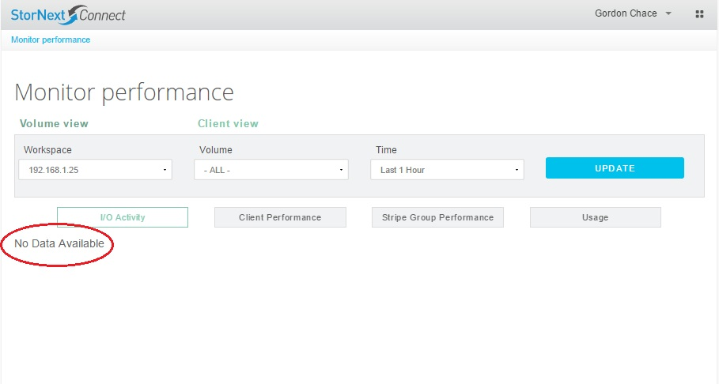
SNConnect Troubleshooting – Monitor Performance

Slide 10
SNConnect Troubleshooting - Monitor Performance
- MDC-1
- SNFS Client
MDC Node-2
SNConnect System
? Sending ?
? Reporting ?
Receiving from remote client?
/var/log/carbon.log
18/01/2016 14:18:21 :: [listener] MetricLineReceiver connection with 10.65.177.115:55599 established
18/01/2016 14:18:21 :: [listener] MetricLineReceiver connection with 10.65.177.115:55599 closed cleanly
18/01/2016 14:18:25 :: [listener] MetricPickleReceiver connection with 10.65.184.247:53244 established
18/01/2016 14:18:25 :: [listener] MetricPickleReceiver connection with 10.65.184.247:53244 closed cleanly
18/01/2016 14:18:30 :: [listener] MetricPickleReceiver connection with 10.65.166.182:59706 established
18/01/2016 14:18:30 :: [listener] MetricPickleReceiver connection with 10.65.166.182:59706 closed cleanly

Slide 11
SNConnect Troubleshooting - Monitor Performance
MDC-1
SNFS Client
MDC Node-2
SNConnect System
? Sending ?
? Reporting ?
/opt/graphite/storage/whisper/domain/default/cluster/default/host
node-2 # ls
dust:mdh:quantum:com (null):mdh:quantum:com sus-m445a:mdh:quantum:com
frostbite:mdh:quantum:com susg300:mdh:quantum:com sus-m445b:mdh:quantum:com

Slide 12
SNConnect Troubleshooting - Monitor Performance
MDC-1
- SNFS Client
- /opt/quantum/mintd/log/mintd.log
shows sending stats every 30 seconds?
Jan 18 14:40:30 INFO Connecting socket...
Jan 18 14:41:00 INFO Connecting socket...
Jan 18 14:41:30 INFO Connecting socket...
Jan 18 14:42:00 INFO Connecting socket...
? Sending ?
- File /opt/quantum/connector/etc/connecthostname contains
MDC Node-2’s metadata IP address (SNConnect System)
- Connector release version 16 (latest) installed vs. 15

Slide 13
SNConnect Troubleshooting - Monitor Performance
MDC-1
- SNFS Client
Verify all systems are set up with the same ntp configuration
If graphite receives stats that are in the future relative to
the graphite server’s time, it drops them
Verify snstatd is running on all Linux systems and configured properly for SNConnect:
# ps ax | grep snstatd
3485 ? Ssl 0:00 /usr/cvfs/bin/snstatd -H snt331009-
# cat /usr/cvfs/config/snstatd.conf
tcp://127.0.0.1:5001
30
protobuf
? Sending ?

Slide 14
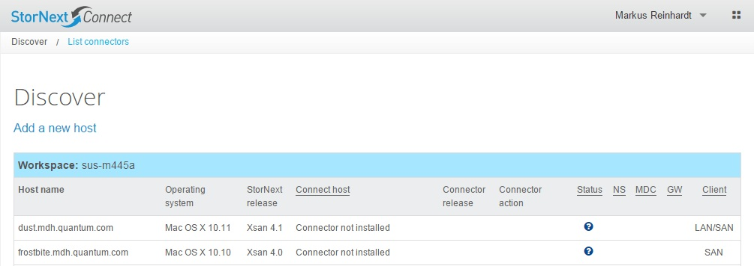
SNConnect Troubleshooting - Host Name (mis)matching
SNConnect Host – MDC-2
/opt/graphite/storage/whisper/domain/default/cluster/default/host/
gateway:quantum:com/
client/kernel/fs/m440_snfs1/sg/sg1/io/san/Wrt_Bytes_Dev/
gateway.quantum.com
# date
Mon Jan 18 16:44:38 CST 2016
# ls -l
total 2624
-rw-r--r-- 1 apache apache 1335496 Jan 18 16:44 count.wsp
-rw-r--r-- 1 apache apache 1335496 Jan 18 16:44 total.wsp
<--- gateway.quantum.com / gateway-meta.quantum.com / IP address

Slide 15
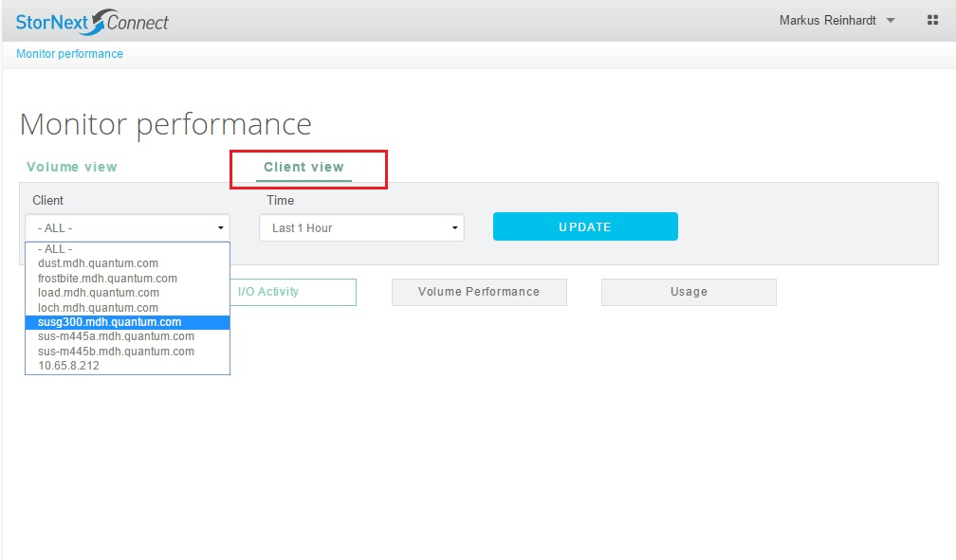
SNConnect Troubleshooting - Host Name (mis)matching
<--- gateway.quantum.com / gateway-meta.quantum.com / IP address
- Each Linux system needs Consistent View of metadata IP addrs and names :
/etc/hosts
192.168.1.25 testm660A.quantum.com testm660A
192.168.1.26 testm660B.quantum.com testm660B
192.168.1.40 gateway.quantum.com gateway

Slide 16
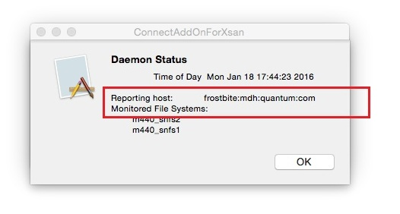
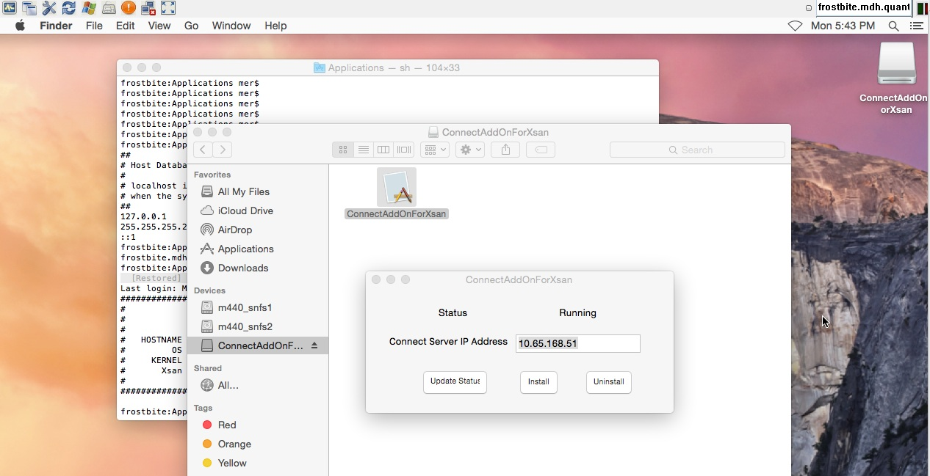
SNConnect Troubleshooting - Host Name matching - Xsan
ConnectAddOnForXsan
- Same /etc/hosts rules for
“consistent view”
everywhere.
- Include name and IP of
Xsan host in /etc/hosts on
Xsan and MDCs.

Slide 17
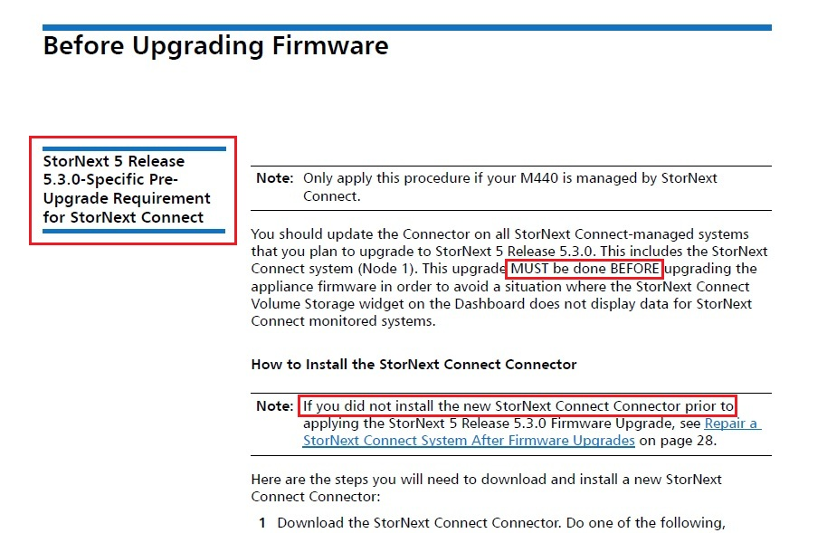
SNConnect Troubleshooting - StorNext 5.3 Release Notes

Slide 18
SNConnect Troubleshooting - Upgrade SNC 1.0.X -> 1.1 issue
QXS Array health monitoring stops being functional
- TSB: 2876 StorNext Connect stops monitoring QXS array health after upgrade from 1.0 to 1.1
- Monitor Performance still reports on File Systems made from QXS array disks
- SNConnect DB at site manipulated manually
- collect: name of QXS and controller A & B IP addresses
- done via postgres sql template
- logistics ???

Slide 19
SNConnect Troubleshooting - Xcellis Customer Install
Customer Install Log

Slide 20
SNConnect Troubleshooting - Xcellis Customer Install
- Error during Step 3 (Settings) in SNConnect Customer Install
TSB: 2877 StorNext Connect Customer Install requires unique netmask choices
"Value given (255.255.255.0) for metadata-netmask must be unique.
The following fields are set to this value: mgt-netmask."
The Customer Install App generates an error if the management and metadata netmasks
are the same. This will occur at Customer Install Step 3 (Settings), in the
"Metatdata network" configuration action.
As a workaround, please provide a unique netmask for the Metdata network in the
Customer Install GUI panel. Maybe 255.255.254.0 ?

Slide 21
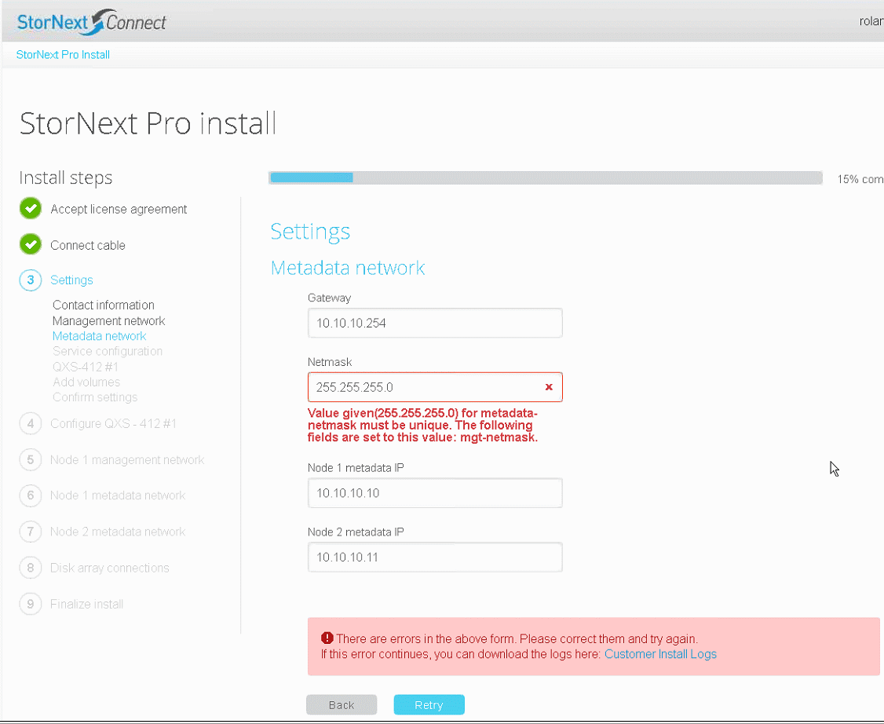
SNConnect Troubleshooting - Xcellis Customer Install

Slide 22
SNConnect Troubleshooting - Xcellis Customer Install
- Serial Number Mismatch early in SNConnect Customer Install
KB: Possible Xcellis HW Serial Number Mismatch At Launch
From the logs, when installing the StorNext Connect software,
the bootstrap will complain about the mismatch and fail with a message similar to:
Jan 6 08:59:04 snmdc2 logger: Bootstrap failed: Serial numbers in BOM (AVxxxxCKH00013 QTMCBSH-15131E8C0B)
do not match system serial number (AVxxxxCKH00017)
- Installation stuck at Step 6 (Node 1 management network) in SNConnect Customer Install
TSB: Xcellis StorNext Connect Installation Hang
During the StorNext Connect installation for an Xcellis, there is a small chance that a user will be unable to complete setting
up their network on Node 1 or Node 2. For Node 1, this could present itself as the installation script not continuing after
Step 5 (Node 1 management network).
For a workaround, connect to the server node that is not responding via ssh and issue the command:
# service stornext_web restart

Slide 23
SNConnect Troubleshooting - Xcellis Customer Install
- Failed attempting to upgrade Connector early in SNConnect Customer Install
KB: StorNext Connect failed to upgrade the “Connector” packages
After accepting the EULA, SNConnect Customer Install failed attempting to upgrade the "Connector" package.
From the screen and Install Log:
Connector - failure - Quantum Connector update did not succeed. Tried to install version '16 r27332626', ,
however version '15 23526570' was installed after attempted install. Please try again. - Command completed
Monitoring …. (site: no ifconfig prior to recovery action)
This issue was recovered in the field by issuing the following command on Node2
# /opt/DXi/scripts/confignetdef.sh 2 all-ipmi
Followed by
# service network restart

Slide 24
SNConnect Troubleshooting - Xcellis 900 GB HDDs
Xcellis shipping with QXS-424 (2400) with 900 GB HDDs
Late-cycle option as an alternative to SSD for metadata
Approx 50% initial Xcellis shipments
NOT Supported via SNConnect Customer Install
Special Install Instructions required: traditional Appl + QXS Provisioning
Now: outline pointing to existing docs
Upcoming: separate document
- Perform SNConnect Deployment after system configured

Slide 25
SNConnect Troubleshooting - stornextconnect.quantum.com
Interactions with stornextconnect.quantum.com
System Serial Number + Authorization Code
- not linked in SNC database until Customer Registers
Xcellis: IB ingest should be clean, Auth Code in Open Me First
Deployment on existing Appliances (Giant Leap)
- StorNextConnectRequest@quantum.com process
- QXS array not matched with Appliance in IB ingest
- Escalate toward Sustaining

