Slide 1
StorNext Connect 1.1 /Xcellis TOI
Lattus Monitoring
Román Saucedo
January 2016

Slide 2
Lattus Monitoring
Extension to SN Connect Monitor Storage Manager app
New Device Type selection in Monitor Storage Manager toolbar
- LATTUS
New Device Target selections in Monitor Storage Manager toolbar
- Lattus I/O path controller name (or select ‘ALL’ for aggregate of all controllers)
Monitor same stats as for Storage Manager libraries*
- Device Activity: Lattus Read/Write bytes & I/O op count
- Operation Activity: Aggregate file store and file retrieve trigger counts (LTO + Lattus)
- Device Performance: Lattus Read/Write throughput & latency
- Storage Usage*: Meaningful stats are not currently available for Lattus (use for LTO only)

Slide 3
Lattus Monitoring
Demo

Slide 4
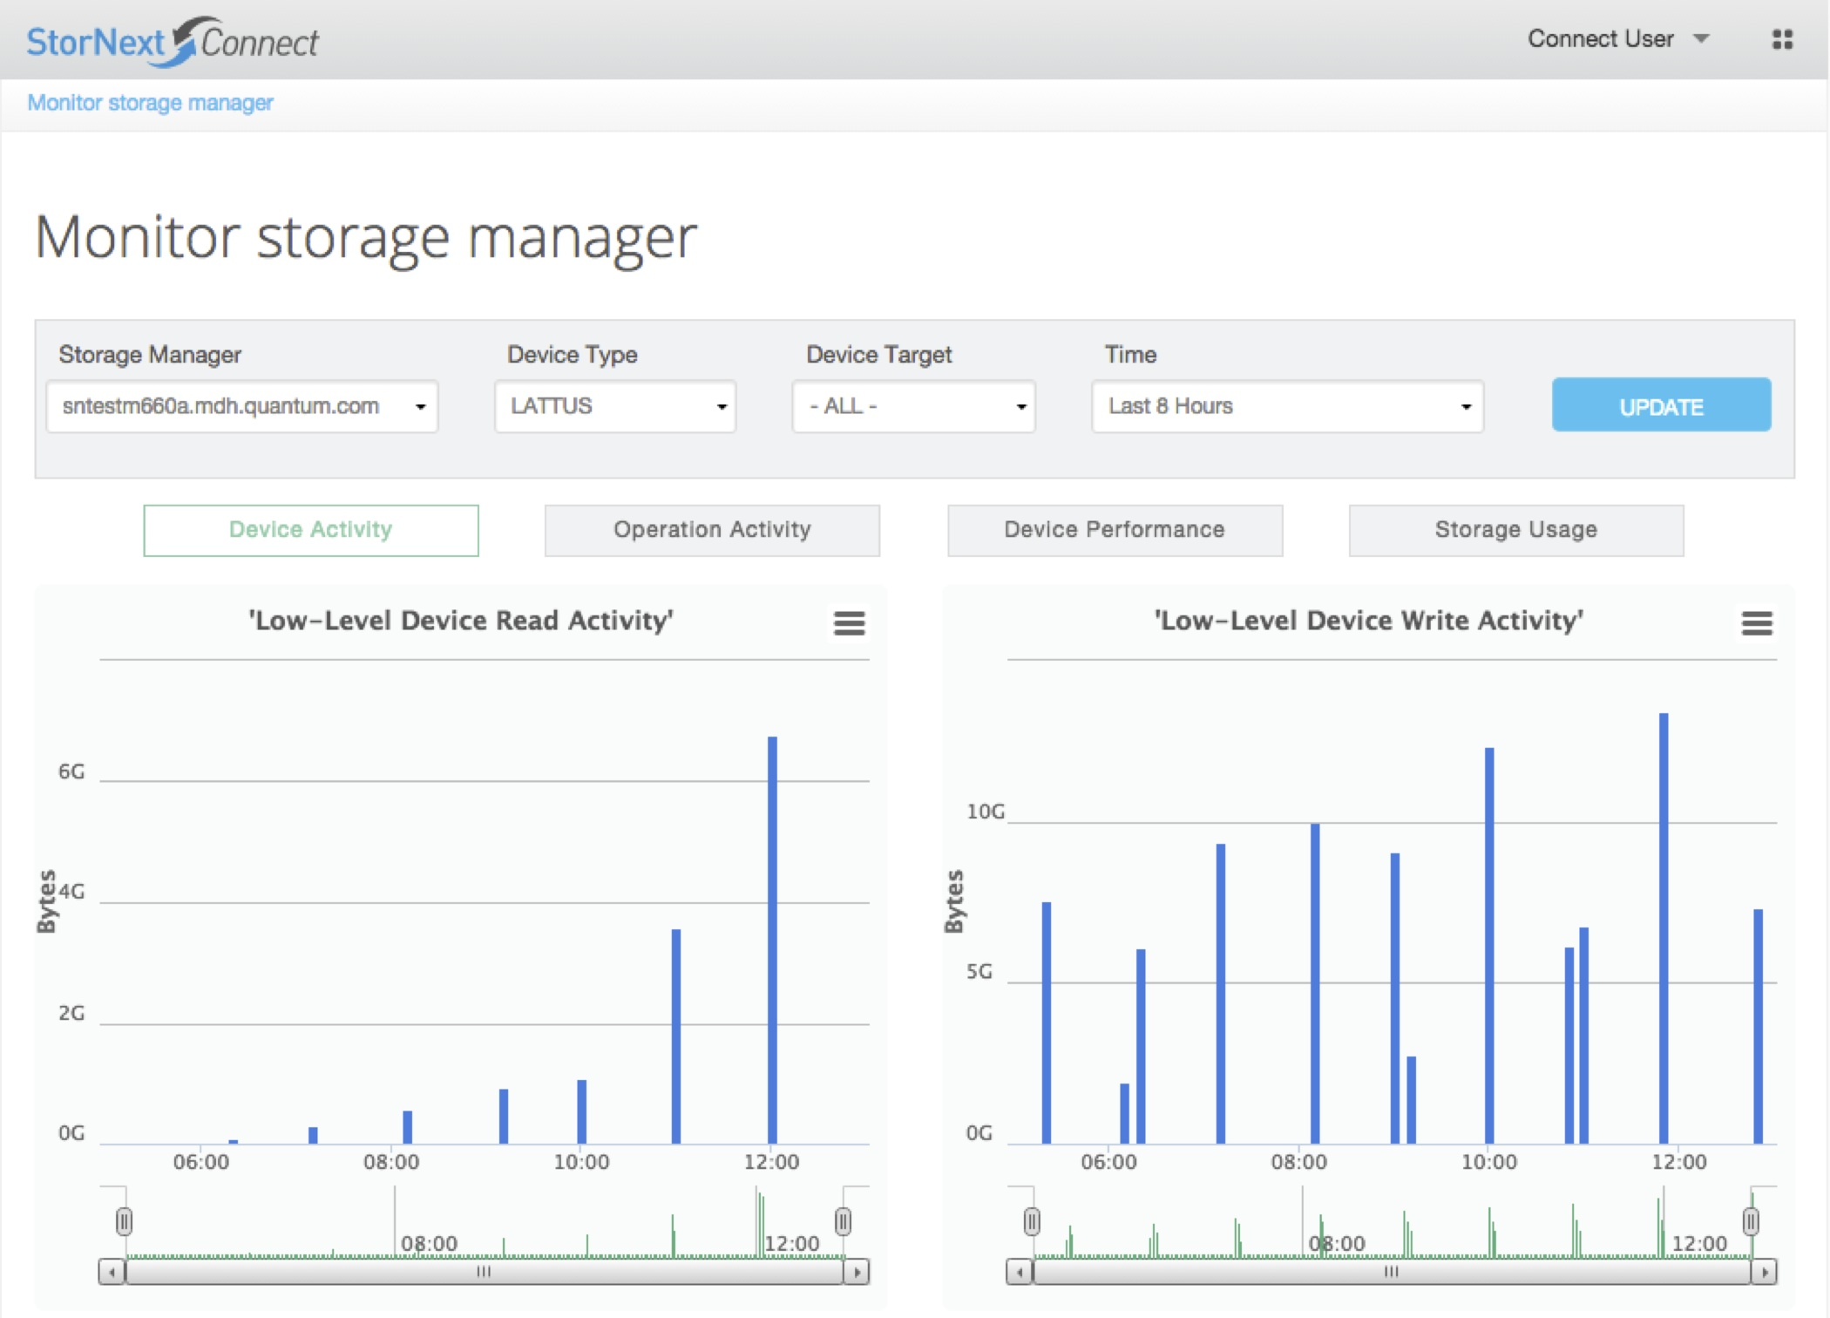
Lattus Monitoring

Slide 5
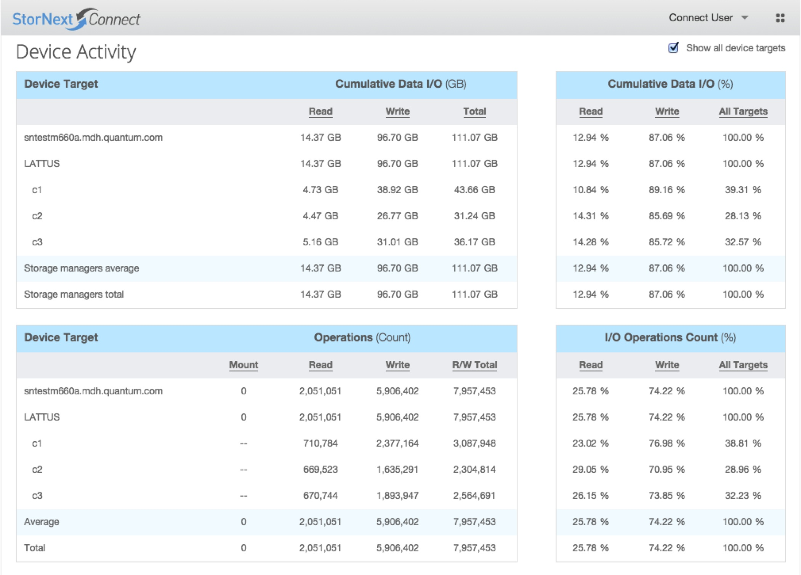
Lattus Monitoring

Slide 6
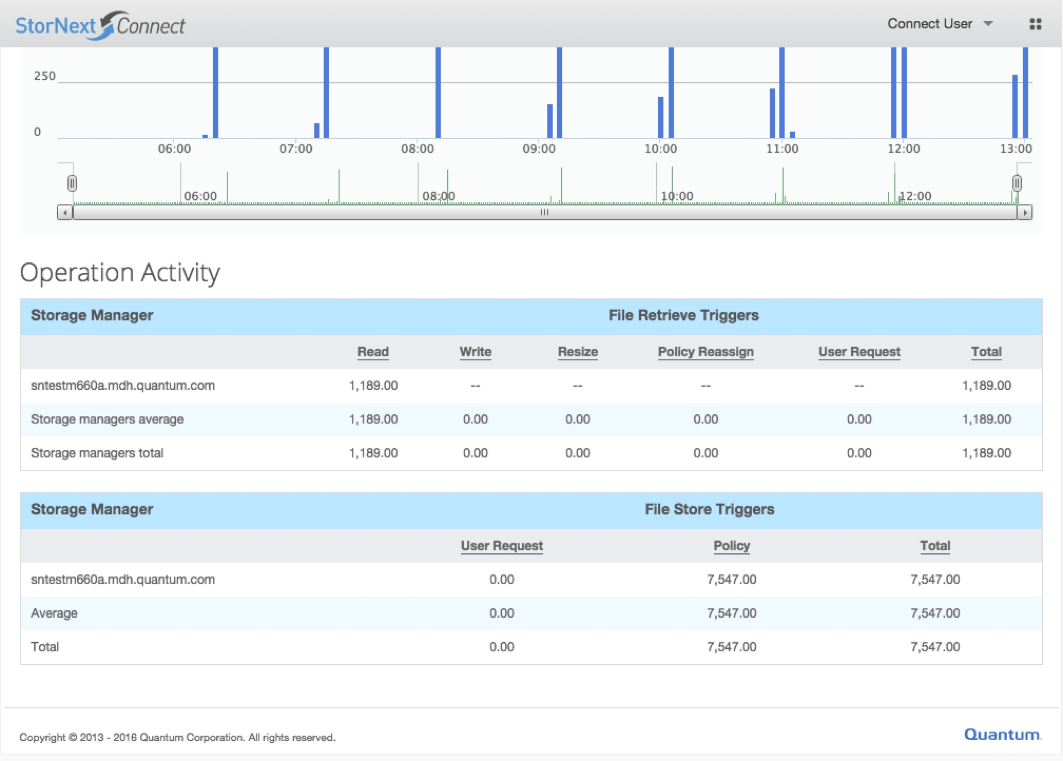
Lattus Monitoring

Slide 7
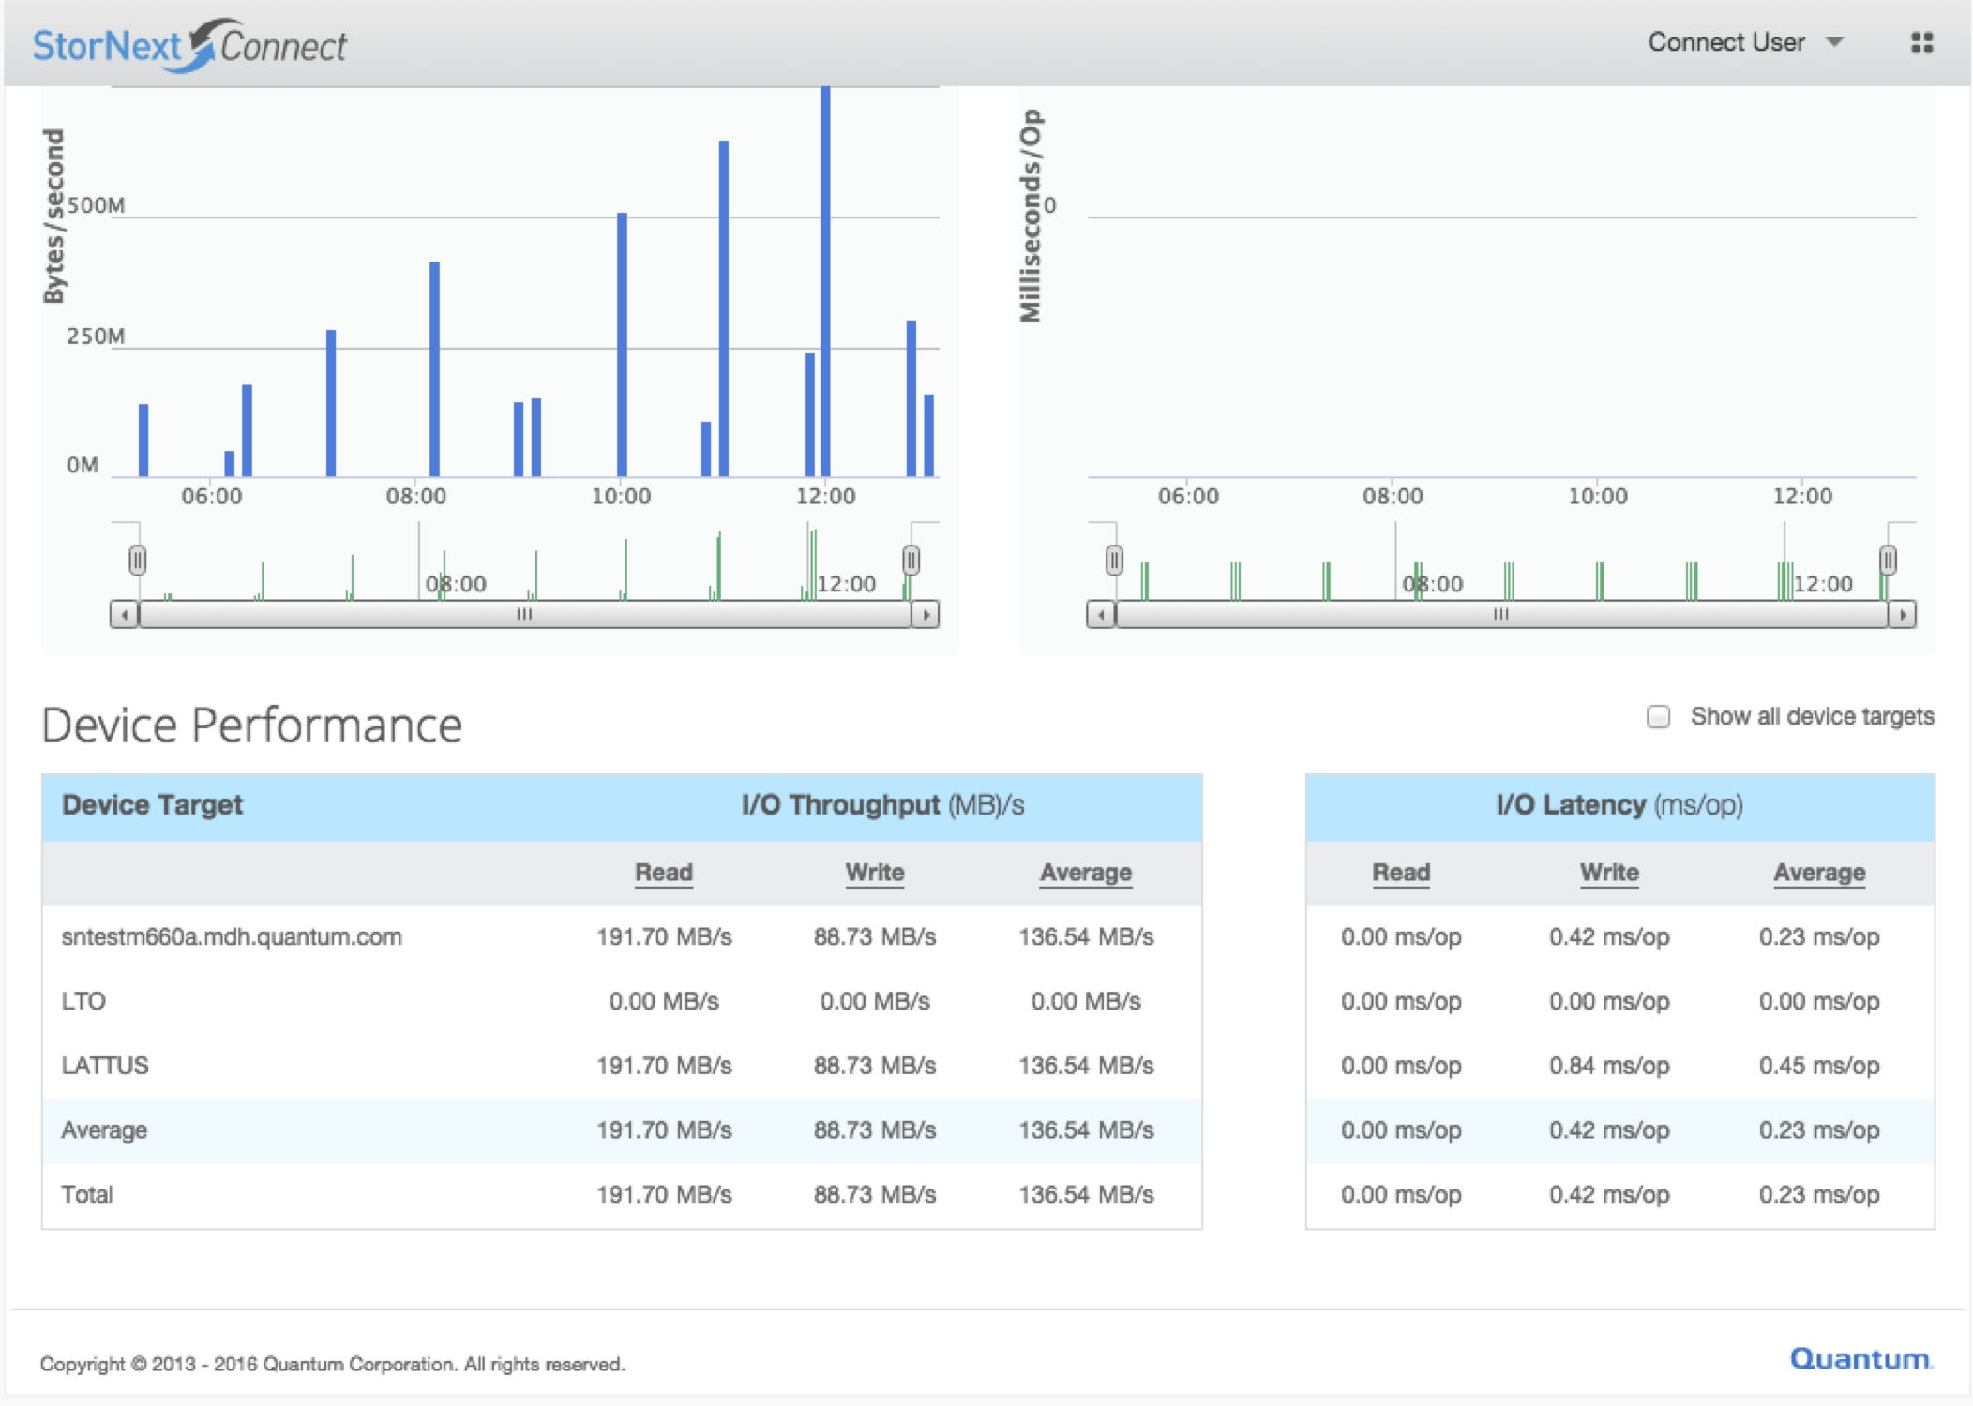
Lattus Monitoring

Slide 8
Lattus Monitoring
Q & A

