Slide 1
StorNext Connect 1.1 /Xcellis TOI
Installing SNConnect on Existing Appliances
Mark Reinhardt
January 2016

Slide 2
Installing SNConnect on existing Appliances
“Giant Leap”
Professional Services Install Guide
StorNext Connect Deployment Guide
6-68343-01
csweb : StorNext Products -> StorNext Connect
Rev A : current download
Rev B : updated soon: clarifications, Xcellis

Slide 3
StorNext Connect Deployment - Prerequisites

Slide 4
StorNext Connect Deployment – Obtain Authorization Code
Customers Request SNConnect for Existing Appliance
Provide: Appliance Serial Number
Receive: Authorization Code
www.quantum.com
StorNext Product Page -> StorNext Connect link
FORM: Request More Information for SNConnect
2) Send email to StorNextConnectRequest@quantum.com

Slide 5
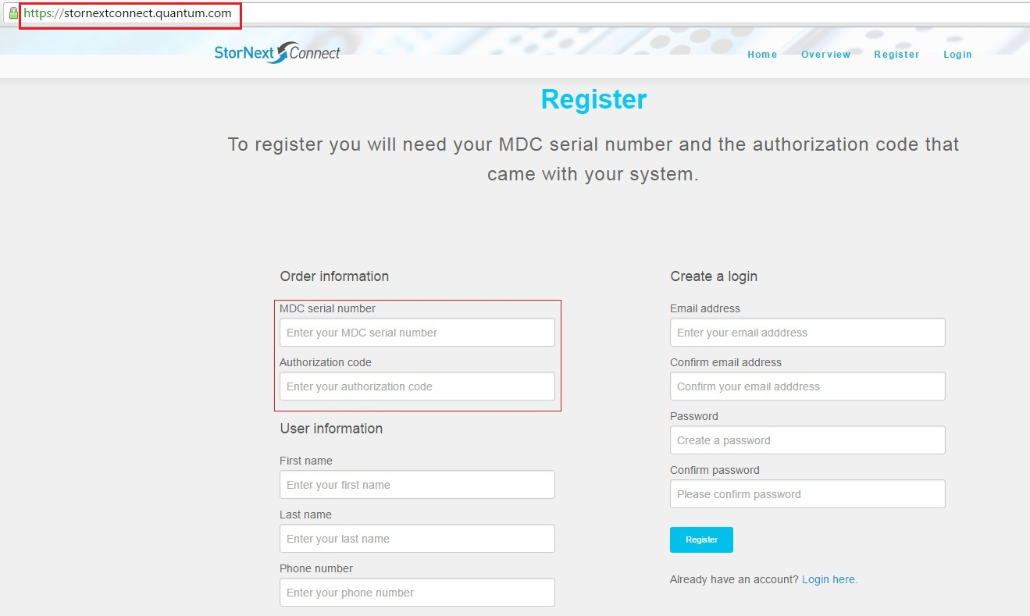
StorNext Connect Deployment - Register

Slide 6
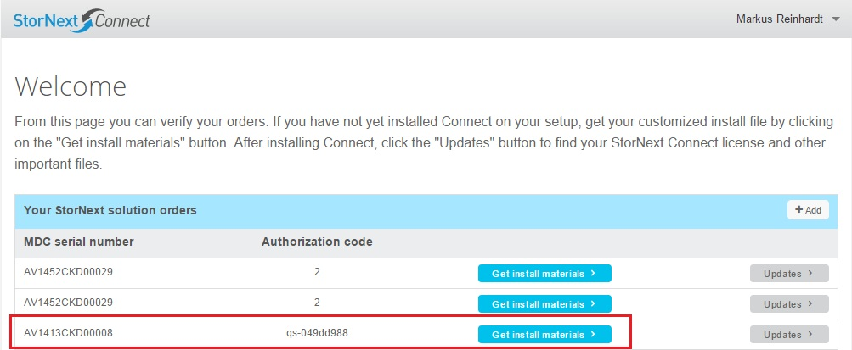
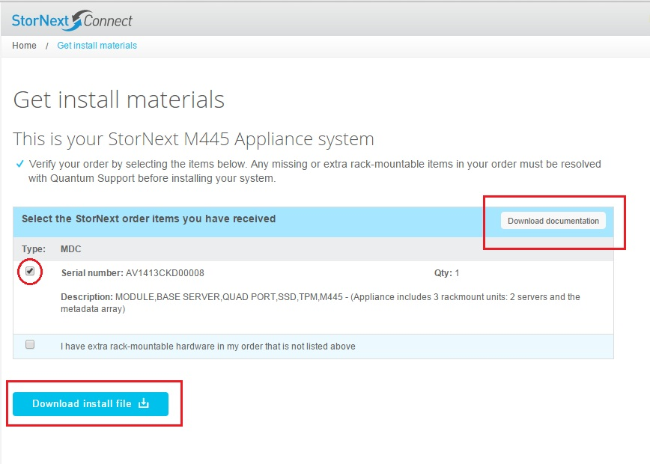
StorNext Connect Deployment – Download Install File
- Download install file:
customer-install-1.1.0…<SN>.fw
Doc files NOT downloadable
“unable to retrieve documentation”

Slide 7
StorNext Connect Deployment - Procedures
Node-1 primary in the HA pair
If metadata network, each MDC’s /etc/hosts file contains
metadata IP and host name of both MDCs
192.168.1.25 testm660A.quantum.com testm660A
192.168.1.26 testm660B.quantum.com testm660B
3. /opt/quantum/connector/etc/connecthostname on both MDCs:
MDC Node-2’s metadata IP address

Slide 8
StorNext Connect Deployment - Procedures
4. On both MDCs: # service quantum_supervisord restart
5. Edit /etc/httpd/conf/httpd.conf on MDC Node-2 to have
a single, active “Listen” line:
Listen 80
Restart httpd: # service httpd restart
6. Open browser to MDC Node-2’s management/public IP

Slide 9
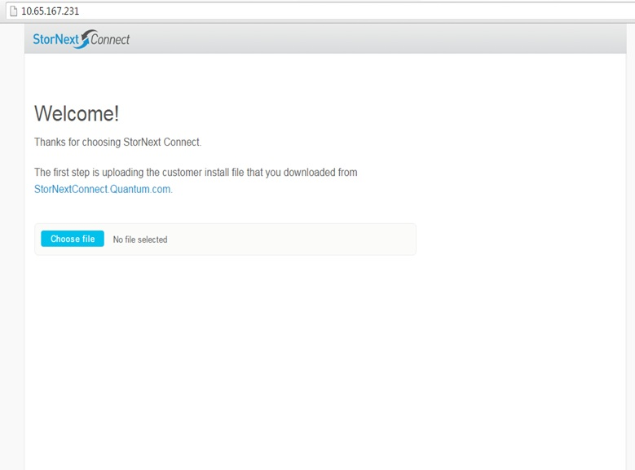
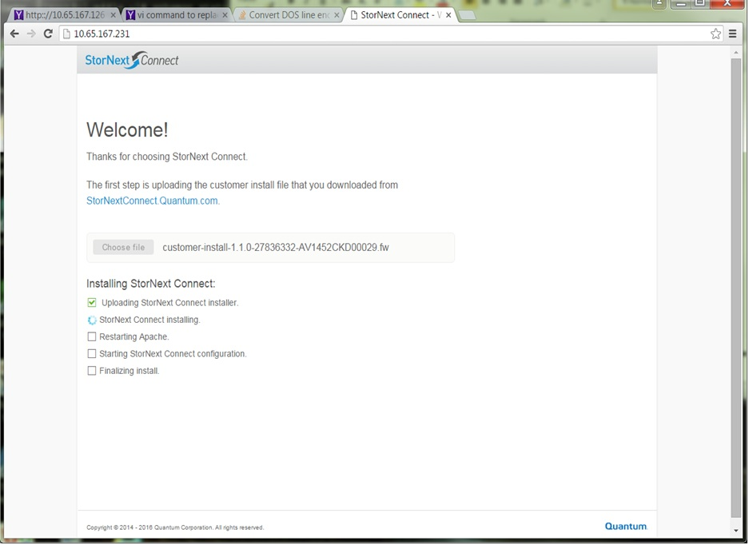
StorNext Connect Deployment - Procedures

Slide 10
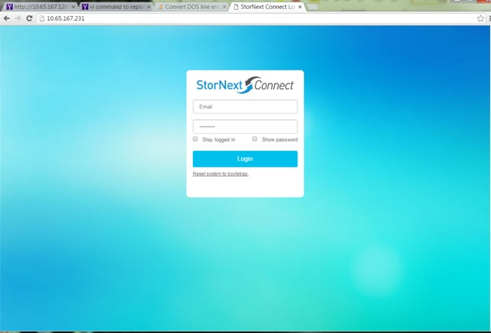
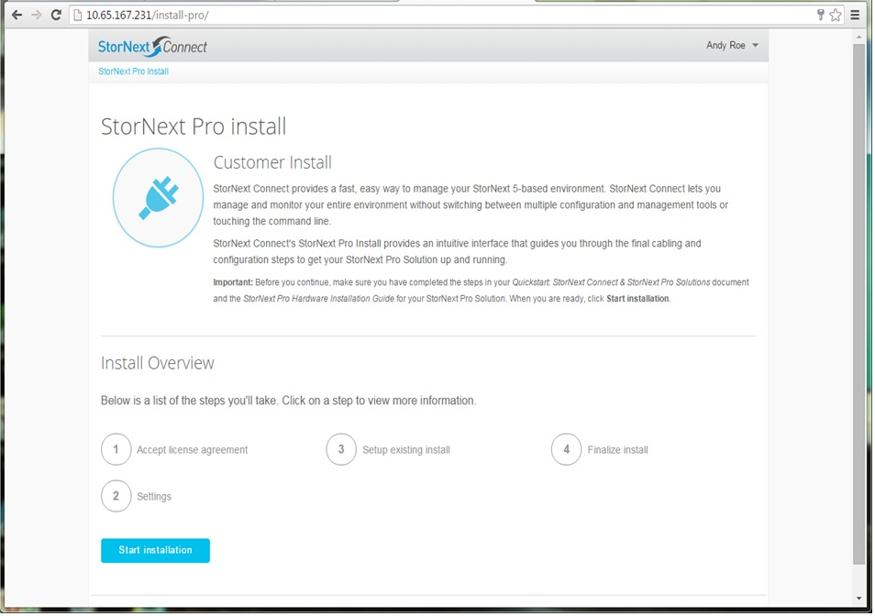
StorNext Connect Deployment - Procedures
Credentials from registration at
stornextconnect.quantum.com

Slide 11
StorNext Connect Deployment - Procedures
Accept EULA
- Register QX/QXS Array
If in download Bill Of Materials : QXS info requested
Often QXS not included with Install Base Order so download’s BOM
will not contain entries : Therefore, no QXS info requested.
- File Systems made from disks in QXS arrays are always reported in
Monitor Performance App
- QXS array health is NOT monitored
- Post-Install procedure used to enter QXS information - More Later

Slide 12
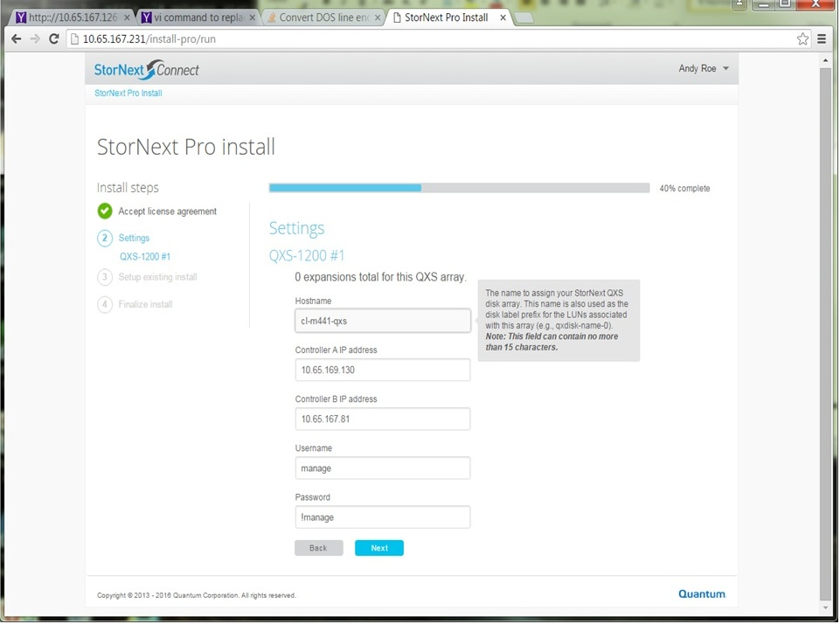
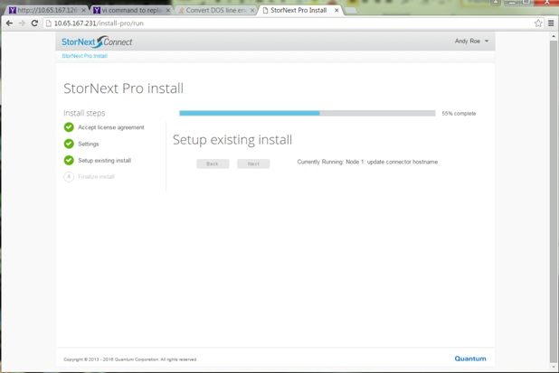
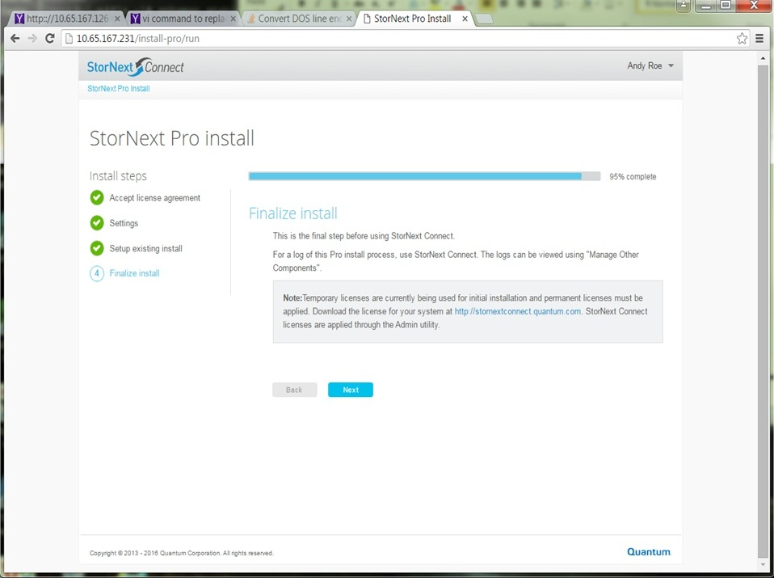
StorNext Connect Deployment - Procedures

Slide 13
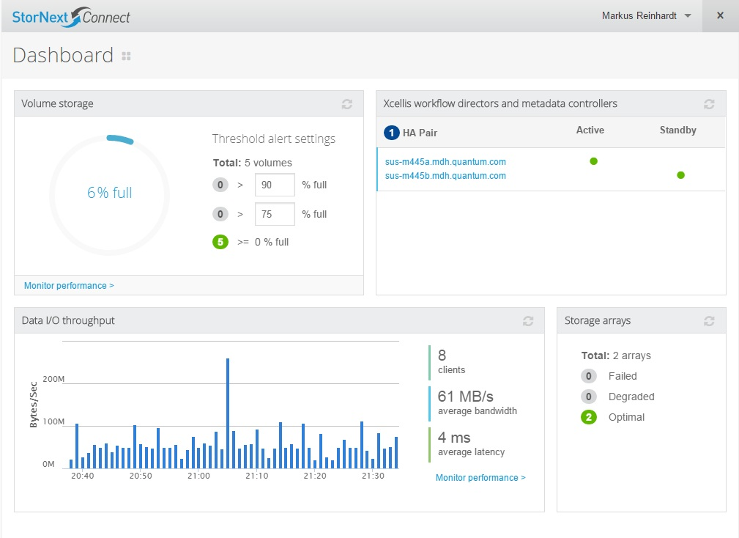
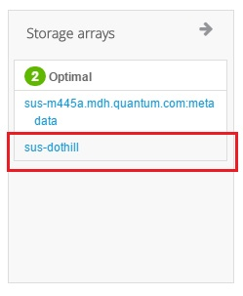
StorNext Connect Deployment - Dashboard

Slide 14
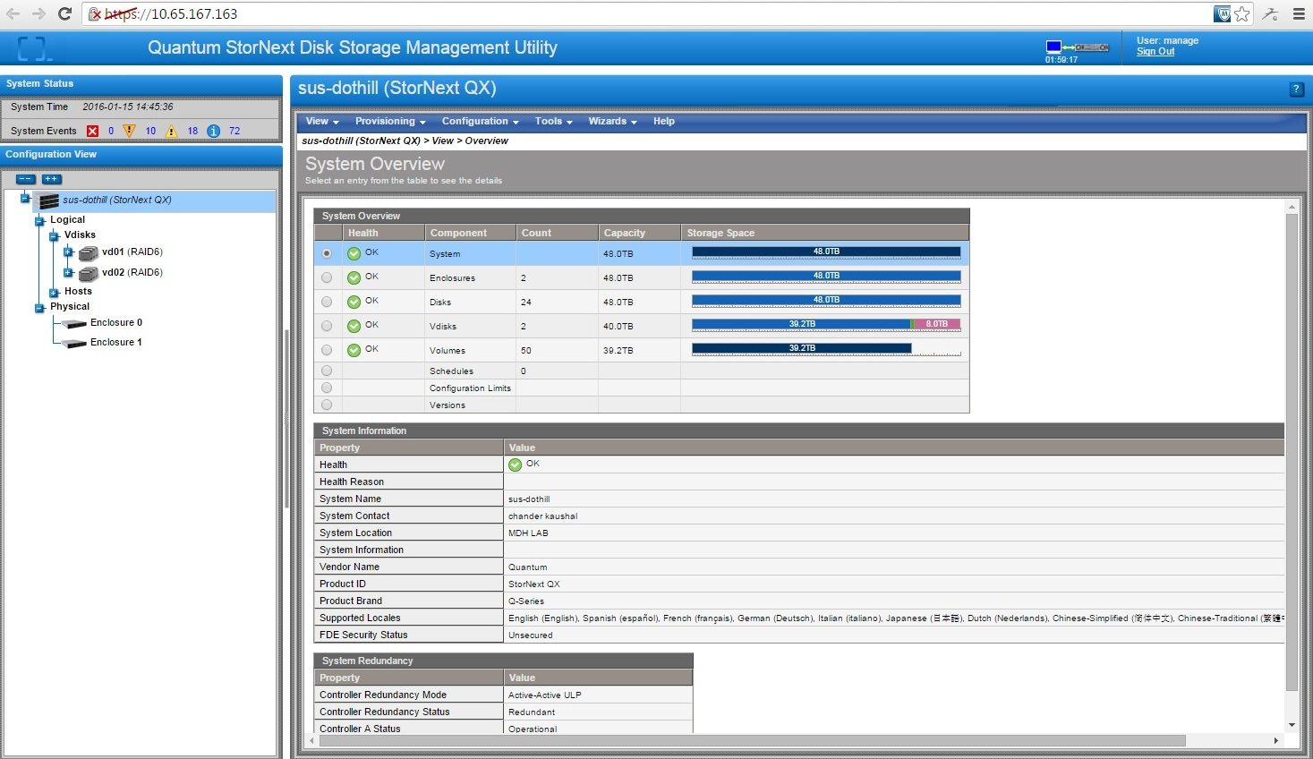
StorNext Connect Deployment – Dashboard Array Link

Slide 15
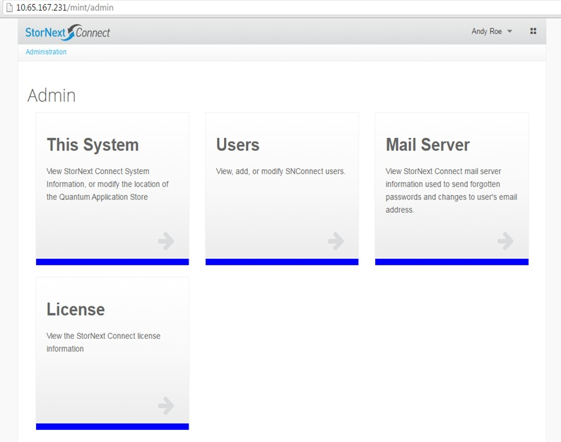
StorNext Connect Deployment - Finalize

Slide 16
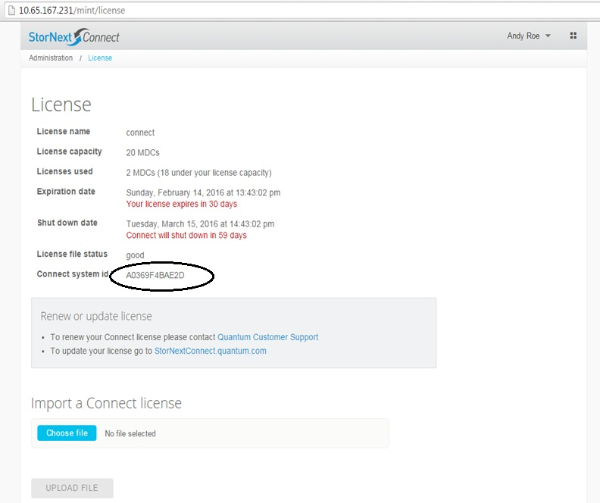
StorNext Connect Deployment - Finalize

Slide 17
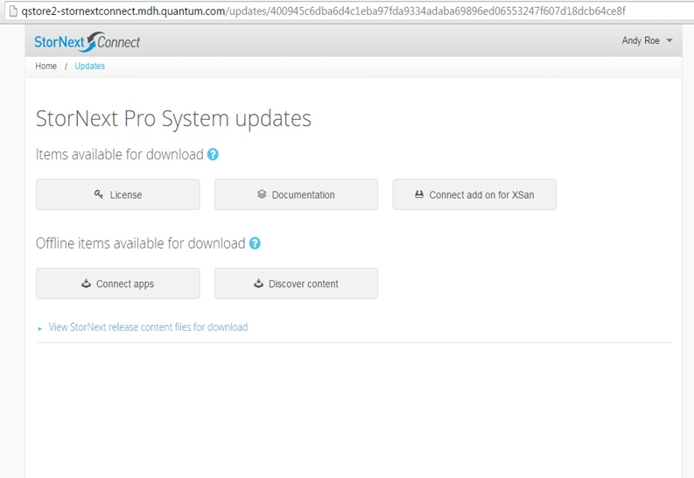
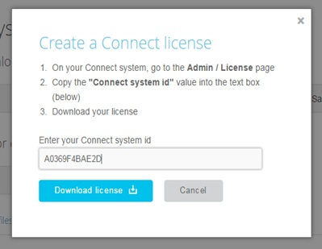
StorNext Connect Deployment - Finalize

Slide 18
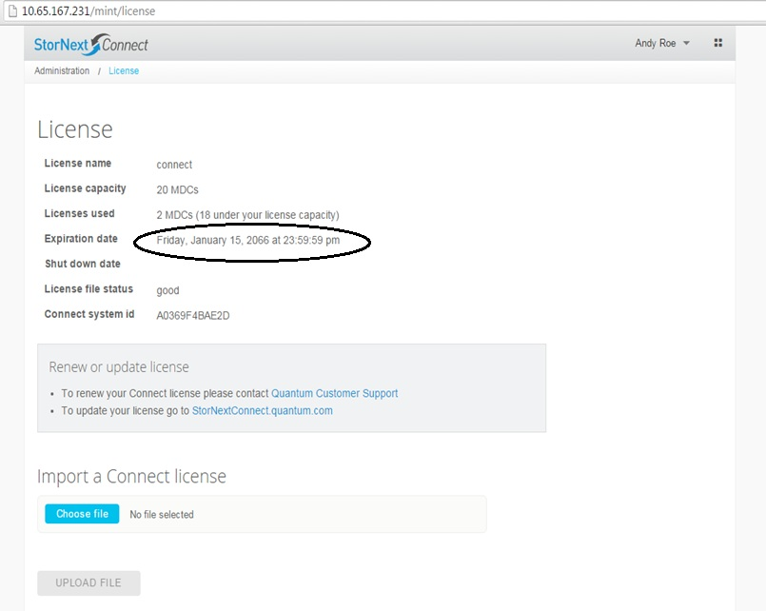
StorNext Connect Deployment - Finalize
After Importing
and Uploading
License File

Slide 19
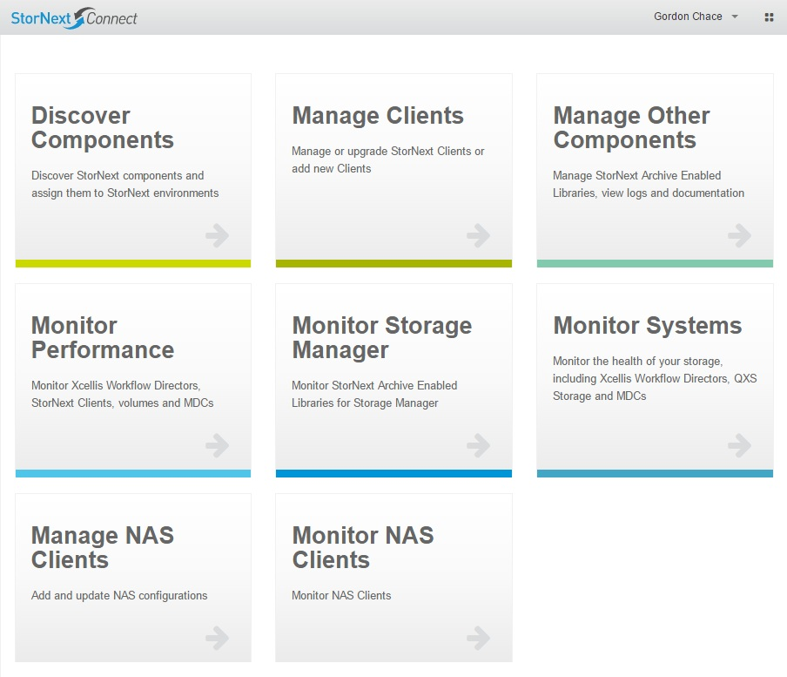
StorNext Connect Deployment – Sanity Check

Slide 20
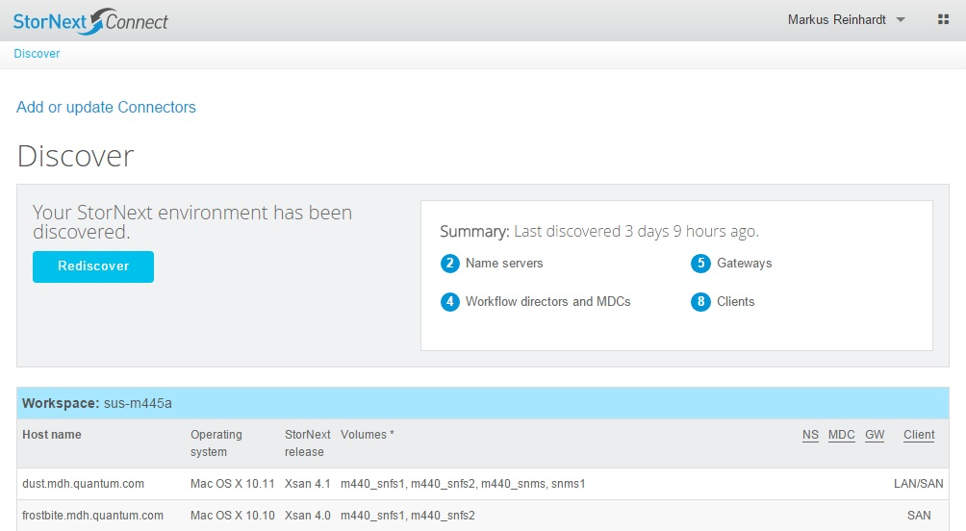
StorNext Connect Deployment – Sanity Check

Slide 21
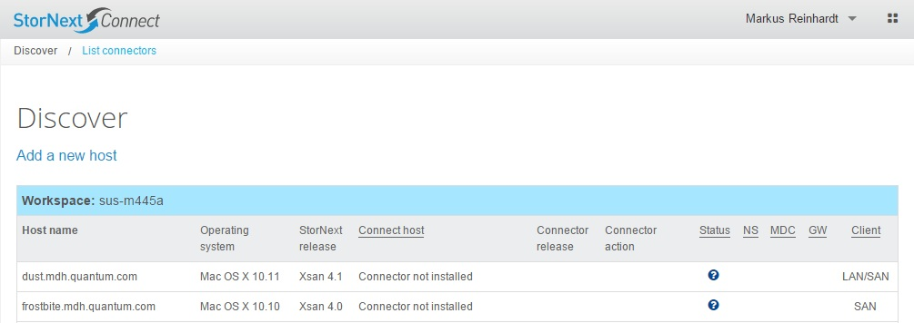
StorNext Connect Deployment – Connector version
Check MDC-1 for v 15
Linux w/ no Connector
Update & ReDiscover

Slide 22
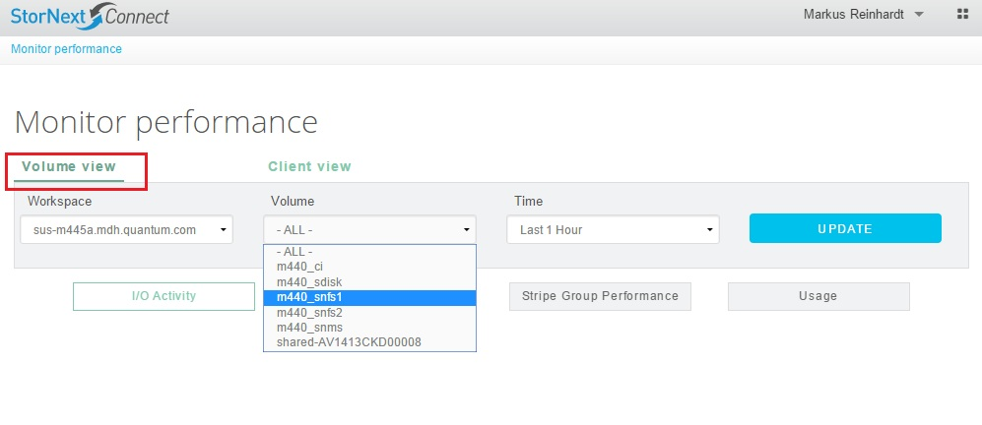
StorNext Connect Deployment – Sanity Check
Test: Windows LAN Client wrote data via G300
to File System / Volume m440_snfs1 …

Slide 23
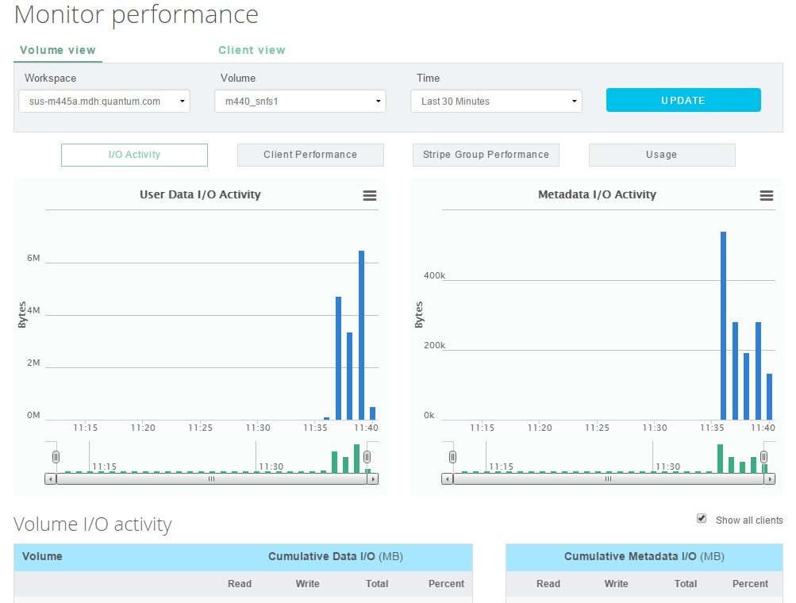
StorNext Connect Deployment – Sanity Check

Slide 24
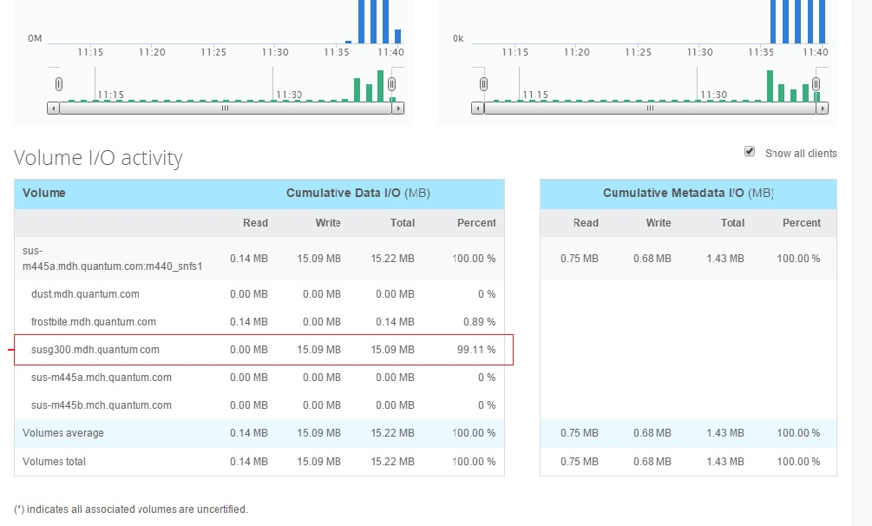
StorNext Connect Deployment – Sanity Check

Slide 25
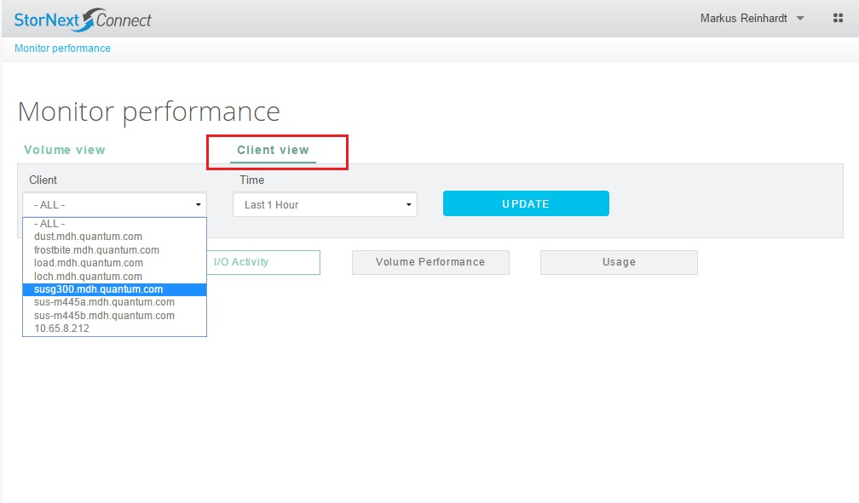
StorNext Connect Deployment – Sanity Check

Slide 26
StorNext Connect Deployment – Last couple of checks
1) If no performance information from Linux systems:
- Check for missing /usr/cvfs/config/snstatd.conf
- Put in place and perform: # service quantum_supervisord restart
QXS not in Install Base w/ Appliance , so not in SNConnect DB
- TSB: 2876 StorNext Connect stops monitoring QXS array health after upgrade from 1.0 to 1.1
- SNConnect DB manipulated manually
- required: name of QXS plus controller A & B IP address
- done via postgres sql template
- logistics ???
- future: add/delete/change QXS from SNConnect as admin activity

