Slide 1
StorNext Connect 1.1 /Xcellis TOI
Disk Catalog (SN Connect Update)
Brent Petit & Román Saucedo
January 2016

Slide 2
Disk Catalog (SN Connect Update)
SN Connect updated to support the new StorNext Disk Catalog
1. New disk catalog is used by the SN Connect Monitor Performance app
- To determine Quantum branded and certified disk vendors & products
2. Same detailed display policy as in SN Connect 1.0
- Shows volume-specific performance numbers only if that volume is comprised of at least one Quantum branded or certified disk
- Otherwise, volume-specific performance numbers are not displayed, but are included in aggregate totals (indicated by asterisk ‘*’ after volume name).
- Policy encourages, but doesn’t strictly require, the use of Quantum branded or certified disks

Slide 3
Disk Catalog (SN Connect Update)
SN Connect 1.0 hard-coded disk catalog file is still supported.
1. Used only if the new StorNext Disk Catalog is not installed, or is compromised
2. Hard-coded Quantum certified disk vendors: DDN, Dot Hill, LSI, NetApp
Demo

Slide 4
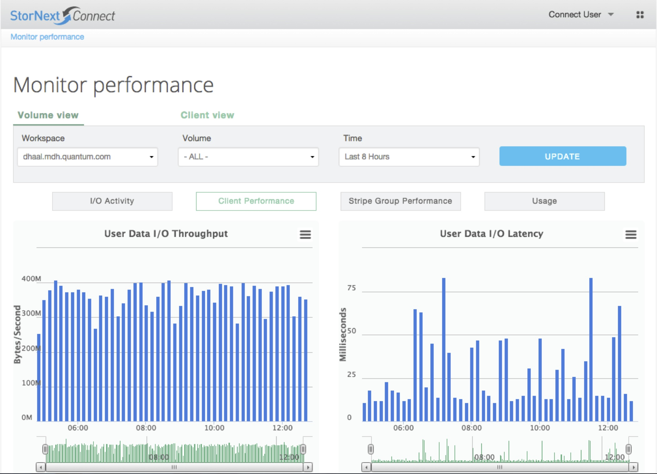
Disk Catalog (SN Connect Update)

Slide 5
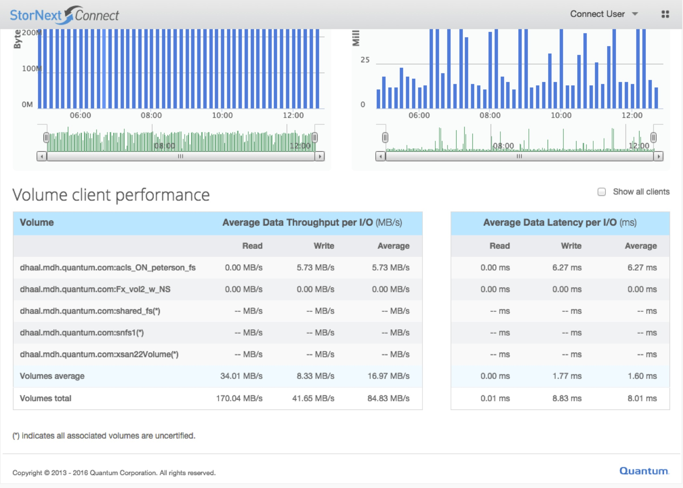
Disk Catalog (SN Connect Update)

Slide 6
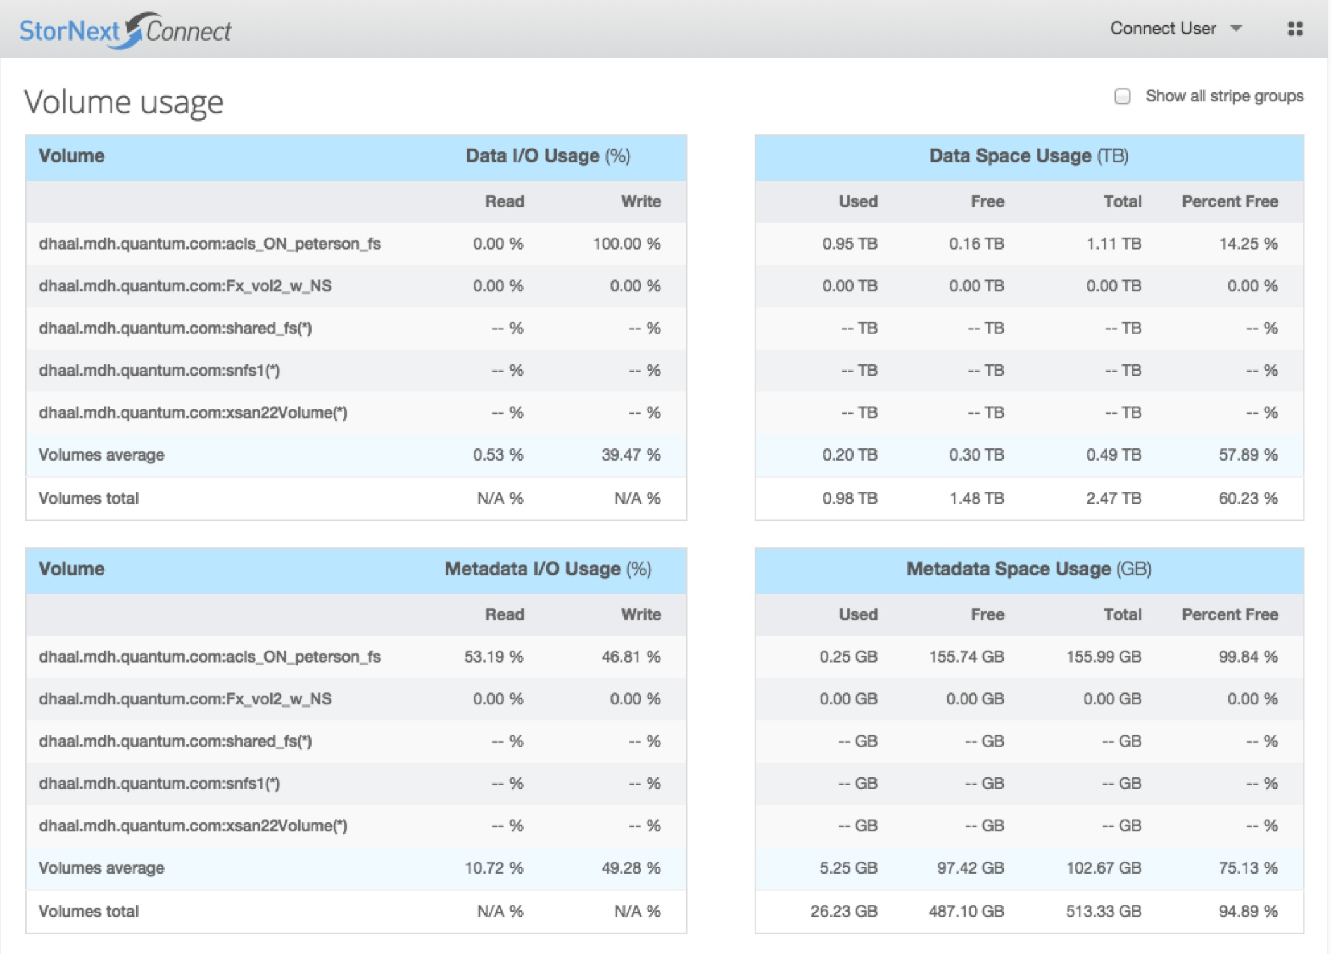
Disk Catalog (SN Connect Update)

Slide 7
Disk Catalog (SN Connect Update)
Q & A

