Slide 1
StorNext Connect 1.1 /Xcellis TOI
Customer Install 1.1 File System Config
John Koniges
January 2016

Slide 2
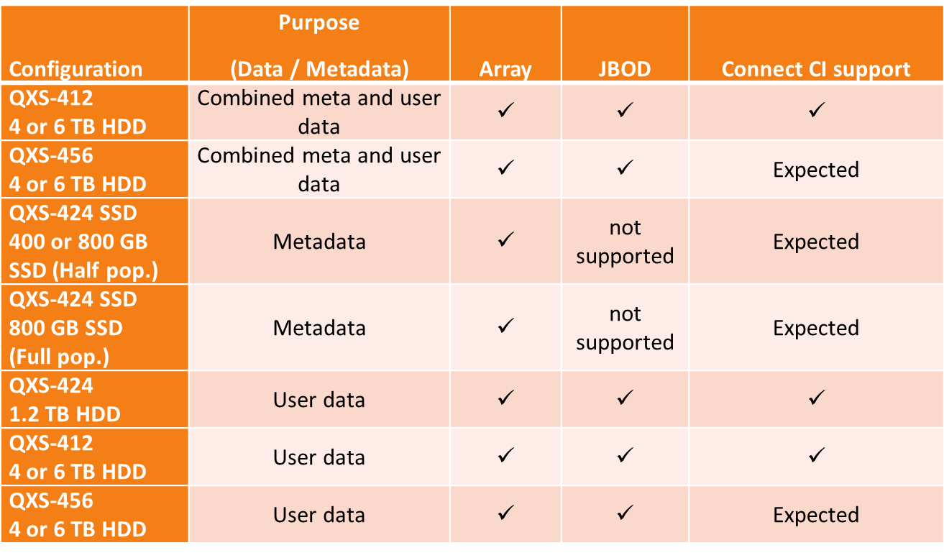
Customer Install 1.1 Xcellis Metadata Configurations
Carved Metadata
Metadata shares enclosure with Data and HAFS
Can be QXS-412 (4TB, 6TB) or QXS-456(4TB, 6TB)
QXS -424 is not supported in a Carved configuration
File Systems
Fixed metadata size
Minimum 1 file system
Maximum is total number of data LUNs
LUNs will be carved as
1% Metadata
2% HAFS
97% Data

Slide 3
Customer Install 1.1 Xcellis Metadata Configurations
Dedicated Metadata
Metadata is on QXS-424
Shared with HAFS
QXS-424 w/ 400GB, 800GB or 900GB Drives
900GB drives are not yet supported in CI
Has additional QXS enclosures for Data
QXS-412(4TB, 6TB), QXS-424(1.2TB), or QXS-456(4TB, 6TB)
File System(s)
Variable Metadata size
Minimum 1 file system
Maximum 64 file systems (32 if half populated) or Maximum number of data LUNs
Smaller of the two values chosen

Slide 4
Customer Install 1.1 Xcellis Metadata Configurations
Colossal
Similar to Dedicated Metadata
Metadata is one its own QXS-424
Shared with HAFS
CI will only create Metadata LUNs
Will not provision file system
Will still create HAFS and HA Pair
File System(s)
Variable Metadata size
Minimum 0 file systems
Maximum 64 file systems (32 if half populated)

Slide 5
Customer Install 1.1 Allowed QXS Disk Types
QXS-412
Usable in Carved and Dedicated metadata types
1 data LUN per enclosure
QXS-424
Usable as metadata for Dedicated and Colossal
With 400GB SSD, 800GB SSD, 900GB HDD (half populated)
800GB and 900GB can also be fully populated.
HAFS will be 2 LUNs in stripe group in fully populated
Usable as data with 1.2 TB HDD for Dedicated
2 data LUNs per enclosure
QXS-456
Usable in Carved and Dedicated metadata types
4 data LUNs per enclosure

